Slide 1
Update on Cure Research for HIV Infection
Robert F. Siliciano, MD, PhD
Professor of Medicine, Molecular Biology, and Genetics
The Johns Hopkins University
Baltimore, Maryland

Slide 2




Financial Relationships With Commercial Entities
Dr Siliciano has no relevant financial affiliations to disclose. (Updated 11/09/18)

Slide 3
Learning Objectives
After attending this presentation, learners will be able to:
Describe the basic mechanisms that allow HIV to persist despite ART
Describe the cause and time course of viral rebound following interruption of ART
Describe current approaches for achieving a cure

Slide 4
HIV replication dynamics
10,000,000
Stop
ART
1,000,000
Set
point
(copes/ml)
100,000
ART
A
10,000
-1 RN
V
1000
100
Limit of
detection
Plasma HI
10
1
Time (months)
Notes:
I would like to discuss new developments in the search for a cure for HIV infection. This is a plot of the level of plasma virus in a typical patient. As you know, treatment with ART reduced plasma virus level to below the limit of detection, but as soon as treatment is stopped, viremia rebound to the previous set point value. Therefore, when we talk about cure, we are really talking about interventions that will prevent viral rebound when patients stop treatment. So the first thing we need to understand is what causes viral rebound. To do this, lets review the dynamics of viral replication in infected individuals.

Slide 5
HIV replication dynamics
10,000,000
v
+
1,000,000
Set
point
(copes/ml)
100,000
ART
Intensify
†
A
10,000
-1 RN
t_{1/2} = 1d
1000
R₀ = 10
V
t_{1/2} = 14d
100
Limit of
detection
Plasma HI
10
Residual viremia
1
Time (months)
Wei et al. Nature 1995
Ho et al, Nature 1995
Perelson et al, Nature 1997
Finzi et al, Nature Med 1999
Dornadula et al, JAMA 1999
Dinoso et al, PNAS, 2009
Robb and Ananworanich, COHA, 2016
Notes:
Following transmission, there is rapid viral replication and a rapid increase in the level of plasma virus. This increase is exponential. This means that rather than increasing in a linear 1 ,2,3,4 fashion, the level of plasma virus goes 1 to 10 to 100 to 1000 . Another way to describe this exponential increase is the reproductive ratio which is the number of new infected cells that you get from each infected cell. For HIV, the reproductive ration is 10, meaning that each infected cells give rise to 10 new infected cells each of which produces enough virus to infect 10 more cells. The initial exponential growth of virus in the days following exposure generates immune responses that bring viremia down to a quasi-stable set point in about one month. If you put someone on ART you get a rapid exponential decay from this set point down to the limit of detection of clinical assays. The drugs very effectively block new infection of susceptible cells but not virus release from cells that already have an integrated provirus. Therefore, this decay actually reflects the rapid death of infected cells. As you can see, there are two populations, one with a half life of only 1 day and another with a half life of two weeks. If these were all we had to worry about, the infection could be cured in weeks to months as is now the case for hepatitis C. Unfortunately, decay does not continue but plateaus at 1-3 copies/ml. This residual viremia does not reflect ongoing cycles of replication during ART because treatment intensification does not further reduce this residual viremia. Rather residual viremia represents virus release from a third population of cells which were infected prior to treatment but which have a much longer half life.

Slide 6
Physiology of resting and
activated CD4⁺ T cells
Naive
Memory
Notes:
These are latently infected CD4+ T cells, and they arise as a result of the normal physiology of CD4+ T cells. Most of the CD4 cells in the body are in a profoundly quiescent state. These resting cells include naïve T cells which have not yet responded to any foreign antigen as well as memory cells that have previously participated in an immune response. These cells circulate throughout the tissues awaiting encounter with antigen.

Slide 7
Response of resting
T cells to antigen
Naive
†
†
Ag
†
†
†
†
Memory
Notes:
When that happens antigen, the relevant cell becomes activated and divides, ultimately generated many activated effector cells with the same specificity. At the conclusion of the immune response, many of these activated cells die, but some survive and return to a resting state as memory cells.

Slide 8
Recall response of memory
T cells to antigen
Naive
†
†
Ag
†
†
†
†
Memory
†
†
Ag
†
†
†
†
Notes:
These cells persist for long periods of time, decades in fact, allowing future responses to the same antigen.

Slide 9
Infection of activated and
resting CD4⁺ T cells
Ag
HIV
†
Naive
Ag
HIV
†
Memory
HIV
†
Notes:
In HIV infection, the virus replicates mainly in the activated cells. and these infected cells die quickly usually in a day as I showed you. The virus does not replicate well in resting T cells due to blocks in numerous steps of the virus life cycle.

Slide 10
Establishment and maintenance
of a latent reservoir
Naive
†
†
HIV
Ag
†
†
†
†
Memory
Notes:
However, one rare occasions some of the activated T cells can become infected as they are in the process of returning to a resting state. This results in a stably integrated form of the viral genome in a memory T cell, a cell population with a very low decay rate. And what is particularly interesting is that as the cell undergoes this profound change from an activated to a resting state, HIV gene expression is turned off.

Slide 11
NFκB sites in the HIV LTR
U 3
R
U 5
Modulatory region
Enhancer
Core
Cell DNA
AP1
USF1
Ets1
LEF
NFκB
NFAT
Sp1
TBP
LBP1
NFAT1
Nabel G, et al. Nature. 1987
Tong-Starksen SE, et al. PNAS. 1987
Bohnlein E, et al. Cell. 1988
Duh EJ, et al. PNAS. 1989
Notes:
This is the genetic region of HIV. Several groups have shown that HIV gene expression is heavily dependent upon the host transcription factor NFkB which is excluded from the nucleus in resting cells. Thus HIV gene expression is automatically extinguished as the cells return to a resting state

Slide 12
A stable latent reservoir for HIV
Naive
†
†
HIV
Ag
†
†
†
†
Memory
Notes:
The end result is a stably integrated but transcriptionally silent form of the viral genome in a long lived memory T cell. This is a perfect mechanism for viral persistence - it allows the virus to persist essentially as pure information, unaffected by immune responses or antiretroviral drugs.

Slide 13
Reactivation of latent HIV
Naive
†
†
HIV
Ag
†
†
†
†
Ag
†
Memory
Notes:
…If the cell becomes activated in the future, it can begin to produce virus again. In 1995, our group developed assays to detect these cells in vivo and found that they are present in everybody with HIV infection. The frequency is very low, only about 1 in a million, but…

Slide 14
Slow decay of latently infected
CD4⁺ T cells
10000
Time to eradication
> 73.4 years
1000
100
10
Frequency
(per 10⁶ cells)
1
0.1
-
0.01
0.001
0.0001
0.00001
0
1
2
3
4
5
6
7
Time on ART (years)
Finzi et al., Nature Med., 1999
Siliciano et al., Nature Med., 2003
Notes:
As you can see from the results of this longitudinal study with many patients who were doing well on ART with undetectable plasma virus, the problem is that this population of infected cells has in extremely long half life measured in years, not days. The latent reservoir is the major barrier to eradication…. As you can see from the results of this longitudinal study with many patients who were doing well on ART with undetectable plasma virus but yet we were able to measure latently infected cells with replication competent virus. As you can see, the problem is that this population of infected cells has in extremely long half life measured in years, not days. The latent reservoir is the major barrier to eradication

Slide 15
HIV replication dynamics
10,000,000
Stop
ART
1,000,000
Set
point
(copes/ml)
100,000
ART
A
10,000
-1 RN
V
1000
14d
100
Limit of
detection
Plasma HI
10
1
Time (months)
Notes:
…and no matter how long patients have been on treatment, viremia rebounds 2 weeks treatment is stopped.
Therefore treatment must be for life or there will be rebound in viremia to the previous set point and disease progression. So it all comes down to preventing rebound of viremia once ART is stopped so that disease progression and transmission don’t occur

Slide 16
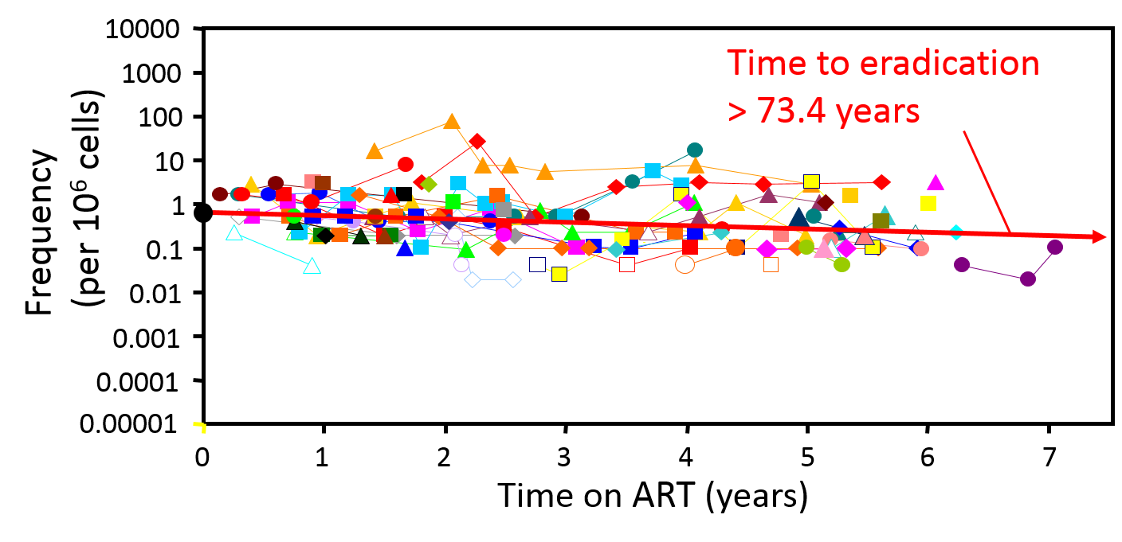
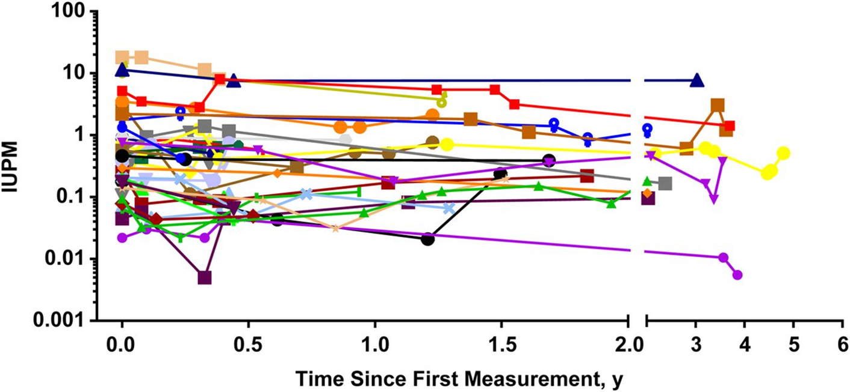
Slow decay of the reservoir
t_{1/2} = 44 months
Finzi et al, Nature Med 1999; Siliciano et al.,
Nature Med., 2003
t_{1/2} = 43 months
Crook et al, JID 2015
Notes:
Our original longitundinal studies were published in 2003. Recently, David Margolis has repeated this study. Many of his patients were on newer regimens, but the results were exactly the same. This means that all of the remarkable progress in
This study was published in 2003 but last year , Dr. Margolis and his colleagues published the results of their study in which they also measured the decay of latently infected resting CD4 cells isolated from suppressed patients. Many of these patients were on the newer ART regimens but as you can see, the results are essentially identical to the earlier study. The frequency of infected cells is about the same, 1 in a million with a 2 log range and essentially no decay. The half-life is almost identical in these 2 studies. We calculated a half-life of 44 months and Margolis calculated a half life of 43 months. So, even though the newer antiretroviral drugs are better with regard to convenience and tolerability, this has not changed the fundamental problem of persistence of latently infected cells.
developing well tolerated ART regimens has not impacted the fundamental problem of a latent, non-replicating form of the virus. The drugs completely block viral replication but do not target the latent form.

Slide 17
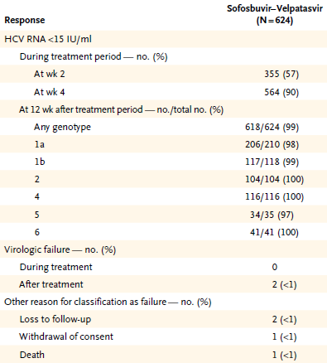
Chronic Hepatitis C infection
Continuous, high level viremia
Rapid viral evolution
Drug resistance with suboptimal treatment
Feld et al., NEJM, 2015
Notes:
This idea is supported by a consideration of hepatitis C infection, which like HIV, can result in continuous high level viremia with rapid viral evolution and drug resistance with suboptimal treatment. And yet with current 2 drug regimens, cure rates approaching 100% can be readily achieved.

Slide 18
Dose Response Curve
100
10
IC
50
1
0.1
Infection (% of control)
0.01
PI and NNRTI
0.001
0.0001
0.00001
0.01
0.1
1
10
100
Concentration/IC
50
Shen et al, Nat Med 2008
Jilek et al, Nat Med 2012
Notes:
To understand this, lets consider the dose response curves for antiviral drugs. Because viruses replicate exponentially we should plot inhibition of viral replication on an exponential or logarythnic scale, so that we can see the amount of infection decreasing from 100% of the control value to 10%, 1%, 0.1% etc as the drug concentration increases. Here are some hypothetical curves. Drugs are evaluated based on the IC50, the drug concentration that causes 50% inhibition. However antiretroviral drugs are dosed to give plasma concentrations well above the IC50. Most drugs have curves like the red curve. But to get a really high level of inhibition, you can see that you need a steep curve, like the green and orange curves. Lin Shen in our group showed that the PIs and NNRTIs have very steep dose response curves, allowing extremely high levels of inhibition.
[If someone asks, the DTG has a curve like the yellow curve but synergized very well with other drugs]

Slide 19
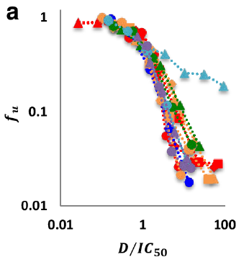
Inhibition of HCV replication by direct acting antiviral drugs
HCV antivirals also have steep dose response curves that produce very high levels of inhibition
Infection (% of control)
HCV infection is readily curable
HCV has no latent form
Concentration/IC
Koizumi et al, PNAS 2017
Notes:
It has recently been shown that HCV antivirals also have steep dose response curves that produce very high levels of inhibition.
Thus HCV infection is readily curable
This is because HCV has no latent form
We think that HIV infection would be readily curable if it were not for the latent form.

Slide 20
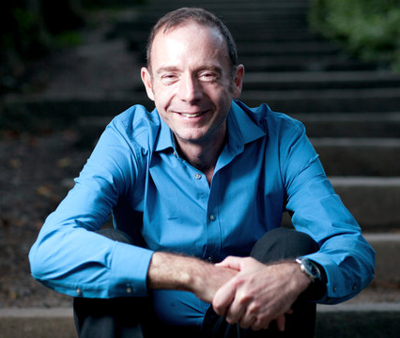
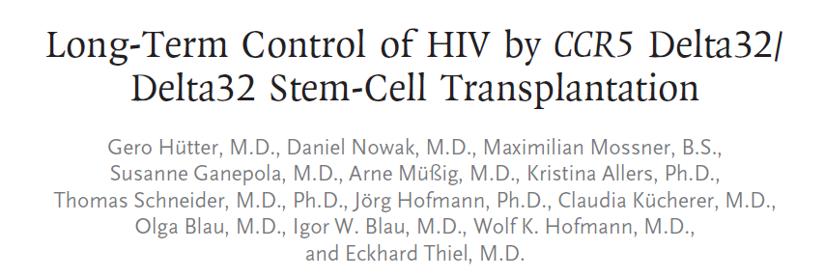
ART is completely suppressive but not curative due to latent reservoir
Host immune system, including latently infected cells, largely eliminated by condition regimen (chemo + irradiation and by graft vs host disease.
Donor cells protected from HIV infection due to absence of CCR5
Notes:
And so we think that ART is completely suppressive but is not curative due to latent reservoir. A single patient has been cured. This is Timothy Brown, who was doing well with HIV infection on antiretroviral therapy when he developed acute myelogenous leukemia. As part of the treatment for leukemia, his German physician arranged a bone marrow transplant from a carefully selected donor who was homozygous for a 32 base pair deletion in the chemokine receptor CCR5, which is critical for HIV entry. Antiretroviral therapy was stopped at the time of the initial transplant 9 years ago, and since that time several labs including our own have been unable to find any residual HIV in this patient. He is the first and only patient cured of an established HIV infection. His cure resulted from the fact that his entire immune system, including latently infected cells, was largely eliminated by condition regimen and by graft vs host disease. And if any latently infected cells were left, the virus they produce could not spread since the donor cells that now comprise his immune system are HIV resistant.

Slide 21
“Boston Patient B”
Below limit
of detection
10,000,000
Matched
allogeneic
HSCT
Stop
ART
1,000000
100,000
10,000
TDF
Plasma HIV RNA
(copies/ml)
FTC
RAL
1000
100
10
1
-42
-30
0
2
4
6
8
Time after Rx interruption (months)
Henrich et al, JID, 2013
Notes:
More instructive are two more transplant cases reported by Tim Henrich. In these pateints CCR5 wild type donors were used and the donor cells were protected from infection simply by continuing antiretroviral therapy throughout the transplant period and for a few years thereafter. Then treatment was stopped and what happened was really interesting. The normal rebound at 2 weeks did not occur. Viremia remained undetectable for several months and then suddenly shot to a million copies/ml, presumably reflecting the activation of one of a small number of latently infected cells remaining in the patient.

Slide 22
The Mississippi baby
1,000000
ART discontinued
AZT
Below limit
of detection
100,000
These delayed rebound cases prove that HIV can persist in a latent form for years and then begin to replicate
3TC
LPV/r
10,000
Plasma HIV RNA
(copies/ml)
>2 years
1000
100
10
0
10
20
30
40
50
Months after Birth
Persaud D et al., NEJM 2013
Notes:
Recently, our Hopkins colleague Debbie Persaud another near cure case, the Mississippi baby. This infant acquired HIV in utero from an infected mother who had no prenatal care. At birth, the viral load was 20,000 and an astute pediatrician started an antiretroviral therapy 30 hours after birth. Viremia fell to below the limit of detection and remained there However, at 18 months, therapy was stopped against medical advice. Remarkably, the viral load remained undetectable. However more than two years after therapy was stopped there was again a sudden rebound in viremia. What is particularly interesting in these three “near cure” cases is that there was little immune response to the virus as a result of the transplant process or early treatment. In the absense of treatment and immune responses, there is nothing to prevent exponential growth of the virus. The delayed rebound observed in these cases can only be explained by assuming that
HIV can persist in a latent form for years and then begin to replicate.

Slide 23
HIV replication dynamics
10,000,000
Stop
ART
1,000,000
Set
point
100,000
ART
10,000
Plasma HIV-1 RNA (copies/ml)
t_{1/2} = 1d
1000
R₀ = 8 -10
t_{1/2} = 14d
100
Limit of
detection
10
1
Time (months)
Notes:
In a typical patient rebound occurs very soon after treatment interruption. So let’s discuss the characteristics of rebound….

Slide 24
HIV replication dynamics
10,000,000
Stop
ART
1,000,000
Set
point
100,000
ART
10,000
Plasma HIV-1 RNA (copies/ml)
t_{1/2} = 1d
1000
R₀ = 8 -10
t_{1/2} = 14d
100
Limit of
detection
10
1
Time (months)
Notes:
The goal of cure research is to find interventions that will allow patients to stop ART without viral rebound to high levels. So lets talk about rebound in more detail

Slide 25
Viral rebound
10,000,000
  Rebound in ~14 d
Stop
ART
1,000,000
  Exponential
ART
100,000
  Multiple latently infected cells reactivate per day
10,000
Plasma HIV-1 RNA (copies/ml)
1000
14d
  Long delays only when <1 cell reactivates per day
100
10
1
1
-1
0
1
2
3
4
5
6
7
Time after interruption of ART (months)
Davey et al, PNAS 1999
Notes:
Rebound is rapid in most patients. Viremia becomes detectable on average 14 days after interruption.
Rebound is exponential, with viremia increasing rapidly up to the previous set point. This is a real problem because rates of viral replication increase rapidly to a level that allows viral evolution and escape from immune responses. In other words, the “horse gets out of the barn” very quickly.
Mathematical models and studies of the diversity of the rebound virus suggest that multiple latently infected are activated every day. Long delays in rebound can only be expected when the reservoir has been reduced to such an extent that less than one cells activated per day on average.

Slide 26
Approaches to cure
  Reservoir reduction results in a delay of rebound
  Sterilizing cure if reservoir is eliminated
10,000,000
Stop
ART
1,000,000
ART
100,000
10,000
Plasma HIV-1 RNA (copies/ml)
1000
100
10
1
1
-1
0
1
2
3
4
5
6
7
Time after interruption of ART (months)
Notes:
There are basically two approaches to cure.
Reservoir reduction results in a delay in rebound, ultimately permitting what is known as a sterilizing cure if the reservoir is completely eliminated.

Slide 27
Approaches to cure
10,000,000
  Immunologic interventions may allow control of viral replication
  Permanent control of viremia=Functional cure
Stop
ART
1,000,000
ART
100,000
10,000
Plasma HIV-1 RNA (copies/ml)
1000
100
10
1
1
-1
0
1
2
3
4
5
6
7
Time after interruption of ART (months)
Notes:
Alternatively, immunologic interventions may permit rapid control of viral rebound to undetetable levels, essentially converting patients with progressive disease into elite controllers. This is sometimes referred to as a functional cure. It is currently unclear which approach is most likely to be successful but I would like to present the results trials representing both approaches. I would first like to discuss the use of broadly neutralizing antibodies in HIV cure efforts

Slide 28
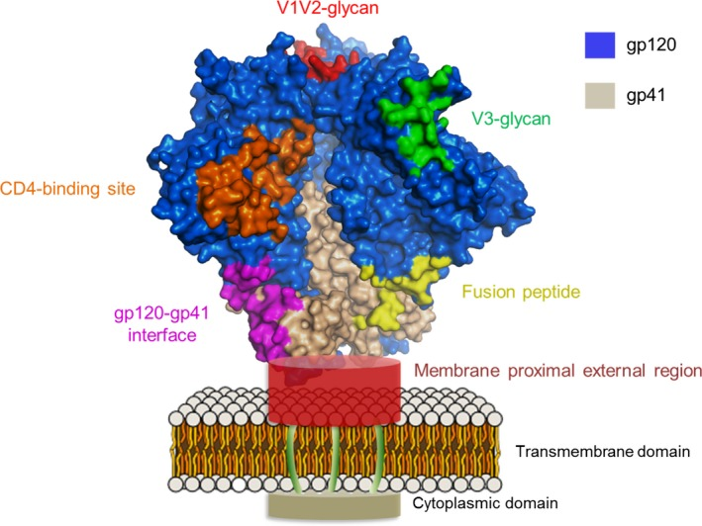
The HIV envelope spike
Bonsignori et al, Imm Rev 2017
Notes:
On the surface of the HIV virus particle are spikes composed of the HIV envelope protein which at high resolultion looks like this. This envelope protein is the target of neutralizing antibodies.

Slide 29
Broadly neutralizing
antibodies
PGT121
  Neutralize diverse HIV isolates
VRC01
  Arise slowly, generally after virus has already escaped
  Have been isolated and sequenced
  Can be administered passively as infusion or with AAV vectors
  Block infection and target infected cells for killing
Bonsignori et al, Imm Rev 2017
Notes:
This is the HIV envelope protein spike which is present on the surface of the virion. Antibodies that bind to the envelope protein can prevent infection. However HIV evolves rapidly and there is tremendous heterogeneity in this protein in difficult infected individuals and even within a single individual. This is one of the big problems with HIV vaccine development Recently several groups have been able to isolate “broadly neutralizing antibodies” that can neutralize many diverse HIV isolates. They arises in some infected individual after a few years, but are of little benefit in those individuals because the virus has already escaped. However they can be infused passively into other patients and they produce a transient reduction in viremia. With respect to HIV cure research, they are of particular interest because they not only block new infection events but also potentially target infected cells for destruction. Productively infected cells will express the envelope protein on the cell surface. The antibodies can then bind and target the infected cell for rapid destruction by natural killer or NK cells. I will illustrate these concepts in the next few slides, focusing on two of the best studied antibodies, VRC01, which binds to and blocks the CD4 binding site on the envelope spike, and PGT121, which binds to a different region of the spike.

Slide 30
Effects of antibodies
NK cell
Notes:
This slide illustrated steps in the HIV life cycle that are blocked by different classes of antiretroviral drugs. The first step is attachment of the virus to CD4. This step can be blocked by neutralizing antibodies. Thus the prevent entry as do chemokine recetor antagonists like maraviroc and fusion inhibitors like enfuvirtide. However, antibodies can do something that antiretroviral drugs cannot do. The envelope spikes are expressed on the surface of the infected cells before the virus buds off, and antibodies can bind and target the cell for lysis by natural killer cells. This mechanism will have no effect on latently infected cells unless the cells are first activated in some way so that they begin to make viral proteins.

Slide 31
Slight delay with bNAb infusion
VRC01
10,000,000
Stop
ART
1,000,000
(copes/ml)
ART
100,000
A
10,000
-1 RN
V
1000
100
Plasma HI
10
1
1
-1
0
1
2
3
4
5
6
7
Time after interruption of ART (months)
Bar et al, NEJM 2016
Scheid et al Nature 2016
Salantes et al, JCI 2018
Notes:
Here are results of a recently study in which a broadly neutralizing antibody called VRC01 was passively infused into pateints on ART. Treatment was stopped to assess the effects of this intervention. All patients rebounded but in some cases the rebound was delayed. However, in interpreting studies like this,…

Slide 32
Rebound dynamics
Drug
washout
Appearance of
productively infected cells
Exponential
growth
10,000,000
1,000,000
(copes/ml)
ART
100,000
A
10,000
-1 RN
V
1000
100
Plasma HI
10
1
1
-1
0
1
2
3
4
5
6
7
Time after interruption of ART (months)
Notes:
…it is useful to divide rebound into 3 phases: the initial period required for washout of antiretroviral drugs, a second represents the time required for productively infected cells to appear, normally very short, and finally the time requires for exponential viral growth of the virus. bNAbs are cleared very slowly over several weeks, and this may explain the delay in rebound observed in the passive infusion studies. In any event, it is unlikely that bNAbs will clear latently infected cells which are not expressing any viral proteins. And thus most investigators feel that it will be necessary to turn on viral gene expression in latently infected cells so that they can be identified and eliminated.

Slide 33
Reservoir reduction and time to rebound
10,000,000
Stop
ART
1,000,000
(copes/ml)
ART
100,000
A
10,000
-1 RN
V
1000
100
Plasma HI
10
1
-1
0
1
2
3
4
5
6
7
Time after interruption of ART (months)
Rothenberger et al, PNAS 2014
Notes:
It is also important to understand the relationship between the degree of reservoir reduction the time to viral rebound. As we have said, without any intervention rebound occurs in around two weeks. Here are some actual rebound data from a recent treatment interruption study. Given the lifelong challenge presented by the stable reservoir of latent HIV, I think we need to view these results longer time scale. One a time scale of years, this variation in the normal time to rebound is minimal

Slide 34
Reservoir reduction vs immune control
10,000,000
Stop
ART
1,000,000
(copes/ml)
ART
Boston patients
100,000
A
10,000
Mississippi
baby
-1 RN
Patients
on ART
V
1000
100
Plasma HI
10
1
0
1
2
Time after interruption of ART (years)
Henrich et al, AIM 2014
Persaud et al, NEJM 2015
Notes:
Truly dramatic delays in rebound have been produced by interventions that cause multilog reductions in the reservoir including allogeneic bone marrow transplantation and very early treatment.

Slide 35
The shock and kill approach for eliminating latent HIV
  LRA in clinical trials
†
  Histone deacetylase inhibitors – promote gene expression
†
T cell activation
  Toll-like receptor agonists – activate the innate immune response
Latency reversing
agents (LRAs)
†
†
Notes:
So how are we going to decrease the HIV reservoir. The most widely discussed approach is called shock and kill. The idea is to turn the latent virus back in so that the infected cell will die from viral cytopathic effects or be recognized and eliminated by the immune system. One way to turn on latent HIV is to activate the T cell, but global T cell activation results in toxicity and so there has been a search for latency reversing agents or LRAs that will turn on latent HIV without inducing T cell activation. Some LRAs that are currently in clinical trials include histone deacetylase inhibitors which are epigenetic modifiers that generally promote gene expression. Some of this were originally developed as cancer drugs but have some ability to activate latent HIV, at least in model systems. There is also interest in toll like receptors which activate the innate immune response and also seem to be able to activate latent HIV.
Toll-like receptor agonists
are potent enhancers of innate antiviral immunity that can also improve the adaptive
immune response.

Slide 36
Current status of LRA trials
  Numerous LRAs identified in model systems
†
  Few shown to work ex vivo with cells from patients
†
T cell activation
  Some evidence for slight transient increases in plasma HIV RNA after LRA treatment indicating some reactivation of latent HIV
Latency reversing
agents (LRAs)
†
†
  In clinical trials, no reduction in the reservoir yet demonstrated
Notes:
We have explored these issues using our primary cells model. When latency is reversed through T cell activation, the infected cells die quickly. But when latency is reversed with a histone deacytlase inhibitor that does not induce T cell activation, the cells don’t die. They just sit there and produce virus.

Slide 37
Targeting the reservoir using antibodies
Barouch et al, CROI 2018
Notes:
On of the most exciting recent studies presented by Dan Barouch at this years CROI meeting involved monkeys that were infected with an HIV-like virus SHIV, and then treated with ART. After 2 years, the monkeys were treated with a latency reversing agent and a broadly neutralizing antibodiy PGT121. After the antibody had been cleared, ART was stopped.

Slide 38
Targeting the reservoir using antibodies
Barouch et al, CROI 2018
Notes:
In the control group, all of the animals showed viral rebound after treatment interuption., but in the groups that received the antibody, there was a delay in rebound and better control of viremia after rebound

Slide 39
Targeting the reservoir using antibodies
Barouch et al, CROI 2018
Notes:
This best seen in the composite plots. One caveat to these exciting results is that the animal were treated after only 7 days of infection. Neverthless, this combined approach is likely to represent a model for cure studies in humans.,

Slide 40
Problems with the “kill” phase
Shock
Kill
  Infected cells may not die quickly after reversal of latency
†
  Cytolyic T lymphocyte (CTL) response is “exhausted”
CTL
†
T cell activation
  Unless treatment is started during acute infection, most of the viruses in the latent reservoir have CTL escape mutations
Latency reversing
agents (LRAs)
†
†
  Vaccines to enhance the cytolytic T cell response may be needed
CTL
Notes:
This may be due to relatively poor latency reversal as well as problems in the kill phase.
-Infected cells may not die quickly after reversal of latency a
-The cytolytic T lymphocytes that normally kill infected cells show an exhausted phenotype
-In addition, nnless treatment is started during acute infection, most of the viruses in the latent reservoir have CTL escape mutations
-Therefore vaccines that enhance the CTL response may be needed in addition to LRAs

Slide 41
Reservoir reduction vs immune control
10,000,000
Stop
ART
1,000,000
Vaccine
+LRA
Control animals
100,000
Immune
control
10,000
Reservoir
reduction
Plasma SIV RNA (copies/ml)
1000
Vaccine + LRA
100
10
1
-1
0
1
2
3
4
5
6
7
Time after interruption of ART (months)
Borducchi et al, Nature 2016
Notes:
This concept is illustrated in a recent study in the SIV model by Dan Barouch and colleauges. SIV infected macaques were treated with ART and then given a vaccine to enhance the CTL response to SIV and an LRA to turn on latent SIV. In this case the LRA was a TLR7 agonist. The black curve shows that average viral loads in control animals. Viremia rebounded rapidly. In animals that received the vaccine and LRA, there was a slight delay in rebound, perhaps reflecting a reduction in the latent reservoir, as well as a lower post rebound set point, indicating improved immune control of viral replication. This study nice illustrates the two different approaches to cure that I will talking about. Although the magnitude of the effects observed here is modest, this is an important step and hopefully the many people working in the cure field will be able to improve upon this.

Slide 42
Time to rebound
Miss.
baby
1,000,000
Boston
pt. A
Boston
pt. B
100,000
Berlin pt.
10000
Chun et al.
Fold reduction in
latent reservoir
1000
100
10
1 wk
1 mo
3 mo
1 yr
10 yr
Lifetime
Time to rebound
Hill et al, PNAS 2014
Notes:
Using mathematical models we have predicted the time to rebound after interventions that reduce the reservoir be the indicated amount. Without interventions, viremia rebounds in about two weeks. Reductions in the reservoir delay rebound. On average, a 1000 fold redution is needed to delay rebound by a year, with very wide variation from patient to patient reflecting differences in reservoir size and the random nature of the reactivation of latently infected cells. This model fist the delayed rebound cases reasonably well. Interestingly, although it is frequently said that cure will require elimination of every single latently infected cell, the model shows that this is not really the case. With a 1000 fold reduction, some patients won’t rebound in their remaining lifespan even though some latently infected cells remain. This is an encouraging finding although we can’t predict this with certainty for individual patients.

Slide 43
Conclusions
ART stops viral replication but does not eliminate latent HIV
Reactivation of latently infected cells leads to viral rebound after ART interruption
Current cure efforts are focused on eliminating the latent reservoir
Broadly neutralizing antibodies have been isolated and developed as agents to block viral entry and target productively infected cells
Reservoir reduction will likely the identification of effective latency reversing agents and effective kill strategies
Long delays in viral rebound will require a 1000 fold reduction in the reservoir

Slide 44
Question-and-Answer
Slide 44 of 44

