Slide 1
Update From CROI 2019:
Ending AIDS by 2030
Robert T. Schooley, MD
Professor and Vice Chair of Medicine
University of California San Diego
La Jolla, California

Slide 2
CROI Update 2019
Vaccine
Update
Ending the Epidemic

Slide 3
AIDS Vaccine Development
The American team said their discovery may lead to a vaccine against AIDS.
"We hope to have such a vaccine ready for testing in about two years," Heckler said.
Miami Herald - April 24, 1984

Slide 4

Prospects for the Rapid Development of an AIDS Vaccine

Slide 5
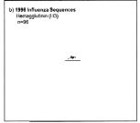
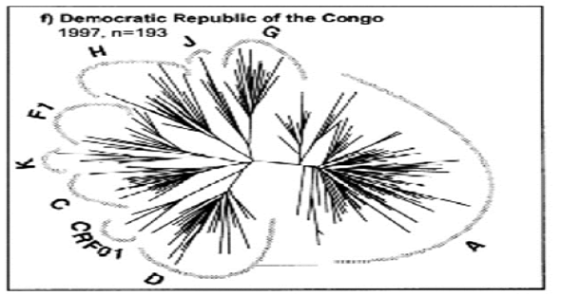

Relative Viral Diversity: HIV and Influenza A
1996 Influenza
Sequences
DRC, 1997, n-= 193
Betty Korber, 2002

Slide 6
Despite the Genetic Diversity, Broadly Neutralizing Abs are Possible
Nussenzweig, CROI 2019

Slide 7
Mapping Broadly Neutralizing Epitopes
Nussenzweig, CROI 2019

Slide 8
Only A Minority of People Make them and it is After Years of Exposure
Nussenzweig, CROI 2019

Slide 9
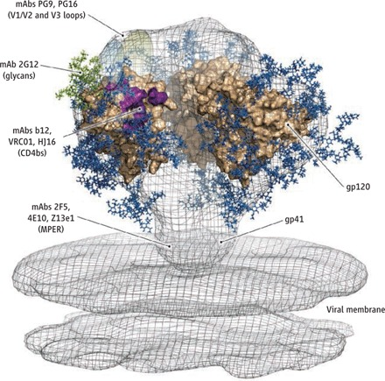
Neutralizing HIV antibodies.
D R Burton, and R A Weiss Science 2010;329:770-773
Notes:
Neutralizing HIV antibodies. Broadly neutralizing monoclonal antibodies (mAbs) target epitopes on the viral envelope spike at the surface of HIV-1. The spike is a heterotrimer containing the viral glycoproteins (gp120)3 (gp41)3. This model is generated by combining cryoelectron tomographic (13), crystallographic (14), and computational analyses. It shows the gp120 core structure (tan) fitted in the electron density map (gray) of the spike. The membrane proximal external region (MPER) and viral membrane are shown. The V1/V2 and V3 protein loops are represented as ovals (light green and light blue) at the top of the spike. Glycans (green and blue) are indicated. The model is derived from (5) with permission from Wolters Kluwer Health–Lippincott Williams and Wilkins; from (6) with permission from Elsevier; and from (13) with permission from Macmillan Publishers Ltd./Nature Publishing Group.

Slide 10
Broadly Neutralizing Antibodies Require Many Somatic Mutations
Nussenzweig, CROI 2019

Slide 11
Sequential Immunization
Nussenzweig, CROI 2019

Slide 12
Monoclonal Abs Reduce Plasma HIV-1 RNA Levels
Nussenzweig, CROI 2019

Slide 13
Nine Study Volunteers - Two BNab’s
Nussenzweig, CROI 2019

Slide 14
Two “Long term” Suppressors
Nussenzweig, CROI 2019

Slide 15
Antibodies Engage other Immune Effectors
Nussenzweig, CROI 2019

Slide 16
T-Cell Responses in Long Term Suppressors
Nussenzweig, CROI 2019

Slide 17
Nussenzweig, CROI 2019

Slide 18
HIV Vaccine Progress: 2019
The good news
  We know much more about what antigens broadly active neutralizing antibodies recognize
  We know that some HIV-1 infected people can make them
  We know that they suppress HIV in vivo
The bad news
  We have no clue about how to make HIV seronegative people make these antibodies with currently understood vaccines or immunization strategies

Slide 19
CROI Update 2019
Vaccine
Update
Ending the Epidemic

Slide 20
Trump Pledges to end the HIV/AIDS Epidemic by 2030

Slide 21
CROI 2019: Another Cure
Diagnosed with HIV-1 in 2003
Developed Stage IV B Hodgkin lymphoma in 2013
Placed on TDF/FTC/EFV->TDF/FTC/Raltegravir
Received ABVD chemotherapy
Failed multiple lines of chemotherapy
Listed for BMT
Unrelated high 9/10 HLA resolution match homozygous for CCR5-delta 32 deletion found
Gupta, CROI 2019; Nature 2019

Slide 22
Transplant Course
Received 3.6 x 106 CD34+ stem cell/kg infusion
Complicated post tx course including sepsis, GVHD
Discharged on day 31
Reactivated CMV->ganciclovir
Reactivated EBV->Rituximab
Gupta, CROI 2019; Nature 2019

Slide 23
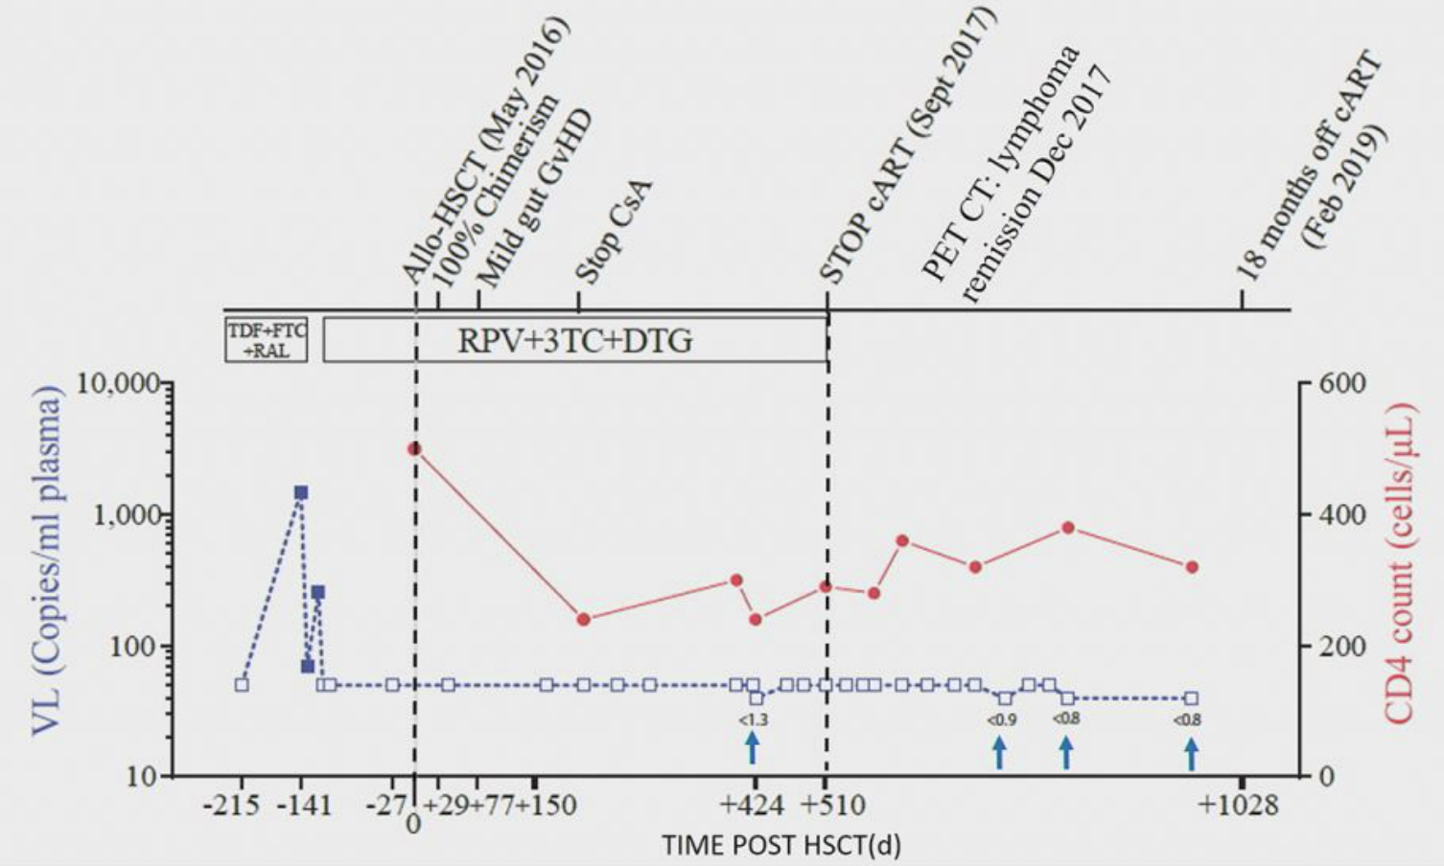
Post Transplant Course
Gupta, CROI 2019; Nature 2019

Slide 24
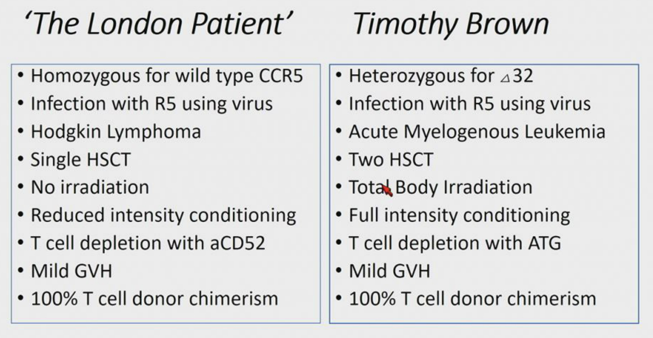
Gupta, CROI 2019; Nature 2019

Slide 25
Antiretroviral Drugs
Fauci, CROI 2019

Slide 27
Probability of Survival After AIDS-Defining OI Diagnosis by Year of Diagnosis
1.0
0.9
0.8
0.7
0.6
0.5
0.4
0.3
0.2
0.1
1997
1996
Proportion Surviving
1995
1994
1993
1992
1984-1991
0 5 10 15 20 25 30 35 40 45 50 55 60
Months After OI Diagnosis
Lee LM, et al. JAMA. 2001;285:1308.
Notes:
Lecture Notes
HIV survival is increasing due to improvements in antiretroviral therapy and an increase in the proportion of HIV-infected persons receiving treatment.¹A retrospective cohort study using data from a population-based registry has confirmed a decline in AIDS-related deaths in recent years. The registry included 394,705 persons with an AIDS-defining opportunistic infection (OI) diagnosed from 1984 through 1997 in the United States. Median survival improved from 11 months among those diagnosed in 1984 to 46 months for those diagnosed in 1995. For patients diagnosed with an OI in 1996 or 1997, 67% were alive ≥36 months later and 77% were alive ≥24 months after diagnosis. Survival times were increased for each year of diagnosis for blacks, whites, and Hispanics.
Reference
1. Slide reprinted with permission from Lee LM, Karon KM, Selik R, Neal JJ, Fleming PL Survival after AIDS diagnosis in adolescents and adults during the treatment era, United States, 1984-1997. JAMA. 2001;285:1308-1315.

Slide 28
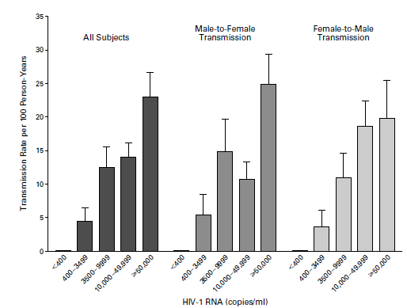
HIV-1 Seroconversion Risk by Plasma HIV-1 RNA Level
Quinn, et. al., N Engl J Med 2000

Slide 29



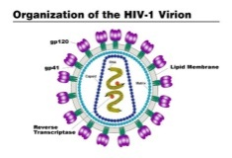
Drugs for Prevention: Whom to Treat?

Slide 30
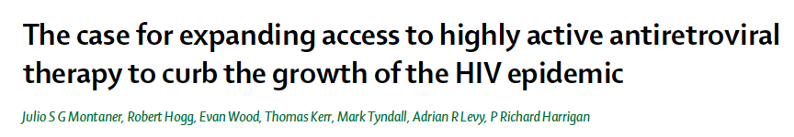
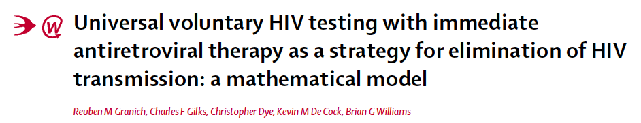
ART for Prevention
Lancet 2006
Lancet 2009
Theoretical model evaluated in the context of a generalized heterosexual epidemic of the same intensity as South Africa.
Indicates that universal and annual voluntary HIV testing followed by immediate ART (irrespective of clinical stage or CD4 cell count) could reduce new HIV cases by 95% within 10 years

Slide 31
HPTN 052/ACTG 5245 Study

Slide 32
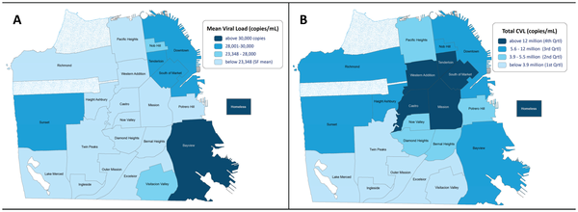
Community Viral Load
Das. et. al., PLoS One 2010

Slide 33
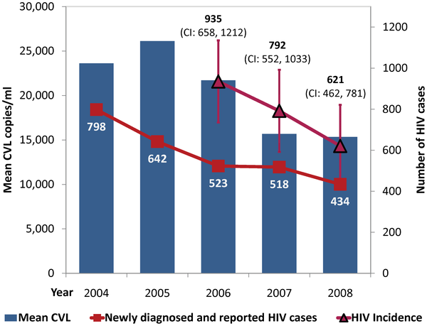
Treating the Infected Partner: Declining Primary Infection with Increased access to Antiretroviral Therapy
Das. et. al., PLoS One 2010

Slide 34
San Francisco: 2007 - 2017

Slide 35
Hillier, CROI, 2019

Slide 36
Drugs for Prevention: Whom to Treat?

Slide 37
PrEP in 2019
Oral PrEP: Seven completed trials
  MSM: 3/3 studies demonstrated reduction in transmission
  Heterosexual women: 2/4 studies demonstrated reduction in transmission
Dalpivarine Ring
  Reductions in women (except youngest age group)
Longer acting oral and injectable PrEP in development
Hillier, CROI 2019

Slide 38
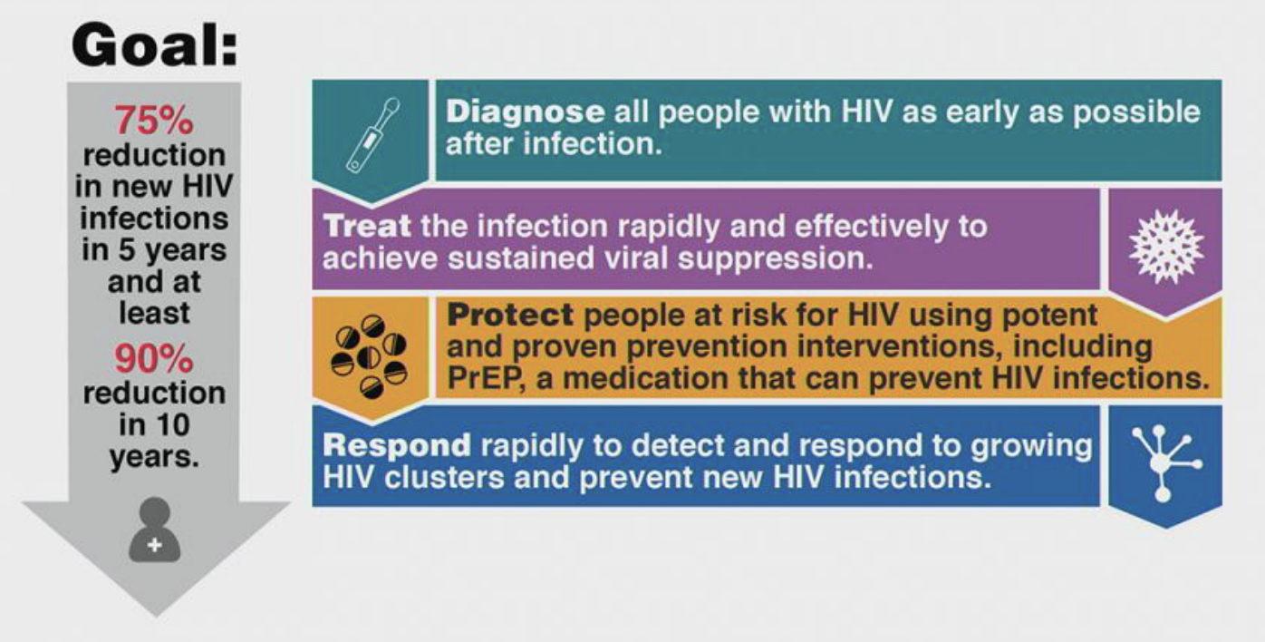
Ending AIDS by 2030: The Plan
Fauci, CROI 2019

Slide 39
What are Our Two Biggest Challenges to Reaching the 2030 Goal?
A failure to follow the science and invest the money in ways that it is effective
Mismatches between where we invest and where the epidemic is going

Slide 41
First the Positives….
Invests $291 million in the Ending AIDS Initiative
  CDC and local health departments: Up $140 million
  Ryan White AIDS Care Program: Up $120 million
  Yes to needle exchange (despite Pence)

Slide 42
And Now the Negatives…..
PEPFAR: Cut
By 1.35 Billion
PEPFAR: Cut
By 1.35 Billion

Slide 44

Walls Will not Protect US from Global Infectious Disease Threats

Slide 46
Health Care (not) For All
Medicaid and ACA subsidies: Cut by $777 billion over 10 years
  Ending coverage for pre-existing conditions
  Requiring additional documentation of citizenship, etc.
  Re-imposing means tests
Medicaid Expansion: Reversed
Medicare: Cut by $845 billion
  Reduce support for graduate medical education
Two Weeks Ago: DOJ decides to support a Texas Court decision that declared the entire ACA invalid

Slide 47
AIDS is no Longer a Bicoastal Problem

Slide 48
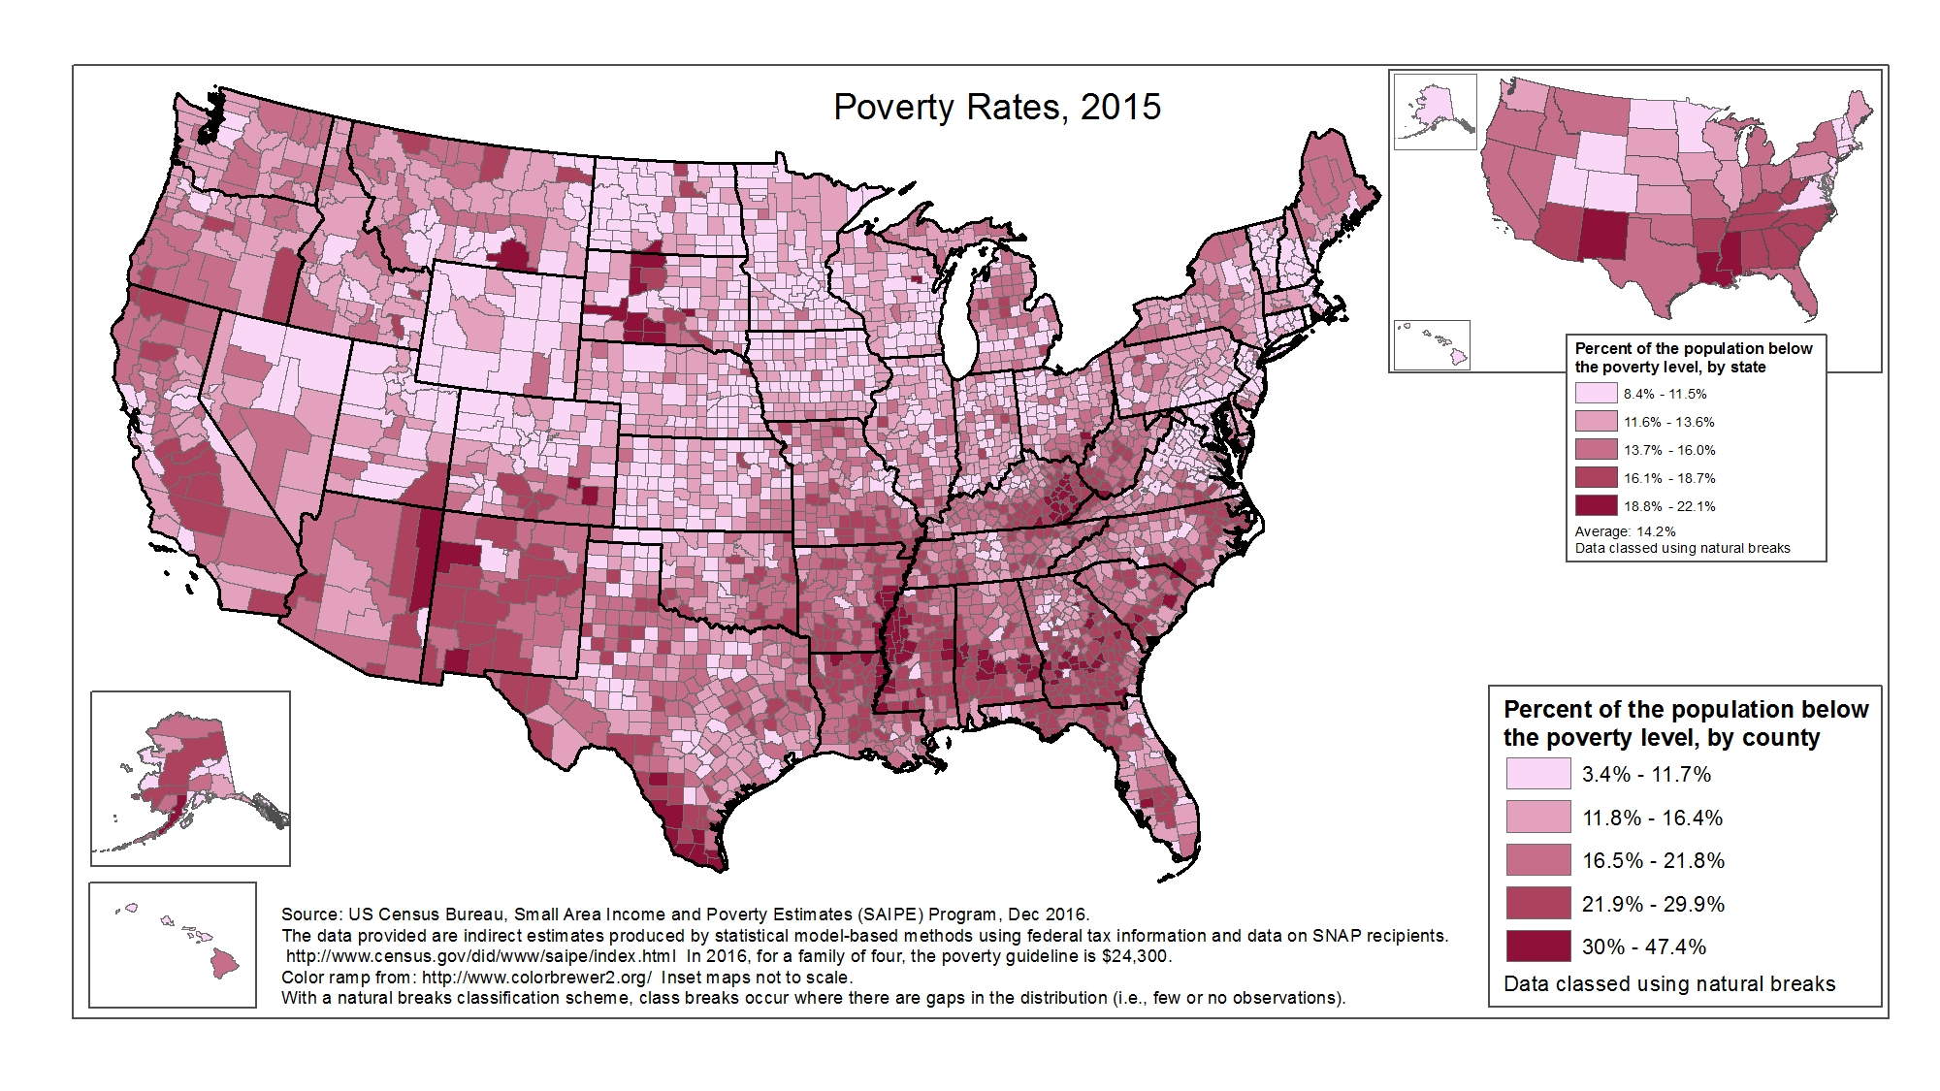
Notes:
POVERTY RATES
These are maps of poverty rates in 2015. The data are grouped into 5 classes, using natural breaks.
At the state level (smaller map, top right), the range is from 8.4% to 22.1%. The 3 states with the highest percentage of the population living below the poverty level are New Mexico, Louisiana, and Mississippi. Other southern and western states have a high percentage of the population living below the poverty level. The lowest percentages are found in the midwest and northeast.
County-level data can illustrate patterns of poverty rates within states, as well as cross-state patterns. At the county level, the range is from 3.4% to 47.4%. As seen in the map, the highest percentage of the population living below the poverty level are found in the southern half of the US, as well as several counties in the Dakotas, and the lowest percentages in the midwest and northeast.
(SAIPE does not provide data for US territories.)

Slide 49
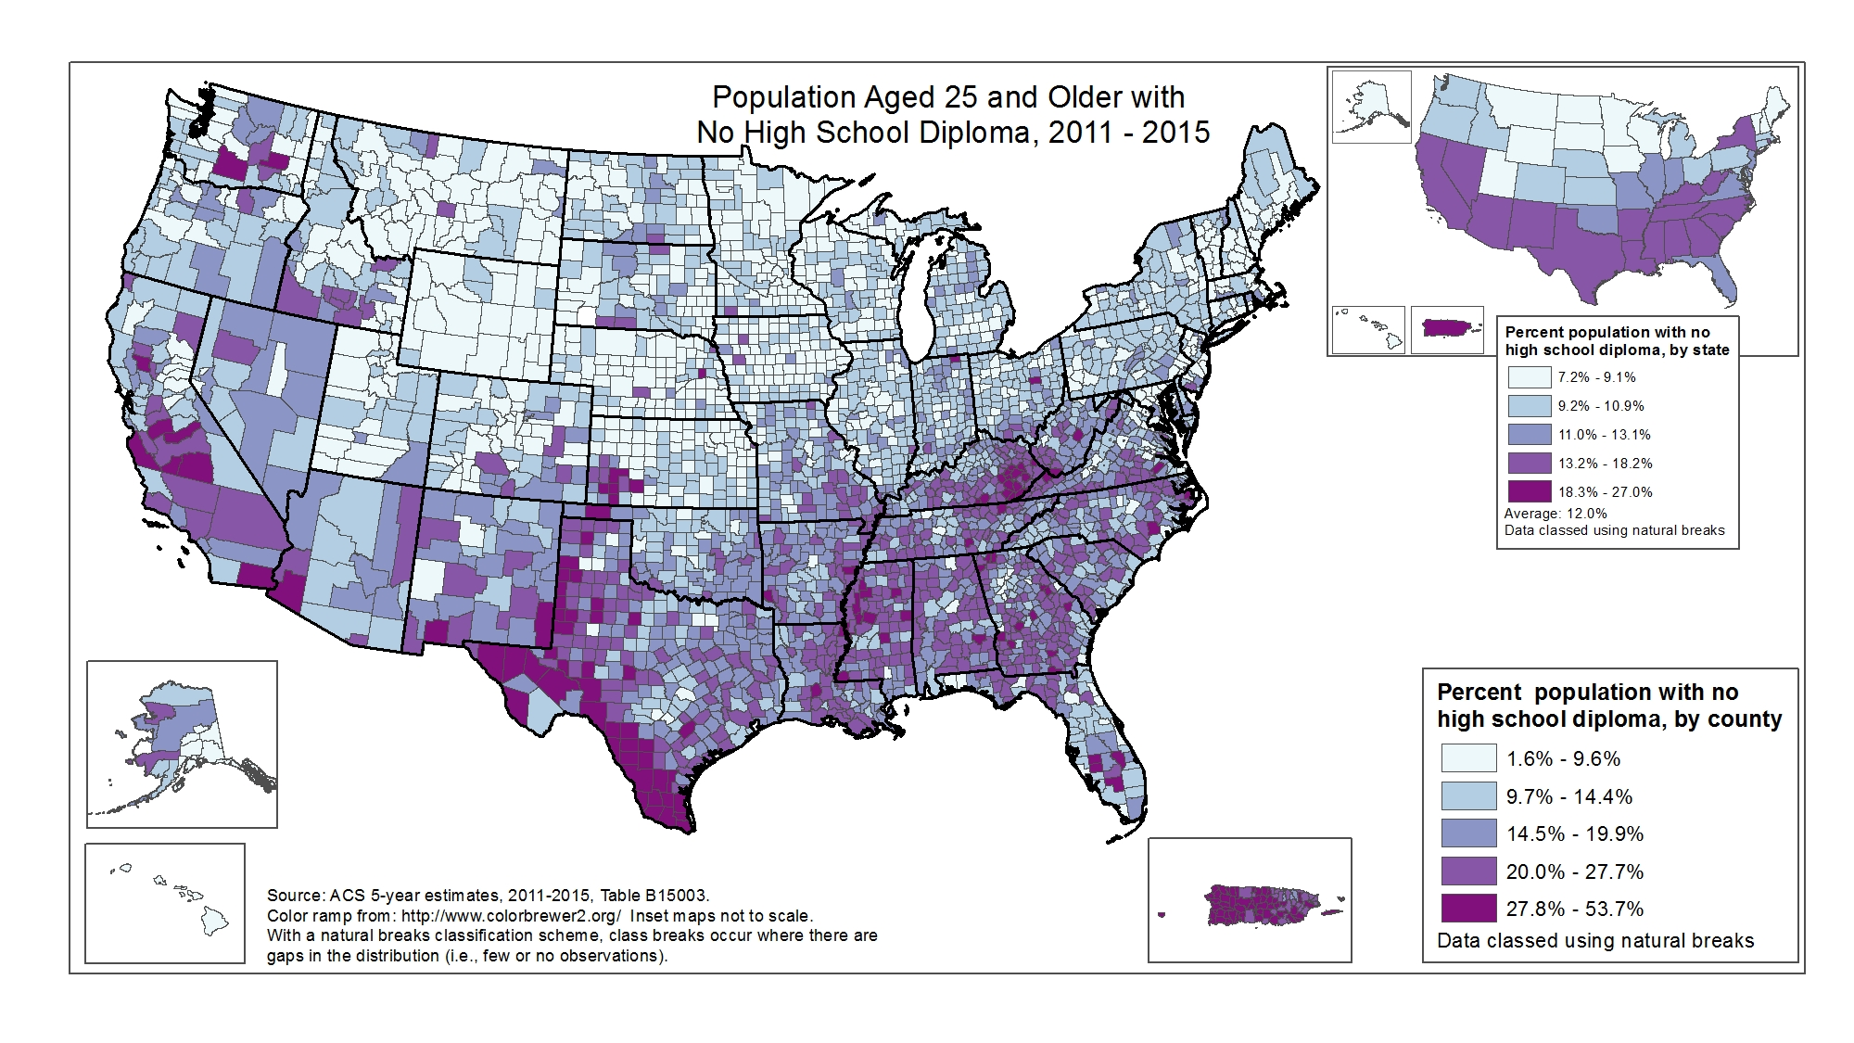
Notes:
Population Aged 25 and Older with No High School Diploma
These are maps of percentage of the population aged 25 and older with no high school diploma, 2011 - 2015. The data are grouped into 5 classes, using natural breaks.
At the state level (smaller map, top right), the range is from 7.2% to 27.0%. With the exception of New York, the states where a high percentage of the population aged 25 and over have no high school diploma are in the southern half of the US (and also Puerto Rico).
County-level data can illustrate patterns of percentage of the population aged 25 and older with no high school diploma within states, as well as cross-state patterns. At the county level, the range is from 1.6% to 53.7%. With a few exceptions, the counties where 20% or greater of the population aged 25 and over have no high school diploma are in the southern half of the US (and also Puerto Rico).
(No data for US territories, other than Puerto Rico.)

Slide 50
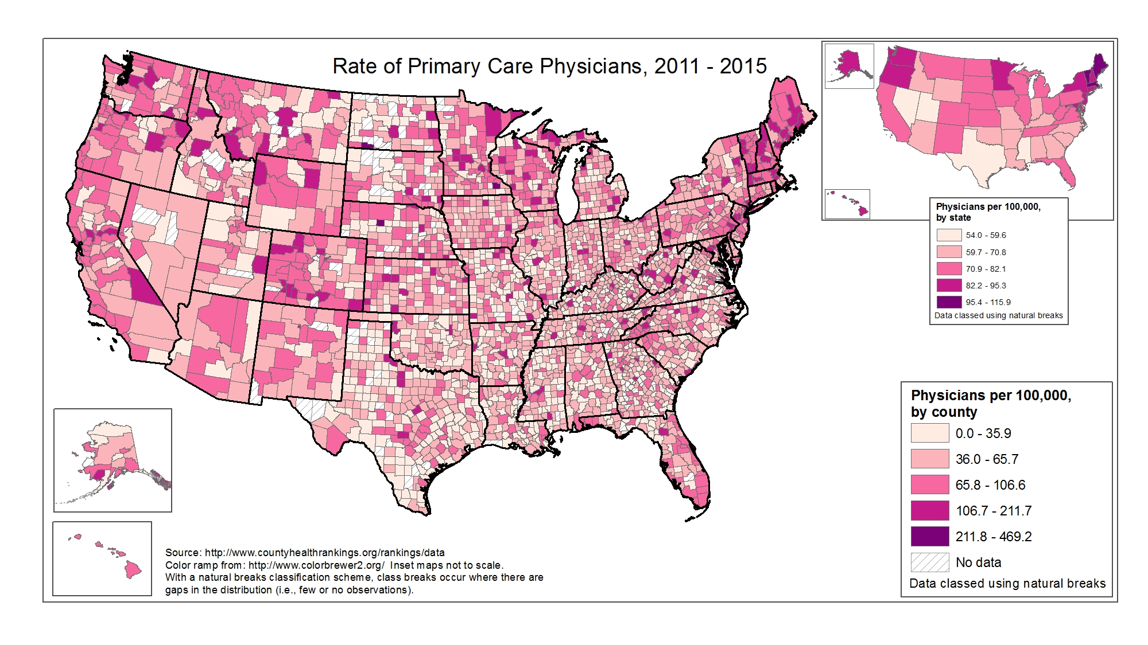
Notes:
RATE OF PRIMARY CARE PHYSICIANS
These are maps of the rate of physicians (per 100,000), 2011 - 2015. The data are grouped into 5 classes, using natural breaks.
At the state level (smaller map, top right), the range is from 54.0 to 115.9 per 100,000. The rate of physicians per 100,000 is highest in AK, HI, WA, OR and the northeastern US. Generally speaking, there is a lower rate of physicians per 100,000 in the south, with the exception of Florida and Tennessee.
County-level data can illustrate patterns of rates of primary care physicians within states, as well as cross-state patterns. At the county level, the range is from 0.0 to 469.2 per 100,000 (there are several dozen counties with no data). The county level pattern of physicians per 100,000 is somewhat random, but somewhat mirrors that at the state level - higher rates out west and in the northeast, and lower rates in the south.
(No data for US territories.)

Slide 51
Ending AIDS: What Can We Do?
Promote policies that have been shown to make a difference:
  Access to health care for all
  Invest in public health
  Invest in research
VOTE!

Slide 52

Thank you!

Slide 53
Question-and-Answer
Slide 60 of 60

