Slide 1
Opioid Withdrawal, Opioid Substitution Treatment, and HIV Infection
R. Douglas Bruce, MD, MA, MS
Associate Clinical Professor of Medicine
Yale University
Chief of Medicine
Cornell Scott-Hill Health Center
New Haven, Connecticut

Slide 2
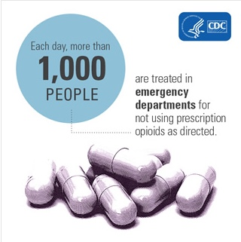
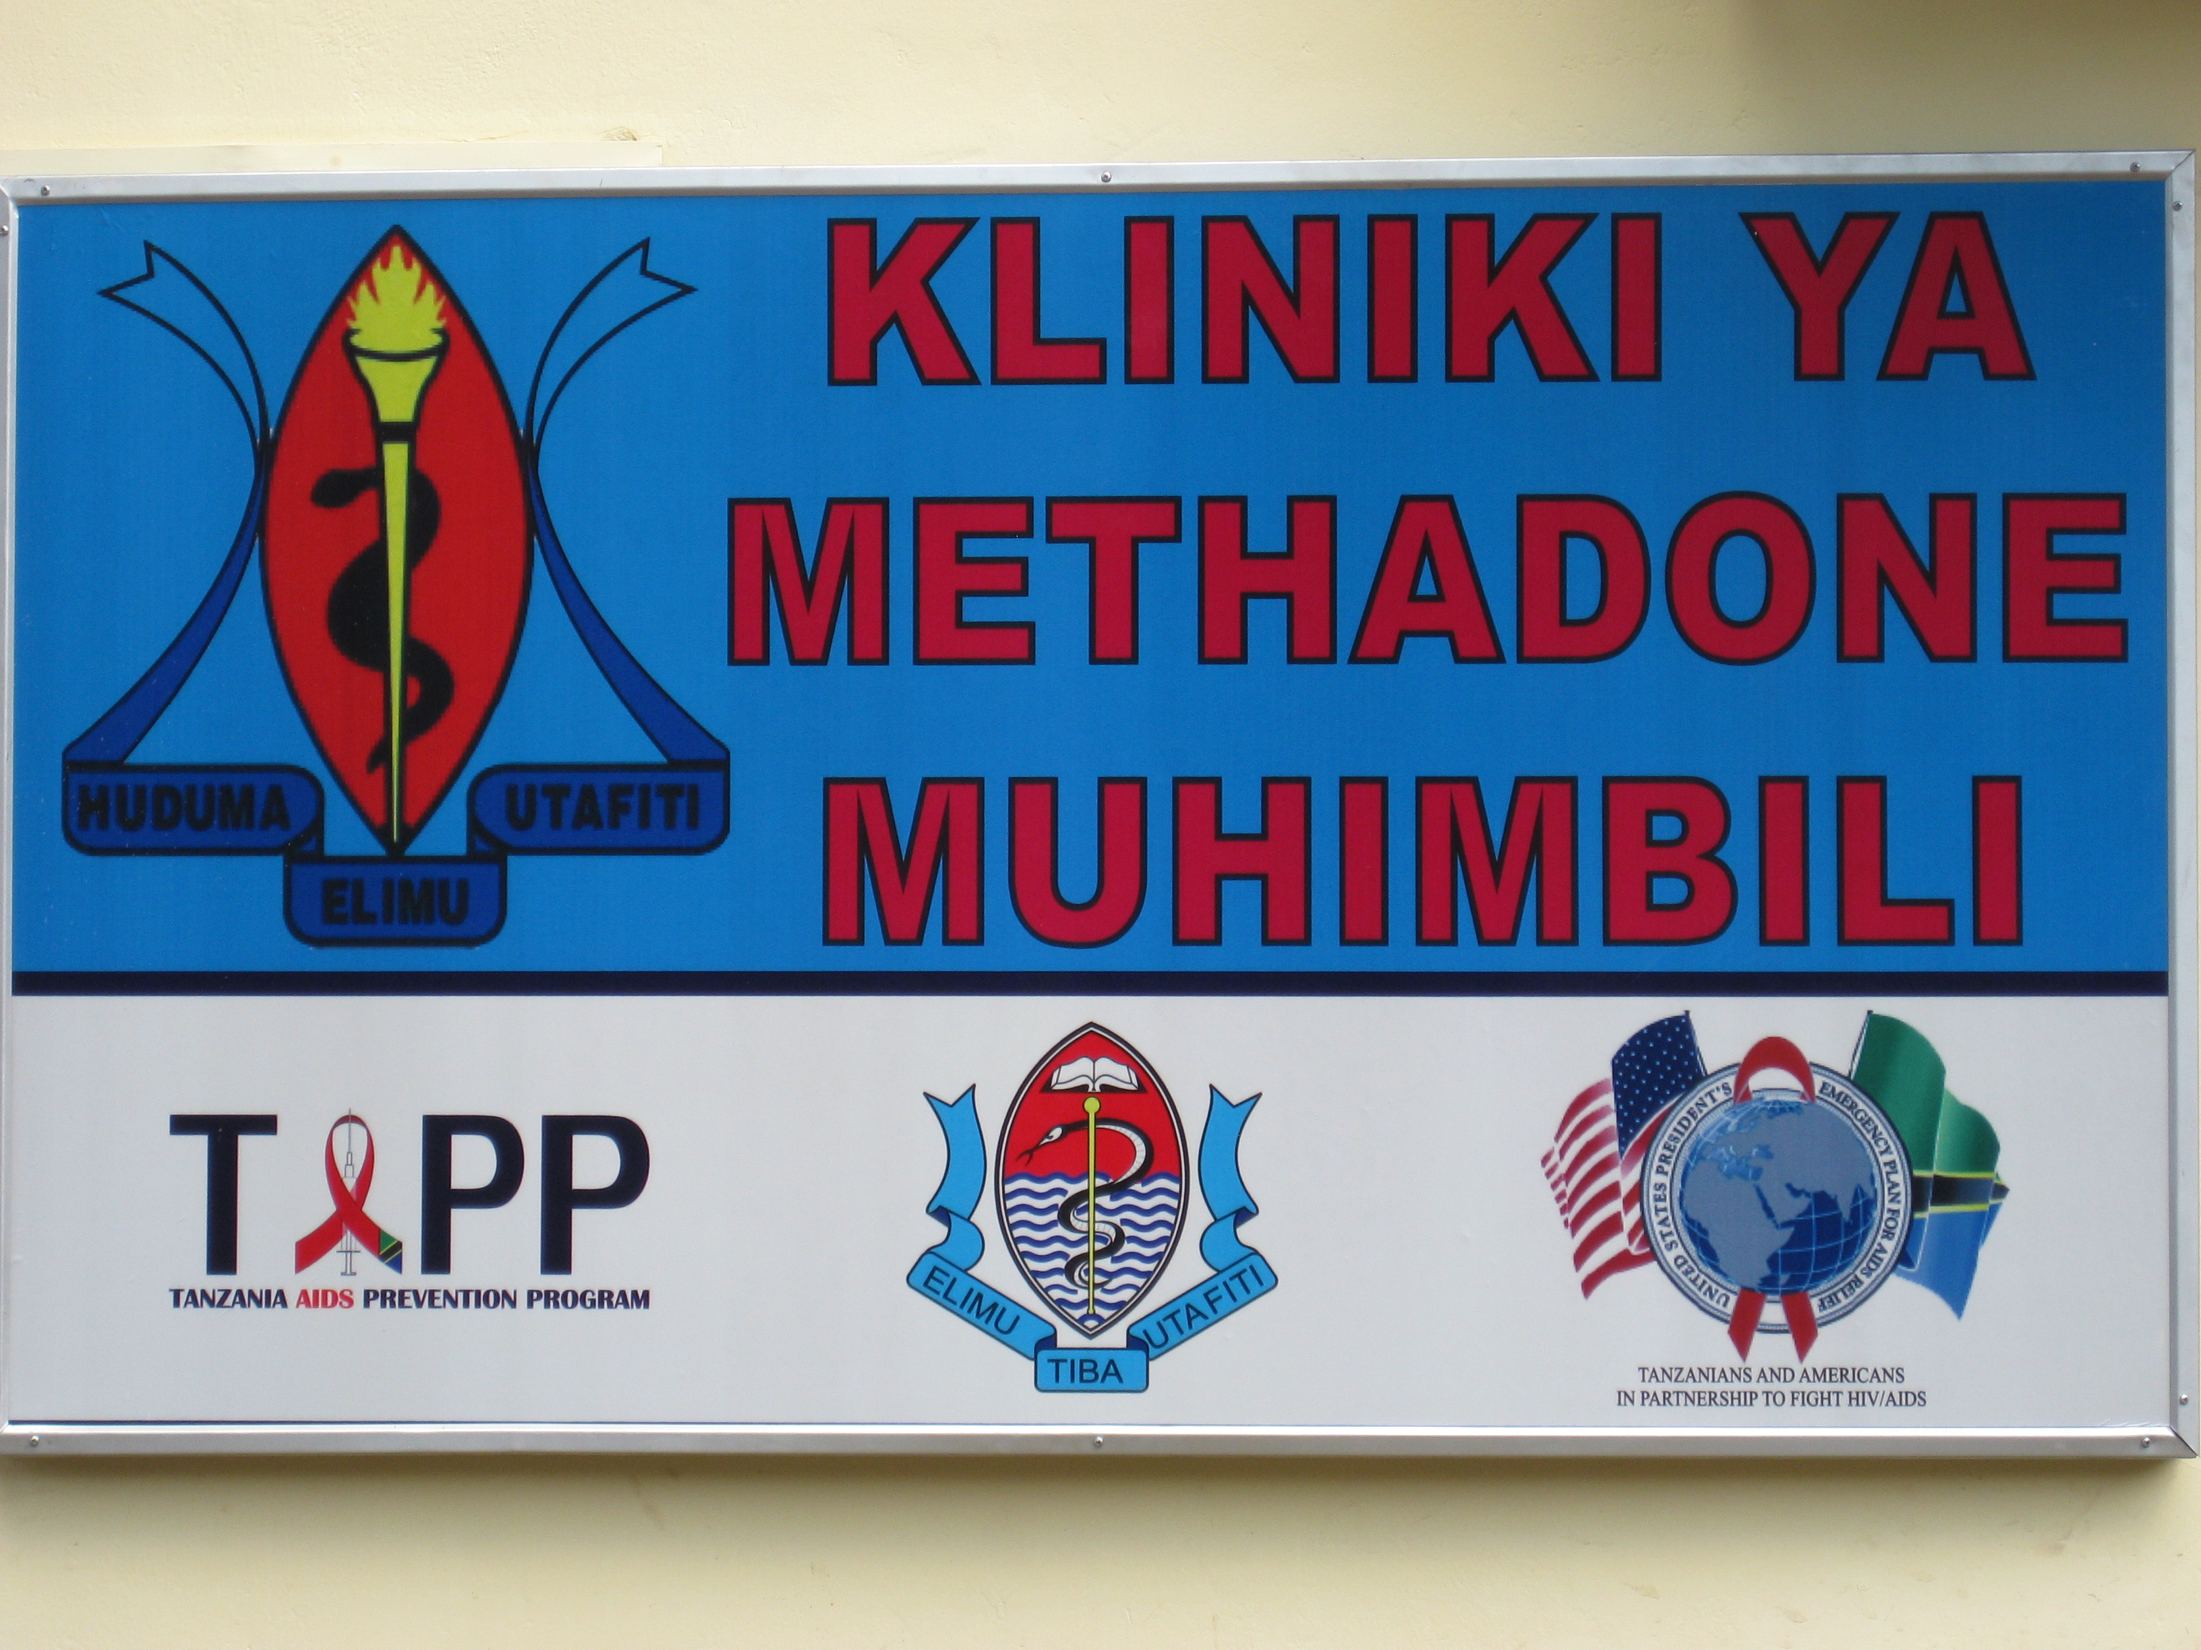
Financial Relationships With Commercial Entities
Dr Bruce has no relevant financial affiliations to disclose. (Updated 11/28/18)

Slide 3
Learning Objectives
After attending this presentation, learners will be able to:
Describe opioid use disorder
Initiate treatment for opioid use disorders
Describe the implications of opioid use disorders in people living with HIV infection

Slide 4
ARS Question 1
According to CDC data, between 1999 and 2016, how many people died of drug overdose in the United States?
  100,000
  200,000
  300,000
  400,000
  500,000
  600,000+

Slide 5
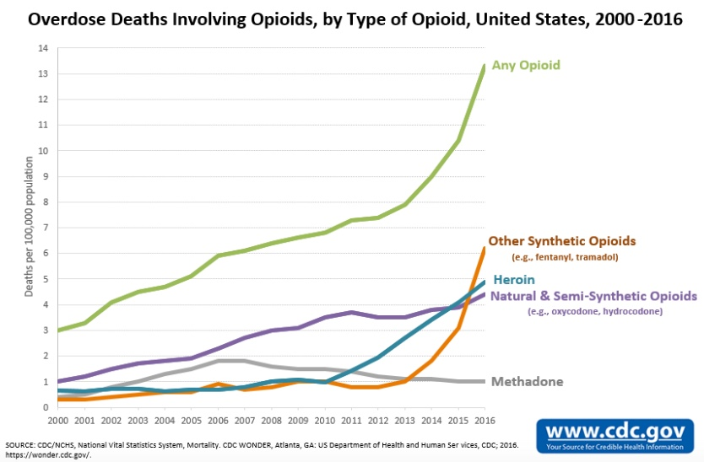

Slide 7
Addiction
A state in which a person engages in compulsive behavior
  The behavior is reinforcing (that is, pleasurable or rewarding)
  There is a loss of control in limiting the intake of the substance

Slide 8
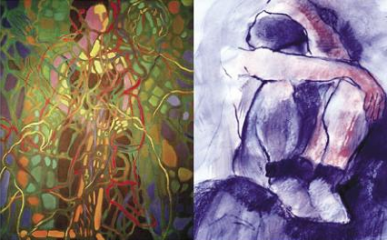
Why do people take drugs?
To feel good
To have novel:
feelings
sensations
experiences
AND
to share them
To feel better
To lessen:
anxiety
worries
fears
depression
hopelessness

Slide 9
Why do some people become addicted?
Biology/genes
Biology/
Environment
Interactions
Environment

Slide 10
Drugs Are Usurping
Brain Circuits
and
Motivational
Priorities

Slide 12
People who use drugs still acquire HIV
Even in the 21st Century, we have outbreaks of HIV infection among people who use drugs (e.g., Indiana).
But there is treatment for opioid use disorders
  Metzger, 1993:
    2 cohorts of patients
    103 out-of-treatment IDU opiate users
    152 subjects receiving methadone treatment
    HIV antibody conversion, 18-months
    22% of those out-of-treatment
    3.5% of those receiving METHADONE

Slide 13
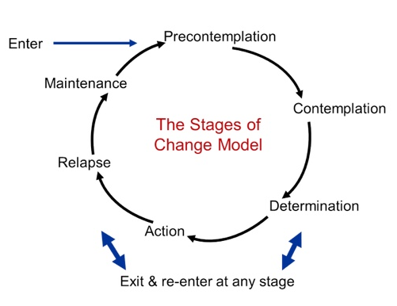
“But it isn’t really a problem”
Transtheoretical Model of Change:
  Helping patients to move along the stages of change
Basics of Harm Reduction
  Syringe exchanges
When helping hurts
  Enabling vs. boundaries
  Graphic by Wayne LaMorte, MD, PhD, MPH

Slide 14
What is medication assisted treatment?
Opioid substitution treatment and medication assisted treatment are the same, but what is it?
Buprenorphine and methadone can
  reduce injection related HIV risk behavior
  decrease psychosocial & medical morbidity
  increase access to and retention with ARV
  improve overall health status
  are associated with decreased criminal activity

Slide 15
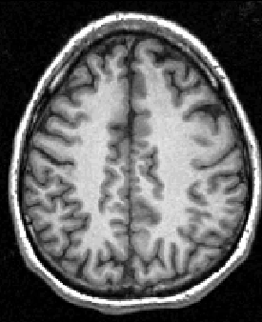
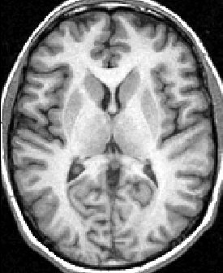
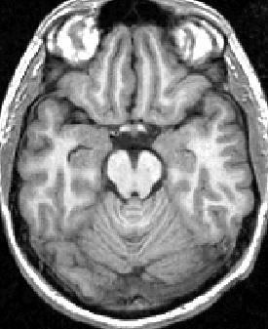
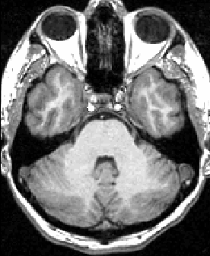
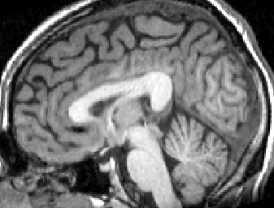
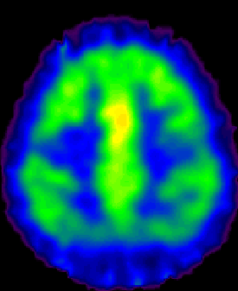
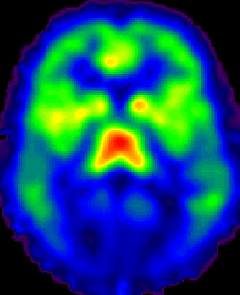
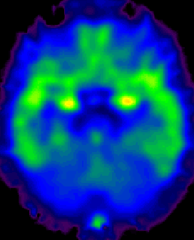
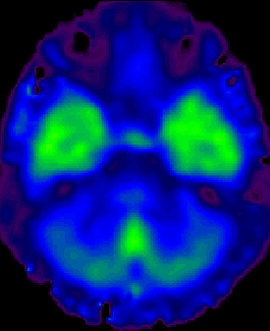
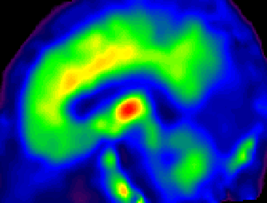
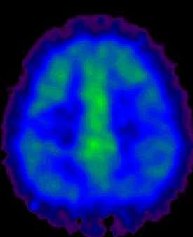
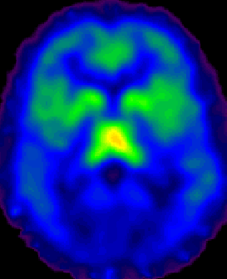
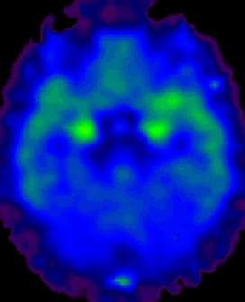
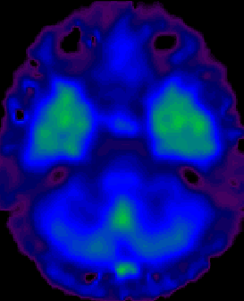
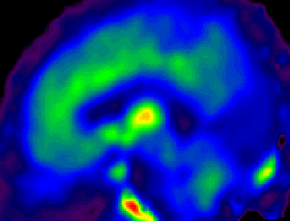
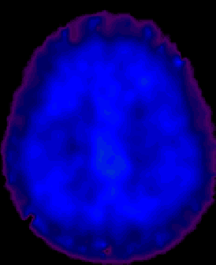
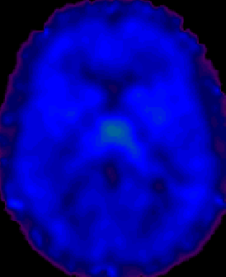

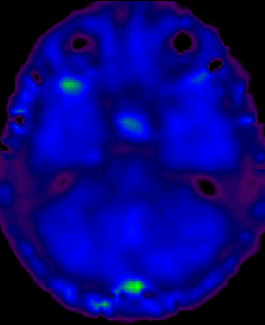
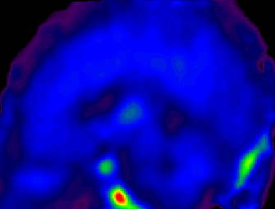
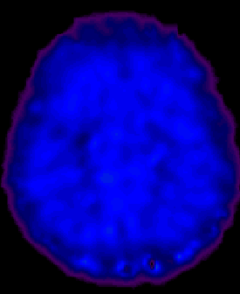
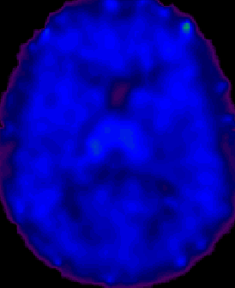
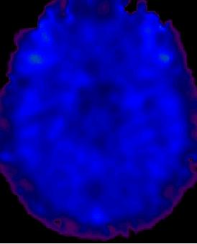
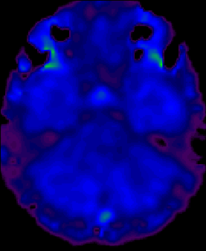
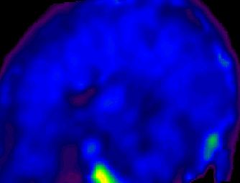
Dose effect on mu-opioid receptor availability
Binding
Potential
(Bmax/Kd)
MRI
4 -
Bup 00 mg
Bup 02 mg
0 -
Bup 16 mg
Slide Courtesy of Laura McNicholas, MD, PhD
Bup 32 mg
December 17, 2018

Slide 16
ARS Question 2
How many patients do you treat with buprenorphine for opioid use disorder?
I don’t have a waiver and so can’t treat anyone
I have a waiver but don’t do it yet
None
1 to 10 patients
11 to 20 patients
21 to 30 patients
31 to 100 patients
Over 100 patients

Slide 18
Medications to treat opioid use disorder
Methadone
    Only in OTP
    Efficacious, best retention
Buprenorphine
    Office based
    Efficacious, retention less than methadone
Naltrexone
    Office based
    Efficacious
    Retention less than methadone & buprenorphine

Slide 20
Best Practices in Treatment
Provision of low threshold, rapid access, appropriately dosed methadone
Culturally appropriate counseling for heroin addiction [can be simple (NA) to more complex (CBT)]
Treatment of the medical issues associated with addiction (e.g., HIV, hepatitis B/C, and Tuberculosis)

Slide 21
Key themes for HIV and substance use
People who use drugs and are infected with HIV have higher morbidity and mortality than the general population and others with HIV infection
Discrimination is still evident among treating people who use drugs for HIV, Hepatitis C and tuberculosis treatments in the US and globally
Adherence remains possible, even in the setting of ongoing substance use

Slide 22
In the Past, Bias: PWID without ART
In the past, people who inject drugs (PWID) were denied HIV therapy until they ceased drug use
While multifactorial, there was a bias against drug users and a failure to recognize addiction as a medical illness
PLWHA with other medical illness were not denied treatment. In some settings (e.g., HIV/HCV; HIV/TB), having another medical illness with HIV makes ART access a priority.

Slide 23
In the Present: The Evidence
Work from Evan Woods in British Columbia showed that in a cohort of 1191 ART naïve patients followed from ART initiation, resistance was found in 25% of the cohort during the first 30 months (PI and NNRTI resistance).
No difference in resistance between people who inject drugs and people who do not inject who were started on ART.

Slide 24
This can be done anywhere
In India, directly observed therapy of DAAs with buprenorphine in the field
In Tanzania, adherence support for HIV and TB medications with methadone
In New Haven, HIV and HCV treatment integrated into the methadone clinic

Slide 25
Practical Next Steps
Screen patients for substance use disorders using standardized questions:
  How many times in the past year have you had 5 or more standard drinks in a day?
  How many times in the past year have you used an illegal drug or a prescription medication for nonmedical reasons?

Slide 26
Additional Next Steps
People who use drugs can take medications and should be eligible for HIV, HBV, HCV, and TB care
Prescribe naloxone and consider becoming a buprenorphine provider
Review guidelines on the treatment of chronic pain and re-evaluate how you prescribe opioids and review

Slide 27
Useful websites:
American Pain Society has resources available online: http://www.americanpainsociety.org/resources/content/primary-care-practitioner.html
American Academy of Pain Medicine resources: http://www.painmed.org/library/main.aspx
Providers Clinical Support System (PCSS) for MAT at https://pcssnow.org/resources/clinical-tools/
Buprenorphine training: https://www.samhsa.gov/medication-assisted-treatment/training-resources/buprenorphine-physician-training

Slide 28
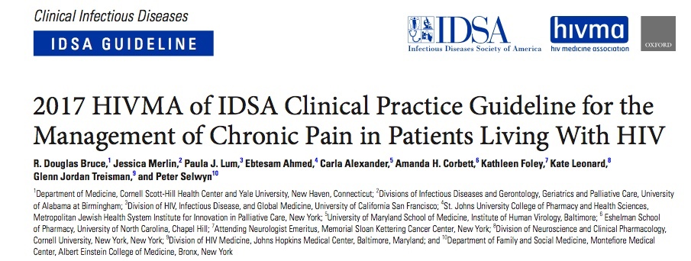
HIV, Pain and Addiction
https://academic.oup.com/cid/article/65/10/e1/4157299

Slide 29
Questions?
Email: robert.bruce@yale.edu

Slide 30
Question-and-Answer

