Slide 1

IAS – USA Fall New York Course: Case Discussion
Luke Jerram
Raj Gandhi, M.D.
Massachusetts General Hospital
Harvard Medical School
Disclosures: Educational grant support to MGH from Gilead, Merck, Viiv;
Consultant: EMD Serono; Theratechnologies
Thanks to Drs. Robert Goldstein, Sarah Turbett, Virginia Pierce; and Marilyn Shi
Notes:
c/w 10/15 version: consolidated slides 13/14; modified slide 21 (in the current version’s numbering); consolidated ANDES study slides; fixed animations on 2-drug maintenance slide; added slide 51.

Slide 2
Case-based Discussion
Who to Start
How to Start
When to switch
Managing ART
PrEP
Surprises

Slide 3
Case Scenario 1
40 yo M diagnosed with HIV in 2007
Family history of CAD
2007-2010: CD4 >1000, VL <50
2010- 2016: intermittent viremia; highest VL 172
2017: VL: 102; CD4 503; CD4:CD8 ratio 0.80
Would you recommend starting ART?
Yes
No
Only if CD4 < 500 or VL >200
Not sure

Slide 4
HIV Therapy Recommended Regardless of CD4: START
  HIV-infected adults with CD4 >500
  Randomized to immediate or deferred ART
  Greatest benefit:
  age >50, VL >50,000, CD4:CD8 <0.5, Framingham score >10%
Number of Serious Events
96
Deferred ART (n=2359)
Immediate ART (n=2326)
57%
Reduction
(P<0.001)
50
47
39%
Reduction
(P=0.04)
Number of Events
42
72%
Reduction
(P<0.001)
29
14
Composite
Endpoint
AIDS-Related
Non-AIDS Related
Components
(Serious Events)
Lundgren J, et al. INSIGHT START Study Group. N Engl J Med. 2015. Borges et al, CROI 2016, #160; Molina J et al, International AIDS Conference 2016, Abstract THAB0201

Slide 5
Do the START Results Apply to HIV Controllers?
Who was in START?
  Median baseline CD4 count 651.
  Median HIV RNA: ≈13,000 (IQR ≈ 3,000, 43,000)
Lundgren J, et al. INSIGHT START Study Group. N Engl J Med. 2015.

Slide 6
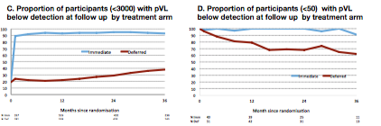
ART in People with VL<3000
n=1138
  Baseline VL <400 (n=347)
  Baseline VL <50 (n=94)
Immediate ART group: greater time with suppressed viremia
  Projected to significantly reduce transmission (0.3 vs. 3.7/100 person-yr)
Serious clinical events did not differ between immediate and deferred groups
DHHS: “Significant uncertainty remains about optimal management of elite controllers”
Sereti I, Gulick R et al, CROI 2017, abstract 473

Slide 7
Should HIV Elite Controllers (EC) Receive ART?
Reasons to not start ART
Drug toxicities
Risk of drug resistance if patient non-adherent
Cost of ART
No proof that ART prevents complications

Slide 8
Should HIV Elite Controllers (EC) Receive ART?
Reasons to not start ART
Reasons to start ART
Drug toxicities
Risk of drug resistance if patient non-adherent
Cost of ART
No proof that ART prevents complications
EC have higher HIV RNA levels, immune activation and inflammation than ART-treated patients – ongoing replication
EC have higher rates of subclinical atherosclerosis and hospitalization for CVD than ART-treated patients
EC may develop low CD4 counts , low CD4/CD8 ratio
Treating EC increases CD4 counts; CD4/CD8 ratio; decreases T cell activation
Landay A, AIDS 2014; Dinoso JB, CID 2008; Chun TW, JID 2013; Pereyra F AIDS 2012; Crowell TA, JID, 2015
Hatano H, PLoS Pathogens, 2013; Kim CJ JAIDS, 2014

Slide 9
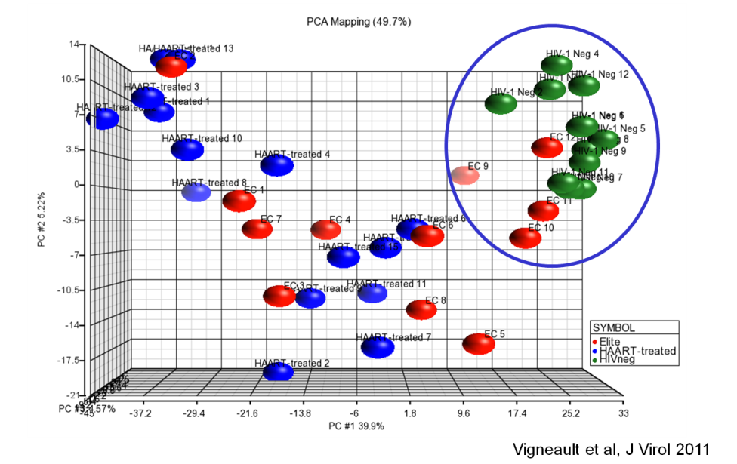
Should all EC be treated?
Some EC have “quiescent” phenotype
  Higher CD4 count
  Lower HIV RNA (ultrasensitive assays)
  Other EC have more “active” phenotype
  Decreased CD4 counts; elevated CD8 counts; decreased CD4:CD8 ratio
  Elevated CRP
  Intermittently detectable VL (predicts loss of EC status¹)
  Different transcriptional profile of immune activation, cytokine genes
Transcriptional profiling: distinct EC subgroups
  I recommend treatment to latter group, citing theoretic rationale
  EC who are not treated must be monitored – may lose control of HIV→ declining CD4 counts, complications
¹Grabar S et al, PLoS One, 2017,

Slide 10
Case Scenario 2
29 yo M undergoes testing for HIV at an STI clinic
Recent unprotected sex with multiple partners
Rapid HIV test positive. HIV Ag/Ab and confirmatory test positive.
HIV RNA, HIV genotype, CD4 count, BUN/Cr, other labs pending
Would you recommend initiating ART on the same day?
Yes
No
It depends

Slide 11
When to Start?
Delays in initiating ART may lead to clinical progression, disengagement from care, sub-optimal outcomes
Does initiation of ART on the same day as HIV diagnosis improve outcomes?
Notes:
Reference
Adapted from Panel on Antiretroviral Guidelines for Adult and Adolescents. Guidelines for the use of antiretroviral agents in HIV-1-infected adults and adolescents. US Department of Health and Human Services; Revised January 29, 2008. http://aidsinfo.nih.gov/contentfiles/adultandadolescnetGL.pdf. Accessed March 13, 2008.

Slide 12
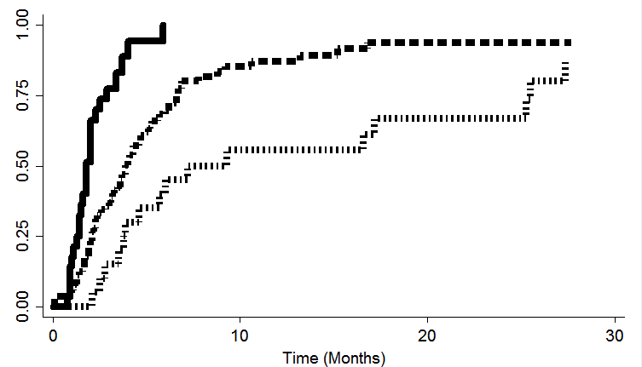
Same day Initiation of ART: San Francisco
Time to VL suppression
86 people with HIV referred to SFGH with recent infection (<6 mo) or CD4 <200
RAPID group (n=39): ART (usually DTG + TDF/FTC) on day of dx, usually 1st dose in clinic.
  Baseline CD4 474 (3-1391)
Standard of care universal ART (n=47): ART started median of 21 d.
  Baseline CD4 417 (11-1194)
RAPID
Standard of care universal ART
Proportion <200 copies
CD4-guided ART (started when <500)
Median time from referral to viral suppression, 1.8 mo in RAPID vs. 4.3 mo. in Standard p<0.001
C Pilcher et al, JAIDS, 2016

Slide 13
Same day Initiation: Haiti
Randomized trial: ART-naïve adults, CD4 <500, no evidence for TB
Standard group: started ART on day 21
Same day group: started ART on day 1
Both groups had multiple visits for physician/social work counseling
Only 4% of same-day patients required regimen adjustment because of abnormal baseline renal function
12-Month Outcomes
P<0.001
100%
92%
Standard ART group (n=285)
Same-day ART (n=279)
P=0.007
80%
71%
P=0.004
54%
Patients (%)
42%
P=0.035
7%
3%
Initiated
ART
Alive and
in Care
In Care and
HIV RNA <50 copies/mL
Died
Koenig S et al, PLoS Med, 2017

Slide 14
Same-day ART Initiation: Conclusions
Need to build systems customized to one’s own setting to facilitate rapid ART initiation
Need to develop delivery systems to improve retention in care
Even if we don’t start ART on the day of diagnosis, initiation should be as soon as possible – no reason to delay unnecessarily based on outdated traditions

Slide 15
Case Scenario 2 -- Continued
HIV Integrase genotype
Trofile
Proviral DNA
Trofile DNA
None of the above
All of the above
29 yo M with positive HIV Ag/Ab and confirmatory test
HIV RNA, CD4 count, BUN/Cr, other labs pending
In addition to HIV RT and PR genotype, which other resistance tests would you order?

Slide 16
HIV Drug Resistance Testing
Patient | Resistance Test
Newly Diagnosed or Treatment Naive | Genotype (RT and PR)
Virologic Failure to 1st or 2nd Lines of Therapy | Genotype (Integrase genotype if failing INSTI)
Suspected Complex Resistance | Phenotype and Genotype

Slide 17
Transmitted Drug Resistance Mutations
CDC study of ART-naive people
  Overall: 18%
  NRTI: 5.7%
  NNRTI: 11.5%
  PI: 3.9%
US National HIV Surveillance System
  Overall INSTI resistance: 0.4%
  Transmitted INSTI resistance: 2/4631 (0.04%) (N155H; E92Q) (high level resistance to EVG, RAL; low level resistance to DTG)
  Porter SE et al. CROI 2017, abstract 477; Hernandez AL, et al. CROI 2017. Abstract 478.

Slide 18
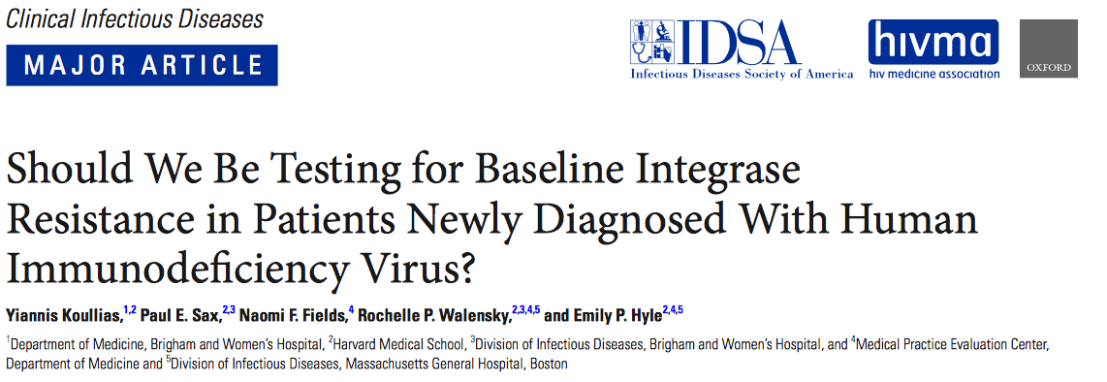
Compared 96-week clinical outcomes and cost-effectiveness of integrase resistance testing in newly diagnosed patients
Conclusion: Integrase resistance testing projected to result in worse outcomes and was not cost effective
  Koullias et al, CID, 2017

Slide 19
Case Scenario 2 – What to Start?
29 yo M with positive HIV Ag/Ab and confirmatory test
HIV RNA, HIV genotype, CD4 count, BUN/Cr, other labs pending
You decide to initiate same-day ART.
Which regimen would you choose?
EFV/TDF/FTC
RPV/TAF/FTC
DRV/r + FTC/TAF
EVG/c/FTC/TAF
DTG + FTC/TAF
DTG/ABC/3TC

Slide 20
Case Scenario 2 – What to Start?
EFV/TDF/FTC – risk of non-response if NNRTI TDR
RPV/TAF/FTC – less potent if VL >100K, CD4 <200
DRV/r + FTC/TAF – less well tolerated than DTG
EVG/c/FTC/TAF – EVG lower genetic barrier to resistance than DTG
DTG + FTC/TAF
DTG/ABC/3TC – Need HLAB5701 first
29 yo M with positive HIV Ag/Ab and confirmatory test
HIV RNA, HIV genotype, CD4 count, BUN/Cr, other labs pending
You decide to initiate same-day ART.

Slide 21
Possible Case Scenario 2 – 2018
29 yo M with positive HIV Ag/Ab and confirmatory test
HIV RNA, HIV genotype, CD4 count, BUN/Cr, other labs pending
You decide to initiate same-day ART.
Which regimen would you choose?
EFV/TDF/FTC
RPV/TAF/FTC
DRV/r + FTC/TAF
EVG/c/FTC/TAF
DTG + FTC/TAF
DTG/ABC/3TC
BIC/FTC/TAF (under review)

Slide 22
Bictegravir
Unboosted integrase inhibitor; high in vitro genetic barrier to resistance, low potential for drug interactions
Phase 3 trials in treatment naïve people: BIC/FTC/TAF vs DTG/ABC/3TC; BIC/FTC/TAF vs. DTG + FTC/TAF:
  BIC non inferior to DTG in terms of virologic suppression; no resistance
Randomized switch study in people suppressed on boosted PI:
  Switching to BIC/FTC/TAF non-inferior to continuing boosted PI
NDA for BIC/FTC/TAF submitted to FDA; decision by Feb 2018
Gallant J et al, Lancet 2017; Sax P et al Lancet 2017; Daar E et al IDWeek 2017
Notes:
Slide:
Study enrolled 629 treatment naïve adults
>90% of participants in both group had VL <50 at wk 48: BIC/FTC/TAF non-inferior to DTG/3TC/ABC
No resistance detected in either group
Both regimens well tolerated
Similar changes in eGFR, BMD and lipid parameters

Slide 23
Case Scenario 3
Which would you prescribe?
ATV/r + FTC/TDF
DRV/c + FTC/TAF
LPV/r + FTC/TDF
DTG + FTC/TAF
EVG/cobi/FTC/TAF
50 yo woman with HIV
On TDF/FTC/EFV with virologic suppression
Developed H/A and stiff neck
CSF exam: WBC 11 (94% L); CSF VL: 20,000
Plasma VL: 50,000
Reported non-adherence with ARVs
HIV Genotype:
  RT: K103N

Slide 24
DTG + 2 NRTIs for People Failing 1st line NNRTI therapy
DAWNING study
Phase 3b (ongoing)
Open-label, non-inferiority
Virologic failure with NNRTI + 2 NRTIs
No primary resistance to
PIs or INSTIs
Investigator-selected NRTIs
(≥1 fully active)
Continuation Phase
DTG + 2 NRTIs (n=312)
DTG +2 NRTI
LPV/r + 2 NRTIs (n=312)
Week 0 24 48 52
Primary
Analysis
Current Interim
Analysis
.
Baseline demographics:
HIV RNA >100K copies/mL: 21%.
CD4 <200 cells/mm³: 50%.
AIDS: 32%.
Duration of 1st line ART: 36 months.
Prior therapy agent:
EFV (78%), TDF (59%), AZT (29%), abacavir (2%).
Data Monitoring Committee recommended discontinuation of LPV/r arm following post-hoc review of week-24 results
Aboud M, et al. J Int AIDS Soc. 2017;20(suppl 5):111-112. Abstract TUAB0105LB.
Notes:
Slide: DAWNING Study: Dolutegravir + 2 NRTIs for Patients Failing NNRTI + 2 NRTIs
In many areas, people who fail first line NNRTI containing regimen switched to a boosted PI, often LPV/r
Is a DTG-based regimen better for 2nd line?
DAWNING randomized >600 people with 1st line NNRTI failure to receive DTG + 2 NRTI or LPV/r + 2 NRTI
IDMC recommended discontinuation of the LPV/r arm because of higher rates of virologic non-response
DAWNING is a non-inferiority study that compared PI-sparing regimen of dolutegravir + 2 NRTIs versus lopinavir/r + 2 NRTIs in HIV-infected patients who failed first-line ART comprising an NNRTI + 2 NRTIs. The Independent Data Monitoring Committee (IDMC) recommended discontinuation of lopinavir/r arm following post-hoc review of week-24 results.¹
Reference
Aboud M, Kaplan R, Lombaard J, et al. Superior efficacy of dolutegravir (DTG) plus 2 nucleoside reverse transcriptase inhibitors (NRTIs) compared with lopinavir/ritonavir (LPV/RTV) plus 2 NRTIs in second-line treatment: interim data from the DAWNING study. J Int AIDS Soc. 2017;20(suppl 5):111-112. Abstract TUAB0105LB.

Slide 25
DAWNING: DTG + 2 NRTI superior to LPV/r + 2 NRTI
DTG + 2 NRTIs superior to LPV/r + 2 NRTIs for VL <50 at wk 24
  Similar in subgroups: VL ≤ or >100K, 2 or <2 active NRTIs, and CD4 < or ≥200
Virologic non-response: 12% (DTG) vs 25% (LPV)
No emergent INSTI, NRTI resistance in DTG arm
  NRTI resistance in LPV/r arm (n=3, 2 with K70R, M184V, 1 with K70R and K219E)
DTG: fewer drug-related adverse events (15 vs 36%)
HIV RNA <50 (ITT)
Dolutegravir Lopinavir/r
Difference (%):
-13.8 (7.3, 20.3)
82%
84%
69%
74%
73%
55%
Patients (%)
Overall
(n=312/312)
2
(n=61/64)
<2
(n=251/248)
Number of Fully Active NRTIs
Aboud M, et al. J Int AIDS Soc. 2017;20(suppl 5):111-112. Abstract TUAB0105LB.
Notes:
Treatment Outcomes
At wk 24, dolutegravir + 2 NRTIs was superior to lopinavir/r + 2 NRTIs with respect to achieving VL <50
Similar results were noted at weeks 36 and 48, and in different subgroups
Virologic non-response: 12 vs 25%
No emergent INSTI or NRTI resistance in the DTG group
DTG arm: fewer drug-related adverse events (15% versus 36%) and less grade 2-4 diarrhea (<1% versus 7%).¹
Reference
Aboud M, Kaplan R, Lombaard J, et al. Superior efficacy of dolutegravir (DTG) plus 2 nucleoside reverse transcriptase inhibitors (NRTIs) compared with lopinavir/ritonavir (LPV/RTV) plus 2 NRTIs in second-line treatment: interim data from the DAWNING study. J Int AIDS Soc. 2017;20(suppl 5):111-112. Abstract TUAB0105LB.

Slide 26
Case Scenario 4
Requests simpler regimen
RAL + FTC/TAF
RPV/FTC/TAF
DRV/r + FTC/TAF
EVG/c/FTC/TAF + DRV
DTG + FTC/TAF
No simpler regimen
50 yo man with HIV (diagnosed 1998)
Multiple previous regimens:
  IDV/r + AZT/3TC; LPV/r + AZT/3TC; EFV/TDF/FTC
Genotype:
  RT: M41L, L100I, K103N, M184V, L210W, T215Y
  PR: M36L, D60E, L63P
VL <50 on DRV/r + DTG + ETR (5 pills/d)

Slide 27
  Switching to E/C/F/TAF + DRV in treatment-experienced patients
Randomized
Open-label (n=135) trial
Primary Efficacy Endpoint
Eligibility criteria
≥4 mo VL <50 on ART containing DRV
2 prior failures ≥ 2-class resistance by historical genotype (inc. ≤3 TAMs and K65R)
Historical genotype with no INSTI-R or currently on RAL
No Q151M, T69ins, or DRV RAMS
Week 0
24
48
144
n=89
E/C/F/TAF + DRV 800 mg QD
n=46
Baseline Regimen
E/C/F/TAF + DRV
E/C/F/TAF + DRV: 2 pills once a day
Huhn GD et al, JAIDS, 2017

Slide 28
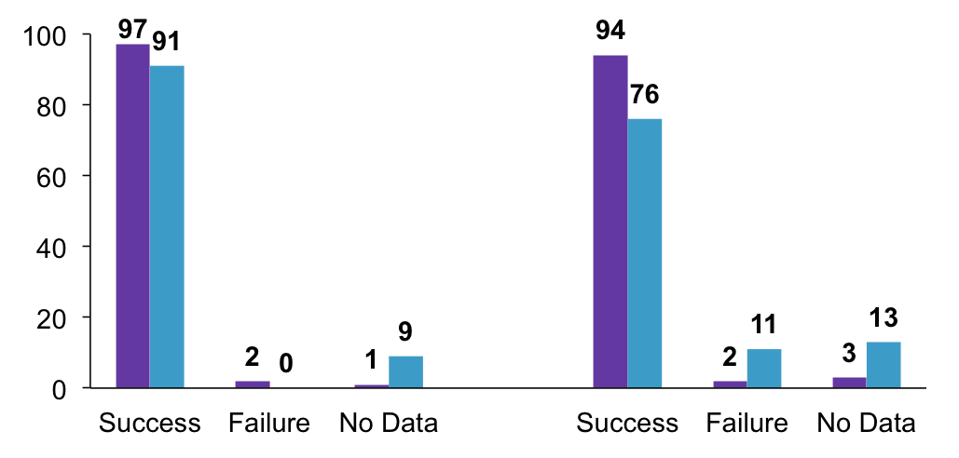
  Switching to E/C/F/TAF + DRV in treatment-experienced patients: VL <50
Week 24
Week 48
Baseline Regimen
E/C/F/TAF + DRV
Proportional difference (95% CI)† | 5.3% (-3.4%, 17.4%) p=0.23 | 18.3% (3.5%, 33.0%) p=0.004
No participants in E/C/F/TAF + DRV developed resistance
Huhn GD et al, JAIDS, 2017

Slide 29
Case Scenario 4: Continued
Requests simpler regimen
RAL + FTC/TAF – TAM1, M184V
RPV/FTC/TAF – L100I affects RPV
DRV/r + FTC/TAF – TAM1, M184V
EVG/c/FTC/TAF + DRV
DTG + FTC/TAF – TAM1, M184V
No simpler regimen
50 yo man with HIV
Genotype:
  RT: M41L, L100I, K103N, M184V, L210W, T215Y
  PR: M36L, D60E, L63P
VL < 50 on DRV/r + DTG + ETR (5 pills/d)

Slide 30
Case Scenario 5
55 yo HIV+ M with diabetes, hypertension, chronic renal insufficiency (creatinine clearance of 25)
HIV RNA 30,000, CD4 cell count 450
HLA-B5701 positive
You want to choose a regimen that avoids TAF, TDF, ABC

Slide 31
For which NRTI-limiting regimen is there supportive phase 3 data for initial therapy?
Darunavir/cobicistat + FTC
Darunavir/ritonavir + raltegravir
Darunavir/ritonavir + dolutegravir
Darunavir/ritonavir + 3TC
Dolutegravir + 3TC
Dolutegravir + rilpivirine
CD4 count 450, VL 30,000
CrCl: 25
HLA-B5701+

Slide 32
Which NRTI-limiting regimen would you use for initial therapy in someone who cannot take TAF, TDF or ABC?
Darunavir/cobicistat + FTC
Darunavir/ritonavir + raltegravir
Darunavir/ritonavir + dolutegravir
Darunavir/ritonavir + 3TC
Dolutegravir + 3TC
Dolutegravir + rilpivirine
CD4 count 450, VL 30,000
CrCl: 25
HLA-B5701+

Slide 33

OR FEW

Slide 34
Current NRTI-limiting Regimens for Initial Therapy
LPV/r + 3TC (GARDEL)¹
  Non-inferior to LPV/r + 2 NRTI
  Disadvantages: high pill burden, toxicities
DRV/r + RAL (NEAT001)^{2,3}
  Non-inferior to DRV/r + TDF/FTC
  CD4 <200: DRV/r + RAL inferior to DRV/r + 2 NRTI
  VL >100 K: more failures with DRV/r + RAL
¹Cahn P et al, Lancet ID 2014; ²Raffi F et al, Lancet, 2014; ³Lambert-Niclot S et al, J Antimicrob Chemother, 2016; ⁴Figueroa MI et al, 15th EACS, 2015

Slide 35
Dolutegravir + 3TC in Treatment-Naïve Patients
PADDLE: promising in 20 pts with VL <100K
A5353: Phase 2 single-arm study
  HIV RNA ≥1000 to <500,000
120 participants enrolled
Week 24, HIV RNA <50 in 90%
Virologic failure (n=3); suboptimal adherence
  1 person with virologic failure: R263RK and M184V
GEMINI-1 and -2: ongoing phase 3 trials
Wk 24 Virologic Outcomes
 | Baseline HIV RNA
 | >100K (n=37) | ≤100K (n=83)
VL <50 (%) | 89 | 90
Virologic non-success (%) HIV RNA >50 copies/mL Other reasons | 8 0 | 0 2
⁴Figueroa MI et al, 15th EACS, 2015
Taiwo BO, et al. J Int AIDS Soc. 2017;20(suppl 4). Abstract MOAB0107LB.
Notes:
Slide:
In small study of 20 pts (PADDLE), DTG + lamivudine looked promising; however, small study, excluded people with bVL >100K
Larger trial, ACTG A5353, evaluated DTG + lamivudine for people with bVL up to 500K
Single arm study: 120 ppt enrolled: 37 with VL >100K, 83 with VL <100K
Wk 24: VL <50 in 90%
VL <100 K and >100 K both did well
VF uncommon; associated with suboptimal adherence; on person developed resistance mutations, including an INSTI mutation (R263K – low level DTG resistance)
DTG + lamivudine being evaluated in two fully-enrolled phase III trials in treatment naïve adults
If efficacious, would be attractive in that it has fewer drugs: may be less expensive to produce, avoids toxicities of 2nd NRTI
HBV coinfected pt would still need tenofovir

Slide 36
ANDES: Treatment Outcomes With DRV/r + 3TC in Treatment-Naïve Patients
Randomized trial
  DRV/r + 3TC (n=75)
  DRV/r + 3TC/TDF (n=70)
VL <400 at wk 24: 95-97%
  Baseline VL >100K: high response rate
Dual therapy non-inferior to triple therapy at wk 24
Promising results; larger trial ongoing
HIV RNA <400 (ITT)
Darunavir/r +: Lamivudine Lamivudine + tenofovir DF
Difference (%):
-2.5 (-7.9, 2.9)
100%
100%
95%
97%
Patients (%)
Overall
(n=75/70)
Baseline HIV RNA
>100K Copies/mL
(n=20/15)
Sued O, et al. J Int AIDS Soc. 2017;20(suppl 4):104. Abstract MOAB0106LB.

Slide 37
Switching to NRTI-limiting regimens after virologic suppression (maintenance)
LPV/r + 3TC/FTC (OLE)¹
ATV/r + 3TC (SALT, ATLAS-M)²⁻³
DRV/r + 3TC (DUAL)⁴
DRV/r + RPV (small trial, n=60)⁵
DTG + RPV (SWORD-1 and -2)
DRV/r + DTG (DUALIS) – being studied
DTG + 3TC (LAMIDOL, ASPIRE)
IM Cabotegravir + IM RPV (LATTE-2 supportive⁶; ATLAS, FLAIR ongoing)
¹Arribas JR et al, Lancet ID, 2015; ²Perez-Molina JA et al, Lancet ID, 2015; ³Di Giambenedetto S et al, J Antimicrob Chemother 2017; ⁴Pulido T HIV Drug Therapy 2016 Glasgow, O331; ⁵Maggiolo F, JAIDS, 2016; ⁶Margolis DA, et al. Lancet. 2017Jul 21. [Epub ahead of print].

Slide 38

Switching to DTG + RPV in Virologically Suppressed Patients: SWORD-1 and -2
  Virologic outcomes at wk 48
Pts on stable 1st or 2nd ART (no change due to VF) and VL <50 for >12 mo.
Randomized 1:1 to continue antiretroviral regimen (CAR) or switch to DTG + RPV
DTG + RPV non-inferior to CAR
DTG/RPV single pill regimen anticipated soon
95
95
95
95
5
4
<1
1
<1
1
Llibre JM et al. CROI 2017; Abstract 44LB.

Slide 39
Case Scenario 6
30 yo M with well controlled HIV on ABC/3TC/DTG
Presented with 4 days of abdominal cramping and diarrhea: 1-2 BM per hour throughout day and night
Noted blood on toilet paper but not in stool
Mild chills; temperature 100.3
Travel: Nantucket. Ate at cookouts, including salads with mayonnaise
Two new male sexual partners; oral anal stimulation

Slide 40
Stool culture result:
Shigella sonnei (Group D)
  Would you treat this patient?
Yes
2. No
3. Only if he doesn’t improve

Slide 41
Stool culture result:
Shigella sonnei (Group D)
Resistant to ampicillin, azithromycin, ciprofloxaxin, TMP/SMX

Slide 42
Case Scenario 7
41 yo HIV negative MSM on PrEP presents with 4 days of watery diarrhea, abdominal cramping
Denies blood in stools, fevers, chills
Reports recent oral anal contact

Slide 43
Stool culture result:
Shigella flexneri (Group B)
Resistant to ampicillin; cipro MIC 0.12; sensitive to TMP/SMX
oral Cipro
oral TMP/SMX
No treatment
IV ceftriaxone
  How would you treat this patient?

Slide 44
Antibiotic-resistant Shigella
Increased risk of antibiotic-resistant Shigella in MSM¹
  7 outbreaks between 2011 and 2015
  6 outbreaks: azithromycin resistance; 2: cipro resistance; 2: ceftriaxone resistance; 3: multi-drug resistance
∼20% of Shigella isolates tested in NYC during 2013–2015: decreased azithromycin susceptibility (>=32 ug/mL)²
  Almost exclusively among MSM, most infected with HIV
1. Bowen A et al, Emerg Infect Dis, 2016; 2. Murray K et al, MMWR, 2017

Slide 45
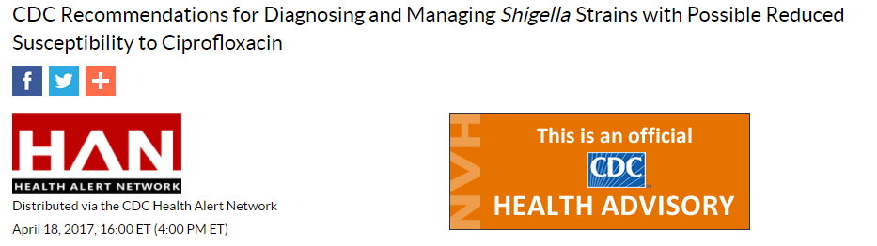
Current CSLI criteria categorize Shigella isolates with Cipro MIC <=1 mcg/mL as susceptible
CDC: increase in Shigella isolates with Cipro MIC of 0.12 – 1 mcg/mL
  Rising MIC may be related to plasmid-mediated quinolone resistance genes (PMQR): found in outbreak of multi-drug resistant Shigella flexneri (many in MSM), sporadic cases of Shigella sonnei
  Not yet known whether FQ use for these isolates associated with worse clinical outcomes or increased risk for transmission
  In Salmonella, MIC in this range considered intermediate or resistant b/o worse clinical outcomes

Slide 46
CDC Recommendations
Diagnosis:
  Order stool culture for suspected Shigella; confirm lab tests cipro dilutions according to recent guidance
Management:
  Avoid antibiotics except in those with severe illness and those at risk for systemic infection (immunocompromised)
  When antibiotics indicated, avoid FQ if MIC >=0.12 even when lab report identifies isolate as sensitive
  If MIC not included, consider contacting Micro lab for this data
  Counsel patients to wait to have sex for 2 wk after diarrhea resolves

Slide 47
Recent Cases
Shigella sonnei (group D): resistant to ampicillin, TMP/SMX, azithromycin (>256) and ciprofloxacin (MIC 8); CTX susceptible
  Patient 1: treated for Giardia, not Shigella
  Patient 2: treated with cefixime; symptoms resolved
  Patient 3: not treated
  Patient 4: not treated; partner also infected
Shigella flexneri (group B): resistant to amp, susceptible to TMP/SMX, cipro MIC 0.12
  Patient 5: not treated

Slide 48
Case Scenario 8
Man in his 50s on TDF/FTC for PrEP
Developed increasing serum creatinine:
  Baseline 1.02
  1 month later: 1.11
  6 months later: 1.32 (eGFR 57)
PMH: hypertension
Meds: lisinopril, TDF/FTC
Social history: MSM; sexually active with multiple partners whom he knows; no illicit drug or excessive alcohol use
BP 140/82. Normal exam

Slide 49
Case Scenario 8
Serum Cr: 1.32
Serum phosphate 1.7 mg/dL
UA: no glycosuria, hematuria, pyuria
Urine protein/creatinine ratio: 0.11
Urine albumin/creatinine ratio: 10
Urine phosphate: 62 mg/dL
Urine creatinine: 186 mg/dL
Fractional excretion phosphate: 22%
Would you:
  Stop TDF/FTC
  Change TDF/FTC to TAF/FTC
  Change TDF/FTC to MVC
  Continue TDF/FTC
  Something else

Slide 50
Changes in Kidney Function with TDF/FTC for PrEP
US PrEP Demonstration Project
N=557; MSM/TGW. Median age 33
Mean CrCl decrease 4.8 mL/min
Mean Cr increase: 0.03 mg/dL
Changes stable through wk 48
15.7% developed worsening proteinuria between baseline and wk 12; remained stable through wk 48
5% developed new onset eGFR < 70
  Predictors: age >=40; baseline eGFR < 90
Tang EC et al, JAIDS, in press

Slide 51
Case Scenario 9
Man in his 30s. MSM
On TDF/FTC for PrEP for approximately 2 months
1 month after starting PrEP developed pruritic rash which spread to his trunk and legs; treated with topical steroids
Evaluated by dermatology: circular red-pink shallowly eroded plaques on arms, hands, upper legs; overlying fine scale/crust
Biopsy: spongiotic dermatitis
Concern for TDF cutaneous reaction
Would you:
  Stop TDF/FTC
  Change TDF/FTC to TAF/FTC
  Change TDF/FTC to MVC
  Continue TDF/FTC
  Something else
AIDS. 2007;21:1370-3

Slide 52
Case Scenario 9 Followup
TDF/FTC was stopped
About 1 yr later, patient had repeat HIV testing: Ag/Ab positive; HIV RNA 100,000; CD4 cell count 600
Patient started on TAF/FTC + DTG, which he tolerated
Which regimen would you start him on?
  ABC-based regimen
  TAF-based regimen
  TDF-based regimen
  NRTI limiting regimen
  Something else

Slide 53
Case Scenario 10:
Pulmonary and Hepatic Nodules in a Man with HIV
Middle-aged man with HIV
CD4 count >500, VL <50 for many years on TDF/FTC + ATV/r
Patient presented with 3-4 weeks of abdominal pain and chest wall discomfort
Admitted to outside hospital for evaluation of chest discomfort. Found to have pulmonary nodules and rim-enhancing lesions in the liver

Slide 54
Case - continued
Past medical history: secondary syphilis several years ago, s/p treatment; non-reactive RPR 4 months prior to presentation
Multiple sexual partners, does not always use condoms. No TB exposures.
Afebrile. No rash or adenopathy. No abdominal tenderness, HSM
AP 695. ALT 119. AST 70. Bilirubin 2.5/0.3 (LFTs had been normal 4 months ago)

Slide 55
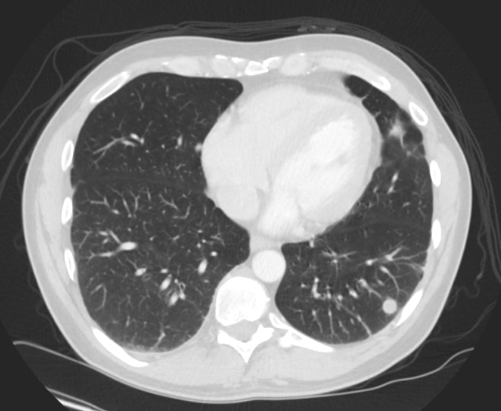
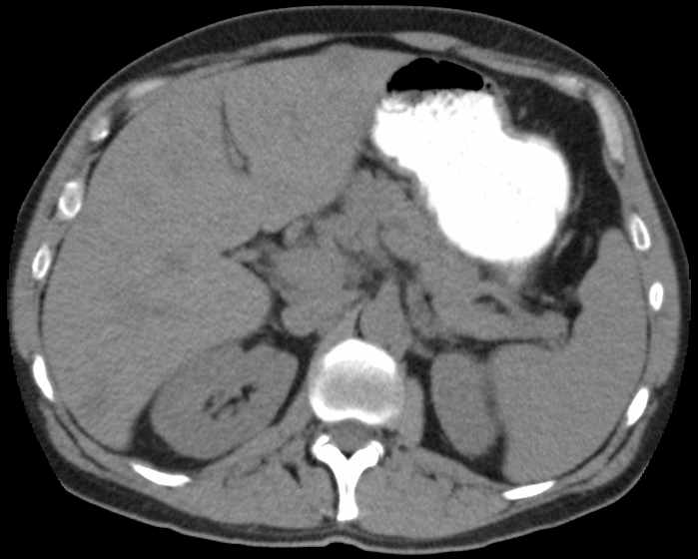
Question
Malignancy
Syphilis
Peliosis hepatis (Bartonella)
Fungal infection
Mycobacterial infection
Multiple pulmonary nodules, measuring 2-10 mm
Multiple rim-enhancing lesions in the liver

Slide 56
Tests
Blood cultures negative.
Cryptococcal antigen negative
Urine histoplasma antigen negative
Serologic testing for Bartonella, Brucella, Coxiella negative
Interferon-gamma release assay negative
HIV RNA undetectable. CD4 cell count 500
HCV RNA undetectable. HCV Ab negative

Slide 57
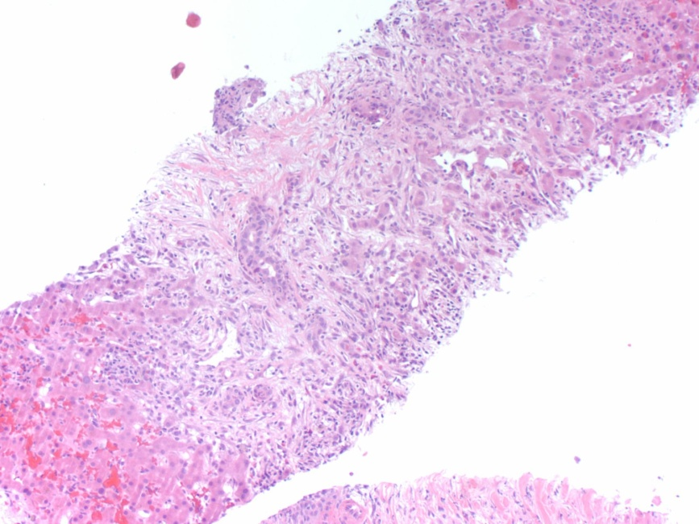
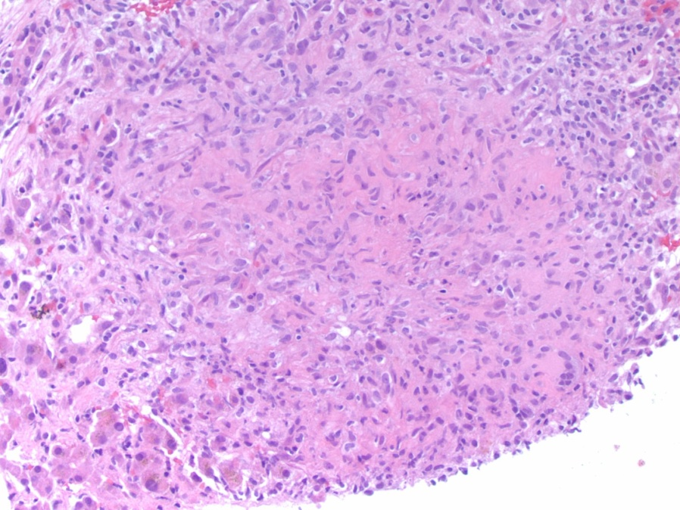
Liver biopsy
Periportal inflammation and edema; granulomas; microbiologic stains negative
Periportal inflammation and edema
Granuloma
Slides courtesy of Dr. Joseph Misdraji, Mass. General

Slide 58
Follow-up
RPR + 1:64
Treated with 3 weekly shots of IM penicillin
AP declined from 695 to normal
ALT declined from 119 to normal
Repeating imaging revealed markedly decreased size of pulmonary nodules and liver lesions!

Slide 59
Syphilitic hepatitis
LFT abnormalities may occur during secondary syphilis
AP may be disproportionately elevated, but not always
  In one case series, median AP 186 (129-1836), median ALT 105 (82-614)
  LFTs normalized after penicillin (within 5 d to 3 mo.)
Pathology: pericholangiolar inflammation, periportal hepatocyte necrosis; spirochetes seen on liver biopsy in some but not all cases
Rare cases of hepatic gumma mimicking cancer have been reported
Crum-Cianflone N et al Int J STD AIDS, 2009. Mullick CJ et al, CID, 2004. Shim HJ. World J Hepatol, 2010
Notes:
59

Slide 60
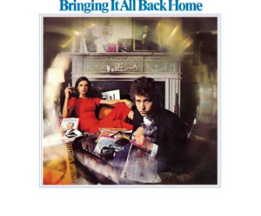
  Take home points

Slide 61
Take Home Points
Whether to treat elite controllers is uncertain; a case can be made
In newly diagnosed patient, initiate ART as soon as the person is ready -- same day if possible
In patients with first line NNRTI failure, DTG based regimen was superior to a PI based regimen
Simplifying ART often possible, even in those with drug resistance
New CDC guidance on diagnosing and managing Shigella
In people who discontinue PrEP because of toxicity, extra counseling, close follow-up are critical
Look out for unusual manifestations of syphilis

