Slide 1
Update from the 2013 Conference on Retroviruses and Opportunistic Infections: Focus on ART
Roy M. Gulick, MD, MPH Professor of Medicine Weill Cornell Medical College New York, NY
From RM Gulick, MD, at Atlanta, GA: April 10, 2013, IAS-USA.
Notes:
Keywords: CROI 2013; Conference on Retroviruses and Opportunistic Infections; ART; antiretroviral therapy; Roy M. Gulick, MD, MPH; Atlanta 2013; HIV

Slide 2
Oh, Baby!
Mother presented in labor, unaware of HIV status, found HIV+
Baby treated with 3-drug ART (ZDV/3TC + NVP) within 30 hours
Mother VL 2K, baby VL 20K
Matched wild-type virus, subtype B
Baby HIV RNA decreased at days 7, 12, 20, then <20 at day 29
HIV RNA continued <20 cps/ml X 16 determinations
Mother and baby lost-to-follow-up; ART stopped at 18 months
Re-presented for follow-up
HIV RNA <20 copies/ml (1 copy/ml) at 24 months
HIV DNA 4 copies / 1 million PBMC at 26 months
No replication-competent virus
HIV Antibody negative
Cure(?)
Persaud CROI 2013 #48LB
Notes:
Keywords: CROI 2013; Conference on Retroviruses and Opportunistic Infections; ART; antiretroviral therapy; Roy M. Gulick, MD, MPH; Atlanta 2013; HIV; baby; cure; HIV RNA; HIV DNA; negative

Slide 3
CDC: U.S. ART Drug Resistance 2007-2010
Study population: Convenience sample of newly diagnosed HIV+ without prior ART use in 10 U.S. surveillance areas reported to the CDC through 6/11
Assessed NRTI, NNRTI and PI mutations
18,144 patients had viral sequences assessed
2932 (16%) of patients had 4788 drug mutation sequences
Of these viral sequences –
14% 1-class resistance; 2% 2-class; 0.5% 3-class
7% to NRTIs; 8% to NNRTIs; 4% to PIs
Estimated annual change for any 1 mutation not significant (3%, p=0.06)
Significant increases in
1-class mutations (4%, p=0.01)
NNRTI mutations (5%, p=0.03)
Kim CROI 2013 # 149
Notes:
Keywords: CROI 2013; Conference on Retroviruses and Opportunistic Infections; ART; antiretroviral therapy; Roy M. Gulick, MD, MPH; Atlanta 2013; HIV; CDC; mutations; NRTI; NNRTI; PI

Slide 4
TAF vs TDF Phase 2, Week 24 Analysis
Study population: Rx-naïve, VL >5000, CD4 >50 (N=170)
100
TDF/FTC/EVG/c 90% (n=58)
90
80
TAF/FTC/EVG/c 88% (n=112)
70
60
% Subjects VL <50 c/mL
50
40
30
20
10
0
2
4
8
12
16
24
Time (Weeks)
Change in serum creatinine at Week 24
TAF +0.07 mg/dL
TDF +0.12 mg/dL (p=0.02)
Notes:
Keywords: CROI 2013; Conference on Retroviruses and Opportunistic Infections; ART; antiretroviral therapy; Roy M. Gulick, MD, MPH; Atlanta 2013; HIV; TAF; TDF; tenofovir; tenofovir alafenamide; tenofonavir disoproxil fumarate; viral load; CD4 count

Slide 5
Percent Change in Bone Mineral Density (DEXA) GS-US-292-0102 – Week 24 Analysis
SPINE
HIP
-0.8%
-0.3%
p = 0.002
p < 0.001
-2.5%
-2.0%
Proportion of subjects with no decrease in BMD
Spine: TAF 38% TDF 12%
Hip: TAF 41% TDF 23%
Notes:
Keywords: CROI 2013; Conference on Retroviruses and Opportunistic Infections; ART; antiretroviral therapy; Roy M. Gulick, MD, MPH; Atlanta 2013; HIV; DEXA; BMD; bone mineral density; TDF; tenofovir; disoproxil fumarate; TAF; tenofovir alafenamide

Slide 6
Second-Line Study: LPV/r + [NRTIs or RAL]
Design: Randomized, open-label non-inferiority study (margin 12%)
Study population: HIV+ patients who failed a 2 NRTI + NNRTI regimen with no prior PI or RAL (N=541)
Baseline: 55% men; 42% Asian, 36% African, 14% Hispanic; VL 4.2 log; CD4 211; 47% prior AIDS illness
Study rx: LPV/r + 2-3 NRTIs (most common regimen TDF + FTC/3TC 46%; genotyping used in 73%) or RAL
Results (week 48):
HIV RNA <200: 81% (NRTIs) vs. 83% (RAL) p=0.59
HIV RNA <50: 70% (NRTIs) vs. 71% (RAL)
CD4: +114 (NRTIs) vs. +150 (RAL) (p=0.01)
Treatment d/c: 29 (NRTIs) vs. 28 (RAL)
Grade 3/4 events: 28 (NRTIs) vs. 19 (RAL)
Conclusion: RAL non-inferior to NRTIs as second-line rx with a PI/r
Boyd CROI 2013 #180LB
Notes:
Keywords: CROI 2013; Conference on Retroviruses and Opportunistic Infections; ART; antiretroviral therapy; Roy M. Gulick, MD, MPH; Atlanta 2013; HIV; lopinavir; LPV; NRTI; RAL; raltegravir

Slide 7
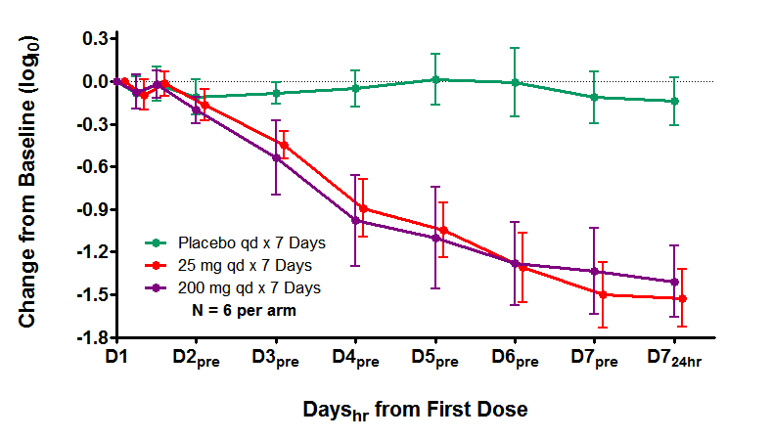
MK-1439: Phase Ib Double-blind, randomized, placebo-controlled Study population: HIV+, treatment-naïve (N=18)
Anderson, CROI 2013; #100
Notes:
Keywords: CROI 2013; Conference on Retroviruses and Opportunistic Infections; ART; antiretroviral therapy; Roy M. Gulick, MD, MPH; Atlanta 2013; HIV; MK-1439

Slide 8
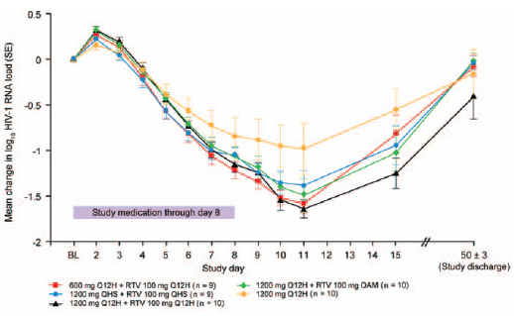
BMS-663068: Oral HIV Attachment Inhibitor
Study pop: CD4 >200, VL >5000 off ART X >8 wks or ART-naive (N=50)
Prodrug of BMS-626529
Inhibits CD4 binding by binding to gp120
PK suggest QD or BID dosing without boosting
↓ baseline susceptibility in some pts due to envelope polymorphisms; screened by baseline IC₅₀
Nettles JID 2012;206:1002
Notes:
Keywords: CROI 2013; Conference on Retroviruses and Opportunistic Infections; ART; antiretroviral therapy; Roy M. Gulick, MD, MPH; Atlanta 2013; HIV; BMS-663068; CD4 count; prodrug; BMS-626529

Slide 9
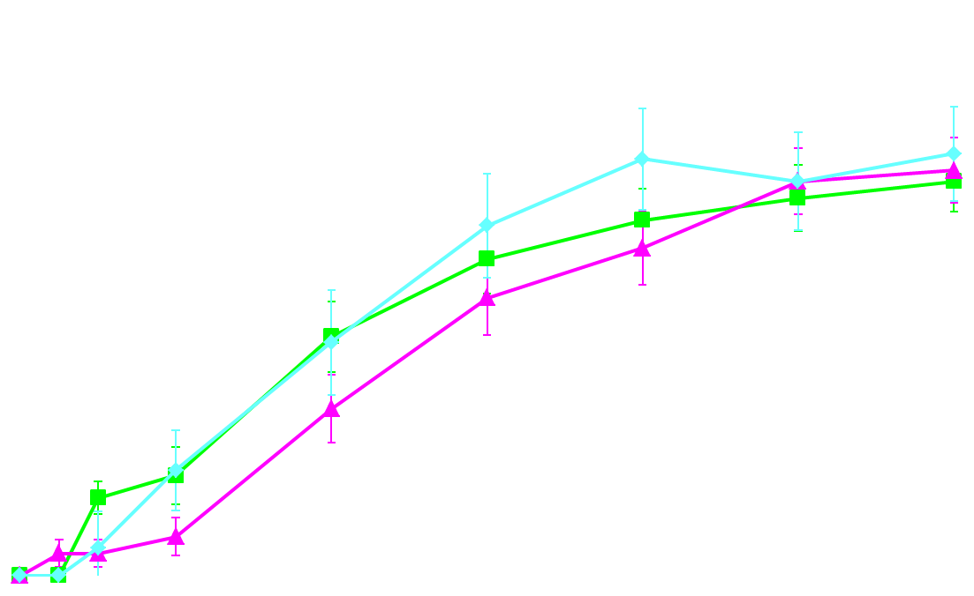
Cenicriviroc (CVC) 202: Phase 2 VL <50 copies/mL (ITT-FDA Snapshot)
100
Study population: Rx-naïve, VL >1000, CD4 >200, documented R5 virus (N=143)
All arms with TDF/FTC
76%
80
73%
71%
60
Subjects with HIV-1 RNA <50 c/mL, % (±SE)
CVC 100 mg
40
CVC 200 mg
EFV
20
randomized 2:2:1
BL
1
2
4
8
12
16
20
24
Weeks
CVC 100 mg (N=59)
0 | 3 | 11 | 25 | 37 | 44 | 42 | 45
2 | 2 | 4 | 17 | 28 | 13 | 40 | 41
0 | 4 | 5 | 12 | 16 | 18 | 19 | 20
CVC 200 mg (N=56)
EFV (N=28)
Gathe CROI 2013 #106LB
Notes:
Keywords: CROI 2013; Conference on Retroviruses and Opportunistic Infections; ART; antiretroviral therapy; Roy M. Gulick, MD, MPH; Atlanta 2013; HIV; cenicriviroc; CVC; TDF; tenofovir; FTC; emtricitabine; EFV; efavirenz; FDA snapshot

Slide 10
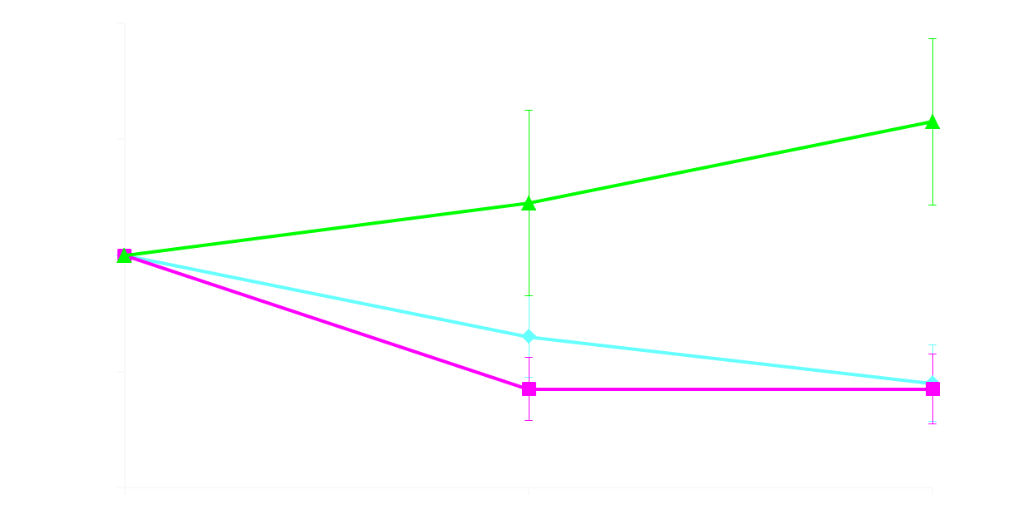
sCD14 Changes from Baseline
Cenicriviroc (CVC) Study 202
EFV
Mean change from baseline in sCD14 levels,ª x 10⁶ ng/L (±SE)
CVC 100 mg
CVC 200 mg
Baseline
Week 12
Week 24
CVC 100 mg
55 | 51 | 47
54 | 50 | 44
28 | 22 | 21
CVC 200 mg
EFV
Gathe CROI 2013 #106LB
Notes:
Keywords: CROI 2013; Conference on Retroviruses and Opportunistic Infections; ART; antiretroviral therapy; Roy M. Gulick, MD, MPH; Atlanta 2013; HIV; cenicriviroc; CVC; sCD14

Slide 11
GSK744 LAP: PrEP Study in Macaques
Study population: male macaques (N=16)
Study treatment:
GSK 744LAP 50mg/kg X 2, 4 weeks apart
Placebo
Weekly SHIV rectal challenge X 8
Results (preliminary)
GSK 744LAP: no infections
Placebo: all infected
Andrews CROI 2013 #24LB
Notes:
Keywords: CROI 2013; Conference on Retroviruses and Opportunistic Infections; ART; antiretroviral therapy; Roy M. Gulick, MD, MPH; Atlanta 2013; HIV;GSK744LAP; PrEP; preexposure prophylaxis; macaque

Slide 12
TDF Intravaginal Ring for PrEP
Polyurethane drug reservoir ring that contains 130 mg of TDF and delivers 2.3 mg/day; replaced every 28 days over 16 weeks
18 macaques (6 ring, 12 controls -- 6 real-time, 6 hx)
Low-dose challenge model: once-weekly SHIV vaginally up to 16 weeks
Results (over 16 weeks):
0/6 macaques with rings vs. 11/12 without rings infected (after median 4 exposures) (P<0.0004)
Rings well retained and well-tolerated X 5 months
Smith, CROI 2013 #25LB
Notes:
Keywords: CROI 2013; Conference on Retroviruses and Opportunistic Infections; ART; antiretroviral therapy; Roy M. Gulick, MD, MPH; Atlanta 2013; HIV; TDF; tenofovir; PrEP; preexposure pprophylaxis; tenofovir disoproxil fumarate intravaginal ring; IVR; intravaginal ring

