Slide 1

On The Road to an HIV Cure:
How Far Have We Come
Alan L. Landay, PhD
Professor and Chairman of
Immunology, Microbiology, and Medicine
Rush University Medical Center
Chicago, Illinois
FORMATTED: 05/03/2016
Chicago, Illinois: May 9, 2016
From AL Landay, PhD, at Chicago, IL: May 9, 2016, IAS-USA.

Slide 2
Learning Objectives
After attending this presentation, participants will be able to:
Describe the barriers that exist to achieving an HIV cure
Provide insights from current clinical trials focused on eliminating latently infected positive HIV cells
Describe the advances we have made in host-directed therapies for cure research and their clinical applications

Slide 3
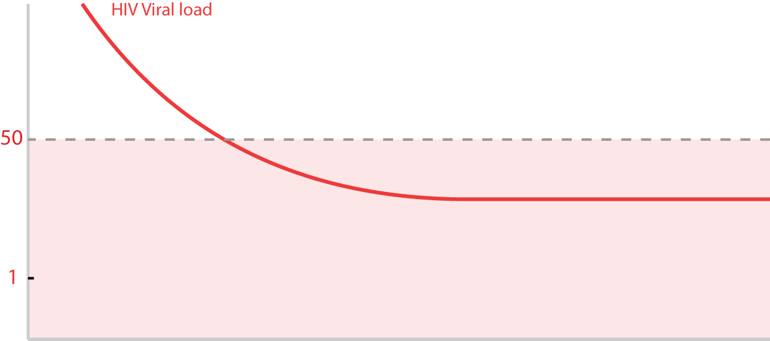
Latently infected T-cells
cART
Homeostatic
proliferation

Slide 4
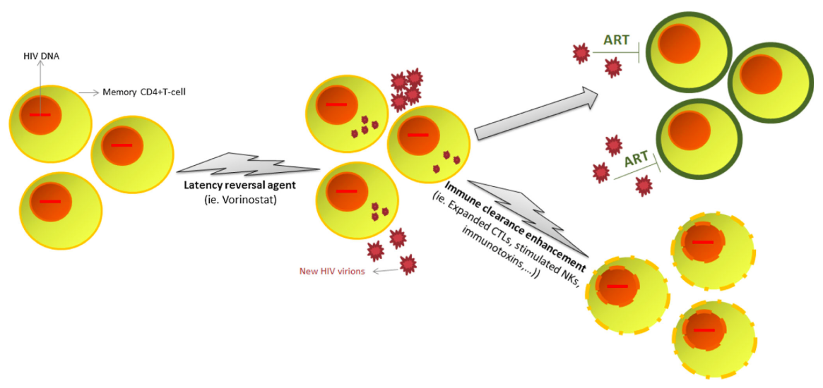
“Shock and kill” strategies
Many researchers believe that the best chance to eliminate HIV is to reactivate the virus in reservoir cells, which would then make it susceptible to killing by ART
Intense research into these “shock and kill” approaches is being undertaken and several classes of latency-reversing agents (LRAs) are being assessed
Garrido & Margolis, J Neurovirol., 2014
Histone deacetylase (HDAC) inhibitors, PKC agonists, a PTEN inhibitor and TLR agonists are showing potential, but it has become apparent that one LRA class alone will not be able to reactivate 100% of latent HIV
More effective latency-reversing interventions and combinations of LRAs and/or LRAs with immune modulation are needed to optimize potency

Slide 5
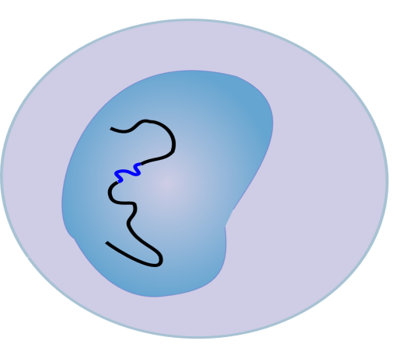
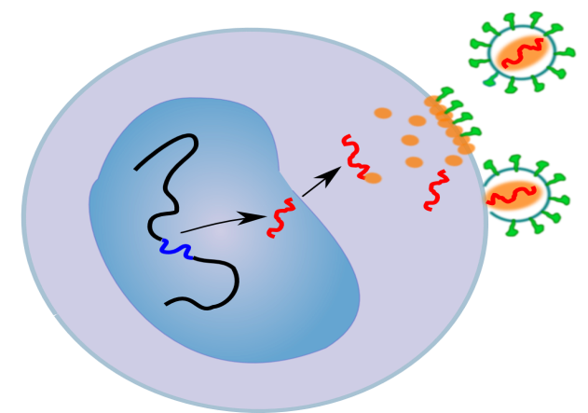

Will “activation” of virus be enough?
?
“activate”
“kill”
HIV DNA
Latent infection
Cell death
therapeutic vaccine
Immunomodulation eg., PDL1

Slide 6
HDAC inhibitors reactivate latent HIV but fail to eliminate latent reservoirs
SAHA(vorinostat): It is able to reactivate latent HIV(mean 4.8 fold in 8 Pts.) in patient sunder ART. No reservoir reduction observed.
(Archin N, et al. Nature 2014)
Romidepsin: It is able to reactivate latent HIV(2.4-5 fold in 6 Pts.) in patients under ART. No reservoir reduction observed.
(Søgaard OS et al., PLoS Pathogens 2015)
Panobinostat: It is able to reactivate latent HIV(mean 3.5 fold in 15 Pts.) in patients under ART. No reservoir reduction observed.
(Rasmussen TA et al., Lancet HIV 2014)
Provided by Satya Dandekar

Slide 7
The “block and lock” strategy
Hypothetical approaches to a functional HIV cure
(1) After HIV-1 infection, there is a sharp increase of viral load in circulating plasma of infected individuals.
(2) The viral load sharply decreases during ART, but episodes of detectable viremia “blips” are observed.
HIV-1 remains latent in most infected individuals, but if ART is discontinued (3), there is an immediate rebound of virus.
(4) HIV Tat inhibitor – didehydro-Cortistatin A (dCA) – in combination with ARVs, potently inhibits HIV-1 transcription and mediates deep latency in cell line models and primary human CD4+ T cells, even after treatment cessation.
Mousseau et al., mBio, 2015 – Susana Valente’s group
Notes:
Cortistatin A is a steroidal alkaloid isolated from the marine sponge Corticium simplex found in Southeast Asia

Slide 8
Host Directed Therapies
Therapeutic Vaccine
Checkpoint Inhibitors
Immune Modulator Drugs
Cell Therapy

Slide 9
Therapeutic Vaccines to Augment HIV Specific Responses
Result in decay of reservoir on ARV
Result in control of virus rebound off ARV

Slide 10
Therapeutic Vaccines to Augment HIV Specific Responses
Old Therapeutic Vaccine Targets
Canary Pox, Ad5, Plasmid DNA
New Therapeutic Vaccine Targets
CMV, AD26, Dendritic cells, MVA HIV Cons
D Barouch et al, Science
July 11, 2014

Slide 11
Hypotheses - A5326
Single doses of anti-PD-L1 antibody (BMS-936559) in patients on suppressive cART will be safe and well-tolerated
Blocking the PD-1/PD-L1 pathway with anti-PD-L1 antibody will enhance HIV-1 specific immune responses
Enhancement of HIV-1 specific immune responses will promote clearance of HIV-1 expressing cells, and reduce persistent viremia

Slide 12
Summary
A single low dose infusion of anti-PD-L1 (BMS-936559)
Generally well tolerated
  Associated with one adverse event consistent with autoimmunity
Resulted in high but short-lived receptor occupancy post-infusion
Appeared to increase HIV-1 specific CD8+ T cell responses in two of six participants
  Corresponded to their ex vivo proliferative response to gag peptides after exposure of pre-therapy samples to anti-PD-L1
  Response rate similar to anti-tumor response in humans and SIV control in rhesus macaques
No clear impact on viremia, cell associated-RNA or –DNA
PD1:PDL1 pathway blockade may improve HIV-1 specific CD8+ responses and may be a useful component of HIV-1 cure strategies

Slide 13
Immune Modulator Drugs
Rapamycin-M tor inhibitor
Jak Stat Inhibitor
Interferon alpha
IL15
IL21
D. Barouch et al, Science July 11, 2014

Slide 14
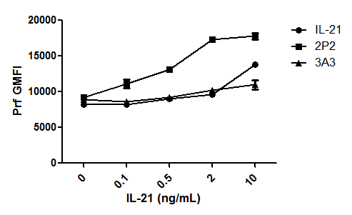
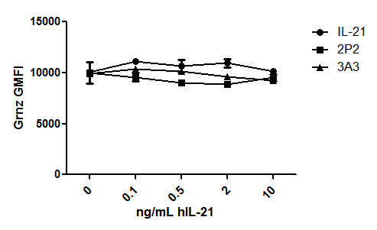
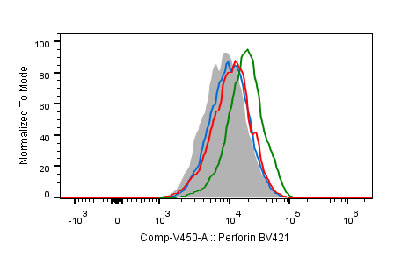
Agonistic IL21 Ab enhances cytotoxicity of NK cells from HIV patients/cART
Total PBMCs from HIV-infected patients under cART treatment
Stimulated with Gag MHC-I peptides with hIL-21, hIL-21/2P2 or hIL-21/3A3 (control)
Measured intracellular cytokines in total NK cells
Perforin
Granzyme B
0ng/mL IL-21
2ng/mL IL-21
2ng/mL IL-21 + 2P2
2ng/mL IL-21 + 3A3
In collaboration with Sharon Lewin’s lab
Perforin

Slide 15

The Berlin patient: CCR5 negative stem cell transplantation

Slide 16
Gene Therapy Strategy 1 - make cells HIV-resistant
Add something that inhibits infection | Transdominant RevM10 Fusion inhibitor C46 Anti-HIV antisense RNA
Remove something that’s necessary | CCR5 co-receptor - Using antisense, ribozymes, RNAi, intrabodies, targeted nucleases
Sacrifice any newly infected cells | LTR-inducible suicide genes, toxins, MazF endonuclease
Provided by Paula Cannon

Slide 17
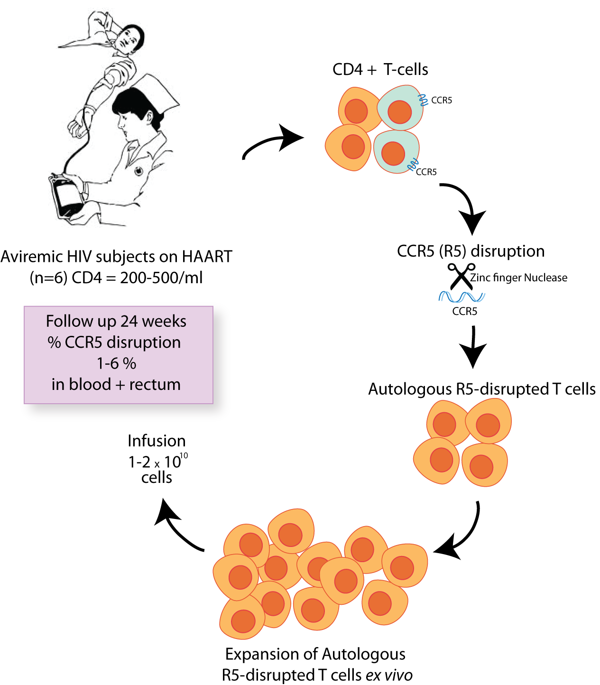


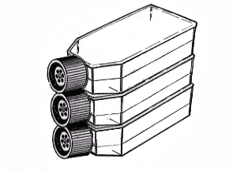
Gene therapy to eliminate CCR5
Leukapharesis
CD4+ T-cell isolation
ZFN modification of CCR5
Re-infuse
+ cyclophosphamide

Slide 18
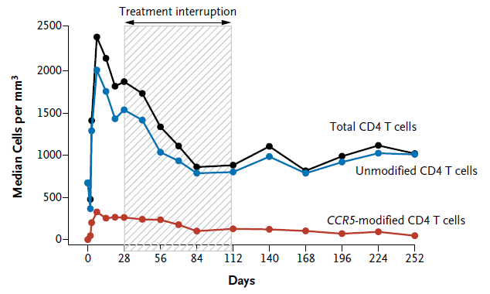
Infusion of CCR5 modified cells is safe and cells survive
Tebas et al., N Engl J Med 2014; 370:901-10

Slide 19
Summary of findings
Infusion of ZFN-treated ex vivo expanded autologous T-cells is generally safe and well tolerated
Durable increases seen in both CD4 counts and total T-cell counts
(for CD4+CD8 infusions)
CCR5 modified T-cells persist long-term in vivo
Cytoxan conditioning further improves both total T-cell counts and the frequency of CCR5 modified cells, in a dose-dependent manner
Provided by Paula
Cannon

