Slide 1

Clinically Significant Drug Interactions,
HIV and Hepatitis C Virus:
How Quickly We Forget!
Jennifer J. Kiser, PharmD
Associate Professor
University of Colorado Skaggs School of Pharmacy and Pharmaceutical Sciences
Aurora, Colorado
FLOWED: 04/20/2016
Los Angeles, California: April 25, 2016
From JJ Kiser, PharmD, at Los Angeles, CA: April 25, 2016, IAS-USA.

Slide 2
Learning Objectives
After attending this presentation, participants will be able to:
Compare and contrast the clinical pharmacology of modern direct acting antiviral agents (DAAs)
Identify therapeutic classes of drugs with the potential for drug interactions with DAAs
Develop a plan for managing interactions

Slide 3
Patient Case
60 yo Caucasian male
History of IDU
HIV and HCV diagnosed 1997
HIV well-controlled
  HIV-1 RNA TND
  CD4 506 cells/mm³ (23%)
ARV history
  AZT/3TC, IDV
  AZT/3TC/ABC, LPV/RTV
  TDF/3TC, ABC, LPV/RTV
  Current regimen: TDF/FTC, DRV/r BID, RAL
Notes:
CD4 nadir 188 in 4/2008

Slide 4
HCV History
Genotype 1a
Treatment experienced – relapsed after 72 weeks PEG/RBV 600mg BID
HCV RNA
  20,100,000 IU/mL (7.3 log₁₀ IU/mL)
Transient elastography (last month)= 9.1 kPa
Disease | F0-F1 (Kpa) | F2 (Kpa) | F3 (Kpa) | F4 (Kpa)
Hepatitis B | <6.0 | >6.0 | >9.0 | >12.0
Hepatitis C | <7.0 | >7.0 | >9.5 | >12.0
HCV-HIV coinfection | <7.0 | <10 | >11.0 | >14.0
Cholestatic Liver disease | <7.0 | >7.5 | >10.0 | >17.0
NAFLD/NASH | <7.0 | >7.5 | <10 | >14.0
Notes:
Liver biopsy (~10 years ago):
grade 2 inflammation, stage 2 fibrosis

Slide 5
Clinical Labs
ALT 32 U/L (7-52)
AST 30 U/L (12-39)
Alk Phos 59 U/L (39-117)
Tbili 0.3 mg/dL (0.1-1.3)
Albumin 4.7 g/dL (3.5-5.7)
SCr 1.07 mg/dL (0.6-1.2)
  Wt 115 kg, 5’7” Ht
  CrCl ~119 mL/min
WBC 8.1 10⁹/L (4-11.1)
ANC 4.8 10⁹/L (1.8-6.6)
RBC 5.39 10¹²/L (4.76-6.09)
Hgb 16.2 g/dL (14.3-18.1)
Hct 49.6% (39.2 to 50.2)
Platelet 175 10⁹/L (150-400)
FIB-4 = 1.82 (< 1.45 F0/1, > 3.25 F3/4)
APRI = 0.44 (>0.77 significant fibrosis, >1 cirrhosis)

Slide 6
Which Hepatitis C treatment does NOT require a change to ARV or increased monitoring?
Grazoprevir/elbasvir
Ledipavir/sofosbuvir
Ritonavir-boosted paritaprevir, ombitasvir, dasabuvir (PrOD) and ribavirin
Sofosbuvir/daclatasvir
1

Slide 7
Grazoprevir/Elbasvir
Hepatically metabolized, less than 1% renally eliminated
 |  | Enzymes | Transporters
Grazoprevir (Protease Inhibitor) | Victim | Substrate CYP3A4 | Substrate OATP1B1 and P-gp
 | Perpetrator | Inhibitor of CYP3A4, UGT1A1 | Inhibitor of BCRP
Elbasvir (NS5A Inhibitor) | Victim | Substrate CYP3A4 | Substrate P-gp
 | Perpetrator |  | Inhibitor of BCRP and P-gp

Slide 8
GZR/EBR Interaction Potential with ARV
 | PK Changes and Recommendation
Ritonavir-boosted atazanavir | GZR ↑, EBR ↑, ATV ↑
Ritonavir- boosted darunavir | GZR ↑, EBR ↑, DRV ↔
Ritonavir-boosted lopinavir | GZR ↑, EBR ↑, LPV ↔
Ritonavir-boosted tipranavir | No data
Cobicistat-boosted elvitegravir | No data
Efavirenz | GZR ↓, EBR ↓, EFV ↓
Etravirine | No data
Rilpivirine | GZR ↔, EBR ↔, RPV ↔
Raltegravir | GZR ↔, EBR ↔, RAL ↑
Dolutegravir | GZR ↔, EBR ↔, DTG ↑
Maraviroc | No data
Tenofovir disoproxil fumarate | GZR ↔, EBR ↔, TFV ↑
Kiser JJ, www.HCVguidelines.org

Slide 9
Ledipasvir
Minimal metabolism, 70% eliminated unchanged, 1% renally eliminated
Absorption is pH dependent
 | Enzymes | Transporters
Victim | “Unknown pathway”, CYP3A4? | Substrate P-gp
Perpetrator |  | Inhibitor of P-gp, BCRP, OATP1B1/3

Slide 10
PPI Use Did Not Impact SVR in TRIO
HCV Target had no data on PPI use, dose, or duration
Retrospective analysis, n=2,034
No difference in SVR rates in those on PPI vs. no PPI with LDV/SOF
Use PPI freely? NO.
  Signal of reduced SVR in those on twice daily PPI
Afdhal N, et al. EASL 2016, #60
Notes:
Dr. Chew showed results of the HCV Target trial, higher SVR in those not on a PPI. These results were very concerning but many unanswered questions because there were no data on actual PPI use, dose, or duration in HCV Target. A retrospective analysis from another group (TRIO network) suggests PPI may not be as problematic as indicated in TRIO. They compared SVR rates in those receiving PPI vs. no PPI using propensity analysis which matched on other clinical and demographic factors and found no difference in SVR rates. Does this mean we can use PPI freely with SOF/LDV? No. Same dosing guidelines on the use of gastric acid modifiers with SOF/LDV apply.

Slide 11
LDV dosing with gastric acid modifiers
Separate antacids by 4 hours.
PPI doses comparable to omeprazole 20mg can be administered simultaneously with LDV/SOF under fasted conditions.
H2 blocker doses should not exceed the equivalent of famotidine 40mg BID.
Equivalent PPI Doses
Esomeprazole 40mg
Pantoprazole 40mg
Lansoprazole 30mg
Rabeprazole 20mg
Omeprazole 20mg

Slide 12
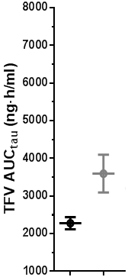

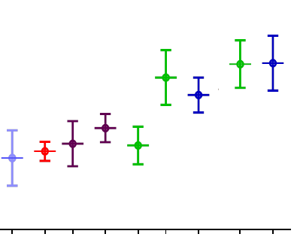
With LDV/SOF, TFV exposures are high in those on PIs
NNRTIs
Without With
LDV/SOF^{1,2} LDV/SOF³
RTV-Boosted PIs
Without With
LDV/SOF⁴⁻⁹ LDV/SOF¹⁰
Range of TFV exposures with available safety data
EFV
RPV
ATR CPA
FPV SQV LPV/r ATV DRV ATV DRV
N = 30 15 17 14
15 35 19* 24 17* 14 12 24 23
TFV exposures are higher when TDF is coadministered with LDV/SOF compared to without LDV/SOF, but
Compared to the range of TFV exposures with available safety data
  For EFV or RPV: TFV exposures fall within the range¹
  For RTV-boosted PIs: TFV exposures partially exceed the range²
* HIV-infected subjects in CASTLE study
1. Data on file
2. Hoetelmans RMW, et al. 6th IWCPHT 2005. Quebec City, Canada. Poster #2.11
3. German P, et al. ICPHHT 2014. #O6
4. Luber AD, et al. HIV Medicine. 2010;11:193-9 (FPV+RTV)
5. Chittick GE, et al. AAC. 2006; 50(4):1304-10 (SQV+RTV)
6. Zhu. 9th IWCPHT. 2008. #023 (ATV+RTV & LPV/r )
7. Kearney B, et al. JAIDS. 2006;43(3):278-83 (LPV/r)
8. Agarwala S, et al. 6th IWCPHT 2005. #16. (ATV+RTV)
9. Hoetelmans RMW, et al. BJCP. 2007;64(5):655-61 (DRV+RTV)
10. German P, et al. CROI 2015

Slide 13
Guidelines Recommendation on LDV/SOF with TDF
LDV/SOF and TDF should be avoided in those with CrCl below 60 mL/min
The combination of LDV/SOF with TDF and boosted regimens should be avoided (pending further data) unless antiretroviral regimen cannot be changed and the urgency of treatment is high
www.HCVguidelines.org

Slide 14
If you can’t avoid TDF + boosted regimen, monitor
Baseline parameters should include estimated renal function, electrolytes (including phosphorus), and urinary protein and glucose levels
Monitor every 2-4 weeks on therapy
  Estimated renal function
    CKD in HIV guidelines suggest using CKD-EPI equation
  Urinary protein and glucose
Lucas GM, et al. CID 2014;59(9):e96-138, www.HCVguidelines.org

Slide 15
Ritonavir-boosted Paritaprevir, Ombitasvir, Dasabuvir (PrOD) and Ribavirin
Primarily hepatically metabolized, minimal renal elimination
 |  | Enzymes | Transporters
Ritonavir-boosted Paritaprevir (Protease Inhibitor) | Victim | Substrate CYP3A4 | Substrate P-gp, OATP1B1, BCRP
 | Perpetrator | Inhibits CYP2C8, UGT1A1 (ritonavir inhibits CYP3A) | Inhibits P-gp, OATP1B1/3, BCRP
Ombitasvir (NS5A Inhibitor) | Victim | Substrate CYP3A4 | Substrate P-gp
 | Perpetrator | Inhibits CYP2C8, UGT1A1
Dasabuvir (Non-nucleoside NS5B inhibitor) | Victim | Substrate CYP2C8>3A4>2D6 | Substrate P-gp
 | Perpetrator | Inhibits UGT1A1 | Inhibits BCRP

Slide 16
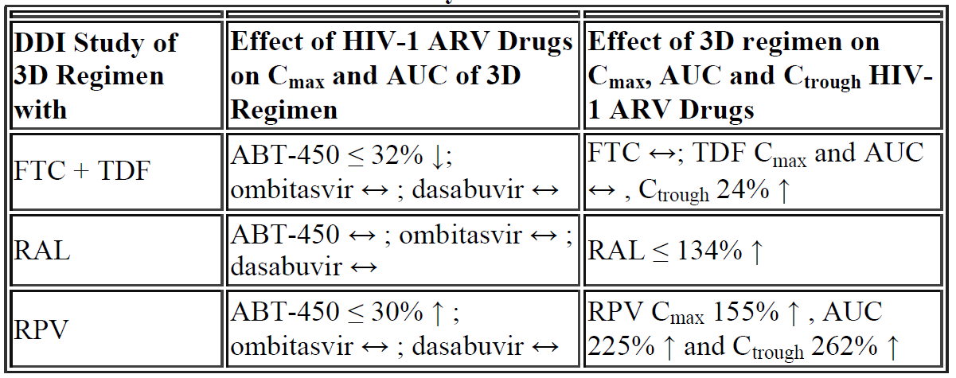
PrOD with RPV and RAL
DDI Study of PrOD Regimen with
Effect of HIV-1 ARV Drugs on C_{max} and AUC of PrOD Regimen
Effect of PrOD regimen on C_{max}, AUC and C_{trough} HIV-1 ARV Drugs
Comments
ok
ok
Not recommended
theoretical concern
for QTC prolongation
Khatri A, et al. ICAAC Sept 5-9, 2014, Washington DC

Slide 17
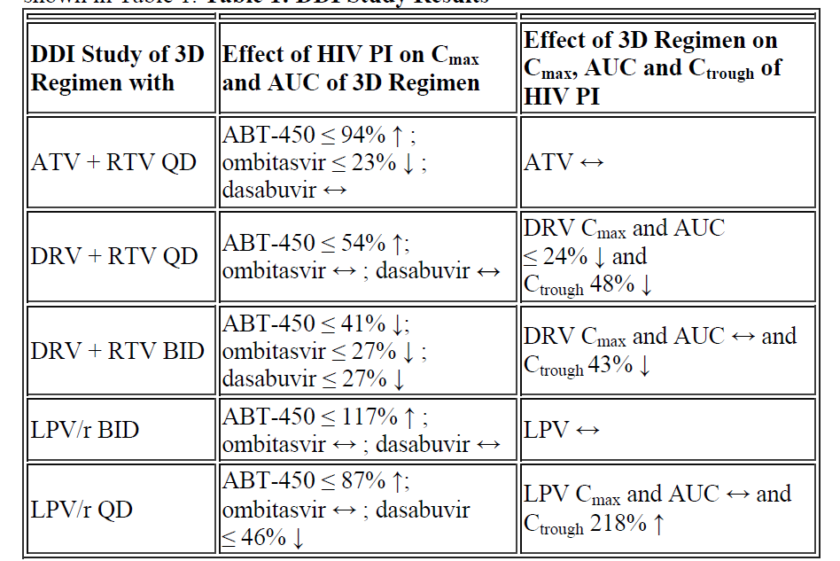
PrOD and HIV PI Interactions
DDI Study of PrOD Regimen with
Effect of HIV PI on C_{max} and AUC of PrOD Regimen
Effect of PrOD regimen on C_{max}, AUC and C_{trough} HIV PI
Comments
Drop the ritonavir booster while on PrOD
Median DRV trough is 3300 ng/mL without PrOD*, troughs are 1056-1600 with PrOD
Not recommended too much RTV
Khatri A, et al. ICAAC Sept 5-9, 2014, Washington DC, *DRV package insert

Slide 18
DRV PK with PrOD in HIV/HCV coinfected patients
DRV reductions less than in healthy volunteers
2 patients had HIV between 40-200 copies/mL on study, but did not appear to be related to DRV exposures
Use with caution until results are available from the parent study, n=230
If combination cannot be avoided, carefully monitor HIV viral load in ARV experienced patients
Wyles D, et al. CROI, 2/22-2/25, 2016, Boston, MA #574

Slide 19
Daclatasvir
Primarily hepatically metabolized (88%), minimal renal elimination (7%)
Dose depends on concomitant medications
 | Enzymes | Transporters
Victim | Substrate CYP3A4 | Substrate P-gp
Perpetrator |  | Inhibitor of P-gp, BCRP, OATP1B1/3

Slide 20
The dose of daclatasvir should be reduced if given with ritonavir-boosted darunavir
TRUE
FALSE
1

Slide 21
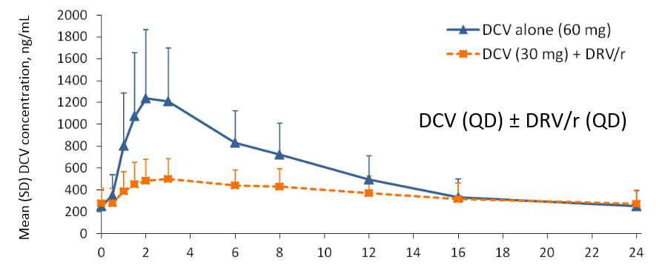
Use Full Dose DCV with DRV/r and LPV/r
9/12 patients that relapsed in ALLY-2 were taking DRV/r with a reduced dose of DCV (30mg)¹
Healthy volunteer PK study indicated DCV Cmax and AUC were 62% and 30% ↓, respectively when used at a reduced dose with DRV/r²
¹Garimella T, et al. AASLD, 11/13-11/17, Boston, MA, #728, ²Gandhi, et al. International Workshop on Clinical Pharmacology of HIV and Hepatitis Therapy, 5/26-5/28, 2015, poster #80

Slide 22
Daclatasvir Dosing with Concomitant Medications
Strong CYP3A Inhibitors | Moderate CYP3A Inhibitors | Strong CYP3A Inducers | Moderate CYP3A Inducers
Decrease DCV dose to 30mg | Standard DCV dose 60mg | DCV Contraindicated | Increase DCV dose to 90mg
Ritonavir-boosted atazanavir | Ritonavir-boosted darunavir | Rifamycins | Bosentan
Clarithromycin | Ritonavir-boosted lopinavir | St Johns Wort | Dexamethasone
Itraconazole | Ciprofloxacin | Antiepileptics | Efavirenz
Ketoconazole | Diltiazem |  | Etravirine
Nefazodone | Erythromycin |  | Modafinil
Nelfinavir | Fluconazole |  | Nafcillin
Posaconazole | Fosamprenavir |  | Rifapentine
Telithromycin | Verapamil
Voriconazole

Slide 23
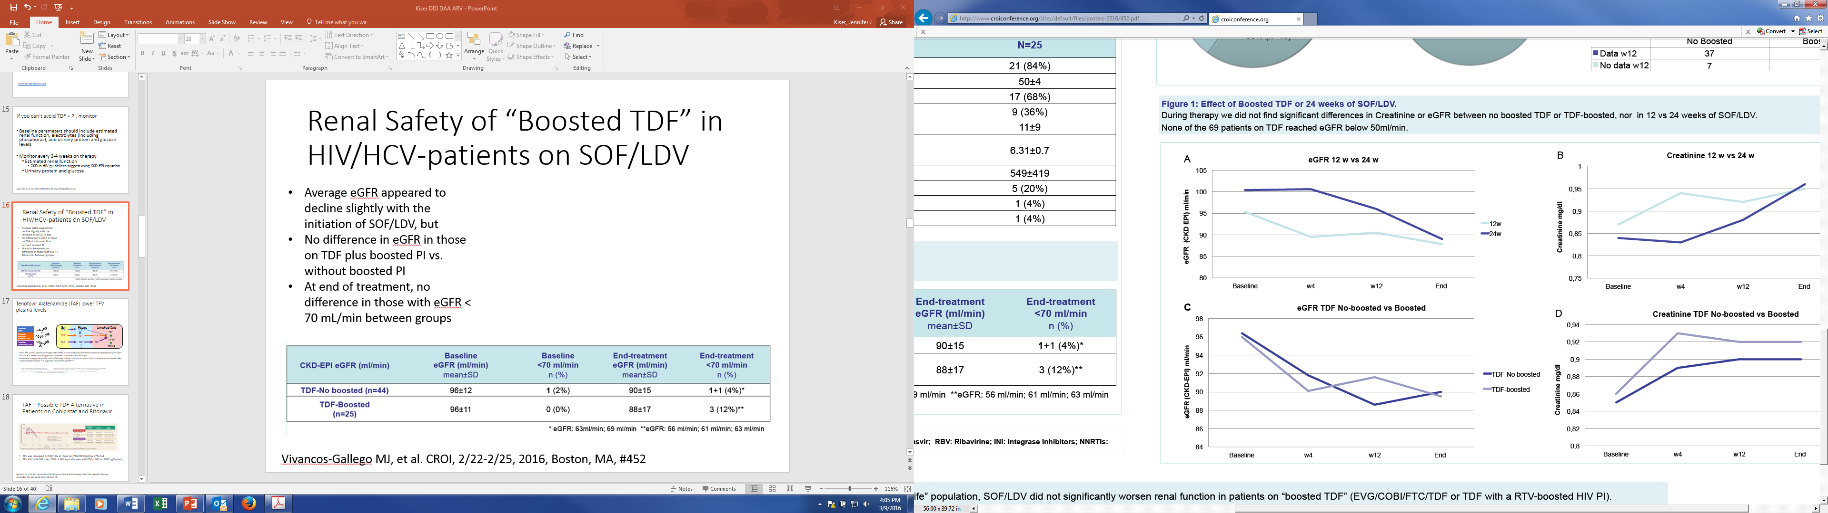
Renal Safety of “Boosted TDF” in HIV/HCV-patients on SOF/LDV
Average eGFR appeared to decline slightly with the initiation of SOF/LDV, but
No difference in eGFR in those on TDF plus boosted PI vs. without boosted PI
At end of treatment, no difference in those with eGFR < 70 mL/min between groups
Vivancos Gallego MJ, et al. CROI, 2/22-2/25, 2016, Boston, MA, #452
Notes:
Patients in boosted group on TDF/FTC/ELV/cobi (60%), TDF/FTC + HIV PI/r (32%), 2 (8%) on TDF/FTC/ELV/cobi plus DRV.
Small case series, no renal measures other than eGFR, but reassuring that for 12-24 weeks of SOF/LDV treatment, no major impact of elevated TFV levels on eGFR
5 patients on TDF + boosted HIV PI received 24 weeks of treatment (guessing they were tx exp cirrhotics)
Patients with eGFR < 70 mL/min at end of treatment were on:
TDF/FTC/RPV (n=2)
TDF/FTC/ELV/cobi (n=2) – patient with eGFR of 56 d/c TDF due to renal impairment at day 74 of SOF/LDV treatment
TDF/FTC/ATV/r (n=1)

Slide 24
Which of the following best describes the differences between the pharmacokinetics of tenofovir alafenamide (TAF) and tenofovir disoproxil fumarate (TDF) when given at standard oral doses?
Plasma concentrations of tenofovir are higher with TAF than with TDF.
Plasma concentrations of tenofovir are lower with TAF than with TDF.
Plasma concentrations of tenofovir are similar with TAF as compared to TDF.
Plasma concentrations are similar but intracellular concentrations of tenofovir diphosphate are lower with TAF than with TDF.
1

Slide 25
Tenofovir Alafenamide (TAF) has lower TFV plasma levels
Gut
Plasma
Lymphoid Cells
Tenofovir
(TFV)
TFV
TFV
TFV
Tenofovir disoproxil
fumarate (TDF)
TDF
TDF
TDF
TFV-MP
Tenofovir alafenamide (TAF)
TAF
TAF
TAF
TFV
TFV-DP
Intact TAF transits directly into target cells where it is intracellularly activated to tenofovir diphosphate (TFV-DP)¹⁻³
TAF has 90% lower circulating plasma TFV levels compared to TDF 300mg⁴⁻⁶
Basolateral transporters (OAT1, OAT3) effectively transfer TFV, but not intact TAF, into renal proximal tubular cells⁷
Lower systemic level of TFV, improved renal safety profile⁸⁻¹⁰
Lee W et. Antimicr Agents Chemo 2005;49(5):1898-1906. 4. Ruane P, et al. J Acquir Immune Defic Syndr 2013; 63:449-5. 7. Bam R, et al. Antiviral ther. 2014. 2014 Apr 4 [Epub]
Birkus G et al. Antimicr Agents Chemo 2007;51(2):543-550. 5. Sax P, et al. JAIDS 2014. 2014 Sep 1;67(1):52-8. 8. Ruane P, et al. JAIDS 2013;63:449-455.
Babusis D, et al. Mol Pharm 2013;10(2):459-66. 6. Sax P, et al. CROI 2015. Seattle, WA. #143LB 9. Sax P, et al. JAIDS 2014. 2014 Sep 1;67(1):52-8. 10. Mills A, et al. ICAAC 2014 . Washington D.C. Abstract# H-647c.

Slide 26
TAF – Possible TDF Alternative in Patients on Cobicistat and Ritonavir
TFV was increased by SOF/LDV in those on F/TAF/ELV/cobi by 27%, but
TFV AUC with TAF only ~20% of AUC typically seen with TDF (~400 vs. 2000 ng*hr/mL)
Garrison KL, et al. 16th International Workshop on Clinical Pharmacology of HIV and Hepatitis Therapy, Alexandria, VA, May 26-28, 2015, abstract 71.

Slide 27
What does the FUTURE hold?
Velpatasvir pharmacology
  pH-dependent absorption
  Increased tenofovir levels with TDF (clinical significance unknown)
  Cannot be used with efavirenz

Slide 28
Therapeutic Classes to Consider
Class | SOF/DCV | GZR/EBR | SOF/LDV | PrOD
Methadone | √ | √ | √ | √
Analgesics | √ | √ | √ | ?
Anxiolytics/Sedative hypnotics/Benzos | √ | √ª | √ | ∆/X
SSRIs | √ | √ | √ | ?
Oral contraceptives | √ | √ | √ | X^{b}
Immunosuppressants | √ | NOT CSA, TAC OK | √ | ∆
Antiepileptics (old) | X | X | X | X
Statins | ∆ | ∆/X | ?^{c} | ∆/X
Calcium channel blockers | √ | ∆/X | ? | ∆
Amiodarone | X | X | X | X
ªmidazolam given orally AUC increased 34%, ^{b}progestin-containing only, LFT elevations with ethinyl estradiol, ^{c}rosuvastatin not recommended, others not studied
Selected based on interaction potential and Lauffenburger JC, et al. Eur J Gastro & Hepatol 2014;26(10):1073-82

Slide 29
Resources for Drug Interactions
University of Liverpool
  www.hep-druginteractions.org
Toronto General Hospital
  http://www.hcvdruginfo.ca/
Specific to antiretroviral interactions
  DHHS Guidelines Drug Interaction Tables
    www.aidsinfo.nih.gov

Slide 30
Summary
The most important consideration in the treatment of coinfected patients is the potential for drug interactions
In general, current therapies have well-characterized pharmacology and manageable drug interaction profiles
A systematic approach to the identification and management of drug interactions is essential
While there are a lot of data to make informed treatment decisions, there are still some interactions we cannot forget

