Slide 1
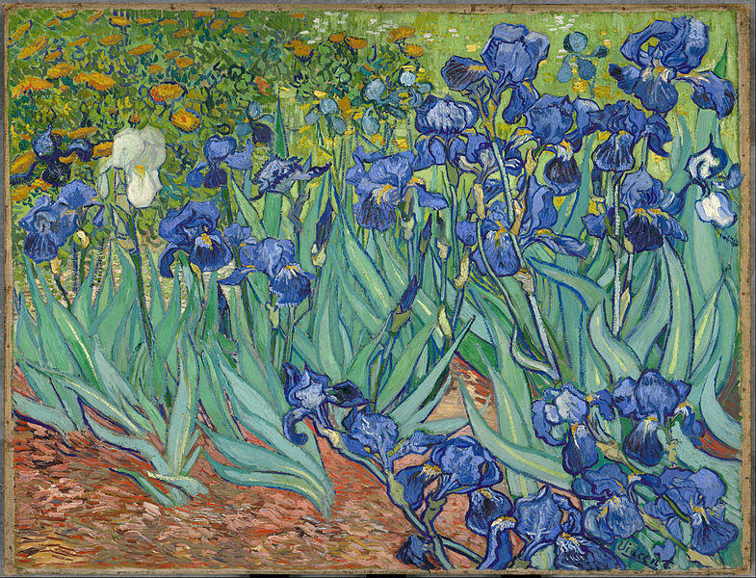

When Will It All Be Over?
HIV Cure Efforts
Davey Smith, MD
Professor of Medicine
University of California San Diego
La Jolla, California
FLOWED: 04/18/16
Los Angeles, California: April 25, 2016
From D Smith, MD, at Los Angeles, CA: April 25, 2016, IAS-USA.

Slide 2
Learning Objectives
After attending this presentation, participants will be able to:
Describe differences between functional and sterilizing cure efforts.
Recognize HIV cure strategies currently in clinical research.
Describe ethical issues around HIV cure research.

Slide 3


Thing 1: HIV Reservoir Persists during ART
HIV infection is characterized by high levels of circulating viruses in the blood
Antiretroviral drugs are capable of suppressing HIV to undetectable levels
HIV rebounds after stopping therapy
START
STOP
HAART
Circulating virus
Limit of detection
Time
From D Smith, MD, at Los Angeles, CA: April 25, 2016, IAS-USA.

Slide 4
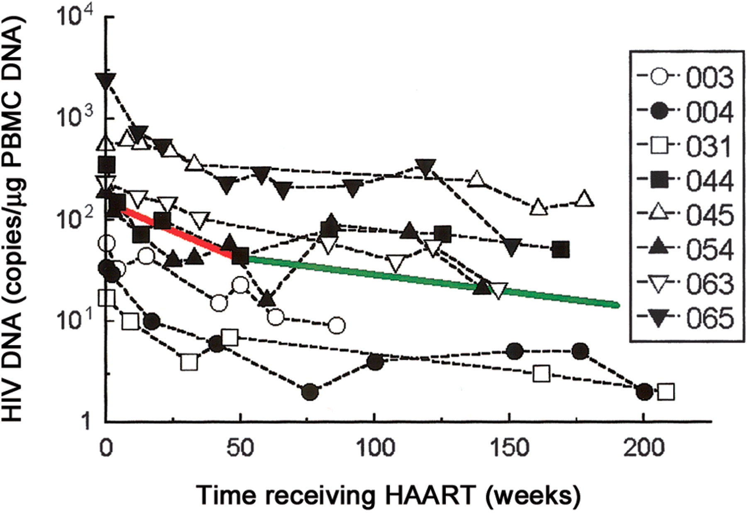


Thing 2
The HIV Reservoir is Stable during ART
Slower-than-exponential decay of HIV-1 DNA during the first 4 years of ART
Strain M C et al. J Infect Dis. 2005;191:1410-1418

Slide 5
Types of Cure
Sterilizing vs. Functional cure
  Sterilizing: HIV is cleared everywhere.
  Functional: the host’s immune system is able to control HIV infection without help from ART.

Slide 6
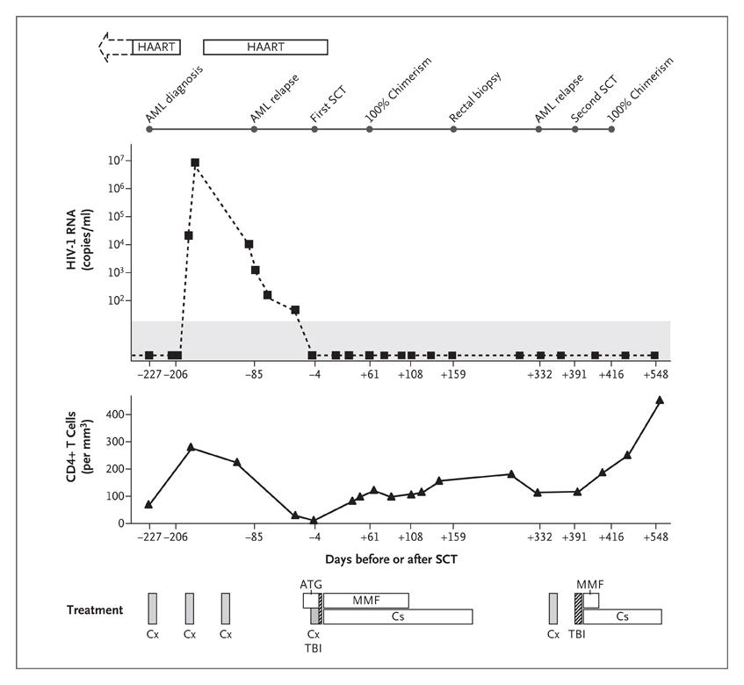



The Berlin Patient
SCT x 2
Chemo and Rad
CCR5 ∆∆32
GVHD
CCR5 WT
AML
HIV
CCR5 ∆∆32
No AML
No HIV
Hütter G et al. N Engl J Med 2009;360:692-698.
Notes:
Figure 3. Clinical Course and HIV-1 Viremia. The clinical course and treatment of acute myeloid leukemia (AML) as well as HIV and the measurement of HIV-1 viremia by means of RNA polymerase-chain-reaction assays are shown from the point of AML diagnosis to day 548 after stem-cell transplantation (SCT). HIV-1 RNA was not detected in peripheral blood or bone marrow from the point at which highly active antiretroviral therapy (HAART) was discontinued, 1 day before SCT, until the end of follow-up, 548 days after SCT. (The shaded area of this graph indicates the limit of detection of the HIV–RNA assay.) The CD4+ T-cell count in the peripheral blood is shown in reference to the immunosuppressive treatments. ATG denotes antithymocyte globulin, Cs cyclosporine, Cx chemotherapy, MMF mycophenolate mofetil, and TBI total-body irradiation.

Slide 7
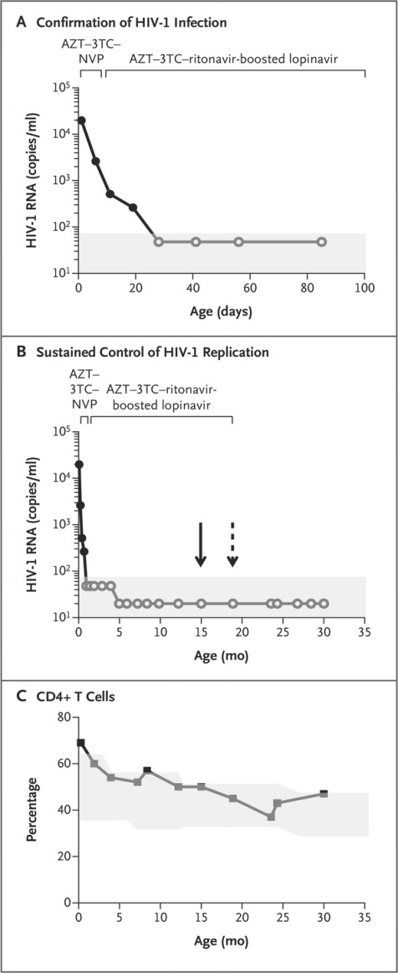
Persaud D et al. N Engl J Med 2013;369:1828-1835.
The Mississippi Baby
Immediate ART
AZT-3TC-NVP
Maintained ART
AZT-3TC-LPV-r
For 18 months
Notes:
Figure 1. Detection of Human Immunodeficiency Virus Type 1 (HIV-1) Infection in the Child. Panel A shows HIV-1 RNA levels indicating confirmed HIV-1 infection, with positive values for HIV-1 RNA in plasma at four time points before and after the initiation of antiretroviral therapy (ART). The decline in the viral load was biphasic, which is typically seen during effective ART. Panel B shows HIV-1 RNA levels indicating sustained control of HIV-1 replication during ART and after the discontinuation of therapy. The solid arrow indicates the last time that prescriptions for ART were filled (at 15 months of age, according to pharmacy records), and the dashed arrow the time of the last administration of ART (at 18 months of age, according to maternal report). In both Panel A and Panel B, solid circles indicate detectable HIV-1 RNA, and open circles undetectable HIV-1 RNA; the shaded area indicates the limit of detection of the plasma viral-load assay. Panel C shows the percentage of CD4+ T cells from the child's birth until 30 months of age. The shaded area indicates the CD4+ T-cell percentage in the normal range (10th to 90th percentiles); fluctuations in the normal range are due to age-related changes.6 3TC denotes lamivudine, AZT zidovudine, and NVP nevirapine.

Slide 8
Persaud D et al. N Engl J Med 2013;369:1828-1835.
The Mississippi Baby
Rebound 3 years later 16k VL
Immediate ART
AZT-3TC-NVP
Maintained ART
AZT-3TC-LPV-r
For 18 months
Notes:
Figure 1. Detection of Human Immunodeficiency Virus Type 1 (HIV-1) Infection in the Child. Panel A shows HIV-1 RNA levels indicating confirmed HIV-1 infection, with positive values for HIV-1 RNA in plasma at four time points before and after the initiation of antiretroviral therapy (ART). The decline in the viral load was biphasic, which is typically seen during effective ART. Panel B shows HIV-1 RNA levels indicating sustained control of HIV-1 replication during ART and after the discontinuation of therapy. The solid arrow indicates the last time that prescriptions for ART were filled (at 15 months of age, according to pharmacy records), and the dashed arrow the time of the last administration of ART (at 18 months of age, according to maternal report). In both Panel A and Panel B, solid circles indicate detectable HIV-1 RNA, and open circles undetectable HIV-1 RNA; the shaded area indicates the limit of detection of the plasma viral-load assay. Panel C shows the percentage of CD4+ T cells from the child's birth until 30 months of age. The shaded area indicates the CD4+ T-cell percentage in the normal range (10th to 90th percentiles); fluctuations in the normal range are due to age-related changes.6 3TC denotes lamivudine, AZT zidovudine, and NVP nevirapine.

Slide 9
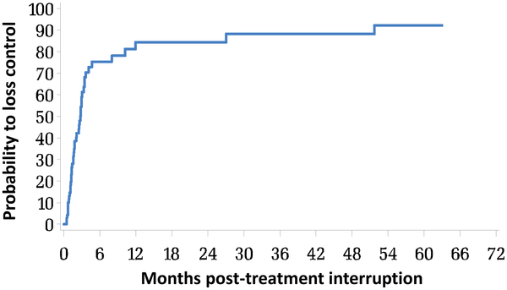

Interruption of Long-term ART Started During Primary Infection May Lead to Viremia Control
Sáez-Cirión ANRS VISCONTI Study. PLoS Pathog 9(3): e1003211.
Notes:
Combination antiretroviral therapy (cART) reduces HIV-associated morbidities and mortalities but cannot cure the infection. Given the difficulty of eradicating HIV-1, a functional cure for HIV-infected patients appears to be a more reachable short-term goal. We identified 14 HIV patients (post-treatment controllers [PTCs]) whose viremia remained controlled for several years after the interruption of prolonged cART initiated during the primary infection. Most PTCs lacked the protective HLA B alleles that are overrepresented in spontaneous HIV controllers (HICs); instead, they carried risk-associated HLA alleles that were largely absent among the HICs. Accordingly, the PTCs had poorer CD8+ T cell responses and more severe primary infections than the HICs did. Moreover, the incidence of viral control after the interruption of early antiretroviral therapy was higher among the PTCs than has been reported for spontaneous control. Off therapy, the PTCs were able to maintain and, in some cases, further reduce an extremely low viral reservoir. We found that long-lived HIV-infected CD4+ T cells contributed poorly to the total resting HIV reservoir in the PTCs because of a low rate of infection of naïve T cells and a skewed distribution of resting memory CD4+ T cell subsets. Our results show that early and prolonged cART may allow some individuals with a rather unfavorable background to achieve long-term infection control and may have important implications in the search for a functional HIV cure.

Slide 10
Interruption of Long-term ART Started During Primary Infection May Lead to Viremia Control
PTCs may not be rare
  15% of VISCONTI cohort
PTCs also identified in ACTG ATI studies of patients treated during acute and chronic infection.
What proportion of patients are PTCs?
What is special about PTCs?
Sáez-Cirión ANRS VISCONTI Study. PLoS Pathog 9(3): e1003211.
Notes:
Combination antiretroviral therapy (cART) reduces HIV-associated morbidities and mortalities but cannot cure the infection. Given the difficulty of eradicating HIV-1, a functional cure for HIV-infected patients appears to be a more reachable short-term goal. We identified 14 HIV patients (post-treatment controllers [PTCs]) whose viremia remained controlled for several years after the interruption of prolonged cART initiated during the primary infection. Most PTCs lacked the protective HLA B alleles that are overrepresented in spontaneous HIV controllers (HICs); instead, they carried risk-associated HLA alleles that were largely absent among the HICs. Accordingly, the PTCs had poorer CD8+ T cell responses and more severe primary infections than the HICs did. Moreover, the incidence of viral control after the interruption of early antiretroviral therapy was higher among the PTCs than has been reported for spontaneous control. Off therapy, the PTCs were able to maintain and, in some cases, further reduce an extremely low viral reservoir. We found that long-lived HIV-infected CD4+ T cells contributed poorly to the total resting HIV reservoir in the PTCs because of a low rate of infection of naïve T cells and a skewed distribution of resting memory CD4+ T cell subsets. Our results show that early and prolonged cART may allow some individuals with a rather unfavorable background to achieve long-term infection control and may have important implications in the search for a functional HIV cure.

Slide 11
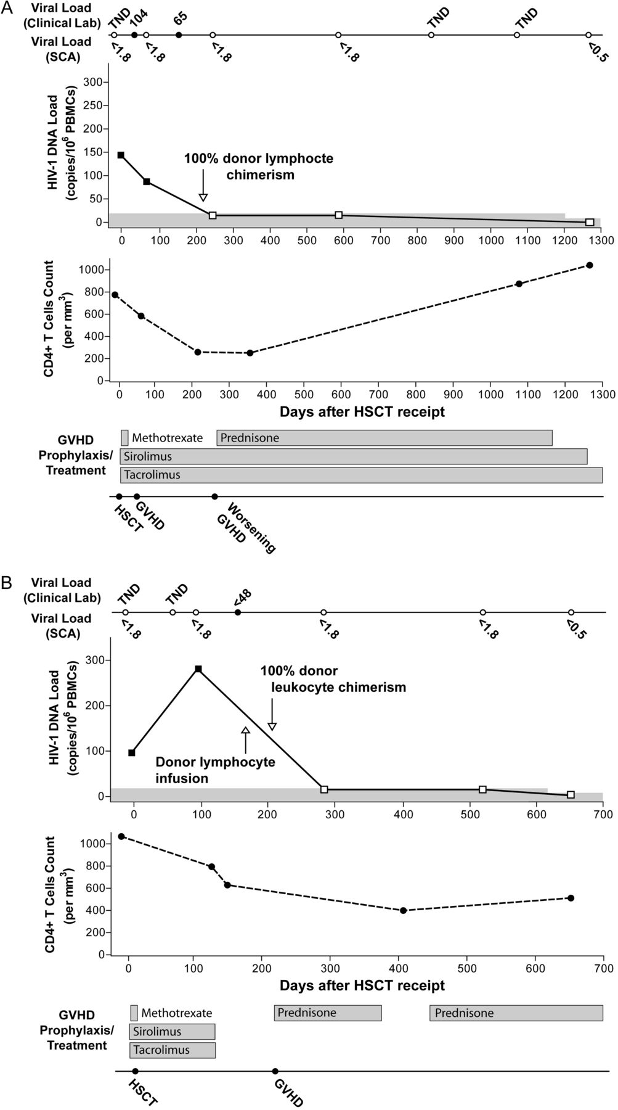
Boston Patients
lymphocyte
CCR5 WT
CCR5 ∆32
Lymphoma
HIV
Henrich T J et al. J Infect Dis. 2013;207:1694-1702
Henrich T J et al. CROI 2014
ART Stopped
No chemo or rad
Notes:
Clinical course after allogeneic hematopoietic stem cell transplant (HSCT) receipt, including longitudinal changes in plasma levels of human immunodeficiency virus type 1 (HIV-1), cell-associated HIV-1 DNA, absolute CD4⁺ T-cell counts, and graft-versus-host disease therapy for patient A (A) and patient B (B). Viral load measurements are shown above and below the solid line on top of each figure. Results from clinical viral load testing, using the Cobas Taqman real-time polymerase chain reaction (PCR) assay (v. 1), are shown above the line (solid circles represent time points when RNA target was detected, whereas open circles denote time points when no target was detected; <48, detectable virus load below the assay limit of quantification of 48 copies/mL). Numbers below the line represent the limit of detection of a highly sensitive, single-copy real-time PCR assay (SCA) in copies per milliliter; no RNA was detected by SCA at any time point. HIV-1 peripheral blood mononuclear cell (PBMC) DNA became undetectable in both patients after full donor chimerism, and no DNA was detected in purified CD4⁺ T cells from the last assay time point (days 1266 and 562 after transplantation for patients A and B, respectively). The approximate relative sensitivity for HIV-1 DNA is represented by the top of the gray line, and open symbols represent the assay detection threshold for negative results. Viral coculture of highly stimulated, purified CD4⁺ T cells obtained from the last time point yielded no detectable HIV-1 p24 antigen from assay supernatants. Loss of detectable HIV-1 DNA and RNA was associated with recovery or plateau of absolute CD4⁺ T-cell counts. Abbreviations: TND, target not detected; GVHD, graft-versus-host disease; Lab, laboratory.

Slide 12
Current Efforts
Eliminating latency (kick and kill)
  Kicking: HDACi, TLR-7 agonists
  Killing: Antibodies, Immunotoxins, DARTs
Enhance HIV-specific immune response
  Therapeutic vaccines
  Immune checkpoint blockade
    PD-1, CTLA-4
Making cells resistant to HIV
  Gene therapy: adding protective stuff, subtracting needed stuff (e.g. CCR5), cutting out provirus

Slide 13

Untreated HIV Infection = Rampant Pollination

Slide 14
ART Stops Rampant Pollination
ART
Stops HIV Replication

Slide 15
The Latent Problem
Latent reservoir 1 in a million CD4+ T cells
ART

Slide 16

Use a Kick to Find Latently Infected Cells
HDACi
IL-7
Prostratin
TLR-7 Agonists
Vaccines
IC Inhibitors

Slide 17
Kick and Kill
HIV-specific immune response or immunotoxin or antibody kills cells producing virus
CTL
ART will keep new cells from being infected

Slide 18
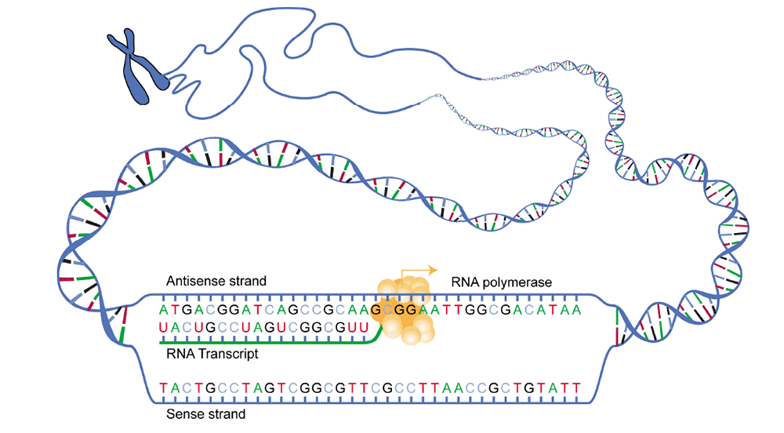
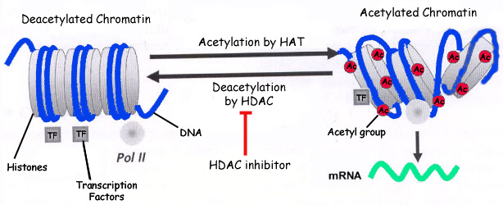
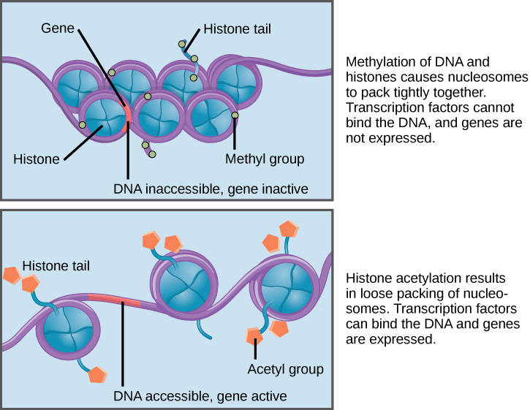
HDAC-i induces HIV-1 transcription
Søgaard OS, et al. (2015). PLoS Pathog. NM Archin et al. Nature 487, 482-485 (2012) doi:10.1038/nature11286

Slide 19
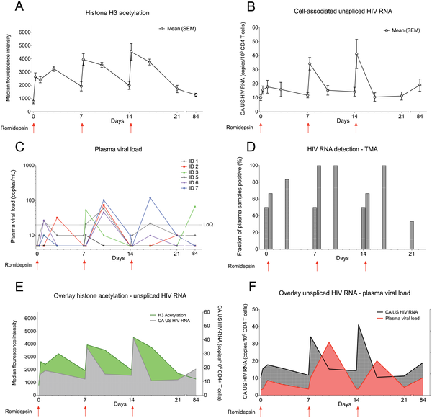
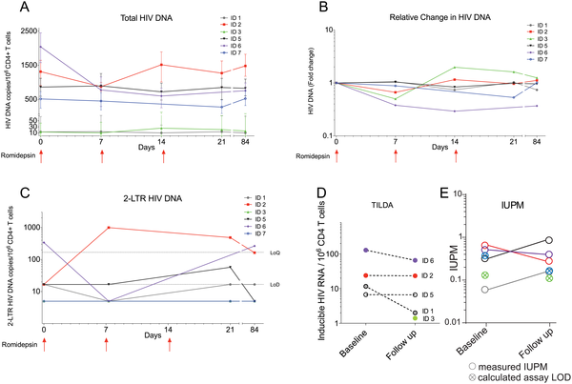
Romidepsin induced HIV-1 transcription
Kick
No Kill
Søgaard OS, et al. (2015) The Depsipeptide Romidepsin Reverses HIV-1 Latency In Vivo. PLoS Pathog

Slide 20
Antibodies
From D Smith, MD, at Los Angeles, CA: April 25, 2016, IAS-USA.

Slide 21
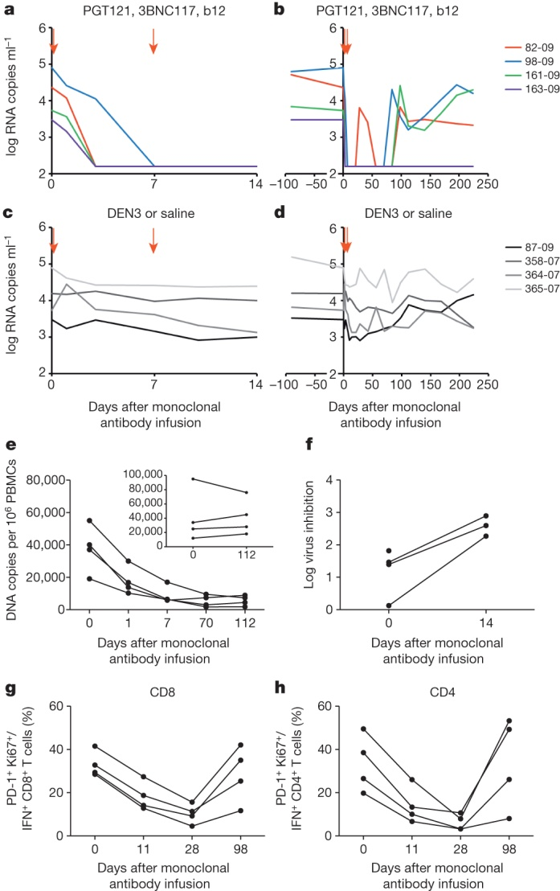
Triple PGT121, 3BNC117 and b12 monoclonal antibody cocktail.
CTL
DH Barouch et al. Nature 000, 1-5 (2013) doi:10.1038/nature12744

Slide 22
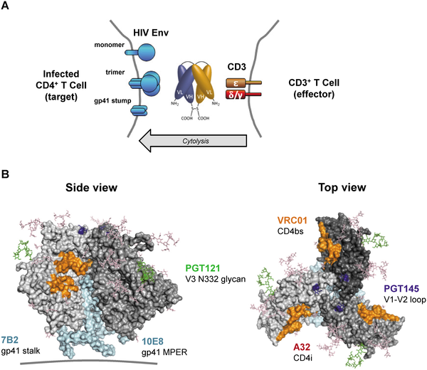
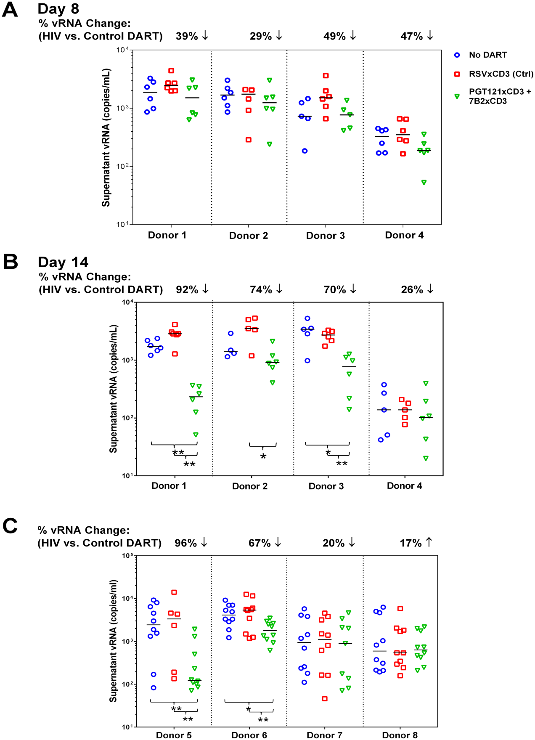
Dual-Affinity Re-targeting Molecules Bind HIV Envelope and Recruit Cytotoxic T Cells
Sloan et al. (2015). PLoS Pathog 11(11):

Slide 23
Improving Host Immune Response
From D Smith, MD, at Los Angeles, CA: April 25, 2016, IAS-USA.

Slide 24
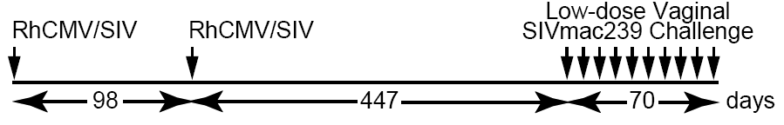

RhCMV/SIV Vector-Mediated Protection
Live RhCMV vectors that contain SIV genes (SIV Gag, Rev/Tat/Nef, Env and Pol) establish persistent, SIV-specific effector memory T-cell (T_{EM}) responses in rhesus macaques and control SIV infection.
SG Hansen et al. Nature 000, 1-5 (2013) doi:10.1038/nature12519
Notes:
We recently reported that approximately 50% of rhesus macaques (RM; Macaca mulatta) vaccinated with SIV protein-expressing rhesus cytomegalovirus (RhCMV/SIV) vectors manifest durable, aviraemic control of infection with the highly pathogenic strain SIVmac239 (ref. 5). Here we show that regardless of the route of challenge, RhCMV/SIV vector-elicited immune responses control SIVmac239 after demonstrable lymphatic and haematogenous viral dissemination, and that replication-competent SIV persists in several sites for weeks to months. Over time, however, protected RM lost signs of SIV infection, showing a consistent lack of measurable plasma- or tissue-associated virus using ultrasensitive assays, and a loss of T-cell reactivity to SIV determinants not in the vaccine. Extensive ultrasensitive quantitative PCR and quantitative PCR with reverse transcription analyses of tissues from RhCMV/SIV vector-protected RM necropsied 69–172 weeks after challenge did not detect SIV RNA or DNA sequences above background levels, and replication-competent SIV was not detected in these RM by extensive co-culture analysis of tissues or by adoptive transfer of 60 million haematolymphoid cells to naive RM. These data provide compelling evidence for progressive clearance of a pathogenic lentiviral infection, and suggest that some lentiviral reservoirs may be susceptible to the continuous effector memory T-cell-mediated immune surveillance elicited and maintained by cytomegalovirus vectors.

Slide 25
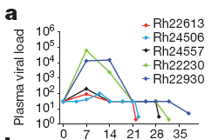
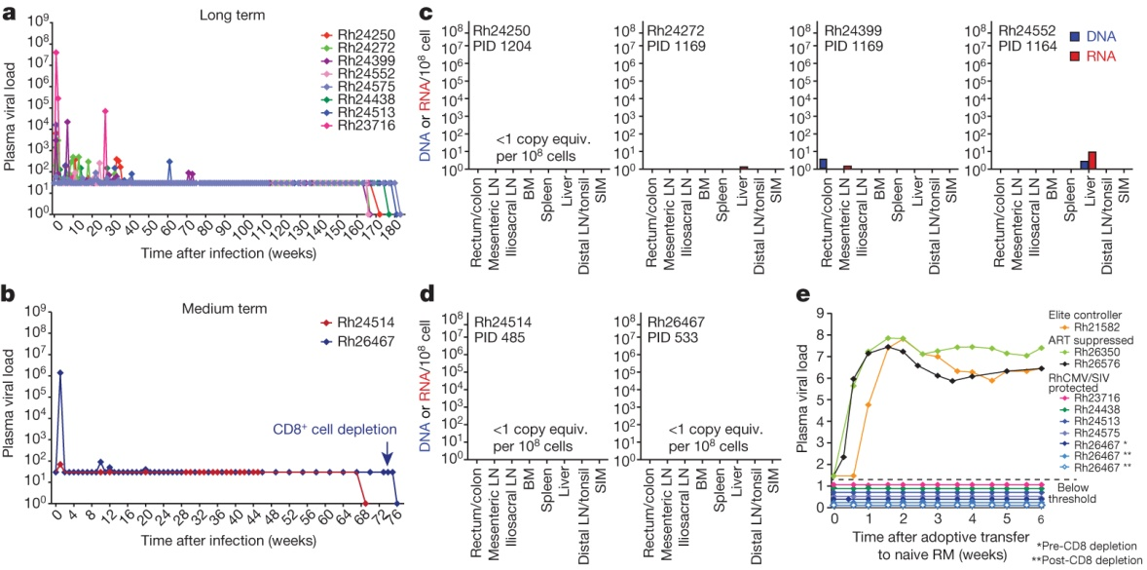
RhCMV/SIV Vector-Mediated Protection
Live RhCMV vectors that contain SIV genes (SIV Gag, Rev/Tat/Nef, Env and Pol) establish persistent, SIV-specific effector memory T-cell (T_{EM}) responses in rhesus macaques and control SIV infection.
SG Hansen et al. Nature 000, 1-5 (2013) doi:10.1038/nature12519
Notes:
We recently reported that approximately 50% of rhesus macaques (RM; Macaca mulatta) vaccinated with SIV protein-expressing rhesus cytomegalovirus (RhCMV/SIV) vectors manifest durable, aviraemic control of infection with the highly pathogenic strain SIVmac239 (ref. 5). Here we show that regardless of the route of challenge, RhCMV/SIV vector-elicited immune responses control SIVmac239 after demonstrable lymphatic and haematogenous viral dissemination, and that replication-competent SIV persists in several sites for weeks to months. Over time, however, protected RM lost signs of SIV infection, showing a consistent lack of measurable plasma- or tissue-associated virus using ultrasensitive assays, and a loss of T-cell reactivity to SIV determinants not in the vaccine. Extensive ultrasensitive quantitative PCR and quantitative PCR with reverse transcription analyses of tissues from RhCMV/SIV vector-protected RM necropsied 69–172 weeks after challenge did not detect SIV RNA or DNA sequences above background levels, and replication-competent SIV was not detected in these RM by extensive co-culture analysis of tissues or by adoptive transfer of 60 million haematolymphoid cells to naive RM. These data provide compelling evidence for progressive clearance of a pathogenic lentiviral infection, and suggest that some lentiviral reservoirs may be susceptible to the continuous effector memory T-cell-mediated immune surveillance elicited and maintained by cytomegalovirus vectors.

Slide 26
PD-1 Axis: Immune Checkpoint
PD-1: a negative regulator of activated T cells is upregulated on exhausted virus-specific CD8 T cells.
Blockade of this pathway using antibodies against the PD-1 and PD-1 ligand 1 restores CD8 T-cell function and reduces viral load.
APC
PD-1
Exhausted HIV-specific T-cell
PD1-L
Latently infected T-cell
Trautmann et al. Nat Med 2006; Day et al. Nature 2006

Slide 27
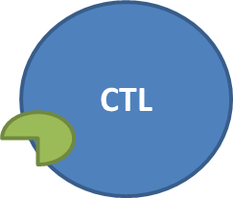

PD-1 Axis: Immune Checkpoint
APC
PD-1
Energized HIV-specific T-cell
PD1-L
Increase HIV CTL+
Identify latently infected cells=
Decrease reservoir
Increased CTL activity
Increased HIV expression
Trautmann et al. Nat Med 2006; Day et al. Nature 2006

Slide 28
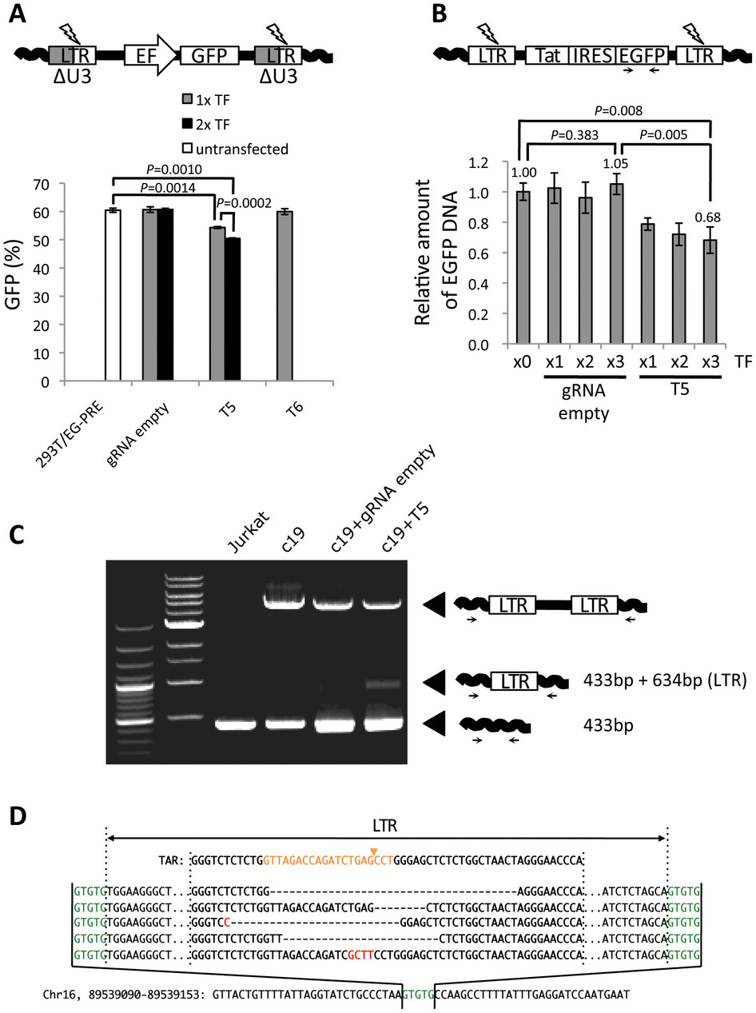
Cutting Out Latent HIV
Gene Editors
TALENs
Zinc Fingers
CRISPR CAS
Ribozymes
Antisense
Types
Zinc fingers
CRISPR CAS
TALENS
Issues
Off-target effects
Cellular delivery
Resistance
Ebina et al. Scientific Reports 3, doi:10.1038/srep02510 (2013)
Notes:
When LTR-targeting CRISPR/Cas9 components were transfected into HIV-1 LTR expression-dormant and -inducible T cells, a significant loss of LTR-driven expression was observed after stimulation. Sequence analysis confirmed that this CRISPR/Cas9 system efficiently cleaved and mutated LTR target sites.

Slide 29

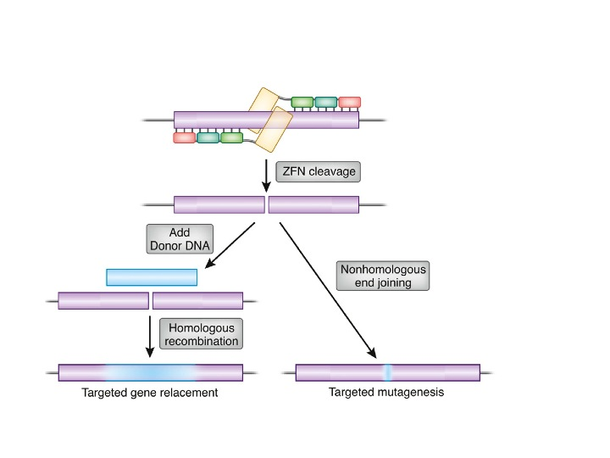
Making Cells Resistant to HIV
CD4
Zinc Finger Nucleases
CCR5
X
CCR5
CD4
Take out CCR5 gene
http://en.wikipedia.org/wiki/File:Repair_outcomes_of_a_genomic_double-strand_break_for_ZFN_cleavage.jpg

Slide 30
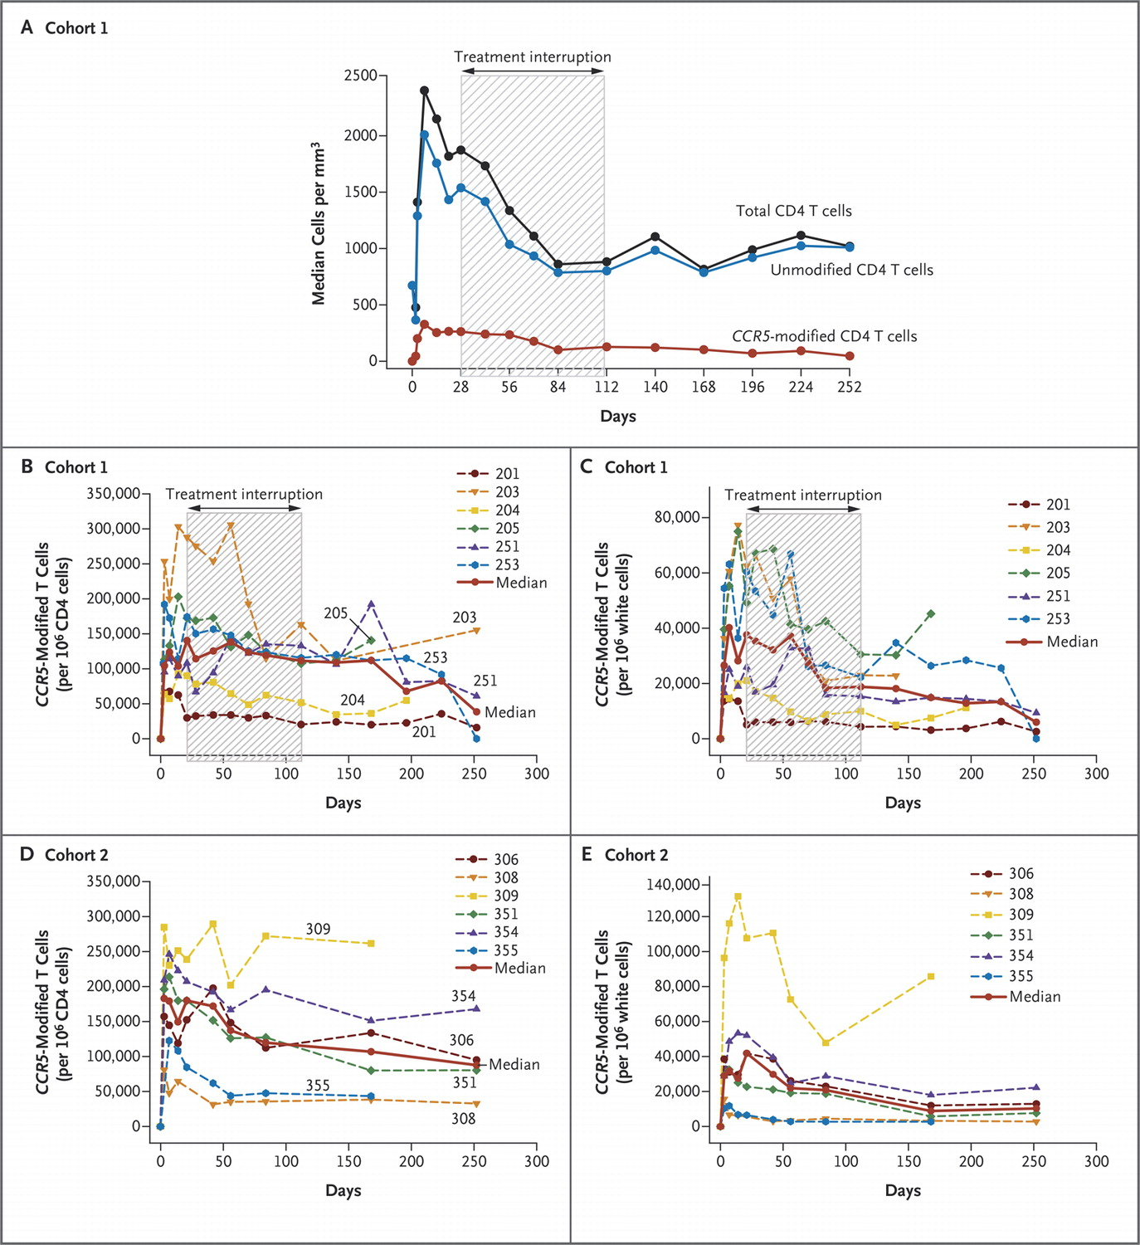
Tebas P et al. N Engl J Med 2014;370:901-910.
Adoptive Immunotherapy
CCR5-Modified CD4 T Cells During Treatment Interruption Did Not Decrease, Unlike Unmodified CD4 T Cells
Notes:
Figure 4. CCR5-Modified CD4 T Cells during Treatment Interruption. The median count for total CD4 T cells, unmodified CD4 T cells, and CCR5-modified CD4 T cells for all patients in cohort 1 is plotted in Panel A. CCR5-modified CD4 T cells in blood are shown as a fraction of CD4 cells (Panels B and D) and as a fraction of white cells (Panels C and E).

Slide 31
Which of these is likely an example of a functional HIV cure?
The Berlin Patient
The Mississippi Baby
The Boston Patients
The Visconti Cohort
1

Slide 32
Which of these is an example of a functional HIV cure strategy?
Therapeutic Vaccine
HDAC inhibitor therapy
PD-1 blockade
CRISPR HIV DNA modification
1

Slide 33
Which of these is an example of a “kick and kill” HIV cure strategy?
Therapeutic Vaccine
HDAC inhibitor therapy
CRISPR HIV DNA modification
CCR5 gene deletions
1

Slide 34
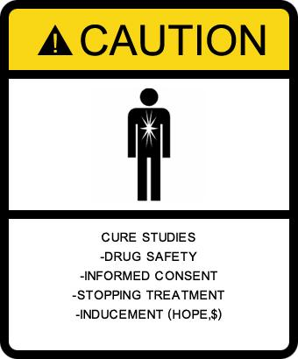
How long will we have to wait?

Slide 35

Thank you for you attention

