Slide 1
Investigational Drugs for HIV
Roy M. Gulick, MD, MPH
Rochelle Belfer Professor in Medicine
Chief, Division of Infectious Diseases
Weill Cornell Medicine
New York, New York
San Antonio, Texas: August 21-23, 2017

Slide 2
Learning Objectives
After attending this presentation, learners will be able to:
Discuss the latest data on investigational HIV drugs in existing classes (nRTI, NNRTI, II)
Learn about investigational HIV drugs in new classes (CD4 attachment inhibitors, maturation inhibitors, capsid inhibitors)

Slide 3
Antiretroviral Drug Approval:
1987 - 2017
ETR
DTG
TAF
RAL MVC
EVG
ENF
ATV
FTC
FPV
RPV
DRV
TPV
NFV
DLV
APV
TDF
RTV
IDV
NVP
LPV/r
EFV
ABC
3TC
SQV
ddC
d4T
AZT
ddI

Slide 4
Newer ART Agents (partial list)
 | NRTI | NNRTI | PI | Entry Inh | II | MI
Phase 3 |  | doravirine |  | albuvirtide fostemsavir ibalizumab PRO140 | bictegravir cabotegravir
Phase 2 | apricitabine dexelvucitabine festinavir | BILR 355 elsulfavirine |  | cenicriviroc PF-232798
Phase 1/2 | elvucitabine |  | TMC 310911 | HGS004 UB-421
Phase 1 | MK-8591 (EFdA) CMX157 | RDEA 806 | CTP-298 CTP-518 PPL-100 SPI-256 | BMS-986197 SCH532706 VIR-576 | BI 224436 INH-1001 | GSK-2838232

Slide 5
NRTI
Needs:
more convenient

Slide 6
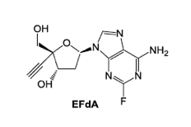
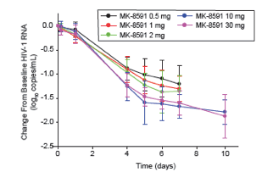
MK-8591 (EFdA)
4’-ethynyl-2-fluoro-2’-deoxyadenosine; EFdA
Non-obligate chain terminator
Inhibits RT by preventing translocation (NRTTI)
½ life 150-160 hours(!)
Potent antiviral activity (PBMC EC50 = 0.2 nM) with broad coverage (HIV-1, HIV-2, MDR strains)
Accumulates in LN, vagina, rectum (animals)
Grobler CROI 2017 #435
Low-dose and parenteral formulations
Phase 1b, single-dose, monotherapy study
Study population: ART naïve (N=30)
Matthews IAS 2017 #TUPDB0202LB

Slide 7
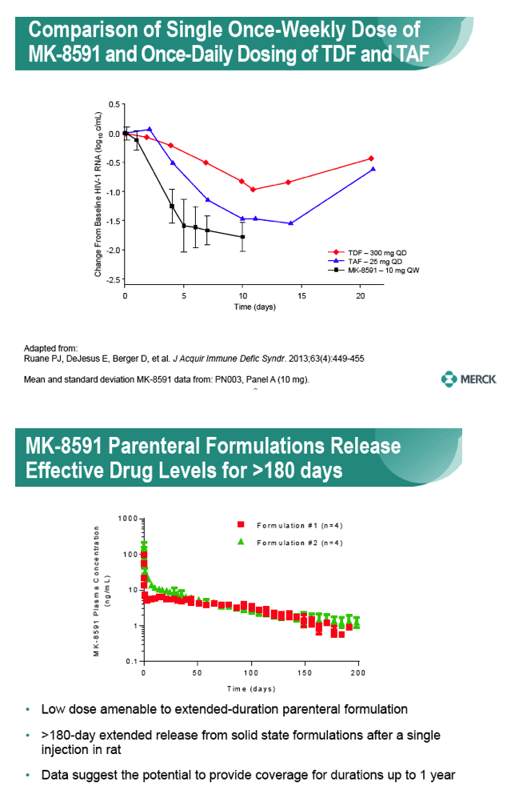
MK-8591 (EFdA)
Grobler CROI 2016 #98
Friedman CROI 2016 #437LB
Grobler CROI 2017 #435

Slide 8
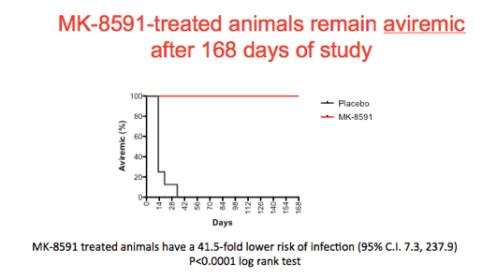
MK-8591 -- Prevention
MK-8591 (vs. placebo) given to male macaques weekly by oral gavage up to 14 weeks
6 days after dosing, macaques exposed to intrarectal SHIV (until infection or a total of 12 challenges)
Conclusion: Supports the potential for PrEP in humans
8 macaques in each group
Markowitz IAS 2017 #MOAX0203LB

Slide 9
NNRTI
Needs:
Less toxicity and better tolerability
Active against NNRTI-resistant viruses
Fewer drug interactions

Slide 10
Doravirine (DOR; MK-1439)
Investigational NNRTI
Pre-clinical
  Potent at low milligram dose
  Metabolized by CYP3A4; not a CYP450 inhibitor or inducer
  Active in vitro against viral strains with:
    K103N
    Y181C
    G190A
    E101K
    E138K
    K103N/Y181C
Phase 1 Schurmann AIDS 2016;30:57-63
Phase 2 (vs. EFV) Gatell JIAS 2016;17:19532
Lai AAC 2014;58:1652-1663

Slide 11
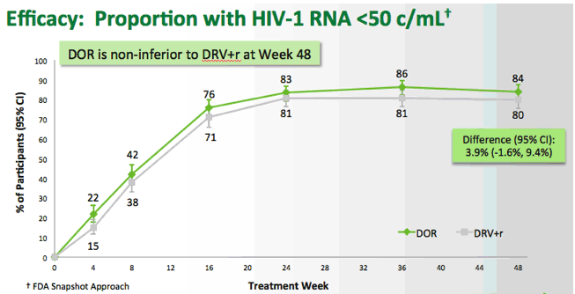
Doravirine (DOR) – Phase 3: DRIVE-FORWARD
Phase 3, multicenter, double-blind, placebo-controlled randomized study
Study population: Rx-naïve, VL >1000, no GT resistance to study drugs (N=769)
Study treatment: 2 NRTIs + [DOR 100 mg vs. DRV 800 mg/RTV 100 mg]
Protocol-defined virologic failure: DOR 19 (5%) vs. DRV/r 24 (6%) → NO drug resistance Discontinued due to AE: DOR 2% vs. DRV/r 3%
Lipids ↓ with DOR (chol -1, triglyc -3 mg/dL) and ↑ with DRV/r (chol +18, triglyc +22)
Molina CROI 2017 #45LB

Slide 12
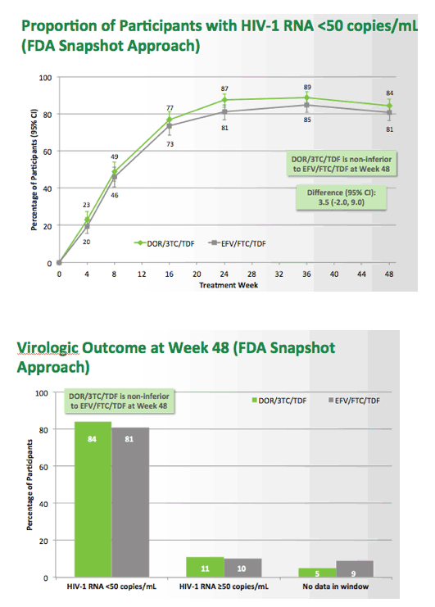
Doravirine (DOR) – Phase 3: DRIVE-AHEAD
Phase 3, multicenter, double-blind, placebo-controlled randomized non-inf study
Study population: Rx-naïve, VL >1000, no GT resistance to study drugs (N=728)
Study treatment: TDF/FTC/DOR 100 mg vs. TDF/FTC/EFV
Protocol-defined virologic failure: DOR 22 (6%) vs. EFV 14 (4%)
Drug resistance: DOR (2%) vs. EFV (3%)
Discontinued due to reasons other than VF: DOR 10% vs. EFV 14%
Dizziness: DOR 9% vs. EFV 37%; Sleep disorders DOR 12% vs. EFV 26%
Squires IAS 2017 #TUAB0104LB

Slide 13
INSTI
Needs:
Active against INSTI-resistant virus
More convenient

Slide 14
Bictegravir (BIC)
In vitro EC50 0.75 nM against wt clinical isolates of HIV-1 and -2
T_{1/2} 18 hours (once-daily); no PK boosting required
No inhibition or induction of CYP3A4 or UGT -- low potential for drug interactions
Phase 1 Gallant JAIDS 2017;75:61-66
Phase 2 (vs. DTG) Sax Lancet HIV 2017;4:e154-e160
Tsiang Antimicrob Agents Chemo 2016;60:7086-7097
Zhang/Custodio CROI 2017 #40

Slide 15
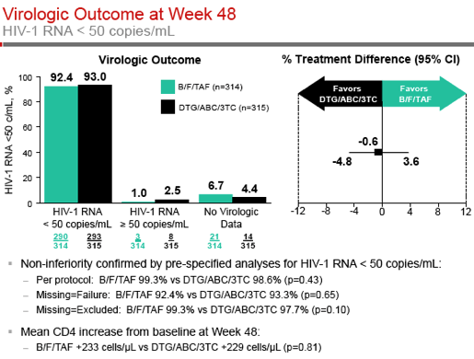
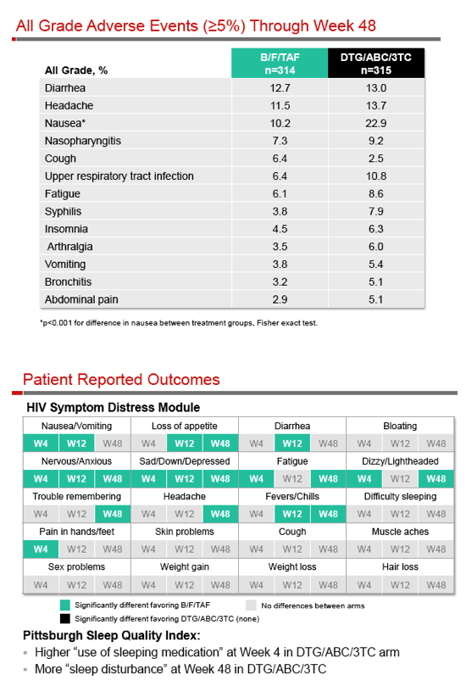
Bictegravir (BIC): Phase 3
Phase 3, double-blind, active-controlled study
Study population: Rx-naïve, VL >500, GFR >50, HLA-B*5701 neg (N=645)
Study treatment: TAF/FTC/BIC vs. ABC/3TC/DTG
Results:
Gallant IAS 2017 #MOAB0105LB

Slide 16
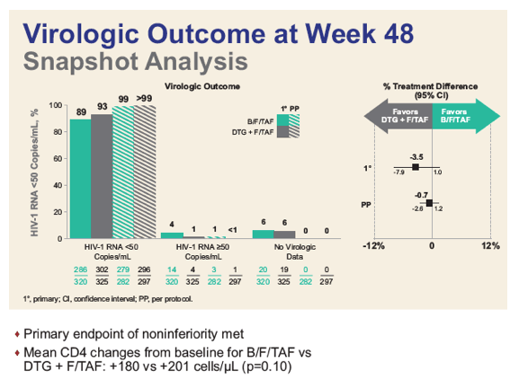
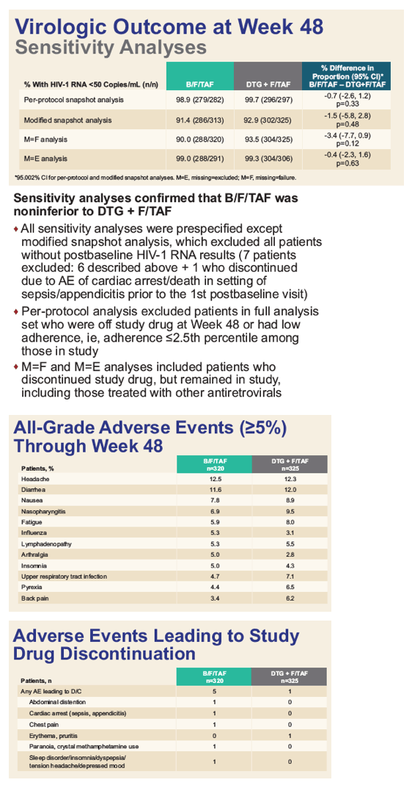
Bictegravir (BIC): Phase 3
Phase 3, double-blind, active-controlled study
Study population: Rx-naïve, VL >500, GFR >30 (N=645)
Study treatment: TAF/FTC/BIC vs. TAF/FTC+DTG
Results:
Sax IAS 2017 # TUPDB0201LB

Slide 17
Cabotegravir (CAB)
    Integrase inhibitor similar to DTG; similar resistance
    Potent in HIV+ individuals (5, 10, 30, 60 mg oral) Margolis EACS 2013; Spreen HIV Clin Trials 2013;14:192
    Nanotechnology formulation; SC + IM injections
    T ½ 21-50 days!
    Supports monthly, bimonthly or quarterly dosing
    Safety: ISR (mostly mild) and nodules with SC dosing
Spreen JAIDS 2014;67:481

Slide 18
LATTE-2: IM CAB + RPV 96 weeks
Randomized, open-label, phase 2b, non-inferiority study
Study pop: ART-naïve (N=309)
Study rx: PO CAB + ABC/3TC X 4 wks, then randomized 2:2:1
Results:
96 wks
Conclusions: IM non-inferior (comparable) to PO; well-tolerated
Phase 3 studies evaluating IM q4 wks
IM CAB + RPV q8 wks – 94%
IM CAB + RPV q8 wks – 87%
PO CAB + ABC/3TC – 84%
ISR
nearly universal
97%+ were mild or moderate
lasted a median of 3 days
2 pts (<1%) d/c due to ISR
Eron IAS 2017 #MOAX0205LB
Margolis Lancet 2017 (epub 7/24/17)

Slide 19
Cabotegravir (CAB) – Prevention: HPTN 077
Phase 2a randomized, double-blind, pbo-controlled
Study pop: low-risk HIV- participants (N=199); median age 31, 66% women, 34% men
Study meds: 3:1 to oral CAB X 4 wks then CAB IM 800 mg q12 weeks or 600 mg q8 wks (or PBO)
Results:
  ISR more common with CAB (34%) vs. PBO (2%); 1.5% d/c’ed
  No other differences in safety/tolerability
  drug troughs lower with CAB 800 q12 wks
Conclusion: CAB 4 wk oral → 600 mg IM q8wks optimal
Landovitz IAS 2017 #TUAC0106LB

Slide 20
HPTN 083: PrEP with TDF/FTC oral vs. CAB IM
Slide 22 of 31
Study population: Adult MSM and TGW, at high-risk for HIV acquisition (N=4500)
    High risk
      any non-condom receptive anal intercourse (RAI)
      >5 partners
      stimulant drug use
      rectal or urethral STI in past 6 months
Study regimen: TDF/FTC daily oral vs. CAB q2 month injections
  double-blind, double-dummy design
Design: non-inferiority, efficacy study
Now enrolling!

Slide 21
Entry Inhibitors
Needs:
Novel mechanism of action
More convenient dosing

Slide 22
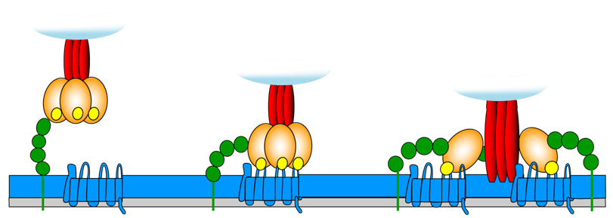
HIV Entry Inhibitors
CD4
Binding
Coreceptor
Binding
Virus-Cell
Fusion
CCR5 Inhibitors
maraviroc*
fostemsavir
enfuvirtide*
gp41
ibalizumab
gp120
V3 loop
CD4
Cell
Membrane
CCR5/CXCR4
(R5/X4)
* = FDA approved
Adapted from Moore JP, PNAS 2003;100:10598-10602.
Notes:
HIV Entry can be divided into 3 discrete steps: attachment of the viral glycoprotein 120 to the CD4 receptor, followed by subtle conformational changes in gp 120 which expose structural elements on the V3 loop that bind to co- receptor, either CCR5 or CXCR4. This induces a structural rearrangement in gp41 which inserts a hydrophobic fusion peptide region into the target cell membrane which brings the virus and cell membrane in close apposition to initiate fusion and ultimately entry of the virus into the target cell.
HIV Entry Inhibitors can be thought of as 3 distict subclasses, each tageting one of the 3 previous steps. I wanted to highlight those small molecules that are furthest along in development. BMS has a series of attachment inhibitors which prevents gp120 from binding to CD4. 806 was presented last year but the follow-on 043 has improved in vitro activity and a longer half-life. Monotherapy data were presented at CROI. 800 mg and 1800 mg twice daily gave a mean VL reduction of 0.7 and 1 log at Day 8, respectively. The 3 CCR5 antagonists that are furthest along include UK-427, SCH-D and the GW-140. SCH-C had been in Phase 2 but was shelved due to QTc issues. SCH-D is now in Phase 2. Monotherapy data were presented at retrovirus as well, demonstrating a 1-1.5 log reduction at 14 days from doses which ranged from 10-50 mg twice daily and a Phase 2b study in TE patients is being conducted by ACTG. The GSK compound licensed from ONO is reportedly also in Phase 2 of development.
GSK - compound was also presented at CROI. SD and MD data were presented and the drug was given BID. Food increased absorption. Dose limiting toxicity was GI intolerance and there was no QTc prolongation.
Finally, enfuvirtide which is a twice daily injectable fusion inhibitor from Roche was approved last year. Its follow-on, T-1249 was discontinued due to issues of production and cost.

Slide 23
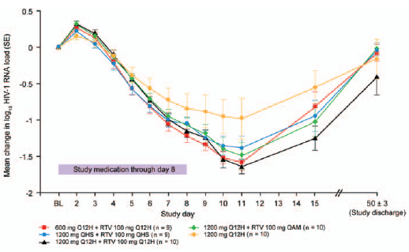
Fostemsavir: Oral HIV Attachment Inhibitor
Prodrug of temsavir
Inhibits CD4 binding by binding to gp120
PK suggest QD (or BID) dosing without boosting
Phase 1 dose-escalation Nettles JID 2012;206:1002
  Up to 1.5 log cps/ml ↓
  ↓ baseline susceptibility in 12% of pts due to envelope polymorphisms
Drug interactions
  none with OCP Magee IAS 2017 #MOPEB0339
  no sign. drug interactions with methadone, buprenorphine Sevinsky IAS 2017 #MOPEB0338

Slide 24
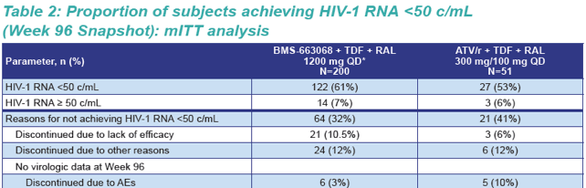
Fostemsavir: Phase 2b Efficacy
Phase 2b, randomized, controlled, partially blinded (to dose)
Study pop: Rx-experienced (>1 wk on >1 ART); IC₅₀ <100 nM for fostemsavir (N=254)
Study rx: RAL + TDF + [fostemsavir 4 doses or ATV/r]
Week 48 VL <50: MITT: 61-82% (fostemsavir) vs. 71% (ATV/r)
Week 96:
FDA “Breakthrough Status” 7/15
Phase 3 in rx-experienced enrolled
DeJesus CROI 2016 #472
Thompson Antivir Ther 2017;22:215-223

Slide 25
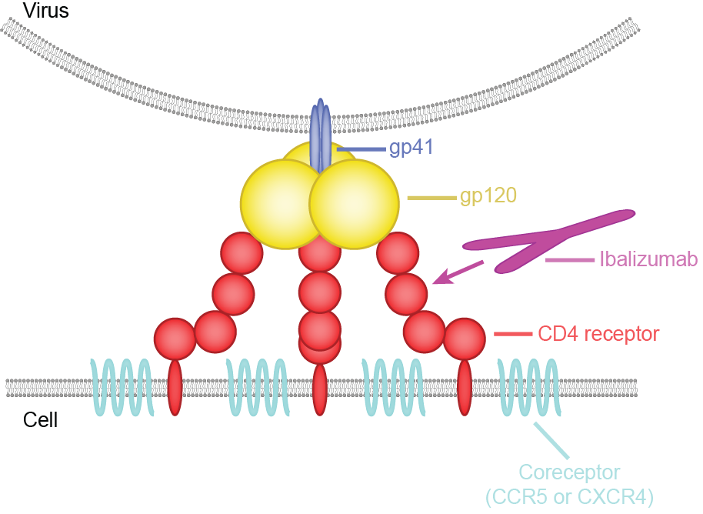
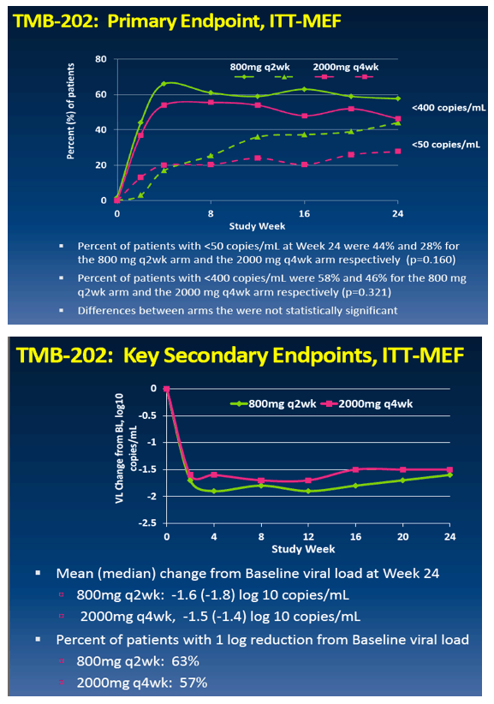
Ibalizumab (IBA): HIV Entry Inhibitor
Monoclonal antibody; IV, SC
Binds to CD4 receptor
Dosing every 1-4 weeks
Phase 1a Kuritzkes JID 2004;189:286
Phase 1b Jacobson AAC 2009;53:450
Phase 2a Norris IAS 2006 #TuPE0058
Phase 2b Khanlou IDSA 2011 #LB9
  baseline susceptibility to IBA not different for those with drug resistance to NRTIs, NNRTIs, PIs, IIs, ENF or MVC
  Weinheimer IAS 2017 #MOPEB0352
Rx-experienced; 3-class resistance; (N=113)

Slide 26
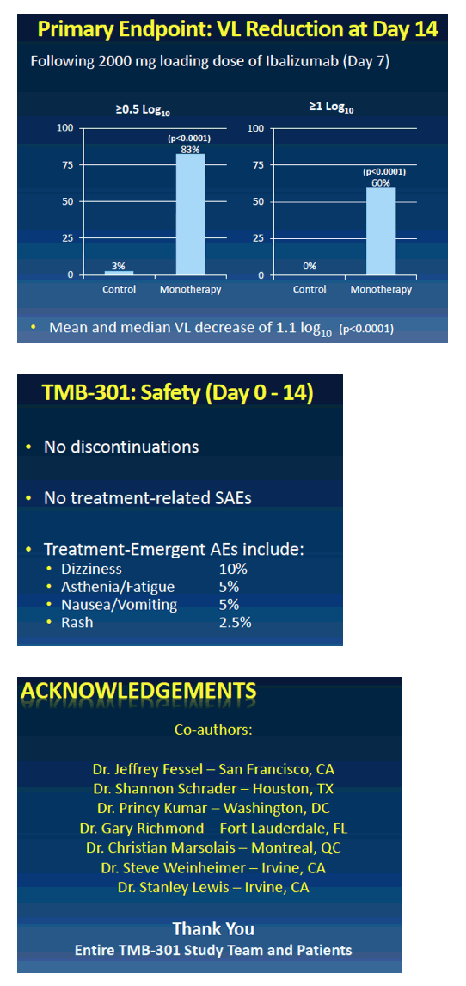
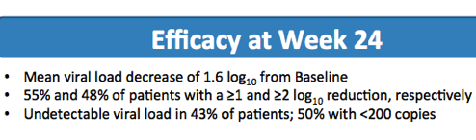
Ibalizumab (IBA): HIV Entry Inhibitor
Phase 3
  Study population: VL>1000, on ART >6 months, 3-class resistance, >1 sensitive drug (N=40)
  Study treatment: continue ART, +IBA 800 mg day 7, +OBR day 14, +IBA day 21 and q 2 wks →24 wks
FDA: orphan drug; breakthrough designation
Lalezari IDWeek 2016 #LB6
Lewis CROI 2017 #449LB

Slide 27
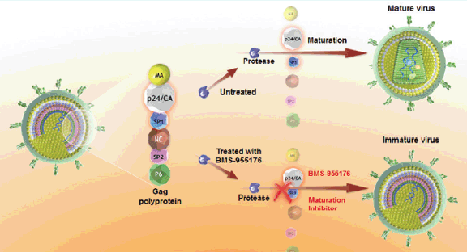
HIV Maturation Inhibitors (MI)
Mature virus
Maturation
Protease
Untreated
Treated with
Maturation inhibitor
Immature virus
Gag
polyprotein
Protease
Maturation
Inhibitor

Slide 28
Capsid Inhibitor
Tse et al CROI 2017 Abstract 38
Target Cell
Producer
Cell
Reverse
Transcription
Gag
Capsid Core
Disassembly
Nucleus
Gag-Pol
Maturation
Pre-integration
complex
Nuclear
Translocation
Integration
Nucleus
Capsid Core
Assembly
GS-CA1
EC₅₀ 140 picomolar in PBMC, Active across all tested subtypes, resistant variants, low fitness
Very long ½ life in RAT model – 9x above paEC₉₅ 10 weeks after single injection

Slide 29




Acknowledgments
Slide 31 of 31
Cornell HIV Clinical Trials Unit (CCTU)
Division of Infectious Diseases
Weill Cornell Medicine
AIDS Clinical Trials Group (ACTG)
HIV Prevention Trials Network (HPTN)
Division of AIDS, NIAID, NIH
The patient volunteers!

Slide 30
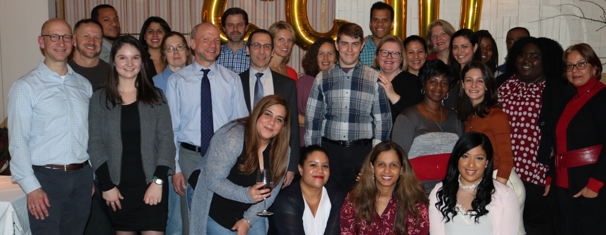
Cornell HIV Clinical Trials Unit
Director: Marshall Glesby, MD Co-Director: Tim Wilkin, MD
Investigators: Leah Burke, MD, Kristie Marks, MD, Mary Vogler, MD
Study Coordinators: Kirsis Ham, NP, Valery Hughes, NP, Todd Stroberg, RN, Louise Walshe, RN
Program Director: Glenn Sturge
Multiple Staff Members!

