Slide 1
New and Noteworthy in Tuberculosis Diagnostics and Treatment
Susan Swindells, MBBS
Professor of Internal Medicine
University of Nebraska Medical Center
Omaha, Nebraska
San Antonio, Texas: August 21 to 23, 2017

Slide 2
Learning Objectives
After attending this presentation, learners will be able to:
Describe the diagnosis and treatment of latent tuberculosis infection
Identify new developments in diagnostics for TB disease
Apply in practice the current guidelines for HIV/TB co-treatment

Slide 3
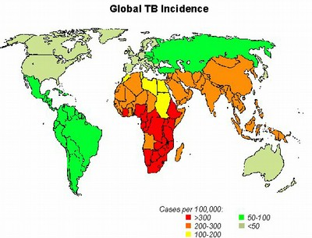
TB is a Major Global Health Problem
23% world population
Infected with TB¹
In 2015:²
10 m new cases
1.2 m had HIV
1.4 m deaths
0.4 m with HIV
> 1000/day
1. Houben PlosMed 2016; 2. WHO report

Slide 4
Case #1
A 34-year-old man establishes care in your clinic
Born in Mexico, he emigrated to the US 6 years ago
HIV diagnosed 6 months ago during admission for community acquired pneumonia
HIV now well controlled on TAF/FTC/elvitegravir/cobi/ (Genvoya)
Last CD4 120, VL < 40
You test him for latent TB with an IGRA (in this case, quantiFERON), result is “indeterminate”

Slide 5
Recommendations for LTBI testing in HIV
Risk of progression to TB disease 10x greater in HIV+
CDC recommends testing after HIV diagnosis and then annually if negative or if exposure risk
If pre-ART negative, repeat after ART initiation
No direct test for LTBI, can use TST or IGRA
Neither test predicts risk of progression to active TB
No benefit to repeating either test once positive
LTBI testing should not be used to diagnose active TB
http://www.cdc.gov/tb/publications/ltbi/diagnosis.htm

Slide 6
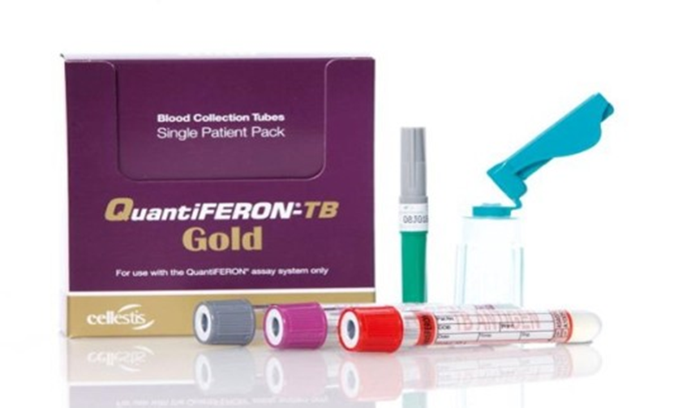
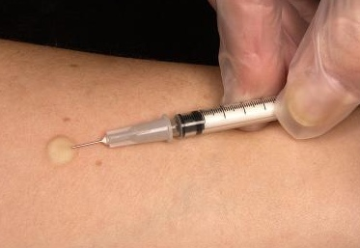
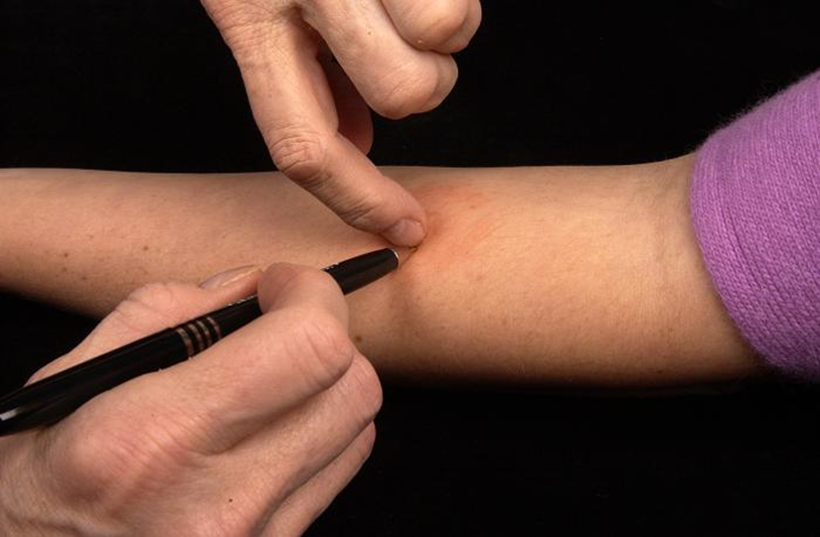
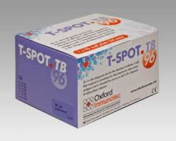
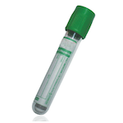
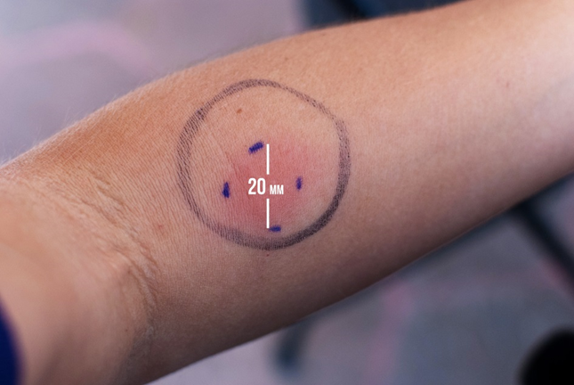
TB Skin Test
Induces DTH response if pt infected
Interferon –Gamma release Assay
Measures immune response to TB in whole blood
2 to 7 days later
≥ 5 mm positive
in HIV+ pts

Slide 7
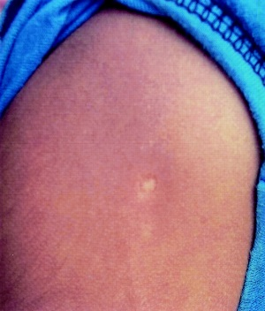
TST/IGRA Comparison
Both tests ~65-70% sensitive in HIV+
TST
IGRA
Requires 2 visits
Interpretation same if pt had BCG vaccine
Result will be negative or positive in mm induration
Requires training to administer and interpret
Testing for anergy not recommended
Cheaper than IGRA
Single visit
Unaffected by BCG
Result can be positive, negative or indeterminate
Indeterminate more common with immunosuppression (CD4 <200)
Blood must be processed in 8-30 h
Limited data in small children, recent TB exposure

Slide 8
Case #1 continued
After 6 months treatment with TAF/FTC/elvitegravir/cobi, CD4 count is 300
Repeat IGRA is positive
Patient has no signs or symptoms of active TB and has a normal chest x-ray

Slide 9
CDC Recommendations for LTBI Treatment in HIV-infected Patients
INH daily or twice weekly for 9 months
INH + rifapentine weekly for 12 weeks
Rifampin (or rifabutin) daily for 4 months
Monitor patients monthly for hepatitis and other side effects
http://www.cdc.gov/tb/topic/treatment/ltbi.htm

Slide 10

Beware Drug-Drug Interactions

Slide 11
RIFAMPIN: A potent inducer of metabolizing enzymes
This complicates co-treatment of TB and other diseases tremendously
Slide 11 of 36
RIF
PXR
RIF
PXR
RXR
RXR
Cytoplasm
CYP3A4
proximal
promoter
CYP 3A4
XRE
Phase II
enzyme
regulatory genes
PGP
regulatory
gene
MDR1 protein
regulatory
gene
DNA
mRNA
Nucleus
Dooley et al. (2008) JID 198: 948.

Slide 12
LTBI/HIV Treatment Considerations
Any ART regimen can be used when isoniazid alone is used for LTBI treatment
Only efavirenz or raltegravir based regimens can be used with once-weekly isoniazid plus rifapentine
  NOTE: TAF contraindicated
Check carefully for DDI with rifamycins
  Can use EFV or double dose DTG with rifampin
  Can use PI with rifabutin at 150 mg daily or 300 mg 3 times a week
https://aidsinfo.nih.gov/contentfiles/lvguidelines/adultandadolescentgl.pdf
http://www.hiv-druginteractions.org/
Both have free apps

Slide 13
Efficacy of IPT in HIV+ Adults: Risk of TB
Slide 13 of 36
11 randomized trials with 8,130 HIV+ participants → overall reduction in TB = 36%, reduction PPD+ = 62%
Woldehanna and Volmink, Cochrane Review 2006

Slide 14
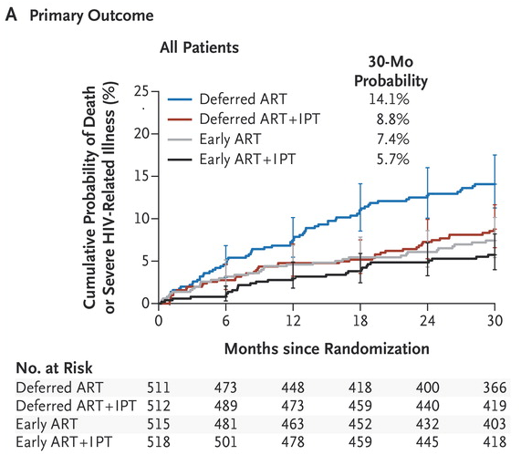
Early ART Prevents TB:
The Temprano Trial
Slide 14 of 39
2056 patients with CD4 <800 randomized to immediate or deferred ART +/- IPT
42% endpoints = TB
ART and IPT decreased risk of TB independently
NEJM 2015

Slide 15
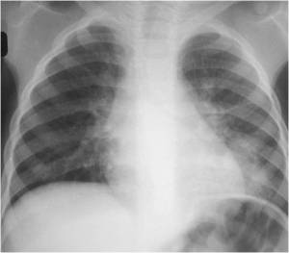
Case #2
54-year-old woman is admitted to your hospital with cough, fever, and weight loss
Diagnosed with HIV on admission, CD4+ 70, HIV RNA 120K
CXR shows pleural thickening and diffuse infiltrate
Sputum AFB smear negative, bronch negative for PCP

Slide 16
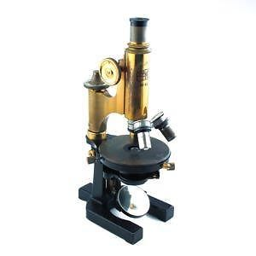
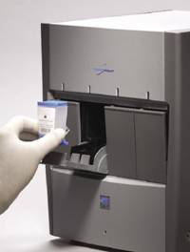
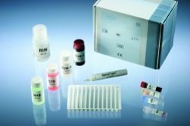
How To Diagnose or Exclude TB:
Novel Diagnostics Now Available
Xpert MTB/RIF: 2 hour molecular test for M.TB diagnosis and rifampin resistance (1)
  More sensitive than AFB smear
  Works in children and extrapulmonary TB
  Screen for MDR and XDRTB
  Xpert Ultra in development (2)
Genotype MTBDR plus
Diagnosis in 5
hours
Identifies RIF and
INH resistance
TB Diagnostic for 2 Centuries
1. Lawn, Lancet ID, 2013 ;2. Alland, CROI 2015

Slide 17
Slide 17 of 36
TB Detection: Sensitivity
TB Detection: Sensitiv
N=992, 45% HIV+, median CD4 151
CID 2016:62 (1 May)
 | Sensitivity (95% CI) | Xpert +/ TB culture +
Overall | 85.8% (78.0, 91.2%) | 91/106
AFB+/TB culture + | 100% ( 94.6, 100%) | 67/67
AFB-/TB culture + | 61.5% (45.9, 75.1%) | 24/39

Slide 18
TB Detection: Specificity
Slide 18 of 36
 | Specificity (95% CI) | Xpert -/ TB culture -
Overall | 98.9% (97.6, 99.4%) | 591/598
AFB+/TB culture + | 100% (51.0, 100 %) | 4/4
AFB-/TB culture + | 98.8% (97.6, 99.4%) | 587/594
US only | 99.3% (98.0%, 99.8%) | 441/444
AFB+/TB culture + | 100% (51%, 100%) | 4/4
AFB-/TB culture + | 99.3% (98.0%, 99.8%) | 437/440
Xpert now FDA approved for use in TB infection control
  Can take pt out of isolation after 1 or 2 negative tests
    http://www.fda.gov/NewsEvents/Newsroom/PressAnnouncements/ucm434226.htm

Slide 19
Case #2 Continued
Your pt is diagnosed with TB by Xpert MTB/RIF with culture pending
Started on treatment for TB with isoniazid, rifampin, ethambutol and pyrazinamide
When should you start ART?

Slide 20

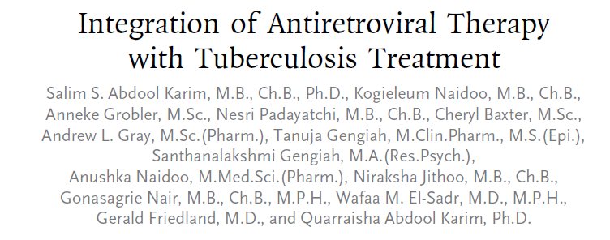
Treatment strategy of immediate TB therapy + early ART (2 vs 8 weeks) saves lives and reduces HIV complications
CAMELIA (Cambodia)
SAPIT (South Africa)
STRIDE (multicontinent)
Notes:
For a long time we had a lot of quesiton about the timing. We know the asnwer now. We have treatment strategy-- CAMELIA 40% reduction in deaths 2 vs 8 weeks. These studies showed that starting ART in patients with TB is NOT harmful and therefore ART should never be delayed in persons with pulmonary TB for fear of jeopardizing HIV or TB treatment outcome

Slide 21
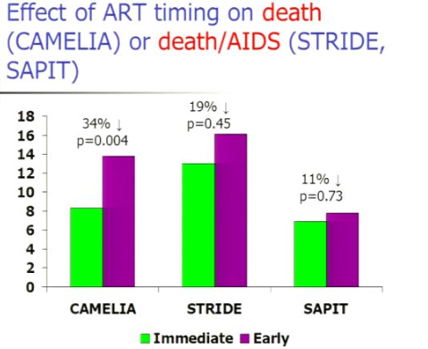
Early ART improves survival, no increased risk of AE but some increase in IRIS

Slide 22
Current Guidelines
WHO, ATS and DHHS guidelines all recommend:
Initiation of ART within 2 weeks for CD4 count <50
Initiation of ART within 8 weeks for CD4 >50
  Exception for TB meningitis where increased AE and death reported with early ART in a randomized trial [Torok CID 2011]

Slide 23
HIV/TB co-treatment options for adults
Slide 23 of 36
ARV* |  | Rifamycin |  | Dose adjustments |  | Other Issues
Preferred
Efavirenz | Rifampin |  | None |  | Watch for CNS toxicity
Lopinavir/ Ritonavir (Darunavir/r) | Rifabutin |  | Rifabutin 150 mg once daily |  | Monitor for uveitis; Must coordinate care
Alternative
Raltegravir | Rifampin |  | Raltegravir 400 or 800 mg twice daily |  | Limited clinical experience
Dolutegravir | Rifampin |  | Dolutegravir 50 mg twice daily |  | Awaiting results of trial in co-infected patients
Nevirapine | Rifampin |  | Avoid NVP lead-in |  | Hepatotoxicity
*All listed antiretroviral drugs should be given together with two NRTI
but not with TAF

Slide 24
Do Not Use Rifamycins With TAF
Slide 24 of 36
TDF has been studied with RIF without significant interaction¹
TAF contraindicated with rifamycins in all package inserts
Based on modeling data with carbamazepine
  Carbamazepine reduced TAF exposure 55%
TAF more influenced by P-Glycoprotein induction than TDF
  (P-GP = protein that pumps foreign substances out of cells)
¹Droste JAH, et al. Antimicrob Agents Chemother 2005

Slide 25
Why Not Just Use Rifabutin?
Cochrane review: “insufficient data to be assured of the effectiveness of rifabutin in TB treatment”¹
  Clinical trials comparing RBT to RIF were largely conducted among patients not on ART
Correct dose uncertain
  Most PK studies done in healthy volunteers; some data to suggest 300 mg tiw insufficient in HIV+ pts
Risk of uveitis
Expensive
No pediatric formulation
¹Davies GR, Cerri S, Richeldi L. Rifabutin for treating pulmonary tuberculosis (Review). In: The Cochrane Library, John Wiley & Sons, Ltd., 2010

Slide 26

Use of EFAVIRENZ with TB treatment
Slide 26 of 36
Food and Drug Administration - January 6, 2012
“If Sustiva is coadministered with rifampin to patients weighing 50 kg or more, an increase in the dose of Sustiva to 800 mg once daily is recommended.”

Slide 27
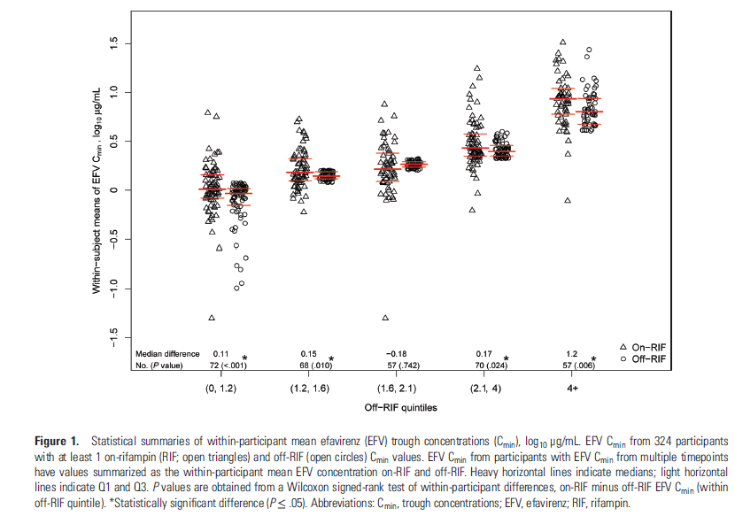
What is the right dose of EFAVIRENZ with TB treatment?
(do we need a dose adjustment?)
Slide 27 of 36
ACTG Trial A5221
EFV PK Substudy, N= 543
EFV with RIF
RIF PK | TB-Rx | No TB-Rx
C_{min} (ng/mL)* | 1.96 (1.24-3.79) | 1.80 (1.26-2.63)
EFV alone
*Median (IQR)
Luetkemeyer et al. Clinical Infectious Diseases (2013) 57: 586.

Slide 28
Case #3 continued
Slide 28 of 36
Your patient with TB starts ART after weeks
10 days later, she has recurrent fever
Worsening dyspnea and cough
A CXR shows progression of the pulmonary infiltrates
You suspect Immune Reconstitution Inflammatory Syndrome (IRIS)

Slide 29
Immune Reconstitution Disease
Slide 29 of 36
More common with early ART
More common with low CD4 count
Rarely severe or fatal
Management:
  Make certain of diagnosis
  Rule out MDR TB or new OI
  Surgical drainage
  Non-steroidal anti-inflammatory drugs
    Quality of evidence low
  Prednisone
    1.5 mg/kg per day for 2 weeks then 0.75 mg/kg per day for 2 weeks reduces risk of adverse events (Meintjes, AIDS 2010)

Slide 30
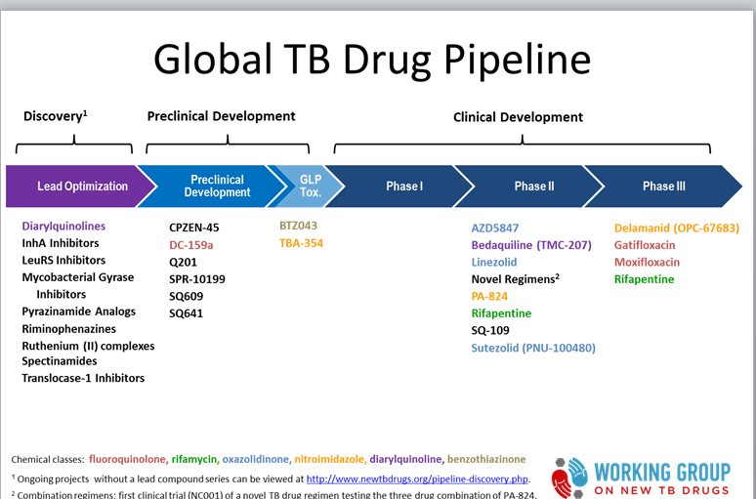
Summary: Barriers to Overcome
No “viral load” test for TB
Treatment shortening not successful so far
Better treatment for children needed
Some TB agents in development interact with ART and some are stalled

Slide 31
Conclusions
TB can be prevented by treating HIV and/or by treating LTBI
Major improvements in TB diagnostics
Not enough new drugs
TB and HIV should be treated concurrently
Drug-drug interactions complicate HIV co-treatment, but
Safe and effective regimens for TB and HIV co-treatment are available
We need more research investment and advocacy

