Slide 1
Management of Sexually Transmitted Infections Among Youth
          The webinar will begin at
          1:00 pm (ET); 12:00 pm (CT); 11:00 am (MT); 10:00 am (PT)
  Listen to this webinar through your computer speakers.
    To test your audio, go to www.youtube.com/watch?v=pNhZBh4dHP0&list=PLF976F0FBA7D0C1E8&index=4
    Still having trouble? Email webinar@iasusa.org
  Having completed the Webinar Check-in form, you no longer need to type your full name and institution in the chat box to ensure that your evaluation form will be activated in your IAS–USA account under “My Activities.” However, you must be preregistered to be eligible to claim credits or a certificate.
Slide 1 of 85

Slide 2
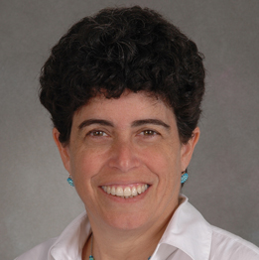
Management of Sexually Transmitted Infections Among Youth
Sharon Nachman, MD
Professor of Pediatrics
Associate Dean for Research
SUNY Stony Brook
Stony Brook, New York
Slide 2 of 85

Slide 3
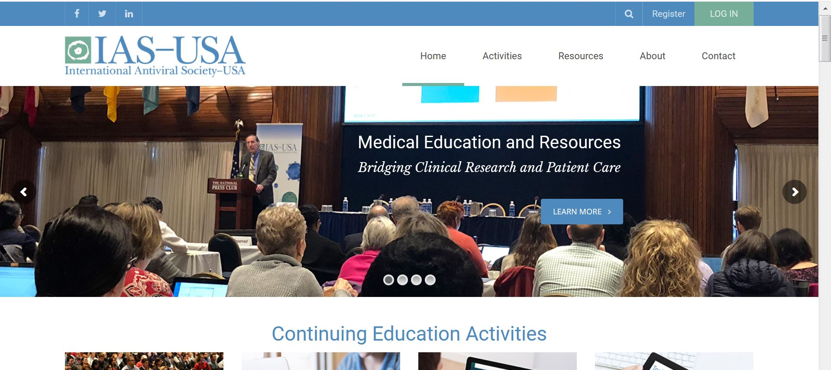
Updating Your Account
Go to www.iasusa.org and log in to your IAS–USA account. If you have not previously logged in on the new website, you will need to use your email address and reset your password.
For more information, visit https://www.iasusa.org/about/faqs/.
Notes:
Please read from the slide

Slide 4

CME Information
The International Antiviral Society–USA
(IAS–USA) is accredited by the Accreditation
Council for Continuing Medical Education
(ACCME) to provide continuing medical education
for physicians.
The IAS–USA designates this live activity for a maximum of 1.25 AMA PRA Category 1 Credits™. Physicians should claim only the credit commensurate with the extent of their participation in the activity.
Notes:
Please read from the slide

Slide 5

Nursing and Pharmacy Credits
Nursing Credits
Educational Review Systems is an approved approver of continuing nursing education by the Alabama State Nursing Association, an accredited approver by the American Nurses Credentialing Center’s Commission on Accreditation. Provider # 5-115. This program is approved for 1.25 hours of continuing nursing education.
Educational Review Systems is also approved for nursing continuing education by the state of California, the state of Florida and the District of Columbia.
This program is approved for 1.25 hours of pharmacotherapy credit.
Pharmacy Credits
Educational Review Systems is accredited by the Accreditation Council for Pharmacy Education (ACPE) as a provider of continuing pharmacy education. This program is approved for 1.25 hours (0.125 CEUs) of continuing pharmacy education credit. Proof of participation will be posted to your NABP CPE profile within 4 to 6 weeks to participants who have successfully completed the post-test. Participants must participate in the entire presentation and complete the course evaluation to receive continuing pharmacy education credit.
UAN # 0761-9999-19-249-L01-P
Notes:
Please read from the slide

Slide 6

Evaluations will be available in your IAS-USA “My Activities” page by 5 pm PT today. See the IAS–USA website for instructions on claiming CME, pharmacy, nursing, or pharmacotherapy credits, or a certificate of participation.
Not Receiving Our Emails?
Check the FAQ section on the IAS–USA website for more information

Slide 7
Grant Support for this Webinar
This activity is part of the IAS–USA national educational effort that is funded, in part, by contributions from commercial companies. Per IAS–USA policy, any effort that uses commercial grants must receive grants from several companies with competing products. Funds are pooled and distributed to activities at the sole discretion of the IAS–USA. Grantors have no input into any activity, including its content, development, or selection of topics or speakers. Generous support for this activity has been received from the following contributors:
Platinum Supporters
Gilead Sciences, Inc
ViiV Healthcare
Gold Supporter
Merck & Co, Inc
Silver Supporter
Cepheid Inc
Additional support provided by Hologic
We appreciate the funders supporting this activity and those observing this activity today. Per ACCME guidelines, funder observers may not participate in discussions or ask questions during the webinar. Thank you.

Slide 8


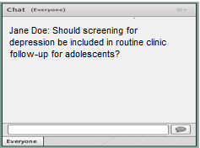
Navigating the Webinar
Poll questions
        A separate window will show the poll questions.
        Choose your response from the POLL, not in the CHAT box.
        Responses will be displayed after the poll closes.
  To ask questions, type into the chat box; questions will be answered at the end of the webinar.
Notes:
Throughout the webinar we will be asking polling questions. A separate window with the question will display at the center of your screen. Then you can choose your response. The totals will display after you vote.
We want this to be an interactive webinar. If you have any questions or comments during the presentations please type them into the Adobe Connect chat box located on the bottom right of your screen and hit the submit button. We will attempt to address as many questions and possible during the scheduled Q & A periods.
Let’s try a few polling questions.

Slide 9
Poll 1
From which geographic region are you viewing this webinar?
A. Western United States
B. Midwest United States
C. Southwest United States
D. Southeast United States
E. Northeast United States
F. Canada
G. Mexico
H. Central/South America
I. Europe
J. Asia/Australia
K. Africa
L. Other

Slide 10
Poll 2
When will the evaluation for this webinar, which you must complete in order to claim CME or other credit, be available on the My Activities page in your IAS-USA account?
Immediately after the webinar ends
By 5 pm PT today
When the moon hits your eye like a big pizza pie

Slide 11
Poll 3
Please rate your level of experience in the medical management of STIs. (1 = Novice, 5 = Expert)
1
2
3
4
5
Novice
Expert

Slide 12
Management of Sexually Transmitted Infections Among Youth
Sharon Nachman, MD
Professor of Pediatrics
Associate Dean for Research
SUNY Stony Brook
Stony Brook, New York
Slide 12 of 85

Slide 13
Financial Relationships With Commercial Entities
Dr Nachman has no relevant financial affiliations to disclose. (Updated 10/29/19)
Reviewer:
Dr Carlos del Rio has no relevant financial affiliations to disclose. (Updated 10/24/19)
CME Planner and Reviewer:
Ms Donna M. Jacobsen has no relevant financial affiliations to disclose. (Updated 10/29/19)

Slide 14
Learning Objectives
Upon completion of this webinar, learners will be able to:
Discuss the incorporation of STI screening in routine care
Review treatment recommendations for youth
Discuss use of vaccines in STI prevention

Slide 15
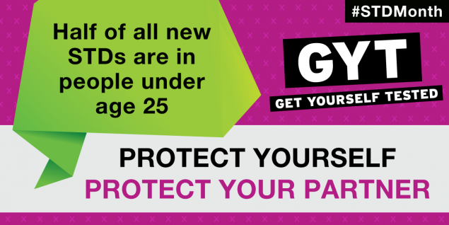
What this talk will cover
Pathogens of interest
  Epidemiology
  Treatments
What’s now out there for prevention
  Vaccines
    New and newer

Slide 16
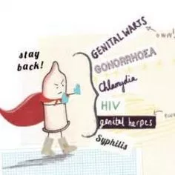
Smorgasbord of STIs
Bacterial vaginosis
Chlamydia*
Genital herpes
Gonorrhea*
Hepatitis
HIV
HPV
PID
Syphilis*
Trichomoniasis*
Other STIs:
  Chancroid
  Lymphogranuloma Venereum
  Mycoplasma genitalium
  Pubic Lice
  Scabies

Slide 17

How accurate are our numbers?
While sexually transmitted diseases (STDs) affect individuals of all ages, STDs take a particularly heavy toll on young people
CDC estimates that youth ages 15-24 make up just over ¼ of the sexually active population
  but account for half of the 20 million new STIs that occur in the US
12.7% of sexually experienced persons aged 15–17 years and aged 18–25 years who were covered by a parent’s insurance plan (13.5% of females and 12.0% of males)
  reported that they would not seek sexual and reproductive health care because of concerns that their parents might find out
Slide 17 of 85

Slide 18

Incidence, prevalence and cost of STIs in the US
Incidence: 20 million new infections
Prevalence: 110 million cases
  8 common infections: Chlamydia, GC, Hepatitis B, HIV, HSV-2, HPV, syphilis, Trichomoniasis
Cost: $16 billion in direct medical costs

Slide 19
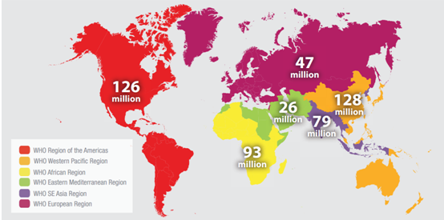
Estimated cases of curable STIs
GC, Chlamydia, Syphilis and Trichomoniasis

Slide 20
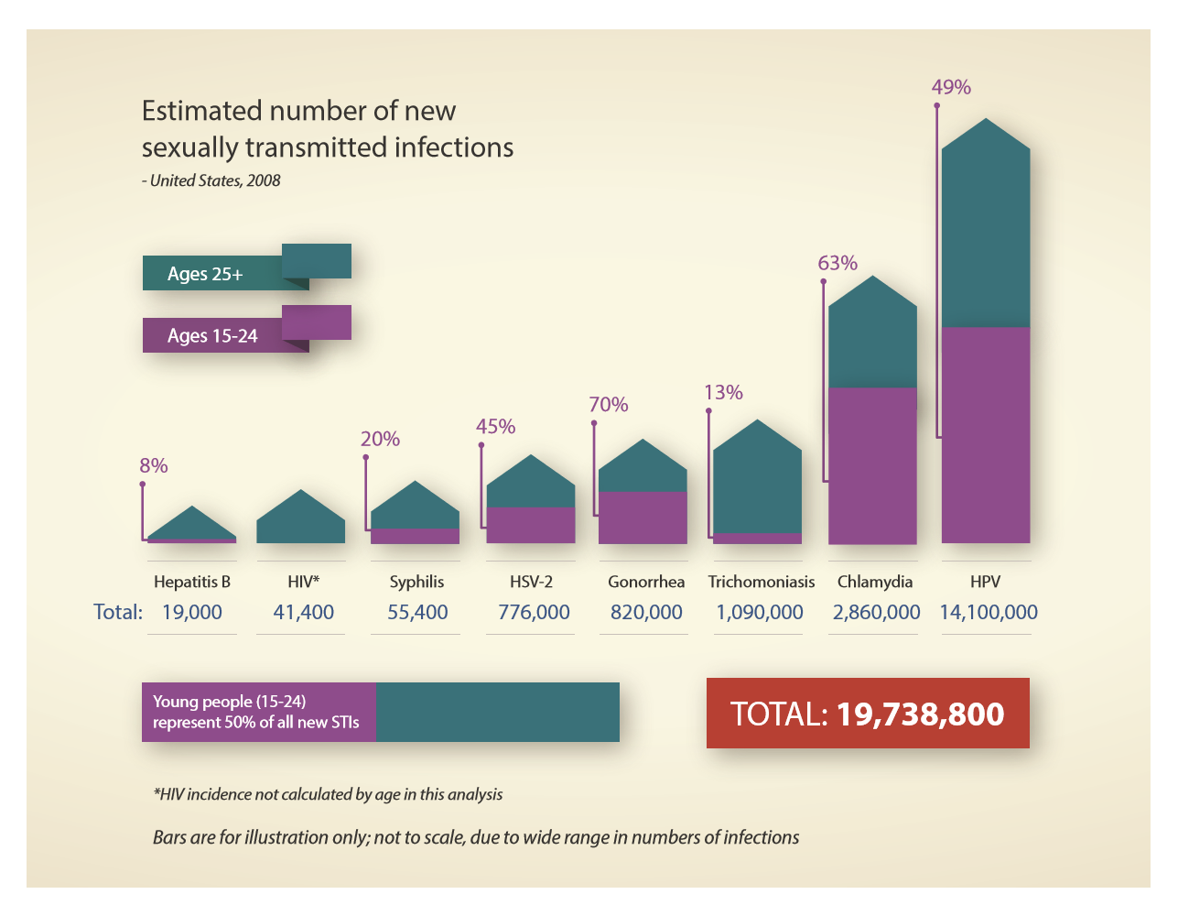
Slide 20 of 85

Slide 21
Slide 21 of 85

Slide 22

What about internationally?
More than 1 million STIs are acquired every day worldwide
Each year, there are an estimated 376 million new infections with 1 of 4 STIs:
  Chlamydia (127 million), gonorrhea (87 million), syphilis (6.3 million) and trichomoniasis (156 million)
    988,000 pregnant women were infected with syphilis in 2016, resulting in over 350,000 adverse birth outcomes including 200,000 stillbirths and newborn deaths
More than 500 million people are estimated to have genital infection with HSV
More than 290 million women have an HPV infection
https://web.archive.org/web/20181018014853/http:/www.who.int/entity/reproductivehealth/publications/rtis/ghss-stis/en/index.html
https://www.who.int/en/news-room/fact-sheets/detail/sexually-transmitted-infections-(stis)

Slide 23
How young you start having sex makes a difference
Younger ages at first intercourse were associated with higher odds of STI in comparison with older ages, but the effect diminished with increasing current age
The odds of having an STI for an 18-year-old who first had intercourse at age 13 were >2x those of an 18-year-old who first had intercourse at age 17
  prevalence odds ratio = 2.25, 95% confidence interval: 1.42, 3.59
Christine E. Kaestle et al Young Age at First Sexual Intercourse and Sexually Transmitted Infections in Adolescents and Young Adults. 2005. Am J of Epi, 161: 8, P: 774–780

Slide 24
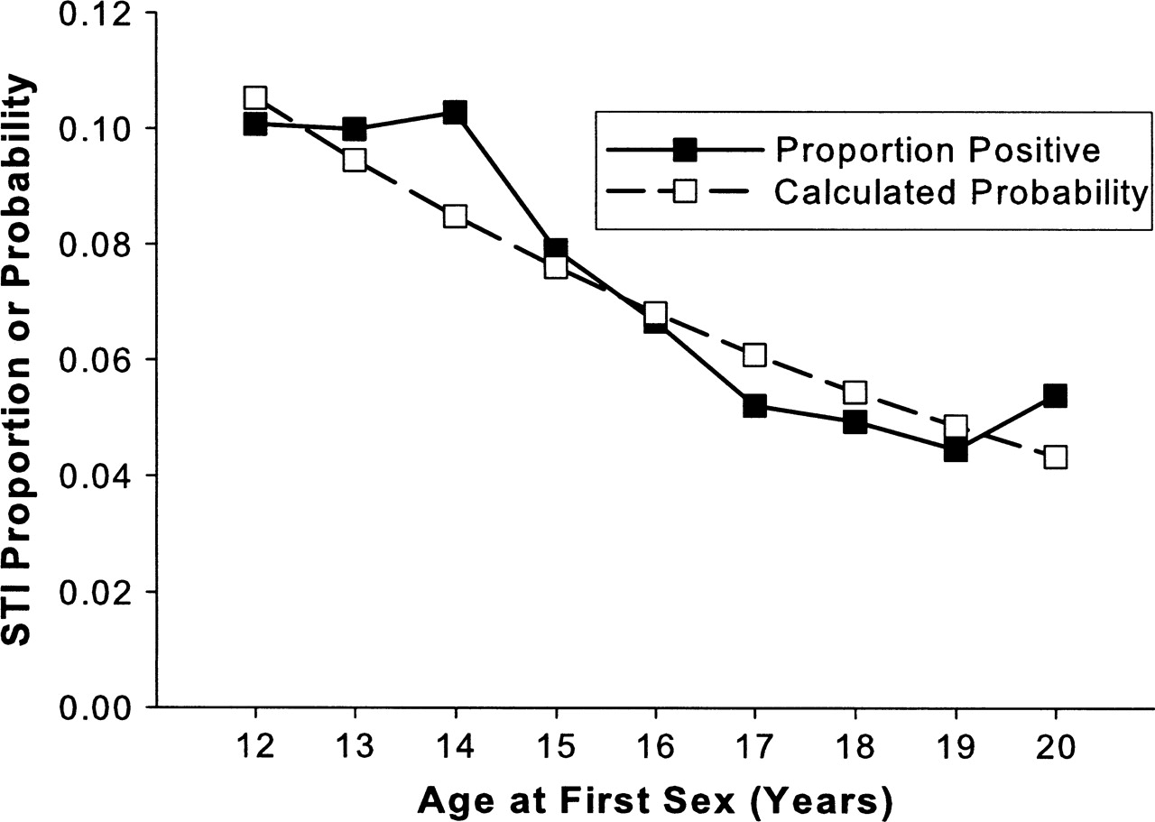
Weighted proportion of participants with a sexually transmitted infection (STI)
Notes:
FIGURE 1. Weighted proportion of participants with a sexually transmitted infection (STI) (Chlamydia trachomatis, Neisseria gonorrhoeae, or Trichomonas vaginalis), by age at first sexual intercourse, and corresponding probability of having an STI, as calculated from simple logistic regression before adjustment for demographic factors (n = 9,844), National Longitudinal Study of Adolescent Health, 2001–2002.
Unless provided in the caption above, the following copyright applies to the content of this slide: American Journal of Epidemiology Copyright © 2005 by the Johns Hopkins Bloomberg School of Public Health All rights reserved

Slide 25

What is it about younger girls mucosa that makes them more susceptible to an STI?
The female genital tract is a complex niche of microflora, hormonal influences, and immune tissues and cells that result in a mucosal immune system that is distinct from other mucosal sites and from our systemic immune system
  Protection while maintaining tolerance toward spermatozoa and the fetus
Upper genital tract most similar to gut and lungs
  Comprised of one layer of columnar epithelial cells, which are joined by tight junctions
Lower genital tract most similar to cornea, esophagus and mouth
  Multiple layers of non‐keratinized and squamous epithelial cells, that cover a basement membrane
  As squamous epithelial cells are turned over, they are renewed from basal epithelial cells in the basement membrane
Ramanathan R, Woodrow K. Engineering immunity in the mucosal niche against sexually transmitted infections.
Wiley Interdiscip Rev Nanomed Nanobiotechnol. 2016 Jan-Feb;8(1):107-22. doi: 10.1002/wnan.1359. Epub 2015 Jul 7.

Slide 26
Slide 26 of 85

Slide 27
Slide 27 of 85
De Tomasi. Immunity in the cervix: interphase between immune and cervical epithelial cells. J Immunology 2019, https://doi.org/10.1155/2019/7693183.

Slide 28

What else contributes to these STI rates?
Psychosocial developmental stage is associated with increased risk-taking behaviors and desire for autonomy
Lower levels of condom use
Complex structure of sexual networks
Older sexual partners
Mental health issues
Substance abuse

Slide 29
It’s all about perception
Do youth consider themselves to have had an STI?
Many of those who reported a negative history of an STI had documentation in the EMR of a positive test for an STI
  2.7% had chlamydia
  2.8% had GC
  6.3% had genital herpes
Yavorsky, A. Prevalence of Sexually Transmitted Infections in At-Risk Adolescent Females at a Comprehensive, Stand-Alone Adolescent Health Center in NYC. Clin Pediatr 2014 aug; 53 (9): 890-895

Slide 30
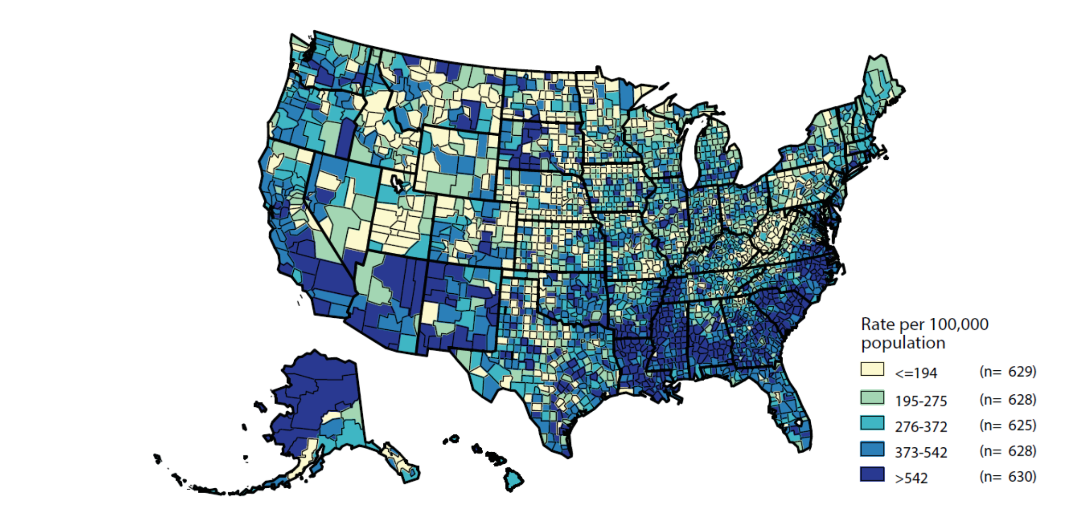
Chlamydia — Rates of Reported Cases by County, United States, 2017
Slide 30 of 85
NOTE: Refer to the NCHHSTP AtlasPlus for further county-level rate information: https://www.cdc.gov/nchhstp/atlas.
Notes:
In 2017, 630 (20.1%) of 3,140 counties had rates of reported chlamydia higher than 542 cases per 100,000 population.
Seventy counties and independent cities reported 43% of all chlamydia cases in 2017.

Slide 31
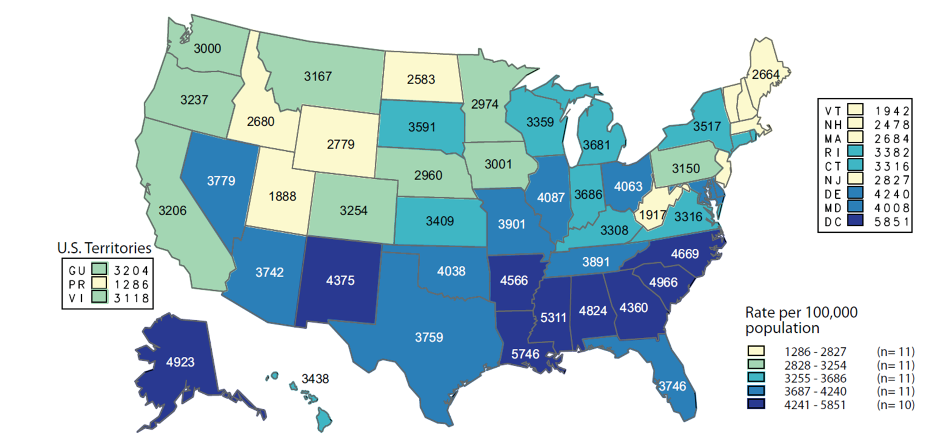
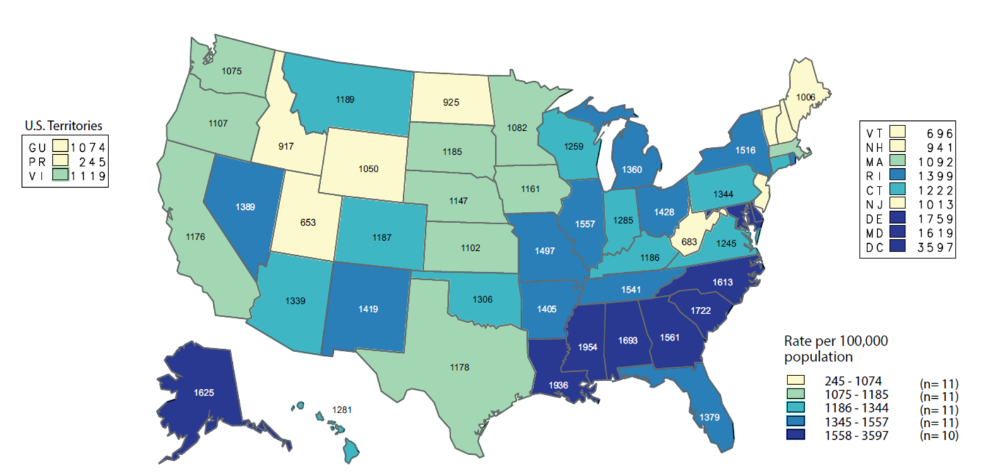
Chlamydia — Rates of Reported Cases Among populations Aged 15–24 Years by State, US 2017
Women
Men

Slide 32
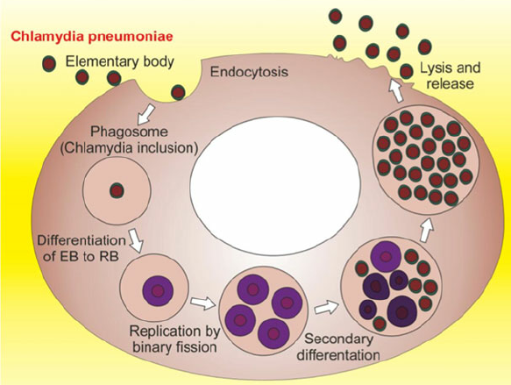
What about the pathogen: Chlamydia
Reportable infection!
Gram negative bacterium
  18 serovars:
    A, B, C -eye disease
    D-K -genital tract
    L1-L3 -Lymphogranuloma venereum (LGV), which is associated with genital ulcer disease in tropical countries
Chlamydia infects columnar epithelial cells: adolescent female at particular risk because of the presence of the squamocolumnar junction on the ectocervix until early adulthood
Unique biphasic life cycle that is adaptable to both intracellular and extracellular environments
An infected male has a 25% chance per sexual encounter of transmitting the infection to an uninfected female

Slide 33
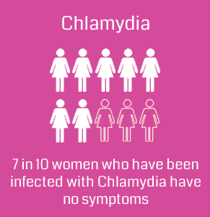
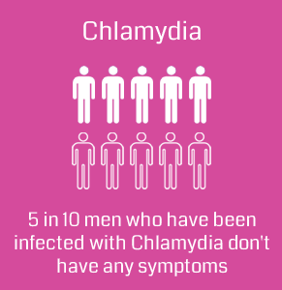
Diagnosis
Annual screening of all sexually active women <25 yrs
NAATs are the most sensitive tests
  NAATs that are FDA-cleared for use with vaginal swab specimens
  -Can be collected by a provider or self-collected
  -specimens are equivalent in sensitivity
First catch urine in men
Rectal and oropharyngeal infection
-test at the anatomic site of exposure
  Just not FDA cleared…

Slide 34
Treatment
Location | First line | Alternatives
Urogenital, pharyngeal and rectal | -Azithromycin 1 g PO x 1 -Doxycycline 100 mg BID x 7 day -Doxycycline delayed release tab 200 mg daily x 7 day | -Erythromycin base 500 mg QID x 7 days -Erythromycin ESS 800 mg QID x 7 days -Levofloxacin 500 mg daily x 7 days
-Meta-analysis show pooled cure rates of 97.5% for doxycycline versus 94.4% for azithromycin
-No data on alternative regimens for oral infection

Slide 35

What about re-infection?
Retest in 3 months!!!
Do not send NAAT testing in under 1 month
  May still have some residual RNA/DNA despite therapy
Avoid sex for 7 days after treatment to avoid reinfection…
  But will they listen?

Slide 36
Next steps for Chlamydia… prevention…
Safety and immunogenicity of the chlamydia vaccine candidate CTH522 adjuvanted with CAF01 liposomes or aluminium hydroxide: a first-in-human, randomised, double-blind, placebo-controlled, phase 1 trial
  Sonia Abraham, Lancet Infectious Disease Aug 2019
Prime boost strategy,
  IM shot at 0, 1 and 4 months, then intranasal at 4.5 and 5 months
Healthy women 19-45 years, N=35
  CTH522 adjuvanted with CAF01 liposomes (CTH522:CAF01),
  CTH522 adjuvanted with aluminium hydroxide (CTH522:AH),
  placebo (saline)
Local safety reactions
CTH522:CAF01 had a better immunogenicity profile

Slide 37
Why did they pick these vaccines and this route?
The vaccine antigen CTH522 is a recombinant, engineered version of the C trachomatis major outer membrane protein (MOMP)
  heterologous immunorepeats from four genital C trachomatis serovars (D, E, F, and G)
The vaccine has been evaluated in mice, pigs, and non-human primates, where T-cell responses and high titres of broadly neutralizing antibodies were induced
  Protection in mice and guinea pigs was seen!
Since the genital mucosa does not have immune inductive sites, other mucosal sites have been explored for induction of local genital immunity
  Intranasal immunization has been shown to induce mucosal immunity in both the respiratory and genital tract
Immunization schedules with systemic priming followed by mucosal boost is highly efficacious in inducing mucosal immunity and induction of IgA.

Slide 38
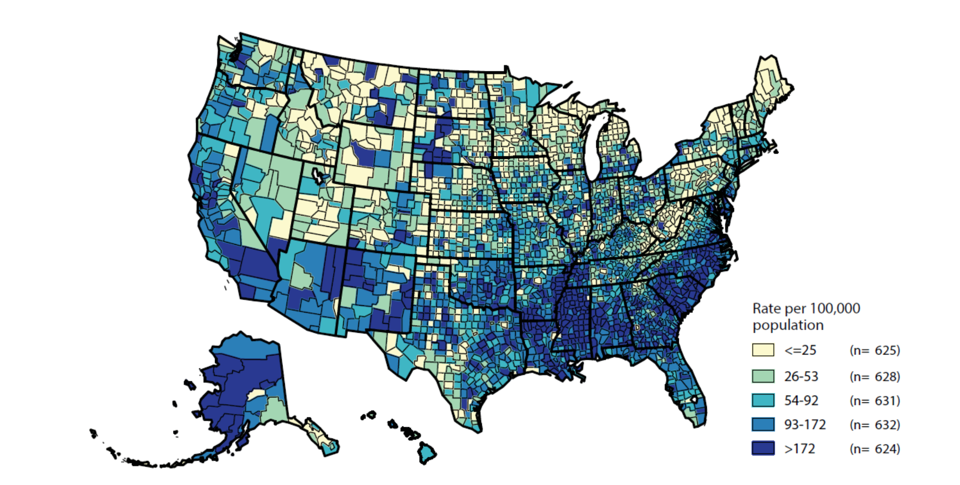
Gonorrhea — Rates of Reported Cases by County, United States, 2017
Slide 38 of 85
NOTE: Refer to the NCHHSTP AtlasPlus for further county-level rate information: https://www.cdc.gov/nchhstp/atlas/.
Notes:
In 2017, 50.0% of reported gonorrhea cases occurred in just 70 counties or independent cities and 625 counties (19.9%) in the United States had a rate of reported gonorrhea less than or equal to 25 cases per 100,000 population.
The rate ranged from 26 to 53 cases per 100,000 population in 628 counties (20.0 %), ranged from 54 to 92 cases per 100,000 population in 631 counties (20.0%), ranged from 93 to 172 cases per 100,000 population in 632 counties (20.1%), and was more than 172 cases per 100,000 population in 624 counties (19.9%).
As in previous years, counties with the highest gonorrhea rates were concentrated in the South.

Slide 39
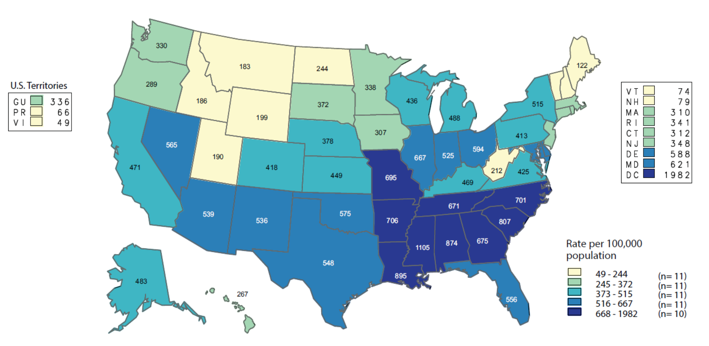
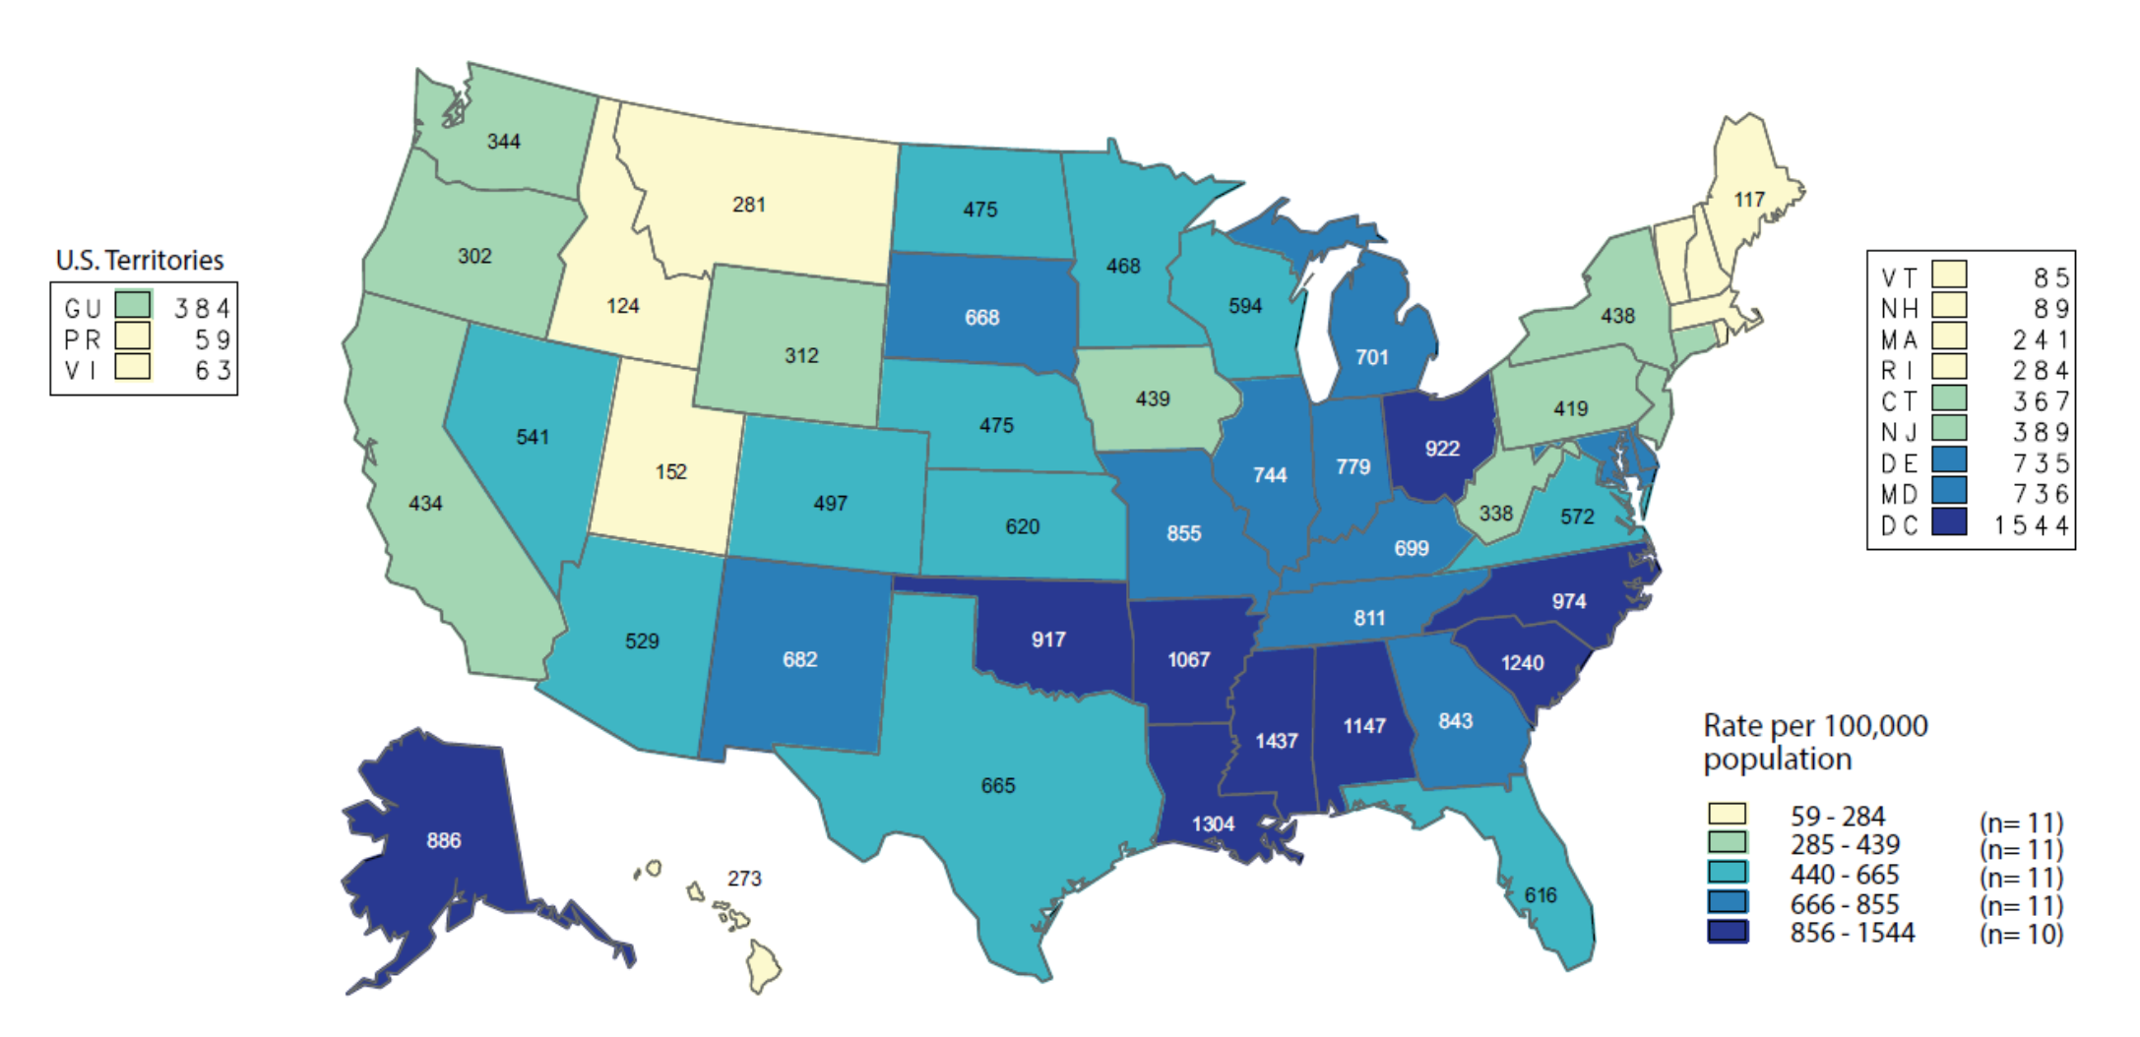
Gonorrhea — Rates of Reported Cases Among
Youth Aged 15–24 Years by State, US 2017
Females
Males

Slide 40
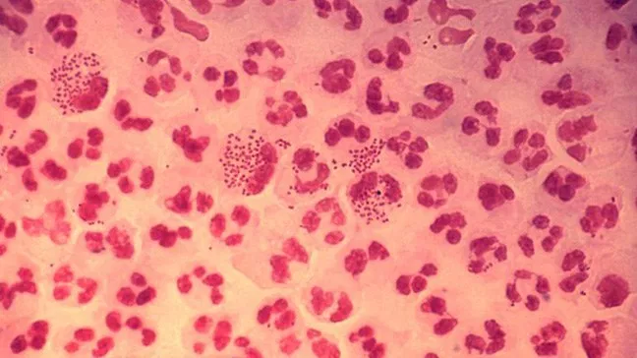
What about the pathogen?
Gram negative diplococcus
  Kidney shaped
N gonorrhoeae typically infects mucous membranes and may remain localized but can disseminate
Manifestations include urethritis, epididymitis, proctitis, conjunctivitis, cervicitis, PID, pharyngitis, and disseminated infection
  Oral sex leads to pharyngeal infection!
Vertical transmission occurs
Gonorrhea can also increase rates of HIV sexual transmission up to 5-fold

Slide 41
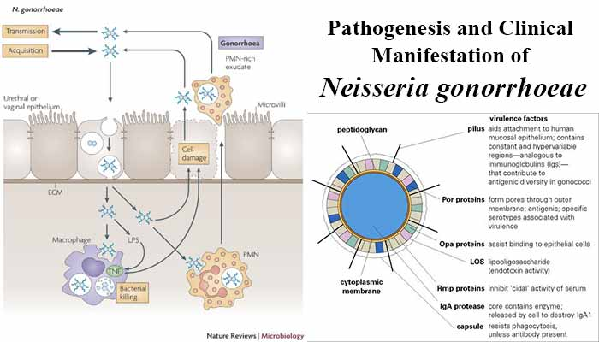
Neisseria easily prevent complement activation, opsonization and bacterial killing

Slide 42
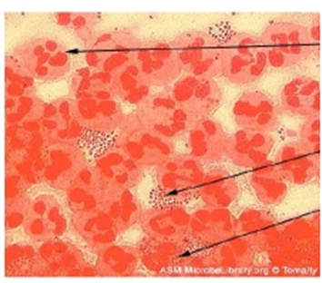
Diagnosis:
History:
-dyspareunia
-vaginal bleeding after sex
Physical exam:
-inguinal adenopathy
-cervical motion tenderness (PID)
-mucopurulent discharge
Don’t forget about arthritis and septicemia!

Slide 43
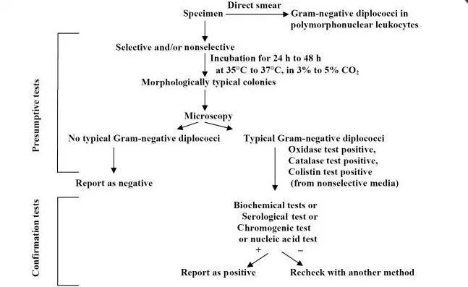
Diagnosis

Slide 44
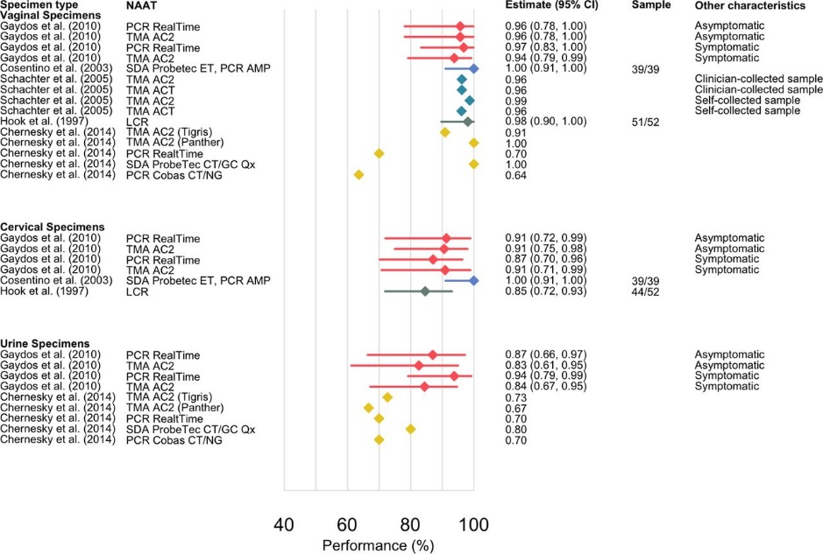
It’s not all about culture…
Organism dies rapidly:
  Likes specific temperature, humidity, growth media
  Gram stain of exudate not so helpful: only positive 40-60% in women
So, use rapid testing, NAAT
  Swab can sit for 48 hours in refrigerator
  High specificity and sensitivity
Ronn, MM. Evaluation of the performance of nucleic acid amplification tests (NAATs) in detection of chlamydia and gonorrhoea infection in vaginal specimens relative to patient infection status: a systematic review. BMJ 2018

Slide 45

Treatment
$64,000 question…
What is the mess that we are in now?
It’s all about resistance

Slide 46
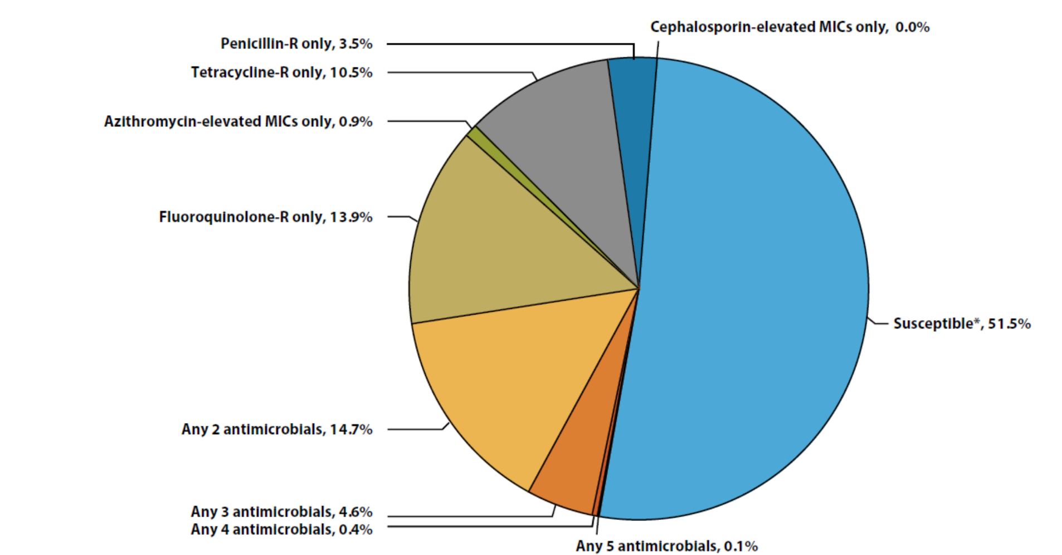
Susceptibility Patterns of Neisseria gonorrhoeae Isolates to Antimicrobials, Gonococcal Isolate Surveillance Project (GISP), 2017
Slide 46 of 85
* Susceptible category only includes isolates with penicillin, tetracycline, and fluoroquinolone MIC values that are considered susceptible and isolates with ceftriaxone, cefixime, and azithromycin MIC values that are not considered elevated.
NOTE: Elevated MIC = Ceftriaxone: ≥0.125 μg/ml; Cefixime: ≥0.25 μg/ml; Azithromycin: ≥2.0 μg/ml.
Resistant (R) MIC = Tetracycline: ≥2.0 μg/ml; Fluoroquinolone: ≥1.0 μg/ml; Penicillin: ≥2.0 μg/ml or PPNG.
ACRONYMS: R = Resistant; PPNG = Penicillinase-producing Neisseria gonorrhoeae and chromosomally-mediated penicillin-resistant N. gonorrhoeae; MIC = Minimum Inhibitory Concentration.
Notes:
Of all the isolates collected in GISP in 2017, 4.6% demonstrated resistance or elevated MICs to at least 3 antibiotics tested and 51.5% were susceptible to all antibiotics tested.

Slide 47
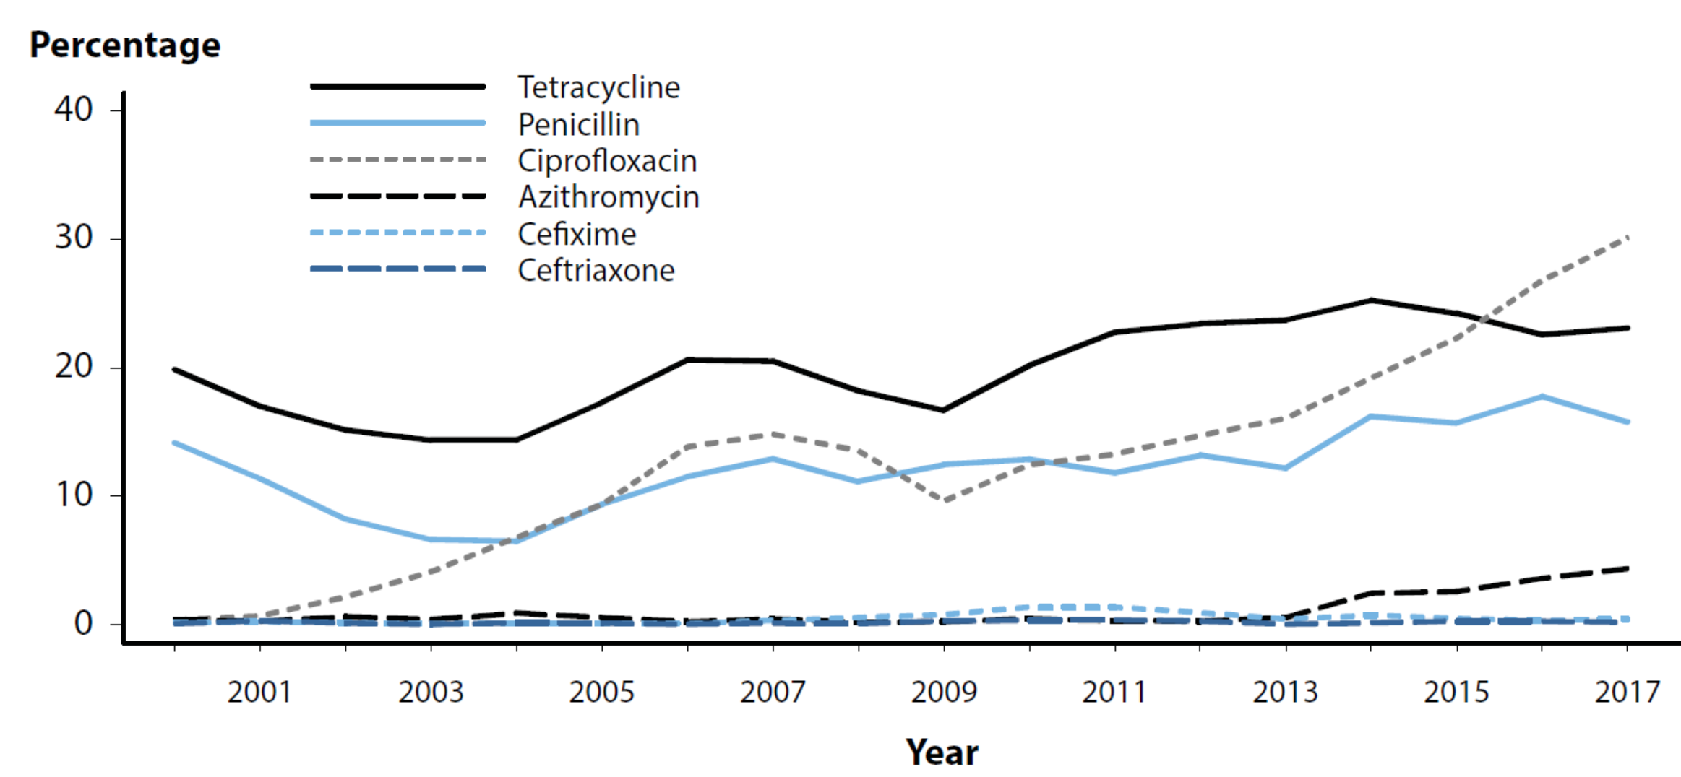
Neisseria gonorrhoeae — Prevalence of Tetracycline, Penicillin, or Fluoroquinolone Resistance* or Elevated Cefixime, Ceftriaxone, or Azithromycin Minimum Inhibitory Concentrations (MICs)†, by Year — Gonococcal Isolate Surveillance Project (GISP), 2000–2017
Slide 47 of 85
* Resistance: Fluoroquinolone (ciprofloxacin) = MIC≥ 1.0 µg/mL; Penicillin = MIC≥ 2.0 µg/mL or B-lactamase positive; Tetracycline = MIC≥ 2.0 µg/mL.
† Elevated MICs: Azithromycin = MIC≥ 1.0 µg/mL (2000–2004); ≥ 2.0 µg/mL (2005–2017); Ceftriaxone = MIC≥ 0.125 µg/mL; Cefixime = MIC≥ 0.25 µg/mL.
NOTE: Cefixime susceptibility was not tested in 2007 and 2008.
ADAPTED FROM: Kirkcaldy RD, Harvey A, Papp JR, et al. Neisseria gonorrhoeae antimicrobial susceptibility surveillance — The Gonococcal Isolate Surveillance Project, 27 Sites, United States, 2014. MMWR Surveill Summ 2016; 65(7):1–24.
Notes:
In 2017, 30.1% of isolates collected from GISP sites were resistant to ciprofloxacin, 23.1% to tetracycline, and 15.8% to penicillin.

Slide 48
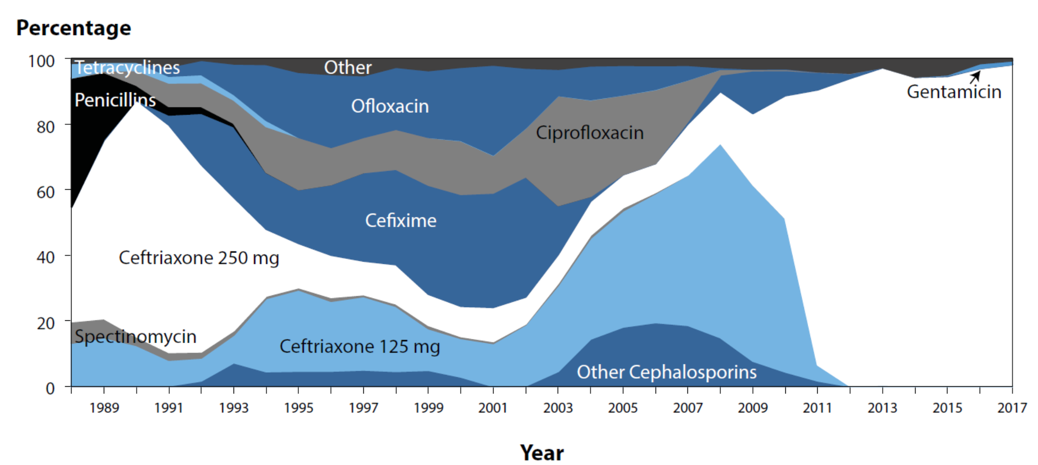
Distribution of Primary Antimicrobial Drugs Used to Treat
Gonorrhea Among Participants, Gonococcal Isolate Surveillance Project (GISP), 1988–2017
Slide 48 of 85
NOTE: For 2017, “Other” includes azithromycin 2g (0.3%), no therapy (0.3%), and other less frequently used drugs (0.1%).
Notes:
The proportion of patients treated with ceftriaxone 250 mg increased from 84.0% in 2011 to 98.1% in 2017.
In 2017, 1.1% of patients were treated with gentamicin 240 mg and 0.1% were treated with cefixime 400mg.

Slide 49
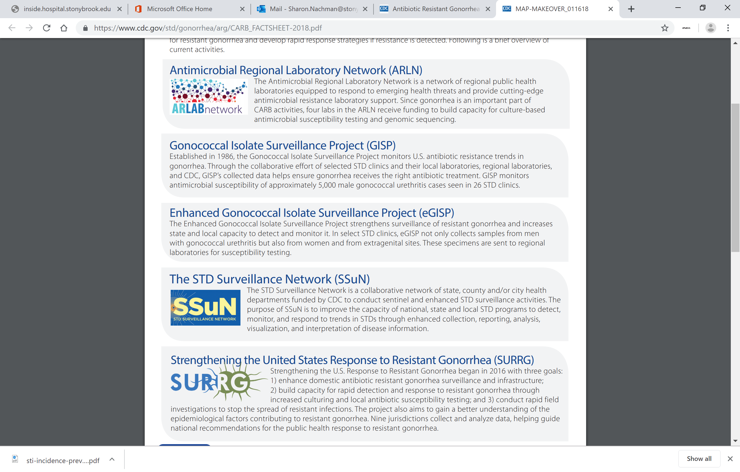
Slide 49 of 85

Slide 50
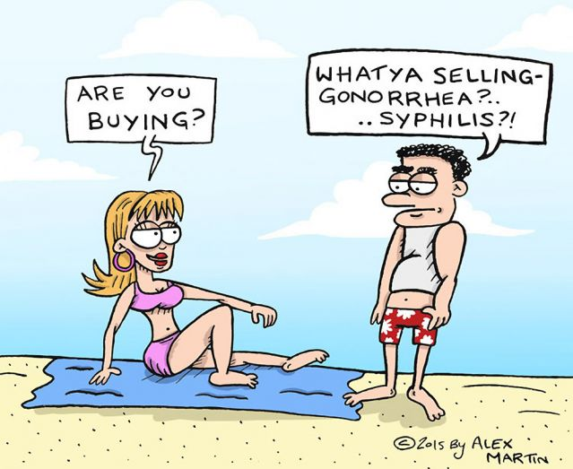
GC treatment guidelines
Urogenital, pharyngeal and rectal:
  Ceftriaxone 250 mg IM x 1 PLUS azithromycin 1 g by mouth x 1
  Alternative regimens:
    Must perform test of cure after 14 days
    Cefixime 400 mg by mouth x 1 PLUS EITHER azithromycin 1 g by mouth OR doxycycline 100 mg BID x 7 days
    Azithromycin allergy: use doxycycline 100 mg BID x 7 days plus ceftriaxone 250 mg IM x1
    Cephalosporin allergy: use gentamicin 240 mg IM PLUS azithromycin 2 g by mouth x 1

Slide 51
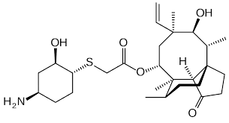
Some new therapies…
With the increase in R we need new antibiotics…
Lefamulin (Xenleta; 150 mg injection or 600 mg tablets)
  Pleuromutilin
Recently licensed for community acquired pneumonia
Inhibits protein synthesis and growth
Lack of cross resistance with other antibiotic classes
Active against all resistant GC
No data on dosing, PK/PD…
https://investors.nabriva.com/static-files/c76a2788-b642-4aa0-85c7-d9092a74381e
Antimicrob Agents Chemother 2017 Sept 11. pii: AAC.01496-17. doi: 10.1128/AAC.01497-17

Slide 52
Looking ahead; prevention?
We are running out of antibiotic options
The basis of immunity and the identification of immune correlates or surrogates of protection still need to be deciphered
  Infection induces very short term limited mucosal immune response
  Lack of correlation between infection and subsequent protection so how do you test success?
Who should get this ‘candidate vaccine’?
  High risk vs universal coverage?
Mening B vaccine
  What's the story here?
Summary and Recommendations from the NIAID Workshop “Gonorrhea Vaccines: the Way Forward. Clin and Vaccine Immunology . Aug 2016

Slide 53
Mening B vaccine
Discontinued meningococcal B vaccine used to combat an epidemic of meningococcal B in New Zealand also offered protection against gonorrhea
  Outer membrane vesicle (OMV) serogroup B meningococcal vaccine, MeNZB
  Offered to anyone under 20 years of age for free
  Estimated vaccine efficacy of 31% against GC!!
Bexsero, approved in U.S. for 10 to 25 years:
  includes the MeNZB OMV component plus three recombinant antigens, NadA, fHBP-GNA2091 and NHBA-GNA1030
  antibody to (antigen) NHBA, in vaccine and conserved in GC, is protective in animal models

Slide 54
NZ saw a decline in reported gonorrhea cases during and after use of MeNZB™
No other sexually transmitted infections (STIs) described in the national surveillance reports declined during this period
Tested the hypothesis in retrospective review:
Individuals who had received the MeNZBTM vaccine were significantly less likely to be cases than controls with an adjusted OR 0.69 (95% CI 0.61–0.79%); p < 0.0001
Petousis-Harris, H. Impact of meningococcal group B OMV vaccines, beyond their brief. Human Vaccines and Immunotherapeutics 2018

Slide 55
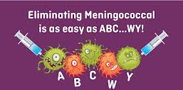
Vaccinate with Mening B!
There are currently two Nm group B vaccines that include OMVs in wide use
Both appear to provide broad protection against their Nm target diseases and both are likely to offer cross protection against GC to a greater or lesser extent
While Bexsero has not yet been formally assessed against GC it not only contains the antigen that has been used(MeNZBTM), but also 2/3 of recombinant proteins in the formulation are variably expressed in GC isolates and induces cross reactive antibodies against the gonococcus
Provision of a booster dose of one of these vaccines at an age prior to sexual debut, may provide a basis for heterologous boosting, could be worth exploring as a strategy…

Slide 56
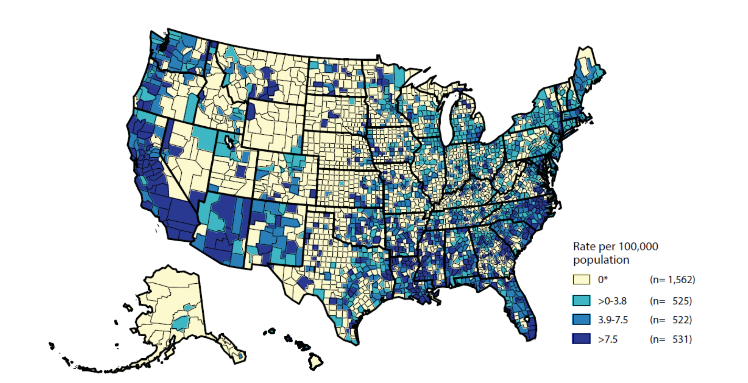
Primary and Secondary Syphilis — Rates of Reported Cases by County, United States, 2017
Slide 56 of 85
* In 2017, 1,562 (49.7%) of 3,140 counties in the United States reported no cases of primary and secondary syphilis. Refer to the NCHHSTP AtlasPlus for further county-level rate information: https://www.cdc.gov/nchhstp/atlas/
Notes:
Of 3,140 counties in the United States, 531 (16.9%) had a P&S syphilis rate greater than 7.5 cases per 100,000 population, 522 (16.6%) reported a rate from 3.9 to 7.5 cases per 100,000 population, 525 (16.7%) reported a rate from >0 to 3.8 cases per 100,000 population, and 1,562 (49.7%) counties reported no cases of P&S syphilis in 2017.

Slide 57
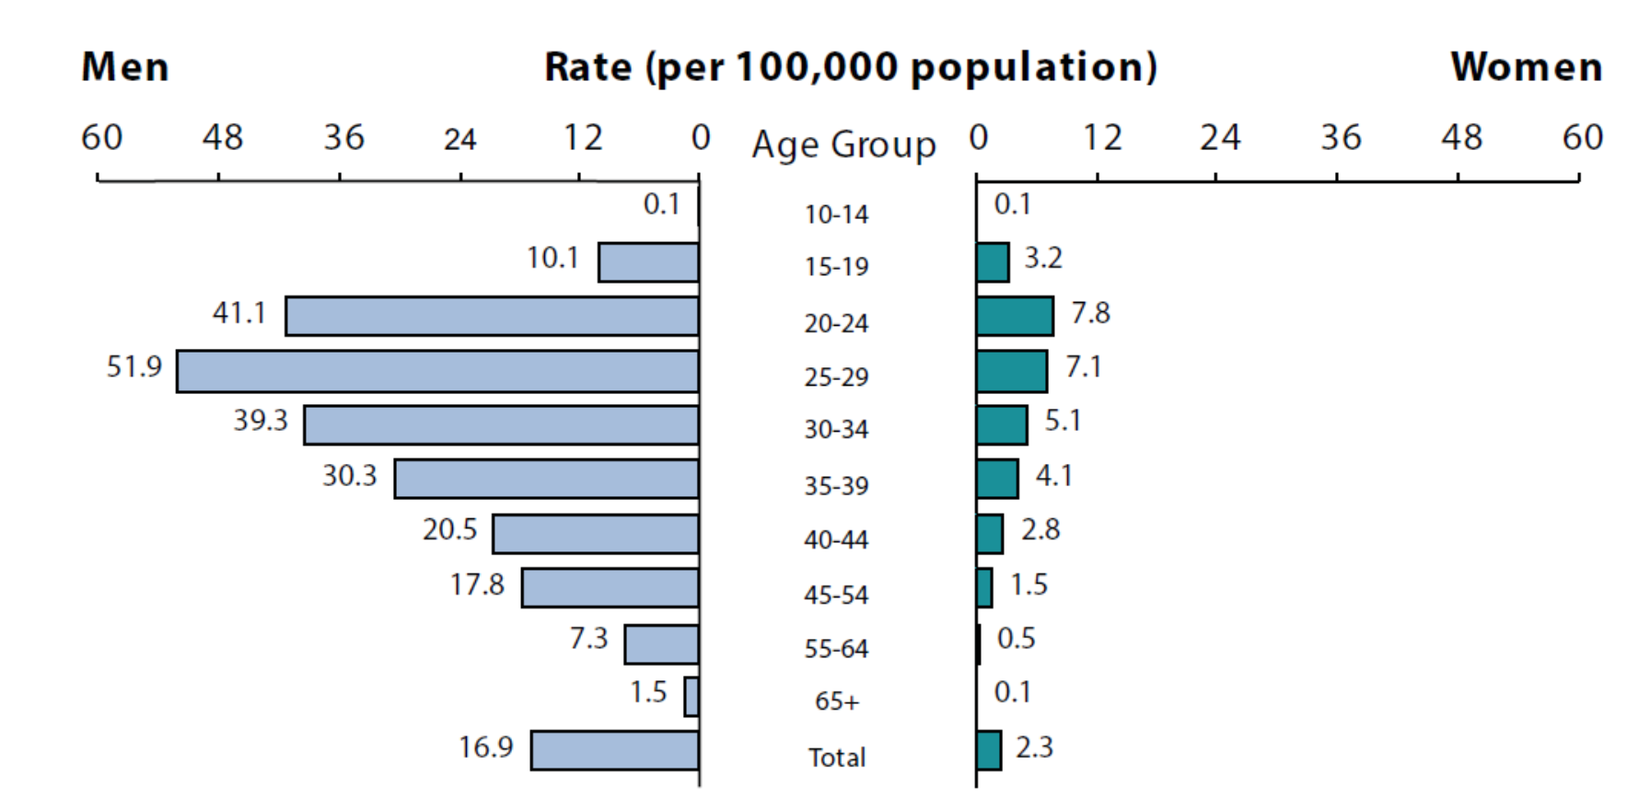
Primary and Secondary Syphilis — Rates of Reported Cases by Age Group and Sex, United States, 2017
Slide 57 of 85
Notes:
As in previous years, in 2017, rates of reported P&S syphilis cases were highest among persons aged 25–29 years.
In 2017, the highest rates were observed among men aged 25–29 years (51.9 cases per 100,000 males), 20–24 years (41.1 cases per 100,000 males), and 30–34 years (39.3 cases per 100,000 males).
The highest rates among women were among those aged 20–24 years (7.8 cases per 100,000 females) and those aged 25–29 years (7.1 cases per 100,000 females).

Slide 58
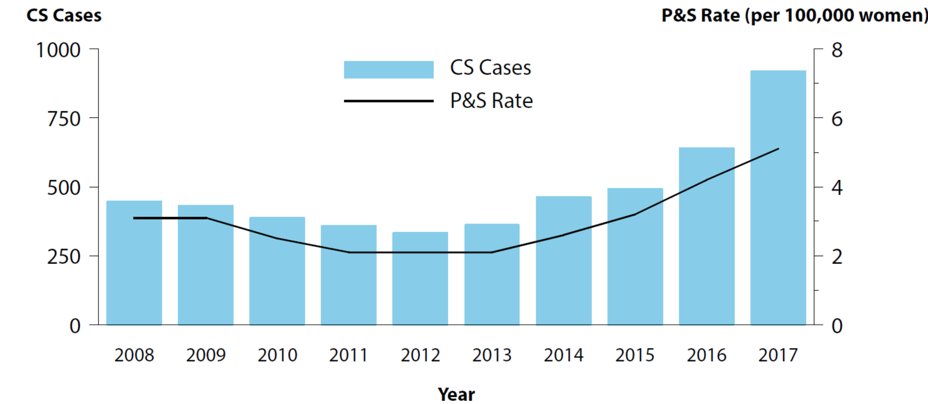
Congenital Syphilis — Reported Cases by Year of Birth and Rates of Reported Cases of Primary and Secondary Syphilis Among Women Aged 15–44 Years, United States, 2008–2017
Slide 58 of 85
ACRONYMS: CS = Congenital syphilis; P&S = Primary and secondary syphilis.
Notes:
In 2017, there were a total of 918 reported cases of congenital syphilis, including 64 syphilitic stillbirths and 13 infant deaths, and the national rate was 23.3 cases per 100,000 live births.
This rate represents a 43.8% increase relative to 2016 (16.2 cases per 100,000 live births) and a 153.3% increase relative to 2013 (9.2 cases per 100,000 live births).
As has been observed historically, this increase in the congenital syphilis rate has paralleled increases in P&S syphilis among all women and reproductive-aged women during 2013–2017 (155.6% and 142.8% increase, respectively).

Slide 59
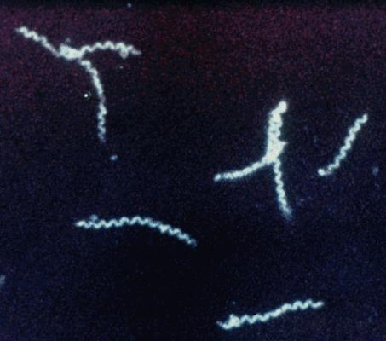
Microbiology 101…
T. pallidum belongs to a family of spiral-shaped bacteria, the Spirochaetaceae (spirochetes), and is related to other pathogenic treponemes that cause nonvenereal diseases (Yaws, Pinta)
In both clinical and laboratory settings, dark-field microscopy is used for visualization of this small organism
T. pallidum has an unusually small genome and lacks genes that encode many metabolic functions and classical virulence factors. The organism is extremely sensitive to environmental conditions and has not been continuously cultivated in vitro
  BUT survives for decades in the untreated host
One factor contributing to T. pallidum's chronicity is the paucity of integral outer membrane proteins, rendering intact organisms virtually invisible to the immune system
Antigenic variation of TprK, a putative surface-exposed protein, is likely to contribute to immune evasion
Slide 59 of 85

Slide 60
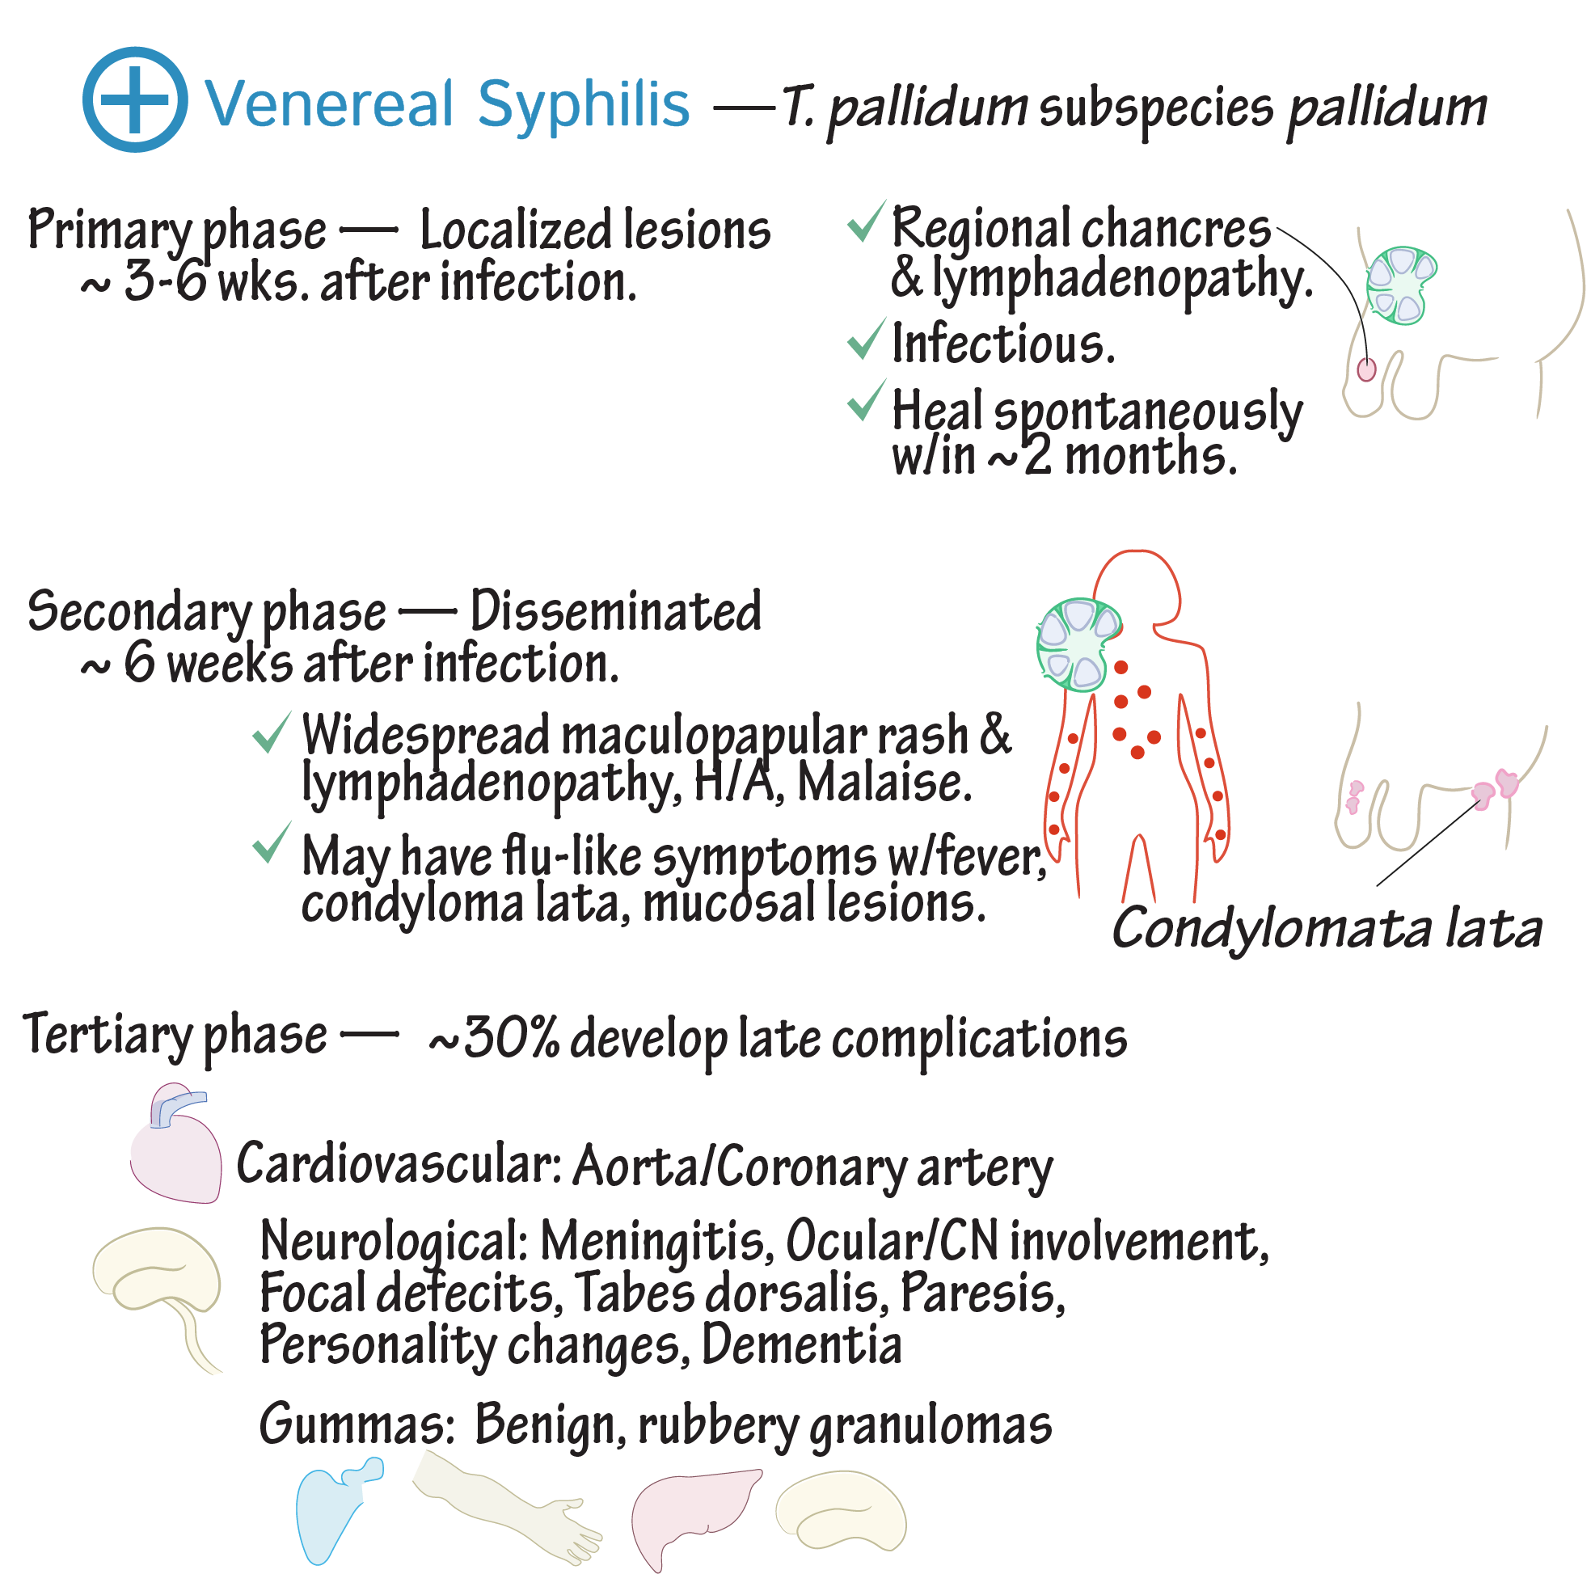
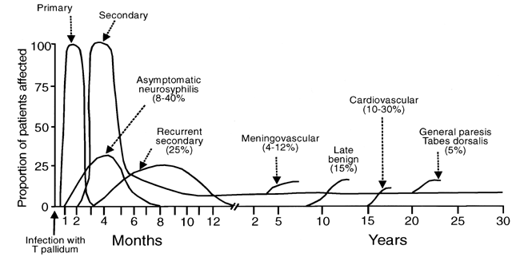
Slide 60 of 85

Slide 61
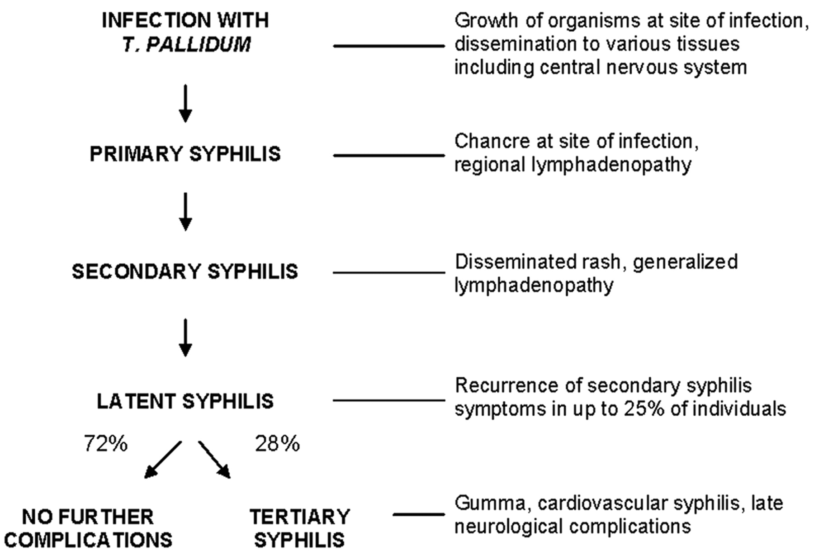
Pathophysiology

Slide 62
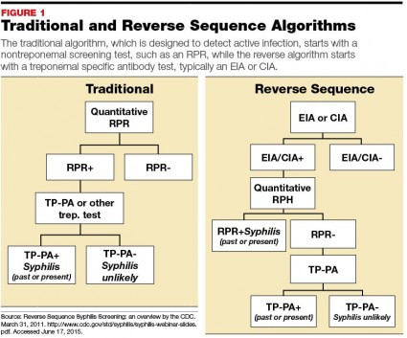
Diagnosis
PROs to reverse sequence:
It can all be automated…no need for hands-on RPR testing!
Optimal for populations with high disease prevalence
CONs to reverse sequencing:
Can not distinguish new infection from prior treated infection
False positive testing can be seen in low prevalence settings
Slide 62 of 85

Slide 63
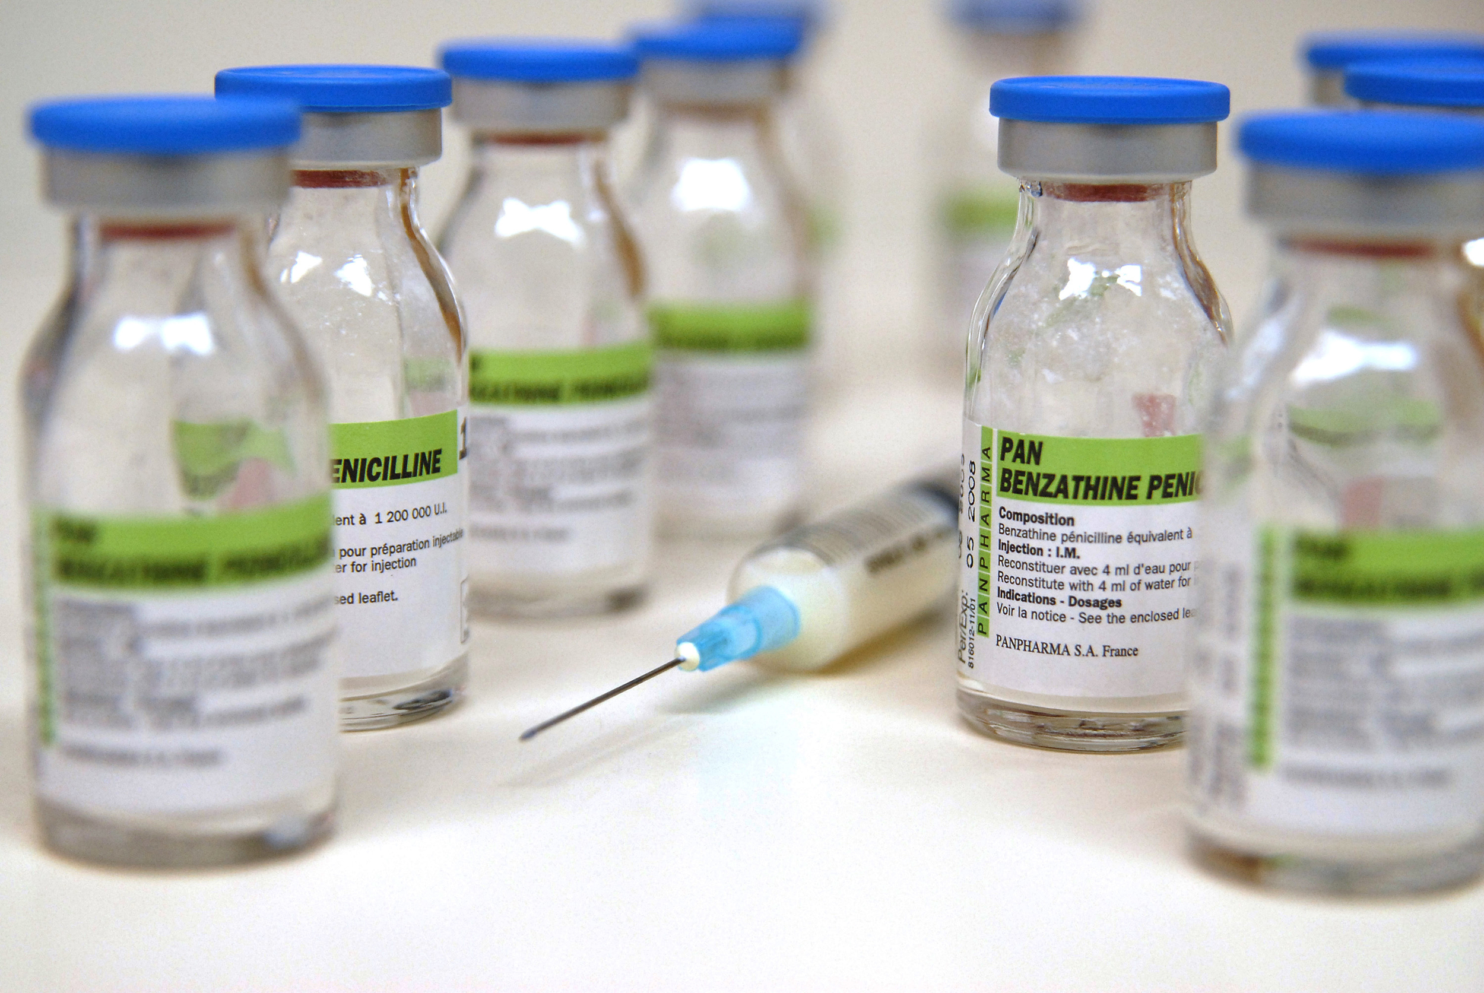
Treatment
For adults: Benzathine penicillin G 2.4 million units IM in a single dose
For children: Benzathine penicillin G 50,000 units/kg IM, up to the adult dose of 2.4 million units in a single dose
Primary and secondary syphilis infected patients need evaluations at 6 and 12 months for treatment failure
Those with latent syphilis should be evaluated at 6, 12 and 24 months

Slide 64
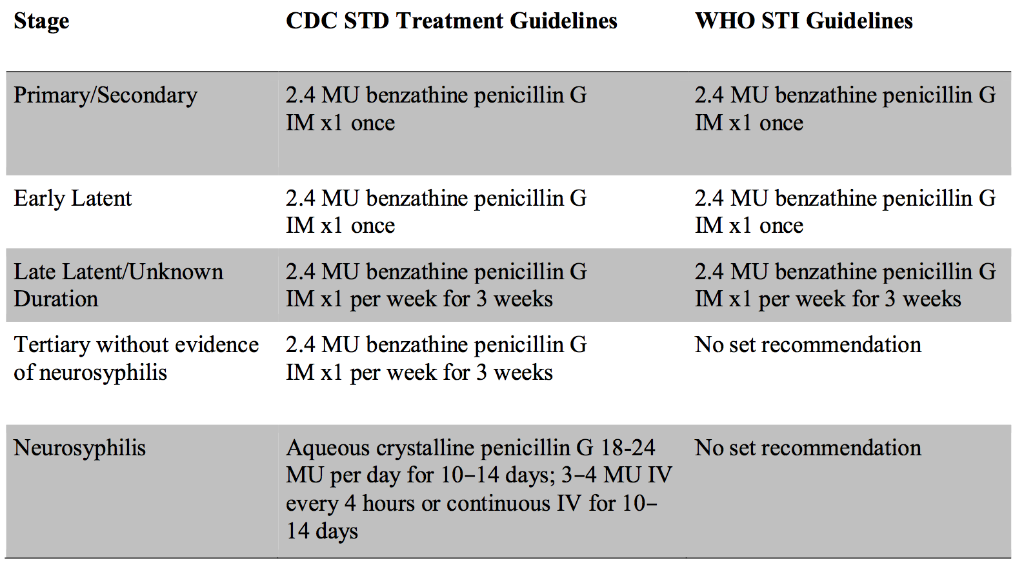
Guidelines for pregnant women
Slide 64 of 85

Slide 65
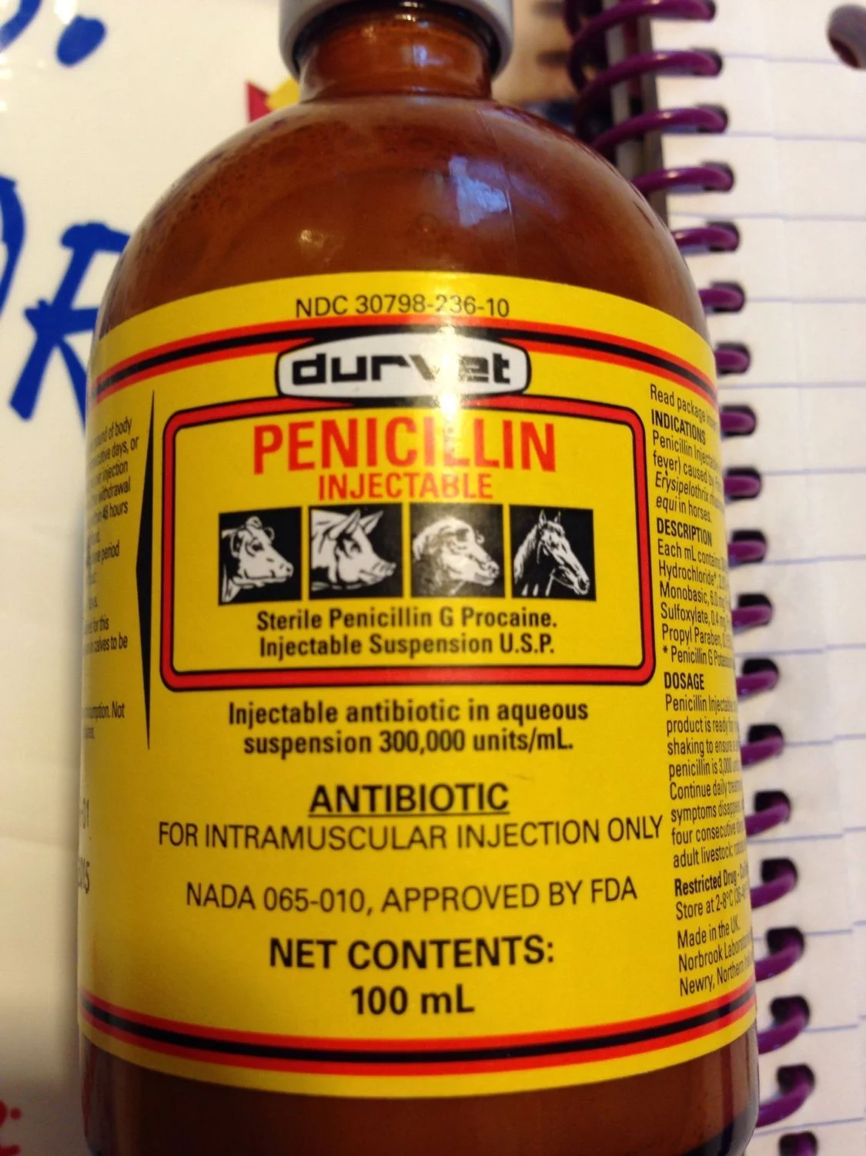
What Should You NOT USE?
Penicillin G potassium or sodium
  Treatment of susceptible strains of microorganisms causing septicemia, empyema, pneumonia, pericarditis, endocarditis, and meningitis
Penicillin G procaine
  Penicillin G and the local anesthetic agent procaine in equimolar amounts.
Schlossberg, D. BENZATHINE PENICILLIN, PENICILLIN G, PENICILLIN V, PROCAINE PENICILLIN (Penicillin)
Antibiotics Manual: A Guide to Commonly Used Antimicrobials, Second Edition, Aug 2017

Slide 66
Allergic to penicillin?
Data to support use of alternatives in the treatment of syphilis are limited
However, several therapies might be effective in nonpregnant, penicillin-allergic persons who have primary or secondary syphilis
  doxycycline 100 mg orally twice daily for 14 days
  tetracycline (500 mg four times daily for 14 days) have been used
Ceftriaxone (1–2 g daily either IM or IV for 10–14 days) is effective for treating primary and secondary syphilis, the optimal dose and duration of ceftriaxone therapy have not been defined
Azithromycin as a single 2-g oral dose has been effective for treating primary and secondary syphilis in some populations
  chromosomal mutations associated with azithromycin and other macrolide resistance and treatment failures have been documented in multiple geographical areas in the US
  DON’T USE IT!

Slide 67
Jarisch-Herxheimer Reaction
The Jarisch-Herxheimer reaction is an acute febrile reaction
  headache, myalgia, fever, and other symptoms occur within the first 24 hours of therapy
Patients should be informed about this possible adverse reaction and how to manage it if it occurs
The Jarisch-Herxheimer reaction occurs most frequently among persons who have early syphilis
  presumably because bacterial burdens are higher
Antipyretics can be used to manage symptoms
  but have not been proven to prevent this reaction
The Jarisch-Herxheimer reaction might induce early labor or cause fetal distress in pregnant women

Slide 68
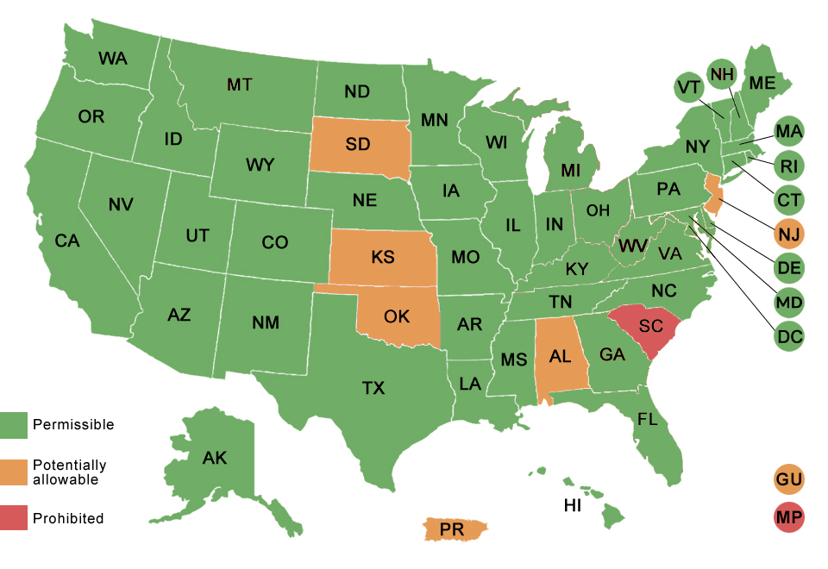
Expedited Partner Therapy
Clinical practice of treating the partners of patients diagnosed with STIs by providing prescriptions or medications to the patient to take to his/her partner without the health care provider first examining the partner
State-specific EPT laws can be found on the CDC website
  http://www.cdc.gov/std/ept/
Does it work?
  Reductions in reinfection rates !
  Endorsed by AAP

Slide 69

Syphilis Vaccine? Not yet…
Mathematical modeling studies predict development of a vaccine with an 80% efficacy would eliminate or markedly reduce congenital/infectious syphilis cases
  Prediction remained consistent regardless of whether a mass vaccination or targeted high-risk vaccination strategy was used
Vaccine needs to be efficacious at preventing all stages of infection
  Must be safe to be used during pregnancy
  Avoid the potential for disease transmission in primary syphilis
  Prevent establishment of latency in an infected individual
Vaccine must be efficient at inducing cross-strain protection
  Numerous T. pallidum strains circulating globally

Slide 70
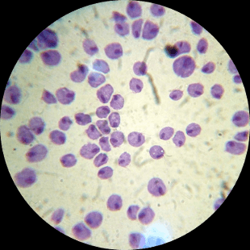
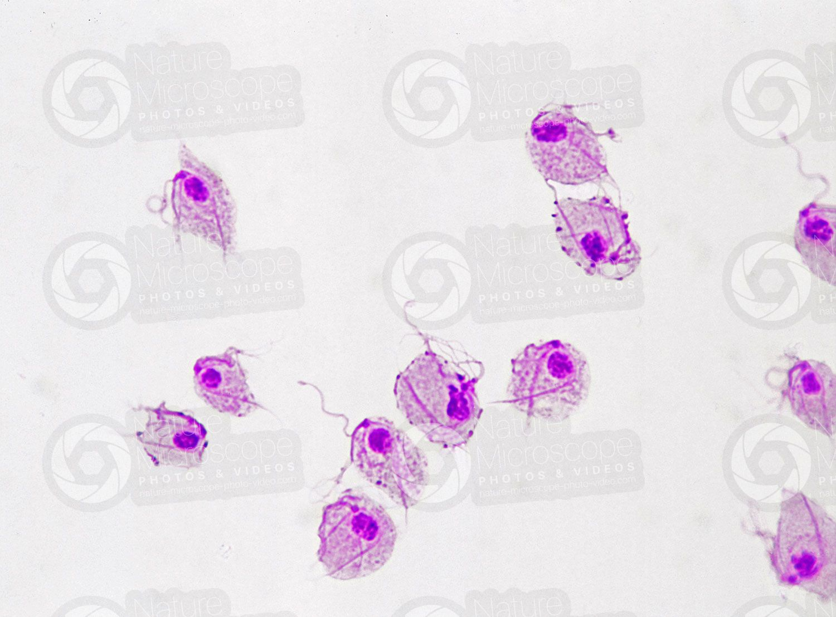
Trichomonas Vaginalis
Most prevalent nonviral STI in the US
  NOT nationally notifiable/reportable
  Affect 3.7 million persons
Infection may increase HIV acquisition risk by up to 3-fold
  Treatment can reduce genital HIV-1 shedding even in those not on ARVs

Slide 71
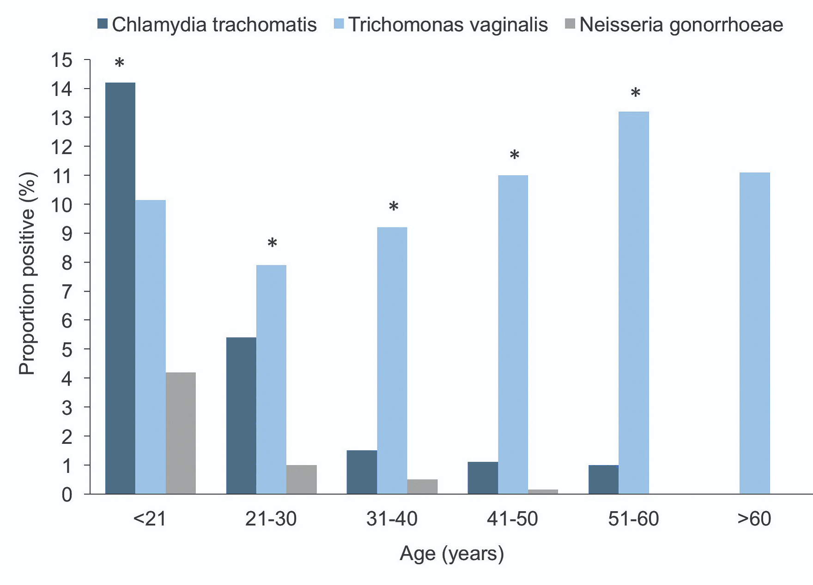
Trichomonas
Prevalence in US is 2.3 million among women 14-49
180 million infected worldwide
50% are asymptomatic carriers!
Can survive outside the body at temps as low as 15⁰ C for up to 48 hours
Munson E. Female epidemiology of transcription-mediated amplification-based Trichomonas vaginalis detection in a metropolitan setting with a high prevalence of sexually transmitted infection. J Clin Microbiol. 2012;50(12):3927–3931

Slide 72
Pathophysiology
3 species are out there…
Trichomonas vaginalis
  Inhabits vagina in females, prostate and seminal vesicles in males, urethra in both
Trichomonas tenax
  Non pathogenic
  Inhabits oral cavity
  Found in dental pockets and around teeth tartar
Trichomonas hominis
  Non pathogenic
  Inhabits ileocecal region

Slide 73
Symptoms ?
Men have symptoms of urethritis, epididymitis, or prostatitis
Women have vaginal discharge that might be diffuse, malodorous, or yellow-green with or without vulvar irritation
Most infected persons (70%–85%) have minimal or no symptoms
Untreated infections last for months to years
Partners of men who have been circumcised might have a somewhat reduced risk of T. vaginalis infection
Douching is not recommended because it might increase the risk for vaginal infections

Slide 74
Diagnosis
Among women, NAAT is highly sensitive, often detecting 3-5x more T. vaginalis infections than wet-mount microscopy
  Wet mount: poor sensitivity (51%–65%), worse in male specimens
  Don’t do cultures!
The APTIMA T. vaginalis assay (Hologic Gen-Probe, San Diego, CA) is FDA-cleared for detection of T. vaginalis from vaginal, endocervical, or urine specimens from women
Assay detects RNA by transcription-mediated amplification
  clinical sensitivity of 95.3%–100% and specificity of 95.2%–100% (665,666)
Among women, vaginal swab and urine have up to 100% concordance (663)
Assay can be used with urine or urethral swabs from men if validated per CLIA regulations.
Other testing kits available!
Check your hospital/clinic for which test you are using

Slide 75
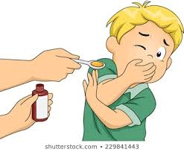
Treatment
Recommended:
  Metronidazole 2 gm orally in a single dose
  Tinidazole 2 gm orally in a single dose
Alternative regimen:
  Metronidazole 500 mg orally twice a day for 7 days
Avoid alcohol
  For 24 hours after finishing metronidazole
  For 72 hours after finishing Tinidazole

Slide 76
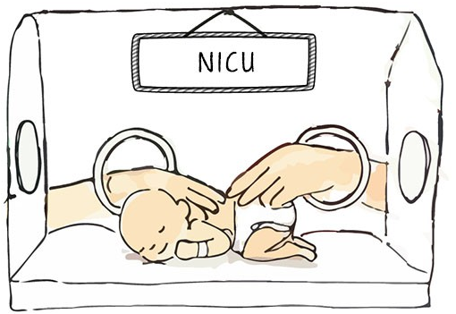
Trichomonas causes other problems…
13,816 women (5,241 black, 4,226 Hispanic, and 4,349 white women) were enrolled at mid-gestation, tested for T. vaginalis by culture, and followed up until delivery
  Low birth weight
  Preterm delivery
  BOTH!
Does metronidazole help to prevent these outcomes?
  Unfortunately no...
  Dose incorrect? Timing incorrect?
N Engl J Med 2001; 345:487-493

Slide 77
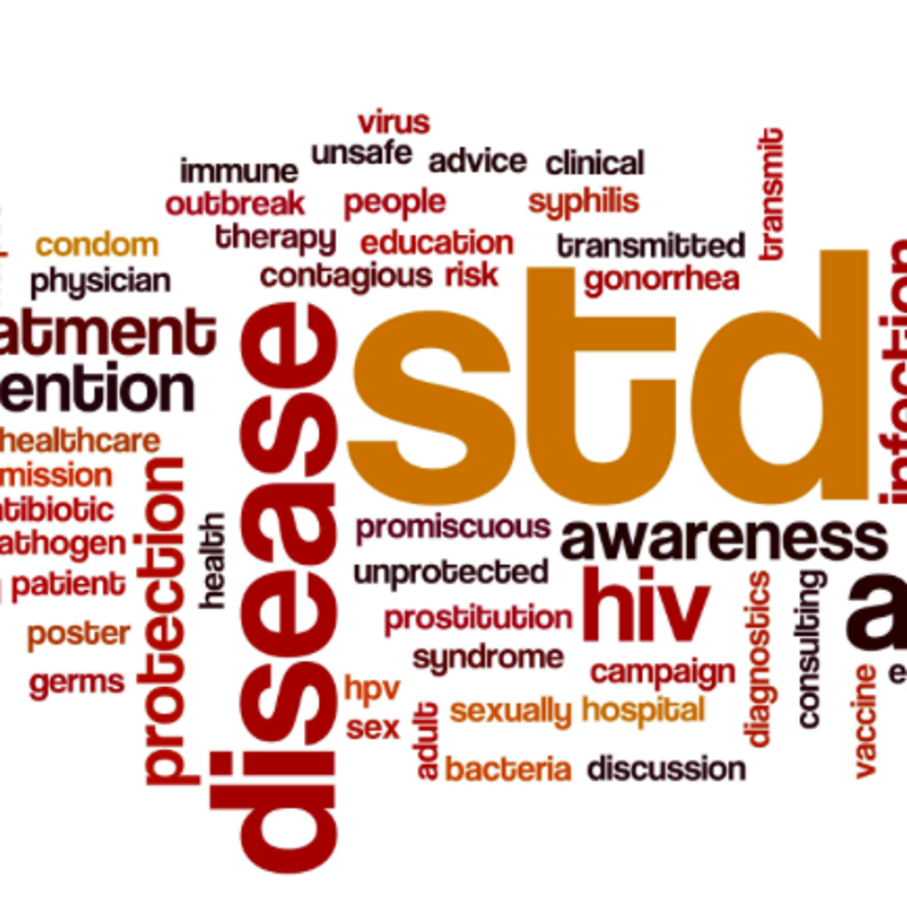
In summary:
STIs are easily transmitted
Think about them, talk with your patients about them
Treat patients and partners
Resistance is a moving target
Vaccines preventing STIs are in our future

Slide 78

Slide 78 of 85

Slide 79
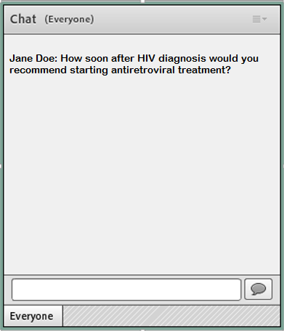
Question-and-Answer
Please type your questions into the CHAT BOX.

Slide 80
The webinar will be available for
on-demand viewing and CME credits at https://www.iasusa.org/activities/webinars/archived-cme-webinars/.
CME credit cannot be claimed for both the live and archived versions of the same webinar.

Slide 81

Evaluations will be available in your IAS-USA “My Activities” page by 5 pm PT today. See the IAS–USA website for instructions on claiming CME, pharmacy, nursing, or pharmacotherapy credits, or a certificate of participation.
Not Receiving Our Emails?
Check the FAQ section on the IAS–USA website for more information

Slide 82
Final Poll
When will the evaluation for this webinar, which you must complete in order to claim CME or other credit, be available on the My Activities page in your IAS-USA account?
Immediately after the webinar ends
By 5 pm PT today
When the moon hits your eye like a big pizza pie

Slide 83
Register Now!
UPCOMING WEBINAR
PrEP Implementation:
Populations, Providers, and Policies
Hyman Scott, MD, MPH
November 19, 2019
Simplifying Antiretroviral Therapy:
Two-Drug Regimens and Long-Acting Treatment
Joseph J. Eron, Jr, MD
January 21, 2020
www.iasusa.org/attend

Slide 84

Improving the Management of HIV Disease®:
An Advanced CME Live Course in HIV Pathogenesis, Antiretrovirals, and Other Selected Issues in HIV Disease Management
Improving the Management of HIV Disease®:
An Advanced CME Live Course in HIV Pathogenesis, Antiretrovirals, and Other Selected Issues in HIV Disease Management
2020 Spring HIV UPDATE Courses
Register
Now
New York, New York
March 19, 2020
Atlanta, Georgia
April 3, 2020
San Francisco, California
April 23 or 24, 2020 (tentative)
Los Angeles, California
Friday, May 1, 2020
Washington, DC
Friday, May 8, 2020
Chicago, Illinois
May 21, 2020
www.iasusa.org/activities/live-courses/hiv-courses/

Slide 85
Thank You
To the audience for your participation
To the International Antiviral Society–USA (IAS–USA)

