Slide 1

GLP-1 Receptor Agonists: Implications for Metabolic Syndrome in People with HIV
Todd T. Brown, MD, PhD
Professor of Medicine and Endocrinology
Division of Endocrinology, Diabetes, and Metabolism
The Johns Hopkins University
Baltimore, MD

Slide 2
Financial Relationships With Ineligible Companies (Formerly Described as Commercial Interests by the ACCME) Within the Last 2 Years
Dr Brown reported serving as a consultant to ViiV Healthcare, Merck & Co, Inc, Janssen Pharmaceuticals, EMD Serono, and Johnson & Johnson. (Updated September 21, 2026)

Slide 3
Learning Objectives
After attending this presentation, learners will be able to:
  Define metabolic syndrome and explain how this definition has evolved over time
  Describe the use and potential adverse effects of glucagon-like peptide-1 receptor agonists (GLP-1 RAs) in management of the components of metabolic syndrome

Slide 4
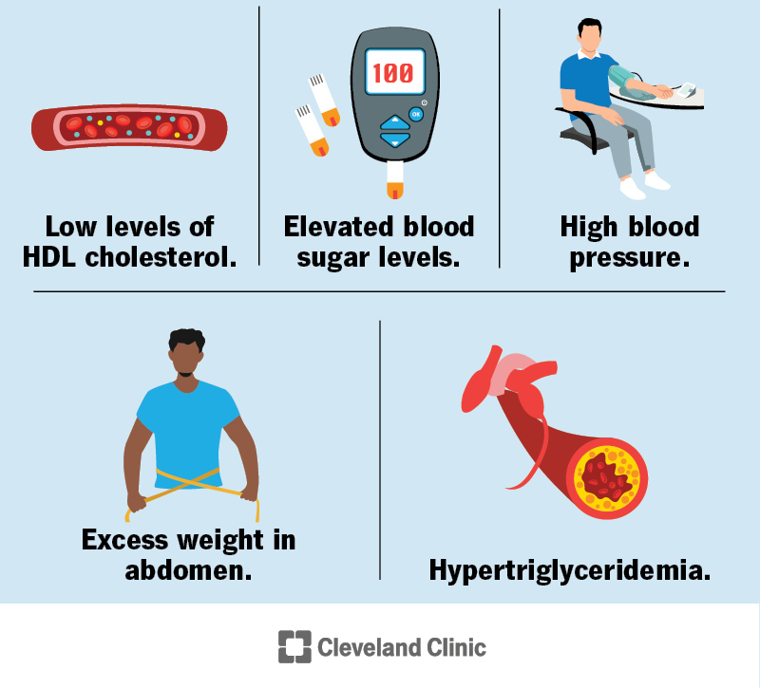
What is the Metabolic Syndrome?

Slide 5
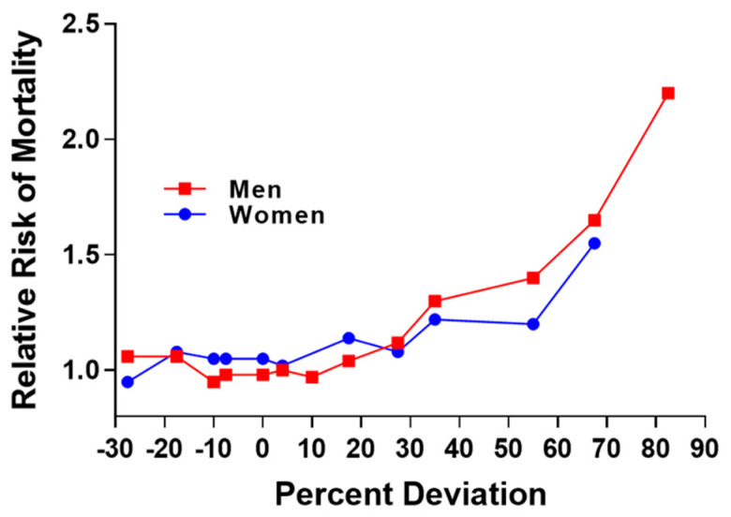
What are the origins of the metabolic syndrome?
Early 1900s: Excess adiposity associated with increased mortality.
Association of Life Insurance Medical Directors, 1913
Bray, Obesity, 1995

Slide 6


What are the origins of the metabolic syndrome?
1947: Fat distribution is an important determinant of health
Vague, Presse Medicale, 1947

Slide 7
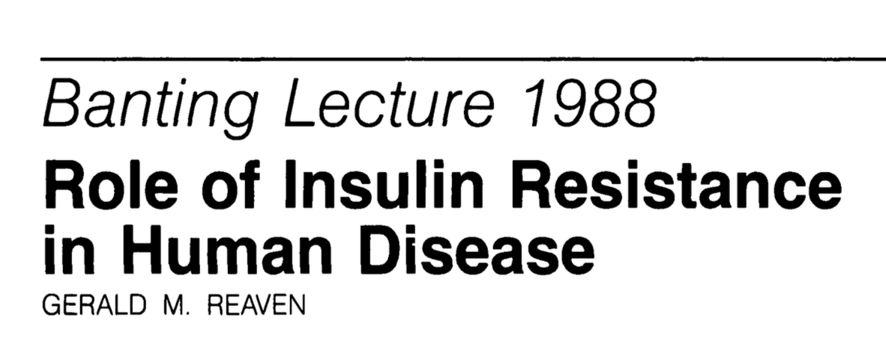
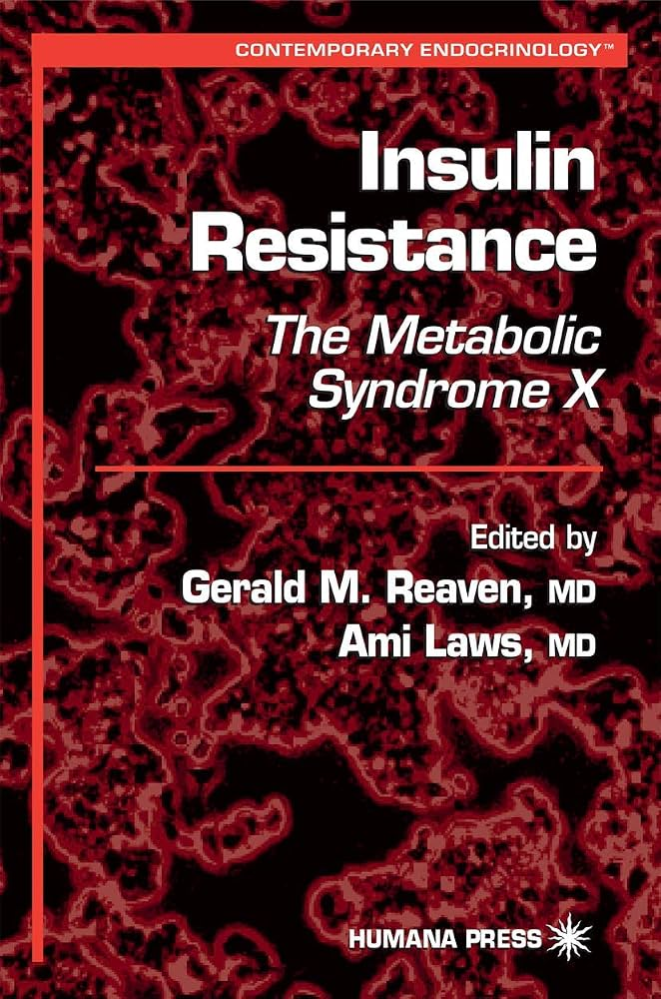
What are the origins of the metabolic syndrome?
1988: Clustering of hypertension, dyslipidemia (high TG, low HDL-c) related to insulin resistance and is a major CVD risk factor.
Reaven, Diabetes, 1988

Slide 8
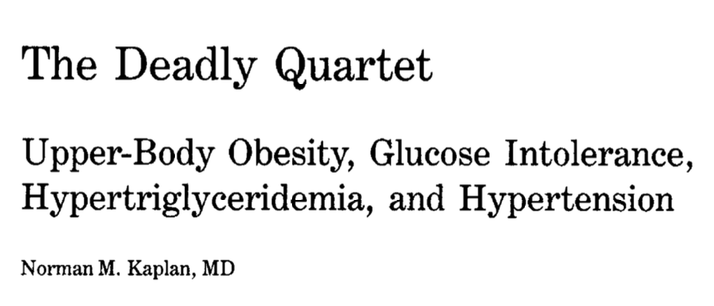
What are the origins of the metabolic syndrome?
1989: Linking central adiposity with metabolic risk factors
Kaplan, Arch int Med, 1989

Slide 9
Do not edit
How to change the design
Question 1: Abdominal obesity is a required criterion of the metabolic syndrome?
The Slido app must be installed on every computer you’re presenting from

Slide 10
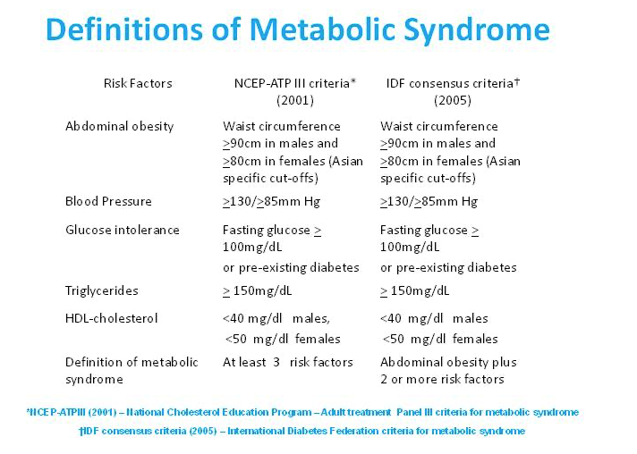

Slide 11
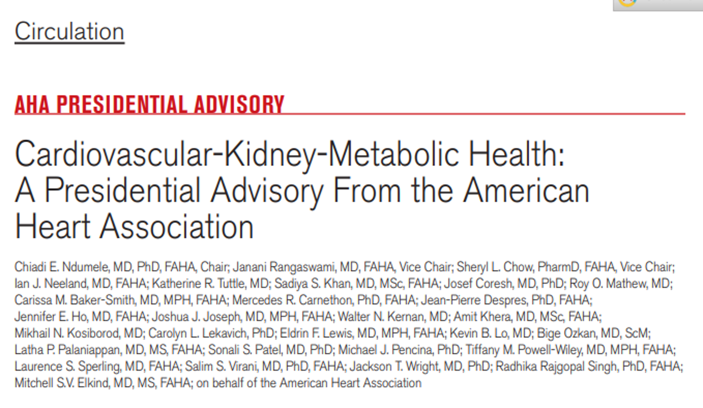

Slide 12
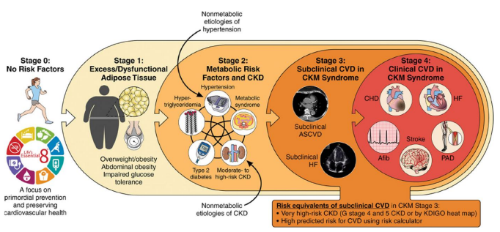
Cardiovascular-Kidney-Metabolic (CKM) Syndrome: Linked by Excess/Dysfunctional Adipose Tissue
Ndumele, Circulation, 2023

Slide 13
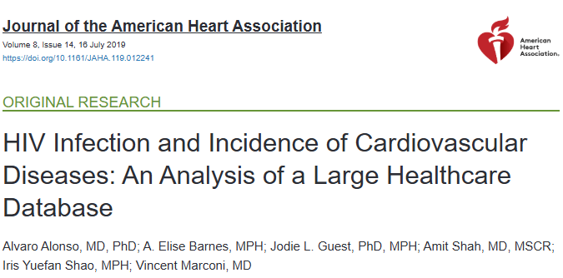
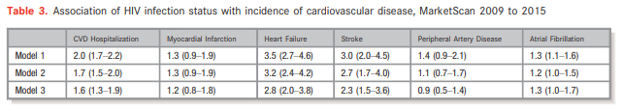
CKM-Related Events More Common in PWH
Notes:
Background
People living with HIV (PLWH) experience higher risk of myocardial infarction (MI) and heart failure (HF) compared with uninfected individuals. Risk of other cardiovascular diseases (CVDs) in PLWH has received less attention.
Methods and Results
We studied 19 798 PLWH and 59 302 age‐ and sex‐matched uninfected individuals identified from the MarketScan Commercial and Medicare databases in the period 2009 to 2015. Incidence of CVDs, including MI, HF, atrial fibrillation, peripheral artery disease, stroke and any CVD‐related hospitalization, were identified using validated algorithms. We used adjusted Cox models to estimate hazard ratios and 95% CIs of CVD end points and performed probabilistic bias analysis to control for unmeasured confounding by race. After a mean follow‐up of 20 months, patients experienced 154 MIs, 223 HF, 93 stroke, 397 atrial fibrillation, 98 peripheral artery disease, and 935 CVD hospitalizations (rates per 1000 person‐years: 1.2, 1.7, 0.7, 3.0, 0.8, and 7.1, respectively). Hazard ratios (95% CI) comparing PLWH with uninfected controls were 1.3 (0.9–1.9) for MI, 3.2 (2.4–4.2) for HF, 2.7 (1.7–4.0) for stroke, 1.2 (1.0–1.5) for atrial fibrillation, 1.1 (0.7–1.7) for peripheral artery disease, and 1.7 (1.5–2.0) for any CVD hospitalization. Adjustment for unmeasured confounding led to similar associations (1.2 [0.8–1.8] for MI, 2.8 [2.0–3.8] for HF, 2.3 [1.5–3.6] for stroke, 1.3 [1.0–1.7] for atrial fibrillation, 0.9 [0.5–1.4] for peripheral artery disease, and 1.6 [1.3–1.9] for CVD hospitalization).
Conclusions
In a large health insurance database, PLWH have an elevated risk of CVD, particularly HF and stroke. With the aging of the HIV population, developing interventions for cardiovascular health promotion and CVD prevention is imperative.

Slide 14
Many CKM Conditions Common in PWH
Stage 1
Stage 2
Adipose Dysfunction
Pre-Diabetes
Central Adiposity
Ectopic Fat Deposition
Proteinuria
Metabolic Syndrome
Hypertriglyceridemia
Type 2 Diabetes Mellitus
Chronic Kidney Disease

Slide 15
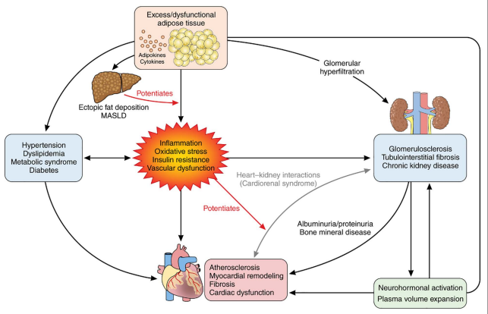
Proposed Pathophysiology of CKM Syndrome
Ndumele,
Circulation, 2023

Slide 16
Proposed Pathophysiology of CKM Syndrome
InSTIs
Legacy ART:
PI, thymidine analoguesI
ART
TDF
InSTIs
Legacy ART:
PI, thymidine analoguesI
HIV
Ndumele,
Circulation, 2023
ART
?ABC

Slide 17
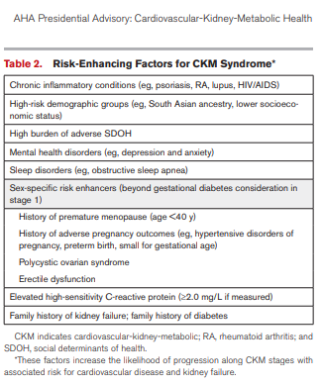
HIV is a risk-enhancer for CKM Syndrome

Slide 18
Can GLP-1 RAs impact the CKM syndrome?

Slide 19
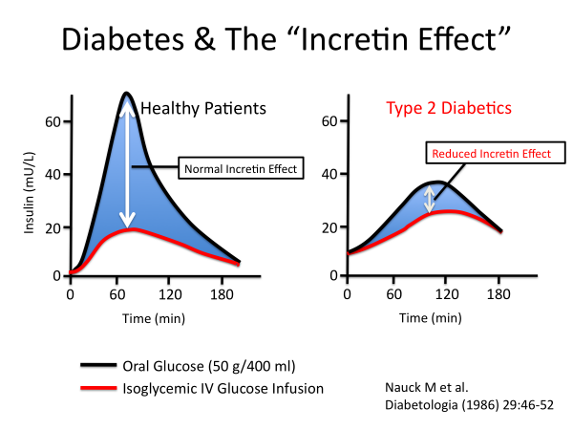
What are Incretins?
Nauck, Diabetologia, 1986
Slide 19

Slide 20
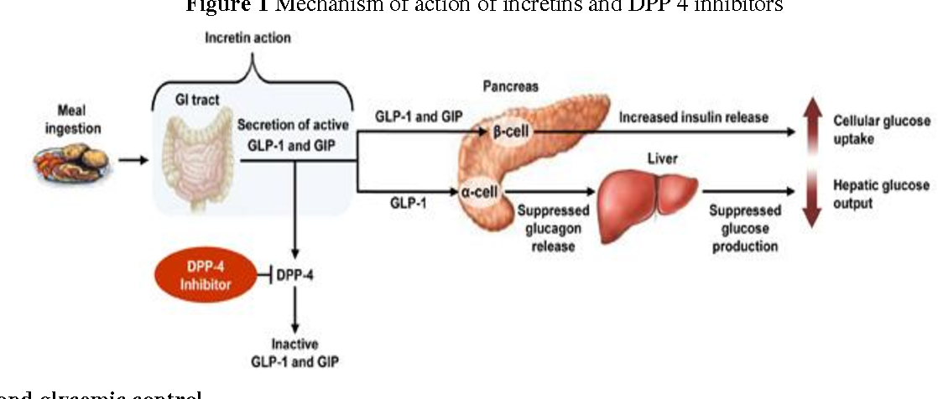
Incretins: Mechanisms of Action
Gothwal, IOSR Journal of Pharmacy, 2013
Slide 20

Slide 21
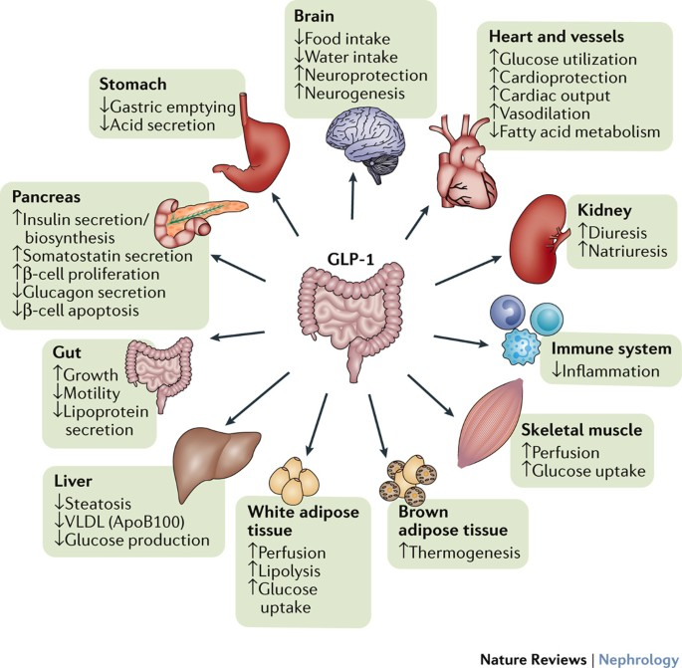
Multiple Sites of Action of GLP-1 RA
Muskiet, NatureReviewsNephrology, 2017
Slide 21

Slide 22
GLP1 RAs in Diabetes: Effects on Glucose and Weight
Drug | Duration | Glucose Effect | Weight Effect
Exenatide | 24 weeks | -0.9% | -2.9 kg
Liraglutide | 52 weeks | -1.1 % | -2.5 kg
Lixisenatide | 24 weeks | -0.72% | -2.7 kg
Dulaglutide | 36 weeks | -1.8% | -4.6 kg
Semaglutide | 40 weeks | -2.1% | -6.4 kg
Tirzepatide | 40 weeks | -2.3% | -11.2 kg
Glucose and weight data from FDA Package Inserts at highest approved dose
Slide 22

Slide 23
GLP1 RAs in Diabetes: Effects on CV Outcomes
Drug | Duration | Glucose Effect | Weight Effect | Reduction in MACE
Exenatide | 24 weeks | -0.9% | -2.9 kg | NO
Liraglutide | 52 weeks | -1.1 % | -2.5 kg | ↓ 14%
Lixisenatide | 24 weeks | -0.72% | -2.7 kg | NO
Dulaglutide | 36 weeks | -1.8% | -4.6 kg | ↓ 12% (1.5 mg)
Semaglutide | 40 weeks | -2.1% | -6.4 kg | ↓ 26% (1 mg)
Tirzepatide | 40 weeks | -2.3% | -11.2 kg | Equivalent to Dulaglutide
Glucose and weight data from FDA Package Inserts at highest approved dose
Slide 23

Slide 24
GLP1 RA for Obesity
Drug | Duration | Max Dose | Weight Effect
Liraglutide | 72 w | 3.0 mg | -8.4 kg/-8%
Semaglutide | 68 w | 2.4 mg | -18.4 kg/-16%
Tirzepatide | 72 w | 15 mg | -22 kg/-18.4%
Oral Semaglutide | 68 w | 50 mg | -15.8 kg/-15.1%
Orforglipron | 72 w | 36 mg | -11.6 kg/-11.2%
Pi-Sunyer, NEJM, 2015; Wadden, JAMA, 2021; Wadden, Nature Med, 2023:Knop, Lancet, 2023; Warton, NEJM, 2025 ;
Slide 24

Slide 25
Semaglutide decreases MetSyn Components in PWH: SLIM Liver Study
Outcome | Baseline | Week 24 | Absolute Difference (95% CI)
Waist Circumference (cm) | 115 | 108 | -6.7 (-8.5, -4.8)
Fasting Glucose (mg/dL) | 100 | 90.5 | -9.9 (-14.7, -5.1)
Triglycerides (mg/dL) | 150 | 131 | -26.8 (-46, -7.5)
HDL-c (mg/dL) | 46 | 47.6 | 2.0 (-0.02, 4.1)
HOMA-IR | 5.4 | 3.9 | -1.5 (-3.2, 0.3)
Lake, Annals of Int Med, 2025
Slide 25

Slide 26
Semaglutide decreases MetSyn Components in PWH with Central Fat Accumulation
Eckhart, Lancet Diabetes Endocrinology, 2024
Slide 26

Slide 27
GLP1RA for Obesity-related Conditions
Condition | Efficacy | FDA approval | Comments
CVD | ↓ 20% MACE (SELECT) | Semaglutide | Secondary Prevention
Heart Failure | ↑ 13% Clin Summary Score ↓ 40% HF Events |  | Preserved Ejection Fraction
MASH | ↓ 29% Steatohepatitis Resolution ↓ 14% Fibrosis | Semaglutide
Chronic Kidney Disease | ↓ 20% albuminuria ↓ 22% in composite kidney endpoint (FLOW) |  | FDA approved for diabetic kidney disease (semaglutide)
MACE: Major Adverse Cardiovascular Event; MASH: Metabolic-Dysfunction Associated Steatohepatitis
Slide 27
Kosiborod, NEJM, 2023; Kosiborod, Lancet, 2024; Sanyal NEJM, 2025;Malhorta,NEJM, 2024; Apperloo, Nature Med, 2025

Slide 28
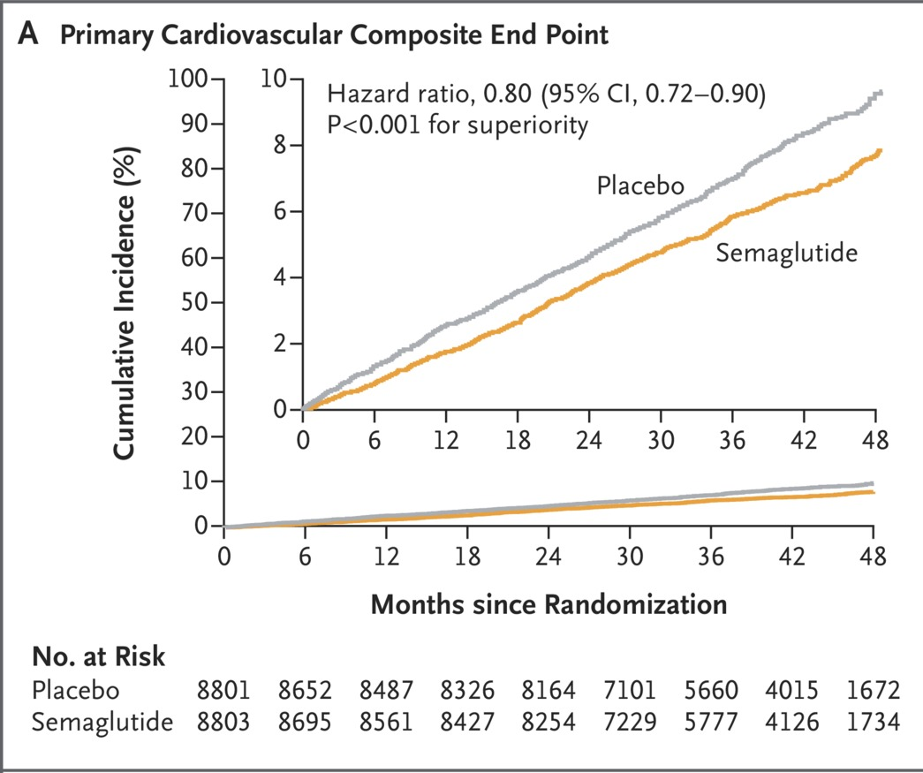
Are CVD benefits of GLP-1 RAs mediated by weight loss? : SELECT Trial
Primary Cardiovascular Endpoint
HR 0.80 (95% CI 0.72-0.90)
Placebo
Semaglutide
Decrease in waist circumference explains
~33% of MACE benefit
MACE: CVD death,
non-fatal MI, non-fatal stroke
Deanfield, Lancet 2025
Lincoff, NEJM, 2023
Slide 28

Slide 29
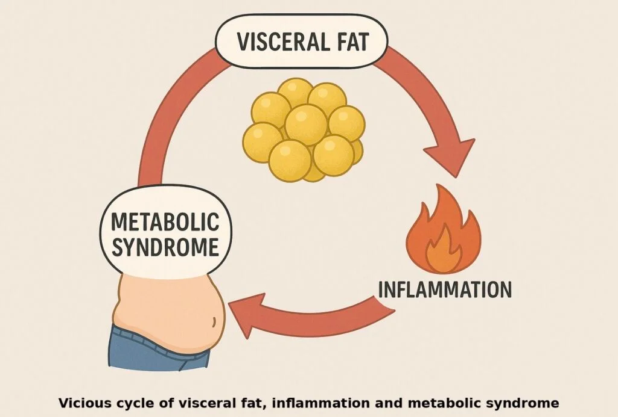
Slide 29

Slide 30
Do not edit
How to change the design
Question 2: Which of the following best characterizes the effect of GLP-1 RAs on systemic inflammation?
The Slido app must be installed on every computer you’re presenting from

Slide 31
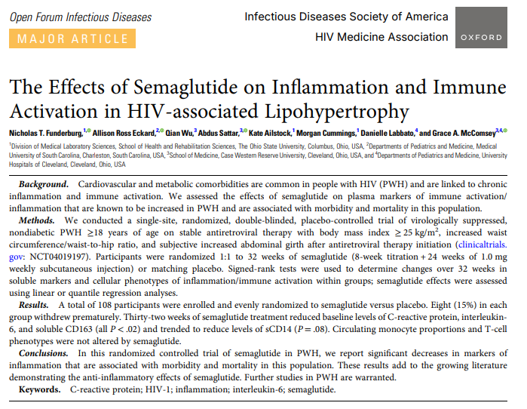
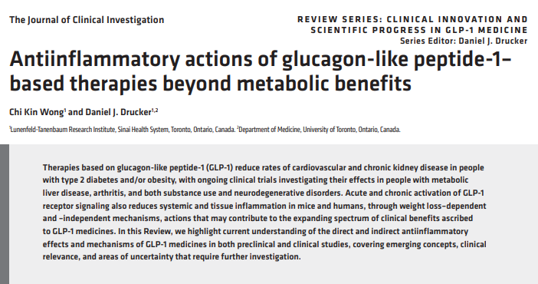
GLP-1 RA decrease markers of systemic inflammation in people with and without HIV
In clinical studies, GLP-1 RAs decrease markers of
systemic inflammation (eg, CRP) by 40-60 %
  ↓ weight and glucose account for 20-60% of
  reduction
Mechanisms vary:
  Direct effect on T cells, NKT cells
  Effects on CNS control of peripheral
  inflammation
  Specific tissues (eg endothelium, microglia)
RCT in 108 people with HIV-associated lipohypertrophy
Semaglutide vs placebo for 32 weeks, max dose 1 mg
↓19% body fat,↓31% VAT (Eckard, Lancet Diabetes, 2025)
↓ 48% CRP, ↓ 10% sCD163, ↓ 17% IL-6
Effect independent of changes in adiposity
Wong, JCI, 2025
Funderburg, OFID, 2025
Slide 31

Slide 32
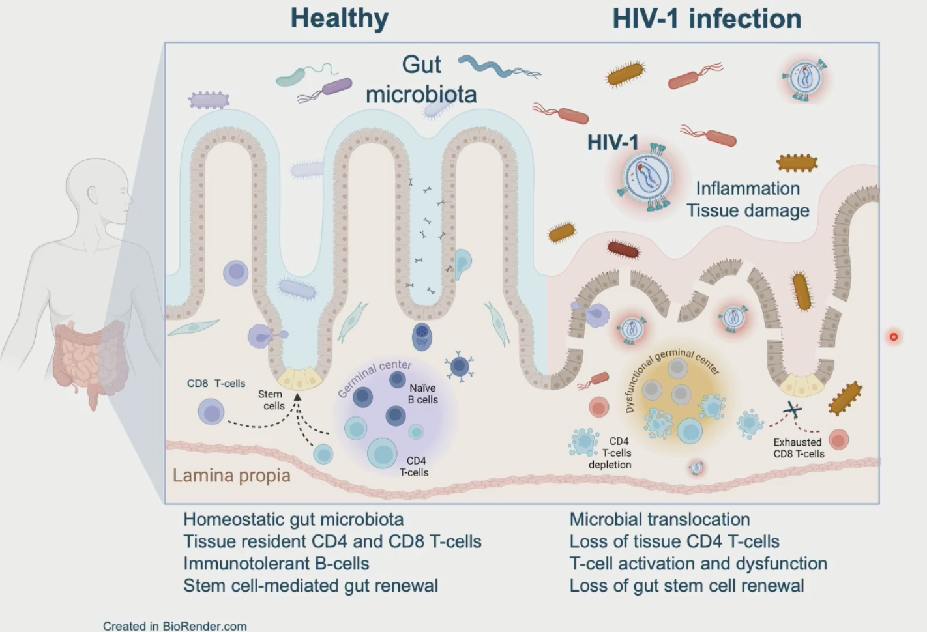
GLP-1 RA Induces Gut T-Cell and Epithelial Remodeling in PWH From a Clinical Trial in South Africa
Slide 32
Marin, CROI 2026, #115

Slide 33
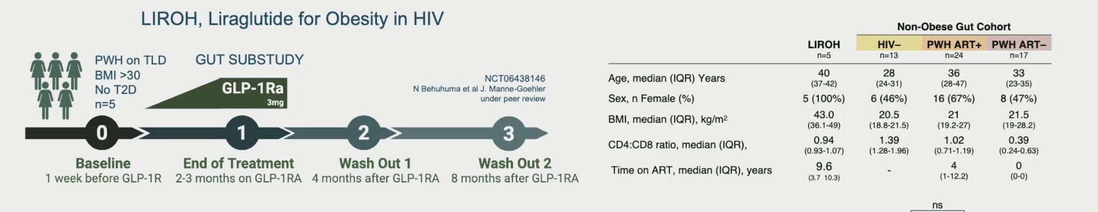
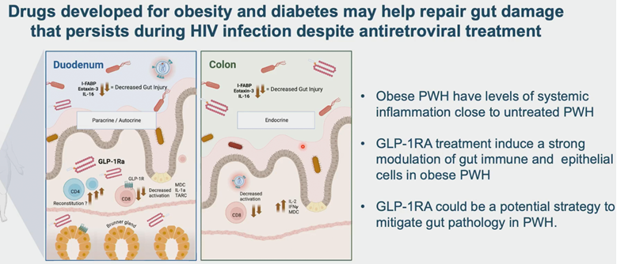
GLP-1 RA Induces Gut T-Cell and Epithelial Remodeling in PWH From a Clinical Trial in South Africa
Slide 33

Slide 34
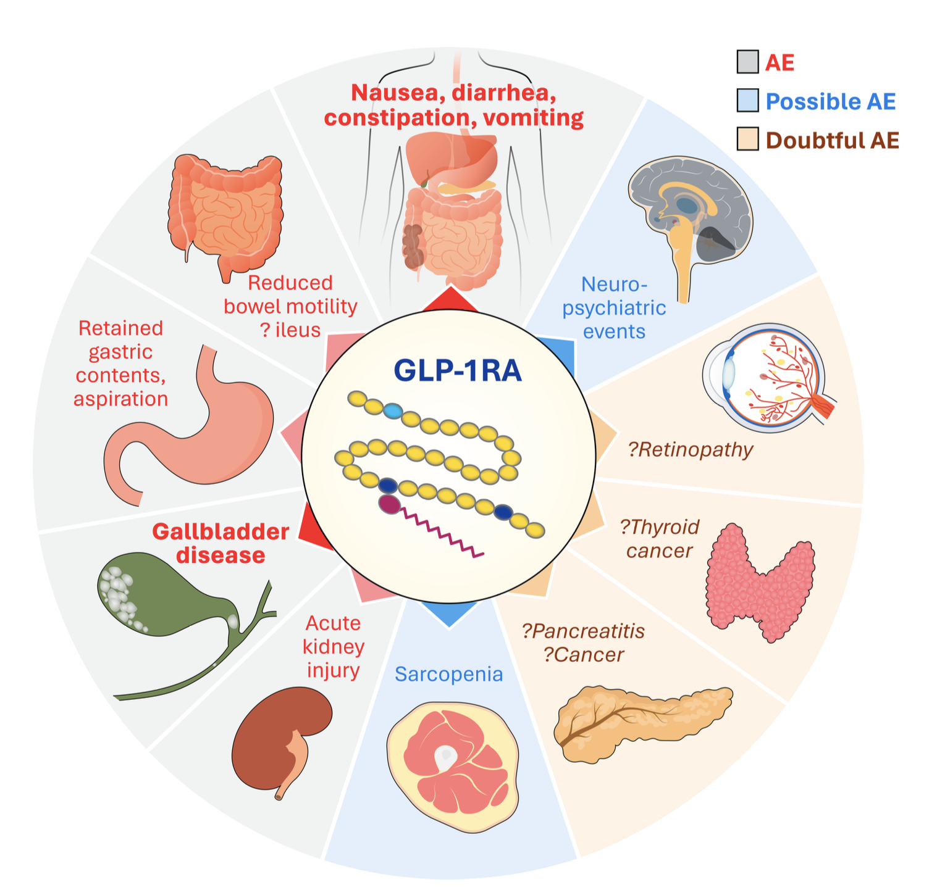
Adverse Effects of GLP1 RAs
Kim, Diabetes & Metabolism J, 2025,
Drucker , Diabetes Care, 2024,
Slide 34

Slide 35

GLP1 RA: Considerations across the life course
Slide 35

Slide 36
FDA Package Insert; Section 8.5: Geriatric Use
Population | Drug | Trial | > 65 years | >75 years
Diabetes | Dulaglutide | Glycemic Control | 19% | 2%
 |  | CVOT | 53% | 10%
 | Semaglutide | Glycemic Control | 24% | 3%
 |  | CVOT | 48% | 10%
 | Tirzepatide | Glycemic Control | 19% | 2%
Obesity | Semaglutide | Weight Reduction | 9% | 1%
 |  | CVOT (SELECT) | 30% | 8%
 |  | MASH | 26% | 2%
 | Tirzepatide | Weight Reduction | 9% | 0.5%
 |  | OSA | Not reported
Slide 36

Slide 37
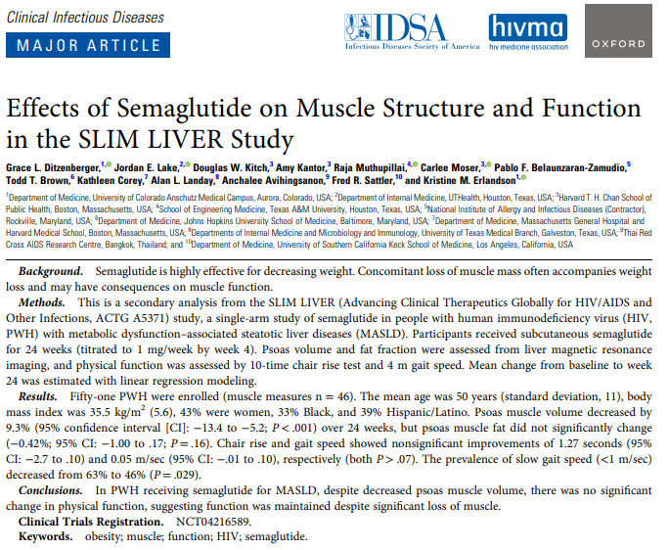
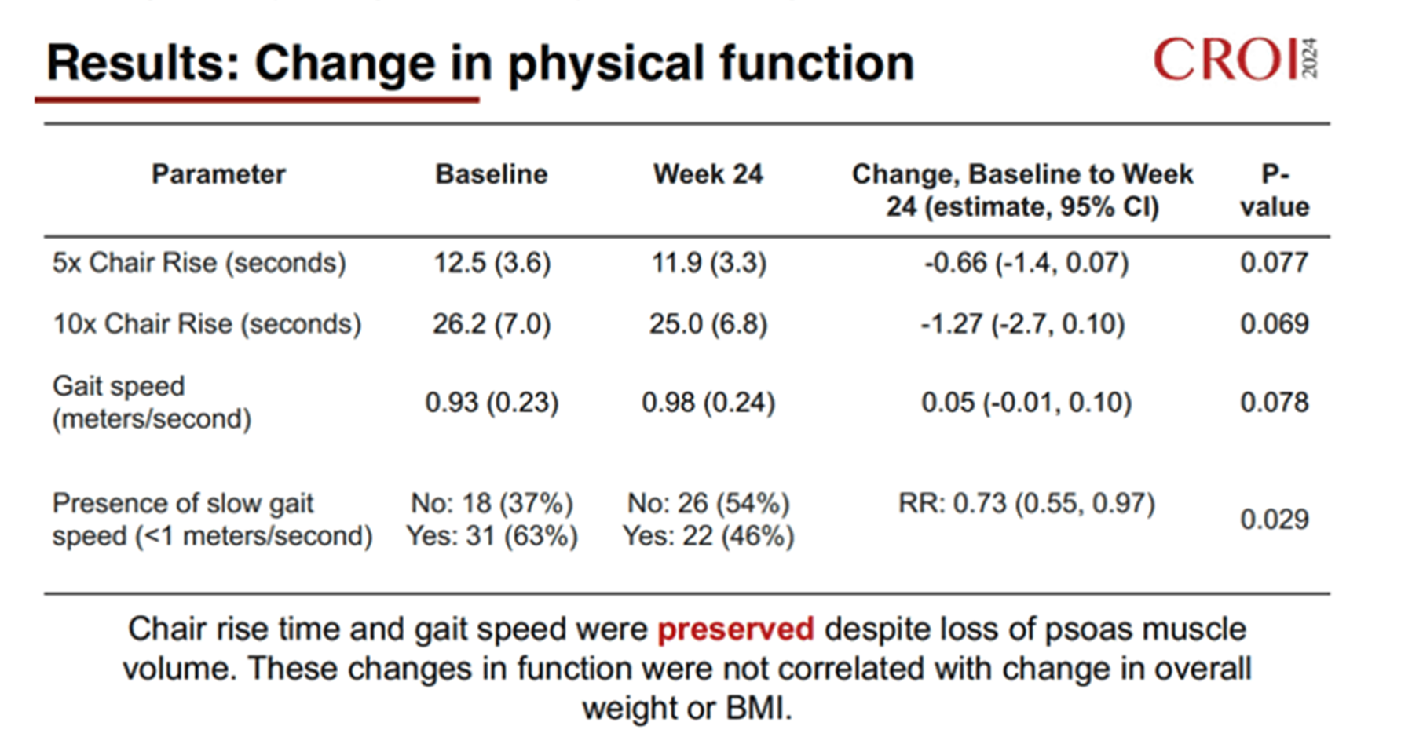
GLP1 RA in Older Adults: Loss of Lean Mass
↓9.3% psoas muscle volume
Is the effect of GLP-1 RA on muscle mass clinically relevant in certain populations?
Does the dose or rapidity of weight loss matter for muscle mass?
Can the effects be attenuated with protein intake and/or resistance training?
General population:
annual decrease in lean mass over 50 years ~1-2%
Rossi, Acta Diabetologia, 2025
Slide 37
Notes:
.

Slide 38
What is the effect of GLP-1 RA on BMD and fracture?
Are there certain sub-populations at increased risk?
14
2
4
7
10
Kushner, Obesity, 2025, calculated from Table S5;
numbers above columns represent absolute number of events
Slide 38
Notes:
.

Slide 39
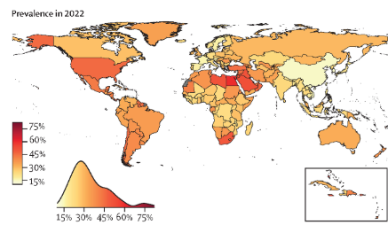
Obesity Prevalence Around the World
Estimated 27% of global population eligible
for GLP-1 RA (Yoo, Lancet Diabetes, 2026)
Universal semaglutide access estimated to
reduce global obesity by 20% and save 28M
lives over 5 years (Staton, Diabetes, 2025)
Slide 39
Lancet, 2024

Slide 40

Access: Achilles’ Heel of GLP-1 RAs
Rapidly changing landscape may decrease cost,
increase production and improve access
New oral formulations: Oral semaglutide, Orforglipron (small molecule)
Patent Expirations: Semaglutide: 2026 in India, China, Brazil, Canada, Turkey;
2032 in US
Development of multi-agonists
  GLP-1 RA/(GIP RA) + Amylin, Glucagon, IGF-1, GDF-15, FGF-21, Activin, NPY
> 60 GLP-1 based compounds in development for multiple indications
Slide 40

Slide 41
Conclusions
PWH have a high prevalence of metabolic syndrome and CKM-related events
GLP-1 RAs improve metabolic syndrome components in PWH and may impact CKM-events (CVD, renal disease, MASLD, heart failure)
GLP-1 RA improve systemic inflammation in PWH
Muscle and bone effects in older PWH need more attention
Access is a critical issue

Slide 42
Q and A Session

