Slide 1

Drug-Drug Interactions With Long-Acting Antivirals: Difficult to Study, Easy to Manage?
David Burger, PharmD, PhD
Professor of Clinical Pharmacy
Research Institute for Medical Innovation
Radboud University Medical Center
Nijmegen, The Netherlands

Slide 2
Financial Relationships With Ineligible Companies (Formerly Described as Commercial Interests by the ACCME) Within the Last 2 Years
Dr Burger reported receiving consulting or advisor fees paid to his institution from Merck Sharp & Dohme and grants paid to his institution from Merck Sharp & Dohme, Gilead Sciences, Inc, and ViiV Healthcare. (Updated October 15, 2026)

Slide 3
Learning Objectives
After attending this presentation, learners will be able to:
  Describe the drug-drug interaction profile of long-acting antiretrovirals
  List potential challenges in performing drug-drug interaction studies with long-acting antiretrovirals
  Explain the value of physiologically-based pharmacokinetic (PBPK) modeling in predicting drug-drug interactions between strong enzyme inducers and lenacapavir

Slide 4
Outline of my presentation
The basics of drug-drug interactions (DDIs) (in 5 minutes)
How to study DDIs with new drugs
DDI profiles of long-acting ART
    CAB/RPV
    LEN
    ISL/LEN
Discussion & Conclusions

Slide 5



Concept of Precipitant and Object of DDIs
AEs (of A)
Precipitant (perpetrator)
AEs (of B)
Drug A
Drug B
Object
(victim)
Loss of Efficacy (of A)
Loss of Efficacy (of B)
Need to understand:
  The disposition or handling of each drug
  The therapeutic window of each drug
Personal Communication:
Professor D J Back

Slide 6
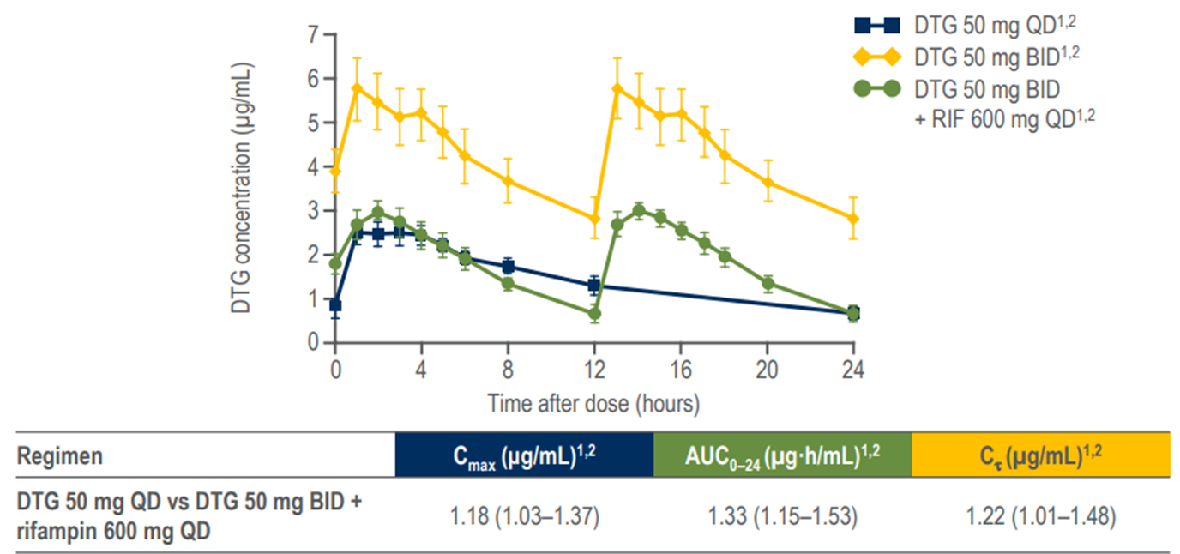
Example of a DDI: Rifampicin + Dolutegravir
UGT1A1 & CYP3A induction
Precipitant (perpetrator)
Object
(victim)
RIF
DTG
Personal Communication:
Professor D J Back
Dooley et al. JAIDS 2013

Slide 7
Two important concepts in PK DDIs: inhibition & induction
Drugs can inhibit metabolic enzymes and drug transporters, leading to increased concentrations of relevant substrates (three categories: weak, moderate, strong)
Drugs can induce metabolic enzymes and drug transporters, leading to reduced concentrations of relevant substrates (three categories: weak, moderate, strong)

Slide 8
Two important differences between PK DDIs based on inhibition & induction
Inhibition starts directly at the first dose, becomes maximal at steady-state, and stops when concentrations of the inhibitor have disappeared (usually, when dosing has stopped. Exception: long-acting!)
Induction requires 1-2 weeks before becoming maximal, remains present 1-2 weeks after dosing of the inducer has stopped.

Slide 9
Understanding (or predicting) PK DDIs
Assess which drug has which role: precipitant or object
Assess the mechanism: inhibition and induction
→ what kind of intervention is needed?

Slide 10
How to study DDIs with new drugs
Preclinical studies
  give an indication whether a drug is a substrate of metabolic enzymes and/or drug transporters (object)
  give an indication whether a drug is able to inhibit or induce hepatic enzymes and/or drug transporters (precipitant)
  These data determine which clinical DDI studies need to be performed during clinical development

Slide 11
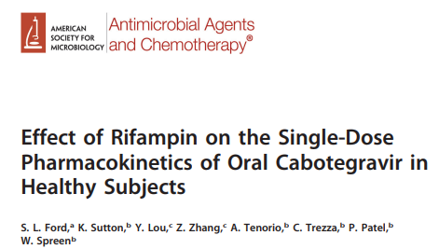
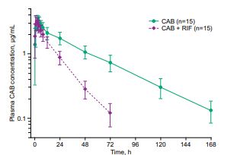
Cabotegravir/rilpivirine (CAB/RPV) - 1
AUC: 59% ↓
2017 (61): e00487-17
Effect of rifampin on rilpivirine AUC even larger: -80% (Edurant SmPC)

Slide 12
Cabotegravir/rilpivirine (CAB/RPV) - 2
AUC: 59% ↓
2017 (61): e00487-17
Effect of rifampin on rilpivirine AUC even larger: -80% (Edurant SmPC)
Co-administration of rifampin and cabotegravir and rilpivirine (oral or i.m.) is contra-indicated

Slide 13
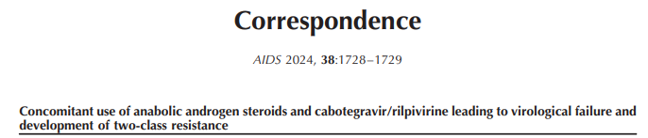
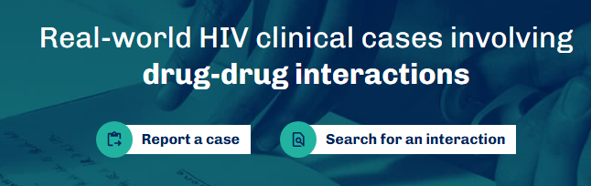
Is testosterone a strong enzyme inducer?
Trough drug level measurement in our case:
CAB: 0.91 mg/L (median population value 1.6 mg/L): 43% ↓
RPV: 0.026 mg/L (median population value 0.066 mg/L): 61% ↓
Alternatively, cases can also reported to www.clinicalcasesddis.com

Slide 14
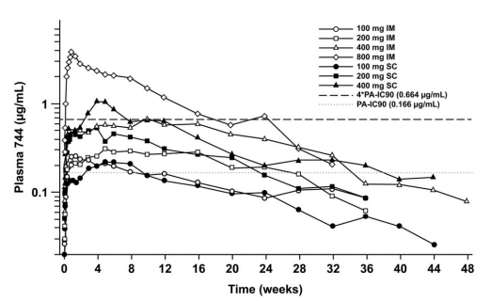
Cabotegravir/rilpivirine (CAB/RPV) - 3
A single i.m. administration of LA CAB/RPV can lead to detectable plasma levels up to 52 weeks or even longer; this makes DDI studies in healthy volunteers unfeasible
Spreen et al JAIDS 2014

Slide 15
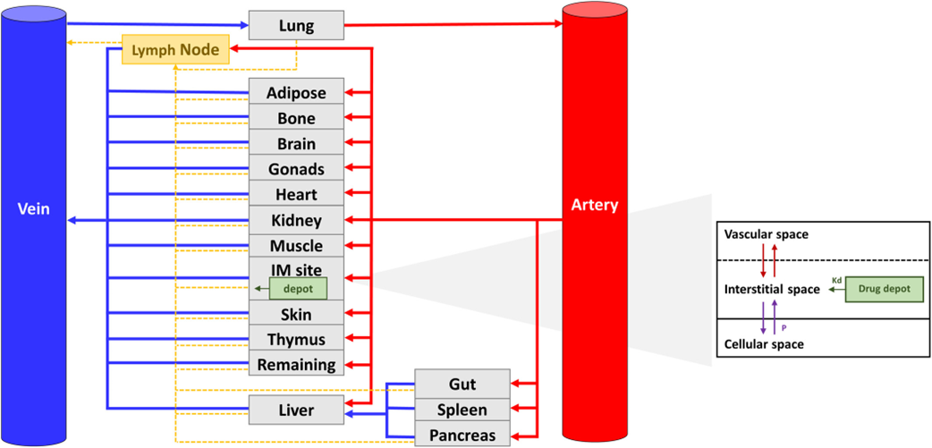
Cabotegravir/rilpivirine (CAB/RPV) - 4
  In the absence of a clinical DDI study, physiologically-based PK (PBPK) modelling might be an alternative
Bettonte et al. CPT Pharmacom & Syst Pharma 2024; 13(5): 781-94

Slide 16
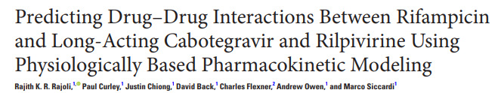
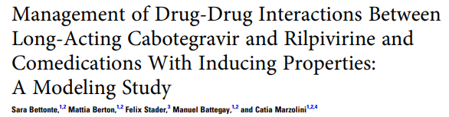
Cabotegravir/rilpivirine (CAB/RPV) - 5
Predicted effect of rifampin administration on trough levels of LA CAB/RPV:
CAB: -46% CAB: -62%
RPV: -82% RPV: -40%
The two models come to the same conclusion = contra-indication, though actual predictions vary to some extent

Slide 17
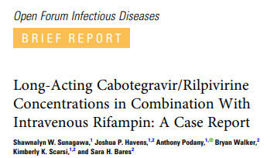
Clinical experience with rifampin & CAB/RPV (1)
Complex case of a TB/HIV-co-infected patient where only parenteral medication was possible, including rifampin and CAB/RPV.
7 days after administration of a 600/900 CAB/RPV loading dose, drug levels were:
CAB: 0.455 mg/L (ref.: approx. 4 mg/L) 89% ↓
RPV: < 0.005 mg/L (ref.: approx. 0.133 mg/L) >96% ↓
OFID 2023

Slide 18
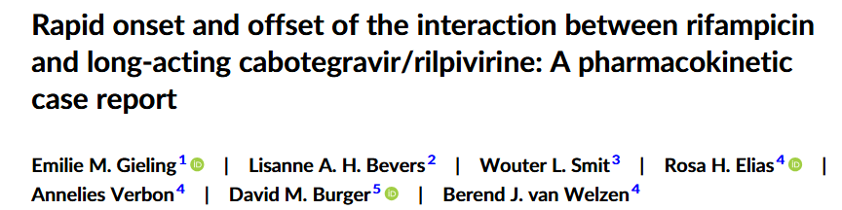
Clinical experience with rifampin & CAB/RPV (2)
Patient stable on LA CAB/RPV required MRSA eradication therapy including RIF 600mg BID.
RIF was started 6 weeks after last LA dose
Drug levels were measured before and at Day 7 of RIF treatment:
CAB: 2.08 → 0.90 mg/L (57% ↓)
RPV: 0.126 → 0.022 mg/L (83% ↓)
Br J Clin Pharmacol 2026; in press

Slide 19
Discussion of clinical cases
Both cases were not exactly similar as the scenarios used in PBPK modelling
Impact of a strong inducer like rifampin was greatest for RPV
Modelling scenarios with increased dosing of CAB/RPV did not lead to therapeutic levels
CAB/RPV remains contra-indicated with strong enzyme inducers

Slide 20
What else can be said about DDIs with LA CAB/RPV?
  Logically, there is no interaction with gastric acid-reducing agents as seen with oral RPV or with cations and oral InSTI
  RPV is a CYP3A substrate, so DDIs with CYP3A inhibitors (e.g., clarithromycin) remain clinically relevant
  DDI alerts (e.g., QTc prolongation) may be presented up to 6 months after last administration (depending on the system): clinically relevant?

Slide 21
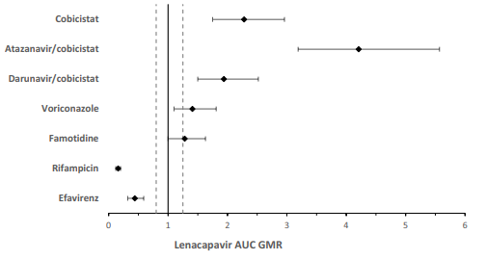
Lenacapavir (LEN) DDIs: as an Object
(studied with oral LEN)(1)
  LEN is a substrate of CYP3A, UGT1A1 and P-gp
Marzolini et al. Expert Opin Drug Metab & Toxicol 2025

Slide 22
Lenacapavir (LEN) DDIs: as an Object
(studied with oral LEN)(2)
  LEN is a substrate of CYP3A, UGT1A1 and P-gp
  Rifampin (strong inducer) = contra-indication
  Moderate inducers (EFV, rifabutin) = not recommended
  Atazanavir/cobicistat (strong inhibitor of all three pathways) = contra-indication
  Inhibition of 1 or 2 pathways (e.g. DRV/c) = not relevant (escape pathway)

Slide 23
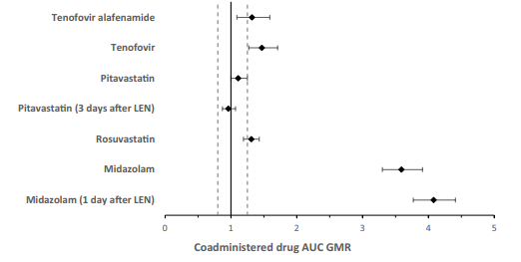
Lenacapavir (LEN) DDIs: as a Precipitant
(studied with oral LEN)(1)
Marzolini et al. Expert Opin Drug Metab & Toxicol 2025

Slide 24
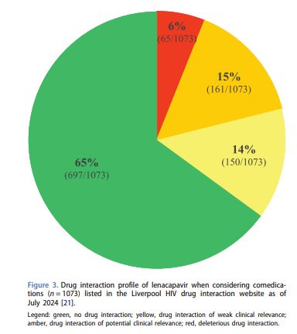
Lenacapavir (LEN) DDIs: as a Precipitant
(studied with oral LEN)(2)
  LEN is a moderate inhibitor of CYP3A: midazolam C_{max} 1.94 ↑; AUC 3.59 ↑.
  Recommendation: be cautious with sensitive CYP3A substrates (i.e.: narrow therapeutic range) up to 9 months after last injection of LEN
Marzolini et al. Expert Opin Drug Metab & Toxicol 2025

Slide 25
Some comments on LEN DDI recommendations (1)
Atazanavir/cobicistat is the only drug that indeed inhibits all three elimination pathways of LEN, and is a contra-indication
However, if a patient is using DRV/c + sorafenib, also all three pathways are inhibited, but no DDI alert will be presented…
Burger et al. J Clin Pharmacol 2023

Slide 26
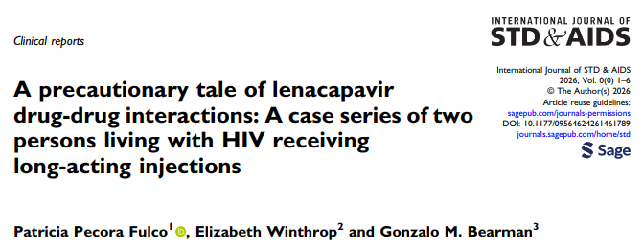
Some comments on LEN DDI recommendations (2)
As LEN is a moderate CYP3A inhibitor, CYP3A substrates that are initiated several months after the last LEN injection are still prone to a DDI. Is the system working?
Case 1: clopidogrel was prescribed 2 months after last LEN injection; no DDI alert was generated
Case 2: patient used daily inhalations of fluticasone (not included in medication list) and developed Cushing syndrome

Slide 27
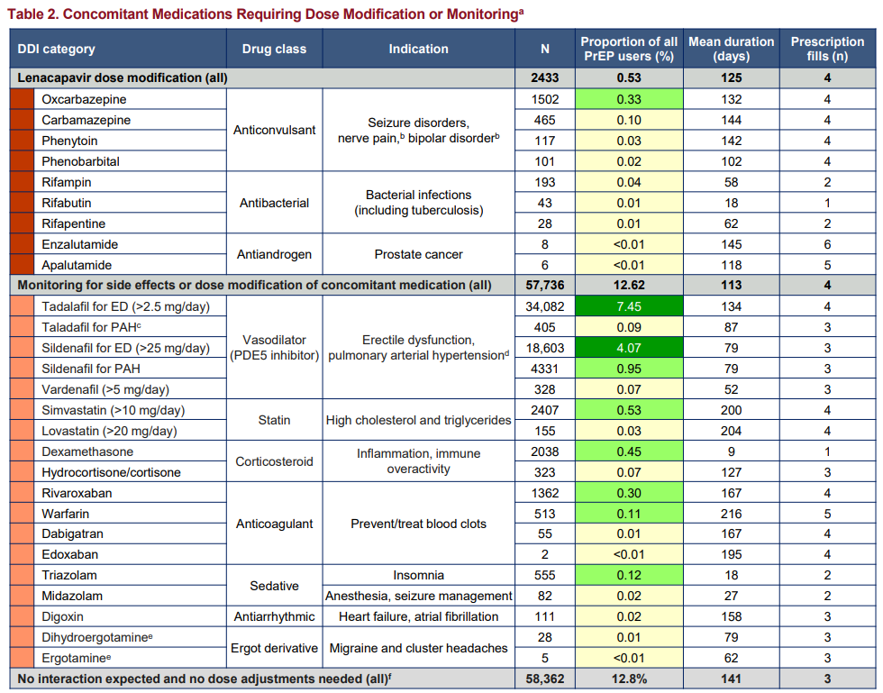
When LEN is used for PrEP, is DDI management different?
CROI 2026; P1062
DDI management not necessarily different, type of co-medication may be somewhat different as PrEP users are usually younger and have fewer co-morbidities

Slide 28
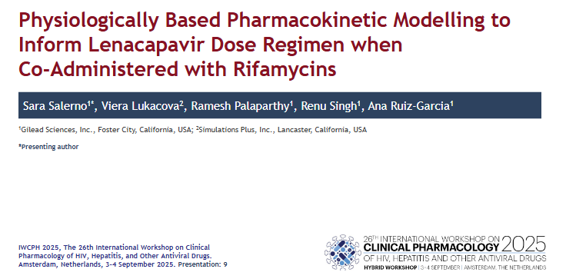
Recently, the LEN PrEP product label was updated with new DDI recommendations (1)

Slide 29
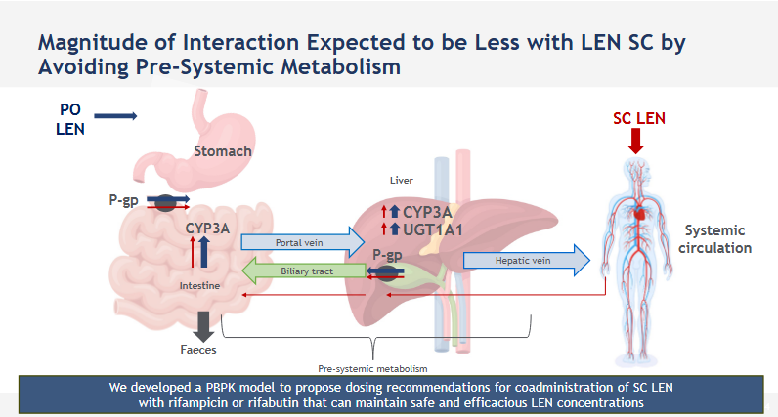
Recently, the LEN PrEP product label was updated with new DDI recommendations (2)
Salerno et al. Antiviral PK workshop 2025; abstract #9

Slide 30
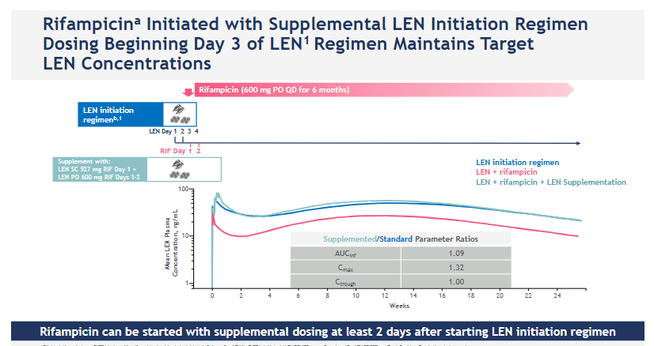
Recently, the LEN PrEP product label was updated with new DDI recommendations (3)
Salerno et al. Antiviral PK workshop 2025; abstract #9

Slide 31
Various responses by regulatory authorities on the proposed DDI recommendations
  US FDA: proposal for DDI management with supplemental LEN doses accepted for all strong and moderate CYP3A inducers (but only for existing LEN users, only for PrEP)
  Canadian FDA: proposal only accepted for rifampin
  EMA: proposal NOT accepted
        “… the predictions rely on untestable assumptions”

Slide 32
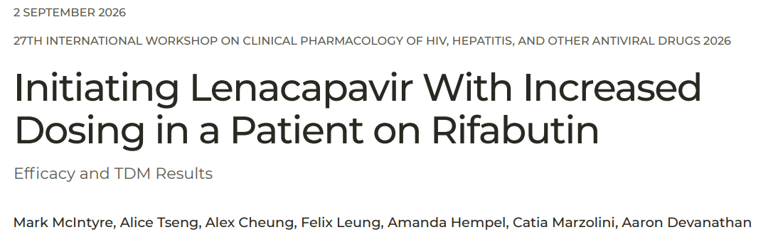
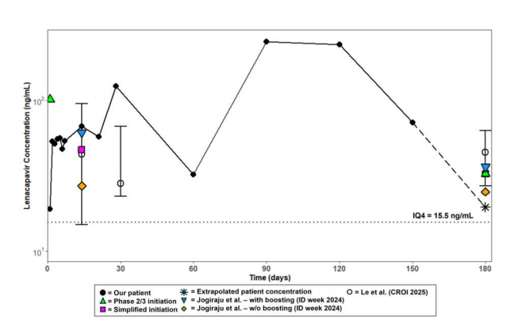
Case presentation
Double off-label:
Only approved for LEN as PrEP
Only approved for patients already on LEN

Slide 33
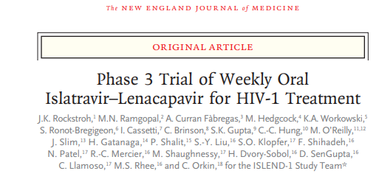
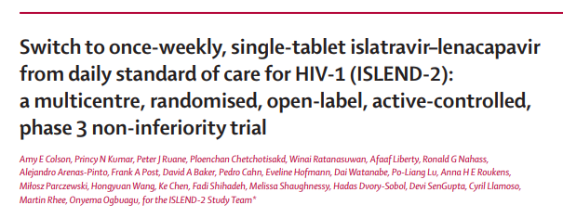


Weekly oral islatravir/lenacapavir (ISL/LEN)

Slide 34
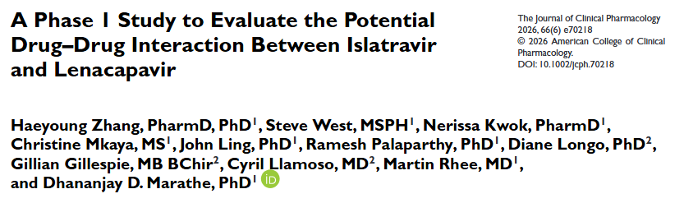
ISL - LEN DDI study
Outcome: no clinically relevant interaction

Slide 35
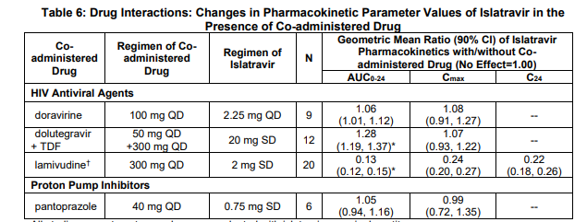

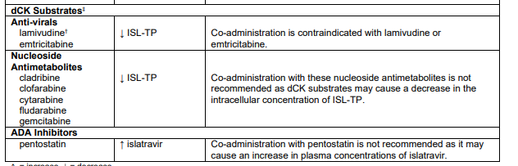
ISL DDI profile

Slide 36
Conclusions
DDIs with LA ART ≠ DDIs with oral ART
No DDIs based on absorption with parenteral ART
    E.g., PPIs + RPV; cations + InSTIs
With LA ART being CYP3A substrates, susceptibility to inducers and inhibitors not different from oral ART; what is the value of PBPK modelling?
Please be aware of DDIs weeks or months after last LA injection

Slide 37




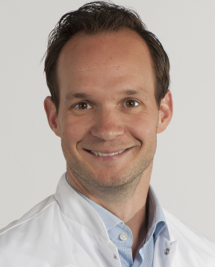

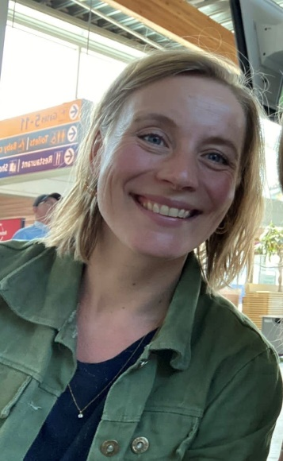



Thank you for your attention
& greetings from Nijmegen

Slide 38
Q and A Session

