Slide 1

Evolving Strategies in Antiretroviral Therapy:
A Case-Based Discussion
Eric S. Daar, MD
Professor of Medicine
University of California Los Angeles
Chief, Division of HIV Medicine
Harbor-UCLA Medical Center
Los Angeles, CA

Slide 2
Financial Relationships With Ineligible Companies (Formerly Described as Commercial Interests by the ACCME) Within the Last 2 Years
Dr Daar reported serving as a consultant to Gilead Sciences, Inc, and Merck & Co, Inc, and receiving research grants paid to his institution from Gilead Sciences, Inc, and ViiV Healthcare. (Updated September 30, 2026)

Slide 3
Learning Objectives
After attending this presentation, learners will be able to:
  Describe clinical scenarios that may impact choice of initial antiretroviral therapy
  List settings in which novel optimization strategies may apply
  Manage virologic failure in patients with poor adherence

Slide 4
What to Start
Slide 4

Slide 5
Patient newly diagnosed with HIV
Patient is 68 yo man not receiving any medical care who presented to Urgent Care with odynophagia and thrush at which time found to have HIV and started on fluconazole with referral for HIV specialty care
Upon presentation to HIV clinic
  Odynophagia and thrush resolved
  Plasma HIV RNA 1.3 million copies/mL; CD4 98 cells/µL; GT- wild type
  HBsAb-neg; HBsAg- neg; HBcAb+; HCV Ab- neg
  CrCl 45 mL/min, HgbA1C 6.2%, LDL 140 mg/dL, HDL 38 mg/dL
Patient is interested in starting therapy as soon as you think appropriate

Slide 6
What would you recommend for ART?
BIC/FTC/TAF
DTG + FTC/TAF
DTG/3TC
DRV/cobi/3TC
Something else
68 yo man with resolving presumptive candida esophagitis
HIV RNA 1.3 million c/mL; CD4 98 cells/µL, HBcAb+, CrCl 45 mL/min,
HIV GT- wild type
Slide 6

Slide 7
Do not edit
How to change the design
What would you recommend for ART?
The Slido app must be installed on every computer you’re presenting from

Slide 8
What would you recommend if CrCl 30 mL/min?
BIC/FTC/TAF
DTG + FTC/TAF
DTG/ABC/3TC (assume HLA-B5701-neg)
DTG/3TC
DRV/cobi/3TC
Something else
68 yo man with resolving presumptive candida esophagitis
HIV RNA 1.3 million c/mL; CD4 98 cells/µL, HBcAb+, CrCl 45 mL/min,
HIV GT- wild type
Slide 8

Slide 9
Do not edit
How to change the design
What would you recommend if CrCl 30 mL/min?
The Slido app must be installed on every computer you’re presenting from

Slide 10
Until recently, preferred DHHS first-line therapy
Preferred Regimens for Most Patients
BIC/TAF/FTC (AI)
DTG + TXF + XTC (AI)
DTG/3TC* (AI)
Key Populations
CAB-LA PrEP in Previous 12 Months
DRV/cobicistat (or ritonavir if pregnant) + TXF + XTC (pending INSTI resistance results)
Pregnancy
DTG + TXF + XTC
or
BIC/TAF/FTC
HBV co-infection
Ensure TXF is part of the regimen
Tuberculosis
Rifamycins induce CYP3A4 and UGT1A1 enzymes, causing significant decreases in concentrations of PIs, INSTIs, and RPV
*Only if HIV RNA <500,000 copies/mL and CD4 >200 cells/µL, no HBV and resistance genotype available
Panel on Antiretroviral Guidelines for Adults and Adolescents. Guidelines for the Use of Antiretroviral Agents in Adults and Adolescents With HIV. Department of Health and Human Services. https://clinicalinfo.hiv.gov/en/guidelines/hiv-clinical-guidelines-adult-and-adolescent-arv/whats-new. Accessed 5/5/26.

Slide 11
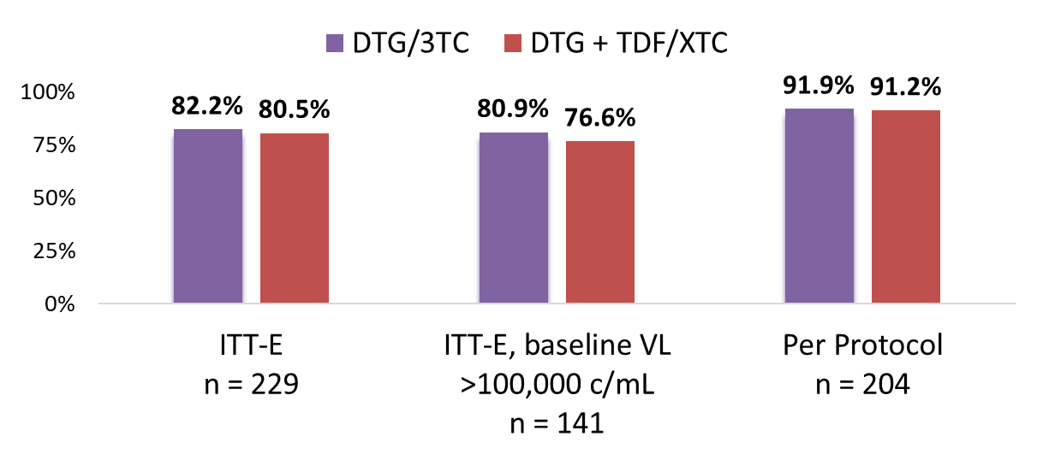
DOLCE Study: DTG/3TC in Treatment-naïve people with advanced HIV infection
Randomized, open-label study assessing the efficacy of DTG/3TC vs DTG plus TDF/XTC at week 48 in treatment-naive PWH with CD4 counts ≤ 200 cells/mm³
Baseline Characteristics
Primary Endpoint: VL < 50 c/mL, week 48
n (%) | DTG/3TC (N = 153) | DTG + TDF/XTC (N = 77)
CD4 ≤ 100 cells/mm³ | 69 (45%) | 29 (39%)
VL ≥ 100,000 c/mL | 94 (61%) | 47 (61%)
VL ≥ 500,000 c/mL | 34 (23%) | 18 (23%)
VL ≥ 1,000,000 c/mL | 16 (11%) | 7 (9%)
Conclusion: DTG/3TC demonstrated high efficacy in PWH with low CD4 counts and high VL
Figueroa MI, et al. Clin Infect Dis. 2026;82(1):122–31.
Slide 11

Slide 12

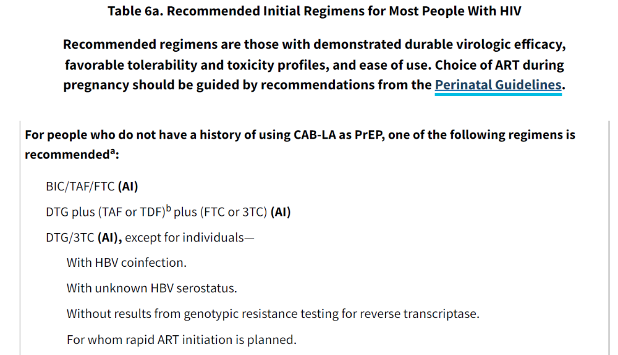

Slide 13
Regimen switch in suppressed patients
Slide 13

Slide 14
Patient suppressed on DRV/cobi/FTC/TAF + DTG with progression of CKD
Patient is 57 yo woman with H/O controlled DM, HTN, and CKD
History of treatment dating back approximately 15 years in outside clinic where reported that approximately 5 years ago she experienced virologic failure with K65R, M184V and K103N, at which time she was switched to DRV/r + FTC/TDF + RAL with suppression, with regimen eventually modified to DRV/cobi/FTC/TAF + DTG with good tolerance, viral suppression and CD4 298 cells/µL
Over course of last 2 years progression of CKD with most recent CrCl repeatedly <30 mL/min
HBsAg-neg/HBcAb+/HBsAb-neg, HCV Ab-neg

Slide 15
What would you recommend for ART?
Continue current regimen
BIC/FTC/TAF
DTG + FTC/TAF
DTG/ABC/3TC (HLA-B5701-neg)
DTG/3TC
DOR/ISL
BIC/LEN
Something else
57 yo woman with DM, HTN, and CKD; HBcAb+, CrCl <30 mL/min and HIV VL <20 copies/mL
H/o VF with K65R, M184V and K103N with exposure to RAL but reportedly while suppressed
Currently suppressed on DRV/cobi/FTC/TAF + DTG
Slide 15

Slide 16
Do not edit
How to change the design
What would you recommend for ART?
The Slido app must be installed on every computer you’re presenting from

Slide 17
Renal Dosing ARVs
Acute or chronic kidney disease
Avoid TDF if CrCl <60 mL/min or TAF if <30 mL/min
Options
    NNRTIs, 2nd gen INSTIs, boosted PIs, attachment inhibitor, capsid inhibitors- no dose adjustment
    ABC/3TC: FDA says no for CrCl<30 mL/min; GL say okay
    3TC: FDA says adjust <30mL/min; GL say okay <30 mL/min
    FTC: FDA says adjust CrCl<30 mL/min; GL say okay to <15 mL/min or HD
    TAF/FTC: not for <30mL/min, but okay on HD (after dialysis on HD days)
https://clinicalinfo.hiv.gov/en/guidelines/hiv-clinical-guidelines-adult-and-adolescent-arv/drug-characteristics-tables-renal-hepatic-insufficiency-full
Slide 17

Slide 18
ART options in acute or chronic kidney disease
Acute or chronic kidney disease
Avoid TDF if CrCl <60 mL/min or TAF if <30 mL/min
Options
Standard tenofovir-sparing regimens
    DTG + ABC/3TC (ABC issues)
    DRV/c + ABC/3TC (ABC issues)
    DTG/3TC, DTG/RPV, CAB/RPV LA, DRV/c+XTC (resistance and DDI issues)
  Novel tenofovir-sparing regimens
    DTG + DRV/c
    More recent/Future: DOR/ISL, BIC/LEN; LEN/ISL QWK
Slide 18

Slide 19
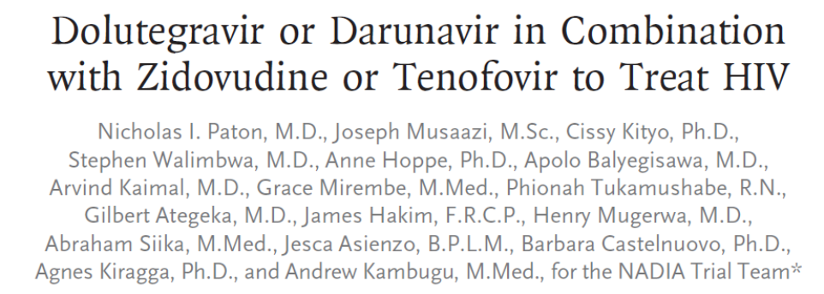

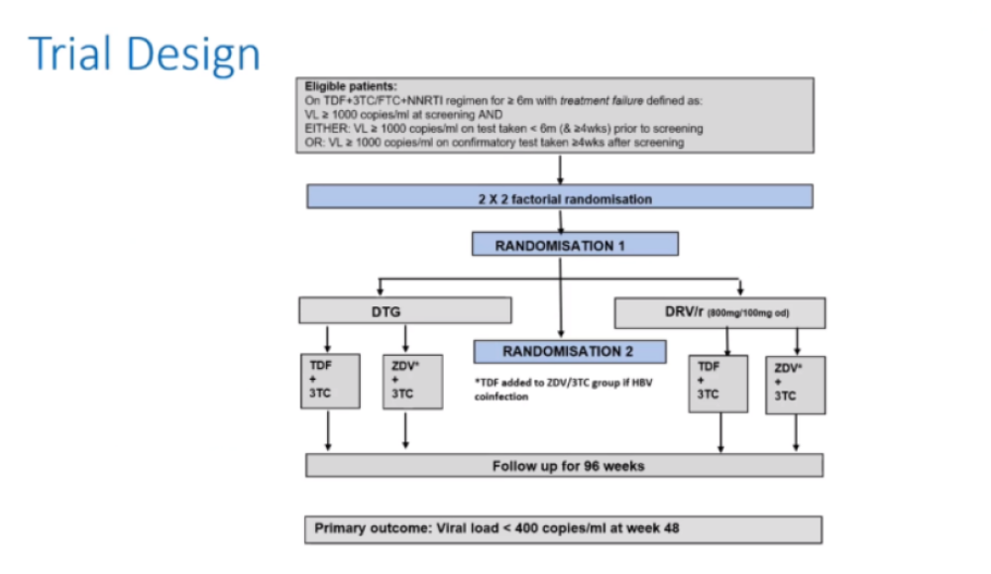
Case for INSTI or bPI + TAF/FTC with underlying resistance
Slide 19
Paton NI, et al. N Engl J Med 2021;385: N330-41.

Slide 20
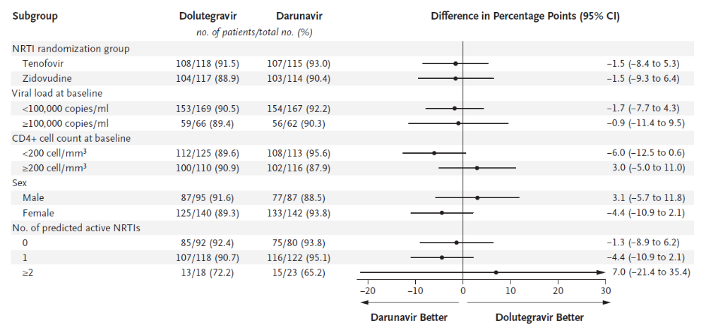
INSTI resistance in 9 (2.3%)
PI resistance in 0
Paton NI, et al. N Engl J Med 2021;385: N330-41.
Slide 20

Slide 21
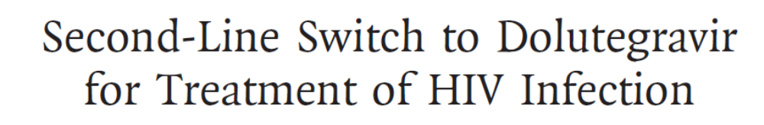
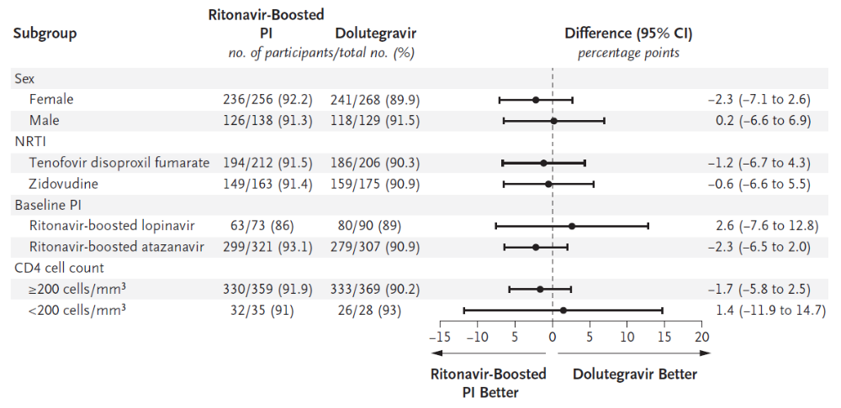
Primary endpoint HIV RNA ≥50 c/mL
DTG (5%) bPI (5.1%)
Difference -0.04% (95% CI -3.1, 3.0), p<0.001
Slide 21
Ombajo LA, et al. NEJM 2023; 388:2349-59.

Slide 22
If you decided that you would not use a TFV or ABC containing regimen, which ARV regimen would you recommend?
DTG/3TC
DRV/cobi + 3TC
DRV/cobi + DTG (± 3TC)
DOR/ISL
BIC/LEN
Something else
57 yo woman with DM, HTN, and CKD; HBcAb+, CrCl <30 mL/min and HIV VL <20 copies/mL
H/o VF with K65R, M184V and K103N with exposure to RAL but reportedly while suppressed
Currently suppressed on DRV/cobi/FTC/TAF + DTG
Slide 22

Slide 23
Do not edit
How to change the design
If you decided that you would not use a TFV or ABC containing regimen, which ARV regimen would you recommend?
The Slido app must be installed on every computer you’re presenting from

Slide 24
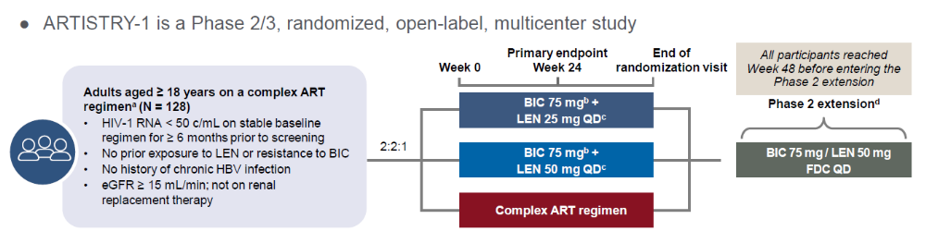
ARTISTRY-1: LEN + BIC once daily
Case for BIC/LEN with underlying resistance
Baseline resistance
NRTIs (82%)
NNRTIs (66%)
PI (47%)
INSTI (9%) (not to BIC)
Slide 24
Orkin C, et al. Lancet 2026; 407:1249-58

Slide 25
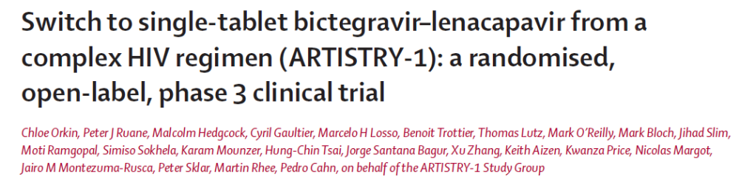
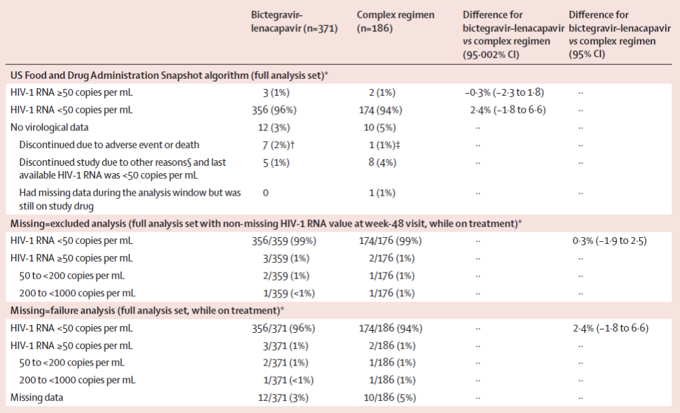
Slide 25
Orkin C, et al. Lancet 2026; 407:1249-58

Slide 26
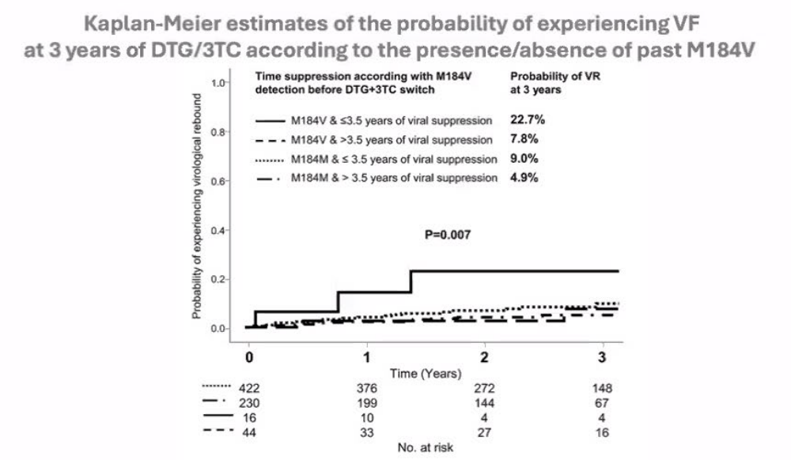
LAMRES Study: Switch to DTG/3TC with historical M184V
Case for DTG/3TC with history M184V
European retrospective study (712 participants with VL <50 c/mL) who switched to DTG/3TC (60 with documented M184V in past)
Median duration of suppression before DTG/3TC initiation 5.2 yrs
Conclusion: Shorter duration of suppression at higher risk of VF with historical M184V mutations
Slide 26
Santoro MM et al., Glob Antimicrobial Resistance 2022

Slide 27
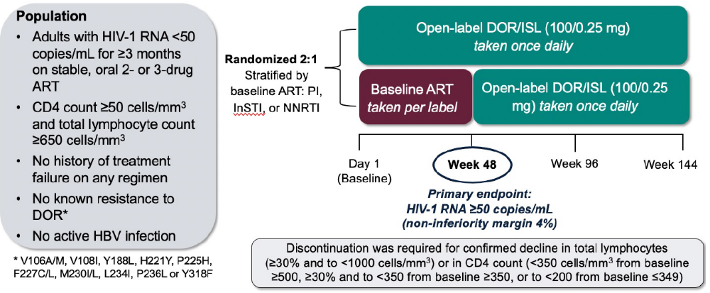
Switch to DOR/ISL (100/0.25 mg) QD from cART
Orkin C, et al. Lancet 2026
Slide 27

Slide 28
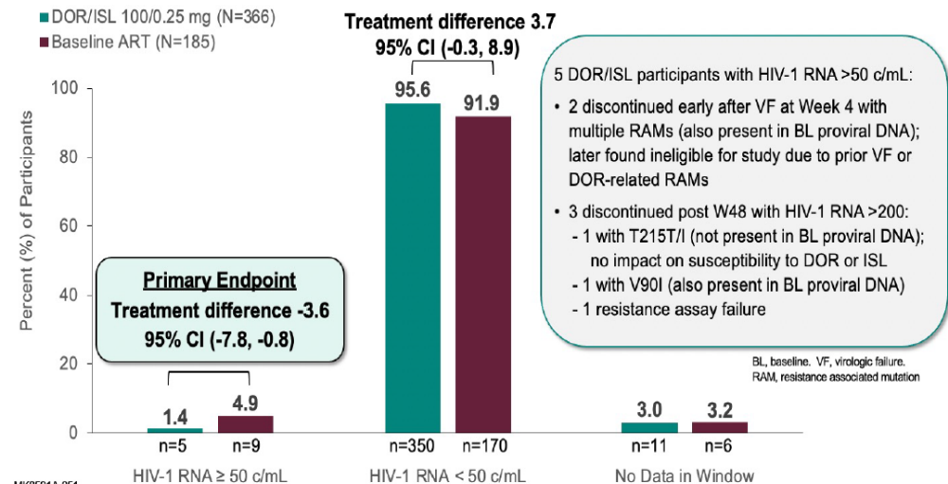
No decline in total lymphocyte or CD4+ lymphocyte counts
Reminder: ISL contraindicated with 3TC and FTC: potentially reduce intracellular ISL
Slide 28

Slide 29
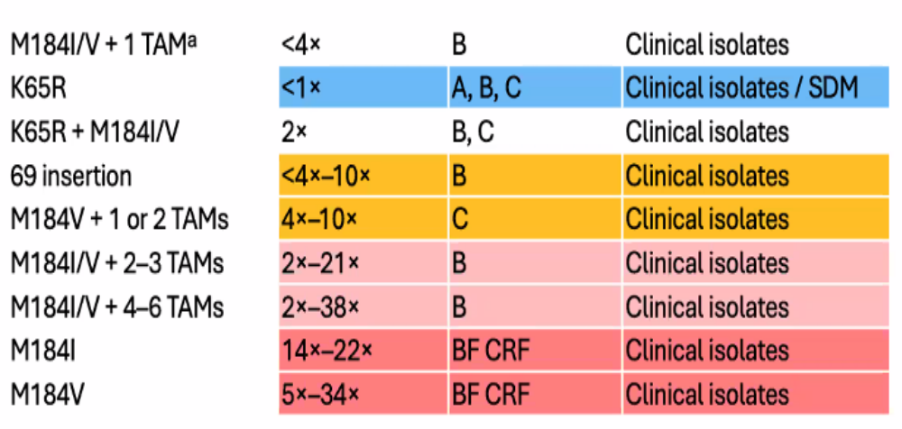
Case for DOR/ISL with M184V
Wensing et al. Top Antivir Med. 2026; 34:527-532
Slide 29

Slide 30
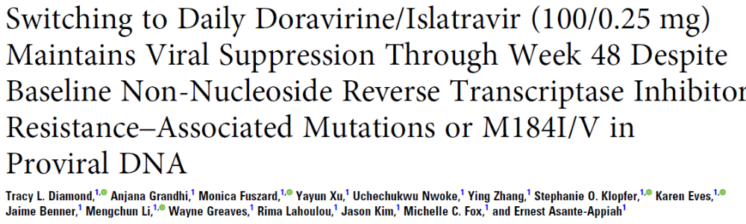
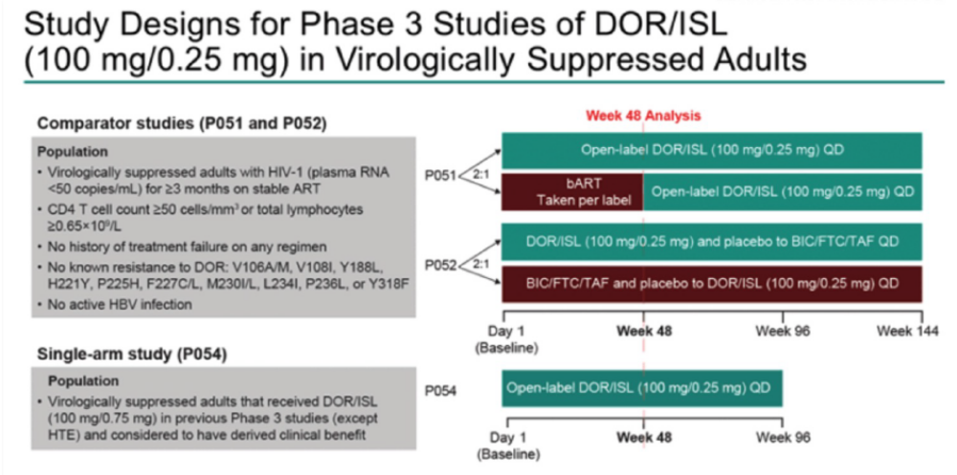
Diamond TL, et al. JID 2026; 10.1093/infdis/jiag257

Slide 31
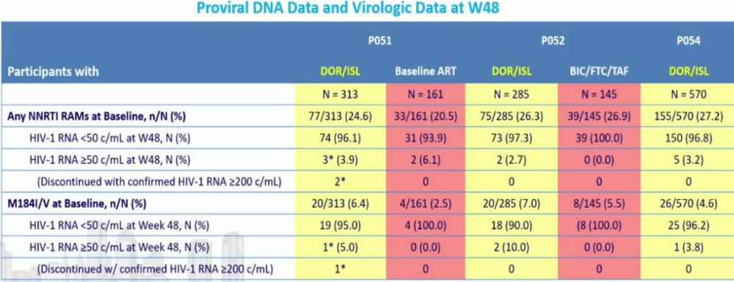
Switch to DOR/ISL (100mg/0.25mg) QD in those with Archived M184I/V

Slide 32
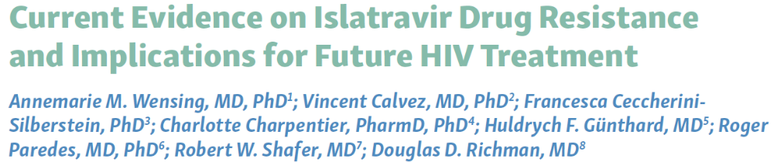
DOR/ISL indicated for those without DOR resistance based upon clinical trial inclusion criteria and in vitro resistance data
M184I/V results in minor or modest reduction in ISL susceptibility; high level resistance with additional mutations (rare)
  Phenotypic analysis of clinical isolates indicate M184V + TAMs highly resistant
Clinical data in those without known NRTI resistance mutations
Proviral DNA data need interpretation with caution as APOBEC-medicated hypermutation can generate M184I mutations
Encourage continued careful review of historical data for documented or inferred NRTI resistance before switch to ISL-based regimen
Slide 32
Wensing AM, et al. Topics Antiviral Medicine 2026;34(3):527-532.

Slide 33
Other than giving HEPLISAV-B, how would HBcAb+ status influence your treatment decision
Would continue TAF until CrCl clearly demonstrates decline to well under 30 mL/min
Would add entecavir if stopping TAF
Would do HBV DNA testing at regular intervals off TAF
Would monitor AST/ALT and only check HBV DNA if transaminases increase
57 yo woman with DM, HTN, and CKD; HBcAb+, CrCl <30 mL/min and HIV VL <20 copies/mL
H/o VF with K65R, M184V and K103N with exposure to RAL but reportedly while suppressed
Currently suppressed on DRV/cobi/FTC/TAF + DTG
Slide 33

Slide 34
Do not edit
How to change the design
Other than giving HEPLISAV-B, how would HBcAb+ status influence your treatment decision
The Slido app must be installed on every computer you’re presenting from

Slide 35
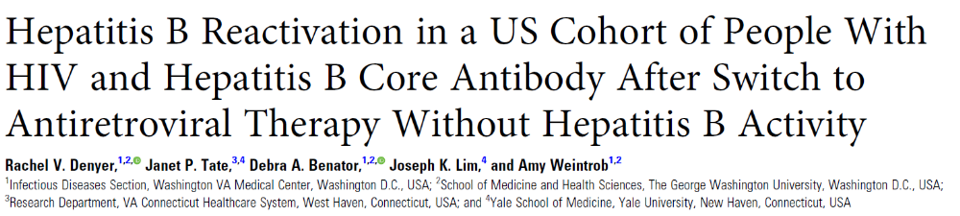
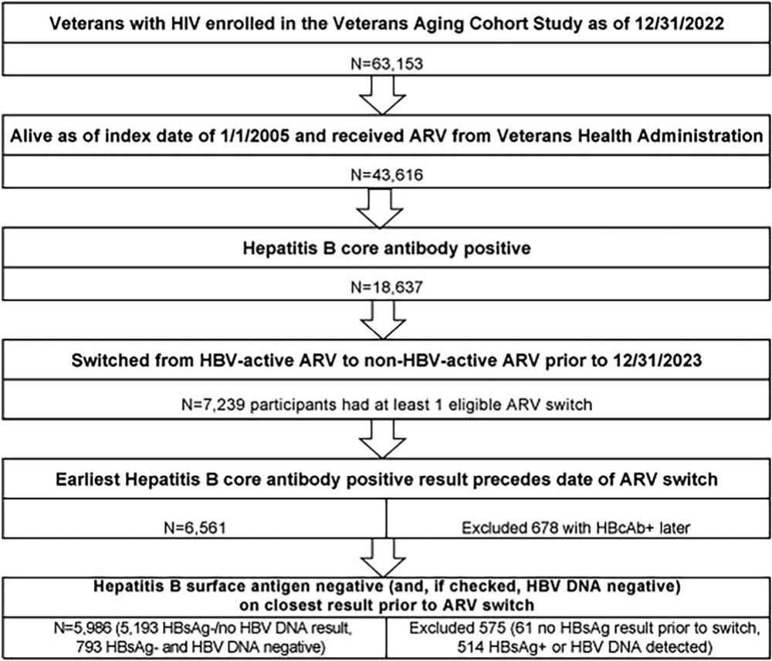
Slide 35
Denyer RV, et al. Clin Infect Dis 2026; 82:e735-42

Slide 36
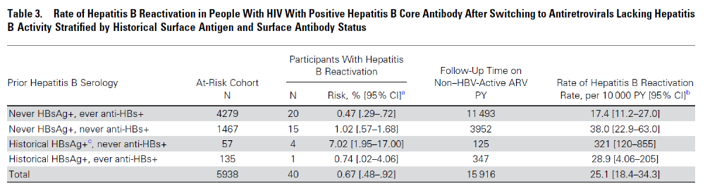
HBV reactivation after switch off HBV-active agents
40 (0.67%) HBVcAb+
Median time to reactivation 8.9 months (IQR 5.5-26.7 months)
Higher reactivation in those HBsAg+ in remote past and no history of HBsAb
Slide 36

Slide 37

People with HIV and prior HBV exposure (HBcAb+) are at variable risk of HBV reactivation when TFV is stopped
Monitoring is recommended regardless of HBsAb status
Recommend ALT every 1-3 months for first 6 months and then every 6 months thereafter with increase prompting HBV DNA testing

Slide 38
Managing VF with limited underlying resistance
Slide 38

Slide 39
Patient with long-standing HIV, poor adherence and renal failure
Patient is 53 yo man with history of psychiatric disease and housing insecurity
At time of HIV diagnosis he had CD4 count of 45 cells/µL and wild type HIV
He reports receiving care at multiple clinics with variety of regimens over past 10+ years (names of which he does not recall)
He has been in our clinic for 2 years having made <3 visits and intermittently being given BIC/FTC/TAF, with poor follow-up for labs and medication refills
He now presents to clinic after ~1 yr with Cr 4.8 mg/dL, bicarbonate 15 mEq/L and potassium 5.8 mEq/L
Admitted for further evaluation
Slide 39

Slide 40
At admission CD4 40 cells/µL and VL 1.35 million c/mL
Further evaluation for renal failure nonrevealing with continued increase Cr despite fluids
Renal biopsy shows BK virus; PCR blood (>10⁴ c/mL) and urine (>10⁷ c/mL) by PCR
HLA-B5701- negative

Slide 41
Which of below would you do?
Get resistance genotype
Get resistance phenotype
I would not do resistance testing
I would do some other type of test
53 yo man with longstanding treatment with unknown regimens and poor adherence
Presents off therapy with renal failure (Cr 4.8 mg/dL)
CD4 40 cells/µL and VL 1.35 million c/mL; HLA-B5701-negative
Renal biopsy shows BK virus

Slide 42
Do not edit
How to change the design
Which of below would you do?
The Slido app must be installed on every computer you’re presenting from

Slide 43
Which ARV regimen would you start?
BIC/FTC/TAF
DTG/ABC/3TC
bDRV + NRTIs
bDRV + INSTI ± NRTIs
BIC/LEN ± other ARVs
DOR/ISL ± other ARVs
Something else
53 yo man with longstanding treatment with unknown regimens and poor adherence
Presents off therapy with renal failure (Cr 4.8 mg/dL)
CD4 40 cells/µL and VL 1.35 million c/mL; HLA-B5701-negative
Renal biopsy shows BK virus
Slide 43

Slide 44
Do not edit
How to change the design
Which ARV regimen would you start?
The Slido app must be installed on every computer you’re presenting from

Slide 45
During hospitalization is given bDRV + DTG with good response
Started on HD
F/U in clinic in 4 weeks with CD4 98 cells/µL and HIV RNA 120 c/mL
Returns to clinic 8 weeks later with HIV RNA 18,500 c/mL stating that he is taking “most days,” with wild type genotype
Returns to clinic 8 weeks later with HIV RNA 650,800 c/mL with continued poor adherence despite good tolerance
Willing to consider LA therapy if we can access for him
53 yo man with longstanding treatment with unknown regimens and poor adherence
Presents off therapy with renal failure (Cr 4.8 mg/dL)
CD4 40 cells/µL and VL 1.35 million c/mL; HLA-B5701-negative
Renal biopsy shows BK virus
Slide 45

Slide 46
What would you recommend for ART?
Continue current regimen (DRV/cobi + DTG) with reinforcement of adherence
BIC/FTC/TAF
LA CAB/RPV
LA CAB/LEN
LA CAB/RPV + LEN
Something else
53 yo man with longstanding treatment with unknown regimens and poor adherence
Presents off therapy with renal failure (Cr 4.8 mg/dL)
CD4 40 cells/µL and VL 1.35 million c/mL; HLA-B5701-negative
Renal biopsy shows BK virus
Slide 46

Slide 47
Do not edit
How to change the design
What would you recommend for ART?
The Slido app must be installed on every computer you’re presenting from

Slide 48
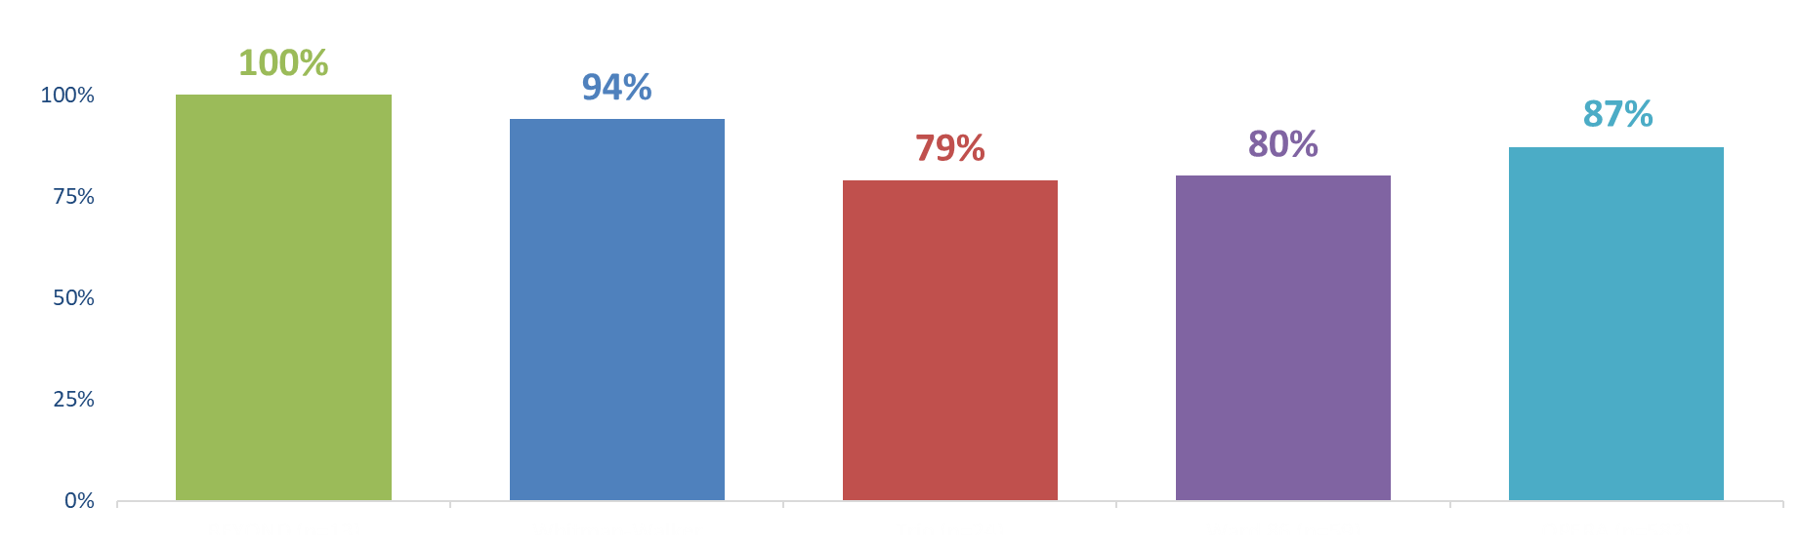
LA CAB/RPV: Virologic Suppression in PWH with Detectable Viremia
Real-World People with HIV with Baseline VL ≥ 50 copies/mL (% suppressed)
N = 13
N = 31
N = 24
N = 59
N = 582
BEYOND
Month 12 Outcomes
Whitman-Walker
Health Cohort
Trio
Median follow-up 5 months
Ward 86
Week 48 Outcomes
OPERA
Median follow-up 15 months
IAS-USA and DHHS guidelines endorse this strategy for those with poor adherence with oral therapy and advanced HIV disease
Schneider S, et al. AIDS 2024. Poster THPEB099; Fessler D, et al. CROI 2024. Poster 1235; Elion RA, et al. IDWeek 2023. Poster 1592; Hickey MD, et al. Clin Infect Dis. 2024;ciae500 (online ahead of print); Hsu R, et al. CROI 2026. Poster 527. Gandhi R, et al. JAMA 2025; DHHS guidelines; https://clinicalinfo.hiv.gov/en/guidelines/adult-and-adolescent-arv.
Slide 48

Slide 49
Patient ultimately started on LA CAB/RPV with recent VLs <200 c/mL
Continues HD
Plasma BK virus has declined to <1000 c/mL

Slide 50
Important References/Links
DHHS (ART and perinatal GL): https://clinicalinfo.hiv.gov/en/guidelines
Gandhi RT, Landovitz R, Sax P, et al. IAS-USA treatment guidelines. JAMA 2025;333:609-628
IAS-USA resistance:
https://www.iasusa.org/hiv-drug-resistance/hiv-drug-resistance-mutations/
Stanford resistance:
https://hivdb.stanford.edu/
Slide 50

Slide 51
Thank You!!
Slide 51

Slide 52
Q and A Session

