Slide 1

It’s Not (Just) the Virus:
Cognitive Aging in People With HIV
Shelli Farhadian, MD, PhD
Associate Professor of Medicine
Division of Infectious Diseases
Yale School of Medicine
New Haven, CT

Slide 2
Financial Relationships With Ineligible Companies (Formerly Described as Commercial Interests by the ACCME) Within the Last 2 Years
Dr Farhadian reported no relevant financial relationships with ineligible companies. (Updated September 18, 2026)

Slide 3
Learning Objectives
After attending this presentation, learners will be able to:
  Explain why clinically significant cognitive impairment persists in people with HIV in the antiretroviral era
  Apply a practical, modifiable risk–focused approach to older adults with HIV and cognitive complaints
  Describe current and emerging strategies to protect brain health in people with HIV

Slide 4
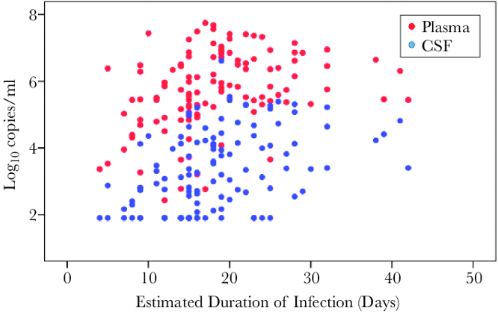
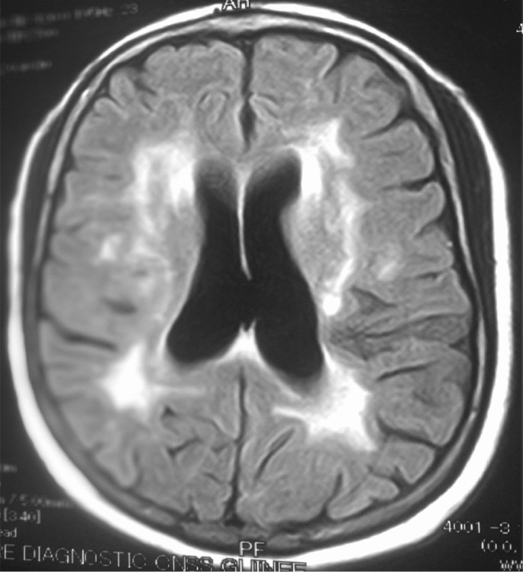
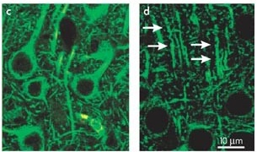
In the absence of treatment, this may cause:
AIDS Dementia Complex /
HIV Dementia
HIV enters the Central Nervous System within days of infection
This leads to:
Immune activation &
Synaptic injury
HIV Viral load (CSF or Blood)
Chan et al, JID 2018
Ellis et al, Nature Reviews Neuroscience 2007
Morgello, HIV Neuropathology, 2018
HIV Dementia: Very rare in individuals on ART!
Slide 4
Notes:
Let’s take a step back. Why are we even talking about HIV and the brain?? In the last ten years, our knowledhe of how HIV affects the brain has grown tremendously. We know from studies of people with acute HIV infection that HIV enters the central nervous system within DAYS of infection, and can be detected in the CSF very soon after a person acquires HIV. If left untreated, HIV will replicate in the brain, causing brain injury and ultimately, in a subset, neurological syndromes like dementia.

Slide 5
NOW: A more common case
HIV was diagnosed in 1985 and started ART in the early 1990s. His CD4 at the time of starting ART was 55 cells/mL
58-year-old man with long-standing HIV presents with several years of memory problems.
Current CD4 count 350, CD4/CD8 ratio 0.6. HIV viral load is undetectable.
He takes medications for hypertension, high cholesterol, and chronic back pain. He lives alone and does not currently have any close friends nearby.
Neurological exam: slow gait, normal reflexes.
Slide 5
Notes:
So, while frank dementia due to uncontrolled virus in the rain is pretty rare nowawayds, as HIV clinicians we are all faced with a much more common scenario. Here is an exmpale from my own clinic.

Slide 6
Do not edit
How to change the design
True or false: In people with HIV, the severity of cognitive complaints closely reflects performance on objective cognitive testing.
The Slido app must be installed on every computer you’re presenting from

Slide 7
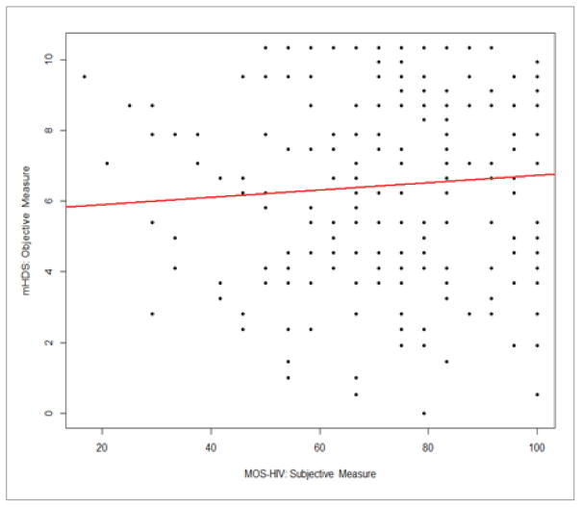
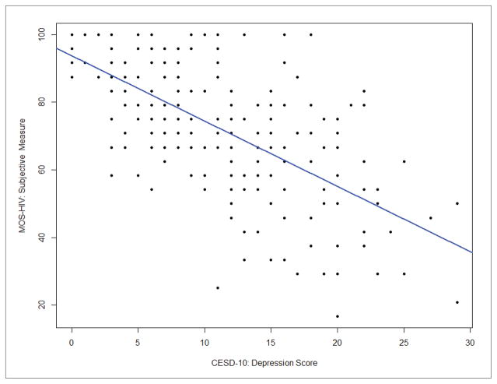
In PWH, Cognitive Complaints Track with Mood
Alcohol use, marijuana use, and psychiatric symptoms (depression, anxiety, PTSD) are significant predictors of subjective cognitive complaints
Subjective cognitive complaint versus objective cognitive deficit (no relationship)
Correlation between subjective cognitive complaint and depression
A cognitive complaint should trigger depression and mental health screening
Yoo-Jeong, J HIV AIDS 2018; Bryant, AIDS Behav 2022
Slide 7
Notes:
Interestingly, our patient’s perceptions of their cognitive status is a much better reflection of mood than of actual impaired cognition. Indeed, subjective cognitive complainst sould not be dismissed, because even if they don’t correlate with objective measures, they do associate strongly wth depression, anxiety, and PTSD. So, one of the ifrst takeaways is, a patiet presenting with a cognitive complaint should be assessed for depression

Slide 8
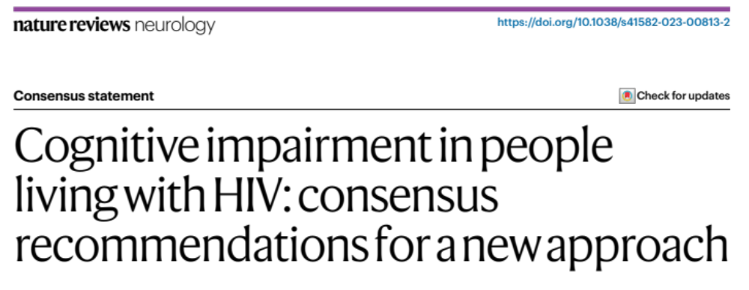
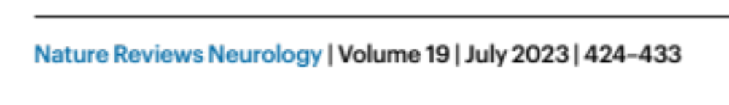
We do not know the true estimate of clinically significant cognitive impairment in PWH on ART
•Current estimates largely based on HAND criteria, which was designed for RESEARCH and not clinical assessment
•HAND estimates include asymptomatic cognitive impairment, which may not be clinically significant
•The HAND criteria typically classify 20–60% (and sometimes up to 90%) of people living with HIV as cognitively impaired. This figure does not align with clinical observations
Slide 8
Notes:
But turning back to objective cognitive impairment in PWH - Overall, we don’t have a solid estimate for the true estmate of hiv related cognitive impairment in the ART era. I won’t spend a lot of time on this today,but I do want to just mention that it is increasingly clear that the HAND criteria are very likely OVERESTIMATING the percentage of PWH who have cognitive impairment, and better tools are needed to truly understand the cope of the problem.

Slide 9
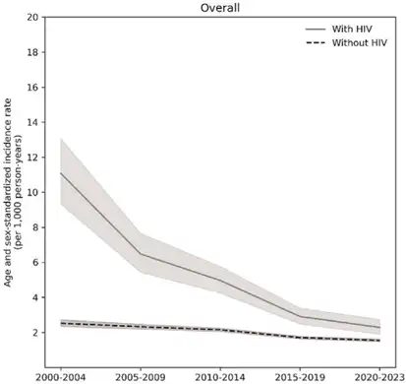
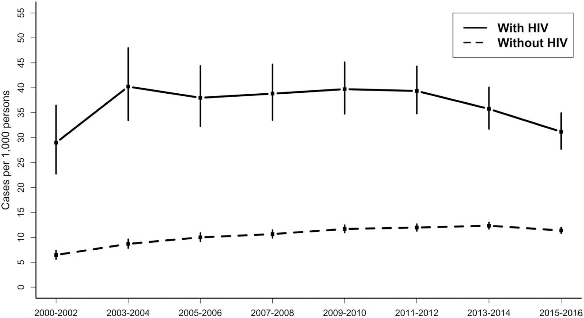
PWH on ART have higher prevalence of
Age-Associated Dementias but incidence is improving with ART
Prevalence of Dementia over time
and by HIV status
Incidence of Dementia over time
and by HIV status
Lam et al, AIDS 2021 and 2022 and 2026
Slide 9
Notes:
What we do know, though, is that people with HIV remain at high risk for the development of Age Associated dementias, like alzheimers disease, parkinsons dementia, and lewy body disease. And higher prevalnce of cognitive fraity (physical frailty and impaired cog testing) 7% versus 1-4% in general older population

Slide 10
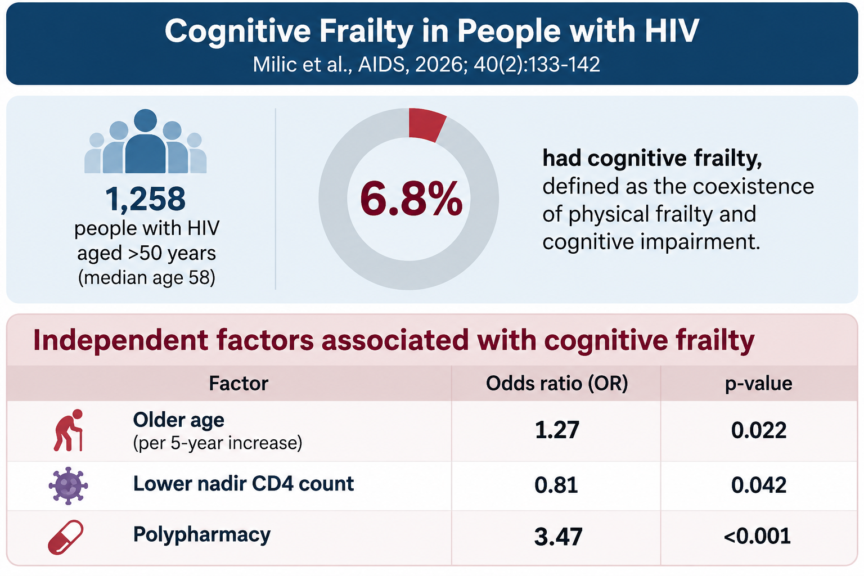
Slide 10
These associations persisted after adjustment for multimorbidity, depression, HIV duration, and dolutegravir exposure.
Milic et al AIDS, 2026 Feb 1;40(2):133-142.
Notes:
Cognitive frailty was more prevalent in older adults with HIV than reported estimates in the general population aged over 65 (1–4.4%). The association with lower nadir CD4 suggests that historical HIV-related immunosuppression may contribute to cognitive frailty, while polypharmacy represents a potentially modifiable risk marker.

Slide 11
How does HIV cause brain problems in the absence of overt viral replication?
HIV proteins and RNA persist in the central nervous system despite viral suppression with ART and are neurotoxic
Abnormal activation of immune cells in the brain despite decades of ART
High rates of multimorbidity, substance use disorder, smoking, vascular disease….

Slide 12
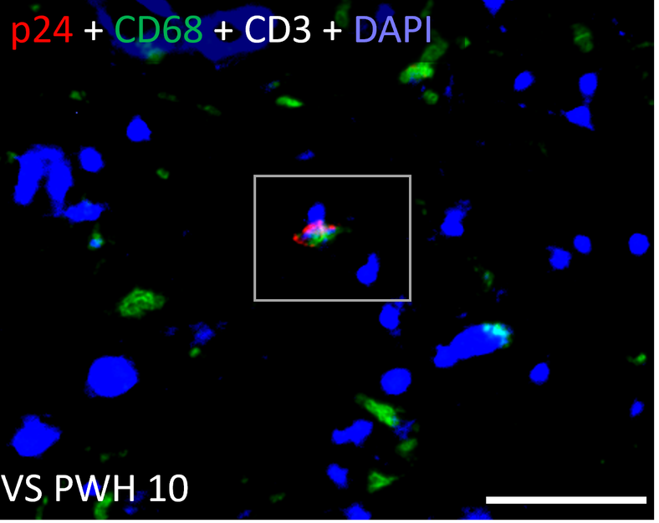
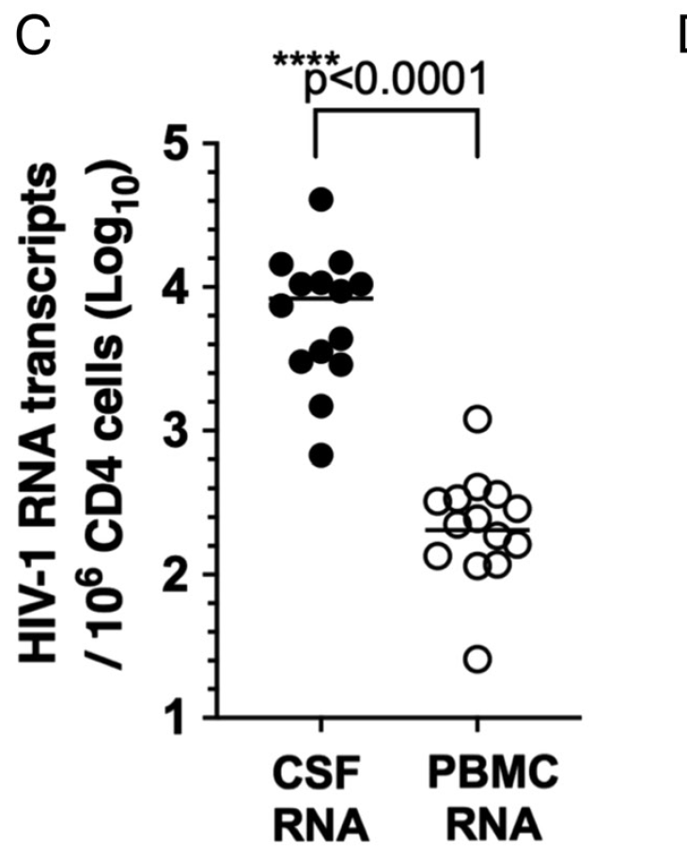
How does HIV cause brain problems in the absence of overt viral replication?
HIV proteins and RNA persist in the central nervous system despite viral suppression with ART and are neurotoxic
HIV p24 protein expressed in microglia,
PWH on ART near the time of autopsy
HIV RNA detectable in CSF in most living PWH on ART
Eddine et al, Plos Pathogens 2024
Anthony et al, J Neuropath Exp Neur, 2005
Lam et al, Drug and Alcohol Dependance, 2020
Suzuki et al, PNAS
2022, PMID: 36413502

Slide 13
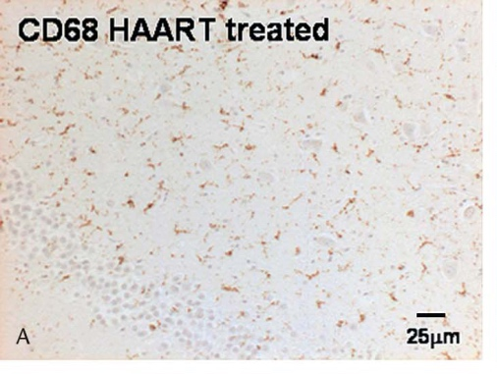
How does HIV cause brain problems in the absence of overt viral replication?
Abnormal activation of immune cells in the brain despite decades of ART
HIV CSF (n = 44) CONTROL CSF (n = 22)
Activated CD68+ microglia in basal ganglia, PWH on ART at autopsy
Eddine et al, Plos Pathogens 2024
Anthony et al, J Neuropath Exp Neur, 2005
Lam et al, Drug and Alcohol Dependance, 2020
Elevated inflammatory proteins (cytokines) in CSF despite decades of ART
Farhadian et al, JCI Insight 2022, PMID: 35801589
Slide 13
Notes:
Three drivers. Aging/comorbidities is critical but I won't cover it today. I'll focus on reservoir persistence and immune activation — biology we can actually probe in living people.

Slide 14
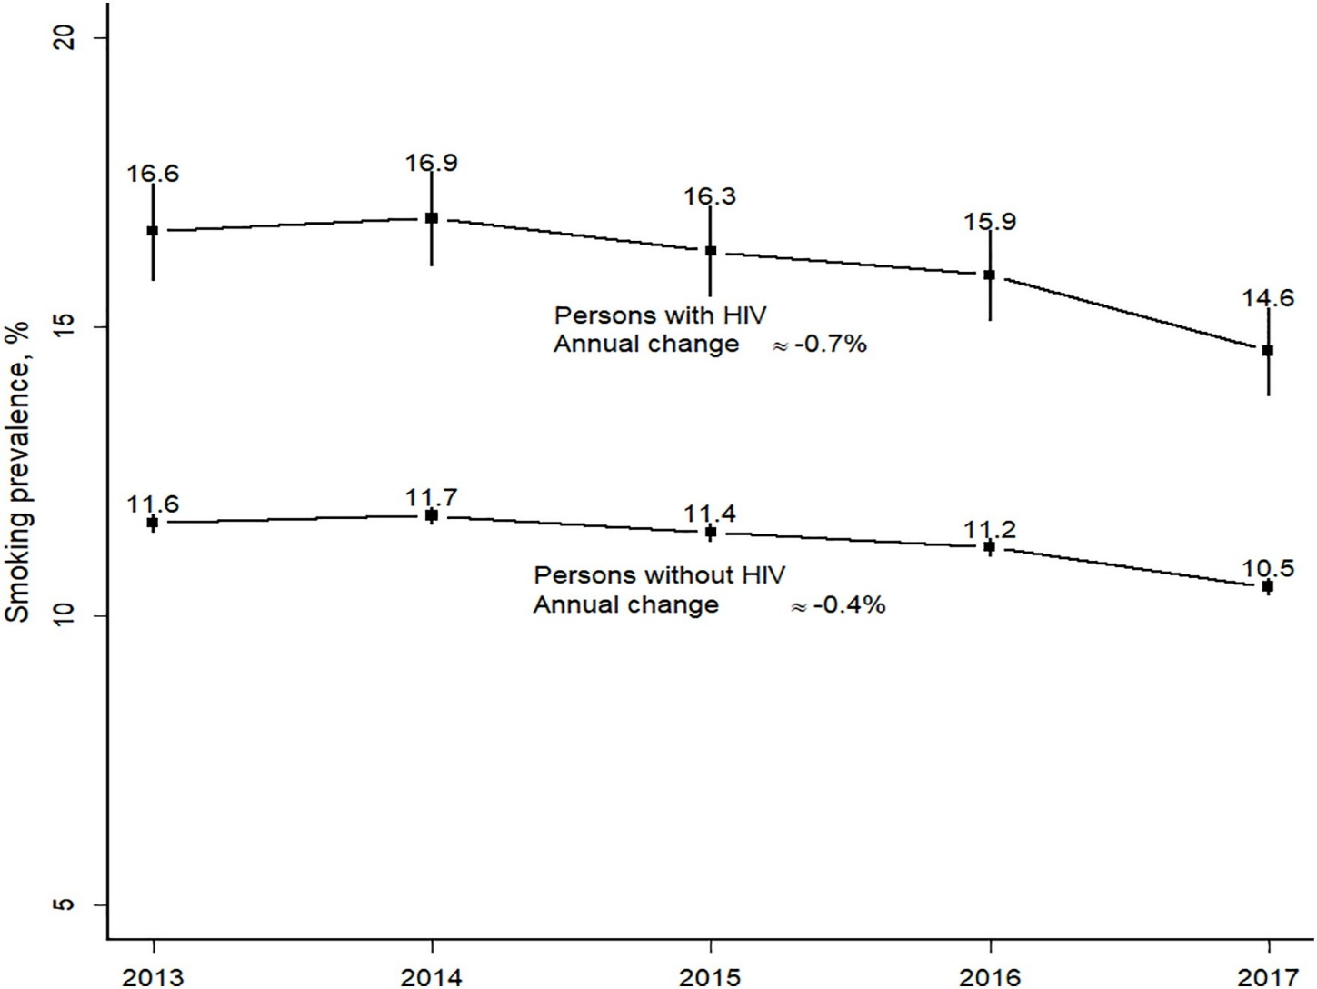
How does HIV cause brain problems in the absence of overt viral replication?
High rates of multimorbidity, substance use disorder, smoking, vascular disease….
HIV
Smoking prevalence
Uninfected
Eddine et al, Plos Pathogens 2024
Anthony et al, J Neuropath Exp Neur, 2005
Lam et al, Drug and Alcohol Dependance, 2020
Slide 14
Notes:
Three drivers. Aging/comorbidities is critical but I won't cover it today. I'll focus on reservoir persistence and immune activation — biology we can actually probe in living people.

Slide 15
How should we clinically approach the older adult with HIV and cognitive complaints?
Slide 15

Slide 16
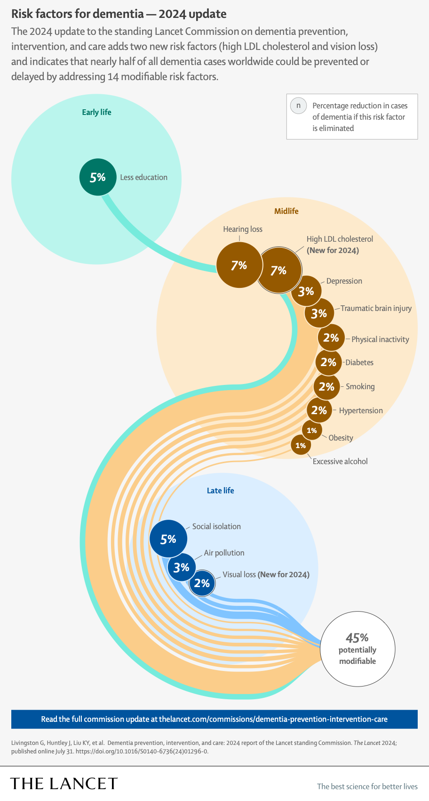
Nearly half of dementia cases worldwide may be preventable
45%
High LDL
7%
Hearing Loss
7%
Smoking
2%
Social Isolation
5%
Slide 16
Notes:
This data comes from the 2024 lancet commission on dementia prevention and care.

Slide 17
Do not edit
How to change the design
This 58-year-old has hypertension, high cholesterol, and a slow gait. Which approach is most likely to protect his long-term cognition?
The Slido app must be installed on every computer you’re presenting from

Slide 18
Search for MODIFIABLE Risks!
  HIV related risk factors
  Low CD4 nadir
  Detectable CSF or plasma viral load
  Duration of HIV infection
  Duration of UNTREATED HIV infection
  Low CD4:CD8 ratio
  ART exposure (PI, Efavirenz use)
  CNS opportunistic infections and treatment
  Comorbid Conditions
  Vascular disease
  Hypertension
  High LDL
  Hearing Loss
  Depression
  Social Isolation
History and Physical
Cognitive, Motor, Behavioral symptoms
Time course
Neurological exam: Gait, motor
Orthostatic vital signs
Short Cognitive Screen
MOCA
Others
Blood tests for reversible causes of dementia (e.g., B12, syphilis)
HIV History
HIV Viral load in plasma
Consider referral for CSF test and/or Brain MRI
Slide 18
Notes:
Next we assess the patient’s past and current medical problems, We ask about their HIV history- how low was their CD4 nadir? How long did they have untreated HIV before starting ART. Knowing this can help us place the risk for HIV related cognitive issues in context, and can also help us interprert brain Mri findings if we end up getting neuroimaging. We ask about curremt efavirenz use since, compared to newer integrase based regimens, efavirenz associated with cognitive and mental health effects and should be avoided in someone with cognitive complaints.
We move on to assess other medical issues, focusing again on the search for modifiable rsk factors. What meds are the patient on- are they sedating or are they simply on too many meds? How about sleep- we know that sleep deficiency is highly prevalent among PWH and under diagnosed and undertreated. Thinking about other comorbidities- do they have hearing loss? Social isolation? These are factors that, if we can begin to address, may improve brain health and function.***

Slide 19
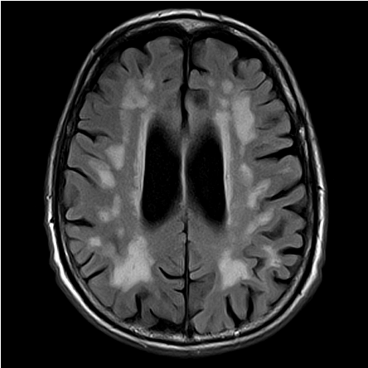
Vascular Risk Factors and Cognition: CSVD
Cerebral small vessel disease (CSVD)
A chronic microvascular disorder of intracranial arterioles, venules, and capillaries — causes cognitive, psychiatric, and physical disability, ~20% of all strokes, and raises future dementia risk.
HIV, hypertension, hyperlipidemia, and advanced age are independent risk factors for CSVD
~2× as prevalent in middle-aged ART-treated PWH
In PWH, hypertension is the strongest independent correlate of CSVD
CSVD (white-matter hyperintensities) associates with worse cognitive performance in PWH
White-matter hyperintensities (MRI, FLAIR)
A feature of both CSVD and HIV
Moulignier et al. Silent cerebral small-vessel disease twice as prevalent in middle-aged well-controlled cART-treated HIV-infected than HIV-uninfected individuals. Clin Infect Dis.
Why it matters : White Matter Hyperintensities are visible on routine MRI and the drivers are modifiable!
Slide 19
Notes:
I want to really zoom in here on vascular risk factors, since, as our patients get older, we are increasingly caring for people with comorbid htn, high cholesterol, and vascular risk.
Many people with long standing HIV have prominent white matter hyperintensities on brin MRI. While we don’t fully understand the pathophysiology behind this, one of the main contributors to WMH in the general population is CSVD, or diseases of the small blood vessels in brain.
A few small WMH are common with normal aging and often of little significance.
But extensie WMH roughly double the risk of stroke and dementia, plus higher rates of death, gait problems, falls, and depression. HIV, hyperlipidemia, and HTN are independent risks for CSVD.
White matter hyperintensities (WMH) in PWH with vascular risk factors may be a marker of cerebral small vessel disease, and while existing lesions don’t reverse in any meaningful way, they are a strong signal to act on vascular risk. The goal is slowing progression and lowering the risks they predict.

Slide 20

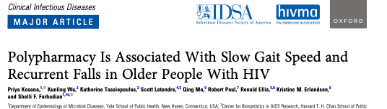
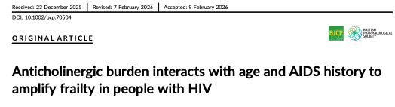
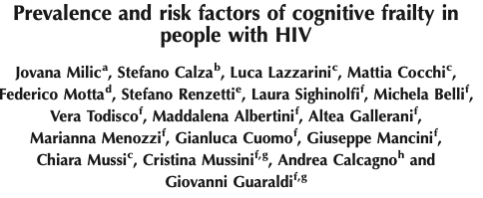
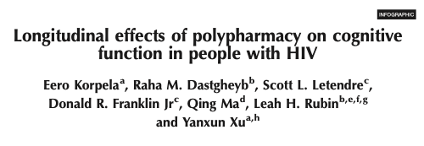
Polypharmacy increases Cognitive Burden, independent of multimorbidity
Slide 20
Notes:
We mentioned polypharmacy briefly earlier, as a risk factor for cognitive frailty. It is worth bri ging up again, since this is a major problem in PWH. Polypharmacy, which we typcalliy think of as five or more NON ART mes, is far more common in PWH. This is a problem becayse…

Slide 21
Do not edit
How to change the design
Recent large studies suggest the recombinant zoster (shingles) vaccine is associated with:
The Slido app must be installed on every computer you’re presenting from

Slide 22
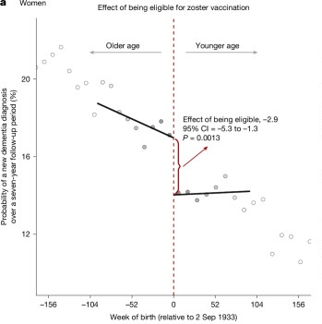
Zoster Vaccination Lowers Dementia Risk !!!
EFFECT OF BEING ELIGIBLE FOR ZOSTER VACCINE
Wales (Nature 2025) –
Zostavax (live attenuated): About **20% relative reduction** in dementia among vaccine-eligible adults. Effect was strongest in women.
Australia (JAMA 2025) –
Zostavax: **1.8 percentage point absolute reduction in dementia over 7.4 years.
US/UK (Nat Med 2024) –
Shingrix vs. Zostavax: Shingrix recipients had 17% more dementia-free survival time.
Eyting M et al. *A natural experiment on the effect of herpes zoster vaccination on dementia.* Nature. 2025.
Pomirchy M et al. *Herpes Zoster Vaccination and Dementia Occurrence.* JAMA. 2025.
Taquet M et al. *The recombinant shingles vaccine is associated with lower risk of dementia.* Nat Med. 2024.
Slide 22
Notes:
What else can we do to protect brain health? Zoster vaccine!! This is inctedibly exciting information just in the last few years, strongluy suggesting that zoster vaccination protects against dementia.
Wales: compare two groups of older adults who had nearly identical characteristics other than vaccination status because of an immunization program in Wales that began on September 1, 2013.
Under the program, which was designed to ration vaccine supply, anyone who was age 79 on that date was eligible for the vaccine for one year. People who were 80 or older on that date were out of luck — they would never become eligible. (As more people reached age 79 in the years to come, they would become eligible until they turned 80.) in this way, similar to a randomized trial.

Slide 23

Potential Brain Health Effects of GLP-1 Receptor Agonists
Roy et al, Neurotherapeutics 2025
Xie et al, Nature Med 2025, PMID: 39833406
Slide 23
Notes:
Well, what about GLP-1??? The answer is, we don’t know yet, but we hae at least a biological basis to thinjk they might impact brain health.

Slide 24
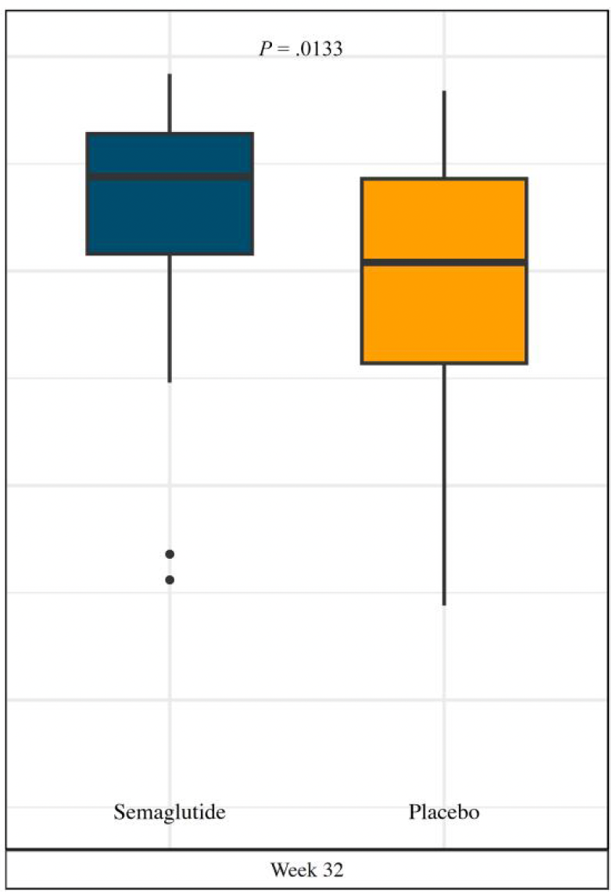
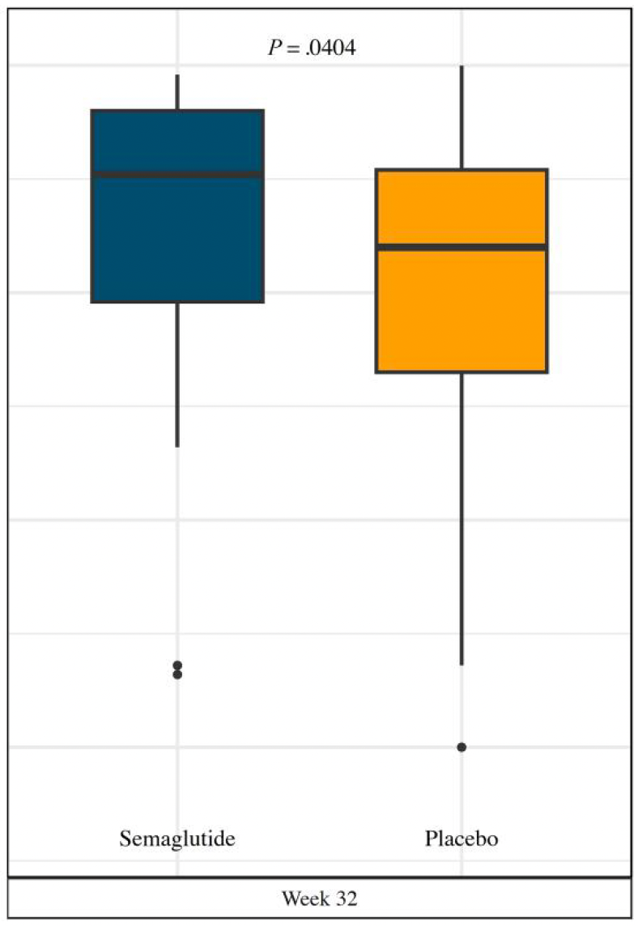

RECENT TRIALS TO IMPROVE BRAIN HEALTH IN PWH
Semaglutide (GLP-1 receptor agonist) | Phase 2b randomized, double-blind, placebo-controlled; PWH with overweight/central adiposity; 32 wk | 2025 | 108 (54/arm) | Positive signal. | Atieh et al, Clin Infect Dis 2025
Tesamorelin (GHRH analog) | Randomized, open-label vs standard of care; PWH with abdominal obesity; 6 mo | 2025 | 73 (target 100; stopped early) | No cognitive benefit | Ellis et al, J Infect Dis 2025;231(5):1230
Pitavastatin (REPRIEVE / ACTG A5332) | Phase 3 randomized, double-blind, placebo-controlled (primary endpoint = major CV events); neurocognitive/brain ancillary analyses | 2023 | 7,769 | CV benefit; ~35% reduction in major CV events. Cognition not worse with statin. . | Grinspoon et al, N Engl J Med 2023;389(8):687 Erlandson et al, AIDS, 2025 Nov 1;39(13)
Visuospatial Performance
Delayed Recall
Atieh et al, Clin Infect Dis 2025, PMID: 41098140
Slide 24
Notes:
So where does all of this leave us? We are living in an exciting tim with regard to many drugs and interventions in clincal trials to see if they impact brain health. Some recent trials I want to highlight- first a study looking at semaglutide, in a double blind ramidnized study of PWH. This study examined a simple cognitive out

Slide 25
WHAT’S IN THE PIPELINE?
 | Design | Status | Brain Health Outcome
Menopausal HRT ACTG A5424 | Phase 4 | Enrolling | Sleep, mental health, cognitive testing
Fostemsavir (prevents binding of sgp120 to CD4 receptor) University of Montreal | Randomized, open label Phase 2. | Enrolling | Secondary outcome: Brief Cognitive Ability measure
Baricitinib (JAK 1/2 inhibitor) Emory | Phase 2, randomized placebo controlled | Enrolling | CSF reservoir, cognitive testing, depressive symptoms, brain MRI
Transcutaneous Vagus Nerve Stimulator plus probiotics (stimulate the autonomic nervous system, ?reduce inflammation) University of Miami |  | Enrolling | Cognitive improvement
Pregnenolone (neuroactive steroid lower in PWH with depression) Harvard/MGH SMOOTH Trial | Phase 2 Randomized Double-Blind Placebo-Controlled Trial | Enrolling | Depression
LM11A-31 – (p75 neurotrophin receptor ligand, mimics nerve growth factor) University North Carolina |  | Planning | Cognition
Pramipexole (increases dopamine transmission) | Open label pramipexole versus escitalopram | Paused | Depression and Mild Neurocognitive Disorder
Tesamorelin + exercise (MGH and CU Anschutz) | Phase 2 randomized placebo controlled | Enrolling | Primary endpoint physical function
Slide 25

Slide 26
Suggested Readings
Lam, J. O., Fan, D., Pothamsetty, N., Samiezade-Yazd, Z., Hu, H., Lopez, E., Lee, C., Lea, A. N., Hou, C. E., Towner, W. J., Horberg, M. A., & Silverberg, M. J. (2025). Dementia incidence and prevalence in older adults with HIV: a 23-year retrospective cohort study. AIDS, 40(4), 486–495. https://doi.org/10.1097/QAD.0000000000004421
Filippidis P, Farhadian SF. Smoldering in the sanctuary: HIV-associated brain injury in the ART era. J Clin Invest. 2026 May 1;136(9):e204831. doi: 10.1172/JCI204831. PMID: 42065243; PMCID: PMC13132375.
Nightingale, S., Ances, B., Cinque, P. et al. Cognitive impairment in people living with HIV: consensus recommendations for a new approach. Nat Rev Neurol 19, 424–433 (2023). https://doi.org/10.1038/s41582-023-00813-2
Atieh O, Daher J, Abboud M, Wu Q, Sattar A, Baissary J, Koberssy Z, Labbato D, Eckard AR, McComsey GA. Effects of Semaglutide on Cognitive Function in People With HIV: A Randomized, Controlled Trial. Clin Infect Dis. 2026 May 20;82(5):753-761. doi: 10.1093/cid/ciaf577. PMID: 41098140; PMCID: PMC13189676.
Slide 26

Slide 27
Q and A Session

