Slide 1

Investigational HIV Drugs and
Emergent Strategies
Roy M. Gulick, MD, MPH
Rochelle Belfer Professor in Medicine
Division of Infectious Diseases
Weill Cornell Medicine
New York, NY

Slide 2
Financial Relationships With Ineligible Companies (Formerly Described as Commercial Interests by the ACCME) Within the Last 2 Years
Dr Gulick reported no relevant financial relationships with ineligible companies. (Updated September 16, 2026)

Slide 3
Learning Objectives
After attending this presentation, learners will be able to:
  Describe new innovations and strategies in antiretroviral therapy with existing drugs
  List new investigational antiretrovirals in the pipeline

Slide 4
ART Pipeline (partial list)
Drug class | Phase 1 | Phase 2 | Phase 3 | Approved
NRTTI |  |  | alimatravir (AMI) (q1 mo po) islatravir (ISL)/LEN* (qwk po) | ISL/DOR (qd po)
NNRTI | bavtavirine (GS-5894; q1 mo po) | ulonivirine (ULO) (qwk) | RPV-ULA (q4 mos IM)
INSTI | VH-310 (q6 mo CAB pro-drug) | GS-3242 (q6 mo IM) lepetegravir (GS-1720; qwk po) VH-184 | CAB-ULA (q4 mos IM) LEN (yearly IM) | CAB+RPV (q2 mo IM) CAB+LEN* (q2+q6 mo IM/SC) BIC/LEN* (qd po)
Capsid | GS-3107 (q1 mo po LEN pro-drug) VH-359 | dezecapavir (VH-499; q6 mo IM)
BNAb | VH-079 (bispecific) | LVB+CAB (q4+q2 mo IV/IM) | LEN+TAB+ZAB (q6 mo IV/IM)
* Individual drugs approved, regimen remains investigional

Slide 5


Cabotegravir (CAB)
Current formulation: CAB-LA 200 mg/ml q2 months
New formulations: CAB-ULA (ultra long-acting) q4 months
  Phase 1 study (“2 to 4”): CAB-LA q2→CAB-ULA q4 months NCT06786520
  Phase 2b study (EXTEND4M): CAB-ULA q4 months NCT06741397
  Phase 3 study (CUATRO): virologically suppressed people NCT07650916 CAB-LA + RPV-LA q2 months vs. CAB-ULA + RPV-ULA q4 months
CAB + RPV in participants with viremia
  Meta analysis (N=244): virologic success 87% Barda HIV Medicine 2025;26:993-1003
  A5359 LATITUDE (N=249): randomized study of CAB+RPV vs. continued oral ART
    Results: regimen failure 24% (CAB/RPV) vs. 38% (oral ART) Rana NEJM 2026;394:858-871
  CROWN Study NCT06694805
    Eligible patients (N=332): VL 1000-100,000 cps/ml on current oral ART
    Study design: 3:1 randomization to LA-CAB+RPV vs continue oral ART
  10/6/26 Press Release: LA-CAB+RPV met 1° endpoint: superior VS to oral at 6 mos.!

Slide 6

CAB + LEN with Viremia
Case Series:
  Call for a Trial (N=34 viremic participants): 32/34 (94%) VS at median 8 weeks Gandhi OFID 2024;11:ofae125
  Retrospective case series (N=46: 22 suppressed, 24 viremic; 17 on RPV): ALL patients with VS by 13 weeks, durable to median 100 weeks
  Gistand JAMA Network Open;9:e2638182 (research letter)
ACTG 5431 (PALACE): People with Active Viremia Treated with LEN and CAB for Effectiveness)
  Single-arm proof-of-concept study (N=38)
ACTG 5433 (LANCET): LEN and CAB in Viremic Adolescents and Adults on TDF/3TC/DTG in Low-Middle Income Countries
  Phase 3b randomized open-label study of oral vs. LA ART (N=420)

Slide 7
Lenacapavir (LEN)
PrEP: q6 month injectable
New formulations with yearly dosing Jogiraju Lancet 2025;405:1147
  Phase 3 single-arm trial (PURPOSE-365): 3000 mg new LEN IM (2 X 3 cc) for PrEP (recruiting) NCT07047716
Oral bridge therapy (LEN 300 mg daily for up to 6 months) currently approved when injections are delayed
PK support LEN 300 mg weekly oral dosing for PrEP
  Submitted to FDA June 2026; PDUFA date 2/2/27
Treatment
  Phase 2 treatment-naïve (CALIBRATE) LEN SC or IM with TAF/FTC or BIC
    High rates of virologic suppression Hagins AIDS 2026;40:302-311
  Novel combinations for treatment at all stages

Slide 8
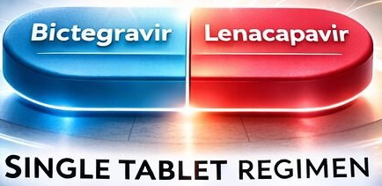
ARTISTRY-1: BIC/LEN Switch
Phase 3 randomized open-label non-inferiority (4%) study
Pt population: VL<50 on “complex” ART regimen X 6 mos; no BIC resistance, no prior LEN exposure (N=557)
  Complex regimen: >2 pills, >2X/day, >2 anchor drugs, parenteral drug, etc.
  At baseline, avg age 60, on ART 28 years, 53% had >2 comorbidities, 60% on concomitant meds, 1/3 >3 pill ART, 39% bid regimens, 77% on PI/b
Study rx: Randomized 2:1 BIC/LEN (75/50 mg) or continue complex ART
Results (wk 48):
  VL <50: 96% BIC/LEN vs. 93% complex ART
  VL >50: 3 (1%) BIC/LEN vs. 2 (1%) complex ART (∆ -0.3%; 95+% CI -2.3%, +1.8%)
  No drug resistance
  Discontinued ART due to AE: 2% (BIC/LEN) vs. 1% (complex ART)
Conclusion: BIC/LEN non-inferior, similar safety, better rx satisfaction
US FDA approved 8/27/26
Orkin Lancet HIV 2026;407:1249-1258; Orkin IAS 2026 #TUPEB099

Slide 9
Do not edit
How to change the design
ARS Question #1: What unique toxicity has been seen with some NRTTIs?
The Slido app must be installed on every computer you’re presenting from

Slide 10
ARS Question #1:
What unique toxicity has been seen with some NRTTIs?
lymphocytopenia
orthostatic hypotension
skin discoloration
thrombocytosis

Slide 11
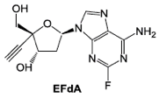
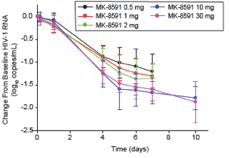
Islatravir (ISL): NRTTI
4’-ethynyl-2-fluoro-2’-deoxyadenosine; MK-8591; EFdA
Inhibits RT by preventing translocation (NRTTI)
Potent antiviral activity (PBMC EC50 = 0.2 nM) with broad coverage (HIV-1, HIV-2, MDR)
Half-life = 50-60 hours in plasma
No drug-drug interactions anticipated
Dose-related lymphocyte toxicity
Phase 1b: single oral dose
Phase 2: rx-naïve – ISL + DOR
Phase 3 switch with VS – ISL/DOR Orkin Lancet 2026;407:599-610 + Colson Lancet 2026;407:611-621
  ISL 0.25mg/DOR non-inferior in both studies; US FDA approved in 4/26
Schurmann Lancet HIV 2020;7:e164-e172
Molina JAIDS 2022;91:68-72

Slide 12
ISLEND-1: ISLATRAVIR (ISL)/BIC Weekly Switch
Phase 3, double-blind, randomized, non-inferiority study
Pt population: On BIC/FTC/TAF with VL<50 for ≥6 mo; no history of VF; no HBV infection (N = 607)
Study rx: Randomized ISL/LEN (2/300 mg) weekly or continue TAF/FTC/BIC
Results: VL at week 48
  >50 copies/ml: 0% ISL/LEN vs. 0.3% TAF/FTC/BIC (∆ -0.3%, 95% CI -1.4%, +0.8%)
  <50 copies/ml: 93% ISL/LEN vs. 92% TAF/FTC/BIC
No emergent resistance; similar CD4 cell counts
Conclusion: ISL/LEN weekly non-inferior to TAF/FTC/BIC daily
Rockstroh IAS 2026 #OAB1406LB + Rockstroh NEJM 7/29/26 (online)

Slide 13
ISLEND-2: ISLATRAVIR (ISL)/BIC Weekly Switch
Phase 3, open-label, randomized, non-inferiority study
Pt population: On standard daily ART with VL<50 for ≥6 mo; no history of VF; no HBV infection (N = 626)
Study rx: Randomized ISL/LEN (2/300 mg) weekly or continue oral ART
Results: VL at week 48
  >50 copies/ml: 0.3% ISL/LEN vs. 1.3% oral ART (∆ -1%, 95% CI -3%, +1.1%)
  <50 copies/ml: 95% ISL/LEN vs. 96% oral ART
No emergent resistance; CD4 -45 ISL/LEN vs. -8 oral ART
Conclusions: ISL/LEN weekly non-inferior to oral ART daily
Colson IAS 2026 #OAX1106LB + Colson Lancet 2026;408:821-832

Slide 14
Investigational Agents –
NRTTIs

Slide 15
Alimatravir (AMI, MK-8527): Investigational NRTTI
Phase 1 in PWoH: Long half-life (t_{1/2} 200-300 hrs) supports weekly-monthly oral dosing Gillespie Clin Transl Sci 2025;18:e70331
Two Phase 1 oral single-dose studies Carstens CROI 2024 #115
  Study population: PWH, ages 18-60 with no prior ART (N=31)
  Study treatment: Single doses of AMI: 0.5, 1, 3, or 10 mg
  Results: VL (log c/ml at day 7): -1.39 (0.5 mg), -1.21 (1 mg), -1.66 (3 mg), -1.39 (10 mg)
Weekly oral PrEP with AMI protects rhesus macaques from rectal SHIV challenge Diamond J Infect Dis 2026;233:e923-e931
Phase 2 study of AMI Mayer IAS 2025 #OAS0106LB + JID 2026 (on line)
  Study population: 18-65 yo without HIV, low risk
  Study treatment: AMI 3, 6, 12 mg or placebo once monthly
  Results: AMI-TP levels achieved and sustained at 2 highest doses

Slide 16
Alimatravir (MK-8527)
AMI Monthly PrEP Dose Selection: Kapoor CROI 2026 #126
  Metabolism: Glucuronidated, renally eliminated
  Fast-acting: achieved target doses 1 hour after dosing
  Optimal dose: 11 mg
AMI selects M184I/V in vitro Diamond IAS 2026 #LB27
AMI could be mass-produced for $15/year! Cross IAS 2026 #OAE0504
Manufacturer commits to voluntary licensing agreement in >129 low- and middle-income countries following AMI approval Press Release 7/24/26
Phase 3 PrEP studies
  Blinded, placebo-controlled trials of oral AMI 11mg qmonth vs. TDF/FTC qd
    EXPrESSIVE-10 (N=4580 girls/women in SSA) NCT07071623
    EXPrESSIVE-11 (N=4390 at risk in 16 countries) NCT07044297

Slide 17
Investigational Agents –
NNRTIs

Slide 18
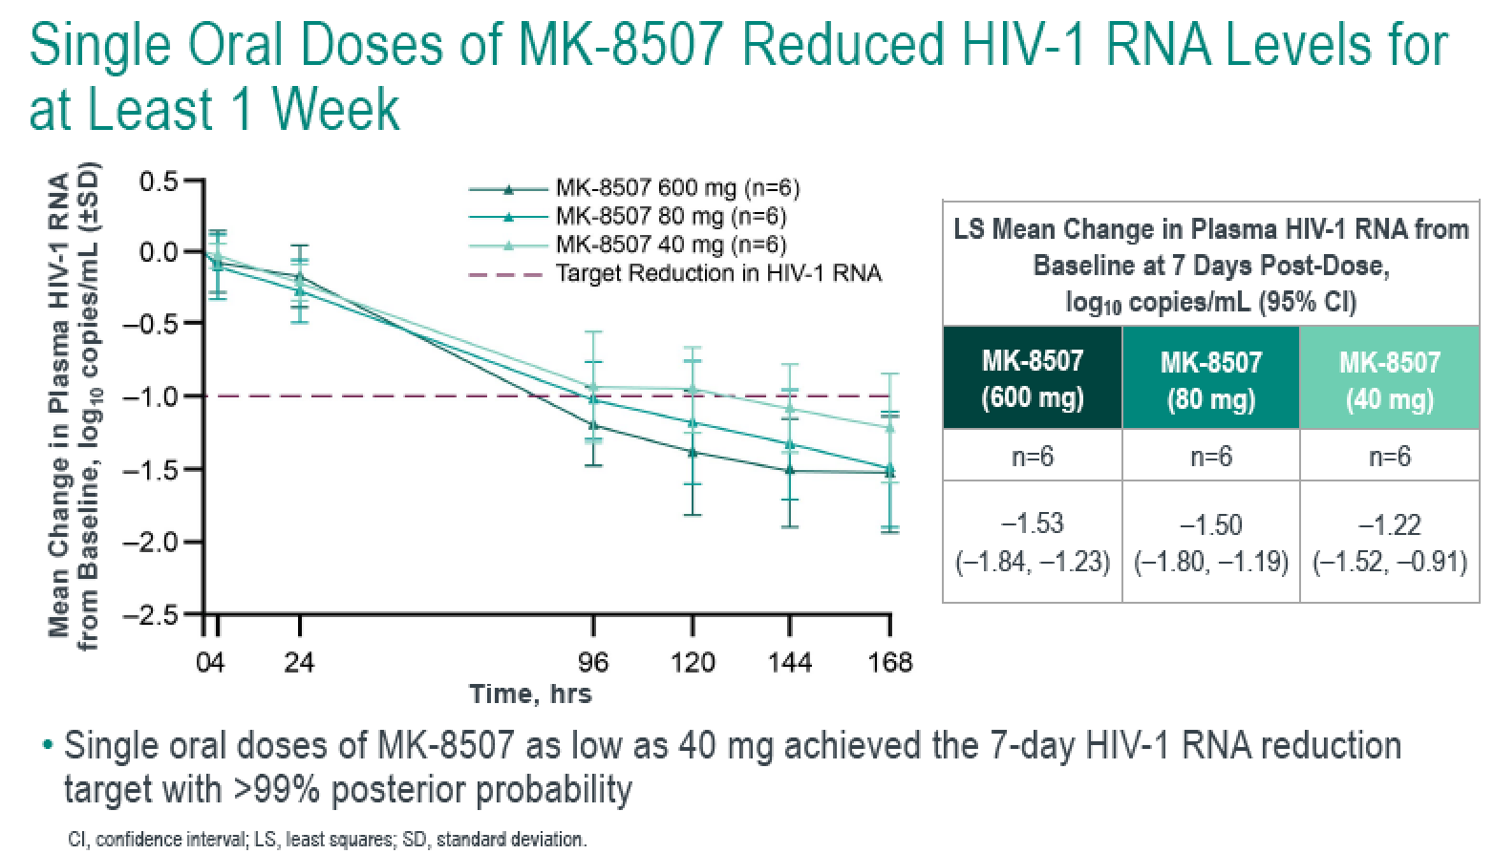
Ulonivirine (ULO, MK-8507): Investigational NNRTI
Potent in vitro (IC50 ~50nM); DOR analog with similar resistance Diamond CROI 2021 #129
T_{1/2} ~ 70 hours -- supports once-weekly oral dosing Ankrom AAC 2021;65:e0093521
Phase 1 study (N=18)
  PWH rx-naïve
  Single doses tested: 40, 80, 600 mg
Phase 2a switch study: ULO (100, 200, 400 mg) + ISL 20 mg qwk vs. BIC/TAF/FTC (N=140)
  ↓ in total lymphocyte and CD4 observed in all ISL 20 mg + ULO arms by 8-12 weeks
Phase 2b switch study: ULO 200 mg + ISL 2 mg qwk Luetkemeyer IAS 2026 #OAB1405LB
  PWH on BIC/TAF/FTC with VL <50 X >6 months (N=157)
  Results (week 24): HIV RNA <50 in 95% (ULO+ISL) vs. 98% (BIC/TAF/FTC)
Schurmann JAIDS 2022;89:191-198
Molina IAS 2025 #OAB0102

Slide 19
Investigational Agents –
INSTIs

Slide 20
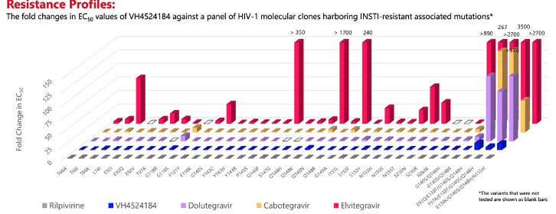
VH-184: “3rd Generation” INSTI: In vitro
Antiviral activity measured against lab and clinical isolates
HIV integrase enzyme IC50 5.8 nM; HIV proviral DNA IC50 0.46nM
HIV in vitro passage with VH-184 X 112 days: no mutations
Active against INSTI-resistant isolates with up to 4 mutations (including Q148H)
Seki IAS 2024 #WEPEB114

Slide 21
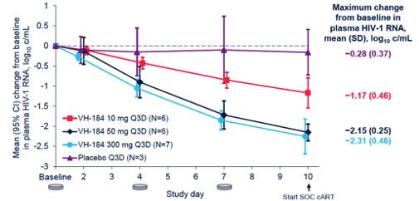
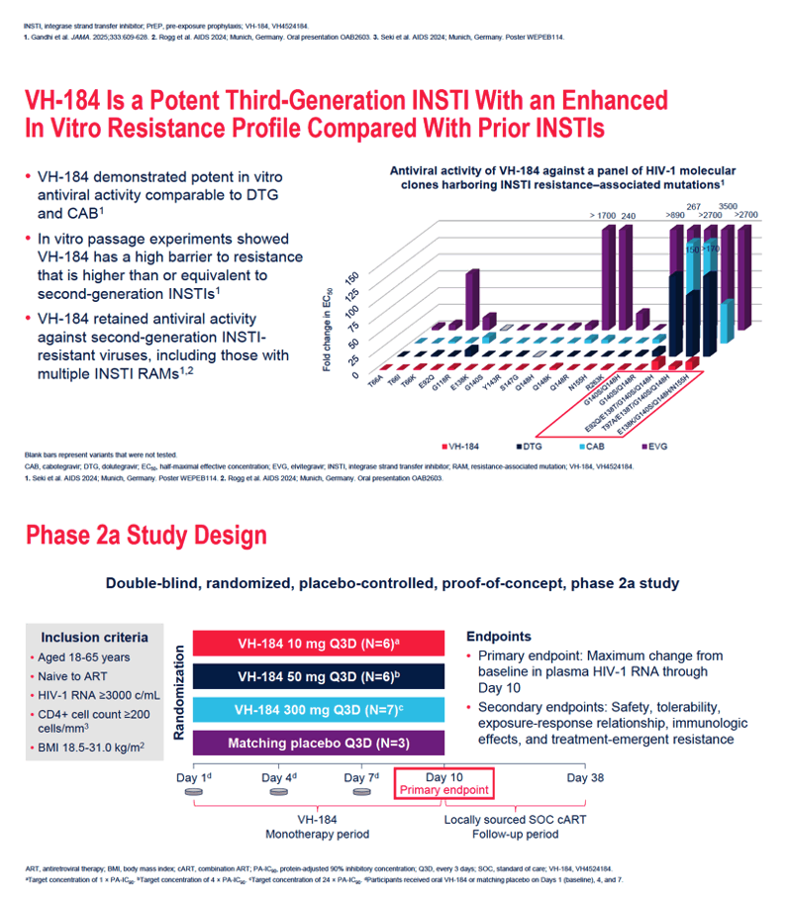
VH-184: “3rd Generation” INSTI: Clinical
Phase 1: People without HIV; t ½ 24 hours; dose-proportional ↑ concentrations up to 300mg; minimal impact on midazolam (CYP3A4 substrate); generally safe/well-tolerated; +moderate food effect Rogg CID 2025;81:510-520
Phase 2a:
Further studies:
  Phase 1: oral + q6 month injectables Back CROI 2026 #176
  Phase 2b in rx-naive (INNOVATE): Oral VH-184/TAF/FTC vs. DTG/3TC
oral
No resistance
at day 10
Rogg CROI 2025 #152 and Rogg CID 6/12/26 (on-line)

Slide 22
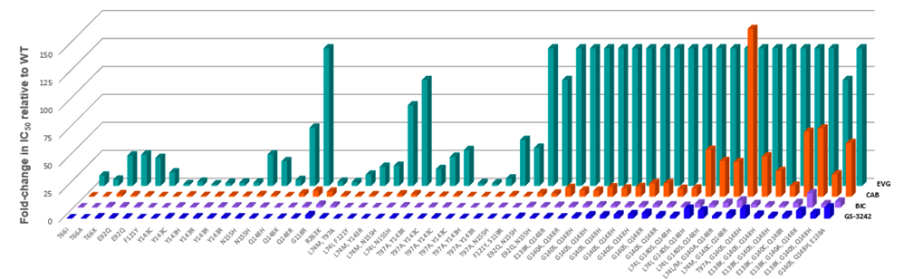
GS-3242: INSTI: In vitro
Potent investigational INSTI; EC50=0.8 nM
Antiviral activity against 55 INSTI-resistant HIV isolates
  Similar to BIC
Hansen IAS 2026 #THPEA026

Slide 23
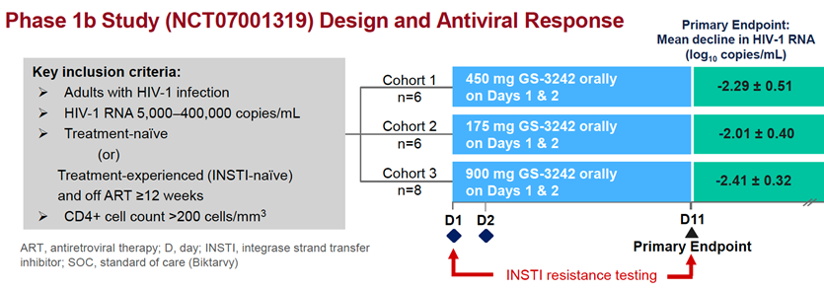
GS-3242: INSTI: Clinical
Phase 1b: Gupta CROI 2026 #174 + Hansen IAS 2026 #THPEA026
Phase 1a and 1b: q4 month injections Gupta CROI 2026 #174
Phase 2 studies: recruiting
  Pulsar 1: Australia, Canada, U.S. (including PR) NCT07645287
    Study population: On TAF/FTC/BIC with VL <50 X >6 months
    Study rx: GS-3242 + LEN injections vs. continued oral TAF/FTC/BIC
  Pulsar 2: Canada, U.S. (including PR) NCT07708727
    Study population: treatment-naïve (except oral PrEP)
    Study rx: GS-3242 + LEN injections vs. oral TAF/FTC/BIC
No genotypic or phenotypic resistance

Slide 24
Investigational Agents –
Capsid Inhibitors

Slide 25
Dezecapavir (VH-499): Investigational Capsid Inhibitor
  Preclinical: binds to the mature capsid hexamer, binding contact similar to LEN, Potent in vitro: HIV EC50 23 pM, selects resistance mutations Wang AAC 2025;69:e0030925
  Phase 1a: People without HIV: VH-499 exceeded target levels, half-life >2 days, and generally well tolerated Thakkar Infect Dis Ther 2025;14:1011
  Phase 1b: single ascending doses of IM or SC VH-499 Thakkar CROI 2026 #175
    Modeling supports q6m IM dosing
  Phase 2a: People with HIV; VH-499 at 25, 100, 250 mg q5 days monotherapy
    HIV RNA change -1.8-2.1 log copies/ml at day 11 Griesel CID 2026 (online 7/29/26)
  Phase 2b: CINERGY trial in treatment-naïve adults (in progress, N=200) NCT07816250
  VH-499 + CAB IM q6 mos vs. oral DTG/3TC

Slide 26
Investigational Agents – bNAbs

Slide 27
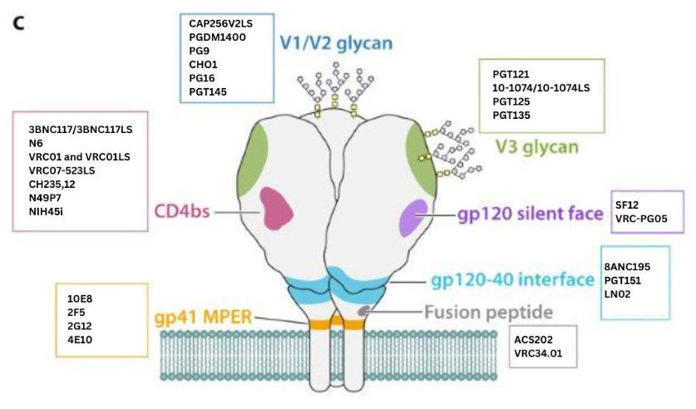
HIV Broadly Neutralizing Antibodies (BNAbs)
Mahomed Clin Micro Rvw 2024;37:e0015222

Slide 28
Do not edit
How to change the design
ARS Question #2: Which bNAb feature is unique among ART?
The Slido app must be installed on every computer you’re presenting from

Slide 29
ARS Question #2: Which bNAb feature is unique among ART?
Prevents HIV entry by binding to gp 120
Can be combined
Can enhance host immunity**
Can be given intravenously or subcutaneously

Slide 30
HIV Broadly Neutralizing Antibodies (BNAbs)
>20 bNAbs evaluated for safety and PK in >6000 humans
Clinical trials generally demonstrate safety and antiretroviral activity
“Vaccinal effect”: enhancing host immunity
Strategies to improve potency, breadth, serum half-life and delivery
  More potent, broader and multi-specific antibodies
  Longer half-lives → dosing every 2-6 months
  Subcutaneous dosing
Combination strategies: Phase 1 and 2 studies
  2, 3, and 4 BnAb combinations
  bNAbs + long-acting ARV (CAB or LEN)
Awan Curr Opin HIV AIDS 2022;17:247-257

Slide 31
Lenacapavir + 2 BNAbs (TAB and ZAB)
teropavimab (TAB, 3BNC117-LS, GS-5423): long-acting CD4-binding site bNAb
zinlirvimab (ZAB, 10-1074-LS, GS-2872): long-acting V3 glycan site-binding bNAb
Pilot phase 1b:
  20 PWH sensitive to TAB and ZAB with VS
  Study Rx: LEN (oral/SC) + bNAb infusions (once!)
  Results: 18 (90%) had VL <50 cps at 26 weeks
  Eron Lancet HIV 2024;11:e146-e155
Pilot phase 1b:
  11 PWH sensitive to TAB or ZAB (not both) with VS
  Study Rx: LEN (oral/SC) + bNAb infusions
  Results: 8/10 VS; 2 had virologic failure at 26 weeks Eron JID 2025;231:1440-1444

Slide 32
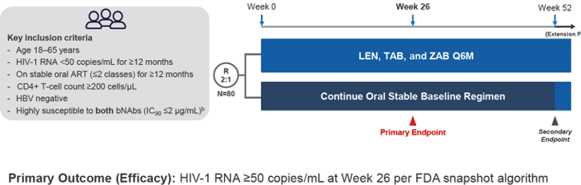
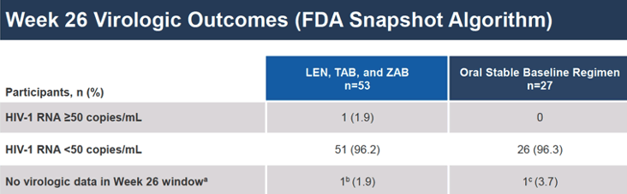
LEN + 2 bNAbs (TAB and ZAB)
Phase 2:
Conclusions:
In PWH highly-susceptible to both bNAbs, switching to LEN, TAB, and ZAB every 6 months was consistent with oral SOC ART. Ogbuagu Lancet Microbe 2026;7:101283
Update at Week 52 (n=53): 89% <50 copies/ml Ogbuagu EACS 2025 #PS09.2
Update at Week 104 (n=41): 98% <50 copies/ml McMahon IAS 2026 #OAB1403
Phase 3 planned: DAYBREAK 1 NCT07682961 and 2 NCT07683000

Slide 33
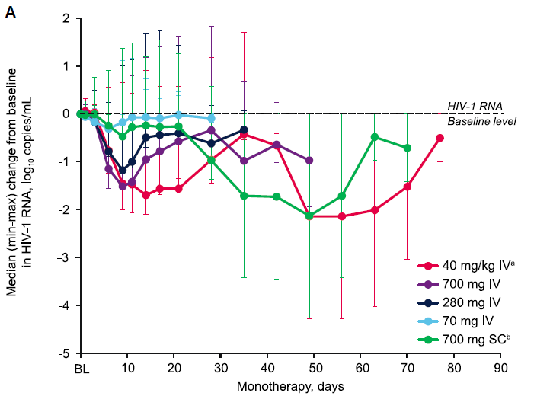
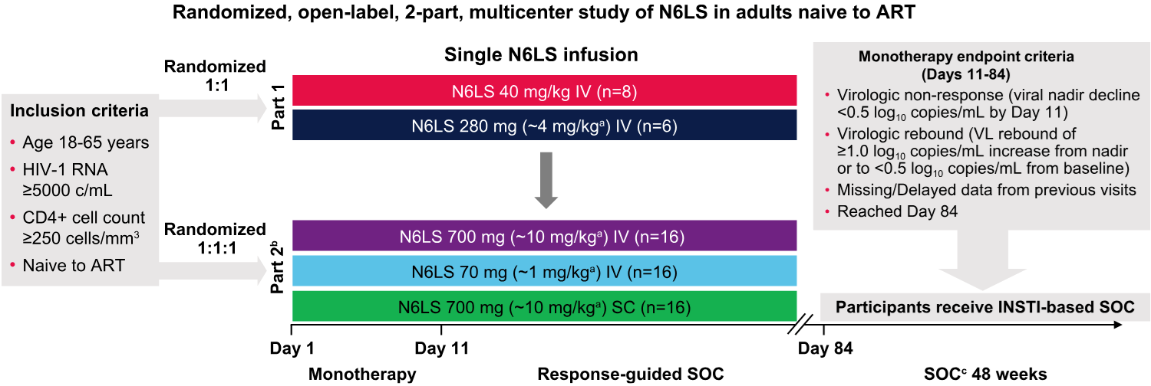
Lotivibart + CAB: BANNER -- Phase 2a Study
Lotivibart (LVB, N6LS, VH-109): LA CD4-binding site bNAb
Phase 1 study in people without HIV showed LVB well-tolerated IV and SC Wu Lancet HIV 2025;12:e485-e495
Phase 2
Conclusion:
LVB was generally safe and efficacious; supports further development of IV or SC dosing
Leone JID 2025;232:e1022-1032

Slide 34
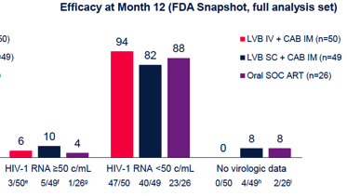
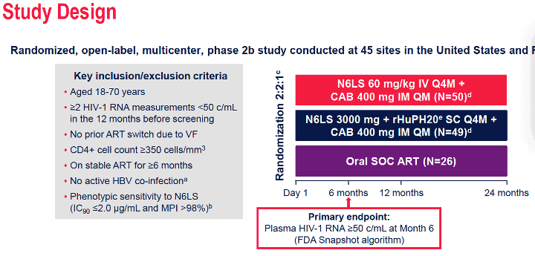
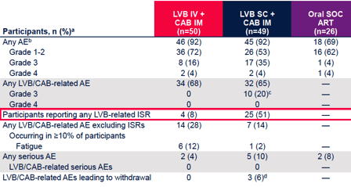
LVB + CAB: EMBRACE Phase 2b Study
Phase 2b: EMBRACE Part 1
(N=125)
Conclusion:
High VS rates; IV better tolerated than SC
Rolle CROI 2026 #178
EMBRACE Part 2: LVB IV q4m + CAB q2m -- fully enrolled
  LVB subcutaneous discontinued, changed to IV
  Gutner IAS 2026 #WEPEB097

Slide 35
ARV Regimens: Now and Near Future
Oral Treatment
  Daily: many 3-drug and newer 2-drug
  Weekly: ISL/LEN, ISL/ULO
  Monthly: ?
Injectable Treatment
  Every 2, 4, 6, 12 months: CAB+RPV, CAB+LEN, LA ART+BNAbs
Oral PrEP
  Daily: TDF/FTC, TAF/FTC
  Weekly: LEN
  Monthly: AMI
Injectable PrEP
  Every 2, 4, 6, 12 months: CAB, LEN

Slide 36




Acknowledgments
Cornell HIV Clinical Trials Unit (CCTU)
Division of Infectious Diseases
Weill Cornell Medicine
AIDS Clinical Trials Group (ACTG)
HIV Prevention Trials Network (HPTN)
Division of AIDS, NIAID, NIH
For slides:
  Alexandra Calmy, Brenda Crabtree, Judy Currier, Charlie Flexner, Raj Gandhi, Raphy Landovitz, James McMahon, Chloe Orkin, Paul Sax, Melanie Thompson; HIV iBASE, NATAP, TAG
The patient volunteers!

Slide 37
Q and A Session

