Slide 1

From Data to Action: Advances and Evolving Strategies in HIV and STI Prevention
Aniruddha Hazra, MD
Associate Professor of Medicine
Section of Infectious Diseases and Global Health
University of Chicago
Chicago, IL

Slide 2
Financial Relationships With Ineligible Companies (Formerly Described as Commercial Interests by the ACCME) Within the Last 2 Years
Dr Hazra reported receiving research grant funding from Gilead Sciences, Inc, and serving as a consultant to Abbott Laboratories, Gilead Sciences, Inc, and ViiV Healthcare. (Updated September 14, 2026)

Slide 3
Learning Objectives
After attending this presentation, learners will be able to:
  Analyze the current HIV preexposure prophylaxis (PrEP) landscape and differentiate available prevention options
  Evaluate real-world outcomes and implementation considerations for long-acting PrEP in key populations
  Describe evidence and public health implications of doxycycline postexposure prophylaxis
  Assess emerging biomedical sexually transmitted infection prevention strategies in development

Slide 4
The PrEP Landscape in 2025
 | Daily FTC/TDF | On-Demand (2:1:1) FTC/TDF | Daily FTC/TAF | Injectable CAB | Injectable LEN | Dapivirine Vaginal Ring
Men who have sex with men | FDA approved, guideline recommended¹⁻⁴ | Off label, IAS-USA and WHO guideline recommended^{2,3} | FDA approved, guideline recommended^{2,4,5} | FDA approved, guideline recommended^{2,3,4,6} | FDA approved, guideline recommended^{7,8,9} | N/A
Transgender women | FDA approved, guideline recommended | Off label, IAS-USA guideline recommended² | FDA approved, guideline recommended | FDA approved, CDC guideline recommended
Heterosexual men
Heterosexual women | FDA approved, guideline recommended¹⁻⁵ | Off label, not recommended (unless risk from anal sex only)² | Off label, IAS-USA guideline recommended^{4,8} | FDA approved, guideline recommended (except in pregnancy)^{3,4,6} |  | Unavailable in US, WHO recommended³
Transgender men |  |  | Off label, not recommended (unless risk from anal sex only)^{2,5}
Persons Who Inject Drugs |  | Sexual activity should be assessed and considered, likely to benefit from any FDA-approved medication for PrEP⁴
¹FTC/TDF PI, ²Gandhi. JAMA. 2024, ³WHO implementation tool for pre-exposure prophylaxis (PrEP) of HIV infection. 2024, ⁴CDC PrEP guidelines. 2021, ⁵FTC/TAF PI, ⁶CAB extended-release injectable suspension PI, ⁷LEN PI, ⁸Landovitz, JAMA 2025, ⁹CDC LEN PrEP guidelines. MMWR. 2025

Slide 5
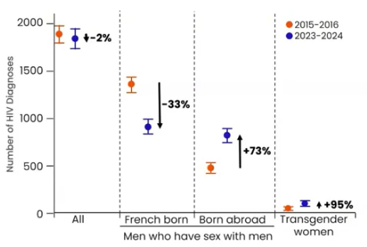
Daily vs On-Demand (2-1-1) TDF/FTC
Low HIV incidence across cohort (0.99/1000 PY, 13 cases) over mean follow-up 49.1 months
  Daily PrEP 0.6/1000 PY (95%CI 0.1-1.8)
  On-Demand PrEP 1.5/1000 PY (95%CI 0.6-3.0)
  Switch 0.9/1000 PY (95%CI 0.2-2.6) (lowest rate of study discontinuation)
Significant population level reductions in new HIV diagnoses in Paris, but progress is uneven
  33% reduction in HIV diagnoses among MSM born in France
  73% increase in HIV diagnoses MSM who migrated or immigrated to France
  95% increase in HIV diagnoses in transgender women regardless of country of birth
Daily and on-demand TDF/FTC both highly effective in preventing HIV
Molina JM. CROI 2026. Abstract 127.

Slide 6
PURPOSE 1 & 2 OLE Wk 52
95% of eligible participants opted to continue/ switch to LEN in the OLE
High adherence through OLE
  PURPOSE 1: ~96–97% on-time injections at OLE doses #2–#3
  PURPOSE 2: ~90–96% on-time injections at OLE doses #2–#3
ISRs remain common (65-90%) but Grade 3 ≤1%
  Most frequent: nodules, pain, swelling, induration
Kiwanuka. IAS 2026. Abstr OAC2802.
Losso. IAS 2026. Abstr OAC2806LB

Slide 7
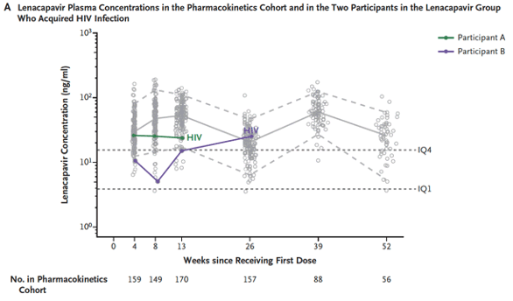
HIV Acquisition on LEN PrEP
(PURPOSE 1 & 2 OLE Wk 52)
6 seroconversions across PURPOSE 1 & 2 studies through OLE Wk 52
PURPOSE 1
  2 new seroconversions post-primary analysis
  • Case 1: Occurred after LEN discontinuation with sub-therapeutic drug levels; no capsid inhibitor mutations
  • Case 2: Low-level viremia, target LEN levels, genotype unsuccessful
PURPOSE 2
  2 seroconversions on study
  • On-time injections, target concentrations
  • N74D capsid mutations detected in both
  1 seroconversion post-primary analysis
  • On-time injections, target concentrations
  • Q67H / K70R capsid mutations detected
  1 seroconversion OLE through Wk 52
  • On-time injections, target concentrations
  • Q67H capsid mutations detected
Kiwanuka. IAS 2026. Abstr OAC2802.
Losso. IAS 2026. Abstr OAC2806LB

Slide 8
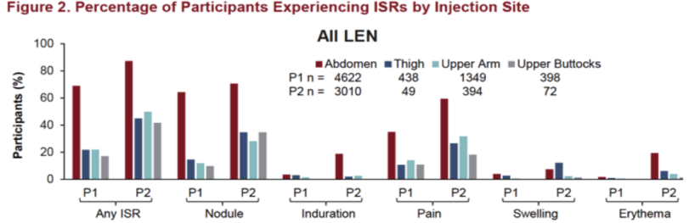
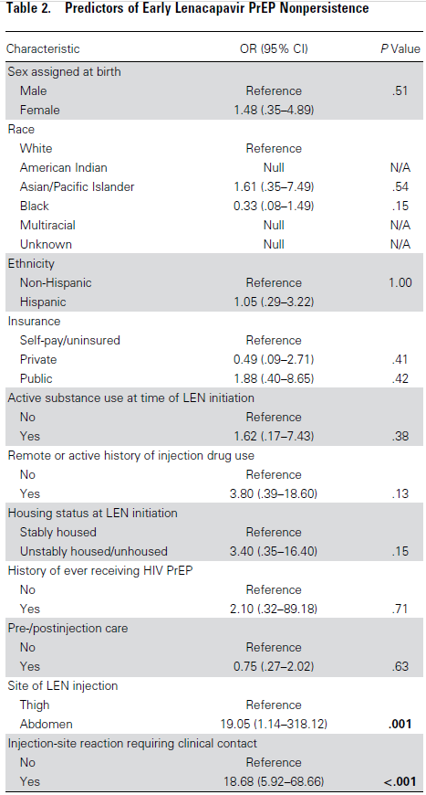
LEN ISRs in PURPOSE and Real-World
ISRs were less frequent with LEN administered in non-abdomen sites in PUPOSE 1 and 2
Early real-world data demonstrates abdominal site associated with:
  ISRs needing clinical contact
  Early LEN discontinuation
Brites. AIDS 2026. Abstr TUPEC184
Hazra A et al. CID 2026.

Slide 9
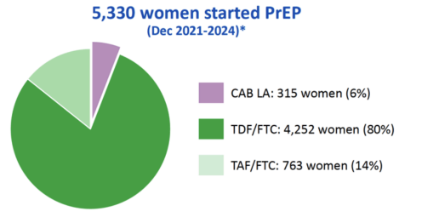
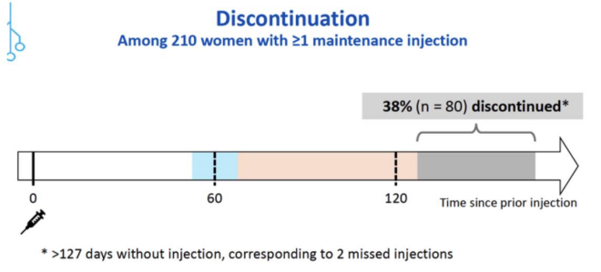
OPERA Cohort:
CAB-LA PrEP Use Among Women
Among 5330 women who initiated PrEP between 2021 and 2024, 6% (n = 315) received CAB-LA
Median follow-up for women initiating CAB-LA PrEP: 13 mo (IQR: 8, 19)
Among 1193 maintenance injections, 88% were on time
Incident HIV infections among women receiving LA CAB PrEP: 0
Armas-Kolostroubis. AIDS 2026. Abstr OAC2805.

Slide 10
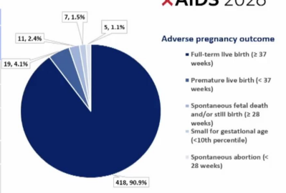
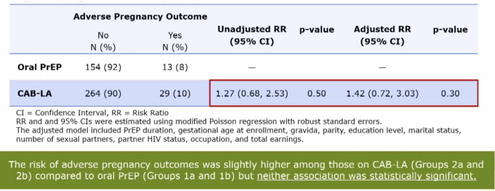
CAB-LA in Pregnancy Updates
Pregnancy Infant and Maternal health Outcome (PrIMO)
Prospective cohort designed to study CAB-LA during pregnancy and breastfeeding in Malawi
Interim analysis based on first 545 births
CAB-LA injections had similar pregnancy outcomes to women who used daily oral PrEP
Saidi. AIDS 2026. Abstr OAC1306LB.

Slide 11
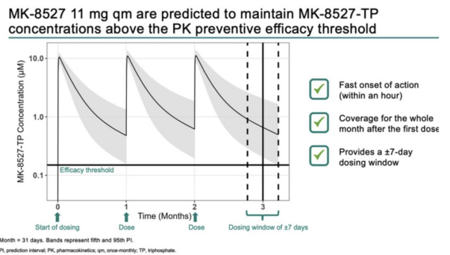
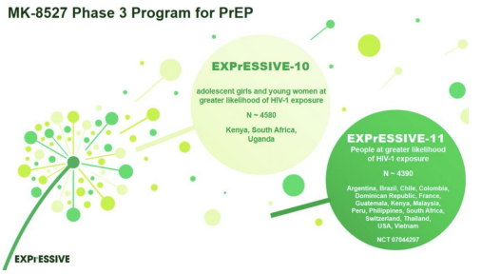
Alimatravir (MK-8527)
Nucleoside reverse transcriptase translocation inhibitor with once monthly PK properties when taken orally
11mg q month selected for phase 3
Efficacy predicted to 38 days to allow +/- 7 day window
Efficacy predicted by PK model in adolescents and pregnancy
Kapoor. CROI 2026. Abstract 126.
Carstens. AIDS 2026. Abstr TUPEB125

Slide 12
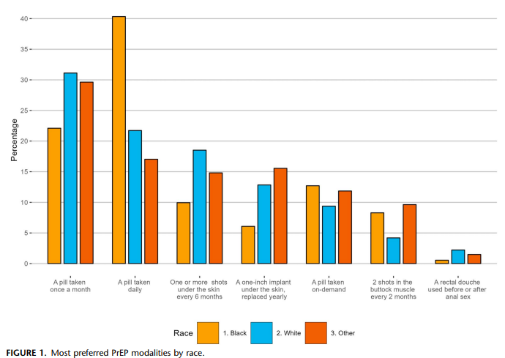
Preferences for Monthly Oral PrEP Over Other PrEP Modalities
National survey of 723 GBMSM on PrEP preferences
Monthly oral PrEP most preferred (28.6%); >50% preferred an oral option
Preferences varied by race, stigma, healthcare trust, PrEP/HIV knowledge, and psychosocial resources
Four distinct psychosocial profiles emerged; monthly oral PrEP led in 3 of 4 groups, while long-acting options remained important across groups
Predominantly Black, less-resourced group strongly preferred daily oral PrEP
Cost, side effects, visit burden, route & dosing frequency shaped preferences
Gravett, R et al. JAIDS. 2025.
Gravett. AIDS 2026. Abstr TUPEC172

Slide 13
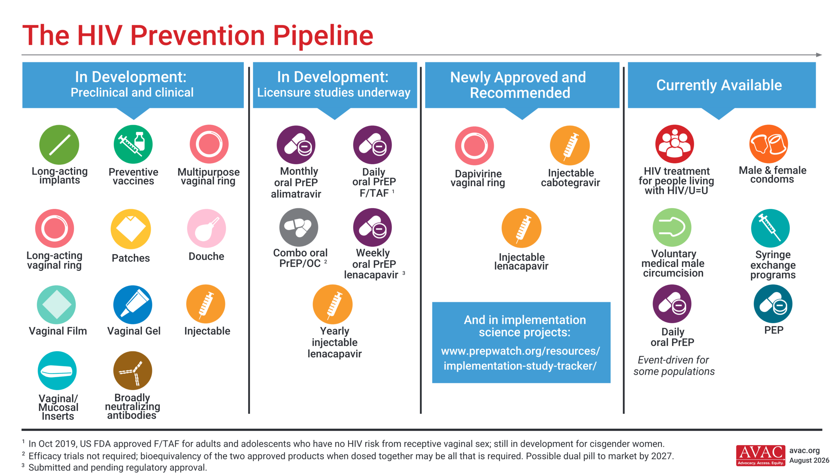

Slide 14
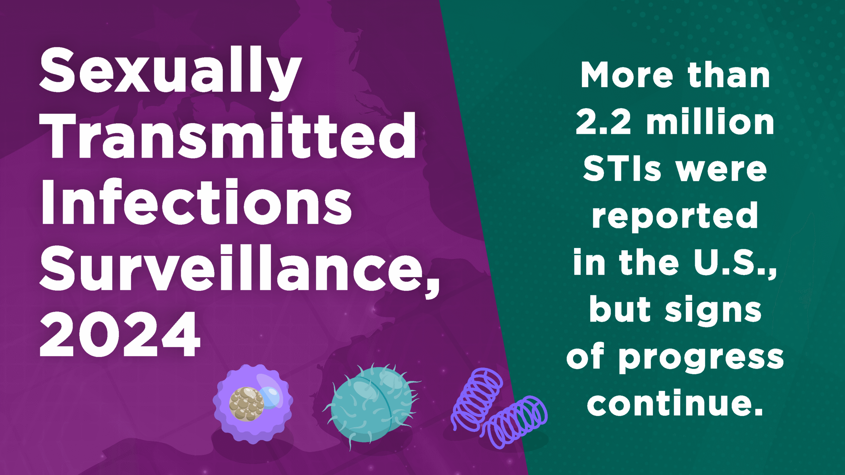
Slide 14

Slide 15
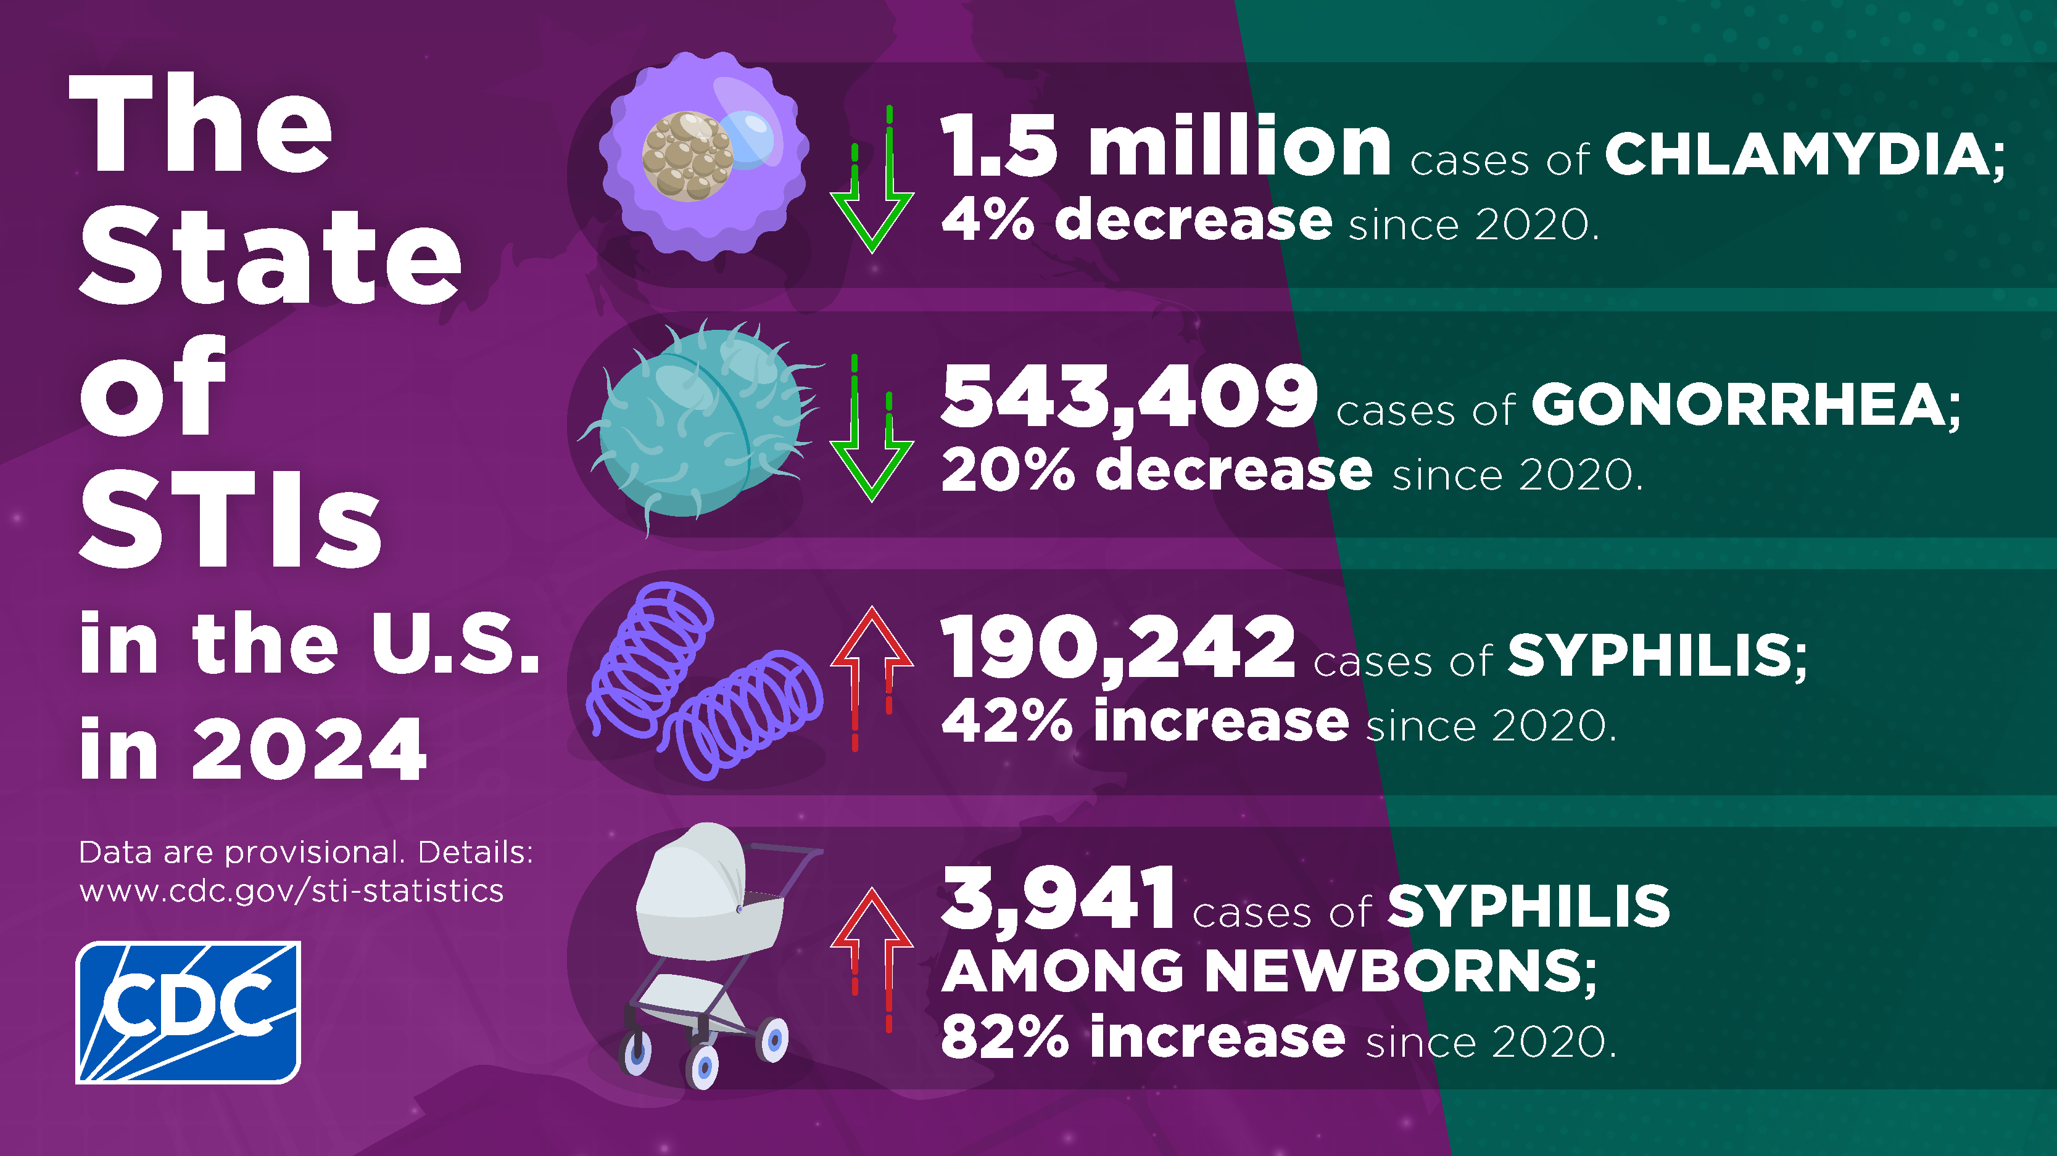
Slide 15

Slide 16
Completed Doxycycline Prophylaxis Studies
Study | Sample Size and Population | STI Rate or Outcome |  | Reduction in Relative Risk
 |  | Doxycycline PPX | No Doxycycline PPX
DoxyPrEP Pilot (Los Angeles, USA, 2011-2012) | Men with HIV (n=30) | 12.3 per 100 PY | 33.2 per 100 PY | 73% (p=0.02)
ANRS IPERGAY (Paris, France, 2015-2016) | Men on HIV PrEP (n=232) | 37.7 per 100 PY | 69.7 per 100 PY | 47% (p=0.008)
DoxyPEP (Seattle and San Francisco, USA, 2020-2022) | Men with HIV (n=174) | 11.8% per quarter | 30.5% per quarter | 62% (p<.001); NNT: 5.3;
 | Men on HIV PrEP (n=327) | 10.7% per quarter | 31.9% per quarter | 66% (p<.001); NNT: 4.7
DOXYVAC (Paris, France, 2021-2022) | Men on HIV PrEP (n=502) | 8.8 per 100 PY* | 53.2 per 100 PY* | 83% (p<0.0001)
DuDHS (Vancouver, Canada, 2019-2020) | Men on HIV PrEP (n=52) | 0 per 100 PY** | 81.6 per 100 PY** | 82% (p=0.011)
DaDHS (Toronto and Vancouver, Canada, 2020-2023) | Men with HIV (n=52) | 23.7 per 100 PY | 119.4 per 100 PY | 80% (p<0.001)
dPEP (Kisumu, Kenya, 2020-2022) | Women on HIV PrEP (n=449) | 25.1 per 100 PY | 29.0 per 100 PY | 12% (p=0.51)
DoxyPrEP Pilot (Tokyo, Japan, 2022-2023) | Women sex workers (n=40) | 79.2 per 100 PY | 232.3 per 100 PY | 67% (p=0.02)
doxyDOT (Kimusu, Kenya 2025) | Women on HIV PrEP (n=60) | 11.2 per 100 PY | 29.6 per 100 PY | 61% (p=0.039)
*Point estimates are for CT and syphilis only. **Point estimates are for CT only. Slide adapted from Hazra et al. Clin Infect Dis.

Slide 17
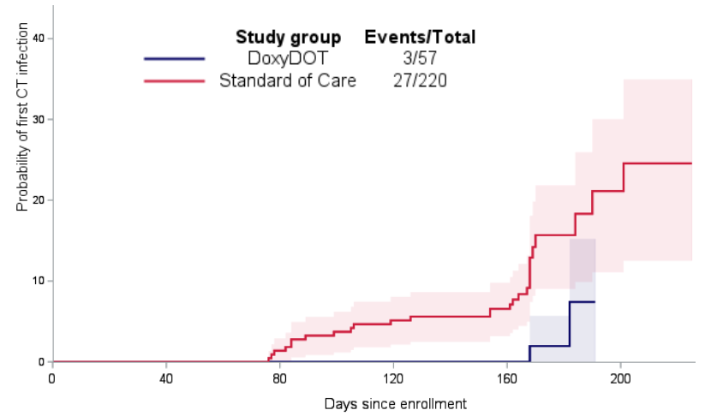


Weekly Doxy Prophylaxis Among Cisgender Women
(DoxyDOT Study)
Open-label, single-arm pilot study
Doxycycline 200 mg once weekly
60 nonpregnant cisgender women in Kenya (ages 18–30)
Key Findings
91% adherence to weekly dosing
61% reduction in chlamydia incidence
Adolescent Trial Network launched a trial of doxyPEP vs weekly doxy vs SOC among adolescent girls and young women in US (ATN-173/HPTN-115)
Stewart J et al. ISSTDR 2025

Slide 18
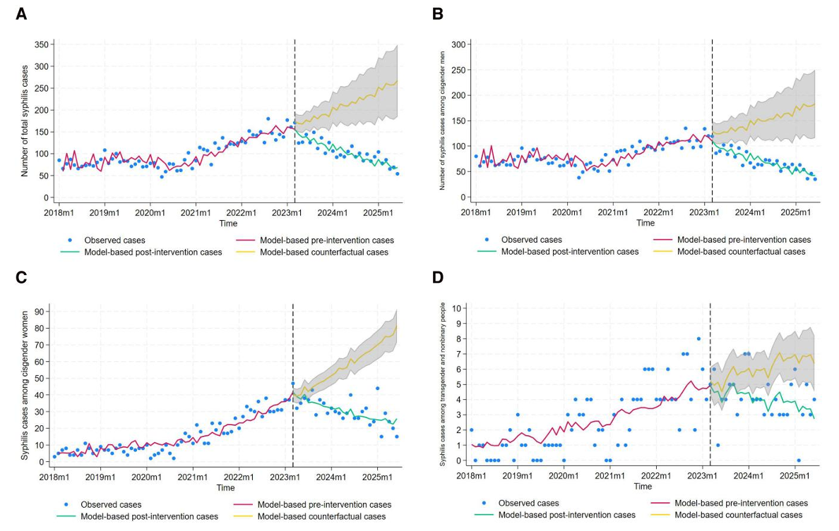
Effect of DoxyPEP on Syphilis in Seattle
Total Cases
Cisgender Men
Cisgender Women
Trans and Gender Diverse
Menza T et al. CID 2026.

Slide 19
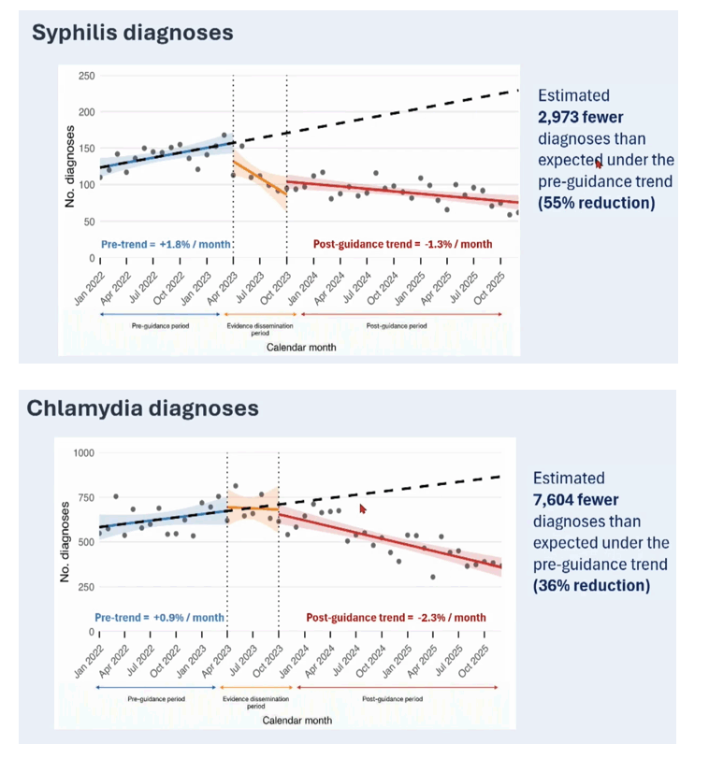
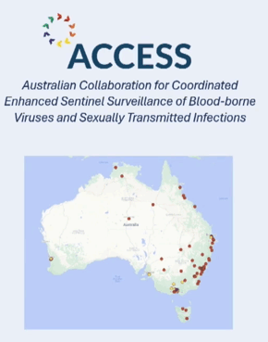
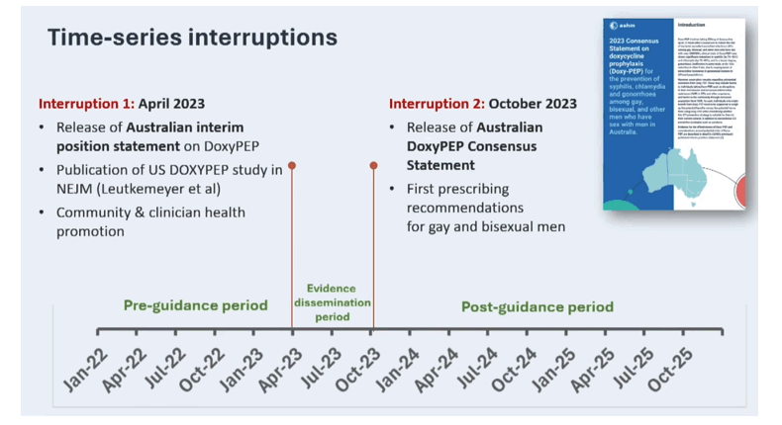
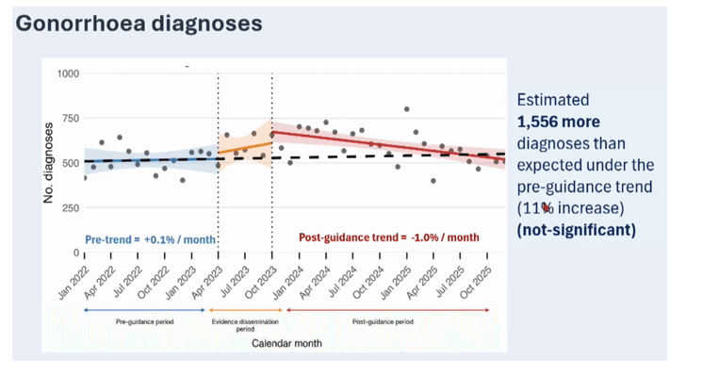
Effect of DoxyPEP on Syphilis and CT in Australia
Traeger. AIDS 2026. Abstr OAC4203

Slide 20
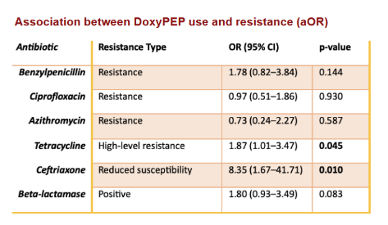
DoxyPEP and GC Resistance
Retrospective cohort (Italy, 2022–2025)
376 gonorrhea episodes (n=318); 20.5% with DoxyPEP exposure
High baseline resistance:
  CIP 73%, TET 96% (17% high-level), AZM 10%, penG 12%
  CRO decreased susceptibility (DS): 2.1%
DoxyPEP associations:
  ↑ Tetracycline high-level resistance (OR 1.87, p=0.045)
  ↑ Ceftriaxone decreased susceptibility (OR 8.35, p=0.01)
No association: ciprofloxacin, azithromycin, penicillin resistance
MICs similar regardless of DoxyPEP exposure
Raccagni AR, et al. CROI 2026. Abstract 1036.

Slide 21
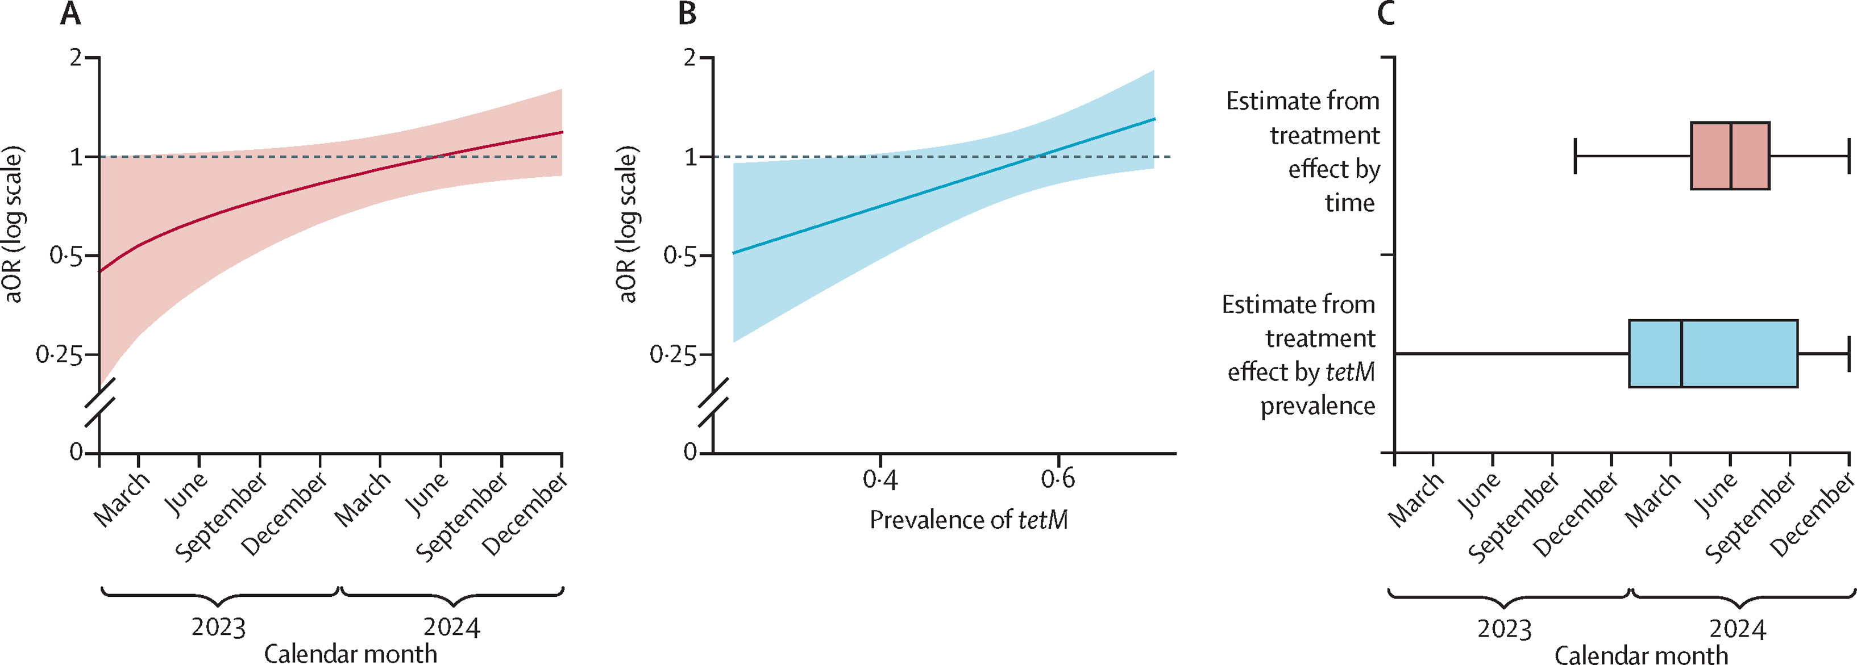
DoxyPEP and GC Resistance
Real-world Kaiser Permanente Southern California cohort, 2021–2025
26,582 MSM and transgender women with HIV or receiving HIV PrEP/PEP underwent STI testing
2,262 (8.5%) received doxyPEP
Retrospective test-negative design assessing doxyPEP fills ≤90 days before STI testing
Overall doxyPEP effectiveness
Chlamydia: 66.5% (95% CI 53.6–75.9)
Syphilis: 60.7% (28.3–78.5)
Gonorrhea: −1.8% (−18.5–12.5)
Gonorrhea effectiveness declined over time
42.3% before statewide doxyPEP implementation
−15.0% by Jan–Jun 2025
Decline coincided with rapid expansion of tetM, which confers high-level tetracycline resistance
Effectiveness fell from 47.2% when tetM prevalence was 20–29.9% → −8.5% when tetM was ≥50%
Yechezkel M et al. Lancet ID 2026.

Slide 22
Syphilis Diagnostics in the DoxyPEP Era
Delayed seroconversion — may extend >2 weeks after ulcer onset
Potential impact of DoxyPEP on syphilis diagnostic algorithms warrants monitoring
Seattle Sexual Health Clinic, 2023–2024 (n = 1,777 PrEP patients)
Median RPR titer: 1:8 in DoxyPEP users vs. 1:32 in non-users
Early syphilis: 12% among users vs. 88% among non-users
Possible explanations:
  Attenuated or delayed antibody response from recent doxycycline use
  Higher prevalence of past treated infections among DoxyPEP users
Raccagni AR et al. 2024
Cannon C et al. ISSTDR 2025

Slide 23
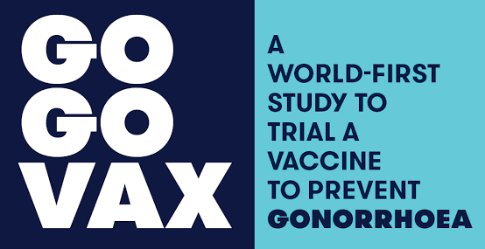
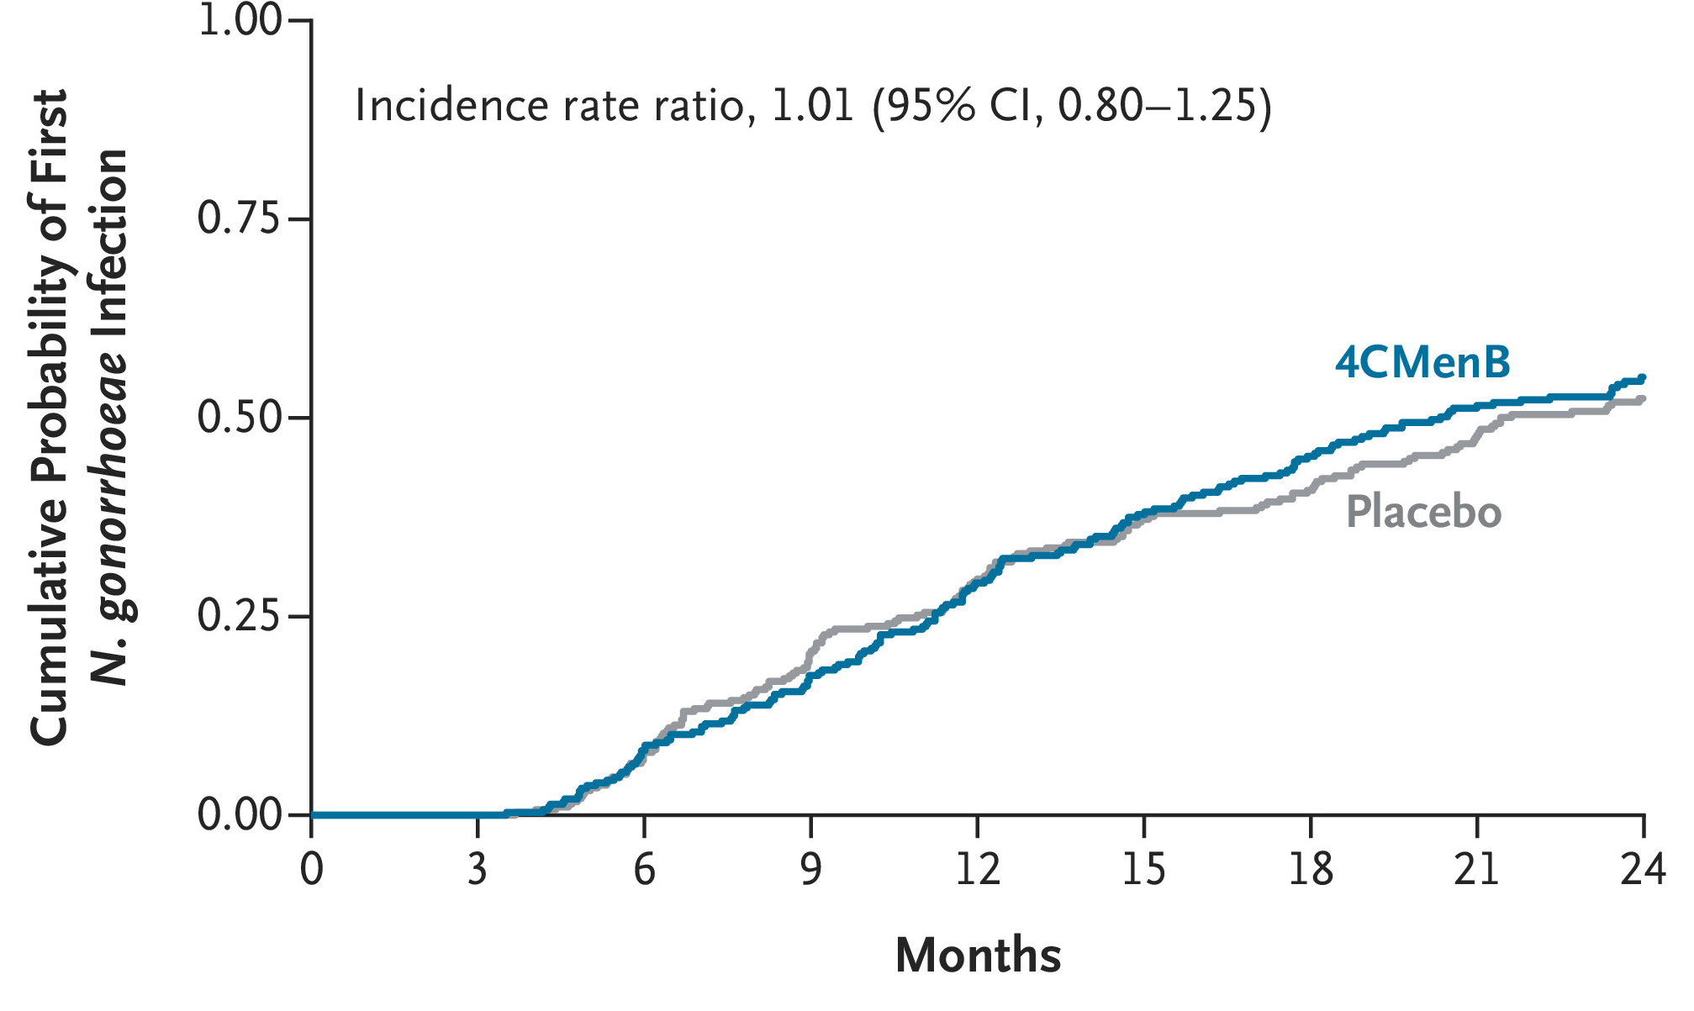
4CMenB Vaccine Does Not Prevent Gonorrhea
Randomized, double-blind, placebo-controlled trial in Australia
587 MSM, age 18–50, at high vulnerability for gonorrhea
Randomized to 2 doses of 4CMenB (Bexsero) vs placebo, 3 months apart
Primary outcome: first N. gonorrhoeae infection ≥4 weeks after dose 2
No reduction in gonorrhea
4CMenB: 48.1 infections/100 person-years
Placebo: 47.8 infections/100 person-years
Vaccine efficacy: −0.5%
IRR 1.01 (95% CI 0.80–1.26; P=0.97)
Despite encouraging observational data, 4CMenB did not reduce gonorrhea incidence in a randomized trial. The study was not powered to assess efficacy by symptoms, anatomic site, or subgroup.
Seib KL. CROI 2026. Abstract 197.
Seib KL et al. NEJM 2026.

Slide 24
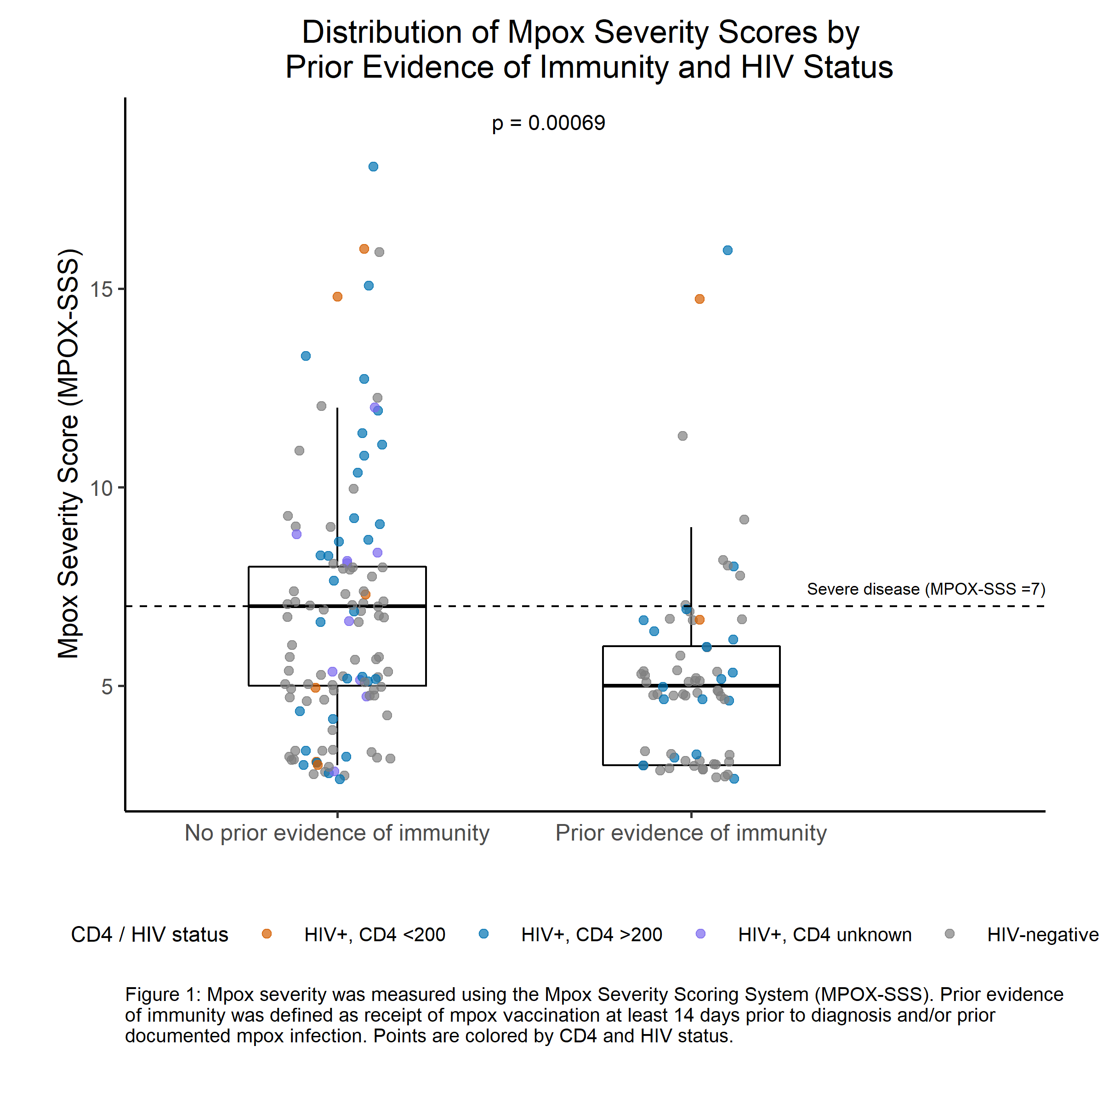
Prior Immunity Still Protects Against Severe Mpox
Multicenter U.S. cohort (7 sites, 186 mpox cases in 2025)
68 (36.6%) had prior immunity from vaccination and/or prior infection
118 (63.4%) had no prior evidence of immunity
Prior immunity associated with substantially less severe disease
Median MPOX-SSS: 5 vs 7 (p<0.001)
Severe disease: 24% vs 52% (p<0.001)
Hospitalization: 2.9% vs 17.8% (p=0.006)
70% lower adjusted odds of severe disease
aOR 0.30 (95% CI 0.14–0.60)
Protection appears durable
Among 66 post-vaccination cases, median time since vaccination was 36 months
No increase in disease severity with increasing time since vaccination
Zucker J. CROI 2026. Abstract 320.

Slide 25
Q and A Session

