Slide 1

From Silos to Solutions:
Integrating HIV and Substance Use Disorder
Treatment and Prevention Services
Sandra A. Springer, MD
Professor of Medicine
Department of Internal Medicine
Section of Infectious Diseases
Yale School of Medicine
New Haven, CT

Slide 2
Financial Relationships With Ineligible Companies (Formerly Described as Commercial Interests by the ACCME) Within the Last 2 Years
Dr Springer reported receiving noncash provisions of study drugs or testing equipment from Cepheid, Roche, Alkermes, Inc, Indivior PLC, and Braeburn Pharmaceuticals, Inc; serving as consultant to Alkermes, Inc, Emergent BioSolutions, and Gilead Sciences, Inc; and serving on a data safety and monitoring board for Eli Lilly and Company. (Updated September 16, 2026)

Slide 3
Learning Objectives
After attending this presentation, learners will be able to:
  Describe the epidemiology of substance use and HIV in the United States
  Explain how to screen for and diagnosis substance use disorders (SUDs)
  Initiate treatment for opioid, alcohol, and simulant use disorders when clinically indicated
  List plans to help patients with SUDs with or at risk for HIV initiate treatment and retain in care

Slide 4
Outline
Review epidemiology of Substance Use/ Substance Use Disorders (SUDs) and HIV
Discuss the steps to integrate SUD and HIV prevention and treatment services
Provide an overview of effective treatments of SUDs
Review interventions to improve initiation and retention on SUD and HIV treatment/ prevention

Slide 5
SLIDO POLL QUESTION
How confident do you feel managing pharmacotherapy for SUD (e.g., buprenorphine, naltrexone) directly within your HIV care setting?
A) Highly confident: I manage it independently without hesitation.
B) Moderately confident: I can do it but frequently require external consultation or advice.
C) Low confidence: I prefer to refer out rather than manage it myself.
D) Not confident/Not permitted: Our clinic does not handle these medications at all.

Slide 6
Do not edit
How to change the design
How confident do you feel managing pharmacotherapy for SUD (e.g., buprenorphine, naltrexone) directly within your HIV care setting?
The Slido app must be installed on every computer you’re presenting from

Slide 7
Substance Use Disorders and Substance Use in the United States
Slide 7

Slide 8
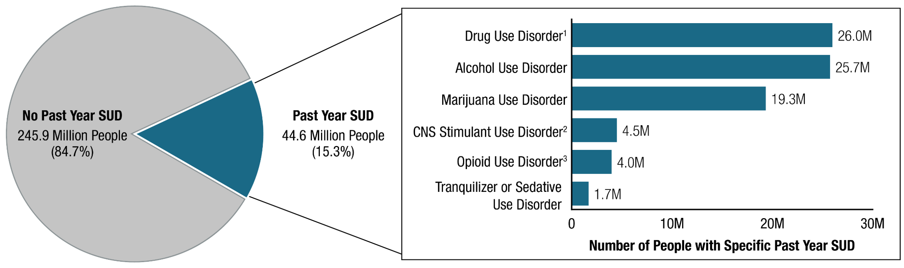
Past Year Substance Use Disorder (SUD): Among People Aged 12 or Older; 2025
https://www.samhsa.gov/blog/release-2025-nsduh-using-data-to-drive-great-american-recovery
Published August 2026.
Notes:
Substance Abuse and Mental Health Services Administration. (2026). 2025 Companion infographic report: Results from the 2021 to 2025 National Surveys on Drug Use and Health (SAMHSA Publication No. PEP26-07-011). Center for Behavioral Health Statistics and Quality, Substance Abuse and Mental Health Services Administration. https://www.samhsa.gov/data/data-we-collect/nsduh-national-survey-drug-use-and-health/national-releases

Slide 9
Self-Reported Opioid and Stimulant Use in 2025
1 in 4 people, almost 70 million people, reported illicit drug use in 2025
7.1 million people reported opioid misuse
780 K reported fentanyl/ synthetic opioid use
9.5 million reported cocaine/ methamphetamine use

Slide 10
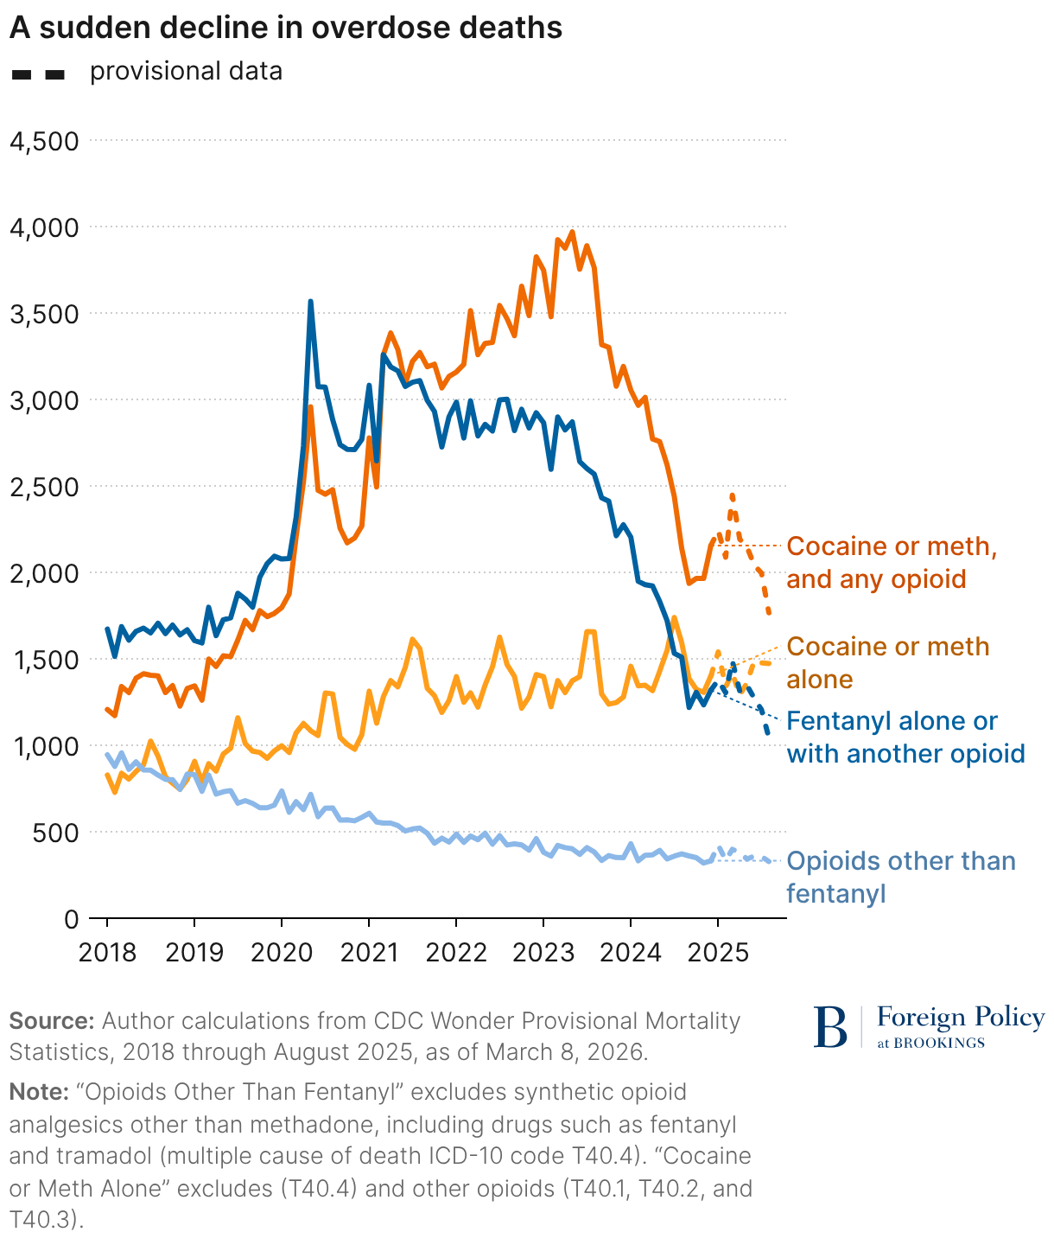
Drug Overdose Deaths
Falling in U.S.
But Not for Everyone

Slide 11
Persons with HIV (PWH) have a Higher Prevalence of Drug Use Disorders than Persons Without HIV (PWOH) or of Unknown Status
*Drug Use Disorder here excludes Cannabis Use Disorder
West B et al. Journal of Substance Use & Addiction Treatment. Volume 164. 2024
Notes:
Data come from the National Survey on Drug Use and Health (NSDUH),
an annual cross-sectional survey sponsored by the Substance Abuse and Mental Health Services Administration
five years of NSDUH data from 2015 (n =57,146), 2016 (n =56,897), 2017 (n =56,276), 2018 (n =56,313), and 2019 (n =56,136) to increase the sample size of individuals who reported their HIV status (N =282,768). exclude data from 2020 onward due to changes in sampling procedures. For this study, restricted the sample to adults aged 18 and older (n =214,505) and excluded children 12–17 (n =68,263), as they have distinct substance use and clinical needs. excluded n =117 adults with “Blank (No answer)” or “Bad data” for HIV status. The weighted prevalence of past-year SUD was 18.6 % among PWH, 7.8 % among adults who were HIV-negative, and 7.5 % among adults whose HIV status was unknown. To focus on SUD, which is a clinical indication of treatment need, excluded 192,222 adults who did not meet past-year DSM-IV criteria for SUD. final unweighted sample included 22,166 adults in the 2015–2019 NSDUH with a past- year SUD who responded to the HIV status question (Fig. 1).
Data on weighted characteristics of the 21,166 individuals aged 18 years and older with SUD in this study, stratified by HIV status group are in Table 1. A total of 0.5 % of the weighted sample were PWH, 0.8 % were HIV status unknown, and 98.6 % reported they are non-PWH.
In the past year, a majority of PWH with a SUD met the criteria for alcohol use disorder (56.6 %) or other drug use disorder (58.5 %) and 23.1 % had a cannabis use disorder (Table 1). Among people with unknown HIV status, 64.1 % reported alcohol use disorder, 26.0 % had a cannabis use disorder, and 34.3 % had another drug use disorder. Over a third of PWH and those with unknown status reported having two or more SUDs (39.4 % of PWH and 34.4 % for HIV status unknown).
AUD DUD (excluding cannabis )
PWH 56.6% 58.5%
Unknown status 64.1% 34.3%
PWOH 75% 20.6%
Prevalence of any past-year SUD treatment was 24.2 % among PWH, 17.3 % among those who reported their HIV status as unknown, and 10.3 % among individuals without HIV. Past-year specialty SUD treatment utilization was also low across groups: 17.8 % for PWH, 10.9 % for those with HIV status unknown, and 7.2 % for individuals without HIV. Only 12.4 % of PWH, 3.7 % of those with unknown HIV status, and 4.9 % of non-PWH indicated a perceived

Slide 12
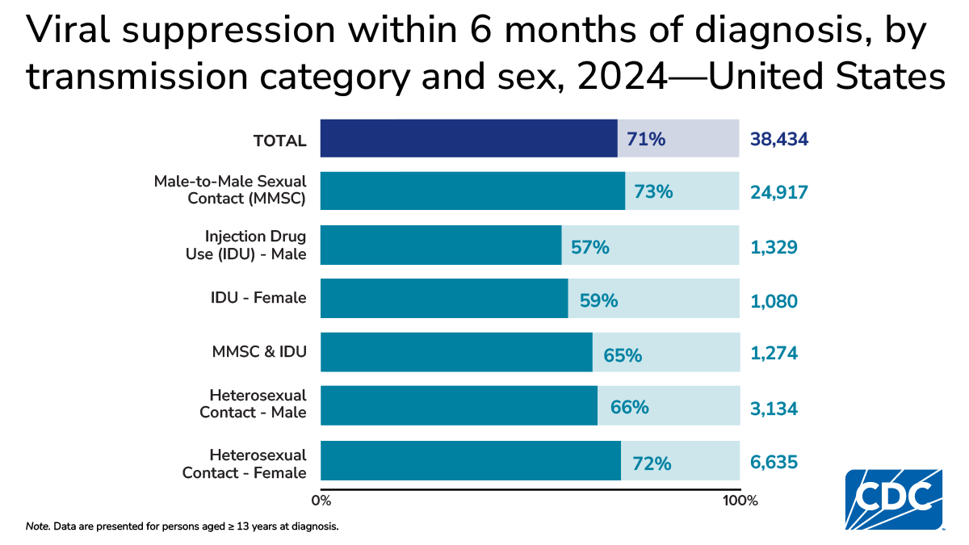

Slide 13
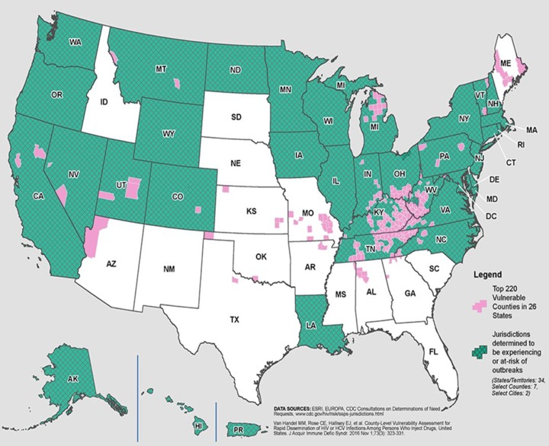
HIV outbreaks are Increasing among
Persons who use Drugs (PWUD)
King County, WA. 27 HIV cases from IDU 2018 (286% increase from 2017)
Lowell and Lawrence, MA, 129 HIV cases PWID from 2015-2018 (2012-2014, entire Mass had 123 IDU cases)
Bangor-Portland
ME
PWID
Over 50
Cases
2024-2026
Scott County, IN 215 HIV cases 2014-2015
Multnomah County, OR. 42 HIV cases mostly IDU in 2018-2019 (200% increase from 2016-2017)
Philadelphia, PA, 59 HIV Cases from IDU in 2018 (60% increase from 2016)
Boston, MA!
PWUD are not receiving PrEP
Or SUD TX
Cabell County WV, 55 HIV Cases from IDU in 2019 thru June (588% increase from 2016) – as of 9/9/19, up to 76 cases
Slide 13
Notes:
Not only are people dying directly from the harms of overdose but also acquiring HIV and other infectious diseases after we had a complete reduction in new HIV cases occurring among PWUD in our original HIV epidemic in the late 1980s fueled by injection of heroin and cocaine but due to SSPs, methadone, RWCA and HAART we had a reduction… but all along we never really figured out how to integrate HIV and SUD prevention and treatmeny services.

Slide 14
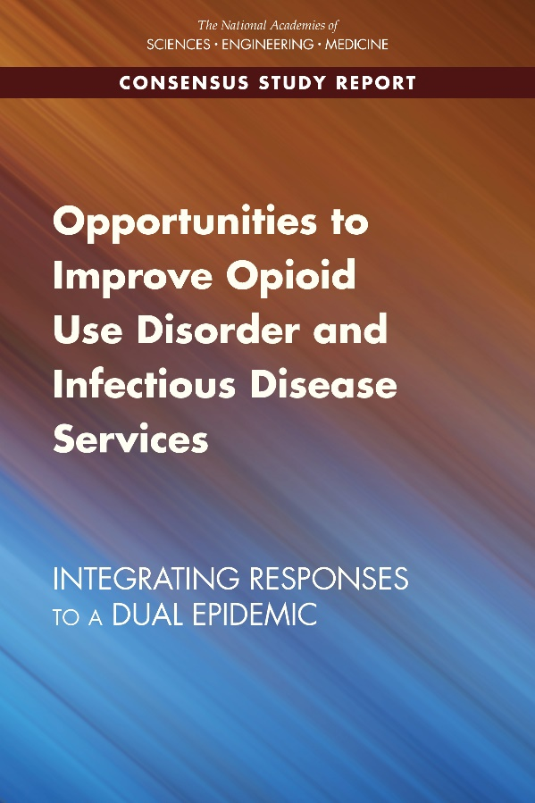
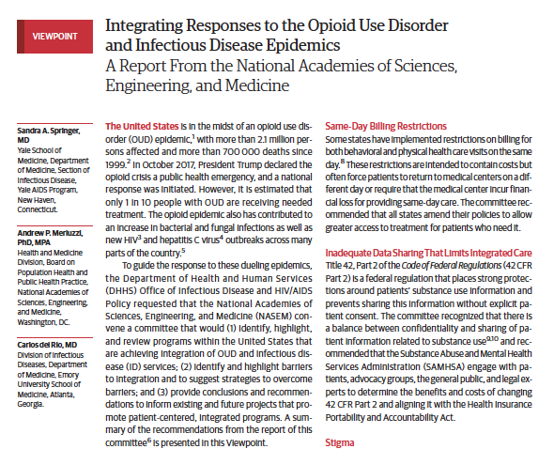
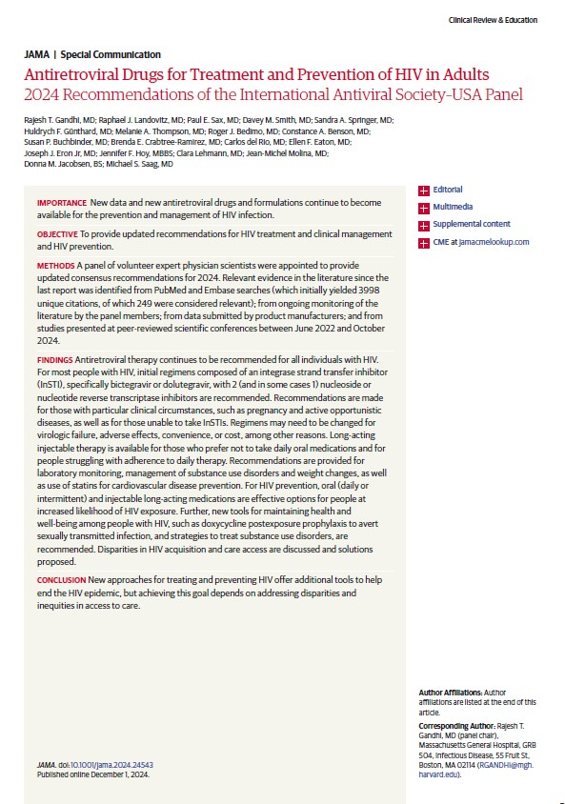
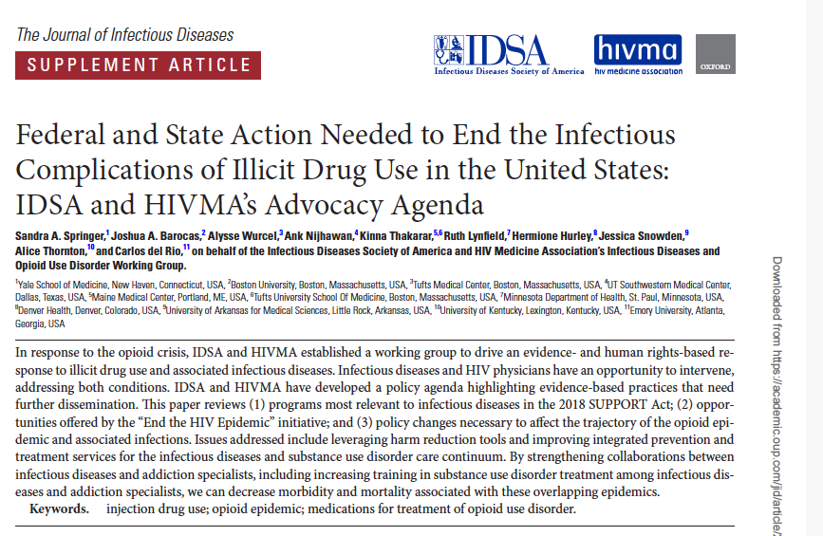
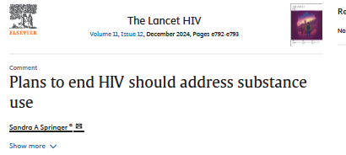
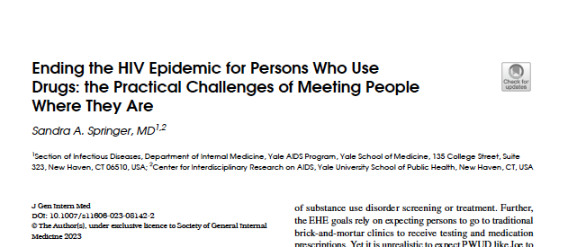
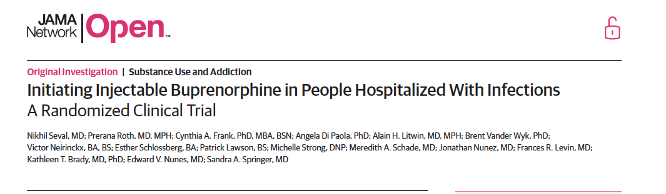
INTEGRATION OF HIV AND SUD TREATMENT IS EVIDENCED-BASED CARE
JAMA
2020
Slide 14

Slide 15
Steps to Integrate SUD with HIV Care
Screen and Diagnose SUD
Provide Treatment (Medications, Behavioral Health)
Help retain in treatment/Overcome Barriers
1
2
3
Slide 15

Slide 16
How do you Diagnose a Substance Use Disorder?
Slide 16

Slide 17
IDENTIFY: DSM-5 SUD Diagnostic Criteria
Diagnosis: ≥ 2 symptom criteria within a 12-mos period
Severity: Mild 2-3 symptoms: Moderate 4-5 symptoms: Severe 6 or more symptoms
Category | Criteria
Loss of control | *Opioids are often taken in larger amounts or over a longer period than was intended There is a persistent desire or unsuccessful efforts to cut down or control opioid* use A great deal of time is spent in activities necessary to obtain the opioid, use the opioid, or recover from its effects Craving, or a strong desire or urge to use opioids
Social problems | Recurrent opioid use resulting in a failure to fulfill major role obligations at work, school, or home Continued opioid use despite having persistent or recurrent social or interpersonal problems caused or exacerbated by the effects of opioids Important social, occupational, or recreational activities are given up or reduced because of opioid use
Risky use | Recurrent opioid use in situations in which it is physically hazardous Continued opioid use despite knowledge of having a persistent or recurrent physical or psychological problem that is likely to have been caused or exacerbated by the substance
Pharmacologic problems | Exhibits tolerance: need for a larger amount to achieve desired effect or diminished effect with same amount Exhibits withdrawal: occurrence of a characteristic opioid withdrawal syndrome or continued use of opioids or closely related substances to avoid withdrawal symptoms
American Psychiatric Association. (2013). Opioid Use Disorder. In Diagnostic and statistical manual of mental disorders (5th ed.). Arlington, VA: American Psychiatric Publishing.
*Substitute the substance for where opioid is
Notes:
DSM=Diagnostic Statistical Manual (basically the ‘bible’ for diagnosis of all psychiatric disorders )
Here I put in opioids for drug asked but you can put in any type of drug, e.g. cocaine, methamphetamine, alcohol, cannabis… same symptoms for all forms of SUD
Diagnosis of an SUD is 2 or more symptoms
Severity is based on number of symptoms
FDA approved medications for OUD require a moderate to severe diagnosis of OUD to prescribe so that is why severity is important!

Slide 18
STEP 1
Start With a Simple Screening Question for Identifying Population
Slide 18

Slide 19
TAPS (Tobacco, Alcohol, Prescription medication, and other Substance use) Tool
EXAMPLE SCREENING
Created with support from NIDA
REPLACED THE NIDA ASSIST ( NM ASSIST) as of 2023
The TAPS tool combines a quick initial screen (TAPS-1) with a brief assessment (TAPS-2) in a single, short questionnaire.
TAPS-1
  · "In the PAST 12 MONTHS, have you used any tobacco product?"
  · "In the PAST 12 MONTHS, have you had 5 or more drinks containing alcohol in one day?" (Men only)
  · "In the PAST 12 MONTHS, have you had 4 or more drinks containing alcohol in one day?" (Women only)
  "In the PAST 12 MONTHS, have you used any illicit drugs (e.g. cocaine, meth (heroin, fentanyl)) or used prescription medications for non-medical reasons?"
IF YES to ANY then Go to TAPS-2
If the patient answers "never" to all, the screen is negative.
Any other response triggers a brief follow-up assessment covering the past 3 months to determine the risk level*
Slide 19
https://nida.nih.gov/taps2

Slide 20
STEP 2
USE A DSM-5 DIAGNOSTIC TOOL TO IDENTIFY A TREATABLE SUD
Slide 20

Slide 21
Screening/Diagnostic Tools For SUD
1.The Tobacco, Alcohol, Prescription medication, and other Substance use (TAPS) Tool | TAPS 1 is 4 item screener and if positive goes to TAPS 2 for DSM 5 SUD diagnosis | McNeely J, Wu L, Subramaniam G, Sharma G, Cathers LA, Svikis D, et al.Performance of the Tobacco, Alcohol, Prescription Medication, and Other Substance Use (TAPS) Tool for Substance Use Screening in Primary Care Patients.Ann Intern Med. 2016;165:690-699. doi: 10.7326/M16-0317. https://nida.nih.gov/taps2/
2. Drug Abuse Screening Test (DAST) | 10 items, no information about drug of concern | Skinner, H. A. (1982). "The drug abuse screening test." Addict Behav 7(4): 363-371.
3. Substance Use Brief Screen (SUBS) | 4 items, preliminary testing in primary care | McNeely J, Strauss SM, Saitz R, Cleland CM et al. A Brief Patient Self-administered Substance Use Screening Tool for Primary Care: Two-site Validation Study of the Substance Use Brief Screen (SUBS). Am J Med. 2015 Jul;128(7):784.e9-19. PMCID: PMC4475501.
4. Rapid Opioid Use Disorder (ROUDA) and Rapid Stimulant Use Disorder (RSUDA) ⁵ | Both 8 items. Diagnose DSM-5 moderate to severe OUD and StUD. Can be administered by non-clinician. Validated to MINI. | Di Paola, A., Farabee, D. and Springer, S.A. (2023), Validation of Two Diagnostic Assessments for Opioid and Stimulant Use Disorder for Use by Non-Clinicians. Psych Res Clin Pract, 5: 78-83.
5. Michigan Alcohol Screening Test (MAST) | 10 items, severity measure | Storgaard H, Nielsen SD, Gluud C. The validity of the Michigan Alcoholism Screening Test (MAST). Alcohol Alcohol. 1994 Sep;29(5):493-502. PMID: 7811333.
6. Alcohol Use Disorders Identification Test (AUDIT ) or AUDIT-C | 10 items, well-validated for AUDIT; 3 items For AUDIT-C | Saunders, J. B., et al. (1993). "Development of the Alcohol Use Disorders Identification Test (AUDIT): WHO Collaborative Project on Early Detection of Persons with Harmful Alcohol Consumption--II." Addiction 88(6): 791-804.
Notes:
Appendix Table 1. Screening Tools for Substance Use Disorders
1. McNeely J, Wu L, Subramaniam G, Sharma G, Cathers LA, Svikis D, et al.Performance of the Tobacco, Alcohol, Prescription Medication, and Other Substance Use (TAPS) Tool for Substance Use Screening in Primary Care Patients.Ann Intern Med. 2016;165:690-699. doi: 10.7326/M16-0317. https://nida.nih.gov/taps2/
2. Skinner, H. A. (1982). "The drug abuse screening test." Addict Behav 7(4): 363-371.
3. McNeely J, Strauss SM, Saitz R, Cleland CM, Palamar JJ, Rotrosen J, Gourevitch MN. A Brief Patient Self-administered Substance Use Screening Tool for Primary Care: Two-site Validation Study of the Substance Use Brief Screen (SUBS). Am J Med. 2015 Jul;128(7):784.e9-19. doi: 10.1016/j.amjmed.2015.02.007. Epub 2015 Mar 10. PMID: 25770031; PMCID: PMC4475501.
5. Di Paola, A., Farabee, D. and Springer, S.A. (2023), Validation of Two Diagnostic Assessments for Opioid and Stimulant Use Disorder for Use by Non-Clinicians. Psych Res Clin Pract, 5: 78-83. https://doi.org/10.1176/appi.prcp.20230022
5.. Storgaard H, Nielsen SD, Gluud C. The validity of the Michigan Alcoholism Screening Test (MAST). Alcohol Alcohol. 1994 Sep;29(5):493-502. PMID: 7811333.
6. Saunders, J. B., et al. (1993). "Development of the Alcohol Use Disorders Identification Test (AUDIT): WHO Collaborative Project on Early Detection of Persons with Harmful Alcohol Consumption--II." Addiction 88(6): 791-804.

Slide 22
STEP 3
PROVIDE INTEGRATED SUD TREATMENT
Slide 22

Slide 23
FDA-Approved Medications for Opioid Use Disorder (MOUD)
 | Methadone | Buprenorphine | Extended-release Naltrexone
Mechanism of Action | Full μ agonist | Partial μ agonist, Partial κ antagonist | Full μ antagonist
Delivery | Oral | Sublingual, film, injection* | Injection
Frequency | Daily | Daily oral; weekly/monthly injection; | monthly
Setting | Licensed drug treatment program | PCC/HIV care setting | PCC/HIV care setting
Other | Highly structured due to safety concerns. OD potential Interacts with some ARVs Reduces HIV Risk Behaviors | No interactions with ARVs Reduces HIV Risk Behaviors Reduces OD Improves HIV Viral Suppression (VS) | Also treats Alcohol Use Disorders No overdose or diversion concerns Reduces HIV Risk Behaviors Reduces Overdose Improves VS*^{2,3}
Notes:
These are 3 pharmacotherapies that have been FDA approved in the United States for treatment of opioid use disorders and in this table I show the differences in mechanism of action and delivery . Also in the U.S. , all of the treatments except for methadone can be given in HIV treatment centers or primary care offices as denoted in the setting.
Of note , A depot formulation of an opioid receptor antagonist, naltrexone (oral approved 1984 , ReVia®) was approved in 2006 for treatment of alcohol use disorder and for opioid use disorder in 2010..
Of note Revia is NOT currently used in the U.S. for opioid use disorder any longer due to following: .
ReVia has not reduced recidivism, retention, : poor compliance so passive-compliance formulations developed (1)
Vivitrol FDA-approved 2006 for Alcohol dependence (effective for prevention of relapse to alcohol use)
FDA-approved in 2010 for Opioid dependence
Ref: Minozzi SCochrane Database Syst Rev 2006; 1: CD001333

Slide 24
Long-Acting Injectable (LAI) Forms of Buprenorphine May Improve Adherence
Form of LA- Buprenorphine | Induction | How to Administer & Location | Dose | Frequency | Outcomes | Special Issues
Sublocade | Can do one dose of SL bupe 4-8mg and then 300 mg injection same day and administer 2nd 300mg dose in 1 week | Sub-Cutaneous (SC) injection Upper Arm/ Thigh/Buttock/ Abdomen | 300mg, 100mg | Monthly | ⬇Use | REMS Refrigeration
Brixadi | Naïve of SL BUP or switch from SL BUP can be done same day | SC injection Upper Arm/ Thigh/Buttock/ Abdomen | 8/16/24/32 mg weekly -64/96/128 mg monthly | Weekly or monthly | ⬇Use | REMS
Notes:
Risk Evaluation and Mitigation Strategy ( REMS) : Sublocade and Brixadi all require REMS pharmacies to store med and dispense
Brixadi available 9/2023.
Sublocade:
What is the REMS (Risk Evaluation and Mitigation Strategy) Program?
A REMS is a strategy to manage known or potential risks associated with a drug, and is required by the Food and Drug Administration (FDA) to ensure that the benefits of the drug outweigh its risks.. SUBLOCADE/BRIXADI is available only through a restricted distribution program called the REMS Program because of the risk of serious harm or death that could result from intravenous self-administration.
What are the REMS program requirements?
All healthcare settings and pharmacies that dispense SUBLOCADE/BRIXADI must be certified in the REMS program
Healthcare providers, healthcare settings, and pharmacies must obtain SUBLOCADE/BRIXADI through a restricted distribution program
Which healthcare settings MUST BE certified in the REMS program?
All healthcare settings and pharmacies that dispense SUBLOCADE/BRIXADI must be certified. Examples of healthcare settings include: group practice, independent practice, institution, Department of Defense (DoD) facility, outpatient clinic, hospital, Veterans Administration (VA) facility, opioid treatment program (OTP), closed healthcare system, other healthcare setting.

Slide 25
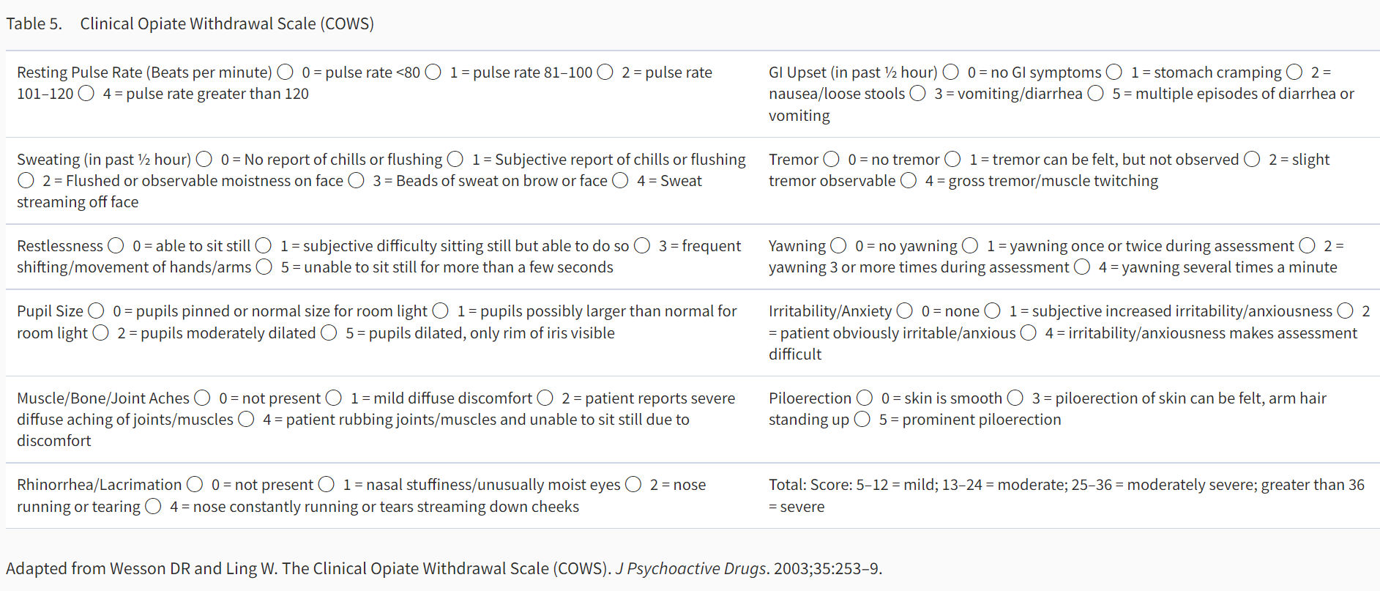
Assess for Opioid Withdrawal
Clinical Opioid Withdrawal Scale (COWS)
Notes:
COWS is a free assessment tool that you can download on your phone or put in your Electronic medical record or on a tablet have a nurse or other administer to assess level of opioid withdrawal in a patient who has been using opioids . The level of withdrawal can tell you if safe to start buprenorphine in a patient who is actively using opioids. For those who have opioid use disorder but are currently not using such as persons who have been in detox facilities/ or prisons – they will not be in withdrawal and thus you just need to start buprenorphine to prevent craving and relapse but start slower to get to a level of at least 8 mg -16 mg for them . In persons who are actively using and in withdrawal you can go much faster in induction of buprenorphine dose and possibly get up to max dose of 16-24 mg in same day. You follow their withdrawal symptoms should decrease and ask them if they are craving opioids scale of 1-10 just like a pain scale and craving should decrease as well. Also can start safely same day LAI Buprenorphine ( sublocade or brixadi in a person who used fentanyl even) usually get COWS to 4 or higher (however there is data to support not in withdrawal). Also can start while a person on opioids still and just start low dose bupe, maintain the opioid then at 5-7 days drop the opioid . All forms of MOUD reduce craving.

Slide 26
SLIDO Case Question. OUD and HIV
A patient with HIV is actively using fentanyl and is interested in treatment. They have had difficulty attending frequent appointments and taking daily medications consistently. The patient is willing to consider medication treatment for opioid use disorder (MOUD).
Which approach is most appropriate?
Offer daily transmucosal buprenorphine (e.g. Suboxone) with ART.
Offer injectable buprenorphine with ART.
Refer the patient to addiction medicine program.
Provide overdose education only; defer MOUD because fentanyl use makes the treatment too complex and at risk of precipitating withdrawal
Notes:
Best answer: B
Key teaching point:
Active fentanyl use is not a reason to withhold HIV care or medications for opioid use disorder. Integrating HIV treatment, buprenorphine-based MOUD, naloxone access, harm-reduction counseling, and flexible follow-up can reduce barriers to care. Initiation and transition protocols for long-acting buprenorphine should be individualized, particularly because fentanyl exposure may complicate withdrawal timing and precipitated-withdrawal risk. See citations in presentation to support this after this poll question. Patient. Already said they are having difficulty taking daily meds so answer B is not the best and the others ( referral, requiring abstinence, and only providing overdose education ) all put patient at risk of overdosing upon discharge.

Slide 27
Do not edit
How to change the design
Which approach is most appropriate?
The Slido app must be installed on every computer you’re presenting from

Slide 28
The Stage of OUD Helps to Know When and How to Start Buprenorphine
Person currently reporting use of opioids in opioid withdrawal
Needs Buprenorphine immediately to alleviate withdrawal
Person reporting opioid use but not in withdrawal
Will Need Buprenorphine soon … when start withdrawal (*COWS 4 or greater)
Person not actively using and at risk of relapse (e.g., release from prison, confined setting)
Start buprenorphine to prevent relapse
Treat craving*
-Low dose of buprenorphine
-Go slow – may take 2 weeks or 4 weeks to get to adequate dose… monitor craving 1-10 scale until get to at least 16 mg daily / start LAI bupe
Or start SL bupe now and maintain the opioid and build up the buprenorphine and then stop the opioid… don’t need to go into withdrawal
Or Start Buprenorphine (LAI) when not in withdrawal or mild withdrawal (Monitor*)
* Protocol to Start SL BUPE in Persons released from Prison/Jail with OUD. Springer SA et al. J Urban Health. 2010
Notes:
Springer SA, Chen S, Altice FL. Improved HIV and substance abuse treatment outcomes for released HIV-infected prisoners: The impact of Buprenorphine treatment. Journal of Urban Health. 2010; 87(4): 592-602. PMID: 20177974; PMCID: PMC2900572.

Slide 29
Safe to Start High Dose LAI Buprenorphine In Persons With OUD Actively Using Fentanyl
Buprenorphine in weekly and monthly LAI has been found to be safe to start in persons with OUD using fentanyl without precipitating withdrawal
Shared decision making is essential to understand withdrawal potential and how to manage
D’Onofrio G et al. JAMA Network Open. 2023
D’Onofrio G et al JAMA Network Open. 2024.
D’Onofrio G et al. JAMA. 2026
Seval N… Springer S. JAMA Network Open 2025.
Shiwach R et al. JAMA Network Open. 2025.(x2)
Springer SA. JAMA Network Open 2025
Notes:
Shiwach R, Le Foll B, Alho H, Dunn KE, Strafford S, Zhao Y, Dobbins, R. Selecting extended-release buprenorphine doses to treat high -risk opioid use in the fentanyl era. JAMA Network Open. 2025 (November)
Springer SA. Is it safe to start high dose extended-release buprenorphine in persons who use fentanyl? JAMA Network Open. 2025 (November),
Gregory C, Yadav K, Linders J, Sikora L, Eagles D. Incidence of buprenorphine- precipitated opioid withdrawal in adults with opioid use disorder: A systematic review. Addiction. 2025;120(1):7-20.
Springer SA. Commentary on Gregory et al.: Fear of precipitated opioid withdrawal should not prevent buprenorphine initiation. Addiction. 2025 Jan;120(1):21-22. doi: 10.1111/add.16701. Epub 2024 Nov 4. PMID: 39494653; PMCID: PMC11645183.
Shiwach R, Le Foll B, Alho H, Dunn KE, Strafford S, Zhao Y, Dobbins RL. Rapid vs Standard Induction to Injectable Extended-Release Buprenorphine: A Randomized Clinical Trial. JAMA Netw Open. 2025 Oct 1;8(10): e2537319. doi: 10.1001/jamanetworkopen.2025.37319. PMID: 41085986; PMCID: PMC12522003.
Seval N, Roth P, Frank CA, Di Paola A, Litwin AH, Vander Wyk B, Neirinckx V, Schlossberg E, Lawson P, Strong M, Schade MA, Nunez J, Levin FR, Brady KT, Nunes EV, Springer SA. Initiating Injectable Buprenorphine in People Hospitalized With Infections: A Randomized Clinical Trial. JAMA Netw Open. 2025 May 1;8(5): e2513000. doi: 10.1001/jamanetworkopen.2025.13000. PMID: 40445619; PMCID: PMC12125644.
D'Onofrio G, Herring AA, Perrone J, Hawk K, Samuels EA, Cowan E, Anderson E, McCormack R, Huntley K, Owens P, Martel S, Schactman M, Lofwall MR, Walsh SL, Dziura J, Fiellin DA. Extended-Release 7-Day Injectable Buprenorphine for Patients With Minimal to Mild Opioid Withdrawal. JAMA Netw Open. 2024 Jul 1;7(7): e2420702. doi: 10.1001/jamanetworkopen.2024.20702. PMID: 38976265; PMCID: PMC11231806. The overall incidence of precipitated withdrawal in the group with COWS scores of 4 to 7 was low (only 2 of 63 precipitated withdrawal patients) compared with 5 of 37 in the group with COWS scores of 0 to 3. Additional research is needed to clearly delineate the association between COWS scores and tolerance of buprenorphine initiation, particularly at the very low range. This is consistent with the same group’s recent publication of a study of 1200 patients in a clinical trial receiving either extended- release buprenorphine (COWS score of >4) or sublingual buprenorphine, which found that there were few patients with precipitated withdrawal (<1%), despite a high prevalence of fentanyl use.(8 below) Given the low rate of precipitated withdrawal in COWS scores of 4 to 7 (3.2%), eligibility criteria to include patients with COWS scores of 4 to 7 were expanded in an ongoing randomized clinical trial, Emergency Department-Initiated BUP Validation, comparing standard sublingual dosing with extended-release buprenorphine in rates of continued engagement in treatment by including those presenting with COWS scores of 4 to 7.
D’Onofrio G, Hawk KF ,Perrone J, et al. Incidence of precipitated withdrawal during a multisite emergency department-initiated buprenorphine clinical trial in the era of fentanyl. JAMA Netw Open. 2023;6(3):e236108. doi: 10.1001/jamanetworkopen.2023.6108
D’Onfrio G et al. JAMA. 2026;335;(11):e2527064. doi:10.1001/jama.2025.27064

Slide 30
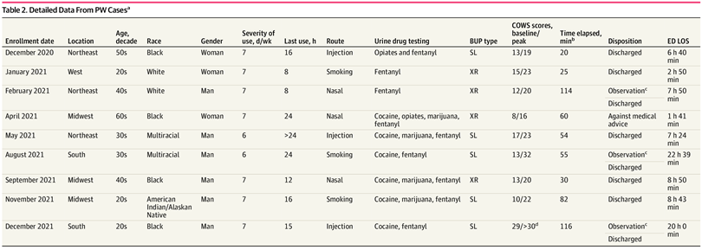
In a Multisite ED-Initiated LAI weekly Buprenorphine trial of 1200 patients with OUD and majority with fentanyl use- the incidence of precipitated withdrawal was less than 1% (N=9)
D’Onofrio G, et al. JAMA Netw Open. March 2023.
Slide 30
Notes:
In a multisite ED-initiated buprenorphine trial of 1200 patients, the incidence was less than 1%.
COWS 4 or greater
Patients are observed in the ED for 2 hours after receiving XR-BUP and discharged with a follow-up appointment for comprehensive addiction treatment within 7 days.
In this study, 28 EDs participated from June 30, 2020, to October 26, 2022. Patients were randomized to standard sublingual buprenorphine inductions or extended-release buprenorphine and were observed for 2 hours. PW was defined⁵ a priori and was considered when a marked escalation in objective COWS scores (score ≥5) occurred, requiring additional buprenorphine and ancillary medications, often within 2 hours of buprenorphine administration.”
Of the 1200 patients, only nine had precipitated withdrawal. Details of their care are in this table and really are notable for a significant amount of heterogeneity among those experiencing withdrawal. Including no clear association with race, gender, time since last use, Routes of use, etc, etc. In addition, time from bup dose to PW development varied. One thing you can see though is that once it developed, the ED LOS was fairly significant.
D’Onofrio G, Hawk KF, Perrone J, et al. Incidence of Precipitated Withdrawal During a Multisite Emergency Department–Initiated Buprenorphine Clinical Trial in the Era of Fentanyl. JAMA Netw Open. 2023;6(3):e236108. doi:10.1001/jamanetworkopen.2023.6108
Methods: “Twenty-eight geographically diverse EDs participated from June 30, 2020, to October 26, 2022.Patients were randomized to standard sublingual buprenorphine inductions or extended-release buprenorphine and were observed for 2 hours. PW was defined⁵ a priori and was considered when a marked escalation in objective COWS scores (score ≥5) occurred, requiring additional buprenorphine and ancillary medications, often within 2 hours of buprenorphine administration.”
All patients experiencing PW were discharged after symptoms resolved, with 1 self-directed discharge. Follow-up rates at 7 days after the ED visit were 86%.

Slide 31
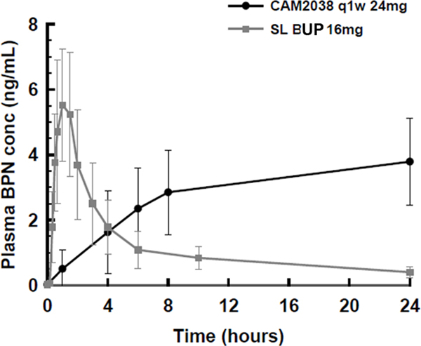
Plasma concentration-time curves of BUP 16 mg TM vs single dose 24 mg CAM2038 (Brixadi)
Linear plasma concentration-time curves of buprenorphine after a single dose of 16 mg sublingual buprenorphine and a single dose of 24 mg subcutaneous CAM2038
D'Onofrio G et al. Acad Emerg Med. 2023 Dec;30(12):1264-1271. doi: 10.1111/acem.14782. Epub 2023 Aug 22. PMID: 37501652; PMCID: PMC10822018.
Slide 31
Notes:
Despite rapid absorption, SL-BUP has low bioavailability (40%), which is why relatively large doses are needed to achieve therapeutic plasma concentrations.²² Once in plasma and bound to the μ-opioid receptor, buprenorphine has a slow rate of dissociation producing a prolonged duration of action as compared to other opioids.²³ It has a large volume of distribution, high protein binding¹⁷and reaches its peak plasma concentration in ~60 minutes after administration, yet there is wide inter-individual variation in both rate of absorption and peak plasma concentrations.¹⁸After 60 minutes, plasma concentrations drop quickly but with a 32-hour terminal half-life, buprenorphine remains available for binding to the μ-receptor for a prolonged period, albeit at decreasing concentrations.²⁴ (Figure 1)

Slide 32
Medication Treatment for OUD Improves HIV Viral Suppression in PWH: Buprenorphine
Buprenorphine 24 wks
Buprenorphine not retained
80
No Buprenorphine
94 PWH & OUD released from prison
Retention on buprenorphine for 24 wks ≈ Viral suppression 6 months after release¹
aOR: 5.37 (95% CI: 1.15-25.1)
*P = .01
60
HIV-1 RNA < 50 c/mL, %
40
20
0
Baseline
3 Mos
6 Mos
NIDA K23 DA 019381, Springer
1. Springer S et al. PLoS One. 2012;7:e38335.
Slide 32

Slide 33
Medication Treatment for OUD Improves HIV Viral Suppression In PWH : Extended-Release Naltrexone
Double-blind placebo controlled RCT
93 PWH & OUD released from prison and jail^{[1]}
Extended-release naltrexone ≈ Viral Suppression 6 months after release^{[1]}
  OR: 2.9 (95% CI: 1.04-8.14; p =0 .04)
Baseline
6 mos
100
80
P =0.002
P =0.294
60
60.6
55.6
HIV-1 RNA < 50 c/mL^{[1]} (%)
37.9
40.7
40
20
0
Extended-Release Naltrexone
Placebo
Slide 33
NIDA: RO1 DA30762, Springer PI
1. Springer S, et al. J Acquir Immune Defic Syndr. 2018 May 1;78(1):43-53 ..

Slide 34
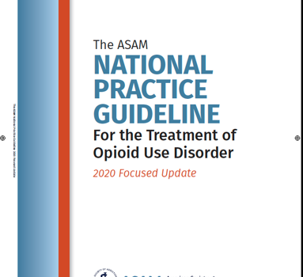
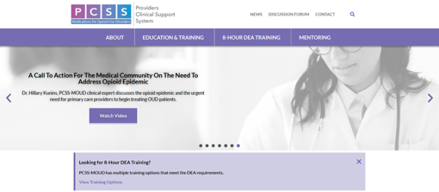
Resources for Diagnosis and Treatment of OUD
https://pcssnow.org
https://www.asam.org/quality-care/clinical-guidelines/national-practice-guideline
Slide 34
Notes:
https://www.asam.org/quality-care/clinical-guidelines/national-practice-guideline
https://pcssnow.org

Slide 35
Treatment of Alcohol Use Disorder
Medication Treatment:
Goal is to reduce craving and amount of alcohol use
Abstinence is not necessarily the goal
Alcohol Withdrawal Risk Assessment:
Behavioral Treatment:
Low risk Drinking
Clinical Institute Withdrawal Assessment of Alcohol Scale, Revised (CIWA)-Ar
*If history of prior withdrawal symptoms that include delirium/seizures, then refer to inpatient detoxification first!
Cognitive Behavioral Therapy
12-step programs (e.g. AA)
Individual Counseling
Sullivan, J.T.; Sykora, K.; Schneiderman, J.; Naranjo, C.A.; and Sellers, E.M. Assessment of alcohol withdrawal: The revised Clinical Institute Withdrawal Assessment for Alcohol scale (CIWA-Ar). British Journal of Addiction 84:1353-1357, 1989
The ASAM Clinical Practice Guideline on Alcohol Withdrawal Management. Journal of Addiction Medicine14(3S):1-72, May/June 2020.
Slide 35
Notes:
Sullivan, J.T.; Sykora, K.; Schneiderman, J.; Naranjo, C.A.; and Sellers, E.M. Assessment of alcohol withdrawal: The revised Clinical Institute Withdrawal Assessment for Alcohol scale (CIWA-Ar). British Journal of Addiction 84:1353-1357, 1989
The ASAM Clinical Practice Guideline on Alcohol Withdrawal Management. Journal of Addiction Medicine14(3S):1-72, May/June 2020.

Slide 36
FDA-Approved Medication Treatments for Alcohol Use Disorders
 | Naltrexone | Extended-Release Naltrexone (XR-NTX) | Acamprosate | Disulfiram
Mechanism of Action | Full μ antagonist | Full μ antagonist | Blocks N-methyl D-aspartate receptors | Inhibits acetaldehyde dehydrogenase
Delivery | Oral | IM | Oral | Oral
Frequency | 50mg Daily | 380 mg q4 weeks* | 2 tablets, 3 times day | Daily
Other | Poor adherence Good efficacy; | Also treats OUD; no diversion; no dependence or respiratory depression increased adherence over oral naltrexone | Not proven to be better than NTX; compliance issues; can be used with buprenorphine or methadone | Poor compliance poor efficacy High level of monitoring needed for toxicity side effects (Vfib etc)
Anton et al. , COMBINE study, JAMA 2006; 2. Garbutt et al. JAMA, 2005.
Notes:
Prevalence rates of AUDs ≈2-4x greater in HIV+ persons (10%)(compared to HIV- ≈ 4.65%)
ETOH increases HIV-risk taking behaviors (sexual and IDU)
ETOH results in poor adherence to ART and increased VL and decreased CD4
ETOH accelerates liver disease in HIV+ (direct, ART toxicity, HCV)
Azar, Springer et al. DAD 2010.
Hendershot et al, JAIDS 2009
Grant, B.F., et al, Drug Alcohol Depend, 2004
Samet et al, 2007
Palepu & Tyndall 2003

Slide 37
Medication Treatment for Alcohol Use Disorder Improves Viral Suppression in PWH : Extended-Release Naltrexone
% Virally Suppressed (<50 c/mL)
P=0.015
P=0.292
P=0.001
NIAAA: R01 AA018944,Springer
Springer et al. J Acquir Immune Defic Syndr. 2018 Sep 1;79(1):92-100
Slide 37
Notes:
Double blind placebo controlled trial. PWH and AUD recruited in prison/ jail administered first dose of medication injection prior to release followed in community for 212 months with a 6 month intervention.
Intention-to-Treat Analysis: Comparison of viral suppression levels <50 copies/mL for participants receiving extended-release naltrexone or placebo (N=100)
Legend: XR-NTX (extended-release naltrexone)

Slide 38
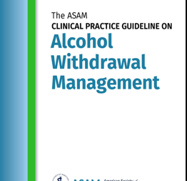
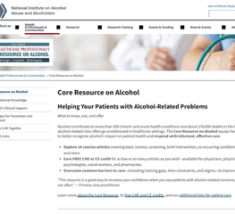
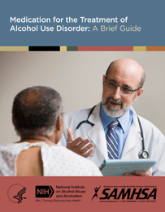
Resources for Alcohol Withdrawal and Alcohol Use Disorder Management
American Society of Addiction Medicine (ASAM)
National Institutes of Alcohol Abuse and Alcoholism (NIAAA)
Substance Abuse and Mental Health Services Administration (SAMHSA)
Slide 38
Notes:
The ASAM Clinical Practice Guideline on Alcohol Withdrawal Management
Journal of Addiction Medicine14(3S):1-72, May/June 2020.
doi: 10.1097/ADM.0000000000000668
https://www.niaaa.nih.gov/health-professionals-communities/core-resource-on-alcohol
https://library.samhsa.gov/sites/default/files/sma15-4907.pdf

Slide 39
Stimulant Use Disorder Treatment
Currently there are no FDA-approved medications for treatment of stimulant use disorder
Behavioral treatments are the recommended treatment:
  Most effective has been Contingency Management (CM) programs that can reduce stimulant use^{1,2}
  Original voucher or incentive-based CM also has alternative “fishbowl method” to reduce stimulant use.
1. Petry NM. Psychiatrist. 2011; 35 (5) :161-163; 2. Brandon S et al. JAMA Open Network 2021.4(5)
Notes:
Contingency management - In contingency management interventions for substance misuse treatment, urine samples are collected multiple times each week (to detect brief periods of abstinence) and abstinence is reinforced each time negative samples are submitted. The reinforcers are monetary based and consist of vouchers, analogous to a clinic-managed bank account,² or a prize draw with prizes ranging from US$1 to 100 in value.³ Importantly, in effective contingency management interventions, the magnitude of reinforcement provided (voucher amounts or draws for prizes) increases with sustained periods of abstinence.
Petry NM. Contingency management: what it is and why psychiatrists should want to use it. Psychiatrist. 2011 May;35(5):161-163. doi: 10.1192/pb.bp.110.031831. PMID: 22558006; PMCID: PMC3083448.

Slide 40
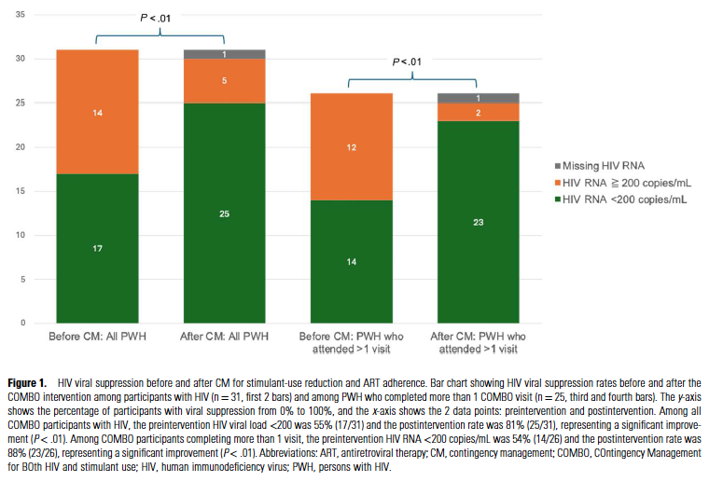
Contingency Management Improves VS among PWH with StUD in an HIV Clinic in San Francisco
Appa A. et al. CID. 2026.
Notes:
12 week single arm pilot implementation effectiveness study weekly CM in a HIV clinic for PWH who had StUD 2023-2024 enrolled N=31 PWH with StUD, 77% Methamphetamine 35% cocaine 19% co fentanyl.
N of 17/31 55% had VS at baseline mean of 5/12 visits 42% . ; 26/31 attended post treatment evaluation included in the analysis, 61/110 stimulant tests were negative 56% and 99% of TDF tests were positive. 88% 23/26 of the retained persons achieved VS p<0.01

Slide 41
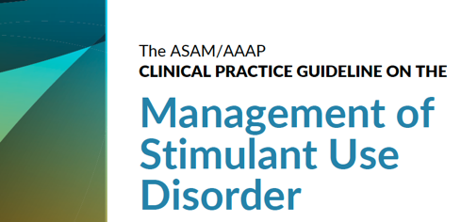
Resource for Treating Stimulant Use Disorders
https://www.asam.org/quality-care/clinical-guidelines/stimulant-use-disorders
Notes:
https://www.asam.org/quality-care/clinical-guidelines/stimulant-use-disorders

Slide 42
Cocaine Use Disorder (CUD) Pharmacotherapies (not FDA approved)
Medication | Mechanism of Action | Results | ASAM | Can treat Co-occurring disorders
Bupropion | Dopamine & Norepinephrine Reuptake inhibitor | Mixed Evidence Not superior to placebo on abstinence at end of treatment 2 RCTS was superior to placebo w/ 3 or more weeks abstinence | Consider for use in those with cocaine use disorder and co-occurring disorders | Major Depression & Tobacco use Disorder
Topiramate | Anticonvulsant, Blocks Voltage-dependent NA channels, Increase GABA receptor activity, Antagonizes Na Glutamate receptors, etc | Mixed evidence MA- Higher rate of continuous cocaine abstinence over 3 wks compared to placebo | Side effects cognitive & paresthesia, appetite suppression Consider for those with AUD and Cocaine use Disorder | FDA Approved for Epilepsy & migraine Can reduce alcohol use
https://www.asam.org/quality-care/clinical-guidelines/stimulant-use-disorders
Notes:
MA=metanalysis

Slide 43
Amphetamine-Type Stimulant Use Disorder (ATS) Pharmacotherapies (not FDA approved)
Medication | Results | ASAM Recs | Treats Co-occurring disorders
Bupropion | Not effective alone for Amphetamine Type Stimulant Use Disorder (ATS) ¹ | Could consider for those who use less than 18 days/ month and have tobacco use | Major Depressive Disorder Tobacco Use Disorder
Bupropion and XR-Naltrexone | Reduced amphetamine type stimulant use ¹ 1 open label study 1 RCT | Consider for those with ATS and Major Depressive Disorder / AUD /Tobacco use Disorder (TUD) high doses of bupropion ( 450 mg XR formulation) used in the studies XR-NTX FDA approved for q4 weeks in AUD and OUD but RCT used q3 weeks | XR-NTX FDA approved for OUD and AUD
Topiramate | Mixed evidence¹ 2 RCTS showed reduction in ATS compared to placebo 1 RCT did not improve abstinence | Side effects have to be monitored (see cocaine use disorder table) Can consider in those with ATS and AUD | Epilepsy , Migraine
Mirtazapine | Mixed MA and SR showed no reduction in ATS use¹ 2 placebo controlled RCTS showed small reductions in ATS use also reduction in sexual risk behaviors (both studies in MSM)¹ 1 large phase 3, parallel-group, double-blind, placebo-controlled RCT for persons with Methamphetamine Use Disorder Randomized to Mirtazapine (30mg daily for 12 weeks) or equivalent placebo-and there was a statistically significant reduction in stimulant use with Mirtazapine ² | Consider in those with co-occurring depression | Major Depressive Disorder
https://www.asam.org/quality-care/clinical-guidelines/stimulant-use-disorders
McKetin R et al. Mirtazapine for Methamphetamine Use Disorder: A Randomized Clinical Trial. JAMA Psychiatry. 2026;83(6):581-589. [PubMed 41920558]
Slide 43
Notes:
MA = metanalysis
SR = systematic review

Slide 44
Emerging Treatment for SUDs:
GLP1 RAs
Slide 44
Notes:
Much research on GLP1 RAs on reducing use of nicotine, alcohol, opioids, cocaine and amphetamine in rodent models; small human RCT in persons with AUD and retrospective review of persons with OUD … will show
Thought is reward pathway mediated by Dopamine that is involved with addiction is impacted with GLP1… reduce craving, use etc….
Human Trials ongoing…. (MANY!)

Slide 45
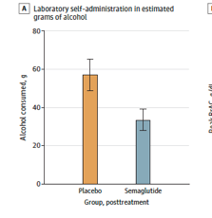
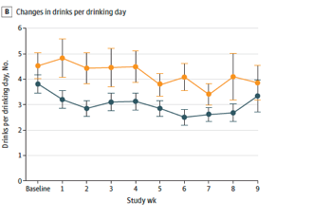
GLP1 RAs As Potential Treatment for AUD
Phase 2 double blind parallel-arm RCT of N=48 non-treatment seeking adults with AUD
Semaglutide (0.25mg/ wk x 4 wks , 0.5mg/wk x 4 wks, 1.0mg x 1wk or placebo weekly
Primary outcome was amount of alcohol consumed
P=0.01
P=0.04
Hendershot C et al. JAMA Psychiatr. 2025
Notes:
Phase 2 double-blind, randomized, parallel-arm trial involving 9 weeks of outpatient treatment in the US from September 2022 to February 2024.
N=48 non–treatment-seeking participants with AUD were randomized.
Participants received semaglutide (0.25mg/week for 4 weeks, 0.5mg/week for 4 weeks, and 1.0mg for 1 week) or placebo at weekly clinic visits.
The primary outcome was laboratory alcohol self-administration, measured at pretreatment and posttreatment (0.5mg/week).
Low-dose semaglutide reduced the amount of alcohol consumed during a posttreatment laboratory self-administration task, with evidence of medium to large effect sizes for grams of alcohol consumed (β, −0.48; 95%CI, −0.85 to −0.11; P = .01) and reduced drinks per drinking day but not by calendar day or number of drinking days
Semaglutide treatment did not affect average drinks per calendar day or number of drinking days,
but significantly reduced drinks per drinking day (β, −0.41; 95%CI, −0.73 to −0.09; P = .04) and
weekly alcohol craving (β, −0.39; 95%CI, −0.73 to −0.06; P = .01),
also predicting greater reductions in heavy drinking over time relative to placebo (β, 0.84; 95%CI, 0.71 to 0.99;P = .04).

Slide 46
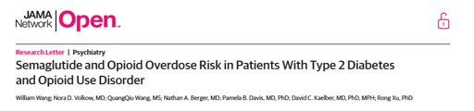
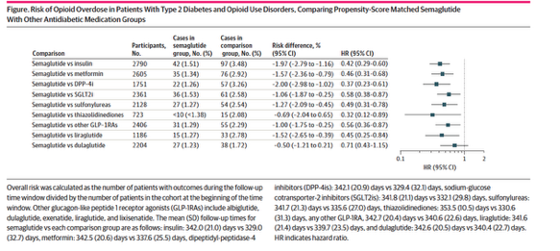
GLP1s May Reduce Overdose Risk In Persons with T2DM and OUD
Wang W, Volkow N et al. JAMA Network Open. 2024. 7 (9)
Notes:
From NIDA staff including Dr. Nora Volkow , Director of NIDA and NIDA staff performed analyses:
33,000 people with OUD and T2DM, Propensity matched scores
Semaglutide versus other treatments for T2DM in persons with OUD and T2DM (ICD 10 codes identified )
Showed marked risk reduction in overdose ….
Ongoing RCTs of GLP1 in persons with OUD ( on different forms of MOUD) etc being conducted now to see if GLP1 reduce opioid use, overdose and improve retention on MOUD… results hope to be in by 2027…..

Slide 47
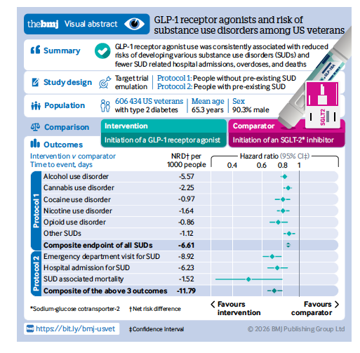
GLP-1 RAs reduce risk of SUDs among Veterans with T2DM
Cai M et al. BMJ 2026.

Slide 48
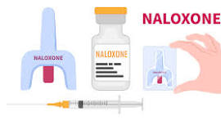
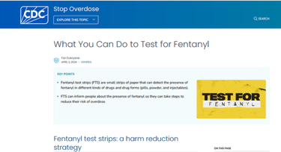
ALWAYS PROVIDE HARM REDUCTION SUPPLIES & EDUCATION
  Overdose: Naloxone Prescriptions
  Provide training on how to recognize overdose & administer naloxone for patients and their loved ones/ friends/partners
  Drug Testing Strips (fentanyl and xylazine)
  Syringe Service Programs (SSPs)
  Safe injection education & supplies
  Safe injection sites

Slide 49
STEP 4
Overcome Barriers to Help Patients Initiate Treatment & Retain in Care
Slide 49

Slide 50




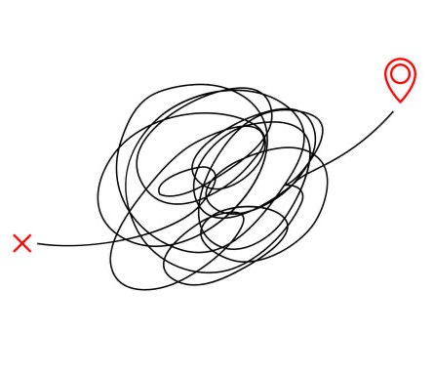

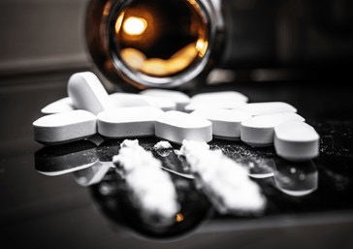



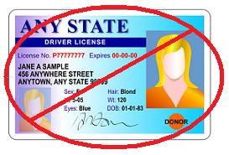
Patient Barriers to Accessing SUD and HIV Prevention and Treatment
Lack of transportation: URBAN and RURAL settings
Housing instability
Poverty
Lack of Insurance
Lack of communication (cell phones)
Lack of personal identification
Substance use that interferes with healthcare
Mental illness
Lack of ability to find pharmacy, pay for medications or pharmacy may not carry meds
Stigma
Difficulty identifying where to go or who to go to….
Slide 50

Slide 51

How do we
Overcome
Barriers?
Bring integrated services to where people live…
Slide 51

Slide 52
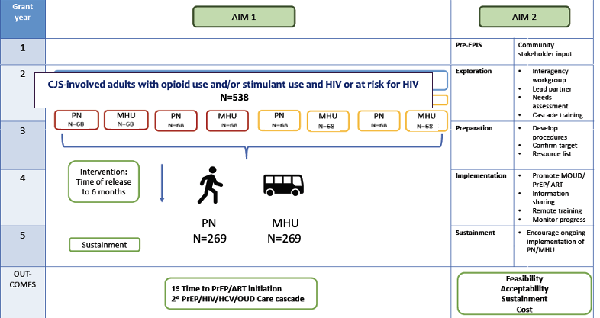
ACTION : Hybrid Type 1 Effectiveness-Implementation RCT
NIDA U01DA053039(MPIs Springer (contact), Knight, Nijhawan) 2019-2026*
Springer et al. BMC Infect Dis. 2022 Apr 15;22(1):380
DALLAS & FORT WORTH, TX
NE & SE COUNTIES, CT
Notes:
Springer et al. BMC Infect Dis. 2022 Apr 15;22(1):380

Slide 53
Mobile Health Unit participants were 3X more likely to start ART/PrEP than those assigned a Patient Navigator.
Of PrEP initiators: 45% on the Mobile Health Unit started LAI PrEP vs 0% in the Patient Navigator group
Springer et al. Abstract 1071. Conference on Retroviruses and Opportunistic Infections (CROI). Denver, CO. February 22-25, 2026.
Springer et al. Abstract 247. IdWeek. Washington, DC. October 21-24, 2026

Slide 54
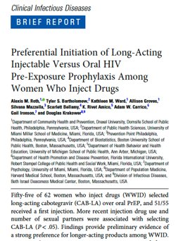
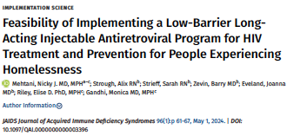
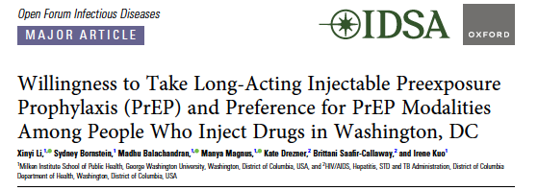
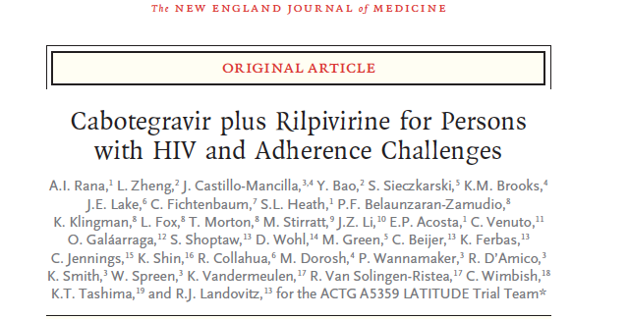
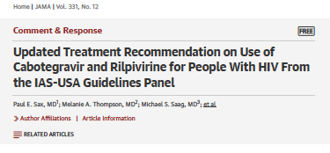
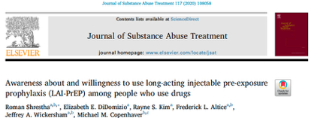
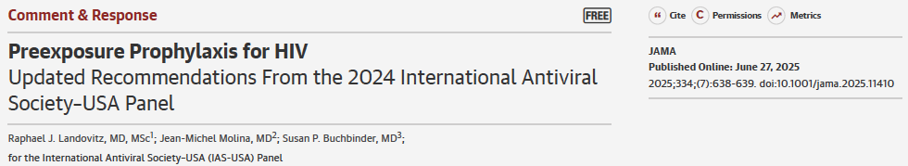
Preference of Long-Acting Injectable (LAI) Forms of PrEP and ART for PWUD

Slide 55
SLIDO POLL QUESTION
A 38-year-old patient with HIV uses opioids and stimulants, has intermittent housing, and reports difficulty taking daily pills. They are interested in LAI ART but have missed several clinic visits in the past. What is the best response?
Continue ART until they achieve Viral Suppression, then discuss LAI ART.
Treat their SUD first, then discuss LAI ART if they achieve abstinence.
Offer and provide LAI ART in addition to developing plans to help overcome barriers to continued receipt.
Do an oral lead in first to see if he will adhere
Notes:
Answer C. Best answer: LAI ART could help this person who already tells you he can’t take daily oral pills. Explore goals and eligibility while building individualized supports. See: Rana A. NEJM 2026.

Slide 56
Do not edit
How to change the design
What is the best response?
The Slido app must be installed on every computer you’re presenting from

Slide 57
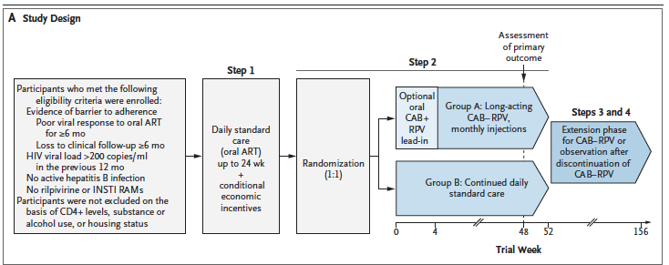
LATITUDE Trial (ACTG A5359): LAI CAB-RPV vs Daily oral ART for PWH with Adherence Challenges
Rana A et al. NEJM 2026; 394:848-71.
Slide 57
Notes:
Open-label RCT of PWH with poor adherence to ART , defined as HIV RNA>200 c/mL ; OR lost to f/u).
Intervention: 24 wks of ‘ adherence support’ economic incentives, SoC with Oral ART ( step 1).
They then were assigned 1:1 either continue with SoC or switch to monthly LAI cab/rpv with or w/out oral lead-in tx (STEP 2).
Primary outcome : regimen failure defined as Virologic failure ( 2 consecutive HIV RNA >200 c/mL or tx discontinuation during the step 2.

Slide 58
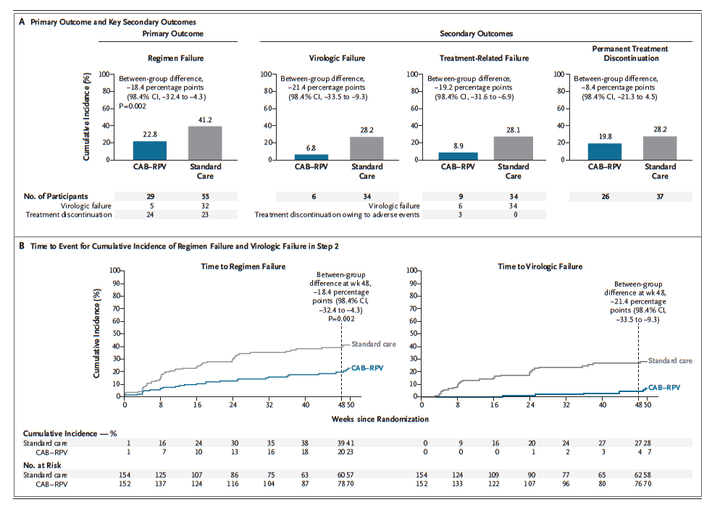
LATITUDE Trial: Primary Outcome
Rana A et al.
NEJM 2026; 394:848-71.
Slide 58
Notes:
Open-label RCT of PWH with poor adherence to ART , defined as HIV RNA>200 c/mL ; OR lost to f/u).
Intervention: 24 wks of ‘ adherence support’ economic incentives, SoC with Oral ART ( step 1).
They then were assigned 1:1 either continue with SoC or switch to monthly LAI cab/rpv with or w/out oral lead-in tx (STEP 2).
Primary outcome : regimen failure defined as Virologic failure ( 2 consecutive HIV RNA >200 c/mL or tx discontinuation during the step 2.
N=453 step1
63% Black
29% female
9% unstably housed/ homeless n=42
32% had hazardous alcohol use
24% cocaine utox +
28% methamphetamine utox +
Opiates or methadone 11% uox +
N=306 in Step 2 Randomized N=152 LAI cab/rpv and N=154 SoC
Of the N=152 in the cab rpv arm N=87 had optional oral lead in and 11 did not complete LAI ; only 141 completed LAI cab rpv
Total of 29 persons had primary outcome of regimen failure 19% in the cab rpv arm and 55 or 36% in the SoC arm
Step 2 STOPPED EARLY due to superiority of CAB/RPV LAI in secondary outcomes at A prespecified analysis after a f/u of 48 wks-
22.8% cumulative incidence of regimen failure by wk 48 was 22.8% in LAI cab rpv and 41.2% in SoC ( 18.4 % difference p=0.002)
Virologic failure 6.8% cab/ rpv vs 28.2 in SoC 21.4 % diff
Adverse event was 43.5% in CAB /rpv and 42.4 in Soc NS.
Figure: Panel A shows the cumulative incidence of regimen failure (the primary outcome), which was defined as the earliest occurrence of either virologic failure or permanent discontinuation of the trial treatment. Also shown is the cumulative incidence of virologic failure, treatment-related failure (defined as the earliest occurrence of virologic failure or premature treatment discontinuation due to treatment-related adverse events), and permanent discontinuation (key secondary outcomes). Panel B shows the times to regimen failure and virologic failure in step 2. The week 48 visit was performed within a prespecified window (>42 to 50 weeks after randomization). CI denotes confidence interval.

Slide 59
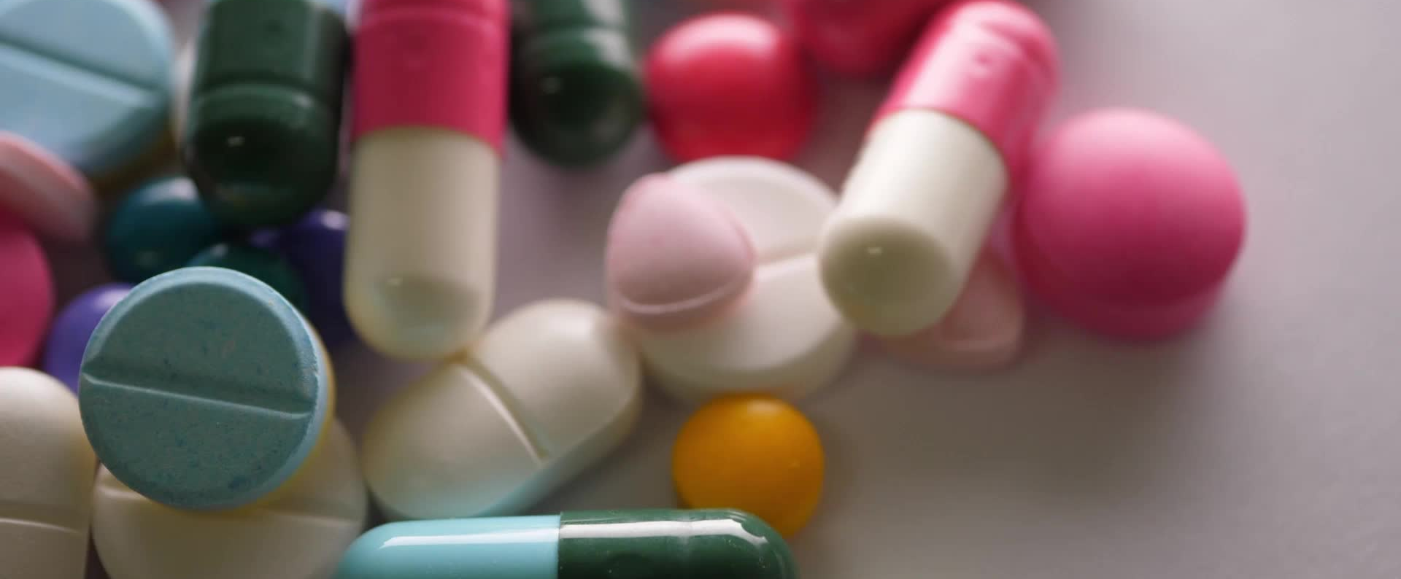
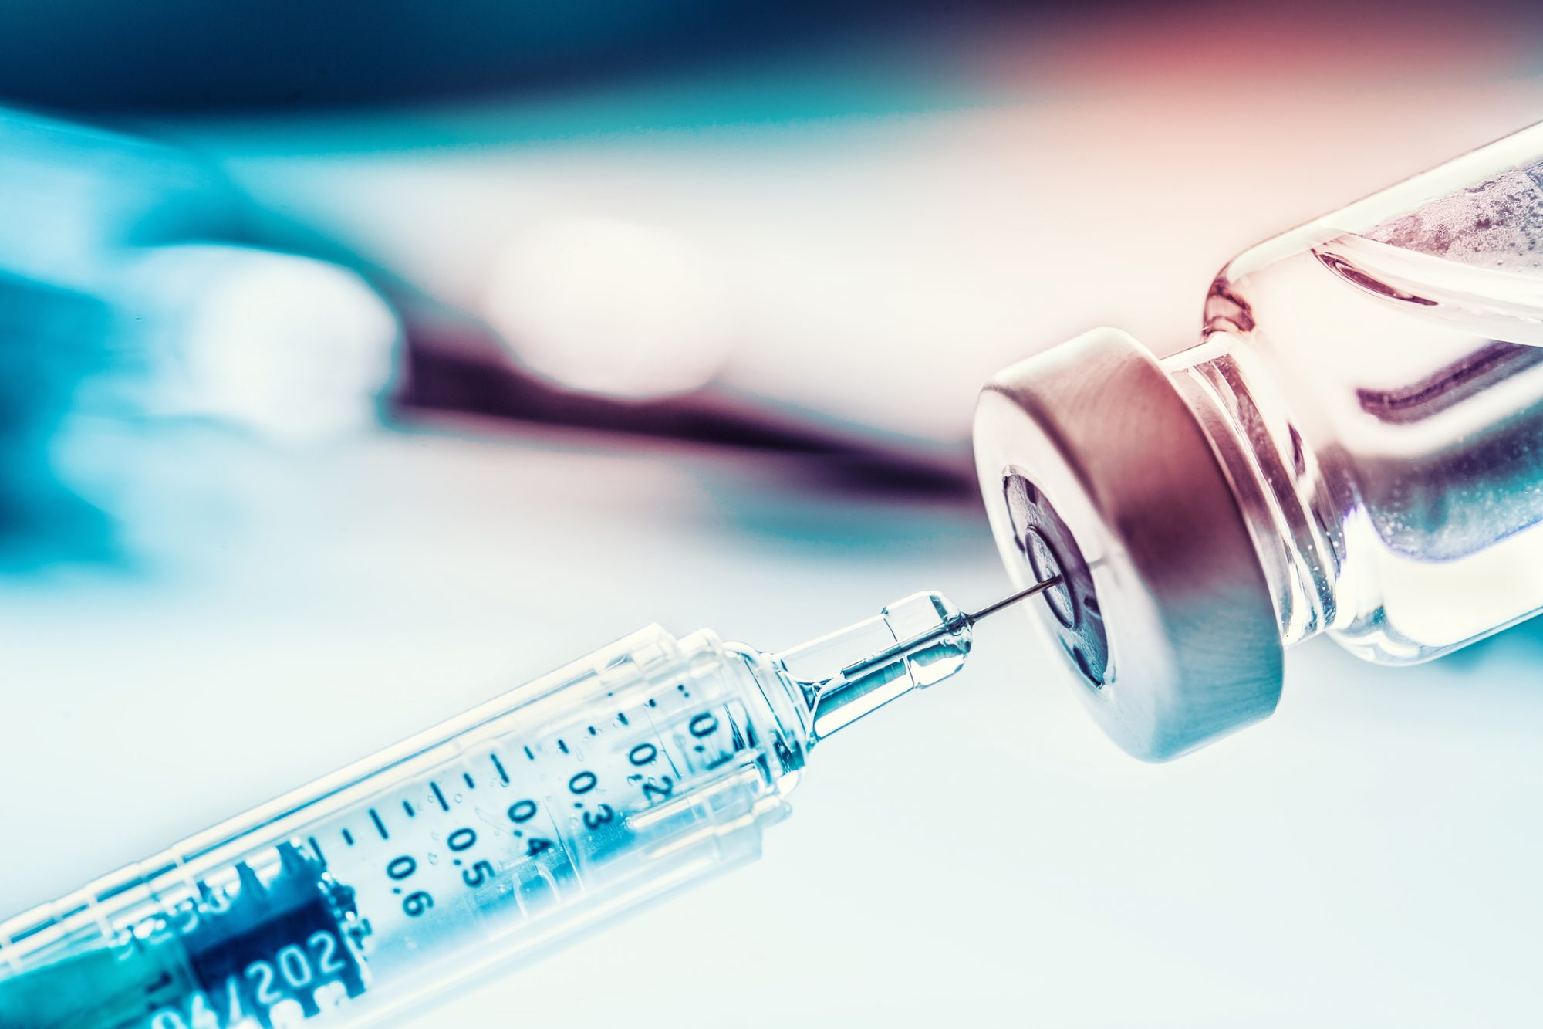
What about access to the medications?

Slide 60
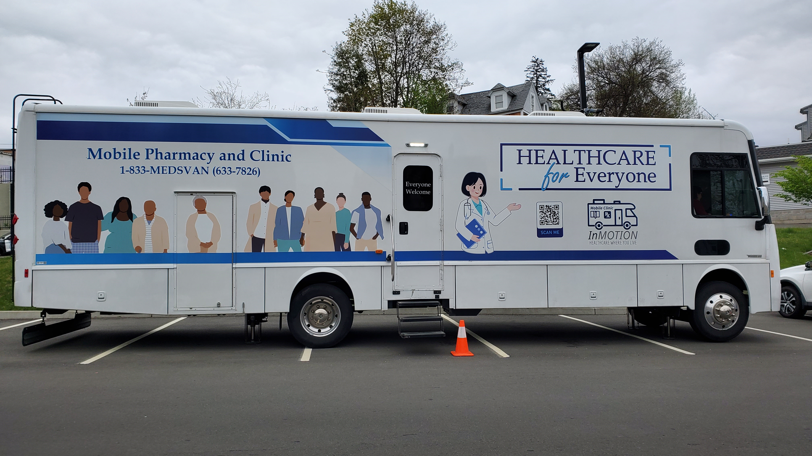
First Legalized Mobile Retail Pharmacy and Clinic In the United States to Provide ART, PrEP & SUD Treatment Where People Live
Mobile Health Clinic
Mobile Retail Pharmacy
Primary Clinical care
Screening for substance use disorders (alcohol, opioid, and stimulant)
Mental health
Rapid testing for HIV and Hepatitis C
Social services
Over 400 Medications
  ART/PrEP (LAI & Oral)
  MOUD (Buprenorphine, LAI/ TM)
  XR-NTX
  Psychiatric illness
  Antibiotics
  Diabetes
  Hypertension etc.
  Vaccinations
Mobile RETAIL Pharmacy and Clinic
Springer SA. J Gen Intern Med. 2023.
Tarfa A… Springer SA. OFID. 2025.
Springer SA et al. CROI. Feb 2026.
NIDA Avant Garde Award: DP1DA056106, 2022-2027
PI: Sandra Springer, MD

Slide 61
Summary
Substance use and SUDs are prevalent among PWH and those at risk for HIV
Screening, Diagnosing and Treating SUD can improve SU & HIV outcomes
Understanding and overcoming barriers to access HIV testing/ PrEP/ART & SUD tx is essential to end HIV.
Provision of medications, including LAI formulations, to people where they want services is essential.

Slide 62
Other Resources

Slide 63
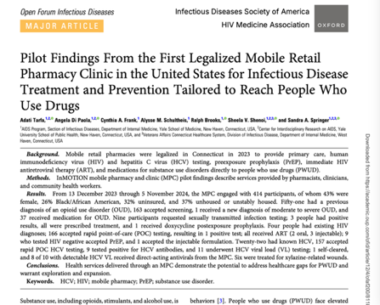
2025 Manuscript Mobile Pharmacy and Clinic Pilot Findings
Tarfa A, Di Paola A, Frank CA, Schultheis AM, Brooks R, Shenoi SV, Springer SA. Pilot Findings From the First Legalized Mobile Retail Pharmacy Clinic in the United States for Infectious Disease Treatment and Prevention Tailored to Reach People Who Use Drugs. Open Forum Infect Dis. 2025 Apr 24;12(4):ofaf200. doi: 10.1093/ofid/ofaf200. PMID: 40276721; PMCID: PMC12019630.
CopyDownload .nbib
PMID: 40276721
Slide 63

Slide 64
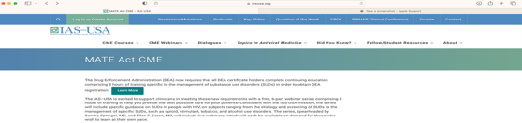






On the IAS-USA Website:
MATE ACT Free CME Webinars:
HIV and SUD
*(MATE Act = Medication Access & Training Expansion)
A ONE TIME 8-HOUR TRAINING IS REQUIRED FOR ALL PRACTIONERS WHO HAVE A DEA REGISTRATION (CONTROLLD SUBSTANCE LICENSE)
Slide 64
Notes:
The Medication Access and Training Expansion (MATE Act) requires all DEA-registered practitioners to complete a total of eight hours of training on the treatment and management of patients with opioid or other substance user disorders. The deadline for satisfying this training requirement is the date of the practitioner's next scheduled DEA registration submission (initial registration or renewal registration). This course bundle totals over eight hours and can be utilized to satisfy the MATE Act training requirement.

Slide 65
National Substance Use Warmline
Cost-free, confidential clinician-to-clinician tele-consultation
Staffed by addiction medicine and HIV specialist physicians, clinical pharmacists, and advanced practice nurses
9:00 AM – 8:00 PM Eastern Time Monday – Friday
(855) 300-3595 | Submit cases online
https://nccc.ucsf.edu/clinician-consultation/substance-use-management/
The National Clinician Consultation Center is supported by the Health Resources and Services Administration (HRSA) of the U.S. Department of Health and Human Services (HHS) as part of an award totaling $2,397,604 with 0% financed with non-governmental sources.

Slide 66
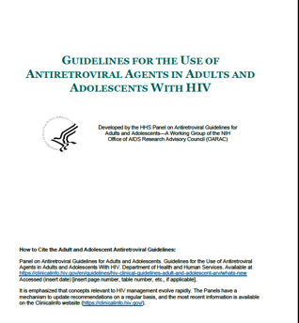

HIV Prevention and Treatment Guidelines that include SUD Management
DHHS
IAS-USA
Updated: September 25, 2025
Gandhi RT, et al. JAMA. 2025. [Published online Dec 1, 2024]
Notes:
Gandhi RT, Landovitz RJ, Sax PE, et al. Antiretroviral drugs for treatment and prevention of HIV infection in adults: 2022 recommendations of the International Antiviral Society-USA Panel. JAMA. 2025; 333(7):609-628. doi:10.1001/jama.2024.24543. [epublished online December 1, 2024]
DHHS: https://clinicalinfo.hiv.gov/en/guidelines/adult-and-adolescent-arv
Updated: September 25, 2025

Slide 67

Acknowledgements
*
*
THE PARTICIPANTS!
The InSTRIDE Research Team*
NIH: NIDA, NIAAA, NCATs
CT Dept of Health: Marianne Buchelli, Susan Major , Ramon Rodriguez-Santana
Community Partners: Jill Corbin and St. Vincent DePaul, Wheeler Clinic, McCall Behavioral Health, Liberation Programs, Staywell Health Clinic, Mayors’ offices and law enforcement in Waterbury, Hartford, Norwich, New Haven, Bridgeport, Aisling McGuckin RN, MSN-MPH (Dept of public Health, Waterbury)
YNHH Pharmacy: Osama Abdelghany, PharmD (Executive Director Oncology) and our other pharmacy partners
CT Department of Consumer Protection, Drug Division: Rod Marriott, PharmD
YNHH Investigational Drug Services: Prashant Patel, PharmD
Yale Legal Counsel: Joanna L. Cohen (Associate General Counsel) and Rosina Mummolo (Assistant General Counsel)
Yale University Office of Federal and State Relations: Richard Jacob (Associate Vice President for Federal and State Relations) and Jillian Jackson (Associate Director for State Relations)
CT Senator James Maroney who supported change in legislation through the General Law Committee
CT Governor Lamont

Slide 68
Q and A Session

