Slide 1
Drug Pricing and Generics: Impact on Ryan White HIV/AIDS Programs
Tim Horn, MS
Director, Medication Access and Pricing
National Alliance of State & Territorial AIDS Directors
Washington, DC

Slide 2
Financial Relationships With Commercial Entities
Mr Horn has no relevant financial affiliations to disclose. (Updated 11/11/19)

Slide 3
Learning Objectives
After attending this presentation, learners will be able to:
Describe the 340B Drug Pricing Program and its role in achieving cost containment and program income for Ryan White HIV/AIDS Programs
Describe to the challenges associated with high antiretroviral drug pricing
Assess the impact of generic drugs on program cost containment and 304B program income

Slide 4
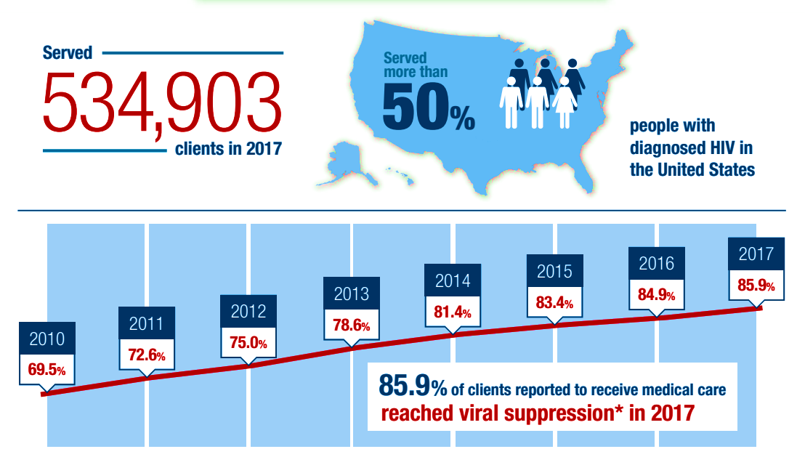
HHS HRSA HAB. Advancing Innovation to End the HIV Epidemic. 2019 Ryan White HIV/AIDS Program Highlights.

Slide 5
RWHAP Core Medical and Support Services
AIDS Drug Assistance Program Treatments ⌯ AIDS Pharmaceutical Assistance ⌯ Early Intervention Services (EIS) ⌯ Health Insurance Premium and Cost Sharing Assistance for Low-Income Individuals ⌯ Home and Community-Based Health Services ⌯ Home Health Care ⌯ Hospice Services ⌯ Medical Nutrition Therapy ⌯ Medical Case Management, including Treatment Adherence Services ⌯ Oral Health Care ⌯ Outpatient Ambulatory Health Services ⌯ Substance Abuse Outpatient Care ⌯ Child Care Services ⌯ Emergency financial Assistance ⌯ Food Bank/Home Delivered Meals ⌯ Health Education/Risk Reduction ⌯ Housing ⌯ Linguistic Services ⌯ Medical Transportation ⌯ Non-Medical Case Management Services ⌯ Outreach Services ⌯ Professional Services ⌯ Psychosocial Support Services ⌯ Referral for Health Care and Support Services ⌯ Rehabilitation Services ⌯ Respite Care ⌯ Residential Substance Abuse Services

Slide 6
RWHAP Core Medical and Support Services
AIDS Drug Assistance Program Treatments ⌯ AIDS Pharmaceutical Assistance ⌯ Early Intervention Services (EIS) ⌯ Health Insurance Premium and Cost Sharing Assistance for Low-Income Individuals ⌯ Home and Community-Based Health Services ⌯ Home Health Care ⌯ Hospice Services ⌯ Medical Nutrition Therapy ⌯ Medical Case Management, including Treatment Adherence Services ⌯ Oral Health Care ⌯ Outpatient Ambulatory Health Services ⌯ Substance Abuse Outpatient Care ⌯ Child Care Services ⌯ Emergency financial Assistance ⌯ Food Bank/Home Delivered Meals ⌯ Health Education/Risk Reduction ⌯ Housing ⌯ Linguistic Services ⌯ Medical Transportation ⌯ Non-Medical Case Management Services ⌯ Outreach Services ⌯ Professional Services ⌯ Psychosocial Support Services ⌯ Referral for Health Care and Support Services ⌯ Rehabilitation Services ⌯ Respite Care ⌯ Residential Substance Abuse Services
The 340B Drug Pricing Program helps Ryan White HIV/AIDS Programs, including ADAPs, to achieve both cost containment and revenue “to stretch scarce federal resources as far as possible, reaching more eligible patients and providing more comprehensive services.”
–H. R. No. 102-384, Part II, Pg. 12, 102nd Congress, Second Session

Slide 7
HIV Drug Cost Considerations

Slide 8
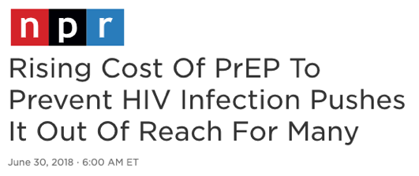

Slide 9
ARS QUESTION 1
Over the past 10 years, list prices of DHHS Guidelines “preferred” single-tablet regimens have increased by how much?
10% to 50%
50% to 100%
100% to 150%
150% to 200%
More than 200%

Slide 10
HHS-Preferred Regimen List Price Increases: 2009–2019
HHS-”Preferred” Regimens, 2009–2019
77%
2009 | EFV/TDF/FTC | $1,658
 | ATV/r + TDF/FTC | $2,452
 | DRV/r + TDF/FTC | $2,466
 | RAL + TDF/FTC | $1,655
2019 | BIC/TAF/FTC | $3,707
 | DTG/ABC/3TC | $3,467
 | DTG + TAF/FTC, TDF/FTC or TDF/3TC | $$3,295 – $4,198
 | RAL + TAF/FTC, TDF/FTC or TDF/3TC | $$3,095 – $3,999

Slide 11
HHS-Preferred Regimen List Price Increases: 2009–2019
HHS-”Preferred” Regimens, 2009–2019
77%
116%
2009 | EFV/TDF/FTC | $1,658
 | ATV/r + TDF/FTC | $2,452
 | DRV/r + TDF/FTC | $2,466
 | RAL + TDF/FTC | $1,655
2019 | BIC/TAF/FTC | $3,707
 | DTG/ABC/3TC | $3,467
 | DTG + TAF/FTC, TDF/FTC or TDF/3TC | $$3,295 – $4,198
 | RAL + TAF/FTC, TDF/FTC or TDF/3TC | $$3,095 – $3,999

Slide 12
Payer and Access Considerations
Total undiscounted spending on ARVs in 2018: $22.8 billion¹
HIV among the top five therapeutic classes in non-discounted spending in 2018, after medications for diabetes, autoimmune diseases, cancer and respiratory diseases¹
ARVs are No. 1 Medicaid outpatient drug expenditure (No. 5 and 4 for commercial and ACA plans, respectively)²
Public and private payers: increasing formulary restrictions, utilization management (e.g., prior auth)
Out-of-pocket spending is an issue; copay assistance programs in crosshairs
1. IQVIA. Medicine Use and Spending in the U.S. 2018 April. 2. Express Scripts. Drug Trend Report, 2018.

Slide 13
Generic ARV Options (2019)
Multi-Source “Generic” Drugs
abacavir, abacavir/lamivudine, atazanavir, didanosine, fosamprenavir, lamivudine, nevirapine, ritonavir, stavudine, tenofovir disoproxil fumarate
Multi-Source “Quasi-Generic Brand” Drugs
Mylan: EFV/TDF/3TC, EFV(400)/TDF/3TC, TDF/3TC
Celltrion: TDF/3TC
Pending Generics
September 2020: TDF/FTC
Mid-2020s: darunavir, raltegravir

Slide 14
ARS QUESTION 2
Can generic drugs be used in DHHS Guidelines-recommended regimens?
No
Only “Initial Regimens in Certain Clinical Situations”
Both “Initial Regimens for Most People With HIV” and “Initial Regimens in Certain Clinical Situations”

Slide 15
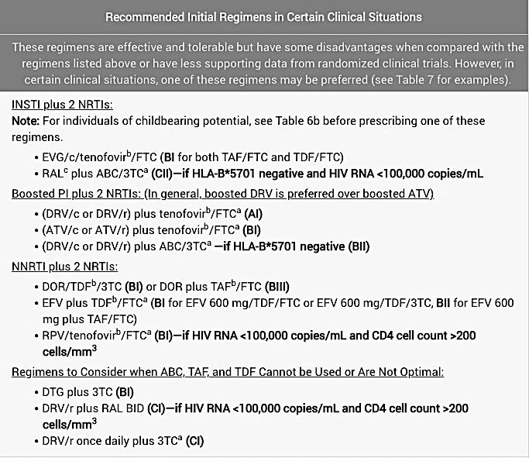
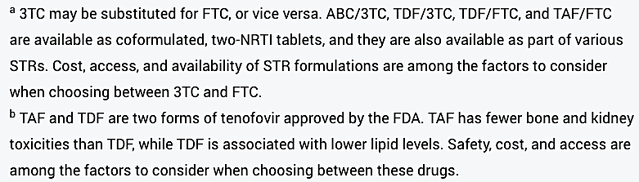
Generics in the HHS Guidelines

Slide 16
U.S. Drug Pricing: It’s Complicated
Average Wholesale Price (AWP)
Wholesale Acquisition Cost (WAC)
Average Manufacturer Price (AMP)
Private sector prices
Nonfederal Average Manufacturer Price (Non-FAMP)
Best Price
Negotiation on most-favored commercial customer price
24% of non-FAMP plus additional discounts
Unit rebate: 23.1% / 13% of AMP or
AMP – Best Price plus CPI penalties
Rebates to PBMs
Copay assistance
Other price concessions
Federal Supply Schedule (FSS) Price
340B Price
Medicaid Price
Generics
Federal Ceiling Price
Supplemental rebates and discounts negotiated (including ADAPs)
Federal Upper Limit
Federal Ceiling; “Big 4” Price
State Maximum Allowable Cost
Supplemental discounts negotiated (VA and DoD)
Commercial Payer MAC

Slide 17
340B and the Ryan White HIV/AIDS Program

Slide 18
340B Background
The 340B Drug Pricing Program was developed to allow manufacturers to continue offering discounted drugs to safety net entities, following the introduction of the Medicaid Drug Rebate Program
Medicaid required manufacturers to calculate average and best prices for the Medicaid program, and any discounts to safety net entities would reduce Medicaid reimbursement
The 340B Program was established to allow manufacturers to exclude these discounts from their Medicaid calculations

Slide 19
Manufacturers and 340B
Why do manufacturers participate in 340B (and Medicaid)?
Manufacturers are not required to participate – they choose to participate and offer discounts
Participation is the only way to receive Medicare Part B and Medicaid reimbursement

Slide 20
340B and RWHAP
RWHAP grantees are essential public health care programs and therefore eligible for 340B Drug Pricing Program
RWHAPs also subject to extensive restrictions on how 340B can be used: program-eligible PLWHIV, ”additive” use consistent with grant terms
HRSA Policy Clarification Notice (PCN) 15-03
Most RWHAP programs – or their contract pharmacies – access up-front discounts
ADAPs, under RWHAP Part B, may choose up-front discounts and/or rebates paid by manufacturer
ADAP Crisis Task Force negotiates supplemental discounts/rebates with manufacturers – agreements with all ARV manufacturers on behalf of all ADAPs

Slide 21
340B Discount and Program Income Basics
340B entities subject to a minimum discount of 23.1% off the Average Manufacturer Price; “Best Price” adjustment also possible
When manufacturer takes a price increase that exceeds the Consumer Price Index for All Urban Costumers (CPI-U), an additional rebate – or “inflation penalty” – is added to base discount
Achieves prescription drug cost containment
Revenue, or “program income,” is generated when clinics are able to purchase the drug at a discounted rate but are reimbursed by third-party payers at a higher usual and customary rate

Slide 22
340B Discount and Program Income Basics
PROGRAM INCOME
Insurance Payment
DISCOUNT FROM MANUFACTURER
DISCOUNT or REBATE FROM MANUFACTURER
WAC/AMP Price
340B Ceiling Price
Voluntary Sub-ceiling ADAP Price
ADAPs
RWHAP Providers

Slide 23
340B Program Income Over Time
Insurance Payment
Insurance Payment
URA 23.1%
PROGRAM INCOME
PROGRAM INCOME
URA 23.1%
PROGRAM INCOME
Insurance Payment
URA 23.1%
CPI Penalty
CPI Penalty
ADAP suppl
ADAP suppl
LAUNCH: $100.00
YEAR 5: $140.00
YEAR 10: $175.00

Slide 24
Challenges to 340B Program Income
Any legislation or regulations that directly or indirectly lower “AMP” or “Best Price”
Legislation or regulations that alter 340B Drug Pricing Program, including entity and patient definitions
Legislation, regulations, or policies allowing payers to reimburse 340B discounted drugs at lower rates
Competition that lowers list prices, AMP, or Best Price
Patent cliffs and commercialization of generic drug products

Slide 25
Medicare & Commercial Plans
Medicare & Commercial Plans
Medicare & Commercial Plans
Medicare &Commercial Plans
Medicare &Commercial Plans
DTG ($58)
TDF/FTC ($58)
TAF/FTC ($58)
TDF/3TC ($33.50)
TDF + 3TC ($3.50)

Slide 26
Medicare & Commercial Plans
Medicare & Commercial Plans
Medicare & Commercial Plans
Mandatory 340B Discount
Mandatory 340B Discount
Mandatory 340B Discount
Medicare &Commercial Plans
Mandatory 340B Discount
Voluntary 340B Discount
Medicare &Commercial Plans
DTG ($58)
TDF/FTC ($58)
TAF/FTC ($58)
TDF/3TC ($33.50)
TDF + 3TC ($3.50)

Slide 27
Medicare & Commercial Plans
Medicare & Commercial Plans
Medicare & Commercial Plans
Mandatory 340B Discount
Mandatory 340B Discount
Mandatory 340B Discount
340B | DTG +
 | TDF/FTC | TAF/FTC | TDF/3TC | TDF + 3TC
List/WAC | $3,480 | $3,480 | $2,745 | $1,833
340B Price | $1,260 | $1,260 | $1,620 | $960
340B Program Income | $2,225 | $2,225 | $1,130 | $880
Medicare &Commercial Plans
Mandatory 340B Discount
Voluntary 340B Discount
Medicare &Commercial Plans
DTG ($58)
TDF/FTC ($58)
TAF/FTC ($58)
TDF/3TC ($33.50)
TDF + 3TC ($3.50)

Slide 28
A Word About PrEP
Generic TDF/FTC
USPSTF
340B Savings
TAF/FTC LA-CAB
Payer Cost Containment

Slide 29
Summary
The era of cost containment and generic competition has arrived; clinician knowledge/engagement increasingly important
Payers asking the same critical questions of data as clinicians: TAF vs. TDF, STRs vs. MTRs, added value of LA ARVs
340B has been a lifeline to US HIV programs, including RWHAP clinics and AIDS Drug Assistance Programs (ADAPs)
ARV market (e.g., generics) and policy dynamics may impact 340B as savings source
The big question: How do we make lower drug prices work to the advantage of people with, or at risk for, HIV?

Slide 30
THANK YOU! thorn@NASTAD.org

Slide 31
Question-and-Answer Period

