Slide 1
Management and Prevention of Common HIV-Related Manifestations
David H. Spach, MD
Professor of Medicine
University of Washington
Seattle, WA

Slide 2
Financial Relationships With Commercial Entities
Dr Spach has no financial relationships with any commercial entities. (Updated 8/5/20)

Slide 3
Learning Objectives
After attending this presentation, learners will be able to:
List the preferred treatment for CAP in persons with HIV
Discuss initiation of ART in persons with active tuberculosis
Describe the approach to isolated hepatitis B core antibody
Summarize pneumococcal & zoster vaccine recommendations

Slide 4
Community-Acquired Pneumonia in Persons with HIV

Slide 5
Treatment of CAP in Persons with HIV
A 38-year-old woman with HIV is seen in clinic in the month of August with a 2-day history of cough, fever, and mild dyspnea on exertion. A COVID-19 test (NP swab) was performed the prior day and is negative.
She is taking bictegravir-TAF-FTC. Recent HIV RNA level <40 copies/mL and CD4 count 430 cells/mm³. She has no other medical problems.
Chest radiograph shows a focal right lower lobe infiltrate and she is diagnosed with community acquired pneumonia (CAP). She is not acutely ill.

Slide 6
ARS Question 1
Based on OI Guidelines, what oral antibiotic treatment should be given for out-patient management of this woman with CAP?
Trimethoprim-sulfamethoxazole
Amoxicillin-clavulanate plus Azithromycin
Amoxicillin-clavulanate
Azithromycin

Slide 7
Adult Opportunistic Infections Guidelines Treatment of CAP in Persons with HIV
Empiric Out-Patient Treatment of CAP in Persons with HIV | Rating
Preferred
*Beta-lactam plus Macrolide (Azithromycin or Clarithromycin) | AI
Respiratory Fluoroquinolone (Levofloxacin or Moxifloxacin) | AI
Alternative
^Beta-lactam plus Doxycycline | BIII
*Preferred beta-lactam = amoxicillin (high-dose) or amoxicillin-CA ^Alternative beta-lactam = cefpodoxime or cefuroxime
Source: Opportunistic Infections Guidelines. CAP. October 10, 2019.

Slide 8
Why Not Use Macrolide Monotherapy? Pneumococcal Antimicrobial Susceptibility Surveillance Data
Source: CDC. Active Bacterial Core Surveillance Data, 2016.

Slide 9
Tuberculosis in Persons with HIV

Slide 10
Case History: Pulmonary TB
A 42-year-old man is admitted to the hospital with a diagnosis of pulmonary TB. He is started on standard RIPE* therapy. He has no evidence of CNS or pericardial involvement.
2 days later HIV testing results return as positive and further labs show a CD4 count of 26 cells/mm³ and HIV RNA 236,300 copies/mL. An HIV genotype is ordered. He is started on TMP-SMX for PJP prophylaxis.
Testing for HBV and HCV are negative and he has no abnormalities on exam other than pulmonary findings.
*RIPE = rifampin + isoniazid + pyrazinamide + ethambutol

Slide 11
ARS Question 2
One week later he feels much improved and is evaluated to consider starting antiretroviral therapy (ART). What would you recommend now?
Defer ART until after 4 weeks of TB therapy
Defer ART until after 8 weeks of TB therapy
Start ART now and start Prednisone 40 mg daily
Start ART now without Prednisone

Slide 12
Adult Opportunistic Infections Guidelines Initiating Antiretroviral Therapy with Active TB
CD4 count <50 cells/mm³: - Initiate ART as soon as possible, but <2 weeks of starting TB Rx (AI)
CD4 count ≥50 cells/mm³: - Initiate ART <8 weeks of starting TB Rx (AI)
Source: OI Guidelines. Mycobacterium tuberculosis. September 27, 2019.

Slide 13
Adult Opportunistic Infections Guidelines for Preventing TB-IRIS
Indication for Pre-emptive Prednisone therapy - Offer for patients with a CD4 count ≤100 cells/mm³ who are:
Starting ART and recently initiated anti-TB therapy,
Responding well to TB therapy, and
Do not have rifampin resistance, KS, or active HBV
Dosing of Pre-emptive Prednisone Therapy - 40 mg/day for 14 days, then 20 mg/day for 14 days
B1
Source: OI Guidelines. Mycobacterium tuberculosis. September 27, 2019.

Slide 14
Prednisone for the Prevention of Paradoxical Tuberculosis-Associated IRIS in Persons with HIV
Study Design
Background: Randomized, placebo-controlled double-blind, study to evaluate prednisone pre-emptive therapy in person with HIV diagnosed with TB in South Africa High Risk - Starting ART <30 days of starting TB Rx - CD4 <100 cells/mm³ Exclusion Criteria - Neurologic TB - Rifampin resistance - Kaposi’s sarcoma - HBsAg+ - Poor response to TB treatment
Prednisone 40 mg/d x 14 days, then 20 mg/d x 14 days
(n = 120)
Placebo
(n = 120)
Source: Meintjes G, et al. N Engl J Med. 2018:379:1915-25.

Slide 15
Pre-emptive Prednisone Reduced TB-Associated IRIS
P = 0.03
39/120
56/120
Prednisone treatment was not associated with an increased risk of severe infections or cancers
Source: Meintjes G, et al. N Engl J Med. 2018:379:1915-25.

Slide 16
ARS Question 3: Pulmonary TB
For this man with pulmonary TB on RIPE, which antiretroviral regimen would you recommend?
Bictegravir-Tenofovir alafenamide-Emtricitabine
Darunavir-cobicistat-tenofovir alafenamide-Emtricitabine
Dolutegravir-rilpivirine (fixed dose tablet)
Dolutegravir 50 mg BID + Tenofovir DF-Emtricitabine

Slide 17
Initial Antiretroviral Options with Rifampin
NRTIs - All OK; use caution with TAF
NNRTIs - Efavirenz: standard dose
PIs - None
INSTIs - Dolutegravir: 50 mg bid - Raltegravir: 800 mg bid
Source: HHS. Opportunistic Infections Guidelines. September 27, 2019.

Slide 18
Immunizations in Persons with HIV

Slide 19
Hepatitis B Vaccine

Slide 20
HHS Opportunistic Infections Guidelines HBV Screening in Persons with HIV
All persons with HIV should be screened for HBV with: - HBsAg - Anti-HBs - Anti-HBc
Source: Opportunistic Infections Guidelines. November 13, 2018.

Slide 21
HBV “Isolated Core Antibody”
A 28-year-old trans woman (preferred pronouns she/her/hers) recently moved and has a visit to new clinic. She has taken DTG plus TAF-FTC x 6 months.
Initial clinic labs show CD4 count 824 cells/mm³, HIV RNA <40 copies/mL, HBsAg (-), anti-HBs (-), and anti-HBc (+). She has never received hepatitis B vaccine.

Slide 22
ARS Question 4
Based on HHS OI Guidelines, what would you recommend now to address the isolated anti-HBc?
Give 1 standard dose HBV vaccine & check anti-HBs in 1-2 months
Give 3-dose series of standard dose HBV vaccine
Check HBV DNA level
She is immune and no further action is needed

Slide 23
Adult Opportunistic Infections Guidelines Approach to Isolated Anti-HBc in Persons with HIV
Isolated Anti-HBc Positive
Single dose HBV Vaccine
Check anti-HBs in 1-2 Months
Source: Opportunistic Infections Guidelines. November 13, 2018.

Slide 24
Adult Opportunistic Infections Guidelines Approach to Isolated Anti-HBc in Persons with HIV
Isolated Anti-HBc Positive
Single dose HBV Vaccine
Check anti-HBs in 1-2 Months
Anti-HBs ≥100 mIU/mL
Immune to HBV
Source: Opportunistic Infections Guidelines. November 13, 2018.

Slide 25
Adult Opportunistic Infections Guidelines Approach to Isolated Anti-HBc in Persons with HIV
Isolated Anti-HBc Positive
Single dose HBV Vaccine
Check anti-HBs in 1-2 Months
Anti-HBs <100 mIU/mL
Anti-HBs ≥100 mIU/mL
Immune to HBV
Complete HBV Vaccine Series
Check anti-HB in 1-2 Months

Slide 26
HBV “Isolated Core Antibody”
Persons with HIV and Isolated anti-HBc: - Anti-HBs response for >18 months after Hep B Vaccine Booster Dose
100% in those who achieved a titer of 100 IU/mL after booster
23% of those who achieved a titer of 10-100 IU/mL after booster
Source: Piroth L, et al. J Infect Dis. 2016:213:1735-42.

Slide 27
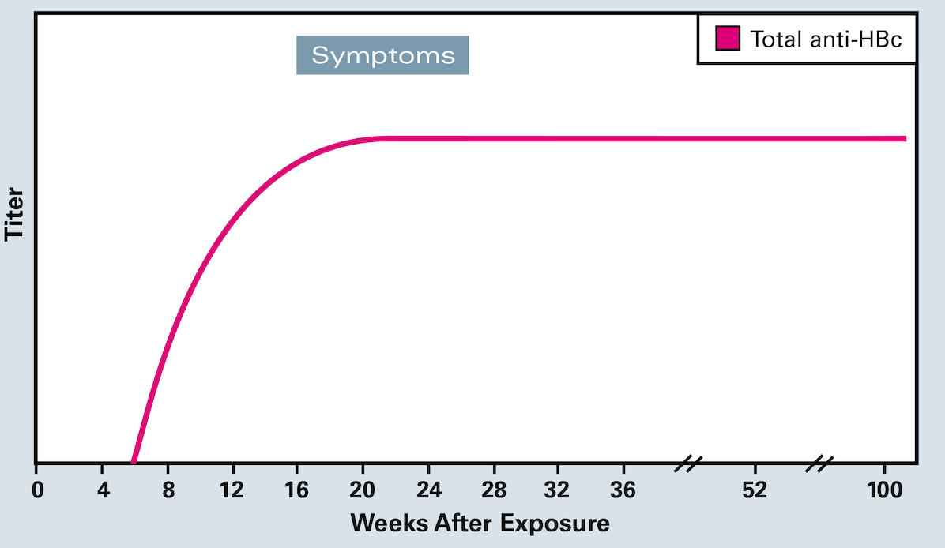
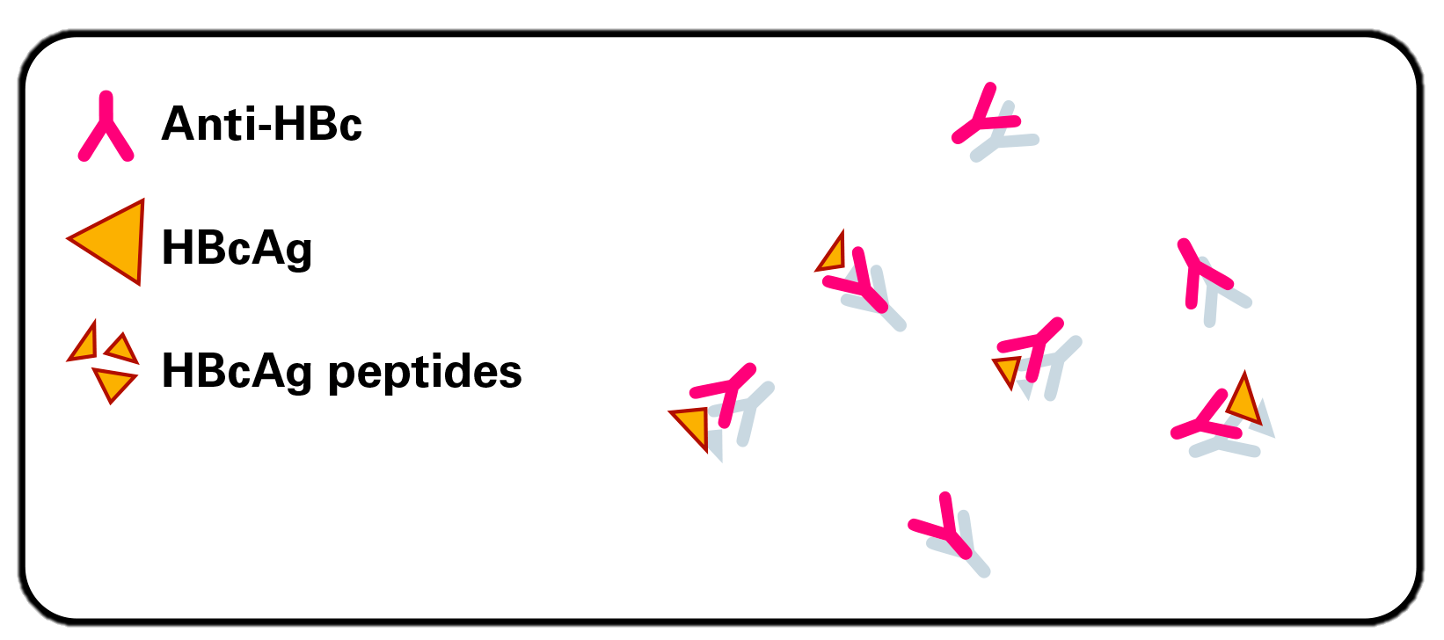
Total Hepatitis B Core Antibody (Total Anti-HBc)
HBV Infection
Illustration: David H. Spach, MD and David Ehlert, CMI

Slide 28
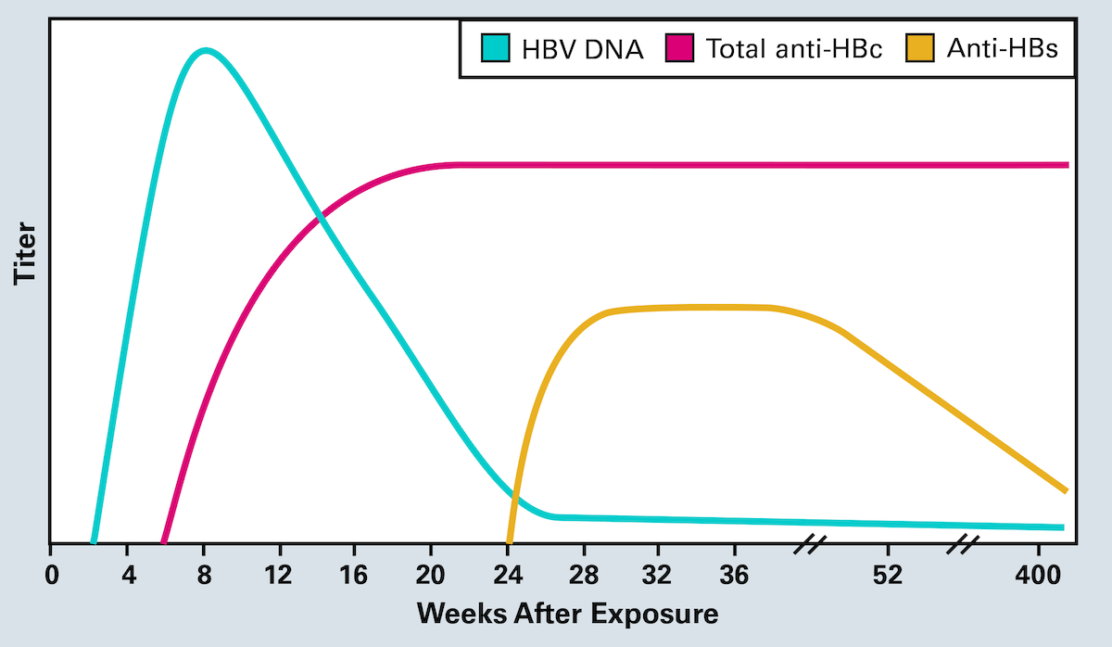
Isolated Anti-HBc Resolved HBV Infection and Waning Anti-HBs
Illustration: David H. Spach, MD and David Ehlert, CMI

Slide 29
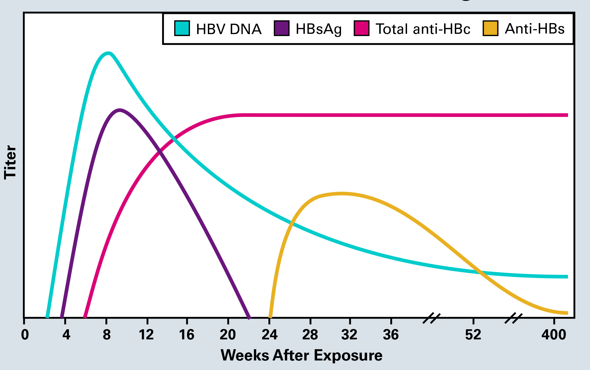
Isolated Anti-HBc Persistent Low-Level HBV Infection with Non-Detectable HBsAg
Unlikely if taking TDF-FTC or TAF-FTC
Illustration: David H. Spach, MD and David Ehlert, CMI

Slide 30
Pneumococcal Vaccine

Slide 31
Conjugate Pneumococcal Vaccine (PCV13)
Polysaccharide Capsule
Protein Conjugate
Cell Wall
Streptococcus pneumoniae

Slide 32
Polysaccharide Pneumococcal Vaccine (PPSV23)
Polysaccharide Capsule
Polysaccharide
Cell Wall
Streptococcus pneumoniae

Slide 33
Adult Opportunistic Infections Guidelines Pneumococcal Immunization for Persons with HIV
Pneumococcal Vaccine-Naïve Adults
Age ≥65
≥8 wks
≥5 yrs
≥5 yrs
PCV13
PPSV23
PPSV23
PPSV23
Source: Opportunistic Infections Guidelines. CAP. October 10, 2019.

Slide 34
Adult Opportunistic Infections Guidelines Timing of Pneumococcal Vaccine-Naïve Adults with HIV
Timing of PCV13 -Give regardless of CD4 cell count (AI)
Timing of 1st Dose PPSV23 if CD4 ≥200 cells/mm³ - Give ≥8 weeks after PCV13 (AI)
Timing of 1st Dose PPSV23 if CD4 <200 cells/mm³ - Defer until CD4 ≥200 cells/mm³ on ART (BIII) - Give ≥8 weeks after PCV13 (CIII)
Source: Opportunistic Infections Guidelines. CAP. October 10, 2019.

Slide 35
Zoster Vaccine

Slide 36
Zoster Vaccines
VZV
Attenuated VZV
Glycoprotein E
AS01_{B} Adjuvant
VZV
+
Zoster Vaccine Live (ZVL)
Recombinant Zoster Vaccine (RZV)

Slide 37
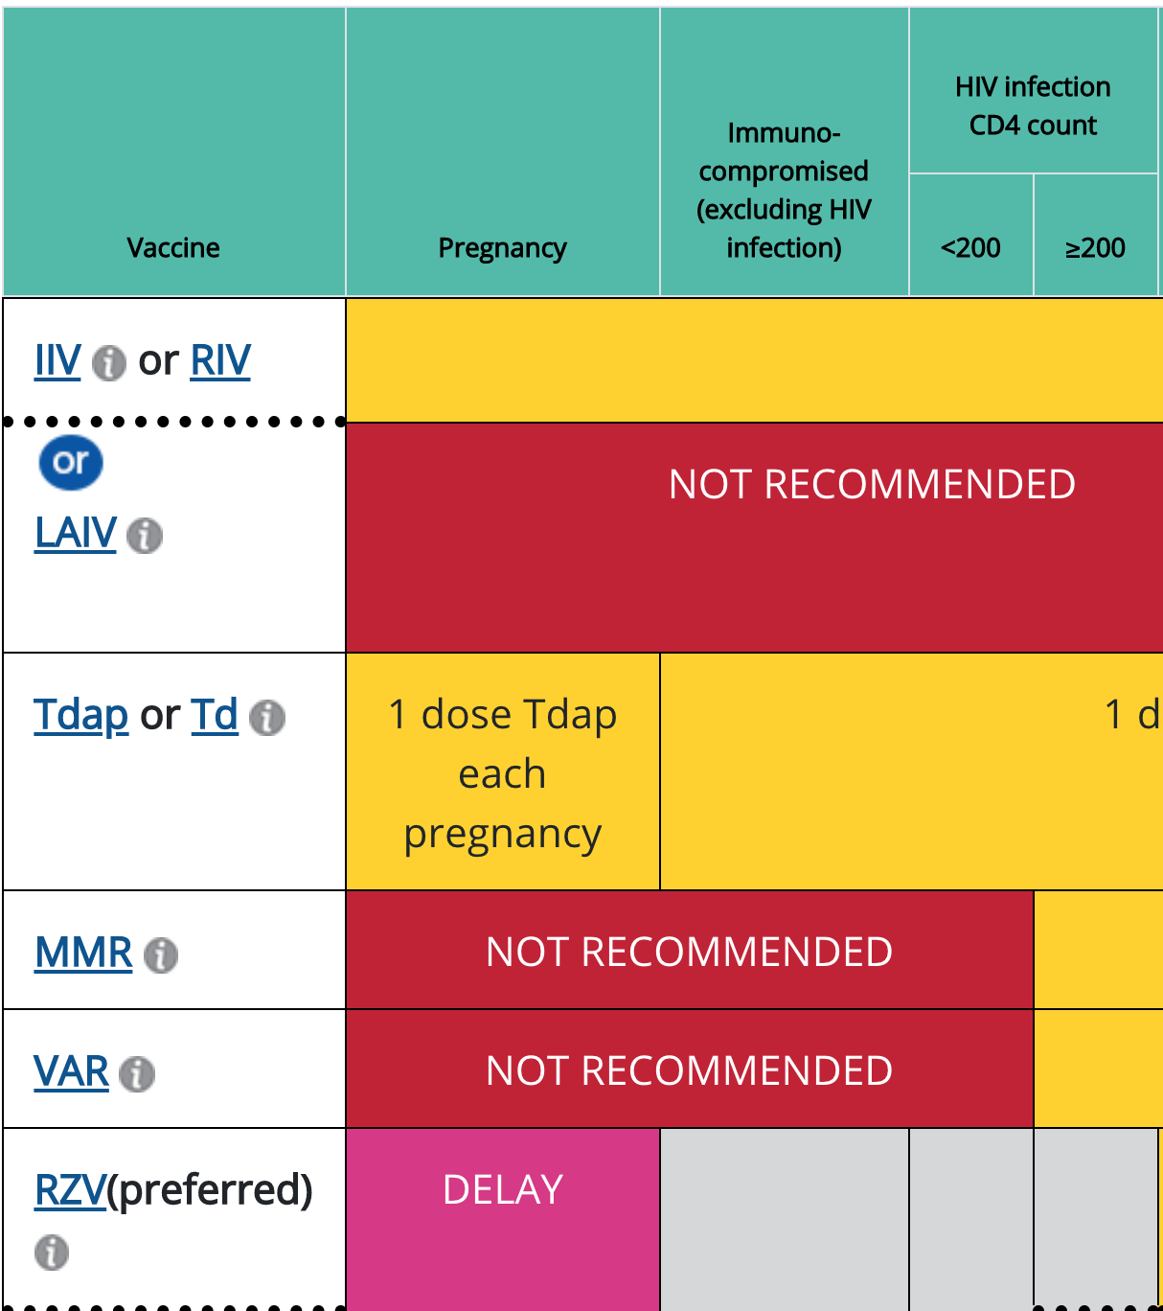
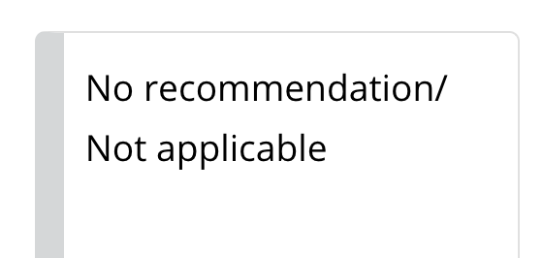
2020 ACIP Recommended Adult Immunization Schedule, by Medical Condition and Other Indications, United States
Source: ACIP. https://www.cdc.gov/vaccines/schedules/hcp/imz/adult-conditions.html

Slide 38
Adult Opportunistic Infections Guidelines Zoster Vaccine in Persons with HIV
Zoster Vaccine in Persons with HIV | Age | CD4 | Dosing | Rating
Preferred
Recombinant Zoster Vaccine (RZV) | ≥50 yrs | Any | 2-Doses 0, 2-6 months | AIII
Alternative
*Zoster Vaccine Live (ZVL) | ≥50 yrs | ≥200 | 1-Dose | BIII
*ZVL contraindicated in persons with a CD4 count <200 cells/mm³ (AIII)
Source: Opportunistic Infections Guidelines. September 5, 2019.

Slide 39
Top 5 Key Points…………
HIV CAP Rx: (1) macrolide + beta lactam or (2) respiratory FQ
Starting ART in person with TB: offer prednisone if CD4 <100
Isolated HBcAb: start with a booster dose of Hep B vaccine
PCV13 Vaccine: do not delay if CD4 <200
Zoster Vaccine: Give RZV to all ≥50 years of age

Slide 40
Question-and-Answer Session

