Slide 1
New and Investigational ART Drugs and Strategies
Judith S. Currier, MD, MSc
Division of Infectious Diseases
David Geffen School of Medicine
University of California Los Angeles

Slide 2
Financial Relationships With Ineligible Companies (Formerly Described as Commercial Interests by the ACCME) Within the Last 2 Years
Dr Currier has no relevant financial relationships with ineligible companies to disclose. (Updated 9/20/21)

Slide 3
Learning Objectives
At the end of this presentations, learners will be able to:
  List 2 investigational drugs currently in phase III trials
  Describe how these investigational agents might be used in treatment in the future

Slide 4
New Drugs on the Horizon
Islatravir
Lenacapravir
GSK 3640254 (aka GSK “254)
Investigational Aspects of Recently approved Agents
Long acting Cabotegravir and Rilpivirine

Slide 5


Slide 6
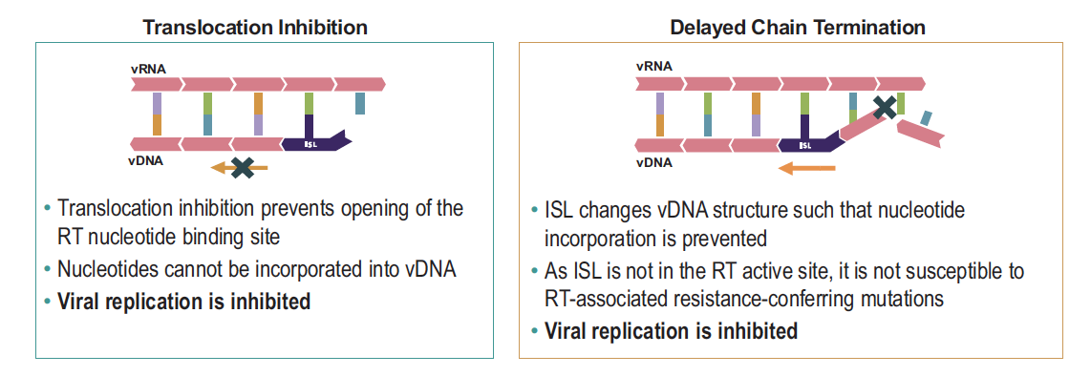
Islatravir
Other Names: EFdA, ISL, MK-8591
Drug Class: Nucleoside Reverse Transcriptase Translocation Inhibitors
Currently under evaluation for both prevention and treatment, including both a pill formulation and an implant.
For treatment: Phase 3 trials combined as a single tablet with Doravirine.
Notes:
HIV inhibition by islatravir occurs at subnanomolar concentrations, and preclinical in vitro studies showed that the drug’s potency is greater than 10 times that of any currently available ARV drug. The active triphosphate of islatravir has an intracellular half-life of up to 128 hours.

Slide 7
Islatravir:
P011 Study Design: from 3 to 2 drugs, 3 doses
Part 1:
3-Drug Dose Ranging
Part 2:
2-Drug Dose Ranging
Part 3:
Maintenance
Wk 24
Wk 60-84
Wk 144
Inclusion criteria
Treatment-naive
RNA ≥1000 c/mL, CD4+ count ≥200 cells/mm³
no ARV drug resistance,
no active HCV or HBV coinfection
N=121
ISL 0.25 mg + DOR + 3TC QD
(n = 29)
ISL 0.25 mg + DOR QD
(n = 29)
ISL 0.75 mg +
DOR 100 mg QD
(n = 80)
ISL 0.75 mg + DOR + 3TC QD*
(n = 30)
ISL 0.75 mg + DOR QD
(n = 30)
ISL 2.25 mg + DOR + 3TC QD*
(n = 31)
ISL 2.25 mg + DOR QD
(n = 27)
DOR/3TC/TDF QD†
(n = 31)
DOR/3TC/TDF QD
(n = 28)
RNA < 50 copies/ml at wk 20
Key findings: 1 Serious drug related AE in the ISL +DOR part 3 arm, No discontinuations for safety events after week 48
Most common AE in ISL + DOR groups: headache (6.5%) ; most common AE in DOR/3TC/TDF group: diarrhea (19%)
  Similar Incidence of both at Weeks 48 and 96
Cunningham. IAS 2021. Abstr OAB0304.
Notes:
3TC, lamivudine; ARV, antiretroviral; BL, baseline; DOR, doravirine; HBV, hepatitis B virus; HCV, hepatitis C virus; ISL, islatravir; QD, once daily; TDF, tenofovir disoproxil fumarate;
VF, virologic failure.

Slide 8
Islatravir: Safety Data Laboratory (P011 Study)
Laboratory abnormality in > 2 participants in any group, n/N (%) | ISL 0.25 mg + DOR QD | ISL 0.75 mg + DOR QD | ISL 2.25 mg + DOR QD | DOR/ 3TC/ TDF QD
Fasting triglycerides ( mg/dL) Grade 3: > 500-1000 | 2/29 ( 6.9) | 0/30 (0) | 1/29 (3.4) | 0/26 (0)
Alanine aminotransferase (IU/ L) Grade 3: 5.0 to < 10.0 x ULN | 0/29 (0) | 1/30 (3.3) | 2/31 (6.5) | 1/31 (3.2)
Creatinine kinase ( IU/L) Grade 3: 10.0 to < 20.0 x ULN Grade 4: >20.0 x ULN | 4/29 (13.8) 1/29 (3.4) | 0/30 (0) 2/30 (6.7) | 0/31 (0) 3/31 (9.7) | 1/31 (3.2) 1/31 (3.2)
No apparent dose related changes in grade 3 and 4 AE’s
Cunningham. IAS 2021. Abstr OAB0304.

Slide 9
Islatravir: Efficacy at 96 weeks
 | ISL (0.25 mg) + DOR QD | ISL (0.75 mg) + DOR QD | ISL (2.25 mg) + DOR QD | ISL Combined | DOR/ 3TC/ TDF QD
 | N=29 | N=30 | N=31 | N=90 | N=31
Outcome (FDA Snapshot Approach)
HIV-1 RNA < 50 copies/ mL, n (%) HIV-1 RNA > 50 copies/ mL, n (%) No virologic data at Week 96 window , n (%) | 25 (86.2) | 27(90.0) | 21(67.7) | 73(81.1) | 25(80.6)
 | 2 (6.9) | 2 (6.7) | 5 (16.1) | 9 (10.0) | 2 (6.5)
 | 2 (6.9) | 1 (3.3) | 5 (16.1) | 8 (8.9) | 4 (12.9)
Reasons for no virologic data in window
Discontinued due to death or Aeª , n (%) Discontinued for other reasons, n (%) On treatment but missing data, n (%) | 0 | 0 | 2 (6.5) | 2 (2.2) | 1 (3.2)
 | 1 (3.4) | 1 (3.3) | 3 (9.7) | 5 (5.6) | 3 (9.7)
 | 1 (3.4) | 0 | 0 | 1 (1.1) | 0
Molina JM et al. HIV Glasgow 2020, abstract O415.
Orkin C et al. HIV Glasgow 2020, abstract P047.

Slide 10
Islatravir: Ongoing trials
Phase III studies of treatment-naive people (NCT04233879),
Heavily treatment-experienced people (NCT04233216)
People with viral suppression who are switching from other regimens (NCT04223778 and NCT04223791).
A phase II study of children and adolescents is also planned (NCT04295772).

Slide 11
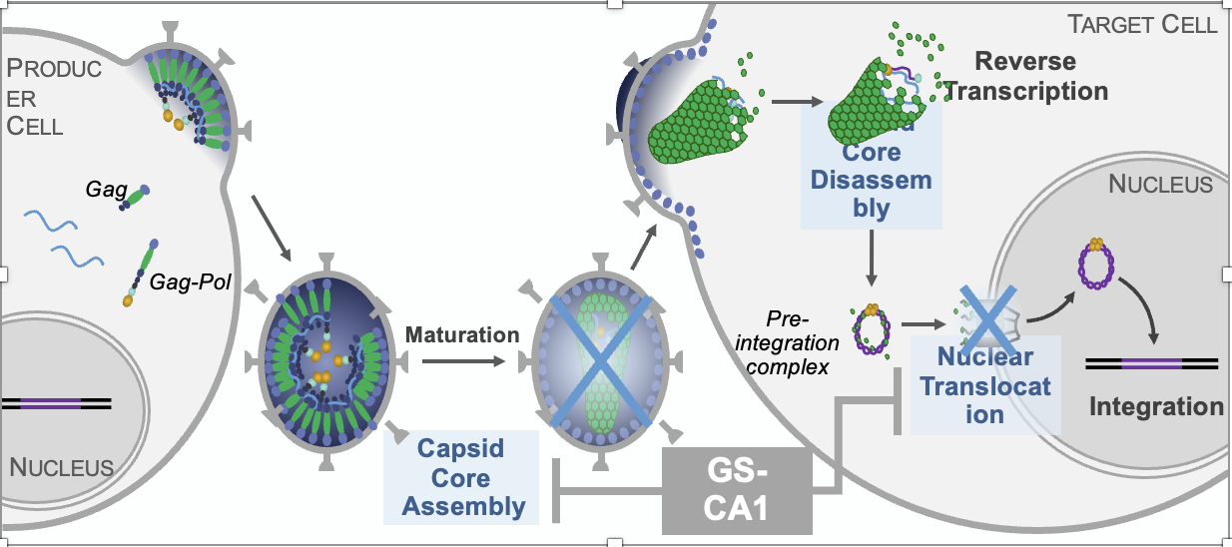

Lenacapravir: Background
Lenacapavir: HIV capsid inhibitor that prevents nuclear assembly, virus assembly and release, and capsid assembly. EC₅₀ 50 picomolar
  Retains full activity against NRTI-, NNTRI-, PI-, and INSTI-resistant HIV-1 in vitro³⁻⁵
  Oral and SC formulations in development
1. Link. Nature. 2020;584:614. 2. Bester. Science. 2020;370:360. 3. Yant. CROI 2019. Abstr 480. 4. Margot. CROI 2020. Abstr 529. 5. VanderVeen. CROI 2021. Abstr 128. 6. Segal-Maurer. CROI 2021. Abstr 127. 7. Molina. IAS 2021. Abstr OALX01LB02.
Slide adapted from : clinicaloptions.com
Notes:
ARV, antiretroviral; INSTI, integrase strand transfer inhibitor; MDR, multidrug resistant; MOA, mechanism of action; NNRTI, nonnucleoside reverse transcriptase inhibitor;
NRTI, nucleoside reverse transcriptase inhibitor; PI, protease inhibitor; SC, subcutaneous.

Slide 12

CAPELLA: Study Design with Lenacapravir
Ongoing, 2-cohort, phase II/III trial
Primary endpoint achieved in prior analysis: ≥0.5 log₁₀ copies/mL decline in HIV-1 RNA at Day 14
in randomized cohort (90% of LEN vs 17% placebo)
  1.93 log 10 reduction in viremia in LEN group in first 14 days
Secondary endpoints: HIV-1 RNA <50 copies/mL, <200 copies/mL at Week 26 in randomized cohort
14 d
Functional Monotherapy
Maintenance Therapy
Oral LEN +
Failing Regimen
(n = 24)
SC LEN Q6M for 52 wk
+ OBR
Eligibility:
HIV-1 RNA ≥400 copies/mL,
resistance to ≥2 agents from 3 of 4 main ARV classes,
≤2 fully active agents
from 4 main ARV classes
(N = 72)
Randomized
Decline of <0.5 log₁₀ copies/mL (vs screening)
or ≥400 copies/mL
Placebo +
Failing Regimen
(n = 12)
Oral LEN for 14 d →
SC LEN Q6M for 52 wk
+ OBR
Repeat
HIV-1 RNA
at Screening
Nonrandomized
Decline of ≥0.5 log₁₀ copies/mL (vs screening)
or <400 copies/mL
Oral LEN + OBR
(n = 36)
SC LEN Q6M for 52 wk
+ OBR
Molina. IAS 2021. Abstr OALX01LB02.
Adapted from Slide: clinicaloptions.com
Notes:
CAPELLA: ongoing, 2-cohort (randomized and nonrandomized), phase II/III trial evaluating the efficacy and safety of lenacapavir in heavily treatment-experienced patients
Primary endpoint achieved in randomized cohort when added as functional monotherapy to a failing ARV regimen: ≥0.5-log decline in HIV-1 RNA 88% with lenacapavir vs 17% with placebo at Day 14 (P <.0001)⁶

Slide 13
CAPELLA: Baseline Characteristics
Characteristic | Randomized |  | Nonrandomized | Total (N = 72)
 | LEN (n = 24) | Placebo (n = 12) | LEN (n = 36)
Median age, yr (range) | 55 (24-71) | 54 (27-59) | 49 (23-78) | 52 (23-78)
Female at birth, % | 29 | 25 | 22 | 25
Black, % | 42 | 55 | 31 | 38
Hispanic/Latinx, % | 25 | 36 | 14 | 21
Median HIV-1 RNA, log₁₀ copies/ml (range) >75,000 copies/mL, % | 4.2 (2.3-5.4) 17 | 4.9 (4.3-5.3) 50 | 4.5 (1.3-5.7) 28 | 4.5 (1.3-5.7) 28
Median CD4+ cell count, cells/mm³ (range) ≤200 cells/mm³, % | 172 (16-827) 67 | 85 (6-237) 92 | 195 (3-1296) 53 | 150 (3-1296) 64
Median time since HIV diagnoses, yr (range) | 27 (13-39) | 26 (14-35) | 23 (9-44) | 24 (9-44)
Median prior ARVs, No. (range) | 9 (2-24) | 9 (3-22) | 13 (3-25) | 11 (2-25)
Median ARVs in failing regimen, No. (range) | 3 (1-7) | 3 (2-6) | 4 (2-7) | 3 (1-7)
Resistance to ≥2 drugs in class, % NRTI NNRT PI INSTI | 96 92 83 83 | 100 100 67 58 | 100 100 83 64 | 99 97 81 69
Molina. IAS 2021. Abstr OALX01LB02.
Slide credit: clinicaloptions.com
Notes:
ARV, antiretroviral; INSTI, integrase strand transfer inhibitor; LEN, lenacapavir; NNRTI, nonnucleoside reverse transcriptase inhibitor;
NRTI, nucleoside reverse transcriptase inhibitor; PI, protease inhibitor.

Slide 14
CAPELLA Secondary Endpoints: LEN Efficacy at Week 26 in Randomized Cohort
FDA-Snapshot Algorithm (n = 36)
Efficacy
100
89
100
86
81
81
80
80
67
60
60
Patients, %
Patients With
HIV-1 RNA <50 copies/mL, %
40
40
19
20
11
20
0
29
32
7
32
0
4/6
12/14
13/16
<50
HIV-1 RNA,
<200
copies/mL
≥50
HIV-1 RNA,
≥200
copies/mL
0
1
≥2
No. of fully active agents in OBR
Mean change in CD4+ cell count: +81 cells/mm³
Incidence of very low CD4+ cell count (<50 cells/mm³) decreased from 22% (8/36)
at baseline to 0% (0/34) at Week 26
Molina. IAS 2021. Abstr OALX01LB02. Reproduced with permission.
Slide credit: clinicaloptions.com
Notes:
LEN, lenacapavir; OBR, optimized background regimen.

Slide 15
CAPELLA: Emergence of LEN Resistance
Outcome, n (%) | Randomized Cohort (n = 36)
Patients meeting criteria for resistance testing* | 11 (31)
No emergent LEN resistance | 7 (19)
Emergent LEN resistance M66I Q67H K70N/R/S N74D | 4 (11) 4 1 1 1
All 4 patients with emergent LEN resistance remained on LEN
  3 patients achieved HIV-1 RNA resuppression at a later visit,
  2 without and 1 with OBR change
  1 patient with no fully active agents never achieved suppression (max decline in HIV-1 RNA: 1.7 log₁₀ copies/mL)
No patients developed additional resistance to OBR agents
* Capsid genotypic and phenotypic resistance testing performed in any patients with HIV-1 RNA ≥50 copies/mL and <1 log₁₀ HIV-1 RNA decrease from Day 1
at Week 4 appt, at any appt after attaining HIV-1 RNA <50 copies/mL and rebound to ≥50 copies/mL, and at any appt with >1 log₁₀ increase from nadir.
If suboptimal virologic response or rebound were confirmed: HIV-1, reverse transcriptase, protease, and integrase genotypic and phenotypic testing
were done.
Molina. IAS 2021. Abstr OALX01LB02.
Slide credit: clinicaloptions.com
Notes:
Appt, appointment; LEN, lenacapavir; OBR, optimized background regimen.

Slide 16
CAPELLA: Wk 26 Safety, Injection Site Reactions in Randomized and Nonrandomized Cohorts
Outcome with incidence ≥5%, n (%) | Total (N = 72)
Adverse event Diarrhea Nausea Cough Headache Pyrexia Urinary tract infection Abdominal distension Arthralgia Back pain Constipation Oral candidiasis Rash | 6 (8) 6 (8) 5 (7) 5 (7) 5 (7) 5 (7) 4 (6) 4 (6) 4 (6) 4 (6) 4 (6) 4 (6)
Any grade 3/4 lab abnormality Low creatinine clearance/high creatinine Glycosuria Nonfasting/fasting hyperglycemia | 19 (26) 8 (11) 4 (6) 4 (6)
Injection site reactions (ISRs)
 | Incidence | Cumulative Incidence, n (%) | Median Duration, d
Swelling |  | 19 (26) | 11
Erythema |  | 17 (24) | 6
Pain |  | 14 (19) | 3
Nodule |  | 13 (18) | 153
Induration |  | 9 (13) | 71
100
80
60
Participants (%)
40
20
0
2
4
6
8
10
12
14
16
18
20
22
24
26
28
Wk After 1st SC Injection
72
39
←No. who received SC injection
56% (40 of 72) had ≥1 ISR related to LEN; 28 grade 1, 2 grade 3, no grade 4
All 36 patients in randomized cohort received second LEN injection
Molina. IAS 2021. Abstr OALX01LB02.
Slide credit: clinicaloptions.com
Notes:
ISR, injection site reaction; LEN, lenacapavir.

Slide 17
CAPELLA: Lenacapravir in MDR HIV
Lenacapavir, in combination with OBR, demonstrated favorable efficacy and safety at Week 26 in heavily treatment-experienced patients with MDR HIV-1 infection
  High rate of virologic suppression (81%)
  Increase in CD4+ cell count (+81 cells/mm³)
    No patients had CD4+ cell count <50 cells/mm³ at Week 26 vs 22% at baseline
  Treatment well tolerated with no AEs leading to discontinuation
  All randomized patients received second SC lenacapavir injection
Data support ongoing evaluation of lenacapavir for
HIV-1 treatment and prevention in heavily treatment-experienced patients with MDR
HIV-1 infection
More information on resistance needed
Molina. IAS 2a021. Abstr OALX01LB02.
Slide adapted from: clinicaloptions.com
Notes:
AEs, adverse events; LEN, lenacapavir; MDR, multidrug resistant; OBR, optimized background regimen; SC, subcutaneous.

Slide 18
CALIBRATE: Lenacapavir in Treatment-Naive
2∘ endpoint
Wk 28
1∘ endpoint
Wk 54
Randomized, open-label phase II trial
Participants at baseline: median age 29 yr; 93% male; 52% Black race; 45% Latinx ethnicity
Primary outcome: proportion with HIV-1 RNA <50 c/mL at Wk 54; secondary outcomes: proportion with HIV-1 RNA <50 c/mL at Wk 28, 38, and 80; change from baseline in log₁₀ HIV-1 RNA and CD4+ cell count at Wk 28, 38, 54, and 80
Induction
Maintenance
Wk 80
LEN SC Q6M +
If HIV-1 RNA <50 c/mL at Wk 16 and 22 switched to TAF or BIC; if ≥50 c/mL discontinued study
LEN SC Q6M
Group 1* n = 52
FTC/TAF‡ PO QD
TAF 25 mg PO QD
ARV-naive adults with HIV-1 RNA ≥200 c/mL, CD4+ count ≥200 cells/mm³,
no active HCV or HBV coinfection
(N = 182)
Group 2* n = 53
LEN SC Q6M
LEN SC Q6M
FTC/TAF ‡ QD
BIC 75 mg PO QD
Group 3† n = 52
LEN 50 mg PO QD
FTC/TAF ‡ PO QD
Group 4 n = 25
BIC/FTC/TAF₴ PO QD
*LEN oral lead-in 600 mg Days 1 and 2, 300 mg Day 8; LEN 927 mg SC Day 15 and then Q6M. †LEN 600 mg Days 1 and 2, then 50 mg from Day 3. ‡FTC/TAF 200/25 mg. ₴BIC/FTC/TAF 50/200/25 mg.
Gupta. IAS 2021. Abstr OALB0302.
Slide credit: clinicaloptions.com
Notes:
ARV, antiretroviral; BIC, bictegravir; F, emtricitabine; LEN, lenacapavir; SC, subcutaneous; TAF, tenofovir alafenamide.

Slide 19
CALIBRATE: Wk 28 Virologic Outcomes
Virologic Outcomes by FDA Snapshot (ITT)
One participant in LEN SC + FTC/TAF → BIC arm had emergent resistance mutations at Wk 10
  CA: Q67H + K70R (LEN fold change = 20)
  RT: M184M/I
Plasma LEN concentrations consistently in target range
100
100
94
92
94
Group 1: LEN SC + FTC/TAF (→TAF)
Group 2: LEN SC + FTC/TAF (→BIC)
Group 3: LEN PO + FTC/TAF
Group 4: BIC/FTC/TAF
80
60
Participants (%)
40
20
4
6
4
6
0
0
0
0
0
HIV-1 RNA
<50 copies/mL
HIV-1 RNA
≥50 copies/mL
No Data
n/N =
49/52
49/53
49/52
25/25
0/
52
2*/
53
0/
52
0/
25
3/
52
2/
53
3/
52
0/
25
*1 discontinuation due to not meeting a protocol criterion of HIV-1 RNA <50 c/mL prior to Wk 28; 1 participant discontinued on Day 2.
Gupta. IAS 2021. Abstr OALB0302.
Slide credit: clinicaloptions.com
Notes:
BIC, bictegravir; F, emtricitabine; ITT, intention to treat; LEN, lenacapavir; SC, subcutaneous; TAF, tenofovir alafenamide.

Slide 20
CALIBRATE: Adverse Events and Injection Site Reactions
LEN was well tolerated with favorable safety profile
  No SAEs or grade 4 AEs related to study drug
  Most common AEs: headache and nausea (11% each)
  GI AEs in SC vs oral LEN:
    Nausea: 12% vs 8%
    Diarrhea: 6% vs 8%
ISRs in 39% of participants; 83% were grade 1 and generally resolved in days
2 discontinuations due to ISRs (grade 1 injection site induration)
Injection Site Reactions
 | Incidence | Cumulative Incidence, % | Median Duration, d
Swelling |  | 18 | 10
Erythema |  | 17 | 5
Pain |  | 16 | 4
Nodule |  | 11 | 189
Induration |  | 11 | 143
100
80
60
Participants (%)
40
20
0
2
4
6
8
10
12
14
16
18
20
22
24
26
28
30
Wk
n =
105
105
105
102
102
102
101
101
Gupta. IAS 2021. Abstr OALB0302.
Slide credit: clinicaloptions.com
Notes:
GI, gastrointestinal; ISR, injection site reaction; LEN, lenacapavir; SAE, serious adverse event; SC, subcutaneous.

Slide 21
Next Generation Maturation Inhibitor: GSK3640254
GSK’254
  Prevents the proteolytic cleavage of specific portions of the Gag protein which prevents processing of the Gag-Pol polyprotein in late stage of HIV replication.
  Pre-existing mutations at the cleavage site led to termination of development of an earlier maturation inhibibitor (bevirimat).
  -Phase 2 A results of a two part study of GSK ‘254 presented at CROI 2021.

Slide 22
Phase IIa Study of GSK3640254: Study Design
Multicenter, randomized, double-blind (sponsor-unblinded), placebo-controlled trial
Part 1
Part 2
Day 7
Unblinded, planned interim analysis*
Day 1
Day 1
Day 10
GSK3640254 140 mg QD
(n = 6)
GSK3640254 200 mg QD
(n = 6)
GSK3640254 80 mg QD
(n = 6)
ART-naïve PWH
(N = 14)
Combination ART started Days 18-24
ART-naive, PWH
(N = 20)
Combination ART started Day 8
GSK3640254 10 mg QD
(n = 6)
GSK3640254 40 mg QD
(n = 6)
Placebo
(n = 2)
Placebo
(n = 2)
Primary endpoint: maximum change in
HIV-1 RNA vs Day 1 during parts 1 and 2
Secondary endpoints: resistance, PK, safety
*Detection of resistance mutations at interim analysis resulted in protocol amendment, reducing duration of monotherapy from 10 days to 7 days in Part 2.
Spinner. CROI 2021. Abstr 126.
Slide adapted from: clinicaloptions.com
Notes:
PK, pharmacokinetics.
This phase 2 study had 2 parts
In part 1 participants received 200 mg, 10 mg or placebo for. 10 days-
In part 1 the 200 mg dose resulted in nearly a 2 log cecline, however 4 of the 6 participants developed evidence of the A364A/V mutation- during monotherapy- they did not start OBR until day 18 which may have been too late- only 1 developed full resistance to the drug.
IN part 2 they explored additional doses and shortened the dosing to 7 days and immediately started standard of care ART on day 8 both the 140 and 200 mg doses had similar pk and both led to 2.5 log reduction in HIV RNA

Slide 23
Phase IIa Study of GSK3640254: Baseline Characteristics
Characteristic | GSK3640254 |  |  |  |  | Placebo (n = 4) | Total (N = 34)
Characteristic | 10 mg* (n = 6) | 40 mg† (n = 6) | 80 mg† (n = 6) | 140 mg† (n = 6) | 200 mg* (n = 6) | Placebo (n = 4) | Total (N = 34)
Mean age, yrs (SD) | 32.7 (8.3) | 27.7 (6.9) | 32.8 (6.2) | 33.2 (8.2) | 29.3 (3.9) | 36.5 (9.3) | 31.8 (7.2)
Male, n (%) | 6 (100) | 5 (83) | 6 (100) | 5 (83) | 6 (100) | 4 (100) | 32 (94)
Mean BMI (SD) | 25.3 (3.7) | 23.9 (4.3) | 24.8 (3.7) | 23.4 (1.6) | 22.6 (2.2) | 23.0 (1.3) | 23.9 (3.0)
Race, n (%) White Black Other | 2 (33) 0 4 (67) | 5 (83) 1 (17) 0 | 4 (67) 2 (33) 0 | 5 (83) 1 (17) 0 | 5 (83) 0 1 (17) | 3 (75) 0 1 (25) | 24 (71) 4 (12) 6 (18)
Mean HIV-1 RNA, log₁₀ copies/mL (SD) | 4.19 (0.311) | 4.67 (0.233) | 4.43 (0.510) | 4.53 (0.577) | 4.82 (0.476) | 4.25 (0.417)* 4.25 (0.417)† | 4.47 (0.489)* 4.57 (0.592)†
*Part 1. †Part 2.
Spinner. CROI 2021. Abstr 126.
Slide credit: clinicaloptions.com
Notes:
BMI, body mass index; SD, standard deviation.

Slide 24
Phase IIa Study of GSK3640254: Antiviral Activity
Part 1
Part 2
0.5
0.5
0
0
-0.5
-0.5
Mean Δ From BL in Plasma HIV-1RNA, log₁₀ c/mL (SD)
Mean Δ From BL in Plasma HIV-1RNA, log₁₀ c/mL (SD)
-1
-1
-1.5
-1.5
GSK’254 40 mg (n = 6)
GSK’254 80 mg (n = 6)
GSK’254 140 mg (n = 6)
Placebo (n = 2)
-2
GSK’254 10 mg (n = 6)
GSK’254 200 mg (n = 6)
Placebo (n = 2)
-2
-2.5
-2.5
1
2
3-4
5-7
8-10
11
1
2
3-4
5-6
7
8
Study days
Study days
Mean Change in HIV-1 RNA vs BL, log₁₀ copies/mL (SD) | Part 1 (Day 11) |  |  | Part 2 (Day 8)
Mean Change in HIV-1 RNA Vs BL, log₁₀ copies/mL (SD) | GSK3640254 10 mg (n = 6) | GSK3640254 200 mg (n = 6) | Placebo (n = 2) | GSK3640254 40 mg (n = 6) | GSK3640254 80 mg (n = 6) | GSK3640254 140 mg (n = 6) | Placebo (n = 2)
Primary endpoint | -0.22 (0.309) | -1.96 (0.337) | 0.14 (0.134) | -1.18 (0.436) | -1.02 (0.330) | -1.45 (0.235) | 0.15 (0.226)
Maximum change | -0.36 (0.252) | -2.01 (0.329) | -0.21 (0.262) | -1.18 (0.436) | -1.02 (0.330) | -1.49 (0.267) | -0.03 (0.127)
Spinner. CROI 2021. Abstr 126. Reproduced with permission.
Slide credit: clinicaloptions.com
Notes:
BL, baseline; SD, standard deviation.

Slide 25
Phase IIa Study of GSK3640254: Resistance
HIV-1 Gag Genotyping Results in GSK3640254 200 mg Group
Resistance mutation A364A/V detected in 4 of 6 patients receiving GSK3640254 200 mg QD at Day 11 in part 1
  Full conversion and phenotypic resistance in 1 of 4
No resistance in 10 mg QD group
Protocol amendment reduced duration of monotherapy from
10 days to 7 days in Part 2
No resistance detected at any dose in part 2 (140 mg, 80 mg, or 40 mg)
GSK’254 10 mg (n = 6)
GSK’254 200 mg (n = 6)
GSK’254 40 mg (n = 6)
GSK’254 80 mg (n = 6)
GSK’254 140 mg (n = 6)
Placebo (n = 4)
0.5
0
-0.5
-1
Δ From BL in Plasma HIV-1RNA, log₁₀ c/mL (SD)
-1.5
-2
-2.5
-3
200-mg dosing period
1
2
3
4
5
6
7
8
9
10
11
12
13
14
15
16
17
18
19
20
21
22
Study days
A364V: Full conversion of the mixture and loss of sensitivity to GSK’254
A364A/V: Mixed population of amino acids “A” and “V” with partial resistance to GSK’254
No resistance
Spinner. CROI 2021. Abstr 126. Reproduced with permission.
Slide credit: clinicaloptions.com
Notes:
BL, baseline; SD, standard deviation.

Slide 26
GSK’254 Summary
In ART-naive persons with HIV, novel HIV-1 maturation inhibitor, GSK3640254, demonstrated dose-response activity
  HIV-1 RNA decreased 1.5 log₁₀ copies/mL with 140-mg QD dose and 2.0 log₁₀ copies/mL with 200-mg QD dose
GSK3640254 was well-tolerated
  No grade 3/4 AEs and no AEs leading to d/c
Investigators conclude these findings support evaluation of GSK3640254 (100 mg QD, 150 mg QD, and 200 mg QD) in combination with 2 NRTIs in phase IIb study
Spinner. CROI 2021. Abstr 126.
Slide adapted: clinicaloptions.com
Notes:
AE, adverse event; d/c, discontinuation.

Slide 27
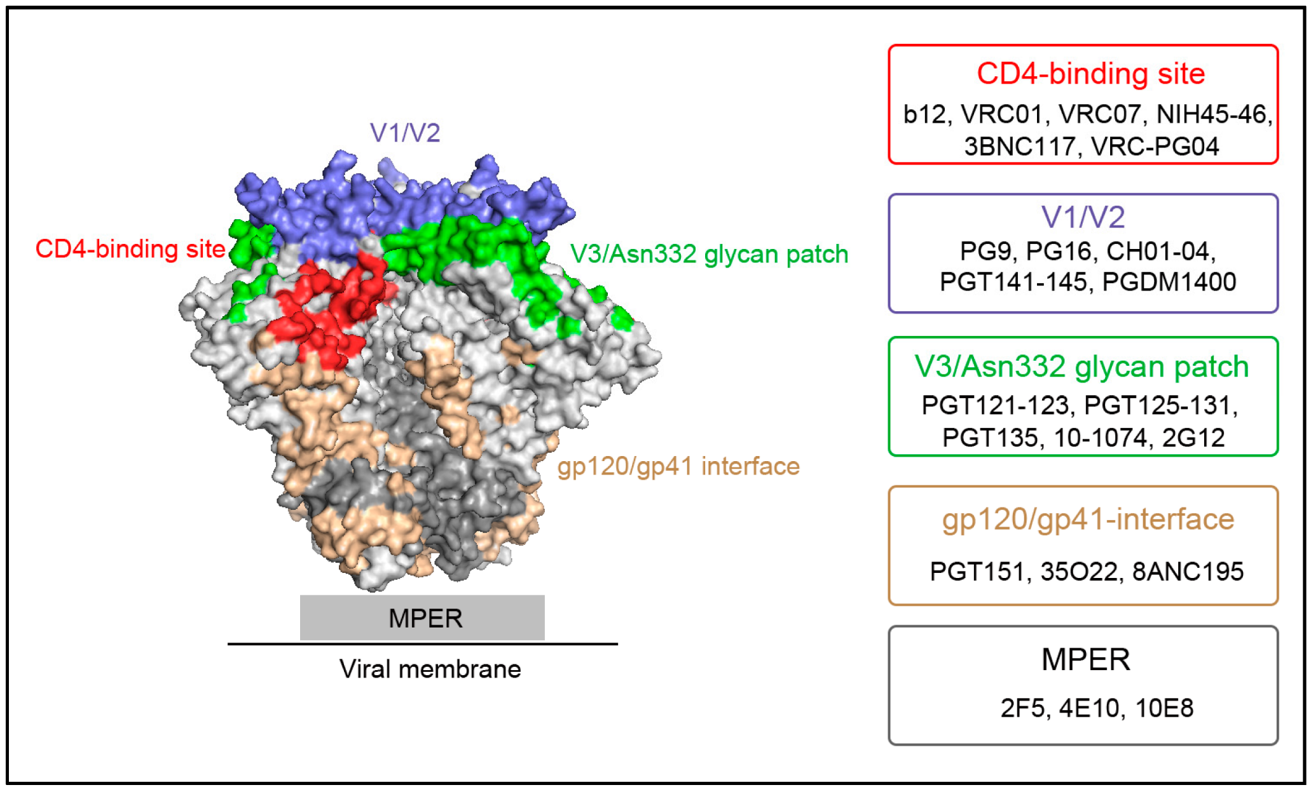
Broadly Neutralizing Antibodies against HIV
Slide courtesy of Pablo Tebas, MD

Slide 28
Future Combinations and Approaches in the works
Long acting cabotegravir and a broadly neutralizing antibodies
  A5357: A single arm trial of long-acting cabotegravir and VRC07LS (a broadly neutralizing antibody; bNAb) as maintenance ART
  A5364: A single arm trial of two bNAbs (3BNC117-LS & 10-1074-LS) to prevent relapse of viremia of discontinuation of oral ART
  A5377, a first-in-human Phase 1 clinical trial of a tri-specific monoclonal antibody (SAR441236) to establish safety, pharmacokinetics, and preliminary antiviral activity
Ongoing Phase 1 study combined with GS-5423 (AKA 3BNC117-LS) in people with virologic suppression

Slide 29
Investigational Approaches with recently approved agents: Long Acting Cabotegravir and Rilpivirine
Long acting cabotegravir and rilpivirine approved for use in patients with viral suppression and no prior resistance in an every 4 week dosing schedule in US and Canada. January 21, 2021. (approved for q8 in EU)
Approved in both an oral formulation cabotegravir 30 mg and rilpivirine and in the sustained release injection to be initiated after an oral lead in.
ATLAS 2M compared 4 week with 8 week dosing in people who were suppressed on 4 week dosing or suppressed on ART outside the trial
  Week 96 follow-up (CROI 2021) HIV RNA during q 8 week (91% < 50 copies) non-inferior to q 4 week dosing (90% < 50 copies/ml)
  Very few grade 3 ISR- rates decreased over time

Slide 30

ACTG 5359
A Phase III Randomized-Control Trial to Evaluate Long-Acting Antiretroviral Therapy in Non-adherent HIV-Infected Individuals
Co- Chairs: Aadia Rana, Jose Castillo-Mancilla Co- Vice Chairs: Raphael J. Landovitz, Karen Tashima
Utilizes cash incentives to help obtain viral suppression followed by use of long acting Cabotegravir
Study Population:
ART-experienced, HIV-infected males and non-pregnant females ≥18 years of age with:
      HIV-1 RNA >200 copies/mL
      Evidence of non-adherence according to at least one of the following criteria:
        Poor virologic response within 18 months prior to entry in individuals who have been prescribed ART for at least 6 consecutive months.
        Loss to clinical follow-up within 18 months prior to study entry with ART non-adherence for ≥6 consecutive months.
      No evidence of any clinically relevant RPV or INSTI resistance-associated mutations (historically or upon screening).
      Ability of site clinician, in conjunction with participant, to construct a ≥3-drug ART regimen with ≥2 drugs predicted to be fully active, including a boosted PI/cobi and/or an INSTI.
Notes:
Anticipated to open later this summer, domestic

Slide 31
Summary
New drugs with novel mechanisms of action and less frequent dosing are progressing in development.
  Islatravir
  Lenacapravir
  GSK’254
Use of approved combination of long acting cabotegravir/rilpivirine slowly being rolled out
  Investigational approaches with q 8 week dosing, combination with other agents and use in populations that have struggled with adherence in progress.

Slide 32
Question-and-Answer Session

