Slide 1


Slide 2
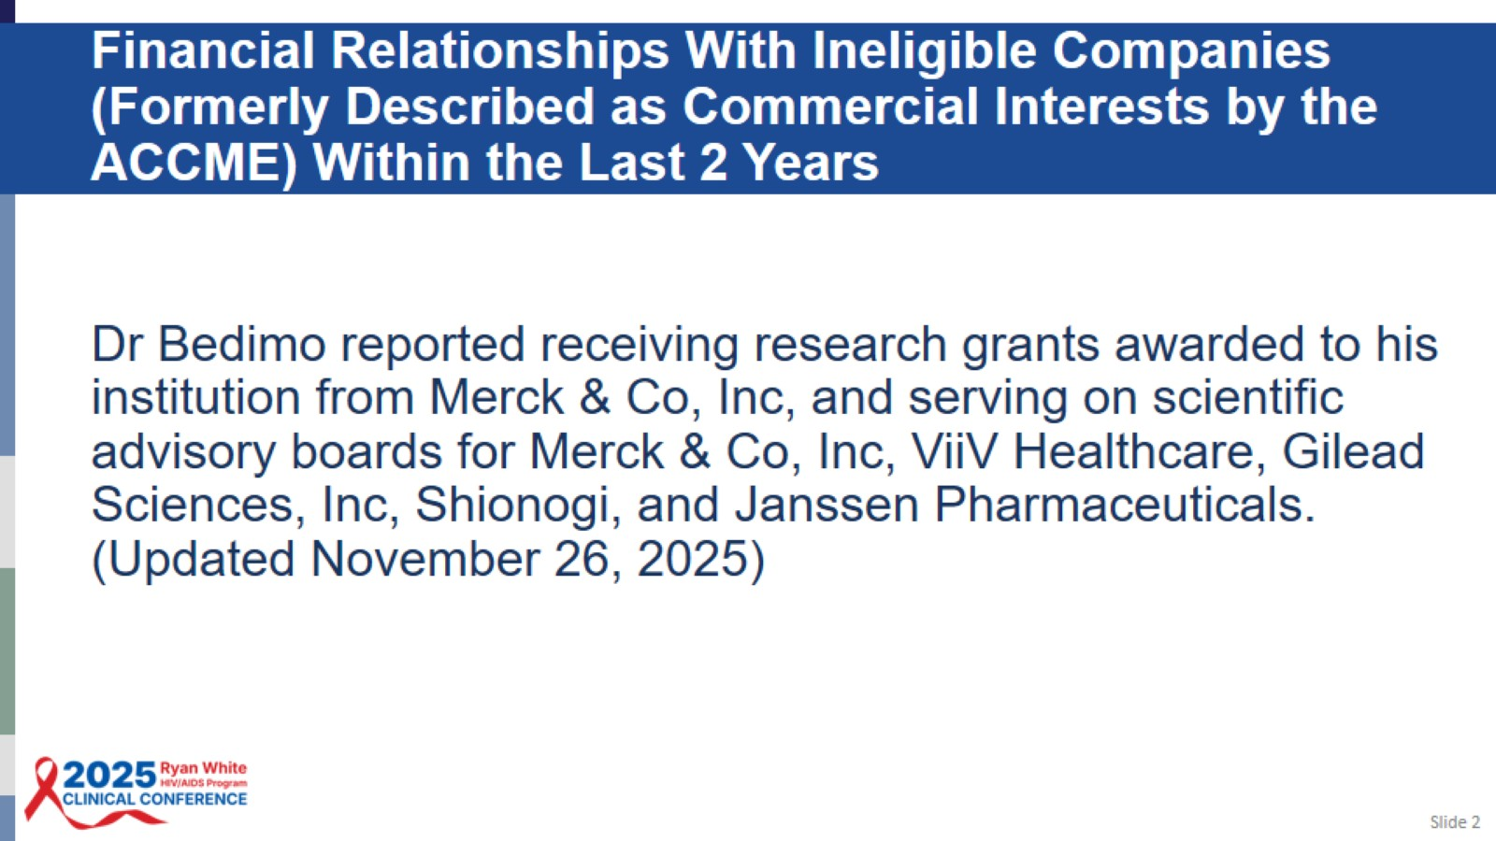
Financial Relationships With Ineligible Companies (Formerly Described as Commercial Interests by the ACCME) Within the Last 2 Years

Slide 3
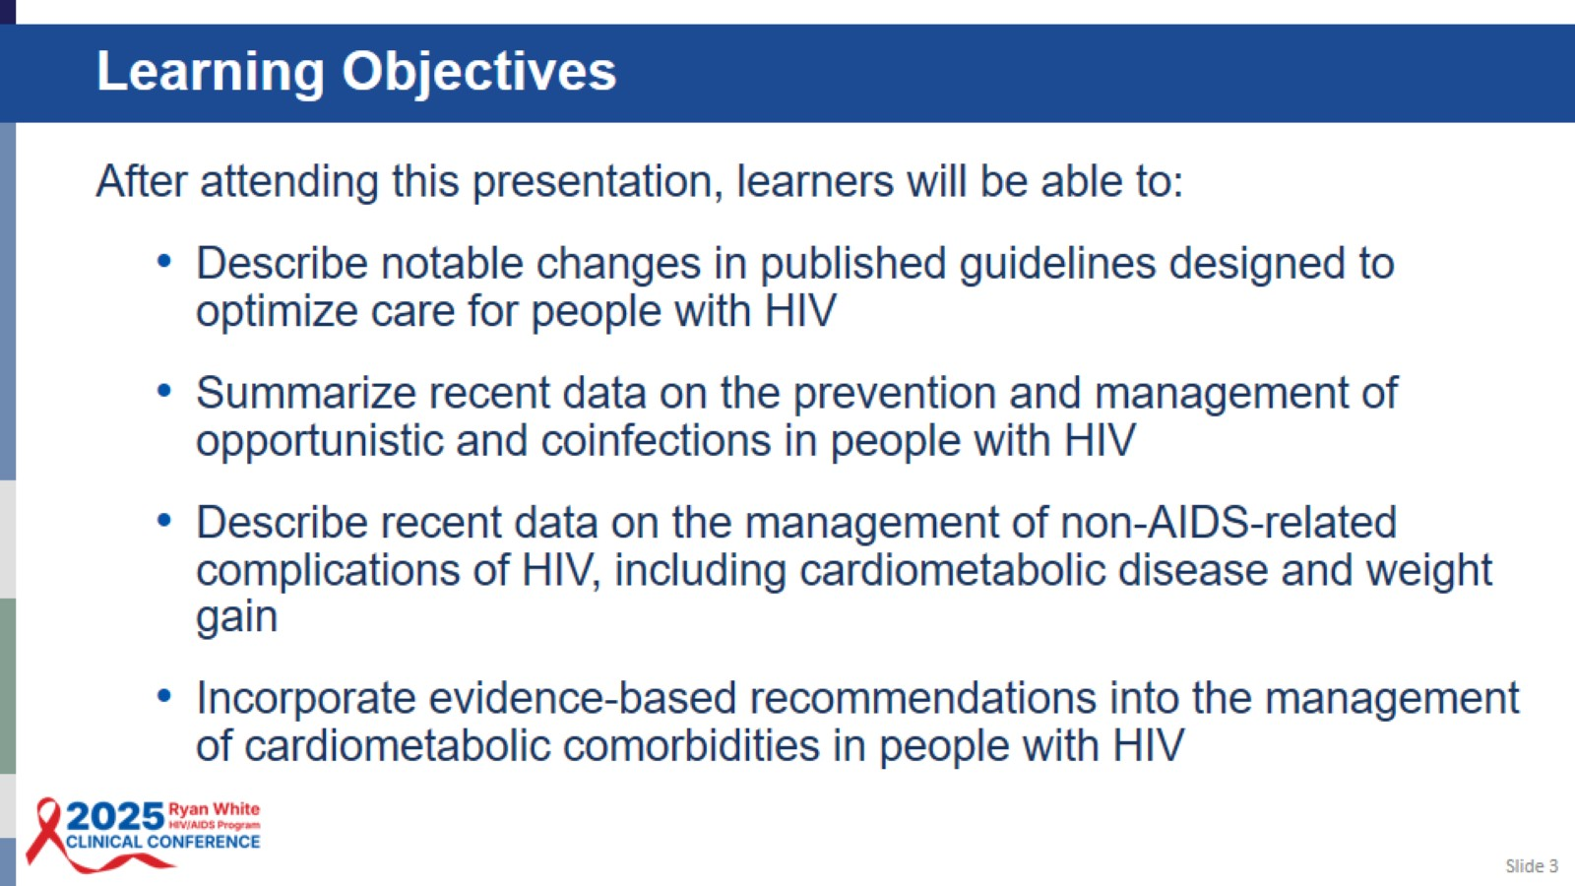
Learning Objectives

Slide 4
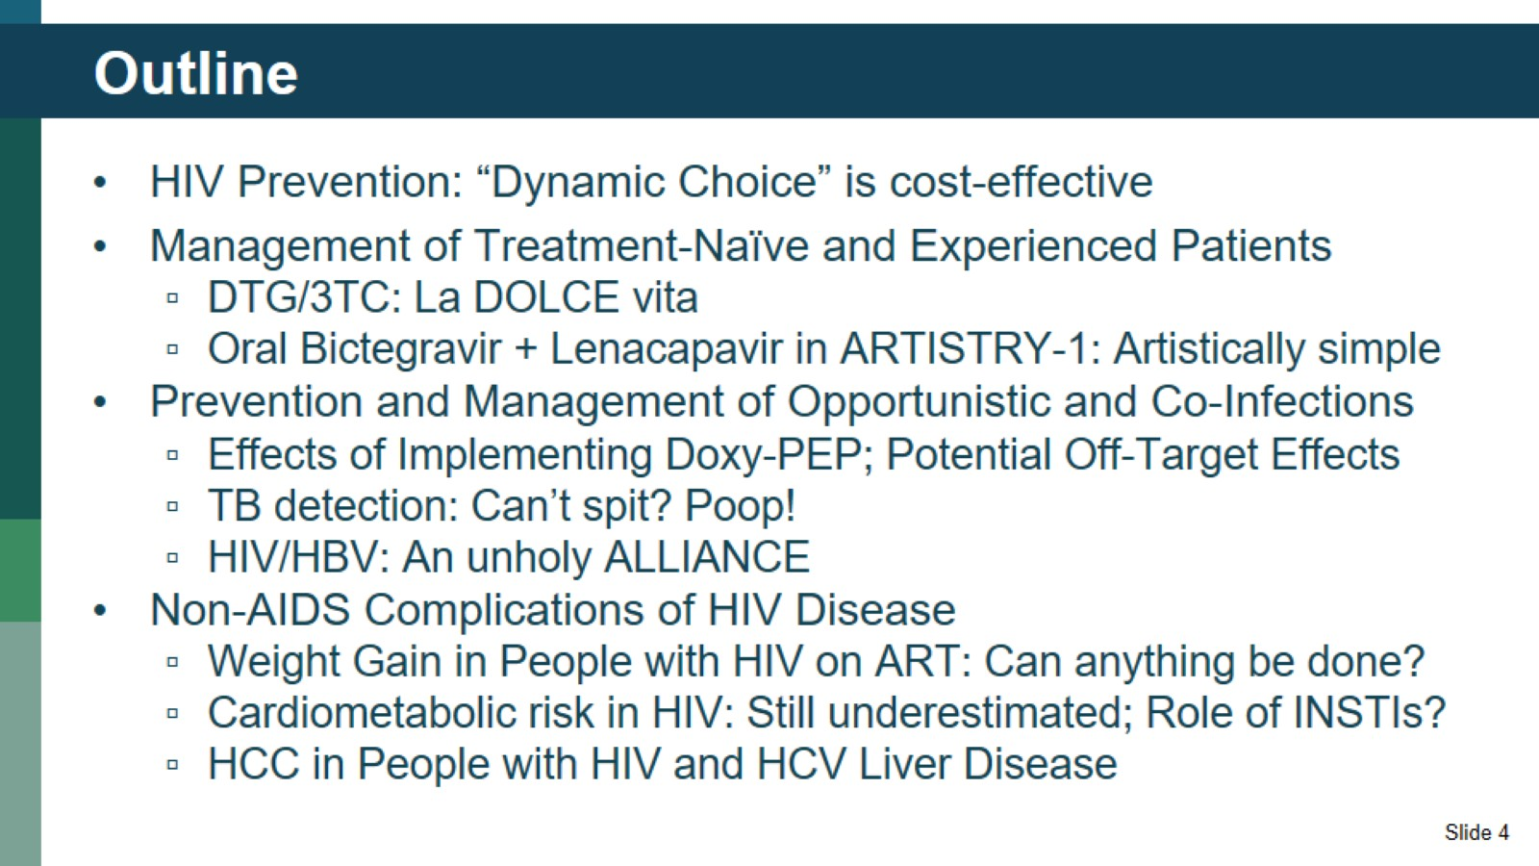
Outline

Slide 5
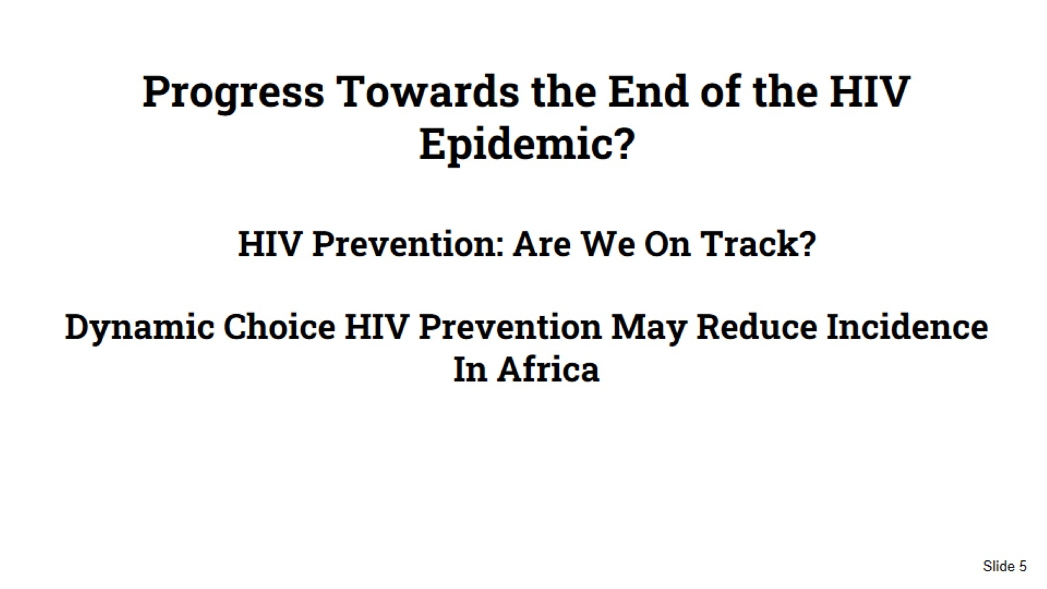
Progress Towards the End of the HIV Epidemic?
HIV Prevention: Are We On Track?
Dynamic Choice HIV Prevention May Reduce Incidence In Africa

Slide 6
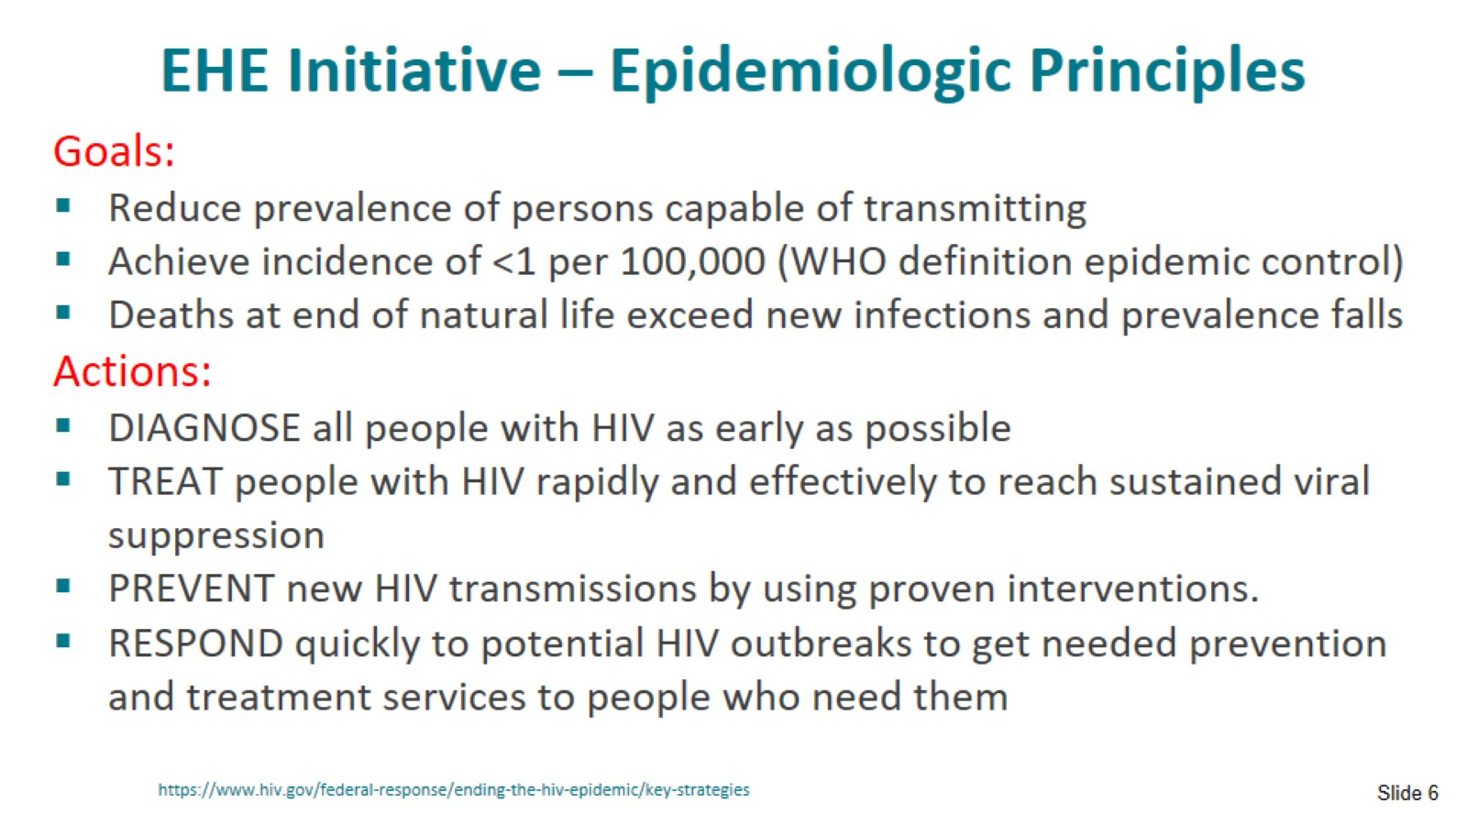
EHE Initiative – Epidemiologic Principles

Slide 7
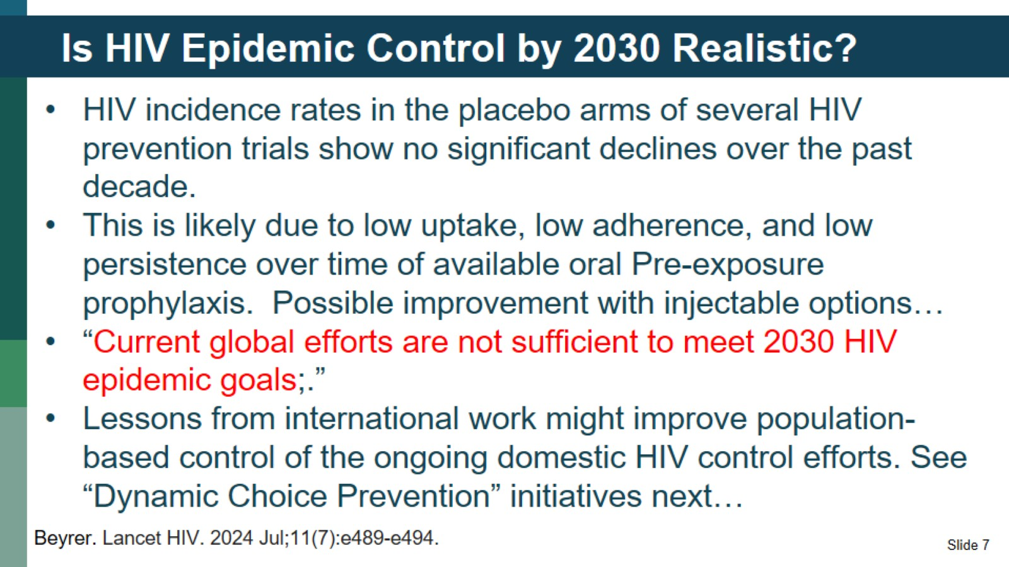
Is HIV Epidemic Control by 2030 Realistic?

Slide 8
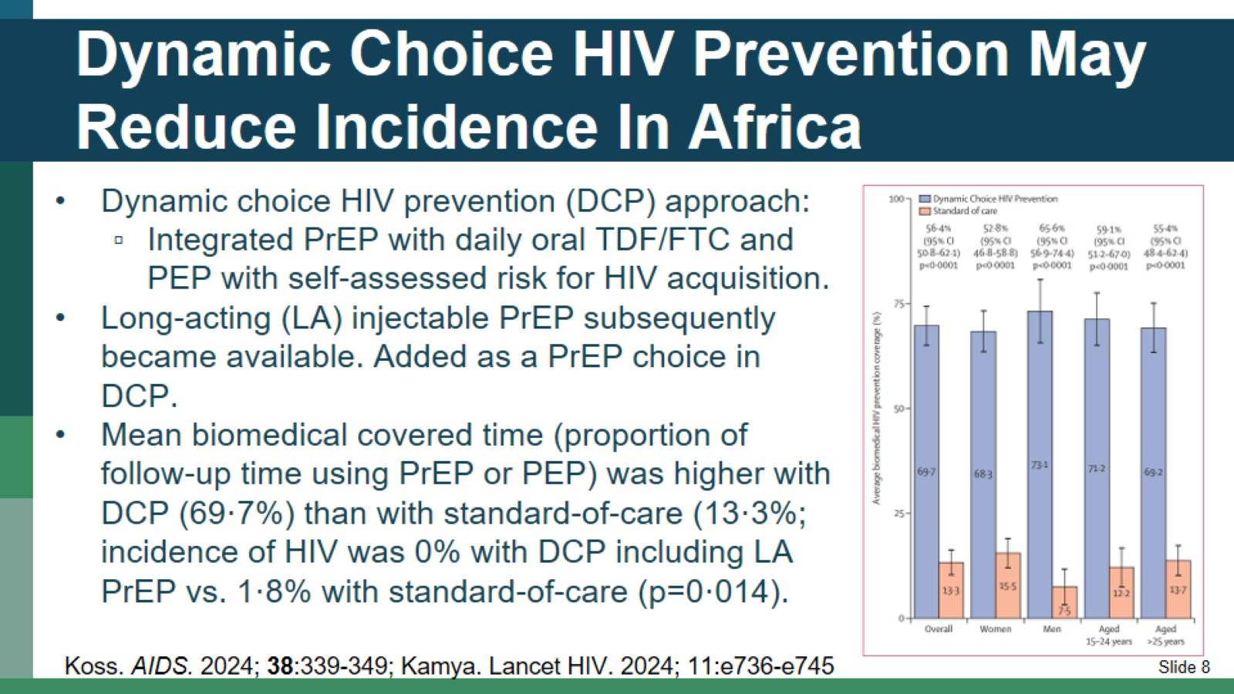
Dynamic Choice HIV Prevention May Reduce Incidence In Africa

Slide 9
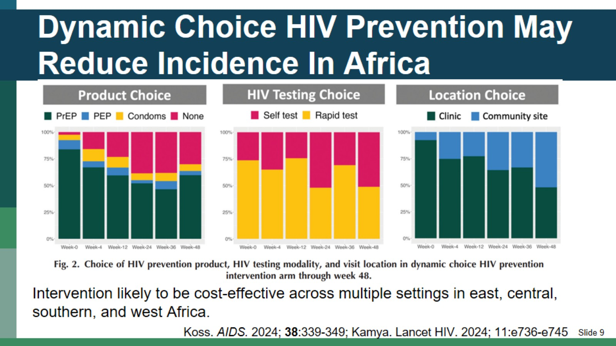
Dynamic Choice HIV Prevention May Reduce Incidence In Africa

Slide 10
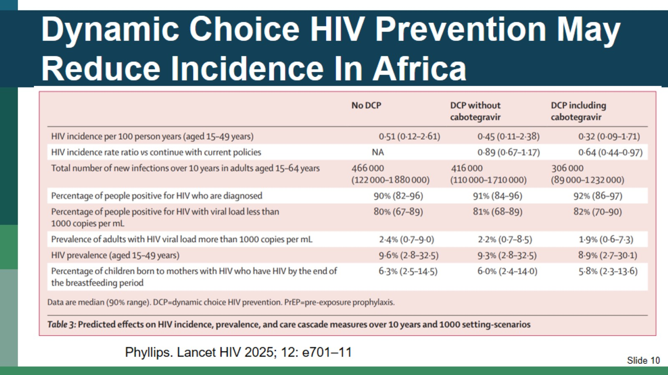
Dynamic Choice HIV Prevention May Reduce Incidence In Africa

Slide 11
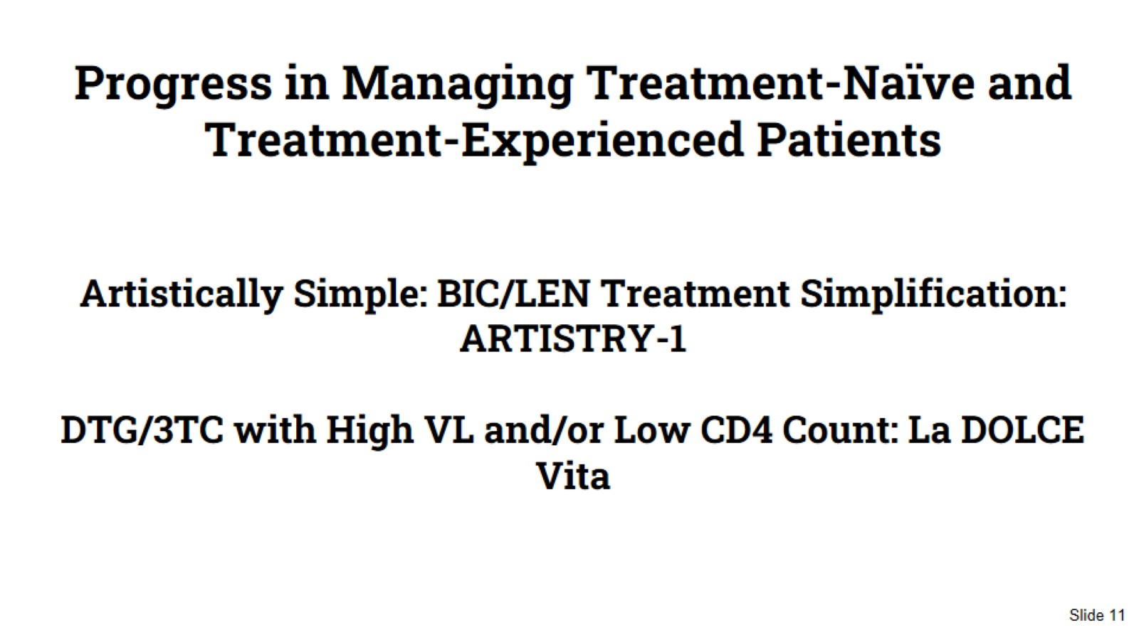
Progress in Managing Treatment-Naïve and Treatment-Experienced Patients
Artistically Simple: BIC/LEN Treatment Simplification: ARTISTRY-1
DTG/3TC with High VL and/or Low CD4 Count: La DOLCE Vita

Slide 12
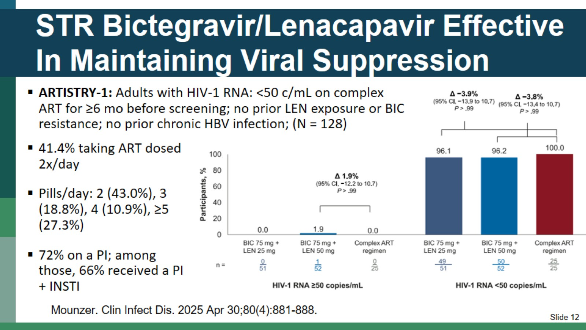
STR Bictegravir/Lenacapavir Effective In Maintaining Viral Suppression

Slide 13
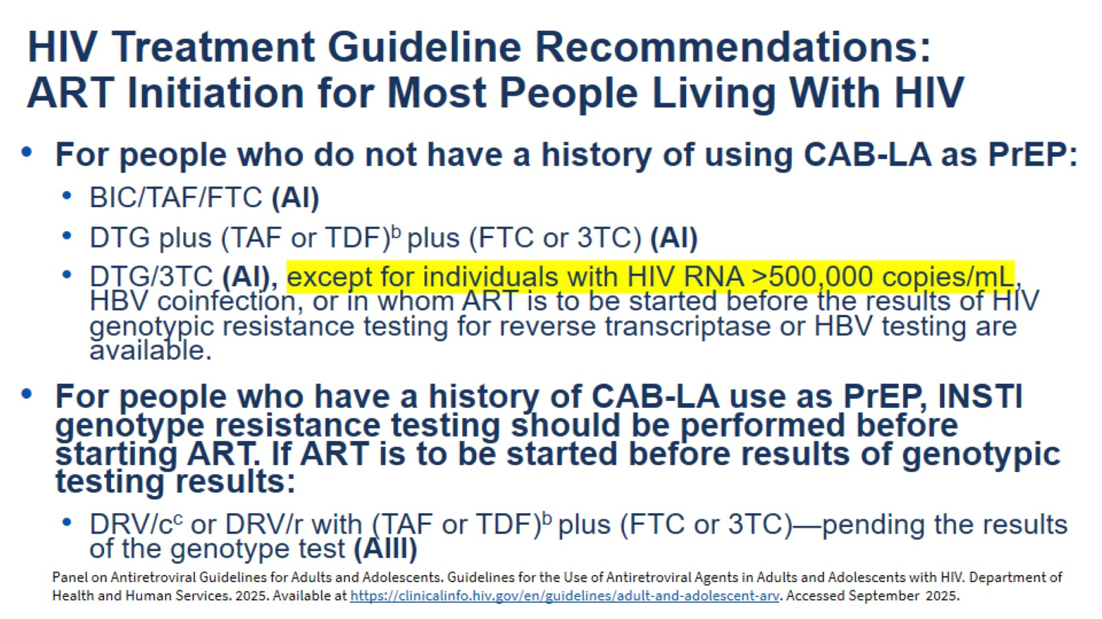
HIV Treatment Guideline Recommendations:
ART Initiation for Most People Living With HIV

Slide 14
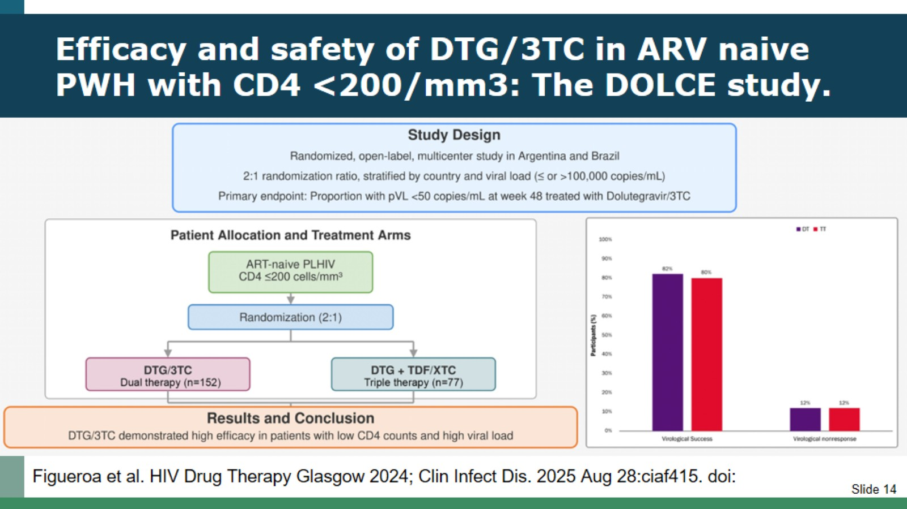
Efficacy and safety of DTG/3TC in ARV naive PWH with CD4 <200/mm3: The DOLCE study.

Slide 15
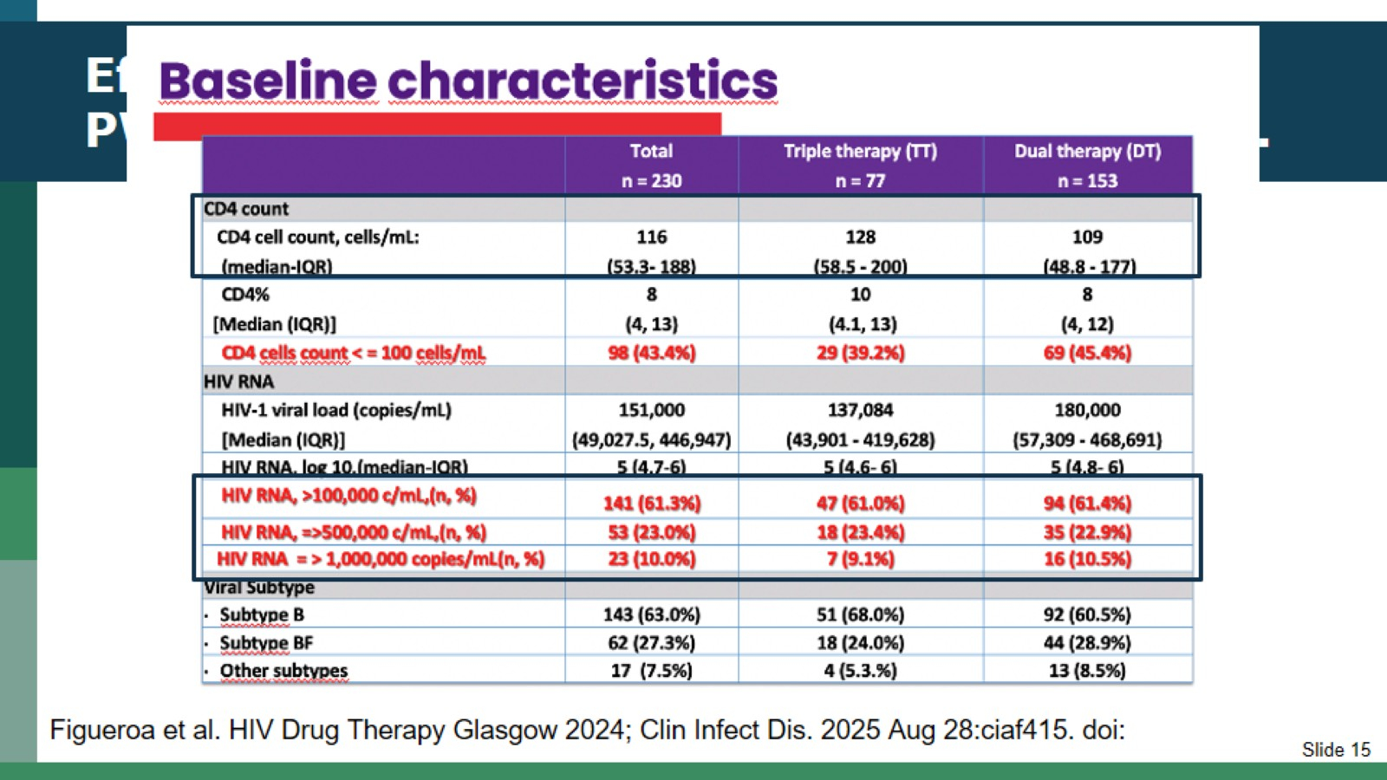
Efficacy and safety of DTG/3TC in ARV naive PWH with CD4 <200/mm3: The DOLCE study.

Slide 16
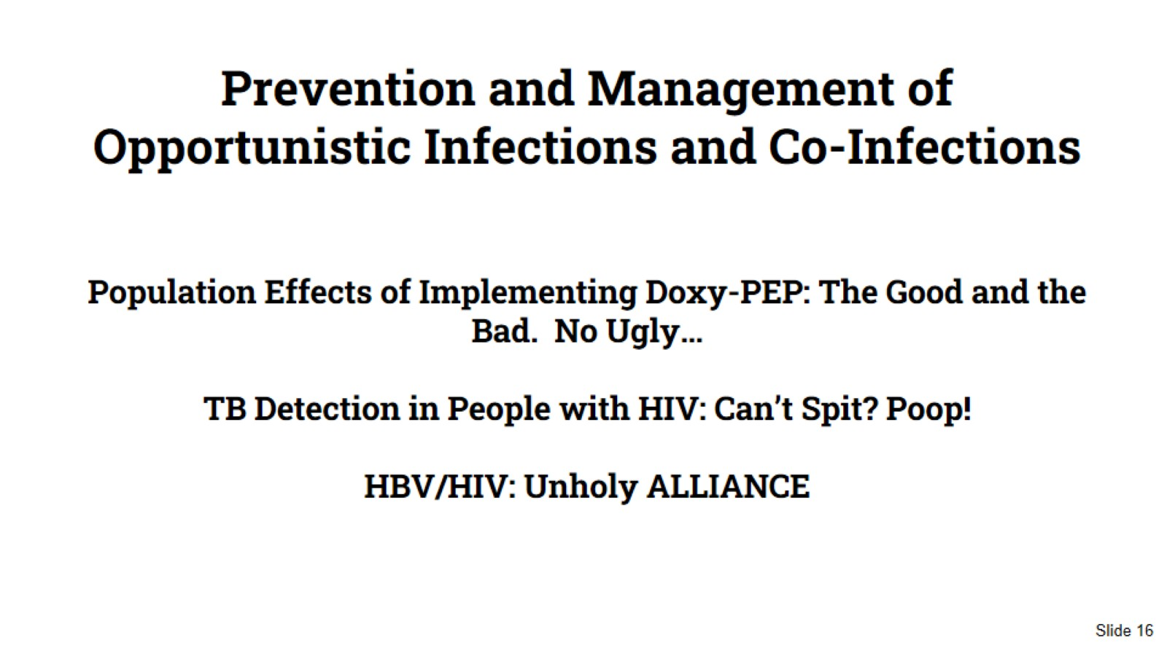
Prevention and Management of Opportunistic Infections and Co-Infections
Population Effects of Implementing Doxy-PEP: The Good and the Bad. No Ugly…
TB Detection in People with HIV: Can’t Spit? Poop!
HBV/HIV: Unholy ALLIANCE

Slide 17
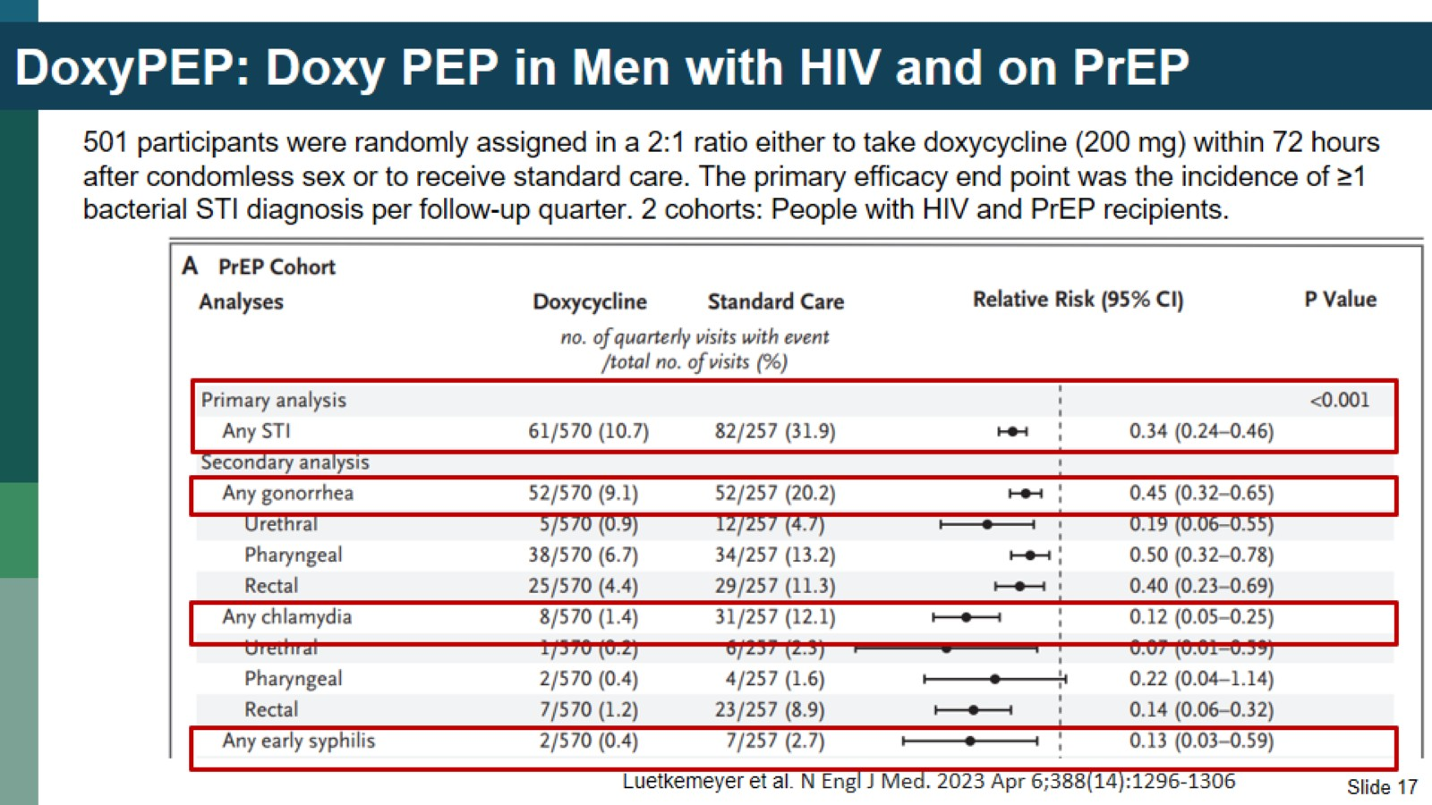
DoxyPEP: Doxy PEP in Men with HIV and on PrEP

Slide 18
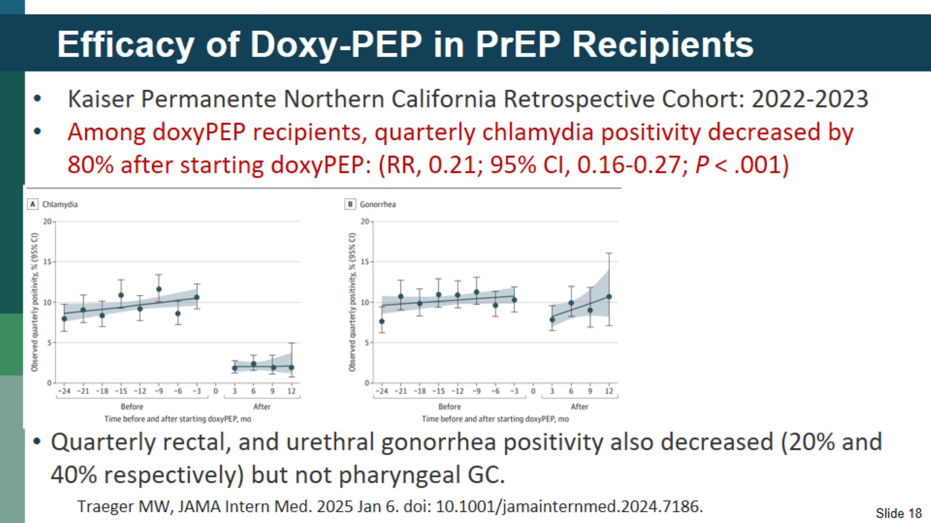
Efficacy of Doxy-PEP in PrEP Recipients

Slide 19
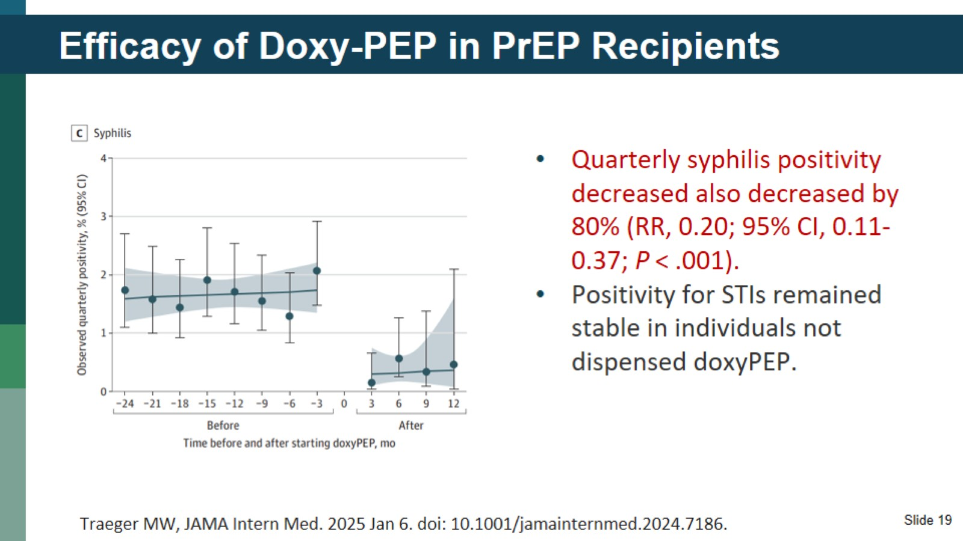
Efficacy of Doxy-PEP in PrEP Recipients

Slide 20
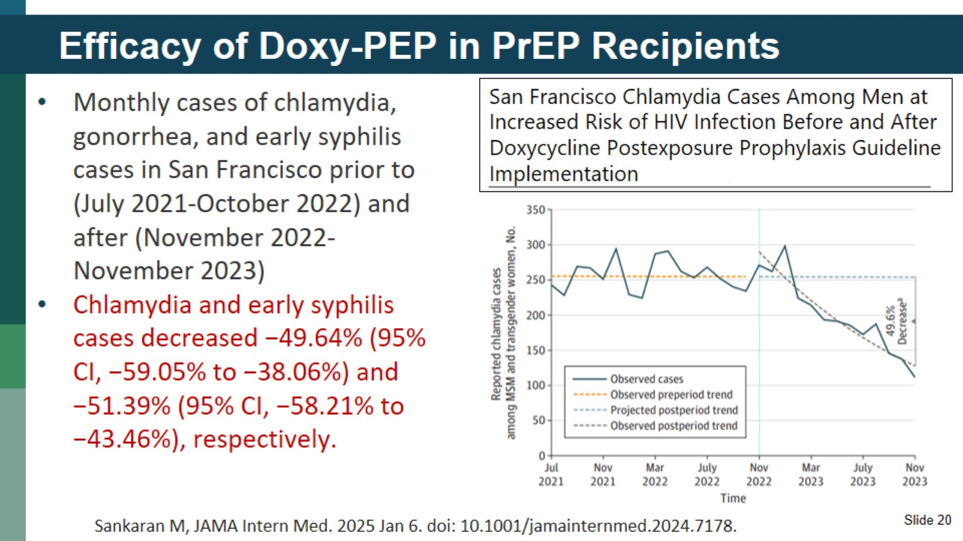
Efficacy of Doxy-PEP in PrEP Recipients

Slide 21
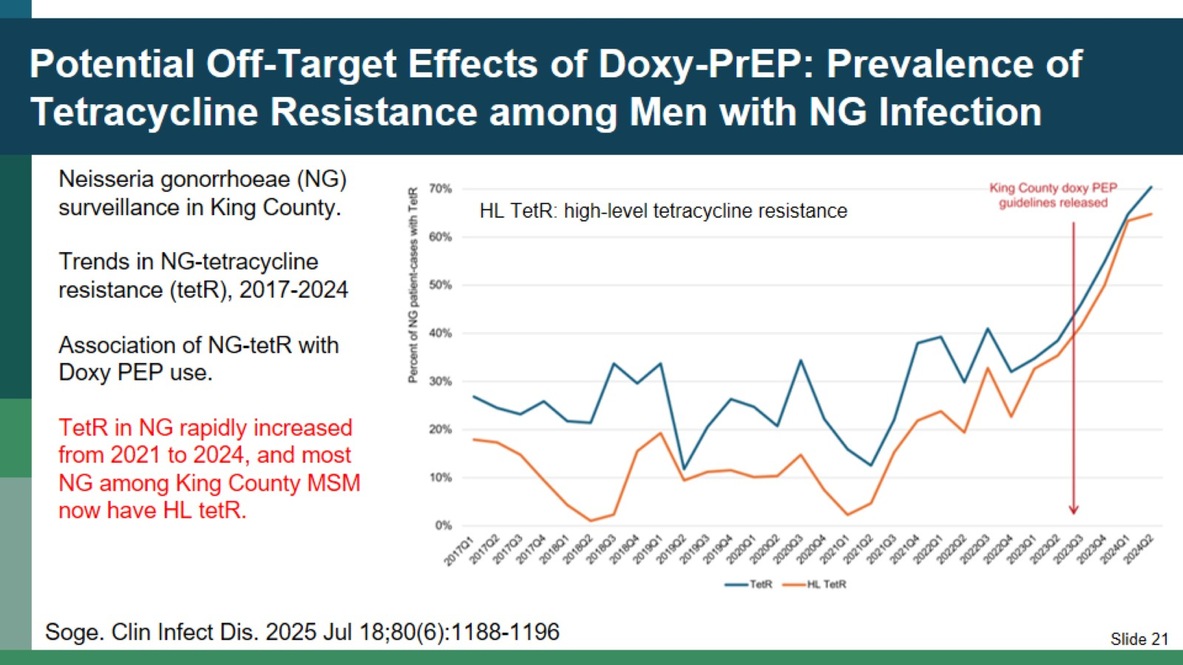
Potential Off-Target Effects of Doxy-PrEP: Prevalence of Tetracycline Resistance among Men with NG Infection

Slide 22
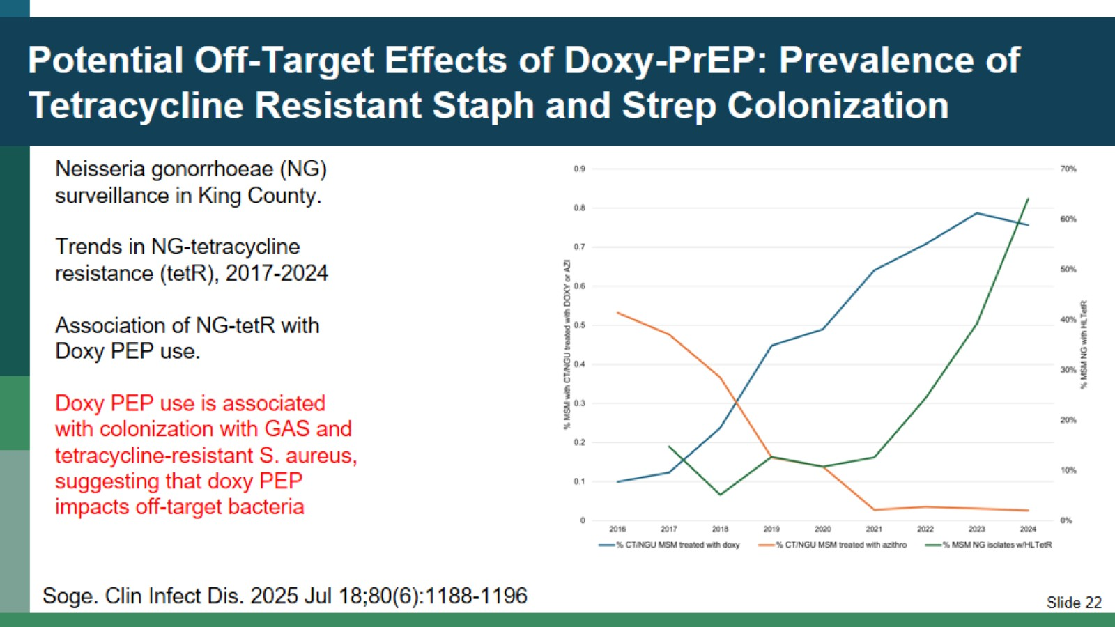
Potential Off-Target Effects of Doxy-PrEP: Prevalence of Tetracycline Resistant Staph and Strep Colonization

Slide 23
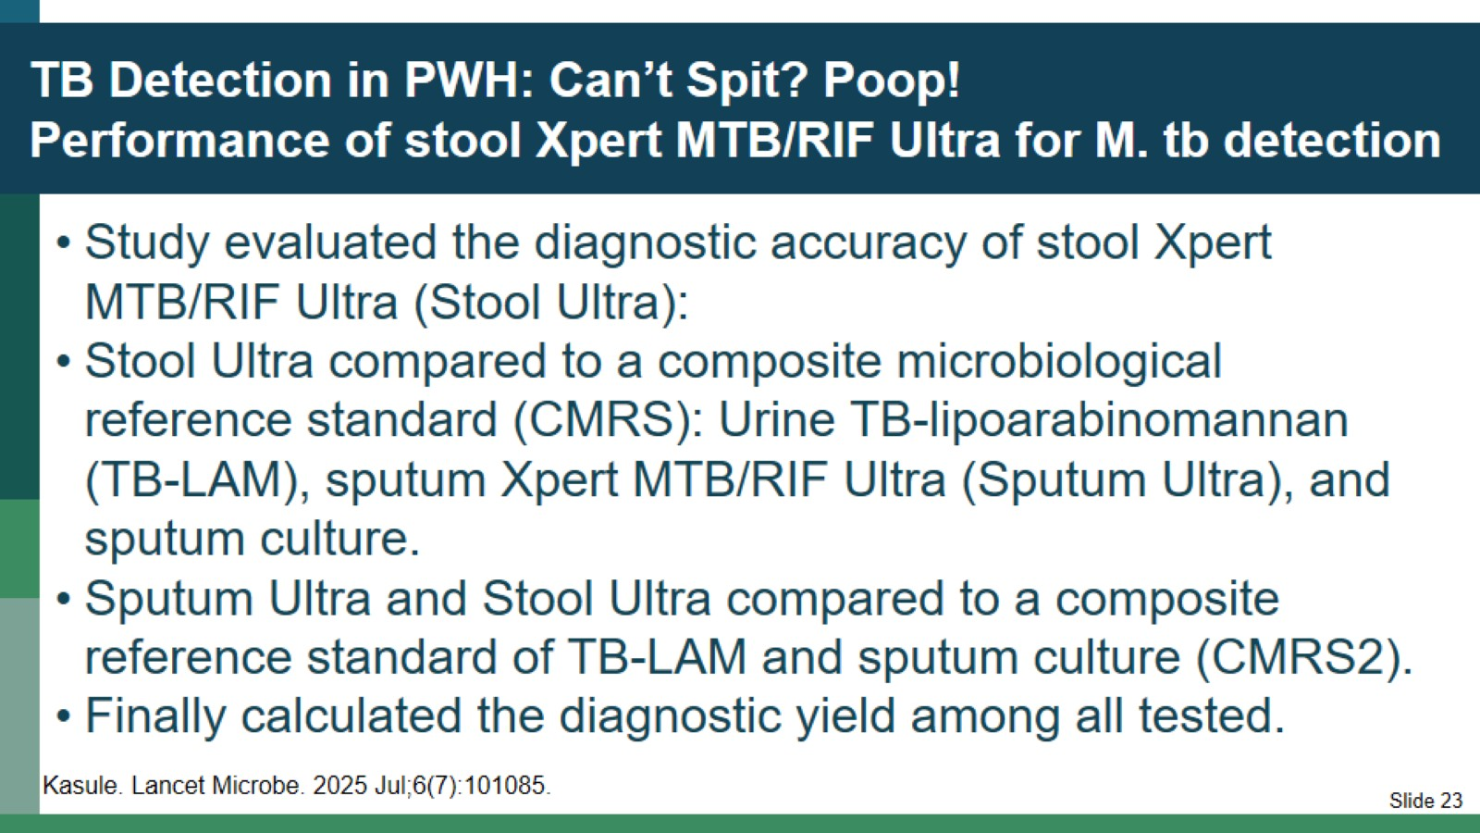
TB Detection in PWH: Can’t Spit? Poop!
Performance of stool Xpert MTB/RIF Ultra for M. tb detection

Slide 24
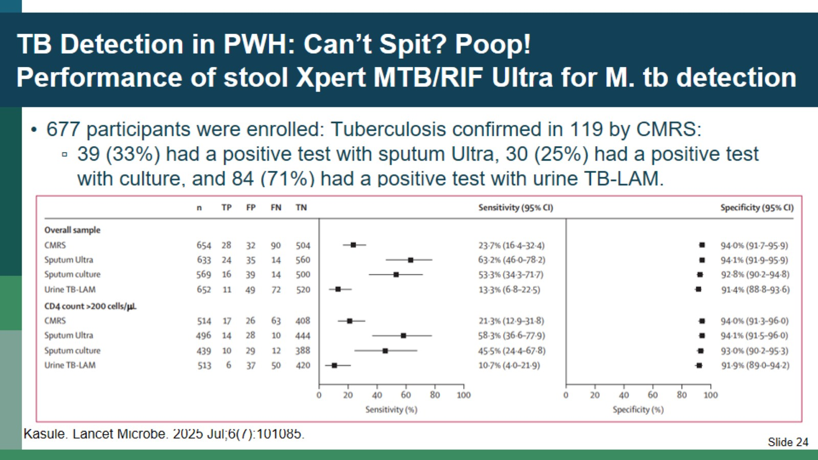
TB Detection in PWH: Can’t Spit? Poop!
Performance of stool Xpert MTB/RIF Ultra for M. tb detection

Slide 25
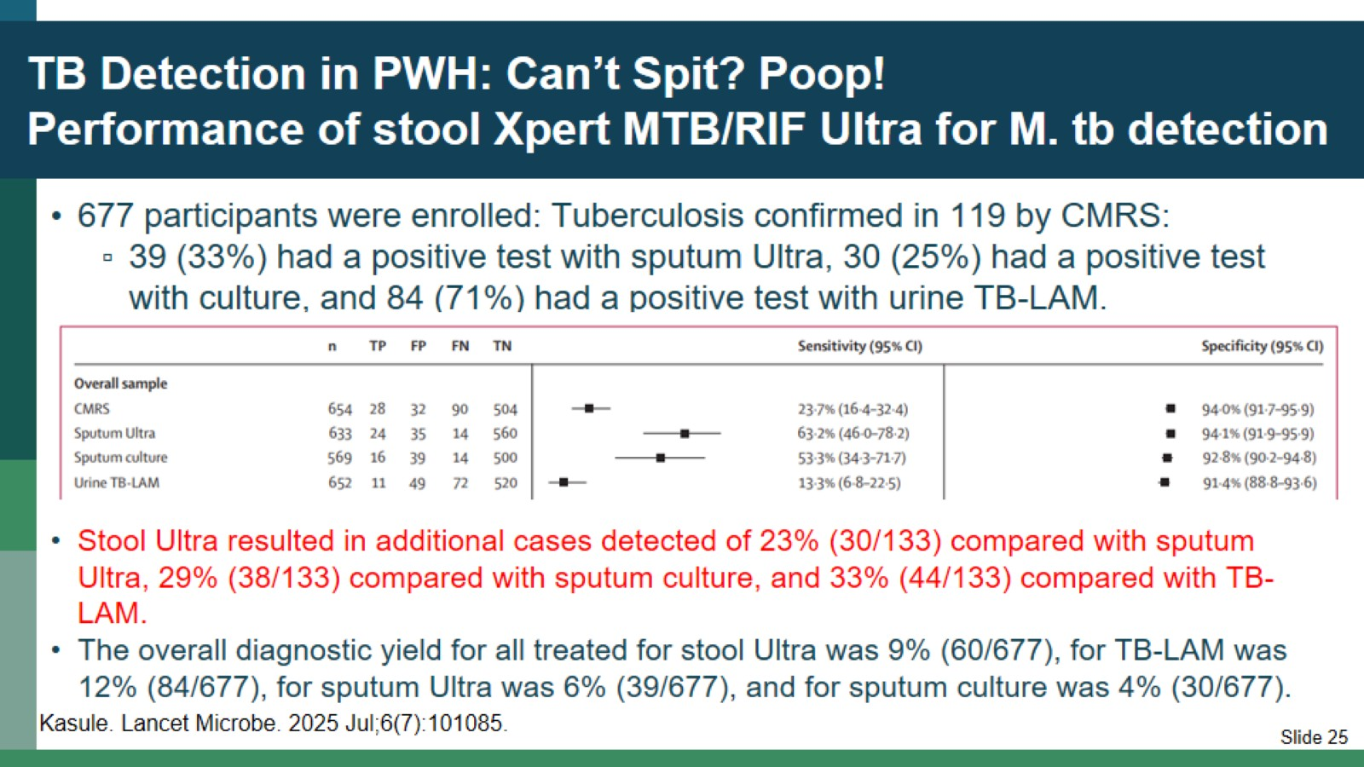
TB Detection in PWH: Can’t Spit? Poop!
Performance of stool Xpert MTB/RIF Ultra for M. tb detection

Slide 26
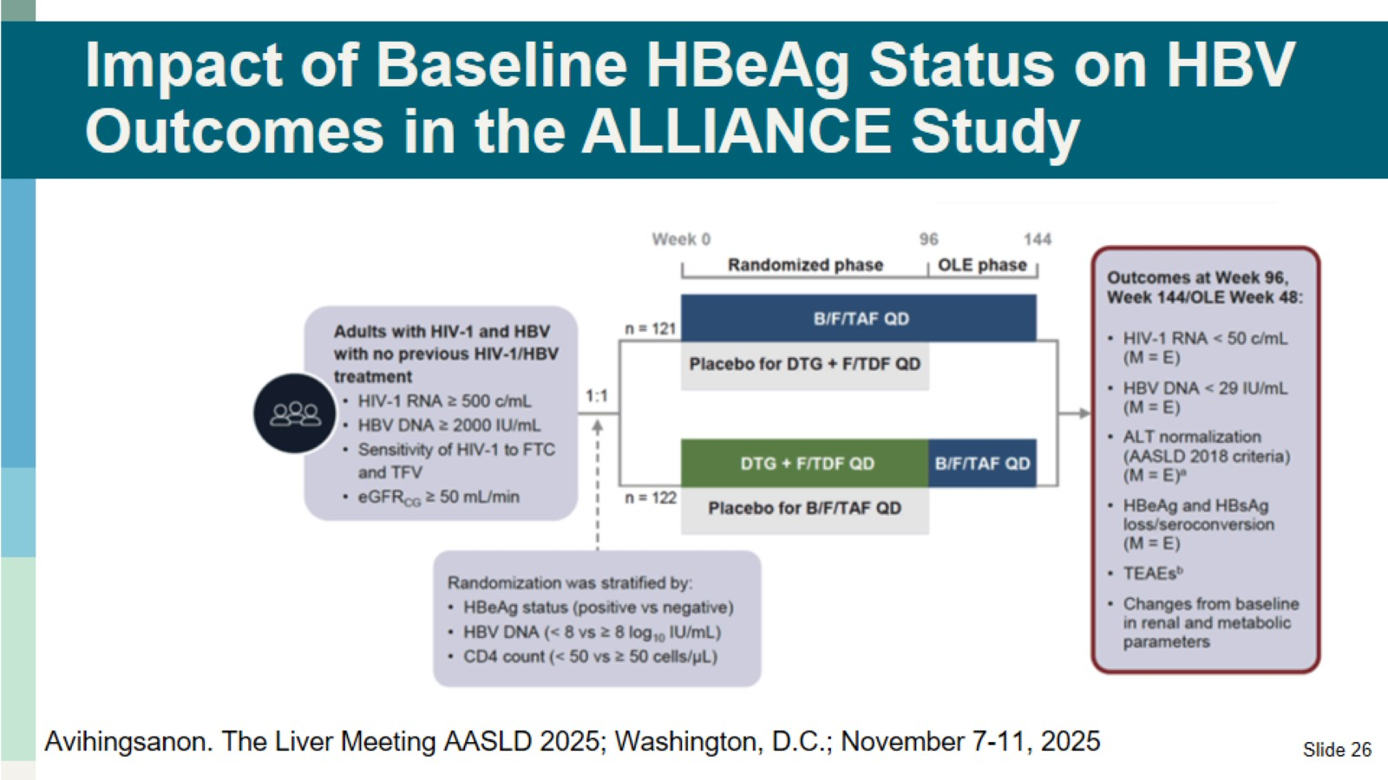
Impact of Baseline HBeAg Status on HBV Outcomes in the ALLIANCE Study

Slide 27
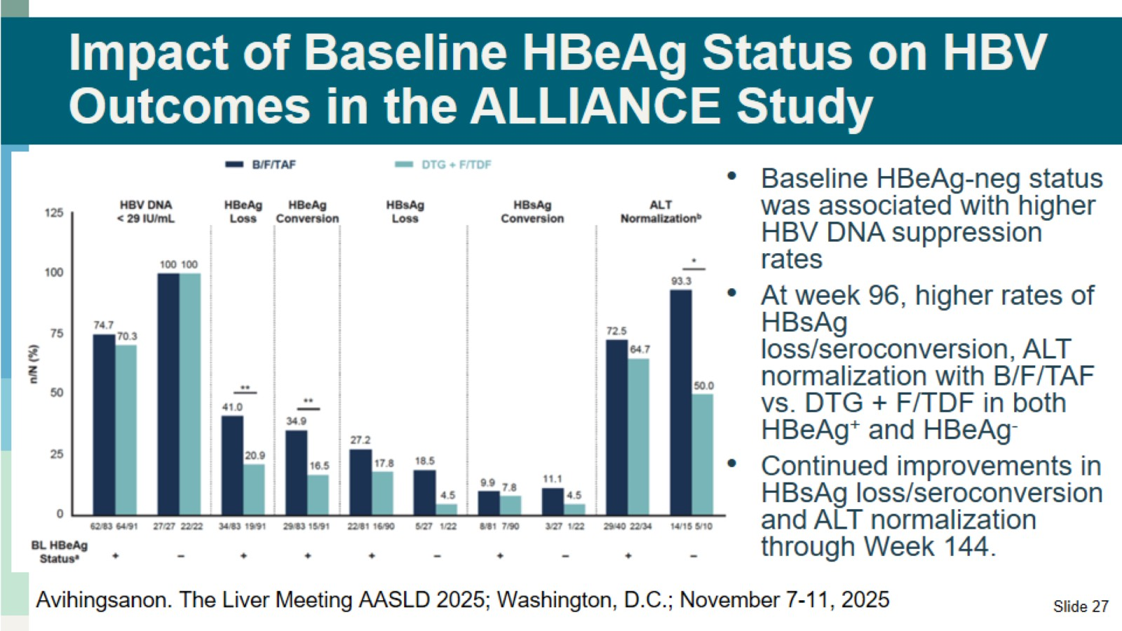
Impact of Baseline HBeAg Status on HBV Outcomes in the ALLIANCE Study

Slide 28
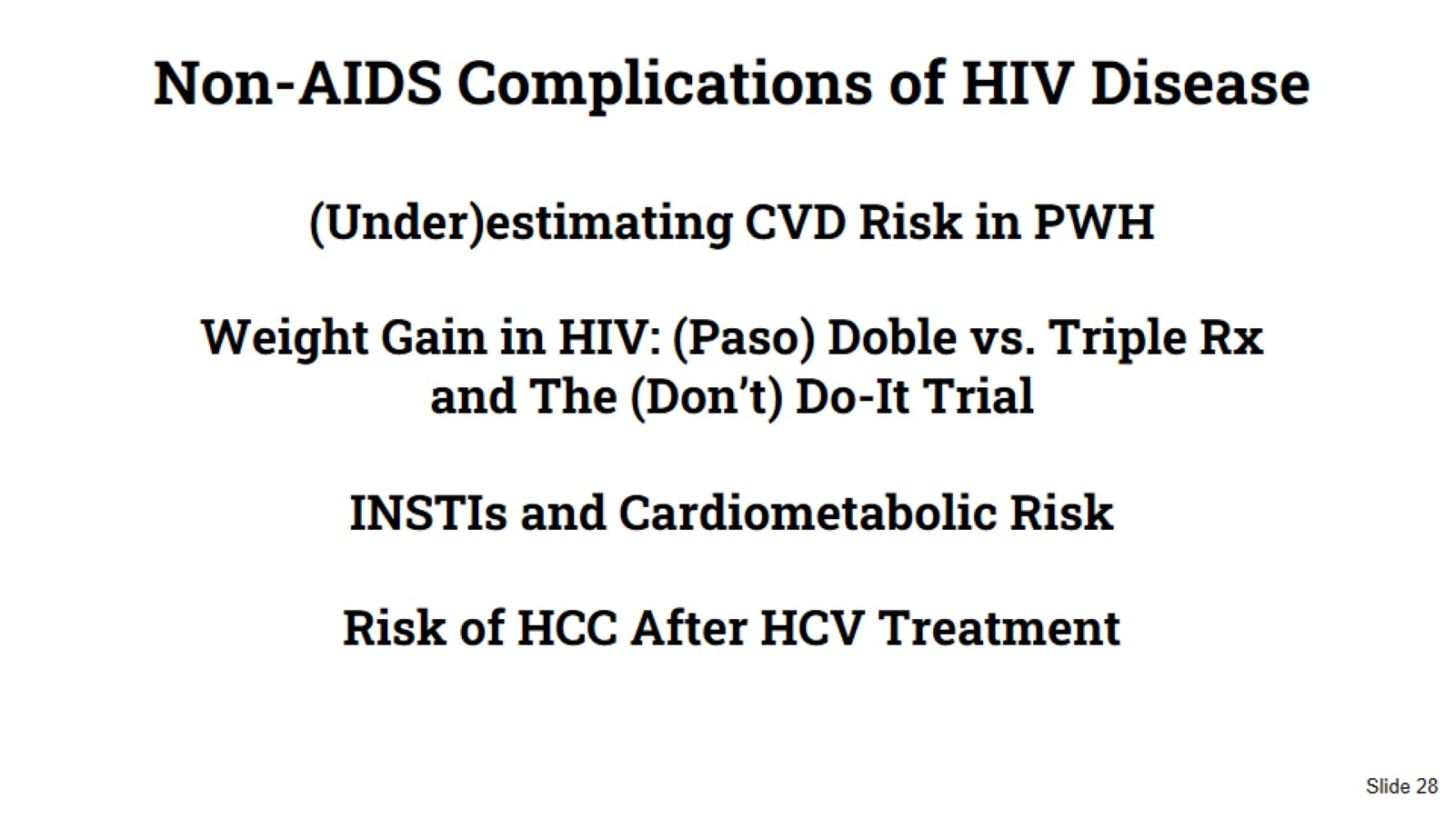
Non-AIDS Complications of HIV Disease
(Under)estimating CVD Risk in PWH
Weight Gain in HIV: (Paso) Doble vs. Triple Rx and The (Don’t) Do-It Trial
INSTIs and Cardiometabolic Risk
Risk of HCC After HCV Treatment

Slide 29
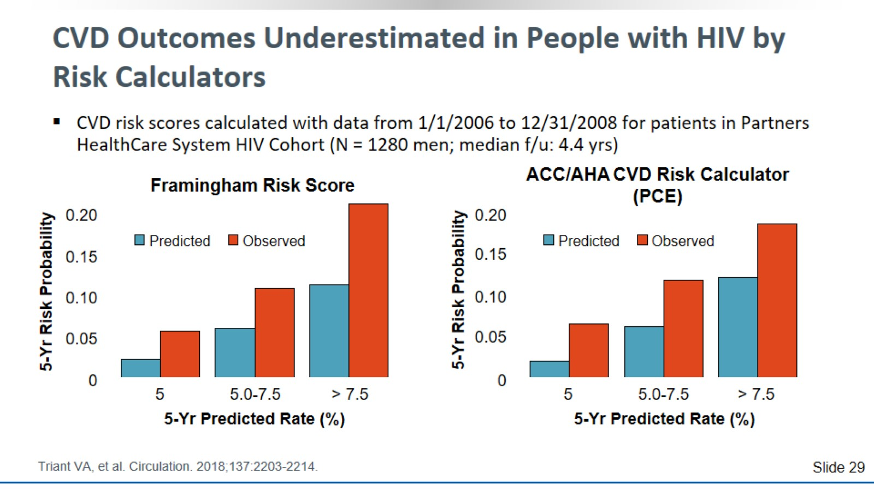
CVD Outcomes Underestimated in People with HIV by Risk Calculators

Slide 30
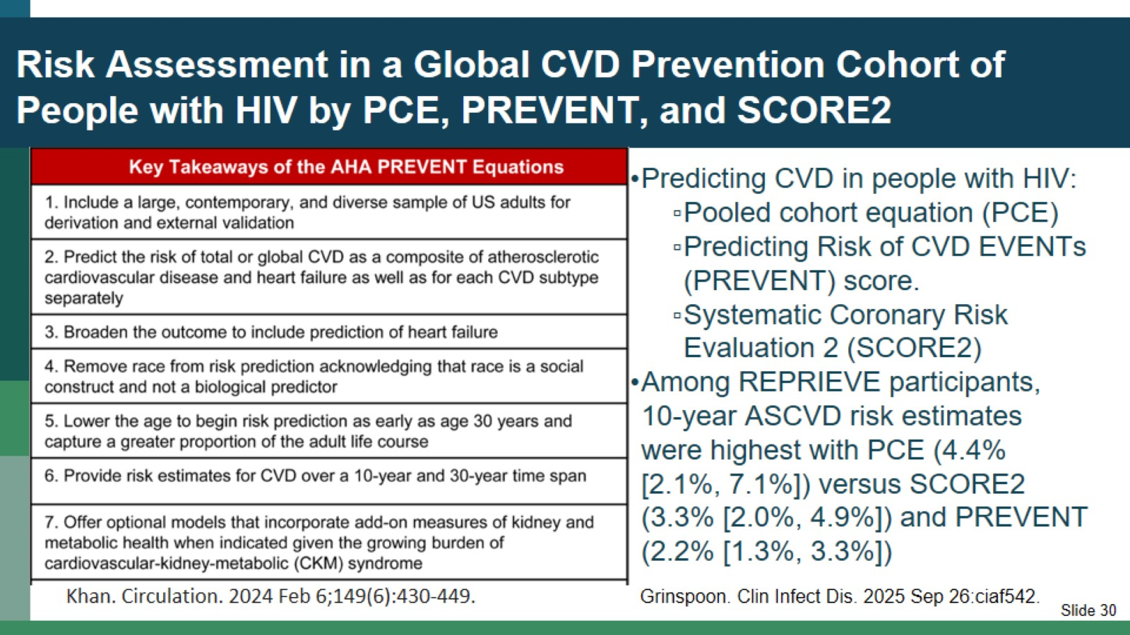
Risk Assessment in a Global CVD Prevention Cohort of People with HIV by PCE, PREVENT, and SCORE2

Slide 31
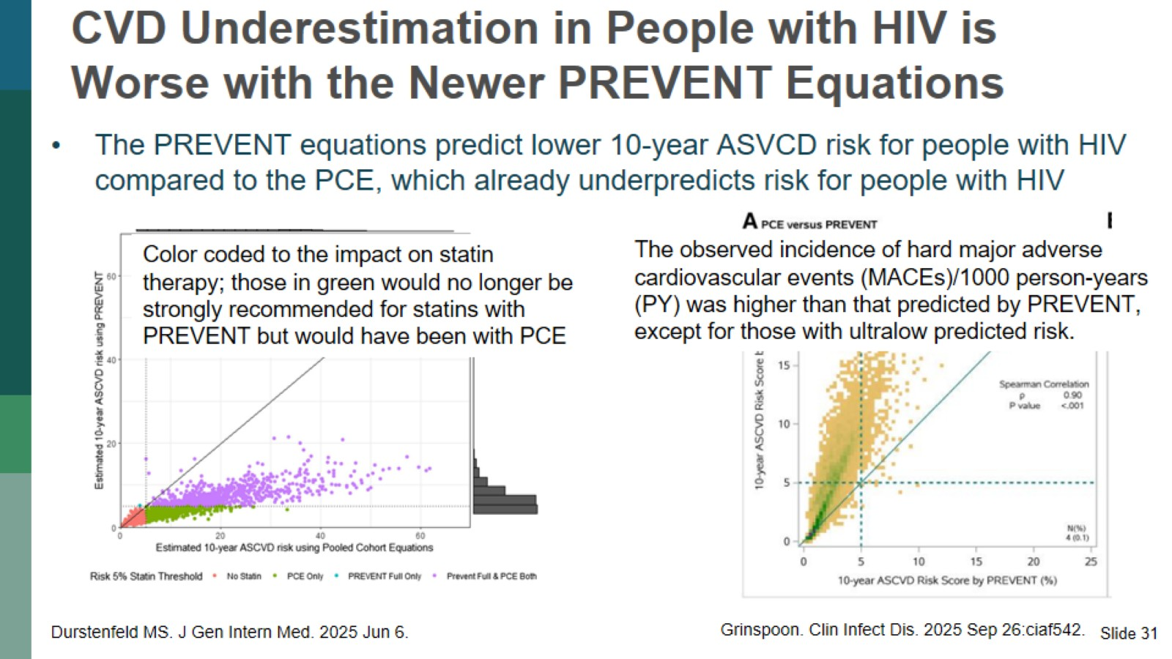
CVD Underestimation in People with HIV is Worse with the Newer PREVENT Equations

Slide 32
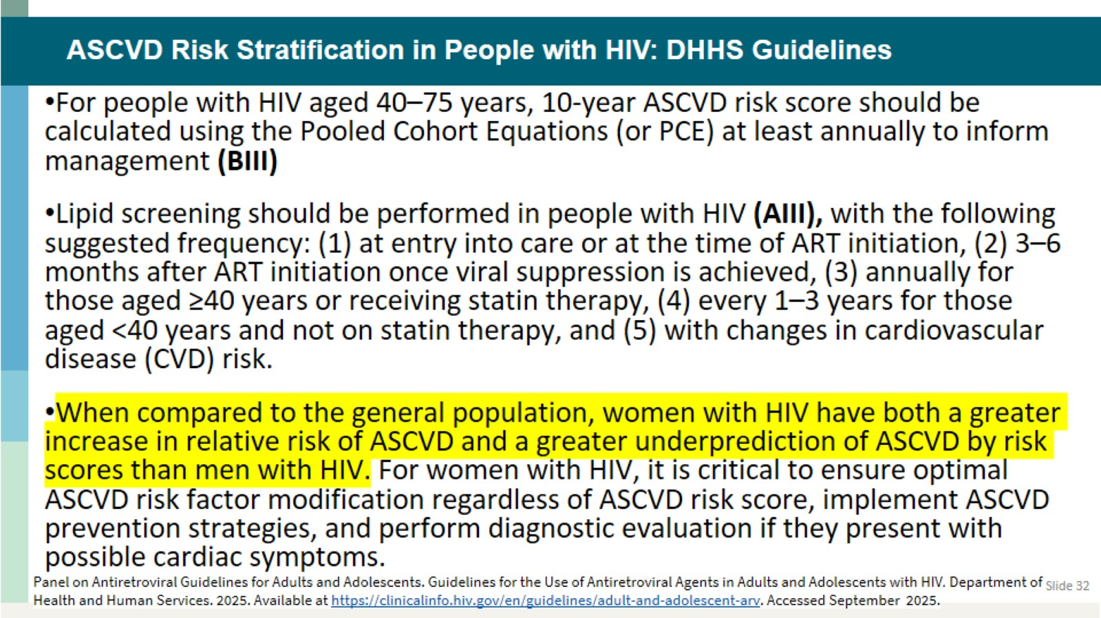
ASCVD Risk Stratification in People with HIV: DHHS Guidelines

Slide 33
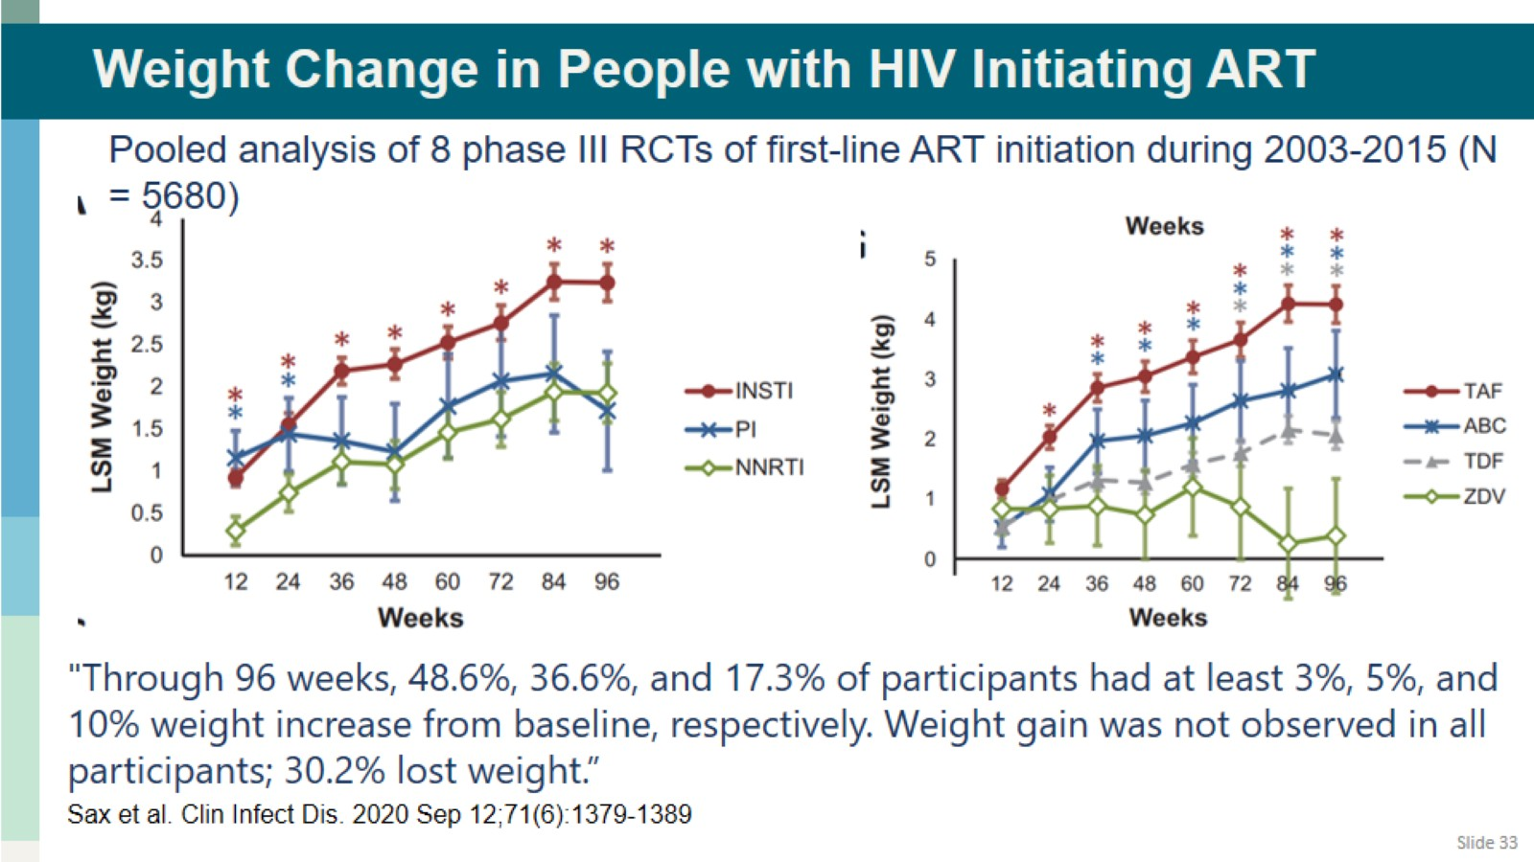
Weight Change in People with HIV Initiating ART

Slide 34
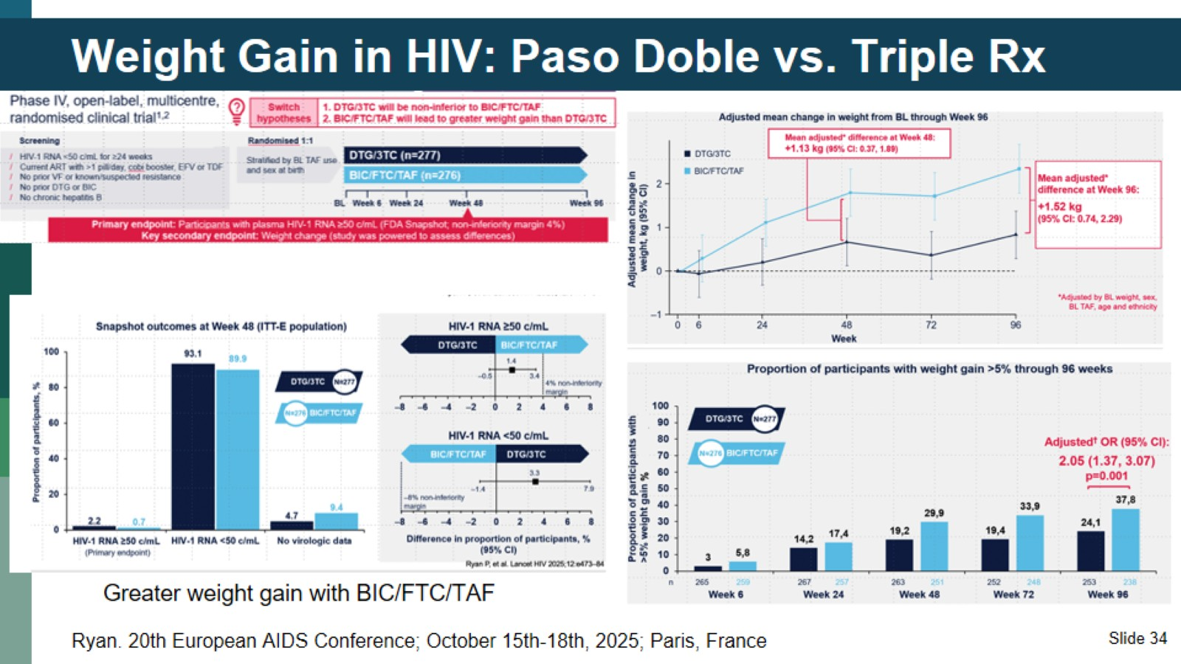
Weight Gain in HIV: Paso Doble vs. Triple Rx

Slide 35
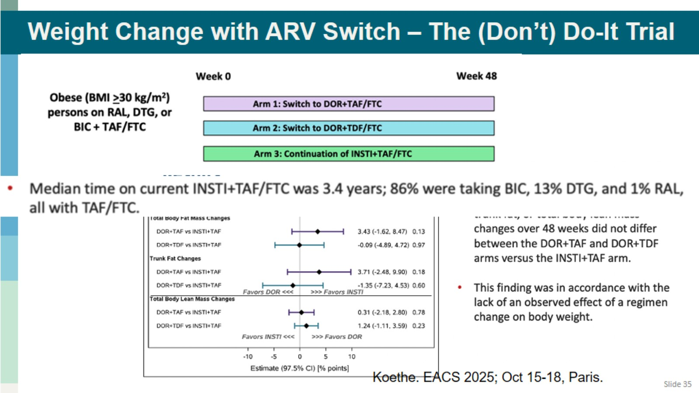
Weight Change with ARV Switch – The (Don’t) Do-It Trial

Slide 36
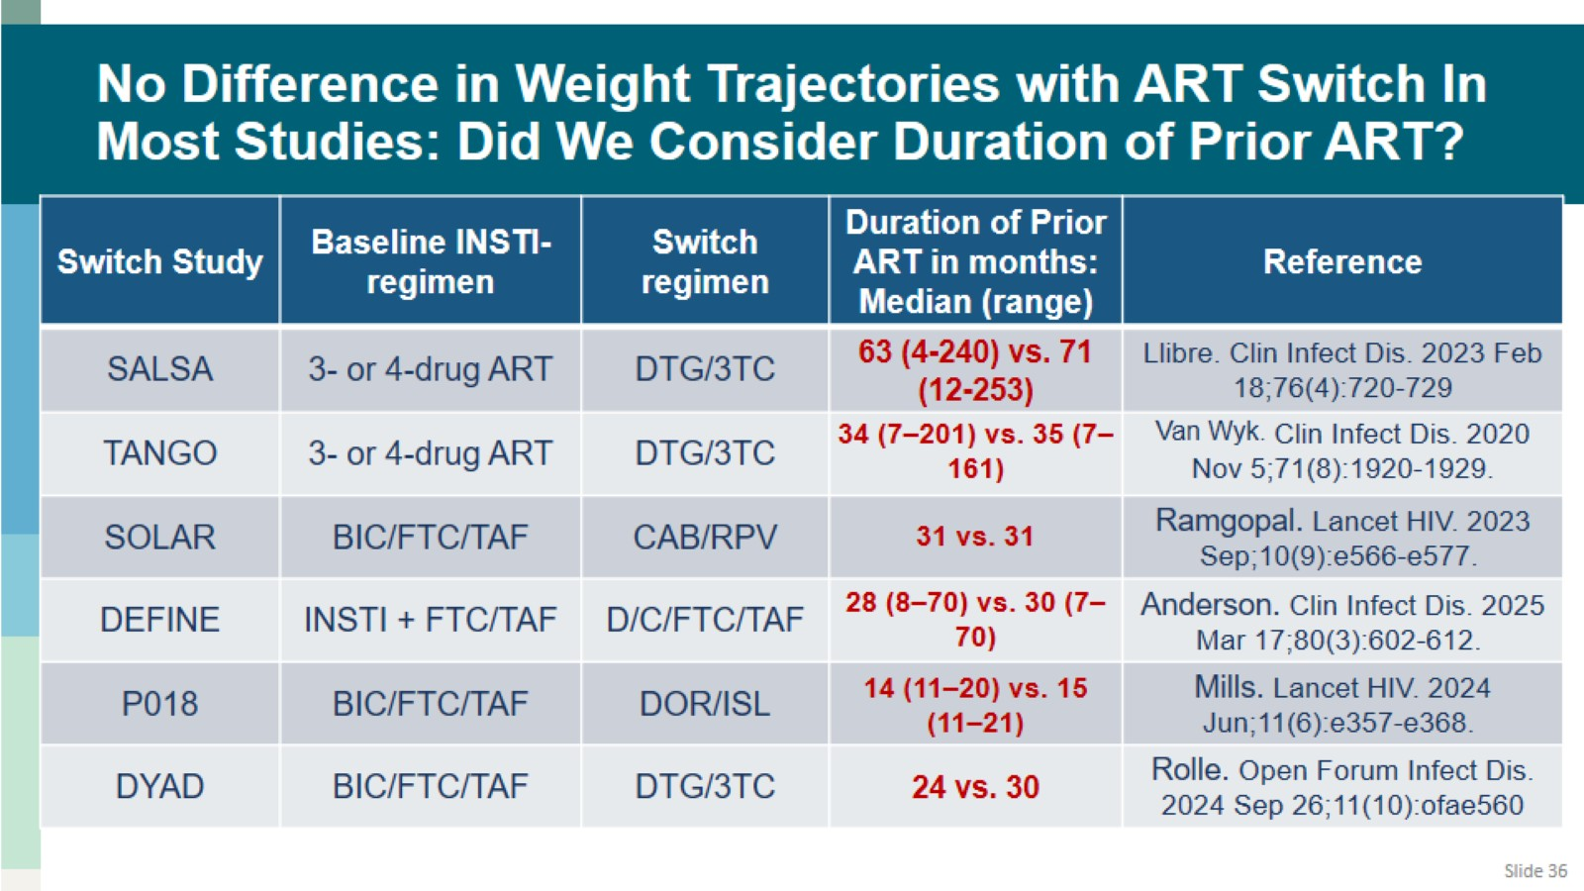
No Difference in Weight Trajectories with ART Switch In Most Studies: Did We Consider Duration of Prior ART?

Slide 37
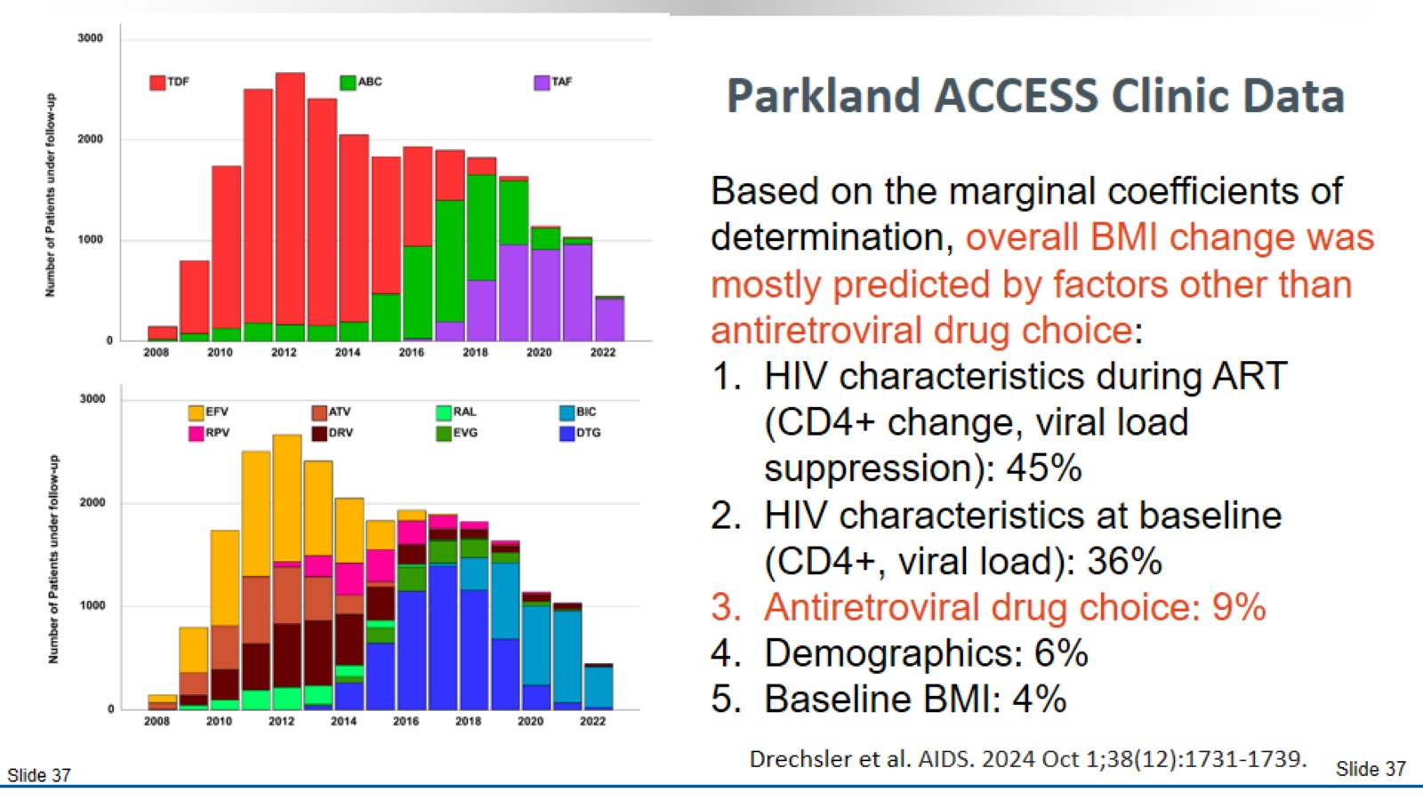
Parkland ACCESS Clinic Data

Slide 38
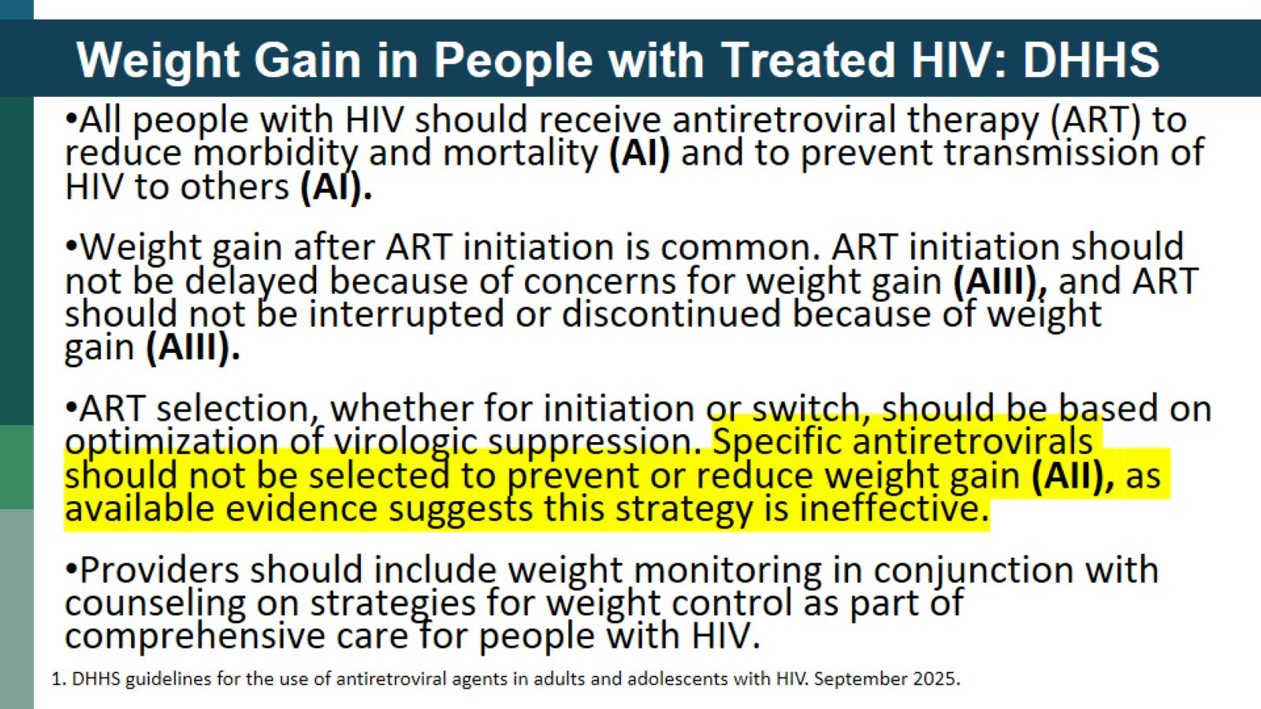
Weight Gain in People with Treated HIV: DHHS

Slide 39
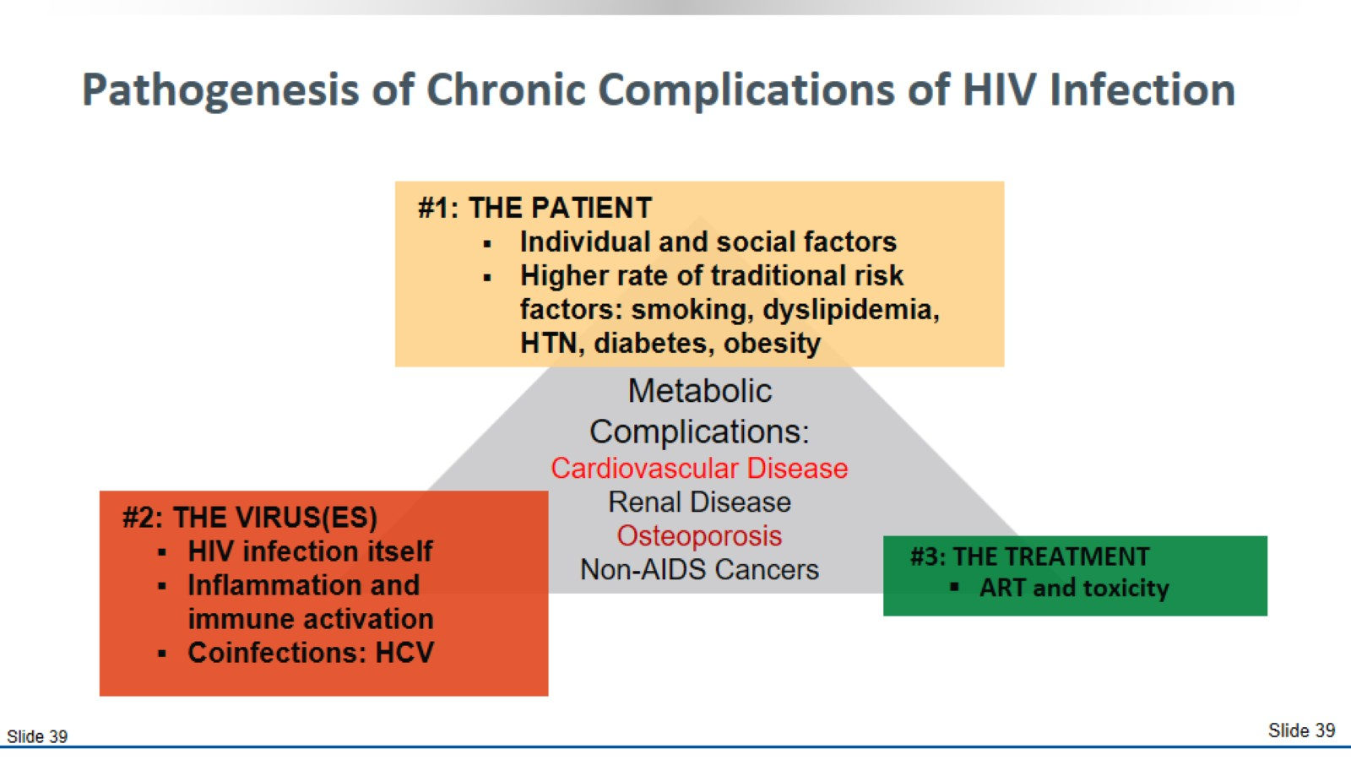
Pathogenesis of Chronic Complications of HIV Infection

Slide 40
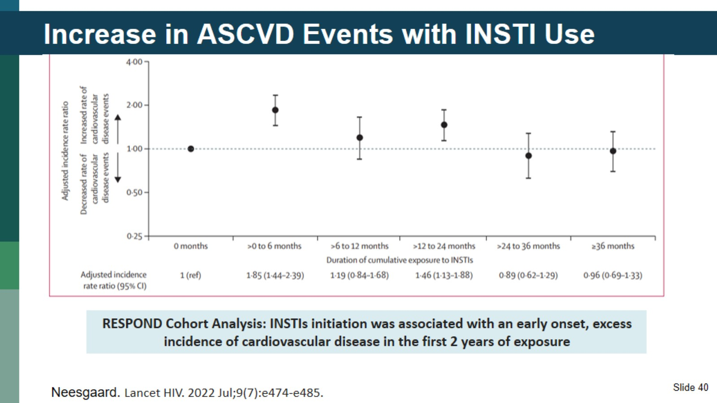
Increase in ASCVD Events with INSTI Use

Slide 41
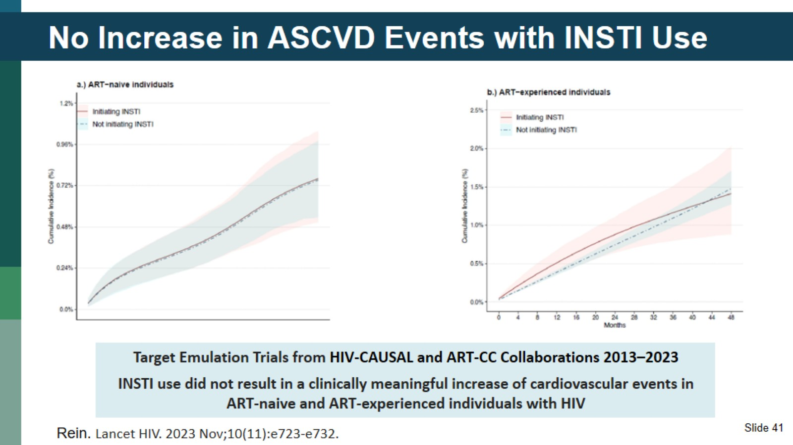
No Increase in ASCVD Events with INSTI Use

Slide 42
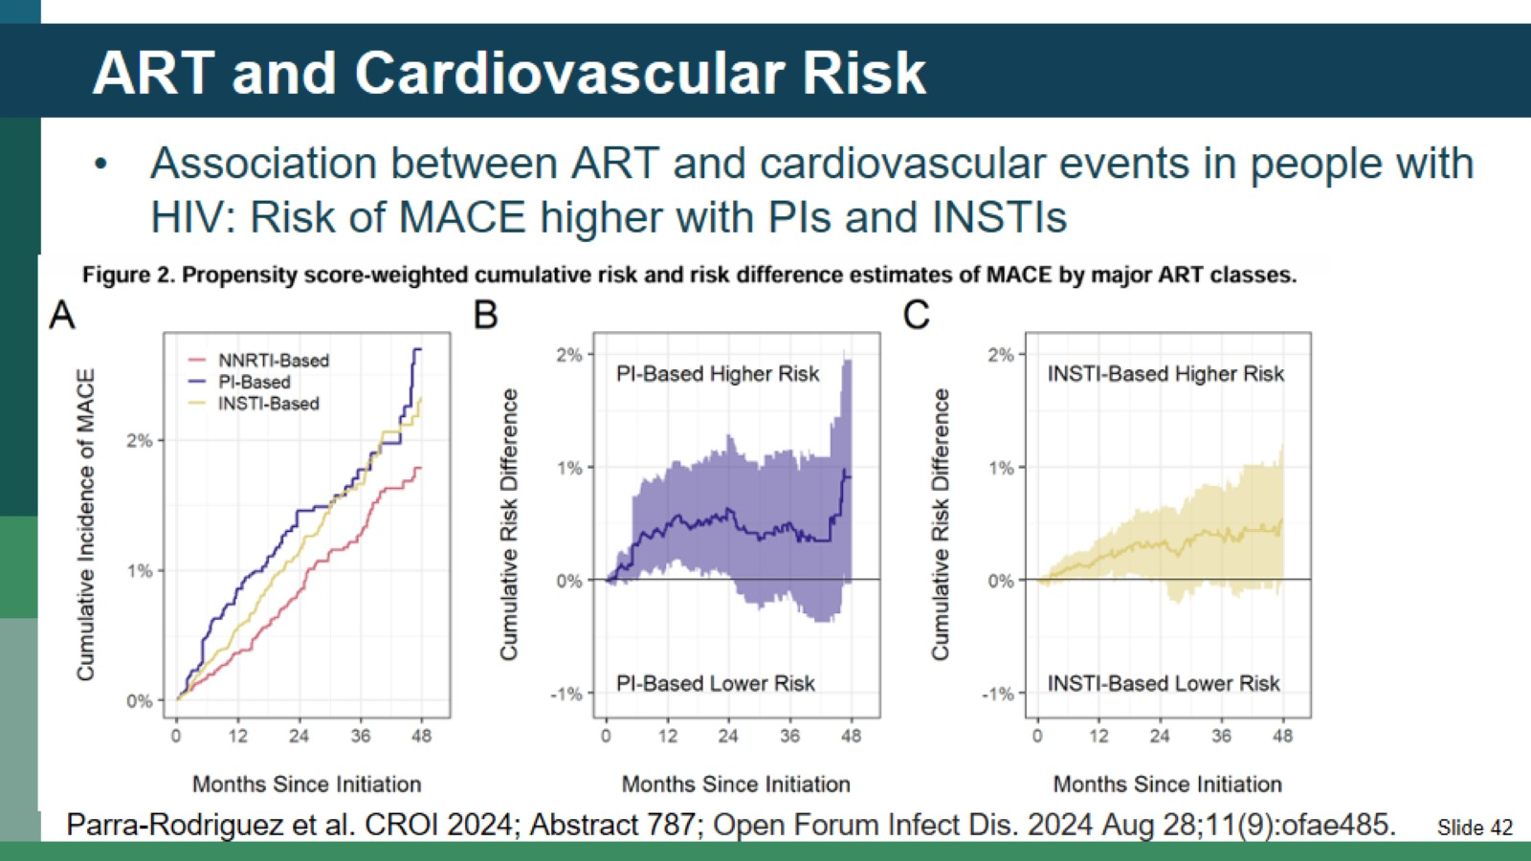
ART and Cardiovascular Risk

Slide 43
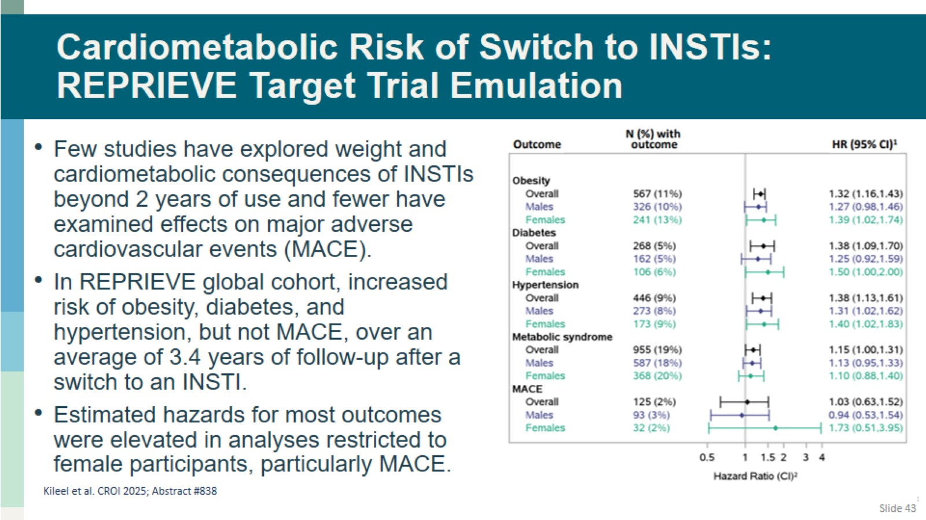
Cardiometabolic Risk of Switch to INSTIs: REPRIEVE Target Trial Emulation

Slide 44
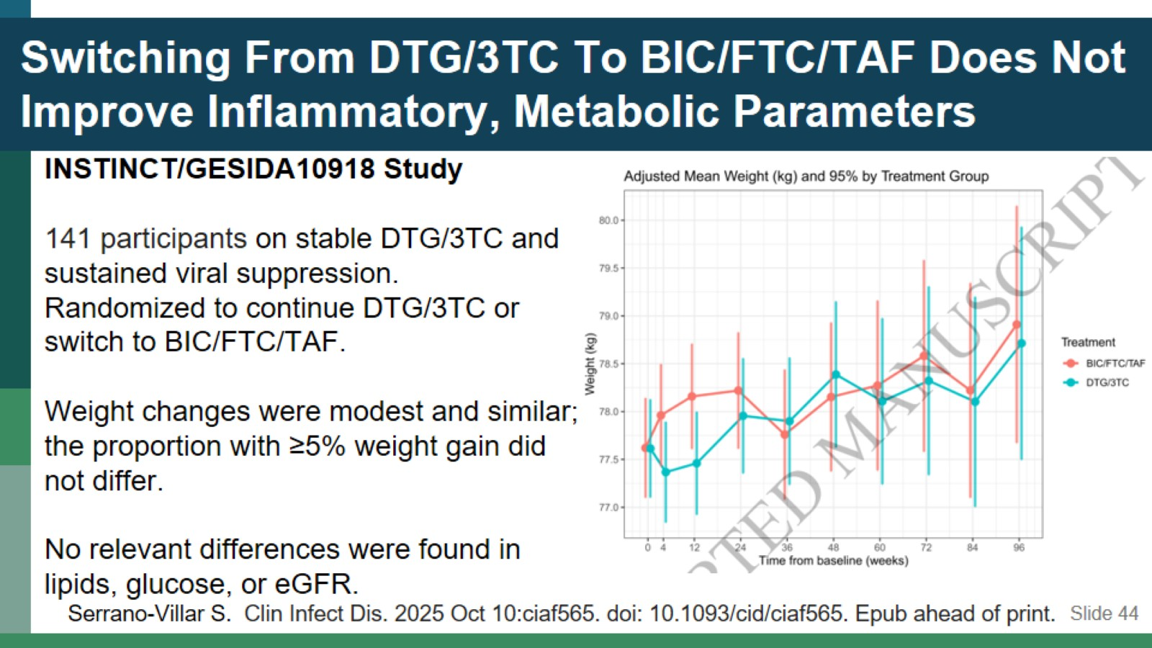
Switching From DTG/3TC To BIC/FTC/TAF Does Not Improve Inflammatory, Metabolic Parameters

Slide 45
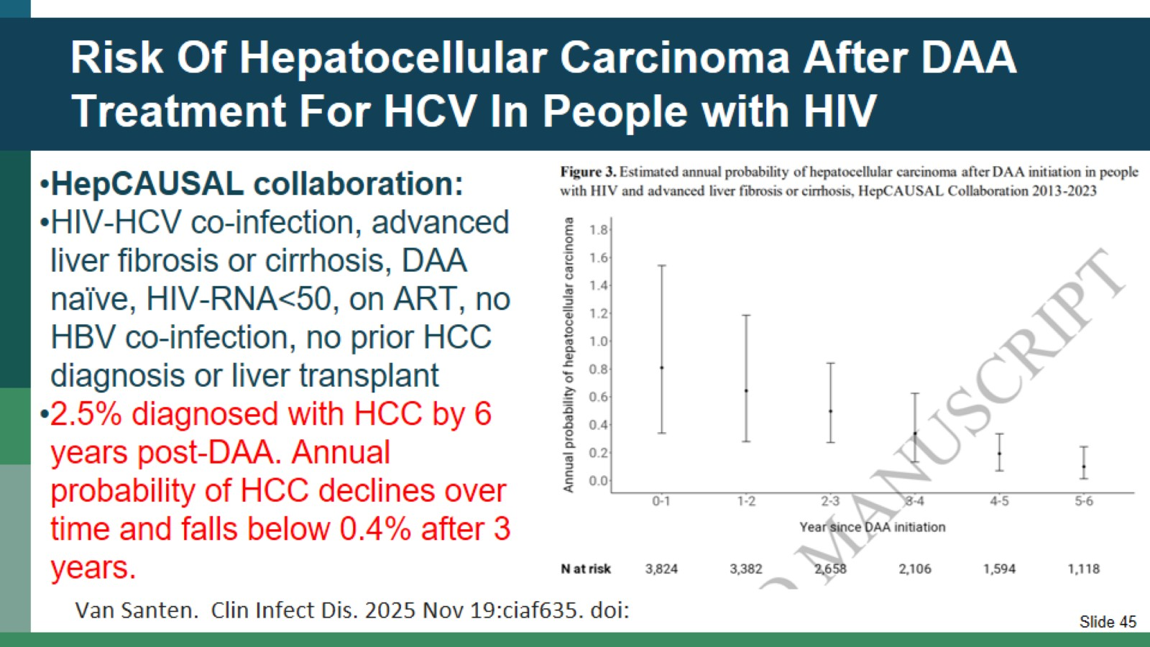
Risk Of Hepatocellular Carcinoma After DAA Treatment For HCV In People with HIV

Slide 46

Question-and-Answer Session

Slide 47

APPENDIX

Slide 48
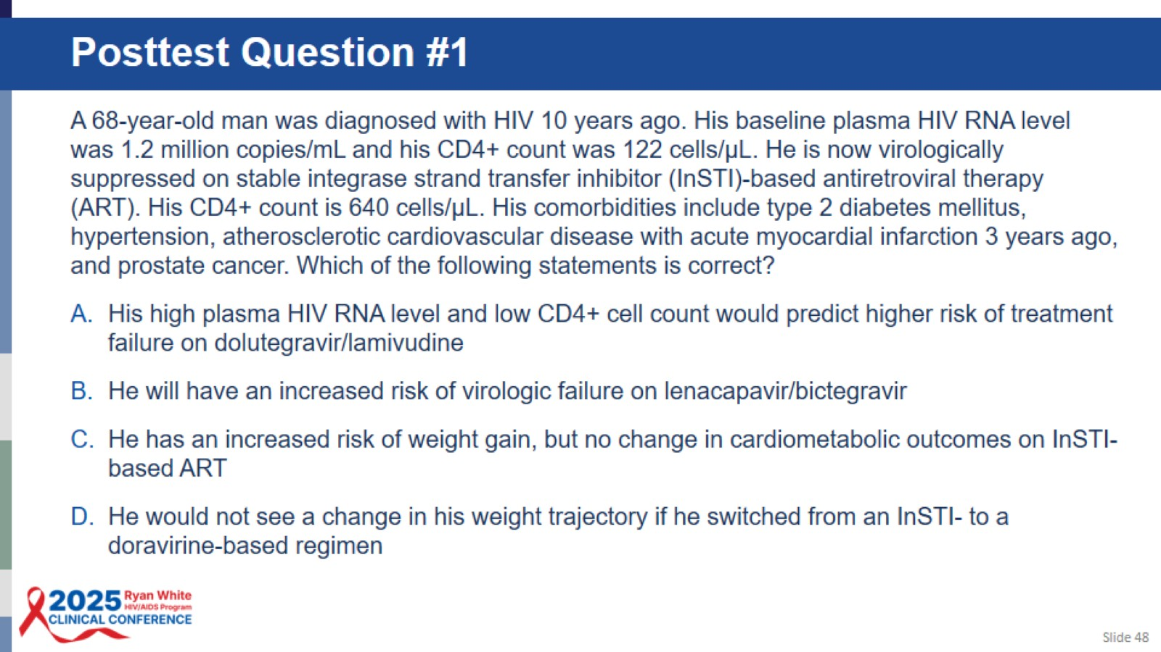
Posttest Question #1

Slide 49
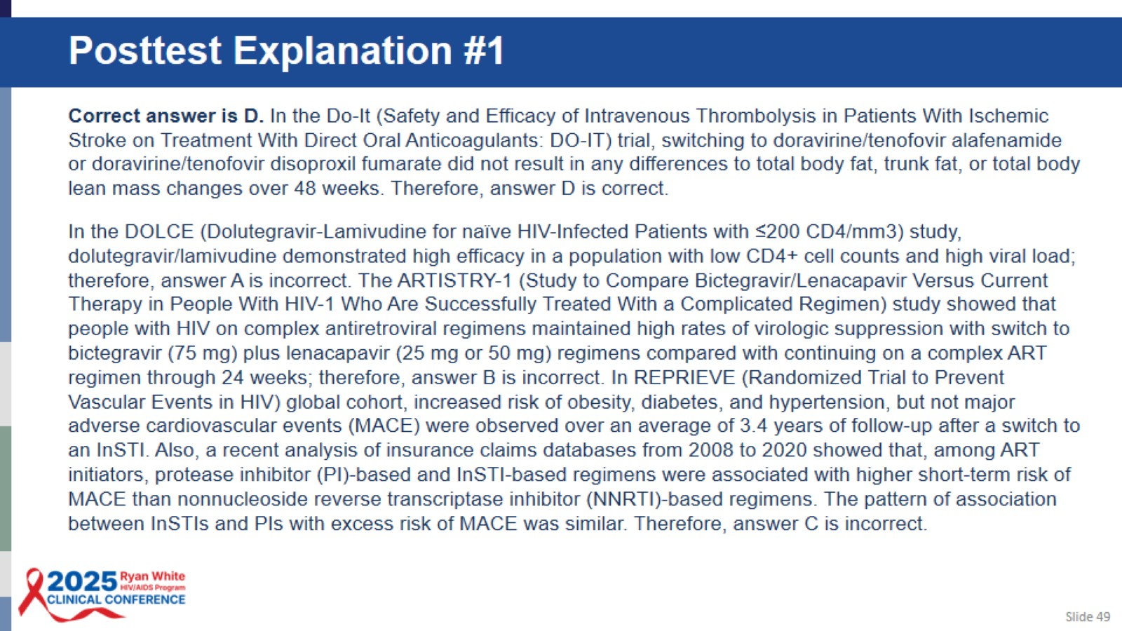
Posttest Explanation #1

Slide 50
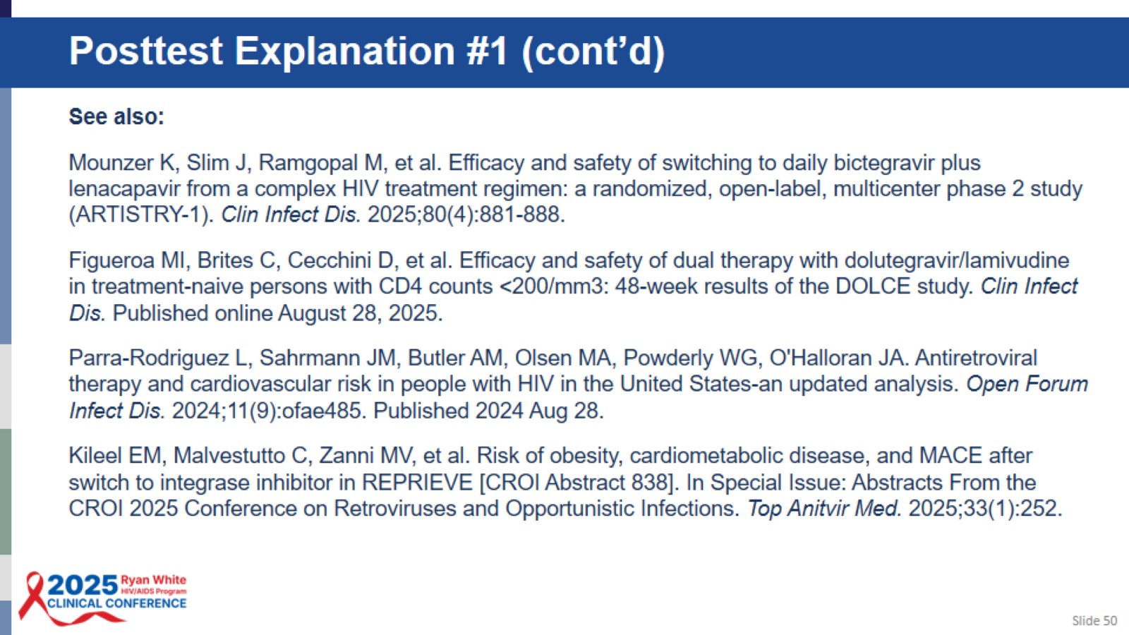
Posttest Explanation #1 (cont’d)

Slide 51
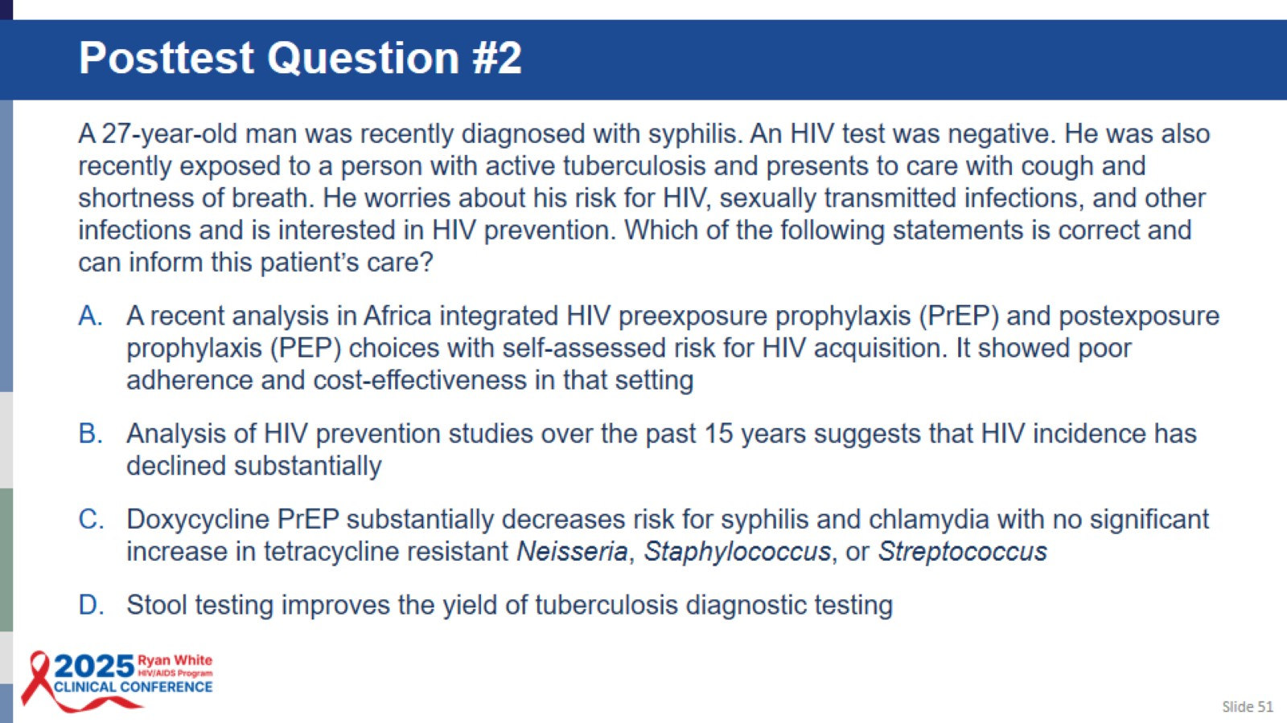
Posttest Question #2

Slide 52
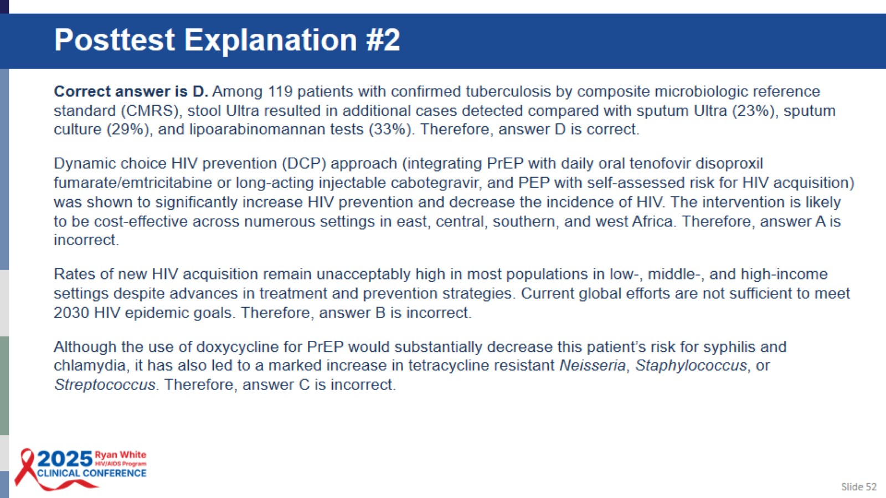
Posttest Explanation #2

Slide 53
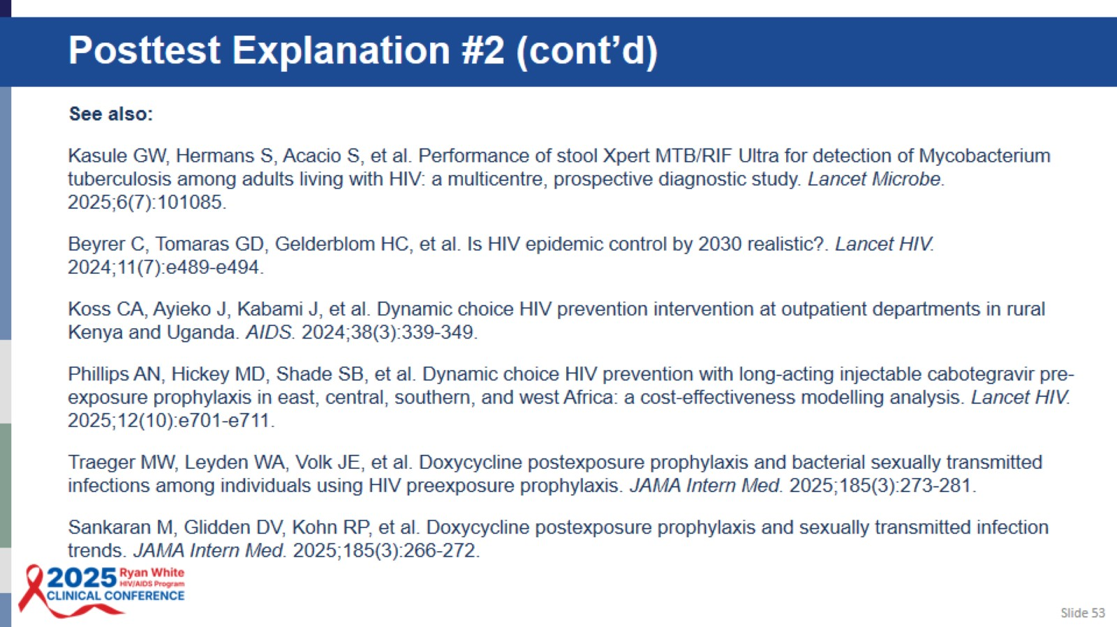
Posttest Explanation #2 (cont’d)

