Slide 1
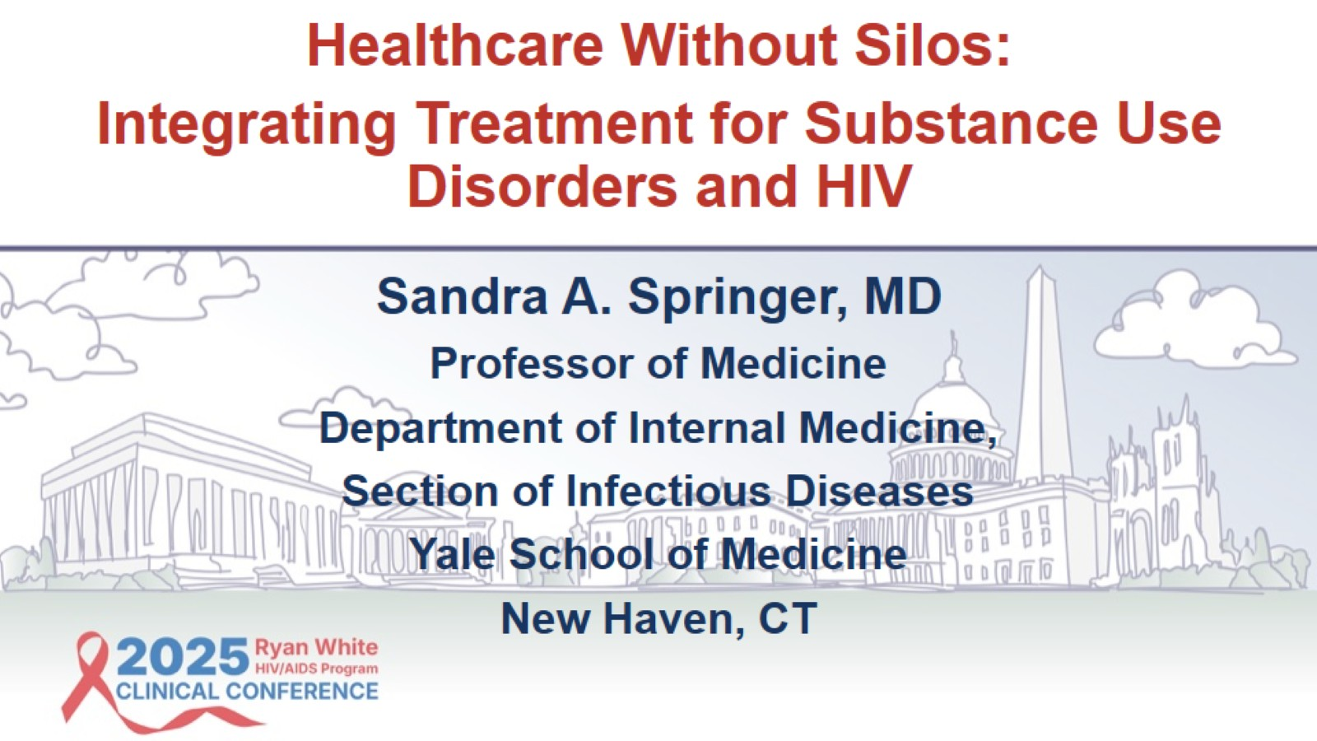

Slide 2
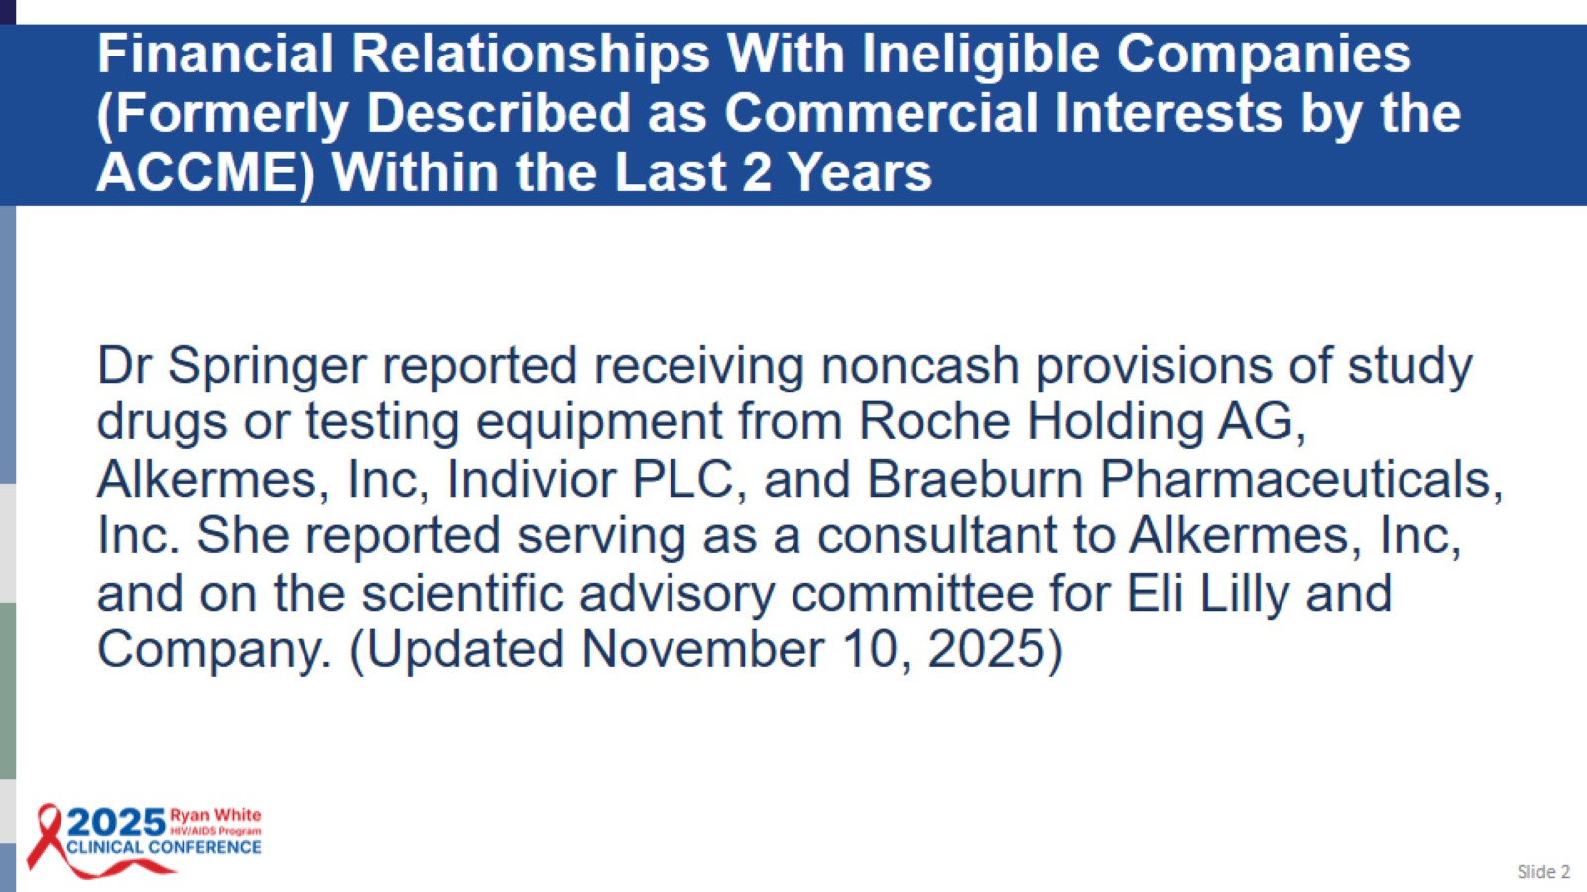
Financial Relationships With Ineligible Companies (Formerly Described as Commercial Interests by the ACCME) Within the Last 2 Years

Slide 3
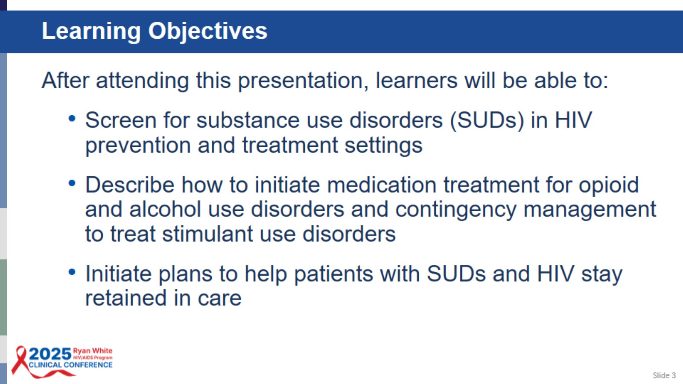
Learning Objectives

Slide 4
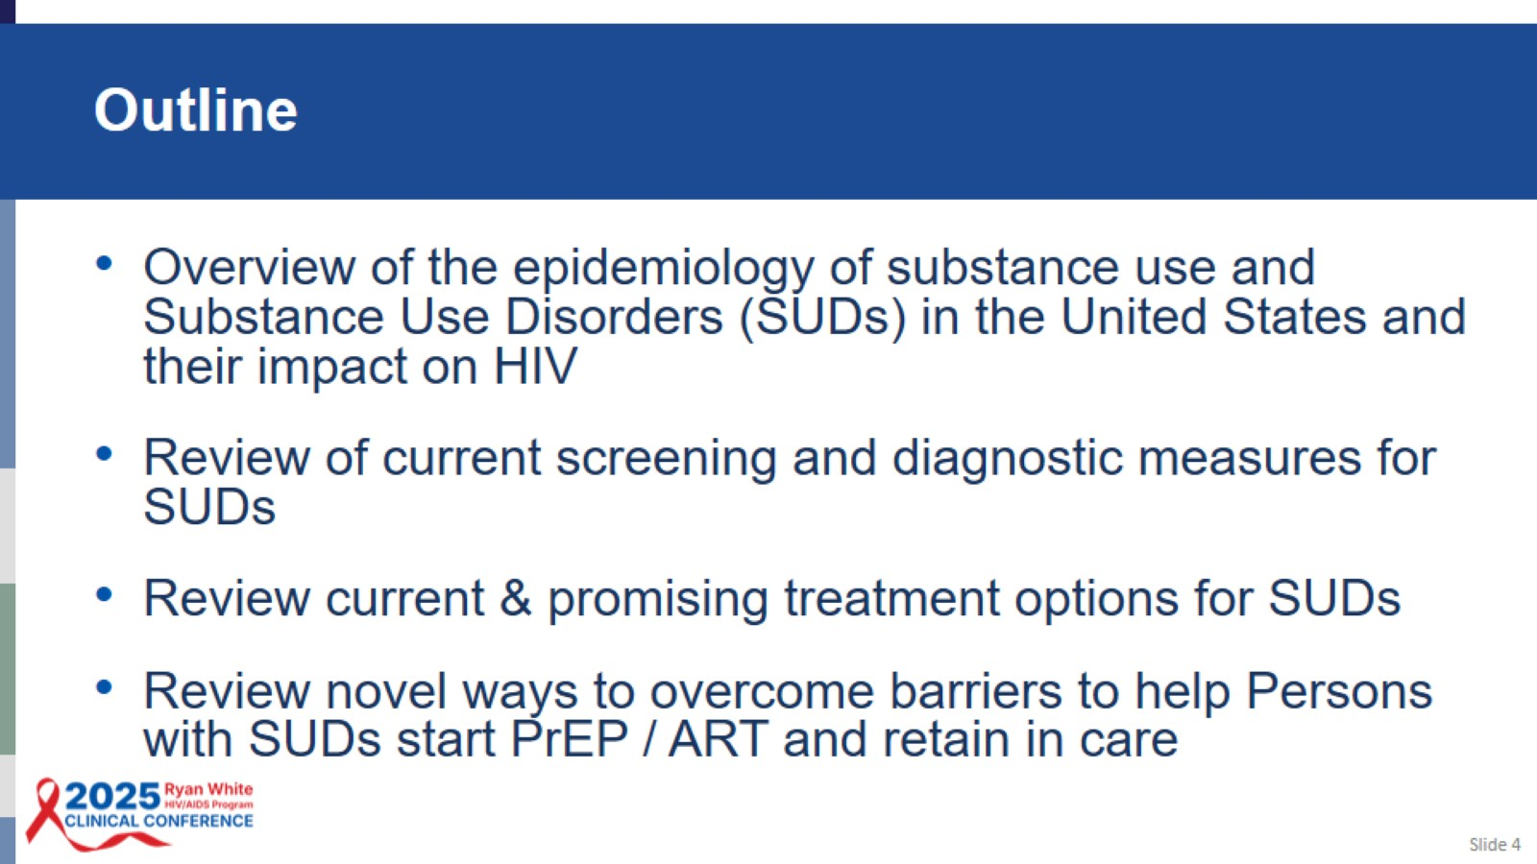
Outline

Slide 5
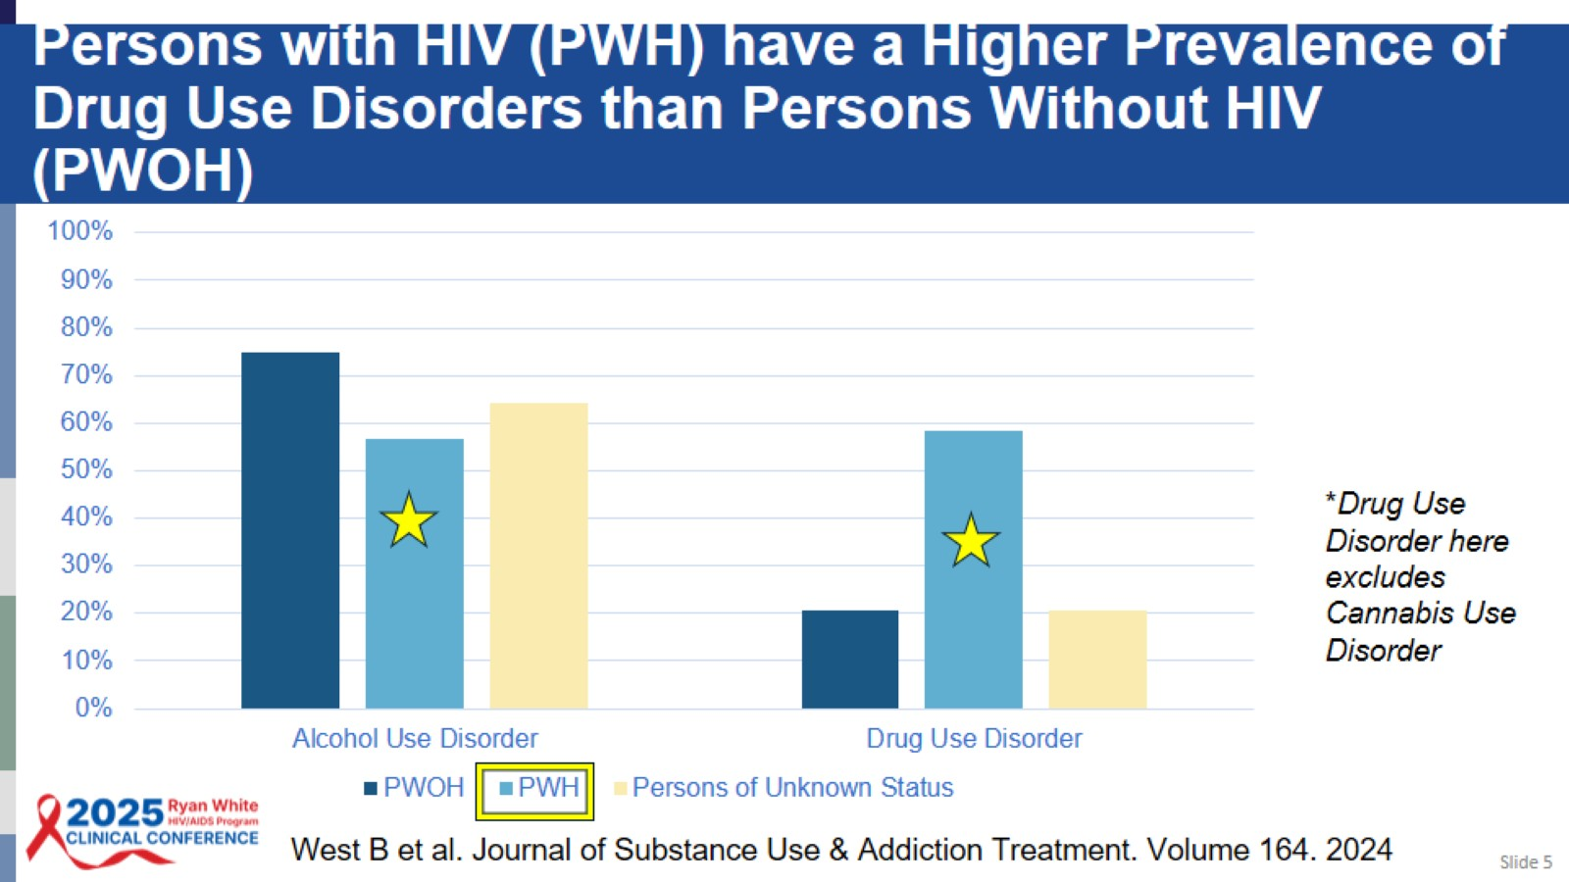
Persons with HIV (PWH) have a Higher Prevalence of Drug Use Disorders than Persons Without HIV (PWOH)

Slide 6
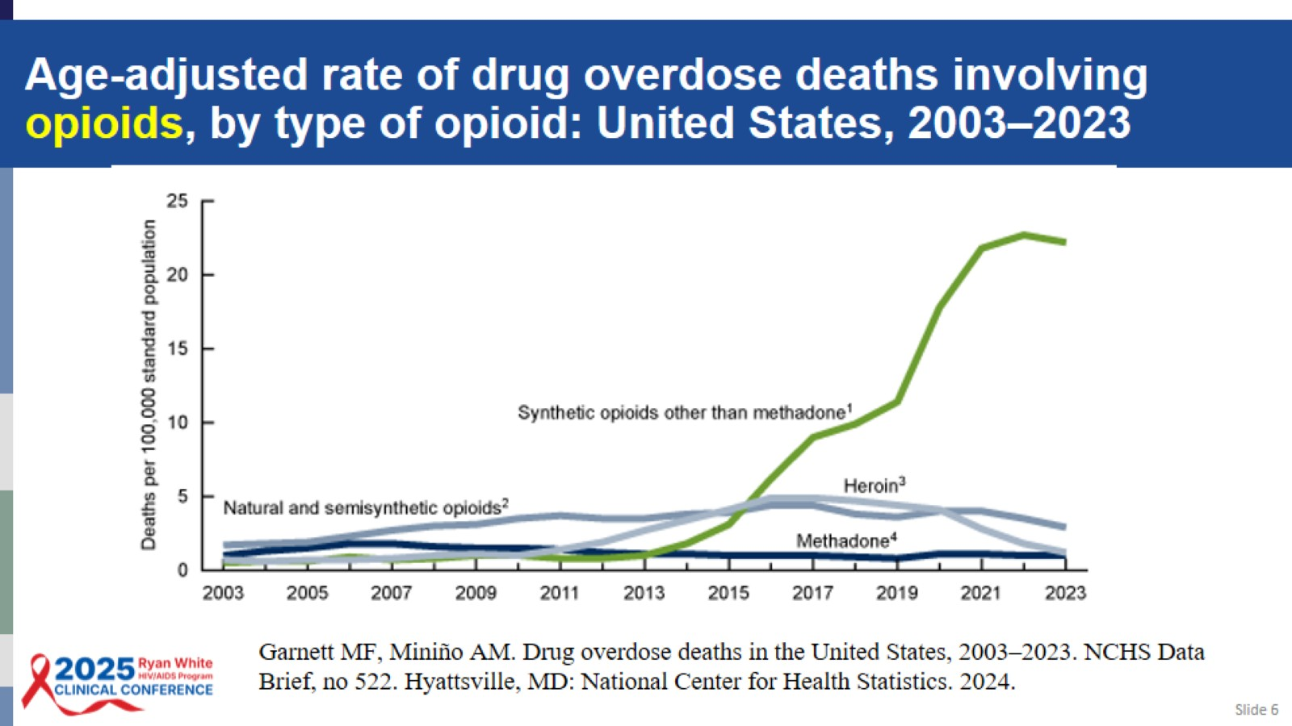
Age-adjusted rate of drug overdose deaths involving opioids, by type of opioid: United States, 2003–2023

Slide 7
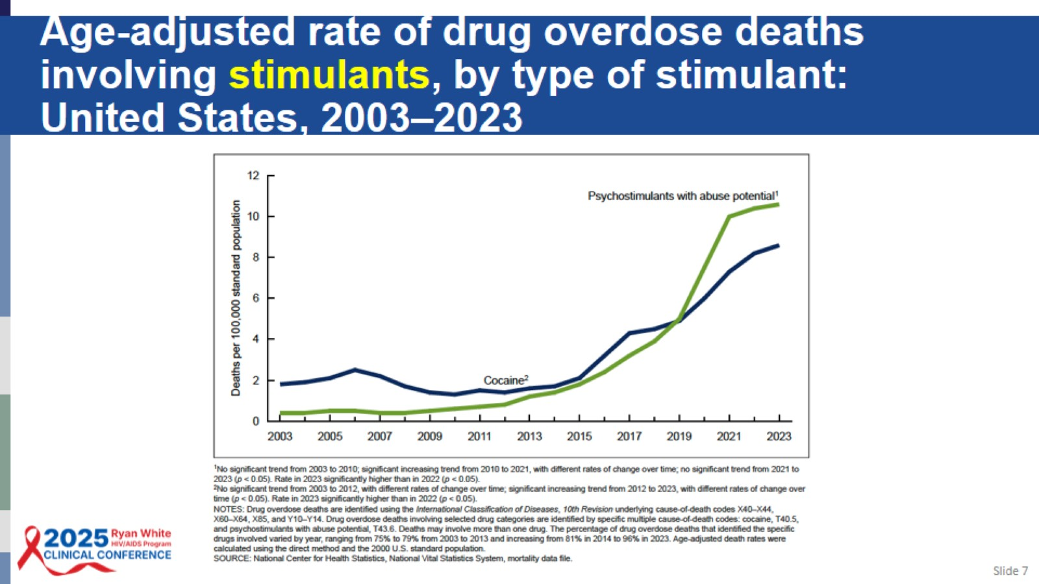
Age-adjusted rate of drug overdose deaths involving stimulants, by type of stimulant:
United States, 2003–2023

Slide 8
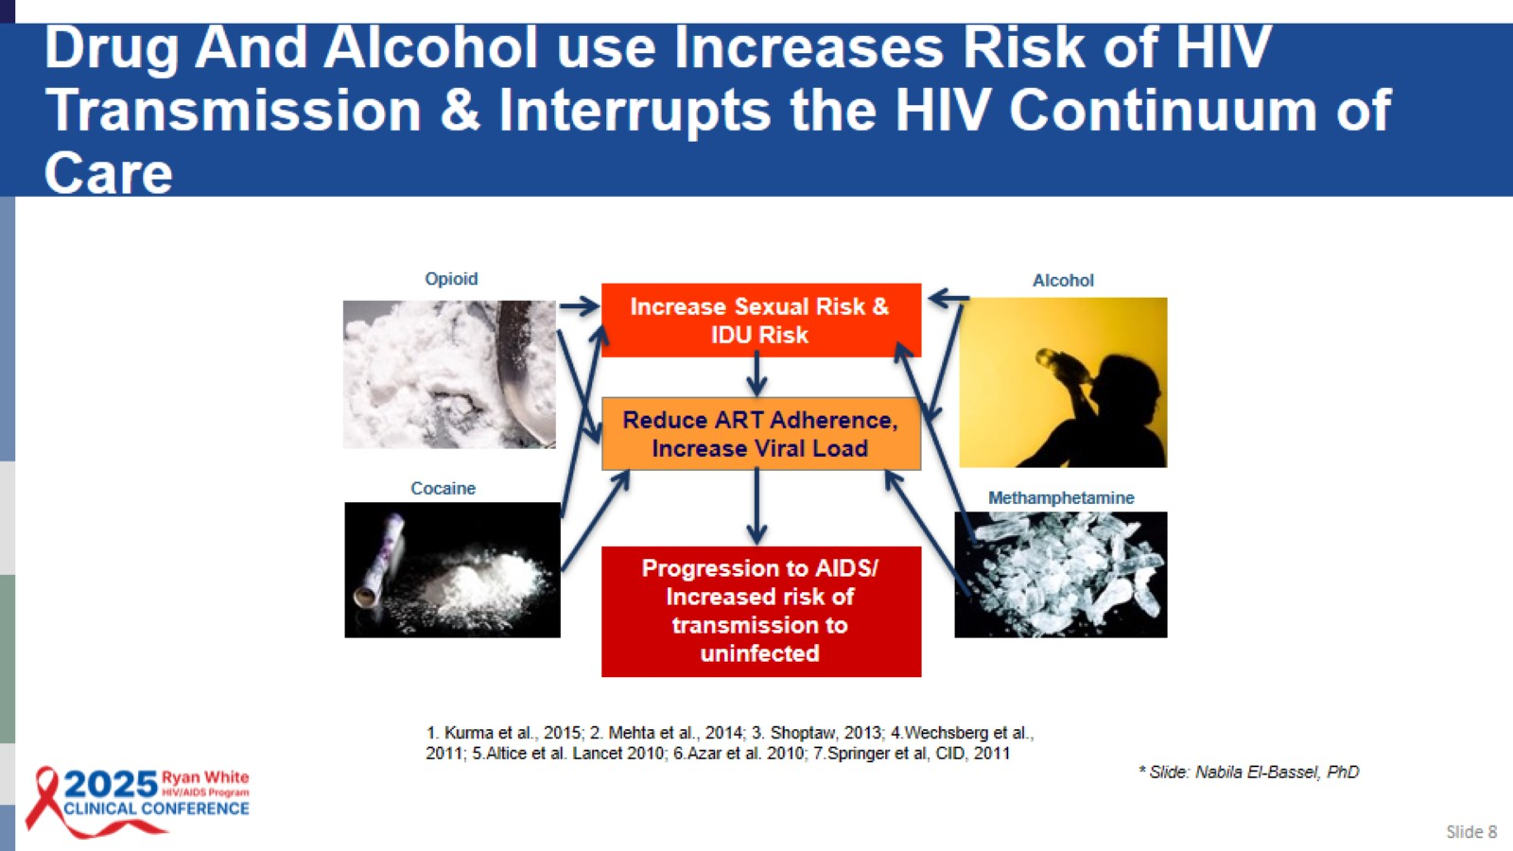
Drug And Alcohol use Increases Risk of HIV Transmission & Interrupts the HIV Continuum of Care

Slide 9
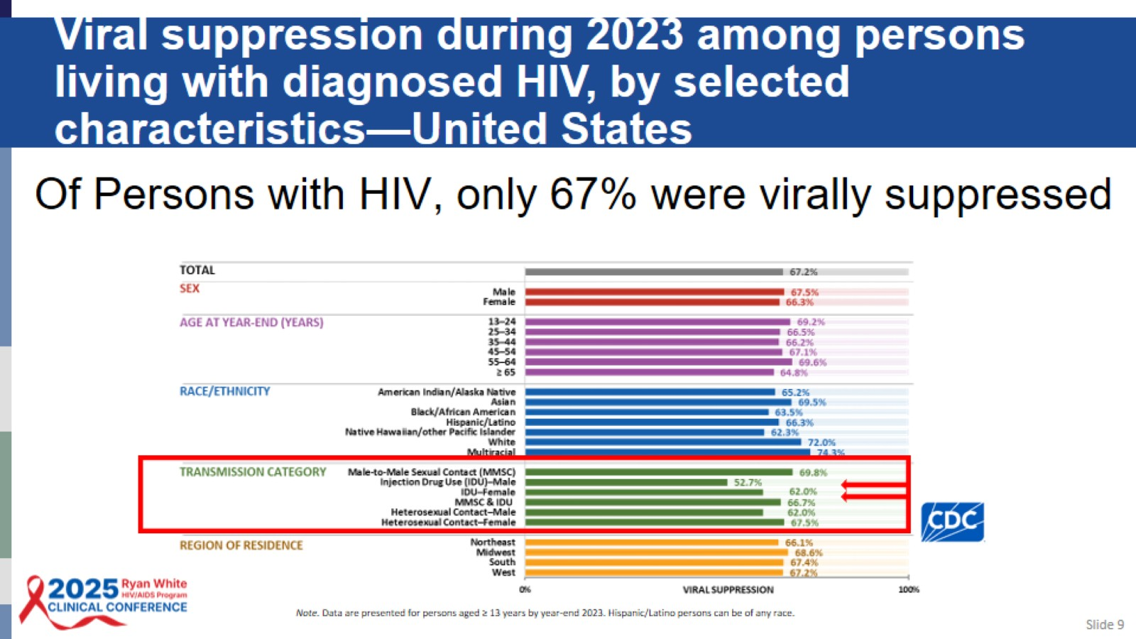
Viral suppression during 2023 among persons living with diagnosed HIV, by selected characteristics—United States

Slide 10
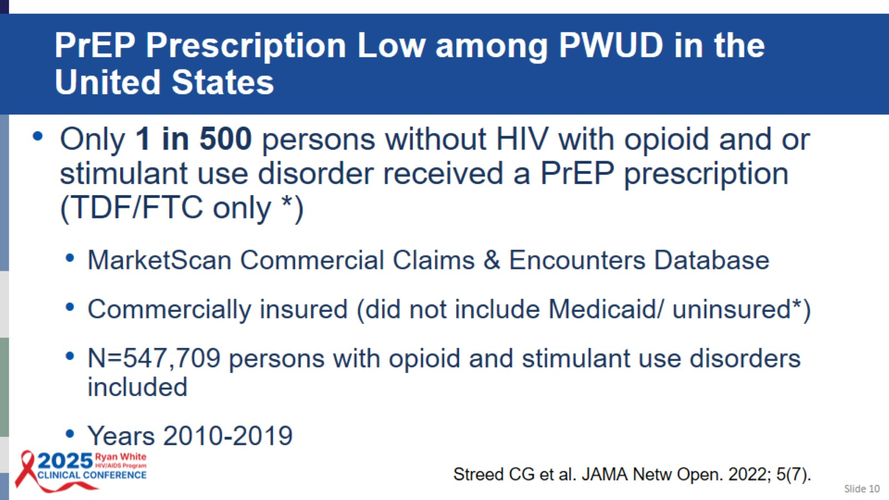
PrEP Prescription Low among PWUD in the United States

Slide 11
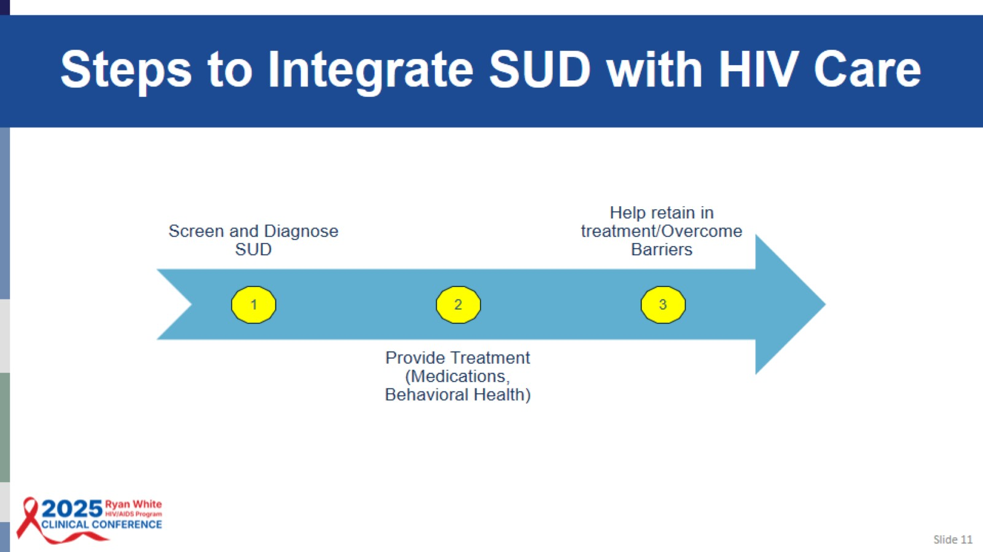
Steps to Integrate SUD with HIV Care

Slide 12

Screen & Diagnose SUD

Slide 13
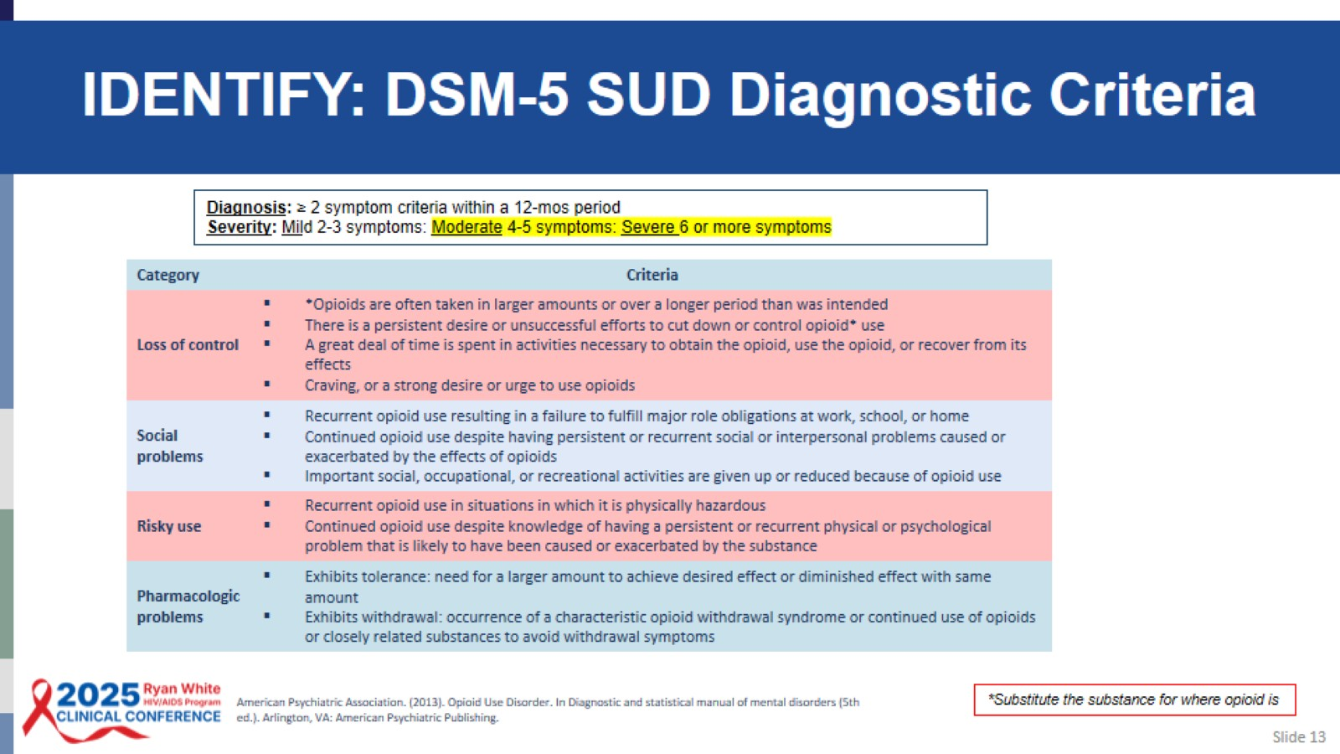
IDENTIFY: DSM-5 SUD Diagnostic Criteria

Slide 14
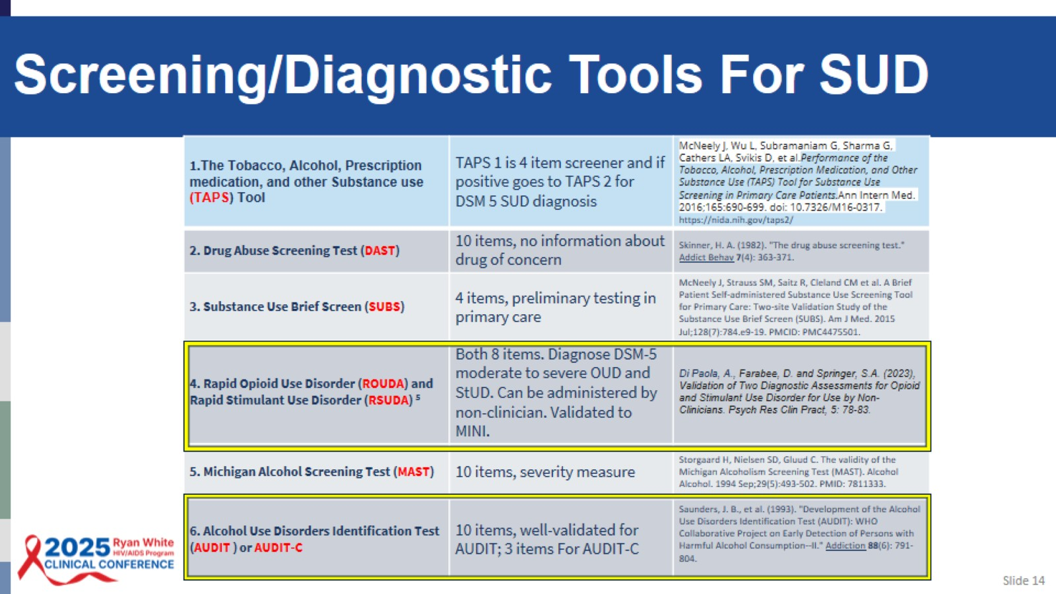
Screening/Diagnostic Tools For SUD

Slide 15
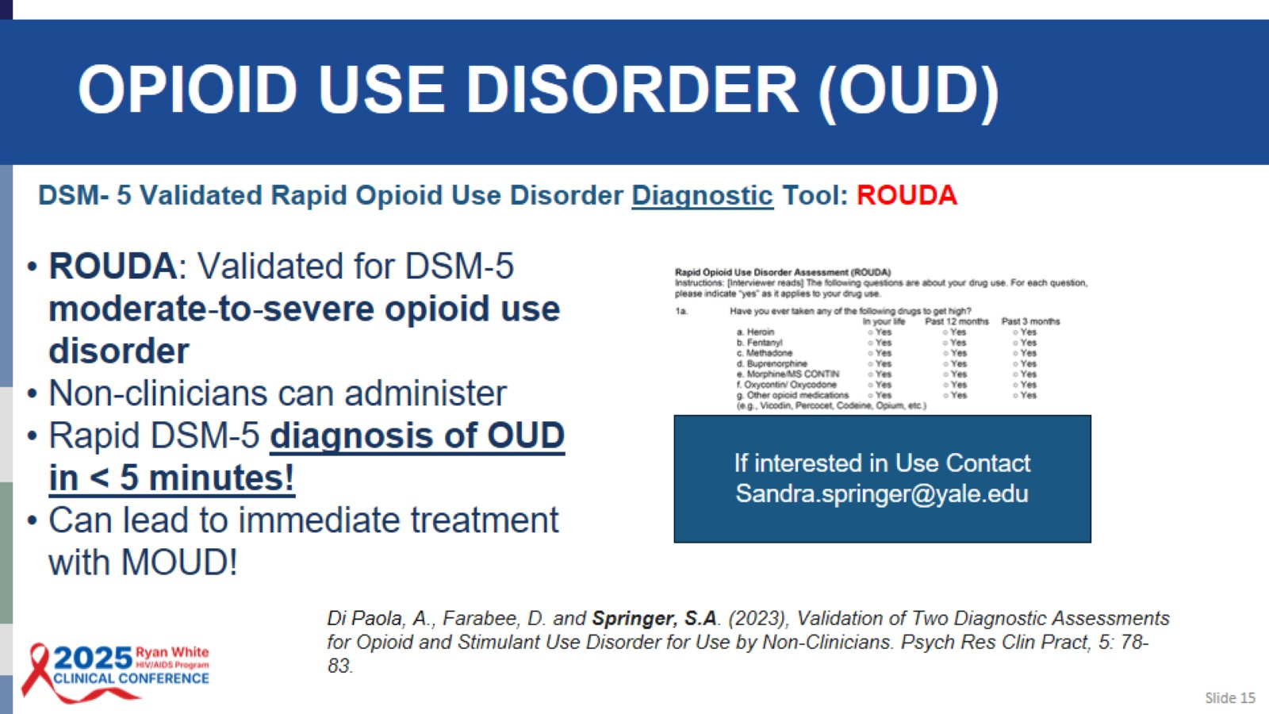
OPIOID USE DISORDER (OUD)

Slide 16
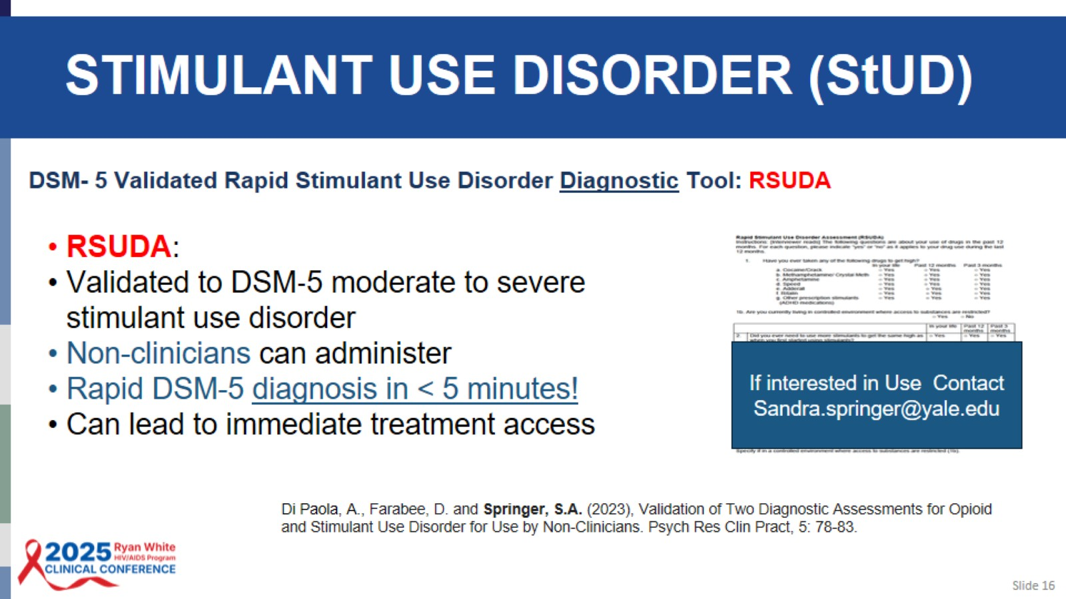
STIMULANT USE DISORDER (StUD)

Slide 17
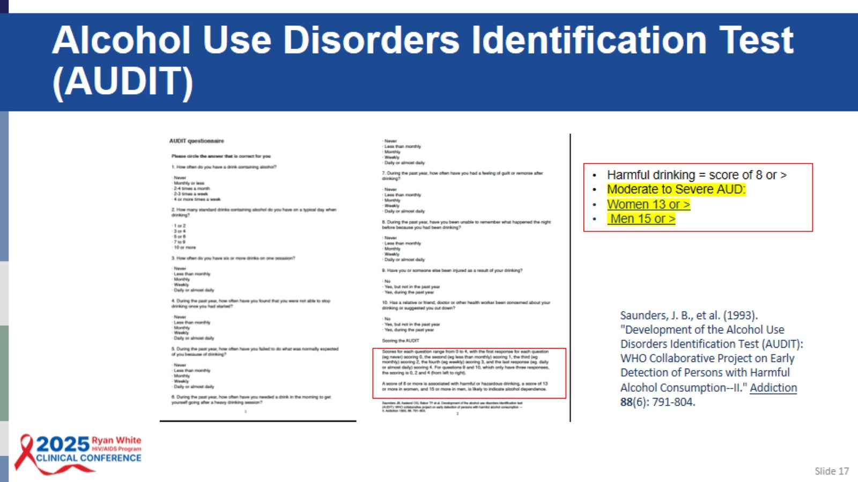
Alcohol Use Disorders Identification Test (AUDIT)

Slide 18

SUD Treatment

Slide 19
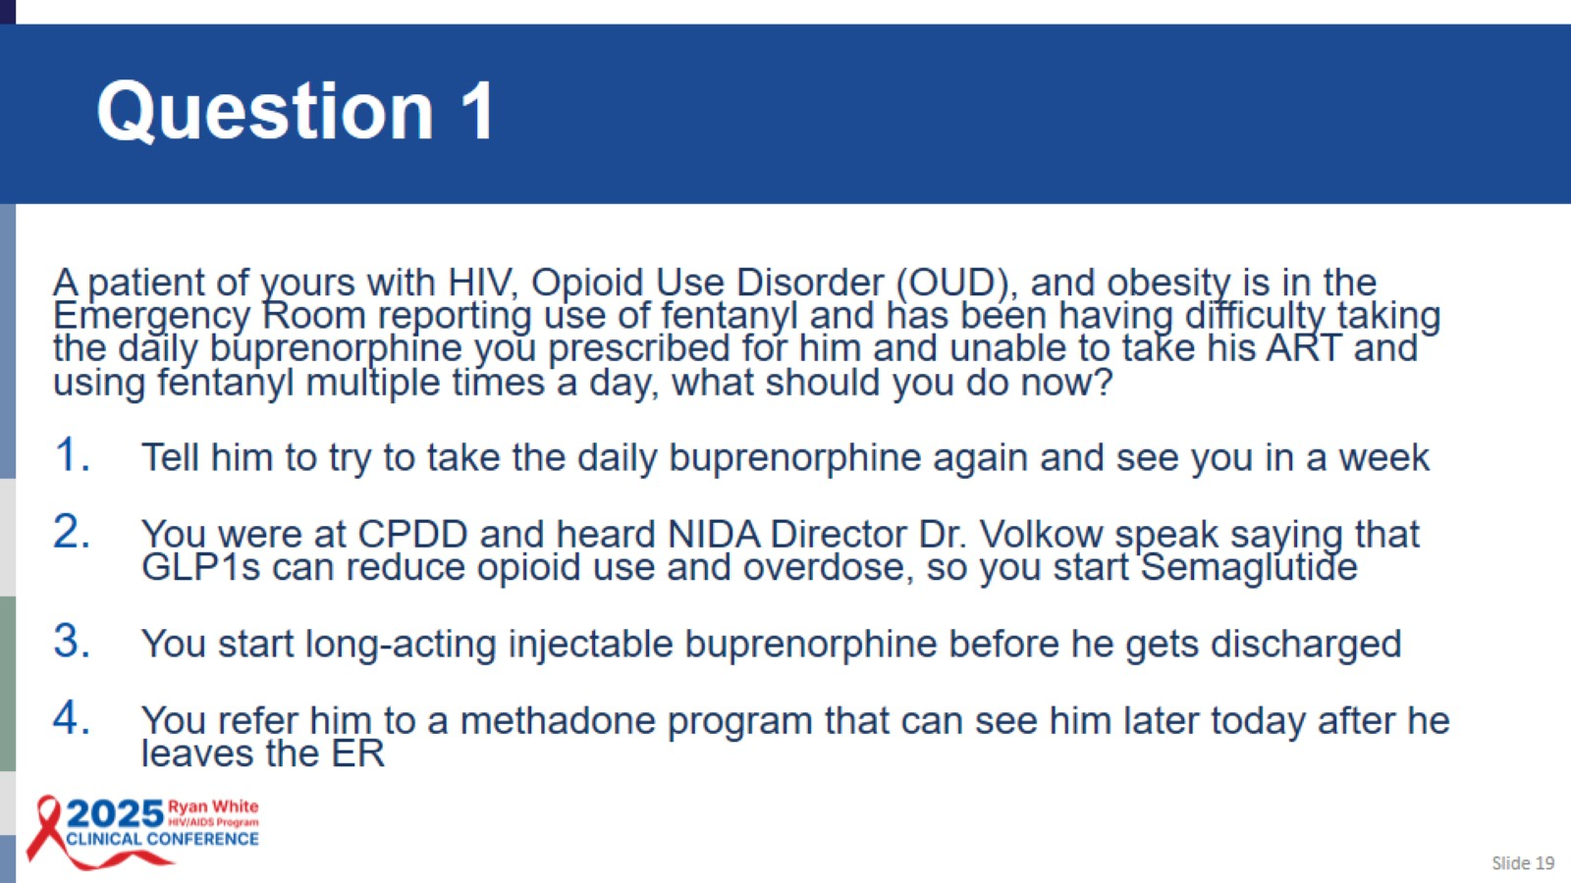
Question 1

Slide 20
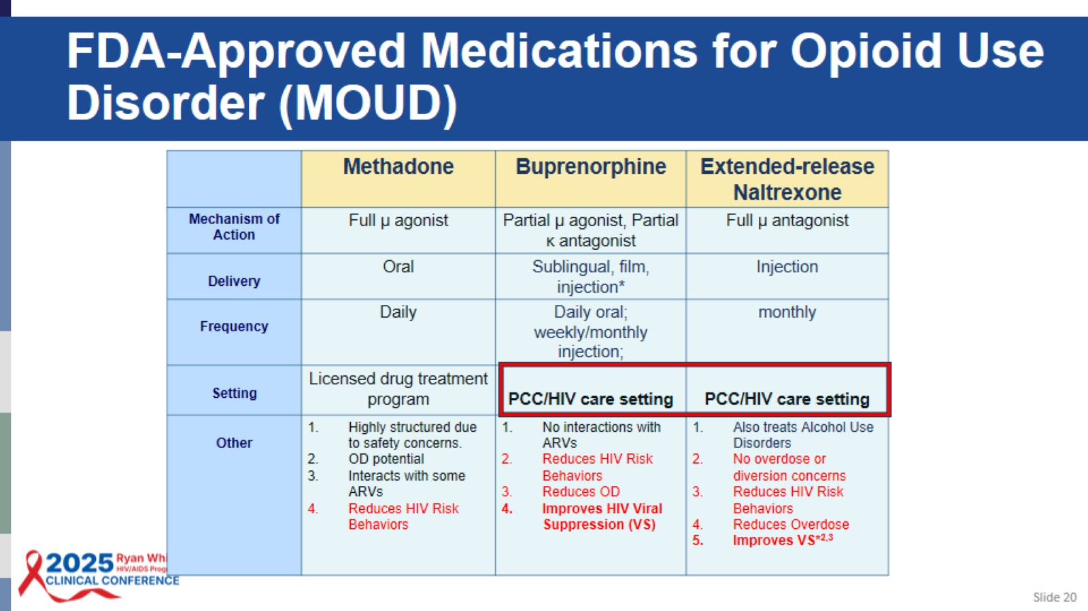
FDA-Approved Medications for Opioid Use Disorder (MOUD)

Slide 21
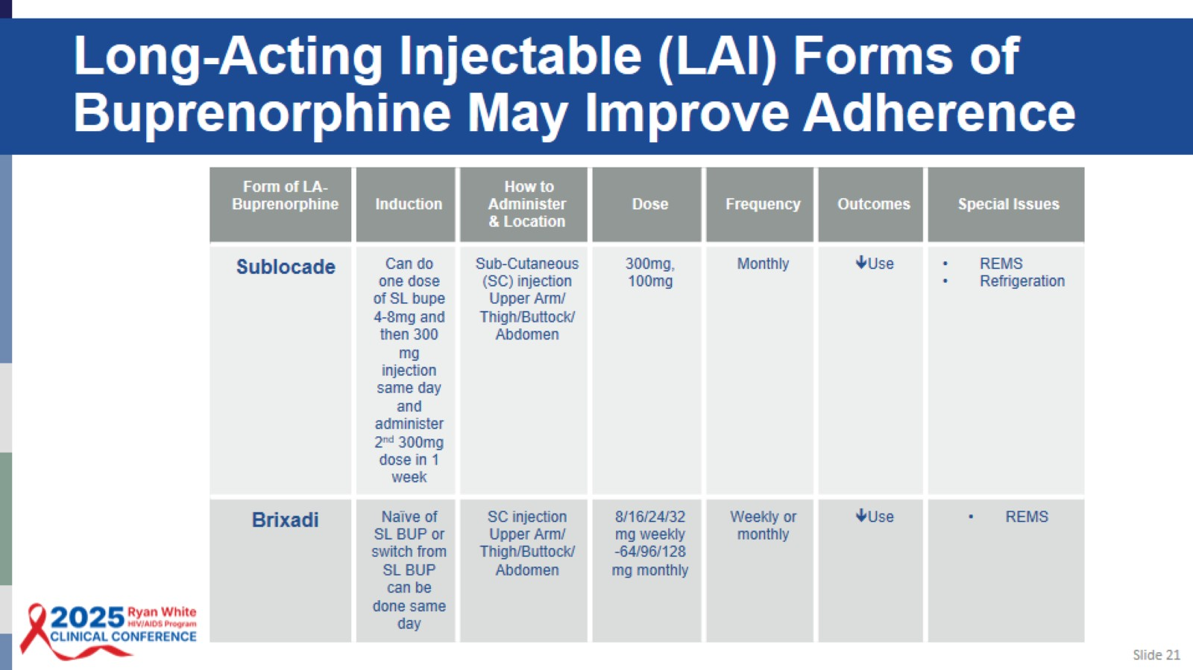
Long-Acting Injectable (LAI) Forms of Buprenorphine May Improve Adherence

Slide 22
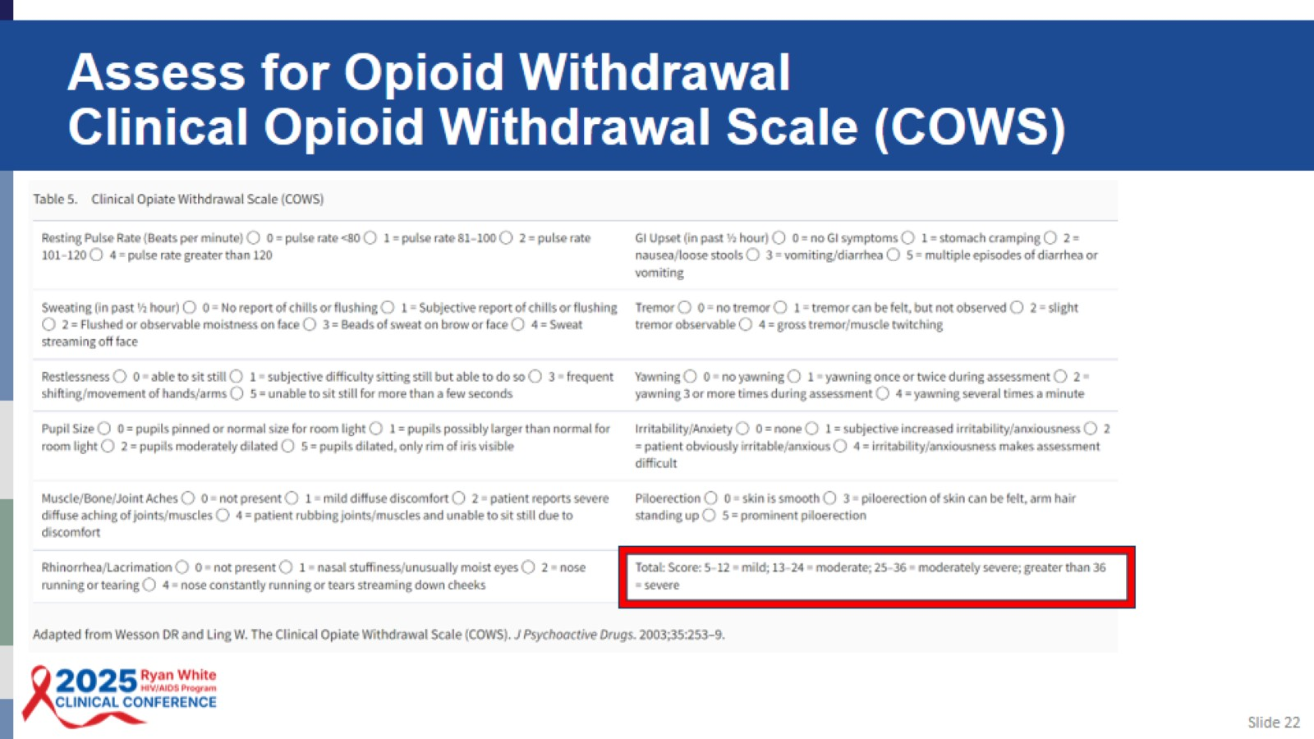
Assess for Opioid Withdrawal
Clinical Opioid Withdrawal Scale (COWS)

Slide 23
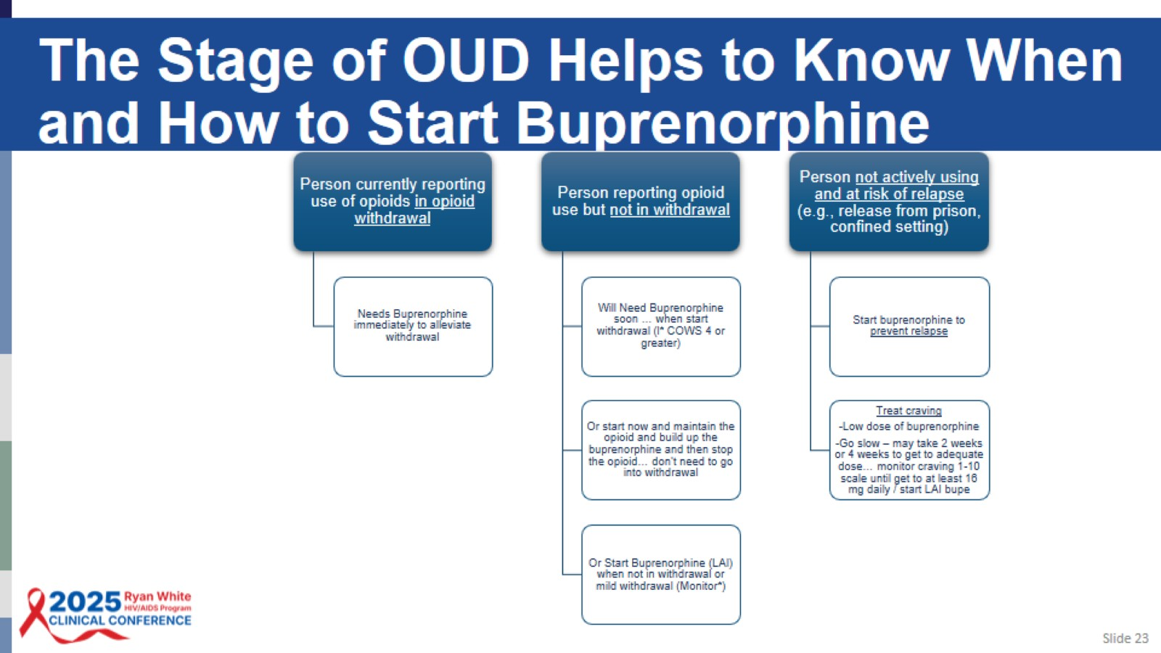
The Stage of OUD Helps to Know When and How to Start Buprenorphine

Slide 24
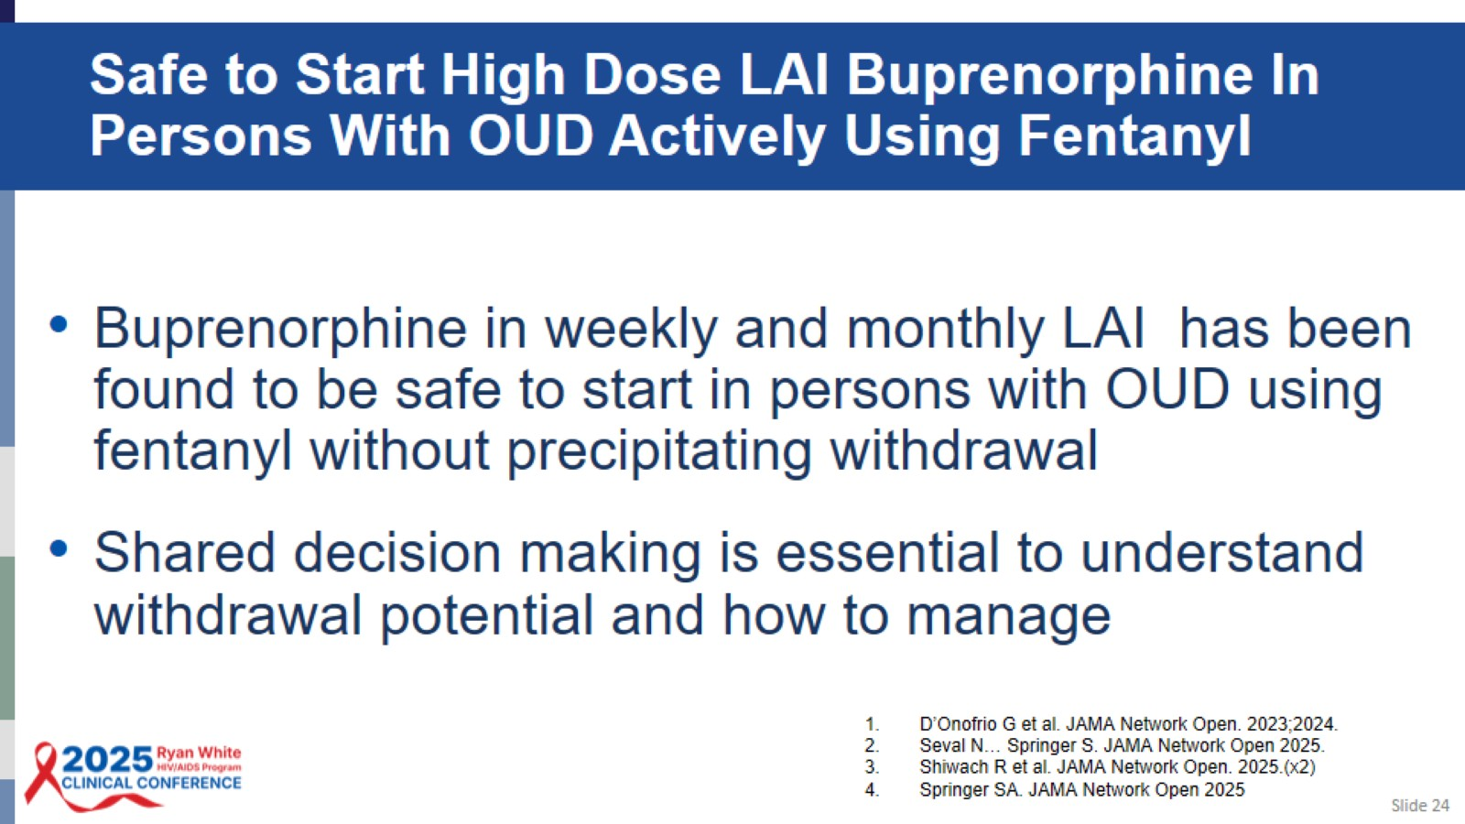
Safe to Start High Dose LAI Buprenorphine In Persons With OUD Actively Using Fentanyl

Slide 25
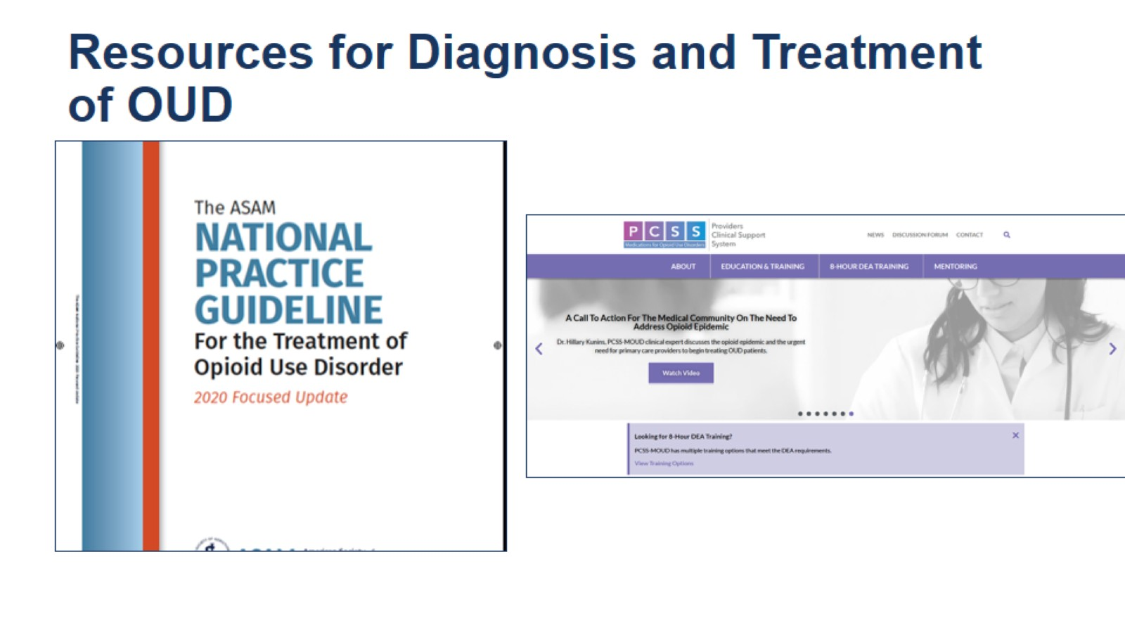
Resources for Diagnosis and Treatment of OUD

Slide 26
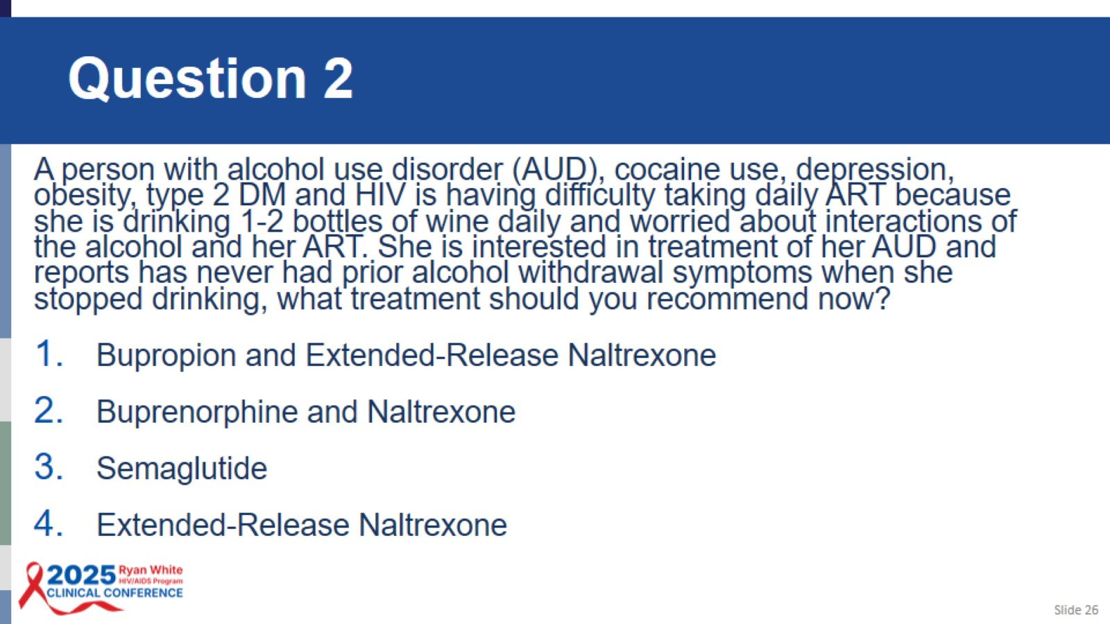
Question 2

Slide 27
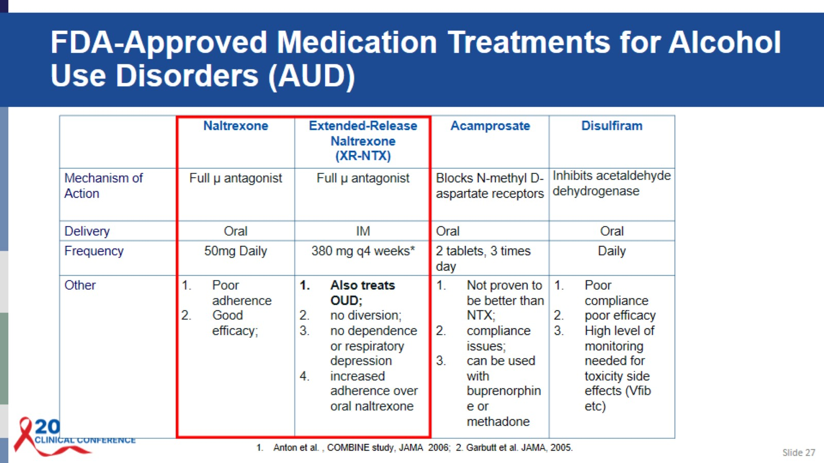
FDA-Approved Medication Treatments for Alcohol Use Disorders (AUD)

Slide 28
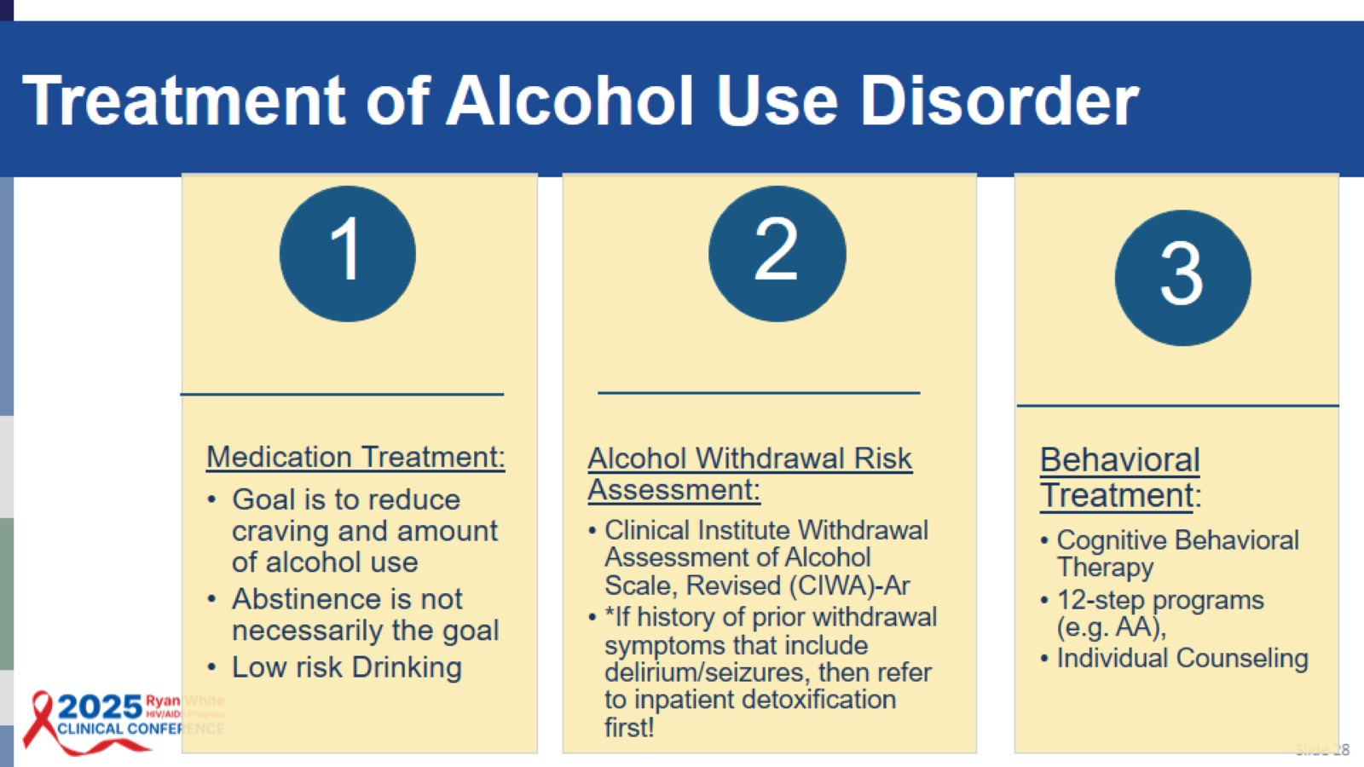
Treatment of Alcohol Use Disorder

Slide 29
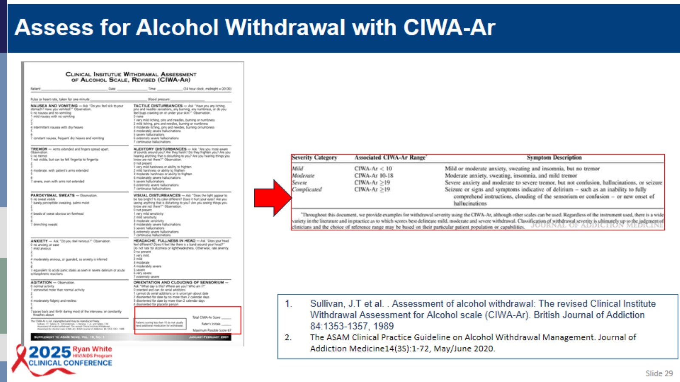

Slide 30
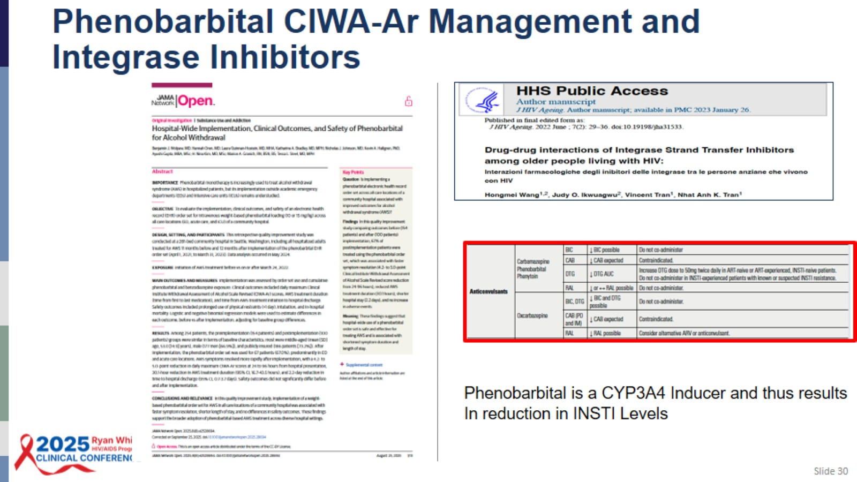
Phenobarbital CIWA-Ar Management and Integrase Inhibitors

Slide 31
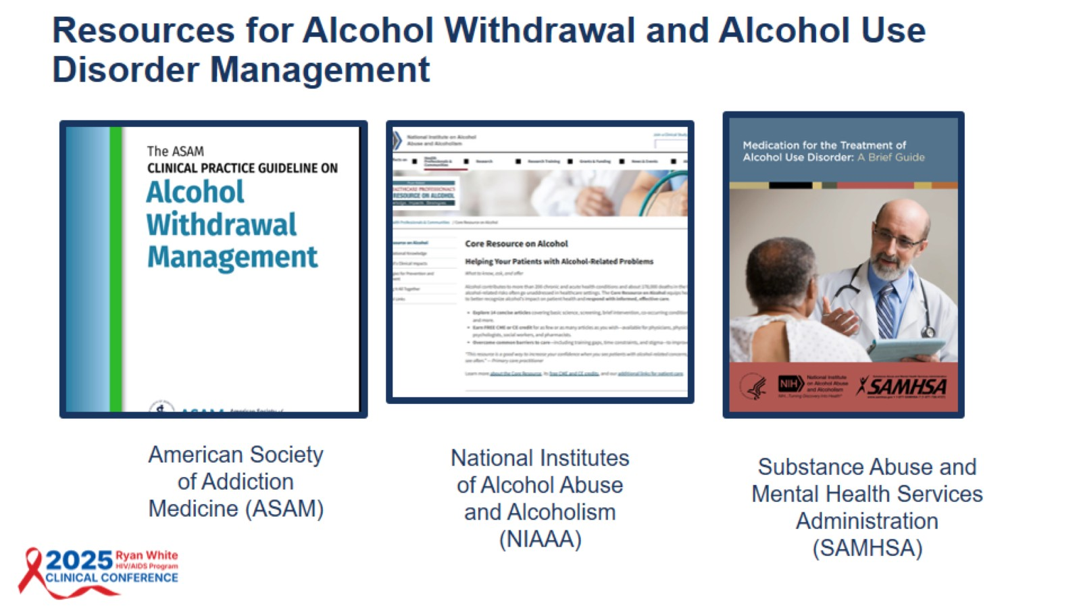

Slide 32
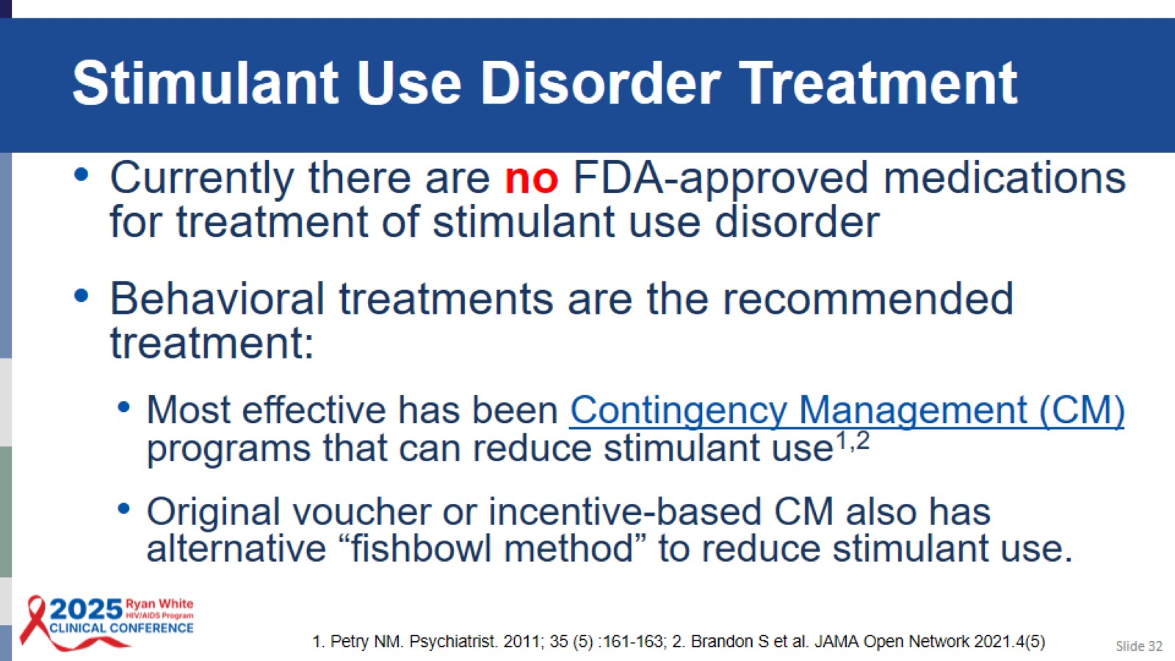
Stimulant Use Disorder Treatment

Slide 33
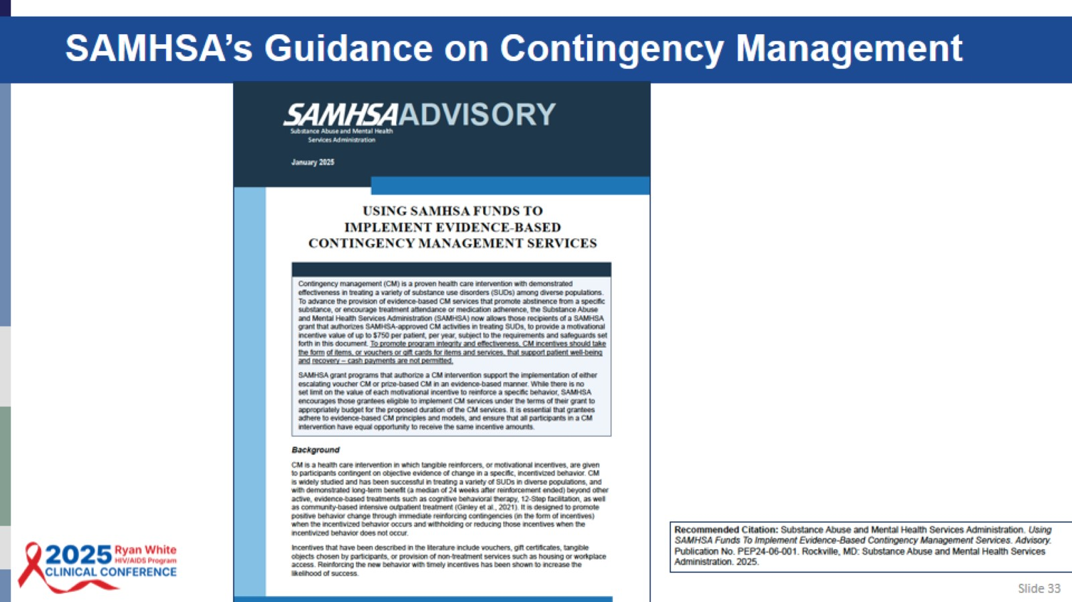
SAMHSA’s Guidance on Contingency Management

Slide 34
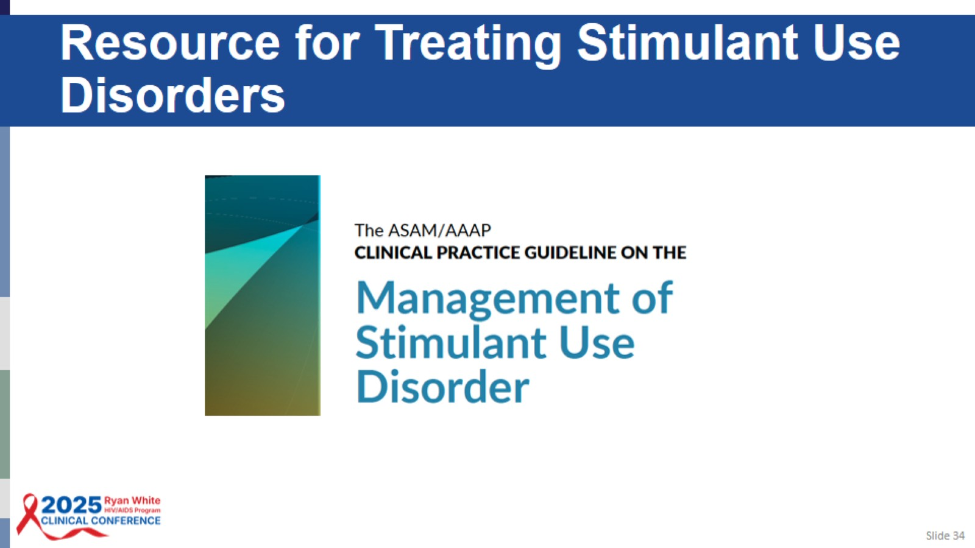
Resource for Treating Stimulant Use Disorders

Slide 35
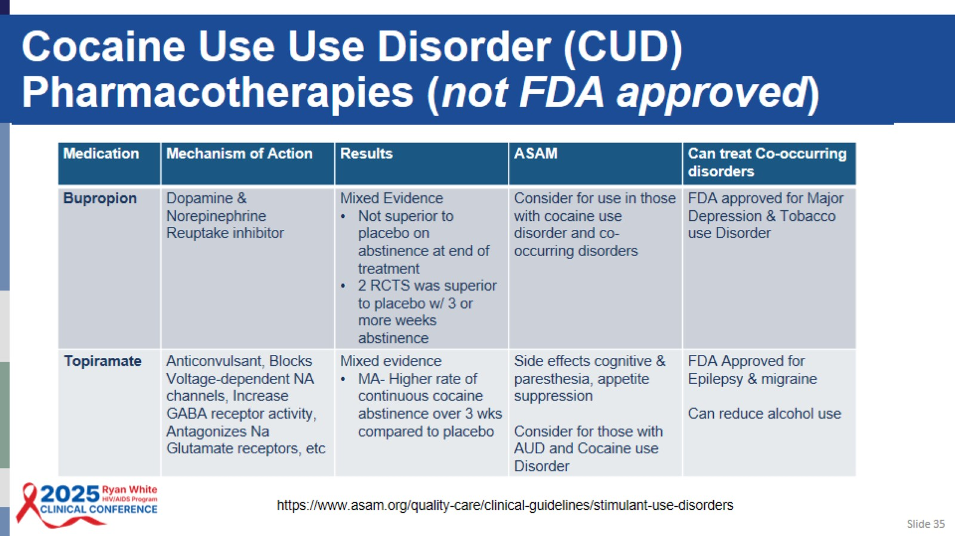
Cocaine Use Use Disorder (CUD) Pharmacotherapies (not FDA approved)

Slide 36
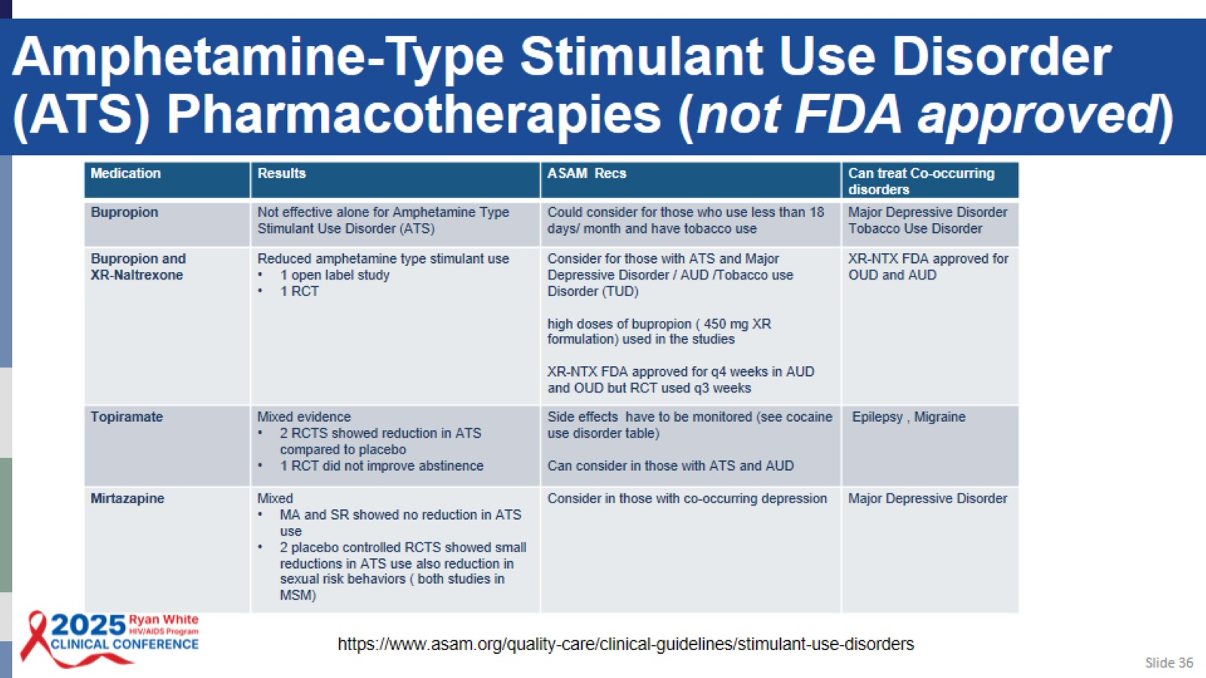
Amphetamine-Type Stimulant Use Disorder (ATS) Pharmacotherapies (not FDA approved)

Slide 37

Emerging Treatment for SUDs:
GLP1s

Slide 38
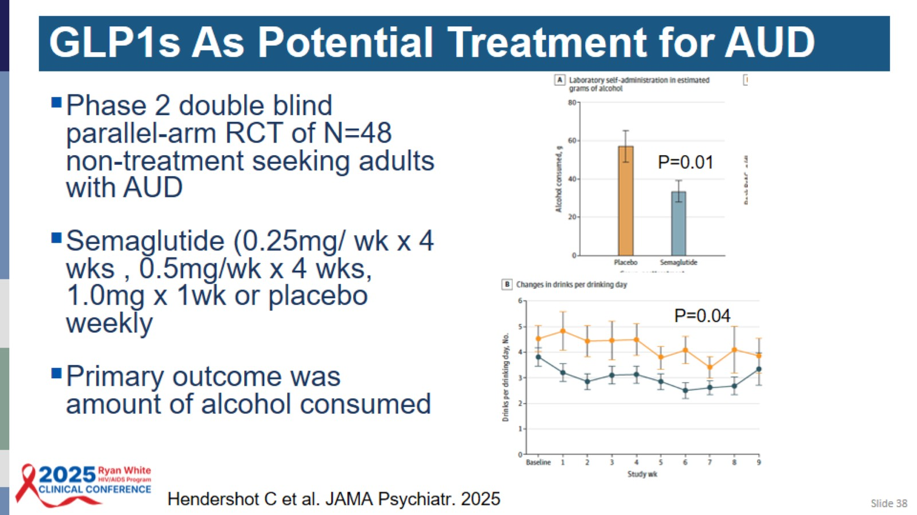

Slide 39
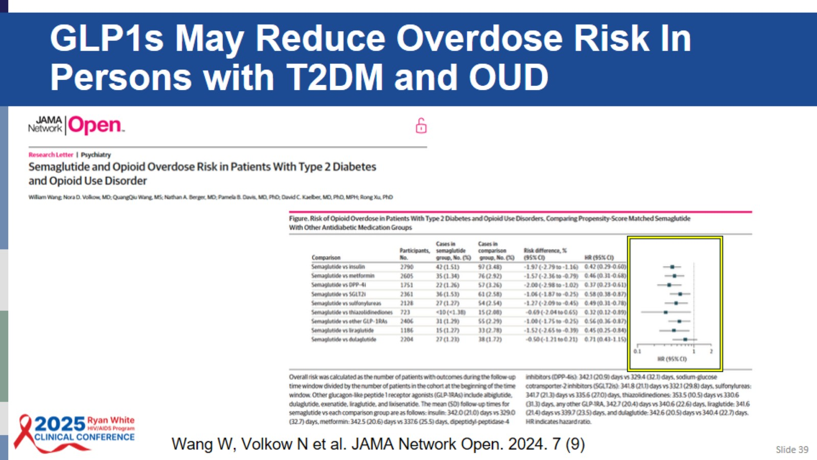
GLP1s May Reduce Overdose Risk In Persons with T2DM and OUD

Slide 40

Treatment of SUD Improves Viral Suppression in People with HIV

Slide 41
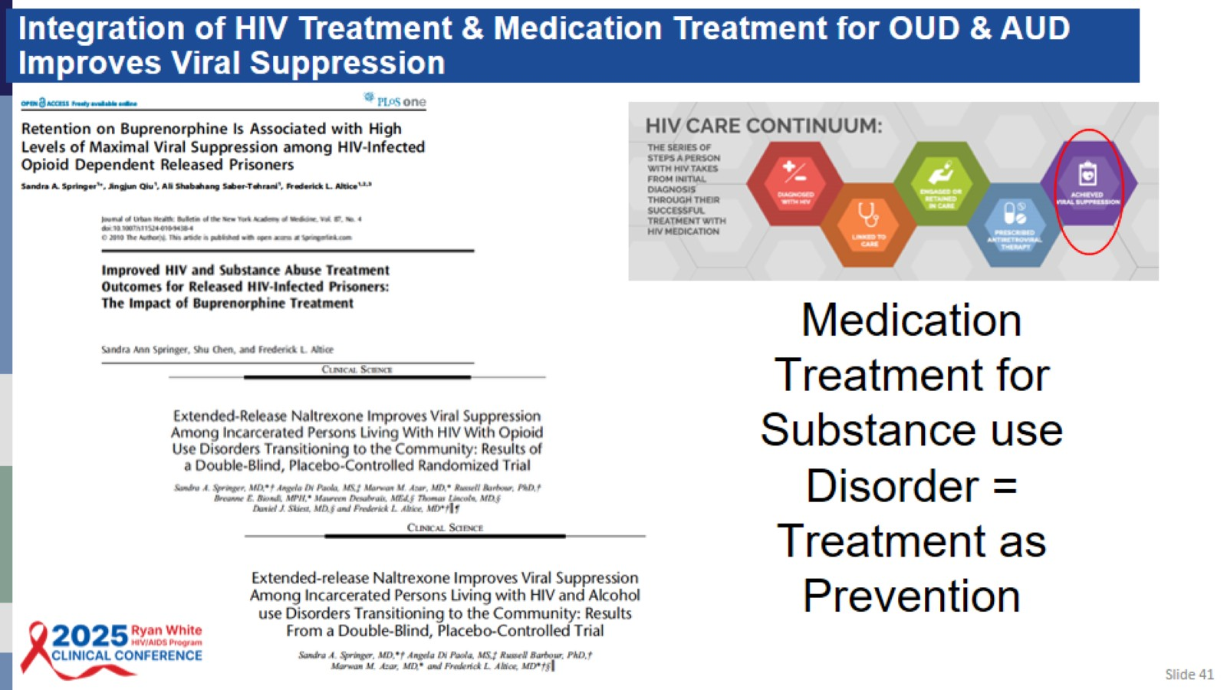
Integration of HIV Treatment & Medication Treatment for OUD & AUD Improves Viral Suppression

Slide 42
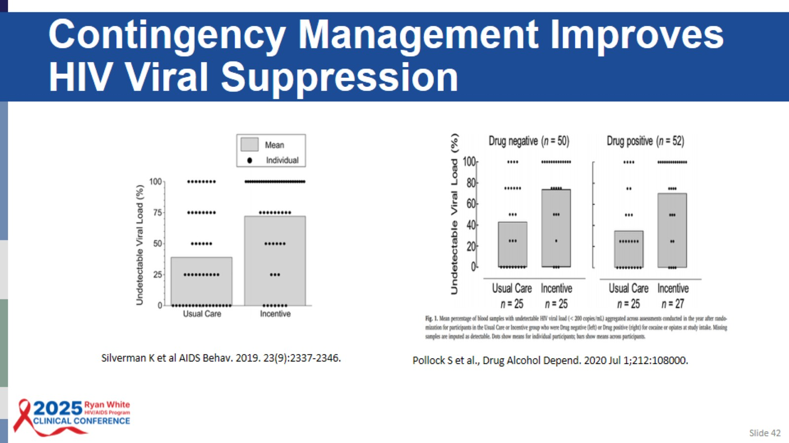
Contingency Management Improves HIV Viral Suppression

Slide 43
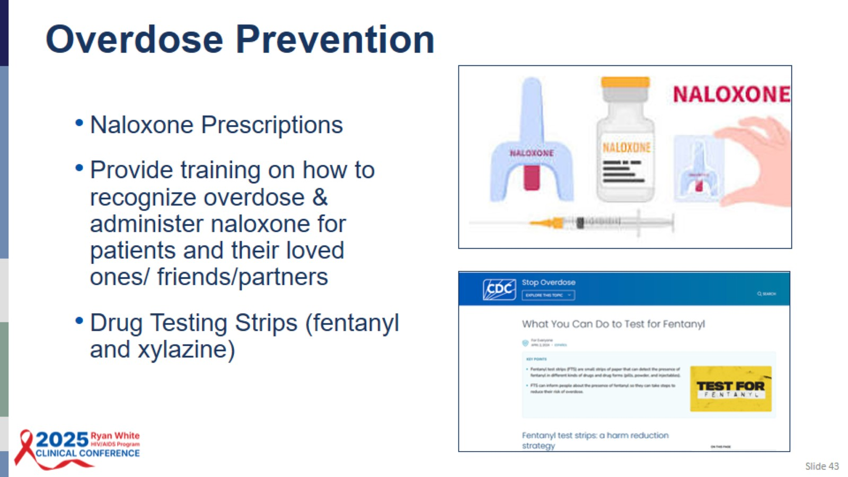

Slide 44

Retain in Care: Overcome Barriers

Slide 45
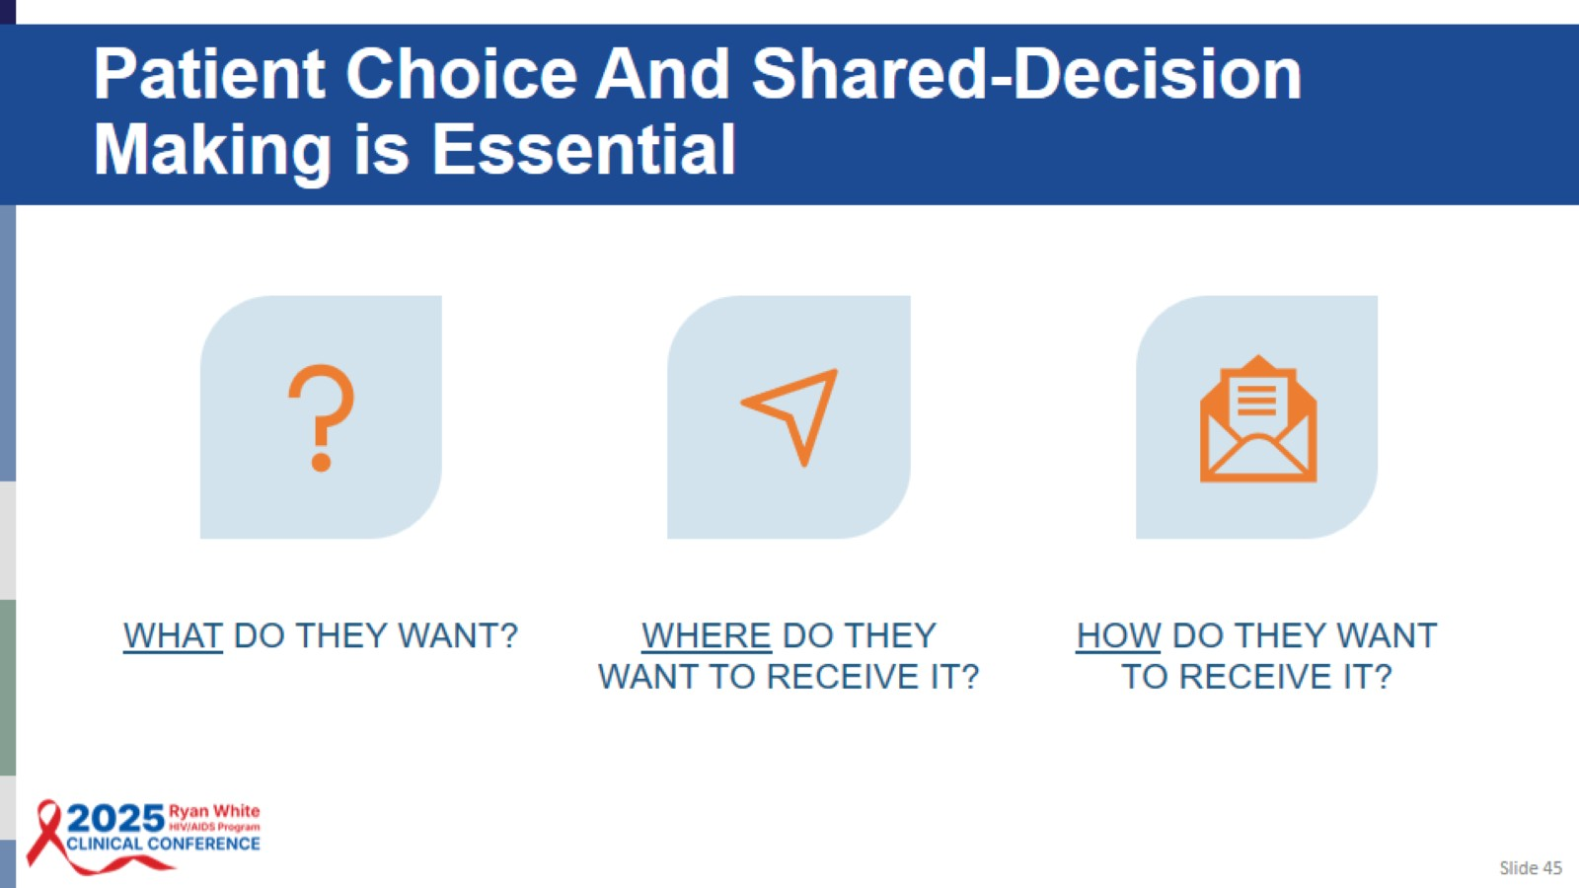
Patient Choice And Shared-Decision Making is Essential

Slide 46
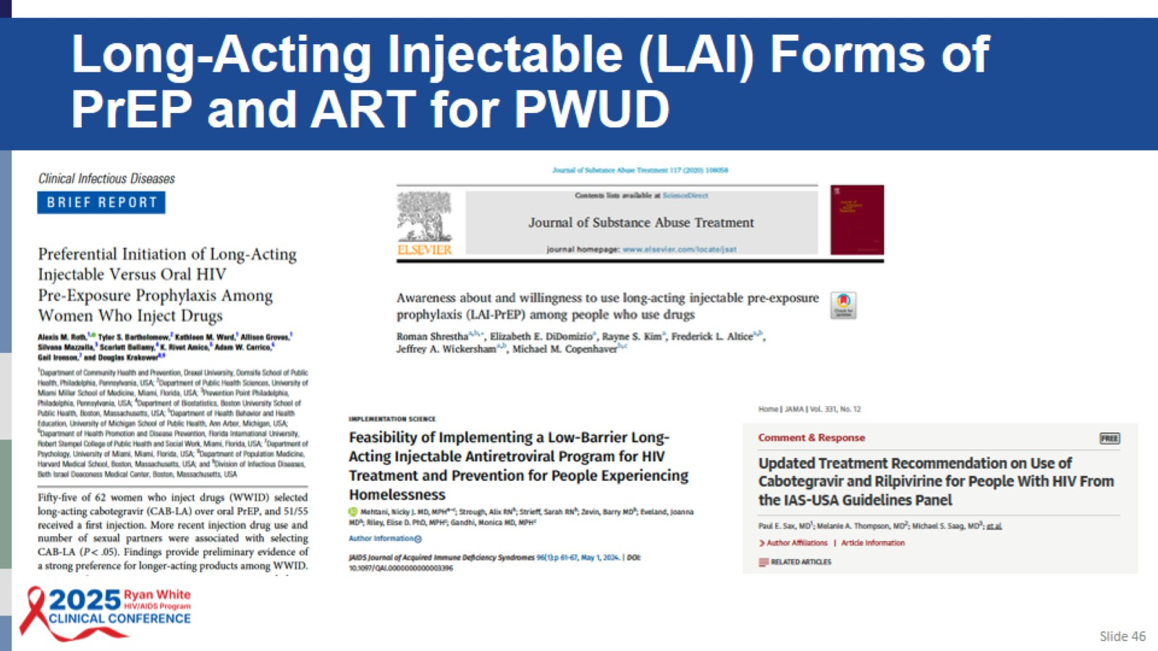
Long-Acting Injectable (LAI) Forms of PrEP and ART for PWUD

Slide 47
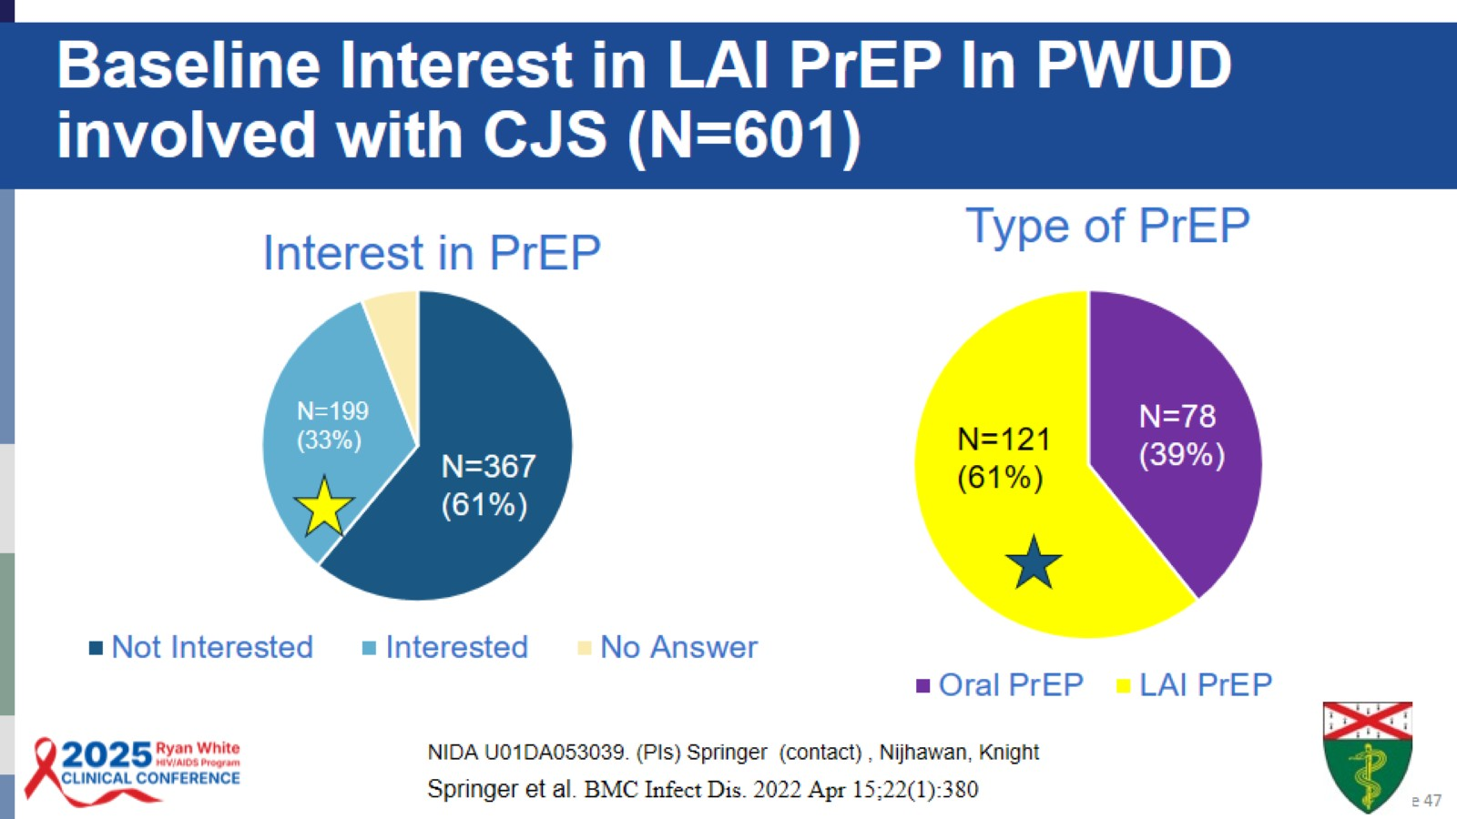
Baseline Interest in LAI PrEP In PWUD involved with CJS (N=601)

Slide 48
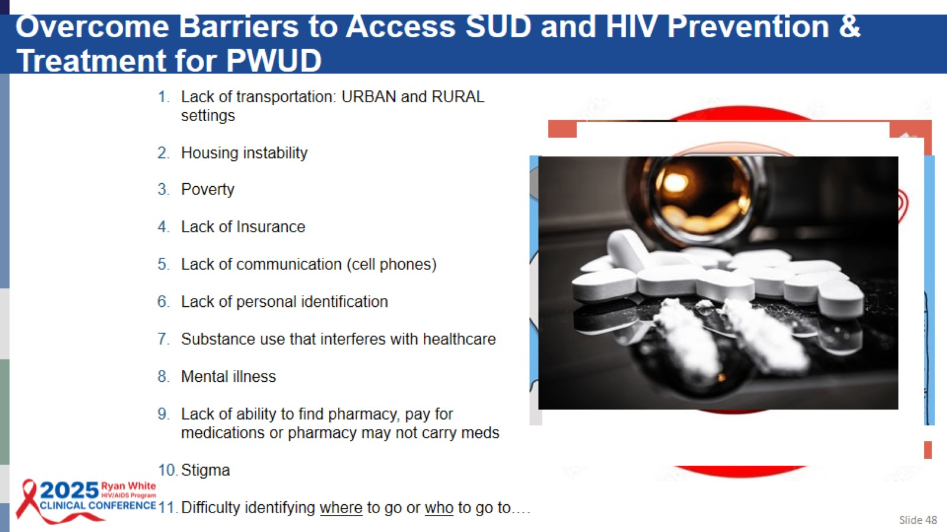
Overcome Barriers to Access SUD and HIV Prevention & Treatment for PWUD

Slide 49
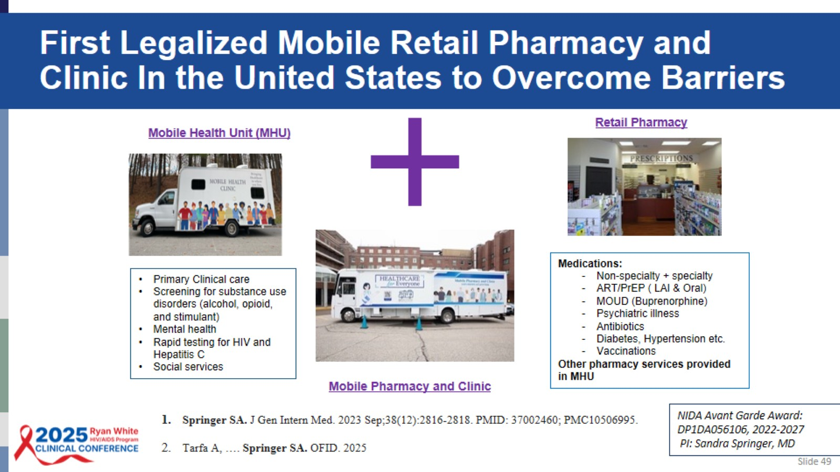
First Legalized Mobile Retail Pharmacy and Clinic In the United States to Overcome Barriers

Slide 50
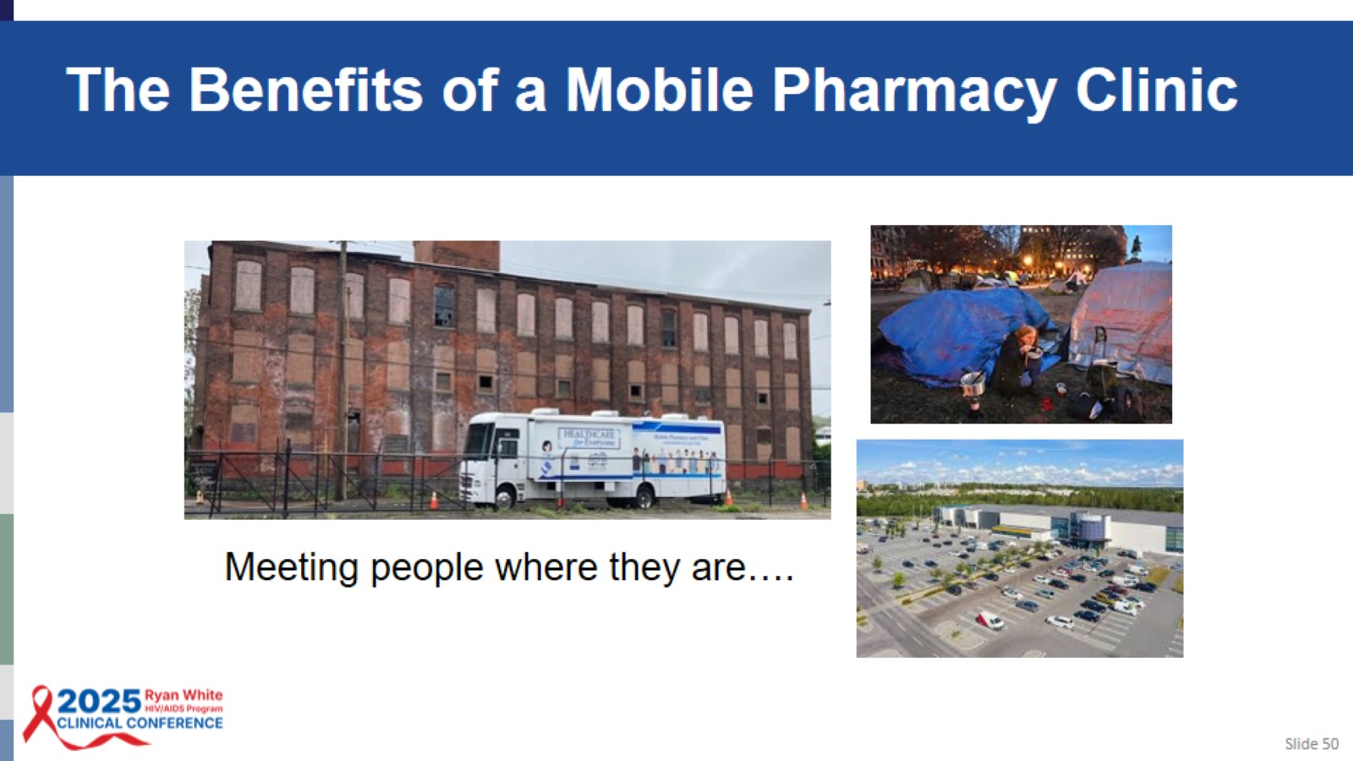
The Benefits of a Mobile Pharmacy Clinic

Slide 51
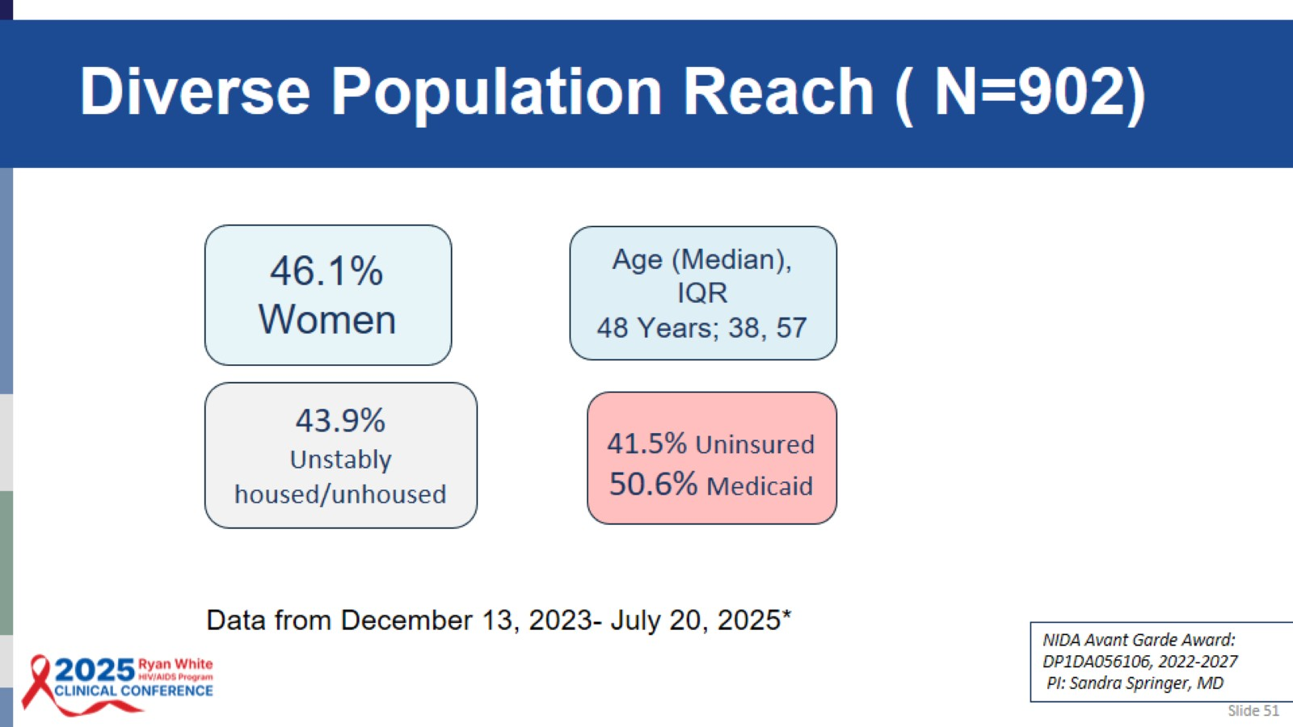
Diverse Population Reach ( N=902)

Slide 52
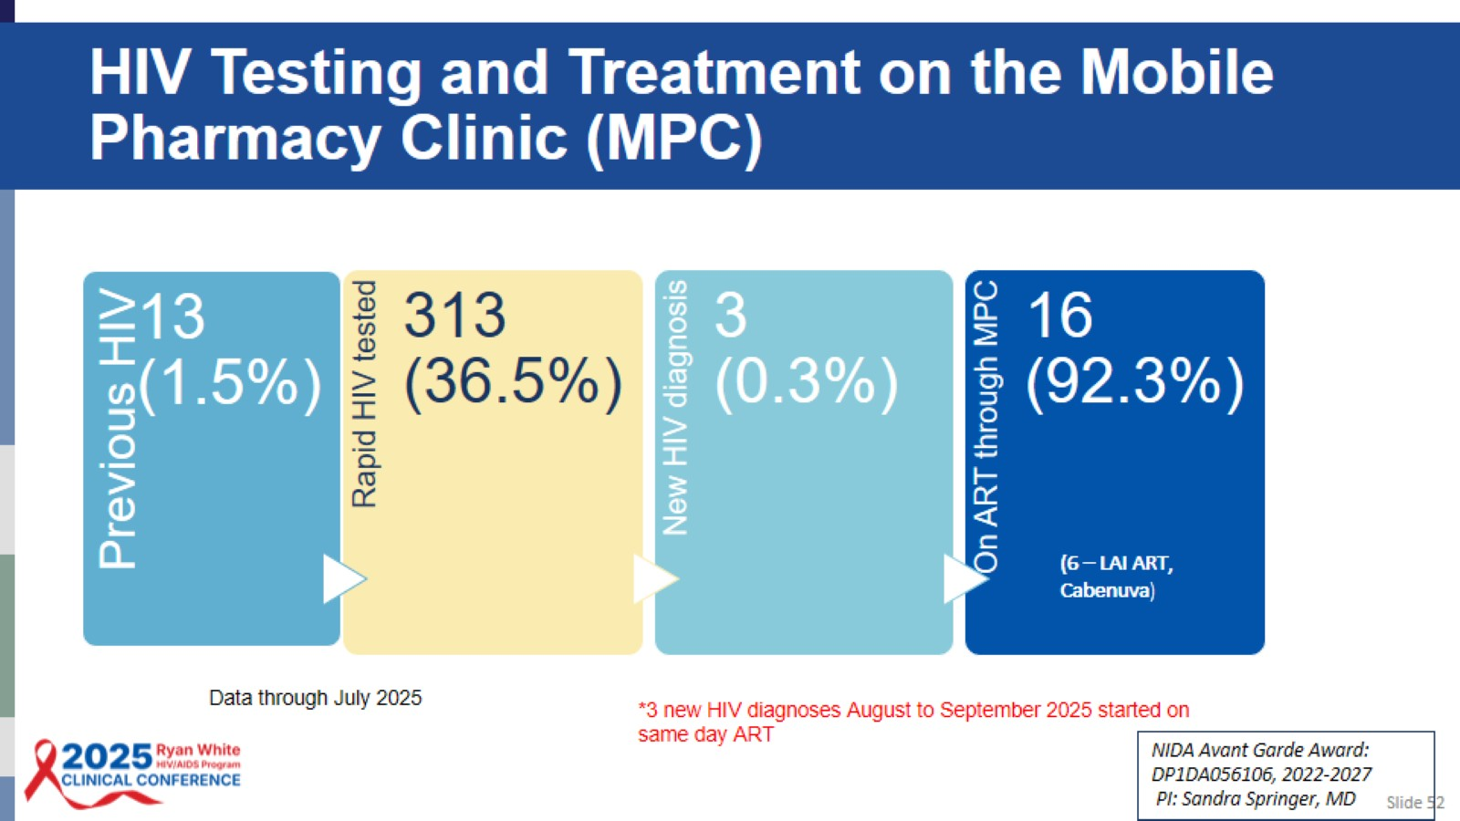
HIV Testing and Treatment on the Mobile Pharmacy Clinic (MPC)

Slide 53
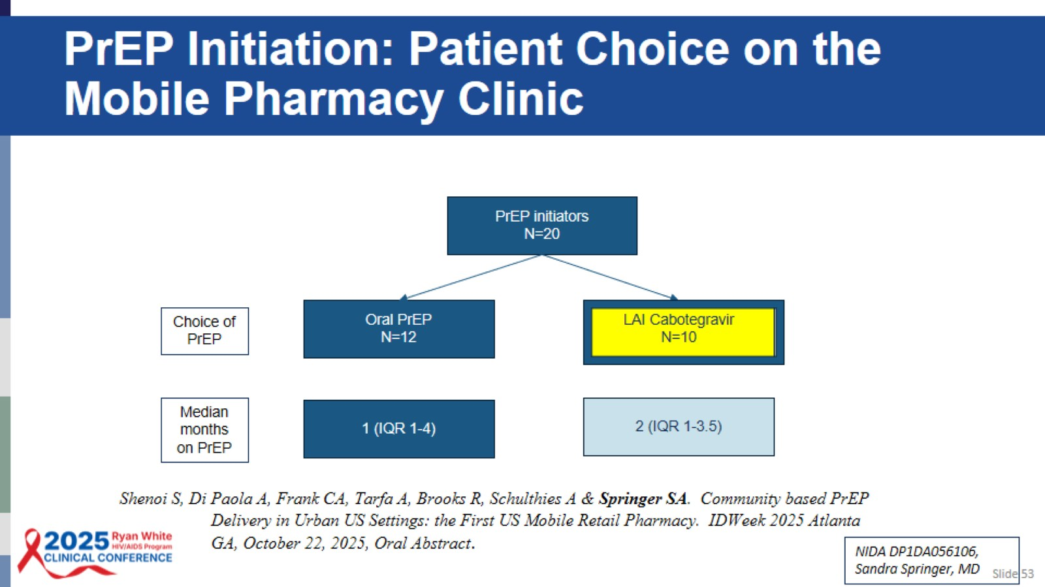
PrEP Initiation: Patient Choice on the Mobile Pharmacy Clinic

Slide 54
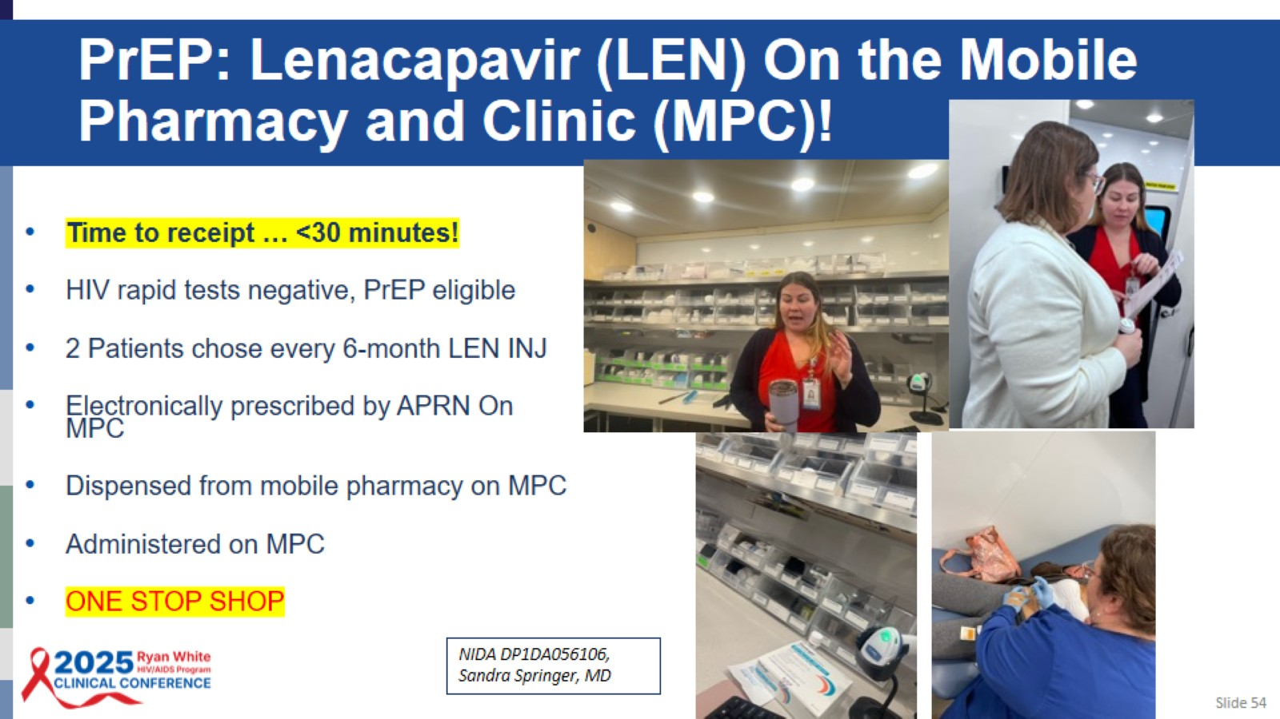
PrEP: Lenacapavir (LEN) On the Mobile Pharmacy and Clinic (MPC)!

Slide 55

Other Resources

Slide 56
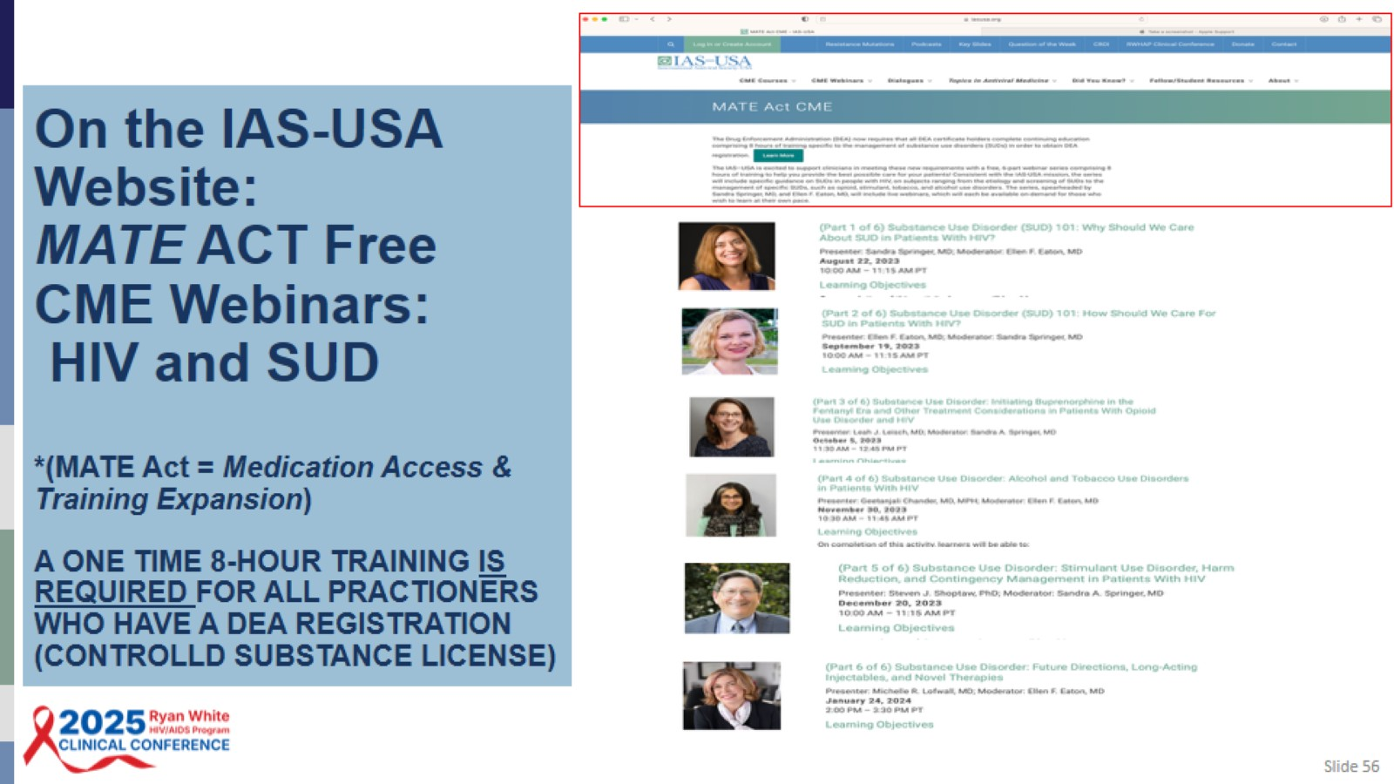
On the IAS-USA Website:
MATE ACT Free CME Webinars:
HIV and SUD
*(MATE Act = Medication Access & Training Expansion)
A ONE TIME 8-HOUR TRAINING IS REQUIRED FOR ALL PRACTIONERS WHO HAVE A DEA REGISTRATION (CONTROLLD SUBSTANCE LICENSE)

Slide 57

National Substance Use Warmline

Slide 58

HIV Prevention and Treatment Guidelines that include SUD Management

Slide 59

Acknowledgements

Slide 60

Question-and-Answer Session

Slide 61

APPENDIX

Slide 62

Posttest Question #1

Slide 63

Posttest Explanation #1

Slide 64

Posttest Question #2

Slide 65

Posttest Explanation #1

