Slide 1
Updates From CROI 2019: Trends in the HIV Epidemic and Progress in Prevention

Slide 2
Updates From CROI 2019: Trends in the HIV Epidemic and Progress in Prevention

Slide 5
CME Information

Slide 6
Nursing and Pharmacy Credits

Slide 7
Grant Support for this Webinar

Slide 8
Navigating the Webinar

Slide 9
Poll 1

Slide 10
Poll 2

Slide 11
Updates From CROI 2019: Trends in the HIV Epidemic and Progress in Prevention

Slide 12
Financial Relationships With Commercial Entities

Slide 13
Learning Objectives

Slide 14
Pretest Question 1

Slide 15
Pretest Question 2

Slide 16
Outline

Slide 17
Outline

Slide 25
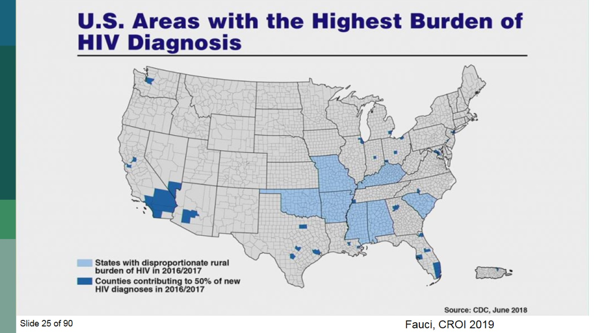

Slide 32
Outline

Slide 33
Undetectable = Untransmittable

Slide 35
Proving the negative: Difficult, if not impossible

Slide 39
Implementing U=U in the Clinic: Can We Predict Non-suppression? (Gillani, Abstract 1056)

Slide 40
Outline

Slide 45
Overdoses in the ALIVE Cohort

Slide 46
Rise in overdose deaths in PLWH, Washington DC, 2013-2017

Slide 47
Suicide rates among PLWH in the US, 2000-2015 (Atlhoff, #893)

Slide 48
Predictors of Suicidality in 11 US Cities

Slide 49
New HIV diagnoses among US PWID, 2010 – 2017 (Lyss, #886)

Slide 50
HIV Outbreaks in PWID in urban centers, Seattle and Massachusetts

Slide 51
Outline

Slide 57
Higher STI rates not just a result of increased screening

Slide 58
GC testing and positivity rates increased in the HOPS study

Slide 59
Outline

Slide 68
PrEP Awareness and Use Increasing in US MSM, NHBS

Slide 69
PrEP Awareness Low Among Women at Risk

Slide 72
TelePrEP as Novel Delivery Approach

Slide 73
PrEP persistence in privately insured and Medicaid patients

Slide 74
Drug resistance among PrEP users who became infected in NYC

Slide 76
Sequential Appearance of Viral Markers and Antibodies during Acute HIV Infection

Slide 77
How to Manage Ambiguous HIV Test Results

Slide 78
How to Manage Ambiguous HIV Test Results

Slide 79
In IPERGAY, fewer pills had less renal effect

Slide 80
Posttest Question 1

Slide 81
Posttest Question 2

Slide 82
Question-and-Answer

Slide 84
See the IAS–USA website for instructions on claiming CME, pharmacy, nursing, or pharmacotherapy credits, or a certificate of participation.

Slide 87
Sexual Health, HIV Prevention, and Primary Care in 2019

Slide 90
Thank You

