Slide 1
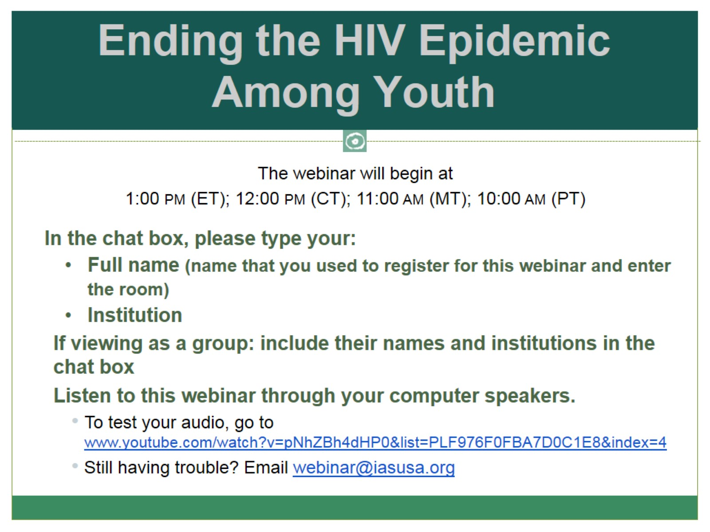
Ending the HIV Epidemic Among Youth

Slide 2

Ending the HIV Epidemic Among Youth

Slide 3
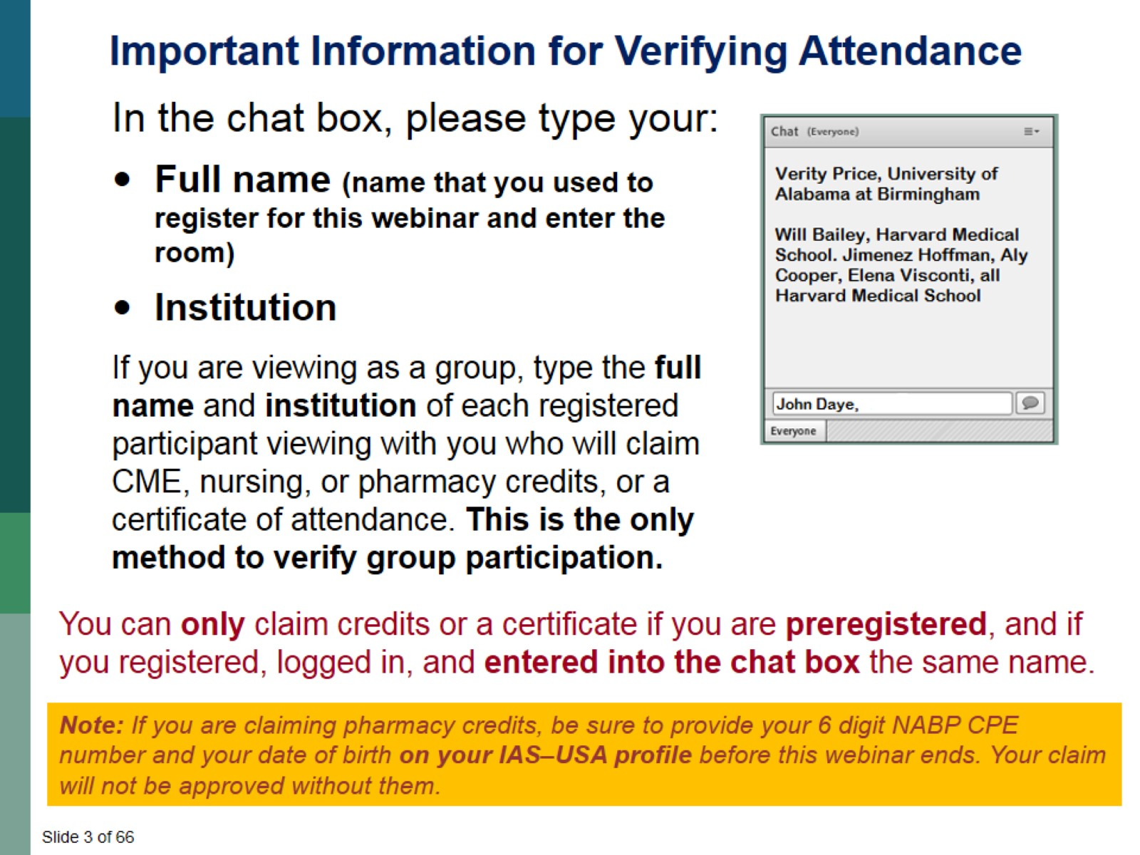

Slide 4
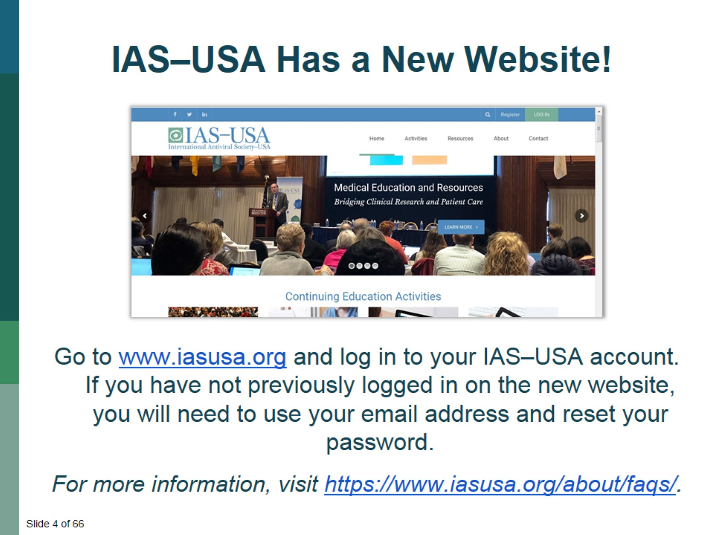

Slide 5
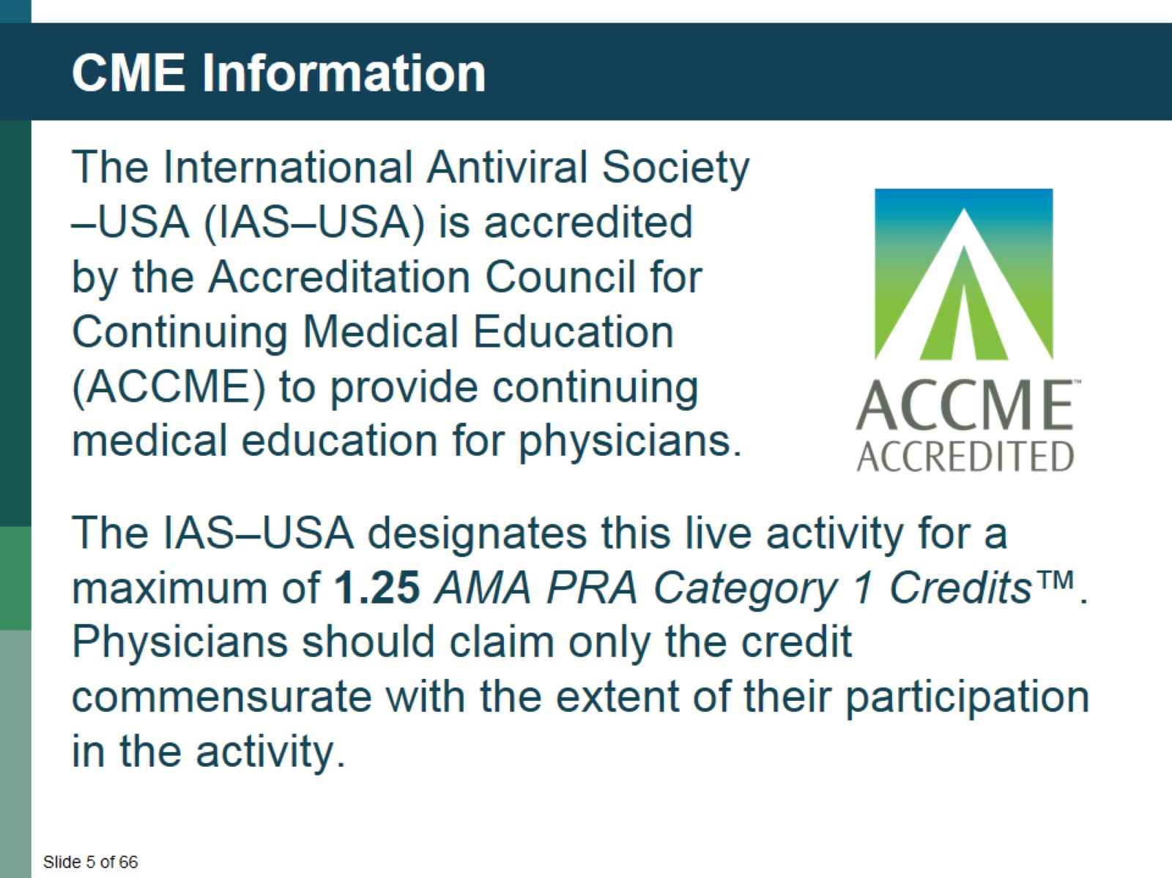
CME Information

Slide 6
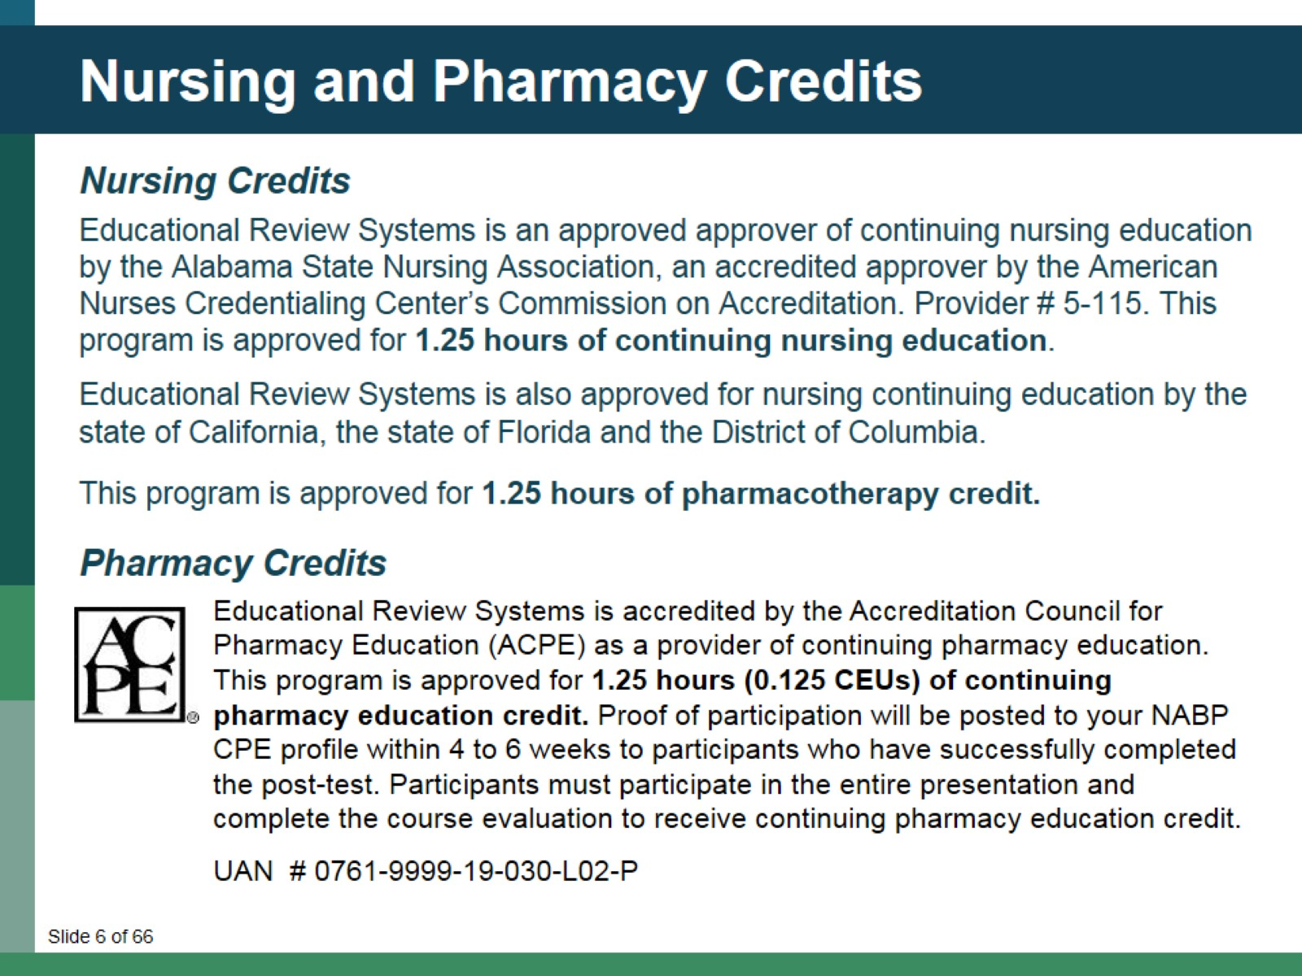
Nursing and Pharmacy Credits

Slide 7
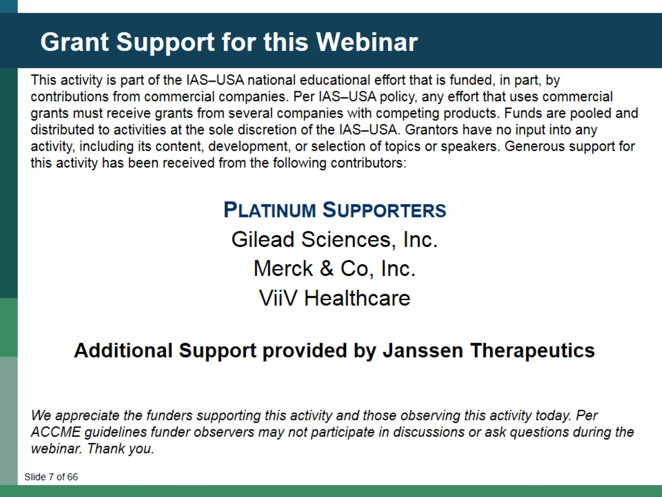
Grant Support for this Webinar

Slide 8
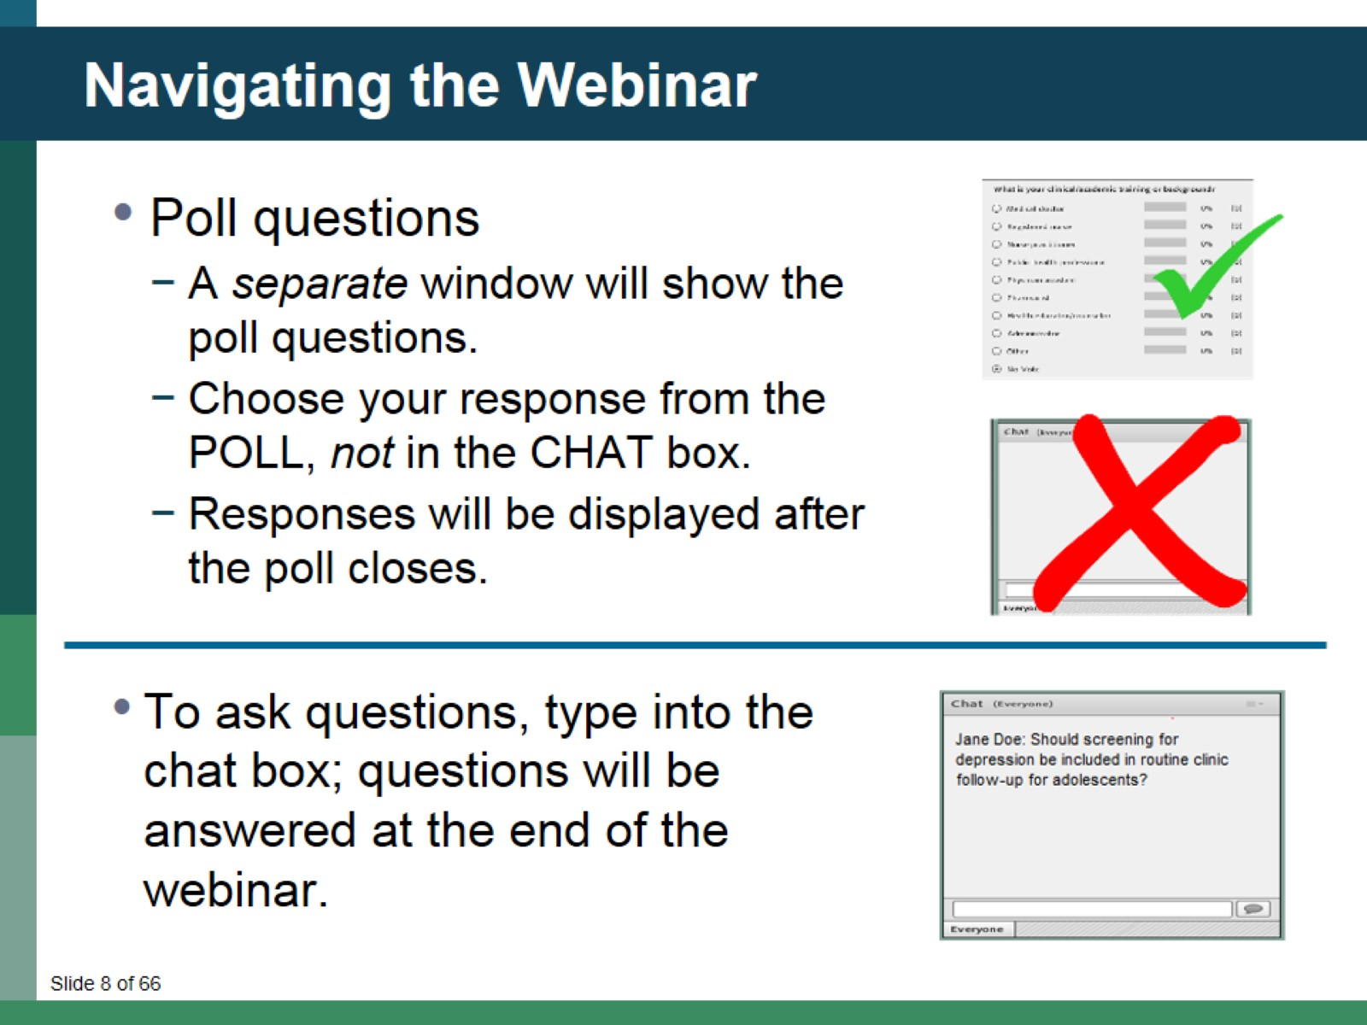
Navigating the Webinar

Slide 9
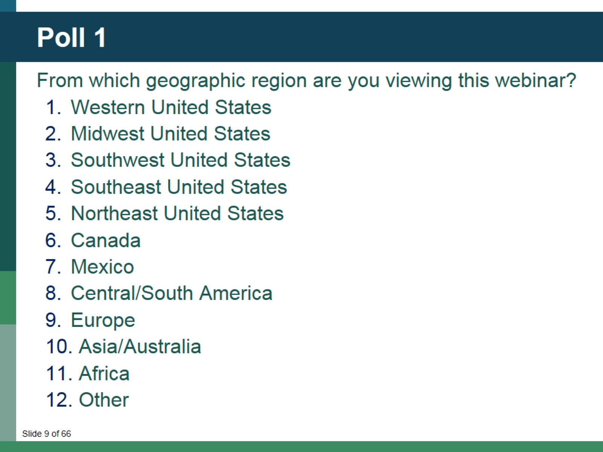
Poll 1

Slide 10
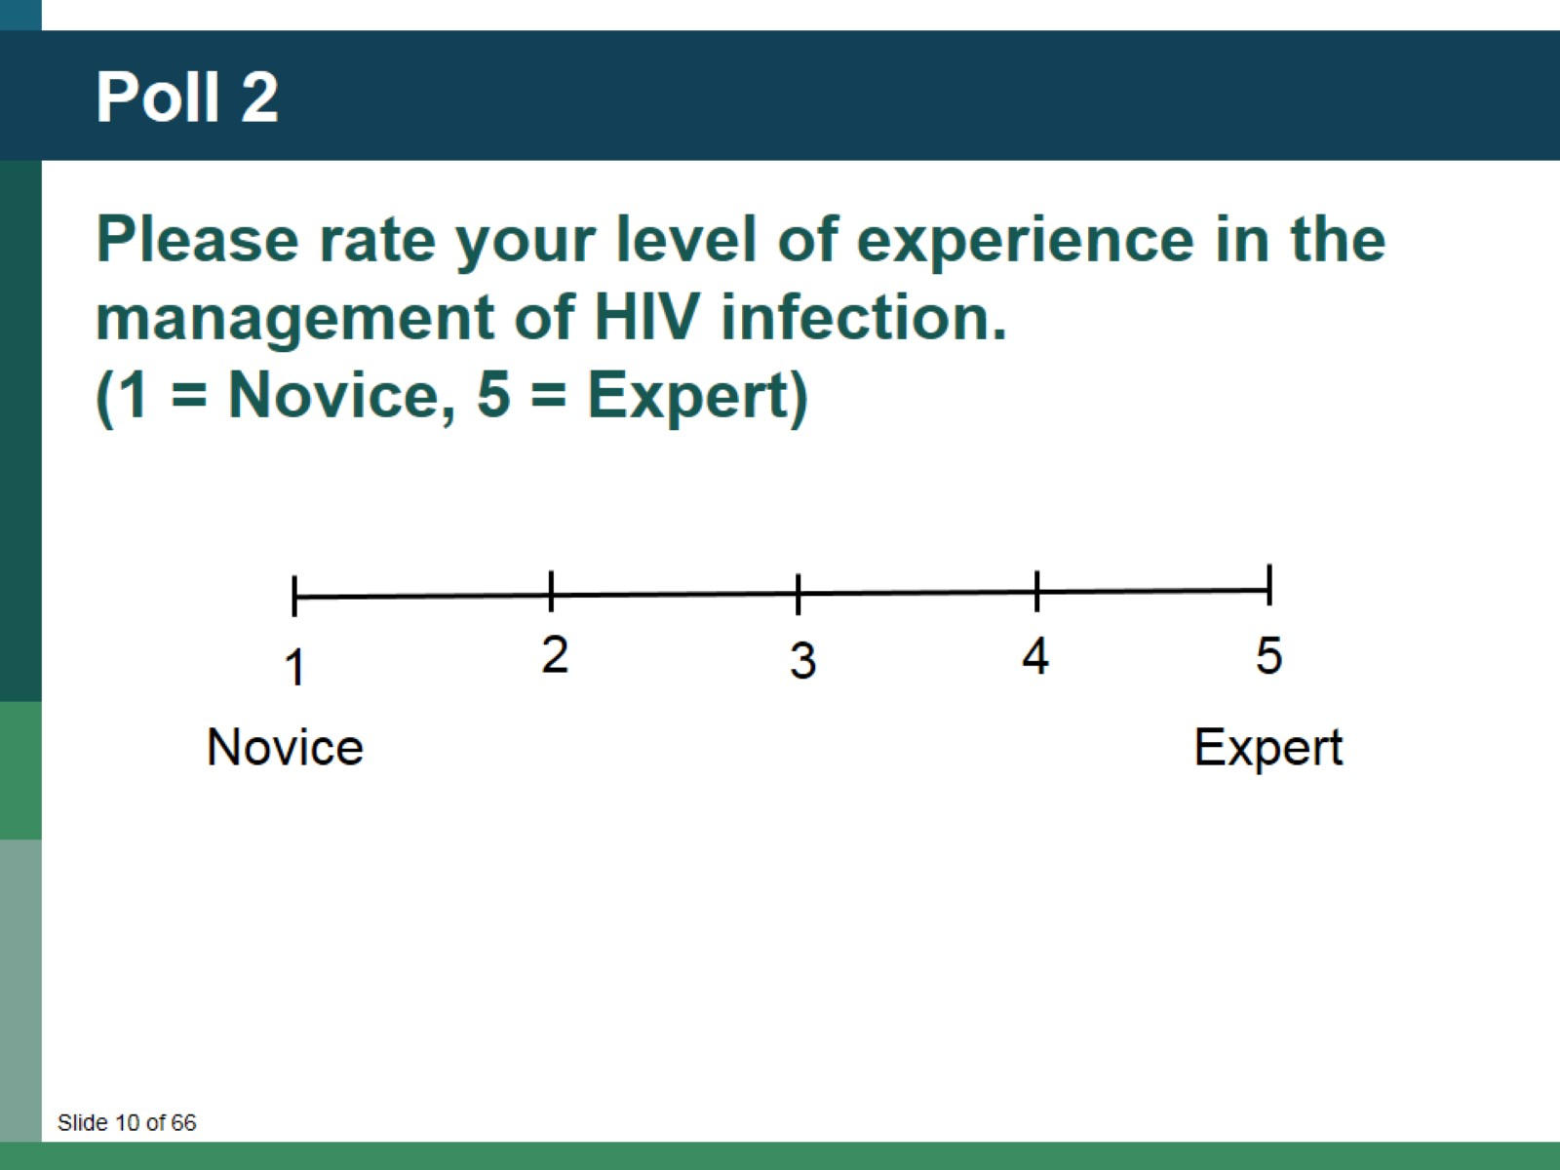
Poll 2

Slide 11
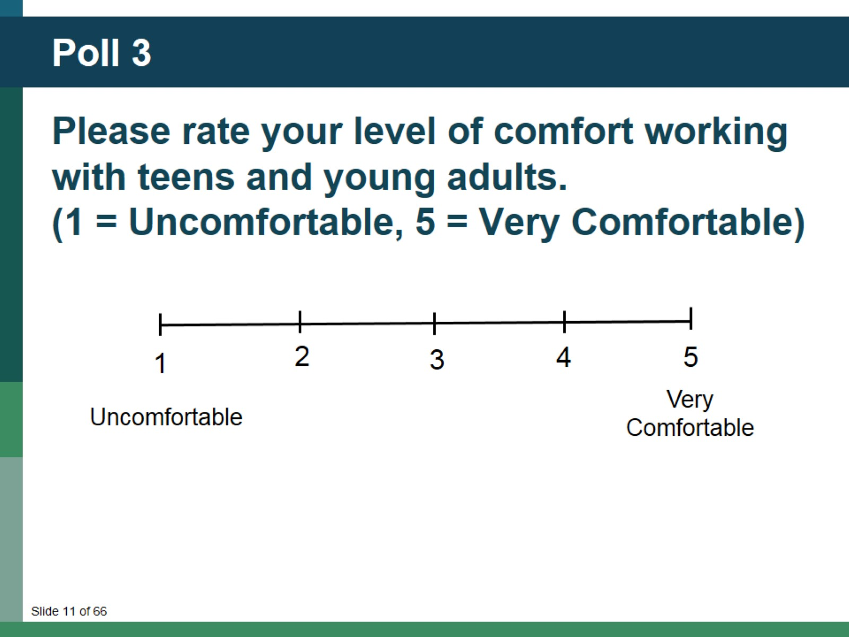
Poll 3

Slide 12

Ending the HIV Epidemic Among Youth

Slide 13
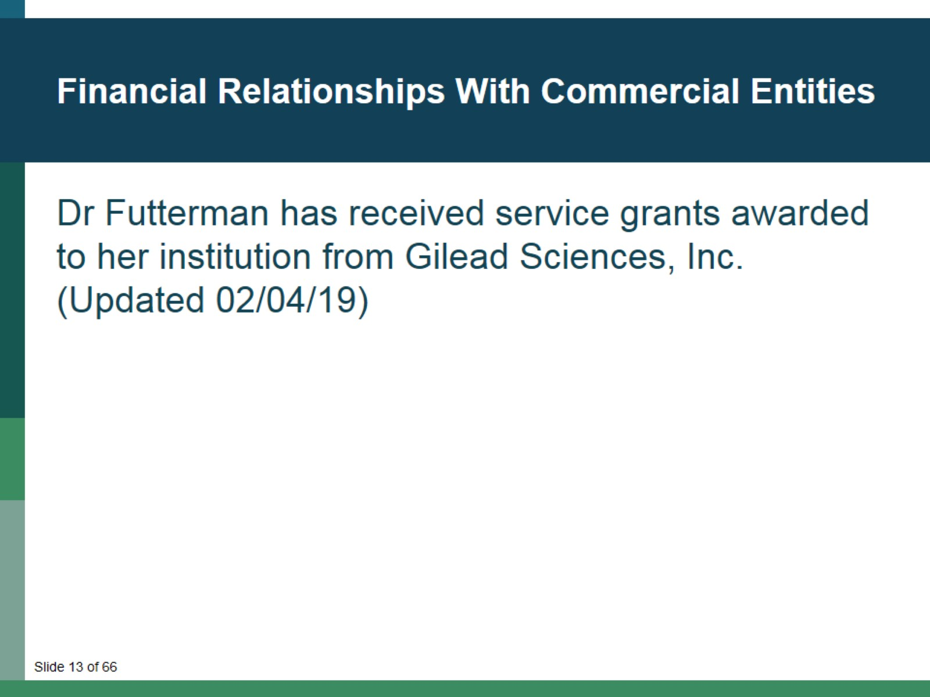
Financial Relationships With Commercial Entities

Slide 14
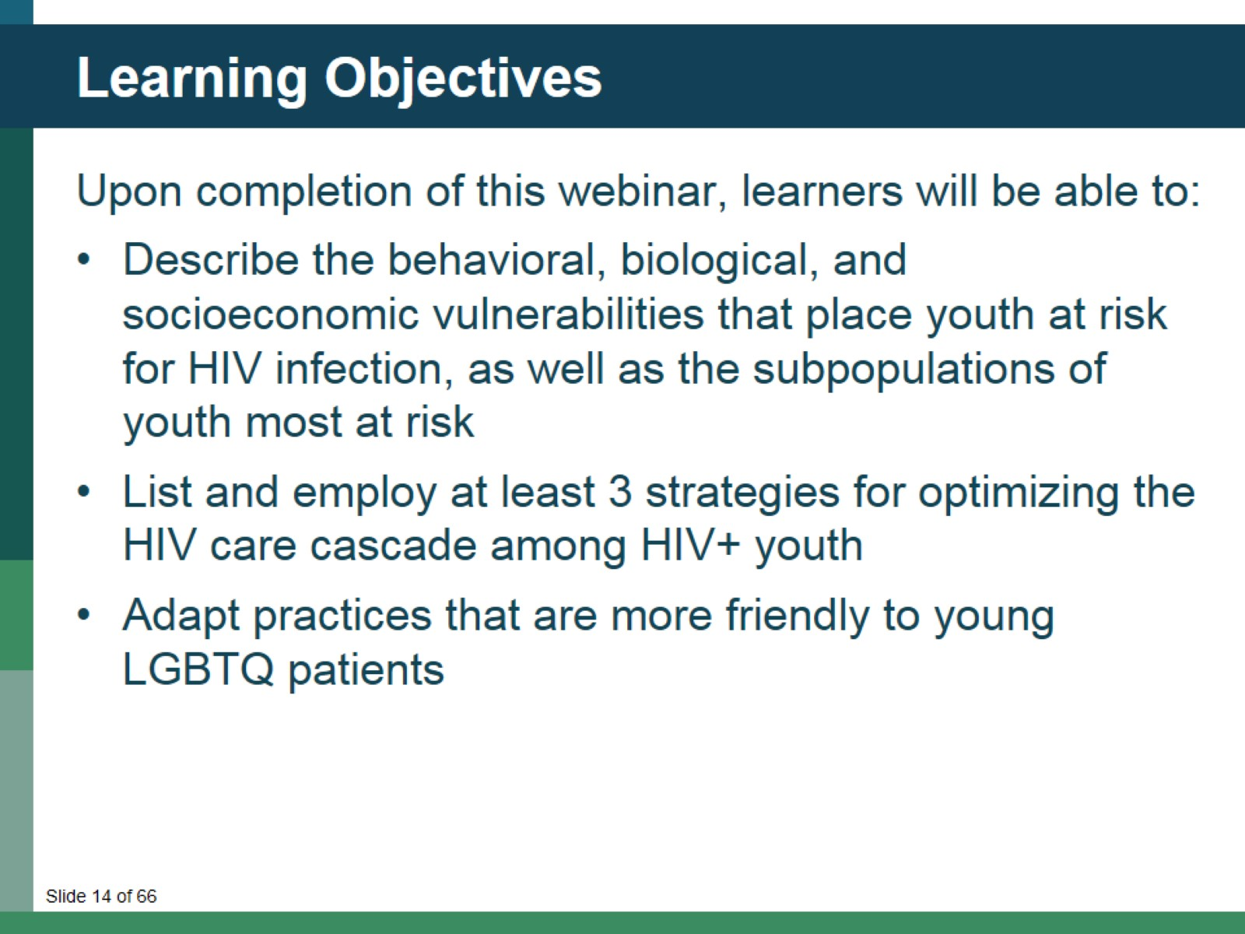
Learning Objectives

Slide 15
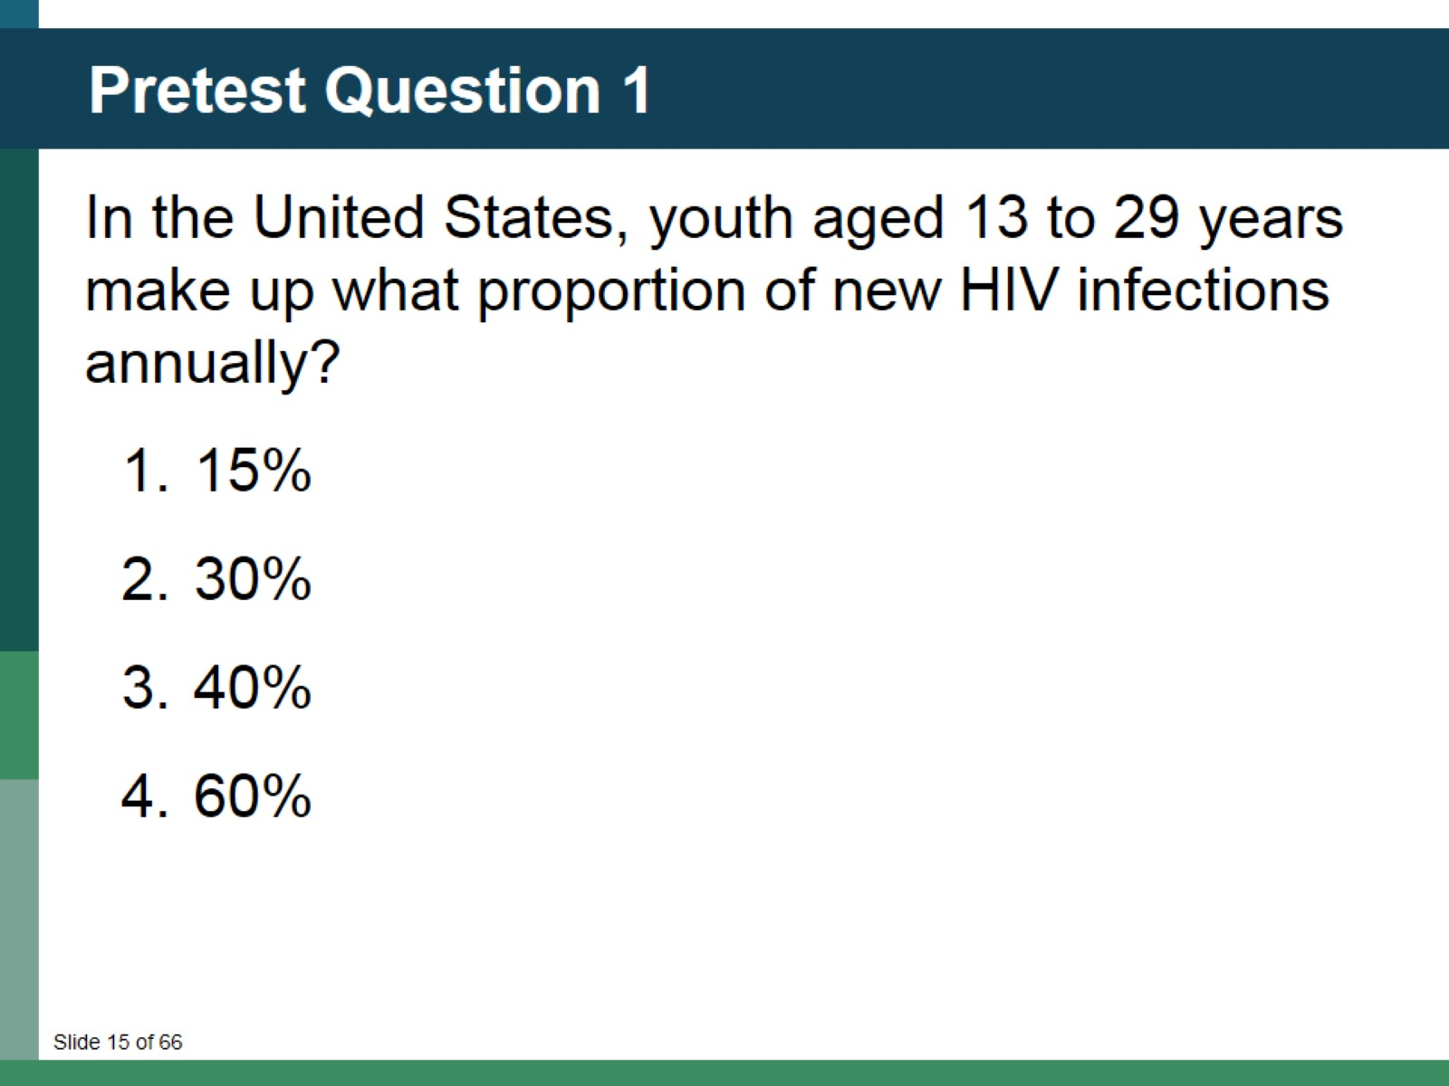
Pretest Question 1

Slide 16
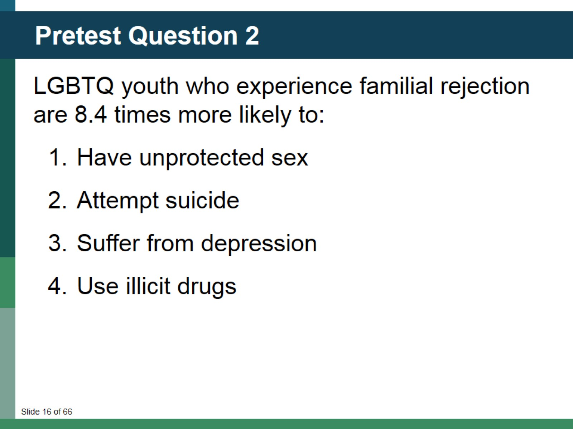
Pretest Question 2

Slide 17
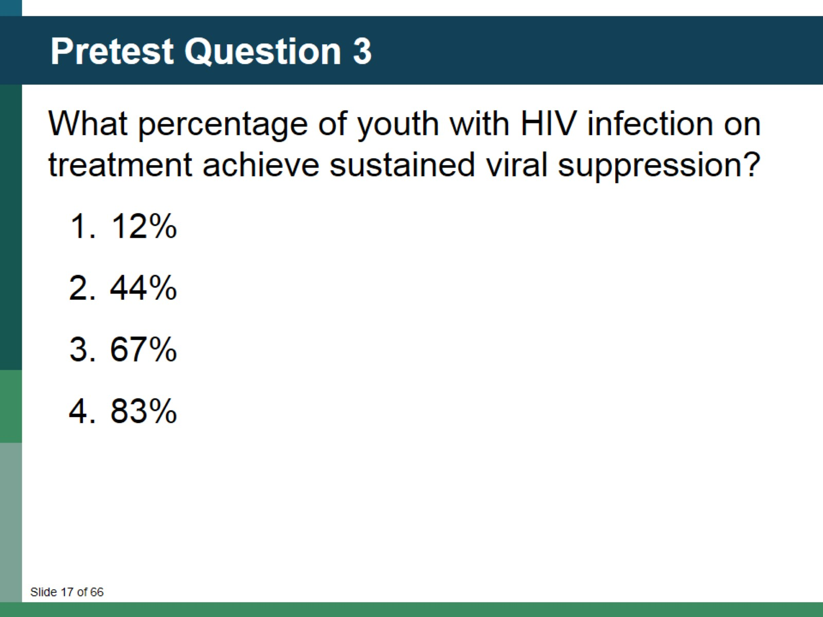
Pretest Question 3

Slide 18
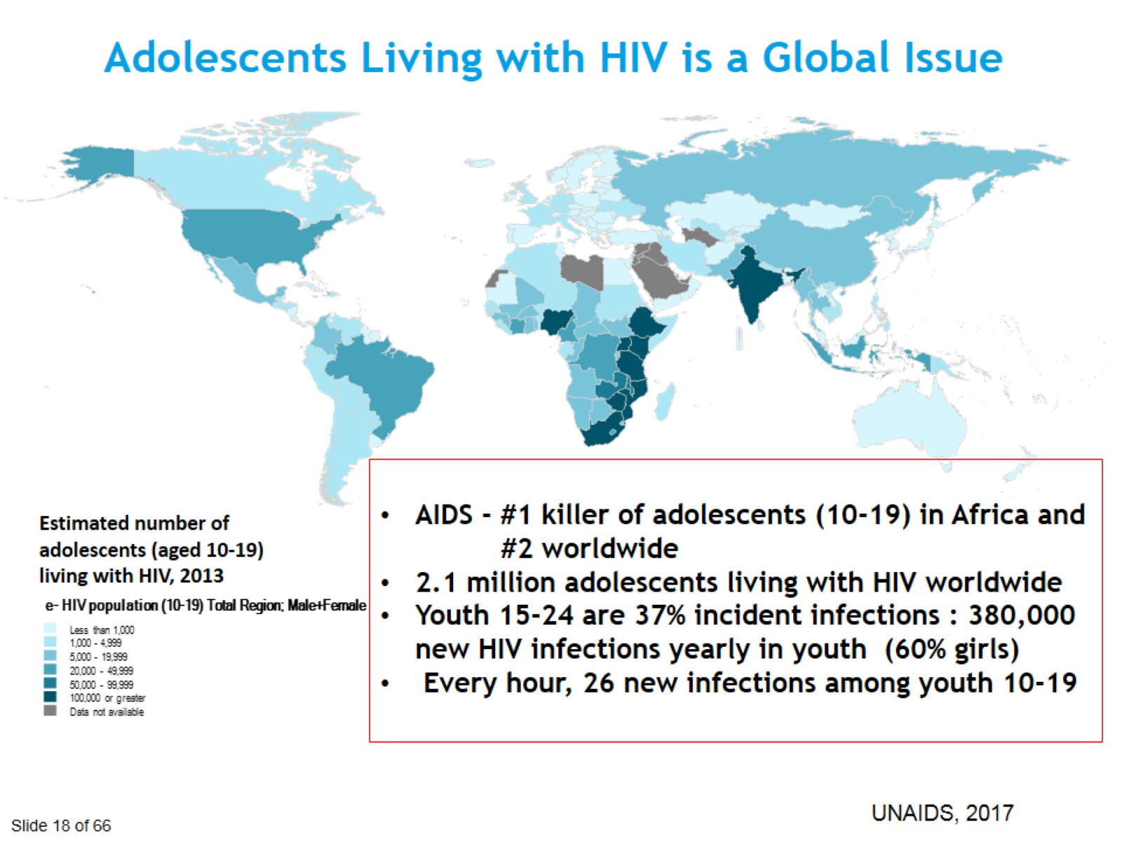
Adolescents Living with HIV is a Global Issue

Slide 19
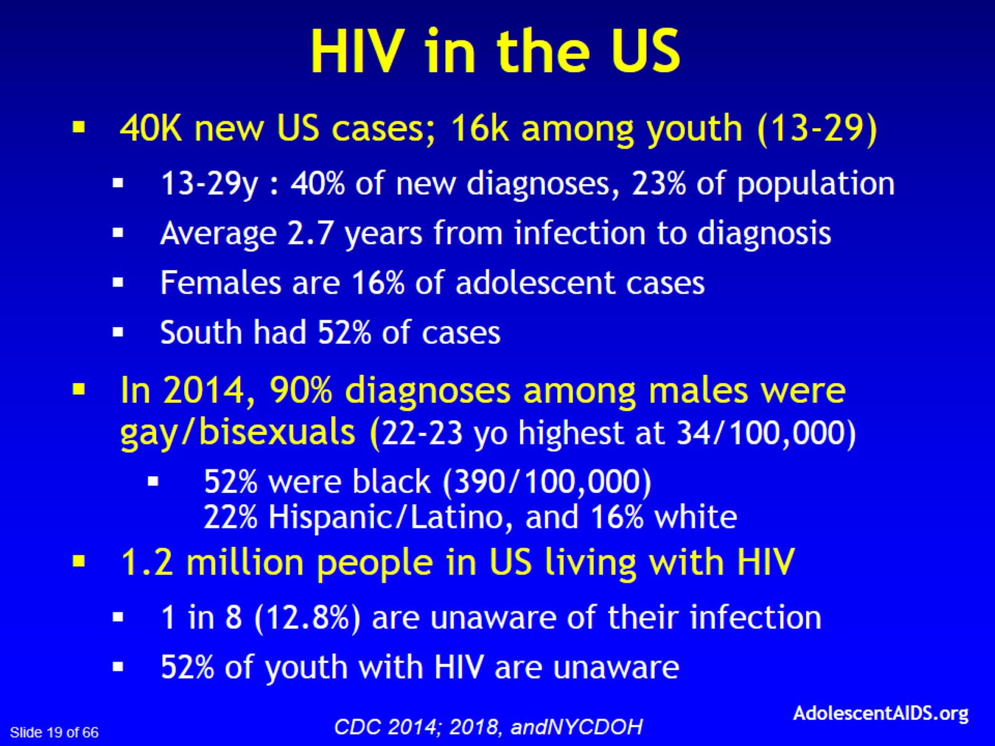

Slide 20
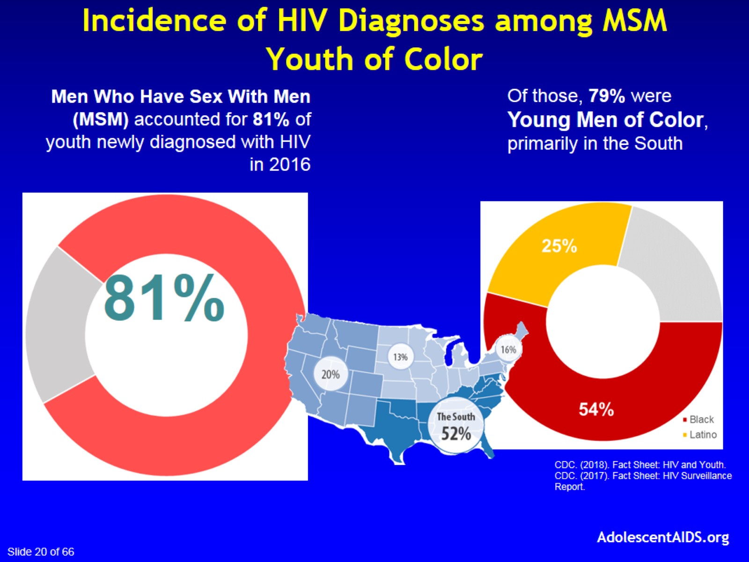
Incidence of HIV Diagnoses among MSM Youth of Color

Slide 21
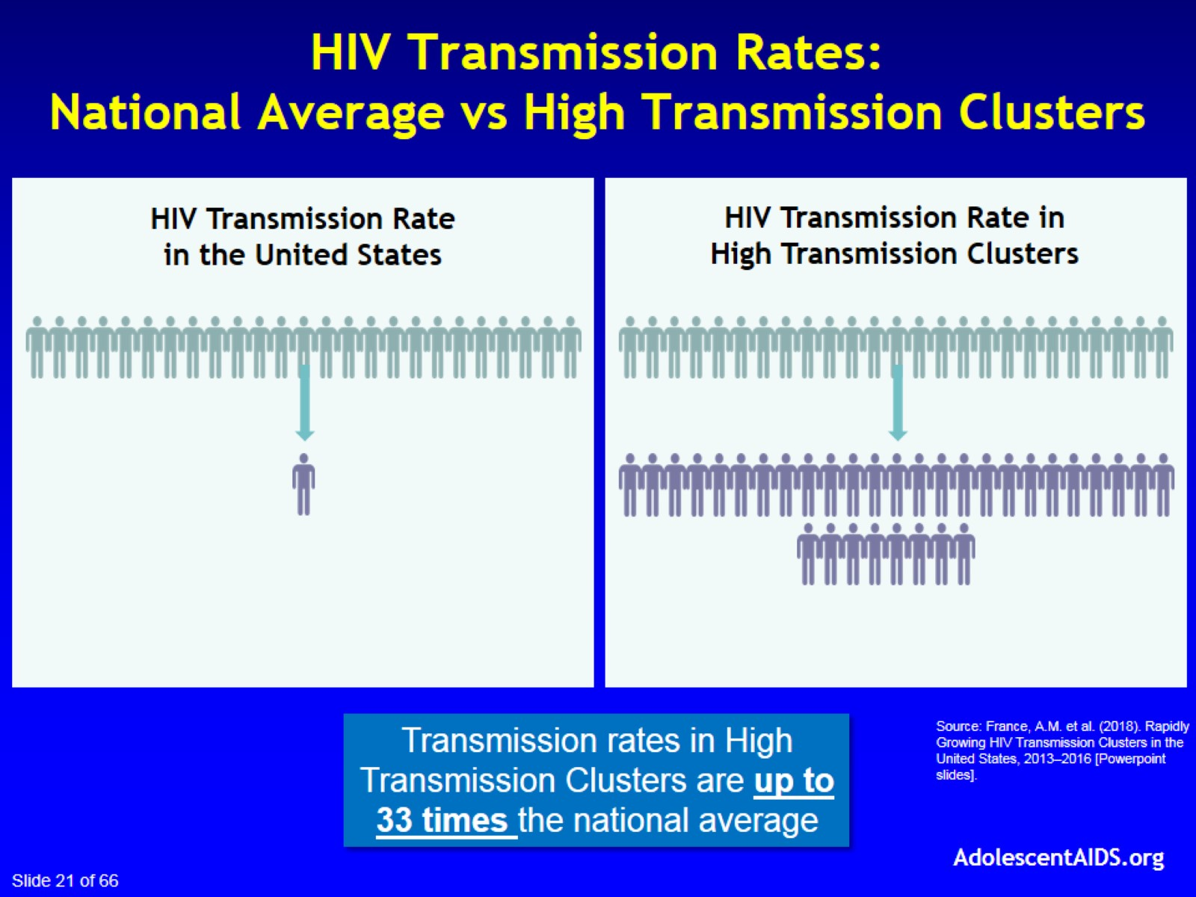
HIV Transmission Rates:
National Average vs High Transmission Clusters

Slide 22
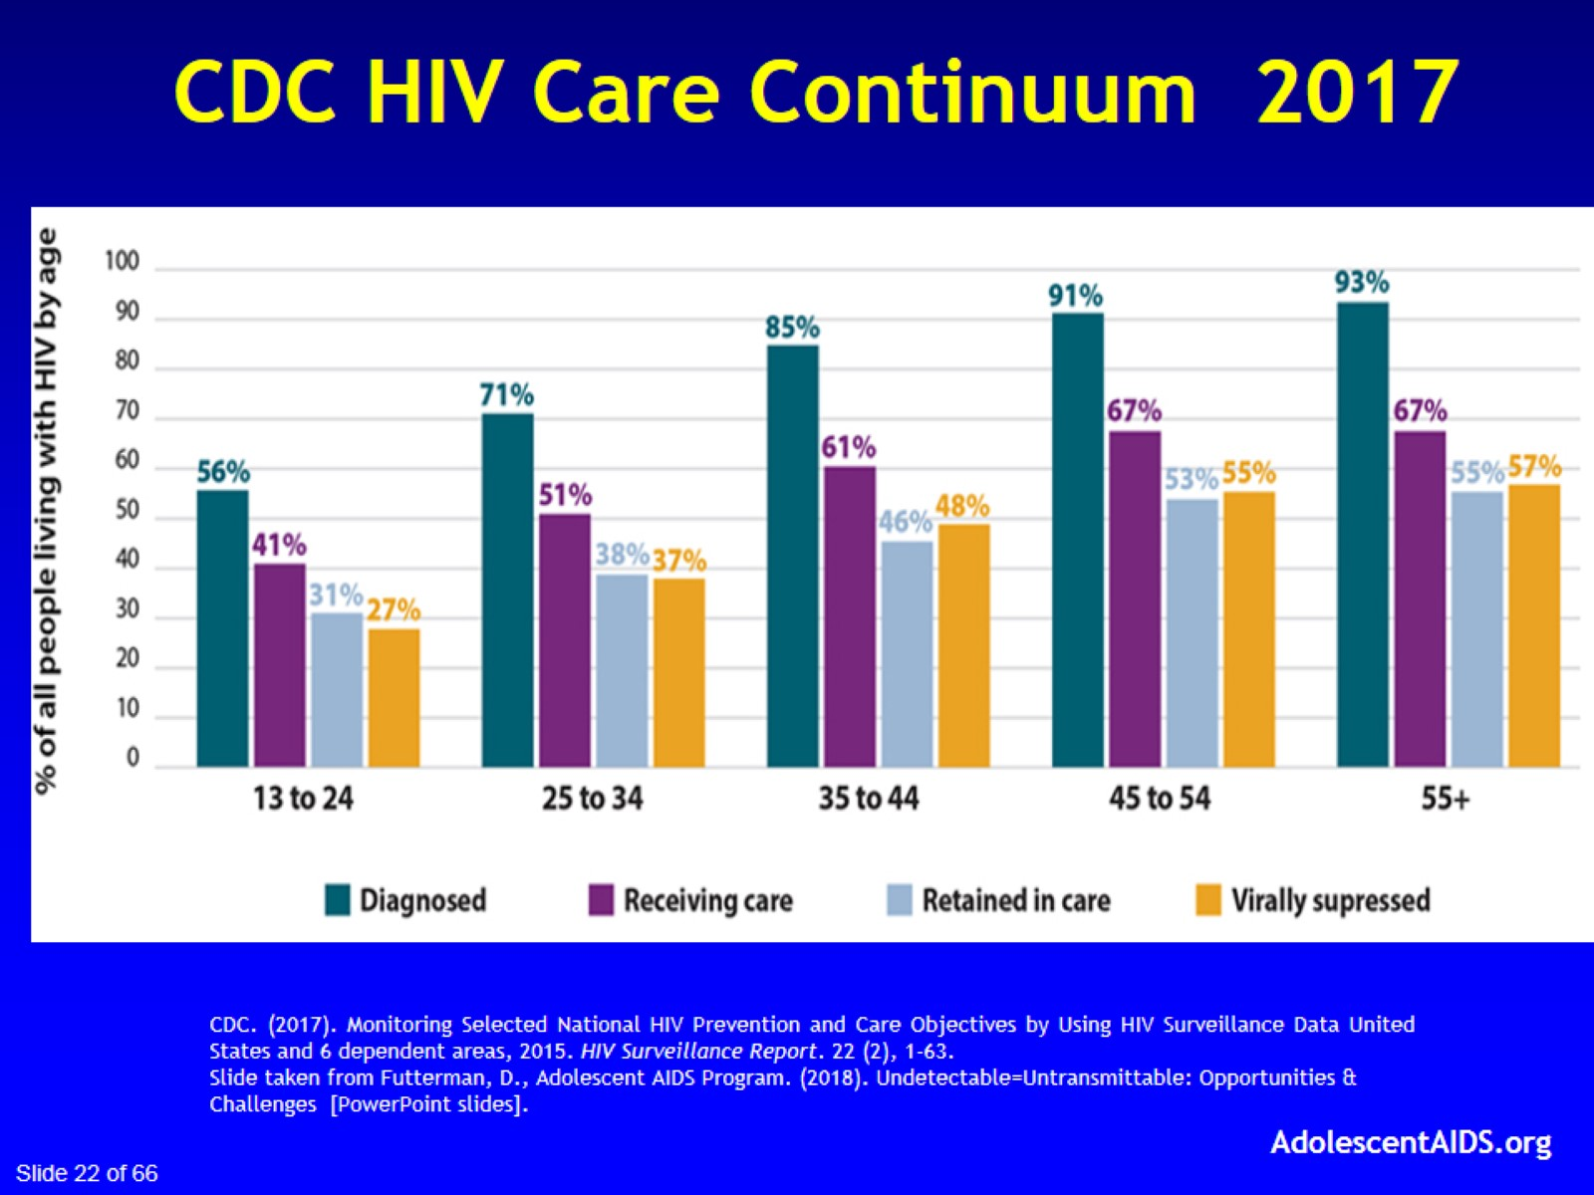
CDC HIV Care Continuum 2017

Slide 23
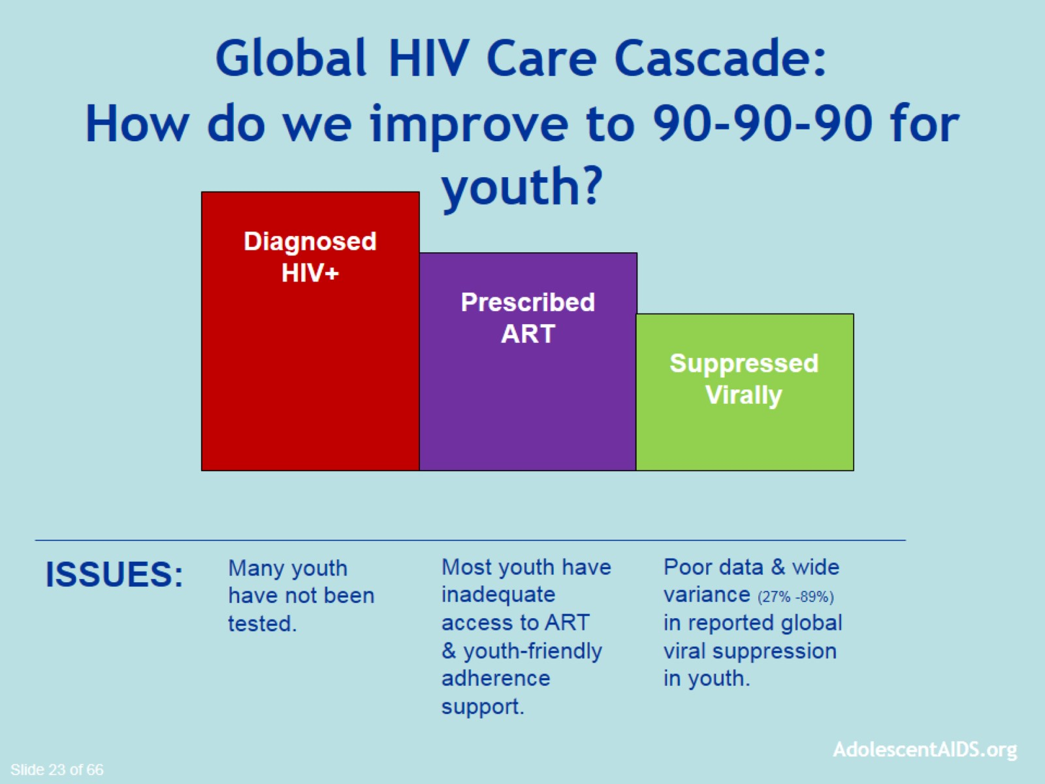
Global HIV Care Cascade:
How do we improve to 90-90-90 for youth?

Slide 24
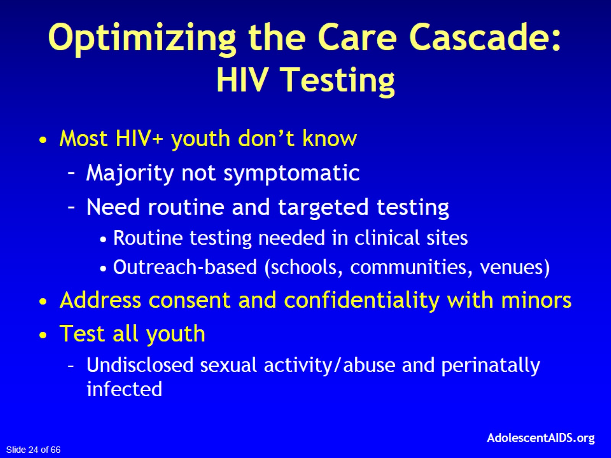
Optimizing the Care Cascade:
HIV Testing

Slide 25
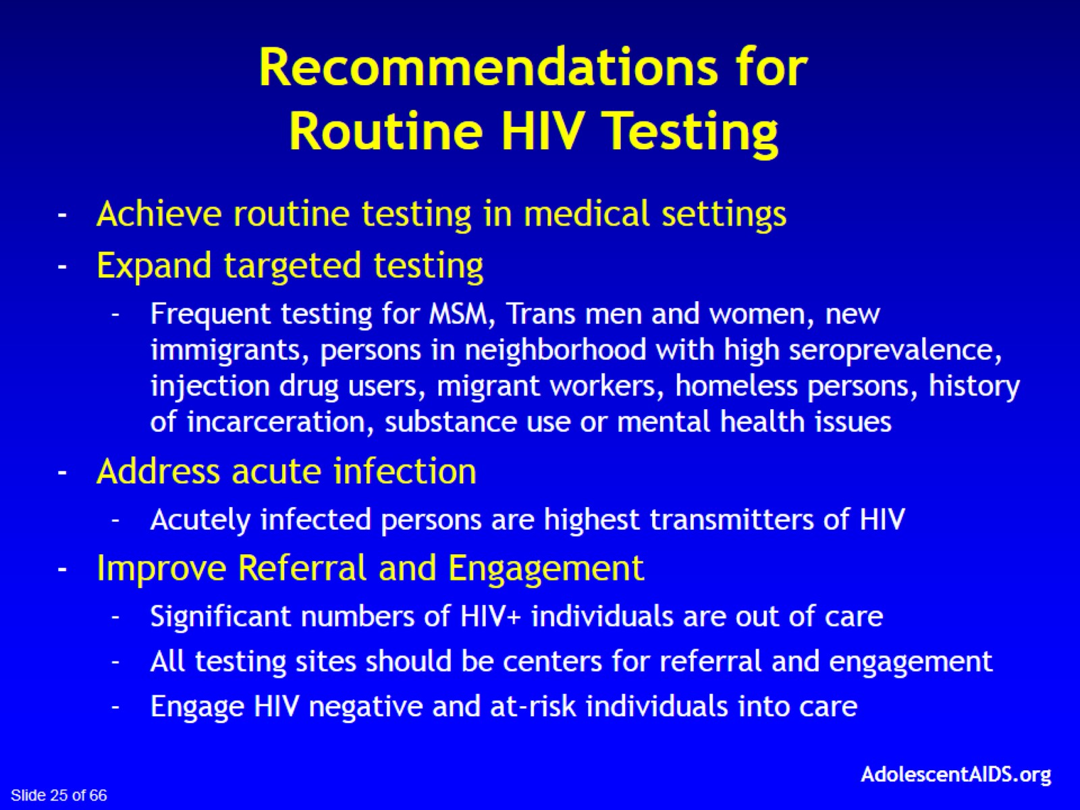

Slide 26
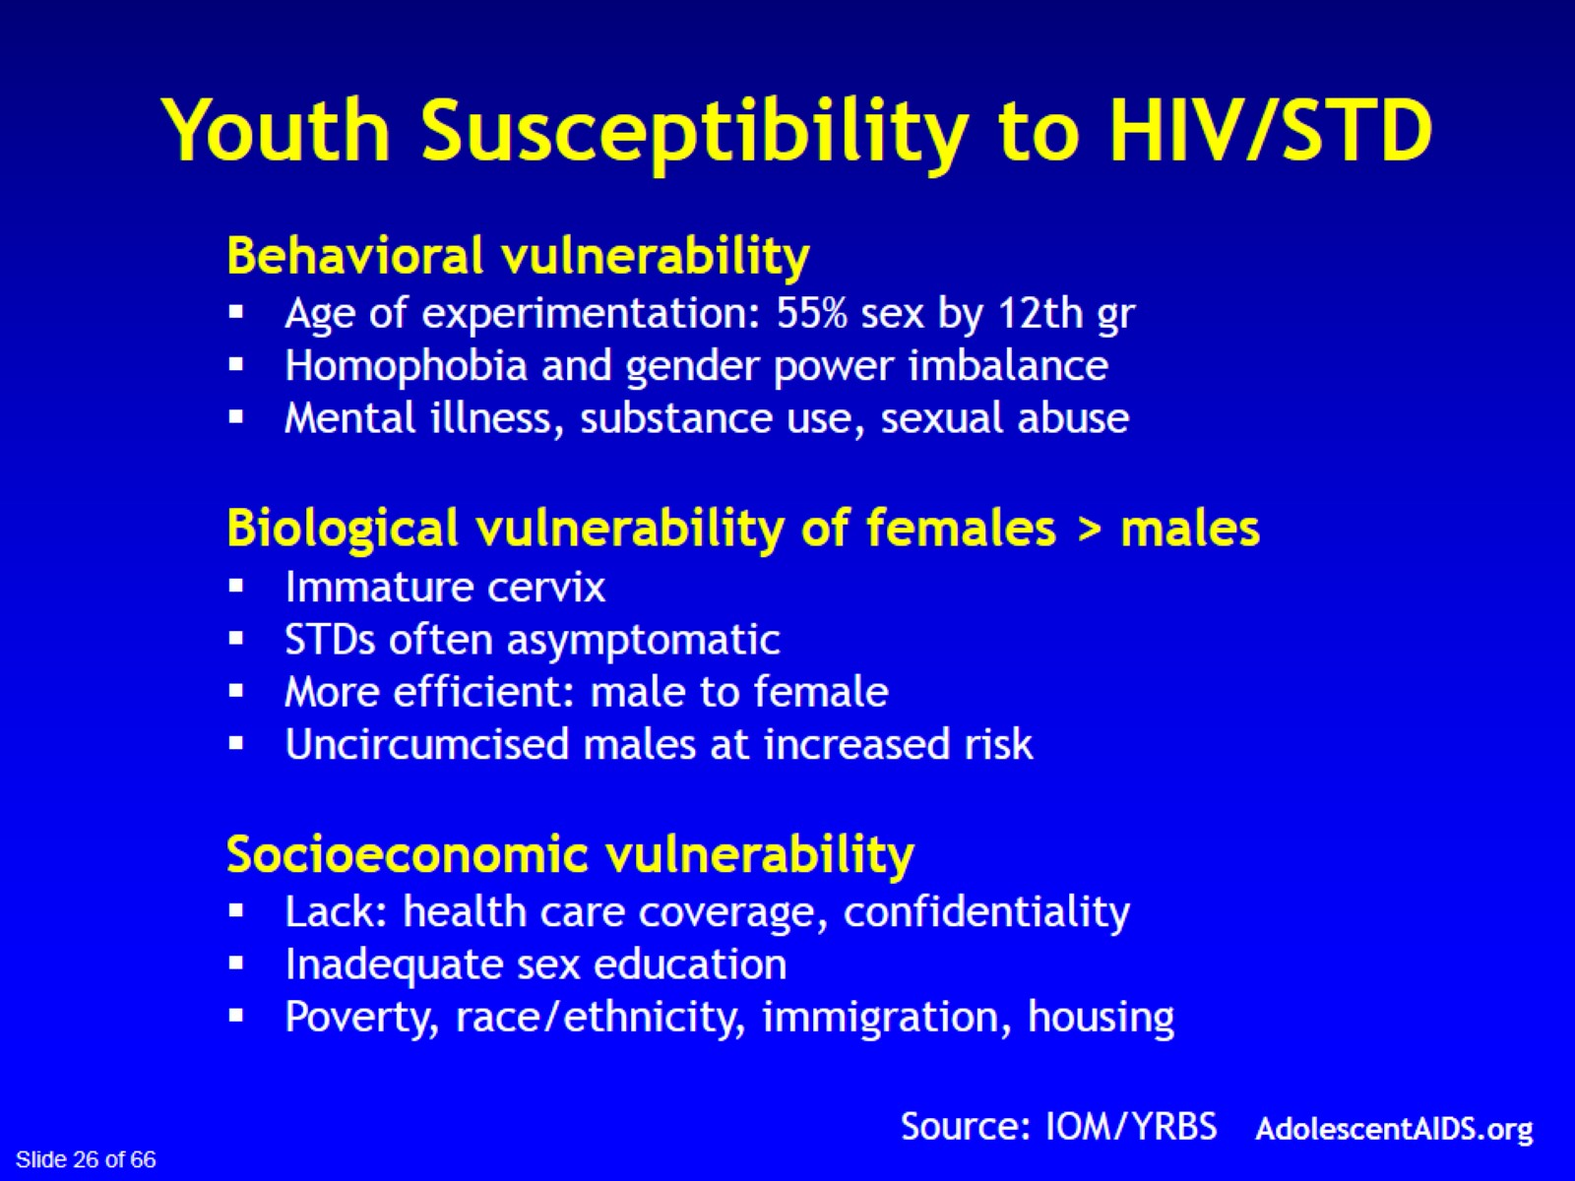

Slide 27
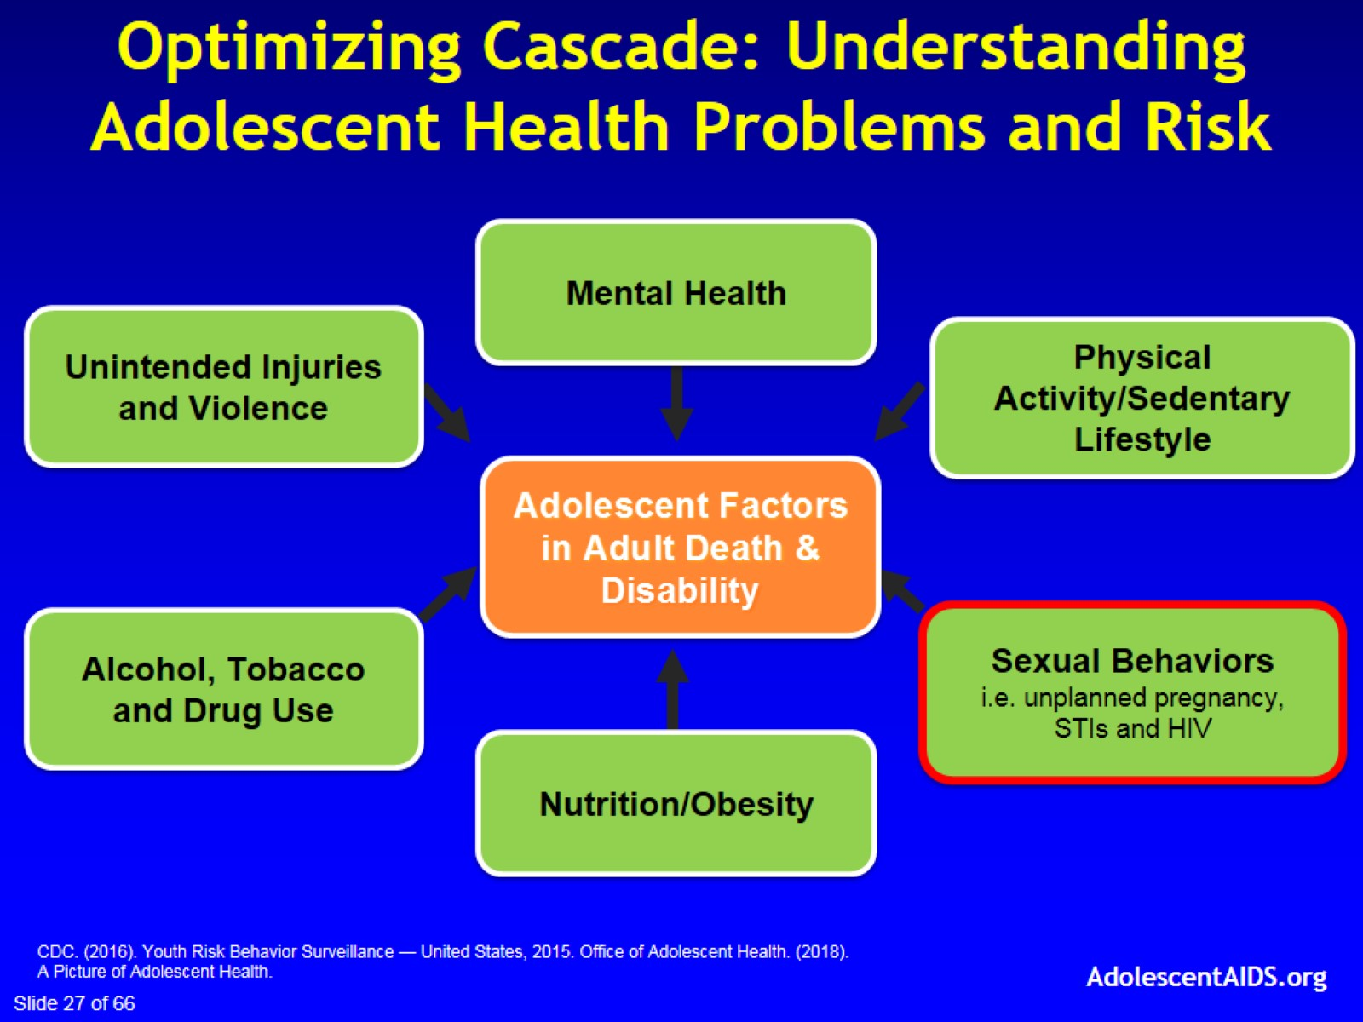
Optimizing Cascade: Understanding Adolescent Health Problems and Risk

Slide 28
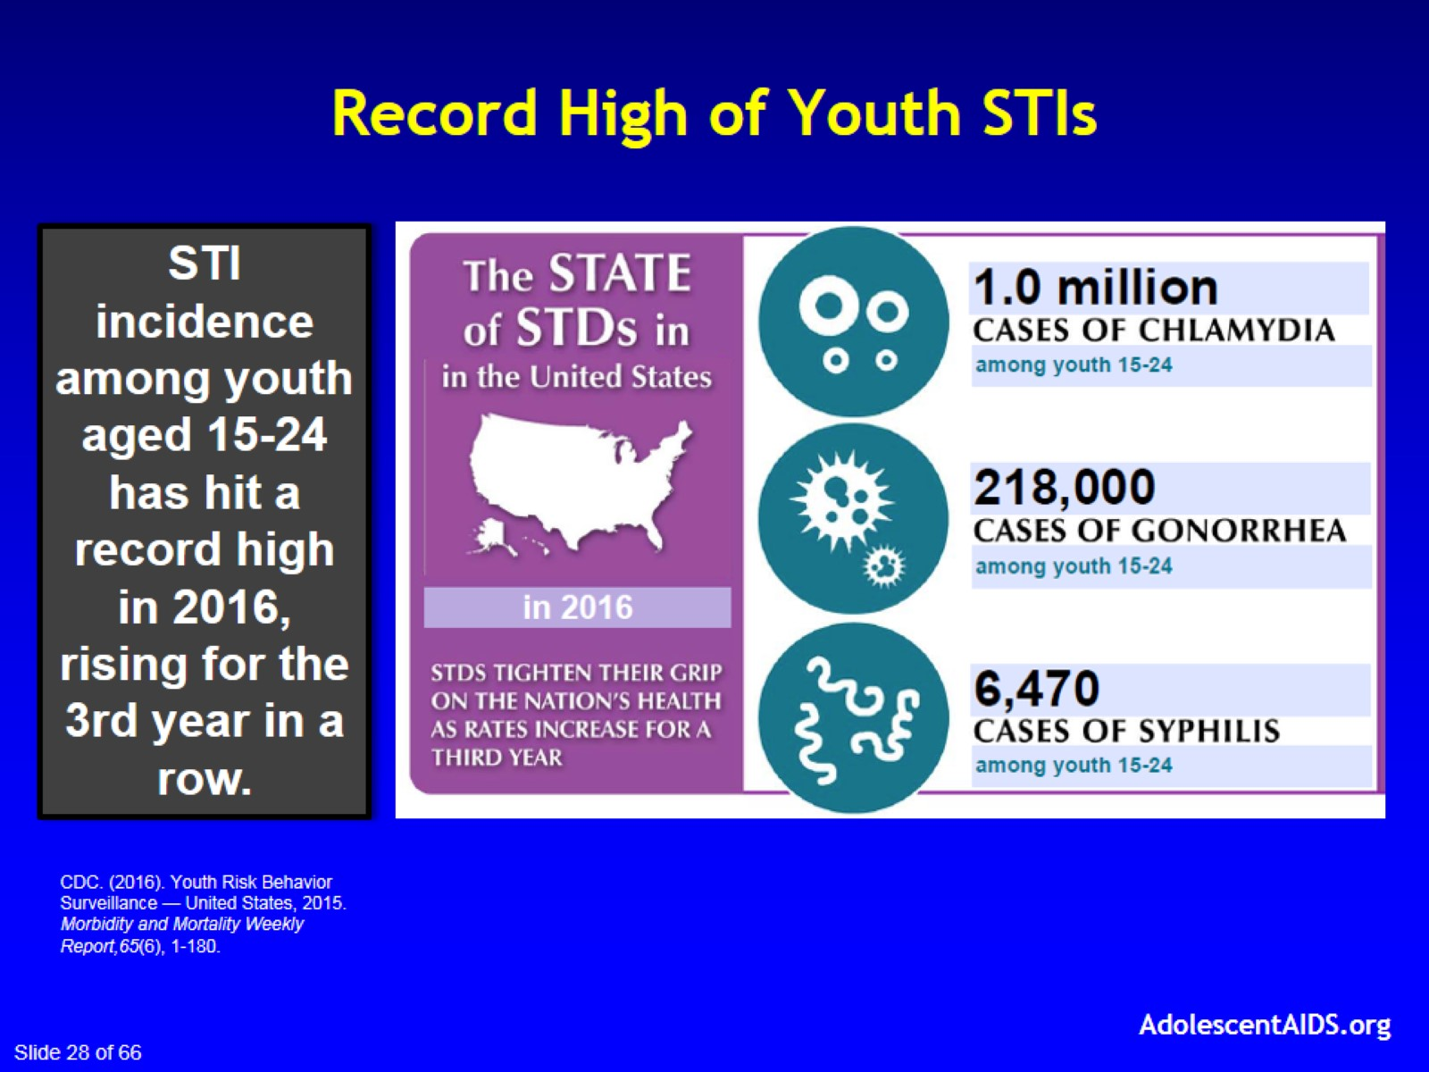
Record High of Youth STIs

Slide 29
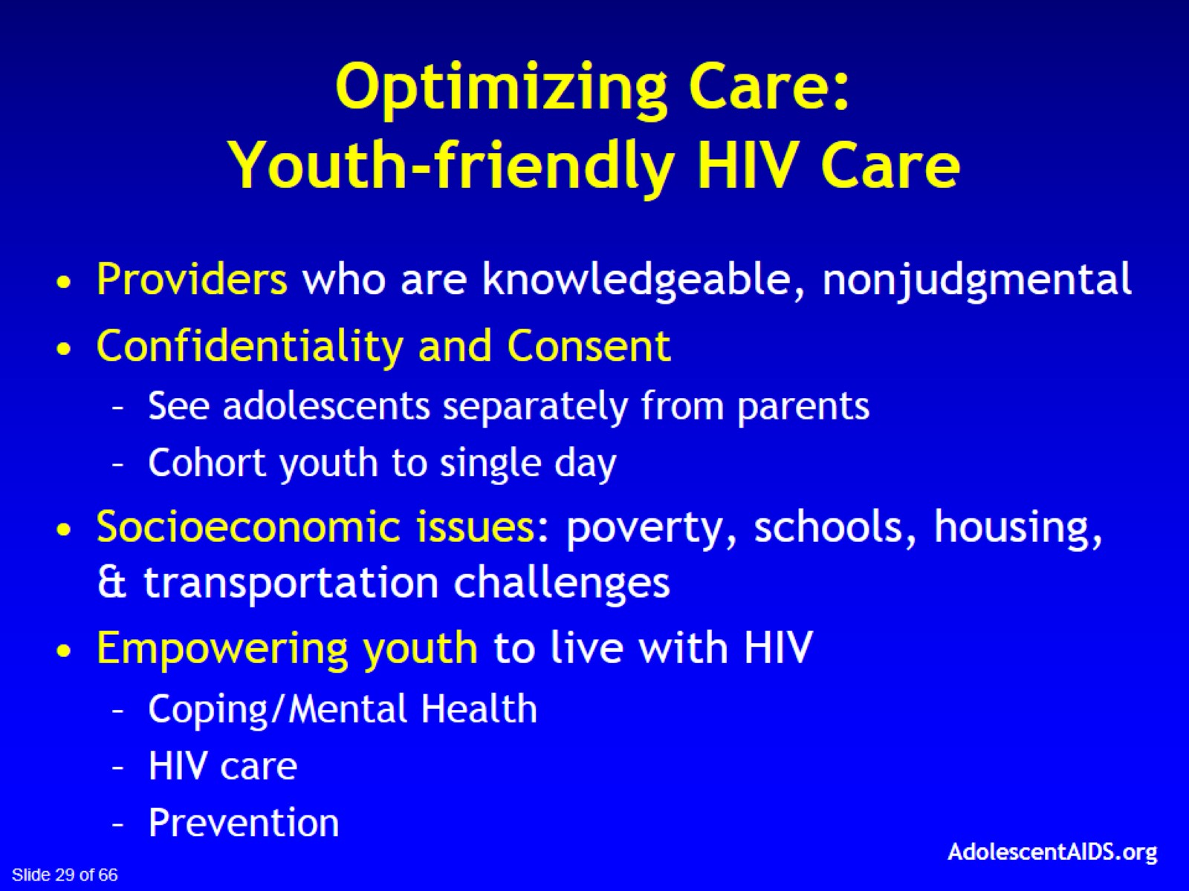
Optimizing Care:
Youth-friendly HIV Care

Slide 30
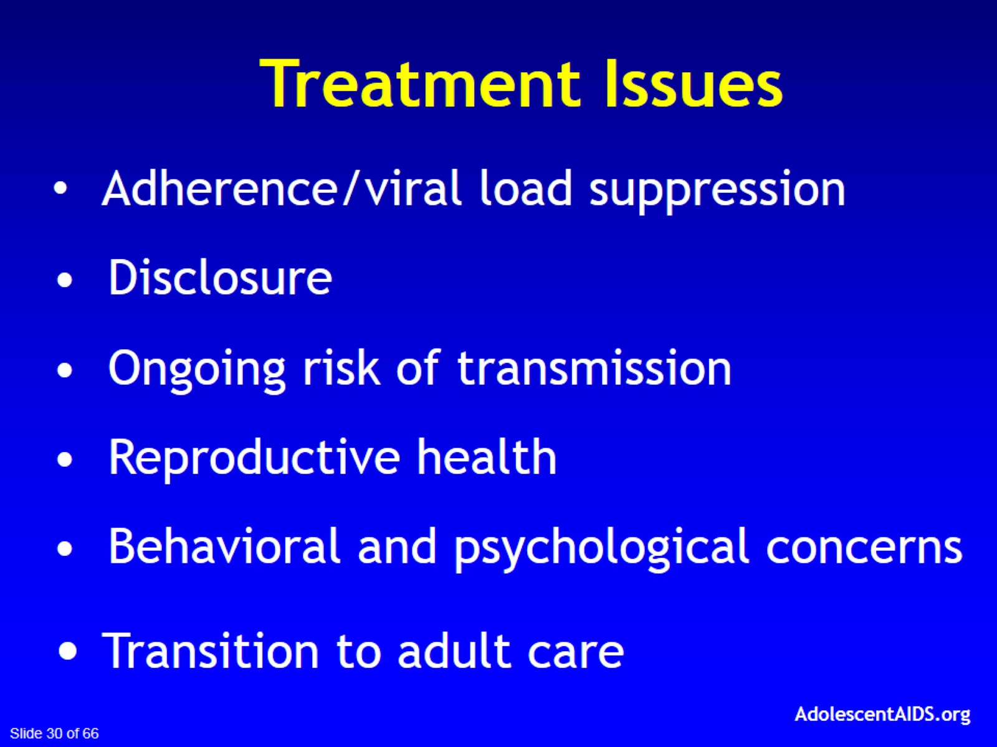

Slide 31
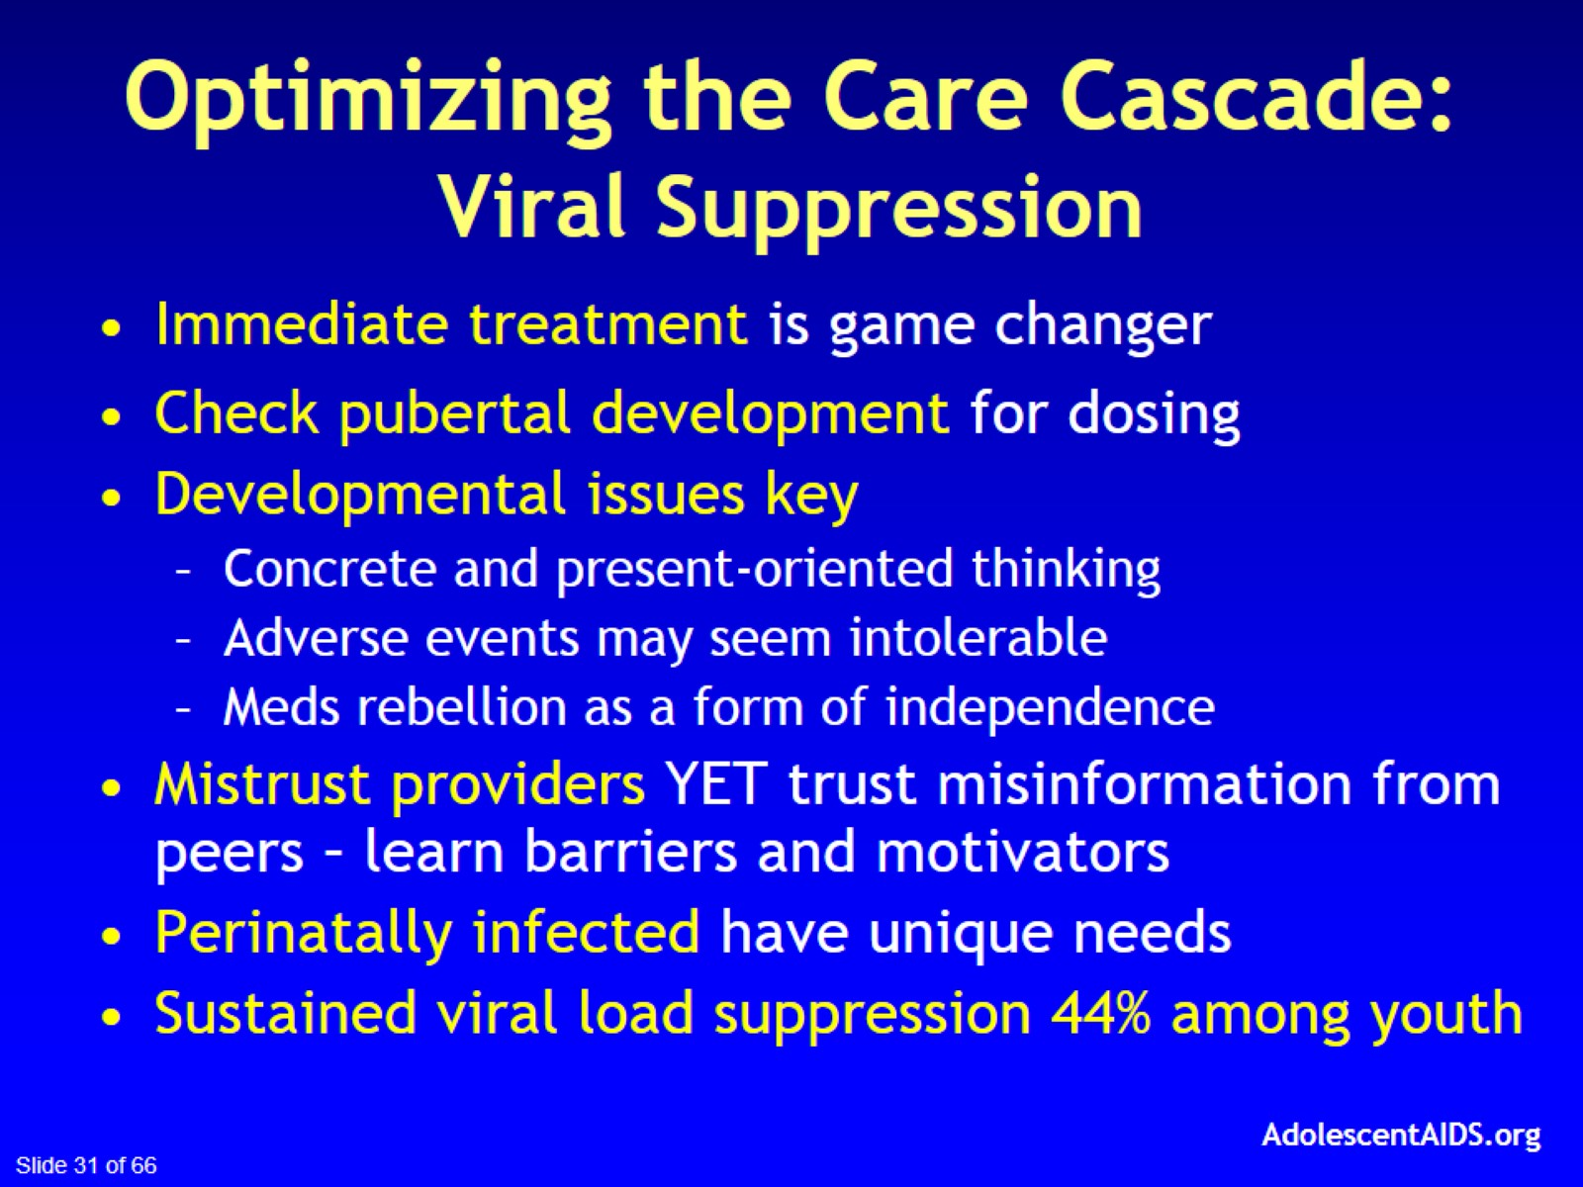
Optimizing the Care Cascade:
Viral Suppression

Slide 32
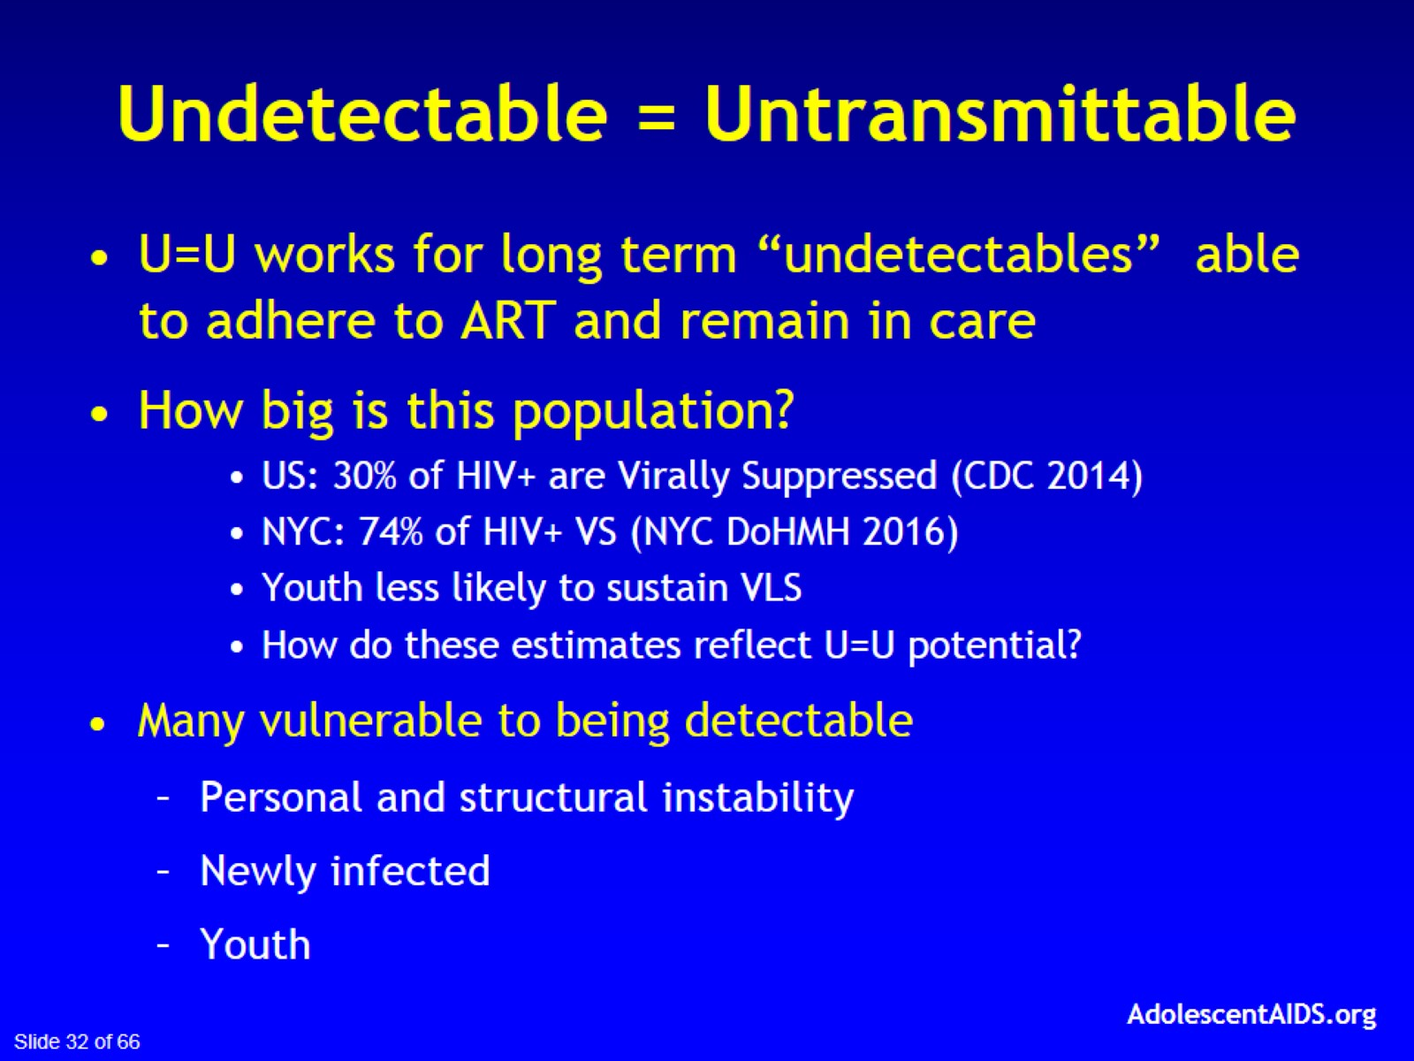
Undetectable = Untransmittable

Slide 33
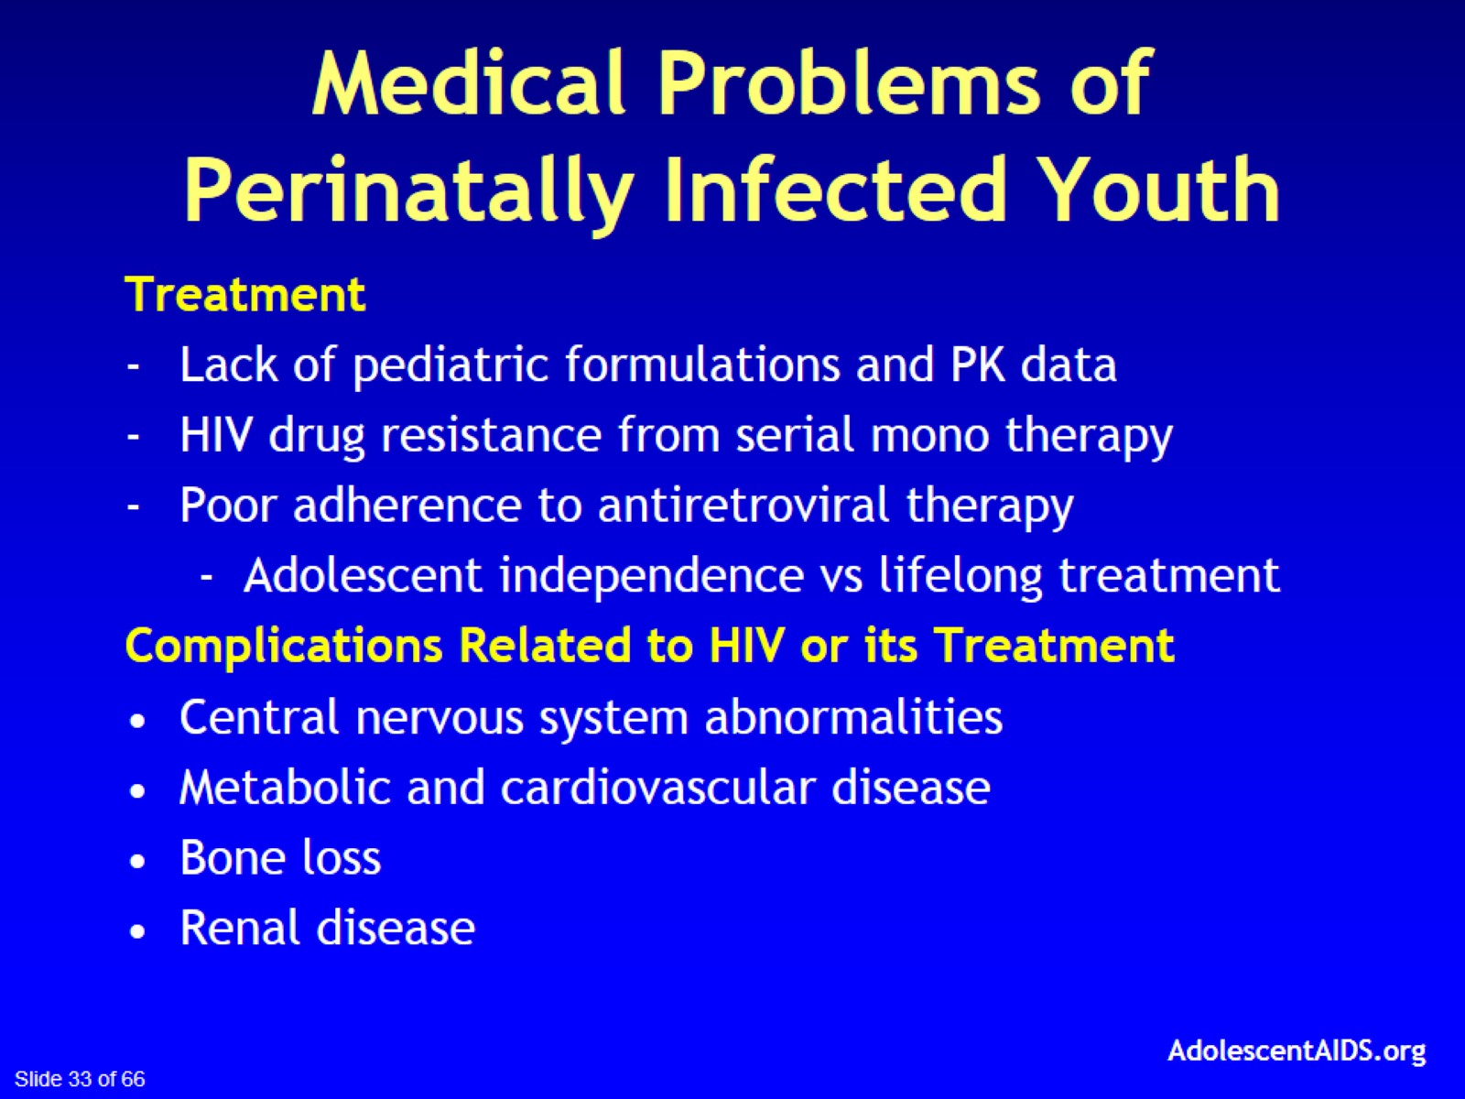
Medical Problems of Perinatally Infected Youth

Slide 34
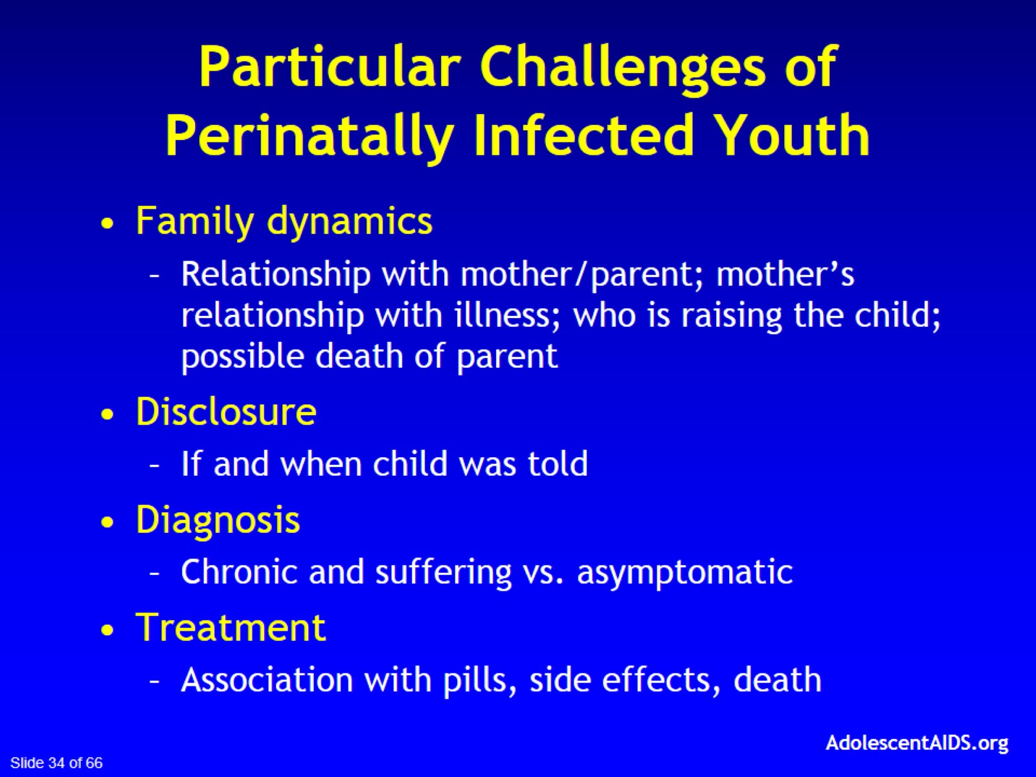
Particular Challenges of Perinatally Infected Youth

Slide 35
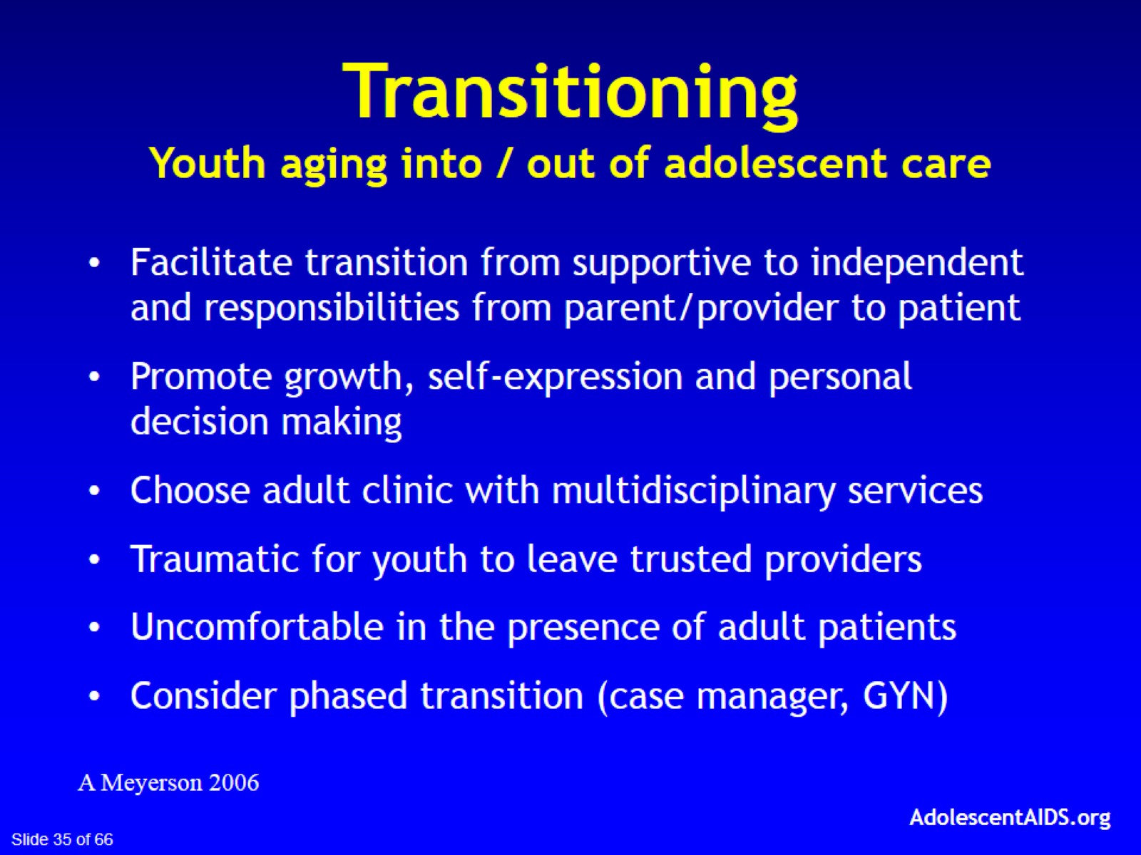

Slide 36

LGBTQ Youth

Slide 37

LGBTQ-Friendly Care

Slide 38

Avoid Stereotypes and
Develop Dialogue

Slide 39
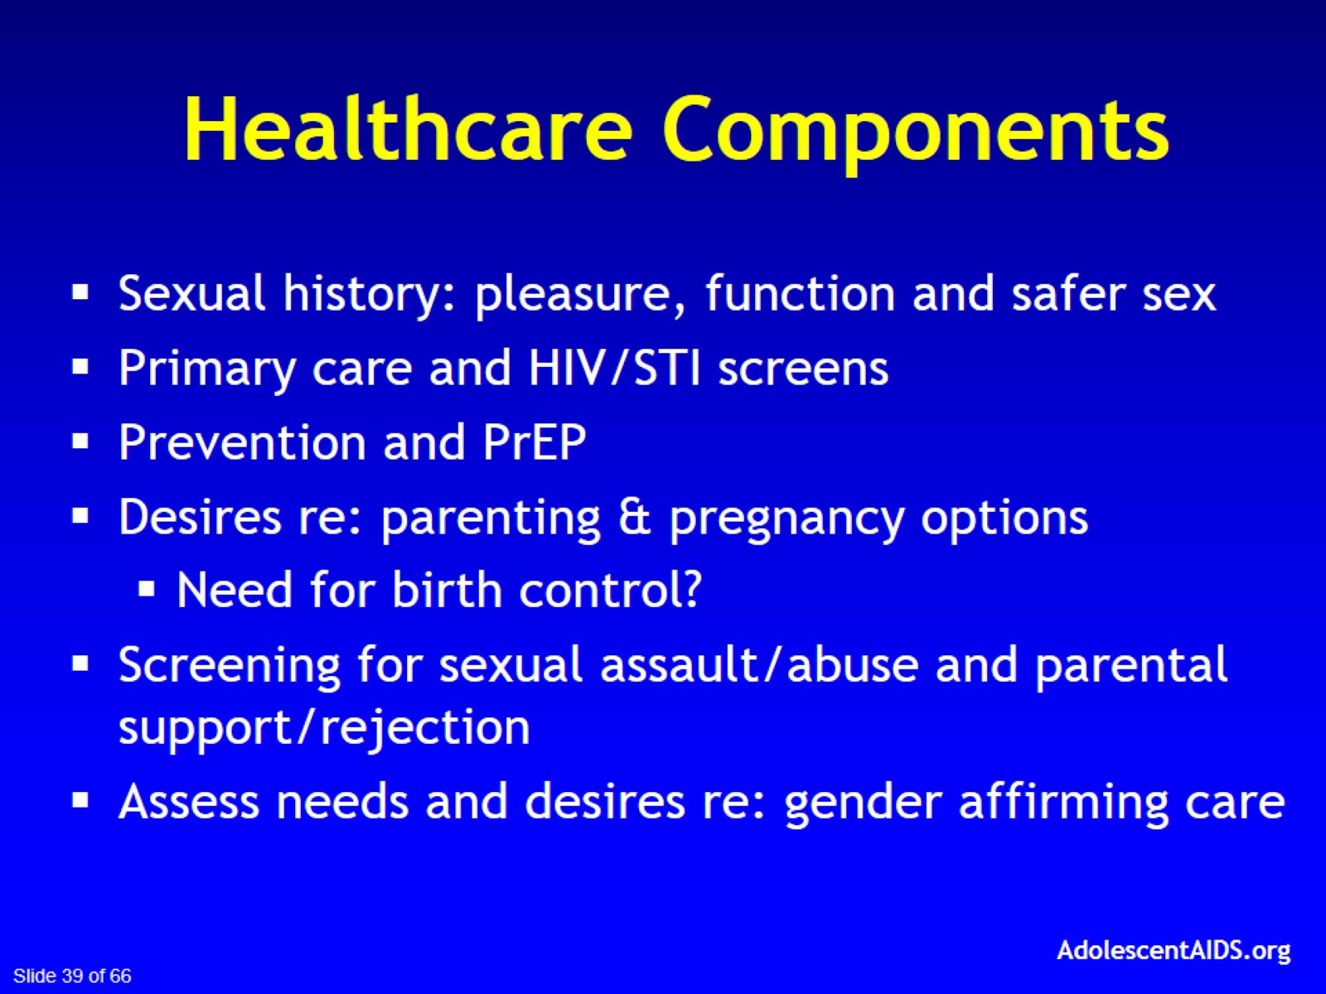
Healthcare Components

Slide 40
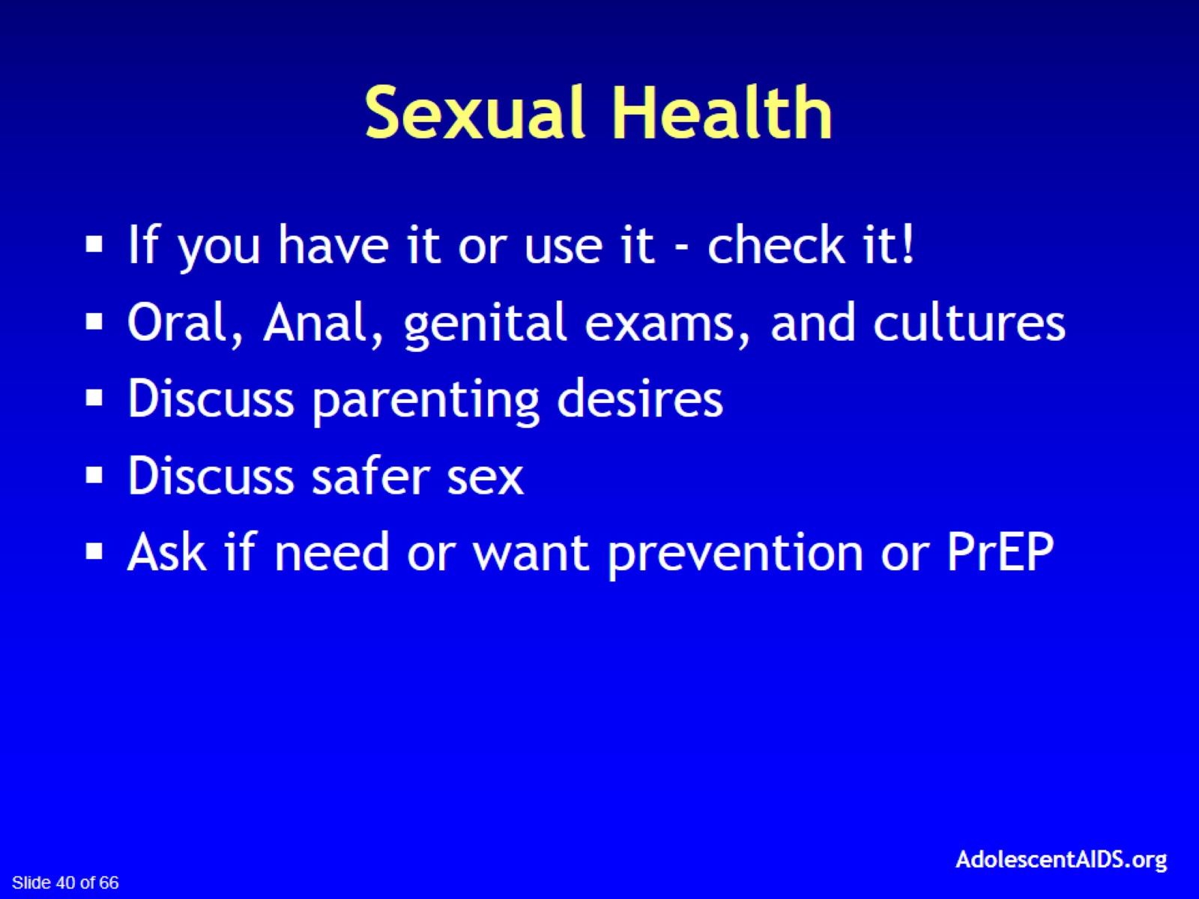
Sexual Health

Slide 41
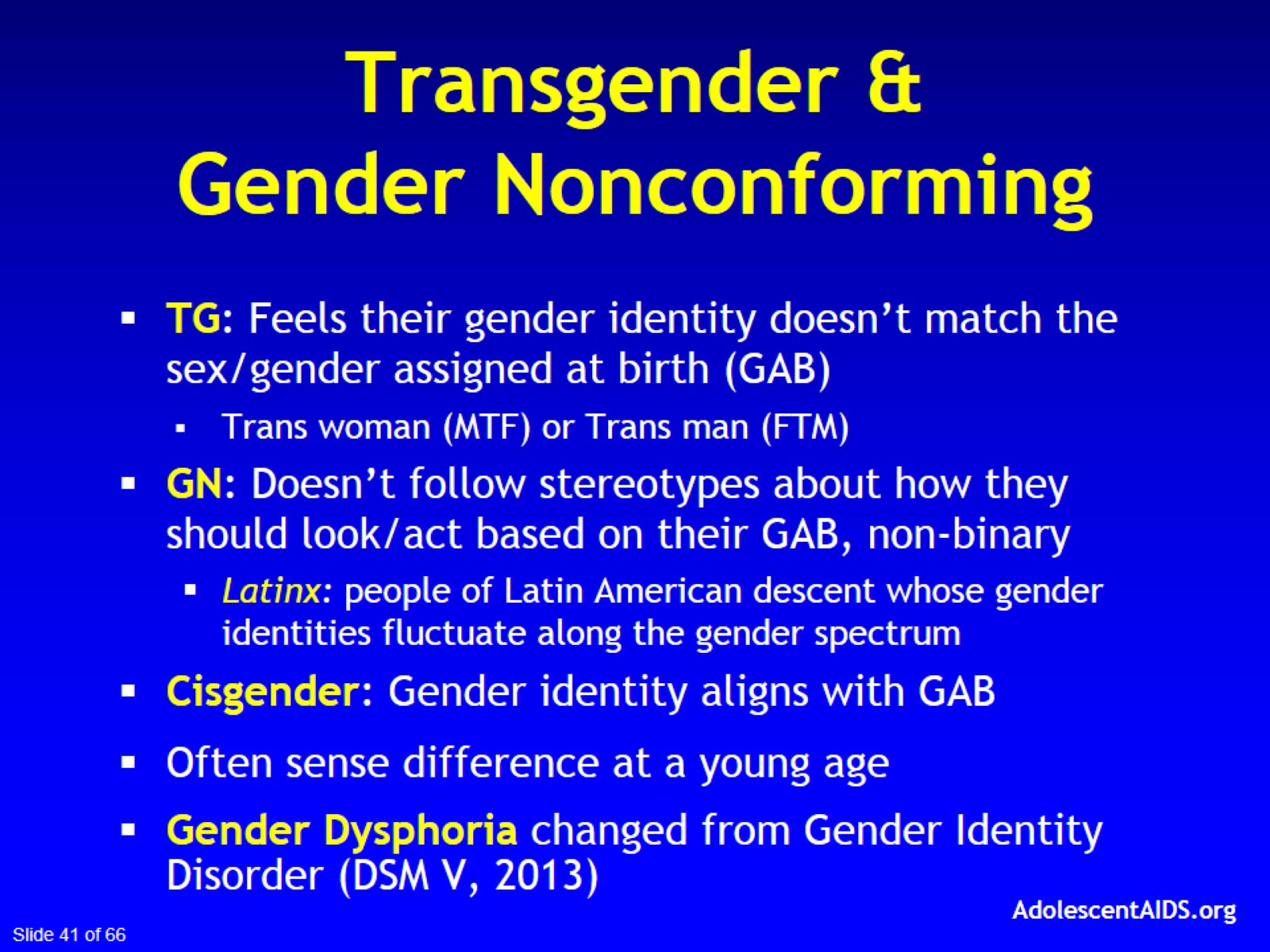
Transgender &
Gender Nonconforming

Slide 42
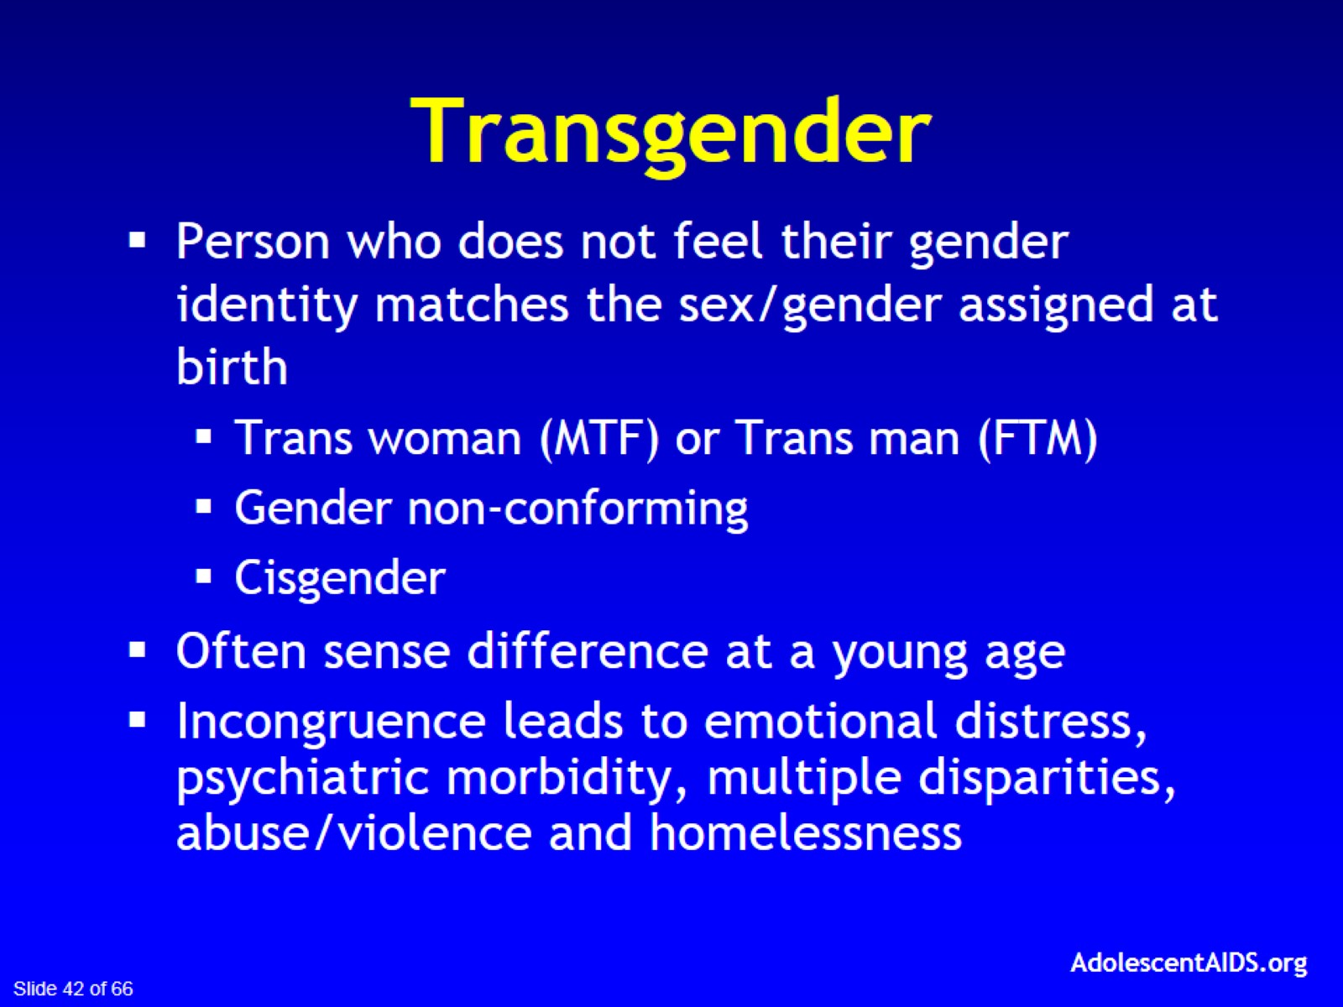
Transgender

Slide 43
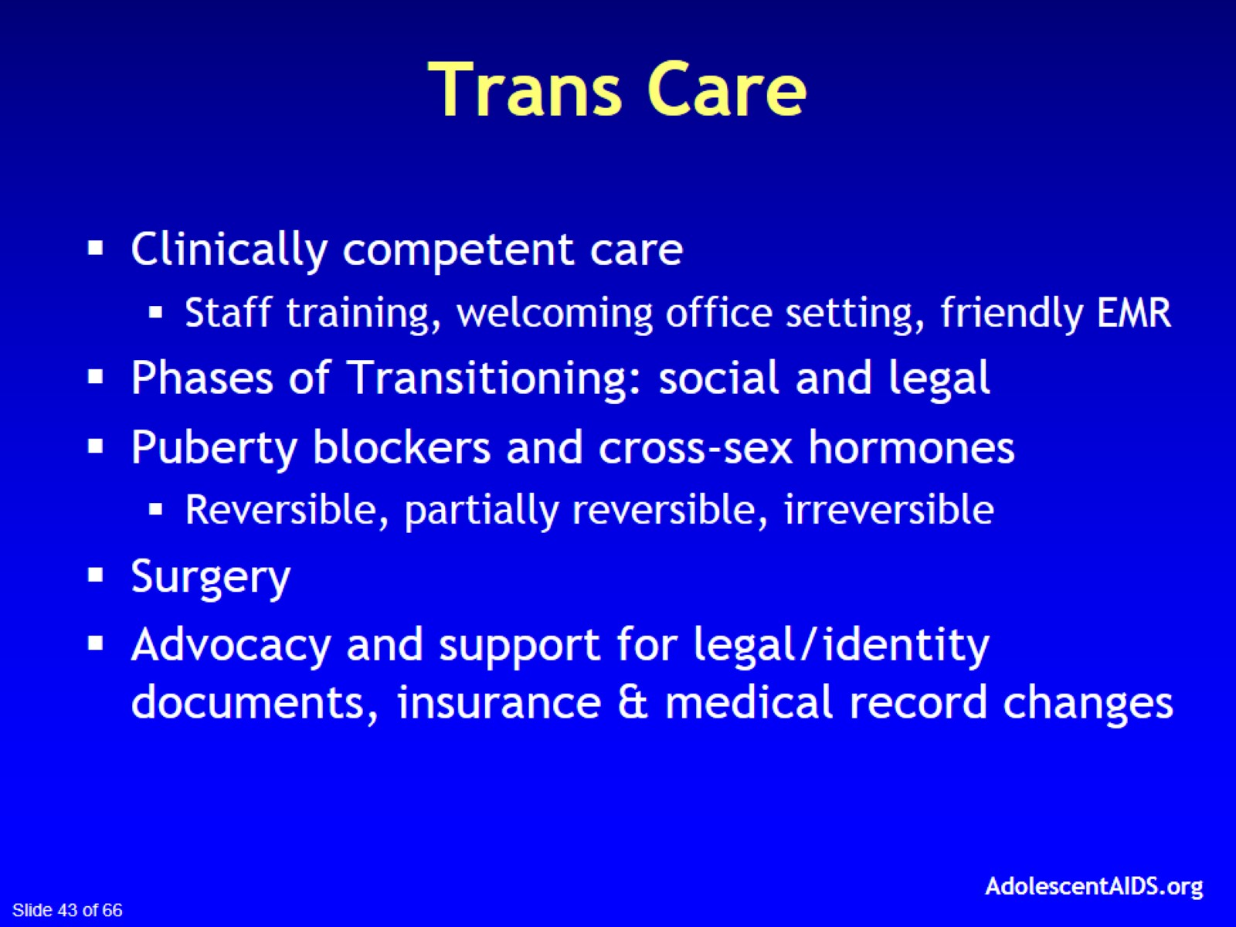
Trans Care

Slide 44


Slide 45
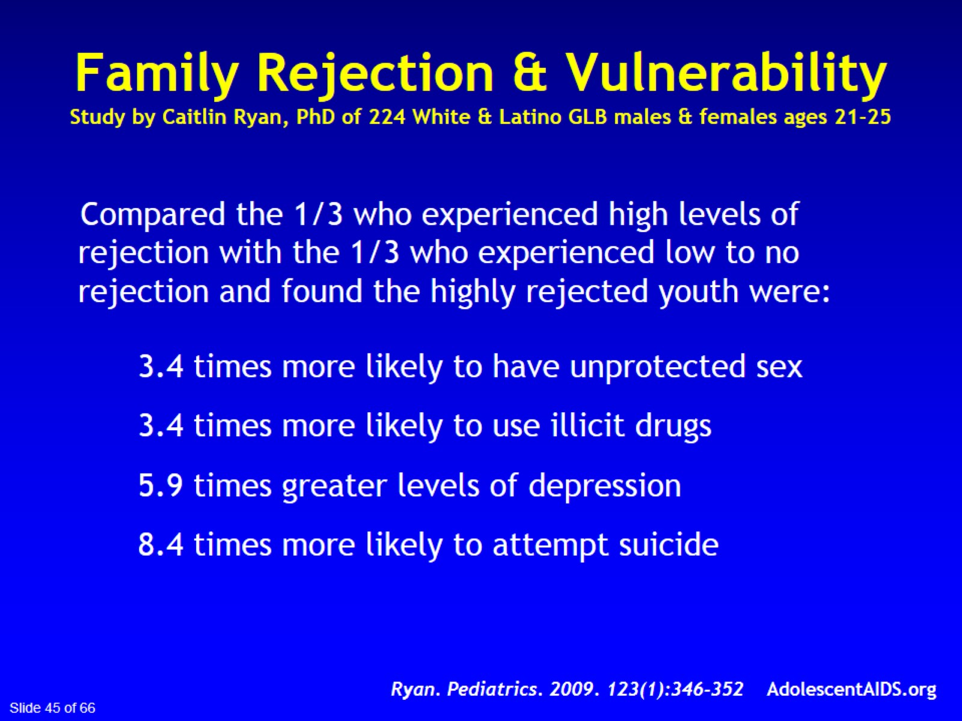
Family Rejection & Vulnerability
Study by Caitlin Ryan, PhD of 224 White & Latino GLB males & females ages 21-25

Slide 46
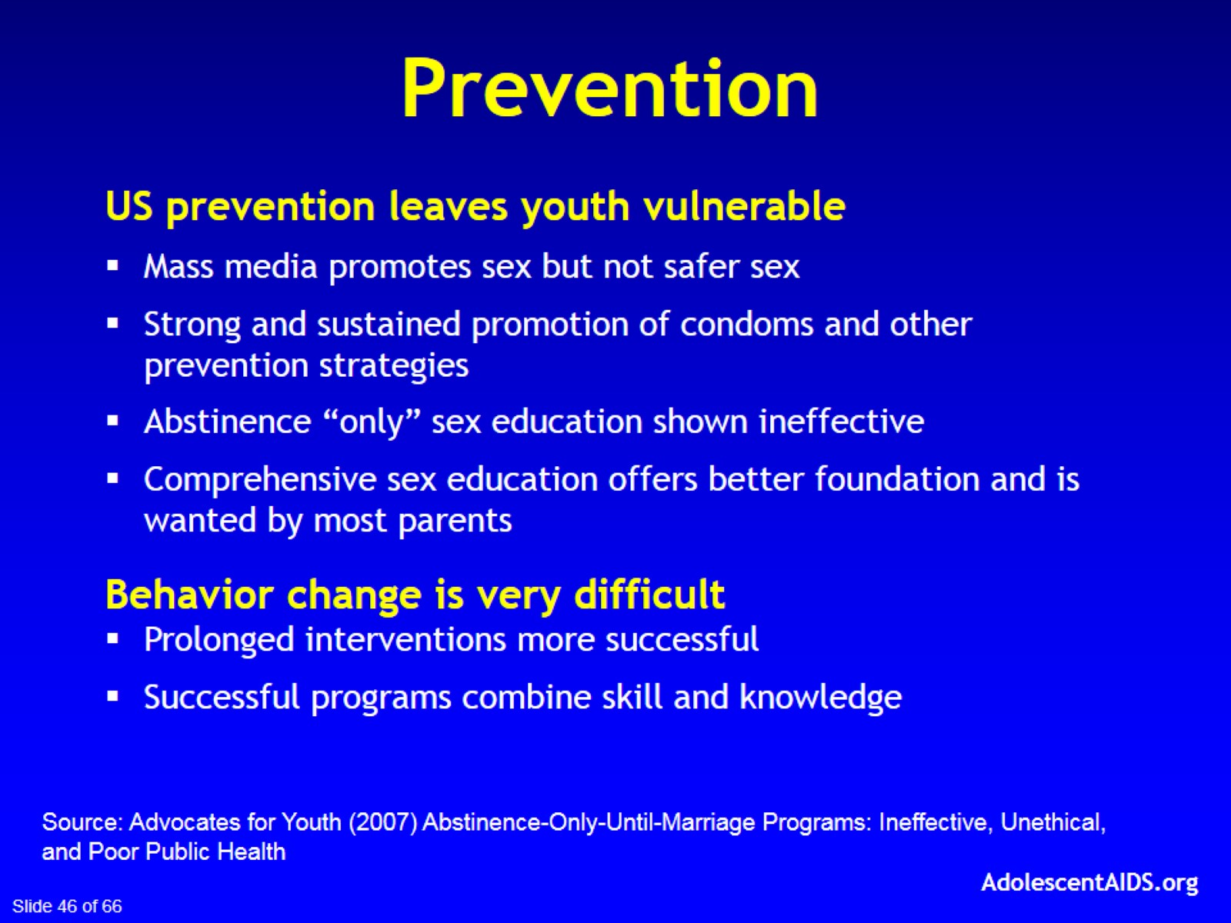

Slide 47


Slide 48
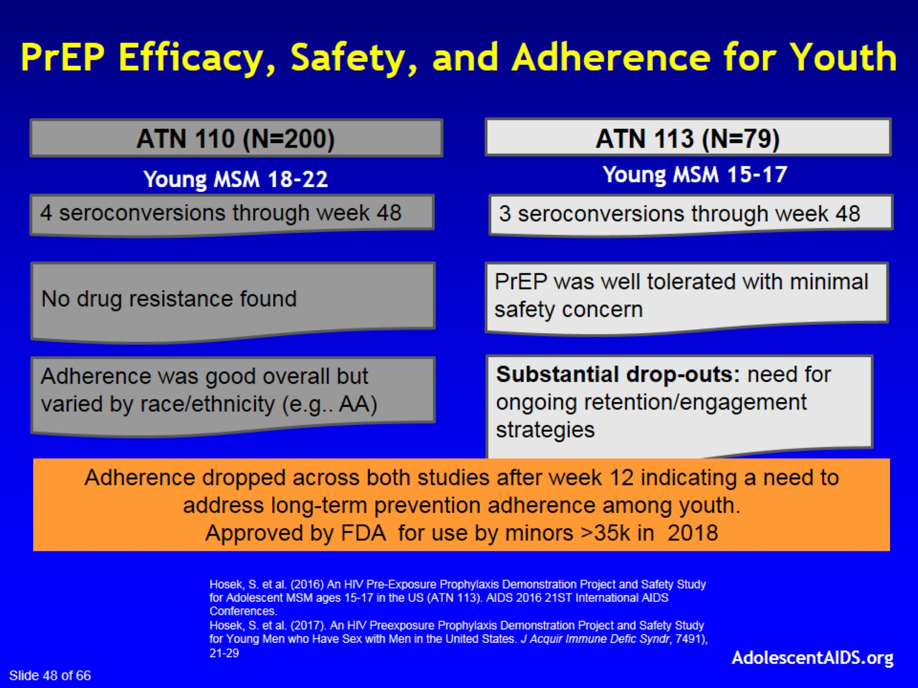
  PrEP Efficacy, Safety, and Adherence for Youth

Slide 49
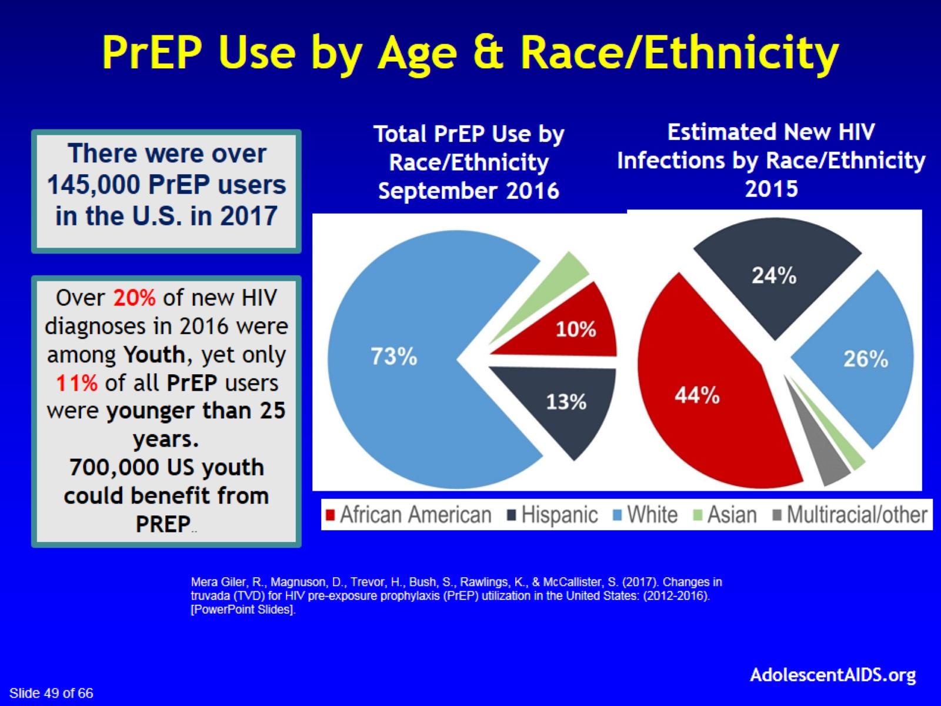
PrEP Use by Age & Race/Ethnicity

Slide 50
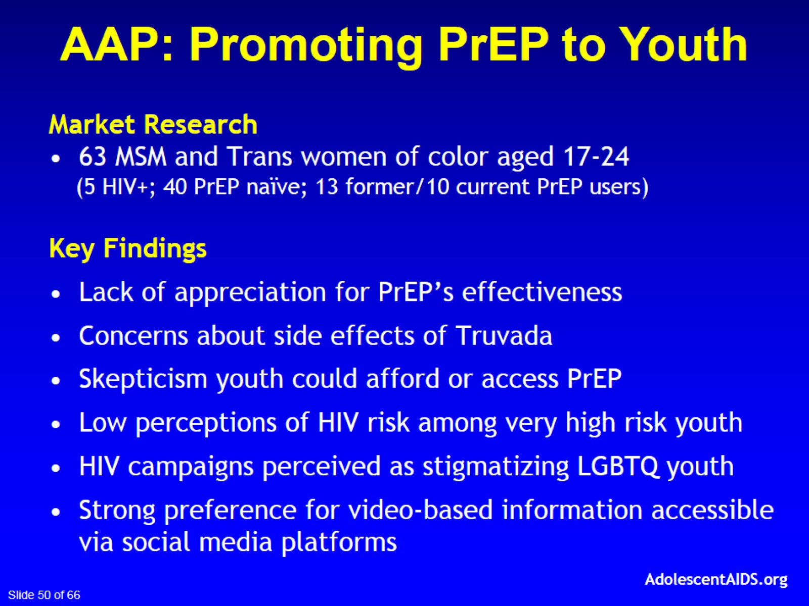

Slide 51
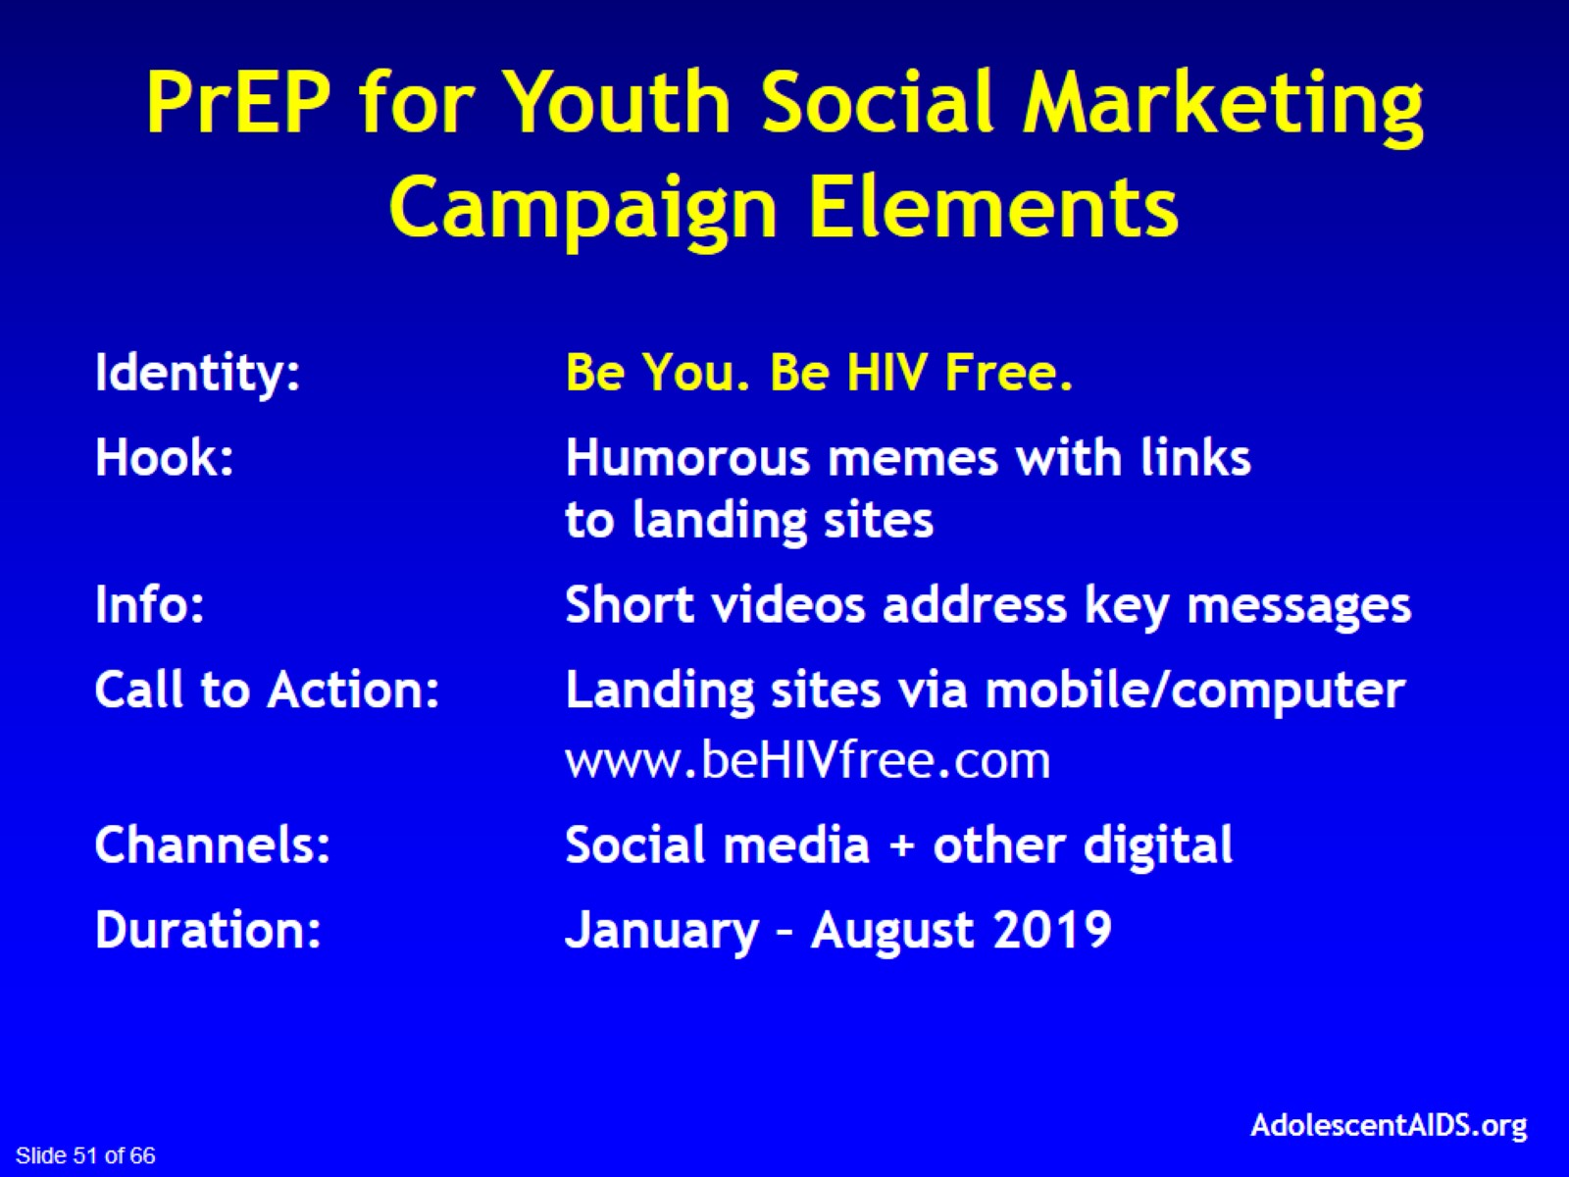

Slide 52


Slide 53


Slide 54
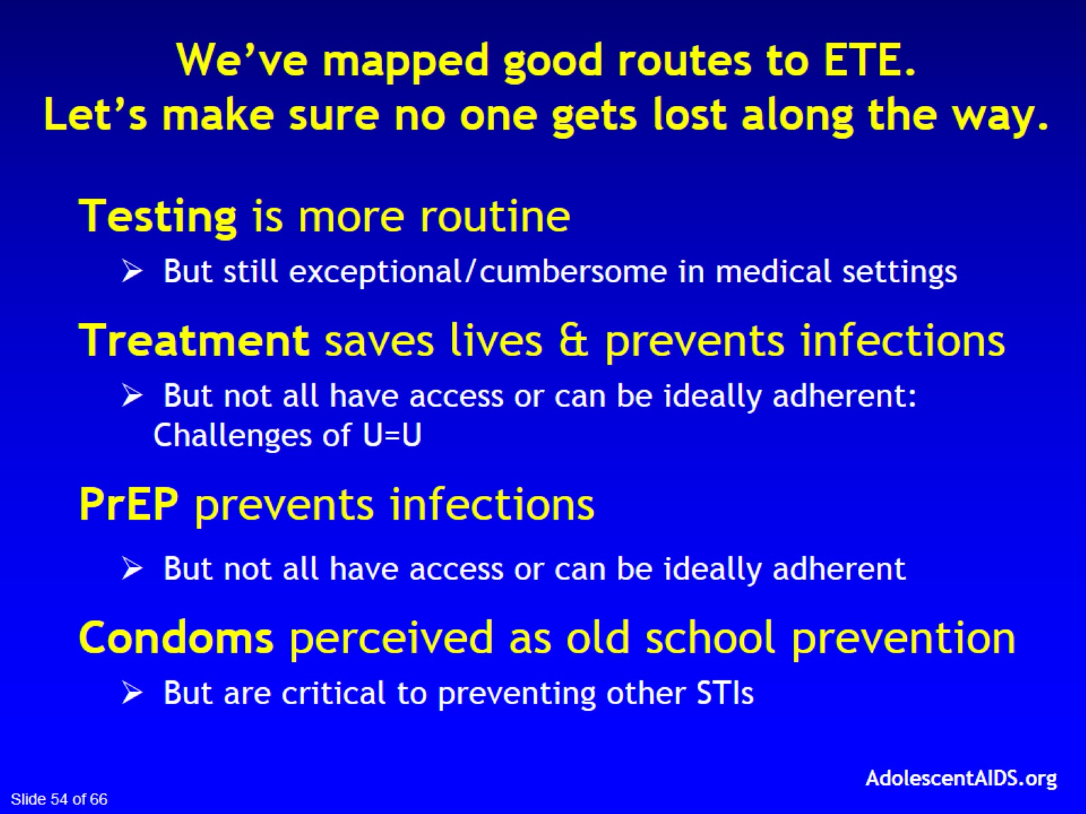
We’ve mapped good routes to ETE.
Let’s make sure no one gets lost along the way.

Slide 55
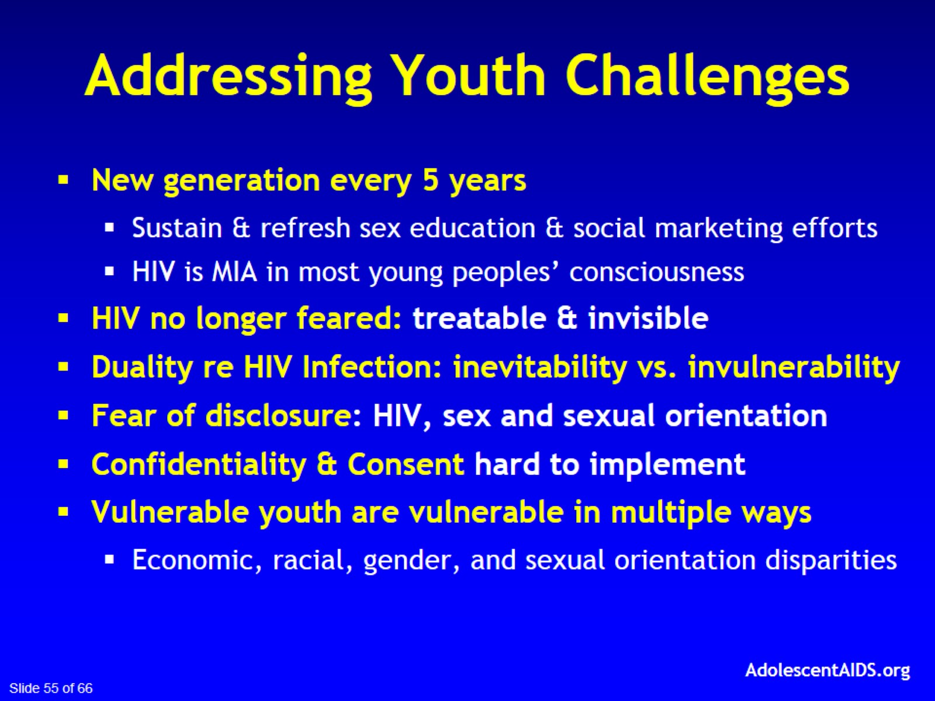
Addressing Youth Challenges

Slide 56


Slide 57
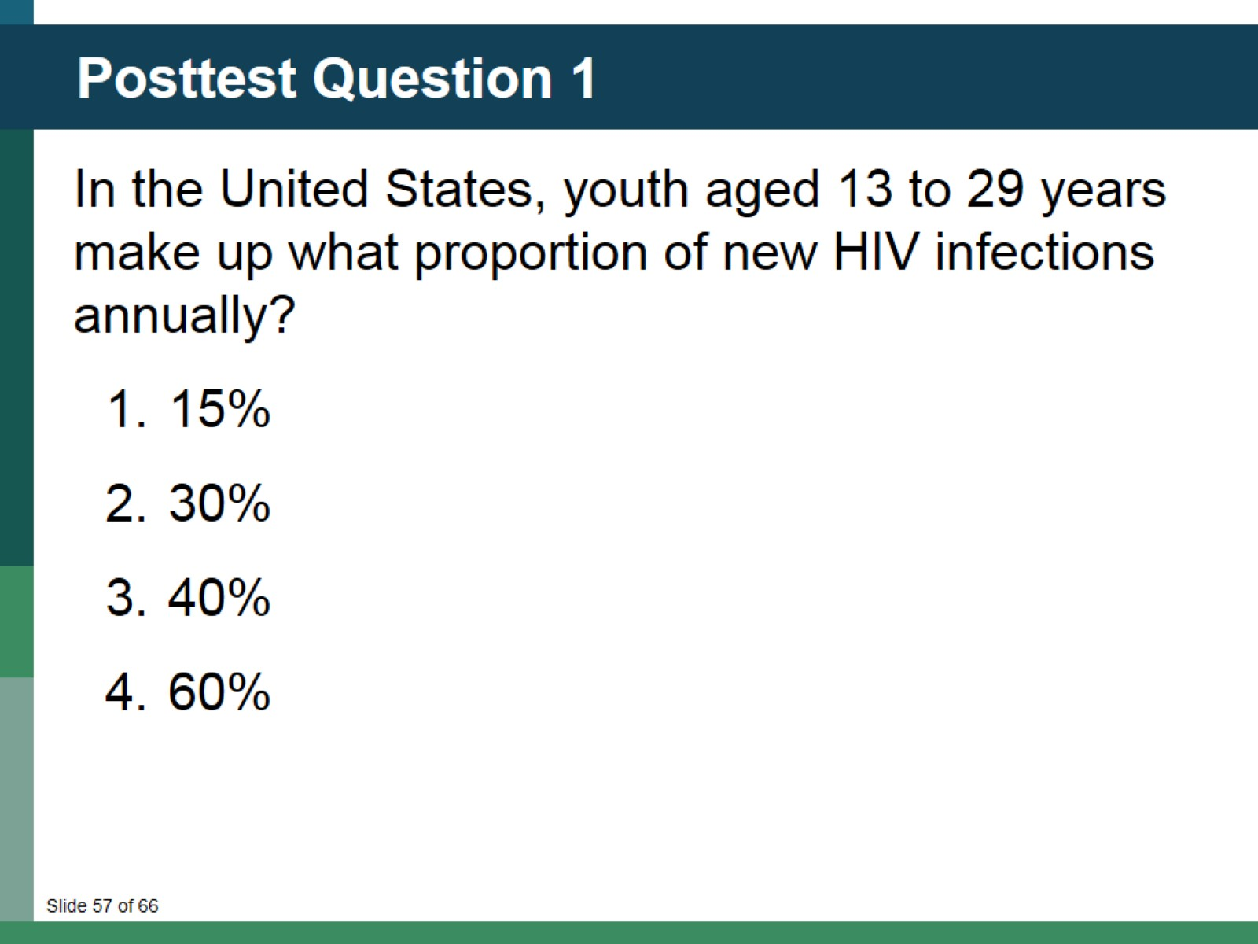
Posttest Question 1

Slide 58

Posttest Question 2

Slide 59
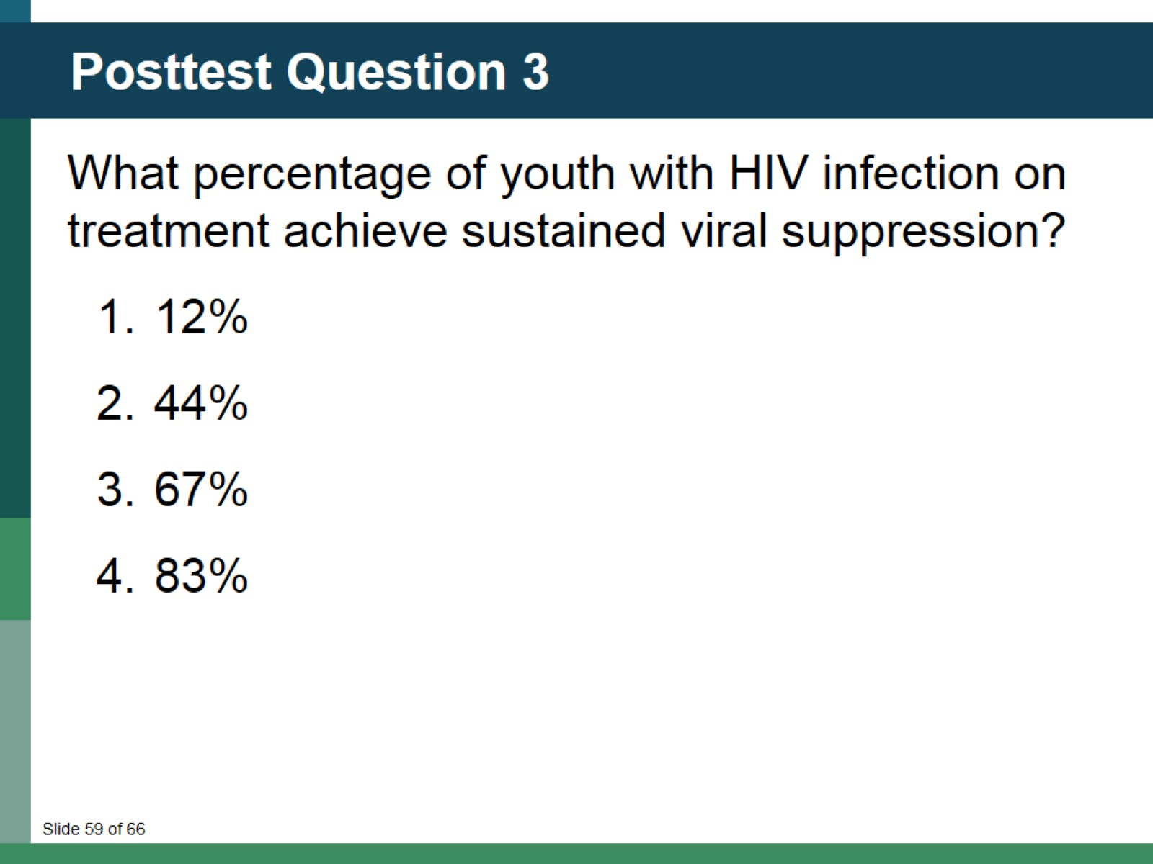
Posttest Question 3

Slide 60
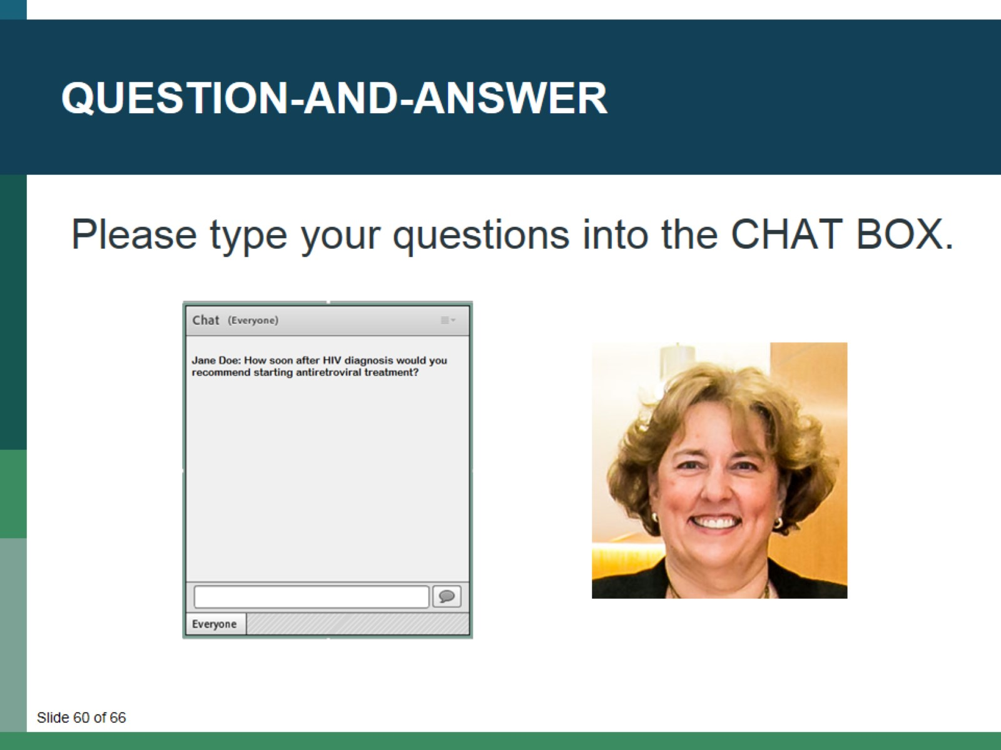
Question-and-Answer

Slide 61
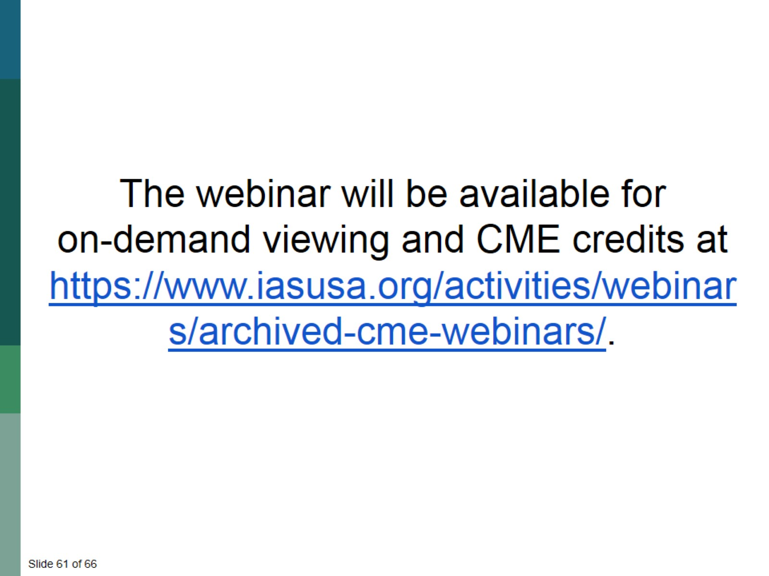

Slide 62

See the IAS–USA website for instructions on claiming CME, pharmacy, nursing, or pharmacotherapy credits, or a certificate of participation.

Slide 63


Slide 64


Slide 65


Slide 66

Thank You

