Slide 1
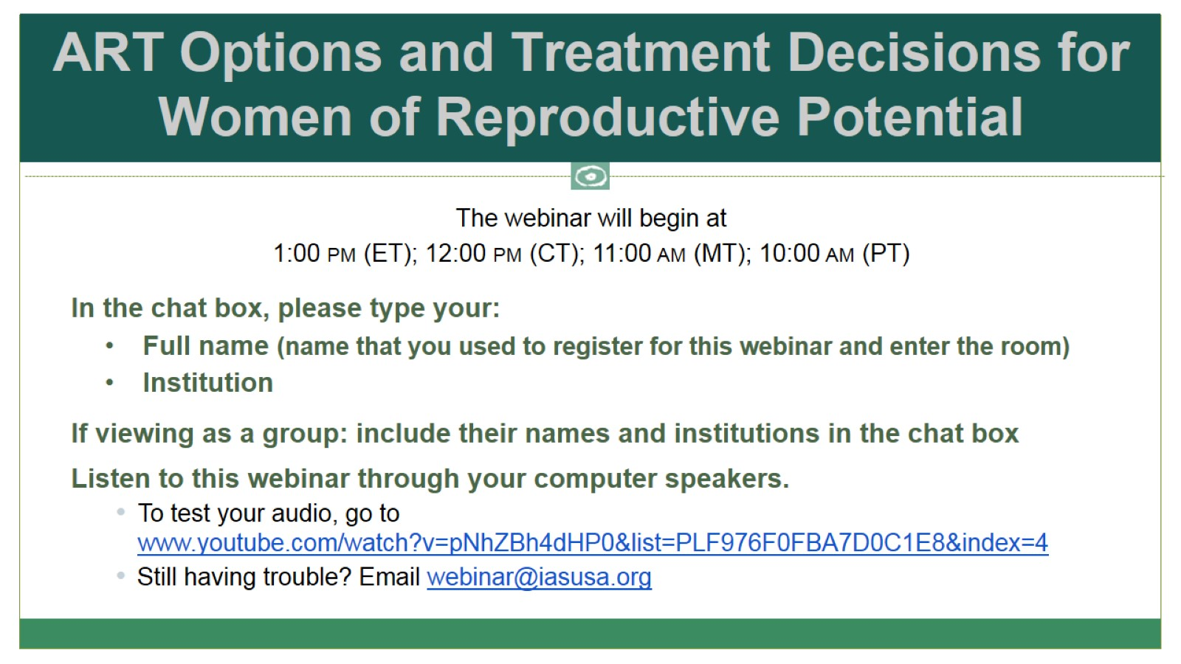
ART Options and Treatment Decisions for Women of Reproductive Potential

Slide 2

ART Options and Treatment Decisions for Women of Reproductive Potential

Slide 3
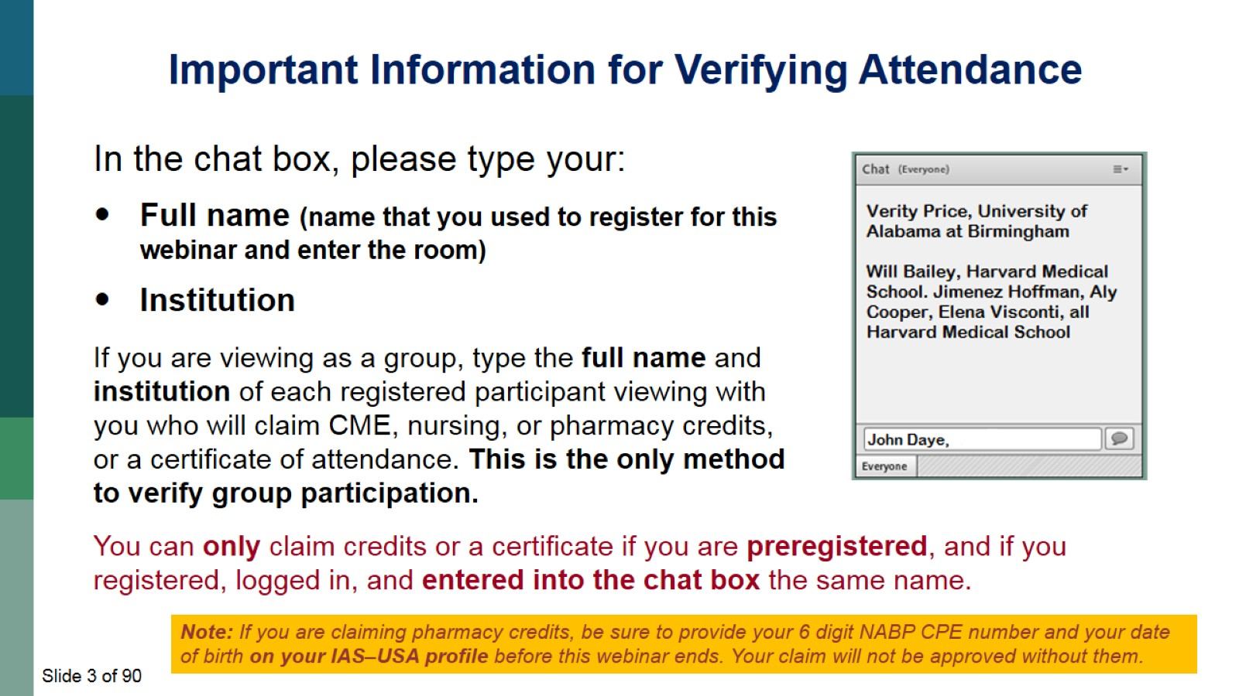

Slide 4
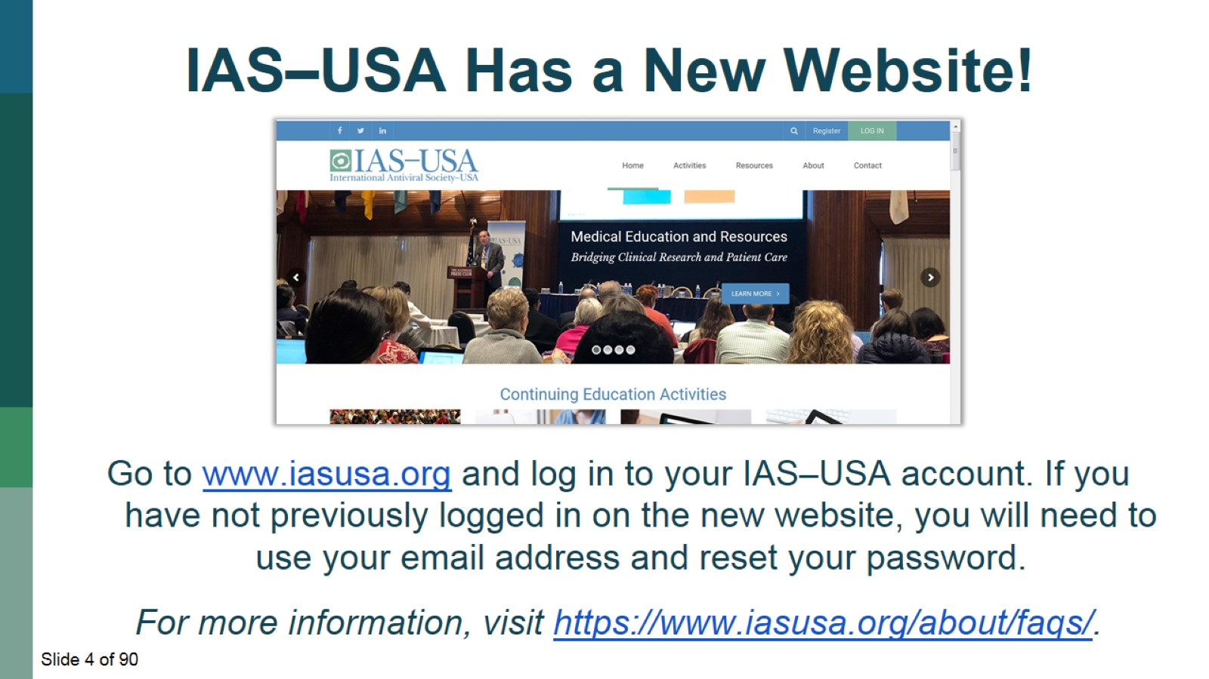

Slide 5
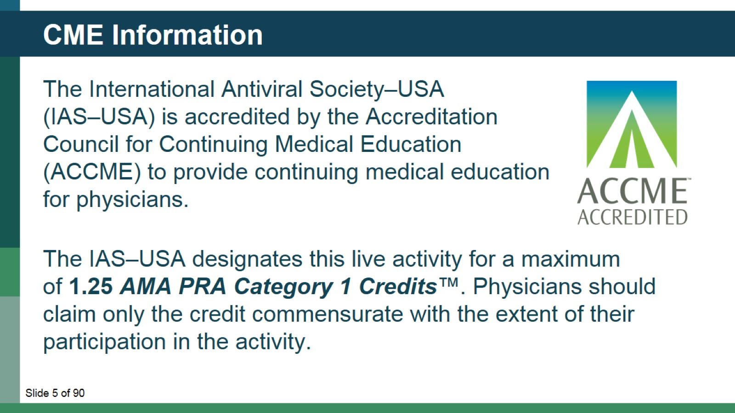
CME Information

Slide 6
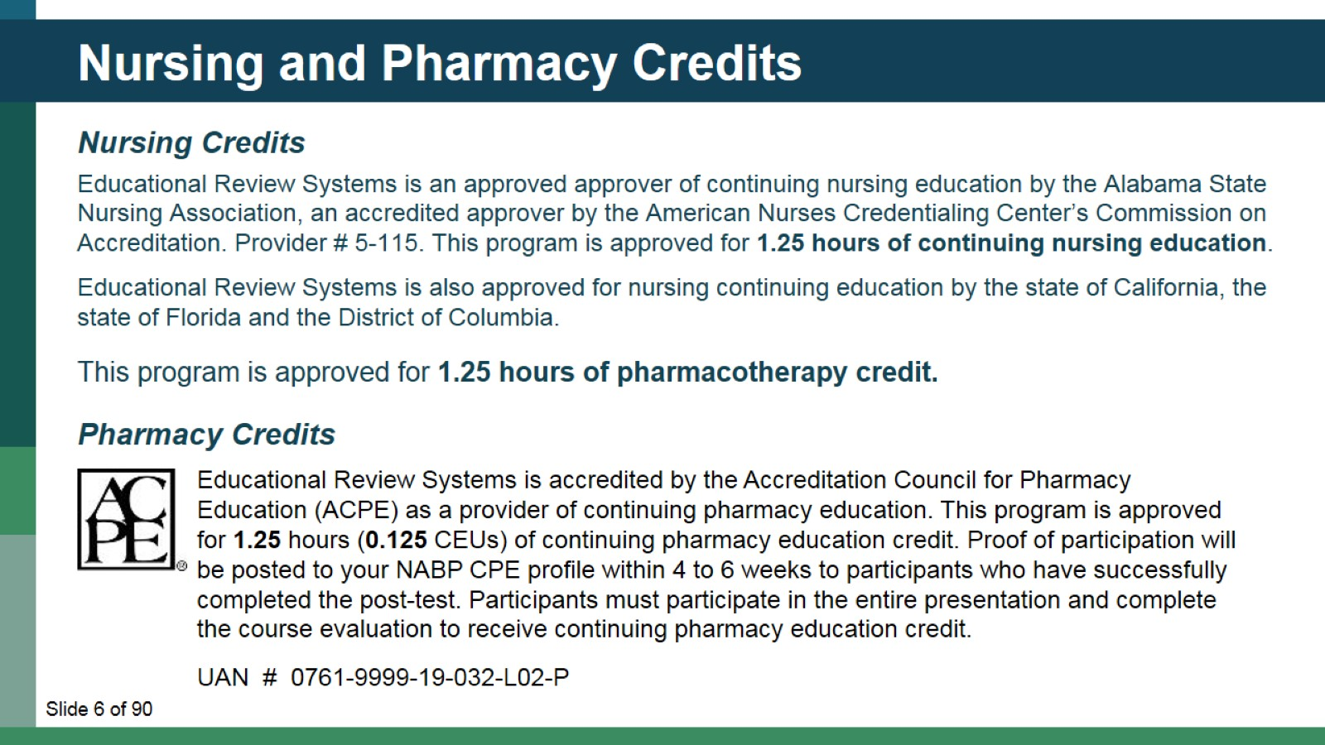
Nursing and Pharmacy Credits

Slide 7
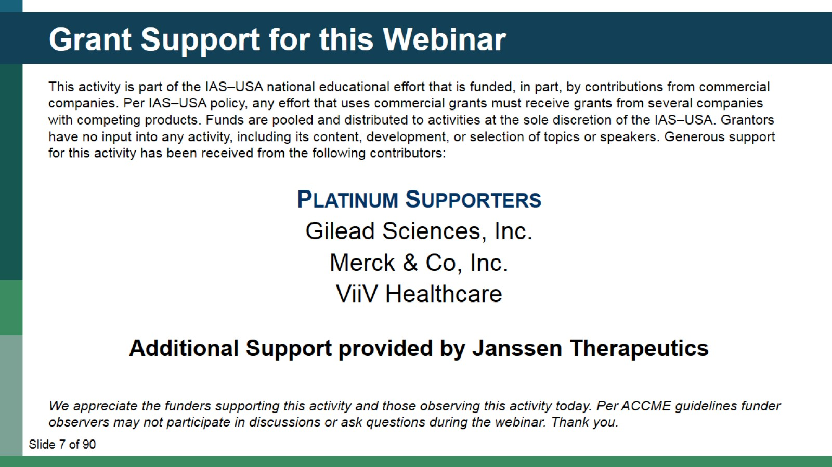
Grant Support for this Webinar

Slide 8
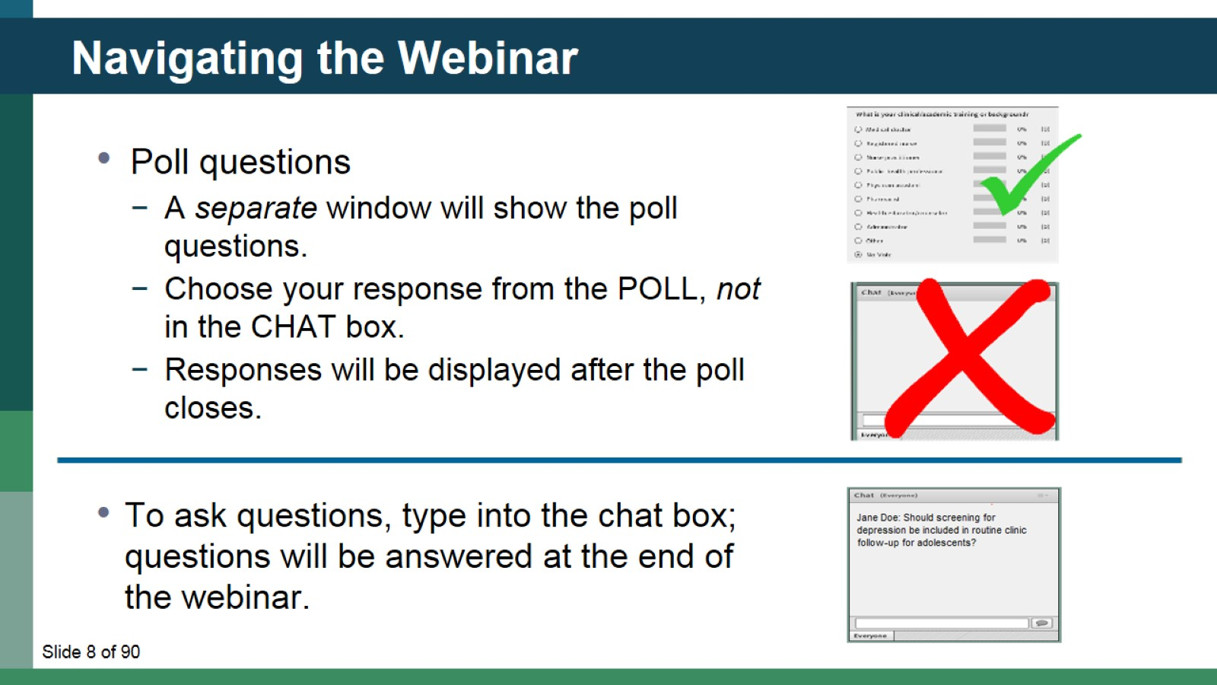
Navigating the Webinar

Slide 9
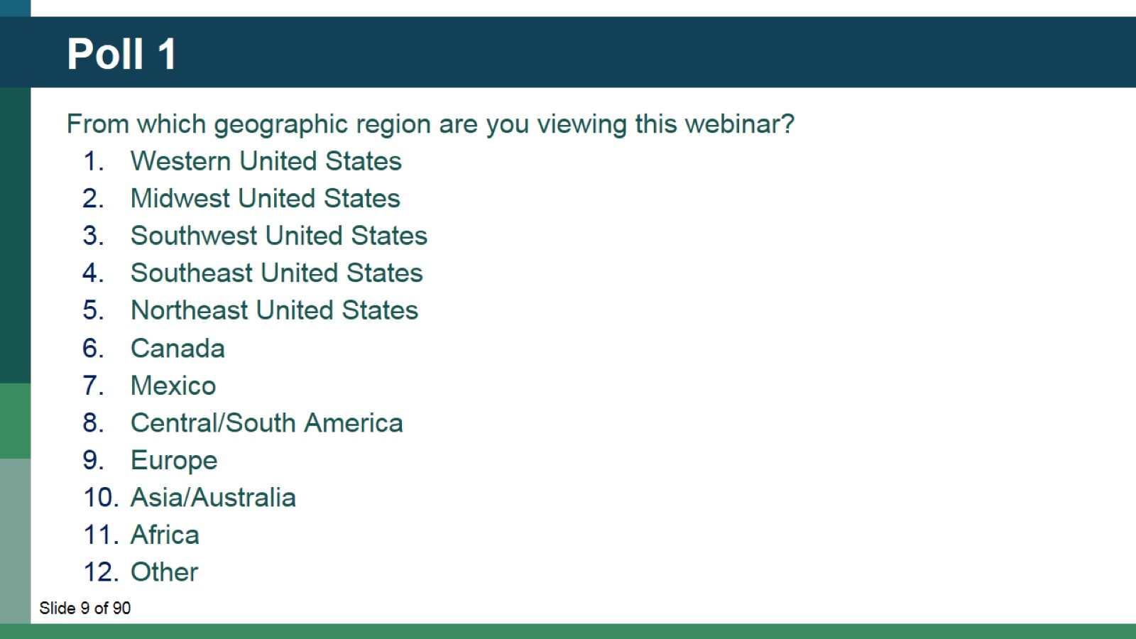
Poll 1

Slide 10
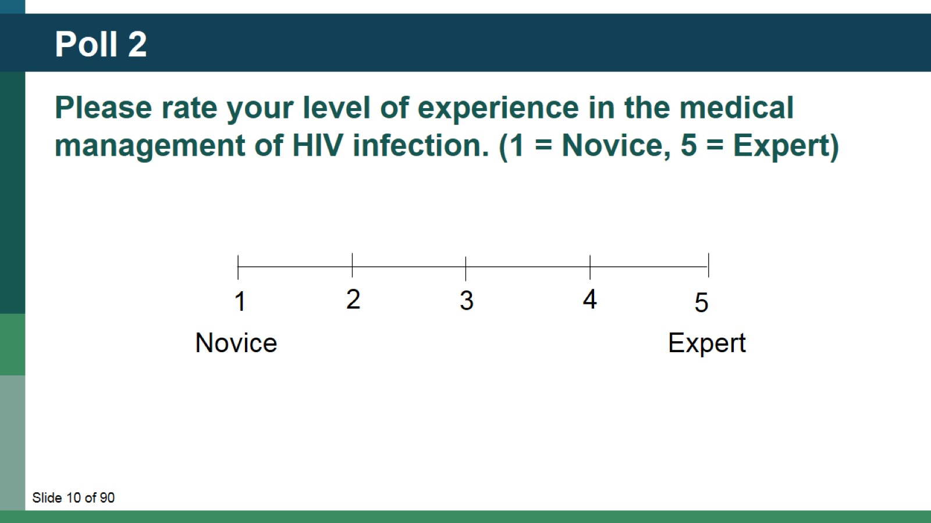
Poll 2

Slide 11
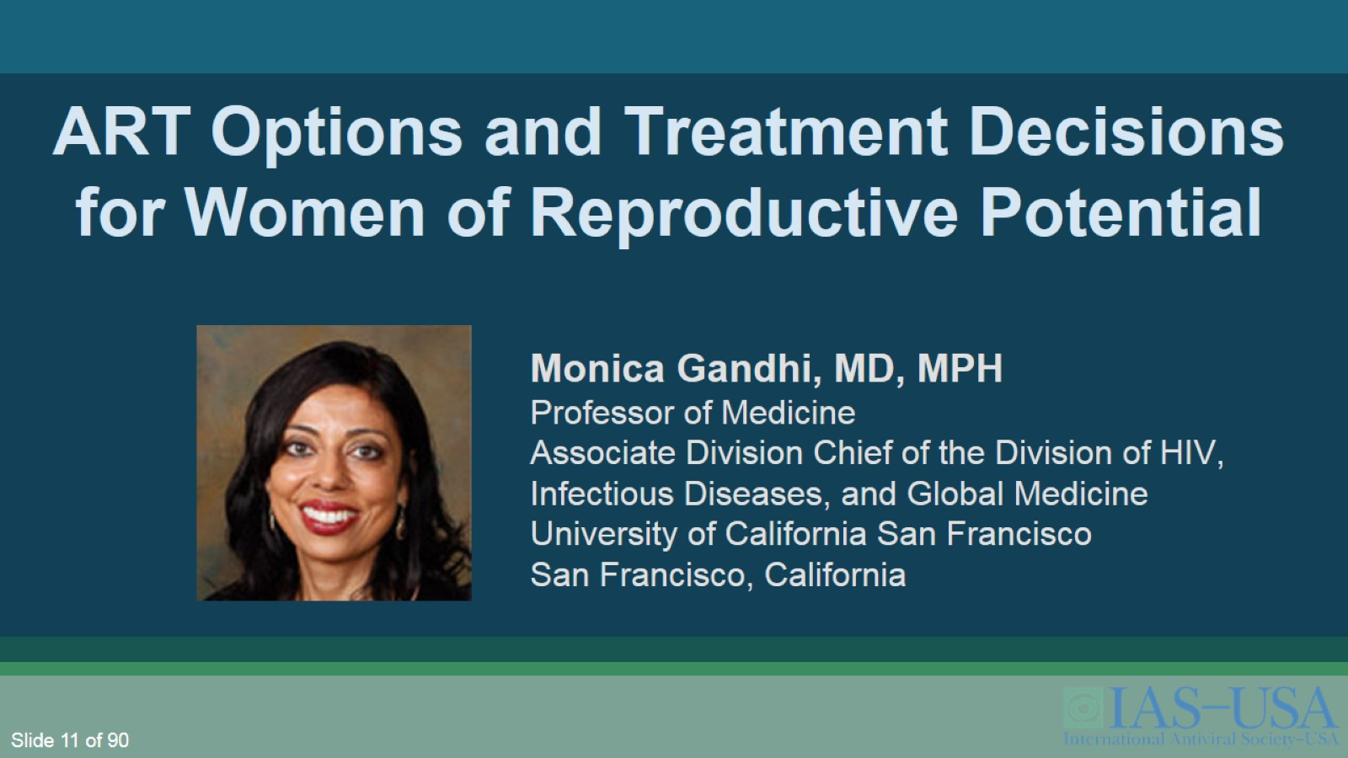
ART Options and Treatment Decisions for Women of Reproductive Potential

Slide 12
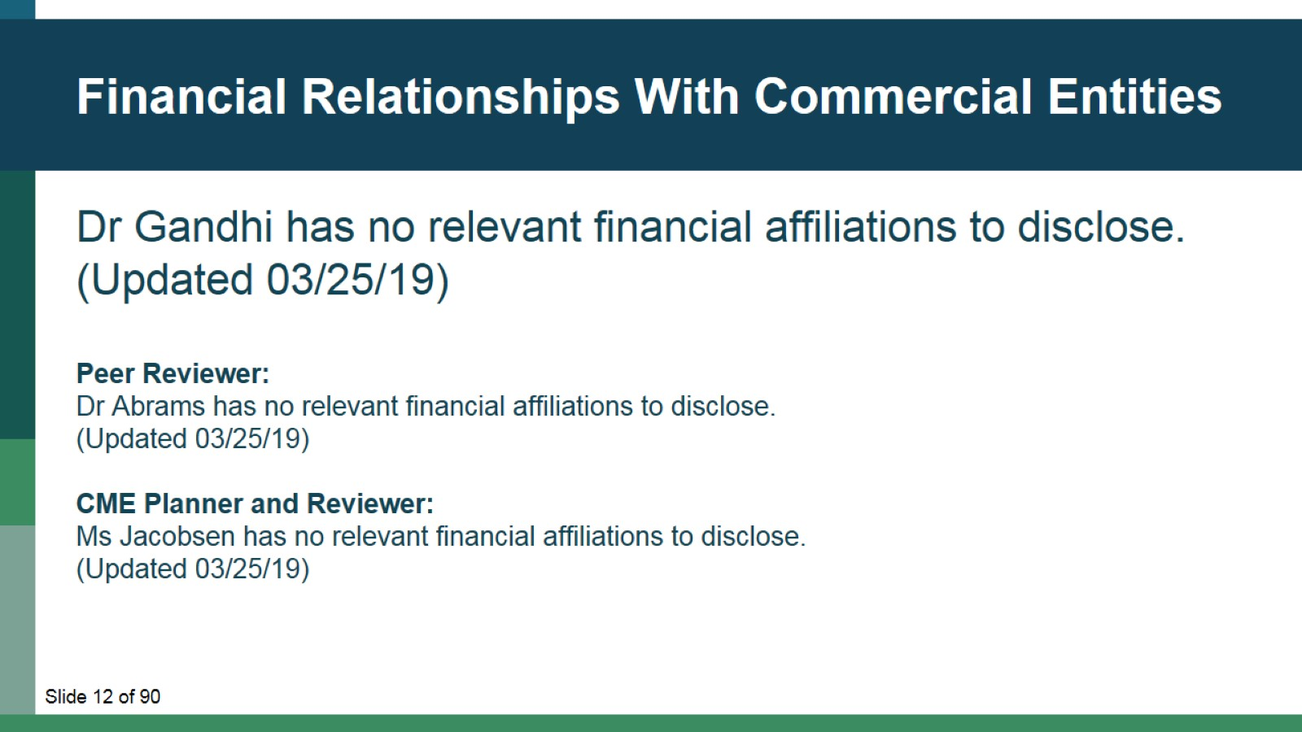
Financial Relationships With Commercial Entities

Slide 13
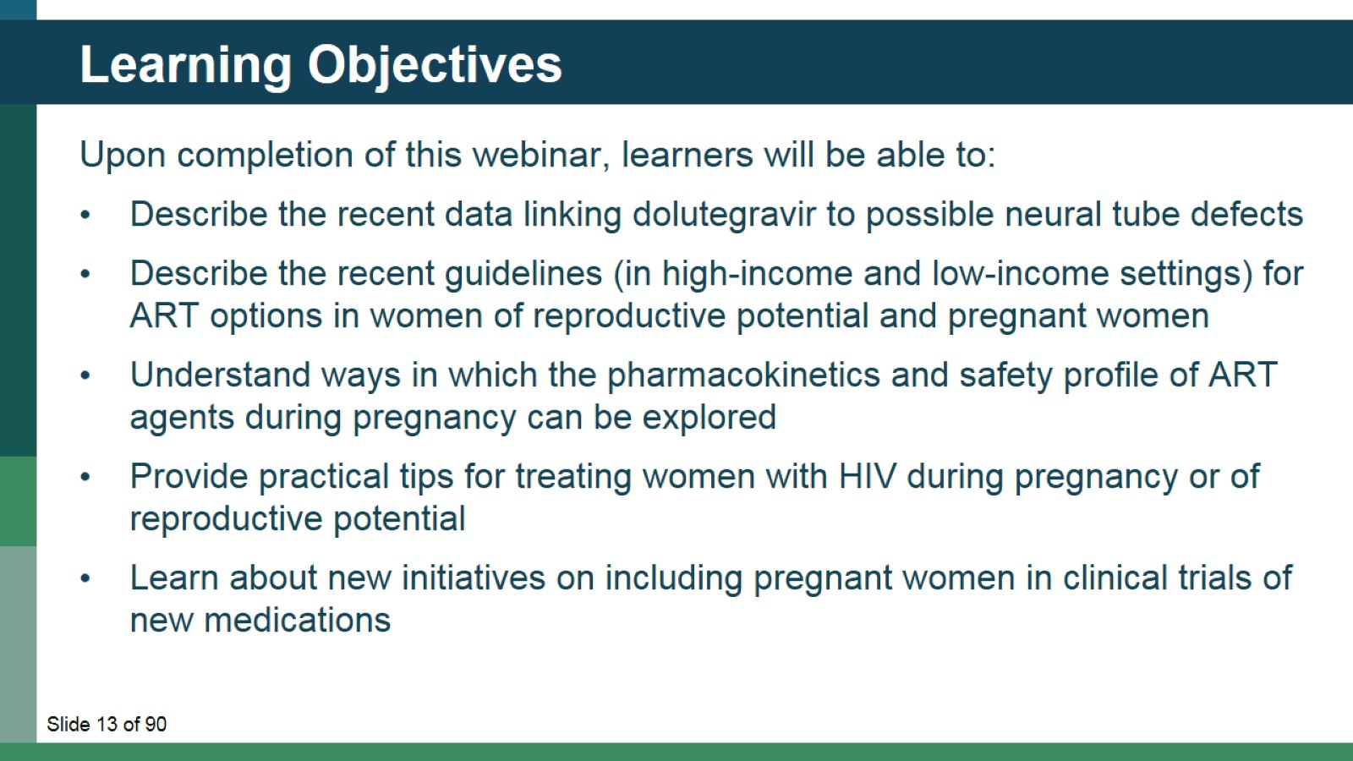
Learning Objectives

Slide 14
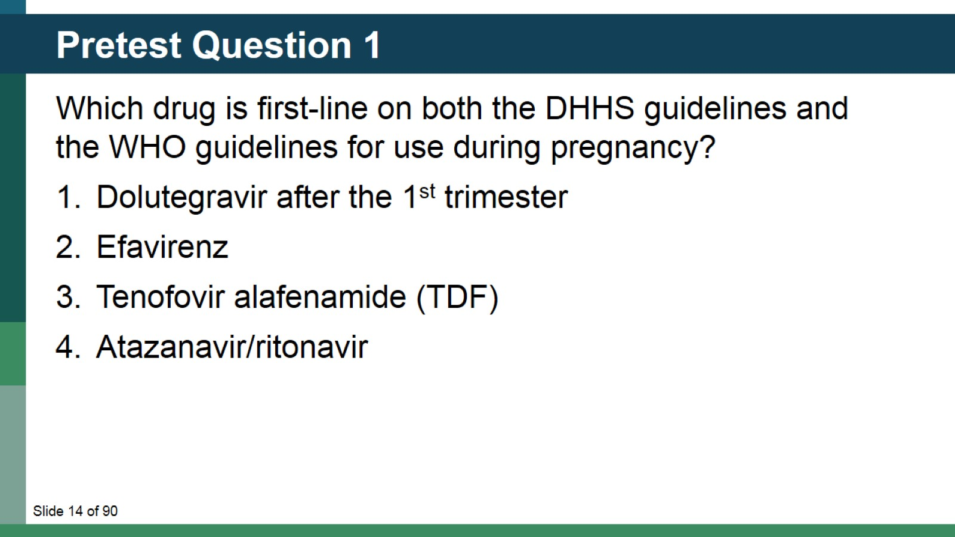
Pretest Question 1

Slide 15
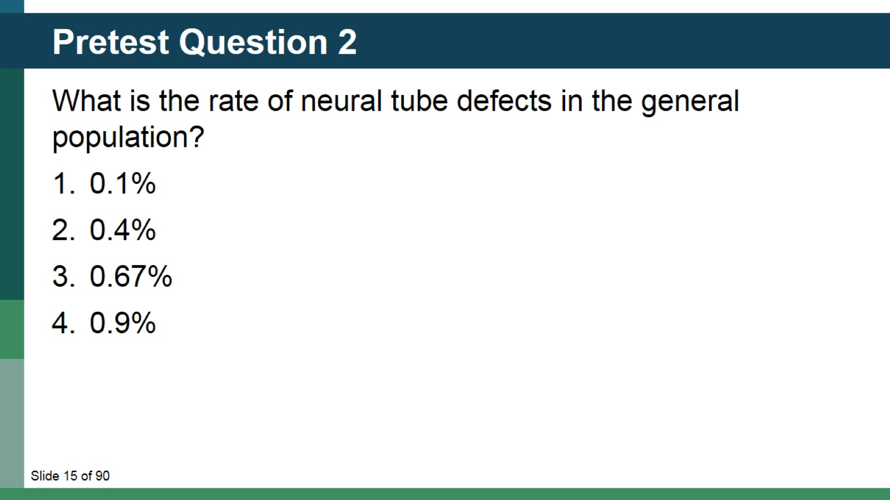
Pretest Question 2

Slide 16
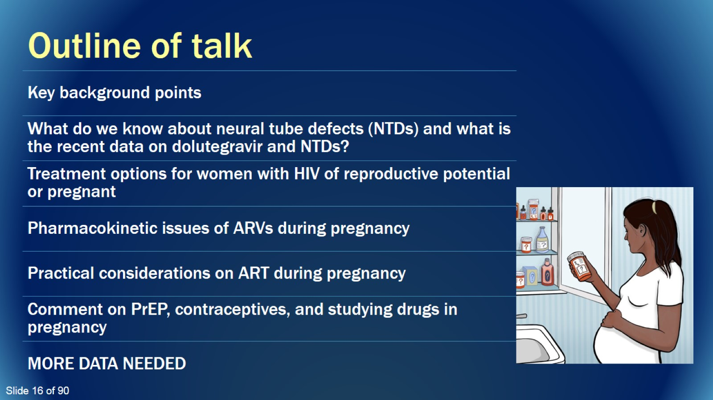
Outline of talk

Slide 17

Key background points

Slide 18
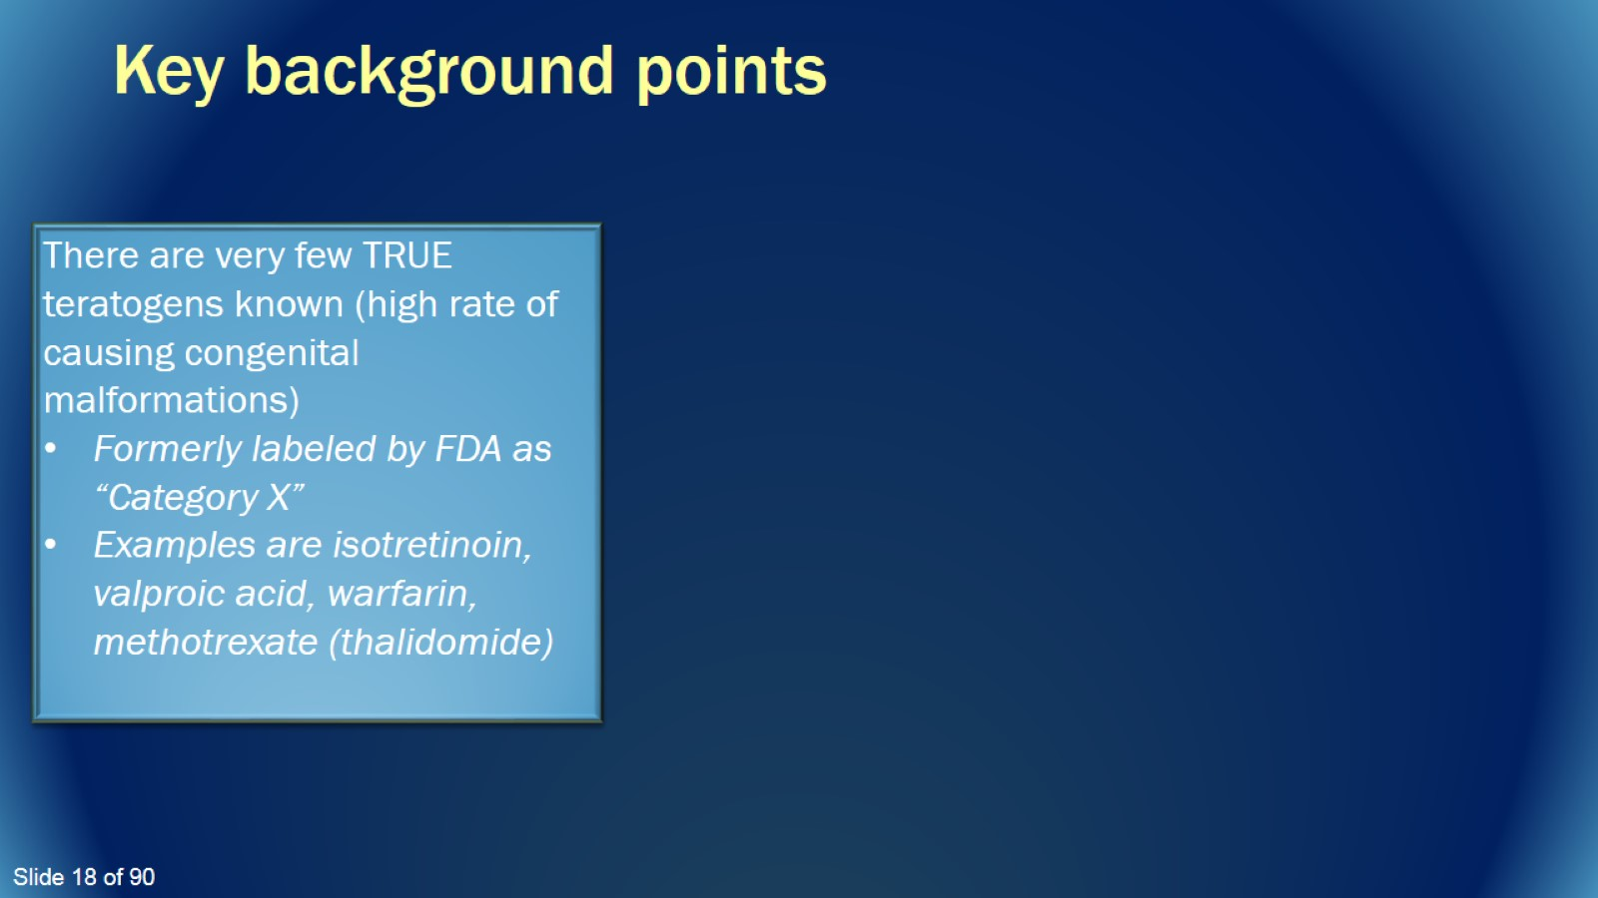
Key background points

Slide 19
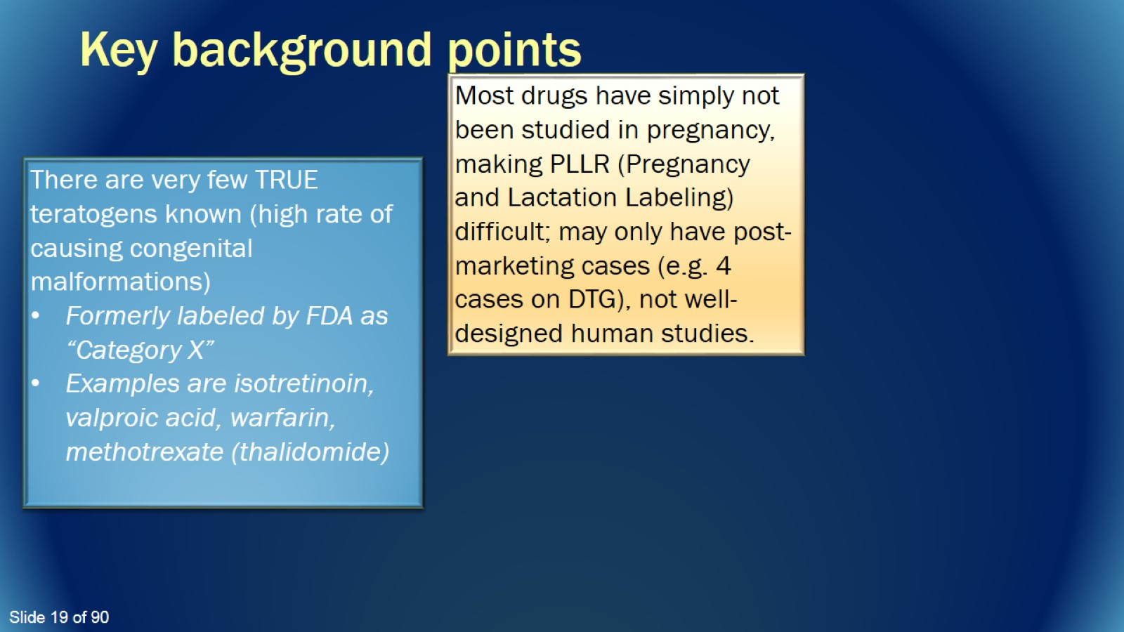
Key background points

Slide 20
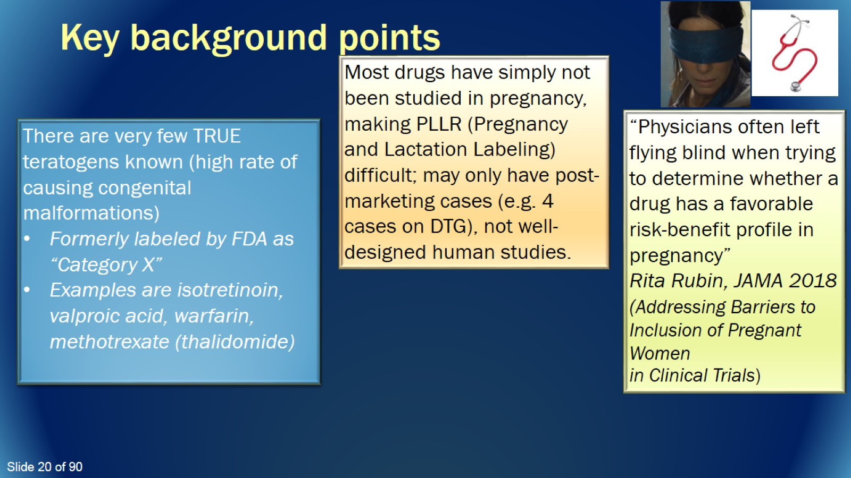
Key background points

Slide 21
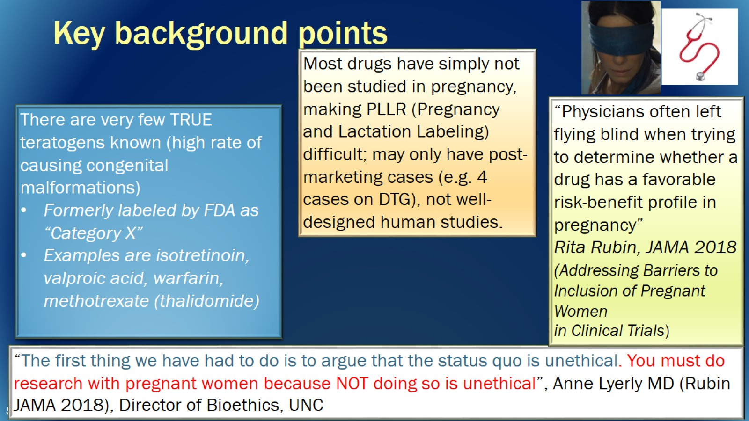
Key background points

Slide 22

How did new data last year shift attention to this topic?

Slide 23
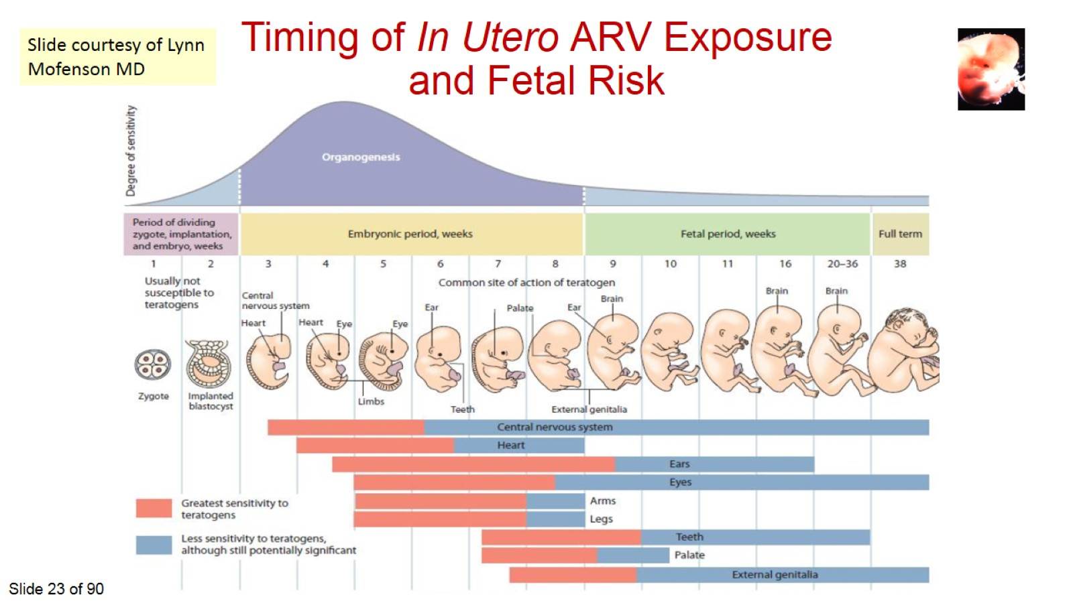

Slide 24
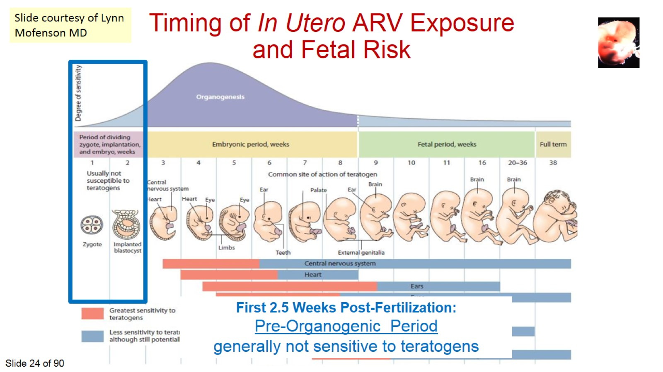

Slide 25
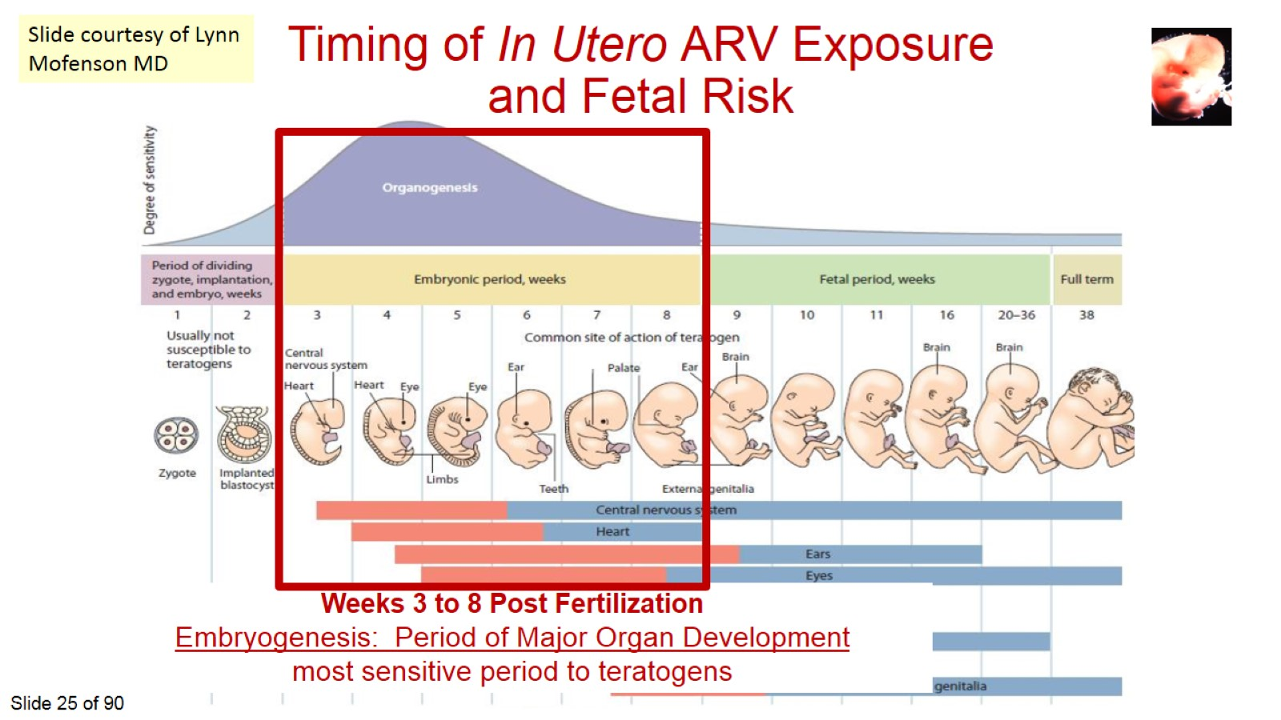

Slide 26
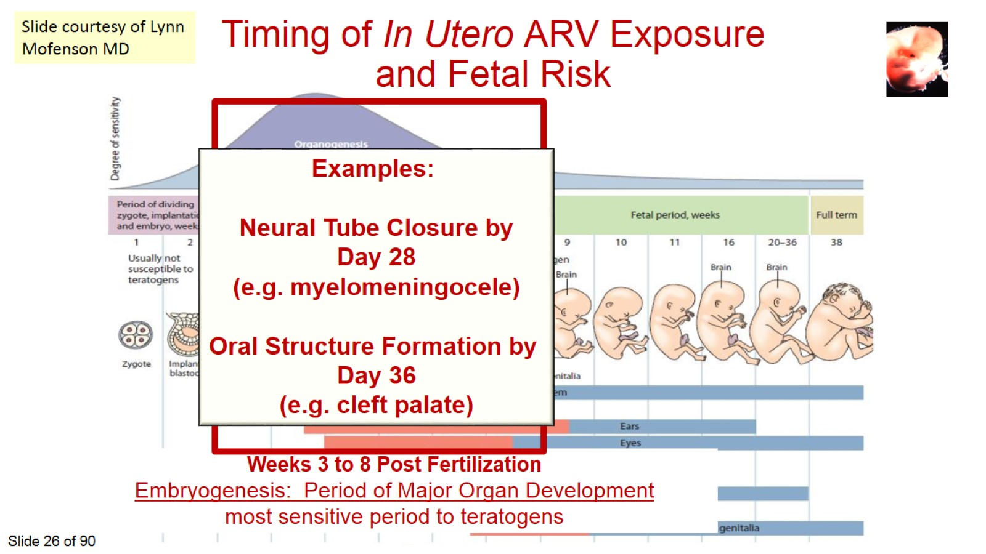

Slide 27
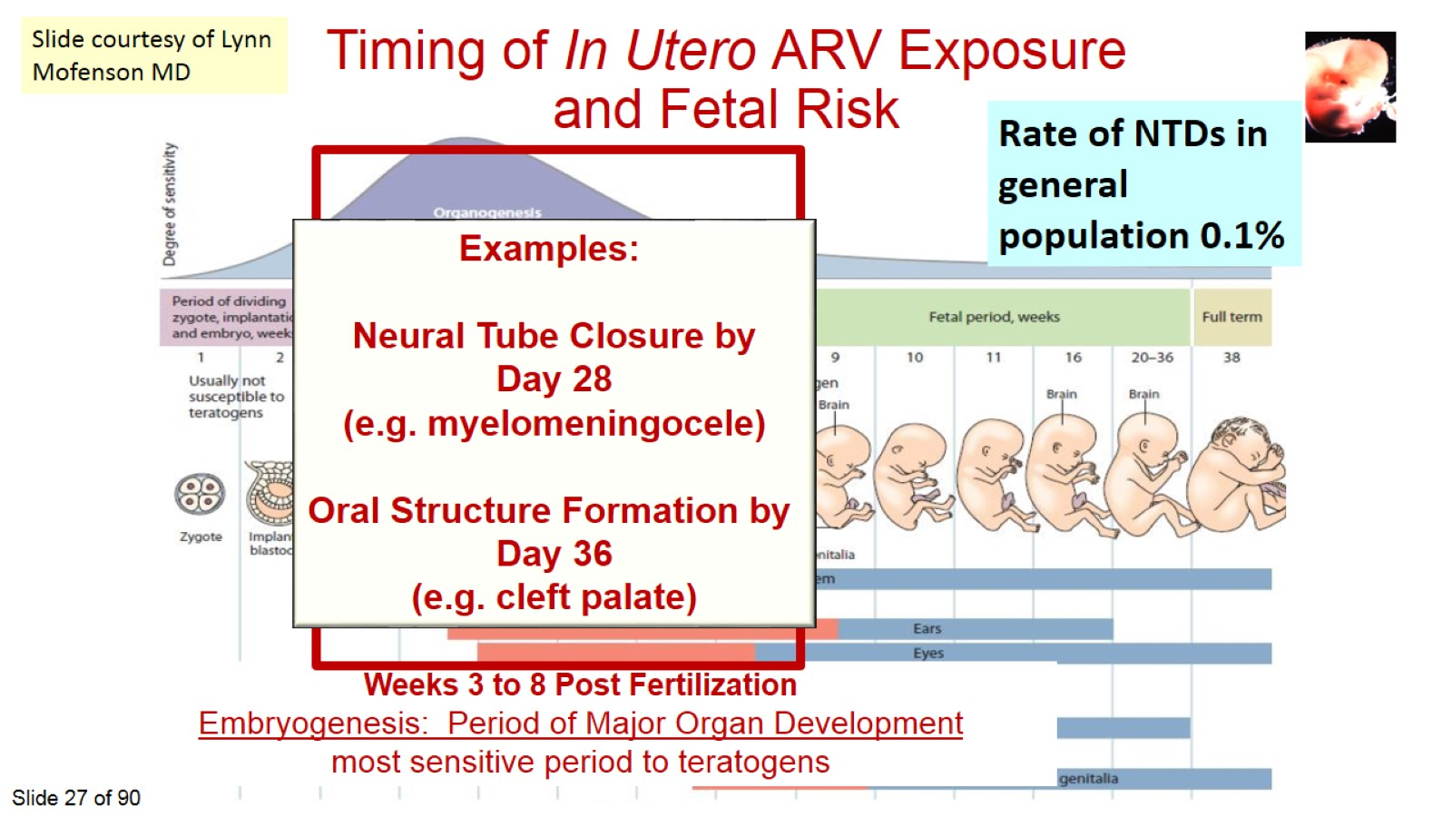

Slide 28
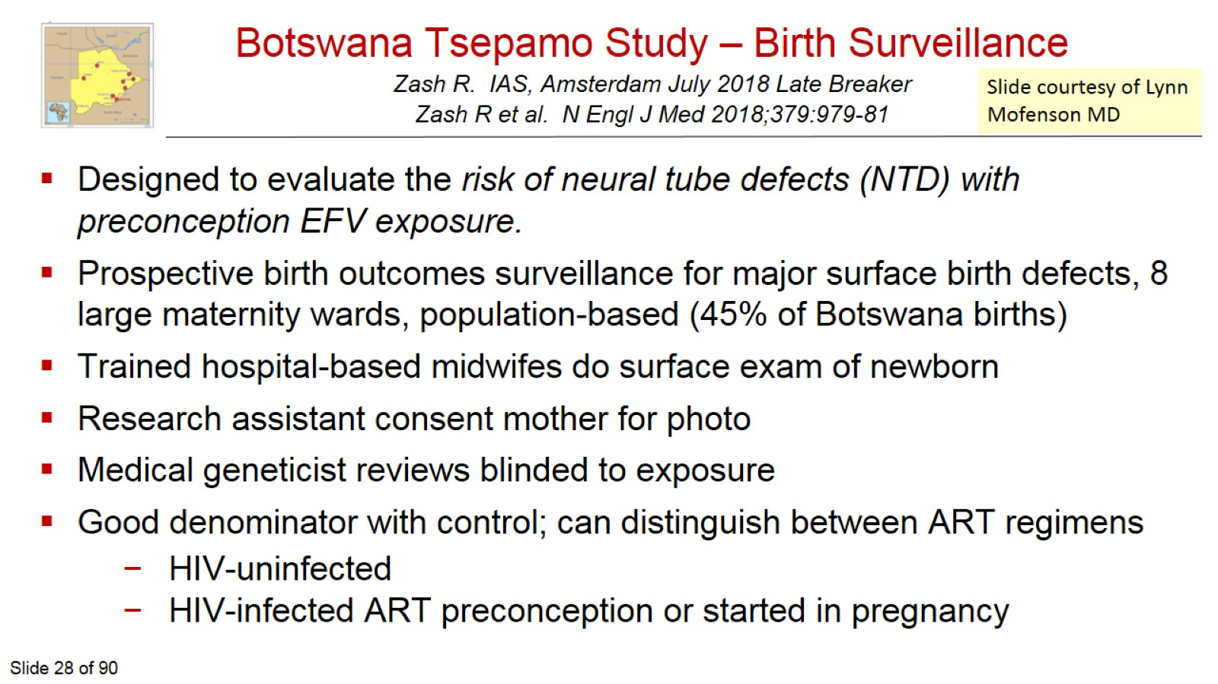
Botswana Tsepamo Study – Birth Surveillance
Zash R. IAS, Amsterdam July 2018 Late Breaker
Zash R et al. N Engl J Med 2018;379:979-81

Slide 29
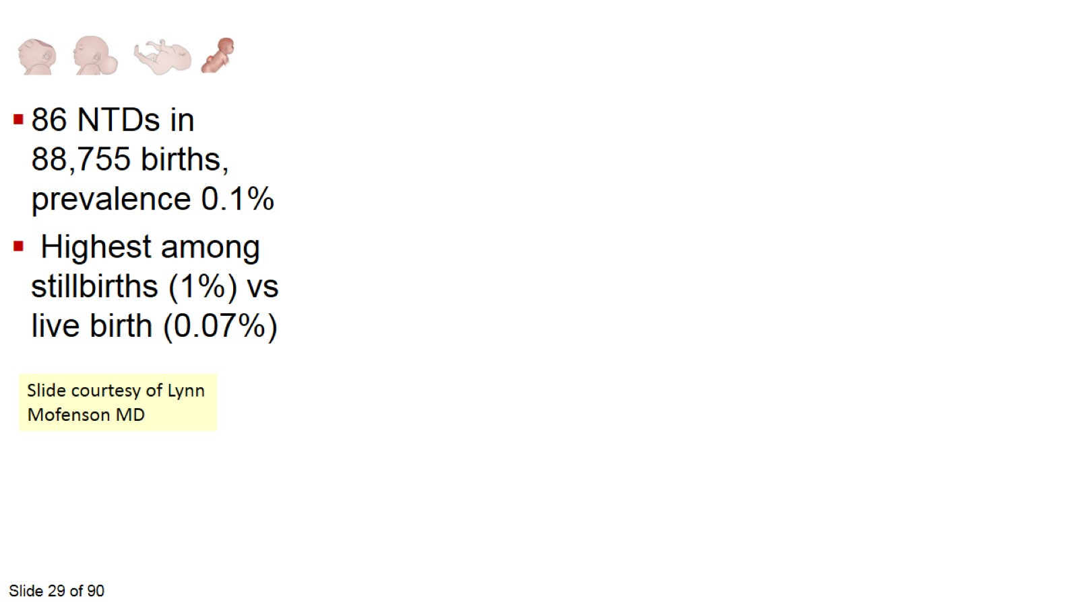

Slide 30
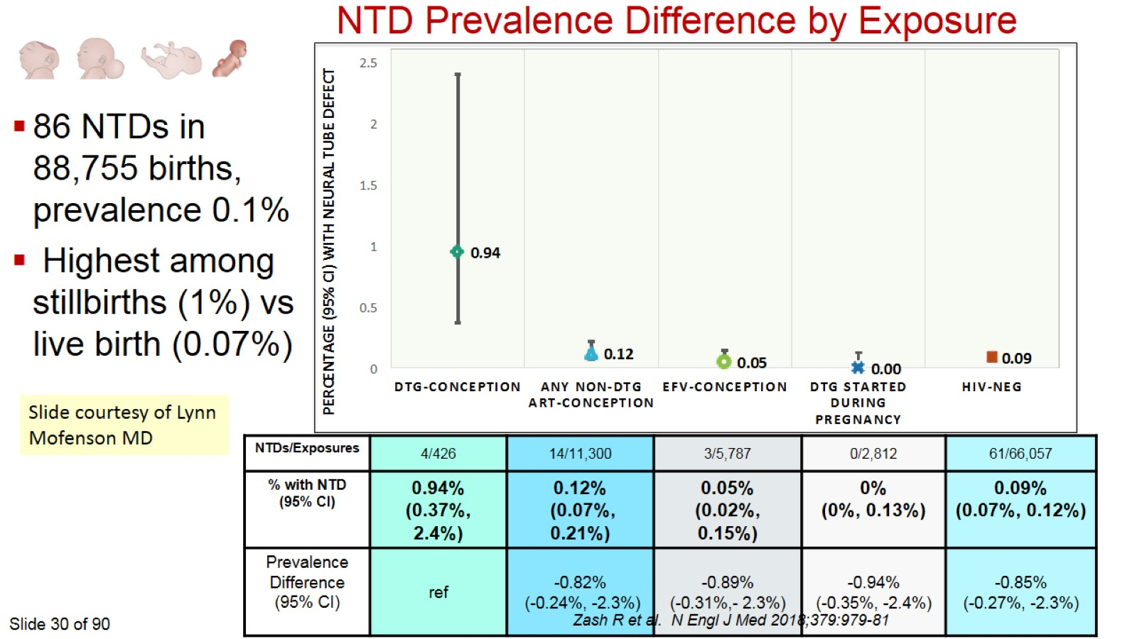

Slide 31
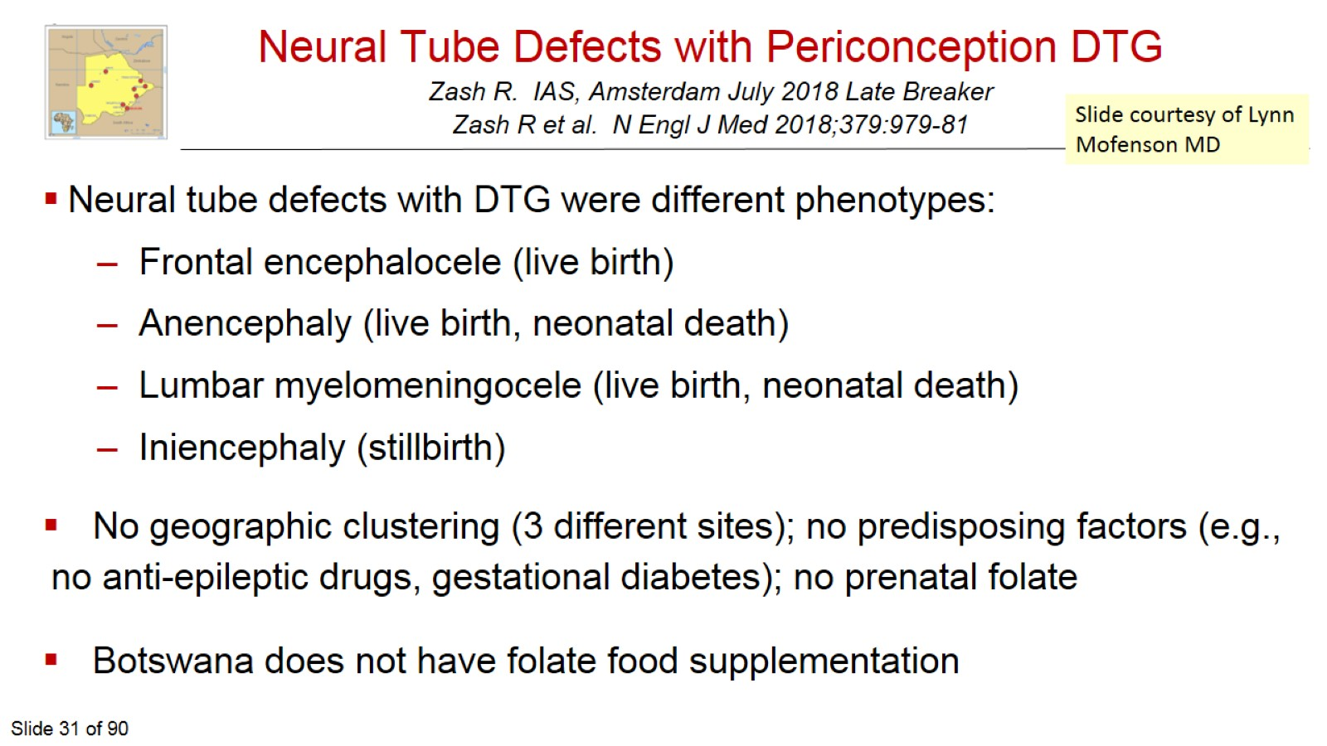
Neural Tube Defects with Periconception DTG
Zash R. IAS, Amsterdam July 2018 Late Breaker
Zash R et al. N Engl J Med 2018;379:979-81

Slide 32
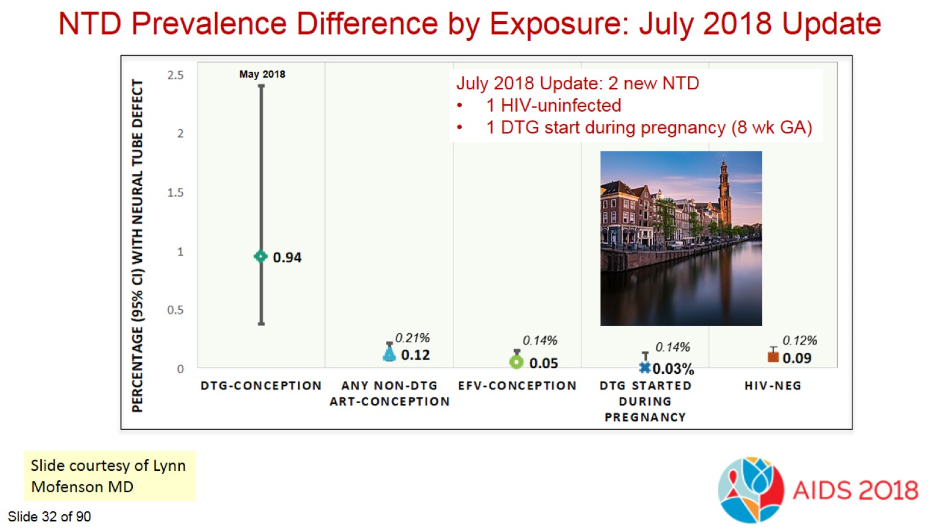

Slide 33
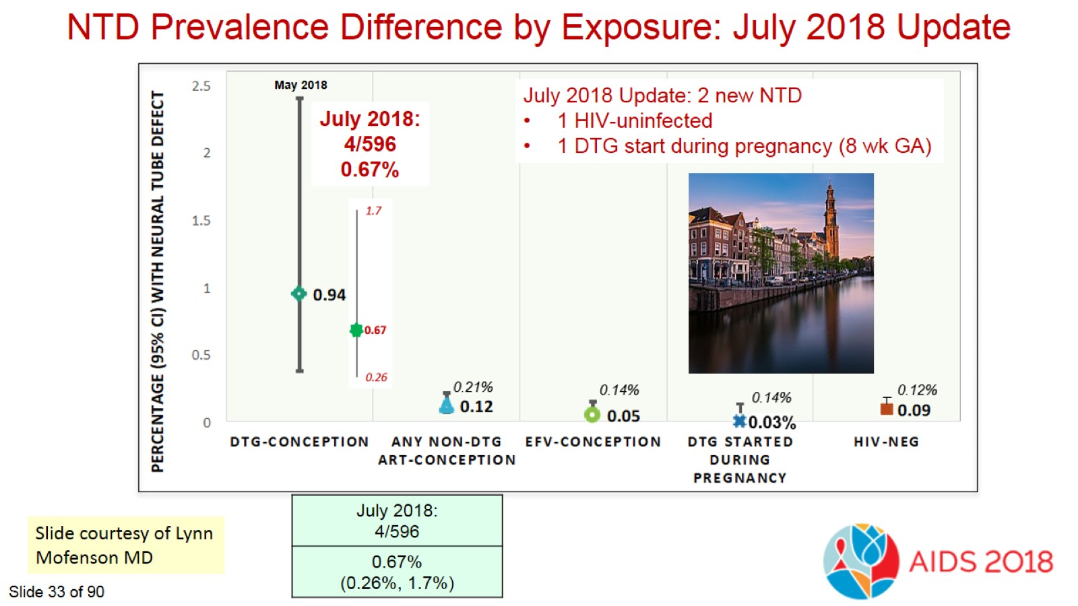

Slide 34
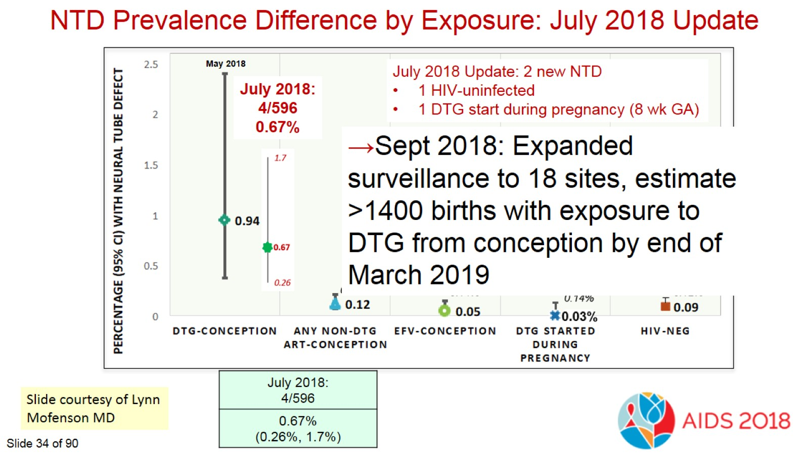

Slide 35
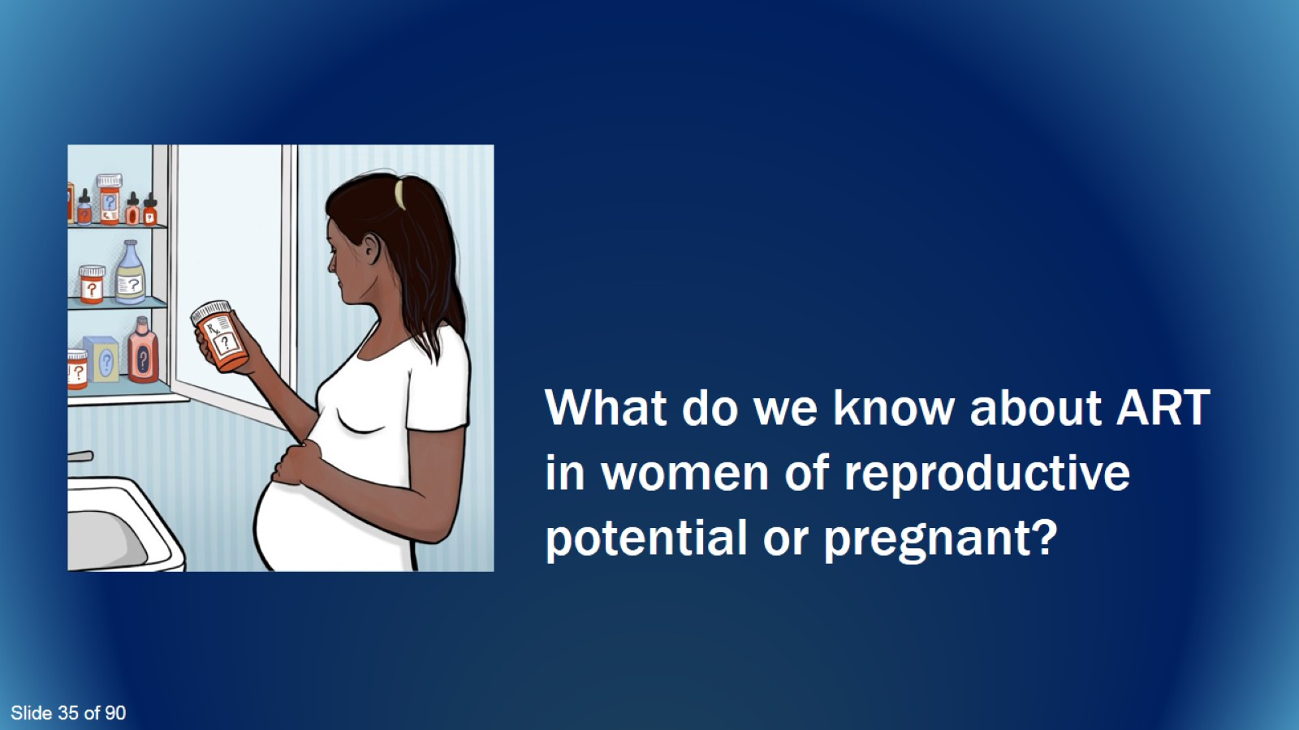
What do we know about ART in women of reproductive potential or pregnant?

Slide 36
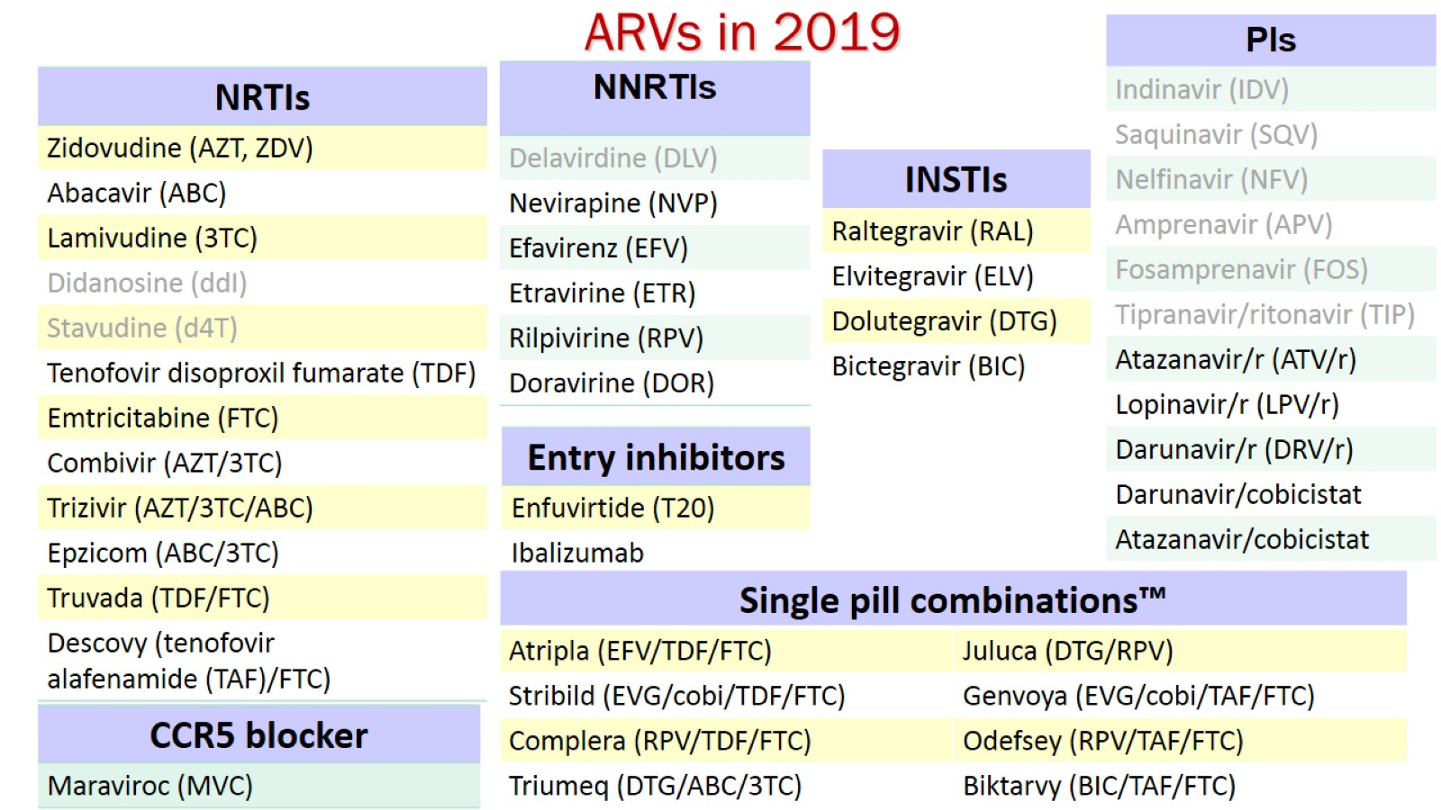
ARVs in 2019

Slide 37
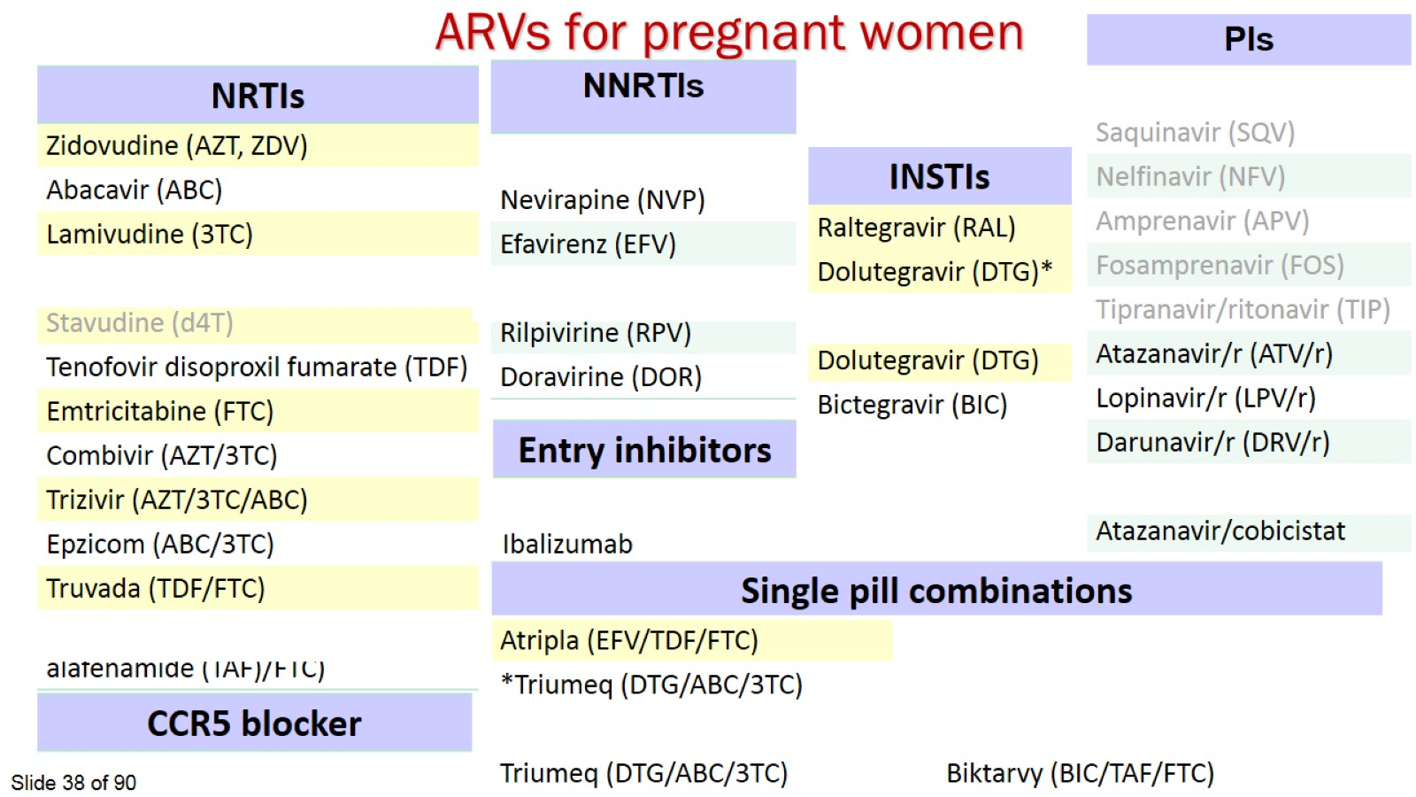
ARVs for pregnant women

Slide 38
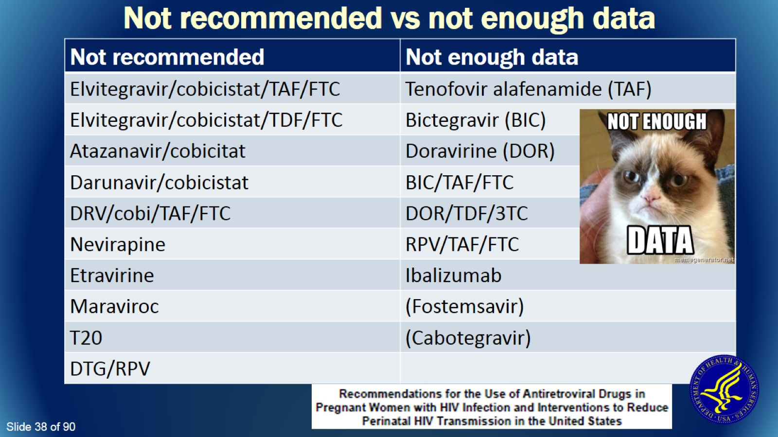
Not recommended vs not enough data

Slide 39
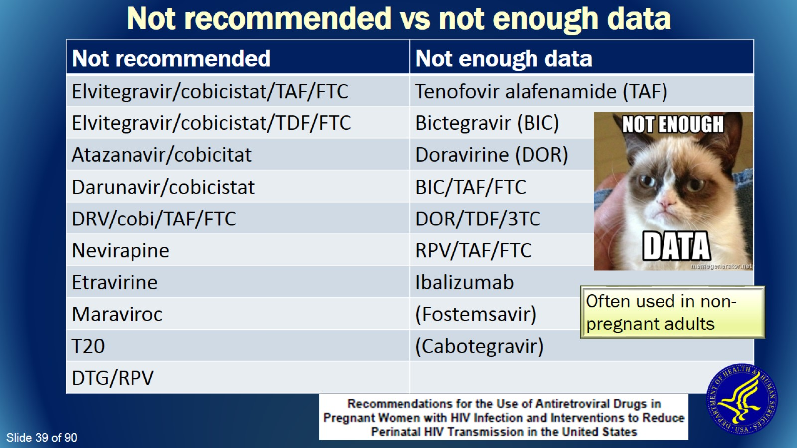
Not recommended vs not enough data

Slide 40
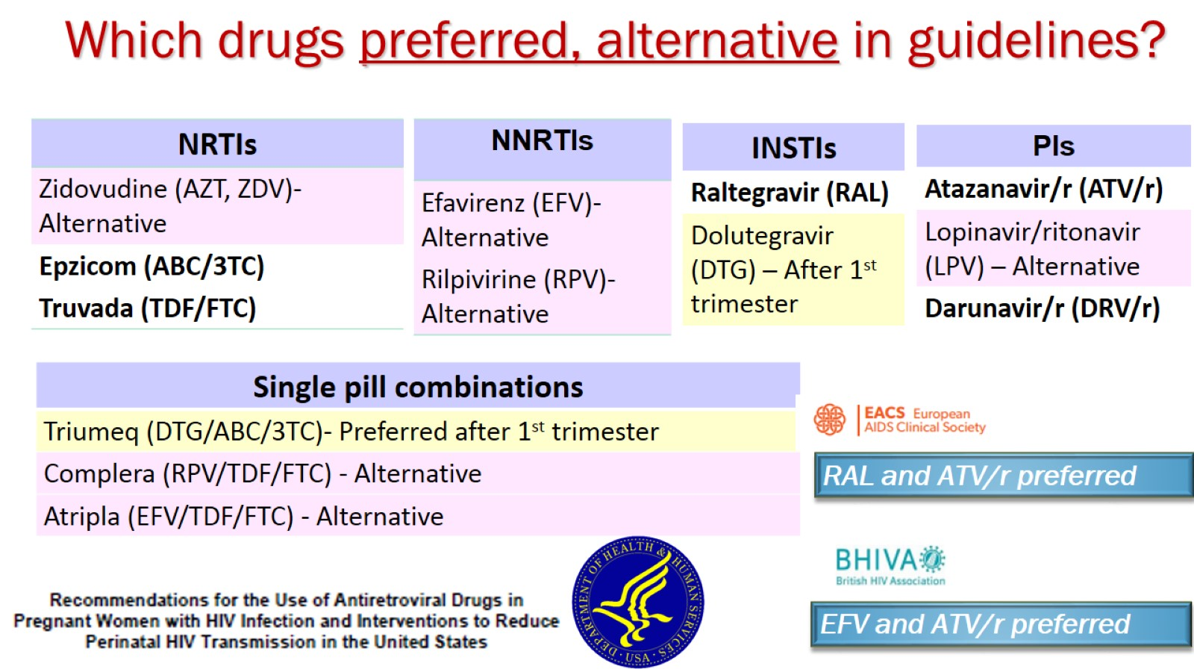
Which drugs preferred, alternative in guidelines?

Slide 41
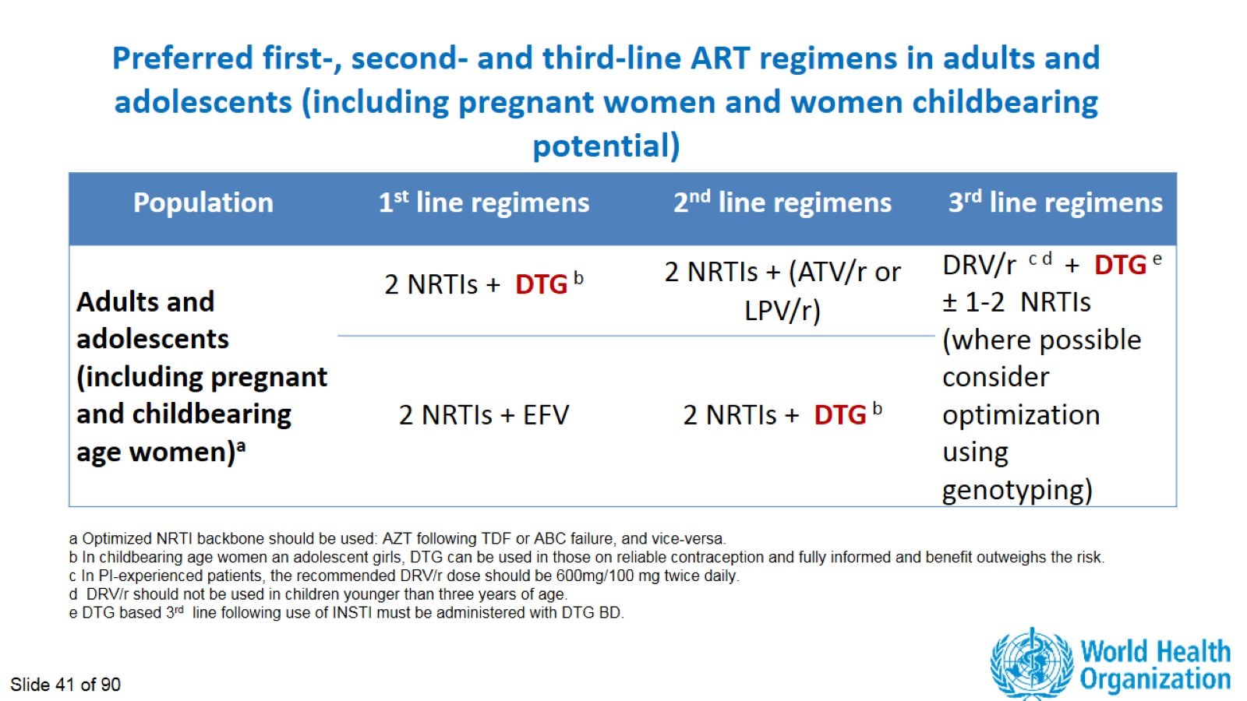
Preferred first-, second- and third-line ART regimens in adults and adolescents (including pregnant women and women childbearing potential)

Slide 42
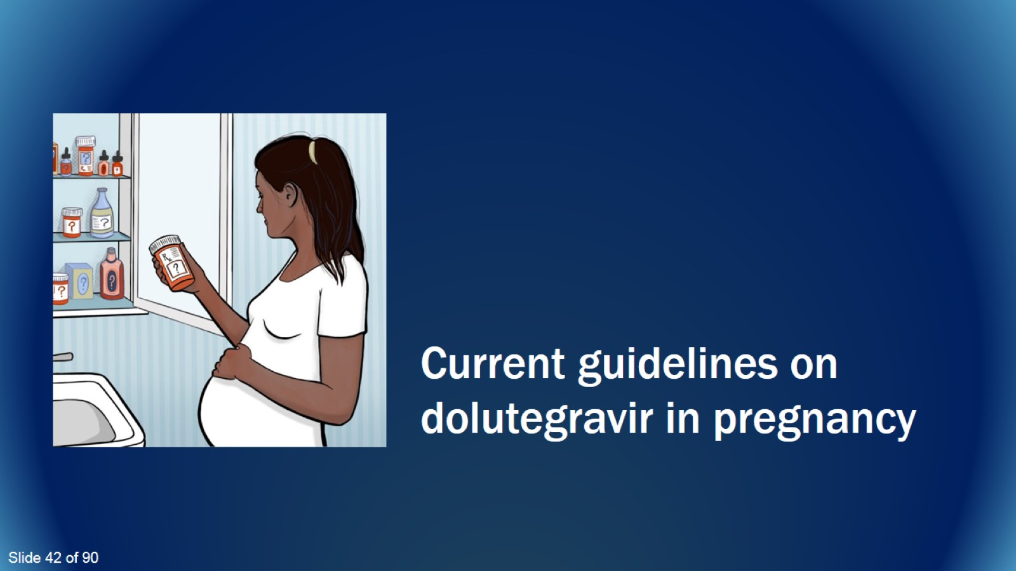
Current guidelines on dolutegravir in pregnancy

Slide 43
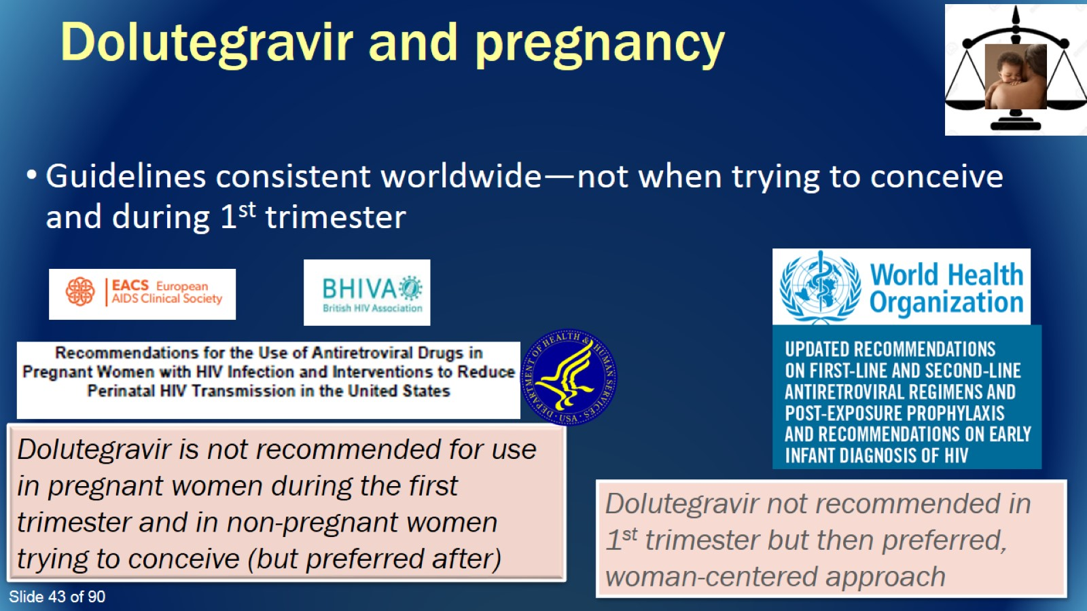
Dolutegravir and pregnancy

Slide 44
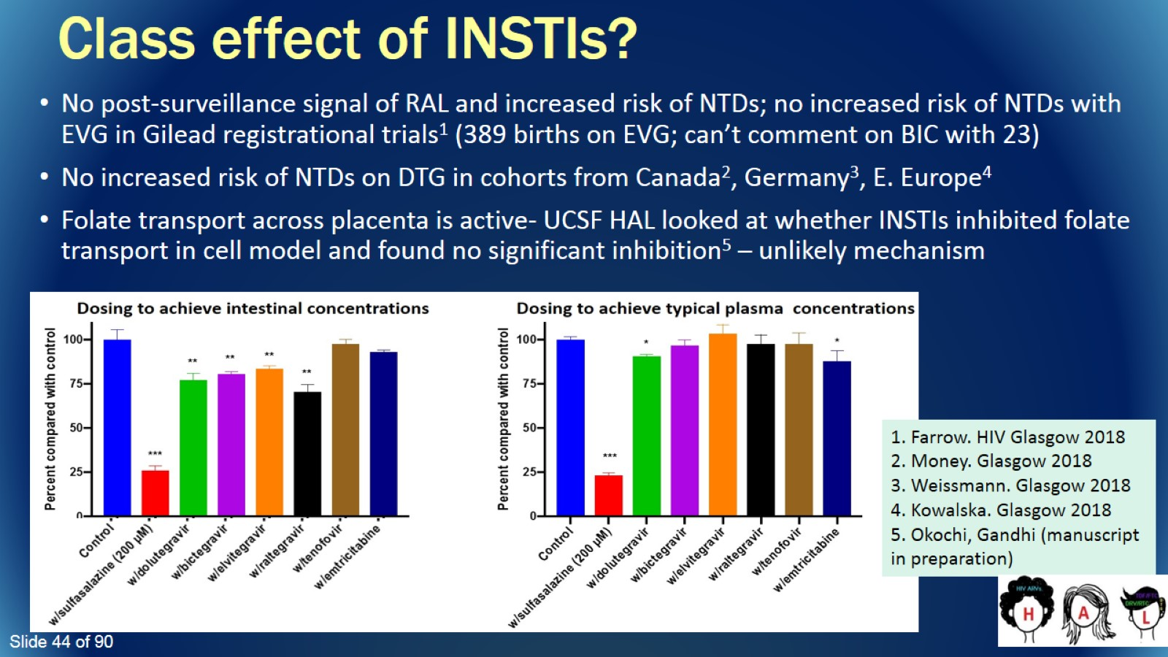
Class effect of INSTIs?

Slide 45
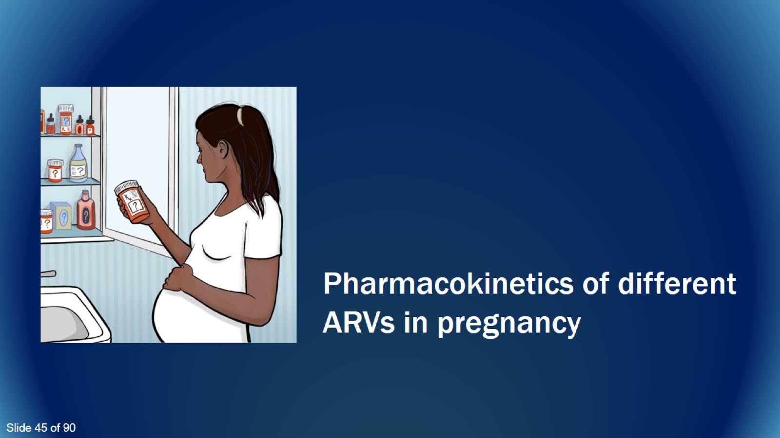
Pharmacokinetics of different ARVs in pregnancy

Slide 46
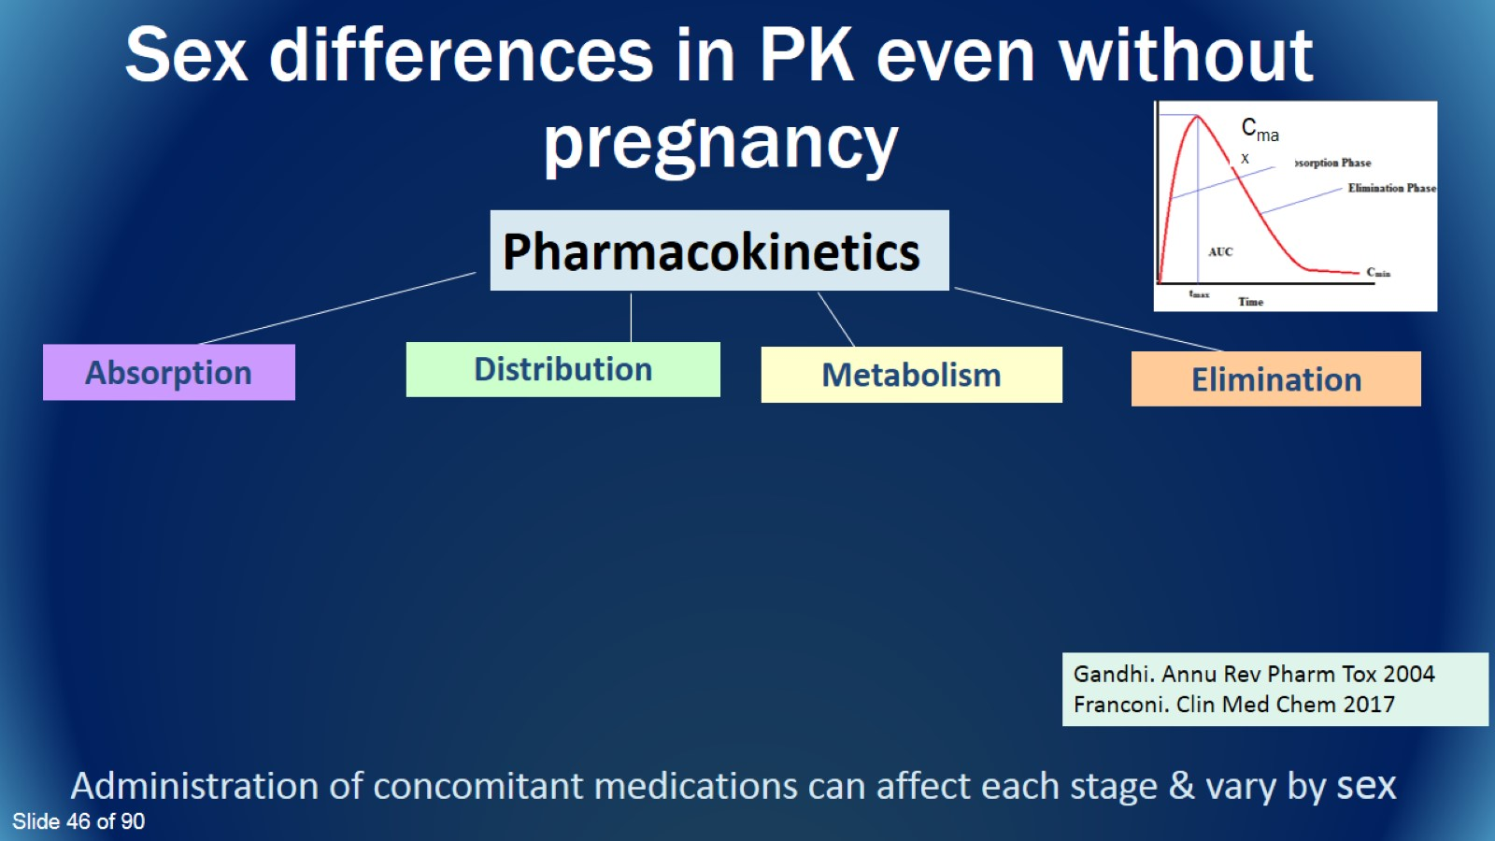
Sex differences in PK even without pregnancy

Slide 47
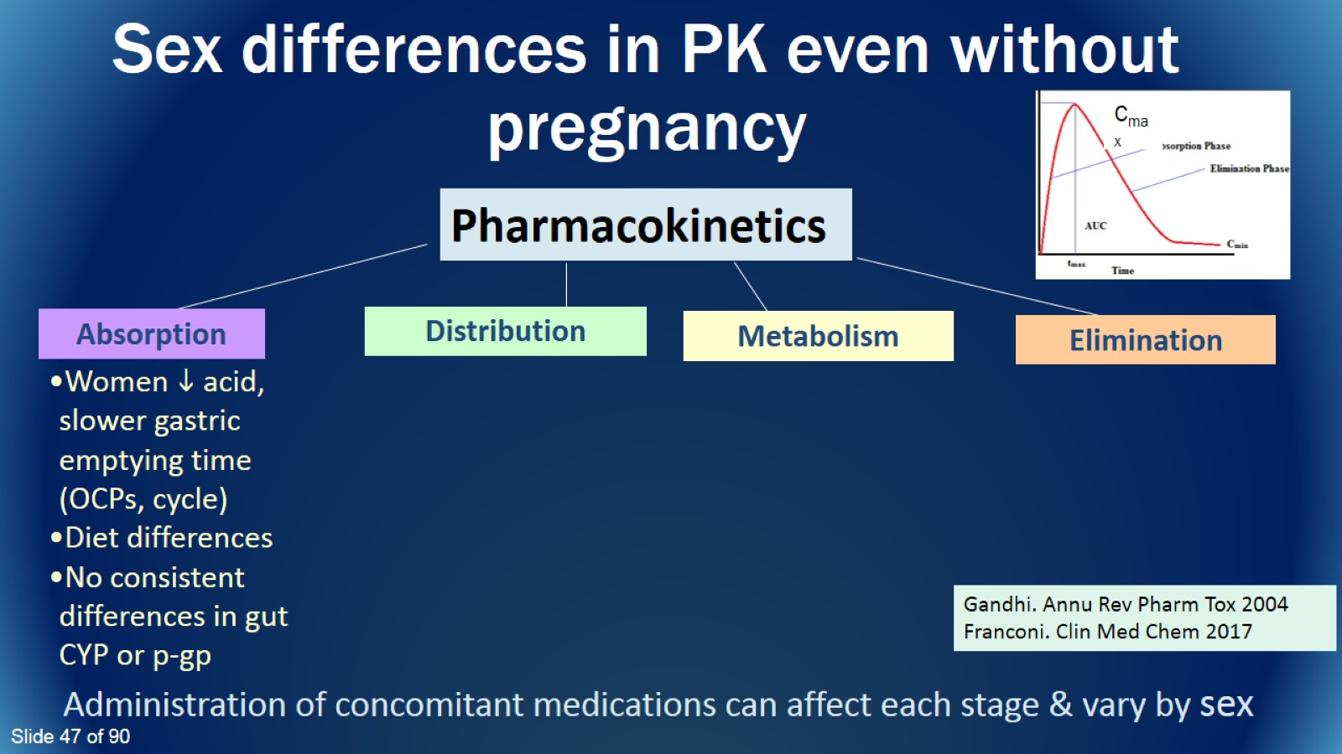
Sex differences in PK even without pregnancy

Slide 48
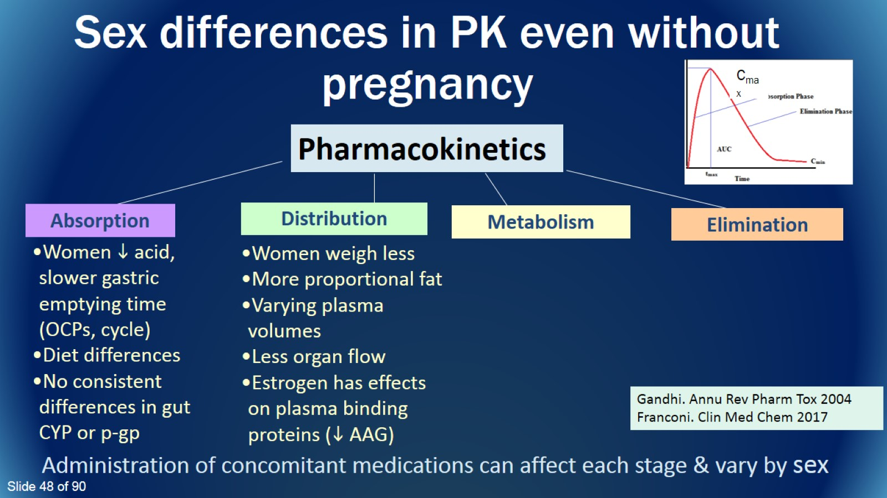
Sex differences in PK even without pregnancy

Slide 49
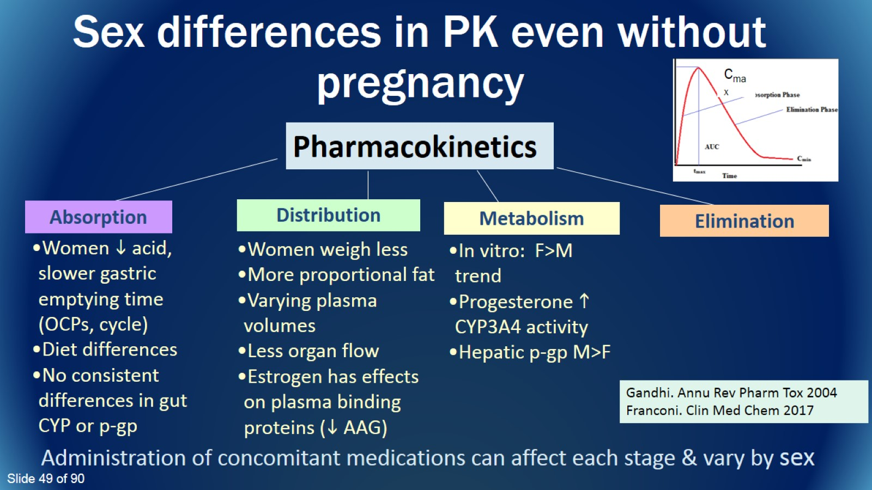
Sex differences in PK even without pregnancy

Slide 50
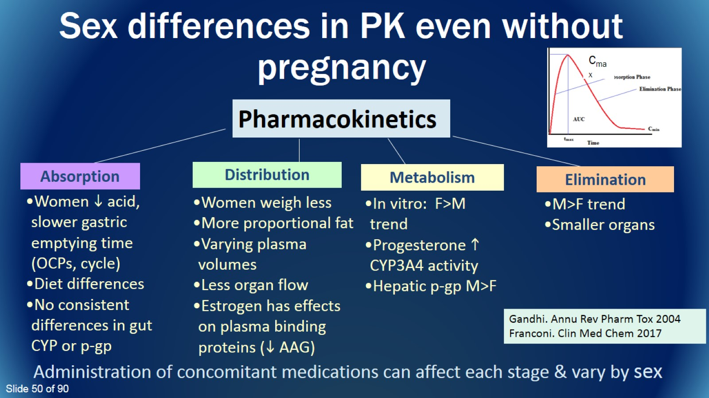
Sex differences in PK even without pregnancy

Slide 51
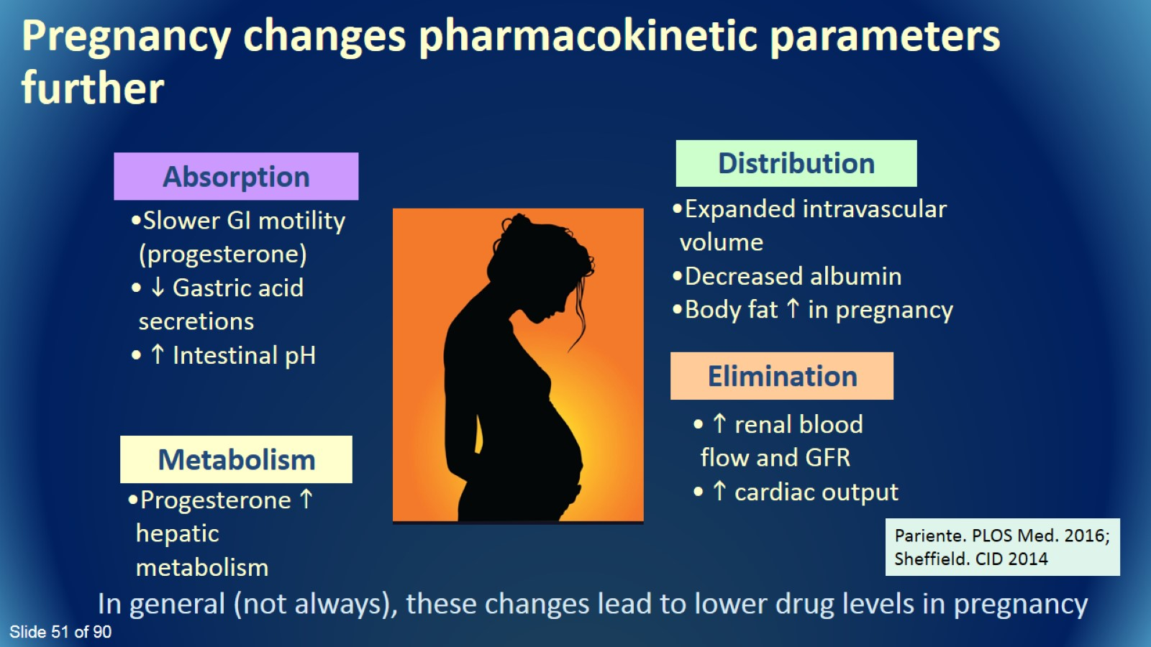

Slide 52
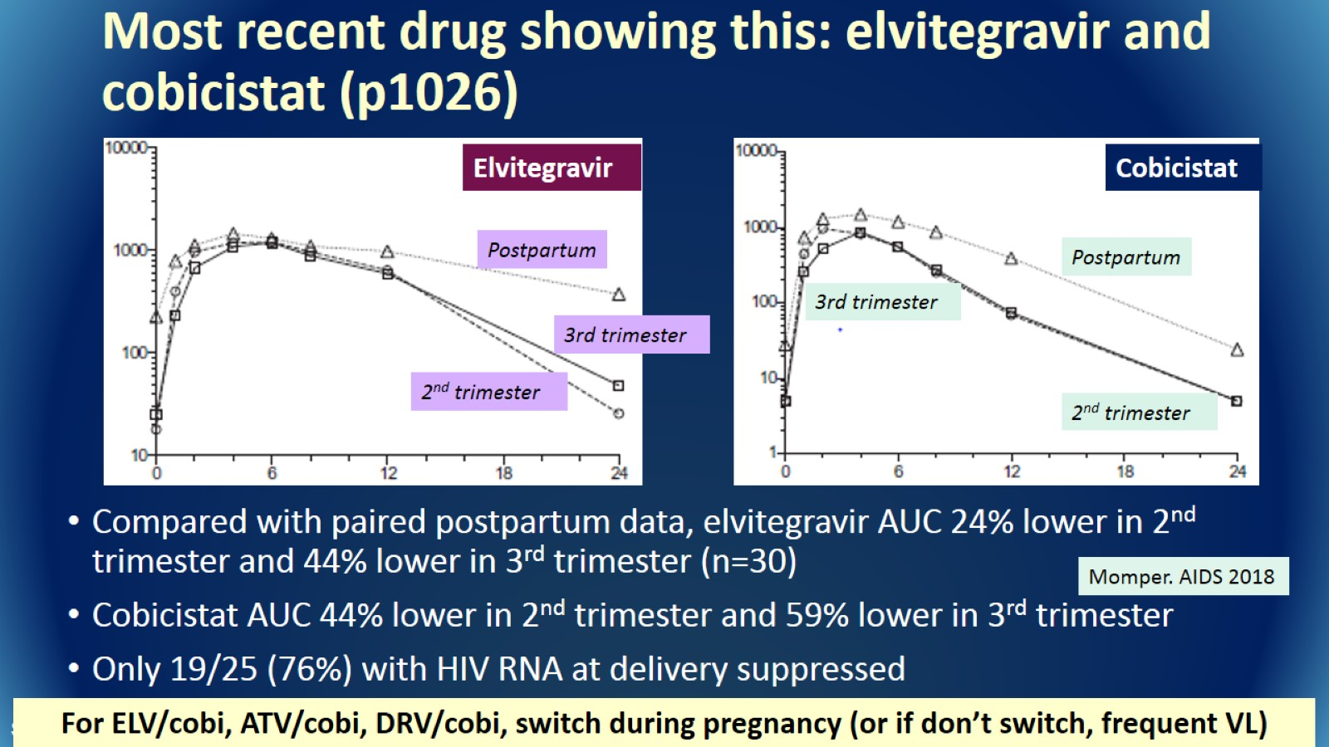
Most recent drug showing this: elvitegravir and cobicistat (p1026)

Slide 53
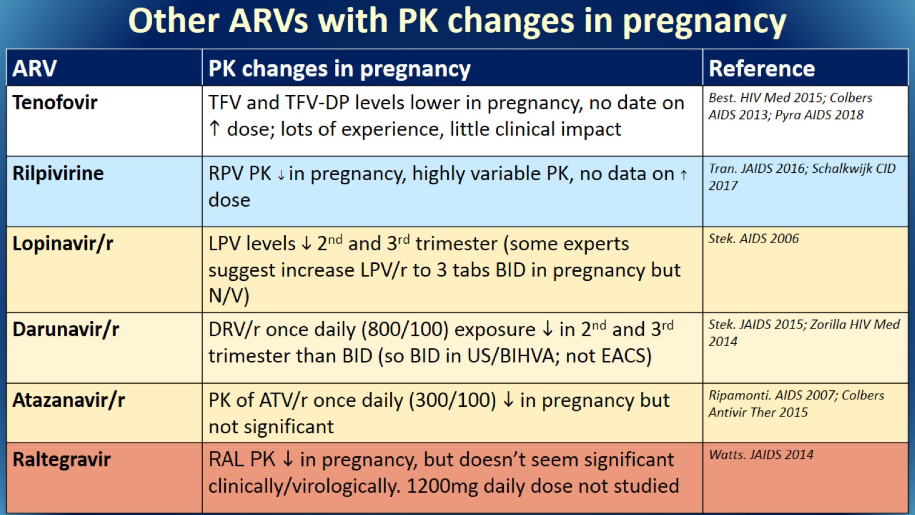
Other ARVs with PK changes in pregnancy

Slide 54

Putting it all together- Practical considerations

Slide 55

What should you consider?

Slide 56


Slide 57


Slide 58


Slide 59


Slide 60


Slide 61


Slide 62


Slide 63

Which ARVs are listed as “can be continued” or “should be switched off”

Slide 64

Other considerations in pregnancy

Slide 65

Monitoring of HIV labs during pregnancy

Slide 66

Comment on PrEP, pre-conception, and sex differences in general

Slide 67

Comment on PrEP

Slide 68

Pre-conception period

Slide 69

Contraceptives and ART (simplified)

Slide 70

More data needed

Slide 71

Women of reproductive potential

Slide 72

Burden of justification

Slide 73

Burden of justification

Slide 74


Slide 75

FDA says study in pregnant women justified when..

Slide 76

“Development of accessible treatment options for the pregnant population is a significant public health issue”

Slide 77

Conclusions

Slide 78

Conclusions

Slide 79


Slide 80

Posttest Question 1

Slide 81

Posttest Question 2

Slide 82

Question-and-Answer

Slide 83


Slide 84

See the IAS–USA website for instructions on claiming CME, pharmacy, nursing, or pharmacotherapy credits, or a certificate of participation.

Slide 85


Slide 86


Slide 87

Sexual Health,
HIV Prevention, and Primary Care in 2019

Slide 88


Slide 89

Thank You

