Slide 1
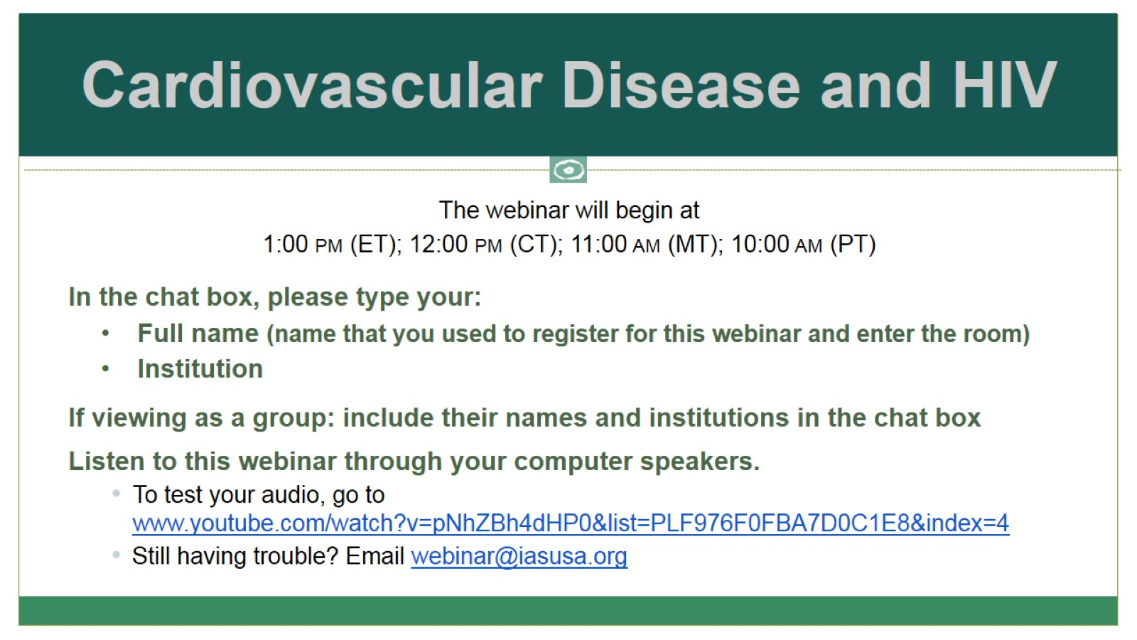
Cardiovascular Disease and HIV

Slide 2
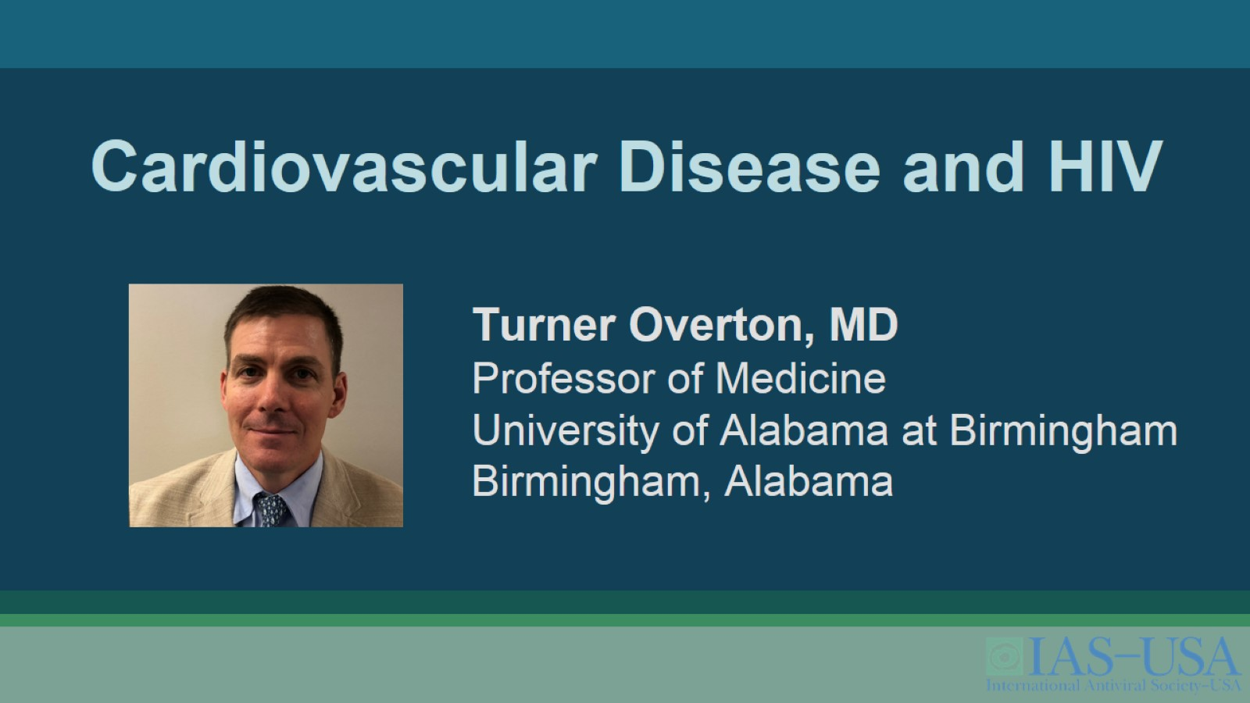
Cardiovascular Disease and HIV

Slide 3
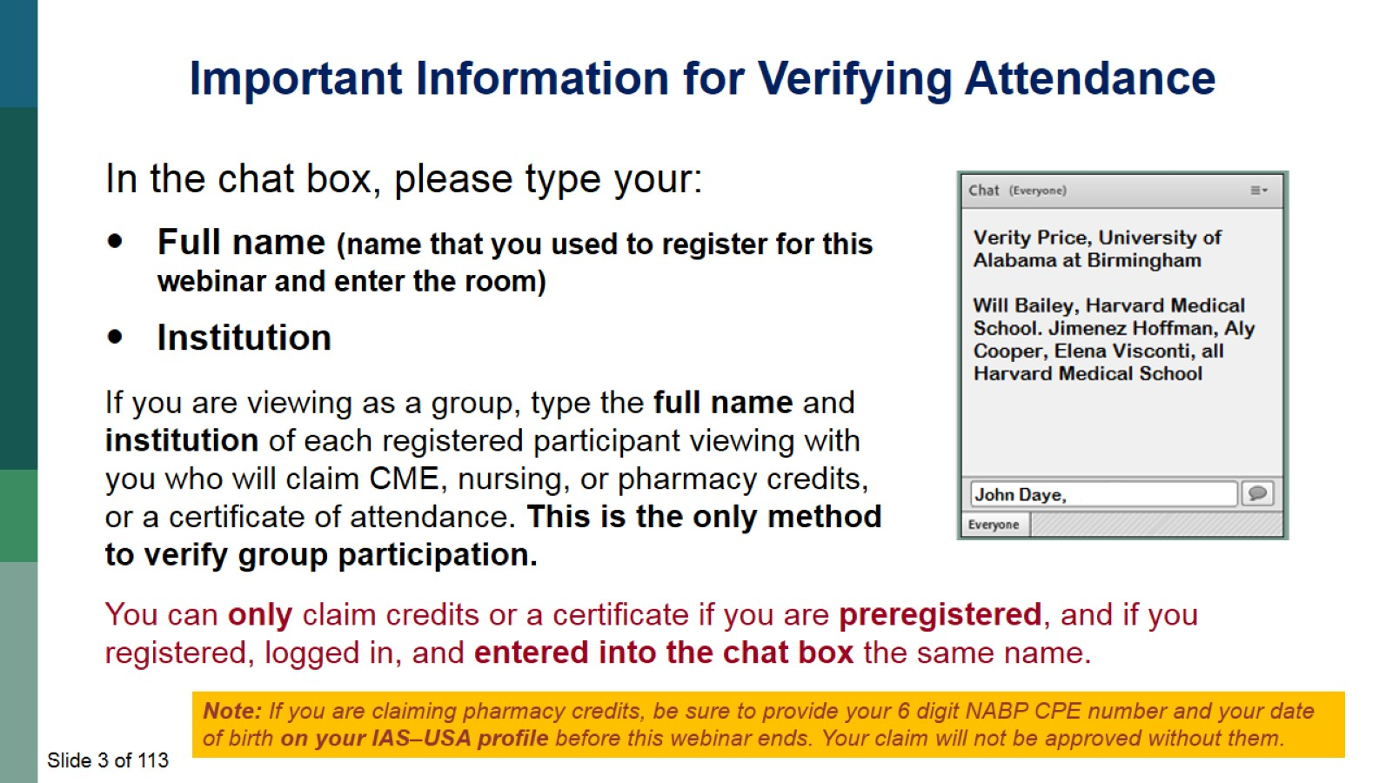

Slide 4
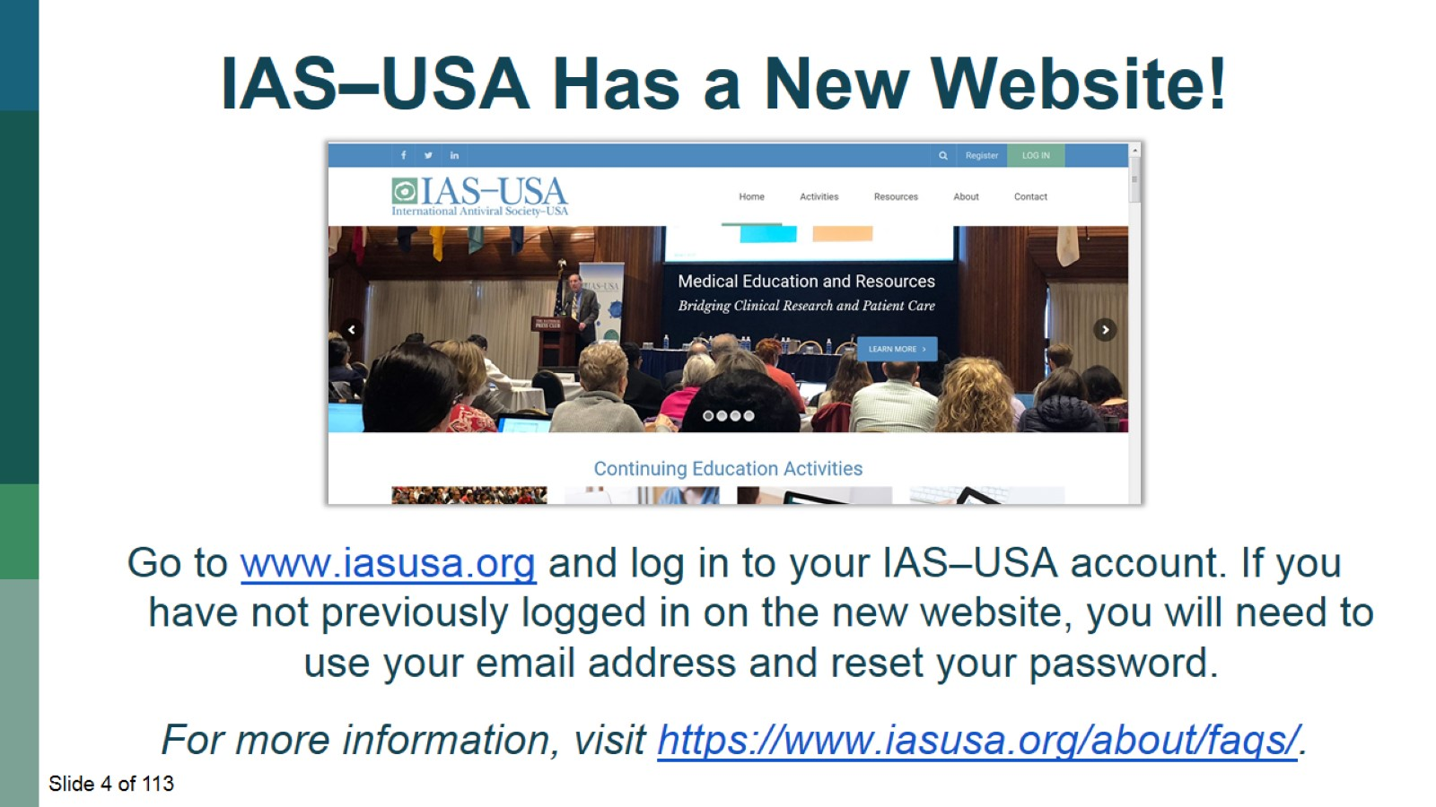

Slide 5
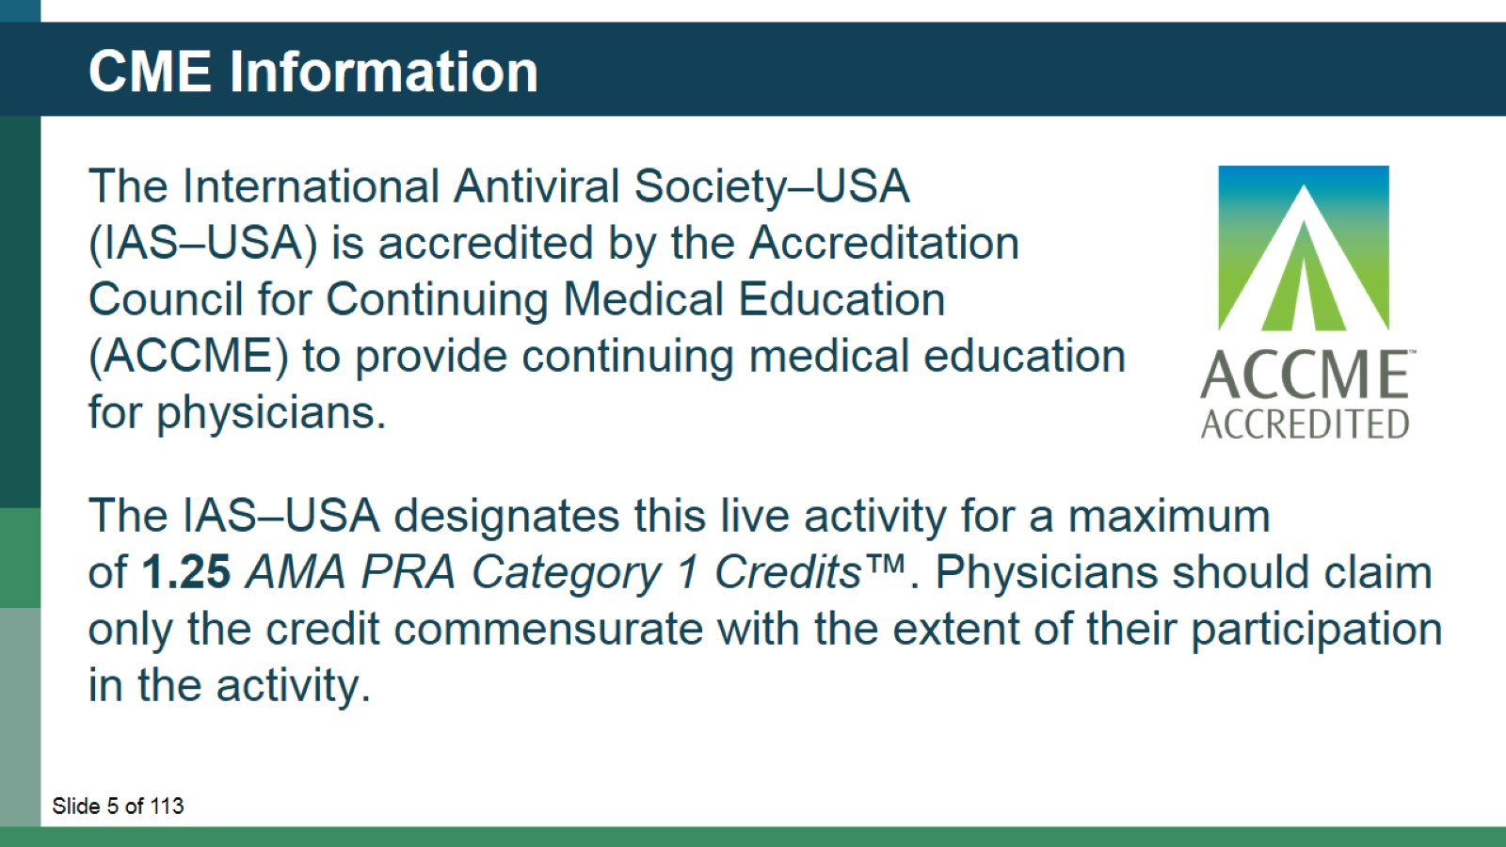
CME Information

Slide 6
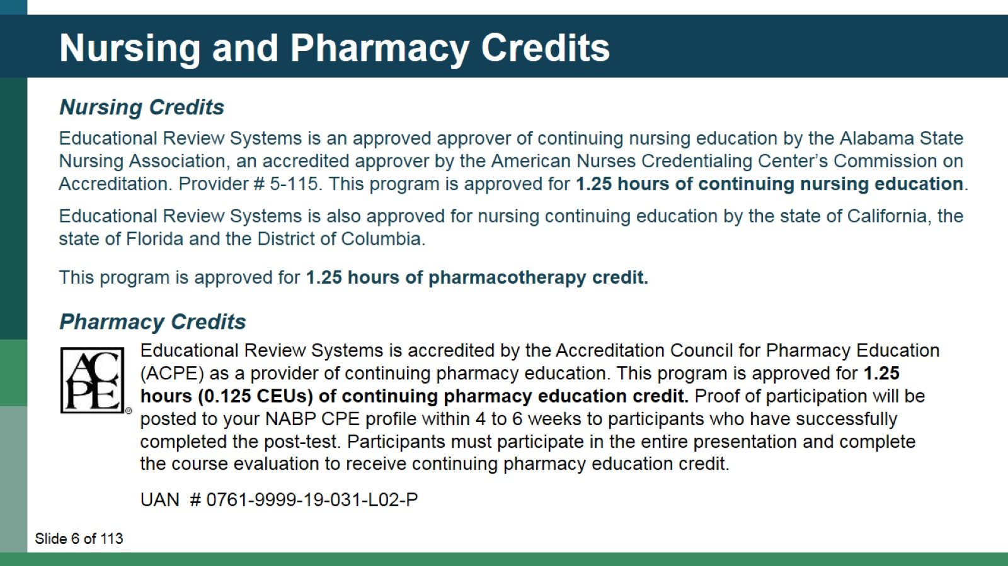
Nursing and Pharmacy Credits

Slide 7
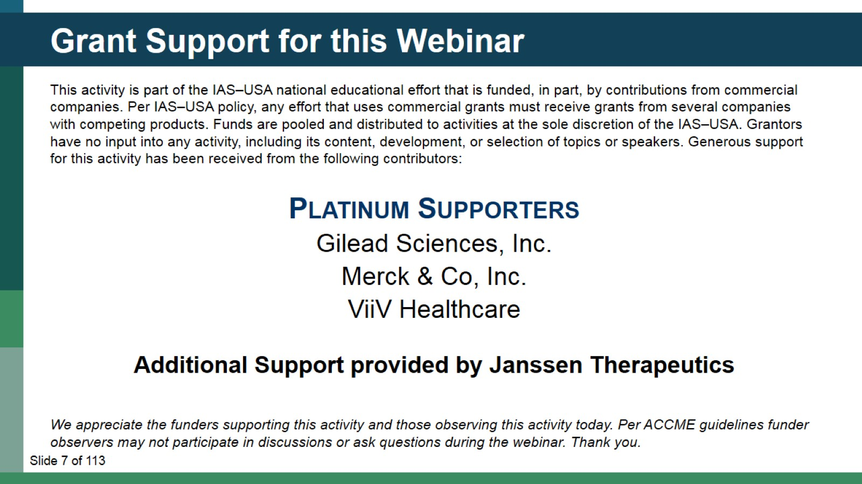
Grant Support for this Webinar

Slide 8
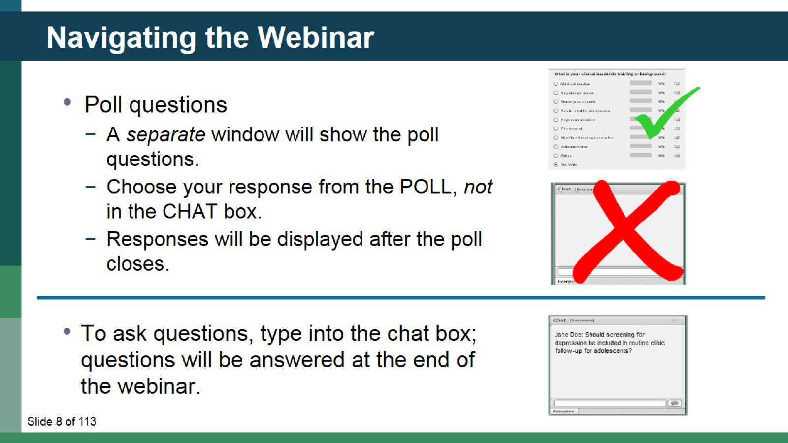
Navigating the Webinar

Slide 9
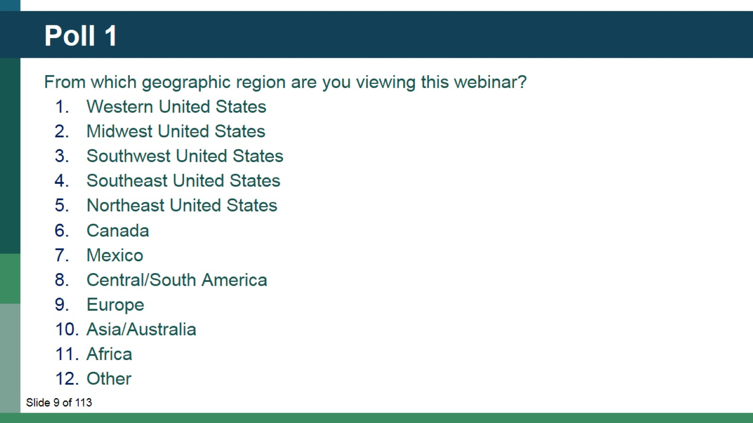
Poll 1

Slide 10
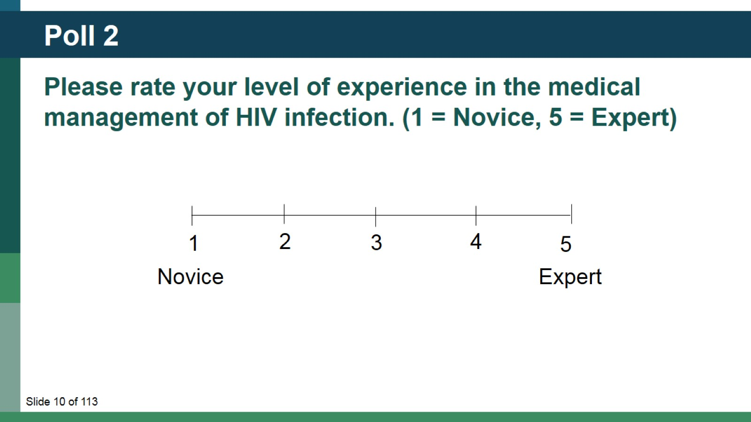
Poll 2

Slide 11
Cardiovascular Disease and HIV

Slide 12
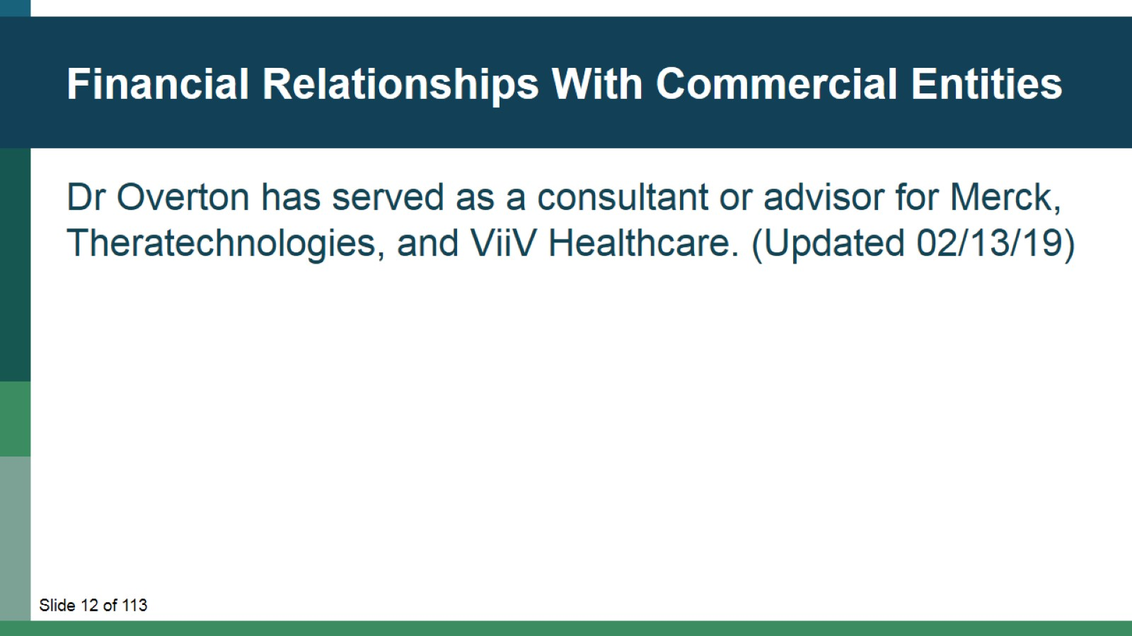
Financial Relationships With Commercial Entities

Slide 13
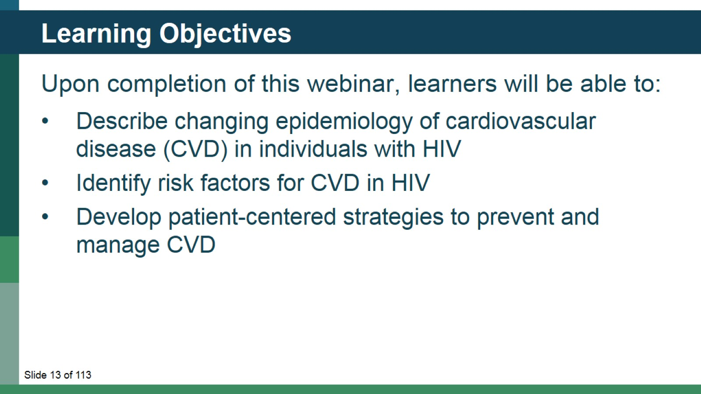
Learning Objectives

Slide 14
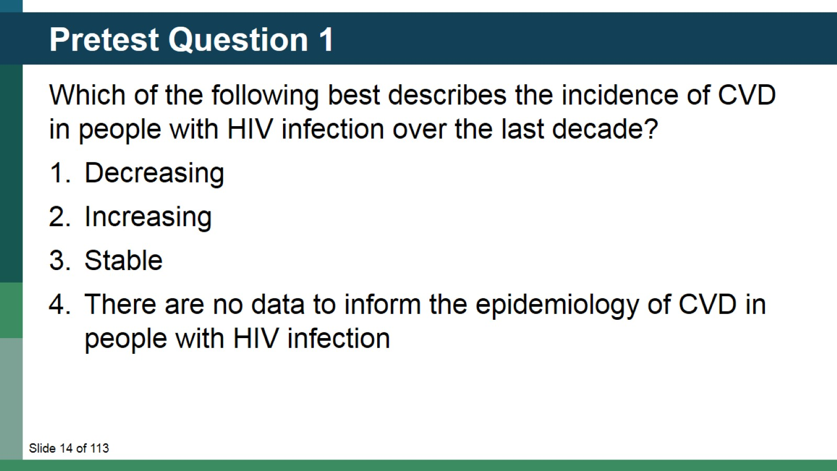
Pretest Question 1

Slide 15
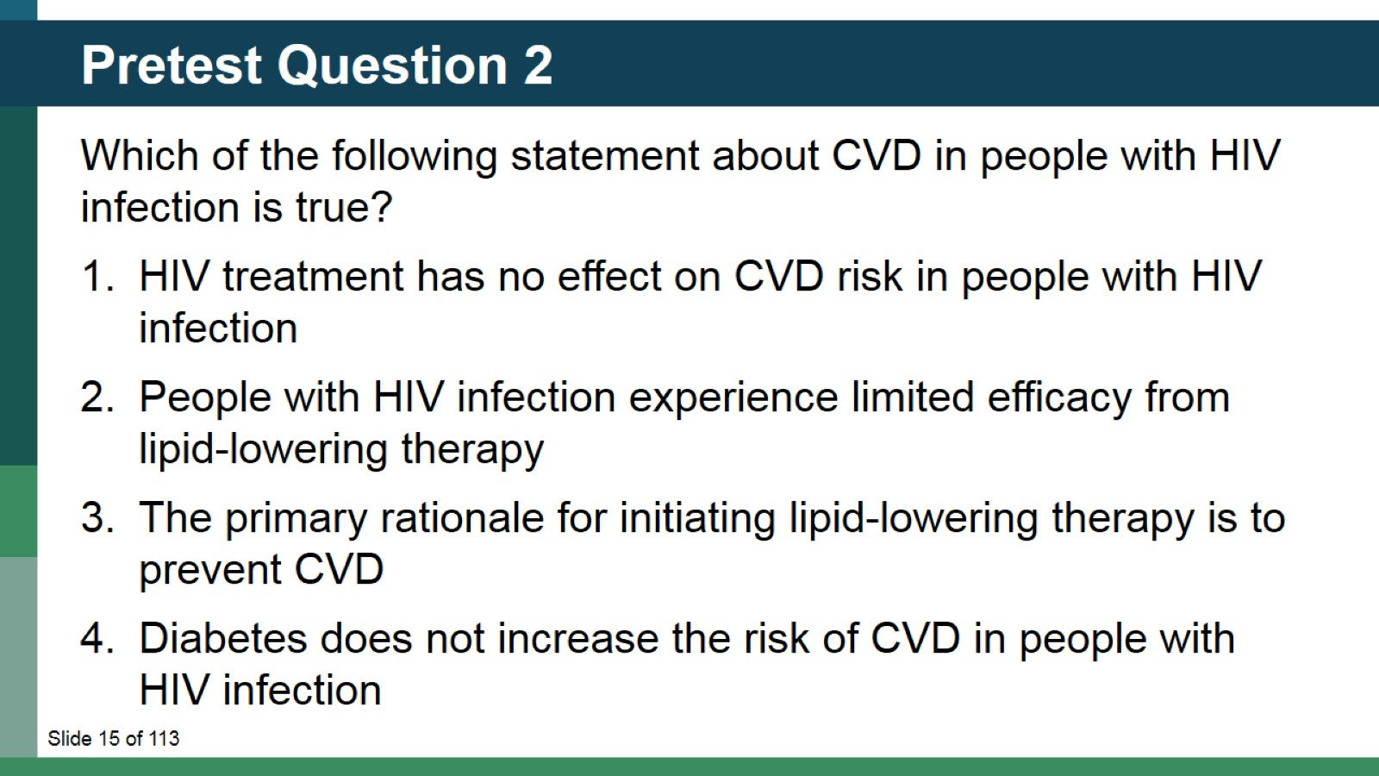
Pretest Question 2

Slide 16
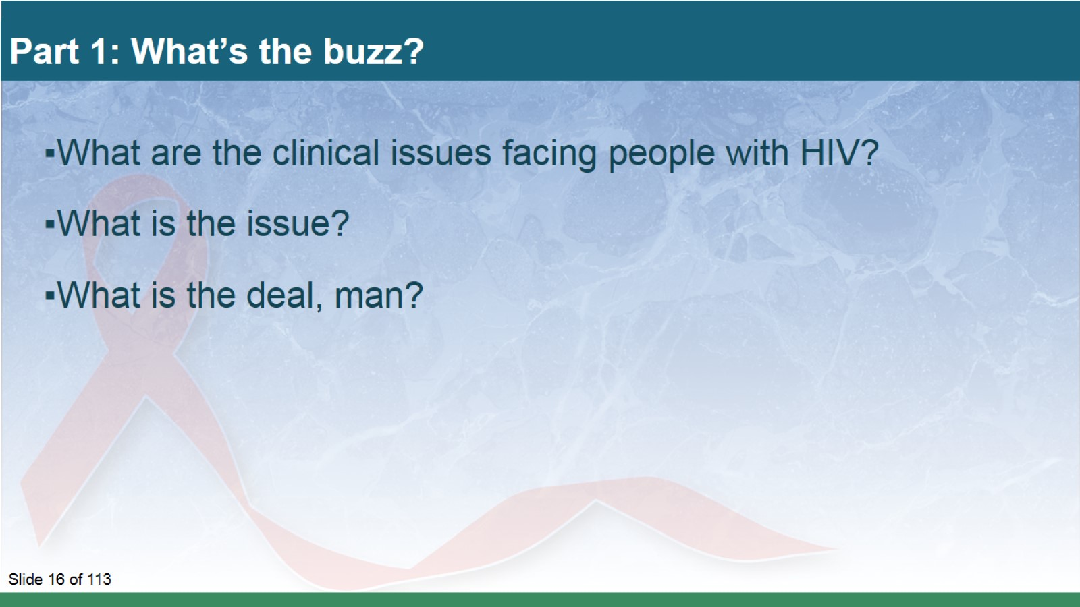
Part 1: What’s the buzz?

Slide 17
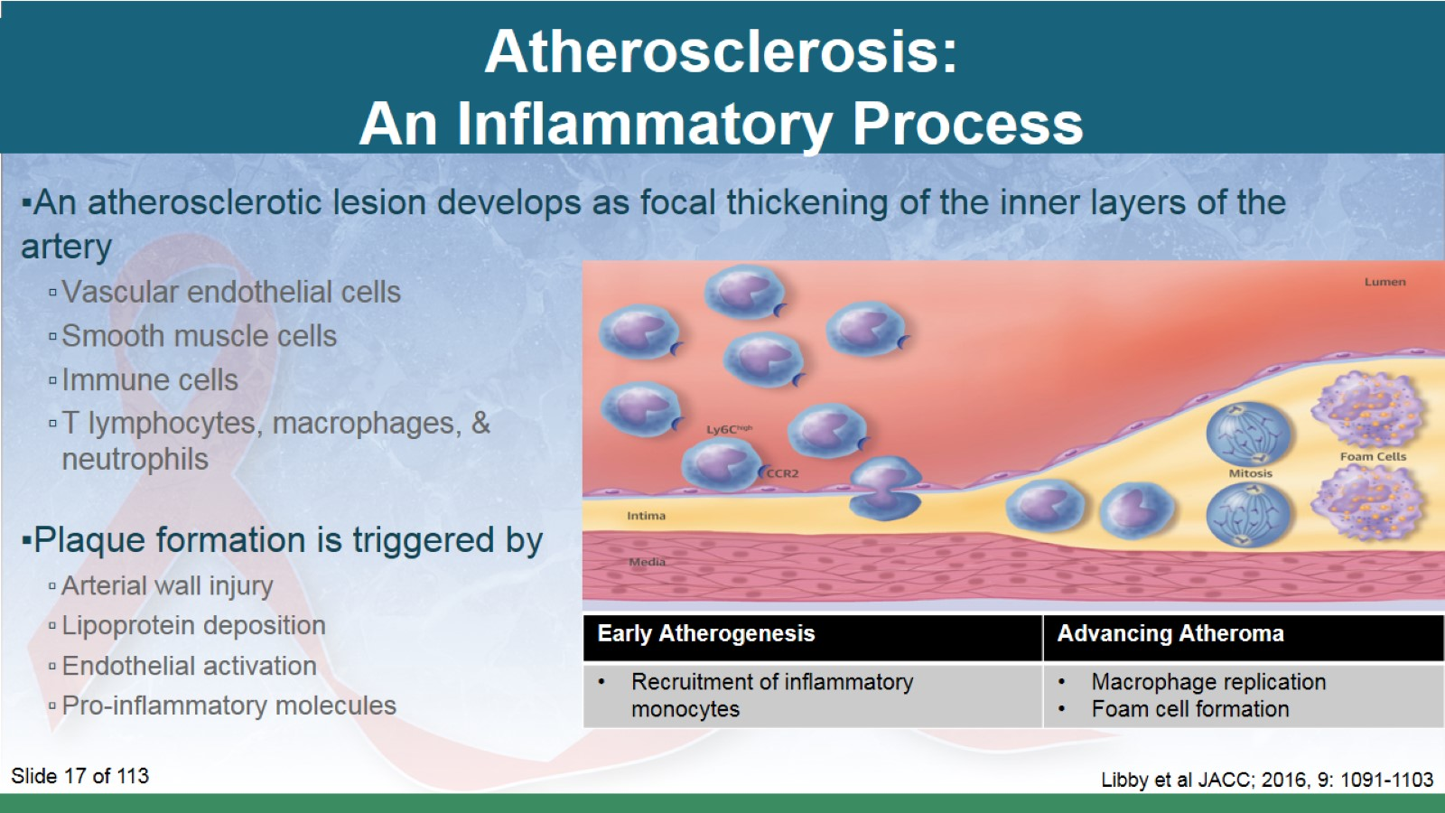
Atherosclerosis:
An Inflammatory Process

Slide 18
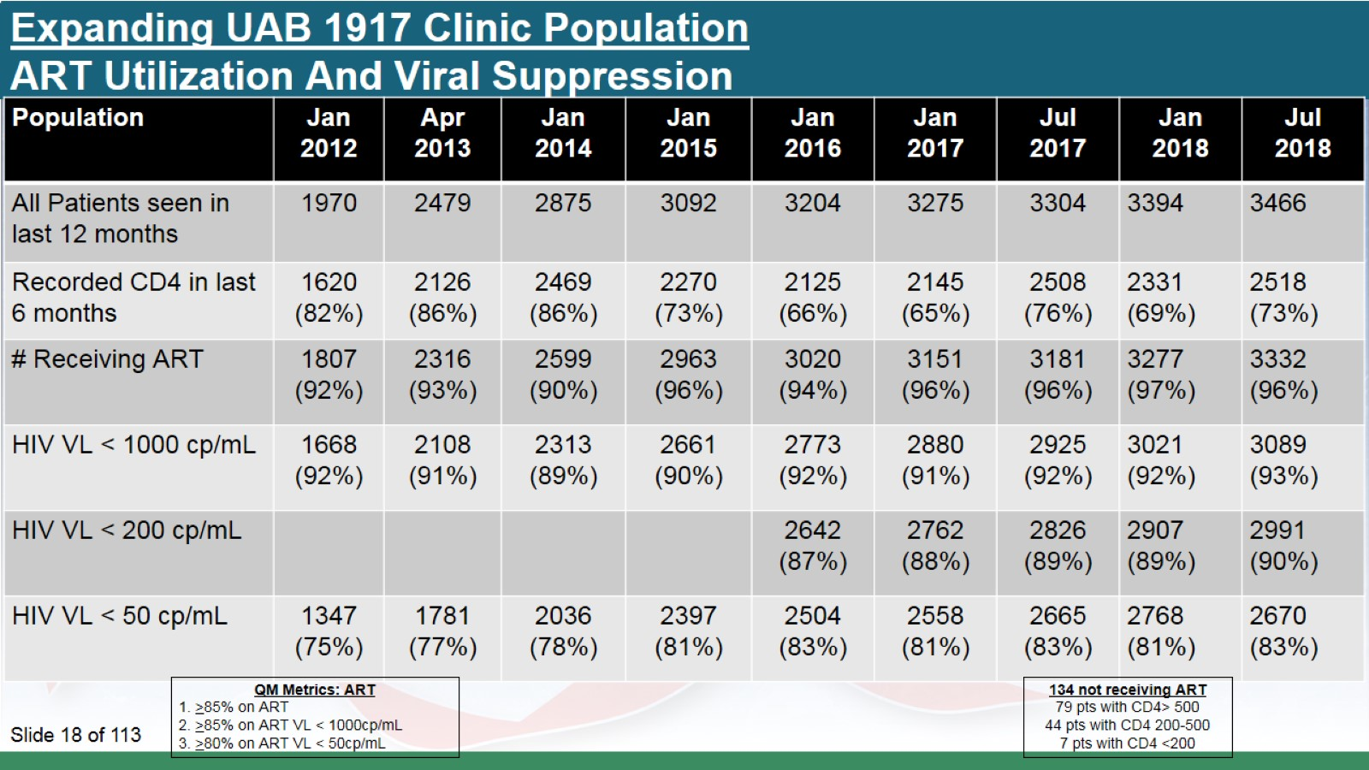
Expanding UAB 1917 Clinic Population
ART Utilization And Viral Suppression

Slide 19
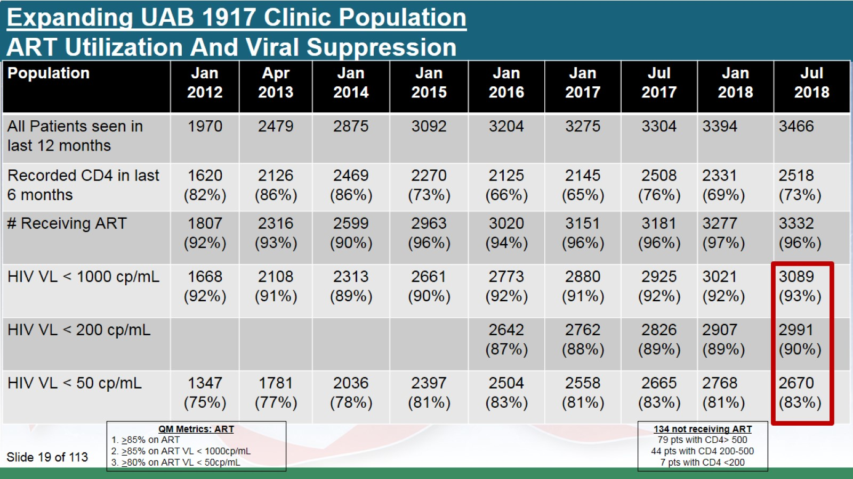
Expanding UAB 1917 Clinic Population
ART Utilization And Viral Suppression

Slide 20
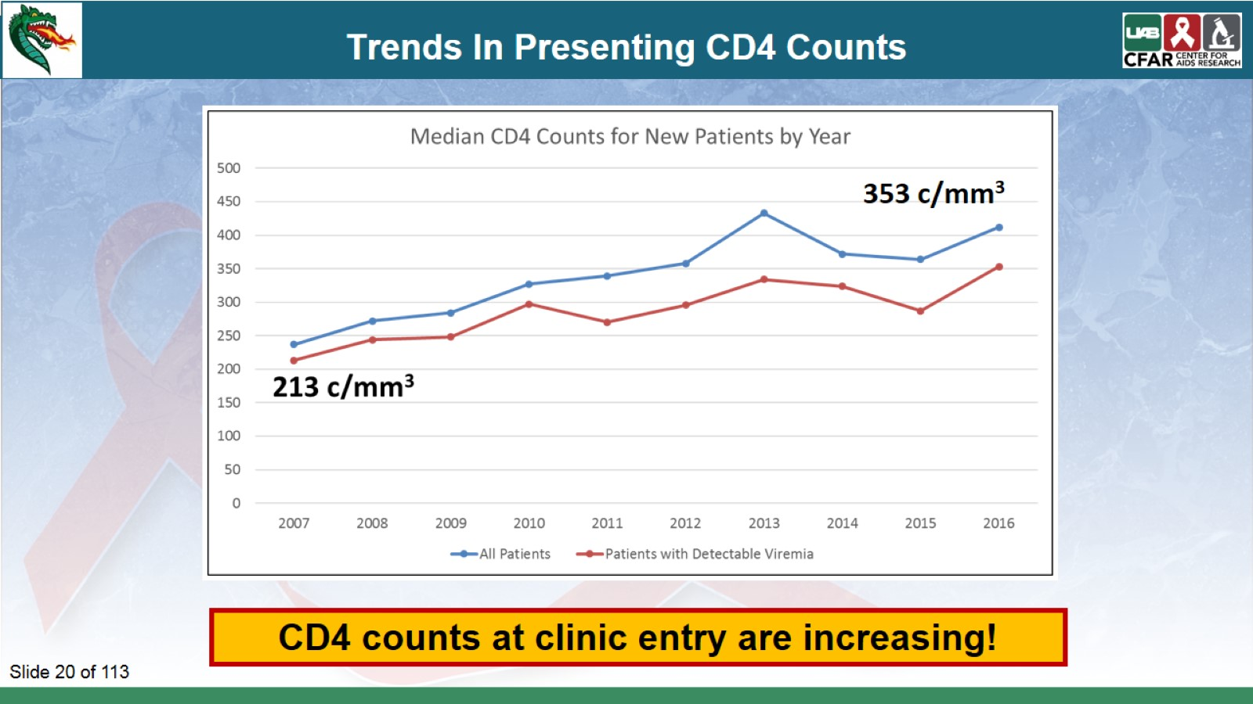
Trends In Presenting CD4 Counts

Slide 21
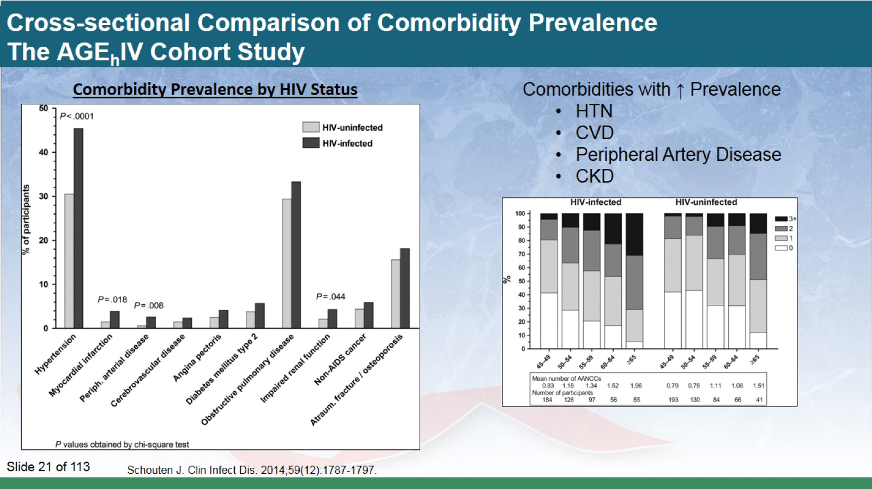
Cross-sectional Comparison of Comorbidity Prevalence
The AGE_{h}IV Cohort Study

Slide 22
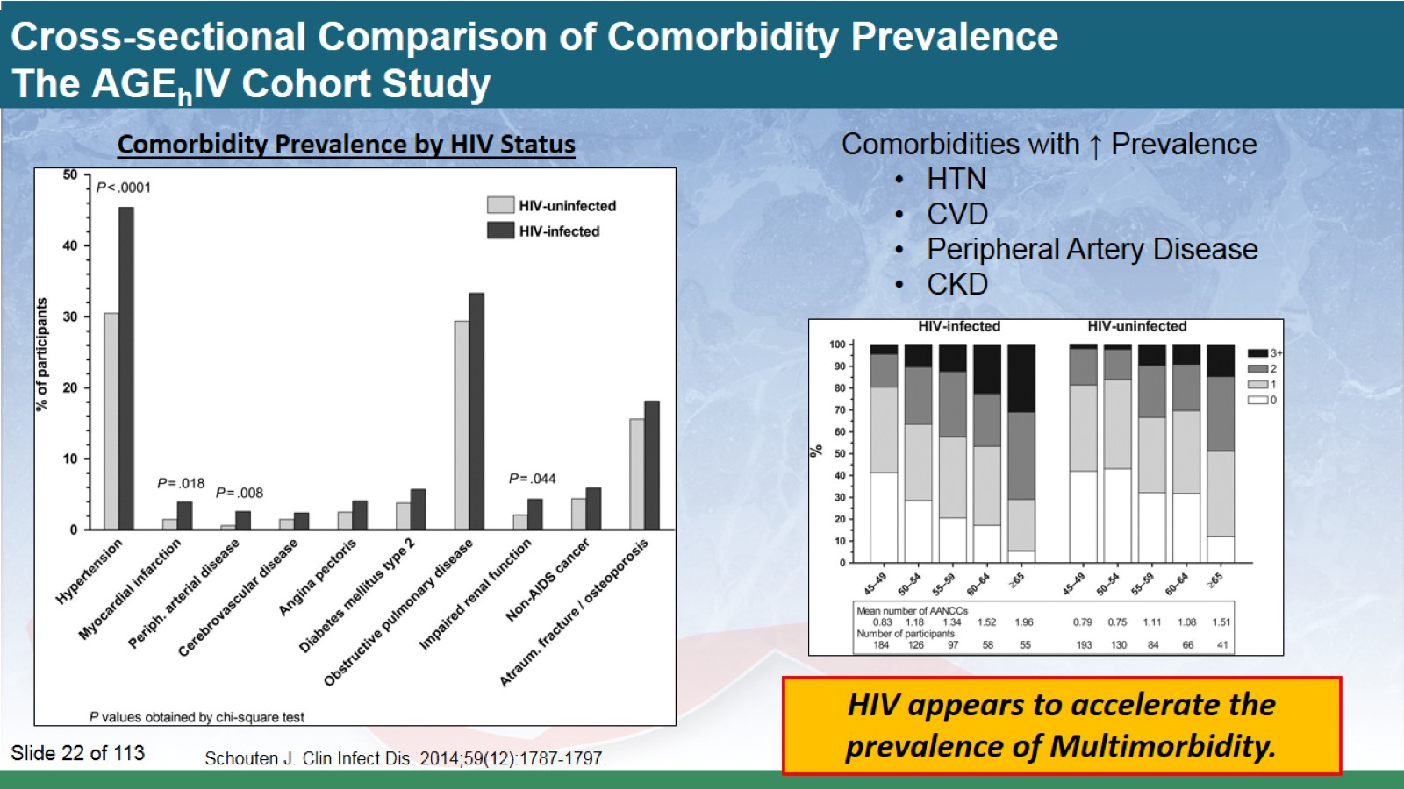
Cross-sectional Comparison of Comorbidity Prevalence
The AGE_{h}IV Cohort Study

Slide 23
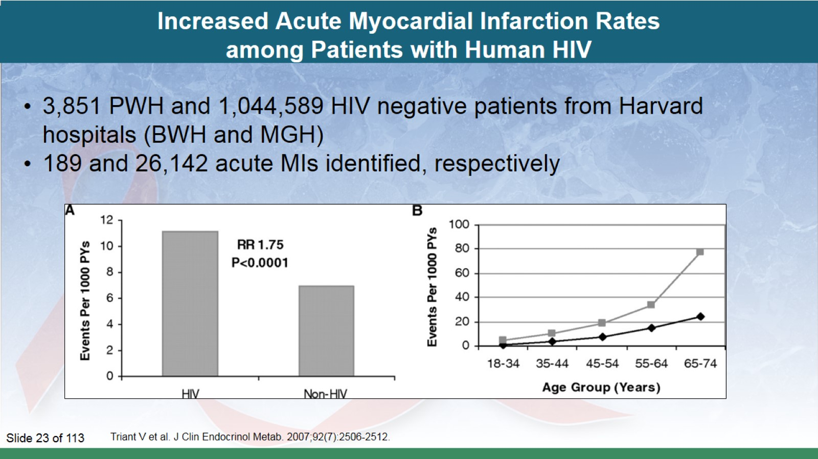
Increased Acute Myocardial Infarction Rates among Patients with Human HIV

Slide 24
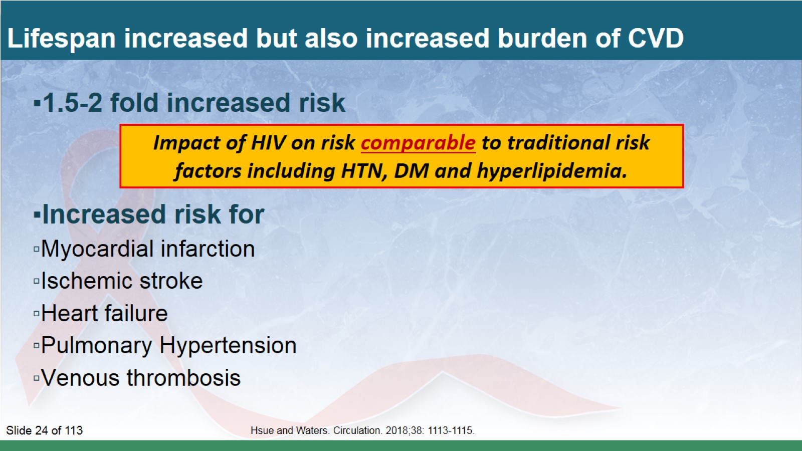
Lifespan increased but also increased burden of CVD

Slide 25
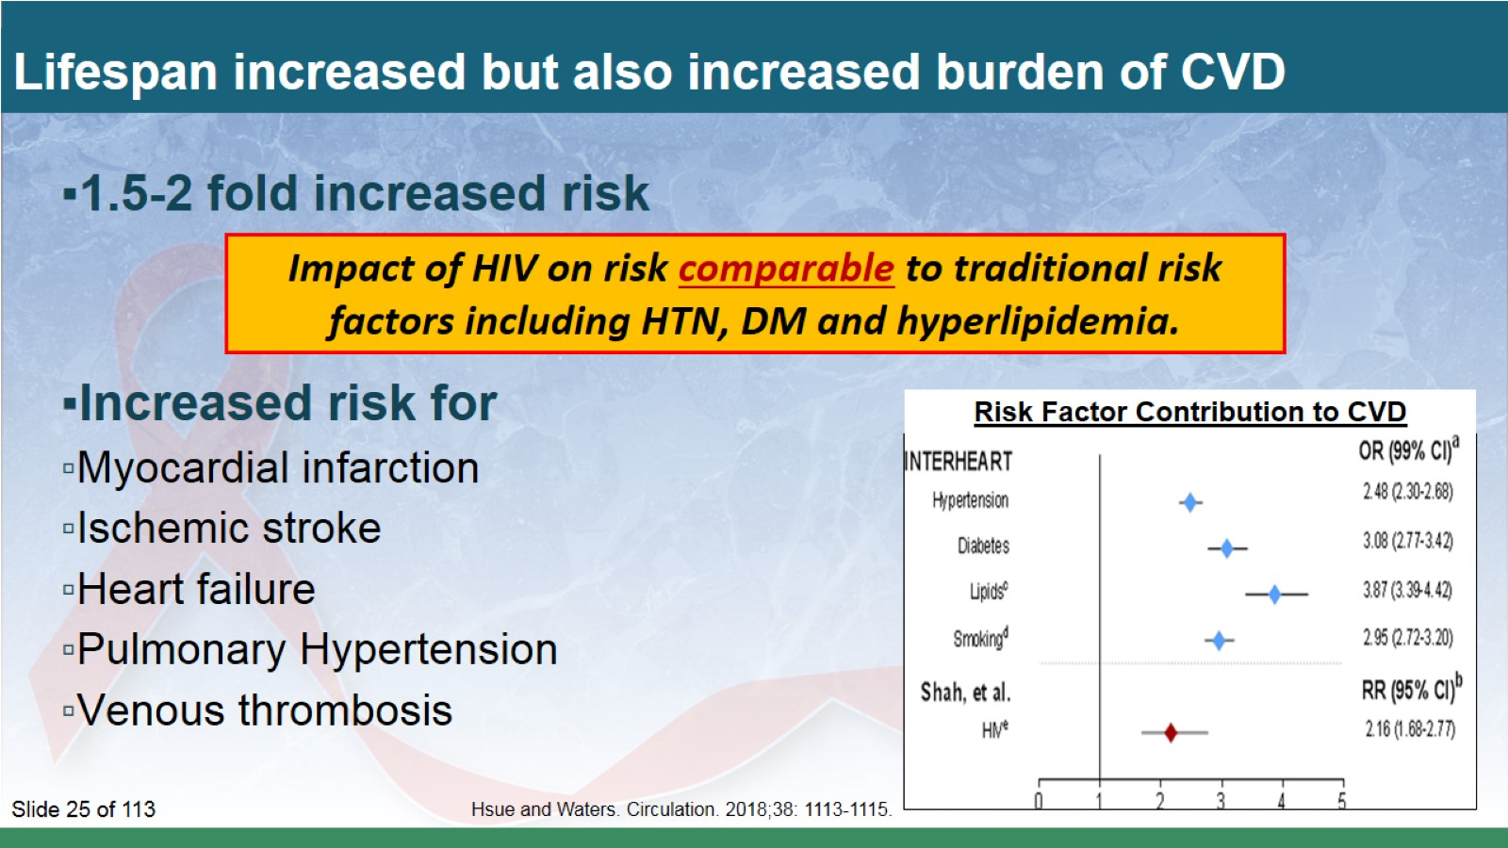
Lifespan increased but also increased burden of CVD

Slide 26
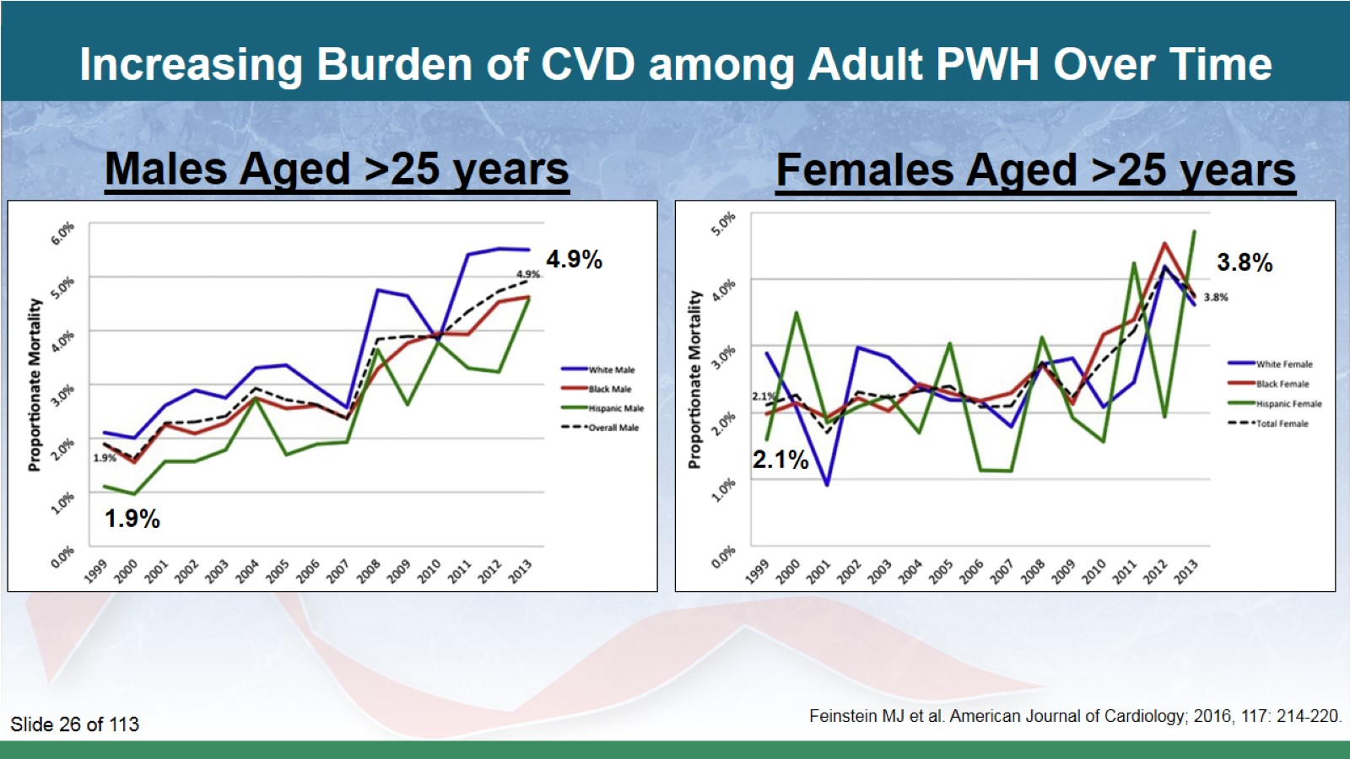
Increasing Burden of CVD among Adult PWH Over Time

Slide 27
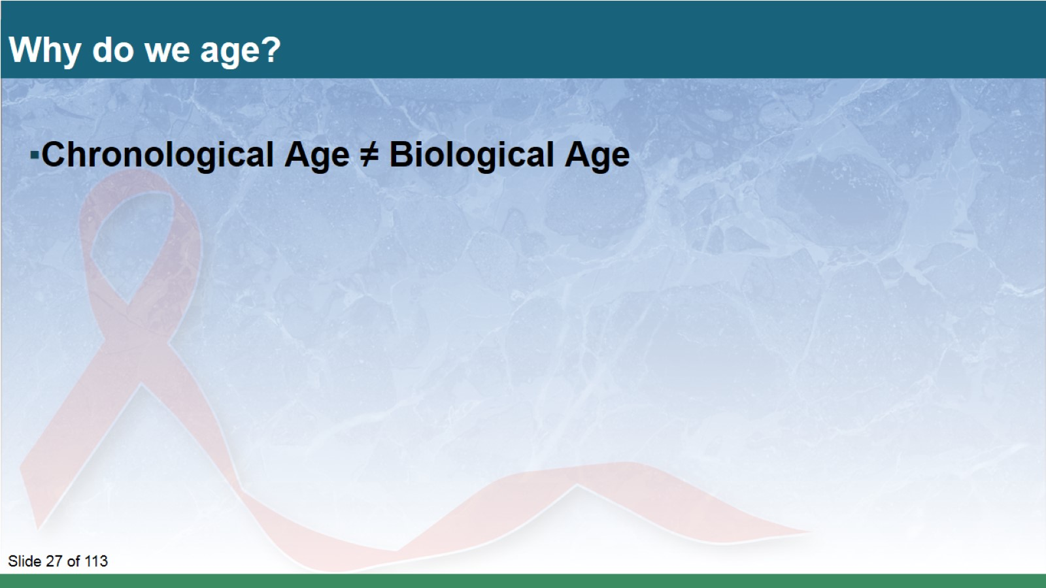
Why do we age?

Slide 28
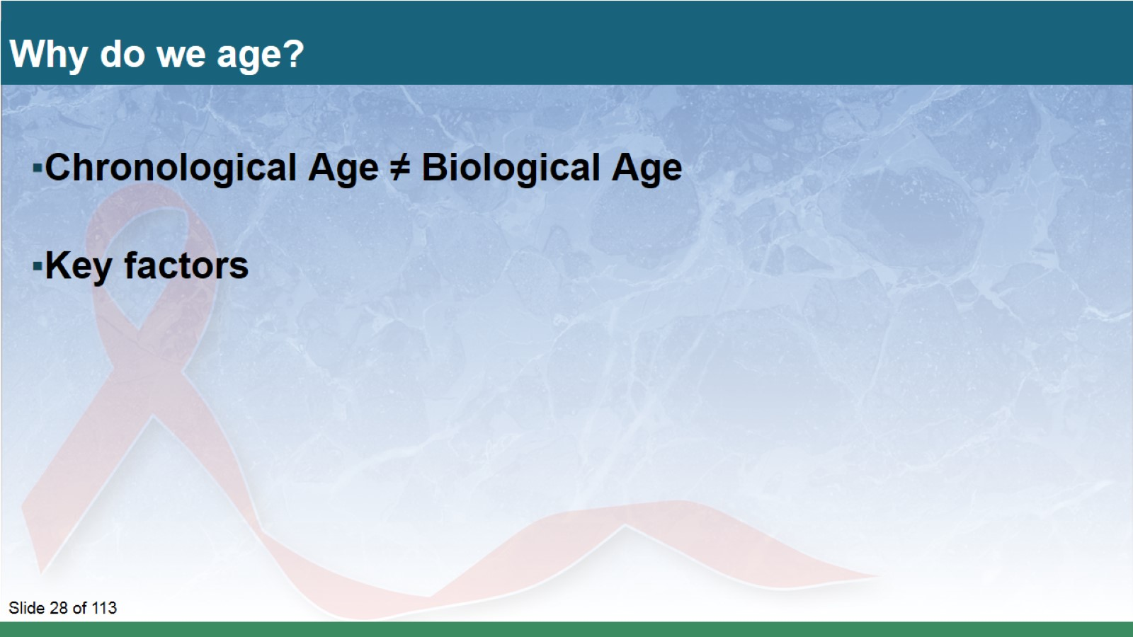
Why do we age?

Slide 29
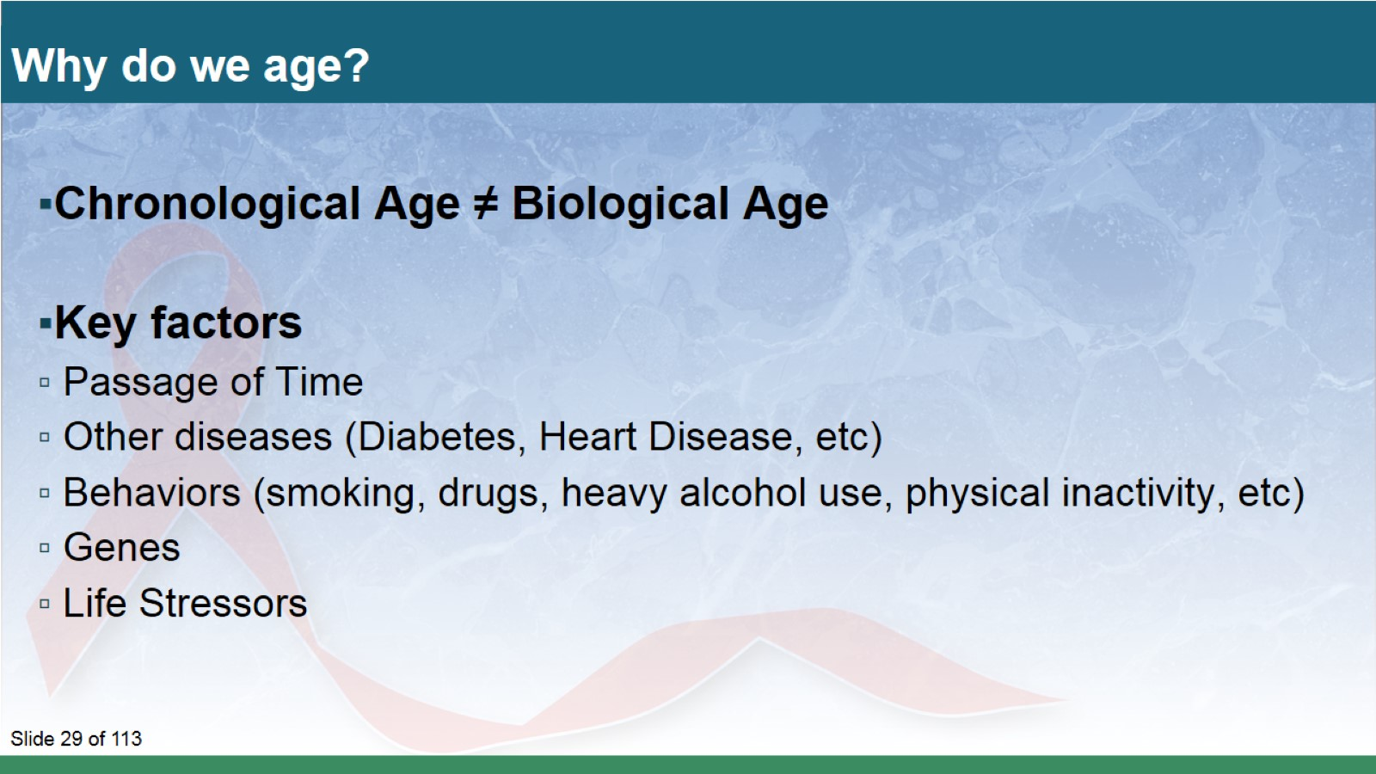
Why do we age?

Slide 30
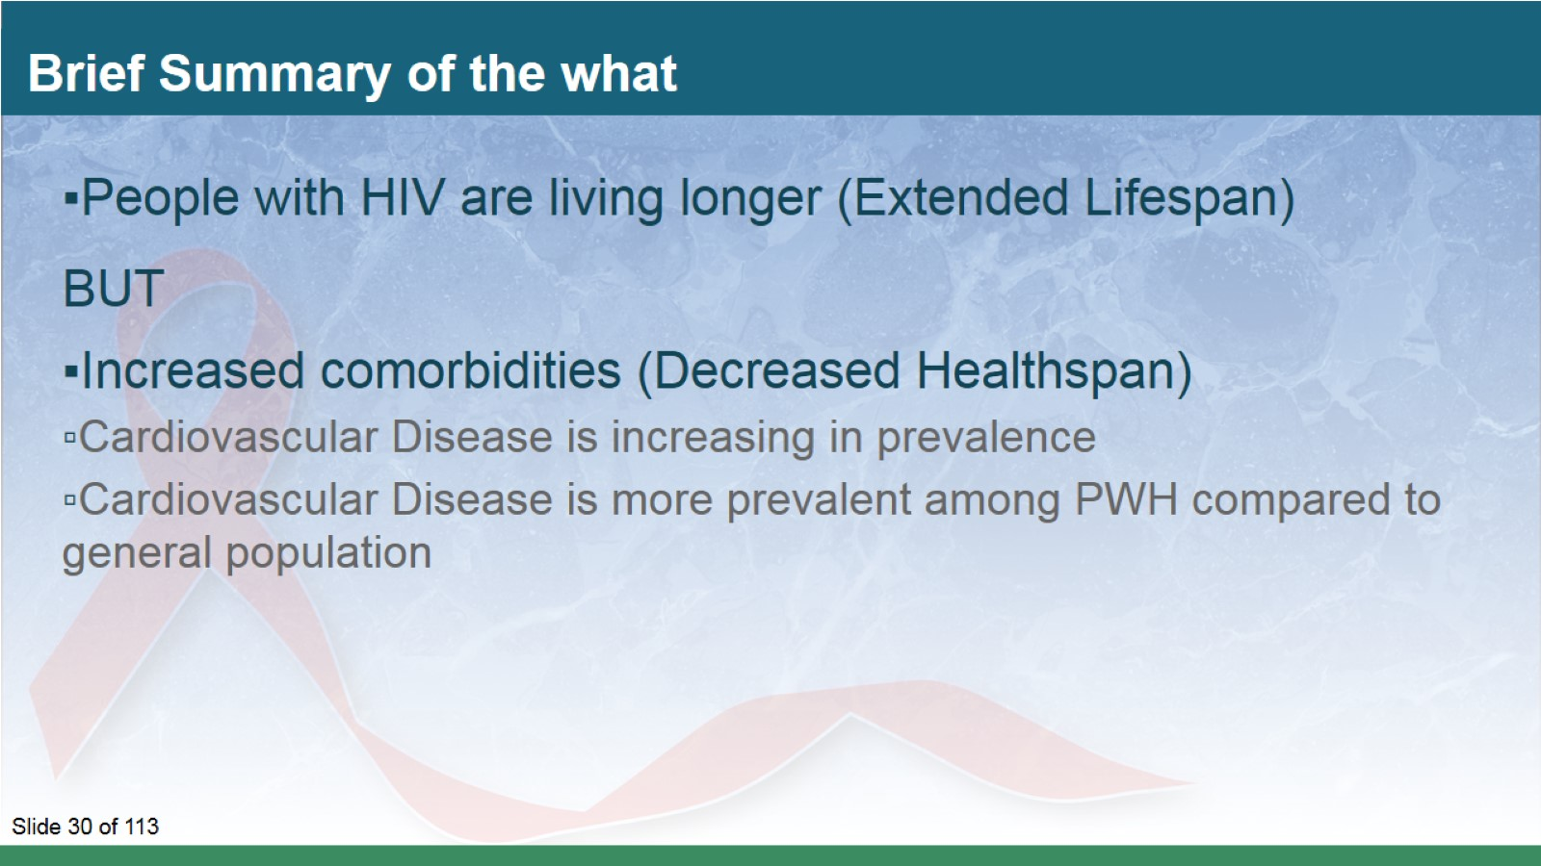
Brief Summary of the what

Slide 31
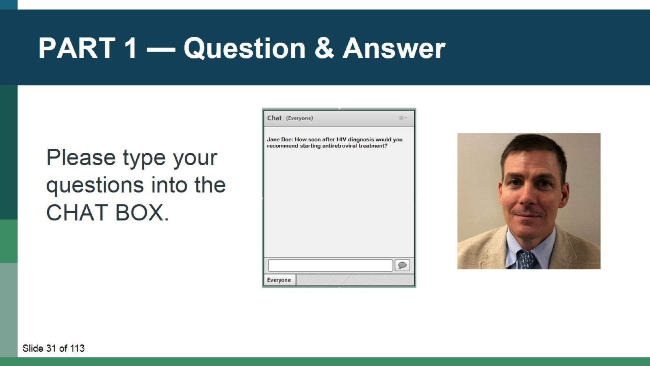
PART 1 — Question & Answer

Slide 32
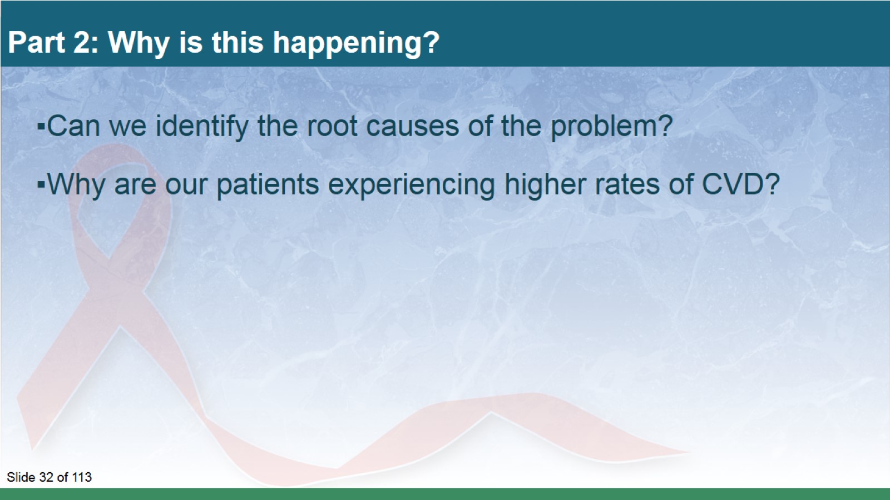
Part 2: Why is this happening?

Slide 33
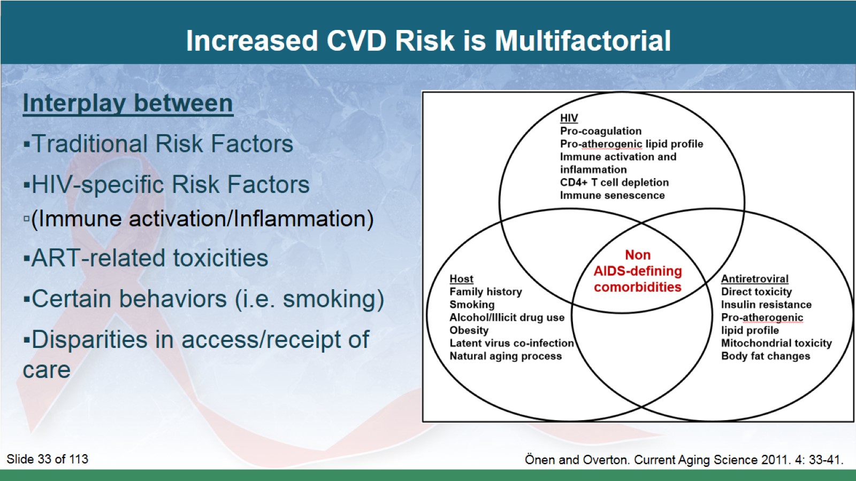
Increased CVD Risk is Multifactorial

Slide 34
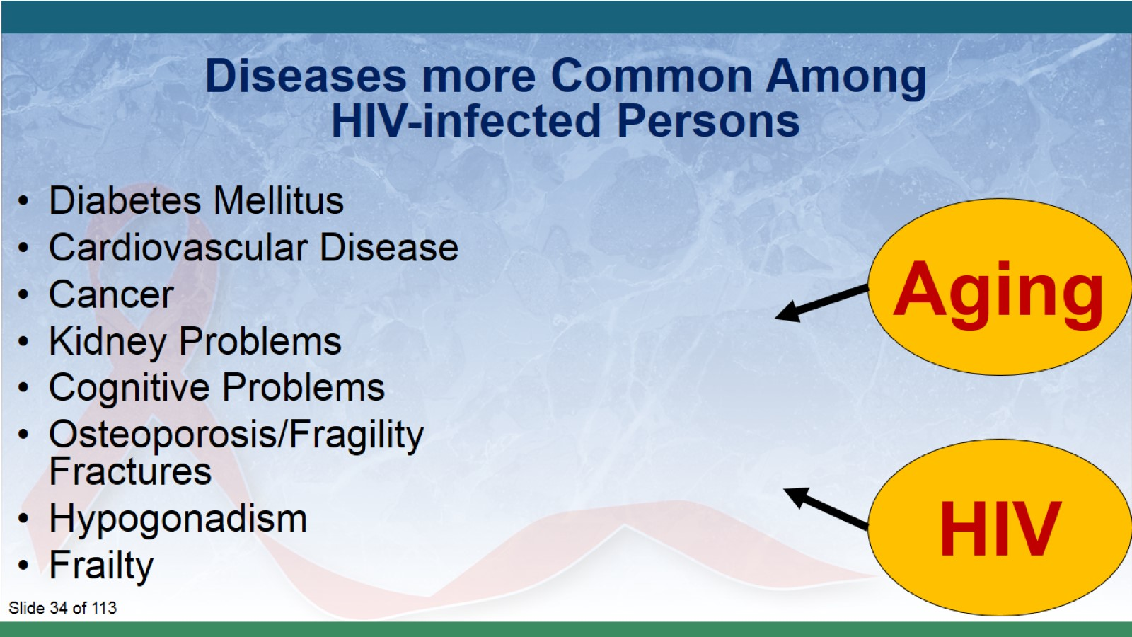

Slide 35
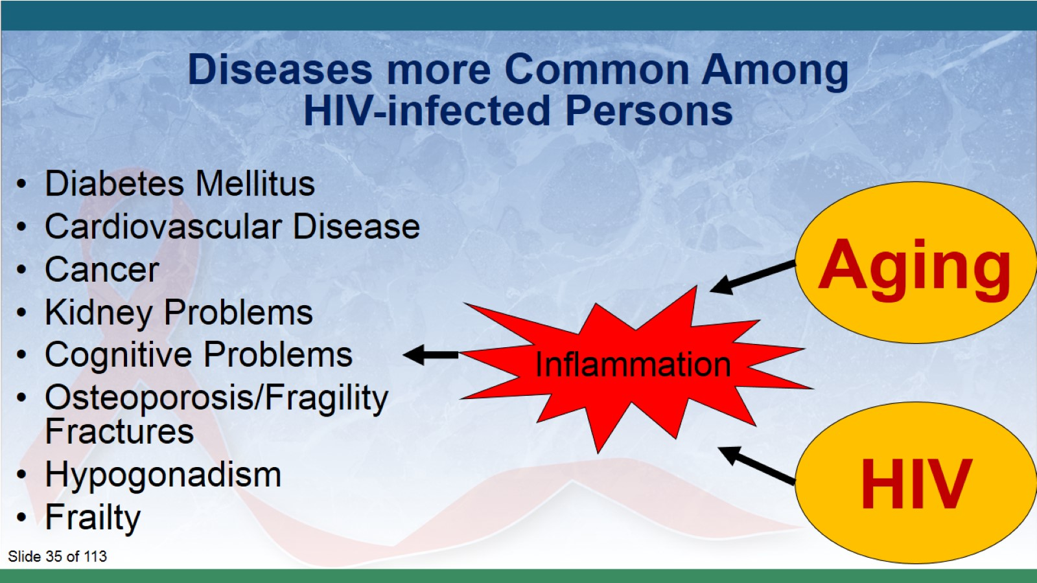

Slide 36
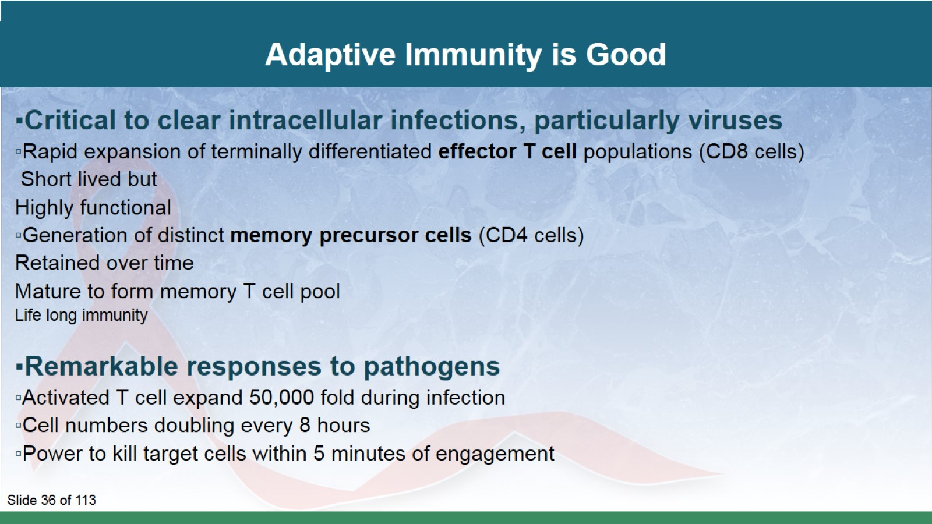
Adaptive Immunity is Good

Slide 37
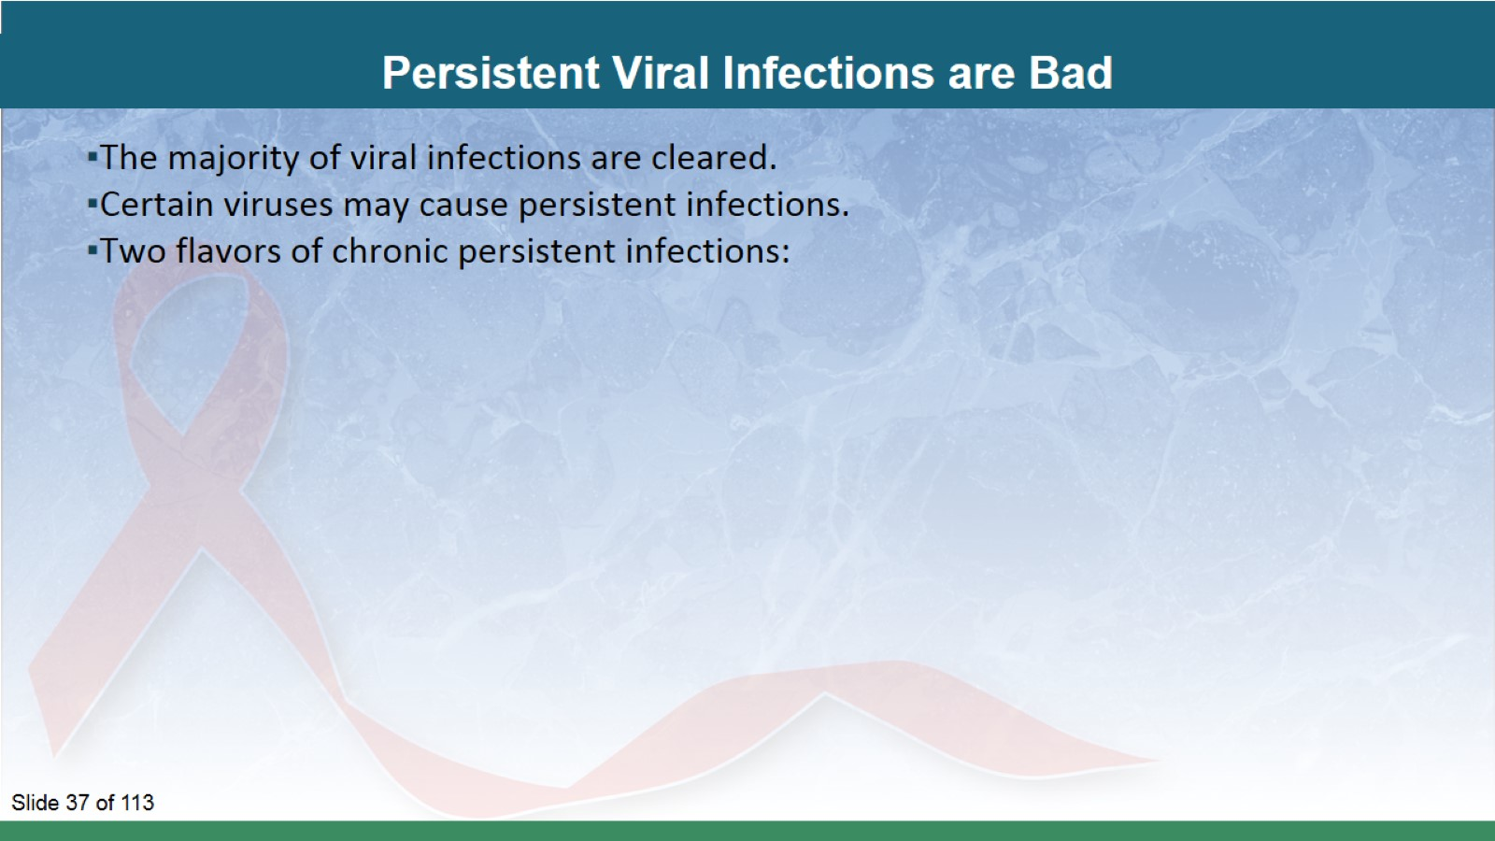
Persistent Viral Infections are Bad

Slide 38
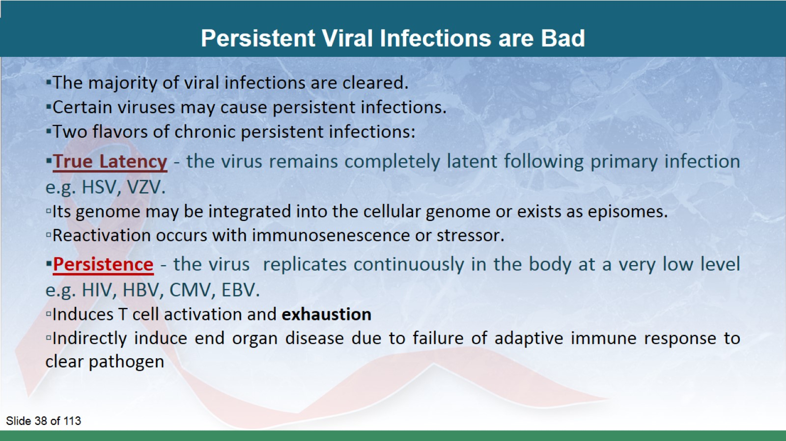
Persistent Viral Infections are Bad

Slide 39
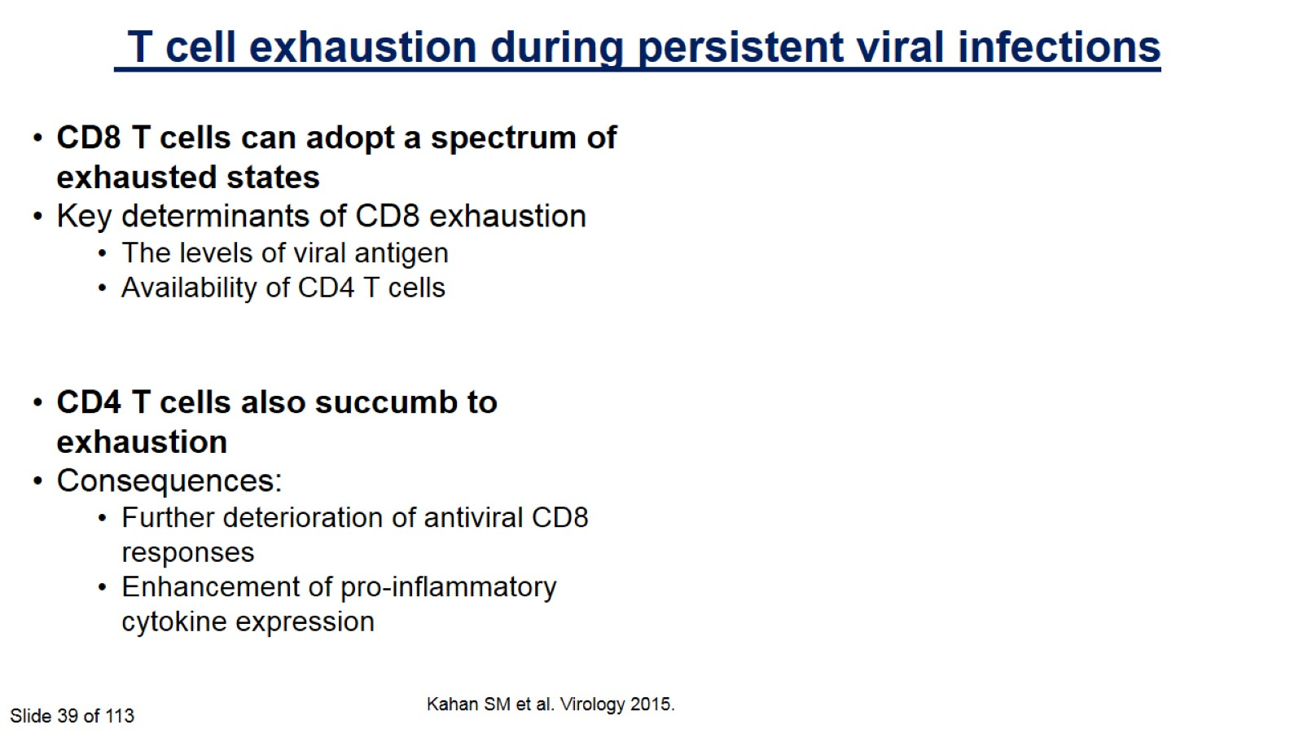

Slide 40
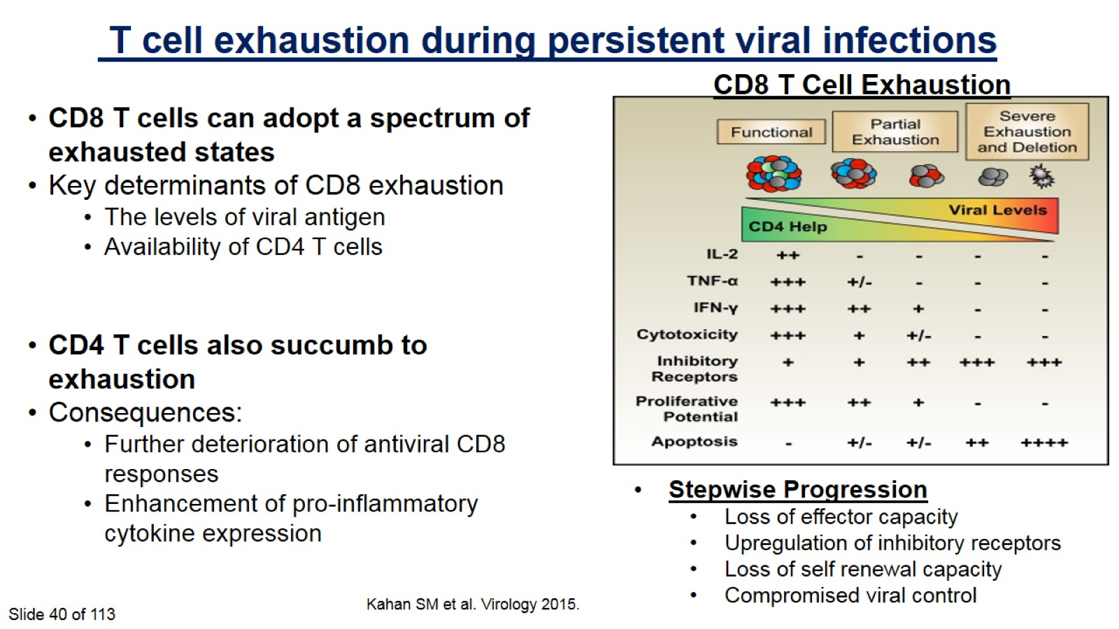

Slide 41
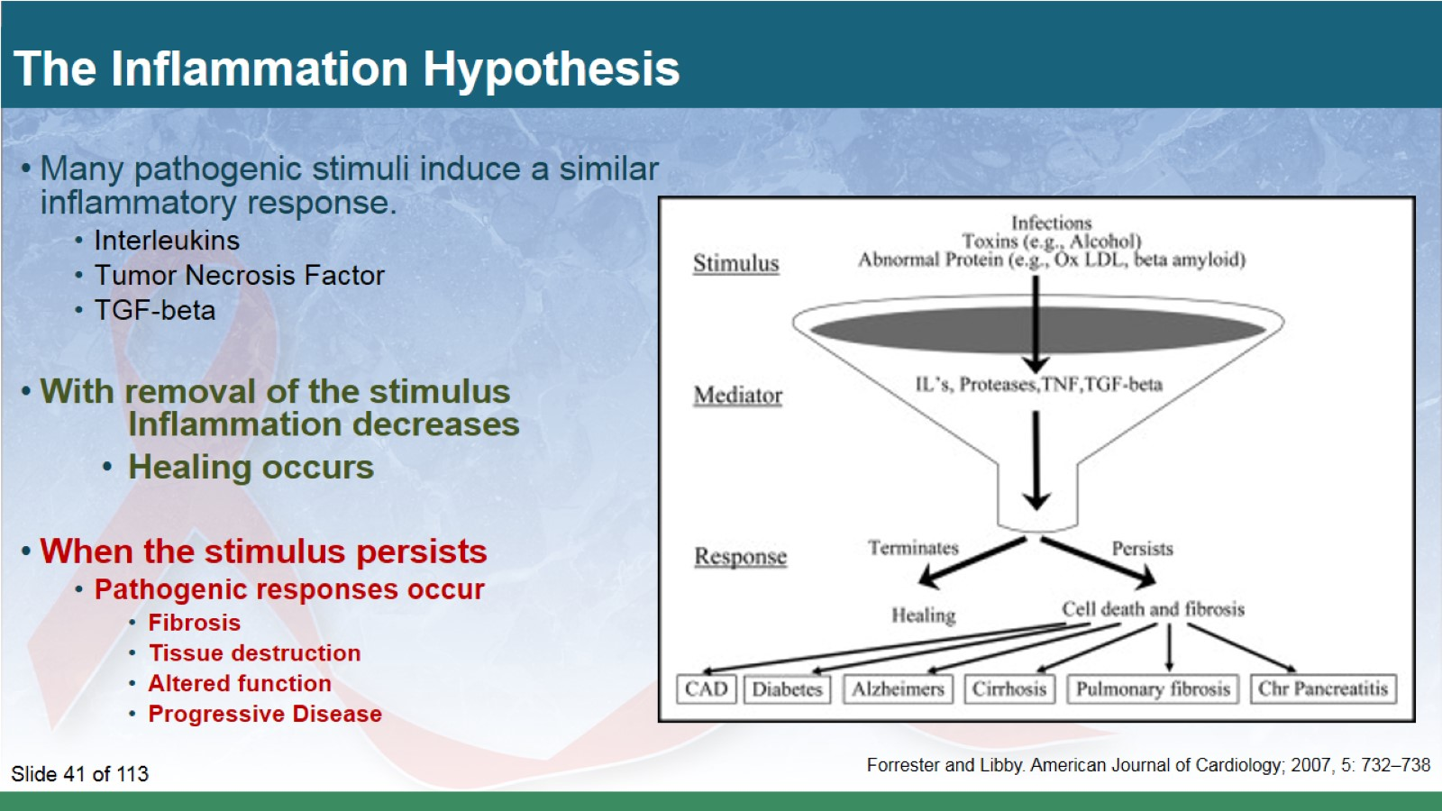
The Inflammation Hypothesis

Slide 42
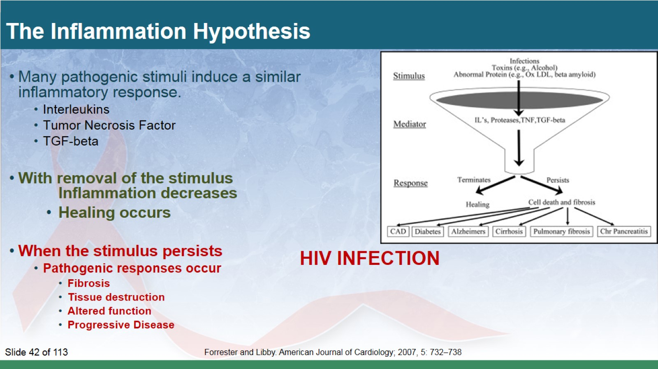
The Inflammation Hypothesis

Slide 43
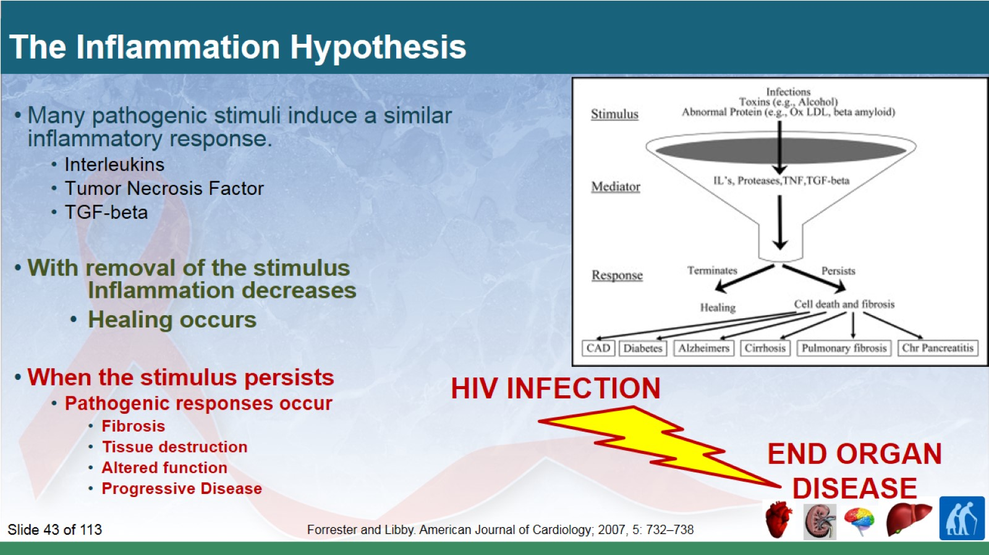
The Inflammation Hypothesis

Slide 44
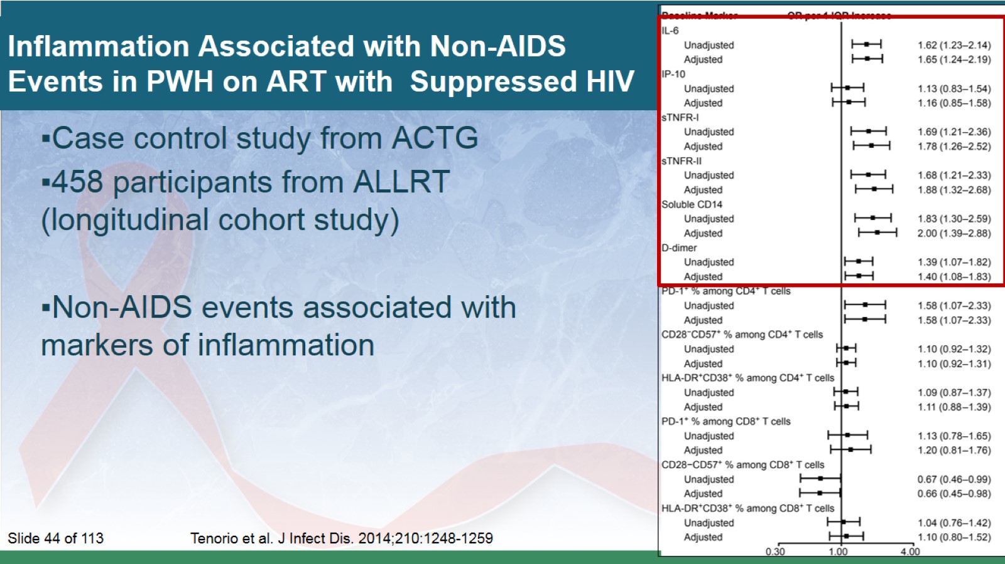
Inflammation Associated with Non-AIDS
Events in PWH on ART with Suppressed HIV

Slide 45
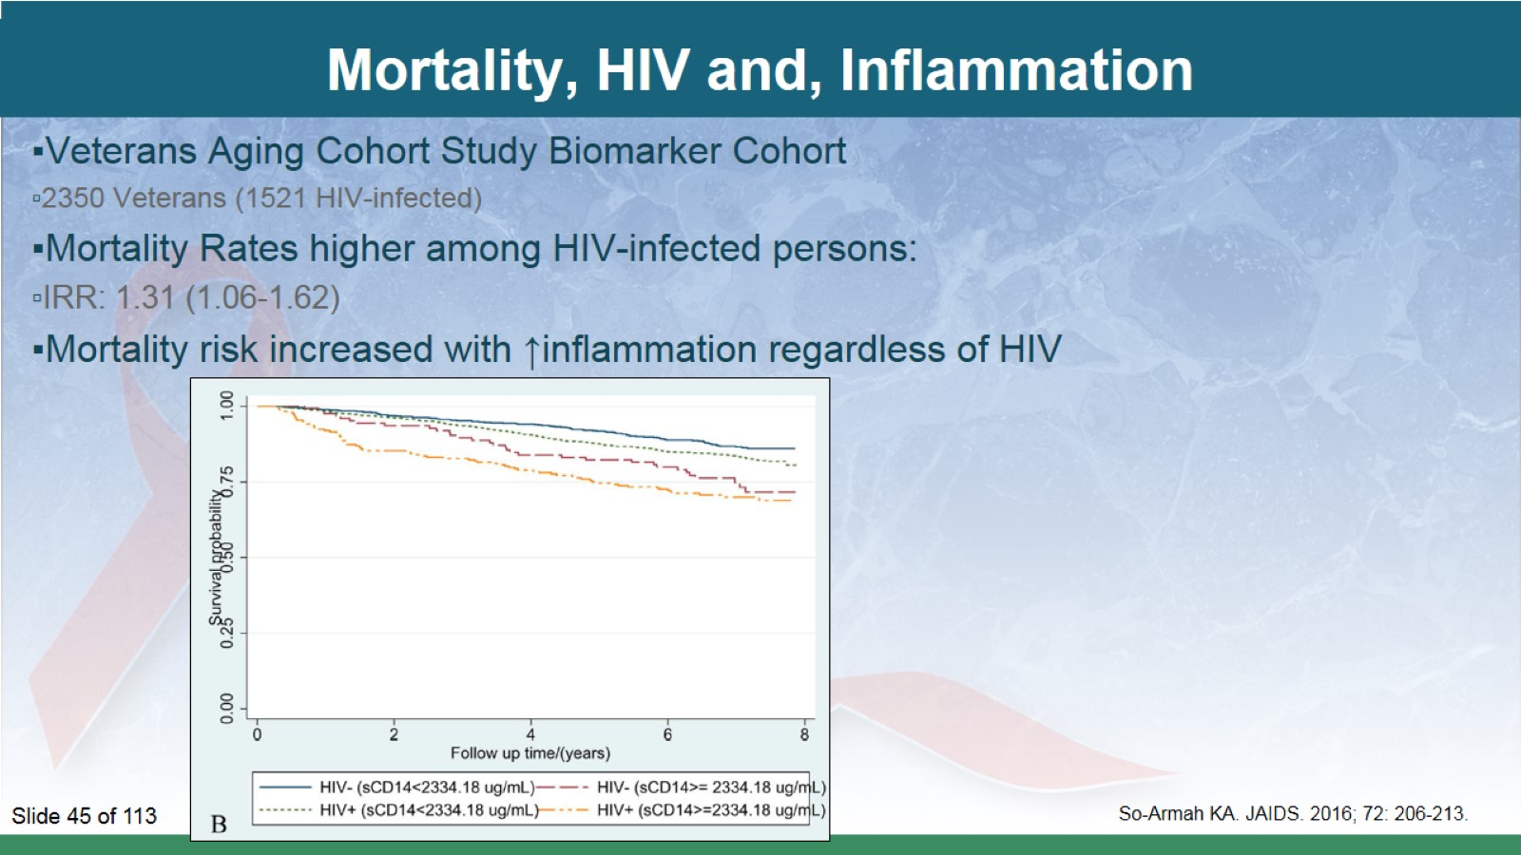
Mortality, HIV and, Inflammation

Slide 46
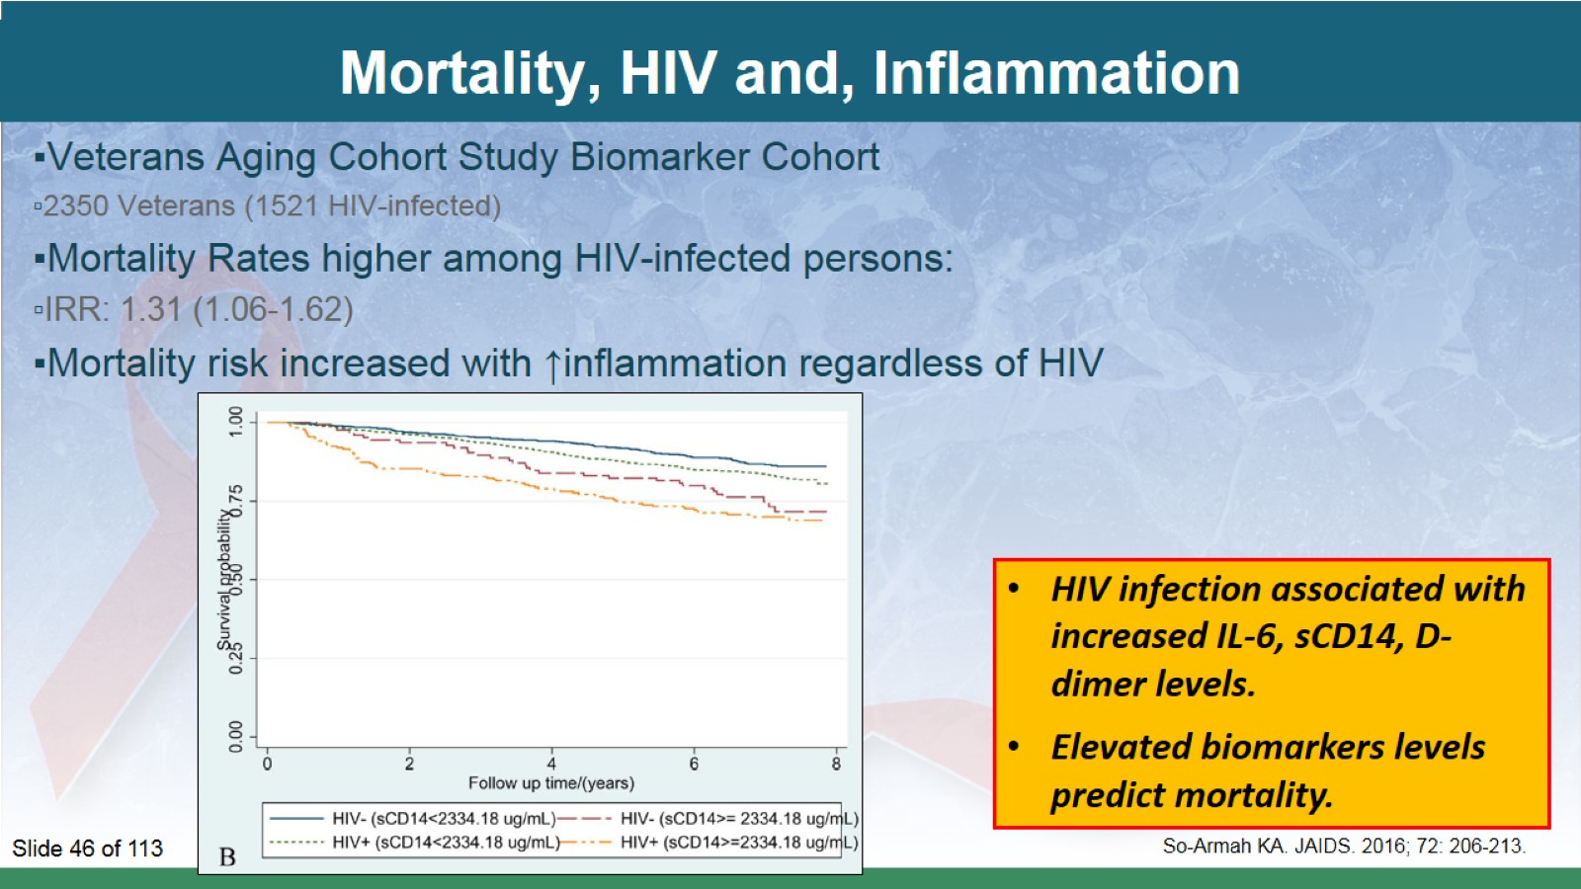
Mortality, HIV and, Inflammation

Slide 47
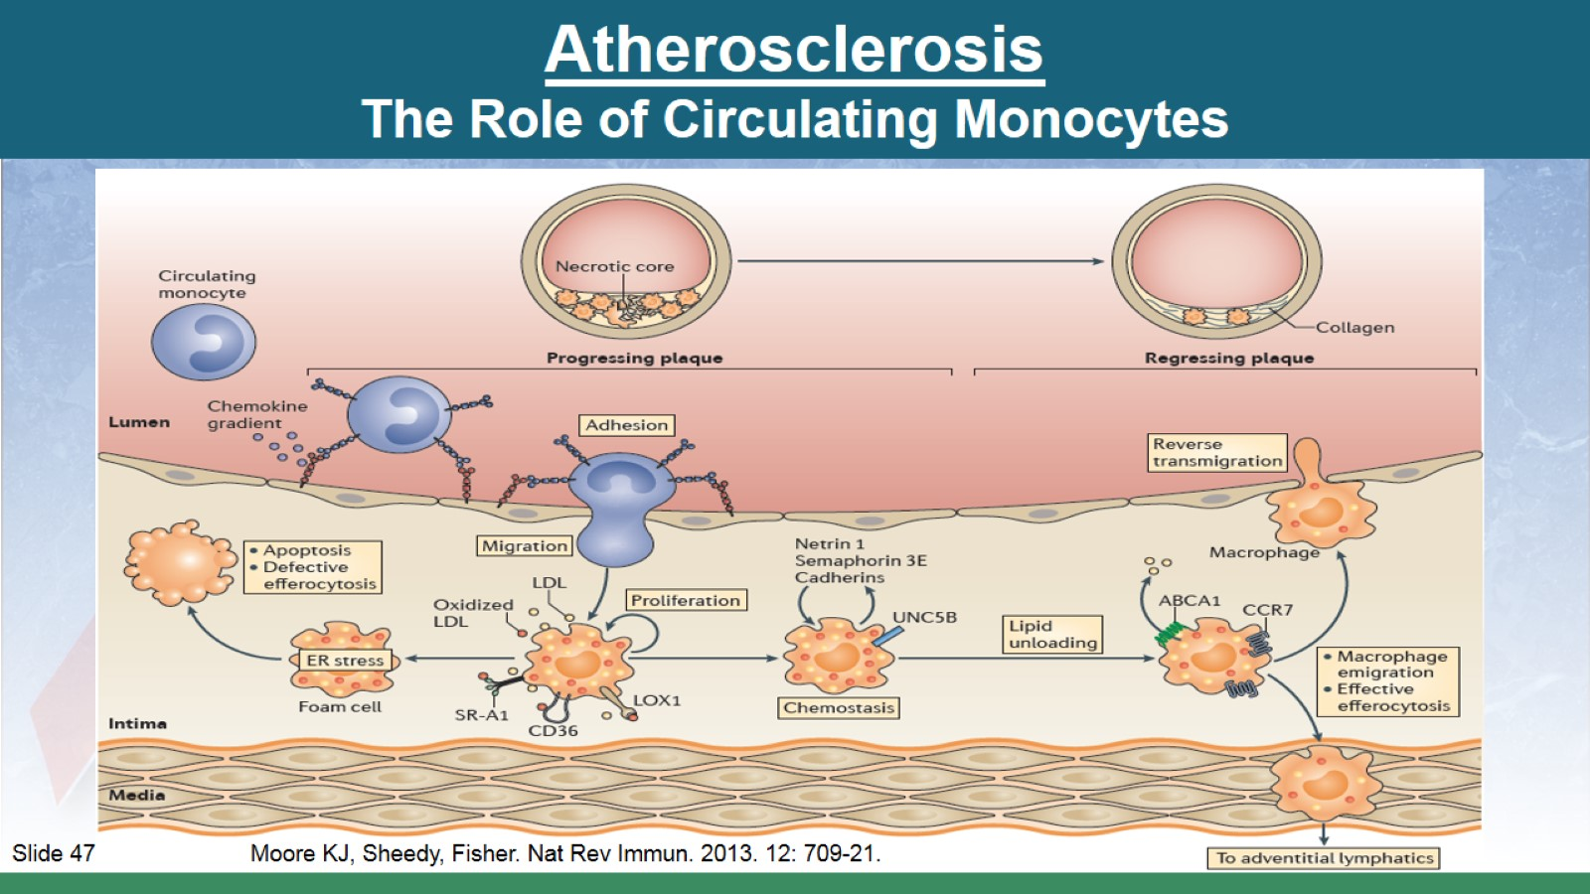
Atherosclerosis
The Role of Circulating Monocytes

Slide 48
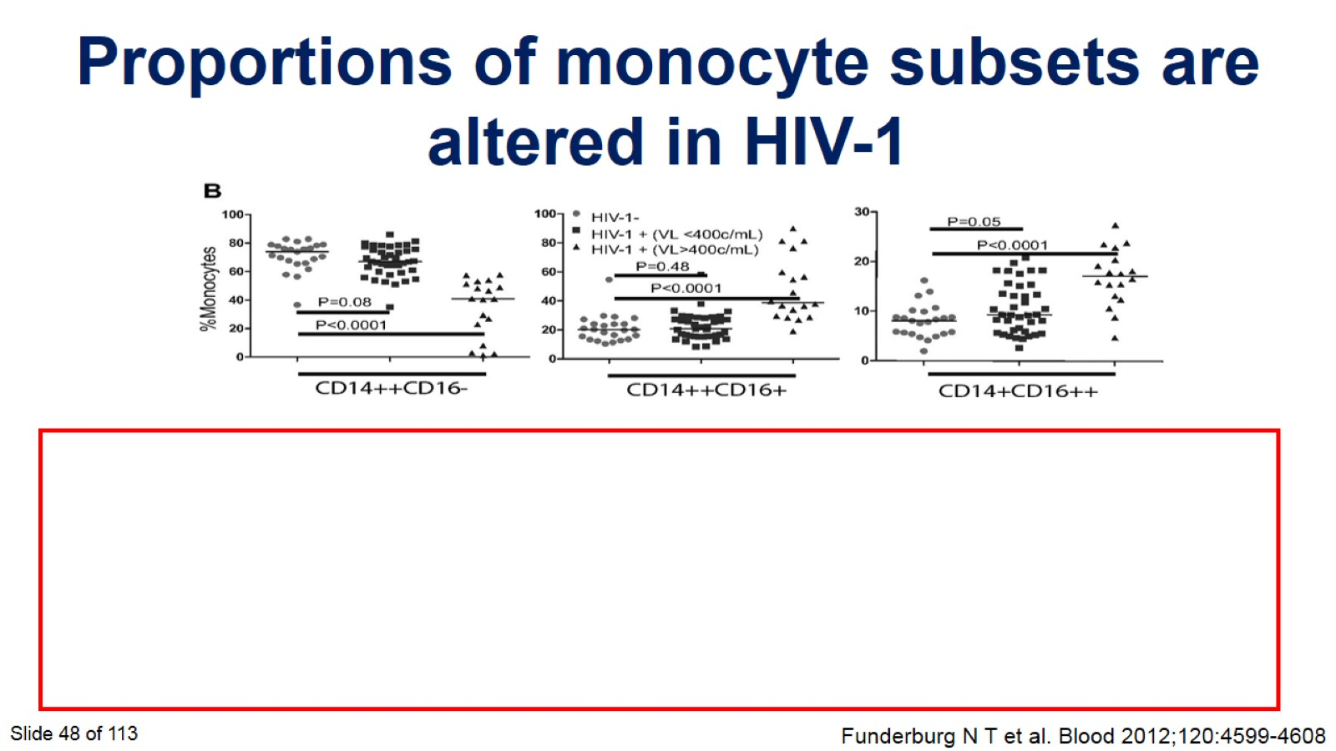

Slide 49
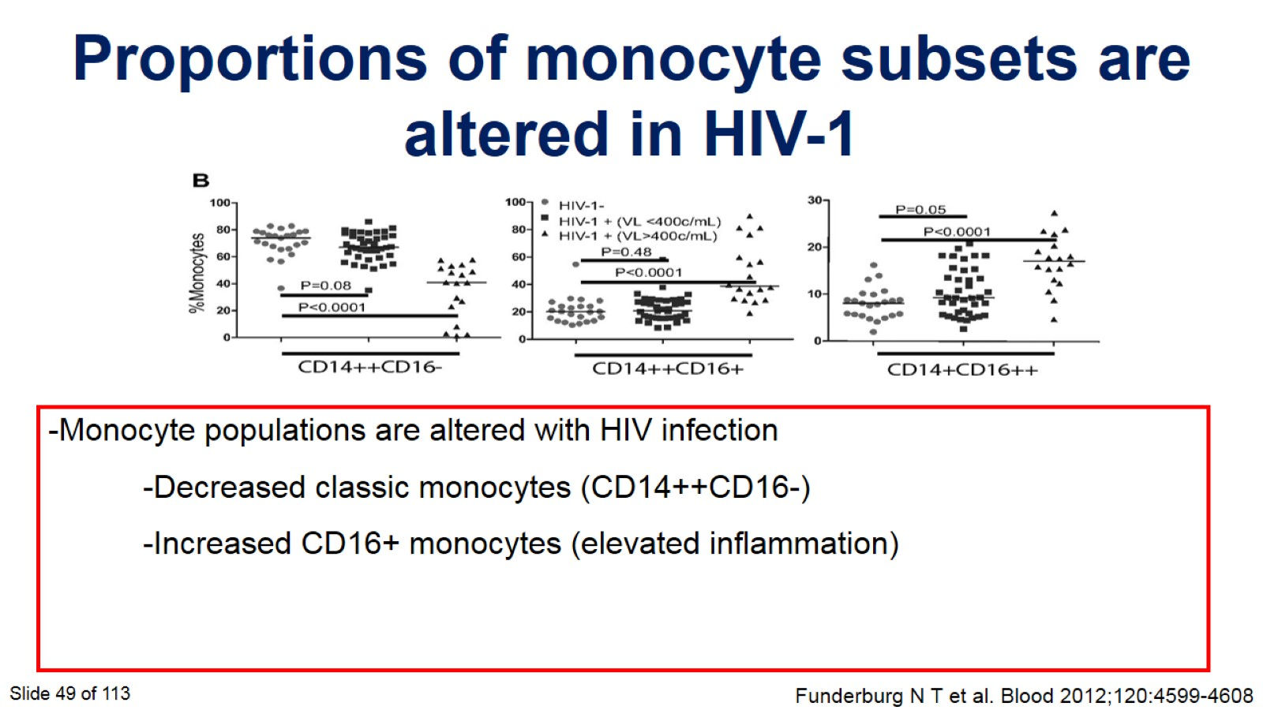

Slide 50
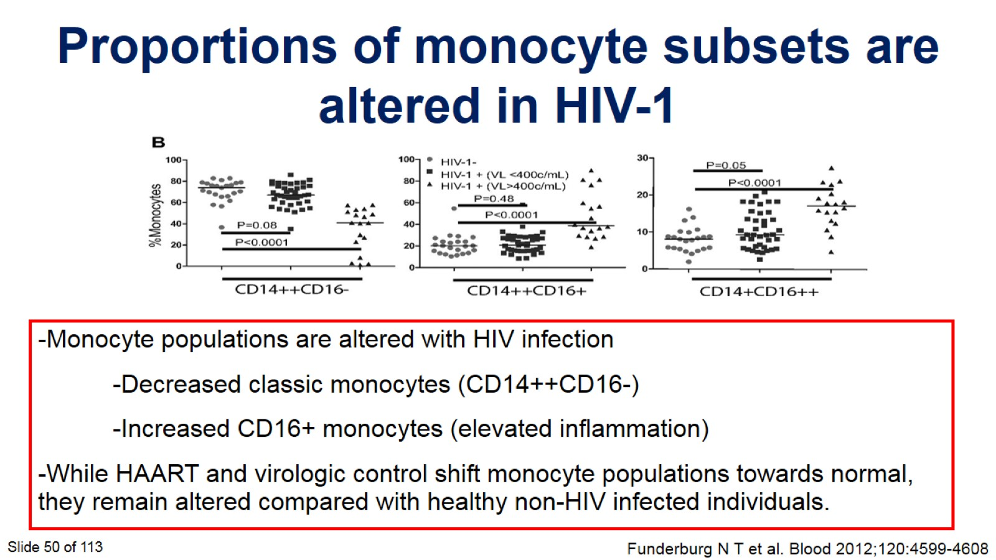

Slide 51
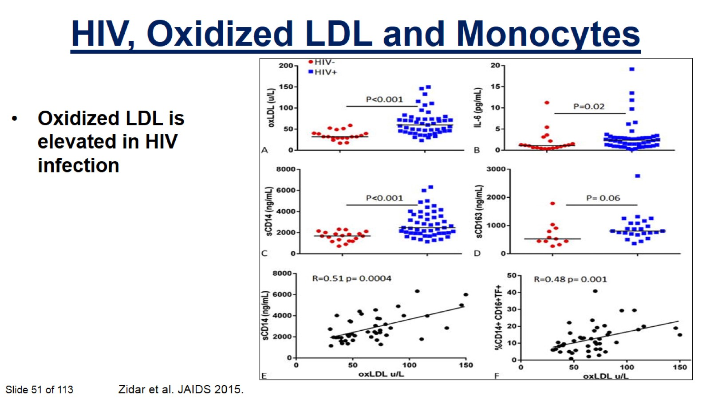

Slide 52


Slide 53

Uncontrolled HIV Replication is Bad

Slide 54

Residual CV Disease Risk With Suppressed Viremia

Slide 55

How is HIV Unique?

Slide 56

Contributions of Traditional and HIV Risk Factors for Myocardial Infarction

Slide 57

Brief Summary of the WHY

Slide 58

PART 2 — Question & Answer

Slide 59

Part 3: How can I change these outcomes?

Slide 60

Case

Slide 61

ARS Question: What is the most important intervention to reduce cardiovascular disease risk?

Slide 62

CVD Mortality Higher in HIV-positive, even with Suppressed HIV Virus.

Slide 63

CVD Mortality Higher in HIV-positive, even with Suppressed HIV Virus.

Slide 64

CVD Mortality Higher in HIV-positive, even with Suppressed HIV Virus.

Slide 65

Are we START-ing ART early enough?

Slide 66

Potential Interventions Beyond Suppressive ART

Slide 67


Slide 68


Slide 69


Slide 70

CVD Risk Prediction and HIV

Slide 71

CVD Risk Prediction and HIV

Slide 72

CVD Risk Prediction and HIV

Slide 73

Approach to Lipid Lowering (Statin) Therapy

Slide 74

HIV Specific Lipid Issues

Slide 75

HIV Specific Lipid Issues

Slide 76

HIV Specific Lipid Issues

Slide 77


Slide 78


Slide 79

Suggested Statins in the Setting of ART

Slide 80

Statins Reverse Atherosclerosis!

Slide 81

Statins Reverse Atherosclerosis!

Slide 82

Statins Reverse Atherosclerosis!

Slide 83


Slide 84

Randomized Trial to Prevent Vascular Events in HIV: REPRIEVE (A5332)

Slide 85

How to Beat Inflammation and Prevent CVD

Slide 86

How to Beat Inflammation and Prevent CVD

Slide 87

Don’t Forget:
The “ABCDEs” of Cardiovascular Disease Management

Slide 88

ASPIRIN Use For Primary Prevention

Slide 89

ASPIRIN Use For Primary Prevention

Slide 90

ASPIRIN Use For Primary Prevention

Slide 91

We Mind Very Much If You Smoke

Slide 92

We Mind Very Much If You Smoke

Slide 93


Slide 94


Slide 95

Diet and Food Insecurity

Slide 96

Diet and Food Insecurity

Slide 97

Diet and Food Insecurity

Slide 98

Diet and Food Insecurity

Slide 99

Lifestyle Modification: Diet

Slide 100

Lifestyle Modification: Diet

Slide 101

Lifestyle Modification: Diet

Slide 102

Lifestyle Modification: Diet

Slide 103

Lifestyle Modification: Exercise

Slide 104

Exercise Training Reduced Oxidative Stress and
Improves Functional Status in HIV

Slide 105

Brief Summary of the HOW

Slide 106

PART 3 — Question & Answer

Slide 107

HIV and CVD Summary

Slide 108

Posttest Question 1

Slide 109

Posttest Question 2

Slide 110

Question-and-Answer

Slide 111


Slide 112

See the IAS–USA website for instructions on claiming CME, pharmacy, nursing, or pharmacotherapy credits, or a certificate of participation.

Slide 113


Slide 114


Slide 115

Thank You

