Slide 1
The Elements of Taking a Sexual History
Allison Agwu, MD, ScM
Associate Professor of Pediatric and Adult Infectious Diseases
The Johns Hopkins University School of Medicine
Baltimore, Maryland
Dr Agwu has served as an advisor to Gilead Sciences, Inc, and Merck & Co, Inc. (Updated 09/28/20)
Planner/Reviewer Financial Disclosures:
Planner/Reviewer 1 has no relevant financial affiliations to disclose. (Updated 05/13/19)
Planner/Reviewer 2 has no relevant financial affiliations to disclose. (Updated 09/24/20)

Slide 2
CME Information
The International Antiviral Society–USA (IAS–USA) is accredited by the Accreditation Council for Continuing Medical Education (ACCME) to provide continuing medical education for physicians.
The IAS–USA designates this live activity for a maximum of 1.25 AMA PRA Category 1 Credits™. Physicians should claim only the credit commensurate with the extent of their participation in the activity.
Notes:
Please read from the slide

Slide 3
Nursing and Pharmacy Credits
Nursing Credits
Educational Review Systems is an approved approver of continuing nursing education by the Alabama State Nursing Association, an accredited approver by the American Nurses Credentialing Center’s Commission on Accreditation. Provider # 5-115. This program is approved for 1.25 hours of continuing nursing education.
Educational Review Systems is also approved for nursing continuing education by the state of California, the state of Florida and the District of Columbia.
Pharmacy Credits
Educational Review Systems is accredited by the Accreditation Council for Pharmacy Education (ACPE) as a provider of continuing pharmacy education. Participants of the session who complete the evaluation and provide accurate NABP e-Profile information will have their credit for 1.25 contact hours (0.125 CEU) submitted to CPE Monitor as early as 14 days after the event and no later than 60 days after the event. Please know that if accurate e-Profile information is not provided within 60 days of the event, credit cannot be claimed after that time. The participant is accountable for verifying the accurate posting of CE credit to their CPE Monitor account within 60 days.
UAN # 0761-9999-20-189-L01-P
Notes:
Please read from the slide

Slide 4
Grant Support for this Webinar
This activity is part of the IAS–USA national educational effort that is funded, in part, by contributions from commercial companies. Per IAS–USA policy, any effort that uses commercial grants must receive grants from several companies with competing products. Funds are pooled and distributed to activities at the sole discretion of the IAS–USA. Grantors have no input into any activity, including its content, development, or selection of topics or speakers. Generous support for this activity has been received from the following contributors:
Platinum Supporters
Gilead Sciences, Inc.
Merck & Co, Inc.
ViiV Healthcare
Additional support provided by Janssen Therapeutics
We appreciate the funders supporting this activity and those observing this activity today. Per ACCME guidelines funder observers may not participate in discussions or ask questions during the webinar. Thank you.

Slide 5
Navigating the Webinar
Poll Questions
A separate window will show the poll questions.
Choose your response from the poll.
Responses will be displayed after the poll closes.
Asking the Presenter Questions
To ask questions, submit using the Q&A button.
Generally, most questions will be answered at the end of the webinar.
Your first and last name must be indicated in order to have questions addressed.
We apologize if we are not able to address all questions.

Slide 6
Poll 1
From which geographic region are you viewing this webinar?
West or Midwest United States
South or Southeast United States
Northeast United States
Canada
Mexico
Central/South America
Europe
Asia/Australia
Africa
Other

Slide 7
Poll 2
Please rate your level of experience in the medical management of HIV infection. (1 = Novice, 5 = Expert)
1
2
3
4
5
Novice
Expert

Slide 8
The Elements of Taking a Sexual History
Allison Agwu, MD, ScM
Associate Professor of Pediatric and Adult Infectious Diseases
The Johns Hopkins University School of Medicine
Baltimore, Maryland
Dr Agwu has served as an advisor to Gilead Sciences, Inc, and Merck & Co, Inc. (Updated 09/28/20)
Planner/Reviewer Financial Disclosures:
Planner/Reviewer 1 has no relevant financial affiliations to disclose. (Updated 05/13/19)
Planner/Reviewer 2 has no relevant financial affiliations to disclose. (Updated 09/24/20)

Slide 9
Learning Objectives
Upon completion of this webinar, learners will be able to:
Describe why taking a sexual history is important at all ages
List important aspects of a detailed sexual history for adolescents, including sexual and gender minority adolescents, older adults, including seniors
Identify and discuss barriers to taking a sexual history
Incorporate approaches to improving sexual history taking and sexual health among patients of all ages

Slide 10
Pretest Question #1
Which statement is FALSE?
Adolescents and young people ages 13 to 24 years account for about 20% of new HIV diagnoses
Rates of sexually transmitted infections are increasing across all age ranges
Approximately 40% of adolescents have had intercourse by the time they complete high school
Individuals over the age of 50 years account for less than 5% of new HIV diagnoses
Notes:
Correct answer is #4

Slide 11
Pretest Question #2
Which is NOT a common reason that practitioners report for not obtaining a sexual history?
Time constraints
Lack of comfort
Irrelevant to chief complaint
Prohibited by employer
Notes:
Answer is #4 (not listed on any of the surveys)

Slide 13
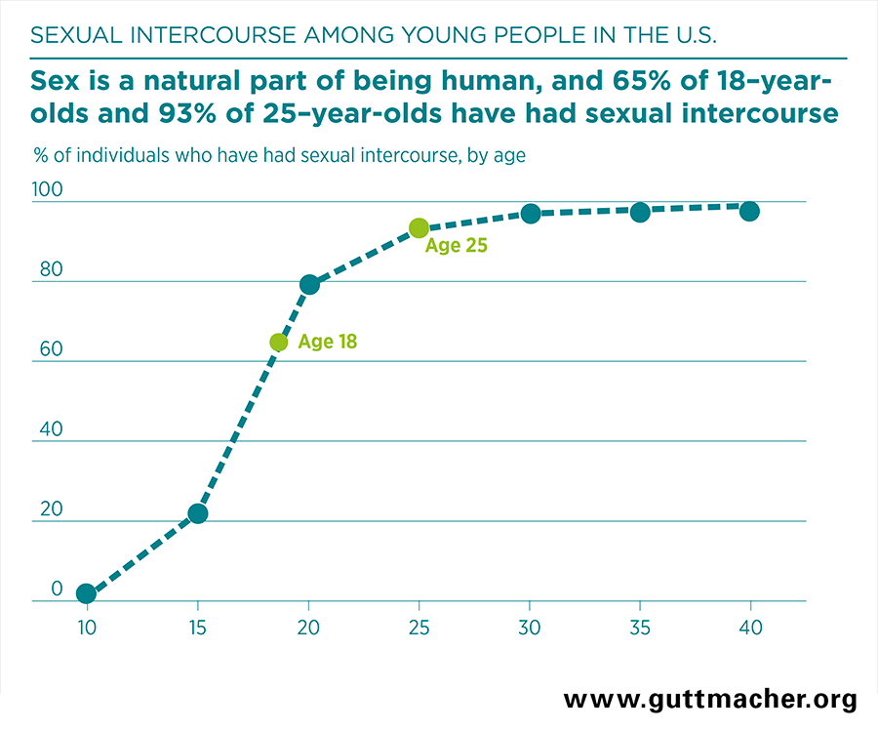
Sex is a normal part of life

Slide 14
Adolescents are having sex.
High school students (9-12th grade)
40% had ever had sexual intercourse.
10% had ≥4 sexual partners.
National Youth Risk Behavior Survey 2017

Slide 15
Adolescents are having sex.
High school students (9-12th grade)
40% had ever had sexual intercourse.
10% had ≥4 sexual partners.
30% had sex during the previous 3 months, and, of those:
46% did not use a condom with last sex.
14% did not use any method to prevent pregnancy.
19% drank alcohol or used drugs before last sex.
7% had been physically forced to have sex when they did not want to.
<10% of all students have ever been tested for HIV.
National Youth Risk Behavior Survey 2017

Slide 16
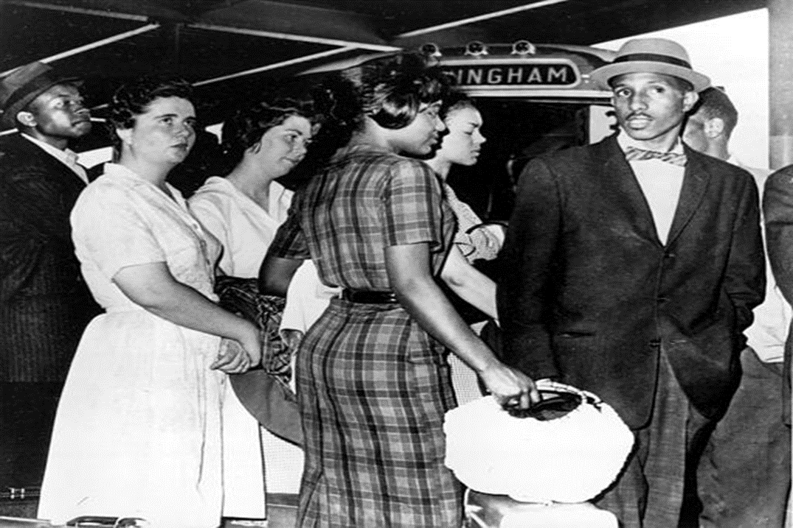
“Risky Behavior” or Normal Development?
&
Cognitive development
Concrete thinking → more complex
Limited ability to perceive consequences
Risk taking & experimentation
Exploration of _______ (fill in the blank)
self-esteem, self-confidence & self-identity
autonomy, peer acceptance & respect
Psychosocial development
Invincibility & independence-seeking
Decreased parental supervision
Runaway, truancy
Notes:
Real or imagined, Feels like they are running away

Slide 17
Youth are at increased risk for STIs/HIV.
Biologic risk
-Anatomy: cervical ectopy, lower circumcision rates
-Lack of immunity from prior infections
-?Greater risk for physically traumatic sex
-Concurrent STIs
Brain development*
-Maturation of “executive suite”: center that includes risk-reward calibration, problem-solving, prioritizing, thinking ahead, self- evaluation, long-term planning, and regulation of emotion
Note: multiple factors (environment, culture, trauma, substance use, illness, parenting style, race/ethnicity) impact development impact maturation
Cognitive development: concrete thinking; limited ability to perceive consequences
*Significant variability
Notes:
Cognitive development

Slide 18
ARS Question 1: Which of the following is true about sexual health in adolescents?
Rates of STIs are declining
Pregnancy rates are increasing
Sexual and gender minority adolescents and youth have higher risk of STIs
There are no data on STIs in adolescents
Notes:
The correct answer is C. Sexual and gender minority youth have higher rates of STIs likely due to multiple reasons (not being included in sexual health programs, access, stigma).

Slide 19
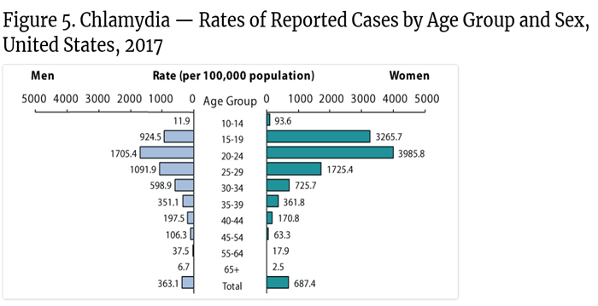
STI rates among adolescents
Rates of chlamydia, gonorrhea, and primary & secondary syphilis ↑ for both sexes in 15–24 year olds
Chlamydia: highest among women 15–24 years; males 15–24 years ↑ 29% (2013–2017), while the rate in females ↑ 9%
Gonorrhea: males 15–24 years ↑ 52%, while the rate in females ↑ 24%.
Reasons for increases include:
↑ incidence
↑ screening among young men
↑ extragenital screening
CDC

Slide 20
Risks among sexual and sender minority (SGM) youth
Compared to heterosexual and cisgender youth:
More likely to have had sex before age 13
More likely to have sex with >4 partners
More likely to have used alcohol or drugs before last sex
Less likely to use condoms last sex
More likely to have not used any pregnancy prevention method with last sex
Levine, Pediatrics, 2013; Kann et al, MMWR, 2018; Rasberry et al., MMWR, 2018

Slide 21
Young transgender men and women
Transgender young women face highest rates of HIV and STIs compared to other SGM youth
↑ HIV/STI risk may be associated with commercial sex work, transactional sex, unemployment, substance abuse, h/o of incarceration, unstable housing, nonconsensual sex, access to care, #partners and condomless anal intercourse
HIV prevalence among transgender men is relatively low (0-3%), a 2011 study suggests that transgender MSM are at high risk for acquiring HIV
857 transgender MSM (ages 18-60); 65%<30): ≈55% reported risk factors indicating a need for PrEP (eg.,where they met their sex partners, not having sex exclusively with cis men, greater # of partners, high alcohol/drug use). 84% aware of PrEP, only 1/3 had ever taken PrEP
Levine, Pediatrics, 2013; Rowniak et al. AIDS Educ Prev 2011; Reisner JIAS 2019; 22(9): e25391
Notes:
Fenway study: Participants must have self‐reported receptive anal sex or frontal/vaginal sex with a cis male sex partner in the past six months. The racially mixed group was 69.7% white, 25.5% mixed or other racial identity, and 4.8% black. Additionally, 22.1% of all participants reported Latinx heritage. All participants had been assigned female sex at birth and currently identify on the transmasculine spectrum (71.6% as male/transgender man, 28.4% as non-binary, and 32.6% as gay).
The study found that 84% of participants recognized that PrEP use was a way to prevent HIV acquisition. Approximately 55% reported higher risk factors which indicated a greater need for PrEP use. These included where they met their sex partners, not having sex exclusively with cis men, greater number of partners, and high alcohol and drug use. However, only one-third of those in the study had ever taken PrEP.

Slide 22
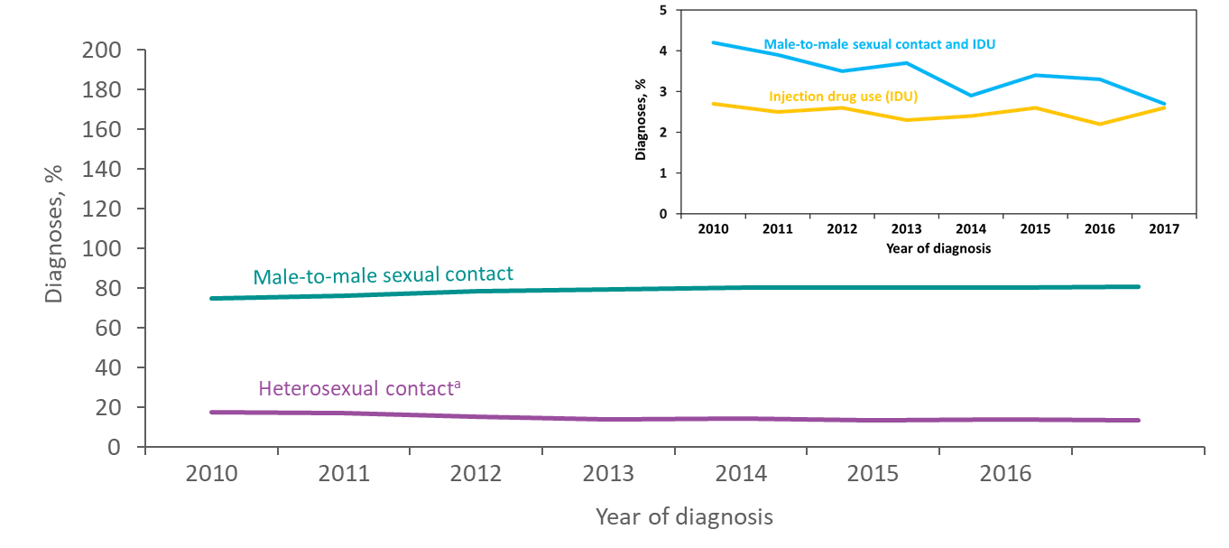
Diagnoses of HIV Infection among Adolescents and Young Adults Aged 13–24 Years, by Transmission Category, 2010–2017—United States and 6 Dependent Areas
≈ 51,000 youth with HIV; 40% unaware of HIV status (CDC 2016)
Trends (2010-16): ↓ 6% overall among youth (32% women; men unchanged);
Among MSM: ↓ 5% among AA; ↓ 6% among white; ↑17% Hispanic/Latino
Note. Data have been statistically adjusted to account for missing transmission category. “Other” transmission category not displayed as it comprises less than 1% of cases.
ª Heterosexual contact is with a person known to have, or to be at high risk for, HIV infection.
Notes:
This slide presents the distribution of diagnoses of HIV infection by transmission category for adolescents and young adults aged 13–24 years with HIV diagnosed from 2010 through 2017 in the United States and 6 dependent areas.
Among adolescents and young adults, the percentage of diagnosed HIV infections attributed to male-to-male sexual contact increased from 75% in 2010 to 81% in 2017. The percentage of diagnosed HIV infections attributed to heterosexual contact decreased from 18% to 14% during this time. The percentage of diagnosed HIV infections attributed to injection drug use alone, and male-to-male sexual contact and injection drug use also decreased from 2010 through 2017. The “Other” transmission category is not displayed as it comprises less than 1% of cases. The category includes hemophilia, perinatal exposure, and risk factors not reported or identified.
Data have been statistically adjusted to account for missing transmission category.
Heterosexual contact is with a person known to have, or to be at high risk for, HIV infection.

Slide 23
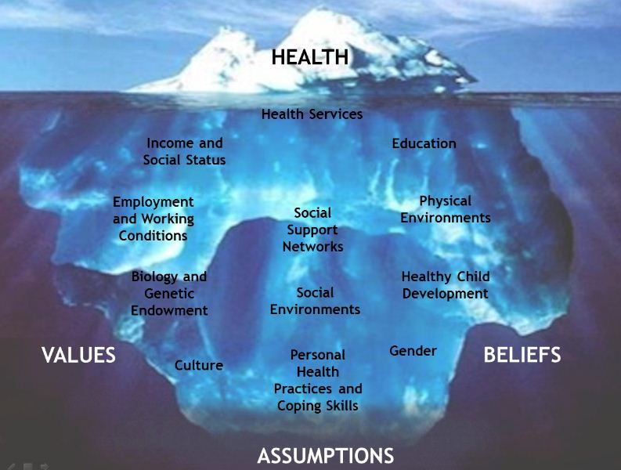
Increased risk for STIs/HIV among youth…..
Stigma
Notes:
Lana

Slide 24
Sex is a normal part of the entire life spectrum

Slide 25
Life events impact sexual activity across the continuum of life

Slide 26
Societal factors: marriage and divorce
Highest: Nevada (4.4 per 100,000); Lowest: Illinois (1.5 per 100,000)
https://www.cdc.gov/nchs/data/dvs/state-divorce-rates-90-95-99-18.pdf

Slide 27
Societal factors: infidelity
American Association for Marriage and Family Therapy Survey of Married Persons
15% of women and 25% of married men have had extramarital affairs.
General Social Survey (2000-2016): similar data with persistent gender difference
Partners’ study: 15 HIV transmissions, 0% were phylogenetically linked to the positive partner
https://www.nytimes.com/2018/01/22/well/marriage-cheating-infidelity.html
https://www.psychologytoday.com/us/blog/all-about-sex/200910/marital-infidelity-how-common-is-it
Rodger A et al. AIDS 2018. WEAX0104LB and Rodger AJ et al. JAMA 2016; 316: 171-81

Slide 28
Factors impacting sexual activity
Number of lifetime and last-year same-sex partners reported by men with respect to their sexual identity
Grulich et al. Sexual Health. 2014; 11: 439-50. (Australia)

Slide 29
Sexual orientation may not be “carved in stone”
https://www.aarp.org/home-family/sex-intimacy/info-2017/can-sexual-preference-change-at-midlife.html

Slide 30
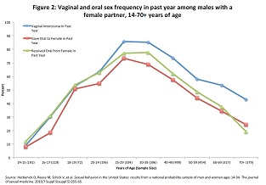
Sex is a normal part of the entire life spectrum

Slide 31
Yasue Tomita, 61 years old
Tomita confessed to being "a bit rusty" but made no apologies for her rambunctious lust for life, or her decision to put aside her knitting and crochet and launch into a career making X-rated movies.
"I like my handicrafts but I wanted to try my hand at this, while my body still works"
https://www.straitstimes.com/asia/east-asia/silver-porn-shows-fifty-shades-of-greying-japan

Slide 32
Seniors and sexual activity
40% of seniors (ages 65-80) are sexually active.
72% have a romantic partner; of those 54% were sexually active.
50% of men vs. 12% of women reported being extremely or very interested in sex
31% of women vs. 51% of men reported having sex.
43% of women vs. 31% of men were satisfied with their sex lives
National Poll on Health Aging. AARP & U of Michigan
(https://www.aarp.org/health/healthy-living/info-2018/older-sex-sexual-health-survey.html)

Slide 33
ARS Question 2: Which of the following is true about sexual health in older adults?
Rates of sexually transmitted infections are declining
Normal changes in physiologic functions can increase risk of STI acquisition
They are more likely to use condoms
PrEP cannot be used in individuals older than age 65
Notes:
The correct answer is B: changes in estrogen levels in women may result in vaginal thinning and decreased lubrication that may increase risk of STI acquisition.

Slide 34
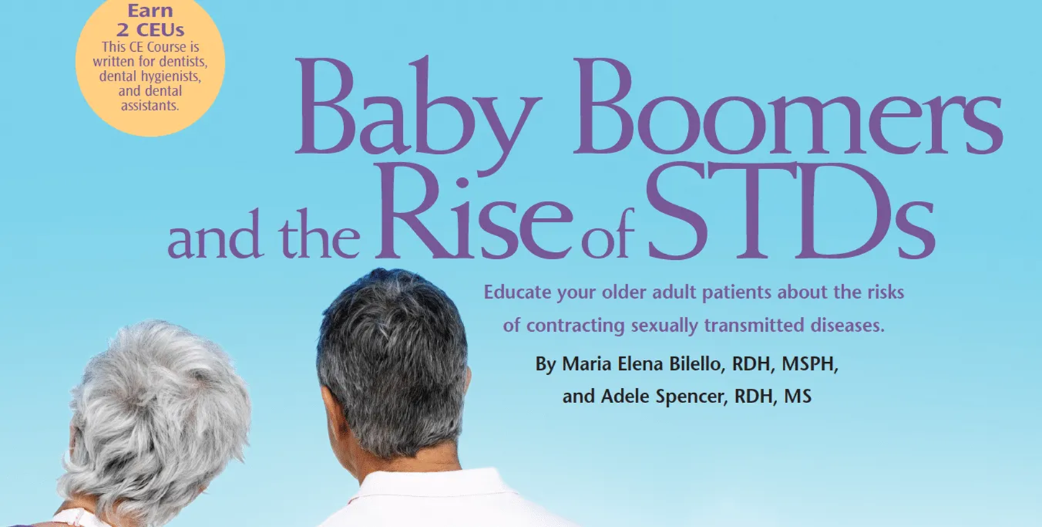
STIs among adults 55 and older
The number of cases of gonorrhea ↑164%, syphilis ↑ 120%, and chlamydia ↑ 86% among Americans ≥55 years old (2014-2018)
CDC; https://www.everydayhealth.com/stds/rise-sharply-among-older-americans/

Slide 35
HIV diagnoses among people ≥50 years old
17% or 1 in 6 new HIV diagnoses were among people age ≥50

Slide 36
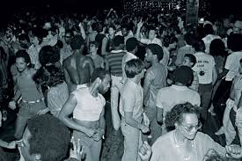
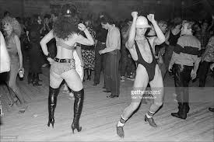
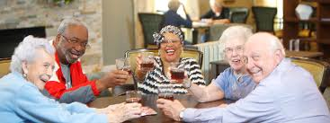
Why are STI rates increasing among older adults?
Relocation
retirement communities, warmer climates
clustering of seniors
Decreased isolation
Divorce or death of partner
end / renewed beginning of sexual activity
different sexual acts
Many not well versed in conversations about sex with partners or providers.
No fear of pregnancy
Unaware of risks
Low condom use (12% of sexually active men and 32% of women reported using condoms every time).
https://www.everydayhealth.com/stds/rise-sharply-among-older-americans/; Lindau NEJM 2007

Slide 37
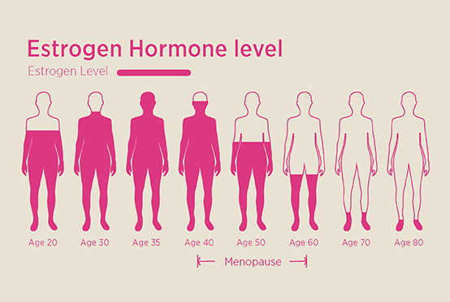
Increased STI risk among seniors: biologic factors
Men: can remain sexually active longer due to drugs for erectile dysfunction (eg.,sildenafil)
Women: ↓ estrogen with menopause→ ↓ circulation, thinning of vaginal tissues, ↑ risk of microabrasions.
Can ↑ susceptibility to STIs and bloodborne infections (eg. HIV, Hep C).
Can remain sexually active longer with vaginal estrogen, lubricants, or moisturizers which can make postmenopausal sex more comfortable.
New drugs (eg., bremelanotide),can treat women with low libido; not approved for women after menopause.
Seniors: more likely to have health conditions that weakens the immune system (such as cancer and its treatments) which may increase the risk of contracting an infection.

Slide 38
Why is assessing sexual activity important?
Physical health
-Assess health
-Opportunity to assess risk, prevent, diagnose, treat STIs
- Assess Medication side effects
-Adherence
Emotional health
Mental health
Psychosocial stressors (abuse)
Overall wellness

Slide 39
Are providers asking about sex?
416 physicians (OB/gyn (21%), IM (25%), general/fam practice (20%), peds (28%))
Mail survey assessing: 1) if they ask patients about sexual activity and specific components of sexual history (eg., partners, practices, sexual orientation) during initial exams, follow-up. 2) training & comfort
Domains: training, attitudes, and practices
51% male, 58% white; 25% AA, 13% Asian-American; average of 94 patients/wk
56% adequately trained about sexual history taking, 64% trained regarding screening
77% fairly/extremely important; 85% felt relevant to medical care
79% felt fairly/extremely comfortable
Only 12-34% asked about components of sexual history routinely
76% asked if thought would be relevant to complaint
Wimberly YH et al. JNMA 2006; 98(12): 1924-9

Slide 40
Are providers asking about sex?
Female (72%) more likely to ask about sexual activity than males (45%);
Pediatricians (75%) more likely to report taking sexual history

Slide 41
Are providers asking about sex?
1200 practicing OB/gyns (53% male, mean age 48 (surveyed about practices of communication about sex with patients)
63% routinely assess patients sexual activity questions
40% routinely ask about sex problems
28% asked about satisfaction
28% asked about orientation/identity
14% asked about pleasure
25% had expressed disapproval of patient’s sexual practices
Sobecki et al. J Sex Med. 2012; 9(5): 1285-94
Notes:
represented by FMGs and/or to consider religion most or very important in their lives)

Slide 42
Provider barriers to asking about sexual history
Lack of knowledge
Personal beliefs
Embarrassment/discomfort
Irrelevant
Fear of being insensitive
Other?
Merrill. South Med J. 1990 83(6): 613-17; Althoff SE. J Sex Med 2013; 10: 26-35

Slide 43
Are patients asking about sex questions/concerns?
International study of 27,500 men & women; 50% reported ≥ 1sexual problem; 19% sought medical care, only 9% reported being asked about sexual health in the prior 3 years by their physician
Survey conducted at a family residency program health center
N=79 respondents
Median age 47 (16-94 years); 69% female; 47% (heterosexual) 53% did not answer; 47% married/18% committed
54% had sexual health concern; 44% of those discussed with primary doctor
Senior survey:
62% of seniors said they would consult a doctor if they were having a problem with their sexual health, only 17% had done so in the prior 2 years.
When issue was discussed, patients raised the issue, not provider.
Study of 1800 18-24 year old MSM:
61% did not disclose their sexuality
Disclosure associated with HIV/STI testing, HPV vaccination
Ryan KL et al. Primer 2018; 2: 23; Stupiansky AIDS Pt Care STDs 2017; Moreira et al. Int J Clin Pract 2005; 59: 6-16
https://www.aarp.org/health/healthy-living/info-2018/older-sex-sexual-health-survey.html;

Slide 44
Patient barriers to addressing sexual health concerns
Althoff SE. J Sex Med 2013; 10: 26-35; Ryan KL et al. Primer 2018; 2: 23; https://pubmed.ncbi.nlm.nih.gov/32818195/

Slide 45
Patient barriers among non-heterosexual patients
Homophobia
Stigma
Discrimination
Lack of access to culturally- and orientation-appropriate medical and support services
Heightened concerns about confidentiality
Fear of losing job
Fear of talking about sexual practices or orientation
https://www.cdc.gov/msmhealth/for-your-health.htm; https://providecare.org/how-identify-signs-symptoms-individual-stigma/

Slide 46
Why don’t patients ask their providers?
Marwick. JAMA 1999; 281(23): 2173-74

Slide 47
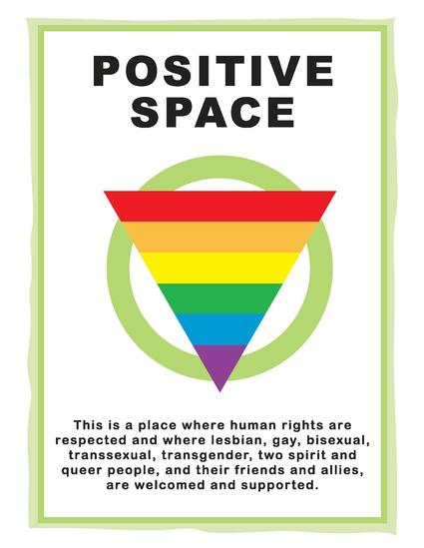
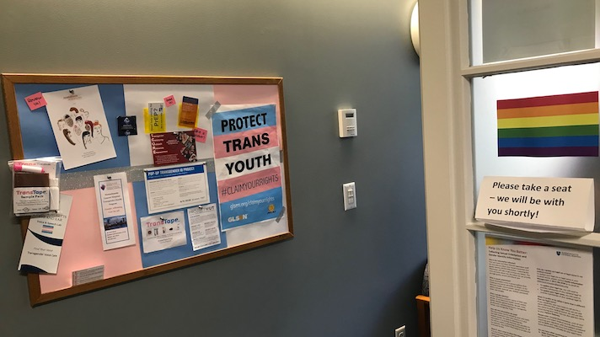
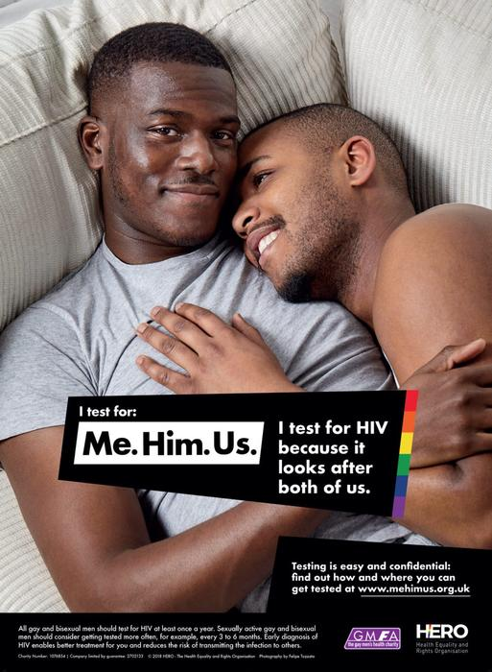
Patient-reported facilitators to addressing sexual health concerns
Notes:
The signs you don’t have on the walls are just as important as the signs that you do.

Slide 48
What can you do?

Slide 49
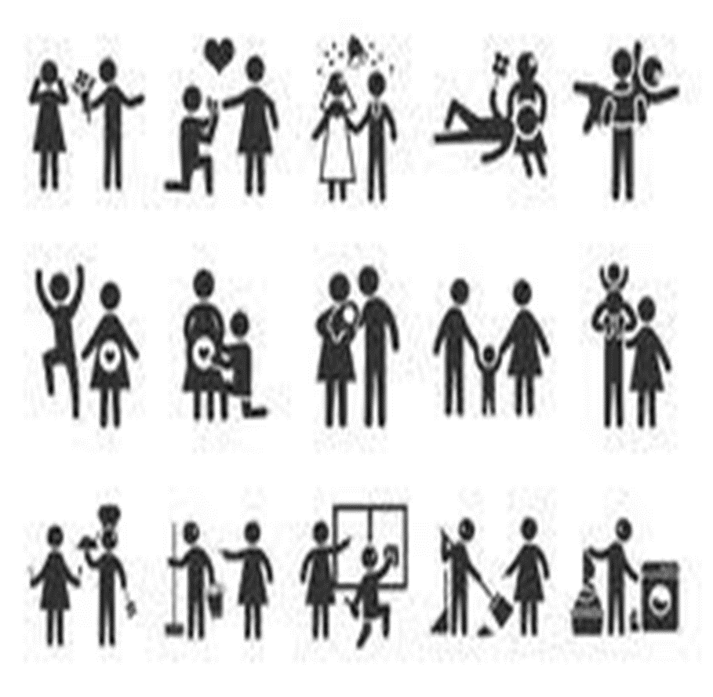
Take a page from adolescent medicine: HEADSS
H – Home/Household
E – Education/Employment
A – Activities
D – Drugs
S – Sex/Sexuality
S – Suicidality/Mental Health
HEADSS assessment should be a conversation not a survey (more in depth probing as therapeutic relationship develops)
Rapport building is key!!!!!

Slide 50
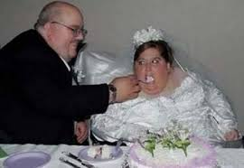
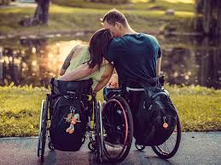
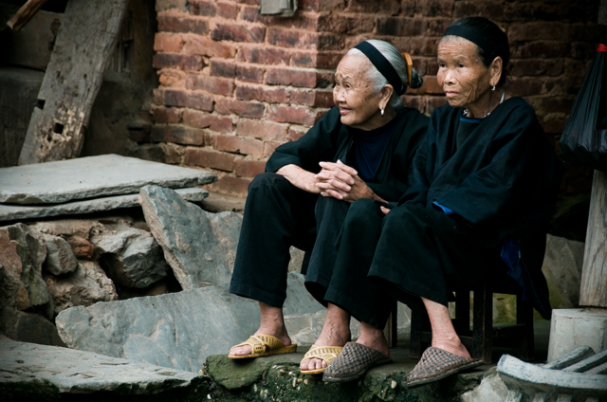
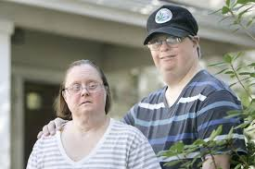
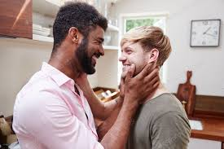

Slide 51
Sexual history 101
Confidential
Nonjudgmental
Non-assuming
Inclusive
Open
Specific and direct
5 Ps (Partners, Pregnancy (prevention/intention, Protection from STIs, sexual Practices, and Past history of STIs)
Avoid medical jargon
Engage the patient in the process of adopting health-promoting behaviors
Notes:
Average duration of sexual history/discussion was 36 seconds in Fortenberry study.

Slide 52
Elements in a sexual history
Confidentiality: Establish a safe and comfortable environment to discuss personal health issues. At the beginning of the visit, emphasize patient confidentiality and its limits
Patient concerns:
open-ended questions
ask specific questions about sexual problems or concerns
Sexual orientation and preferences:
how a person identifies their sexuality/gender does NOT always tell you who they have sex with or who they are attracted to
do NOT assume sexuality or practices
Age of sexarche (debut)/ re-emergence of sex:
younger adolescents who are in relationships with older partners know less about STI and pregnancy prevention/negotiation of safe sex practices
seniors: re-activating sexual activity
https://journalofethics.ama-assn.org/article/why-do-we-take-sexual-history/2005-10 (AMA)

Slide 53
Elements in a sexual history
Types of sexual practice
Orifices (oral, anal, vaginal)
Use terms that are relatable (eg., bottom, top)
Devices, potions, douches, etc
Elicits info to assess of sexual practice in the assessment for STI risk and presentation
Last sexual intercourse: important for pregnancy and contraceptive counseling; STI treatment and prevention
Sexual partner assessment:
# lifetime partners (+/-); #partners in last 6 months, where they meet their partners; nature of the relationship (eg., serial monogamy, concurrency, one-offs, recycled), ability to negotiate use of condoms/birth control, when and how they have sex (choice?), and intimate partner violence screening
AMA
Notes:
Practices may differ by partner

Slide 54
Elements in a sexual history
Pregnancy prevention or desires:
counseling is consistent with patient’s goals, and information and advice is appropriate.
prior pregnancies and outcomes: important in contraceptive and reproductive counseling to identify risk and needs.
Sexually transmitted infections (STIs)
prevention practices: condom usage (eg, consistency, correct use, access), lube, PrEP, STI/HIV testing, partner info (status).
symptoms: many patients may be asymptomatic; education regarding STIs.
history of prior STIs: Eliciting this history is an opportunity to discuss how to prevent future STIs, potential infertility and to assess STI risk.
AMA

Slide 55
Elements in a sexual history
Problems related to sexual intercourse
physical: fatigue, chest pain, erectile dysfunction, libido, etc
mental/emotional
psychosocial
History of sexual abuse
physical, mental/emotional, psychosocial, legal
AMA

Slide 56
Sexual history: provider concerns
Not every question needs be asked at the initial visit
-can reserve some for subsequent visits
-sexual history becomes routine
- ↑ patient comfort raising future questions/concerns
As patients see you being sensitive and comfortably asking questions→ more likely to view you as a resource for sexual health info.
The more comfortable you are…..the more comfortable your patients will be
AMA

Slide 57
Sexual history: provider discomfort
Some providers may feel uncomfortable obtaining a sexual history
Understanding the rationale & ↑experience in asking sensitive questions about sexual health practices and beliefs may ↓ anxiety
Understanding our own feelings about diversity in sexuality and sexual health across the lifespan will help us communicate with our patients about these issues.

Slide 58
Sexual history: getting started
Althoff SE. J Sex Med 2013; 10: 26-35

Slide 59
Sexual history: getting started
Prospective opening questions (not out of left field)
Link to ?s about menopause, menstrual issues, birth control, life events, etc
Ask about sexual activity (do not assume orientation, identity, partners, practices (even in partnerships))
“Certain conditions/medications can affect how some people have sex, have you had any concerns related to that?”
Do you identify your sexual identify in any way? If yes, how? hetero, same gender loving, bisexual, pansexual……
“When you picture your ideal partner(s) who do you envision?”
“Are you interested in men, women, both, other?”
“I know this may be embarrassing, but I ask all of my patients these questions because it’s important for your health”
“I ask everyone between 12 and 112 these questions….” (Kelly Gebo)
“You got any crushes?” (Amaka Agwu)
“Are you satisfied with your sexual life?”
“How do you like to have/enjoy sex?”

Slide 60
What do you do with the information?

Slide 61
Prevention
Risk reduction:
Condoms (male and female)
Older men may not get firm enough erections to use condoms effectively, in which case the condom might slip off. Consider erectile dysfunction drugs
Pregnancy (prevention, planning)
Comprehensive and non-stigmatizing info about sexual and reproductive health
Promote healthy sexuality even if not sexually active
Lubrication: for males and females; products for vaginal thinning (eg, estrogens)
Education about practices that may increase risk
Eg. use of oil-based lubricants, unprotected anal intercourse

Slide 62
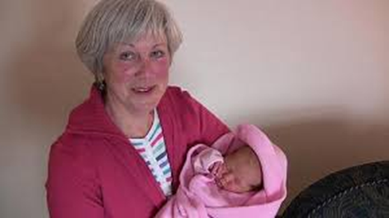
Family planning and reproductive health
Pregnancy among adolescents declining (across all demographics); ↓ 64% (1991-2015)
80% of adolescent pregnancies unplanned
All options are available to adolescents
Pregnancy can occur among perimenopausal women (chance of natural conception; 10% (age 45)→ 0% (age 51))
Eijkemans. Hum Reproduc. 2014; 29(6): 1304-12/;AAP Technical report from the Committee on Adolescence; CDC

Slide 63
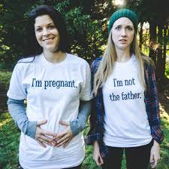
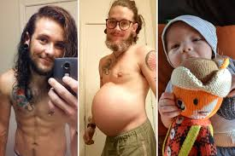
Family planning and reproductive health (sexual gender minority)
Important to have open discussions with all SGM, about reproductive health and family planning
Sexual behavior and sexual identity are not always aligned
Many SGM may have sexual encounters that may not be predicted by their orientation, conversation about birth control is important
https://www.advocate.com/commentary/2015/06/03/op-ed-why-there-epidemic-pregnancy-among-queer-youth

Slide 64
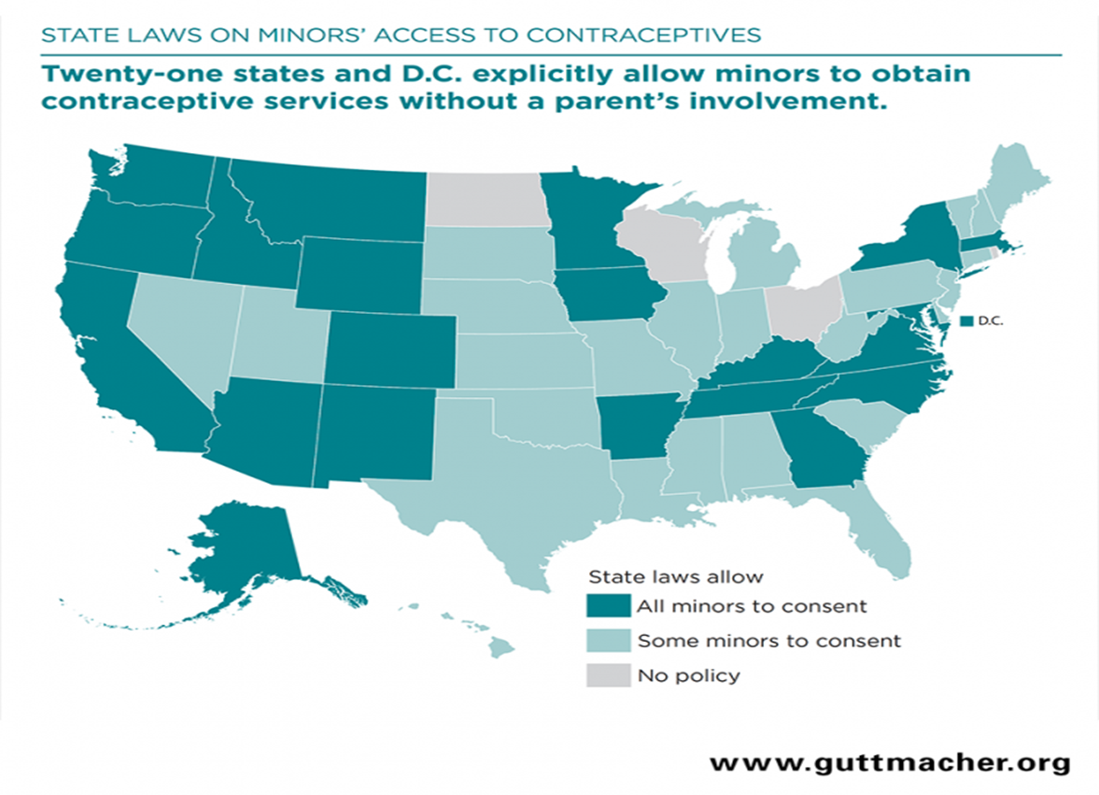
Prevention: STIs
Screening:
based on sexual behaviors, anatomy/body parts used for sex identified through the inclusive sexual history
Gonorrhea, chlamydia, syphilis, Hep C, etc
Extra-genital GC and CT screening in patients with history of oral/anal sex
Sexually active individuals: screened at least annually with more frequent intervals based on risk behavior
Testing: Nucleic acid amplification test (NAAT) testing sufficient in most cases
Treatment:
CDC 2015 STD Treatment Guidelines for specific STI testing recommendations (2020 forthcoming)
All 50 states + DC allow minors to consent to STI services without parental involvement. 32 states explicitly allow minors to consent to HIV testing and treatment.
http://www.cdc.gov/std/tg2015/screening-recommendations.htm; www.guttmacher.org

Slide 65
New reported chronic HCV:
Millenials (20-30s): 37%
(born 1981-96)
Adults (late 30s-50s): 23% (born 1966-80)
Baby boomers (late 50s-70s): 36% (born 1945-65)
https://www.cdc.gov/nchhstp/newsroom/2020/hepatitis-c-impacting-multiple-generations.html

Slide 66
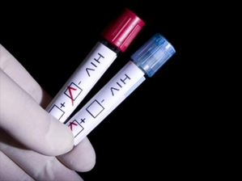
U.S. HIV Screening Recommendations
Universal screening
13-64 years old
All pregnant women
Repeat screening
Subsequent tests for all persons with increased risk at least annually
Family diagnosis
Clinical suspicion (even outside of age range)
Patient request
CDC
Notes:
Lana

Slide 67
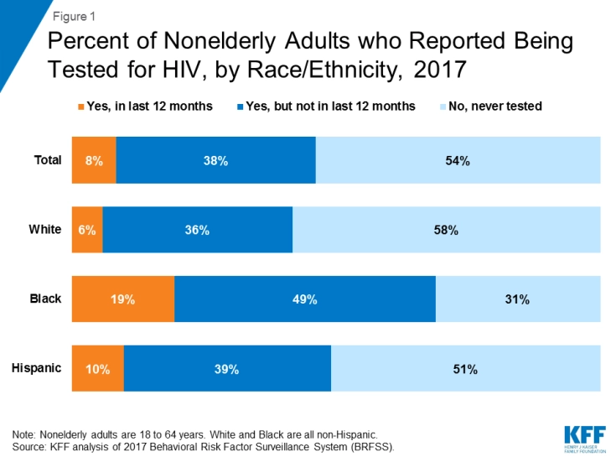
HIV testing
Patient and provider barriers to testing include:
low perceived risk of infection
confidentiality
access to services
previously mentioned

Slide 68
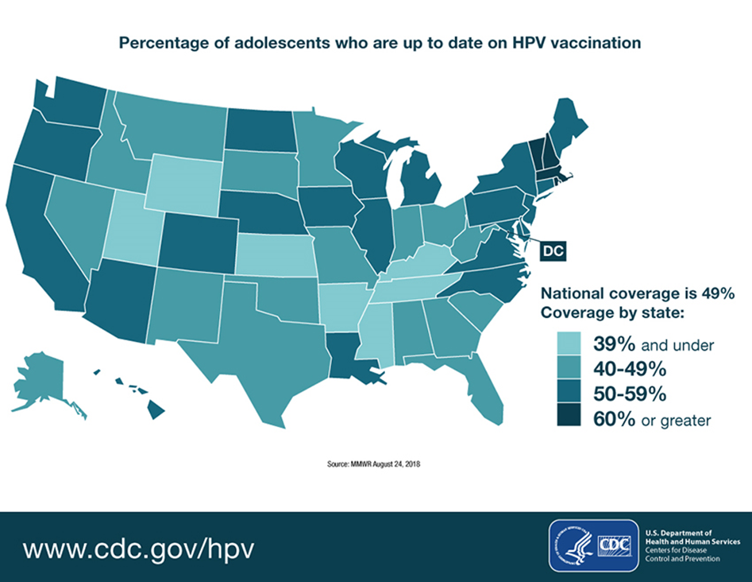
Prevention
Biomedical prevention:
Prexposure prophylaxis (PrEP)
Post-exposure prophylaxis
-non-occupational (nPEP)
Immunization: Hep A, Hep B, HPV

Slide 69
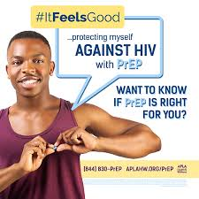
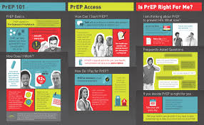
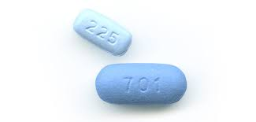
Pre-Exposure Prophylaxis (PrEP)
FTC/TAF
FTC/TDF
FDA-approved for PrEP (weight ≥35 kg)
Does not need to be prescribed by specialist!
Celum and Baeten. Antiviral Therapy 2012; 17:1483-1493
Notes:
Counseling regarding risk reduction
Referral to health care
Guidance about testing
Condoms and other preventive messages

Slide 71
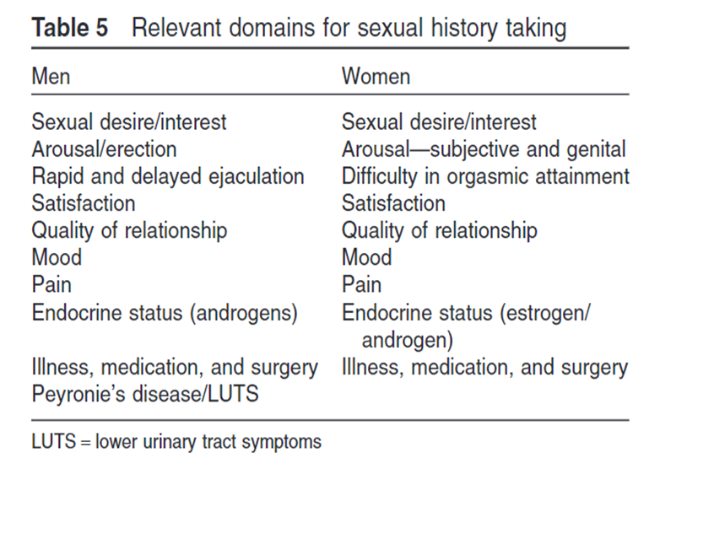
Addressing sexual health and dysfunction
Althoff SE. J Sex Med 2013; 10: 26-35

Slide 72
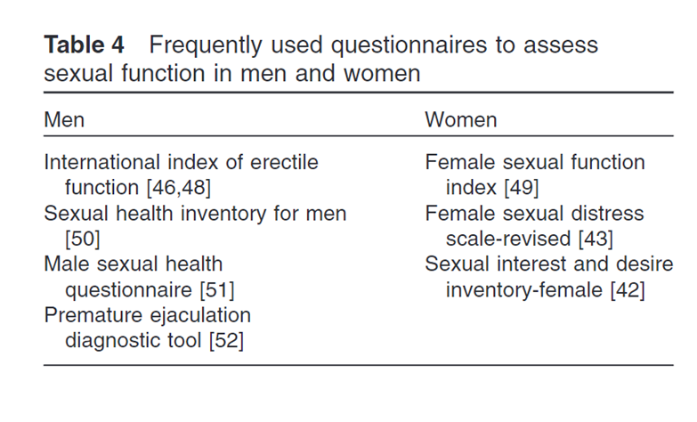
Assessing sexual function: questions, tools, and resources
Are you satisfied with your level of sexual desire, interest, and activity? Why or why not?
Are you satisfied with your ability to achieve and maintain your arousal (physical, mental)? Erection?
During lovemaking do you have difficulty with genital lubrication (wetness)?
Do you frequently feel like you ejaculate sooner than you would like?
Do you have difficulty achieving orgasm?
Have you noticed any changes to the shape of your penis, your stream?
Do you have pain during lovemaking?
Are you satisfied with the quality of your sex life? Why? Why not?

Slide 73
Posttest Question #1
Which statement is FALSE?
Adolescents and young people ages 13 to 24 years account for about 20% of new HIV diagnoses
Rates of sexually transmitted infections are increasing across all age ranges
Approximately 40% of adolescents have had intercourse by the time they complete high school
Individuals over the age of 50 years account for less than 5% of new HIV diagnoses
Notes:
Correct answer is #4

Slide 74
Posttest Question #2
Which is NOT a common reason that practitioners report for not obtaining a sexual history?
Time constraints
Lack of comfort
Irrelevant to chief complaint
Prohibited by employer
Notes:
Answer is #4 (not listed on any of the surveys)

Slide 75
Resources
AAP: Office-Based Care for Lesbian, Gay, Bisexual, Transgender, and Questioning Youth
American Academy of Pediatrics. Adolescent Sexual Health Resources (https://www.aap.org/en-us/advocacy-and-policy/aap-health-initiatives/adolescent-sexual-health/Pages/Sexual-History.aspx)
Bright Futures Guidelines for Preventive Services (https://brightfutures.aap.org/families/Pages/default.aspx) https://www.priorityhealth.com/provider/clinical-resources/~/media/documents/preventive-care/chlamydia/five-ps-taking-sexual-history-checklist.pdf
Sexual and Reproductive Health Services in the Pediatric Setting (https://pediatrics.aappublications.org/content/140/5/e20172858)
AAP: Contraception for Adolescents Technical Report (https://pediatrics.aappublications.org/content/pediatrics/134/4/e1257.full.pdf)
Advocates for Youth (https://advocatesforyouth.org/resources-tools/?_sft_type=health-information)
STDs in Adolescents and Young Adults (https://www.cdc.gov/std/stats17/adolescents.htm)
2015 STD guidelines http://www.cdc.gov/std/tg2015/screening-recommendations.htm
https://www.cdc.gov/std/treatment/SexualHistory.pdf
National Association of Community Health Centers and National LGBT Health Education Center. Taking Routine Histories of Sexual Health: A System-Wide Approach for Health Centers. https://www.lgbthealtheducation.org/wp-content/uploads/COM-827-sexual-history_toolkit_2015.pdf. Accessed June 17, 2019.

Slide 76
Question-and-Answer Session
Please submit your questions using the Q&A Button.

