Slide 1
Chronic Pain in People With HIV: An Evidence-Based, Practical Approach

Slide 2
Evaluations, and information on how to claim CME, pharmacy, nursing, or pharmacotherapy credits, and certificate of participation, will be emailed by 5:00 pm PT tomorrow.

Slide 3
Update Your IAS−USA Profile If you have an IAS–USA profile but have not reviewed it in a while, please go to www.iasusa.org and log in to your account to update your information—your current phone number, email address, institution, title, degrees, and so on. Pharmacists: Delivering pharmacy credits to your NABP CPE profile now requires that you provide your date of birth on your IAS–USA profile. Login to update your IAS–USA profile to prevent problems with processing your credit requests.

Slide 4
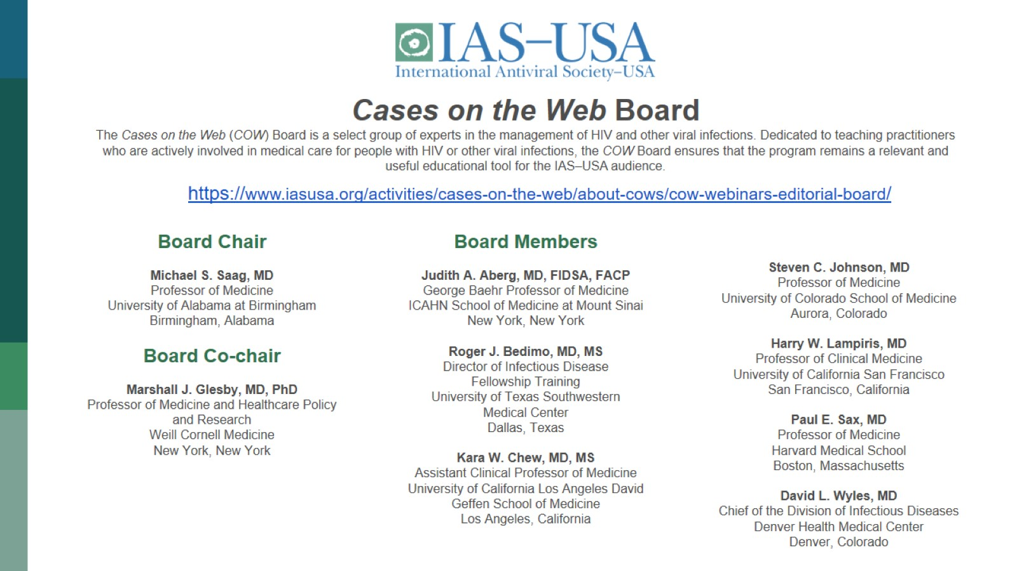
Board Chair Michael S. Saag, MD Professor of Medicine University of Alabama at Birmingham Birmingham, Alabama Board Co-chair Marshall J. Glesby, MD, PhD Professor of Medicine and Healthcare Policy and Research Weill Cornell Medicine New York, New York Board Members Judith A. Aberg, MD, FIDSA, FACP George Baehr Professor of Medicine ICAHN School of Medicine at Mount Sinai New York, New York Roger J. Bedimo, MD, MS Director of Infectious Disease Fellowship Training University of Texas Southwestern Medical Center Dallas, Texas Kara W. Chew, MD, MS Assistant Clinical Professor of Medicine University of California Los Angeles David Geffen School of Medicine Los Angeles, California Steven C. Johnson, MD Professor of Medicine University of Colorado School of Medicine Aurora, Colorado Harry W. Lampiris, MD Professor of Clinical Medicine University of California San Francisco San Francisco, California Paul E. Sax, MD Professor of Medicine Harvard Medical School Boston, Massachusetts David L. Wyles, MD Chief of the Division of Infectious Diseases Denver Health Medical Center Denver, Colorado

Slide 5
COVID-19: What We Know Today A Dialogue About the Public Health, Scientific, and Clinical Aspects of the Pandemic

Slide 8
Chronic Pain in People With HIV: An Evidence-Based, Practical Approach

Slide 9
CME Information

Slide 10
Nursing and Pharmacy Credits

Slide 11
Grant Support for this Webinar

Slide 12
Navigating the Webinar

Slide 13
Poll 1

Slide 14
Poll 2

Slide 15
Chronic Pain in People With HIV: An Evidence-Based, Practical Approach

Slide 16
Learning Objectives

Slide 17
Pretest Question 1

Slide 18
Pretest Question 2

Slide 19
What is chronic pain?

Slide 20
What is chronic pain?

Slide 21
Chronic Pain in People with HIV (PWH)

Slide 22
Chronic Pain in People with HIV

Slide 23
Epidemiology

Slide 24
Epidemiology

Slide 25
Epidemiology: CNICS study

Slide 26
Epidemiology: CNICS cont’d¹

Slide 27
Epidemiology: CNICS cont’d

Slide 28
Epidemiology: CNICS cont’d

Slide 29
Epidemiology: CNICS cont’d

Slide 30
Pathophysiology

Slide 31
Pathophysiology: pain sensitivity

Slide 32
Pathophysiology: inflammation

Slide 33
Pathophysiology: inflammation

Slide 34
Treatment

Slide 35
What interventions have been studied in PLWH to date?

Slide 36
What kinds of interventions are needed?

Slide 37
Skills TO Manage Pain (STOMP)

Slide 38
Chronic Pain in People with HIV

Slide 39
History and screening

Slide 40
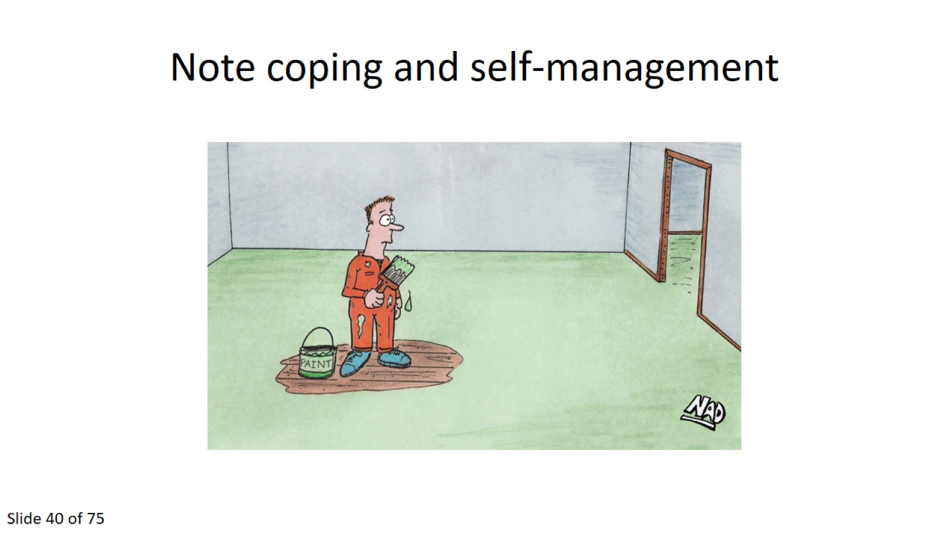
Note coping and self-management

Slide 41
Diagnostic Testing

Slide 42
Treating chronic pain is challenging because:

Slide 43
General chronic pain treatment pearls

Slide 44
Learn some MI and CBT tricks

Slide 45
Pain Education

Slide 46
Safe, effective management strategies

Slide 47
Opioid prescribing in the U.S., 2017

Slide 48
Serious opioid-related harms: OD Deaths

Slide 49
Role of opioid prescribing in all serious opioid-related harms

Slide 50
Role of opioid prescribing in all serious opioid-related harms (cont’d)

Slide 51
Latest recommendations

Slide 52
Long-term opioid therapy (LTOT): Harms¹

Slide 53
Long term opioid use for chronic (>3 month) pain: Benefit versus Harm

Slide 54
Indications for long term opioid therapy

Slide 55
Predicting risk of opioid misuse

Slide 56
LTOT: to sum it up

Slide 57
If you do prescribe opioids: Opioid “risk mitigation” strategies

Slide 58
Identify opioid misuse behaviors

Slide 59
Opioid tapering (reducing or stopping)

Slide 60
Opioid tapering (cont’d)

Slide 61
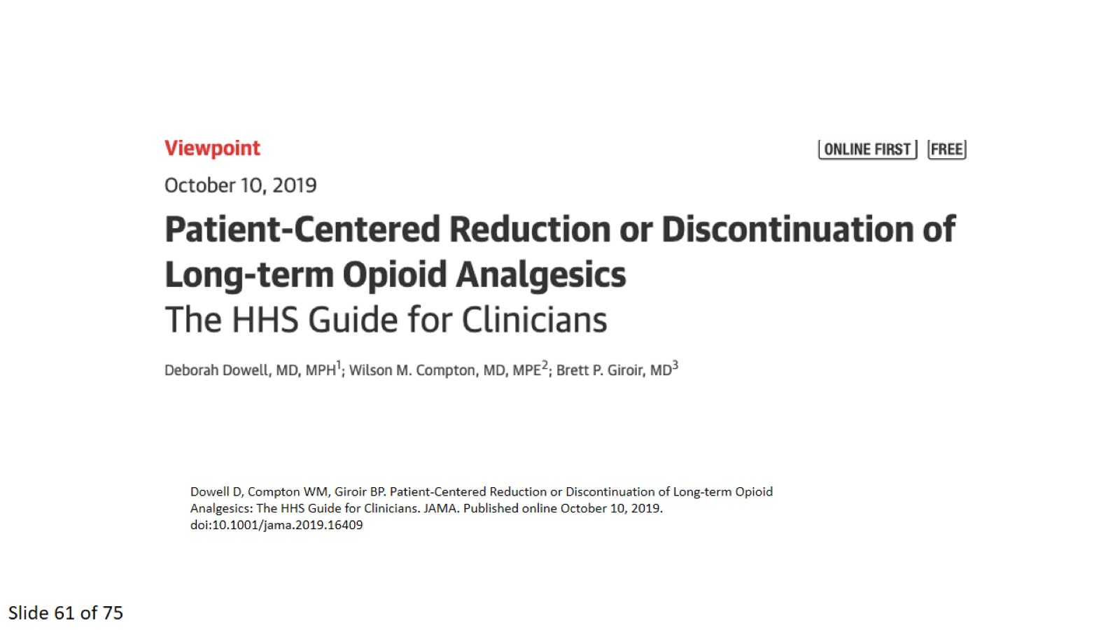

Slide 62
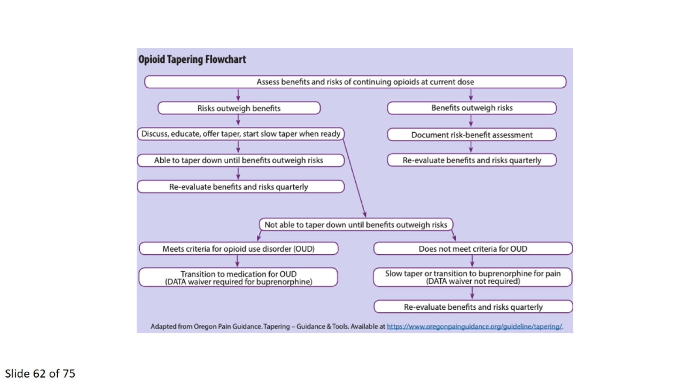

Slide 63
Chronic Pain in People with HIV

Slide 64
Buprenorphine: when to use it

Slide 65
Novel approaches to buprenorphine induction

Slide 66
Novel approaches cont’d

Slide 67
Translating LTOT evidence into policy: 2016 CDC Guideline

Slide 68
Translating LTOT evidence into policy: 2016 CDC Guideline

Slide 69
Translating LTOT evidence into policy: 2016 CDC Guideline

Slide 70
Translating LTOT evidence into policy: challenges

Slide 71
Translating LTOT evidence into policy: have we gone too far? Anecdotes:

Slide 72
Gabapentinoids

Slide 73
Posttest Question 1

Slide 74
Posttest Question 2

Slide 75
Question-and-Answer Session

Slide 76
Evaluations, and information on how to claim CME, pharmacy, nursing, or pharmacotherapy credits, and certificate of participation, will be emailed by 5 pm PT tomorrow.

Slide 79
COVID-19: What We Know Today A Dialogue About the Public Health, Scientific, and Clinical Aspects of the Pandemic

Slide 81
Thank You

