Slide 1
Investigational New Antiretrovirals: What’s Hot!

Slide 2
CME Information

Slide 3
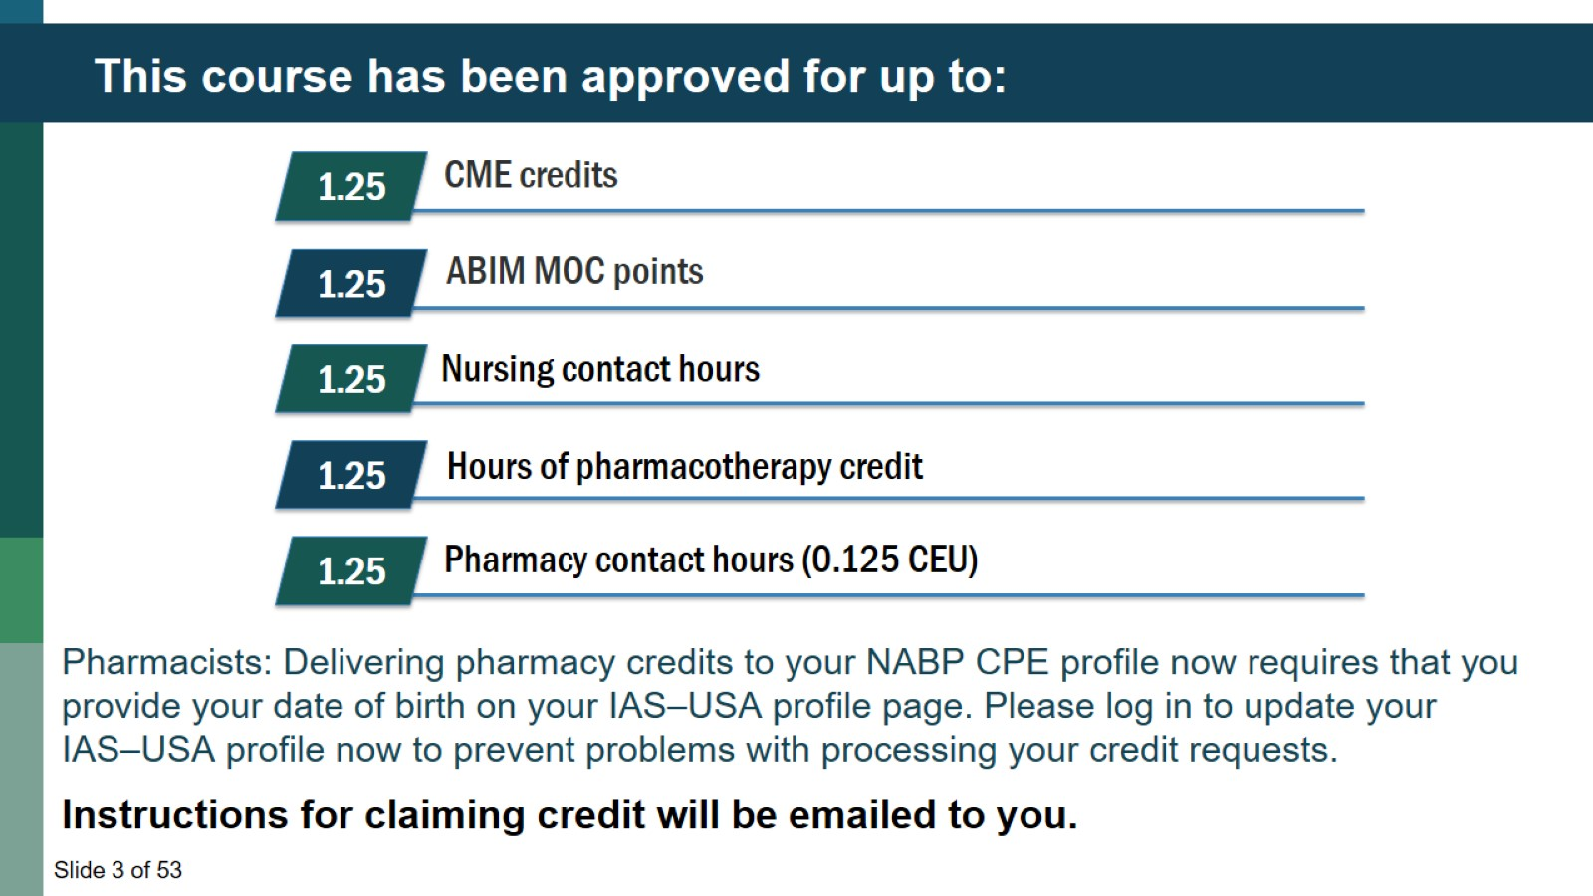
This course has been approved for up to:

Slide 4
Grant Support for this Webinar

Slide 5
Navigating the Webinar

Slide 6
Poll 1

Slide 7
Investigational New Antiretrovirals: What’s Hot!

Slide 8
Learning Objectives

Slide 9
Pretest Question #1

Slide 10
Pretest Question #2

Slide 11
Goals of Antiretroviral Therapy

Slide 12
Why We Need New Antiretroviral agents courtesy of Raj Gandhi

Slide 13
New Agents Recently Approved

Slide 14
Cabotegravir/Rilpivirine Therapy – Every 8 weeks

Slide 15
ATLAS-2M: Virologic Failure, Resistance and Tolerability and Preference (48 weeks)

Slide 16
New Agents in Existing Classes – MK-8507 NNRTI Once Weekly

Slide 17
New Agents in New Classes

Slide 18
Islatravir (MK-8591, ISL): Nucleoside Reverse Transcriptase Translocation Inhibitor (NRTTI)

Slide 19
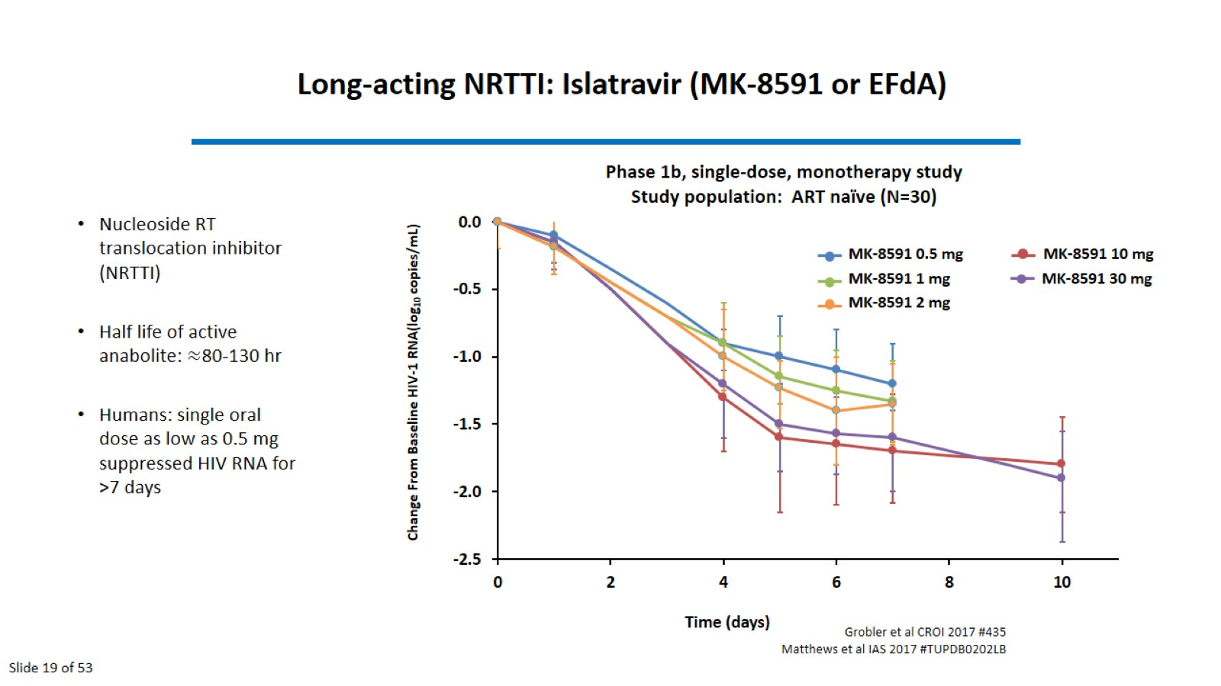
Long-acting NRTTI: Islatravir (MK-8591 or EFdA)

Slide 20
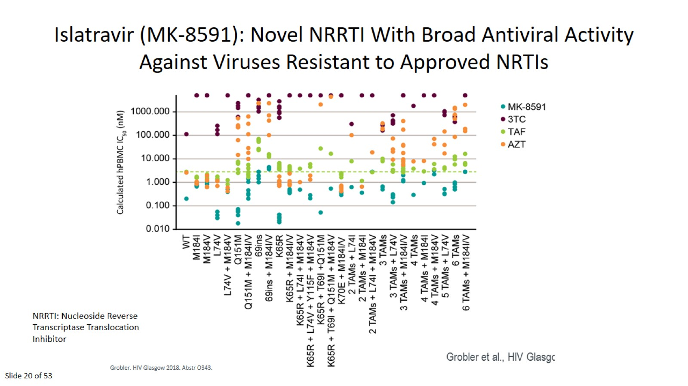
Islatravir (MK-8591): Novel NRRTI With Broad Antiviral Activity Against Viruses Resistant to Approved NRTIs

Slide 21
Islatravir – Implant with ISL-TP concentrations

Slide 22
Lenacapravir – Capsid Function

Slide 23
Lenacapravir

Slide 24
Sub-cutaneous Lenacapravir

Slide 25
Resistance Selection in vitro with Lenacapravir

Slide 26
Resistance Selection in vivo with Lenacapravir

Slide 27
Single Sub-cutaneous dosing of Lenacapravir

Slide 28
Oral plus Sub-cutaneous dosing of Lenacapravir

Slide 29
Maturation Inhibitor – GSK3640254

Slide 30
Maturation Inhibitor – GSK3640254

Slide 31
Maturation Inhibitor – GSK3640254

Slide 32
Broadly Neutralizing Monoclonal Antibodies against HIV

Slide 33
Antibodies with improved potency and breadth: Reduction in VL after VRC01LS or VRC07-523LS Infusion

Slide 34
How Will These Agents Be Used

Slide 35
Opportunities and Challenges for Prevention

Slide 36
How Will These Agents Be Used

Slide 39
HPTN 083 – Cabotegravir for Prevention

Slide 40
HPTN 083 – Cabotegravir for Prevention

Slide 41
Islatravir for HIV prevention – Prevention in Macaques

Slide 43
Capsid Inhibitor – single injection – SHIV Challenge in Macaques

Slide 44
How Will These Agents Be Used

Slide 45
Study Design

Slide 46
Antiviral Activity during Functional Monotherapy

Slide 47
Participants with HIV-1 RNA <50 copies/mL (M=F): To date (Feb2021) in those who received SC LEN (n=72)

Slide 48
Islatravir in Treatment Experienced Patients

Slide 49
Long Acting Therapy – Combinations Needed

Slide 50
Long Acting Therapy – Combinations Needed

Slide 51
Long Acting Therapy – Combinations Needed

Slide 52
Post test Question #1

Slide 53
Post test Question #2

Slide 54
Question-and-Answer Session

Slide 55
Queries

