Slide 1
Geriatric Assessment for People with HIV

Slide 2
CME Information

Slide 3
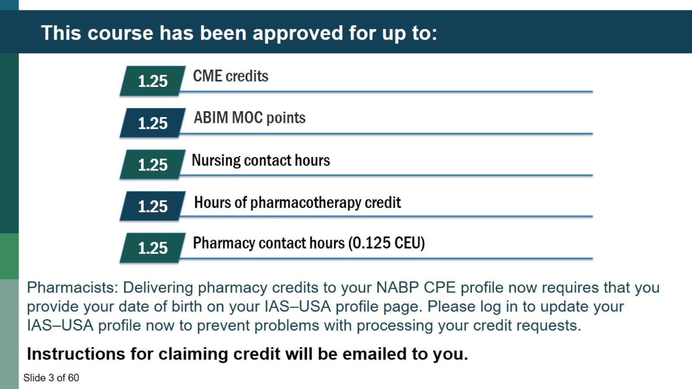
This course has been approved for up to:

Slide 4
Grant Support for this Webinar

Slide 5
Navigating the Webinar

Slide 6
Poll 1

Slide 7
Geriatric Assessment for People with HIV

Slide 8
Learning Objectives

Slide 9
Learning Objectives & IAS-USA 2020 guidelines

Slide 10
Pretest Question #1

Slide 11
Pretest Question #2

Slide 12
Why Geriatric Assessment is Important: The Numbers

Slide 13
Why Age 50?

Slide 14
Physiologic changes with Aging

Slide 15
Why do we need a different approach for Older Adults?

Slide 16
What is Comprehensive Geriatric Assessment?

Slide 17
5Ms: Focus of Geriatrics

Slide 18
Multi-complexity: Relevance to HIV and geriatrics

Slide 19
Multimorbidity Requires a Different Approach

Slide 20
Multimorbidity Requires a Different Approach

Slide 21
Consider Prognosis

Slide 22
Polypharmacy & Prescribing Issues

Slide 23
Case: Routine Follow-up visit

Slide 24
Approach to Polypharmacy

Slide 25
Potentially Inappropriate Medications

Slide 26
Simple interventions effective at reducing PIMS

Slide 27
Approach to Polypharmacy

Slide 28
Prescribing Cascade occurs often!

Slide 29
Approach to Polypharmacy

Slide 30
Drug-Drug Interactions

Slide 31
Deprescribing Research and Clinical Resources

Slide 32
Multi-complexity: Relevance to HIV and geriatrics

Slide 33
What is a Geriatric Syndrome?

Slide 34
What is a Geriatric Syndrome?

Slide 35
Geriatric Syndromes In PWH

Slide 36
Geriatric Syndromes travel together in PWH

Slide 37
Frailty

Slide 38
Fried Frailty Phenotype- most studied in PWH

Slide 39
Frailty Index (Cumulative Deficit Model)

Slide 40
Frailty = Vulnerability

Slide 41
Frailty and Disability Distinct but Overlap

Slide 42
Functional status: self report disability

Slide 43
Short Physical Performance Battery

Slide 45
Back to the Case: Geriatric Syndromes

Slide 46
Why Falls?

Slide 47
Falls in PWH

Slide 48
CDC STEADI fall algorithm

Slide 49
Case: Positive Screen

Slide 50
Develop a Comprehensive Plan

Slide 51
Case

Slide 52
Key Take Home Points: Geriatric Syndromes

Slide 53
Geriatric Assessment During Covid

Slide 54
Geriatric Assessment During COVID

Slide 55
How will I be able to do This?

Slide 56
Educational Resources: Where to Learn More

Slide 57
Summary

Slide 58
Posttest Question #1

Slide 59
Posttest Question #2

Slide 60
Question-and-Answer Session

