Slide 1
What to Do Next: Use of Resistance Testing and Managing ART Failure in People With HIV

Slide 2
Financial Relationships With Ineligible Companies* Within the Last 2 Years

Slide 3
Learning Objectives

Slide 4
Pretest Question 1

Slide 5
Pretest Question 2

Slide 6
IAS-USA New Guidelines

Slide 7
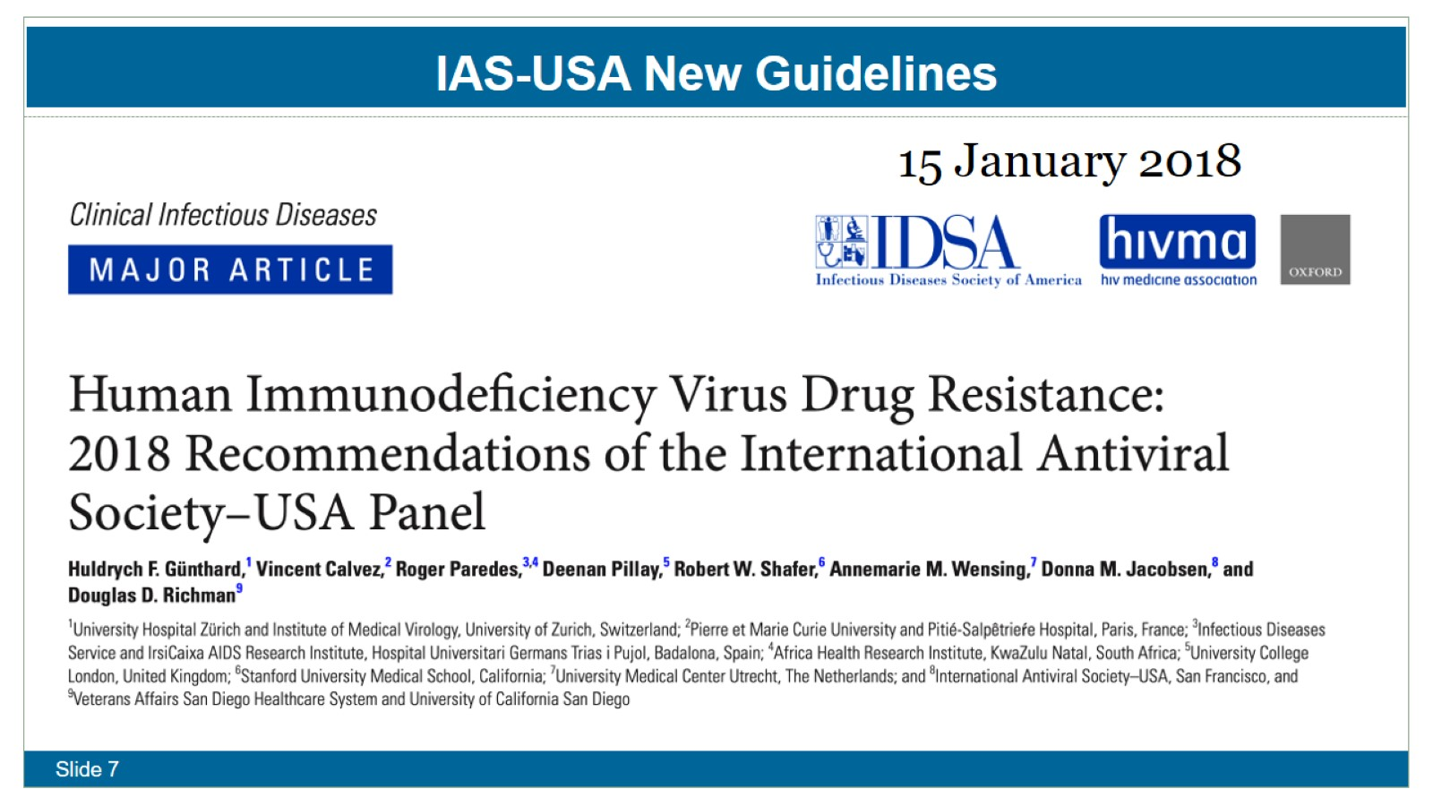
IAS-USA New Guidelines

Slide 8
IAS-USA Resources (https://www.iasusa.org)

Slide 9
Stanford Database (https://hivdb.stanford.edu)

Slide 10
HIV Drug Resistance Testing

Slide 11
HIV-1 Genome

Slide 12
Mutation Nomenclature

Slide 13
Question

Slide 14
Case 1

Slide 15
ARS Question 1: You want to start an InSTI regimen. Should you check an InSTI Resistance Panel?

Slide 16
Question

Slide 17
Case 2

Slide 18
ARS Question 2: At this point which regimen would you choose?

Slide 19
High Efficacy of Switching to Bictegravir/FTC/TAF with Suppressed HIV and pre-existing M184V/I

Slide 20
Question

Slide 21
Case 3

Slide 22
ARS Question 3: At this point which regimen would you choose?

Slide 23
NADIA: 2nd-Line ART after NNRTI Failure

Slide 24
D²eft: DTG + DRV/r, DTG + TDF/XTC or DRV/r + 2NRTI in PWH failing 1st-line NNRTI

Slide 25
Recent studies of DTG with NRTI resistance

Slide 26
Question

Slide 27
Case 4

Slide 28
ARS Question 4: Should you change ARV therapy now?

Slide 29
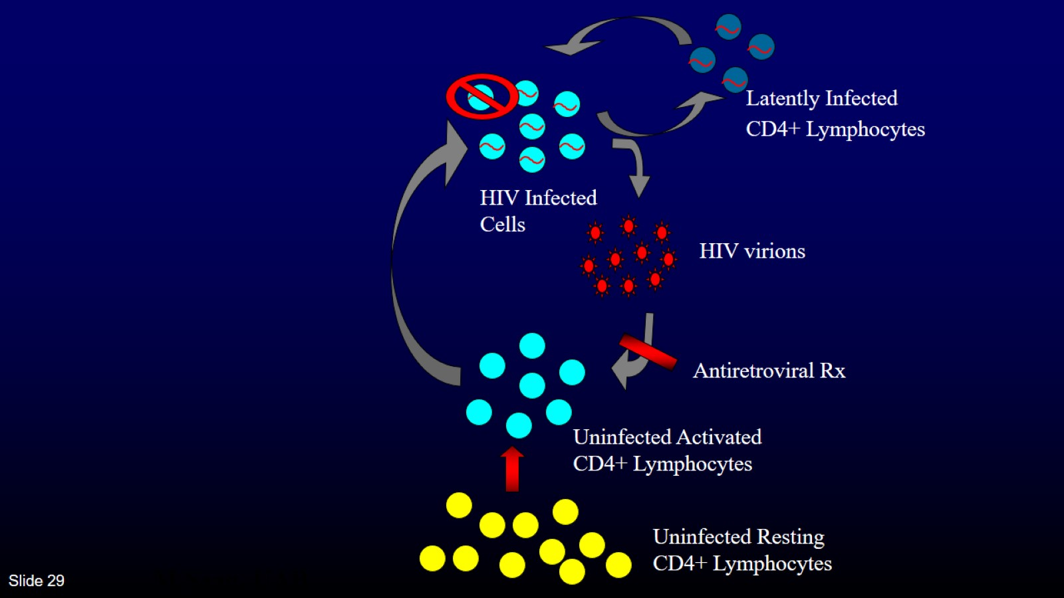

Slide 30
Question

Slide 31
Case 5

Slide 32
ARS Question 5: He claims full adherence. Which of the following is the most likely cause of the virologic failure?

Slide 33
Question

Slide 34
Case 6

Slide 35
ARS Question 6: Which regimen would you choose?

Slide 36
What is Immunologic Failure ?

Slide 37
Question

Slide 38
Case 7

Slide 39
ARS Question 7: At this point would you order a cellular DNA genotype test?

Slide 40
Question

Slide 41
Case 8

Slide 42
ARS Question 8: You recommend

Slide 43
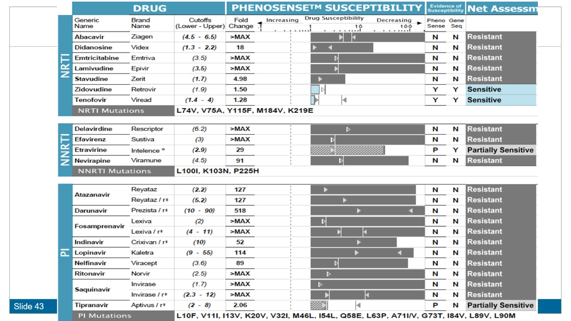

Slide 44
Question

Slide 45
Case 9

Slide 46
ARS Question 9: What do you recommend

Slide 48
Failure with R263K on BIC or DTG and 1 or 2 NRTI

Slide 49
Question

Slide 50
Case 10

Slide 51
ARS Question 10: What regimen do you recommend while waiting for genotype results?

Slide 52
Case 11

Slide 53
ARS Question 11: What regimen do you recommend while waiting for genotype results?

Slide 56
Question

Slide 57
Case 12:

Slide 58
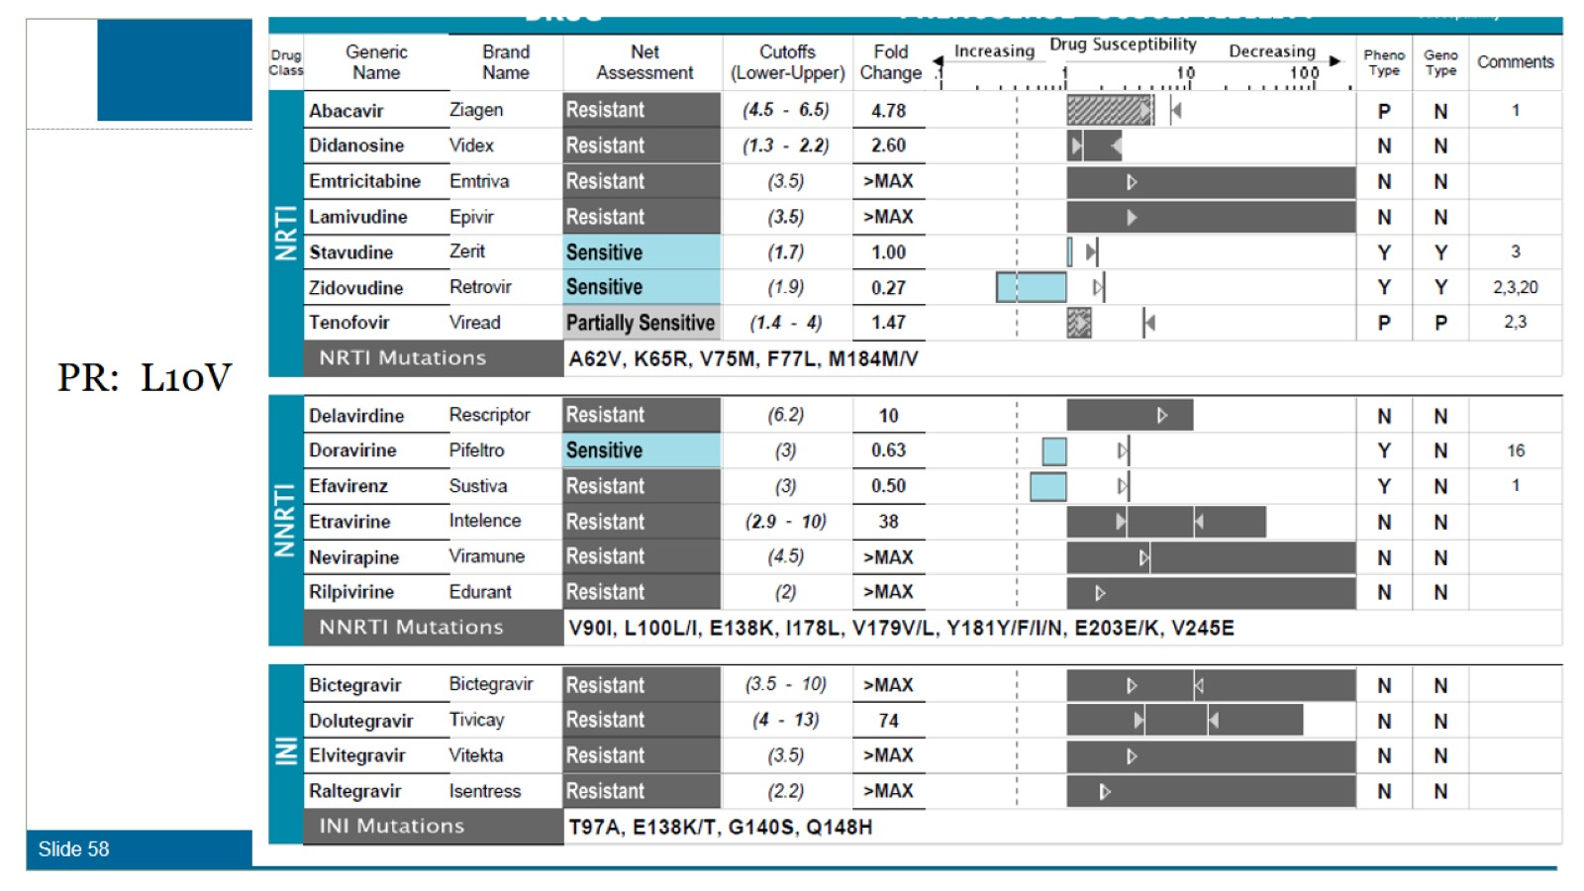
Case 4 continued:

Slide 60
ARS Question 12: You recommend

Slide 63
CAPELLA STUDY- Lenacapavir in MDR HIV

Slide 64
Bottom line on LEN resistance in MDR study

Slide 65
Prevalence of Patients with Limited Treatment Options

Slide 66
Virologic Success in Those with or without LTO

Slide 67
Summary

Slide 68
Posttest Question 1

Slide 69
Posttest Question 1

Slide 70
Posttest Question 2

Slide 71
Posttest Question 2

Slide 72
Question-and-Answer Session

