Slide 1
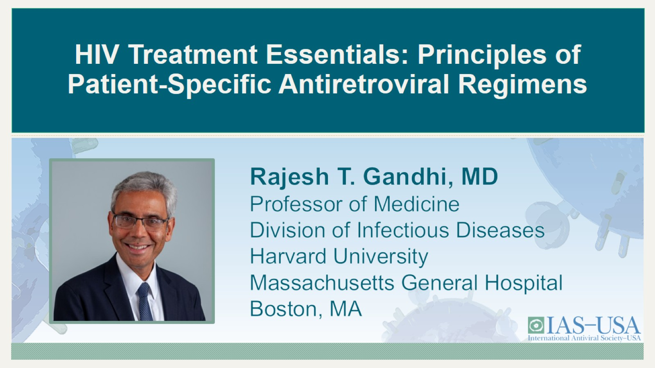
HIV Treatment Essentials: Principles of
Patient-Specific Antiretroviral Regimens

Slide 2

Financial Relationships With Ineligible Companies (Formerly Described as Commercial Interests by the ACCME) Within the Last 2 Years

Slide 3
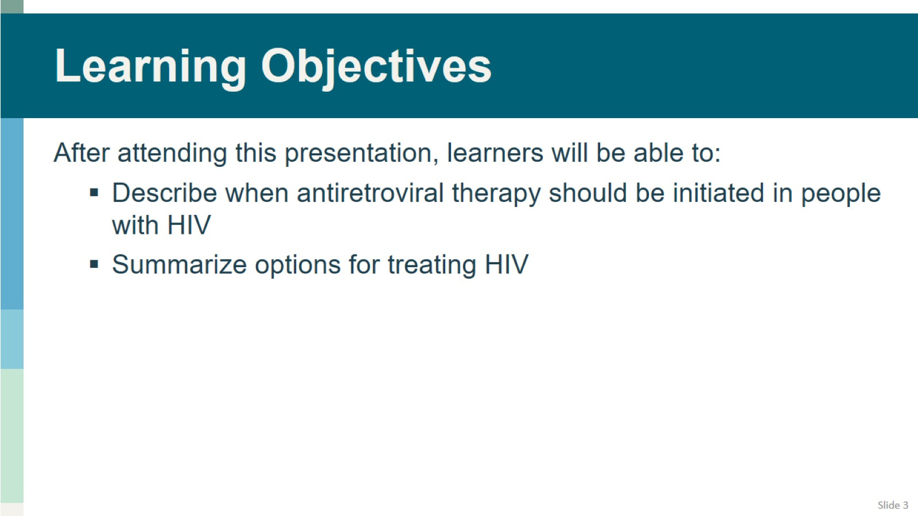
Learning Objectives

Slide 4
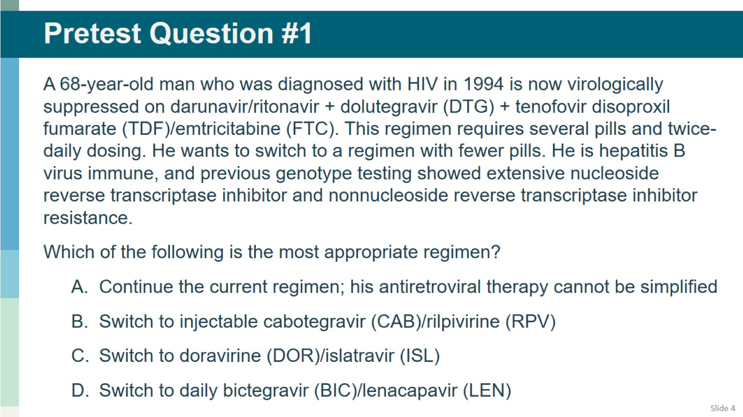
Pretest Question #1

Slide 5
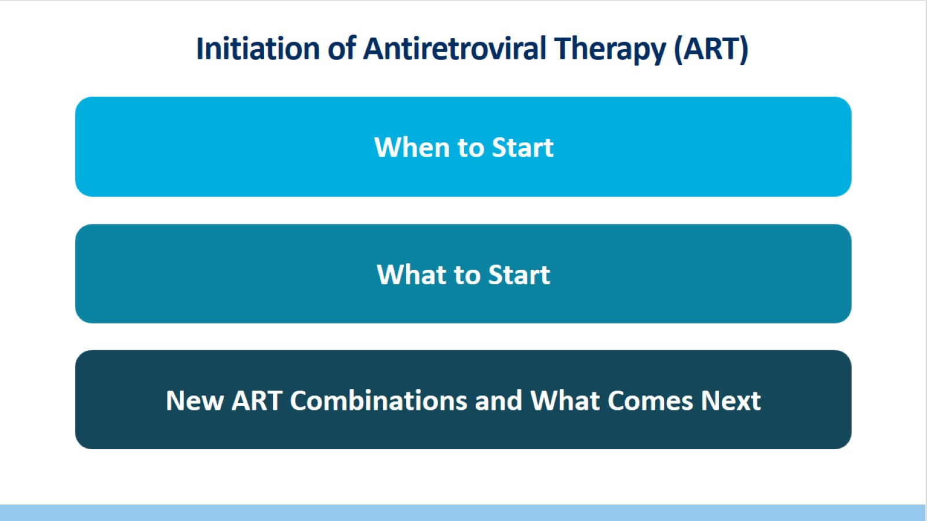
Initiation of Antiretroviral Therapy (ART)

Slide 6
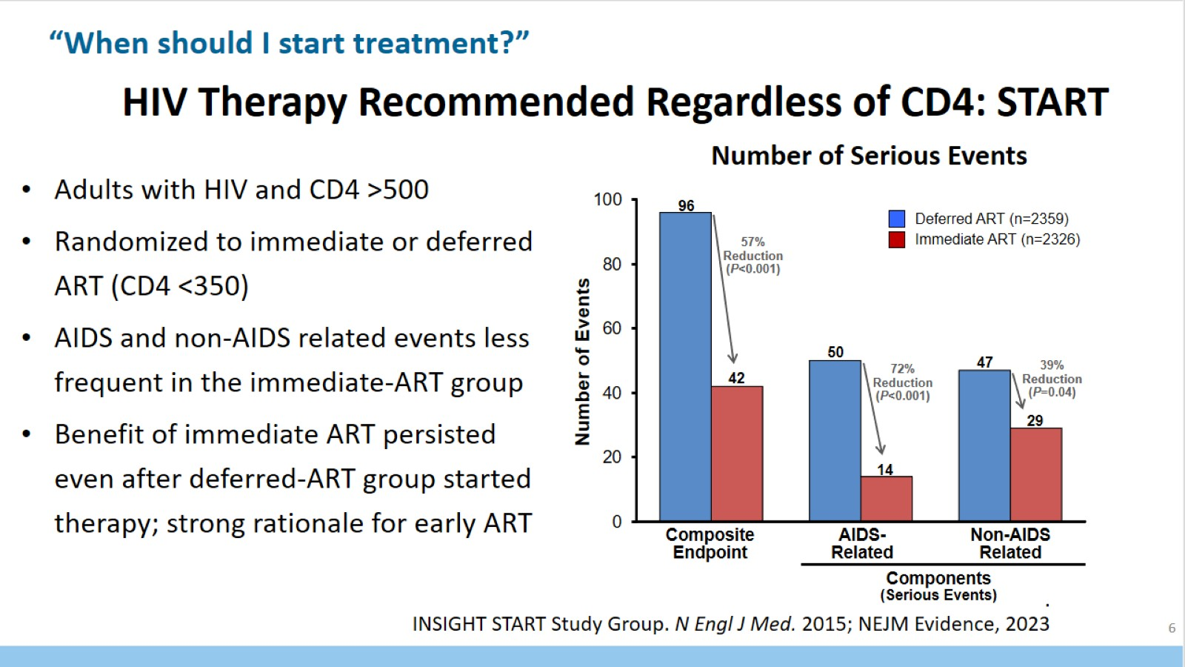
HIV Therapy Recommended Regardless of CD4: START

Slide 7
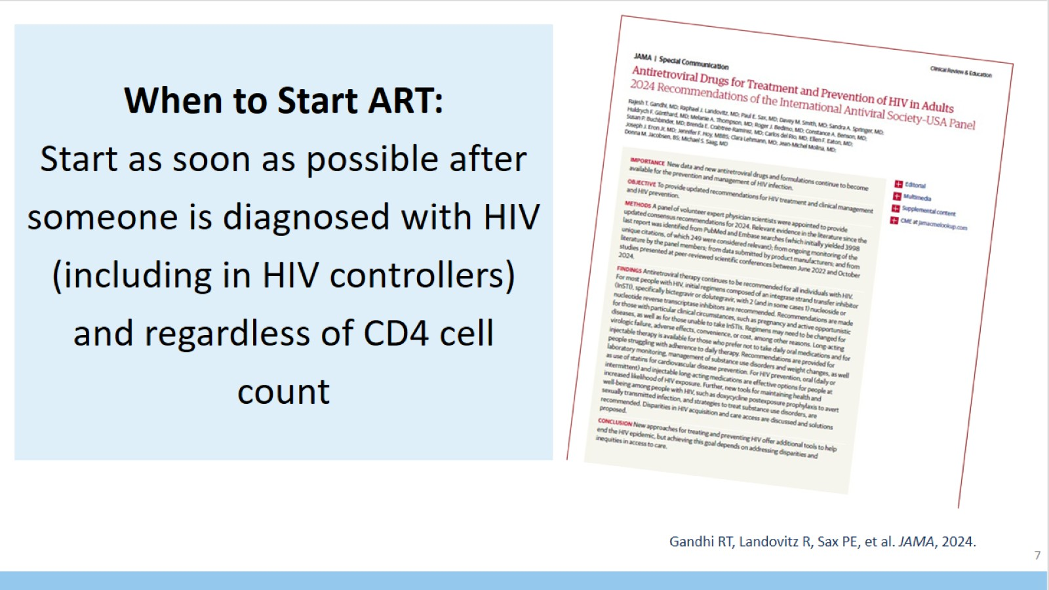
When to Start ART:
Start as soon as possible after someone is diagnosed with HIV (including in HIV controllers) and regardless of CD4 cell count

Slide 8
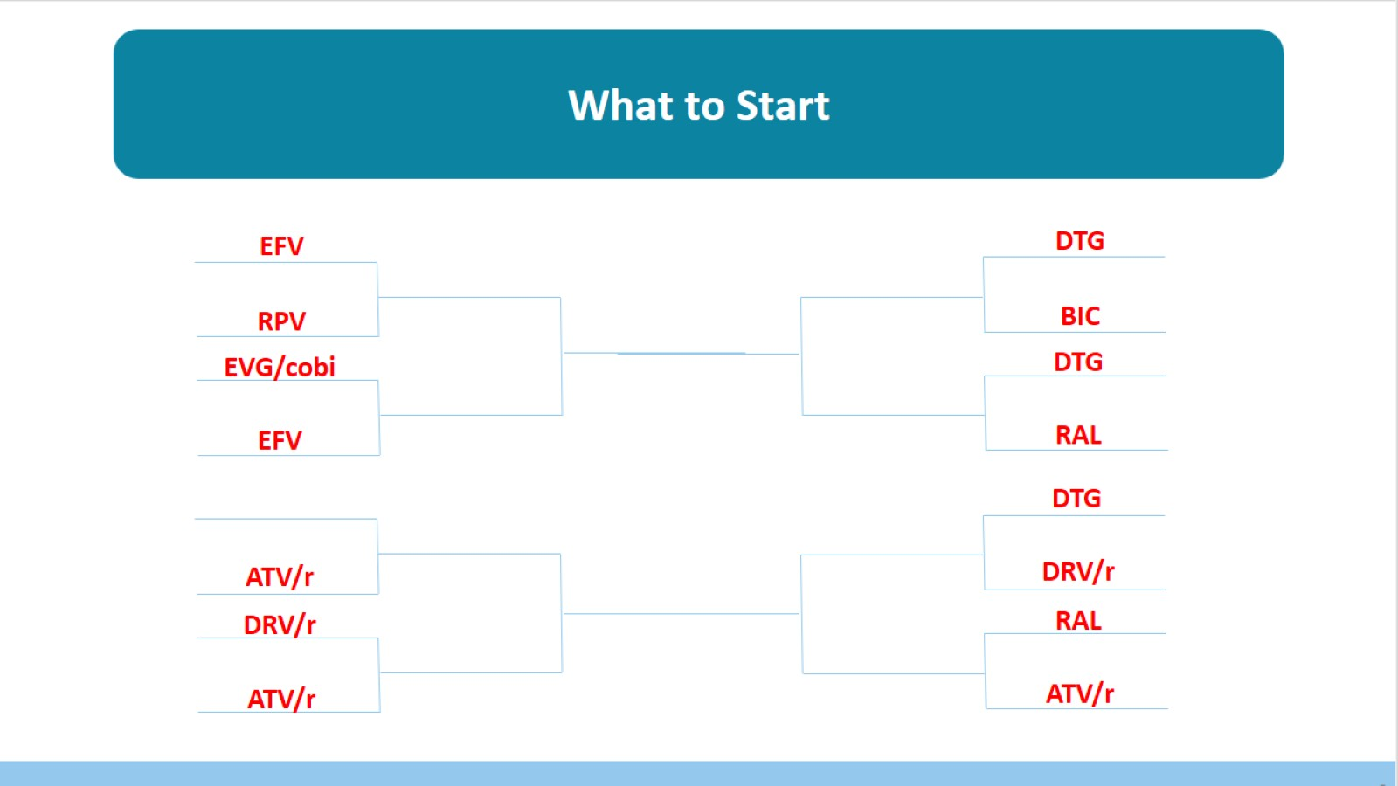

Slide 9
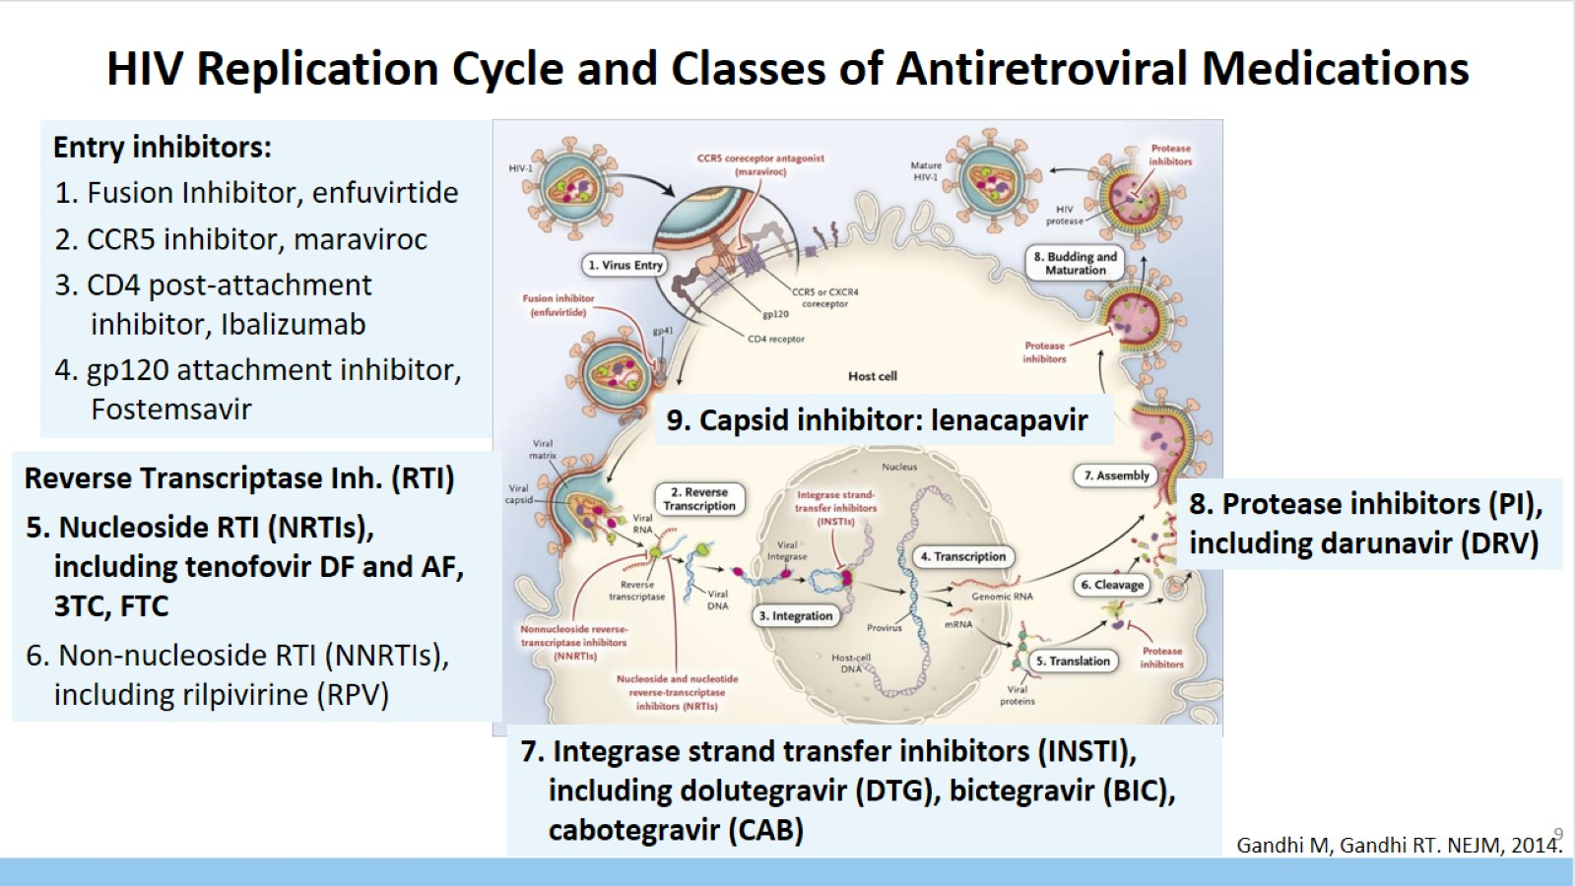
HIV Replication Cycle and Classes of Antiretroviral Medications

Slide 10
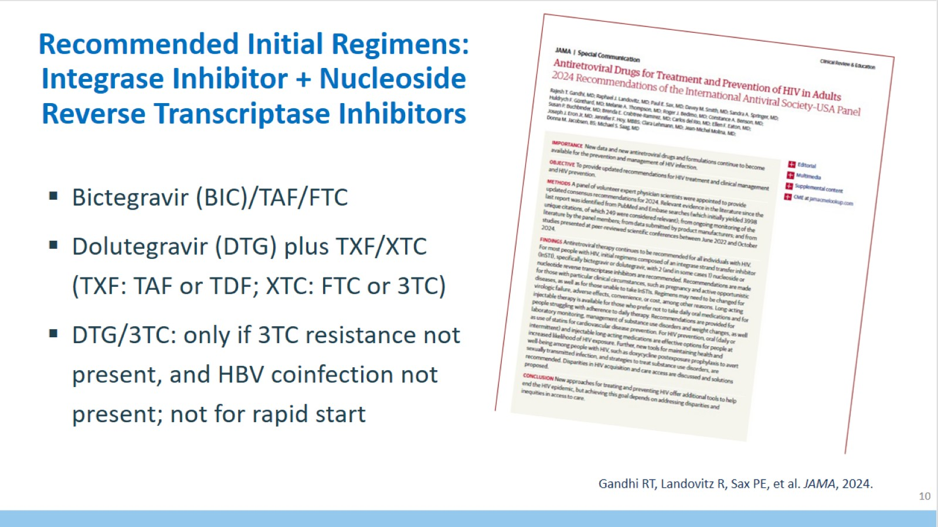
Recommended Initial Regimens: Integrase Inhibitor + Nucleoside Reverse Transcriptase Inhibitors

Slide 11
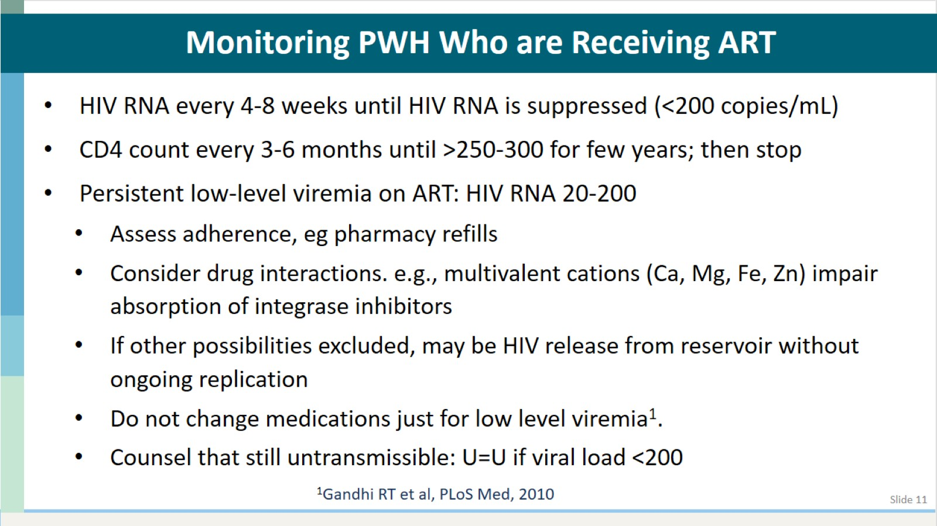
Monitoring PWH Who are Receiving ART

Slide 12
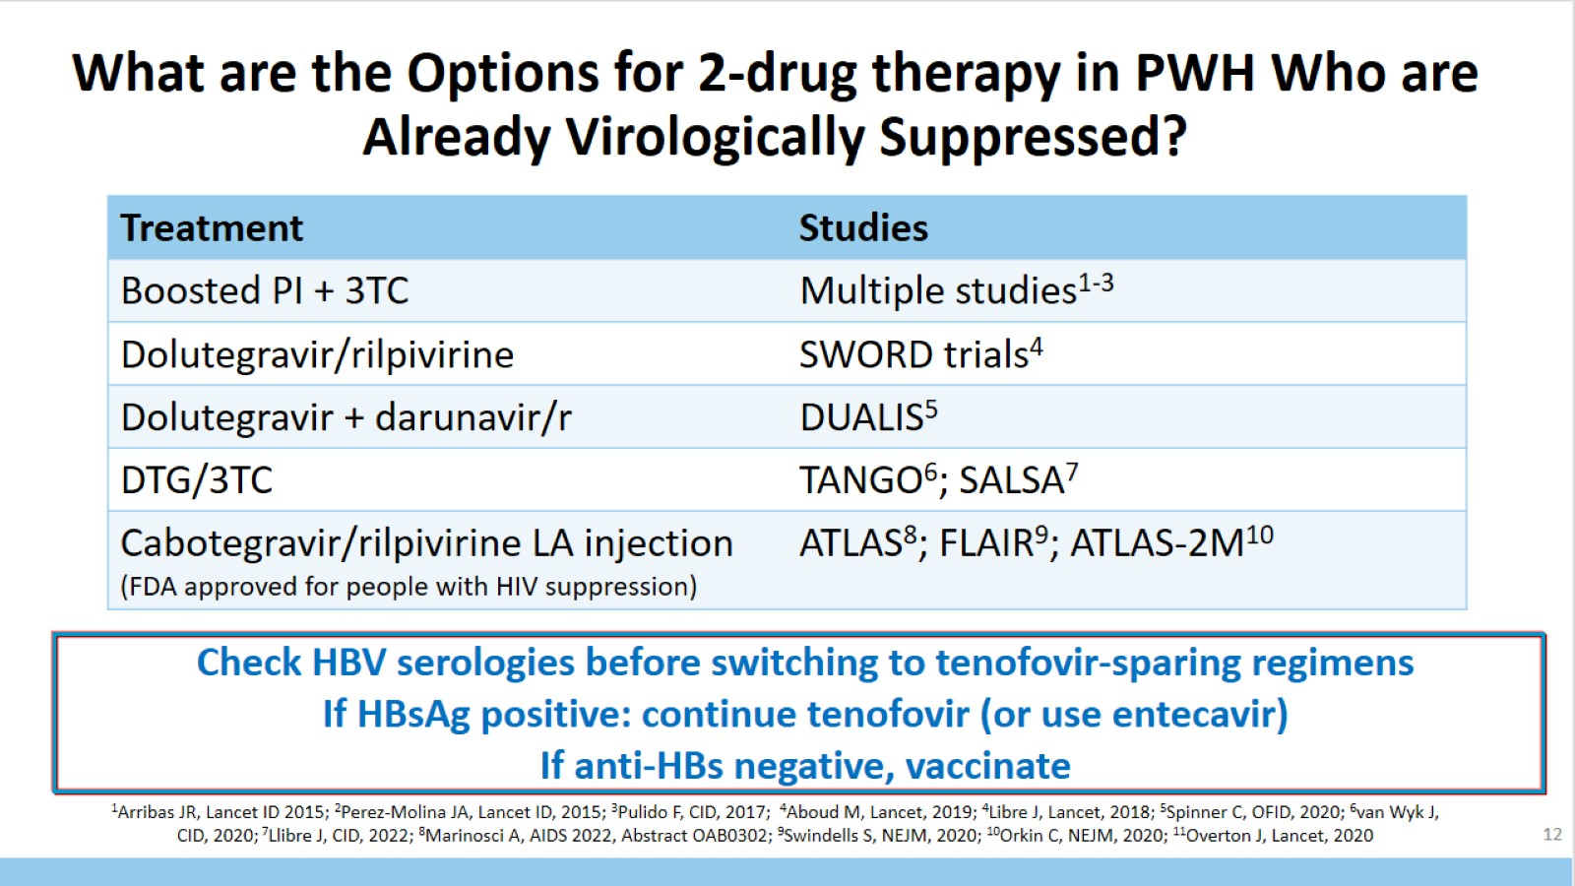
What are the Options for 2-drug therapy in PWH Who are Already Virologically Suppressed?

Slide 13
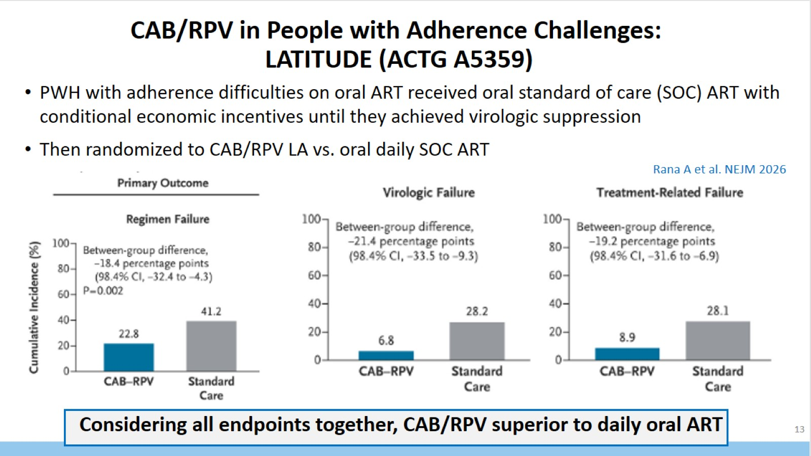
CAB/RPV in People with Adherence Challenges:
LATITUDE (ACTG A5359)

Slide 14
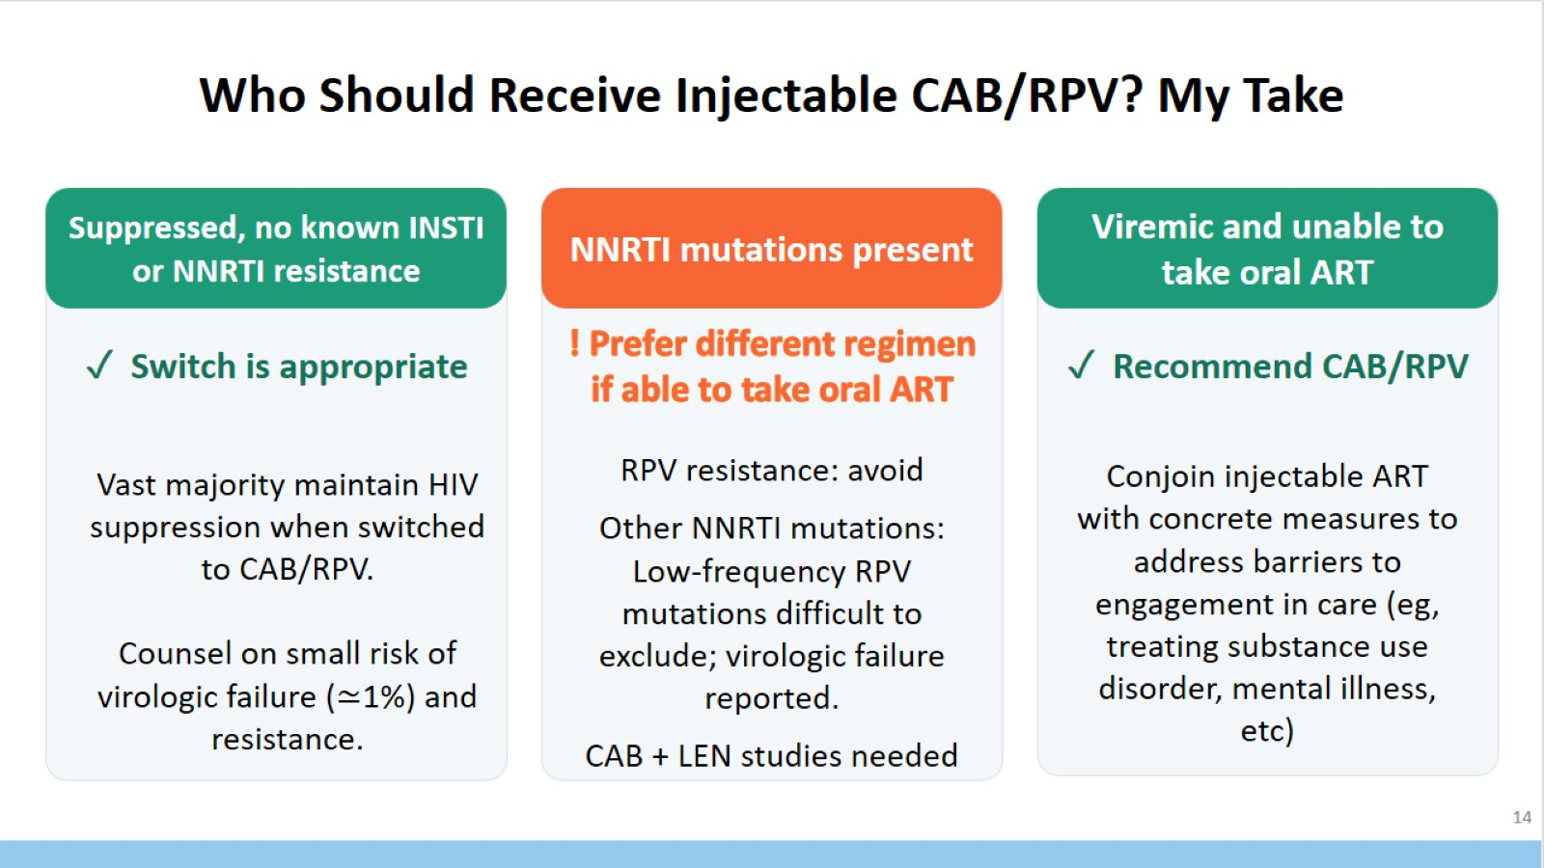
Who Should Receive Injectable CAB/RPV? My Take

Slide 15
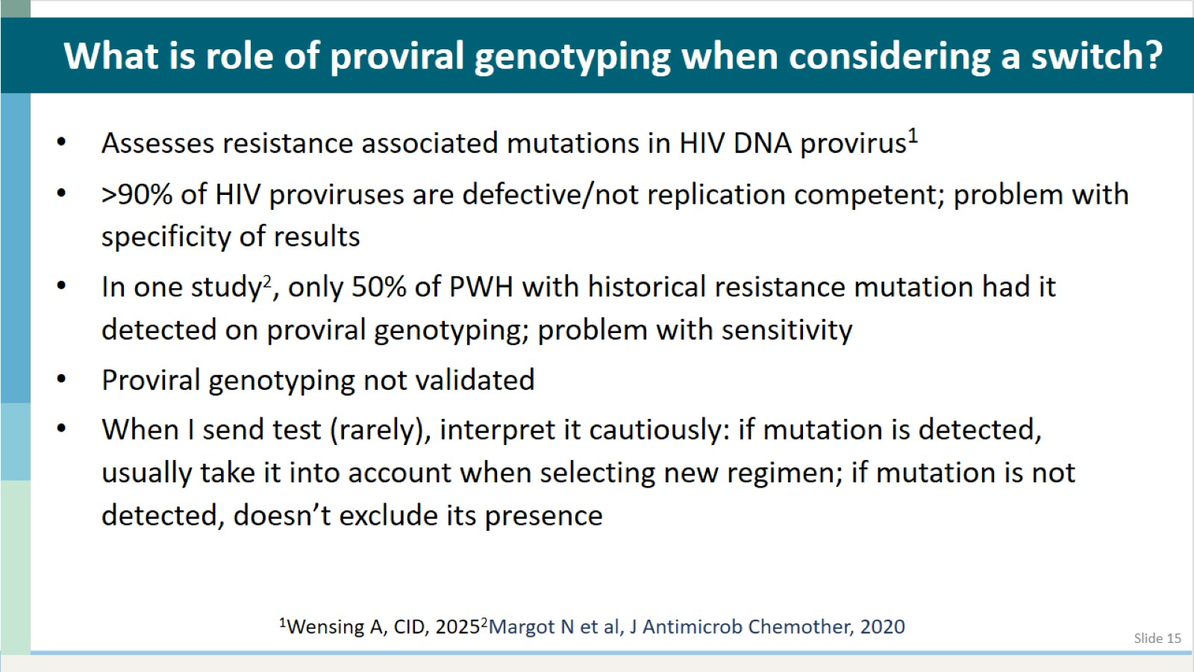

Slide 16
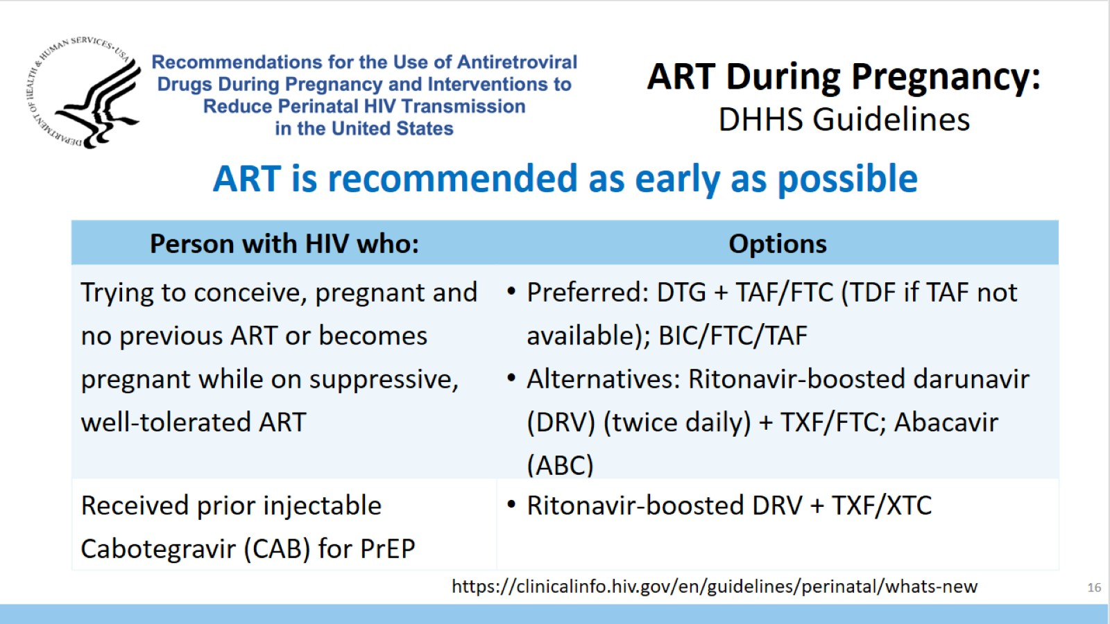
ART During Pregnancy:
DHHS Guidelines

Slide 17
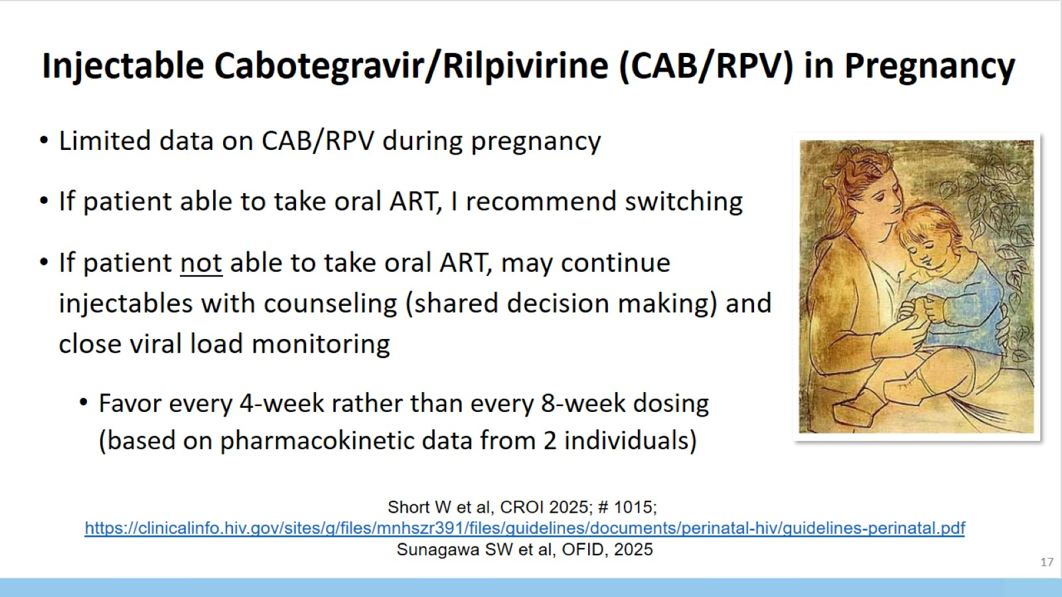
Injectable Cabotegravir/Rilpivirine (CAB/RPV) in Pregnancy

Slide 18
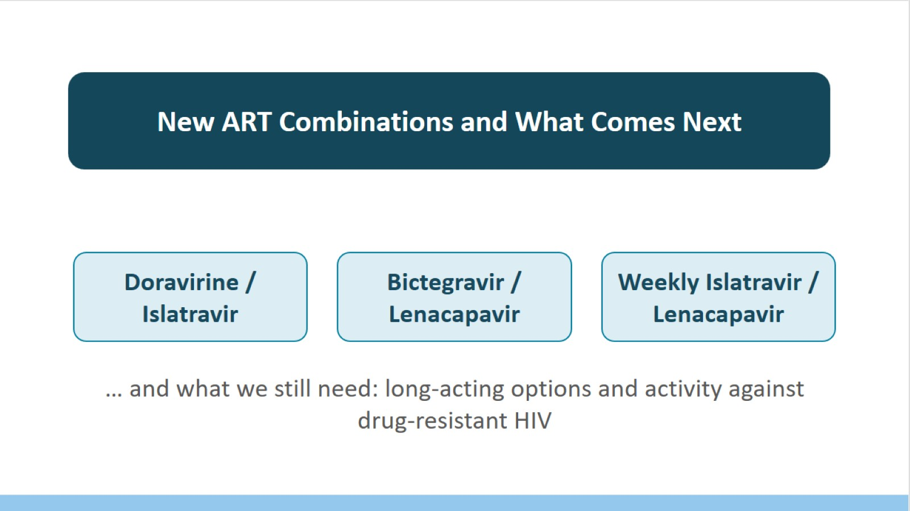

Slide 19
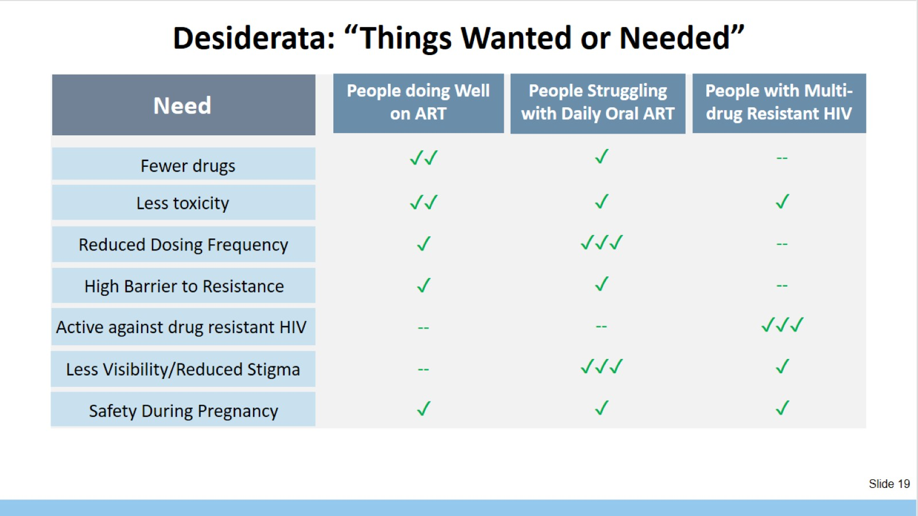
Desiderata: “Things Wanted or Needed”

Slide 20
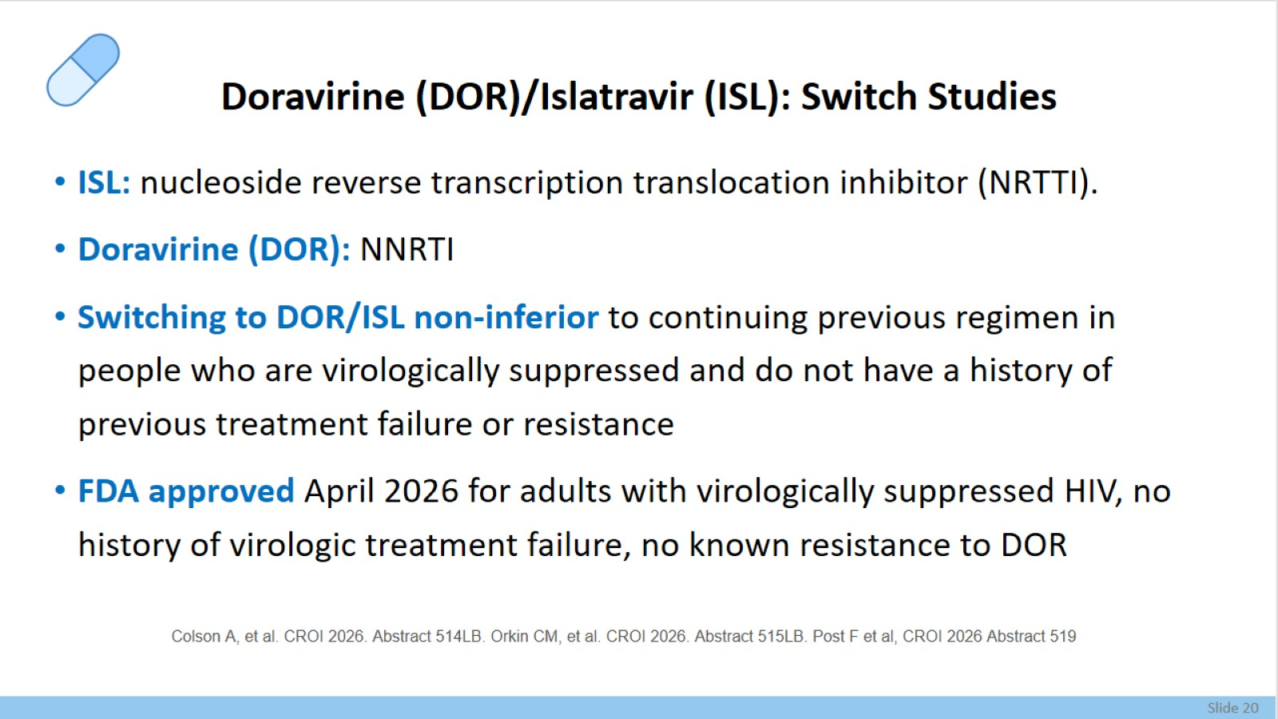
Doravirine (DOR)/Islatravir (ISL): Switch Studies

Slide 21
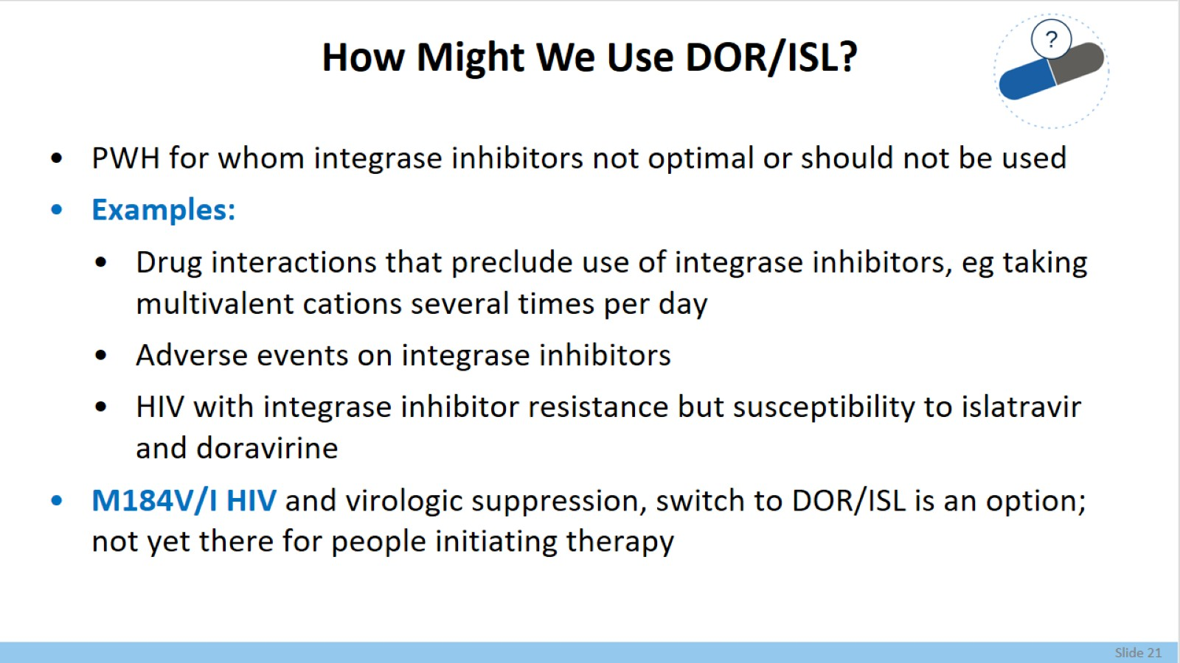
How Might We Use DOR/ISL?

Slide 22
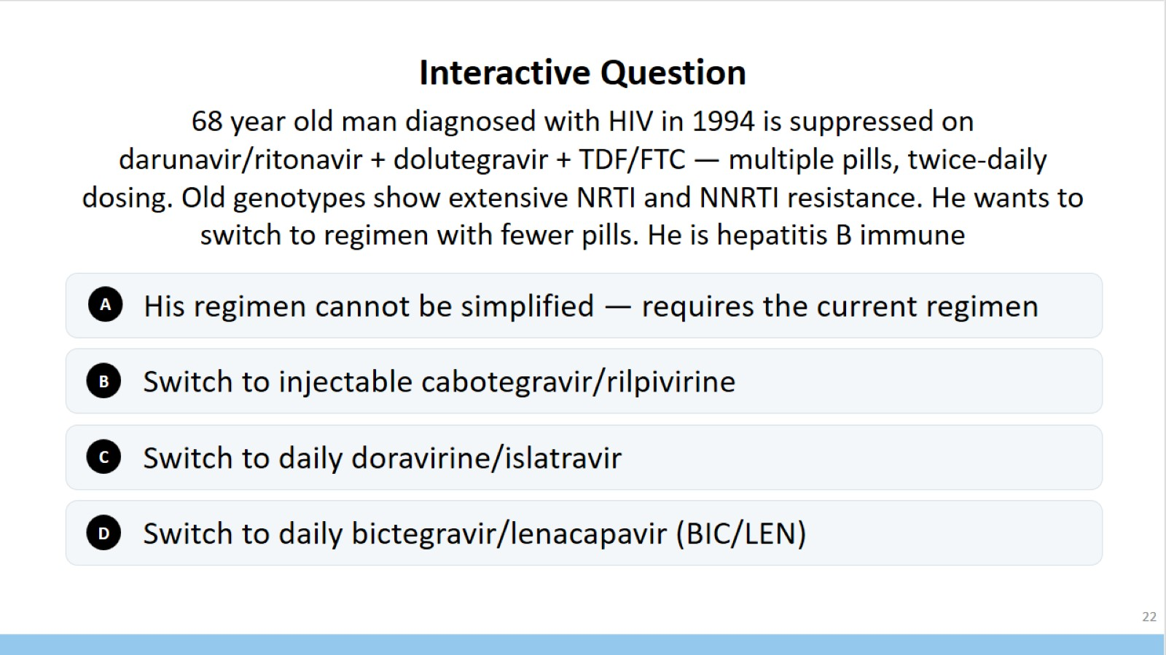
Interactive Question

Slide 23
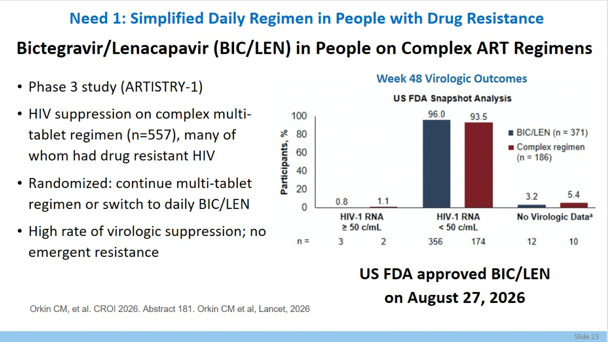
Bictegravir/Lenacapavir (BIC/LEN) in People on Complex ART Regimens

Slide 24
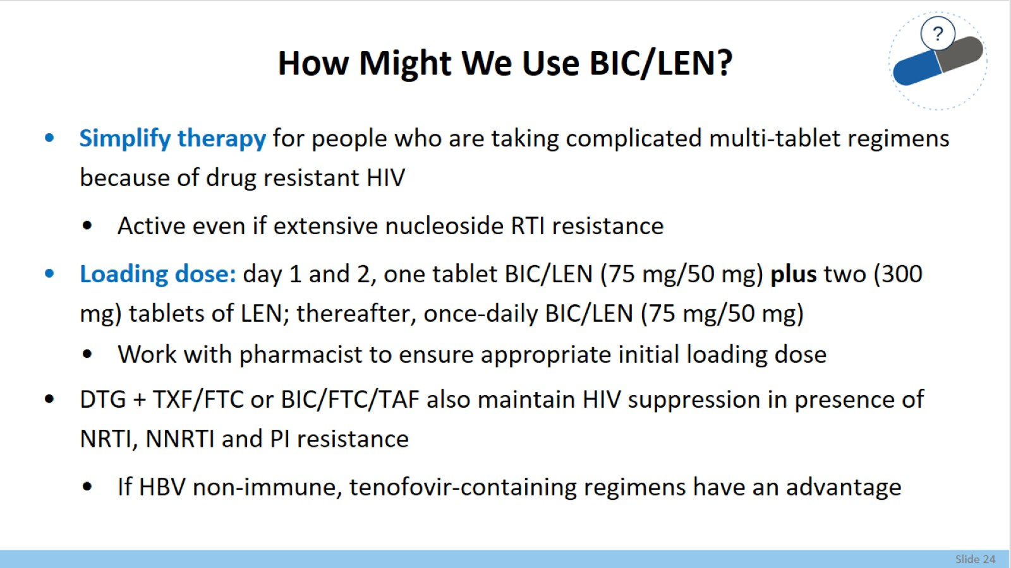
How Might We Use BIC/LEN?

Slide 25
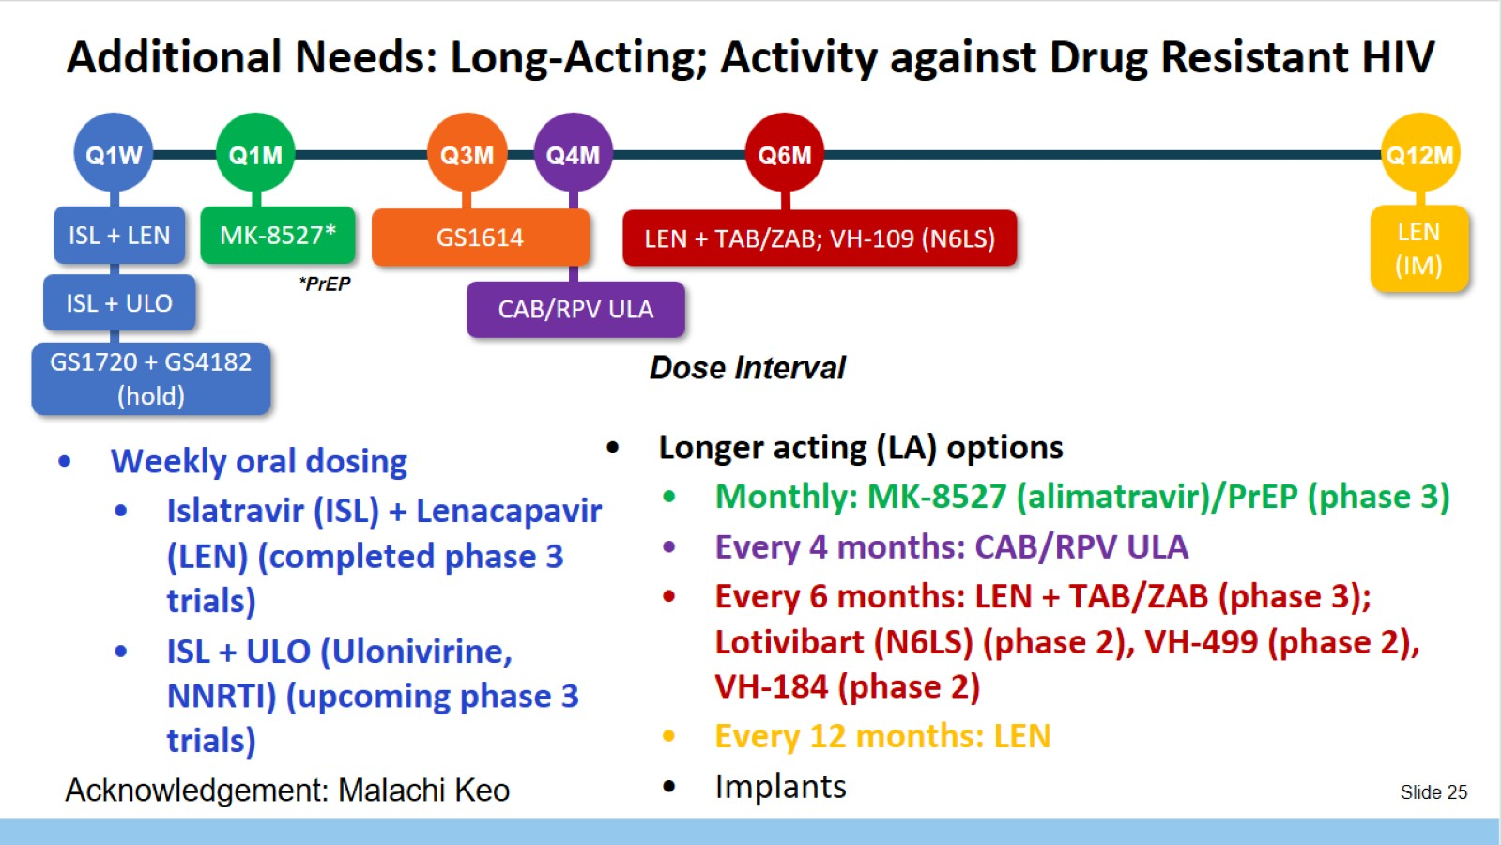
Additional Needs: Long-Acting; Activity against Drug Resistant HIV

Slide 26
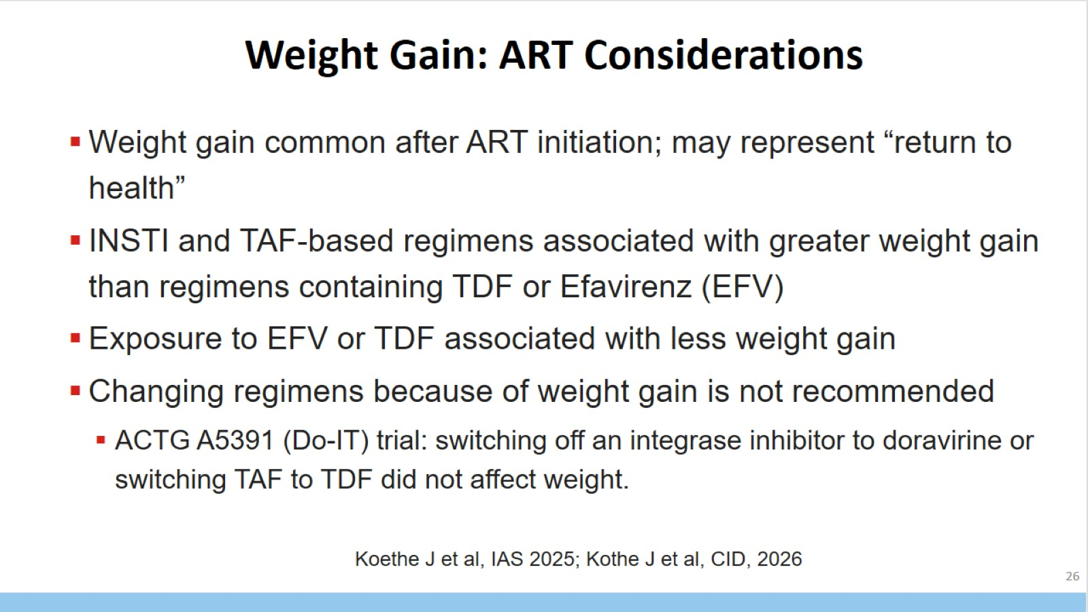

Slide 27
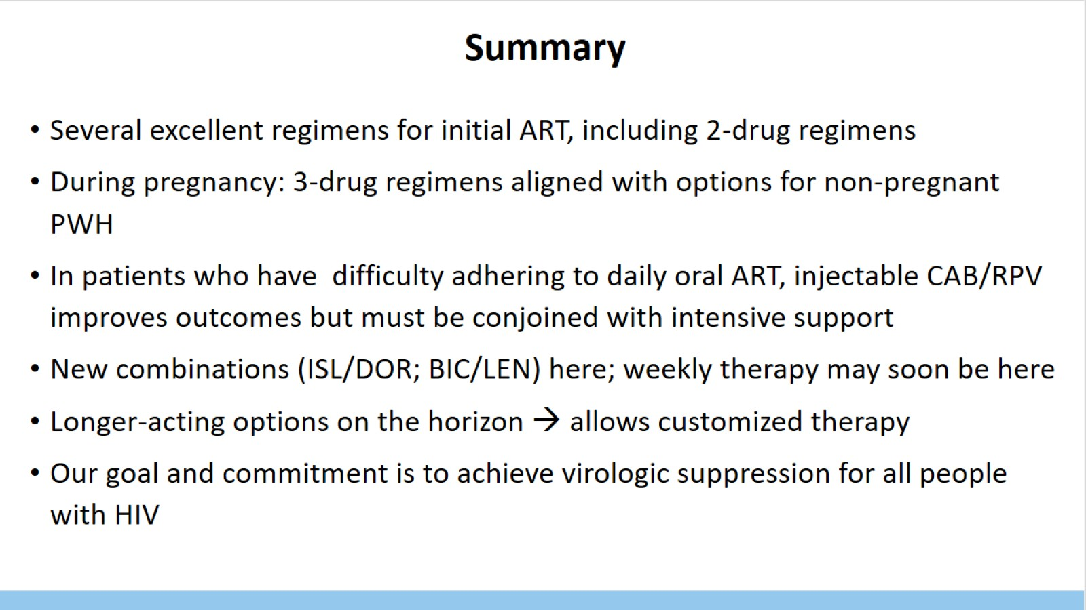
Summary

Slide 28
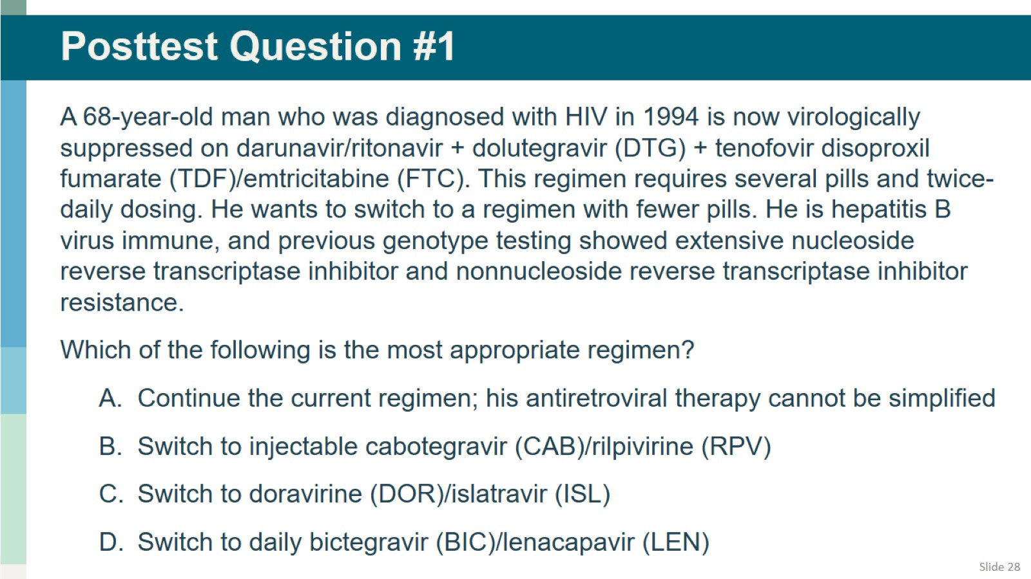
Posttest Question #1

Slide 29
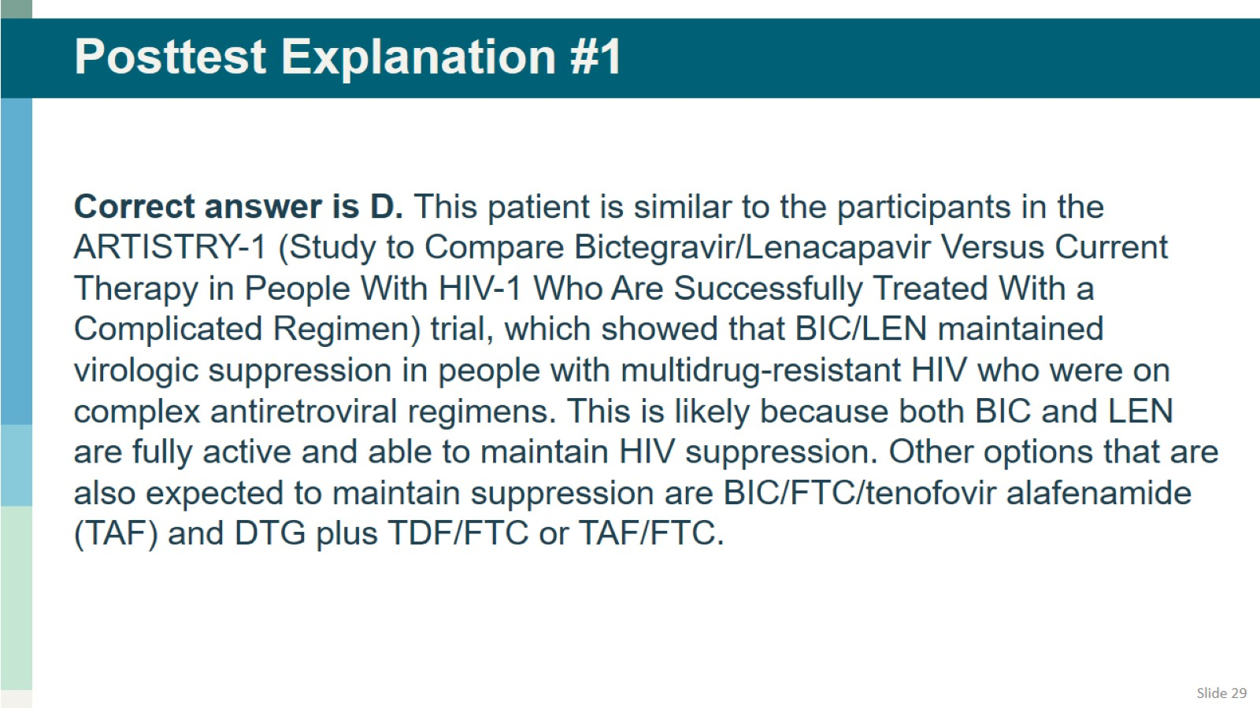
Posttest Explanation #1

