Slide 1

Clinical Cases: Management of Special Populations and Complications

Slide 2
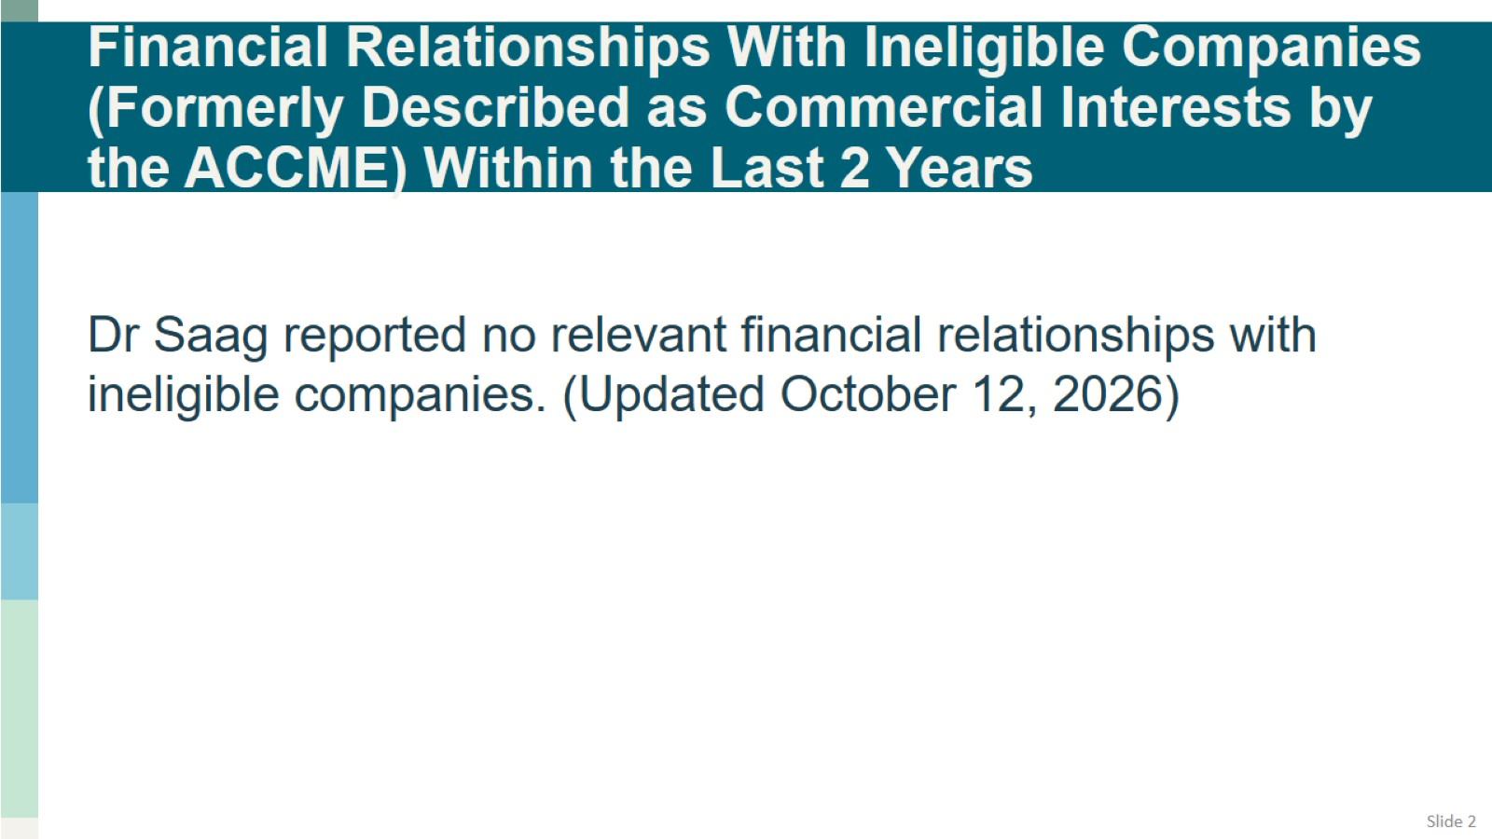
Financial Relationships With Ineligible Companies (Formerly Described as Commercial Interests by the ACCME) Within the Last 2 Years

Slide 3
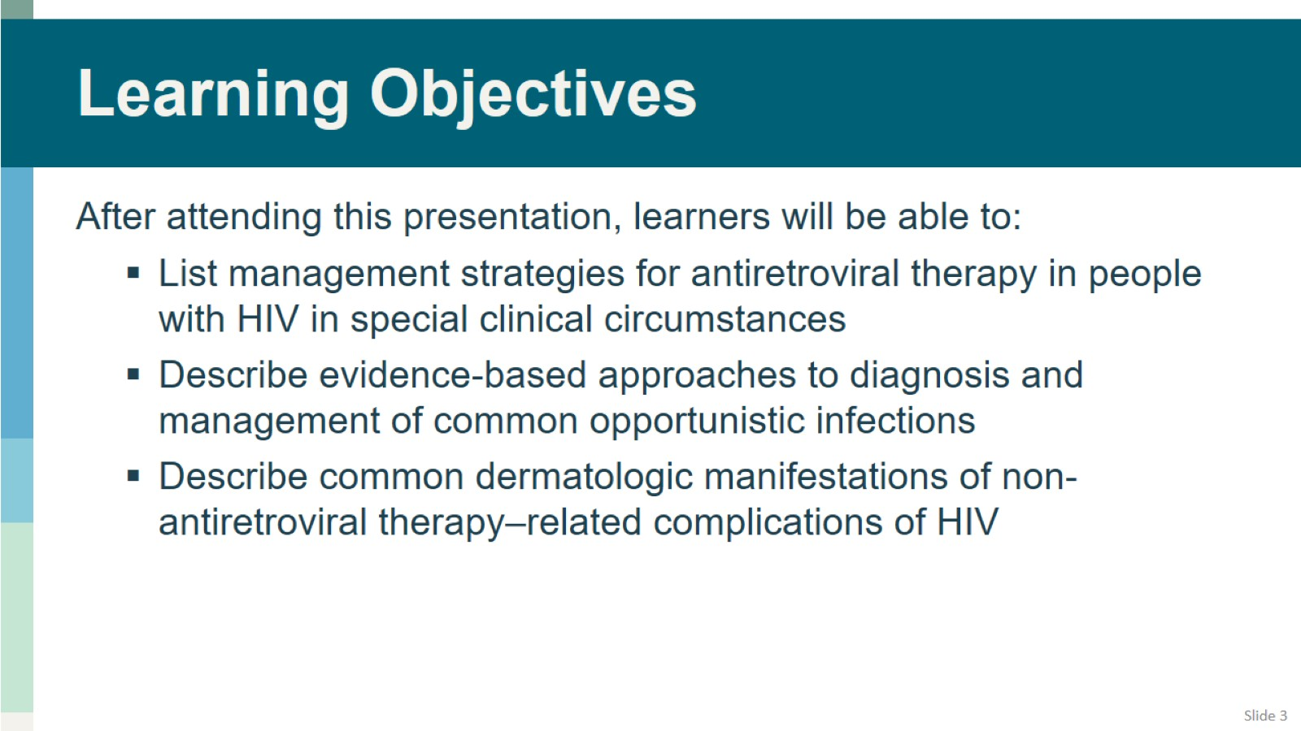
Learning Objectives

Slide 4
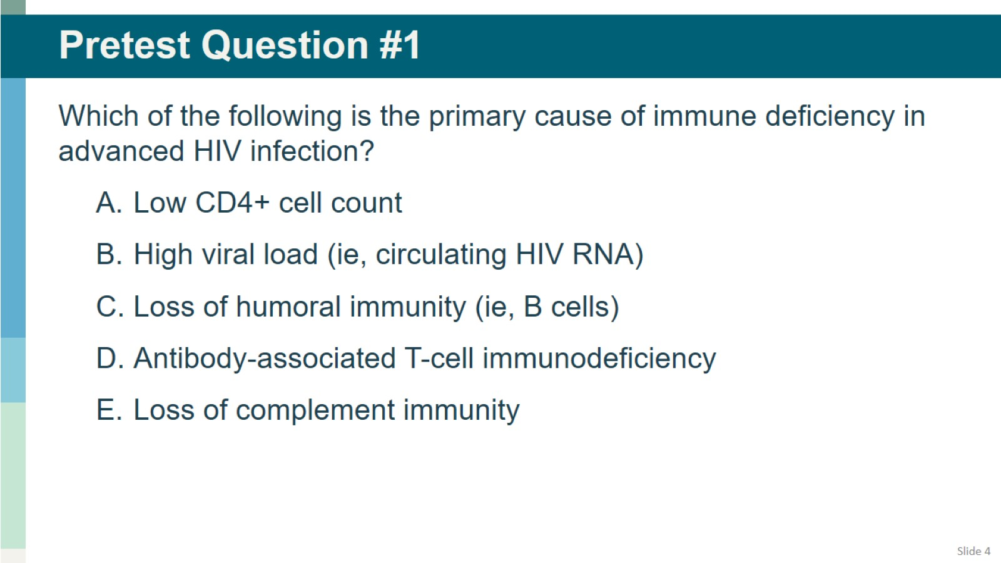
Pretest Question #1

Slide 5
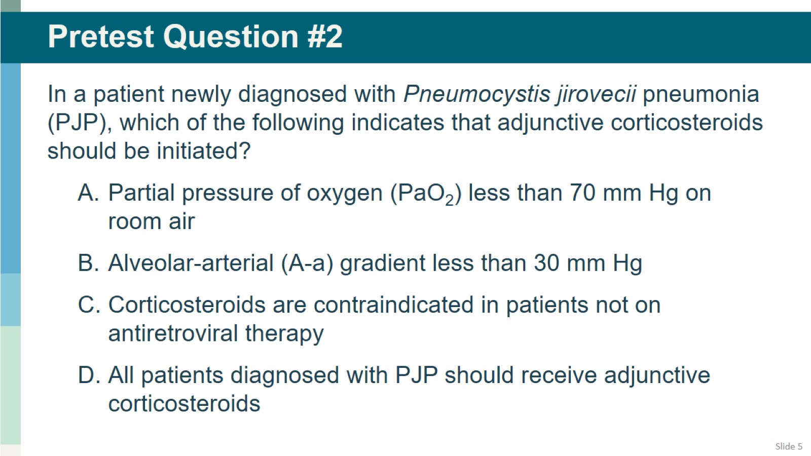
Pretest Question #2

Slide 6
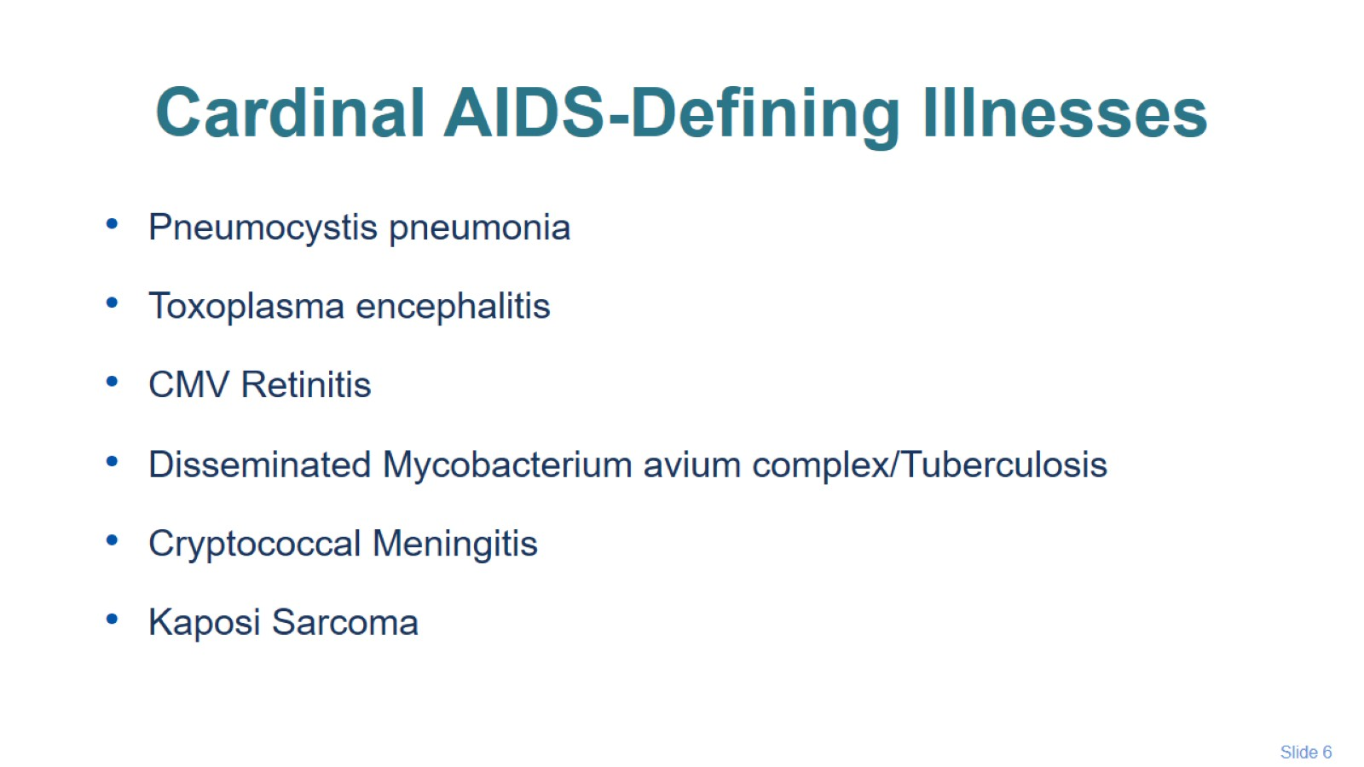
Cardinal AIDS-Defining Illnesses

Slide 7
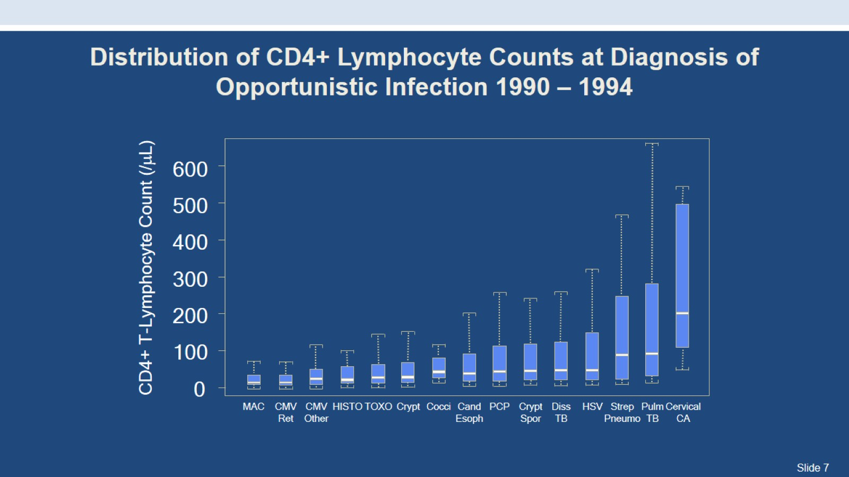
Distribution of CD4+ Lymphocyte Counts at Diagnosis of Opportunistic Infection 1990 – 1994

Slide 8
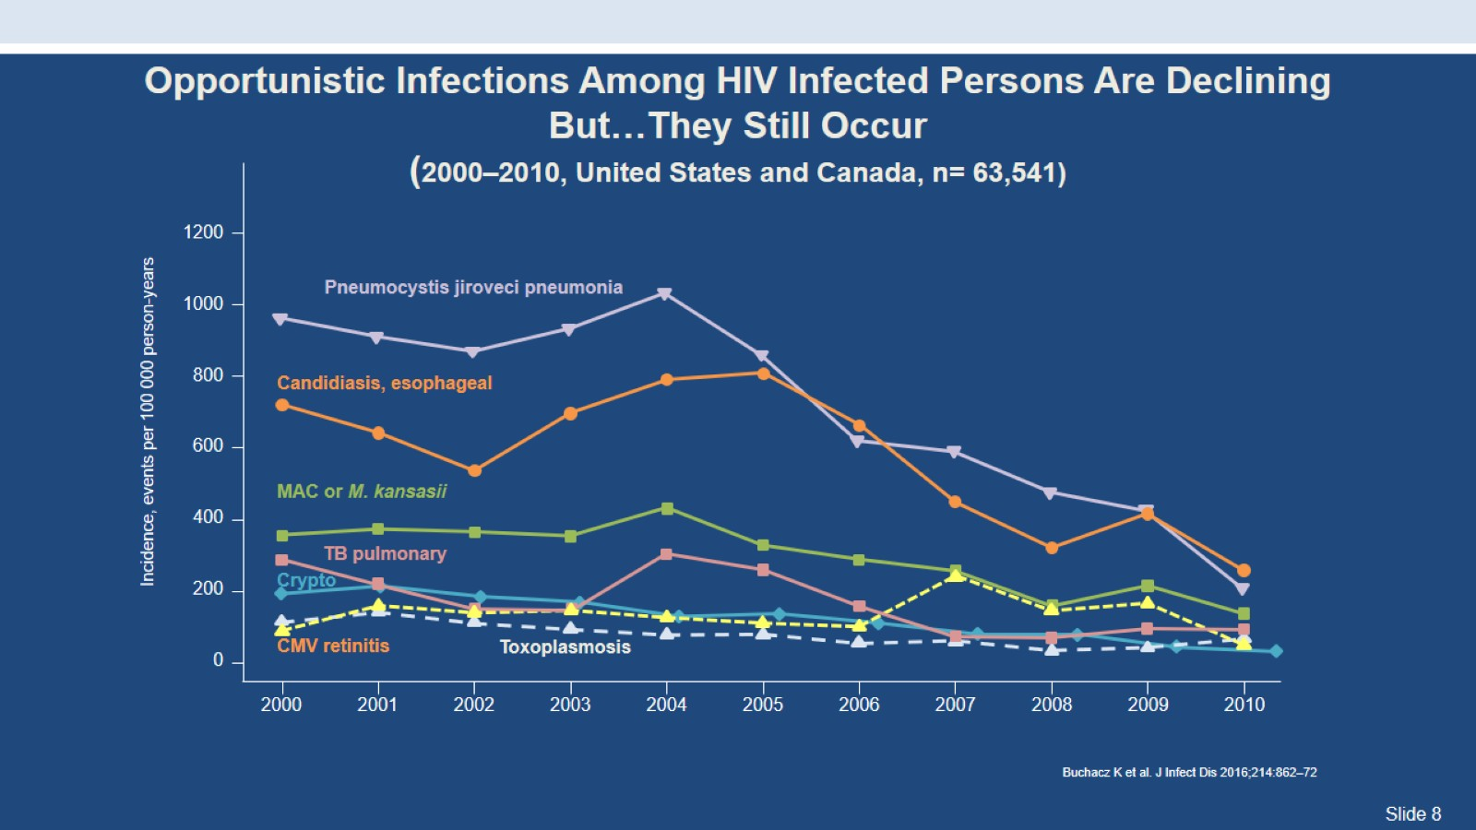
Opportunistic Infections Among HIV Infected Persons Are Declining But…They Still Occur
(2000–2010, United States and Canada, n= 63,541)

Slide 9
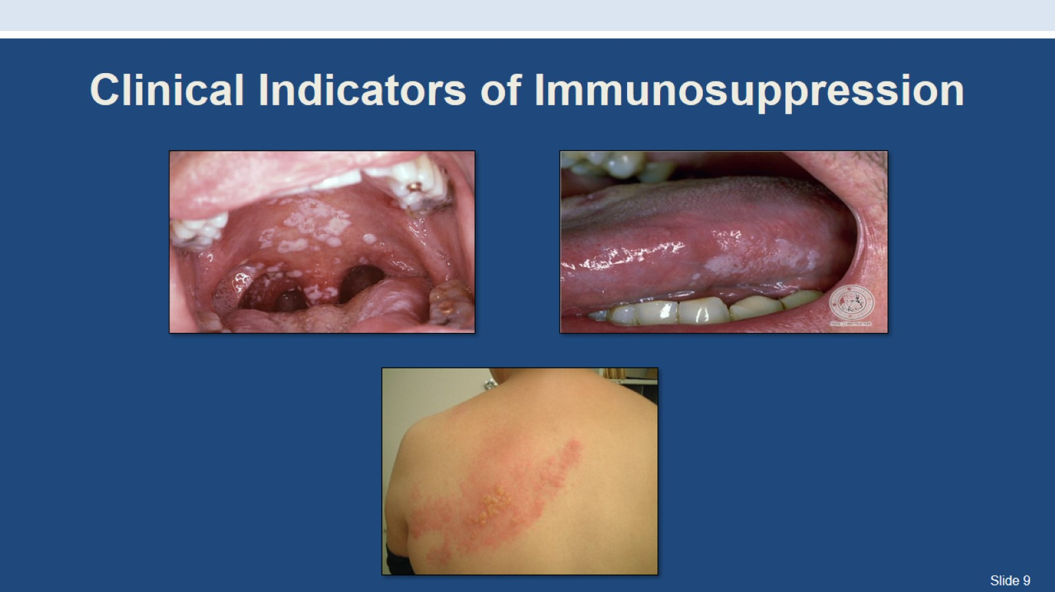
Clinical Indicators of Immunosuppression

Slide 10
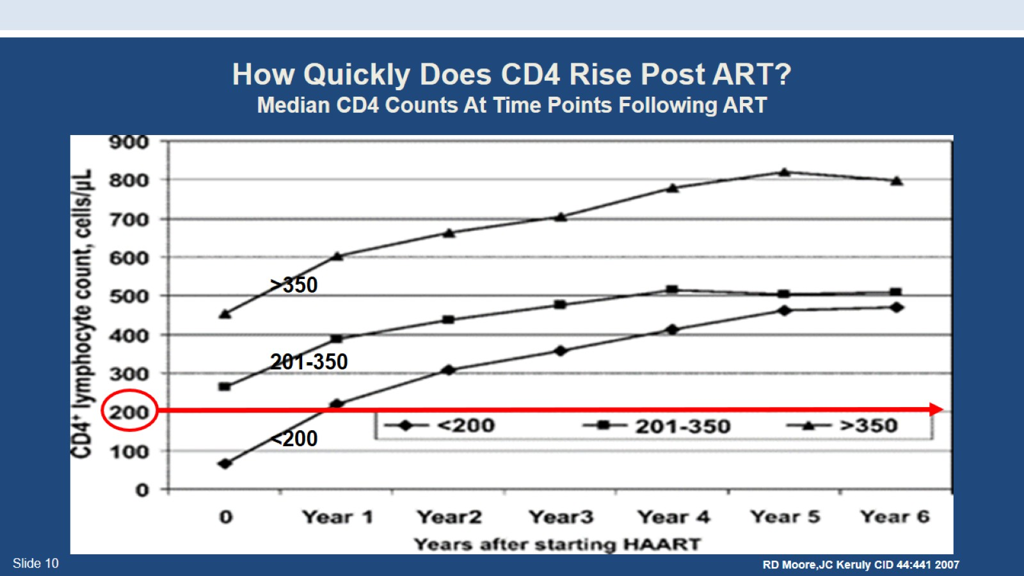
How Quickly Does CD4 Rise Post ART?
Median CD4 Counts At Time Points Following ART

Slide 11
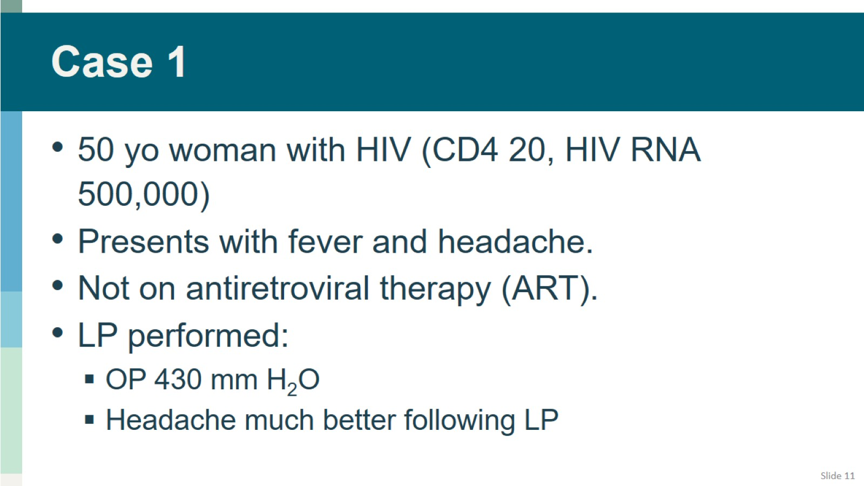
Case 1

Slide 12
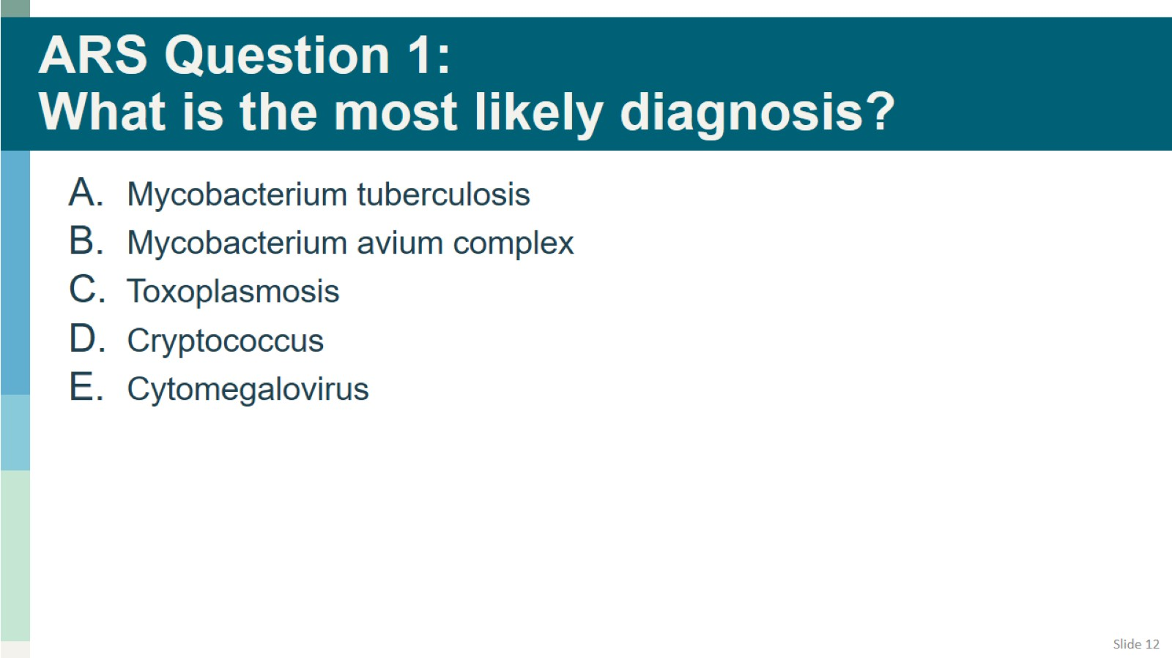
ARS Question 1:
What is the most likely diagnosis?

Slide 13
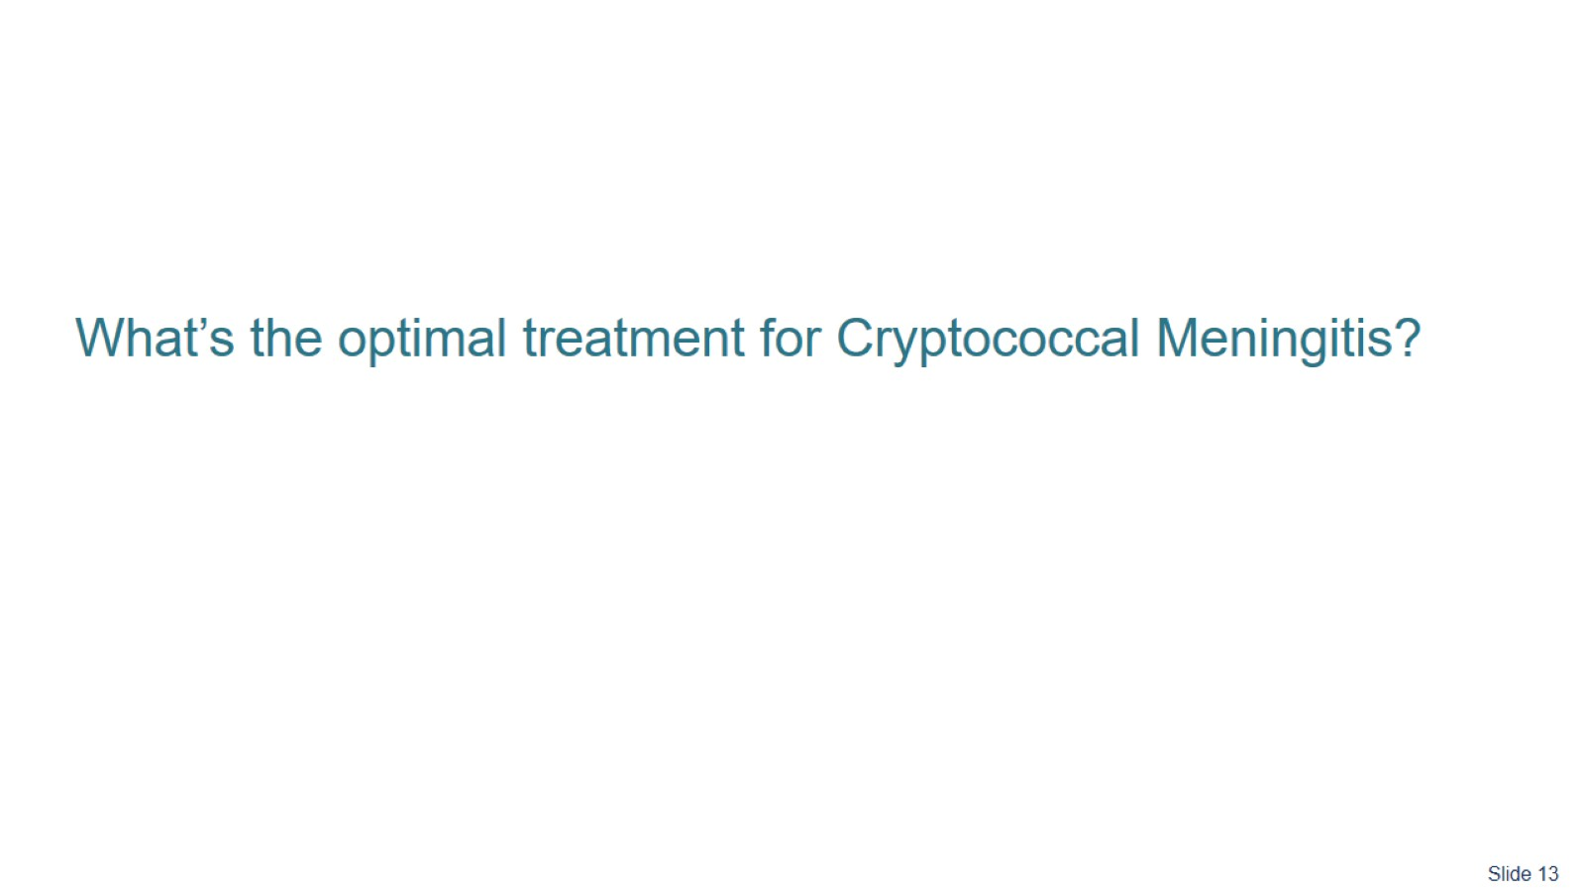

Slide 14
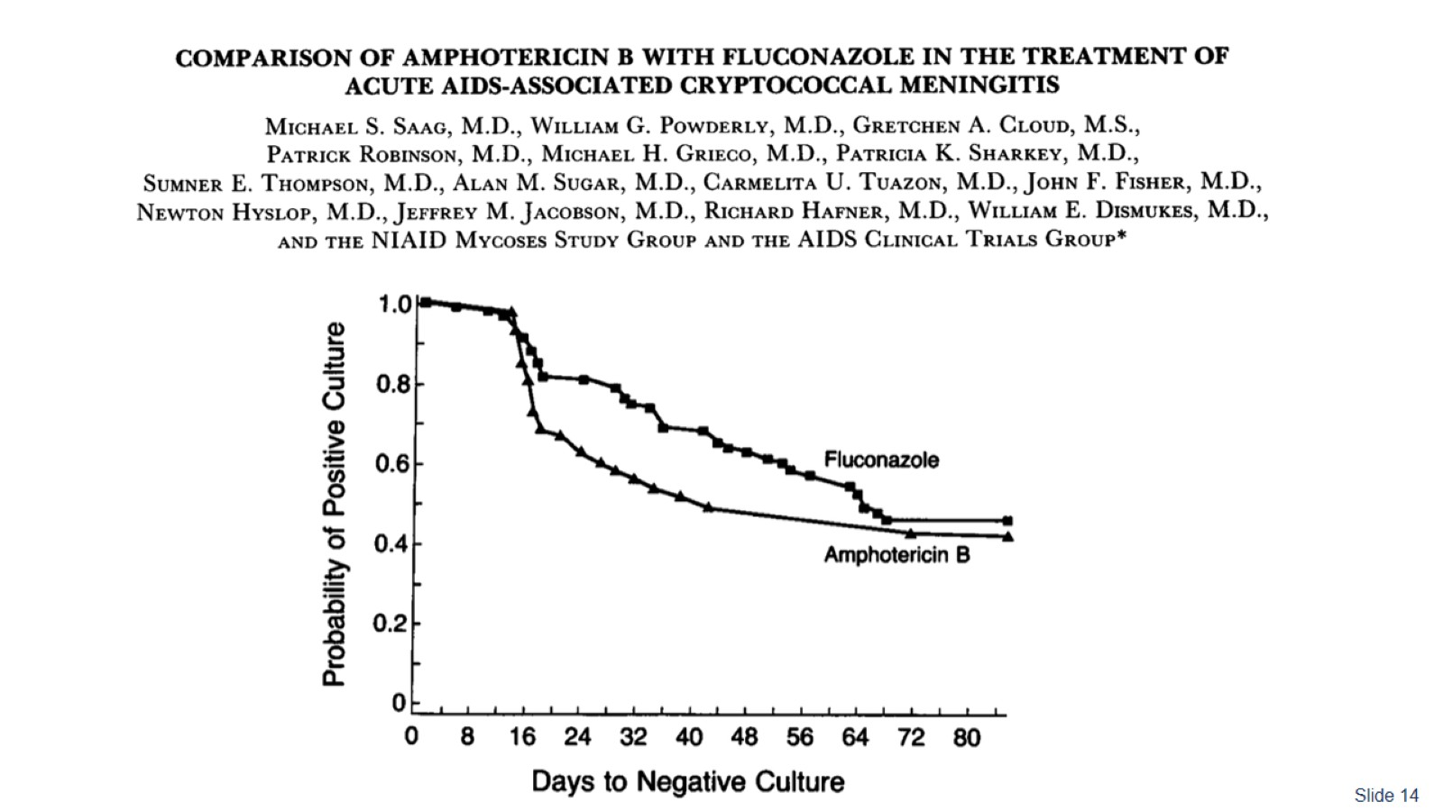

Slide 15
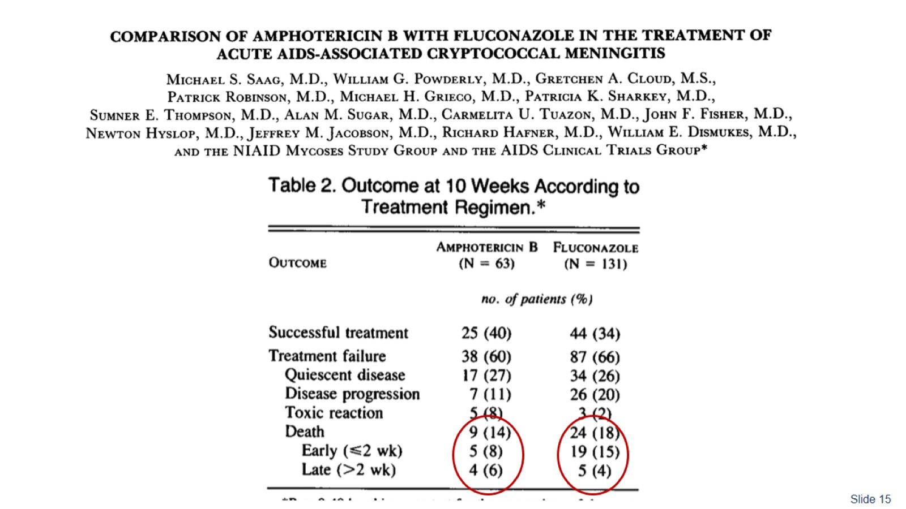

Slide 16
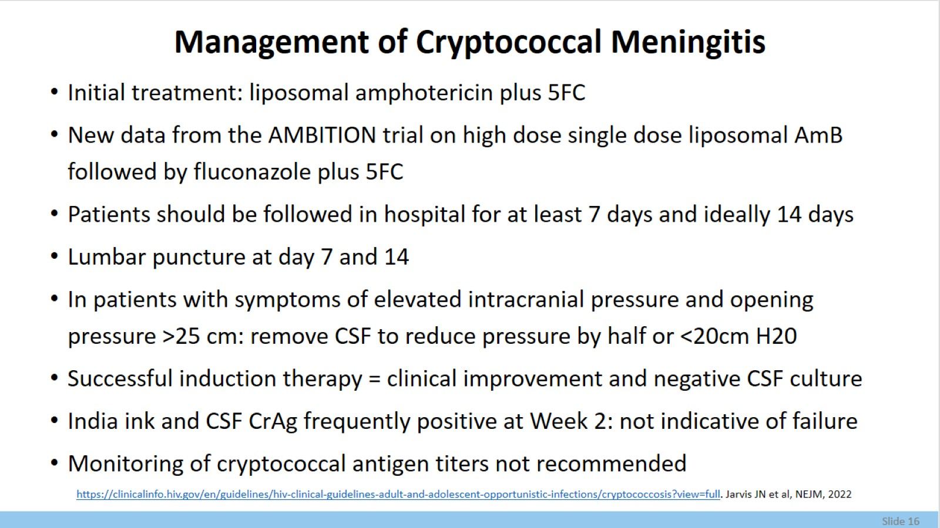
Management of Cryptococcal Meningitis

Slide 17
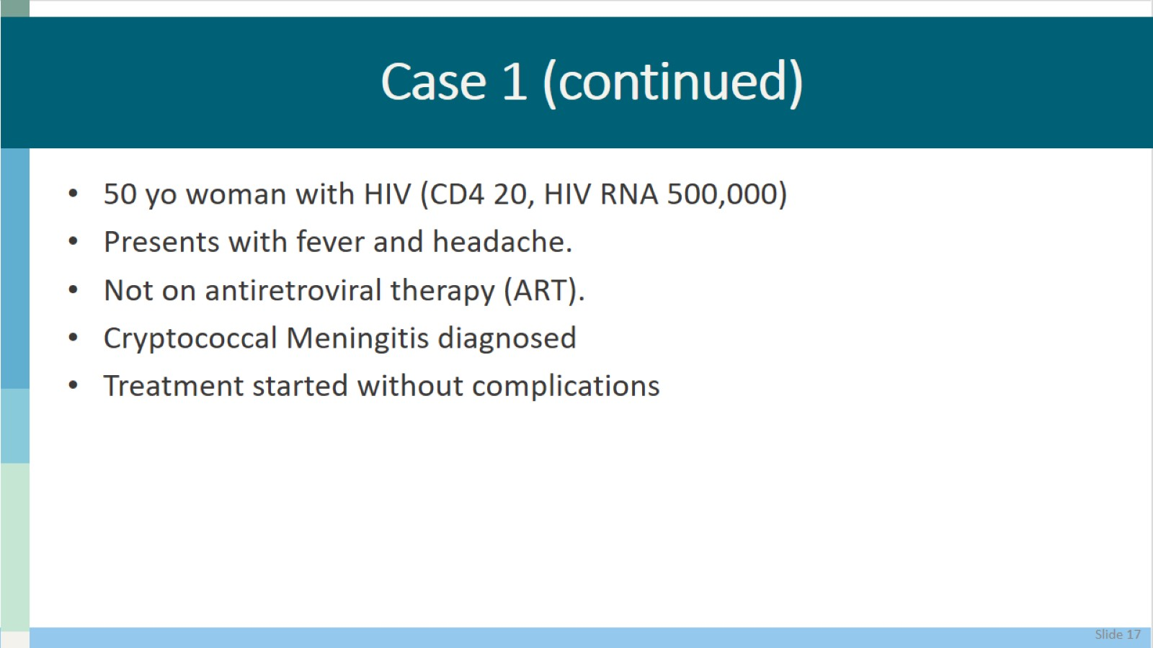
Case 1 (continued)

Slide 18
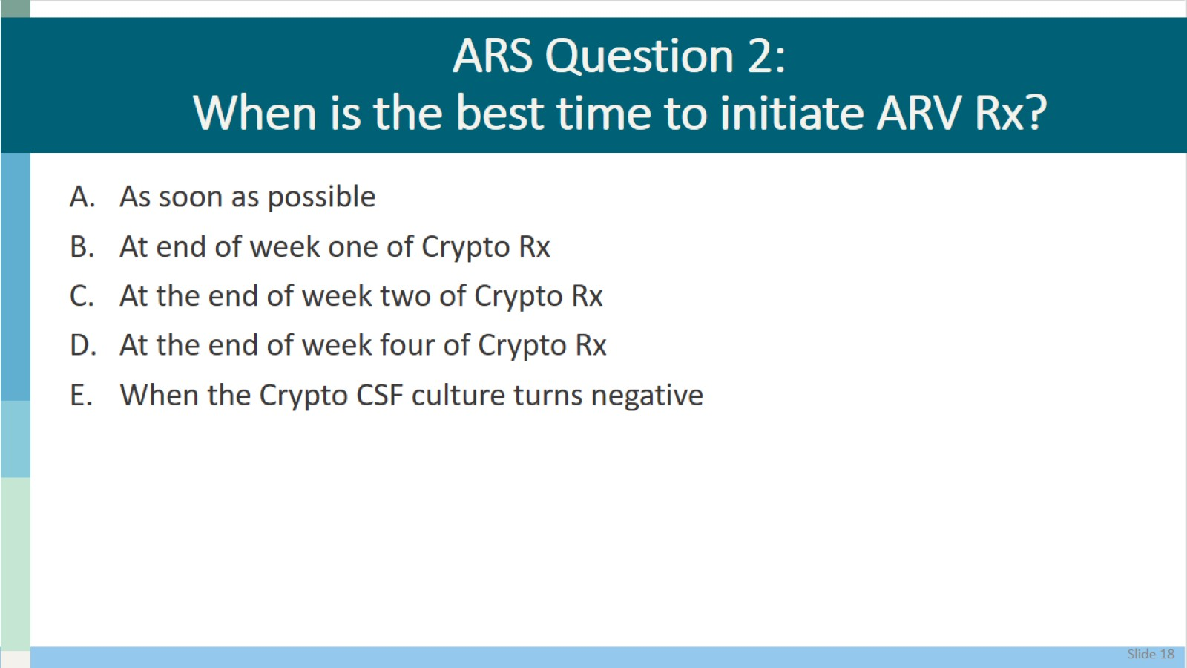
ARS Question 2:
When is the best time to initiate ARV Rx?

Slide 19
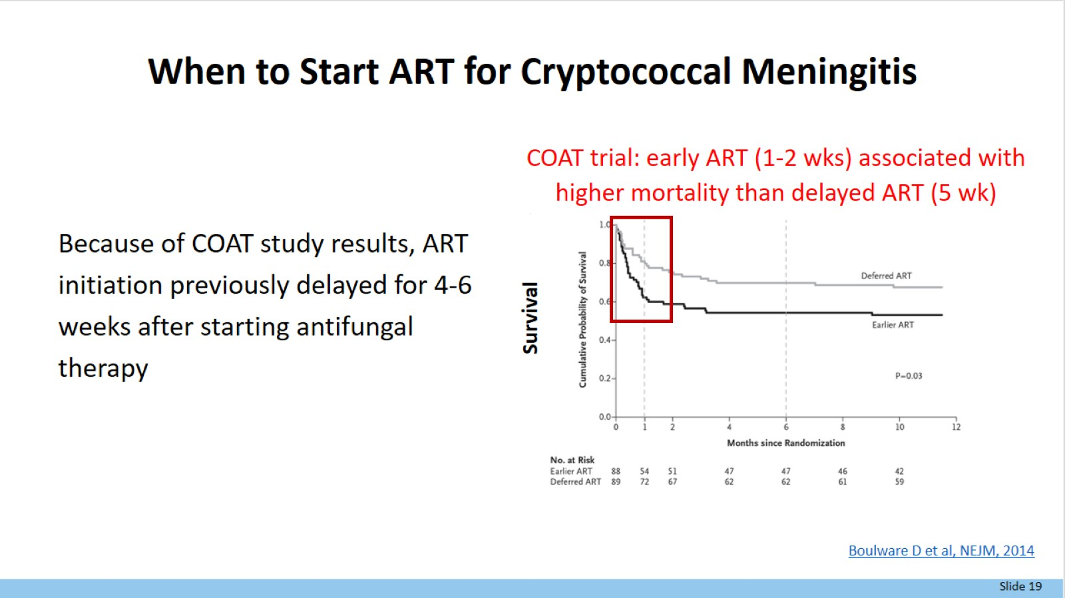
When to Start ART for Cryptococcal Meningitis

Slide 20


Slide 21
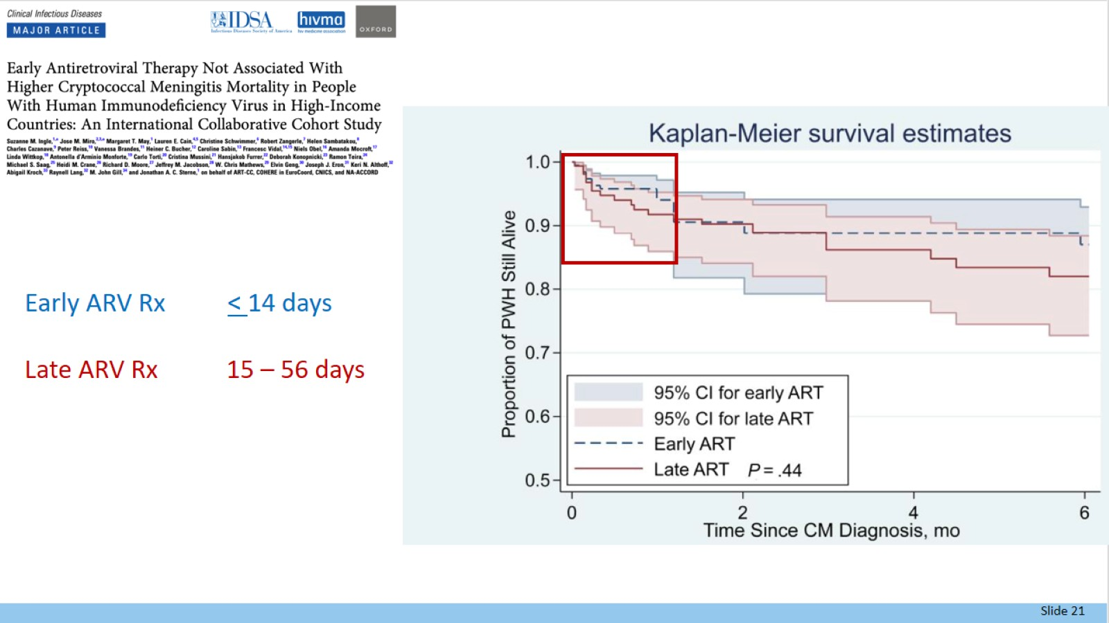

Slide 22
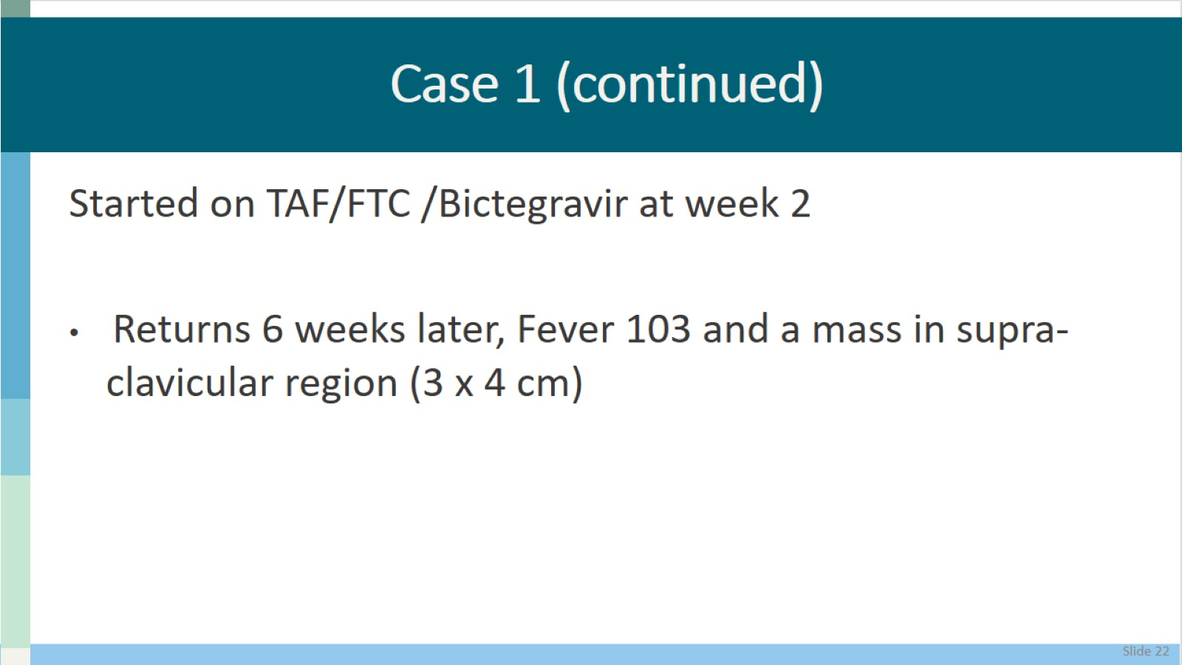
Case 1 (continued)

Slide 23
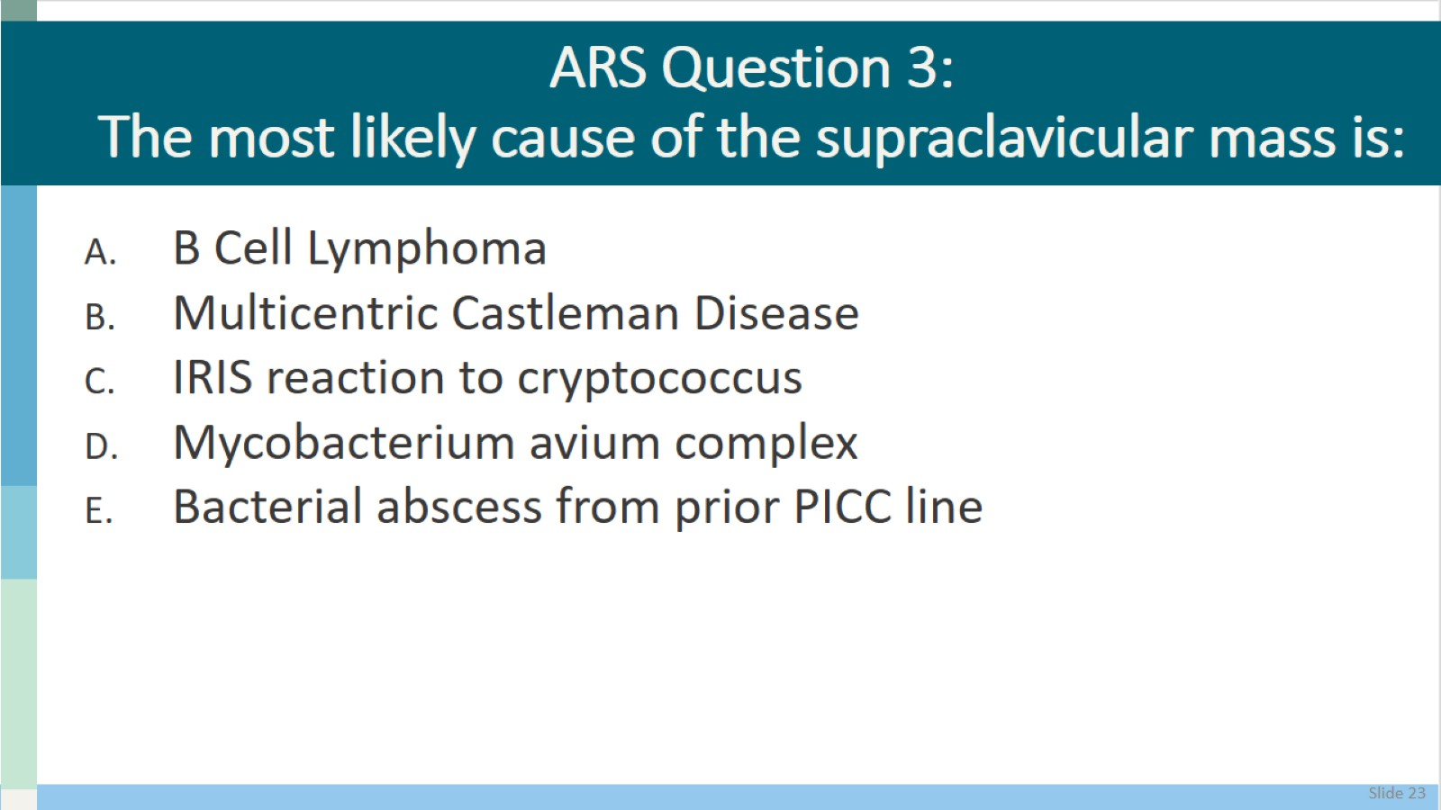
ARS Question 3:
The most likely cause of the supraclavicular mass is:

Slide 24
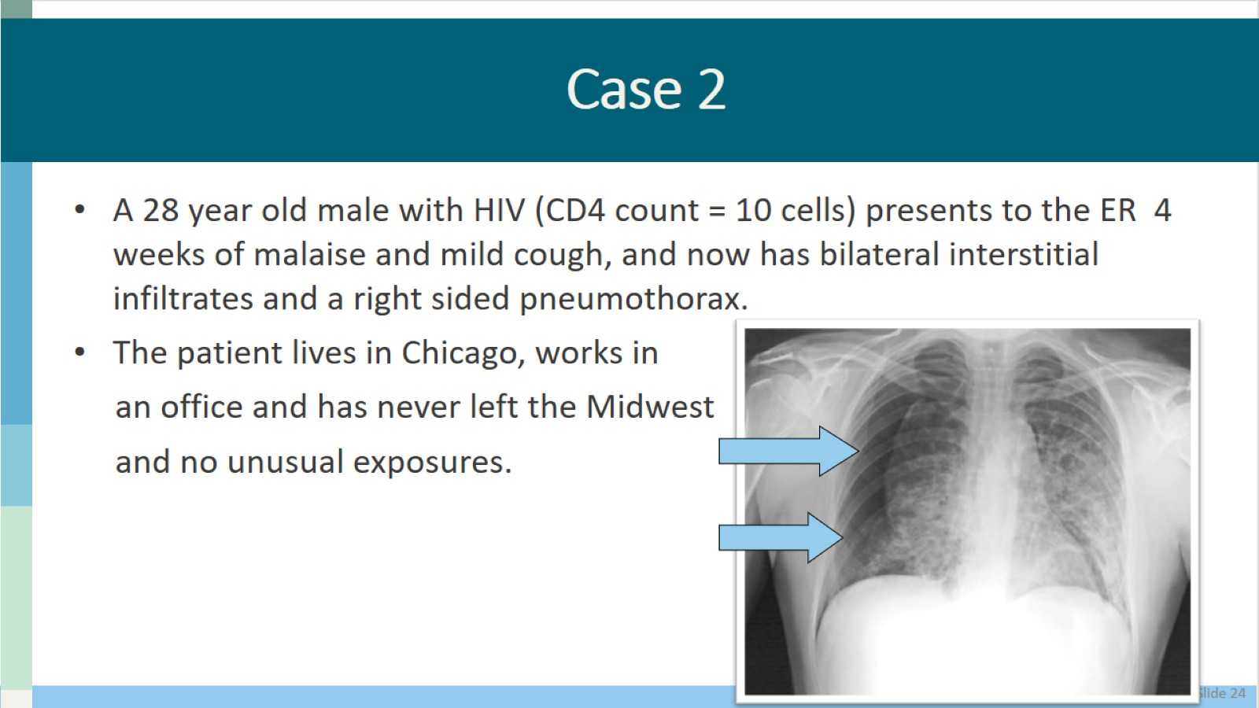
Case 2

Slide 25
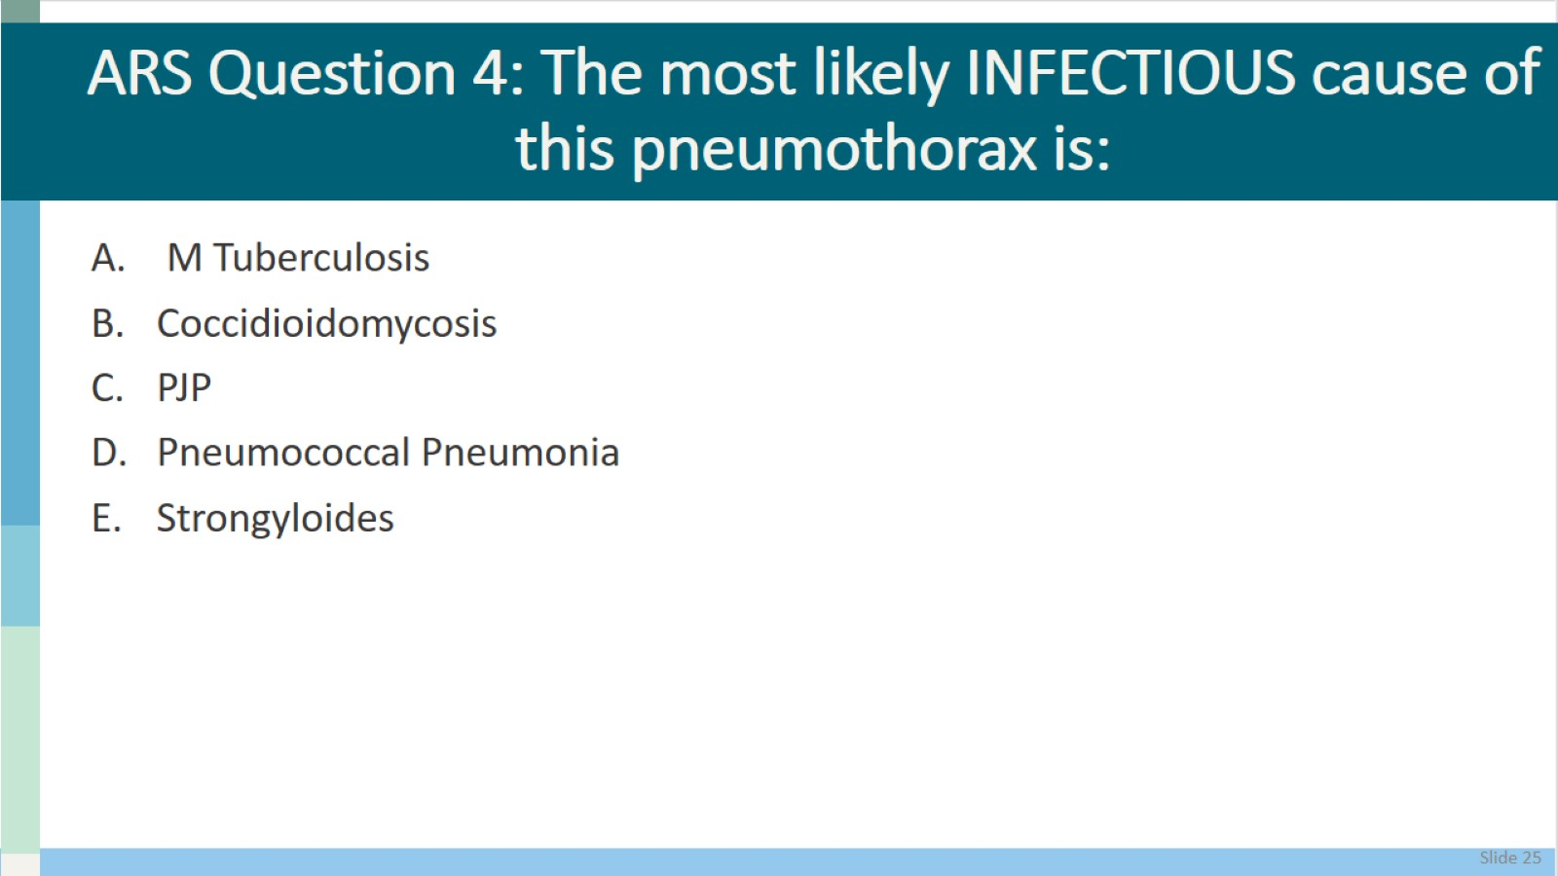
ARS Question 4: The most likely INFECTIOUS cause of this pneumothorax is:

Slide 26
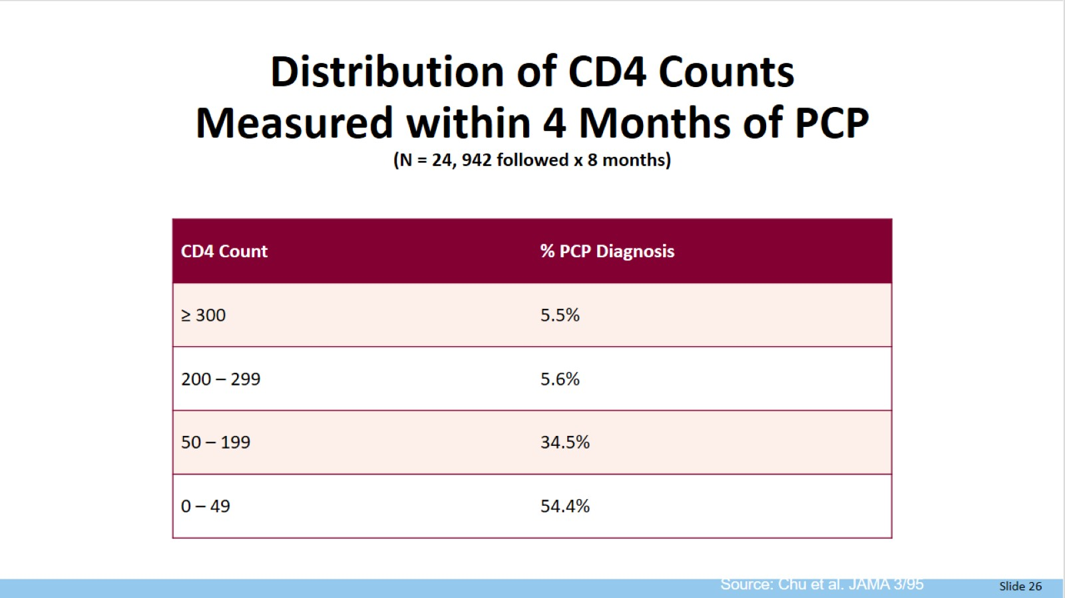
Distribution of CD4 Counts
Measured within 4 Months of PCP
(N = 24, 942 followed x 8 months)

Slide 27
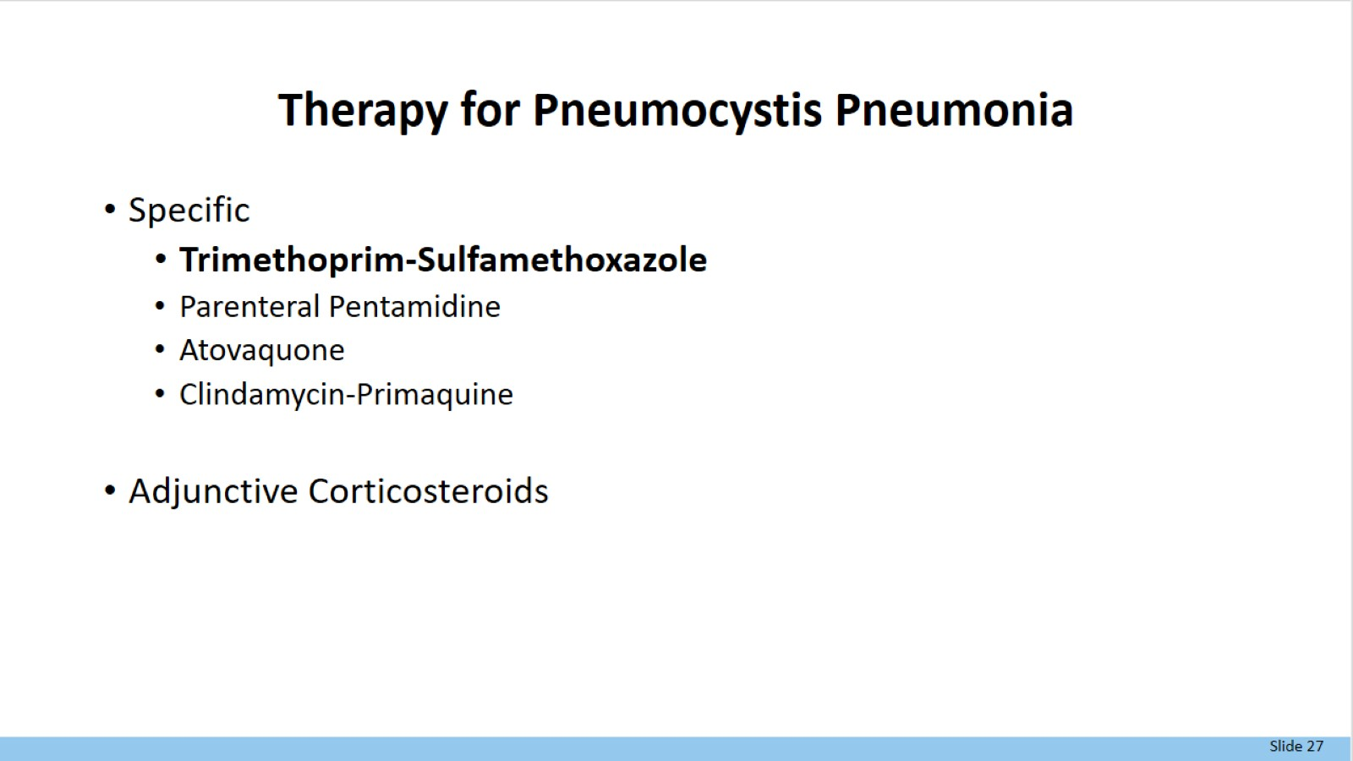
Therapy for Pneumocystis Pneumonia

Slide 28
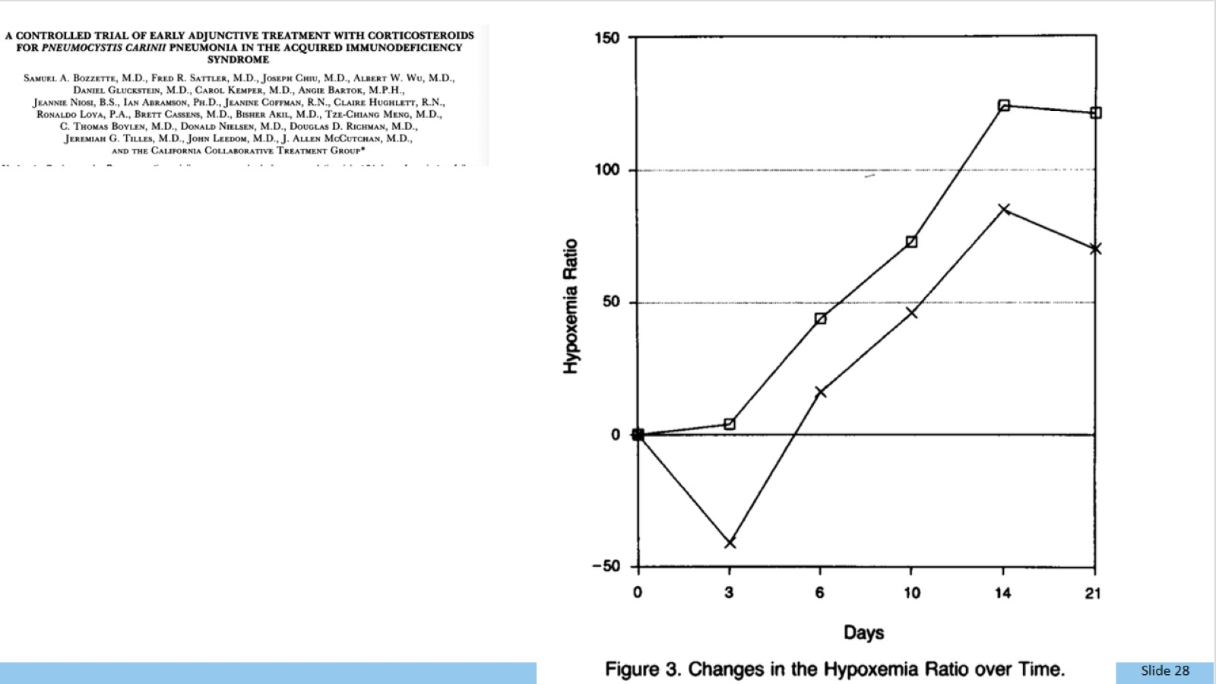

Slide 29
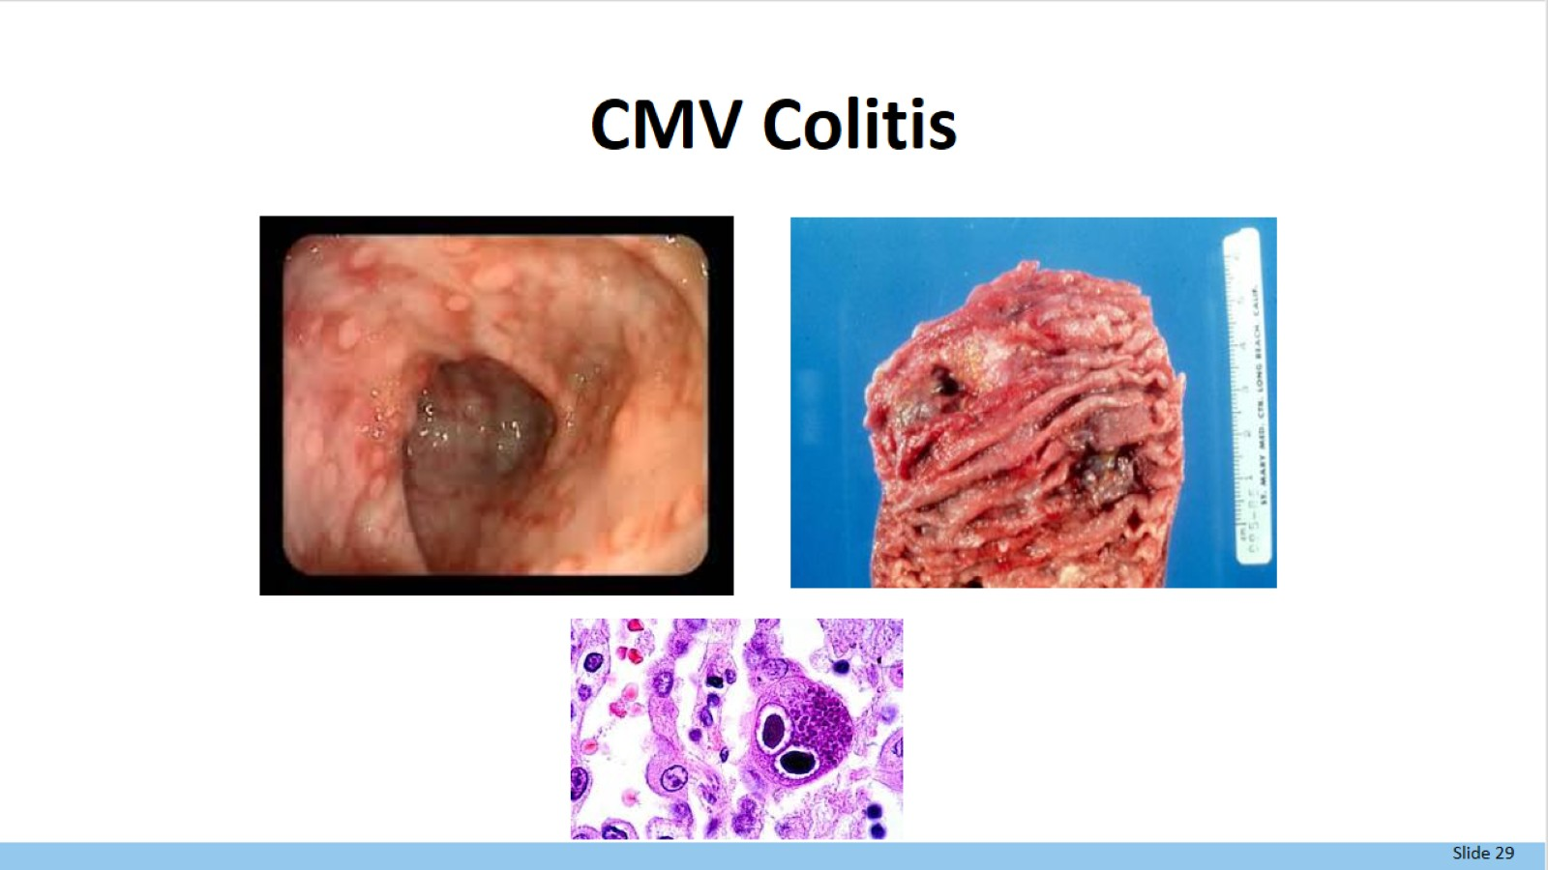
CMV Colitis

Slide 30
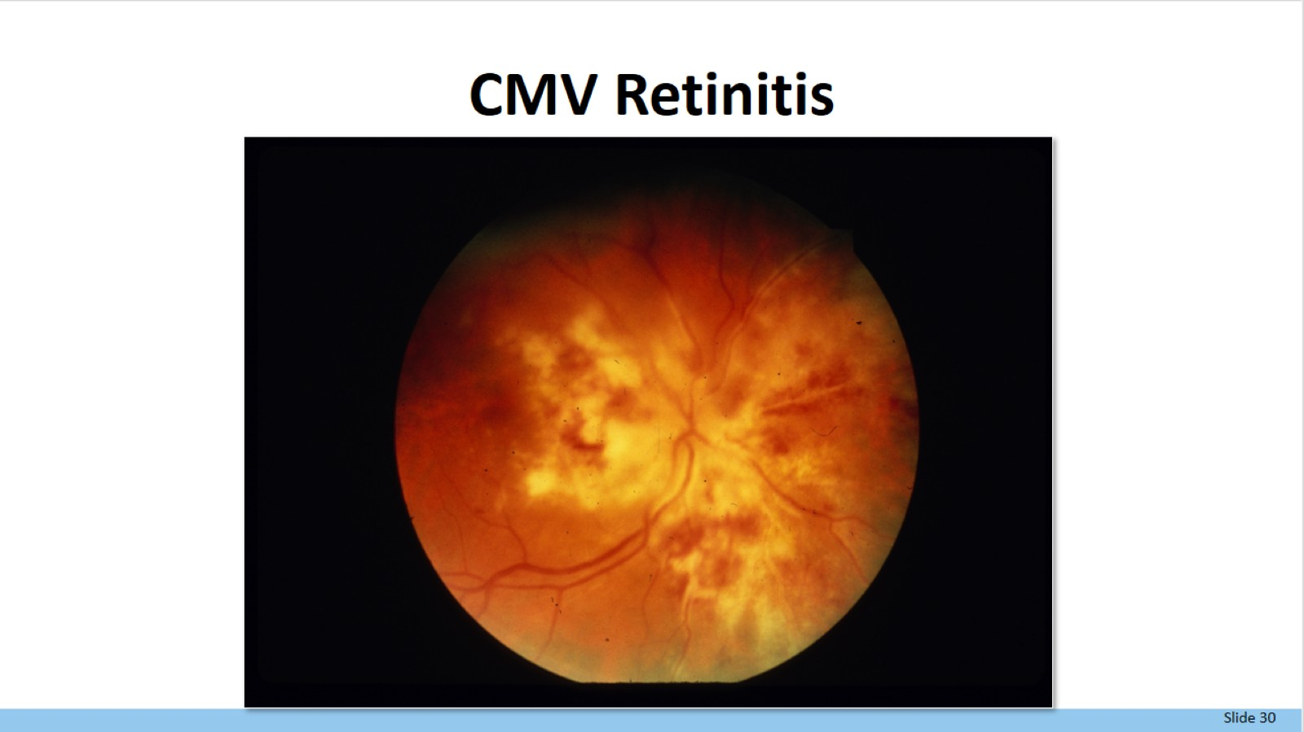
CMV Retinitis

Slide 31
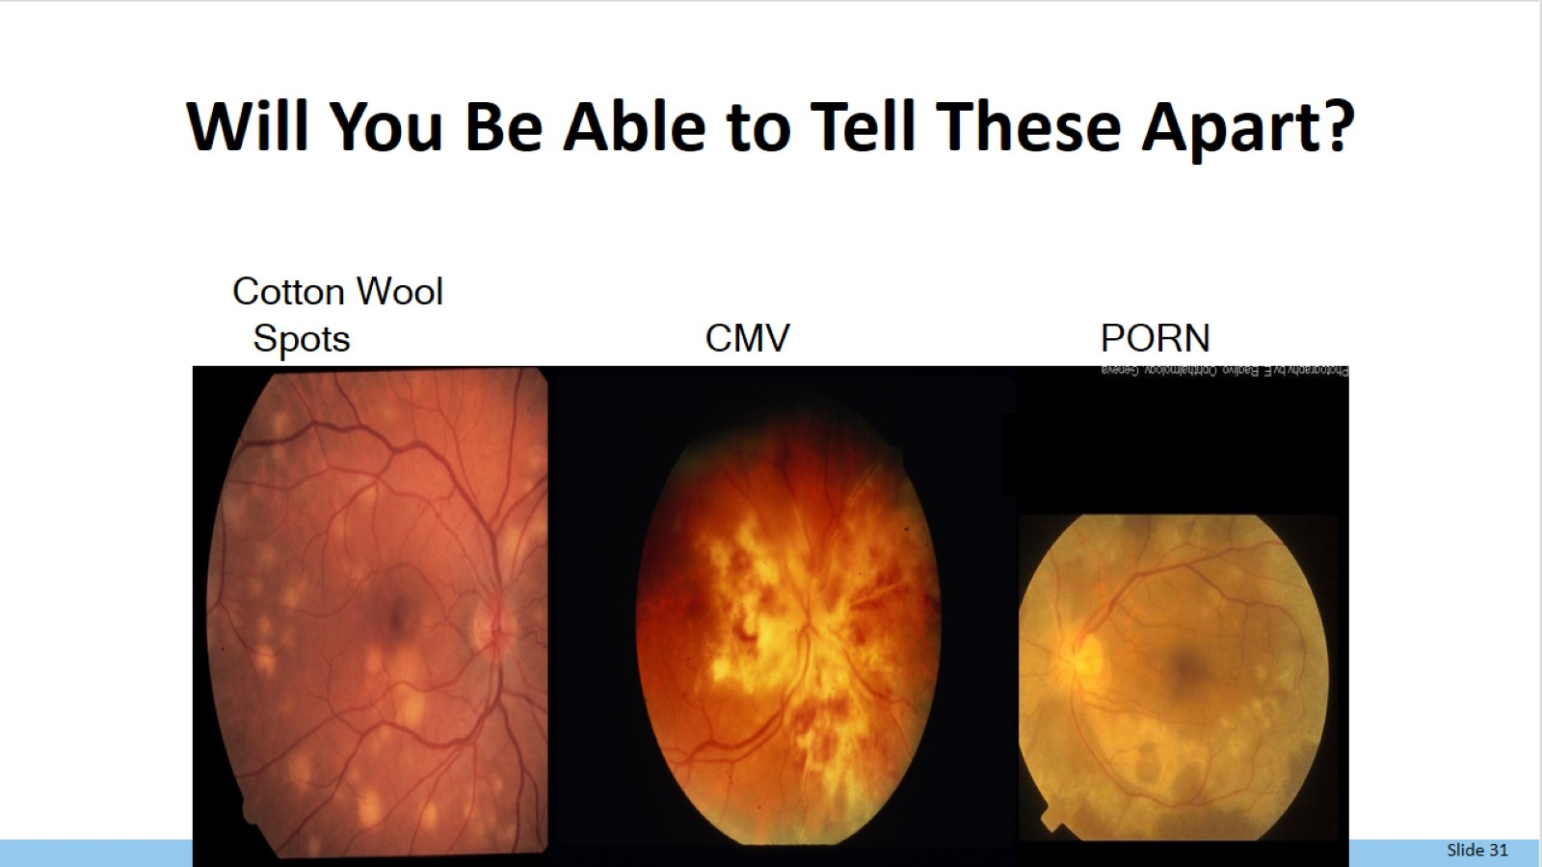
Will You Be Able to Tell These Apart?

Slide 32
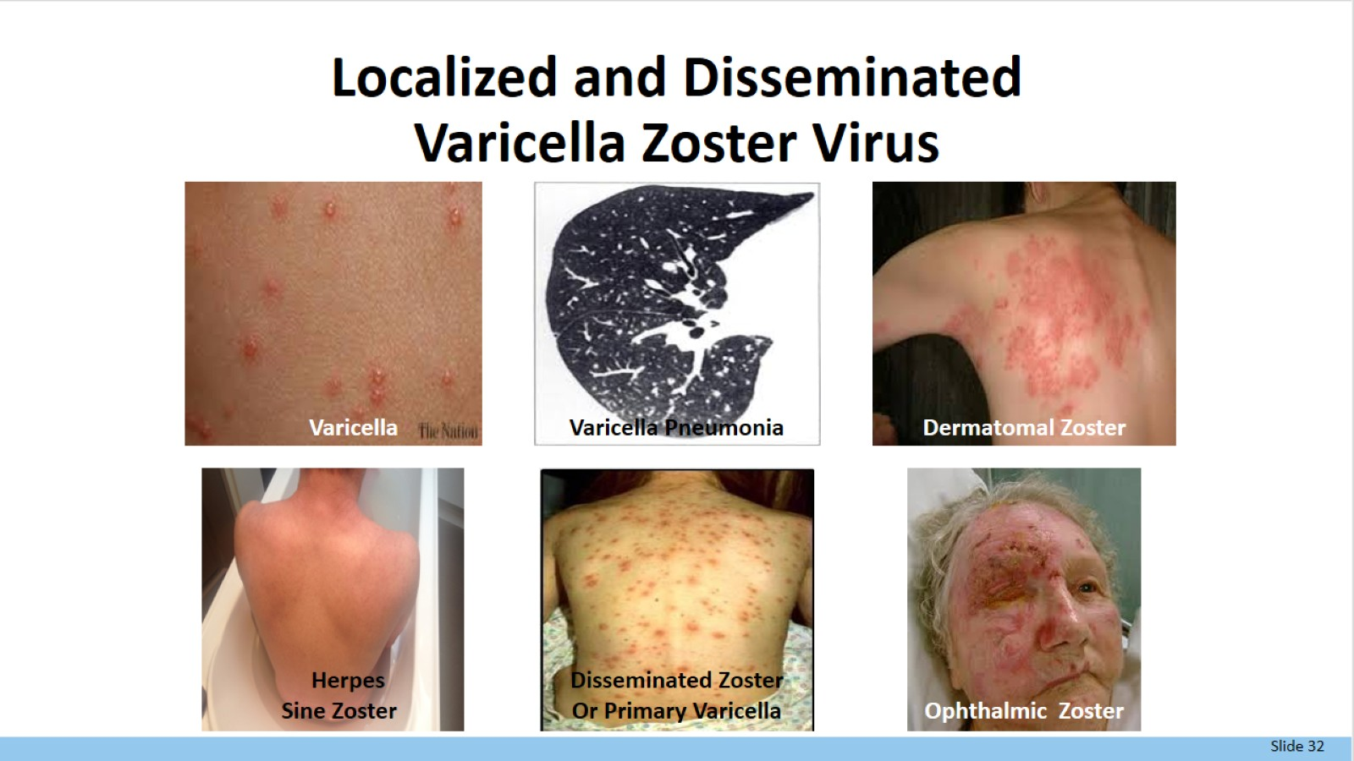
Localized and Disseminated
Varicella Zoster Virus

Slide 33
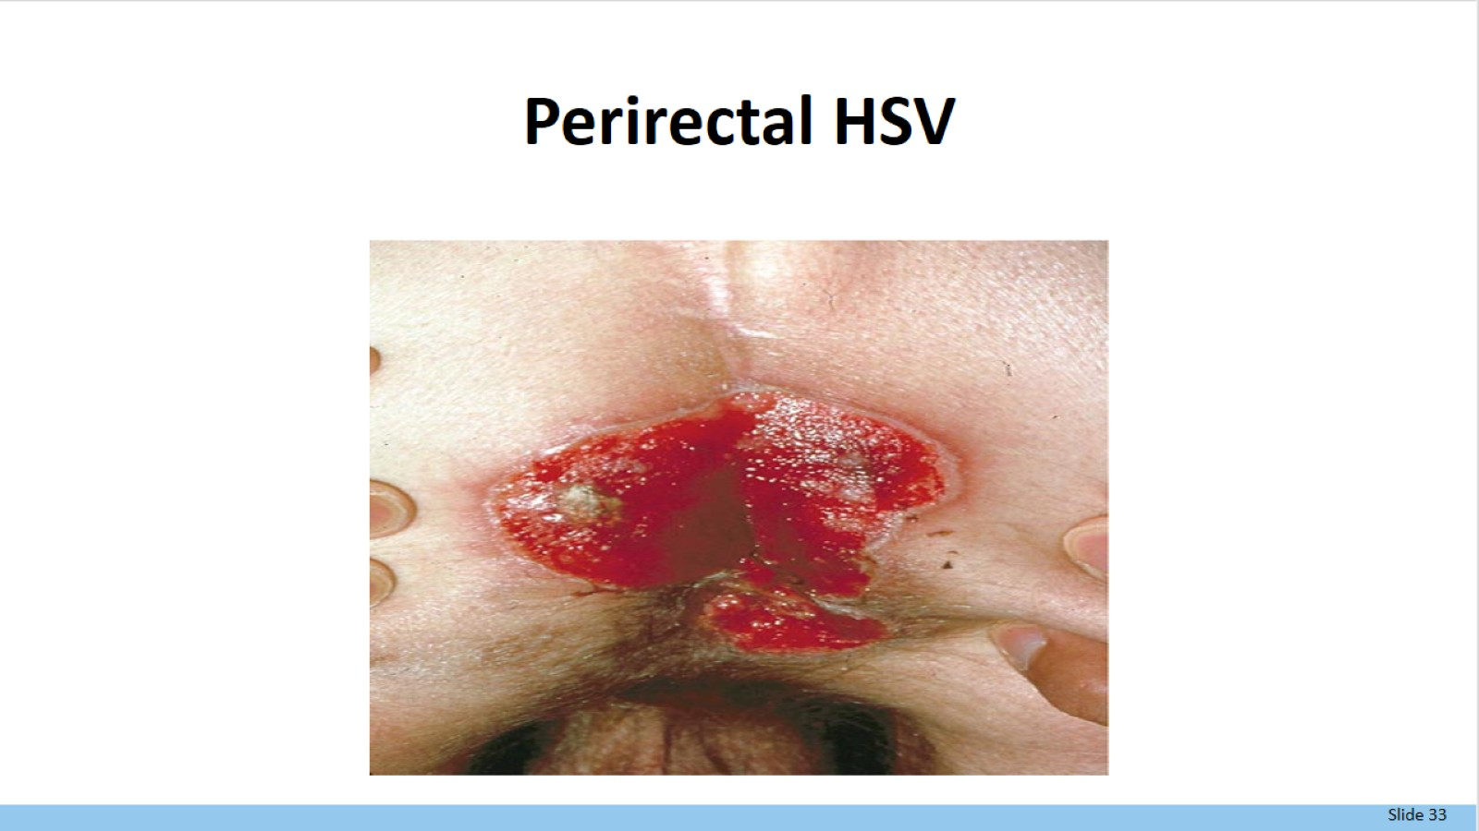
Perirectal HSV

Slide 34
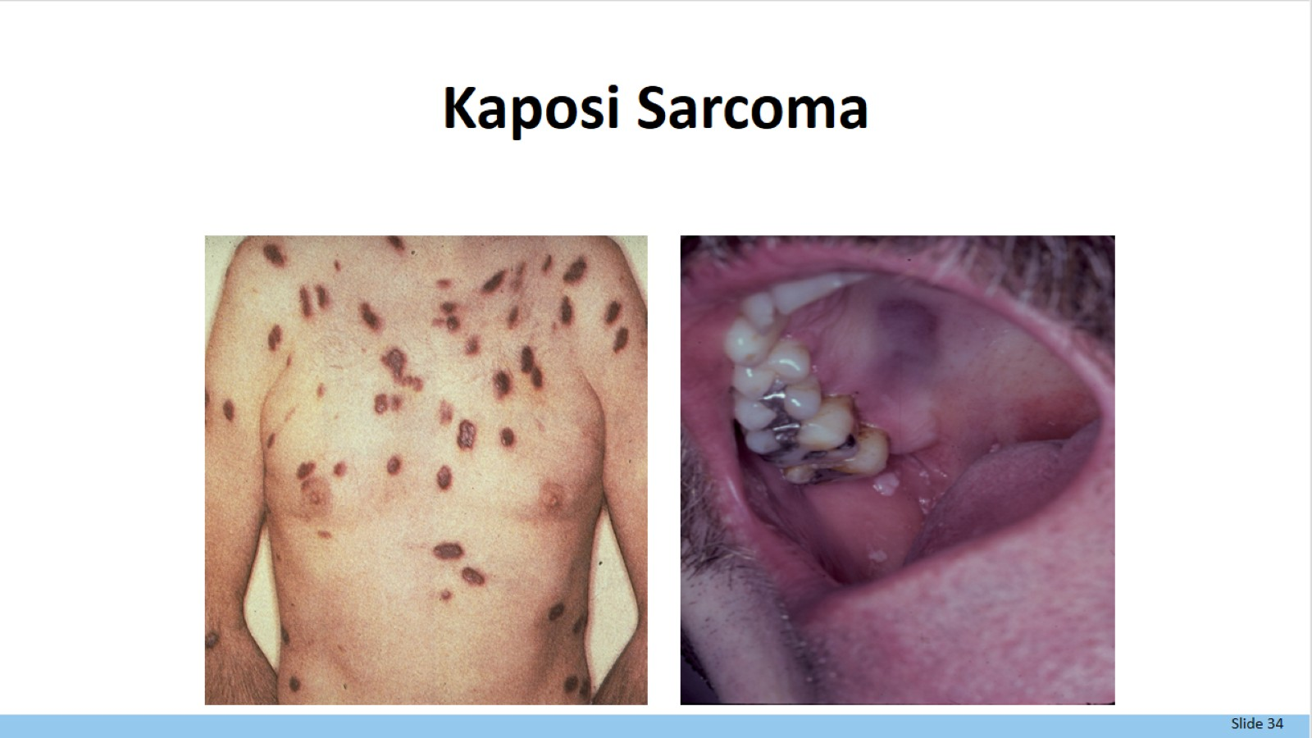
Kaposi Sarcoma

Slide 35
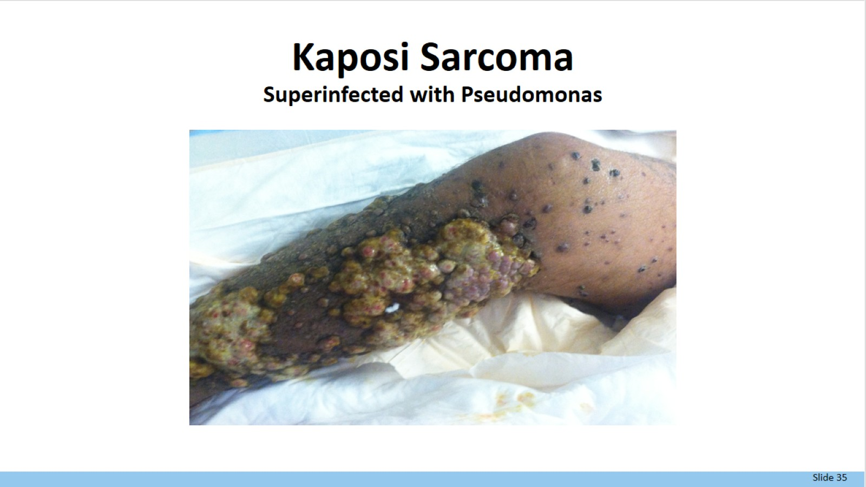
Kaposi Sarcoma
Superinfected with Pseudomonas

Slide 36
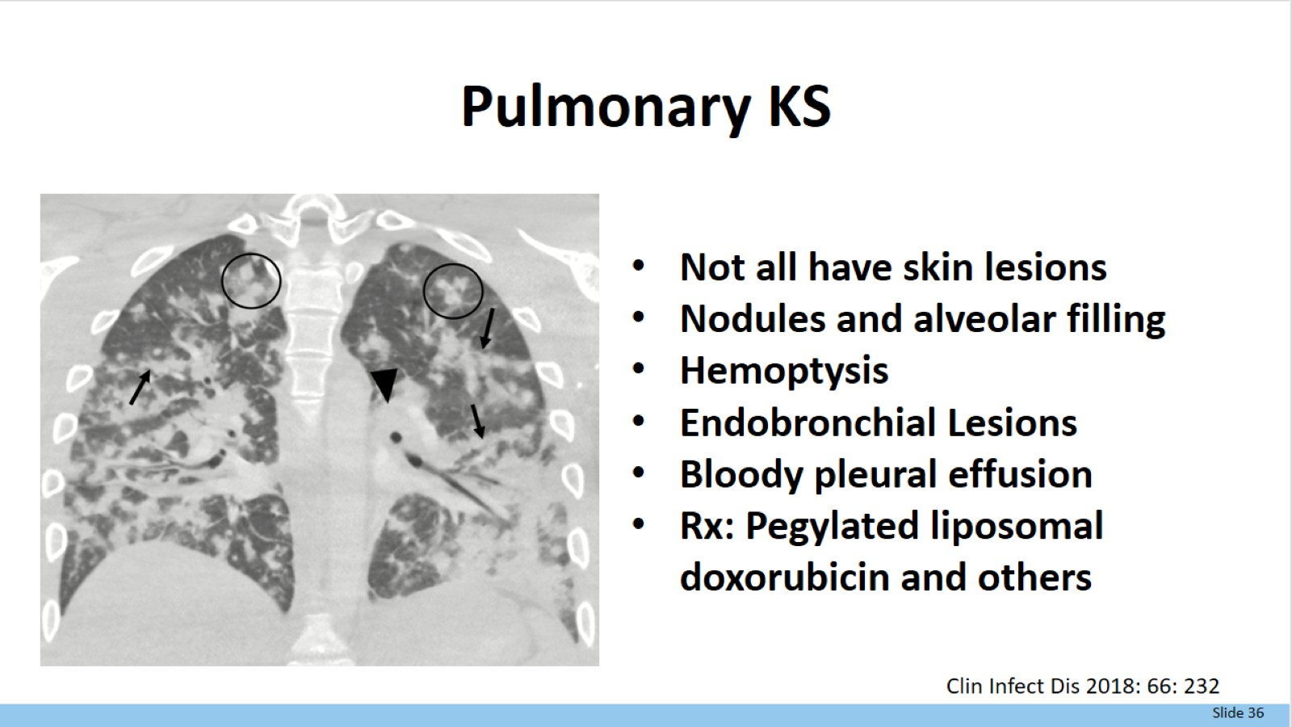
Pulmonary KS

Slide 37
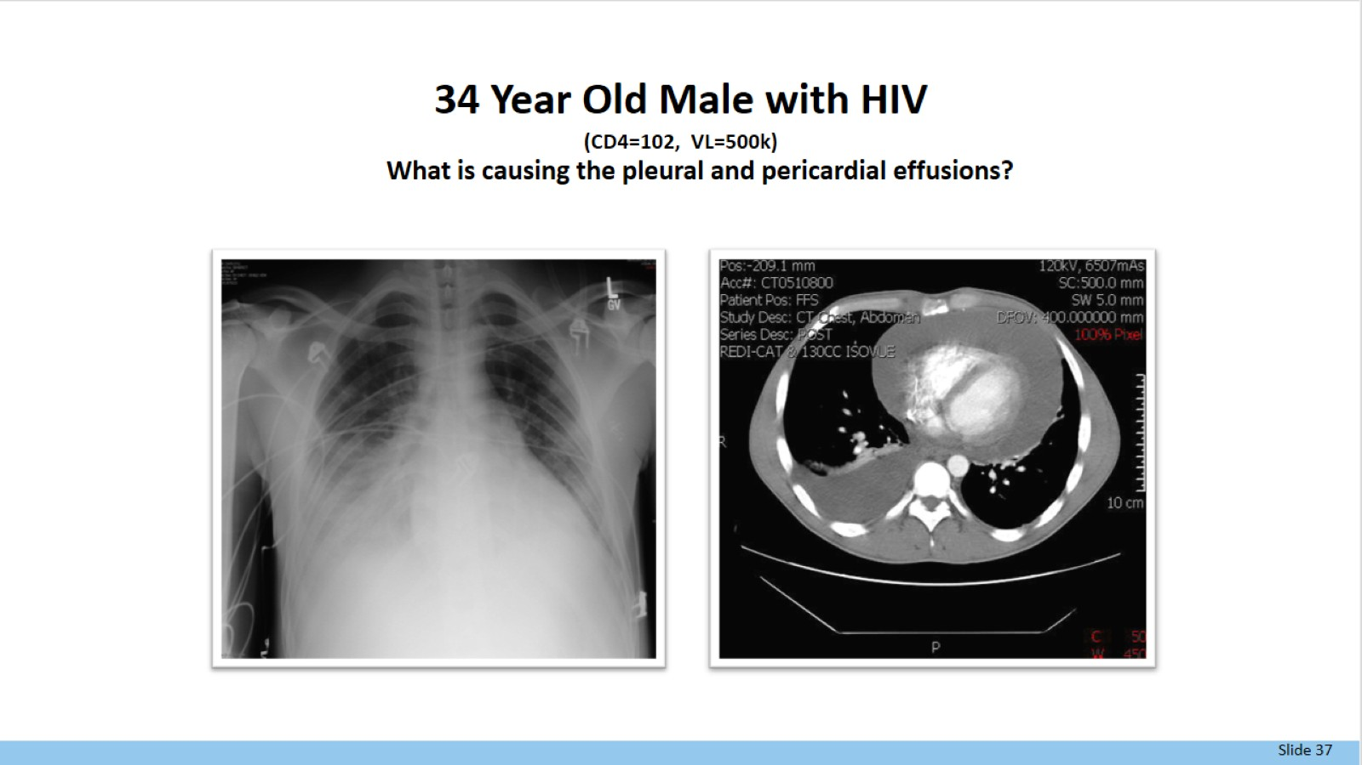
34 Year Old Male with HIV
(CD4=102, VL=500k)
What is causing the pleural and pericardial effusions?

Slide 38
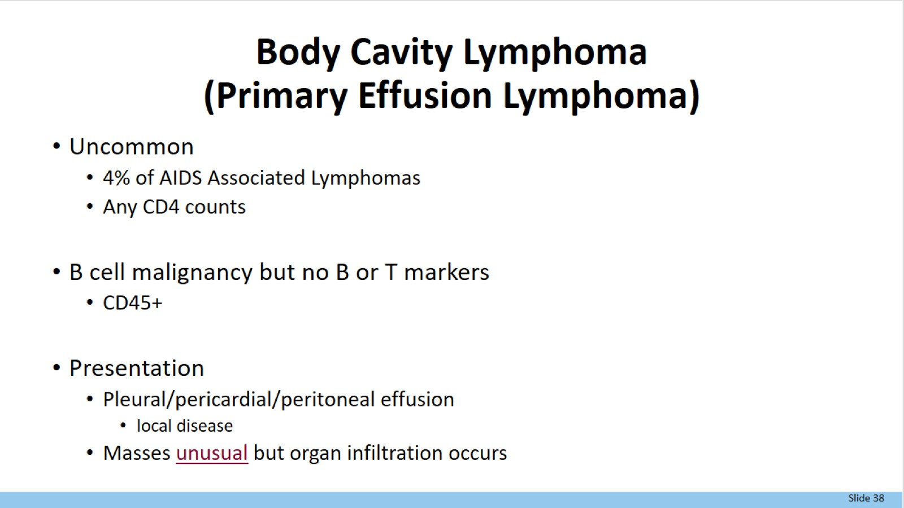
Body Cavity Lymphoma
(Primary Effusion Lymphoma)

Slide 39
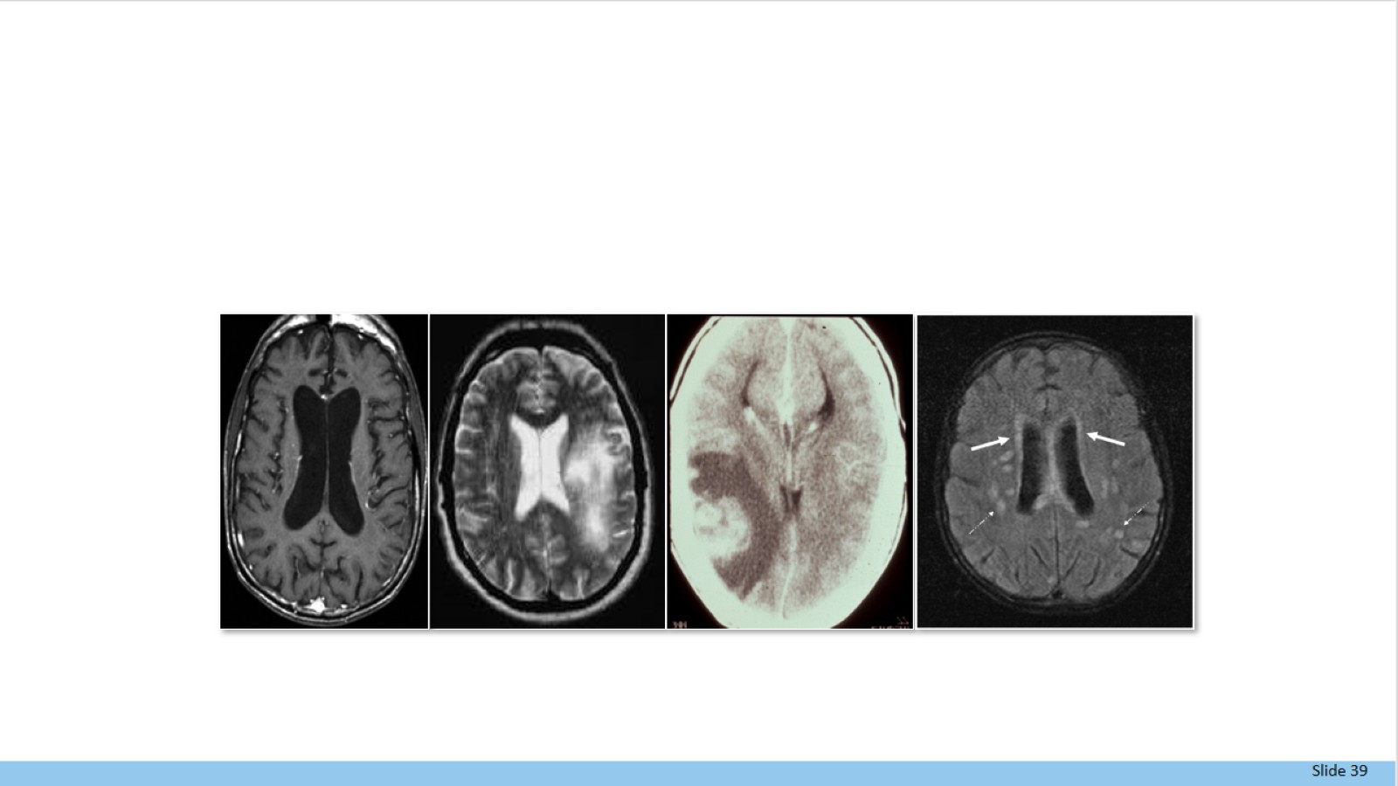
HIV

Slide 40
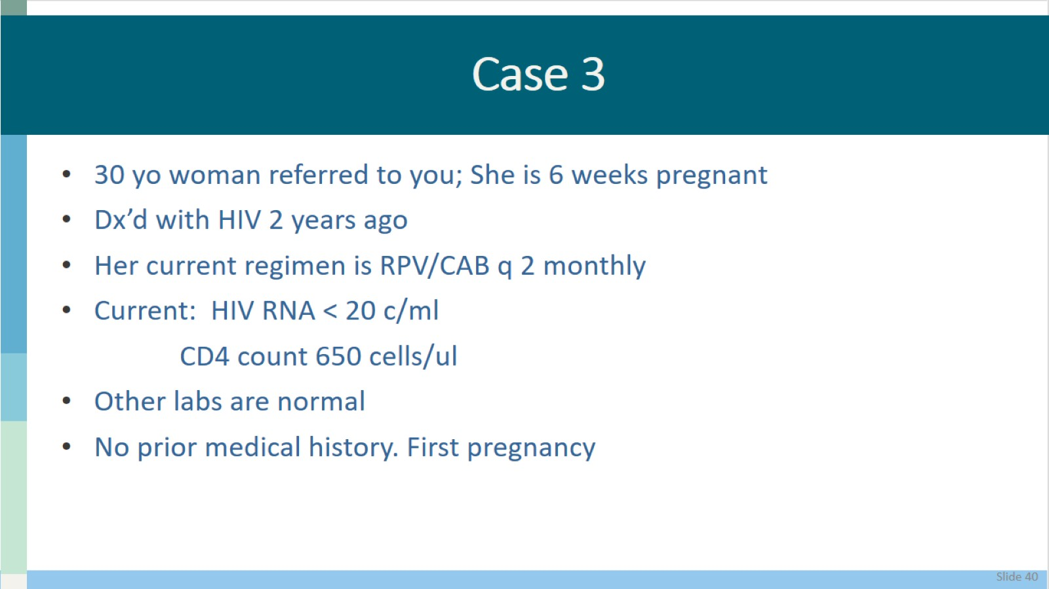
Case 3

Slide 41
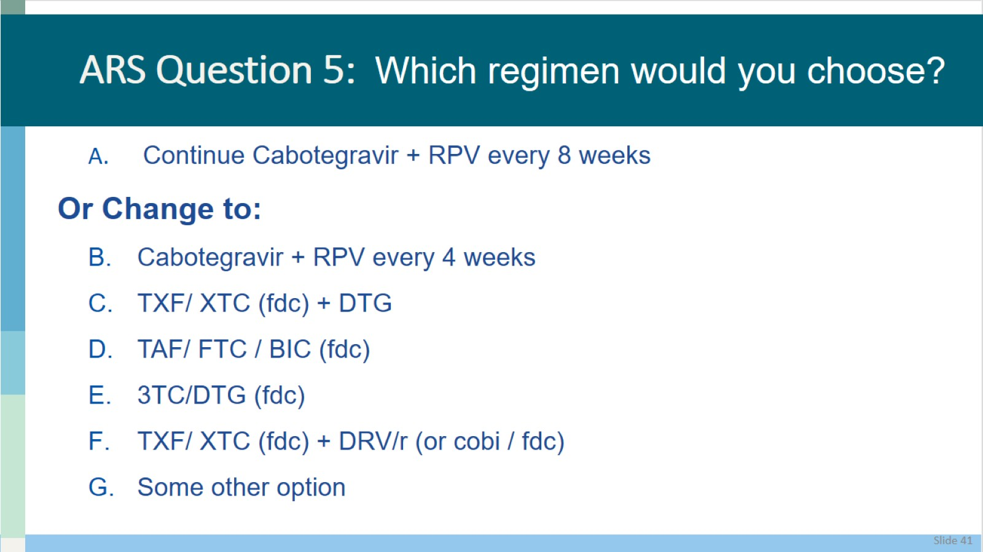
ARS Question 5: Which regimen would you choose?

Slide 42
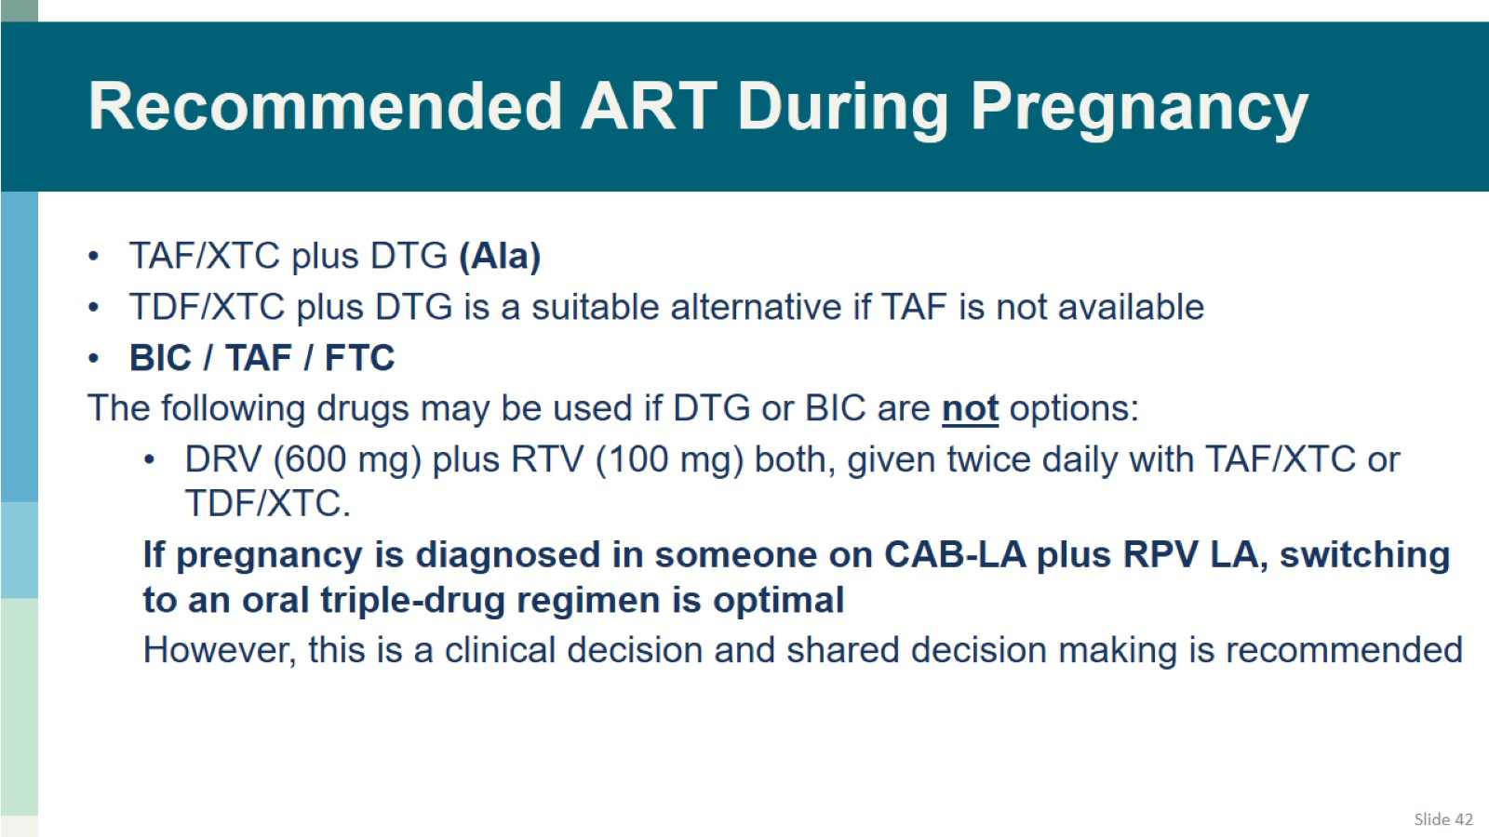
Recommended ART During Pregnancy

Slide 43
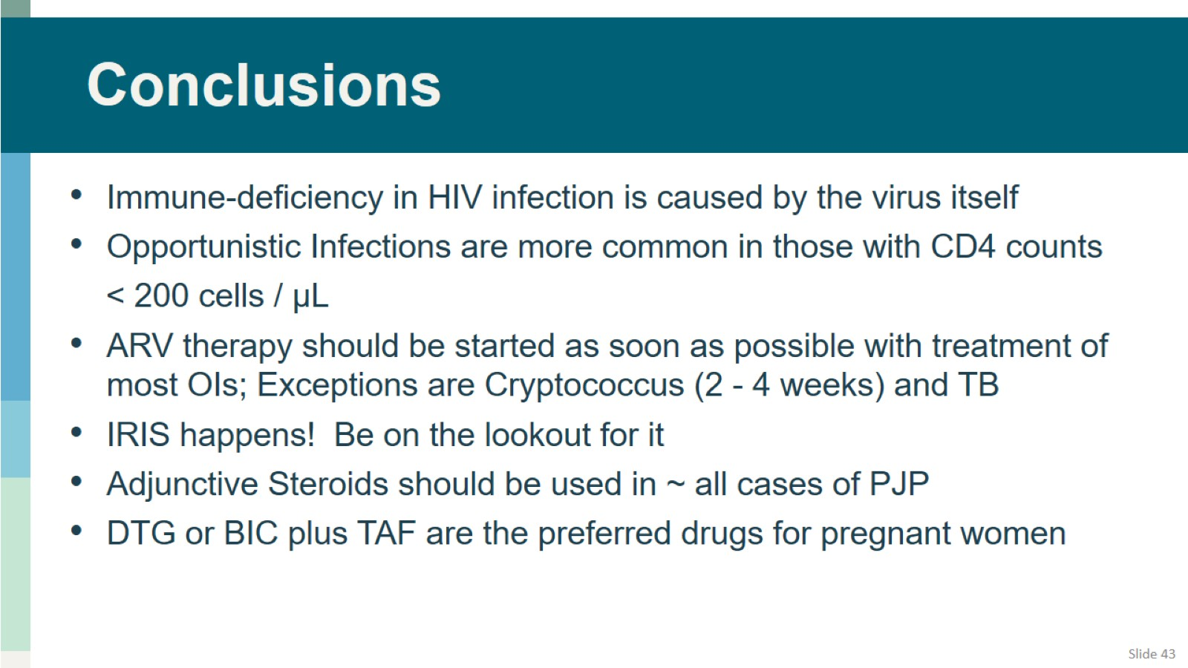
Conclusions

Slide 44

Posttest Question #1

Slide 45
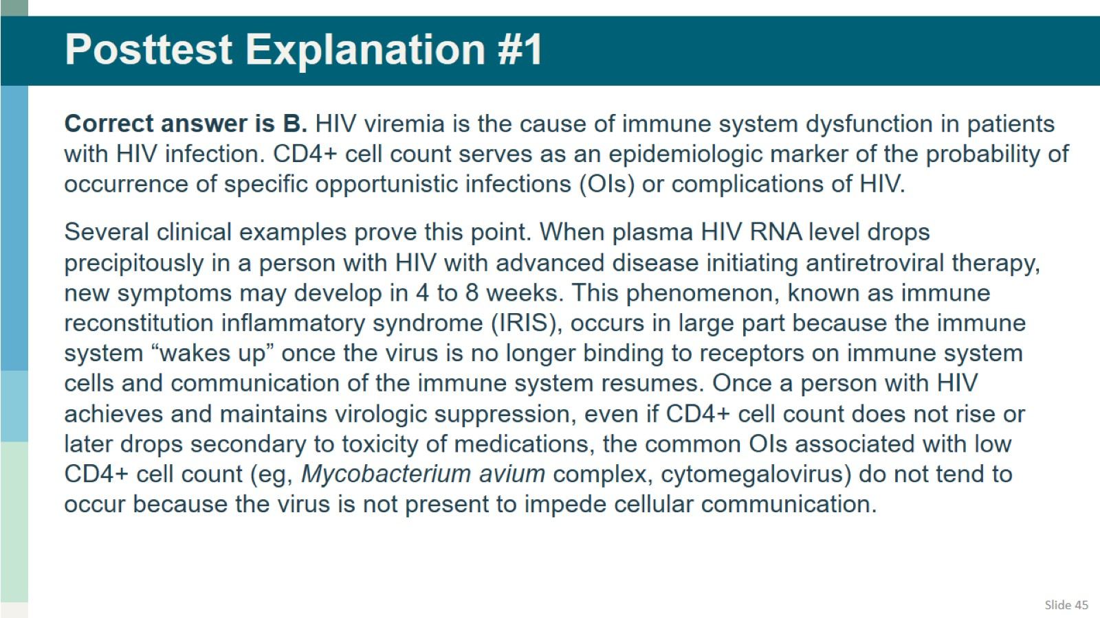
Posttest Explanation #1

Slide 46

Posttest Question #2

Slide 47
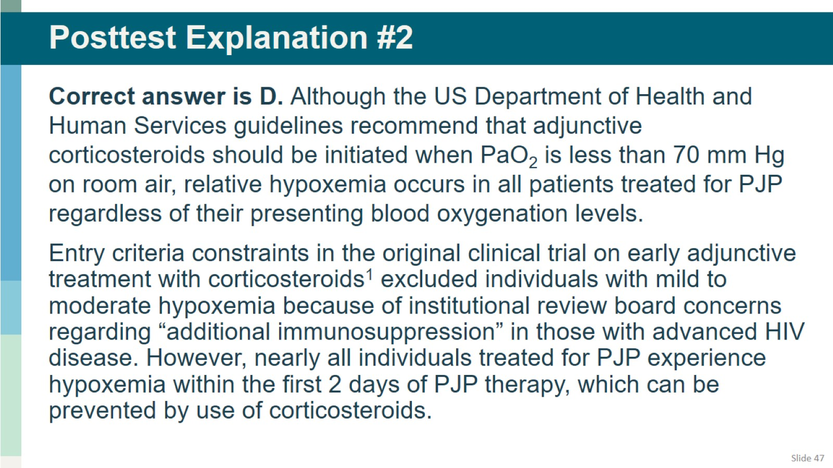
Posttest Explanation #2

Slide 48
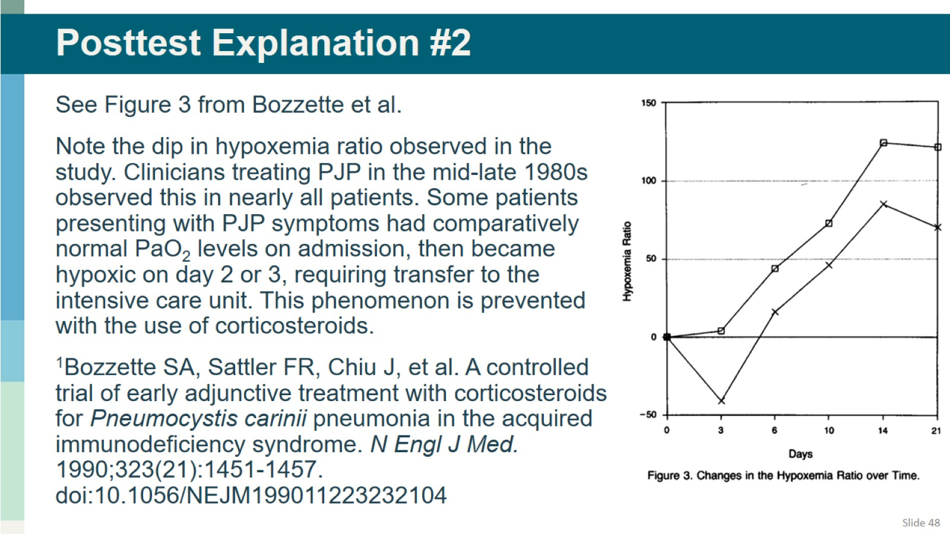
Posttest Explanation #2

Slide 49


Slide 50

Q and A Session

