Slide 1

Initial Evaluation and Preventative Care for Individuals Newly Diagnosed With HIV

Slide 2
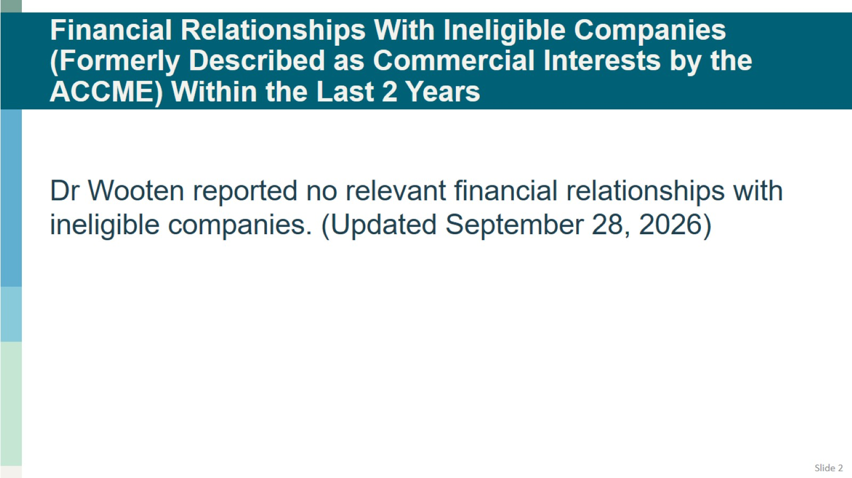
Financial Relationships With Ineligible Companies (Formerly Described as Commercial Interests by the ACCME) Within the Last 2 Years

Slide 3
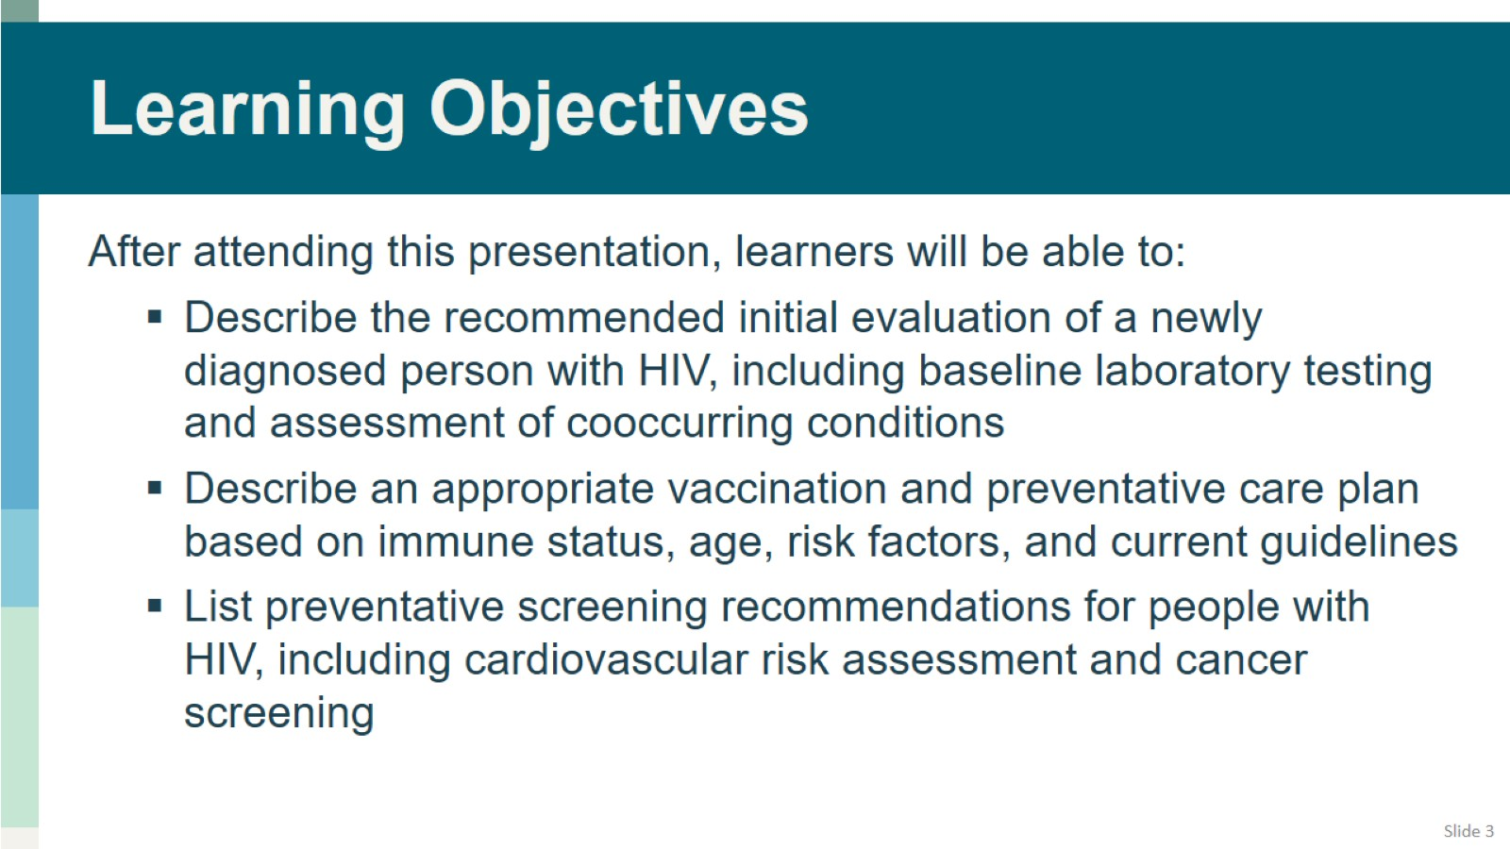
Learning Objectives

Slide 4
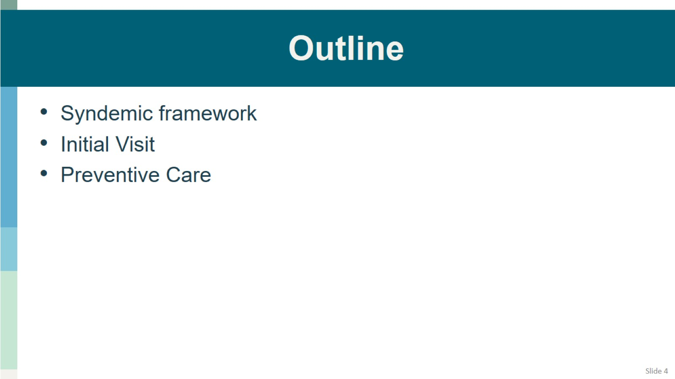
Outline

Slide 5
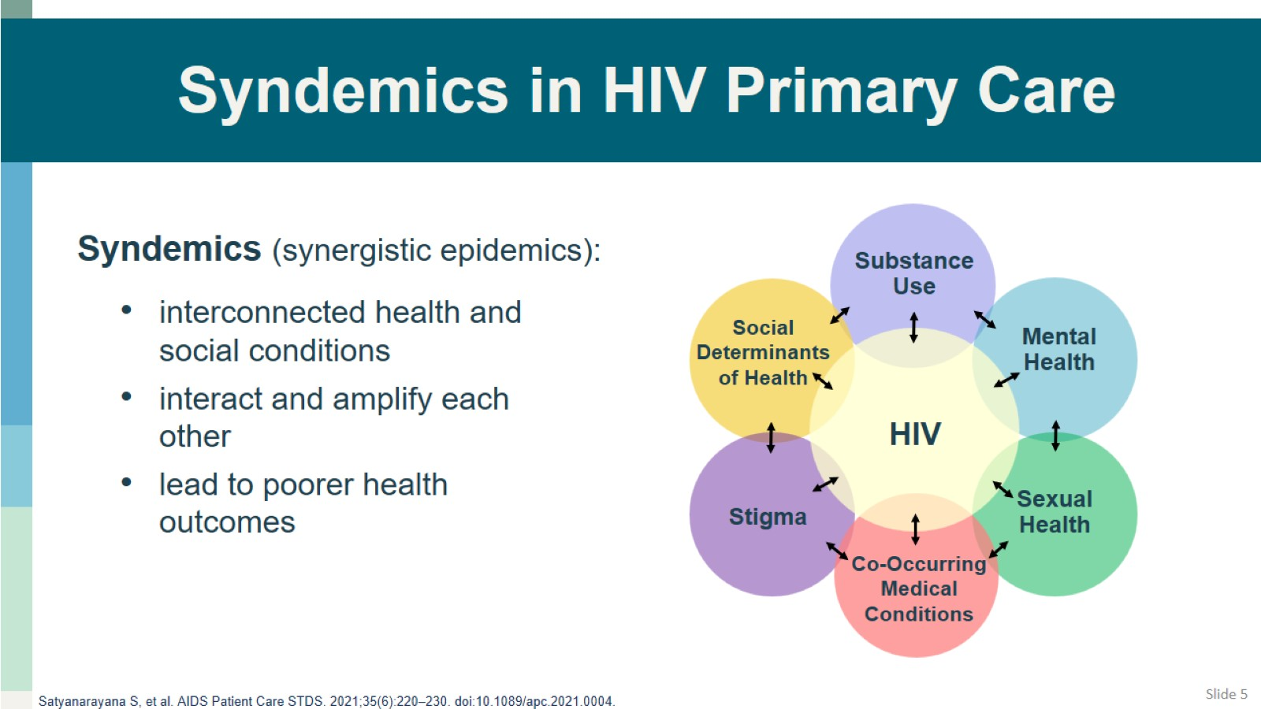
Syndemics in HIV Primary Care

Slide 6
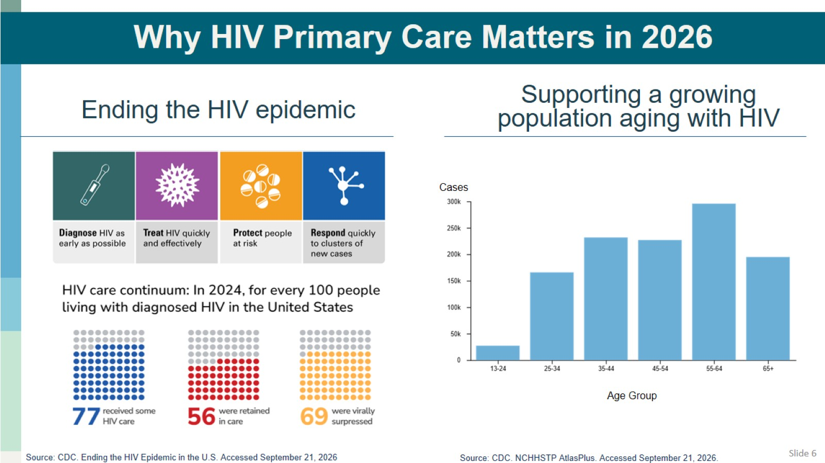
Why HIV Primary Care Matters in 2026

Slide 7
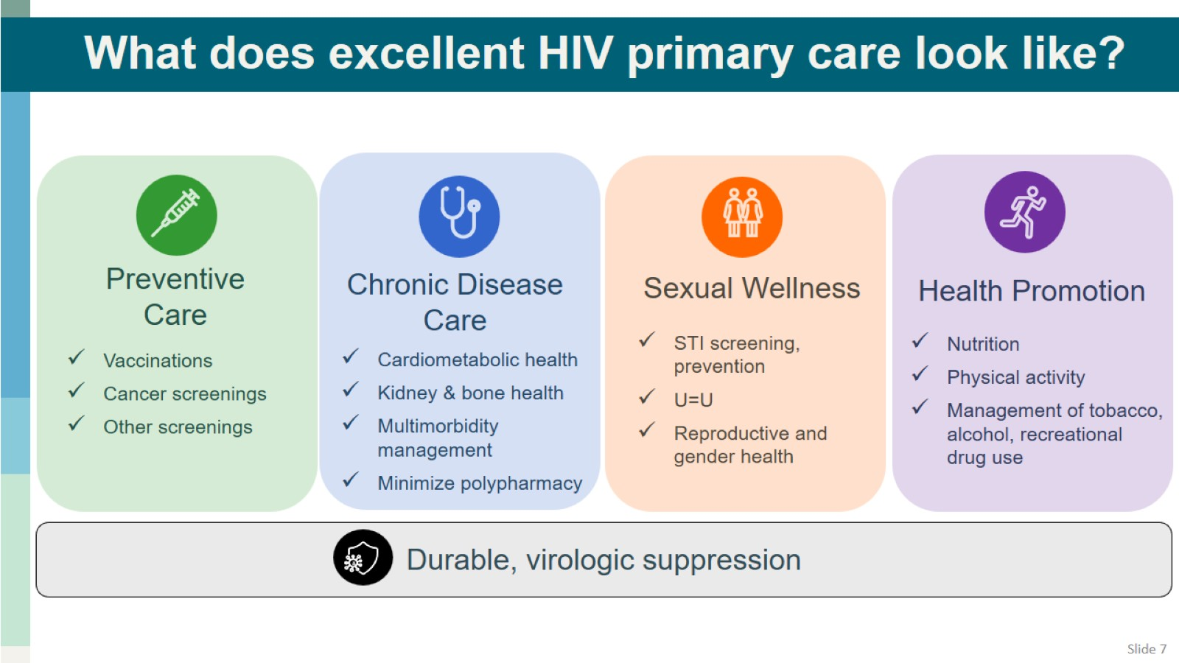
What does excellent HIV primary care look like?

Slide 8
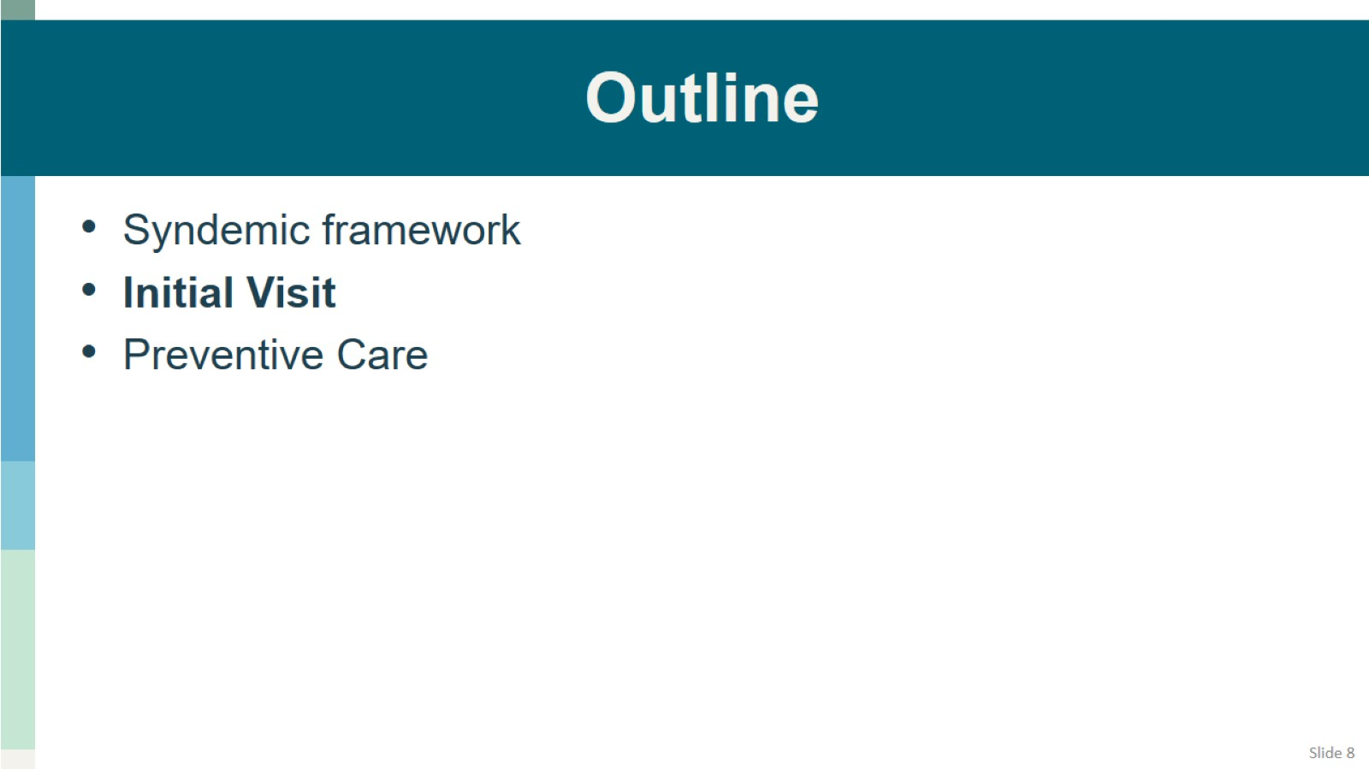
Outline

Slide 9
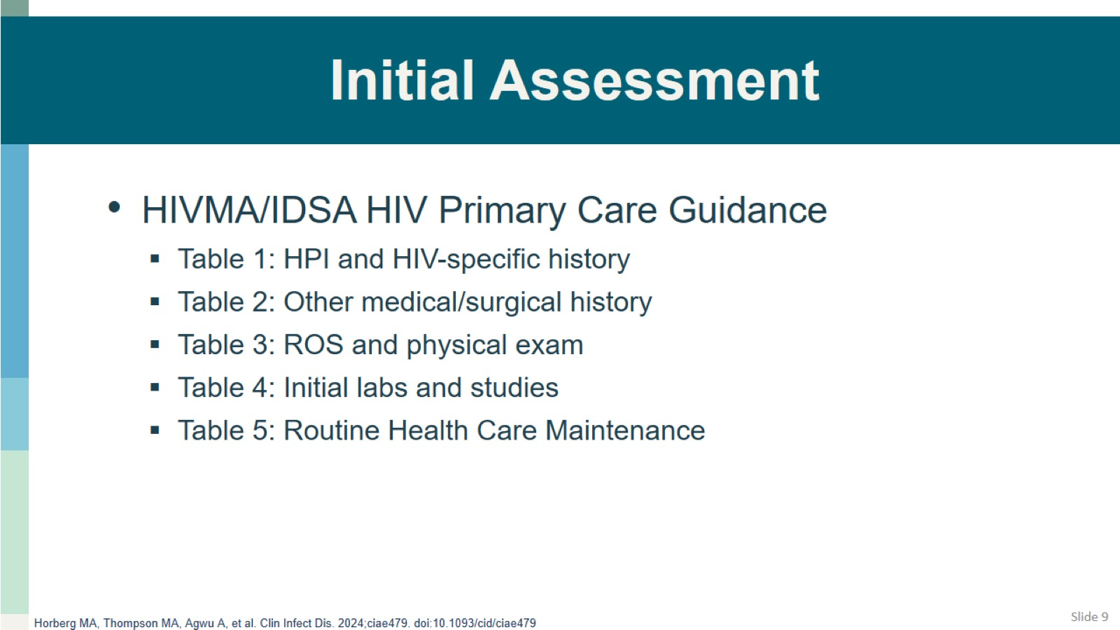
Initial Assessment

Slide 10
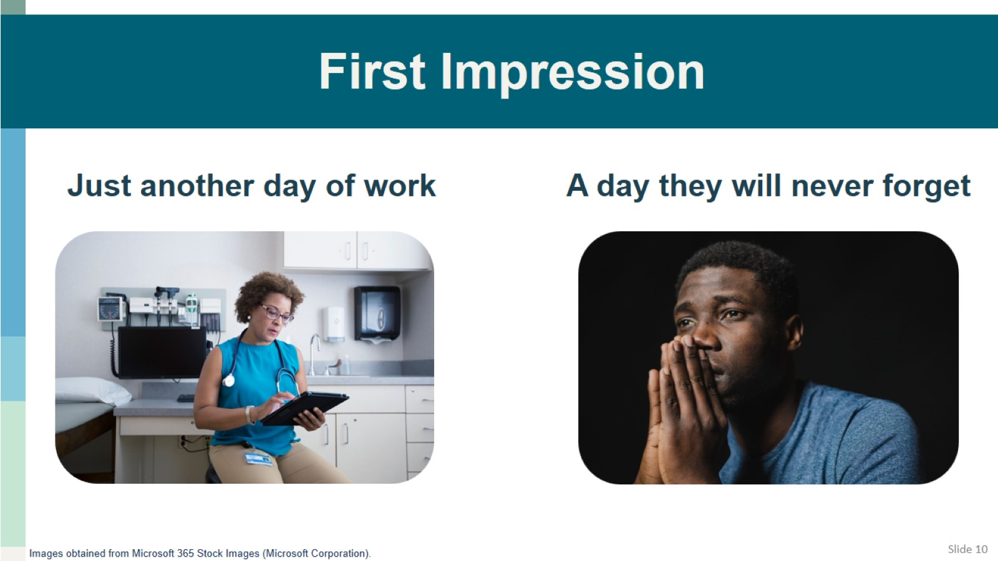
First Impression

Slide 11
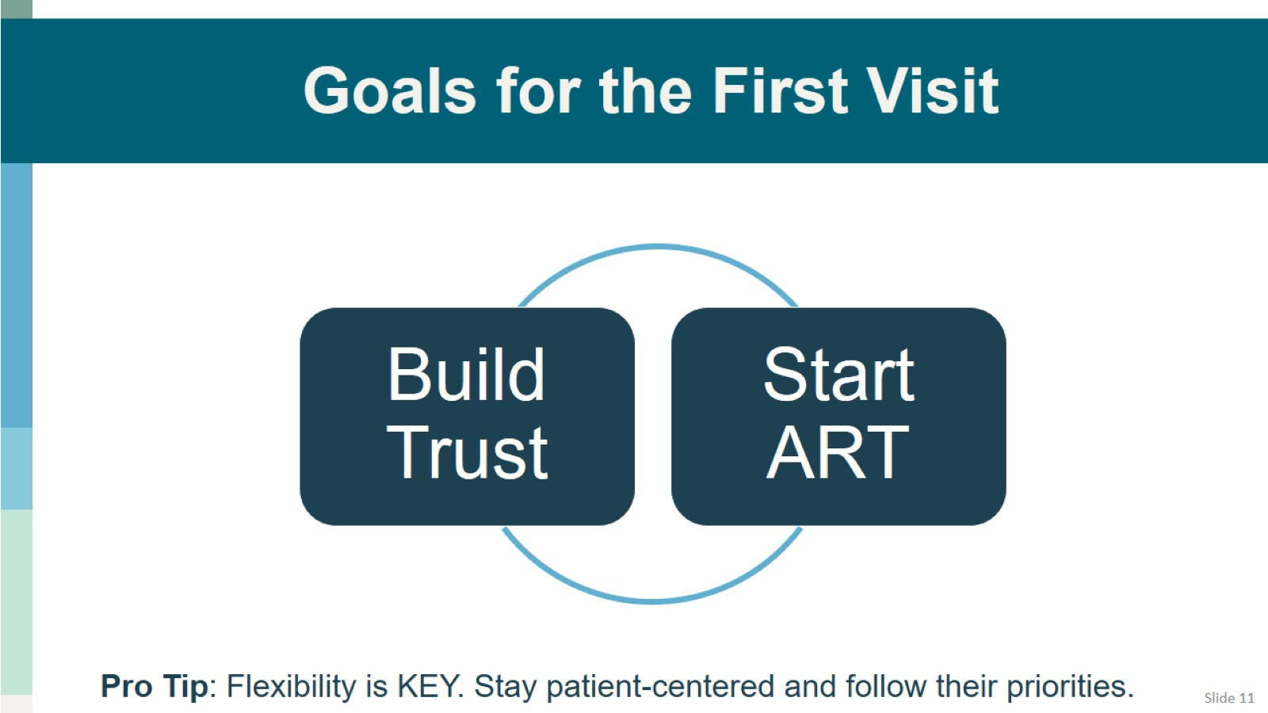
Goals for the First Visit

Slide 12
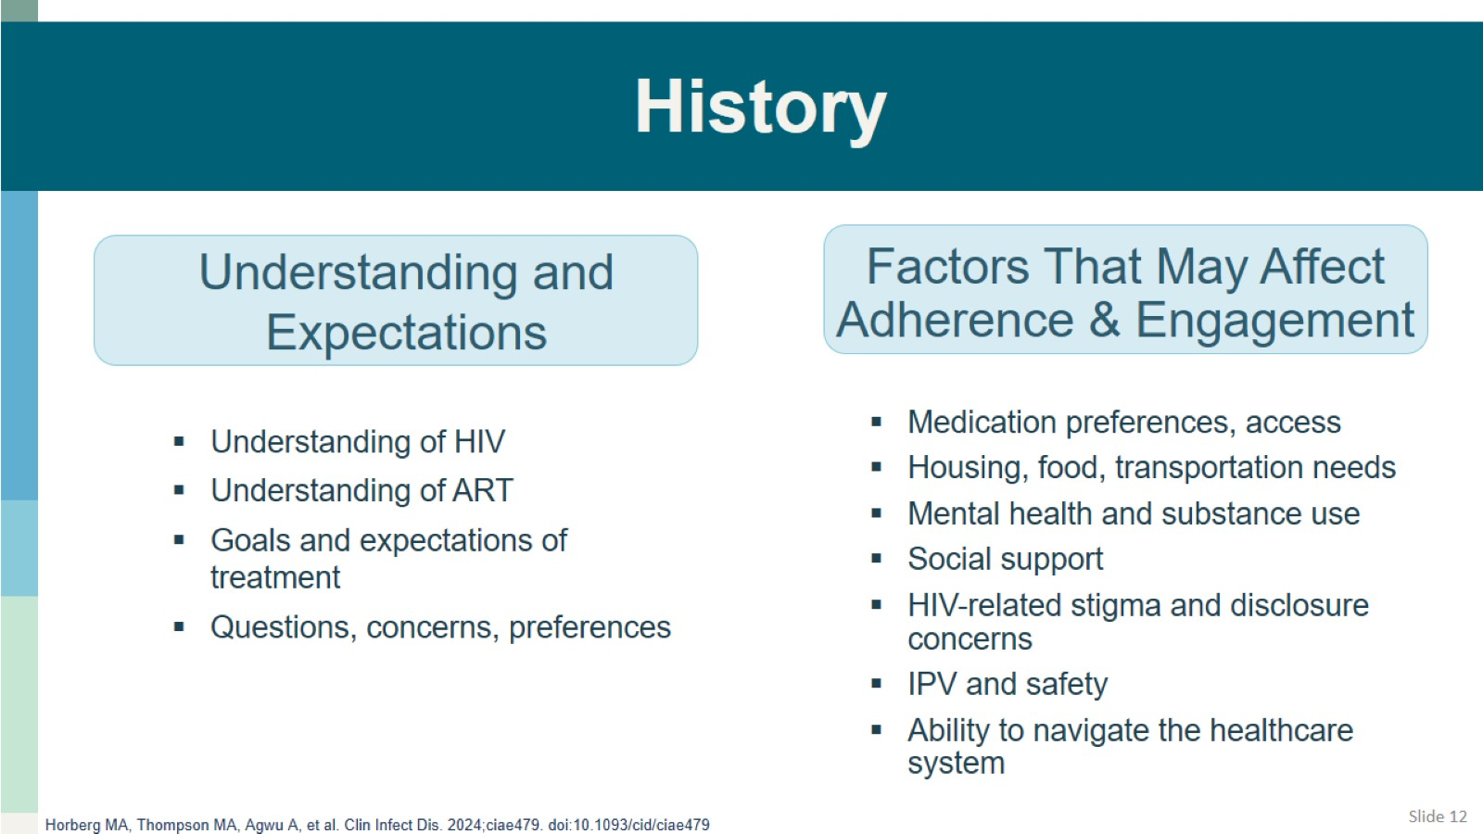
History

Slide 13
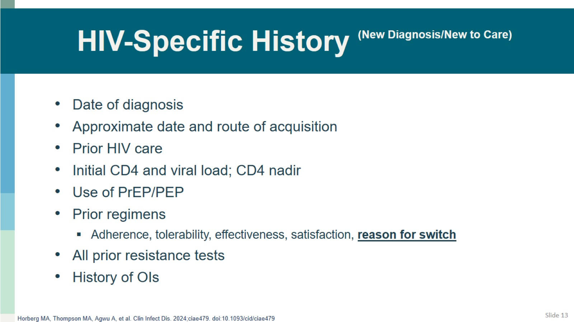
HIV-Specific History ^{(New Diagnosis/New to Care)}

Slide 14
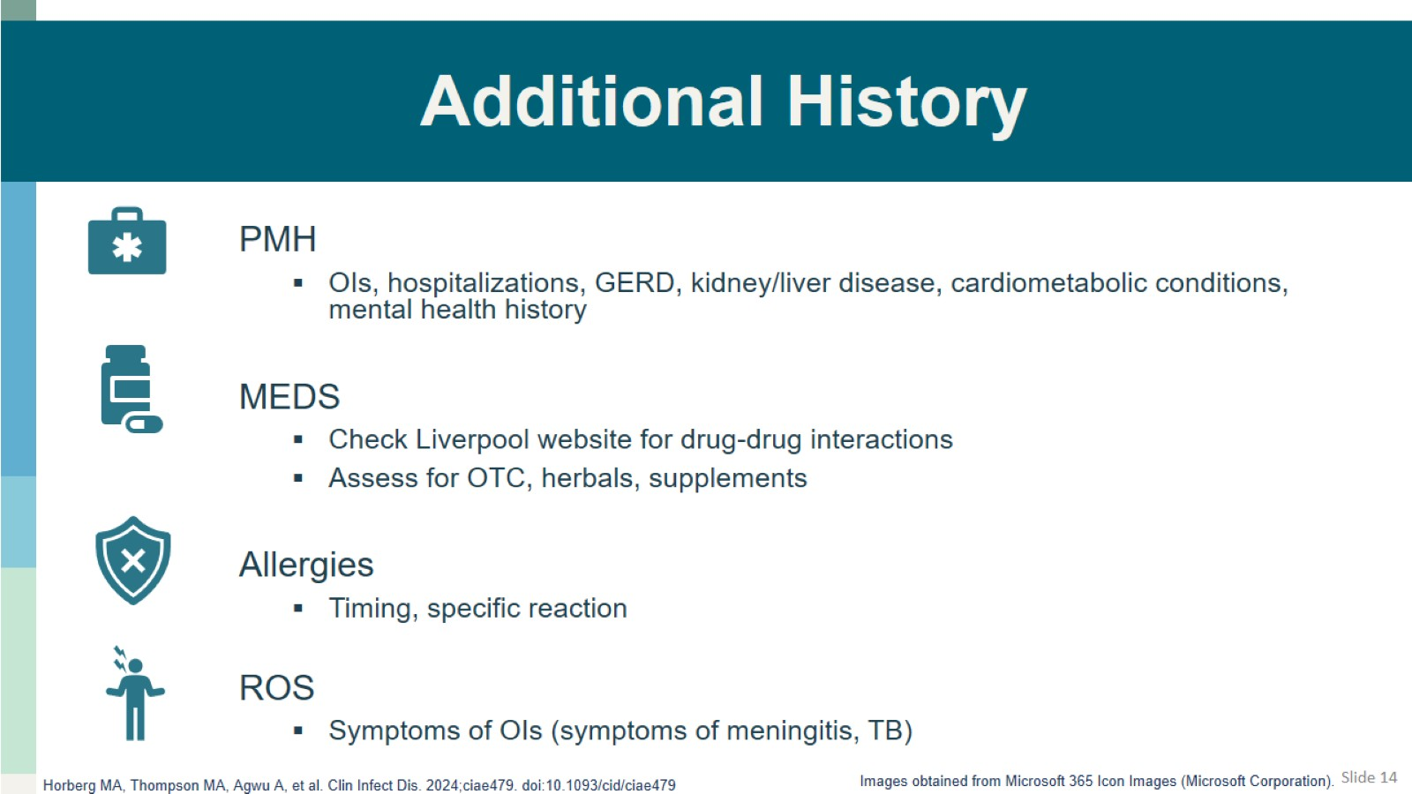
Additional History

Slide 15
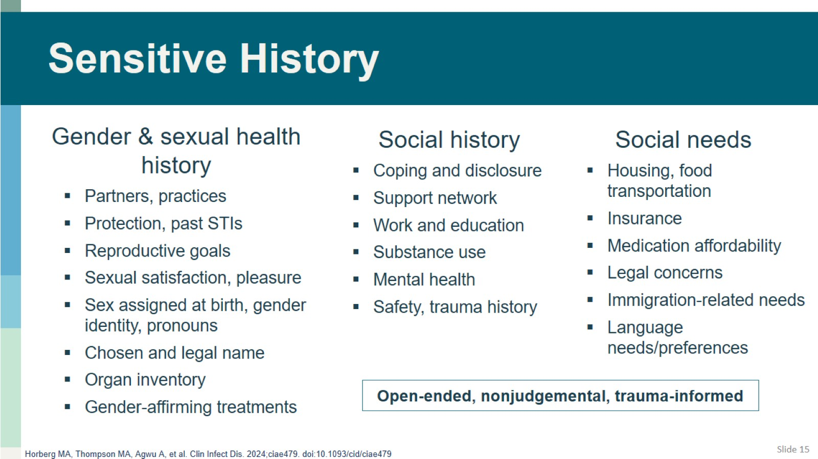
Sensitive History

Slide 16
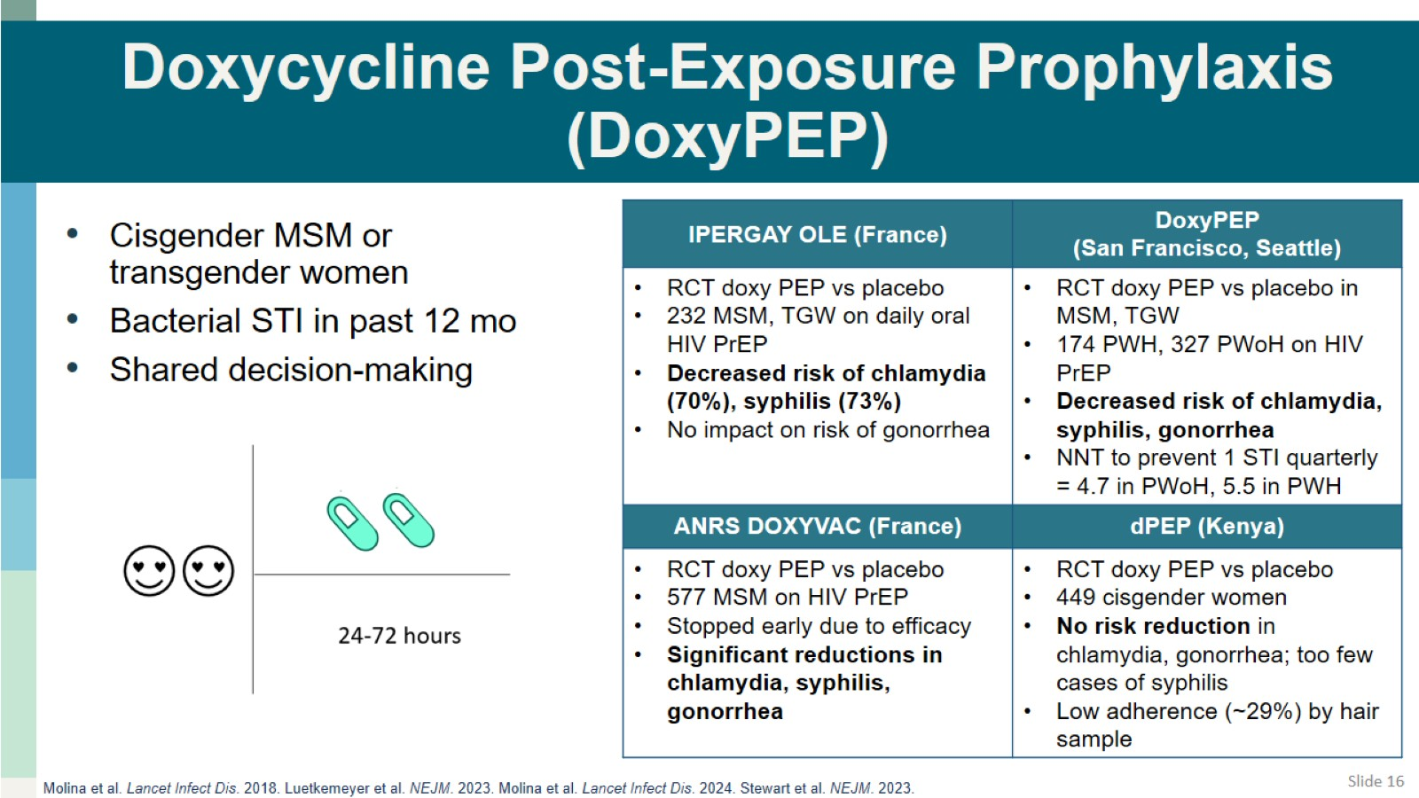
Doxycycline Post-Exposure Prophylaxis (DoxyPEP)

Slide 17
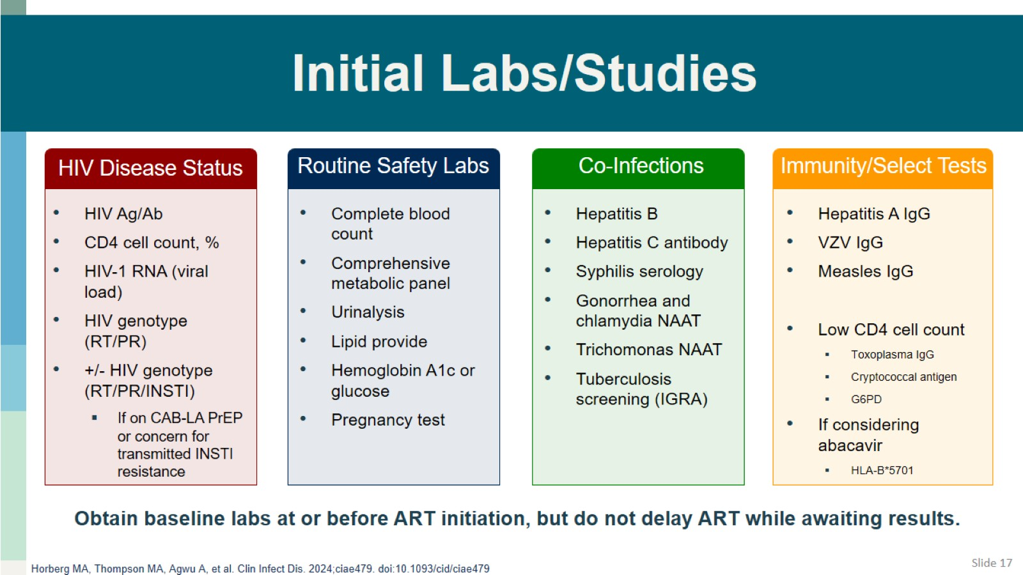
Initial Labs/Studies

Slide 18
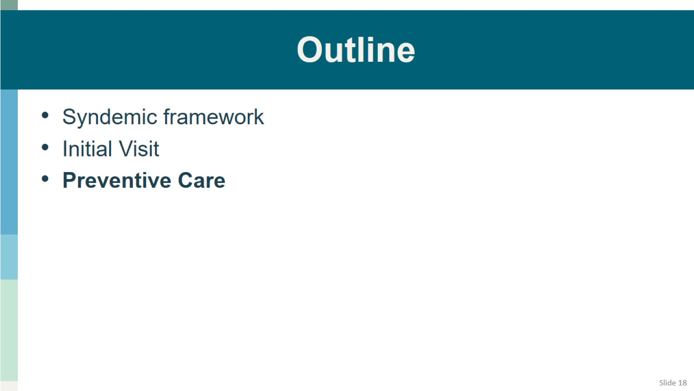
Outline

Slide 19
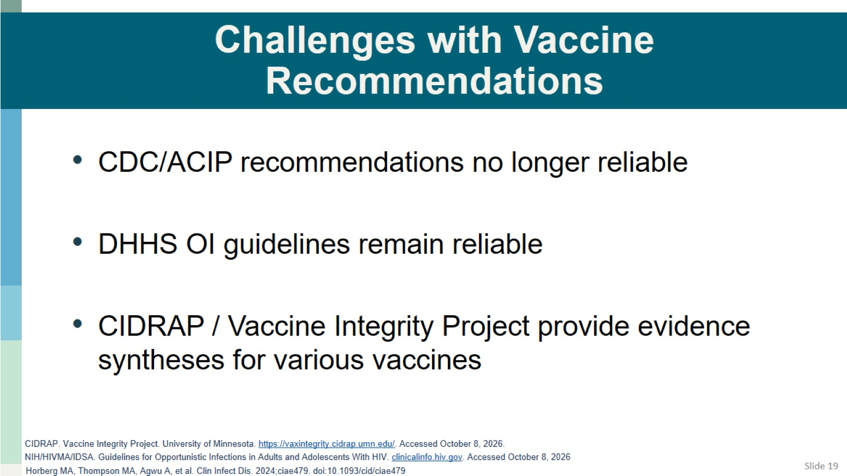
Challenges with Vaccine Recommendations

Slide 20
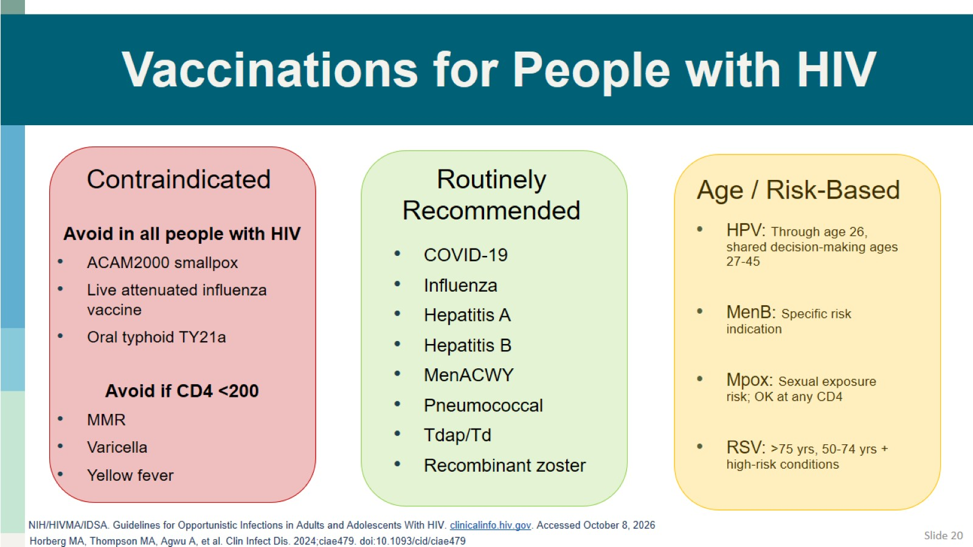
Vaccinations for People with HIV

Slide 21
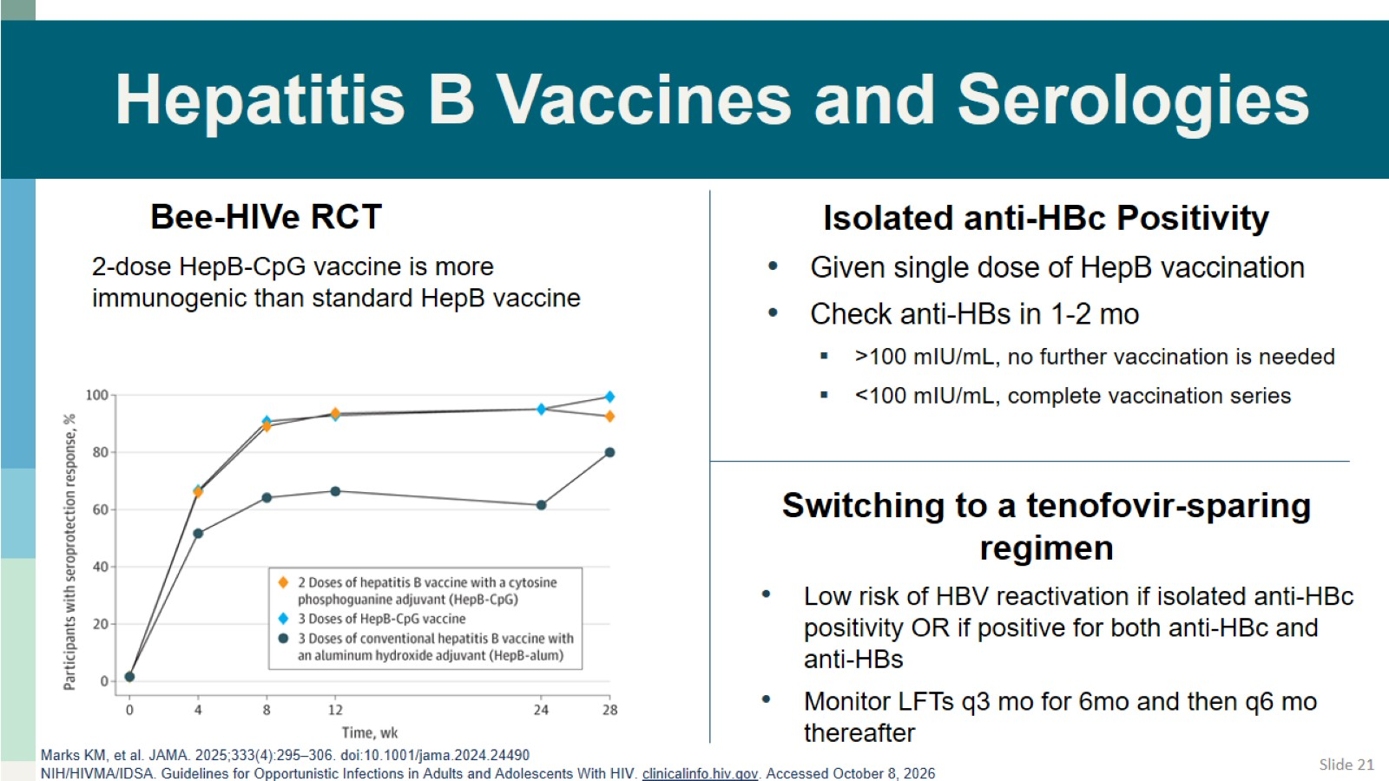
Hepatitis B Vaccines and Serologies

Slide 22
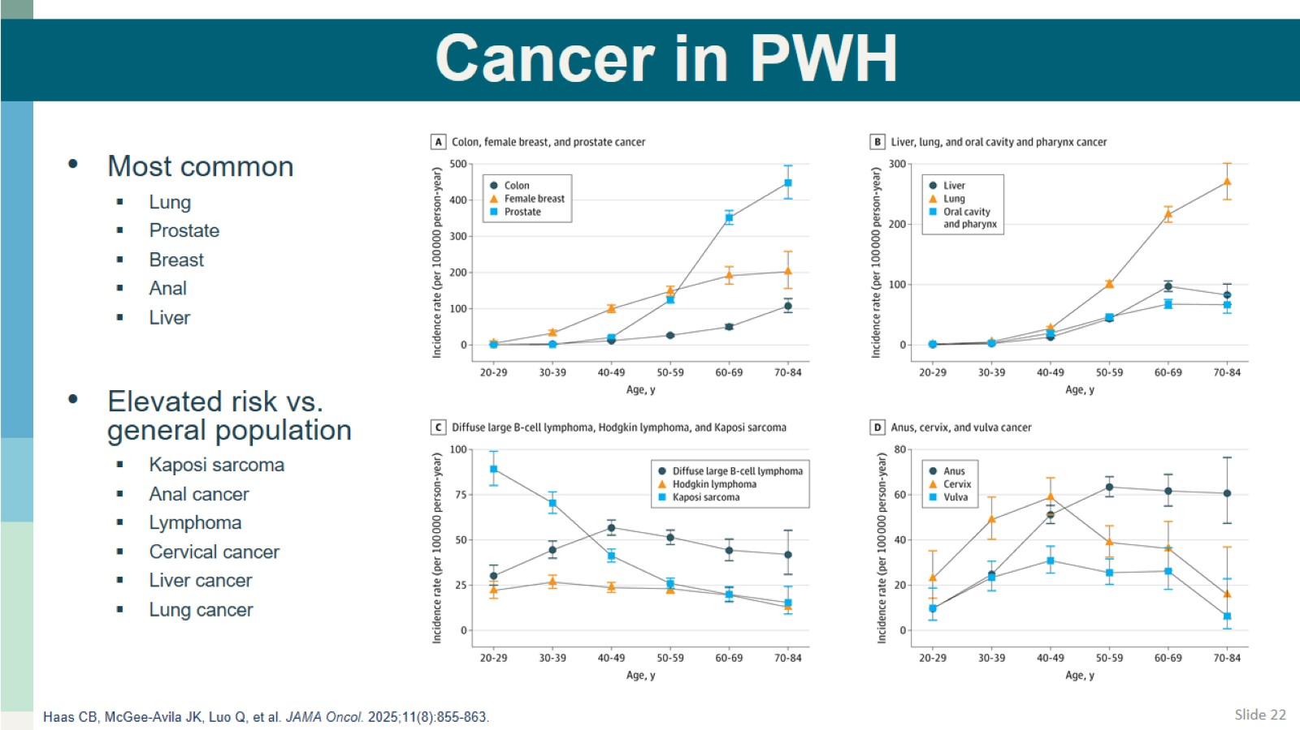
Cancer in PWH

Slide 23
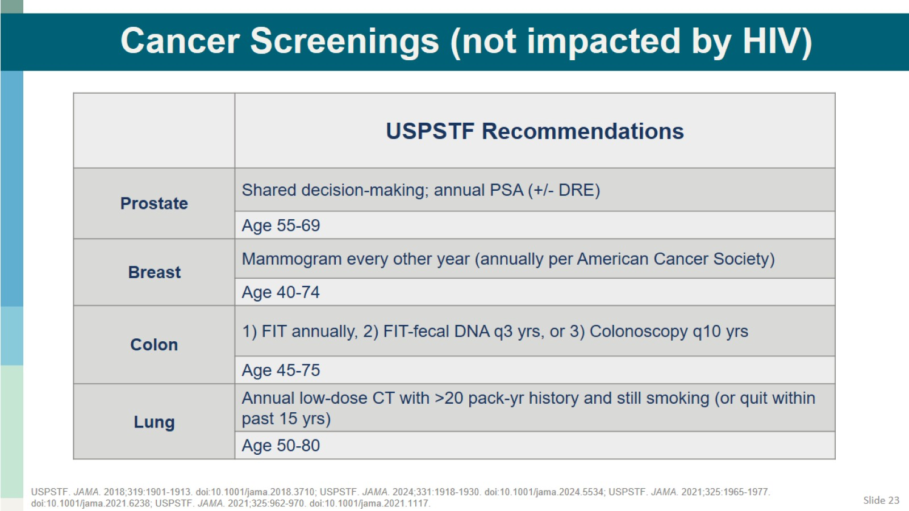
Cancer Screenings (not impacted by HIV)

Slide 24
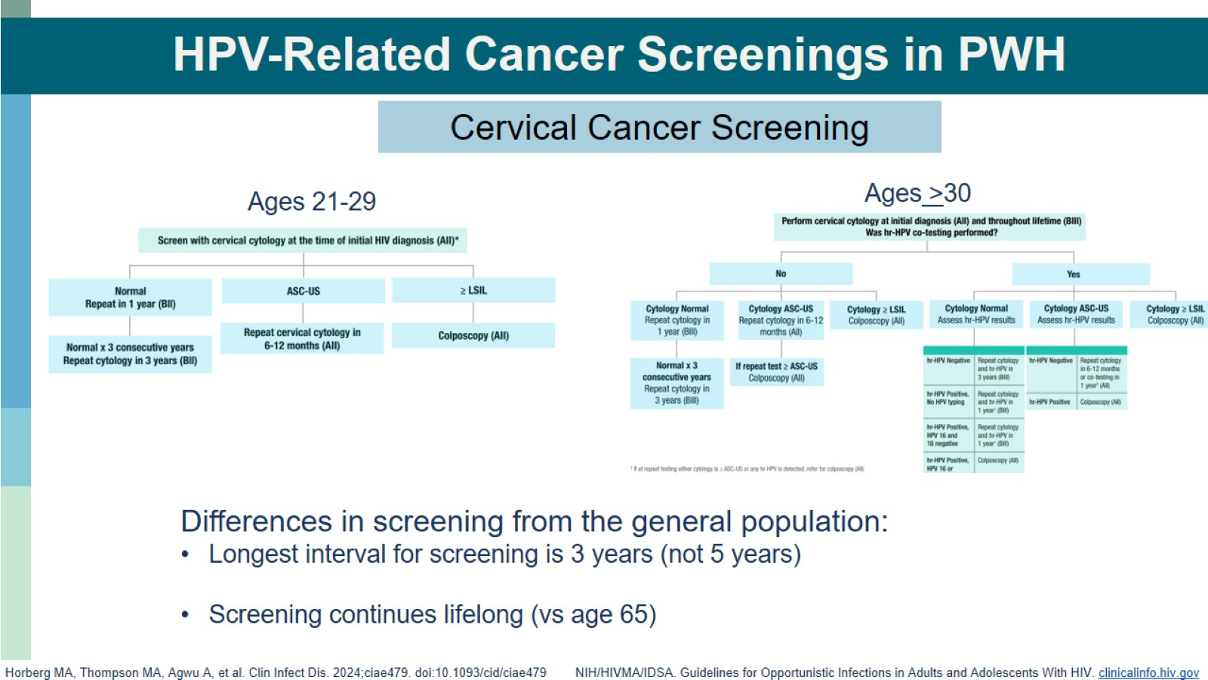
HPV-Related Cancer Screenings in PWH

Slide 25
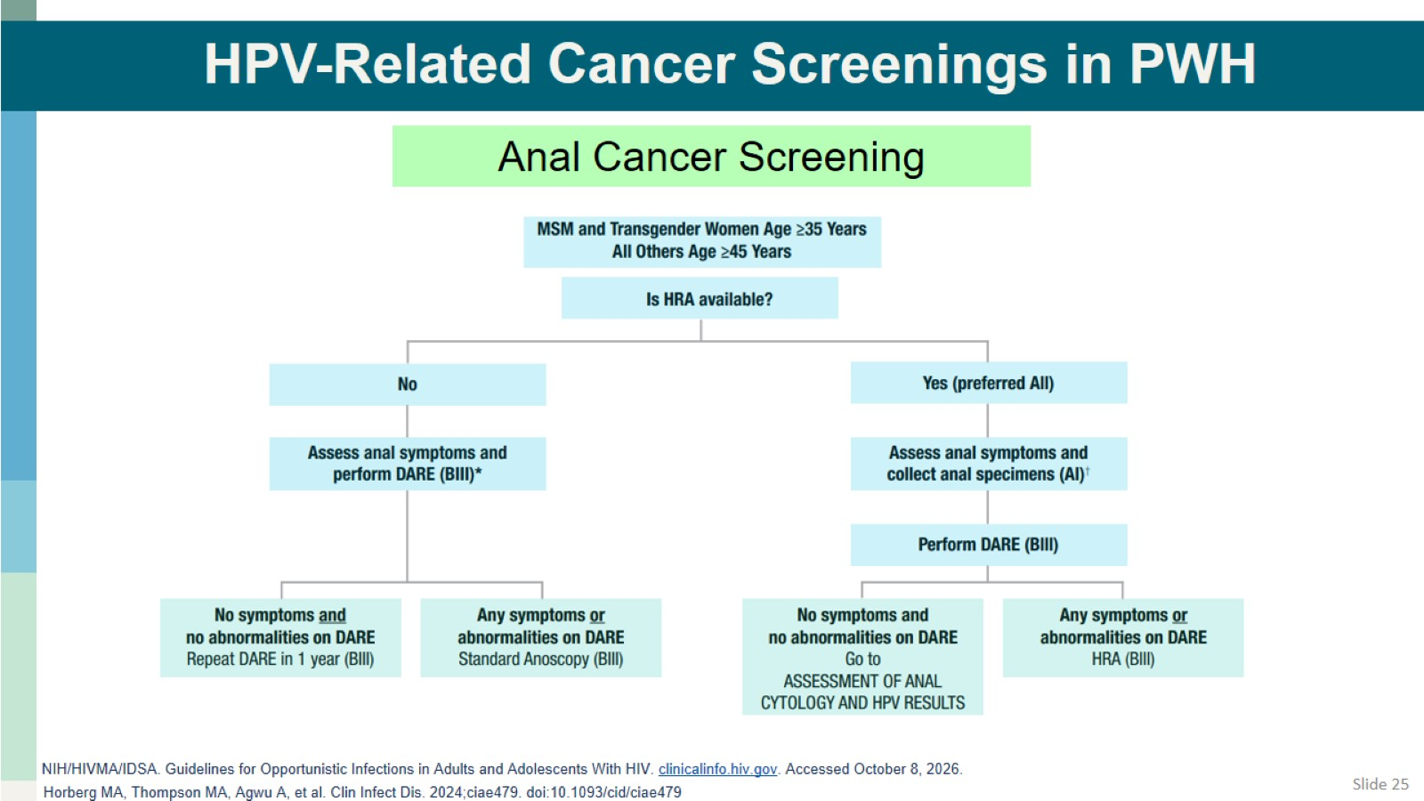
HPV-Related Cancer Screenings in PWH

Slide 26
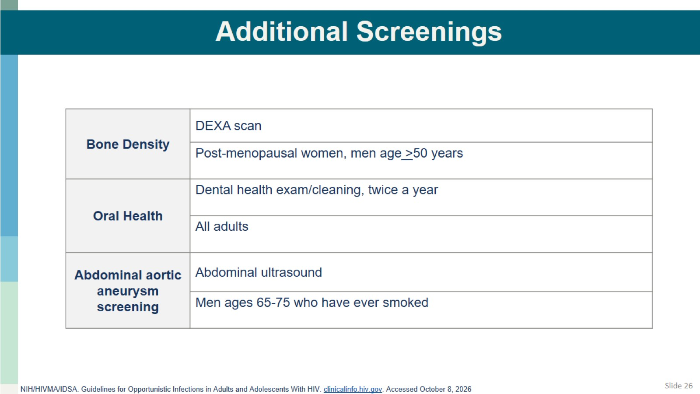
Additional Screenings

Slide 27
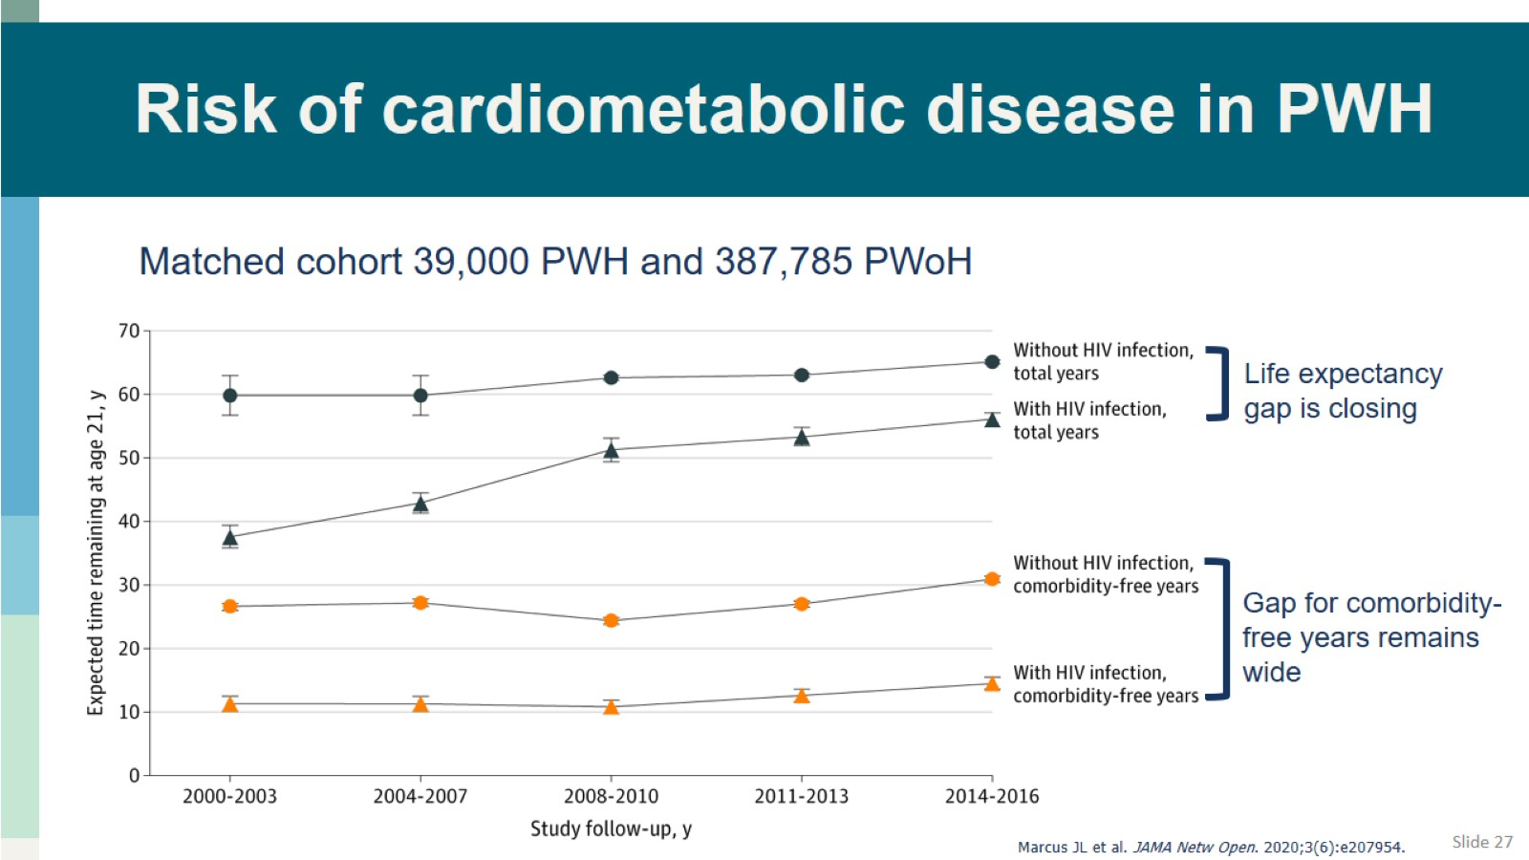
Risk of cardiometabolic disease in PWH

Slide 28
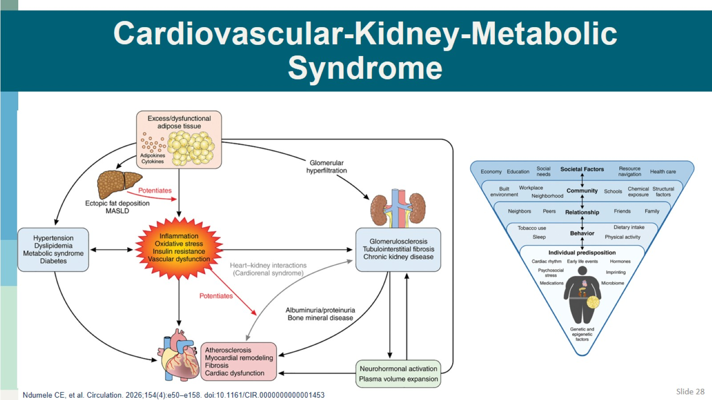
Cardiovascular-Kidney-Metabolic Syndrome

Slide 29
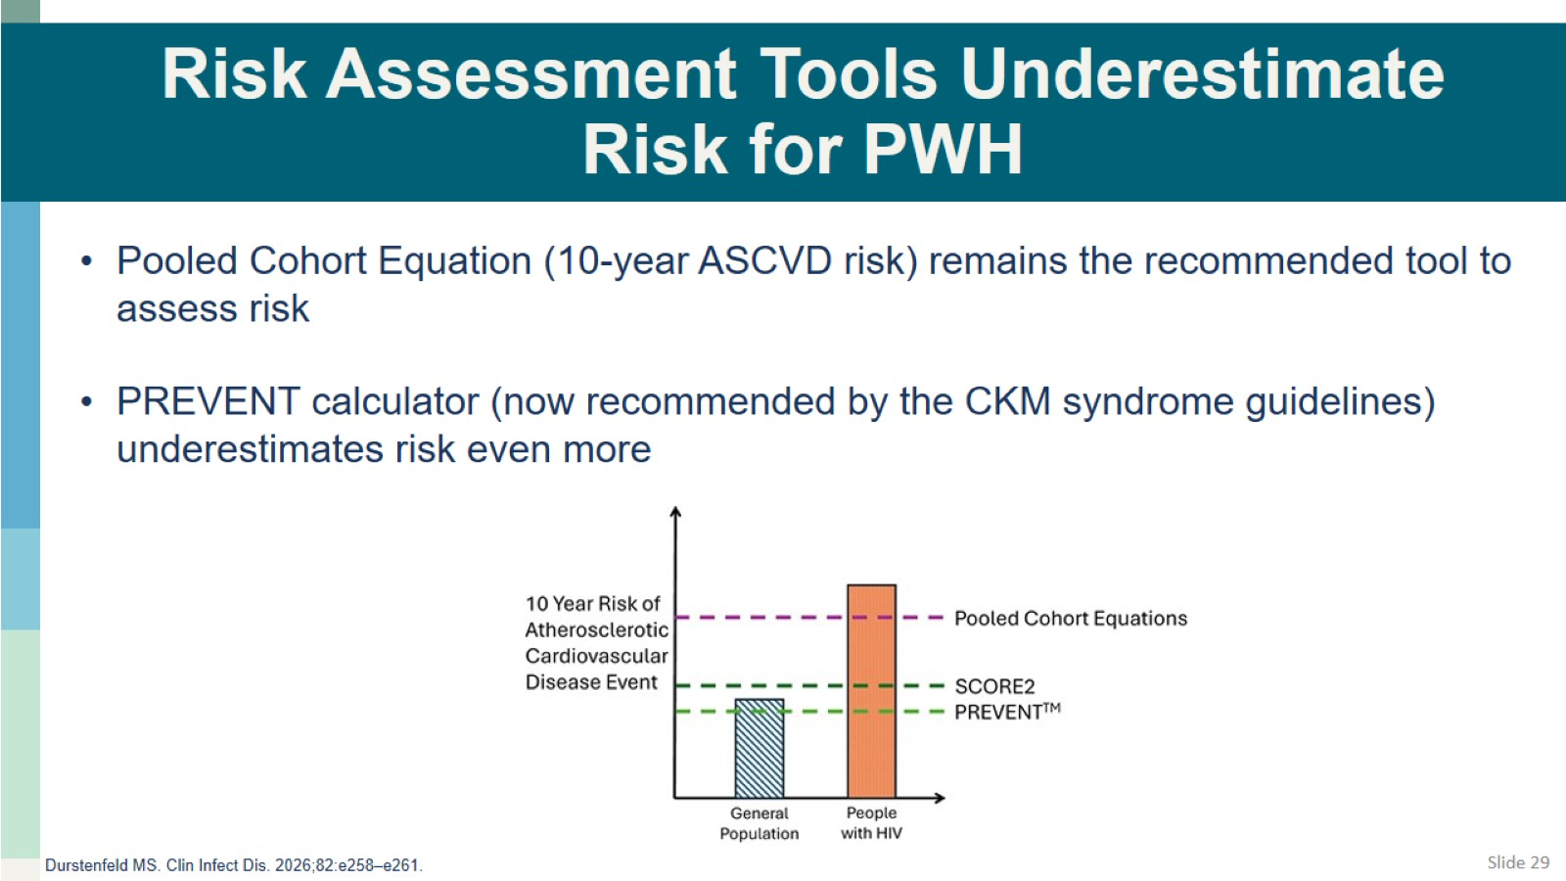
Risk Assessment Tools Underestimate Risk for PWH

Slide 30
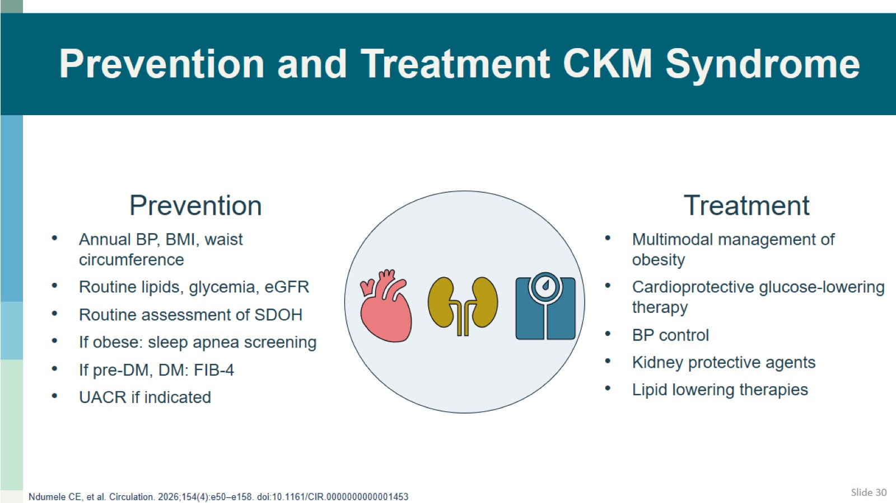
Prevention and Treatment CKM Syndrome

Slide 31
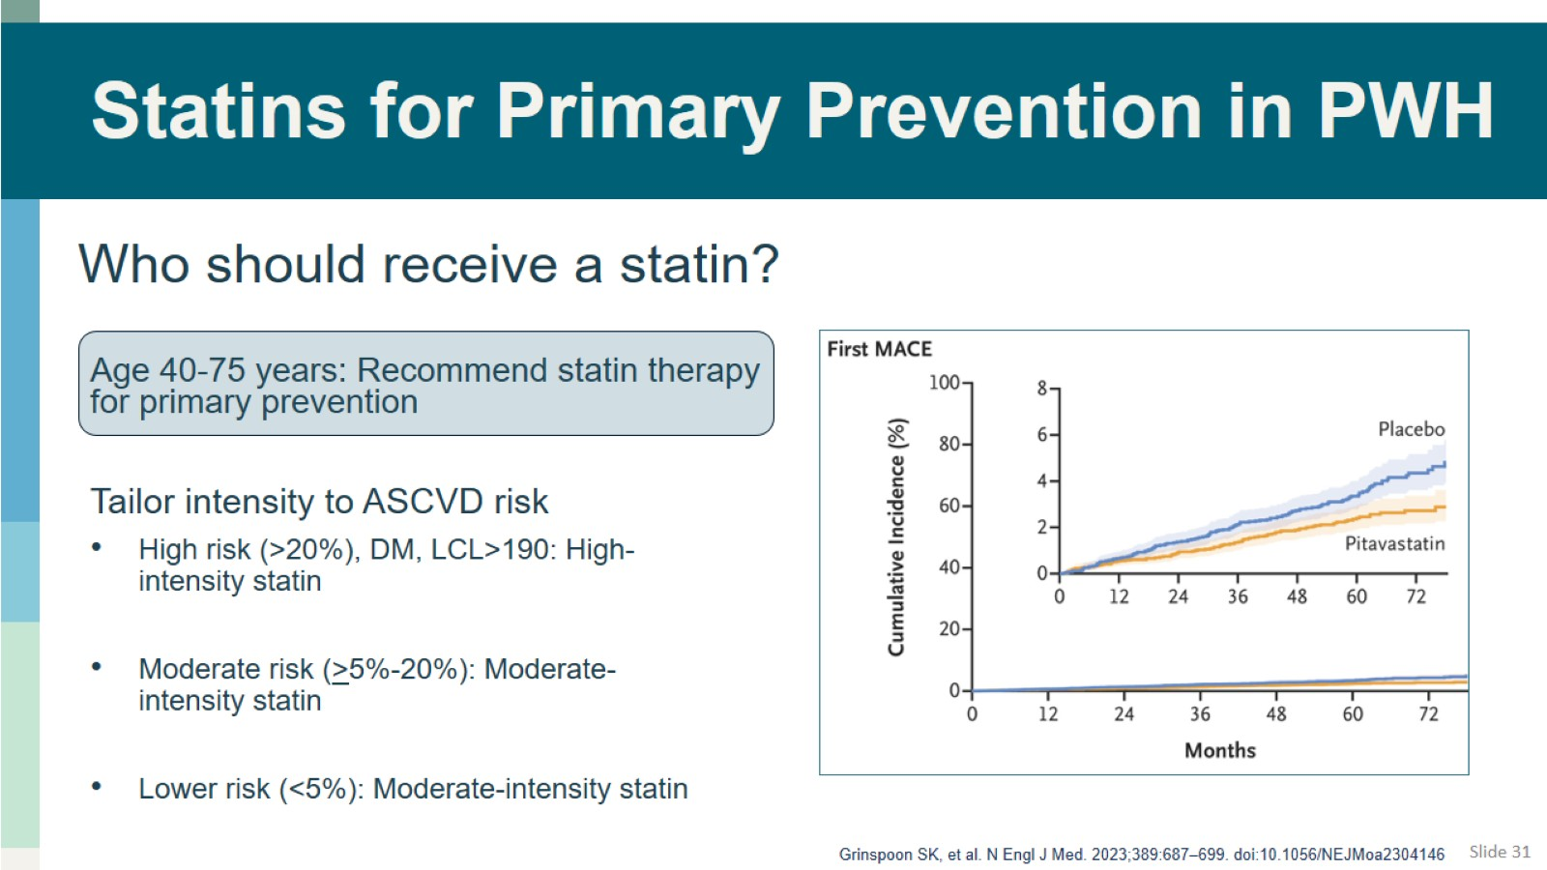
Statins for Primary Prevention in PWH

Slide 32
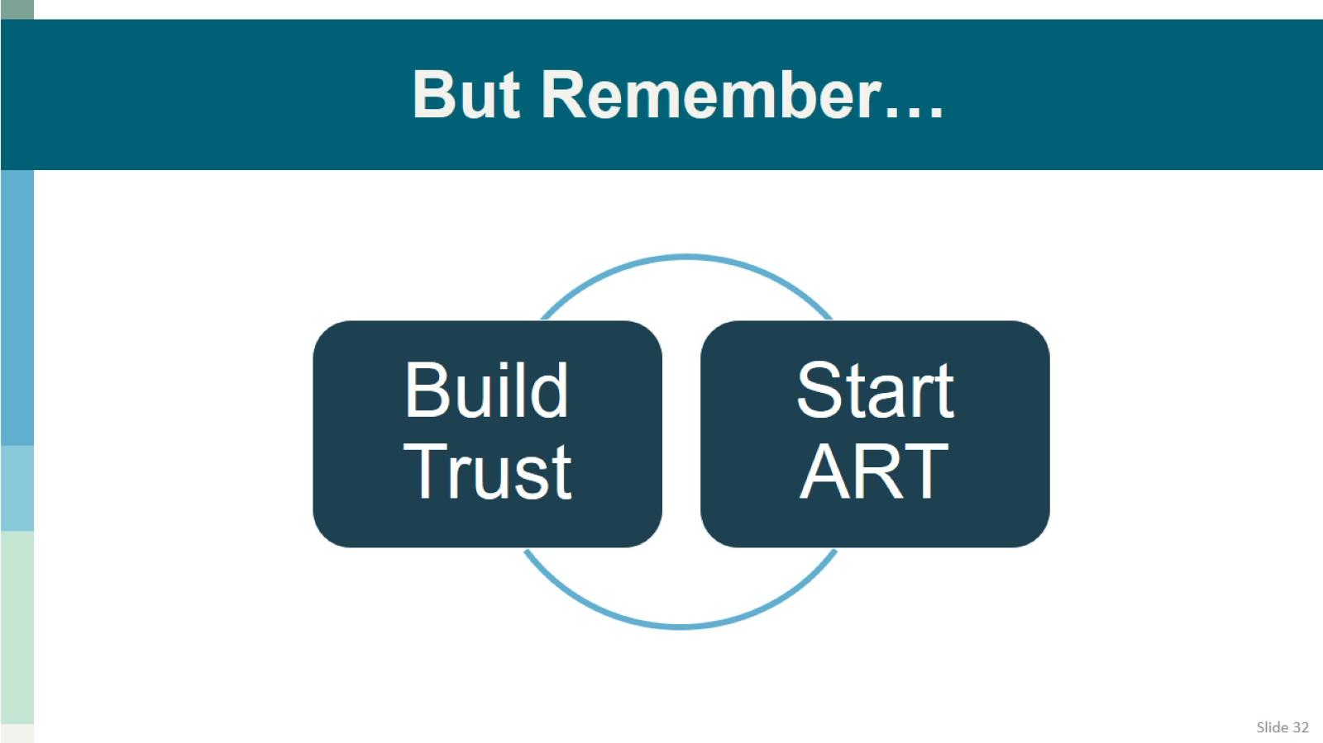
But Remember…

