Slide 1

Historic Overview of M184V:
Why Did We Care?

Slide 2
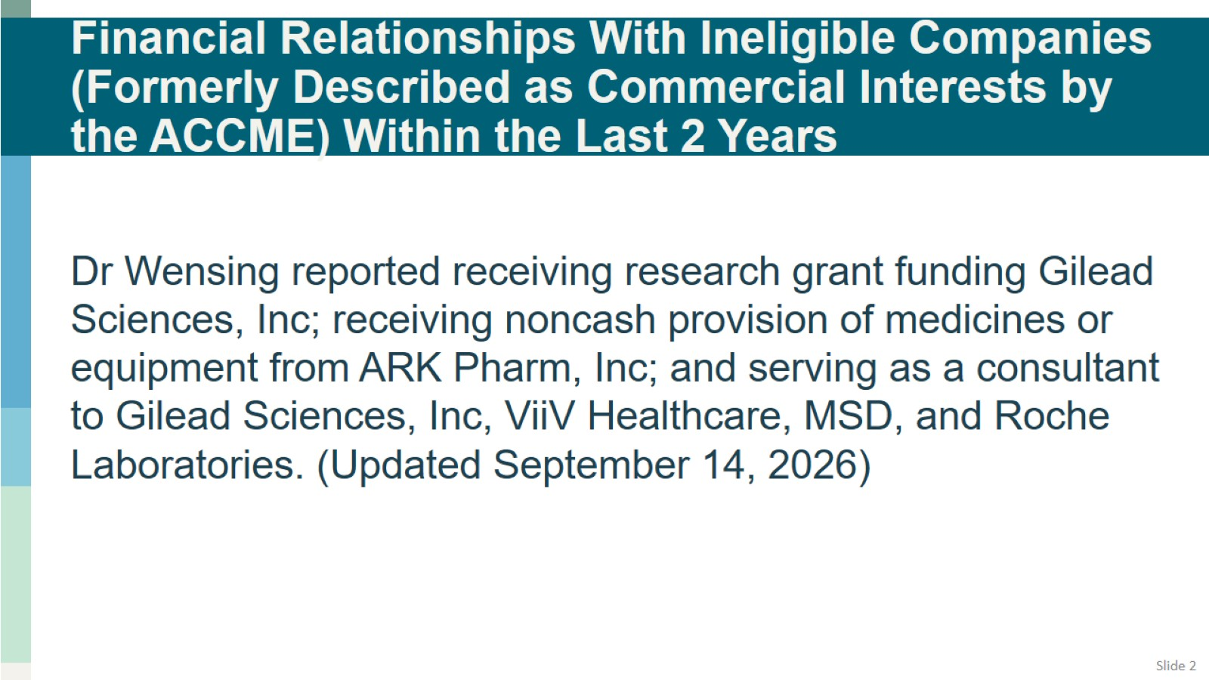
Financial Relationships With Ineligible Companies (Formerly Described as Commercial Interests by the ACCME) Within the Last 2 Years

Slide 3
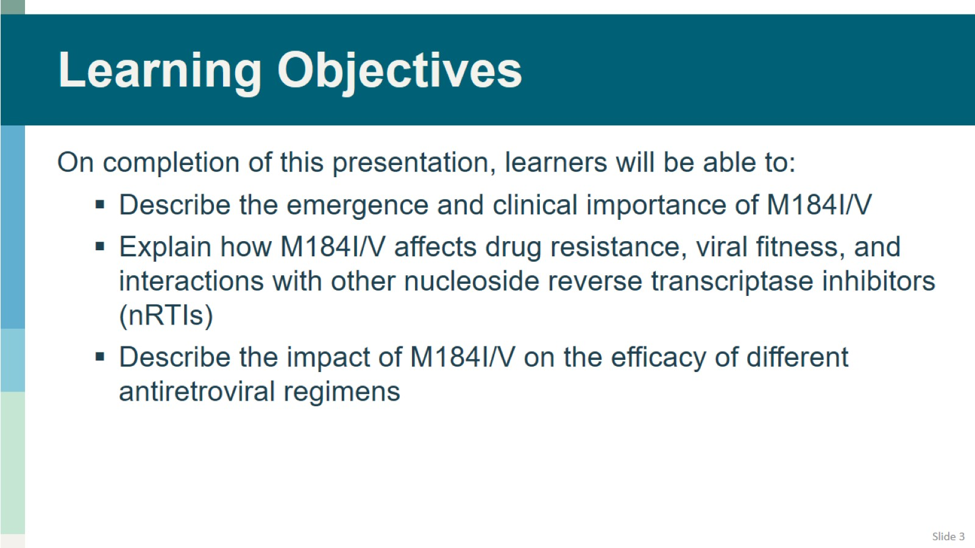
Learning Objectives

Slide 4
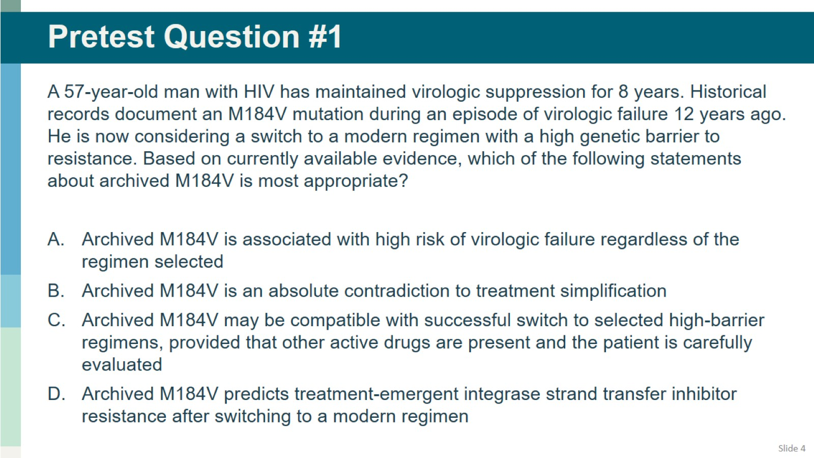
Pretest Question #1

Slide 5
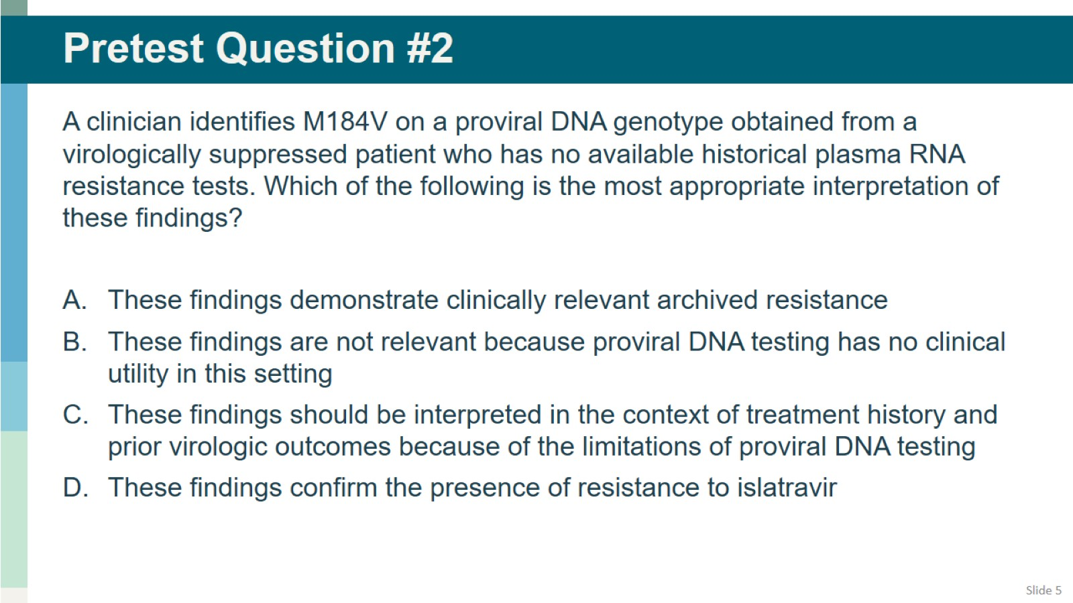
Pretest Question #2

Slide 6
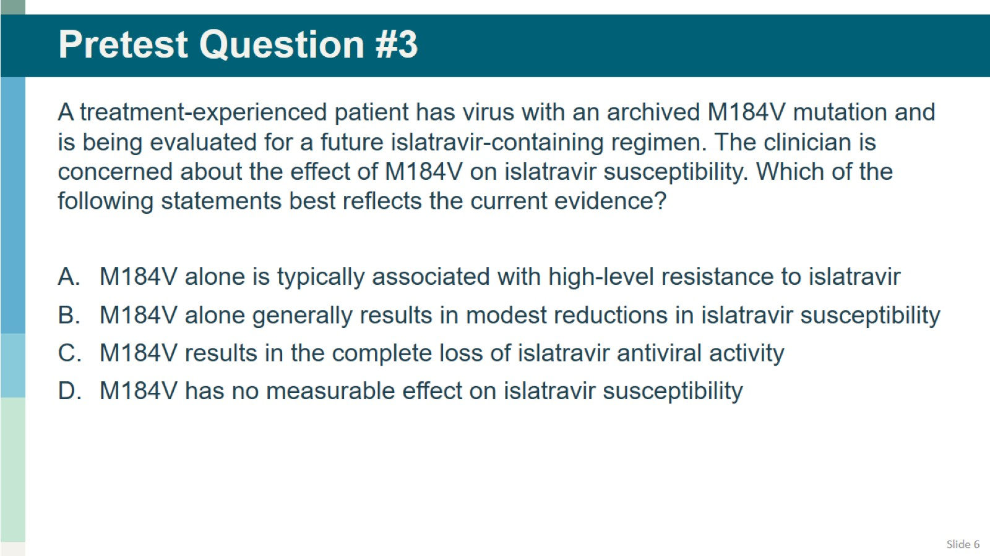
Pretest Question #3

Slide 7
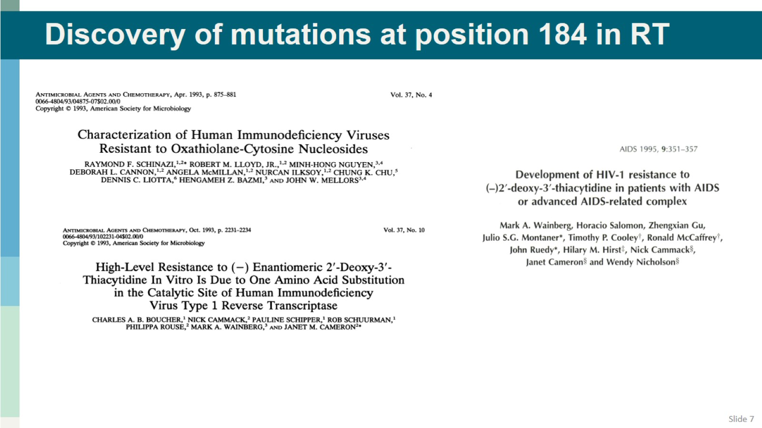
Discovery of mutations at position 184 in RT

Slide 8
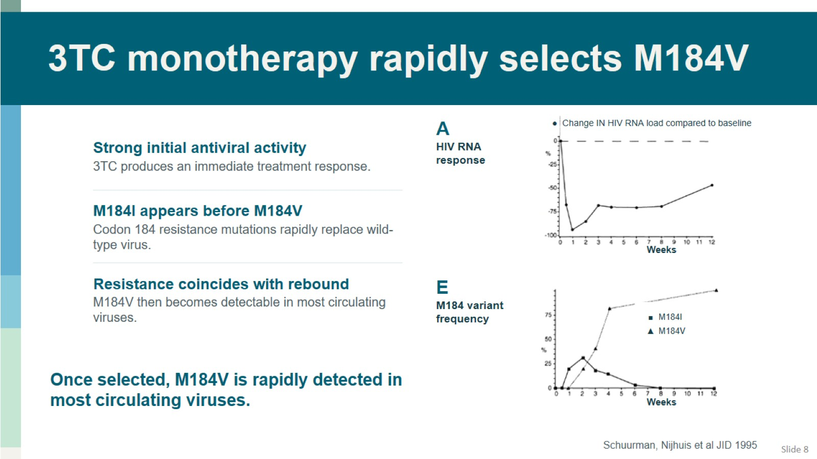
3TC monotherapy rapidly selects M184V

Slide 9
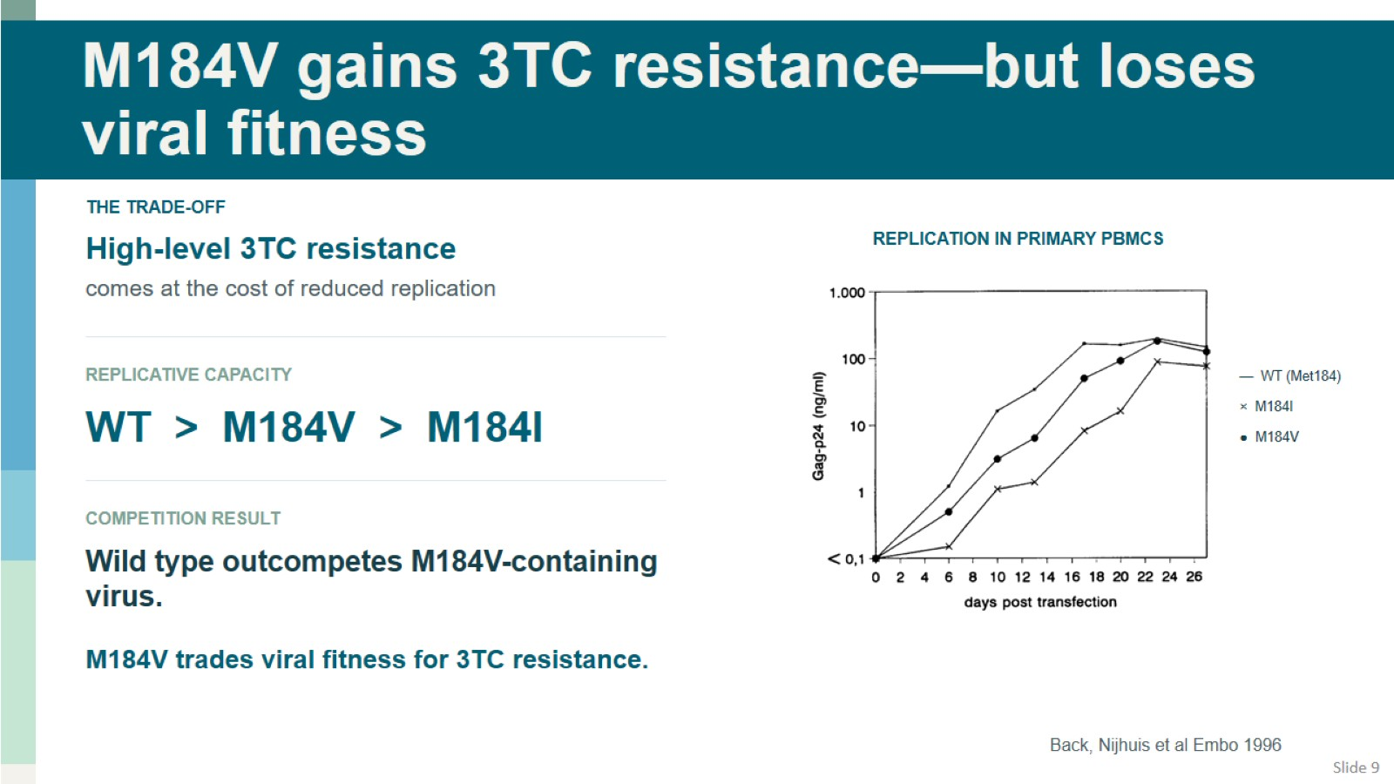
M184V gains 3TC resistance—but loses viral fitness

Slide 10
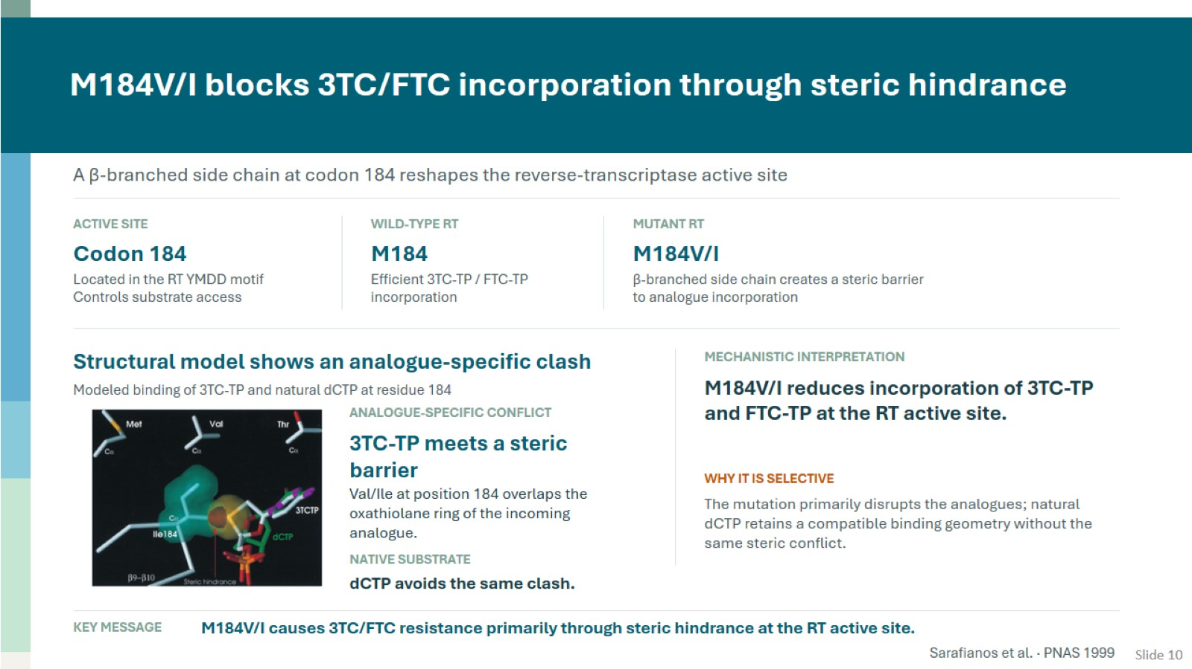
M184V/I blocks 3TC/FTC incorporation through steric hindrance

Slide 11
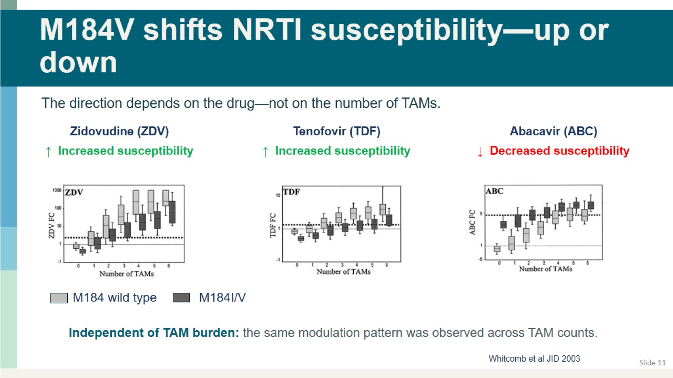
M184V shifts NRTI susceptibility—up or down

Slide 12
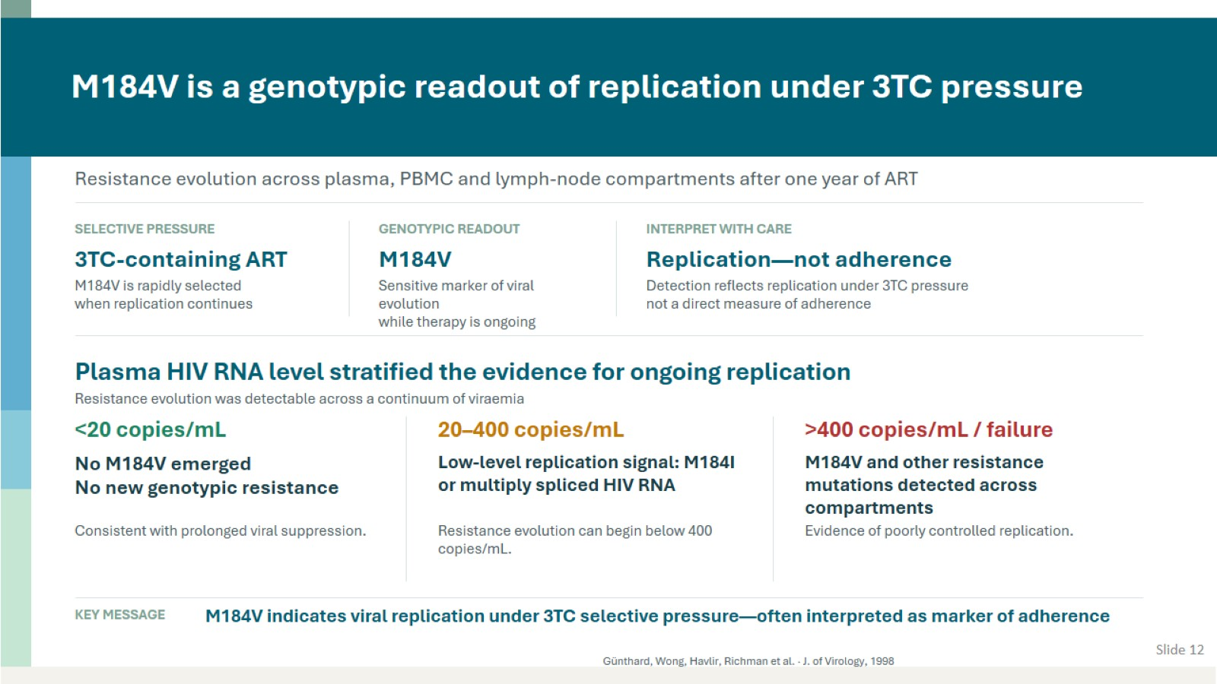
M184V is a genotypic readout of replication under 3TC pressure

Slide 13
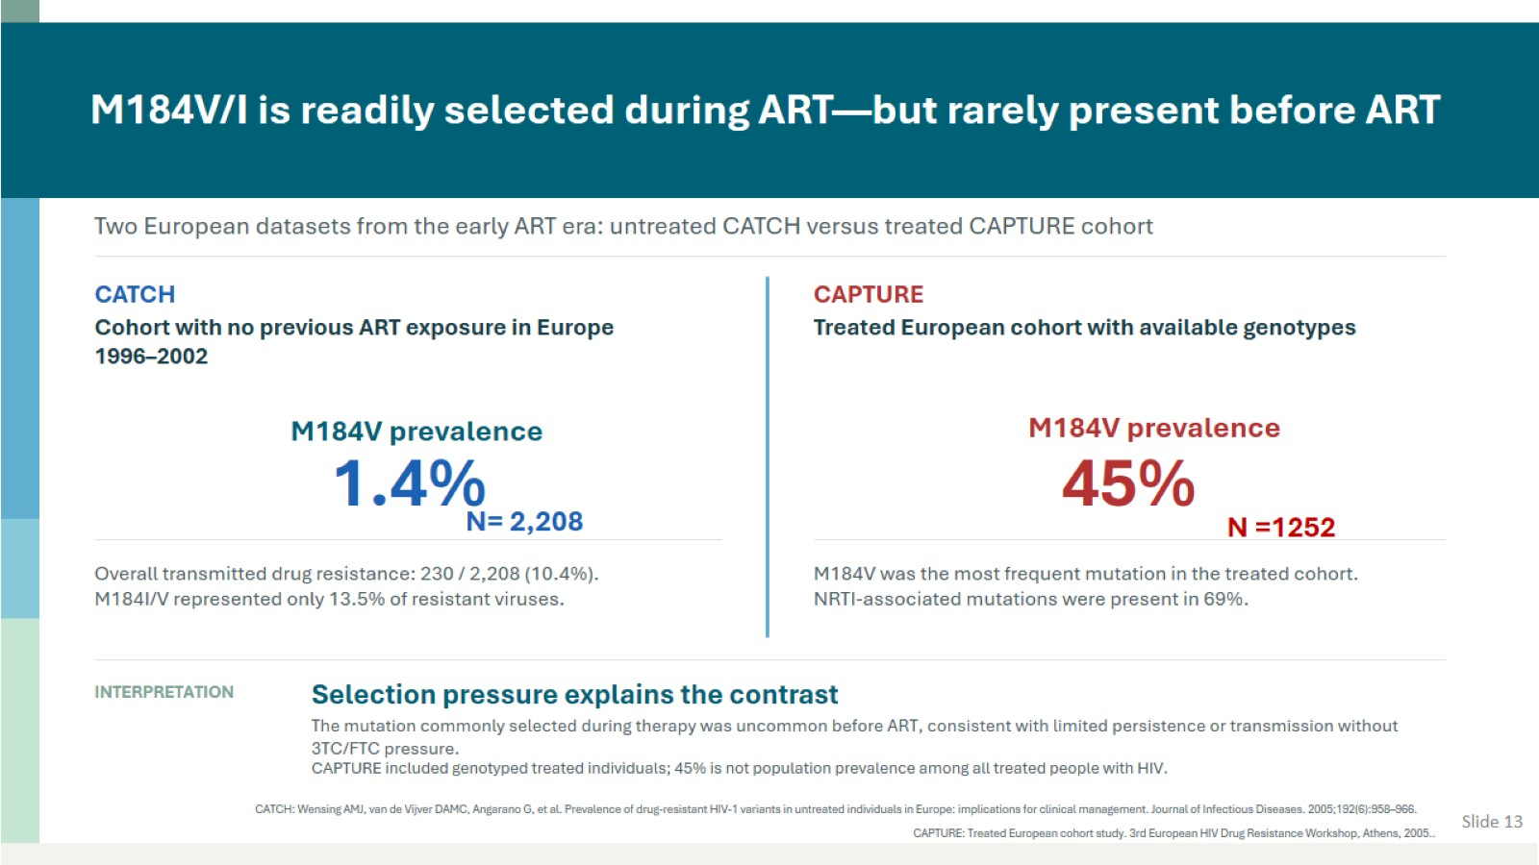
M184V/I is readily selected during ART—but rarely present before ART

Slide 14
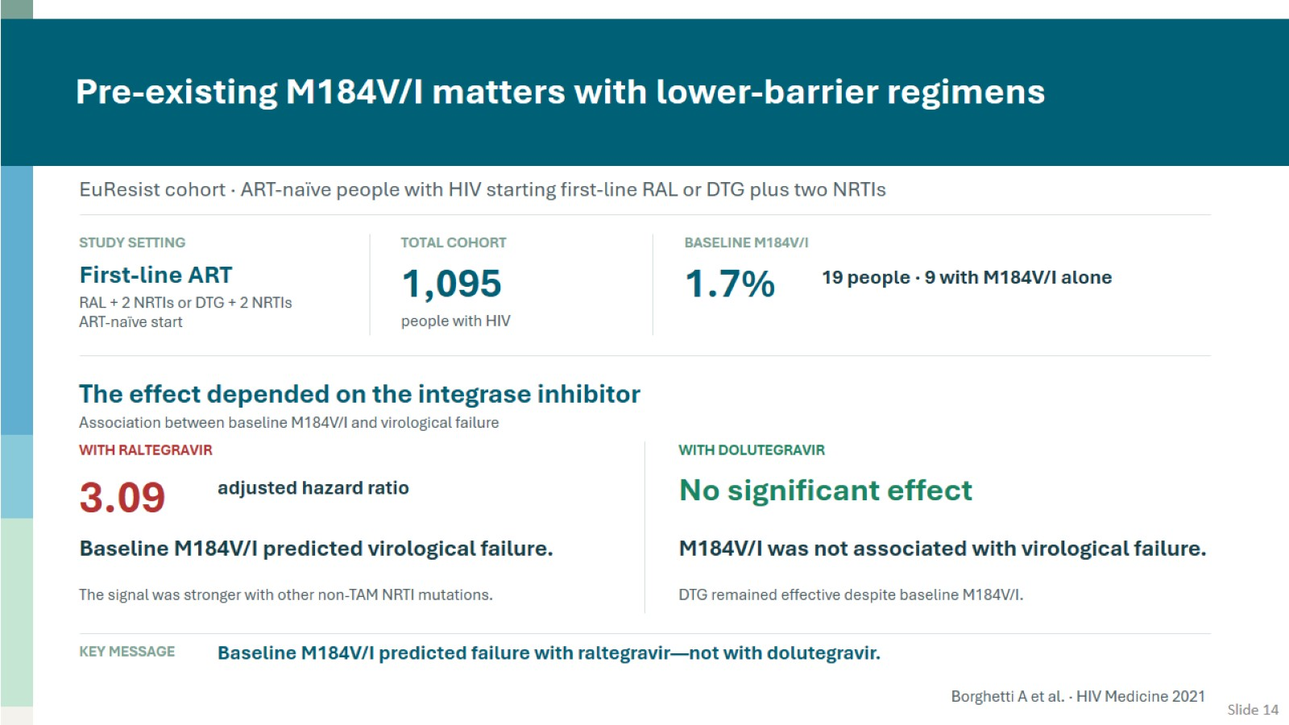
Pre-existing M184V/I matters with lower-barrier regimens

Slide 15
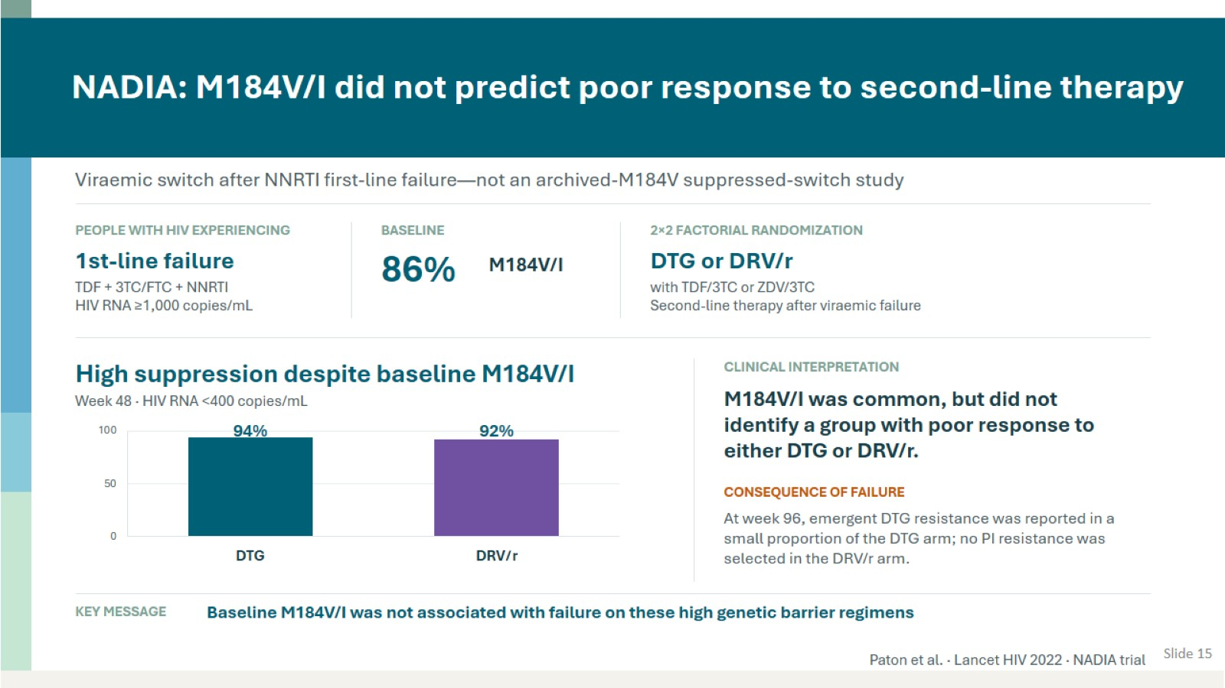
NADIA: M184V/I did not predict poor response to second-line therapy

Slide 16
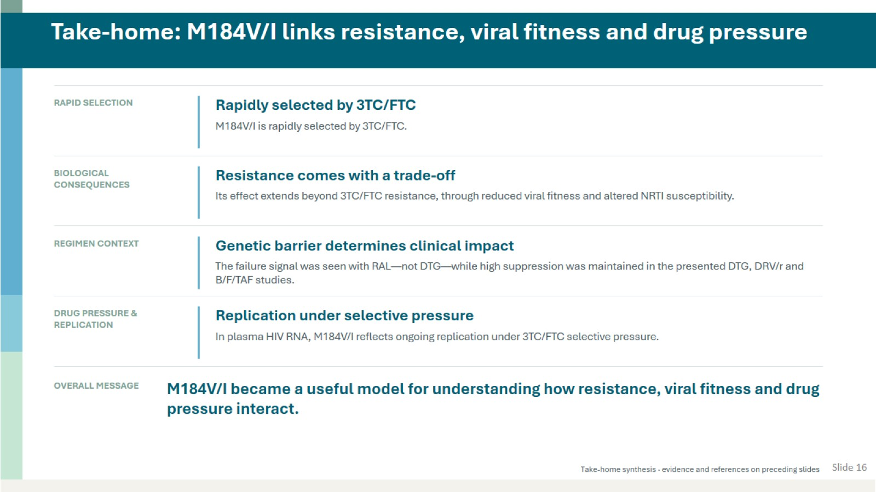
Take-home: M184V/I links resistance, viral fitness and drug pressure

Slide 17

Q and A Session

Slide 18
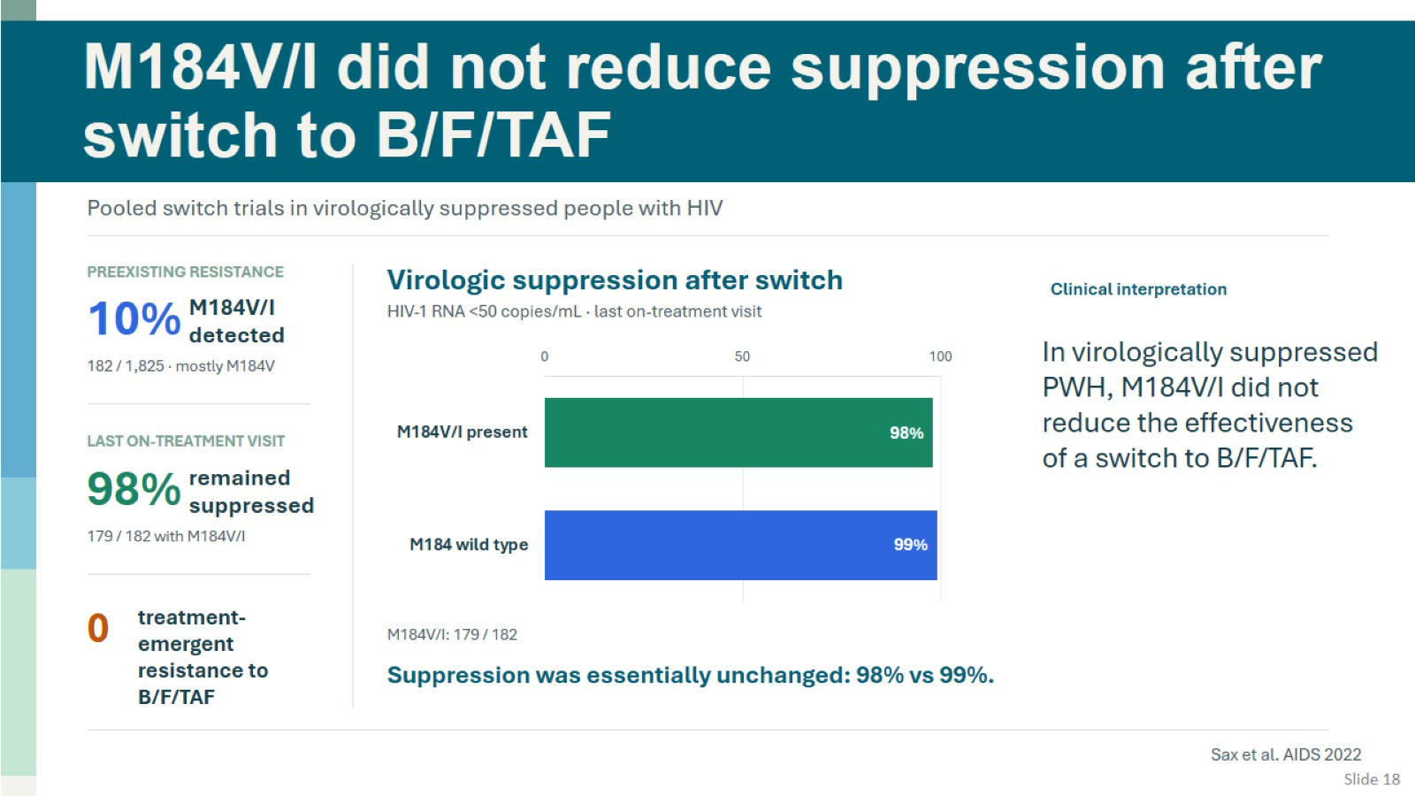
M184V/I did not reduce suppression after switch to B/F/TAF

